Slide 1

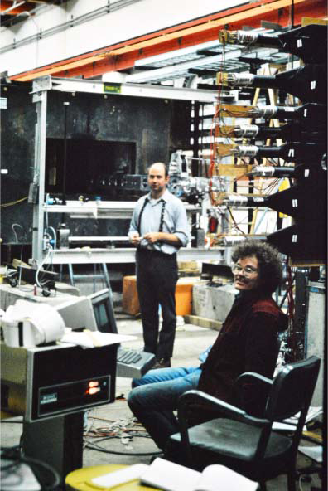
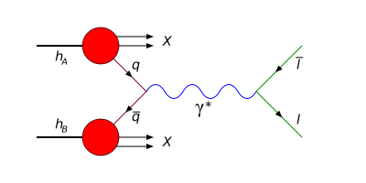
Physics with Pair of Particles
from muons, to pions, to photons
June 17, 2016
Kirk McDonald Fest
C. Biino-Palestini

Slide 2
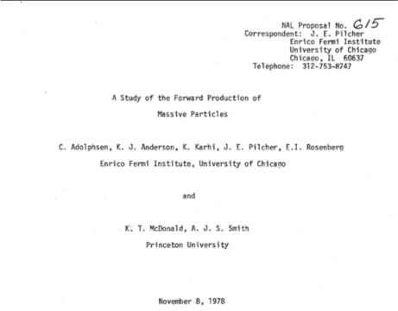
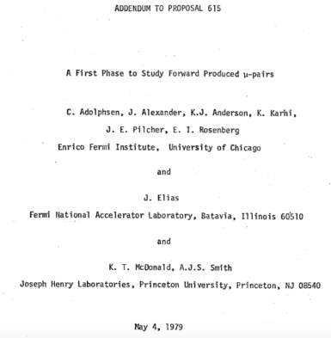
(Proposed: 1978-05-04, Approved: 1979-07-01, Completed: 1984-07-15)
Ran for 2260 hours
June 17, 2016
Kirk McDonald Fest
C. Biino-Palestini

Slide 3


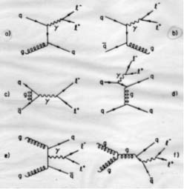
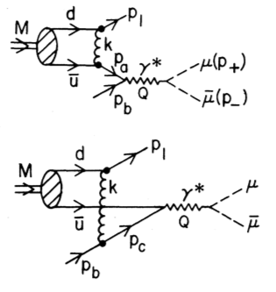

Naïve picture confirmed by early Drell-Yan experiments
Start including QCD higher order corrections
Internal gluon exchanges – effects of the pion bound state – should have observable effects ➔ “Higher Twist” contributions
A large x_{F} quark with p_{T}>0 must be far off-shell ➔ can couple to longitudinal photons.
where x_{F} is the momentum fraction of the quark in the pion
Berger & Brodsky
PRL 42, 940 (1979)
June 17, 2016
Kirk McDonald Fest
C. Biino

Slide 4
E615: Search for departures from the simple DY model
and test QCD predictions
E615 Physics Goal:
Study pion structure functions
High statistics measurement of the muon pair angular distribution as a function of x_{F} using a 255 GeV/c beam
Search for scale breaking effects in the pion structure function by comparing measu-rements at 255 Gev/c with ones at 80 GeV/c
Perform π⁺/π⁻ test at high x_{F} with 255 GeV/c beams to check that the production does proceed through q q annihilation.
E615 Detector design:
Cross section for the production of lepton pairs at x_{F} > 0, M_{ll} > 4 GeV/c², s=10-20 GeV is of the order of 100 pb per Nucleon ➔ high intensity beam
Muon pairs in the final state ➔ beam dump experiment
Should maintain good acceptance in the angular variables at large x_{F}
The detectors acceptance is peaked at large x_{F} where logarithmic and higher twist scale dependence are predicted.
Reduce low mass acceptance
Ready identification of Drell-Yan events
π W μ⁺μ⁻ X (in the continuum region M_{μ+μ-} , from 4 to 9 GeV/c²)
June 17, 2016
Kirk McDonald Fest
C. Biino

Slide 5
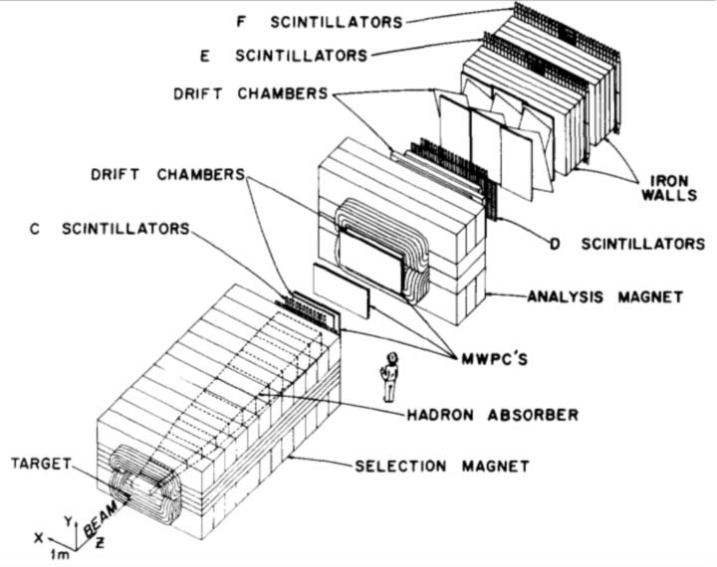
At the High Intensity Area of the Proton West Lab at Fermilab,
among the first users of the new superconducting accelera-tor, the Tevatron, data taking in 1983-1984.
June 17, 2016
Kirk McDonald Fest
C. Biino

Slide 6
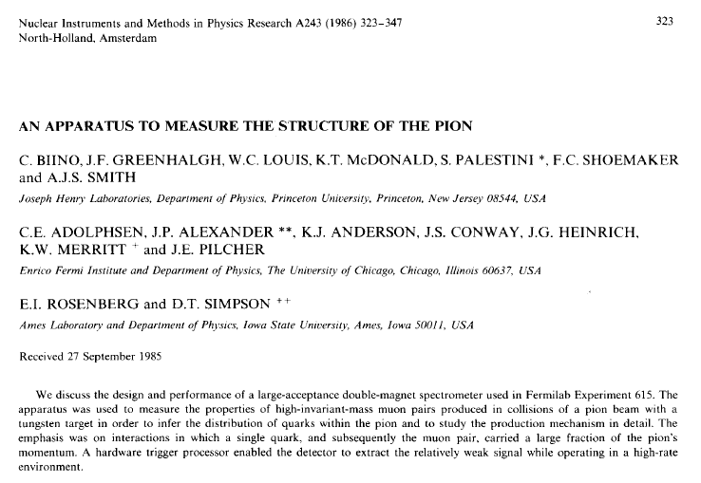
Kirk McDonald, Stew Smith, Frank Shoemaker, Jim Pilcher, Kelby Anderson, Bill Louis,
John Greenhalgh, Eli Rosenberg,
Jim Alexander, Chris Adolphsen, John Conway, Joel Heinrich, Sandro Palestini, Cristina Biino
June 17, 2016
Kirk McDonald Fest
C. Biino

Slide 7
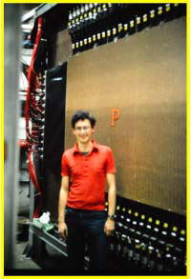
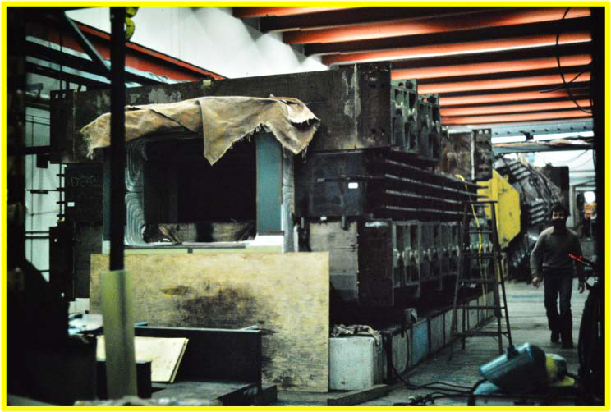
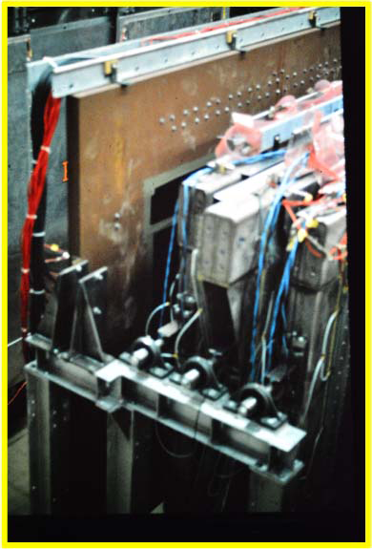
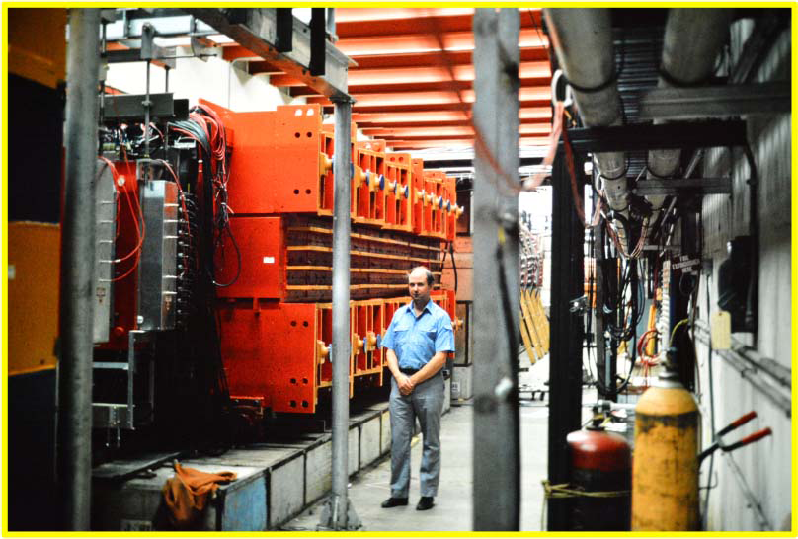
June 17, 2016
Kirk McDonald Fest
C. Biino

Slide 8
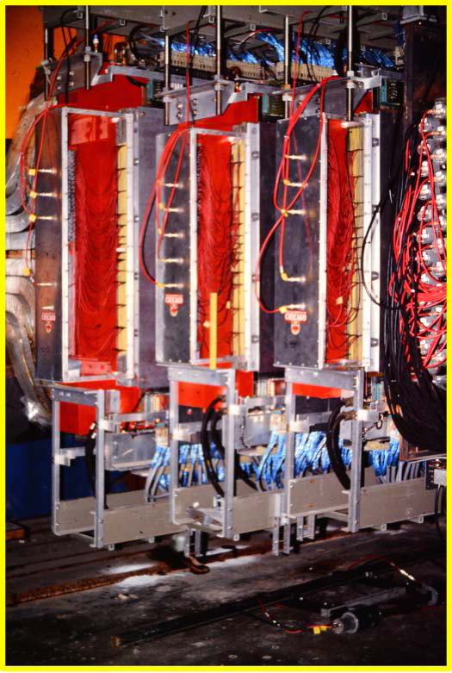
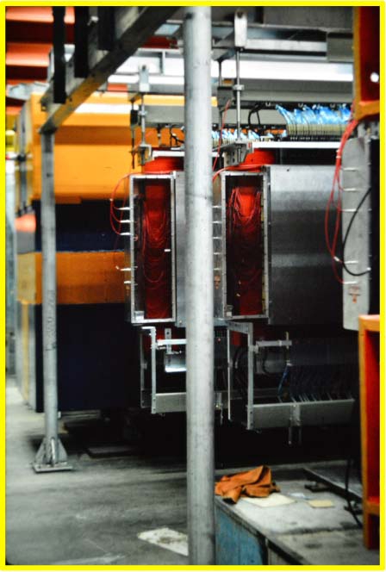
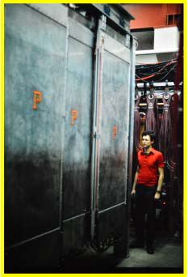
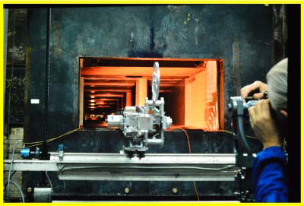
June 17, 2016
Kirk McDonald Fest
C. Biino

Slide 9
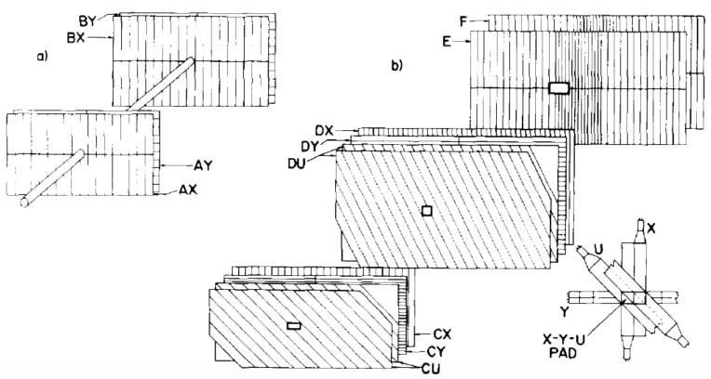
Scintillation counters
Beam holes to reduce the number of accidental triggers associated with muons (from pion decays) in the beam.
A&B(x,y) hodo to veto events associated with an incident muon outside the beam pipe
C&D(x,y,u,u,) provide detailed informations on the candidate muon pair positions for the trigger selection
E&F banks to confirm muon identification
June 17, 2016
Kirk McDonald Fest
C. Biino

Slide 10
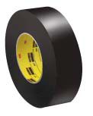

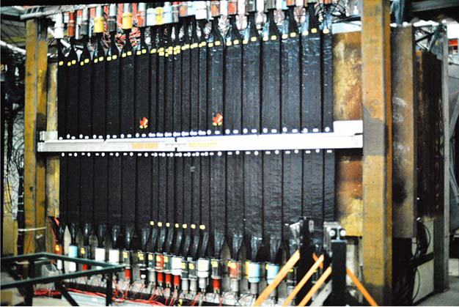
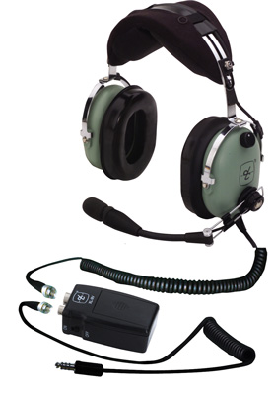
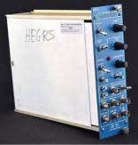
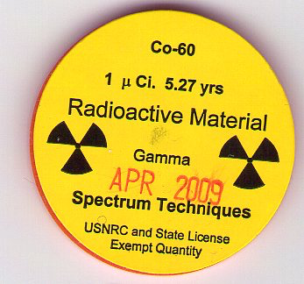
Black scotch tape
QVT
Scintillator Timing
June 17, 2016
Kirk McDonald Fest
C. Biino

Slide 11
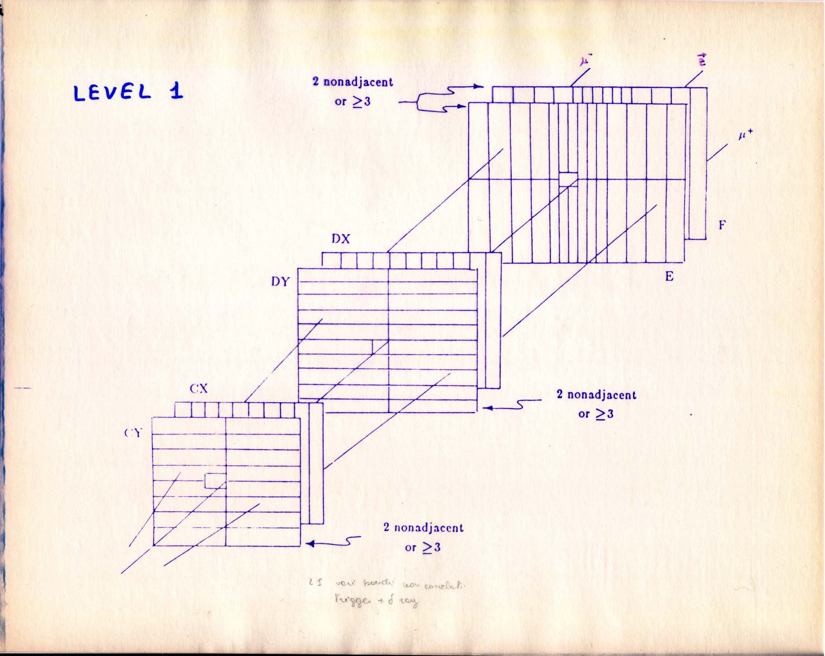
The trigger was based entirely on scintillator counter informations, to select events with 2 penetrating particles produced in the Be target and to discriminate against pairs with low invariant mass or containing a halo muon from beam pion decays.
Level I: 2 distinct tracks, in time
Level II: point back to target in y
Level III: M_{μμ} > 2 GeV (lookup
tables)
MOST of the TRIGGER ELECTRONICS was desi-gned and built in Prince-ton for this experiment.
The discriminators, latches, and trigger processors used ECL integrated circuits while a few standard NIM modules were used in forming final coincidences at each trigger level.
The Level-1 decision was reached about 40 ns after the signals emerged from the scintillator discriminators.
The Level-2 decision was available 10 ns after the
Level-1.
Strong limits coming from signal cables length of the drift chambers …
June 17, 2016
Kirk McDonald Fest
C. Biino

Slide 12
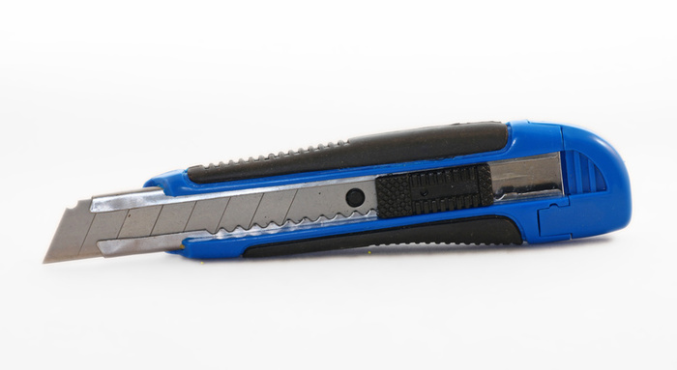
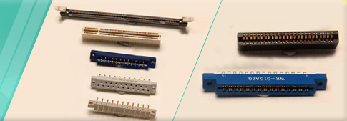
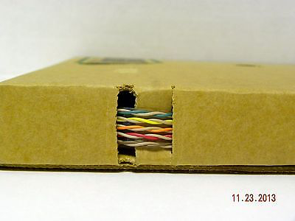
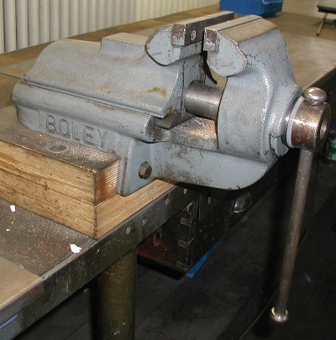
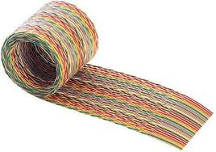
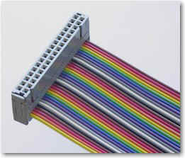
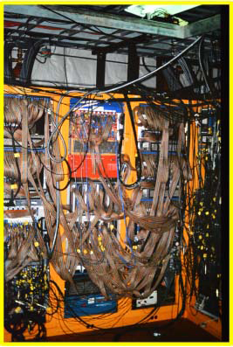
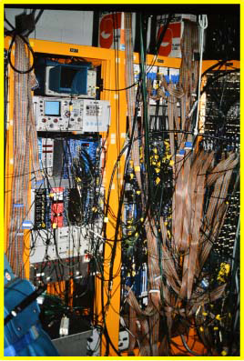
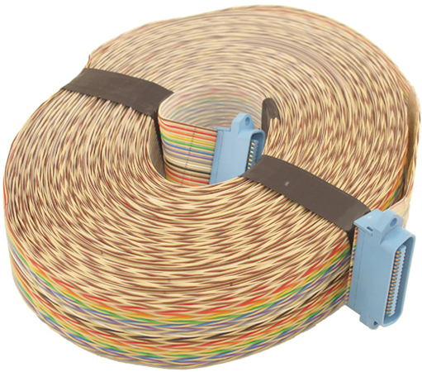
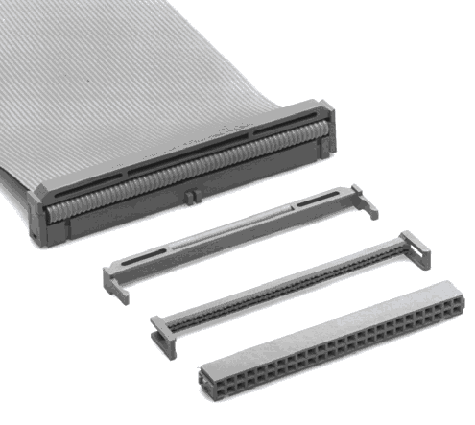
Twist & flat
"...you are in a twisty maze of passageways, all alike"
June 17, 2016
Kirk McDonald Fest
C. Biino

Slide 13
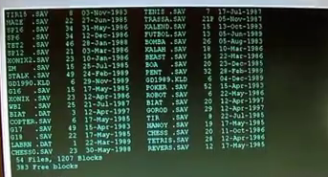
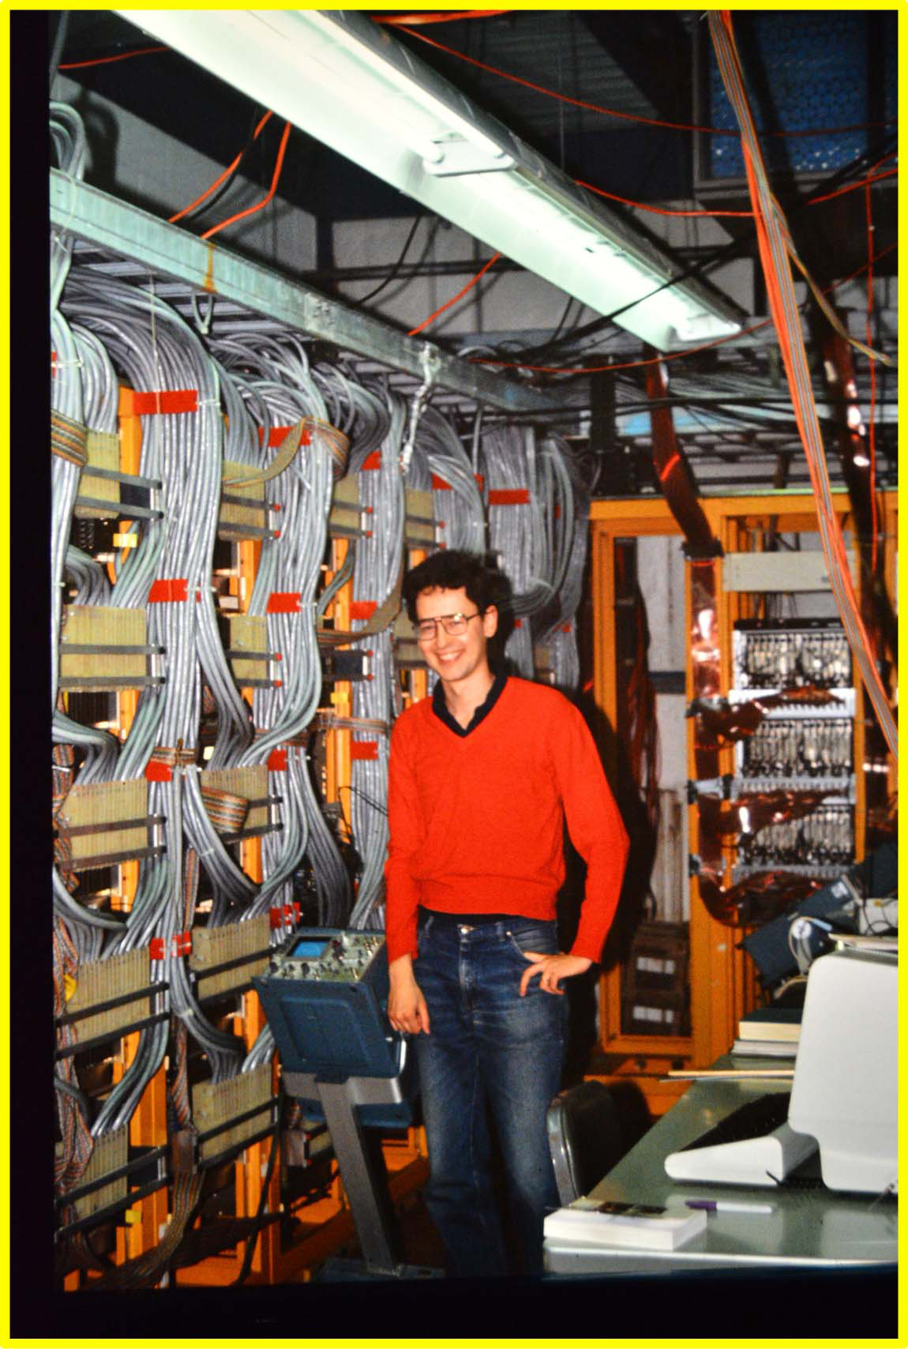
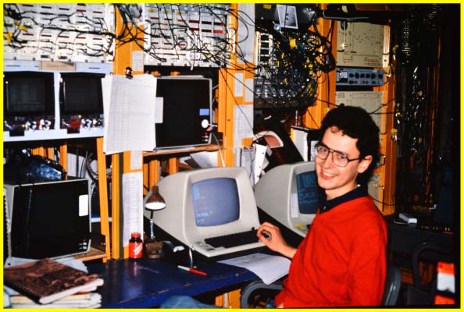
June 17, 2016
Kirk McDonald Fest
C. Biino

Slide 14
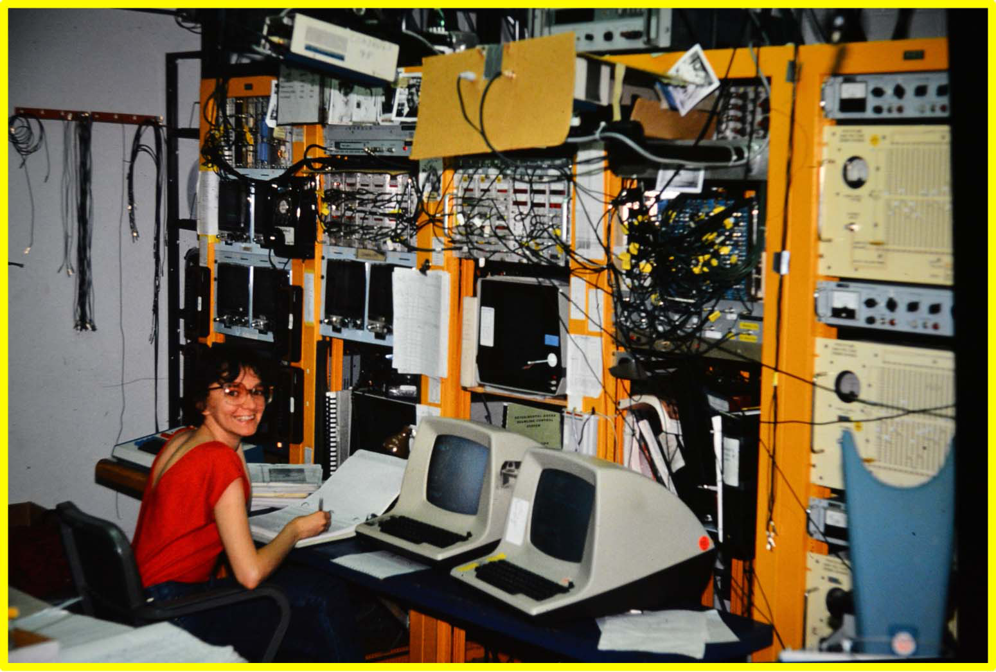
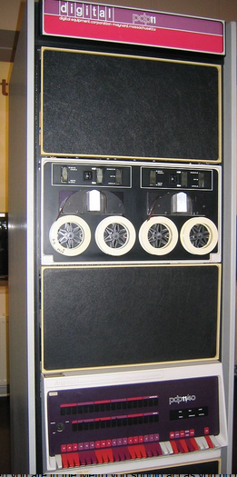
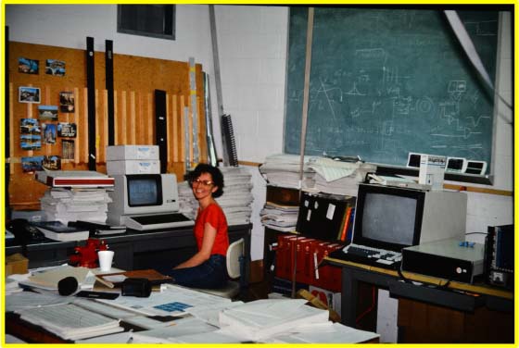
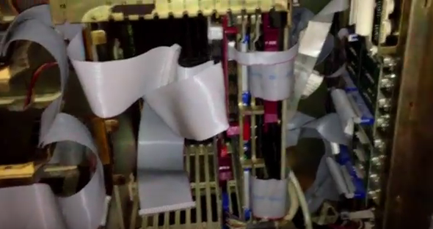
Anybody remembers what was THIS ?
June 17, 2016
Kirk McDonald Fest
C. Biino

Slide 15
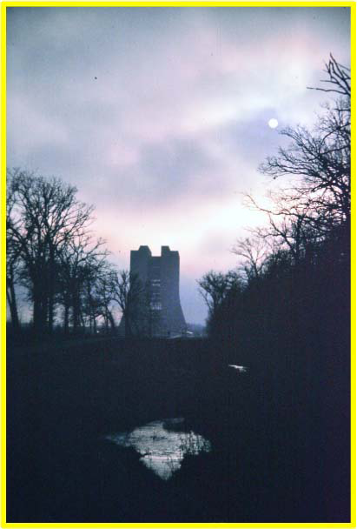
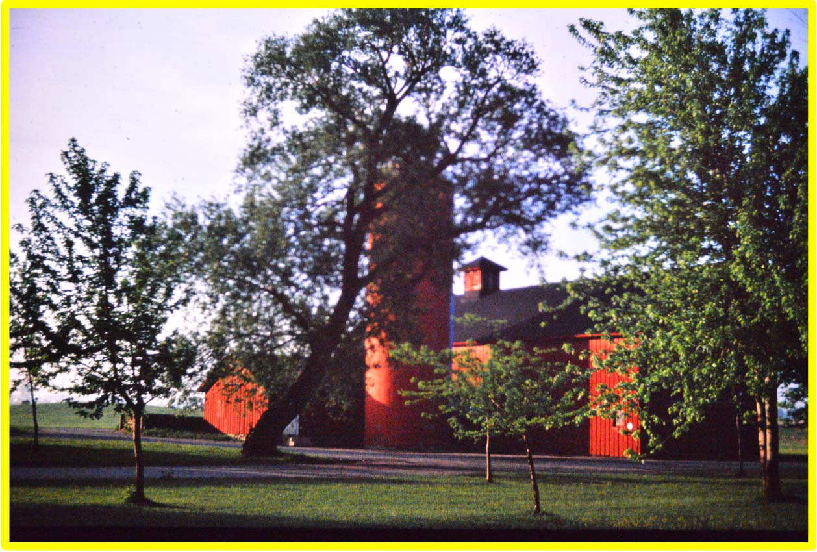
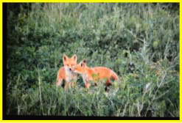
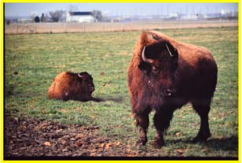
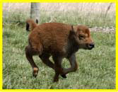
June 17, 2016
Kirk McDonald Fest
C. Biino

Slide 16
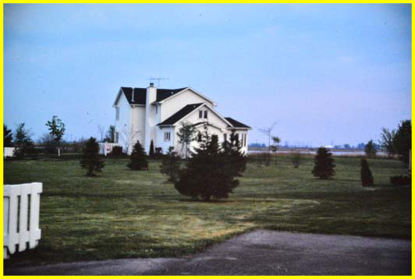
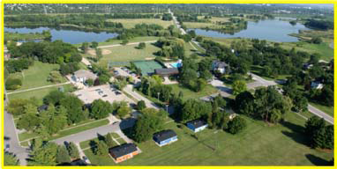
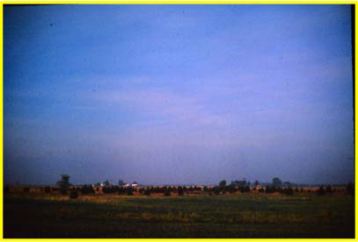
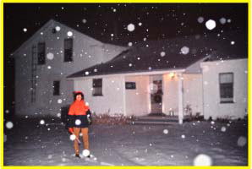
Fermilab Village
“Princeton House”
in Sauk circle
June 17, 2016
Kirk McDonald Fest
C. Biino

Slide 17
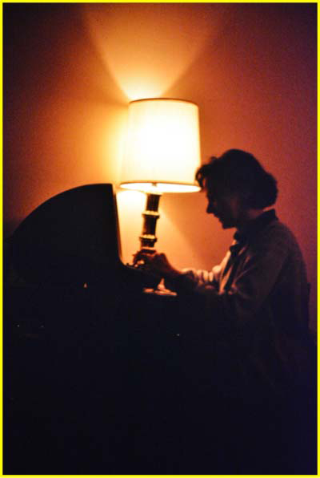

~40 M events written on tape.
A final sample of 103K events with
M>2.5GeV/c²
and x_{F} > 0.3
Maybe E615 the first collaboration to get a terminal in the village to profit of the night….
… to push E615 tapes through the reconstruction program running
at the computer center - 7th flloor of the Hi-Rise.
June 17, 2016
Kirk McDonald Fest
C. Biino

Slide 18






E615 FUN
E615-Cineforum of screwball comedies in the “Chicago house” at FNAL village with the help of Kelby Anderson
From Woody Allen movies to
… a galaxy far far away ...
June 17, 2016
Kirk McDonald Fest
C. Biino

Slide 19









…more E615 FUN
Chez Leon
June 17, 2016
Kirk McDonald Fest
C. Biino

Slide 20



E615 - time for far away FUN
“Rosie” magnet incident…
Kirk suggesting the
best vacation destination!
June 17, 2016
Kirk McDonald Fest
C. Biino

Slide 21




Summers in
Princeton !
Happily house
and
dog sitting
June 17, 2016
Kirk McDonald Fest
C. Biino

Slide 22







June 17, 2016
Kirk McDonald Fest
C. Biino

Slide 23
Direct CP Violation in the neutral Kaon system
Experimental situation on ε/ε’ from previous generation experiments (early 90’s):
  NA31 (CERN) (23.0 ± 6.5) x 10⁻⁴
  E731 (Fermilab) (7.4 ± 5.9) x 10⁻⁴
(ε′ /ε) ≠ 0 ? ⇒ Second generation of experiments:
  KTEV (Fermilab)
  NA48 (CERN)
Measure the double ratio:
BR(K_{L} → π⁰π⁰ ) BR(K_{S} → π⁺π⁻ )
R= ⎯⎯⎯⎯⎯⎯⎯⎯⎯⎯⎯⎯⎯ = 1− 6 Re(ε′ / ε )
BR(K_{S} → π⁰π⁰ ) BR(K_{L} → π⁺π⁻ )
by counting the number of decays in two beams of K_{L} and K_{S}
Need > 3. 10⁶ K_{L} → π⁰π⁰ for stat. error on R < 0.1%
and look for cancellation of systematic effects related to differences in acceptance, efficiency, backgrounds
June 17, 2016
Kirk McDonald Fest
C. Biino
C. Biino
Notes:
K_{S} → π⁺π⁻ : 68.6% K_{L} → π⁺π⁻ : 0.2%
K_{S} → π⁰π⁰ : 31.4% K_{L} → π⁰π⁰ : 0.1% KL decays are rare and are affected by background
cτ_{S} = 2.67 cm
cτ_{L} = 15.5 m
Lifetimes are very different

Slide 24
The ideal experiment…
Simultaneous
K_{L}, K_{S} beams
Identical detector
illumination
D
E
T
E
C
T
O
R
K_{L}, K_{S} beams
Identical K_{L}, K_{S}
energy spectra
Decay Volume
Identical trigger
and acquisition
biases
Overlapping
decay volume
Exploit cancellations of the double beam method i.e. for perfectly overlapping and concurrent beams the corrections are minimized
June 17, 2016
Kirk McDonald Fest
C. Biino
C. Biino
Notes:
Strategy to minimize systematic effects
The 4 modes are collected concurrently ⇒ cancellation of fluxes, dead times, inefficiencies, accidental rates
use same decay regions for all modes, apply lifetime weighting to equalize distribution of K_{S} and K_{L} decay positions ➔cancellation of detector acceptance effects
use quasi-homogeneous liquid Krypton calorimeter to detect π⁰π⁰ and magnetic spectrometer for π⁺π⁻ ⇒ optimize resolution, uniformity, linearity and stability

Slide 25

NA48 simultaneous and collinear K_{L} & K_{S} beams
20 m long
K_{S} from protons on target
K_{S} and K_{L} beams are distinguished by proton tagging upstream of the K_{S} target
June 17, 2016
Kirk McDonald Fest
C. Biino

Slide 26

NA48 detector
Muon veto and hadron calorimeter (background, trigger)
Quasi homogeneous liquid krypton calorimeter to detect π⁰π⁰ events
Scintillation hodoscope (trigger and timing π⁺π⁻)
Magnetic spectrometer to detect π⁺π⁻ events σ(P)/P ≅ 0.5 % ⊕ 0.009 P(GeV/c)%
(≅ 1% for 100 GeV/c track momentum)
1 m
Decay products
From K decays
June 17, 2016
Kirk McDonald Fest
C. Biino
C. Biino

Slide 27


NA48: the AKS anticounter
Defines beginning of decay region for π⁺π⁻ and π⁰π⁰ K_{S} decays
Plastic scintillation counters following a
Photon converter :
  iridium crystal 3mm thick , 0.98 X₀ for amorphous iridium ⇒ 1.79 X₀ for the aligned crystal and less scattering
K_{S} beam
Exploiting photon convertion enhancement in an aligned crystal
June 17, 2016
Kirk McDonald Fest
C. Biino

Slide 28


NA48 Tagging performance
NA48: K_{S} are tagged using the difference between the event time and the nearest proton in the Tagger:
K_{S} = |t_{tag} - t_{K}| ≤ 2ns
K_{L} = |t_{tag} - t_{K}| > 2ns
Done for both π⁺π⁻ and π⁰π⁰
Identify K_{S}, K_{L} with decay vertex
position in transverse plane
June 17, 2016
Kirk McDonald Fest
C. Biino
C. Biino

Slide 29


NA48 and KTeV: the art of calorimetry
3100 CsI crystals
0,5 m depth (~27 X₀)
σ(E)/E ≅ 2.0 % / √E ⊕ 0.45%
(E in GeV) ; 0.7% energy resolution for
19 GeV γ
KTeV
NA48
10 m³ of LKr (13212 cells)
1.25 m depth (~27 X₀)
σ(E)/E ≅ 3.2 % / √E ⊕ 0.09 /E ⊕ 0.42%
(E in GeV) ;<1% energy resolution for 25GeV γ
Unprecedented stability ; <0.1% corrections
June 17, 2016
Kirk McDonald Fest
C. Biino
C. Biino

Slide 30

Experimental results comparison
PDG average: Re(ε’ / ε) = ( 16.5 ± 2.3 ) 10⁻⁴
Direct CP violation established
June 17, 2016
Kirk McDonald Fest
C. Biino
C. Biino
Notes:
Weigthed average
This is a very significant improvement in resolution and consistency of results over 3 and 9 years ago
Direct CP violation is established, and the experimental precision is challenging the computational accuracy of the Standard Model

Slide 31

The Large Hadron Collider
The Large Hadron Collider is a
27 km long pp collider ring
housed in a tunnel about 100 m
underground near Geneva
Diameter 8.5 km
Beam energy: 7 TeV
Luminosity: 10³⁴
Protons/bunch: 1.15x10¹¹
Bunches: 2808
Bunch spacing: 25 ns
Machine current: 0.5 A
Beam Stored energy: 362 MJ
Operating temperature: 1.9 K
Number of magnets: ~9300
Magnet Stored Energy 8800 MJ
Power consumption: ~120 MW
Cost: 9.0x10⁹ $
June 17, 2016
Kirk McDonald Fest
C. Biino
C. Biino

Slide 32

The LHC collider
Two general purpose detectors, designed to search for the Higgs Boson
The Large Hadron Collider (LHC), one of the largest and truly global scientific projects ever
pp collisions at a centre of mass energy of 7, 8 and 13 TeV
PbPb collisions at a centre of mass energy of 2.76 TeV/nucleon
June 17, 2016
Kirk McDonald Fest
C. Biino

Slide 33

The CMS collaboration
42 Countries
190 Institutions
2200 Scientific Authors
800 PhD Students
June 17, 2016
Kirk McDonald Fest
C. Biino

Slide 34

The CMS Detector
http://cms.web.cern.ch/
CMS
JINST 3 (2008) S08004
June 17, 2016
Kirk McDonald Fest
C. Biino

Slide 35

June 17, 2016
Kirk McDonald Fest
C. Biino

Slide 36


Higgs → γγ results
EPJC 74 (2014) 3076
PhysRevD 90 (2014) 052004
m_{H} = 124.7 ± 0.4 GeV
Significance = 5.7 (expected 5.2) σ
μ = σ BR/σ_{SM} BR_{SM}= 1.14 + 0.26 – 0.23
Γ_{H} < 3.4 GeV @ 95% CL
m_{H} = 126.0 ± 0.5 GeV
Significance = 5.2 (expected 4.6) σ
μ = σ BR/σ_{SM} BR_{SM}= 1.17 ± 0.27
Γ_{H} < 5.0 GeV @ 95% CL
June 17, 2016
Kirk McDonald Fest
C. Biino
Notes:
3 years after the discovery! NB in each channel the mass is measured by maximizing a likelihood with m_H as parameter of interest
sigmaxBRxLum = 1.3K events - plot/distribution of the di-photon mass
Events selection: 2 gamma at high pt; vertex: recoiling charged particles, ATLAS pointing thanks to longitudinal segmentation of em_calo
Background: 70% from prompt gamma gamma ; 30% from jet gamma
Fairly high event yield~470 events; bad S/B ratio=1:20; good mass resolution: 1-2%
➔H - search for a narrow resonance in the gamma gamma mass distribution
Clear signal is observed with mass.. With a Local significance of… & Signal strength mu relative to SM prediction of …
*CMS- New calibration & strong effort on systematics
Diphoton mass spectrum weighted by the ratio S/(S + B) in each event class, together with the background subtracted weighted mass spectrum
Sum of the 25 signal-plus-background model fits to the event classes in both the 7 and 8 TeV datasets, together with the data binned as a function of mγγ. The 1σ and 2σ uncertainty bands shown for the background component of the fit are computed from the fit uncertainty in the background yield in bins corresponding to those used to display the data. These bands do not contain the Poisson uncertainty that must be included when the full uncertainty in the number of background events in any given mass range is estimated. The lower plot shows the residual data after subtracting the fitted background component.
* ATLAS -

Slide 37




…search for high mass diphoton resonances
Why diphoton searches?
Clean signal over smooth and well known background (i.e. H(125) → γγ) :
two high p_{T} photon candidates
Several models of physics beyond SM.
Models with extended Higgs sectors predict appearance of spin-0 resonances;
Extra-dimensional models predict appearance of spin-2 resonances.
Notes:
HOT TOPIC NOWADAYS
: two high p_T photon candidates Reconstructed as high energy deposits in EM calorimeters.
: Isolated. No additional activity in the direction of the two photons candidates
: Signature of resonant production: localized excess of events in the diphoton invariant mass spectrum.
Several extensions of the Standard Model predict high-mass states decaying to two photons. Benchmark models…
Spin-0 analysis e.g. extended Higgs sector
• 2HDM
ü✓ 5 physical states h0, H0, A0, H±
ü✓ Under certain conditions, scalar and/or pseudo-scalar states can have sizablebranching ratio to diphoton
Spin-2 analysis e.g. Randall-Sundrum graviton
• Model predicts tower of Kaluza-Klein
Analysis Strategy : *Select diphoton pairs and search for a local excess of events in the m spectrum.(Simple selection criteria, categorize events according to S/B ratio to enhance sensitivity.)
*Measure energy scale, resolution and efficiency in data.(Using Z → ee and Z → ll)
*Parametrize background mass spectrum from data.
*Test compatibility of data with resonant diphoton production.
*Blind analysis: (Selection criteria and signal width hypotheses fixed a-priori.All analysis inputs (energy calibration, efficiency, etc..) checked before box-opening. December dataset re-blinded to study analysis improvements.)
graviton states with TeV mass scale
• Phenomenology
ü✓ mG* = mass of lightest KK excitation
ü✓ κ/MPl = dimensionless coupling to SM fields
Search for new physics in high mass diphoton events in 3.3 fb-1 of proton-proton collisions at √s=13 TeV and combined interpretation of searches at √s=8 TeV and 13 TeV.

Slide 38





Mass spectra at 3.8 T and 0 T
Data re-reconstructions during winter shut-down, using ECAL updated channel-to-channel calibration, crucial for energy resolution.
Additional 0.6 fb-1 dataset , recorded at B=0T.
30% improvement in mass resolution above 500GeV.
June 17, 2016
Kirk McDonald Fest
C. Biino
Notes:
(Data re-reconstructions during winter shut-down, using ECALupdated channel-to-channel calibration crucial for energy resolution.
Over the winter shutdown data were re-reconstructed using new channel-tochannel calibration obtained on the 2015 dataset.
Data re-reconstruction, using updated channel-to-channel
calibration, completed over the winter shutdown.
Constants to equalize channel-to-channel response obtained on 2015 data.
In the high mass region, resolution improved by ~30% Lead to 30% improvement in mass resolution above 500GeV leading to a ~10% improvement in analysis sensitivity).
Results interpreted in terms of spin-0 and spin-2 resonances. J=0: assumed gluon-fusion production, J=2: RS-graviton Three widths (/m=1.4x10-4, 1.4x10-2, 5.6x10-2)
Vertex id important to maintain good mass resolution
Observed diphoton invariant mass mγγ spectra for the event categories used in the analysis of the 13 TeV data: (a,b) magnetic field strength B= 3.8 T; (c,d) B= 0 T; (a,c) both photons in the ECAL barrel detector, (b,d) one photon in the ECAL barrel detector and the other in an ECAL endcap detector. The results of a likelihood fit to the background-only hypothesis are also shown. The shaded regions show the 1 and 2 standard deviation uncertainty bands. The lower panels show the difference between the data and fit, divided by the statistical uncertainty in the data points.

Slide 39

Limits are set on scalar resonances produced through gluon-gluon fusion, and on Randall-Sundrum gravitons. A modest excess of events compatible with a narrow resonance with a mass of about 750 GeV is observed. The local significance of the excess is approximately 3.4 standard deviations. The significance is reduced to 1.6 standard deviations once the effect of searching under multiple signal hypotheses is considered.
Just a statistical fluctuation?
More data needed to verify excess origin: looking forward to results from 2016 LHC run
June 17, 2016
Kirk McDonald Fest
C. Biino
Notes:
A search for the resonant production of high-mass photon pairs is presented. The analysis is based on samples of proton-proton collision data collected by the CMS experiment at center-of-mass energies of 8 and 13 TeV, corresponding to integrated luminosities of 19.7 and 3.3 fb−1, respectively. The search focuses on spin-0 and spin-2 resonances with masses between 0.5 and 4 TeV and with widths, relative to the mass, between 1.4×10−4 and 5.6×10−2.
Observed background-only p-values for narrow-width scalar resonances as a function of the resonance mass mX, from the combined analysis of the 8 and 13 TeV data. The results for the separate 8 and 13 TeV data sets are also shown. The inset shows an expanded region around mX= 750 GeV.

Slide 40
As a young physicist coming to Princeton to work on E615 was the best possible experience.
Working on building and commissioning an experiment, take data, do the analysis and write the papers in just a few years!
I want to celebrate Kirk work: a great school of physics.
But thanks to Kirk generosity it was much much more than a work experience!
Thank you!
June 17, 2016
Kirk McDonald Fest
C. Biino
Notes:
I hope you will forgive me for indulging in showing pictures I enjoy looking…
Simpler conditions (in some ways… also more primitive!)
Quality of the papers. Citation index!
The broad mix of tasks and the skills acquired is harder to offer these days.

Slide 41

June 17, 2016
Kirk McDonald Fest
C. Biino

Slide 42


…Rosanna Cester, at the origin of the
Torino-Princeton connection that brought me here in 1982,
is sending her
congratulations to Kirk
June 17, 2016
Kirk McDonald Fest
C. Biino

Slide 43
Spare Slides
June 17, 2016
Kirk McDonald Fest
C. Biino

Slide 44

Naïve picture confirmed by early Drell-Yan experiments
Start including QCD corrections at first order
Internal gluon exchanges – effects of the pion bound state – should have observable effects ➔ “Higher Twist” contributions
Berger & Brodsky:
pion at x_{F}→1
PRL 42, 940 (1979)
A large x_{F} quark with p_{T}>0 must be far off-shell ➔ can couple to longitudinal photons.
where x_{F} is the momentum fraction of the quark in the pion
June 17, 2016
Kirk McDonald Fest
C. Biino

Slide 45

E615: π W μ⁺μ⁻ X
Selma dipole magnet, momentum kick of 3.2 GeV/c
Berillium absorber
25 planes of wire chambers upstream and downstream of the spectrometer magnet measuring position and time of the tracks
6 banks of plastic scintillators arranged in 14 planes.
2 iron walls
June 17, 2016
Kirk McDonald Fest
C. Biino

Slide 46



Flow chart of the PRINCETON three levels trigger logic.
Scheme of the ECL circuitry for the Level-I and -2 C- and D-hodoscope logic. The "top" and "'bottom" E- and F-counter discriminator outputs passed through similar Level-1 non-adjacency logic similar to that shown for the "left" and "right" Cy- and Dy-counter signals.
A detail of the analog summing network used in the Level-1 and -2 circuitry
The Level-1 decision was reached about 40 ns after
the signals emerged from the scintillation-counter discriminators.
The Level-2 decision was available 10 ns after the
Level-1.
Strong limits coming from signal cables length of the drift chambers …
June 17, 2016
Kirk McDonald Fest
C. Biino

Slide 47
… and the real case
Both KTeV and NA48 were almost ideal fixed target experiments measuring R using the double ratio method and recording the four modes concurrently.
Short term
variation
K_{L}, K_{S} beams
Non overlapping
decay volume (lifetime)
Different
illumination
D
E
T
E
C
T
O
R
K_{L}, K_{S} beams
Non identical K_{L}, K_{S} energy spectra
Decay Volume
Trigger and acquisition
biases (intensity, accidentals)
Collimator scattering
Different
backgrounds
June 17, 2016
Kirk McDonald Fest
C. Biino
C. Biino

Slide 48
NA48 method and set-up
Strategy to minimize systematic effects:
the 4 modes are collected concurrently
⇒ cancellation of fluxes, dead times, inefficiencies, accidental rates
use same decay regions for all modes, apply lifetime weighting to equalize distribution of K_{S} and K_{L} decay positions
⇒ cancellation of detector acceptance effects
use quasi-homogeneous liquid Krypton calorimeter to detect π⁰π⁰ and magnetic spectrometer for π⁺π⁻
⇒ optimize resolution, uniformity, linearity and stability
June 17, 2016
Kirk McDonald Fest
C. Biino

Slide 49


NA48: the Tagger
2x12 thin scintillator foils
Proton rate ≈ 30MHz → split the intensity between foils, readout by Flash ADC 8 bits at 960 MHz
⇒ time resolution : 140 ps
⇒ double pulse separation : 4 ns
June 17, 2016
Kirk McDonald Fest
C. Biino

Slide 50

Pileup challenge
Z → μμ event with 25 reconstructed vertices
In 2012 Pileup levels of ~35 were routine at starts of fills
June 17, 2016
Kirk McDonald Fest
C. Biino

Slide 51





Higgs production and decay
for m_{H}=125 GeV
for m_{H}=125 GeV
Most sensitive channels:
H → ZZ* → 4l
H → γγ
H → WW → 2l2ν
H → ττ
H → bb
June 17, 2016
Kirk McDonald Fest
C. Biino
Notes:
Decay into 2 PARTICLES
Production and decay of a SM Higgs boson: 4 major H prod modes at hadron collider.1) ggfusion red , 2)Vbfusion blue, 3)associated to W,z violet4) associated with top pair green
*Production: Light q and g in the protons have small/no direct coupling to H boson → first produce massive particles, to which the H would couple more willingly… Processes(2 different couplings: gg fusion and top associated prod vs VB fusion and W/Z assoc. prod)
-Gluon fusion blue sigma ~10pb -Vector Boson Fusion rosso sigma~1 pb -W/Z associated prod.
-Top associated prod -B-quark associated prod
All production increases by a factor 2.5 at 14 TeV, factor 5 for ttH
RUUN1: for 1.5 10^15 pp interactions → 560K Higgs produced
2015-2018 factor 10 more H; 2020-2022 factor 30; 2025-2030 factor 300 more Higgs
*Decay, given the mass many decay channels are open and contribute
Htobb has largest BR but suffers from large background processes.
In exp search , associated production channels WH and ZH used, with W or Z decaying leptonically
B) HtoZZ and Htogg have small BR but backgrounds very small , cleanest channels for signal observation
C) HtoWW and Htotautau have large BR , are crucial for discovery and measurement anthough large backgrounds in experimental search
Coupling to H boson ~ particle’s mass
H likes to decay to the heaviest kinematically allowed pair of particles (m<m_H/2)
H→WW*, ZZ* do not drop out sharply for m_H<2m_W and m_H<2m_Z
H→ gg,gammagamma,Zgamma (massless final states) are possible via loops with top and W
Increase sensitivity by measuring as many channels as possible. (i.e.Events with 2 forward jets → enhances VBF; events with additional leptons, missing energy→ enhances v+H contribution)
Five main channels → first are the 2 golden channels
Plots from https://twiki.cern.ch/twiki/bin/view/LHCPhysics/CERNYellowReportPagesAt8TeV

Slide 52


Higgs → ZZ* → 4l results
PhysRevD 89 (2014) 092007
PhysRevD 90 (2014) 052004
m_{H} = 125.6 ± 0.4 GeV
Significance = 6.7 (expected 7.2) s
μ = σ BR/σ_{SM} BR_{SM}= 0.9 ± 0.3
Γ_{H} < 3.4 GeV @ 95% CL
m_{H} = 124.5 ± 0.5 GeV
Significance = 8.2 (expected 5.8) σ
μ = σ BR/σ_{SM} BR_{SM}= 1.7 ± 0.4
Γ_{H} < 2.6 GeV @ 95% CL
June 17, 2016
Kirk McDonald Fest
C. Biino
Notes:
CMS - Distribution of the four-lepton reconstructed mass for the sum of the 4e, 4μ, and 2e2μ channels for the low-mass region. Points with error bars represent the data, shaded histograms represent the backgrounds, and the unshaded histogram the signal expectation for a mass hy- pothesis of m_{H} = 126 GeV. Signal and ZZ* background are normalized to the SM expectation, Z + X background to the estimation from data.
ATLAS - (a) Distribution of the four-lepton invariant mass for the selected candidates in the m_{4ℓ} range 80–170 GeV for the combined 7 TeV and 8 TeV data samples. Superimposed are the expected distributions of a SM Higgs boson signal for m_{H}=124.5 GeV normalized to the measured signal strength, as well as the expected ZZ* and reducible backgrounds. (b) Distribution of the BDT_{ZZ}* output, versus m_{4ℓ} for the selected candidates in the 110–140 GeV m_{4ℓ} range for the combined 7 TeV and 8 TeV data samples. The expected distribution for a SM Higgs with mH=124.5 GeV is indicated by the size of the blue boxes, and the total background is indicated by the intensity of the red shading.
***sigmaxBxLumi = 72 events
Search for a narrow peak in 4-lepton inv. Mass; Low statistics & background channel; Use kinematical discriminators and categories
4 charged leptons (low pt zone is important), kinematic reconstruction of 2 Z, four body decay fully reconstructed → spin parity studies.
Background: is ZZ dominant , EWK well calculable process , estimated by calculations and validated in control regions.
Small event yield~20 events; excellent high S/B ratio 2:1 (is the best)
Good mass resolution 1-2 %

Slide 53





Higgs results combination: m_{H}
Better than 0.3% precision
ATLAS&CMS: arXiv:1503.07589
LHC combination
June 17, 2016
Kirk McDonald Fest
C. Biino

Slide 54



Limits on total Higgs width
From direct measurements are dominated by instrumental resolution:
CMS ATLAS
H→γγ Γ_{H} < 2.4 GeV @95% CL H→γγ Γ_{H} < 5.0 GeV @ 95% CL
H→ZZ→4l Γ_{H} < 3.4 GeV “ “ H→ZZ→4l Γ_{H} < 2.6 GeV “ “
but SM expectations is: Γ_{SM} = 4.15 MeV!
•
Indirect measurements based on comparison of on-shell and off-shell
H*→ZZ. Off-shell to on-shell ratio is ~proportional to Γ_{H}
*Should consider negative interference with box diagram
*Assume that gg is the dominant production mechanism
•
CMS:
Γ_{H} < 22 MeV < 5.4 Γ_{SM}
ATLAS:
Γ_{H} < 22.7 MeV < 5.5 Γ_{SM}
Phys.Lett. B 736(2014) 64
arXiv:1503.01060
June 17, 2016
Kirk McDonald Fest
C. Biino
Notes:
Limits on total width from constraints on the off shell production (diagramma con il triangolino) ; old result:ATLAS-CONF-2014-042;
Off-shell prod cross section and mu are independet of the width ➔ ratio of mu_off/mu_on shell allows measuring the width
Analysis based on ZZto4l and ZZto2l2nu used by both exp ATLAS uses also WW to2l2nu
Obtain a constrain on the ratio Width_h/Width_SM
ATLAS off shell mu <6.2 @95% CL
Is a Boson: has integer spin →ZZ, WW, 2gamma

Slide 55



Upper limits for spin=0 hypotheses
Hypothesis test based on simultaneous unbinned likelihood fit to m in all four analysis categories.
Signal model.
  Shape from convolution of detector response and intrinsic line-shape.
  Mass window: 500GeV-4.5TeV.
/m = 1.4x10⁻⁴
/m = 1.4x10⁻²
/m = 5.6x10⁻²
Spin-2 version gives equivalent message
June 17, 2016
Kirk McDonald Fest
C. Biino
Notes:
J=0 assumed gluon-fusion production; J=2: Randall Sundrum graviton; 3 widths
Nevents
L(μ ,θ)=Πi=1 [ μ S(mi∣θS) + B(mi∣θB) ]⋅Poisson(Nevents∣NB+μ NS)
Background model:
Parametric function of m:
Independent shape for each of the category. Coefficients treated as unconstrained nuisance parameters.
Possible mismodelling studied on simulation and explicit uncertainty added to the fit.
Frequentist hypotheses tests.
Test statitics: based on LHC-type likelihood ratio.
Upper limits set based on CLs method.
Background hypothesis rejection evaluated through background-only p-value.
Asymptotic formulas used throughout (validity tested for a subset of the calculations using sampling distributions).
Spin-2 version gives equivalent message (and it's available in backup)

Slide 56



p-values
Largest excess observed for m_{X} = 760GeV and /m = 1.4x10⁻².
Local significance: 2.8-2.9  depending on the spin hypothesis.
Similar significance for narrow-width hypothesis.
Trial factors estimated from sampling distribution of max(p0),
taking into account all the 6 signal hypotheses (spin and width).
“Global” significance < 1.
/m = 1.4x10⁻²
/m = 5.6x10⁻²
June 17, 2016
Kirk McDonald Fest
C. Biino
Notes:
Combination of 8 and 13 TeV data
CMS presented two searches for diphoton resonances at 8TeV.
HIG-14-004: (PLB 750 (2015) 494) search range 150-850GeV, spin-0 and spin-2 intepretation.
EXO-12-045: search range 500-3000GeV, spin-2 only interpretation.
Combination in all 6 signal hypotheses tested at 13TeV.
At each mass, pick most sensitive analysis: HIG-14-004 in 500-850GeV, EXO-12-045 otherwise.
Cross section ratios at 750GeV.
For spin 0 (gg → S): (13TeV)/(8TeV) = 4.7
For spin 2 (GRS): (13TeV)/(8TeV) = 4.2
Compared to single analyses, sensitivity improved by 20-40%.

Slide 57

Excess at 760GeV comes mostly from EB-EB categories.
Driven by 3.8T category.
(where the observed excess is ~unchanged w.r.t. the previous results).
Observed one event in the 0T dataset compatible with 3.8T excess.
Notes:
Hypoth test based on simultaneous unbinned likelihood fit to m_gg in all 4 categories.
Shape from convolution of detector response and instrinsic line-shape, mass window used 500 Gev to 4.5 TeV
Parametric function of background model , independent for each category
Upper limits set based on CL method, background hypoth rejection evaluated through backgroundonly p-value

Slide 58

p-values
Results interpreted in terms of scalar resonances and RS gravitons production
of different widths.
Observation generally consistent with SM expectations.
Modest excess of events observed at m_{X} = 750(760) GeV for the 8+13TeV(13TeV) dataset.
Local significance is 3.4(2.9), reduced to 1.6(<1) after accounting for look-elsewhere-effect.
More data needed to verify excess origin: looking forward to 2016 LHC run
June 17, 2016
Kirk McDonald Fest
C. Biino
Notes:
Observed background-only p-values for narrow-width scalar resonances as a function of the resonance mass mX, from the combined analysis of the 8 and 13 TeV data. The results for the separate 8 and 13 TeV data sets are also shown. The inset shows an expanded region around mX= 750 GeV.

Slide 59

Mass spectra at ATLAS
Search for new resonances decaying to diphotons performed with 3.2 fb⁻¹ 13
TeV data, with two analyses targeting “spin-0” and “spin-2” scenarios
• Most of the γγ spectrum consistent with B-only hypothesis
• Largest deviation from background-only hypothesis observed in broad region around 750 GeV, with global significance 2.0 (1.8) σ for the spin-0 (spin-2) analysis
• 8 TeV data re-analyzed using latest Run1 calibration, compatibility with 13
TeV results assessed
  Scalar 1.2 σ (gg) – 2.1 σ (qq)
  Graviton 2.7 σ (gg) – 3.3 σ (qq)
• More data needed to verify excess origin: looking forward to 2016 LHC run
June 17, 2016
Kirk McDonald Fest
C. Biino

