Slide 1
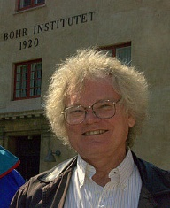
Kirk T McDonald Symposium
Physics-Related Photos
Niels Bohr Institute
Copenhagen, 2011
Photo by Sylvia Kirk
Princeton University
June 17, 2016

Slide 2
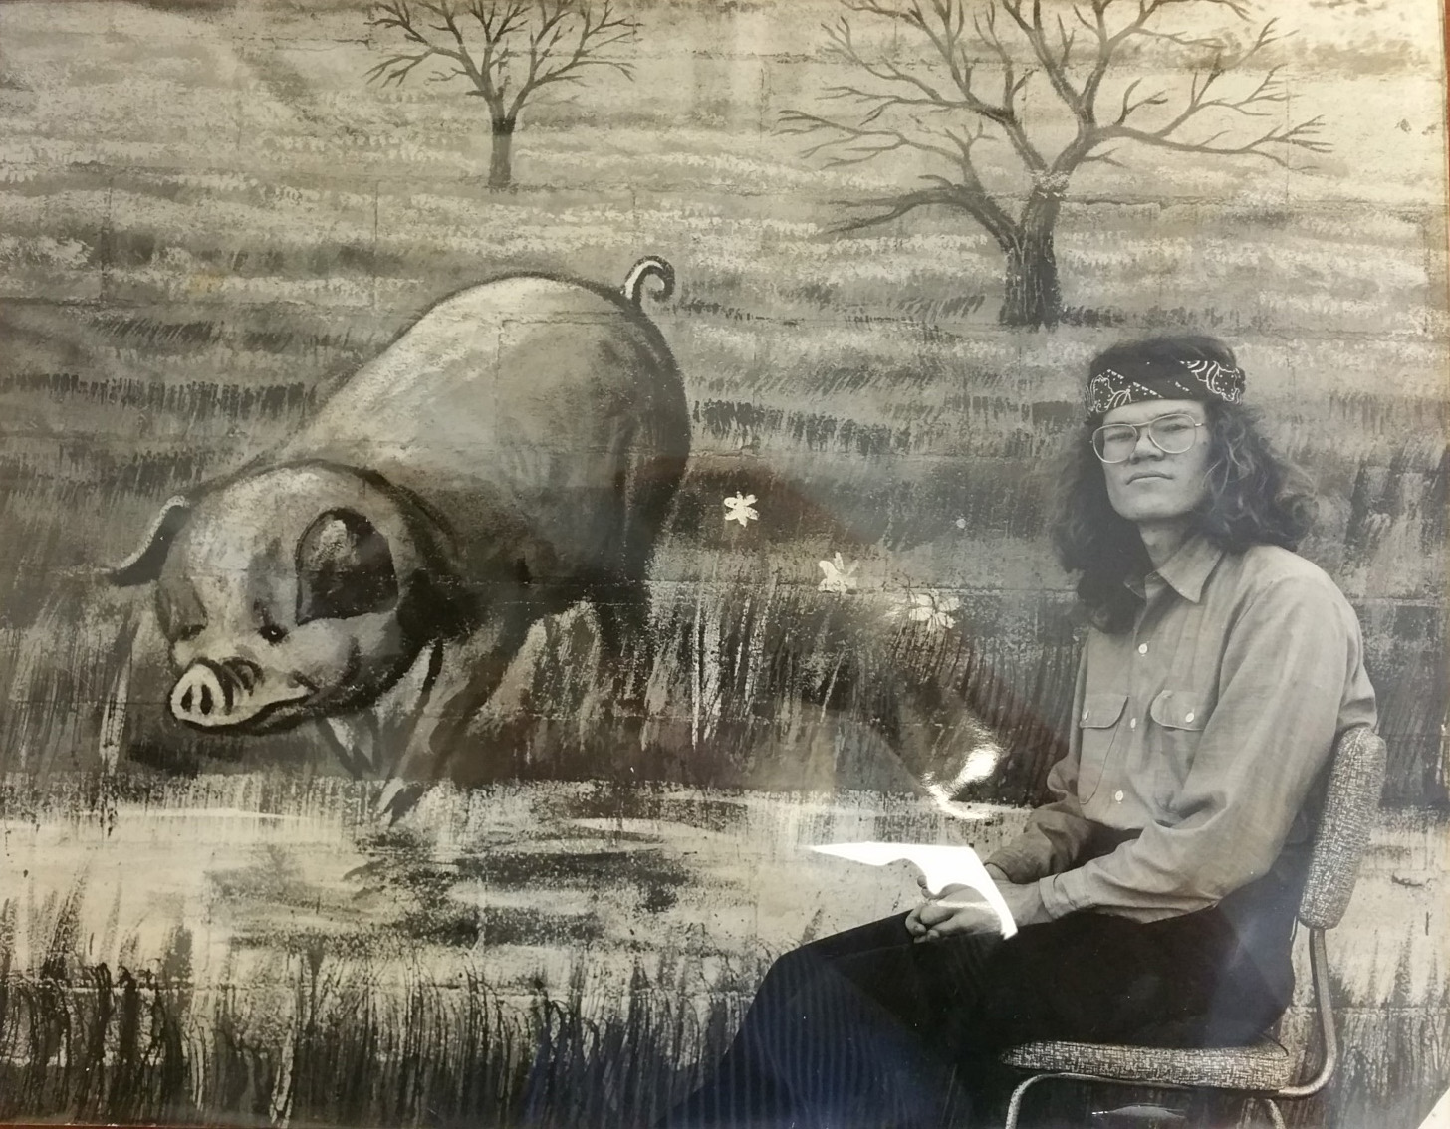
KTM, Tucson, 1971, Photo by Nancy Schaefer

Slide 3
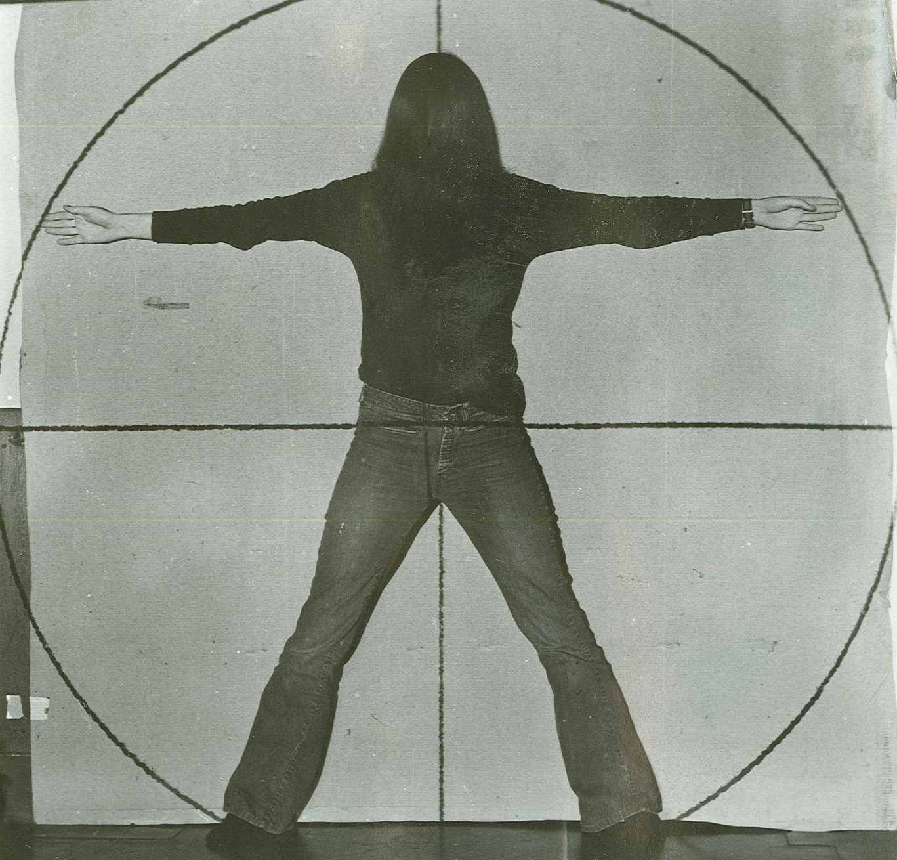
Nancy Schaefer, Vitruvian Woman, Caltech, 1971

Slide 4
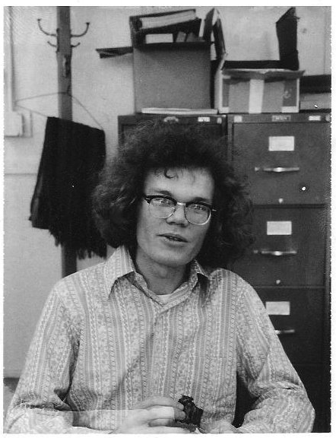
KTM, LBL, 1971 (Did 2nd half of PhD thesis, on p d → He³ γ, at the 184” cyclotron)

Slide 5
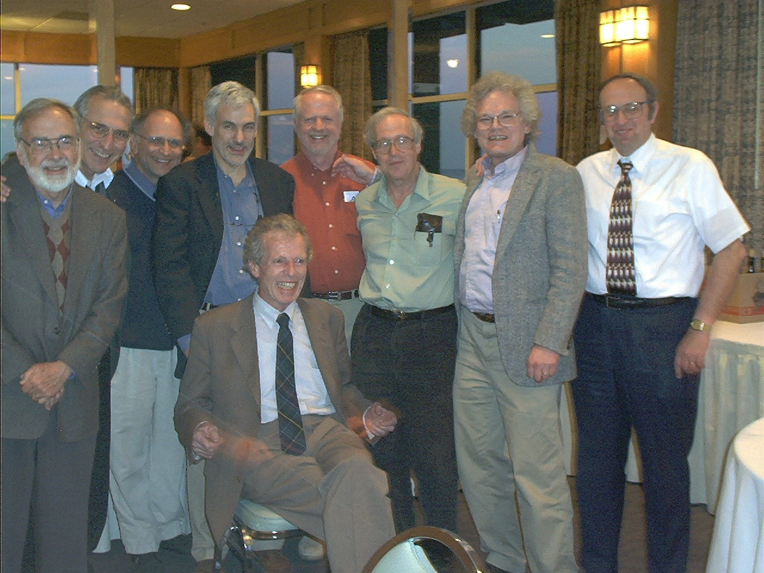
The Heusch Puppies, HeuschFest, Santa Cruz, 2002
Charlie Prescott, Elliott Bloom, Leon Rochester, Bruce Winstein, Bill McNeely, Steve Yellen, KTM, Abe Seiden
Clemens August (Titus) Heusch (1932-2015)

Slide 6
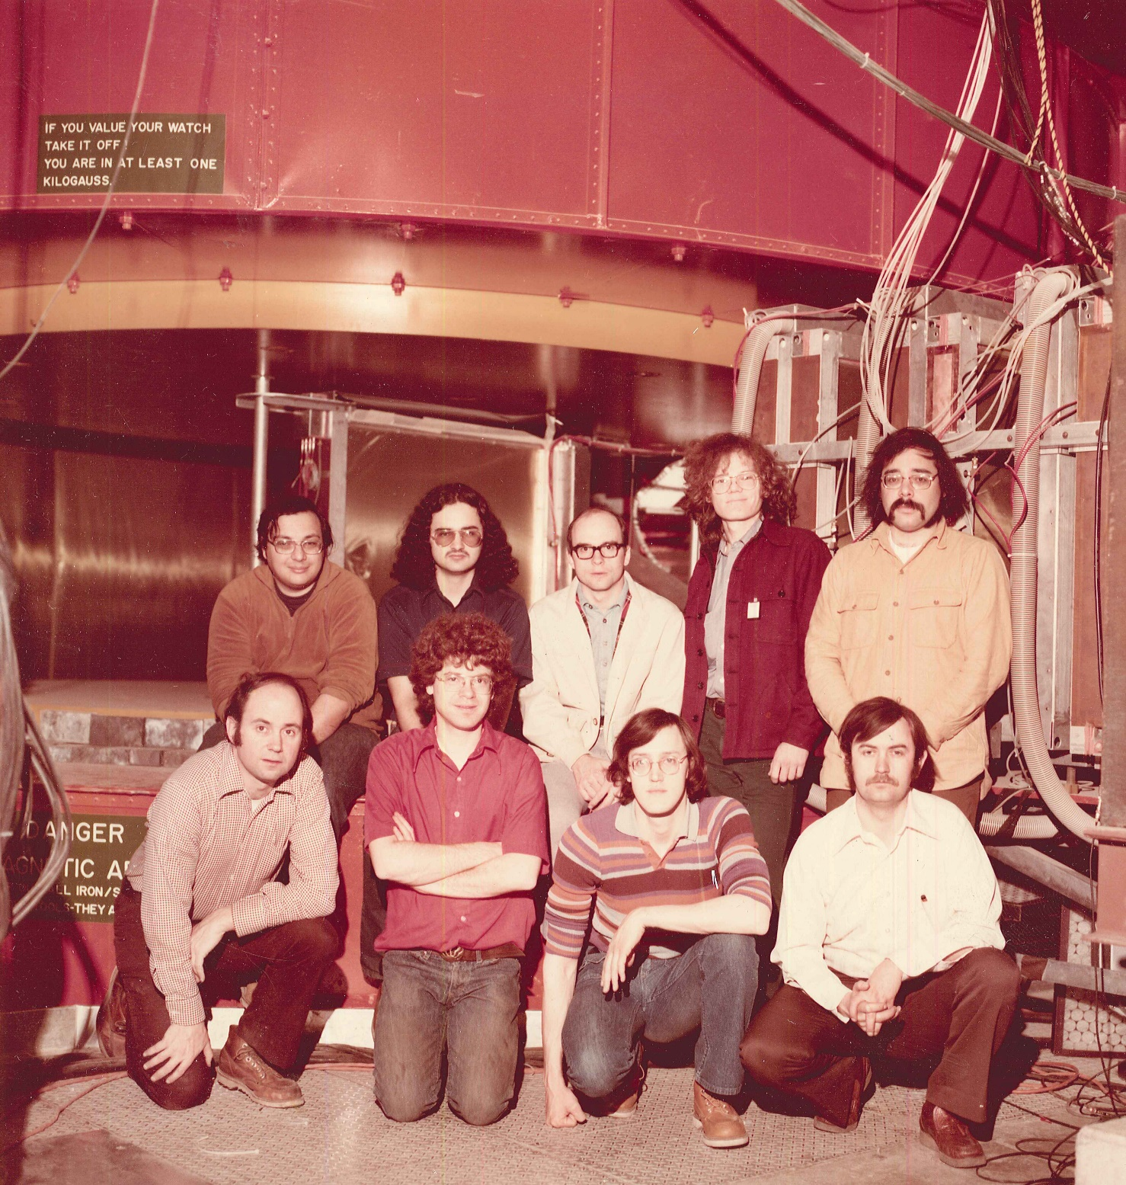
FNAL E331, 1976
Eli Rosenberg, Jim Branson, Jim Pilcher, KTM, Gary Sanders
Stew Smith, Jon Thaler, Greg Henry, Kelby Anderson

Slide 7
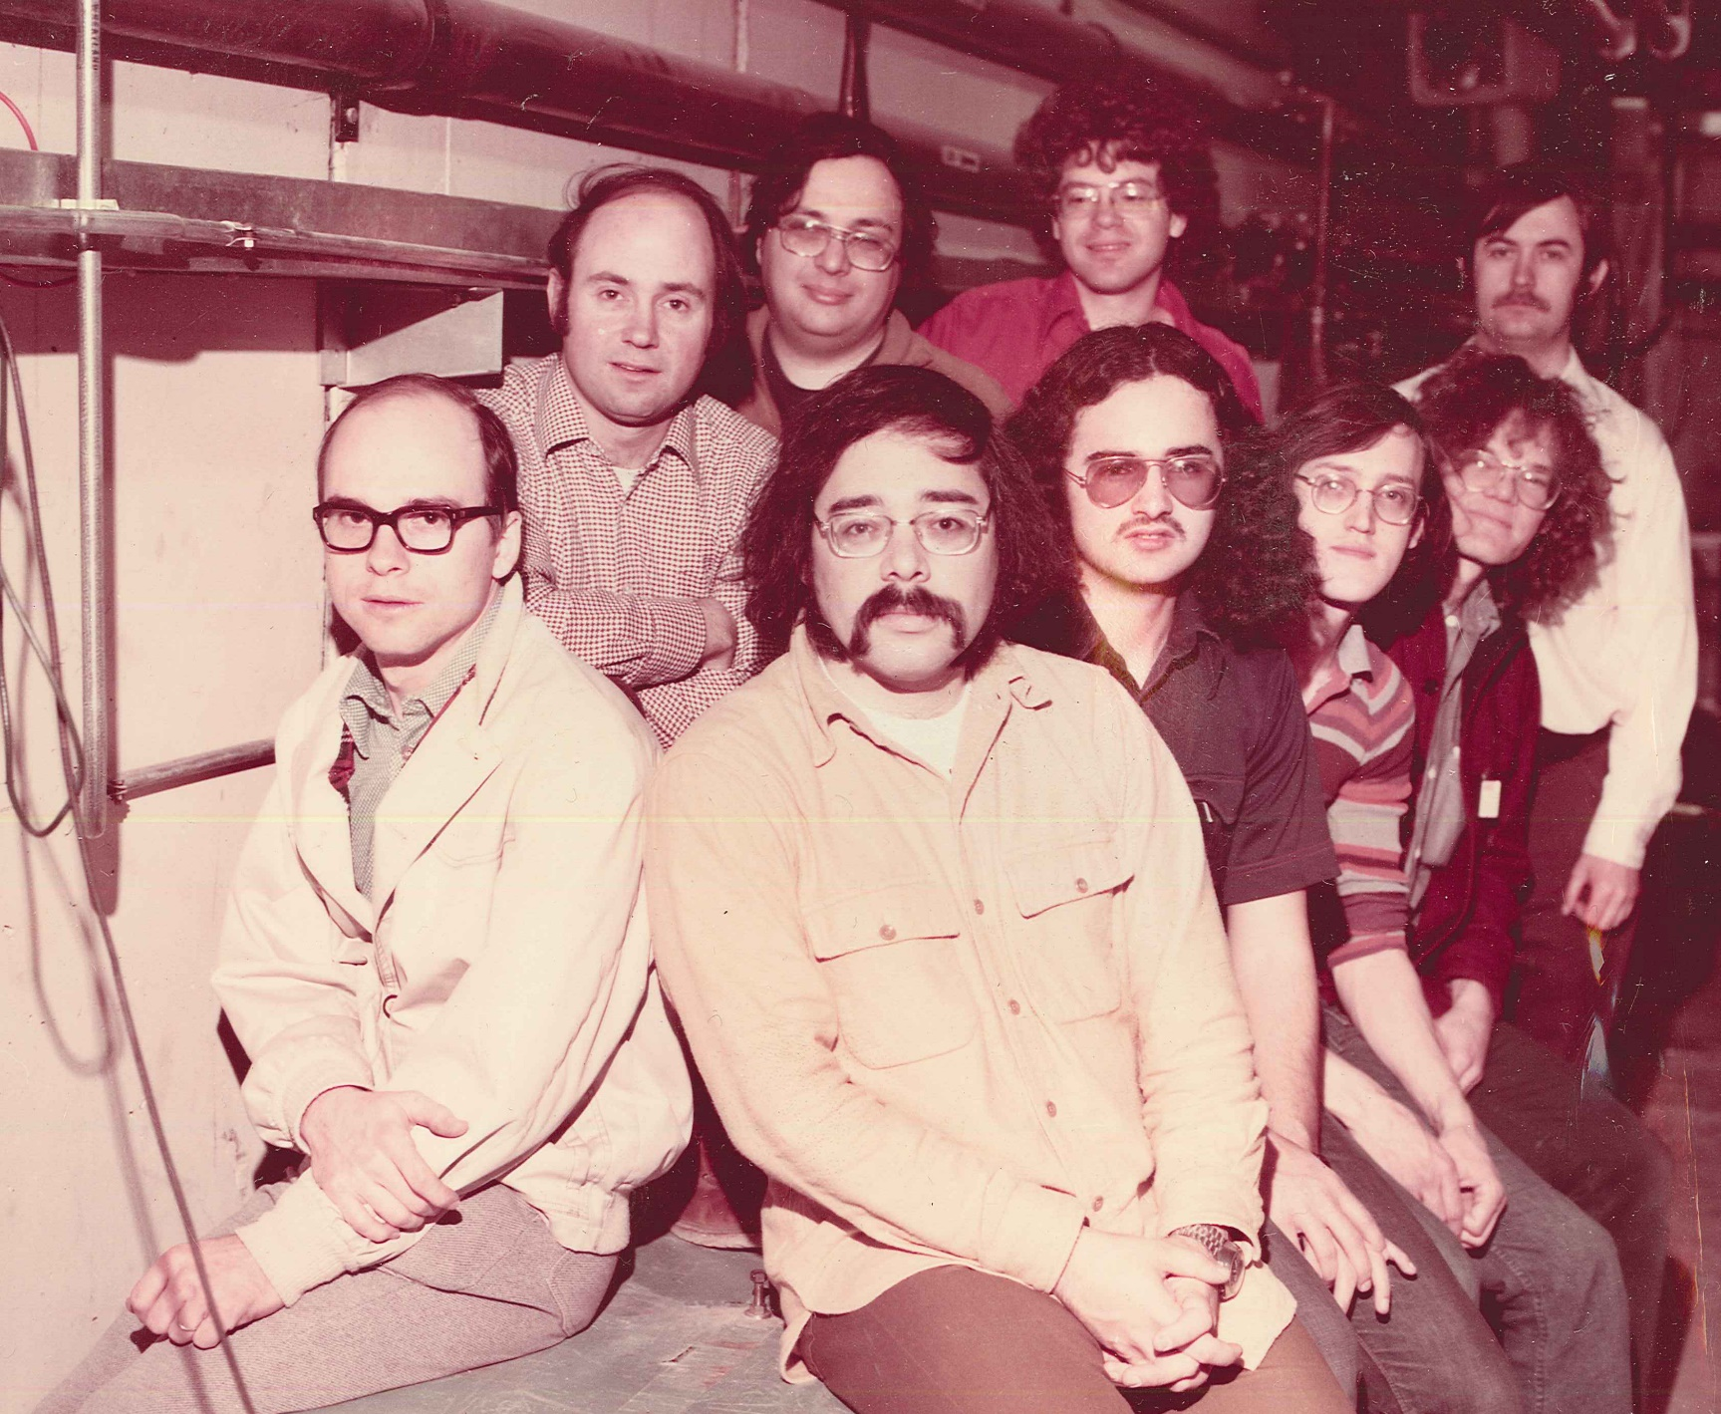
FNAL E331, 1976
Stew Smith, Eli Rosenberg, Jon Thaler, Kelby Anderson
Jim Pilcher, Gary Sanders, Jim Branson, Greg Henry, KTM

Slide 8
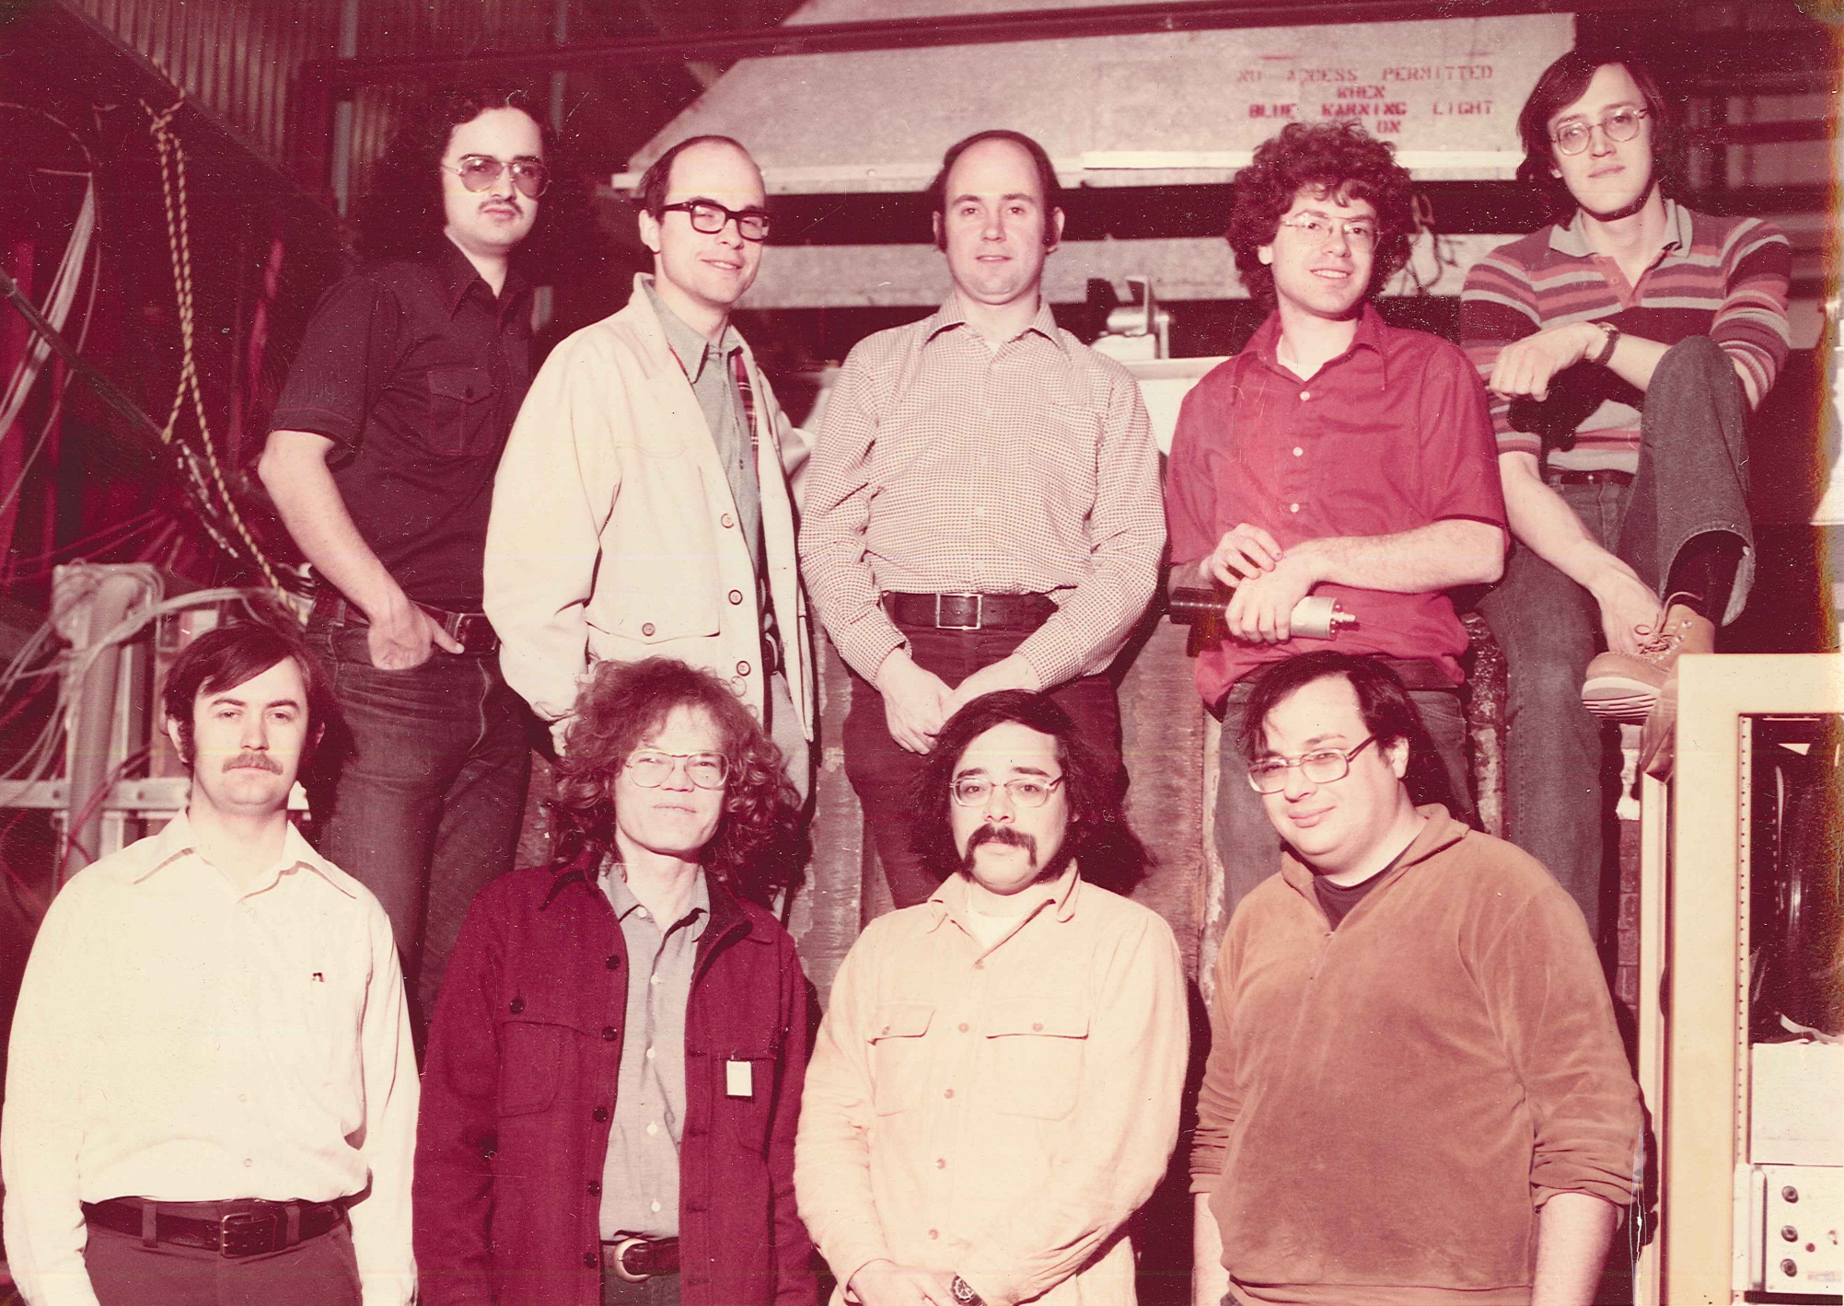
FNAL E331, 1976
Jim Branson, Jim Pilcher, Stew Smith, Jon Thaler, Greg Henry
Kelby Anderson, KTM, Gary Sanders, Eli Rosenberg

Slide 9
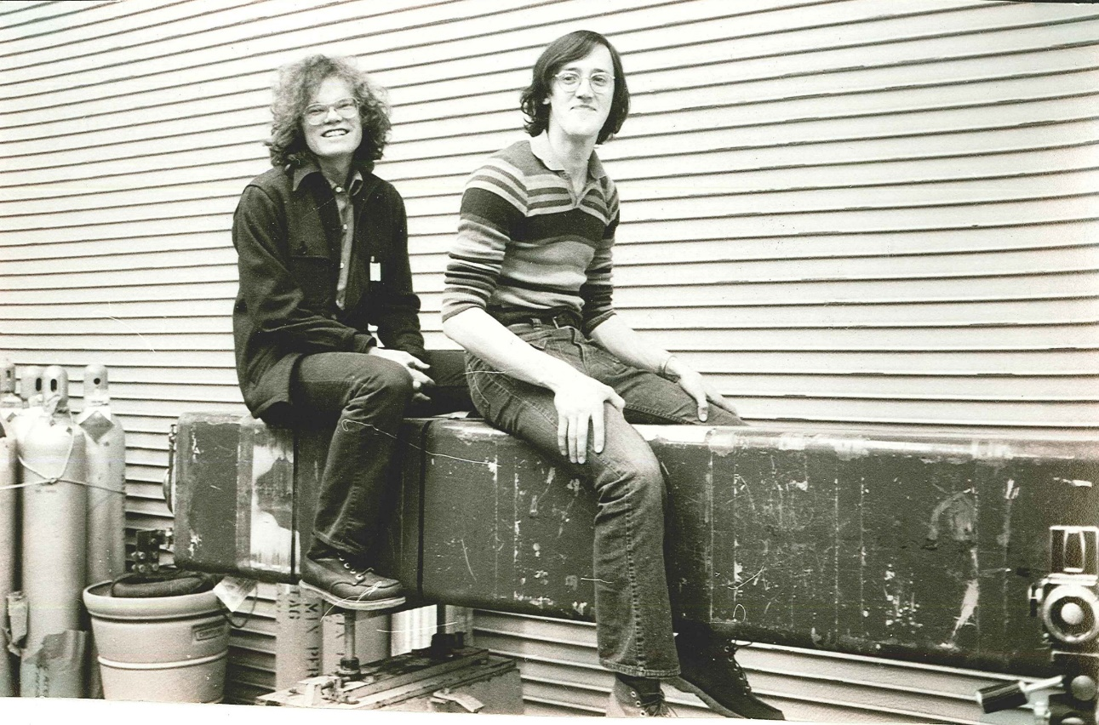
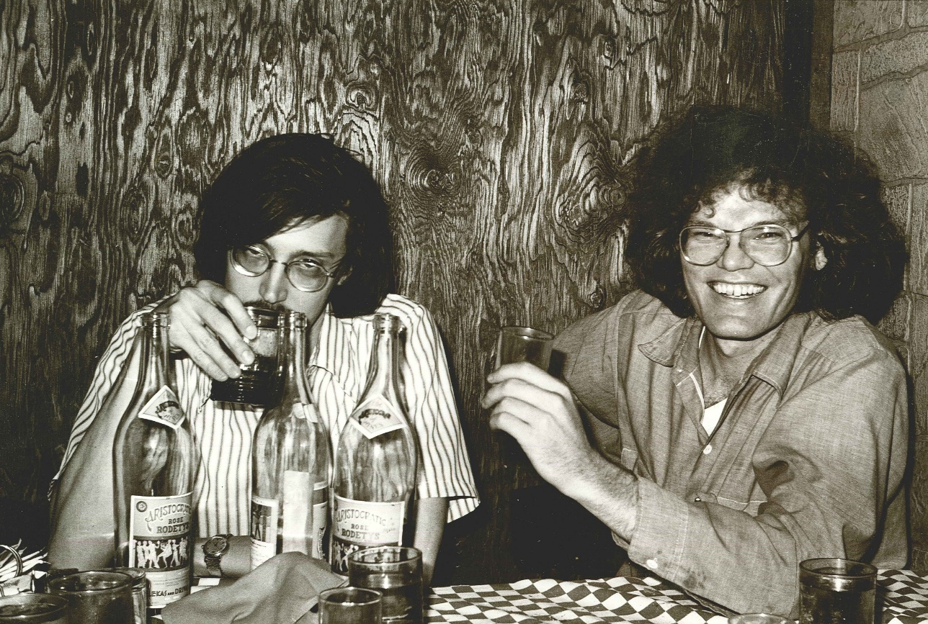
Greek Islands Restaurant, Chicago
Horsing around on a quadrupole
FNAL E331, 1976, KTM, Greg Henry

Slide 10
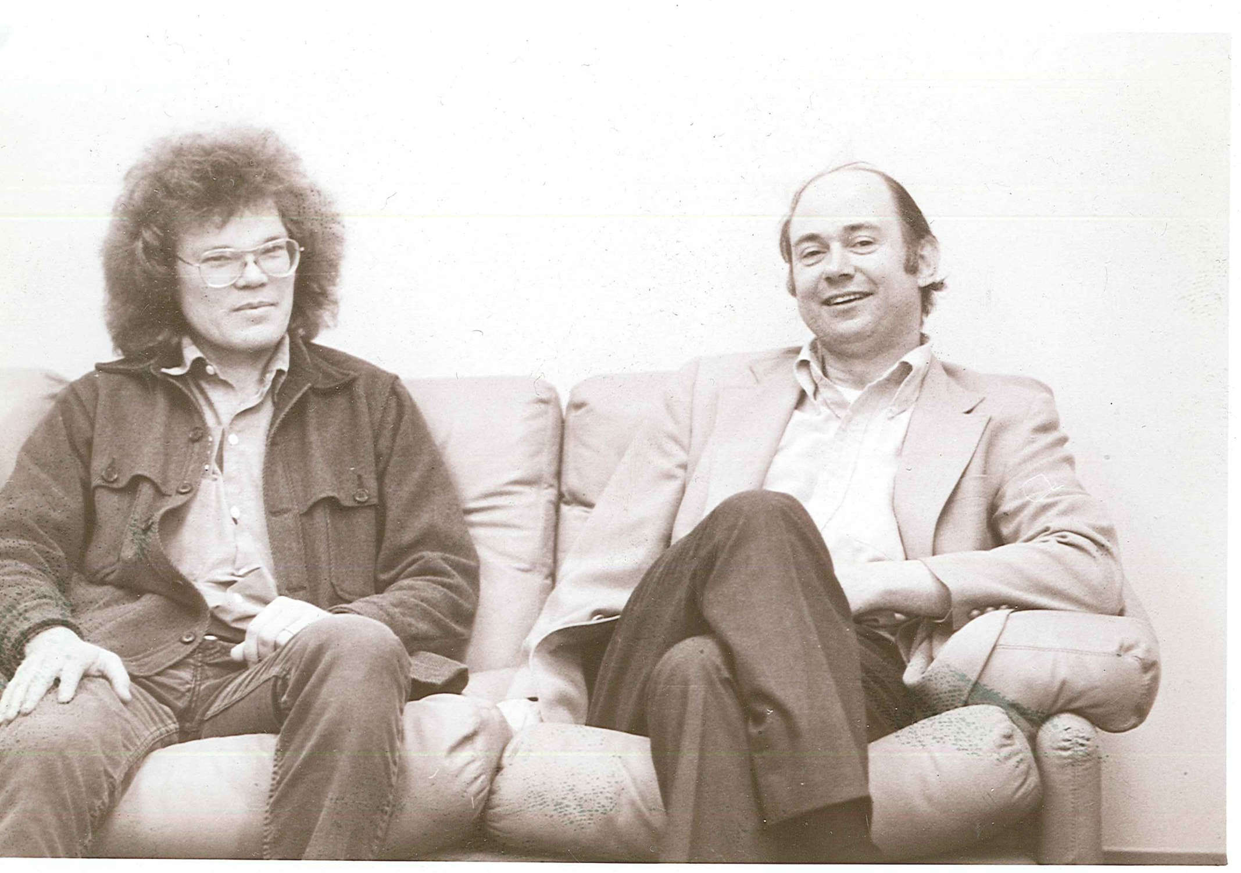
KTM, Stew Smith, MIT, 1979, Photo by Sam Ting

Slide 11
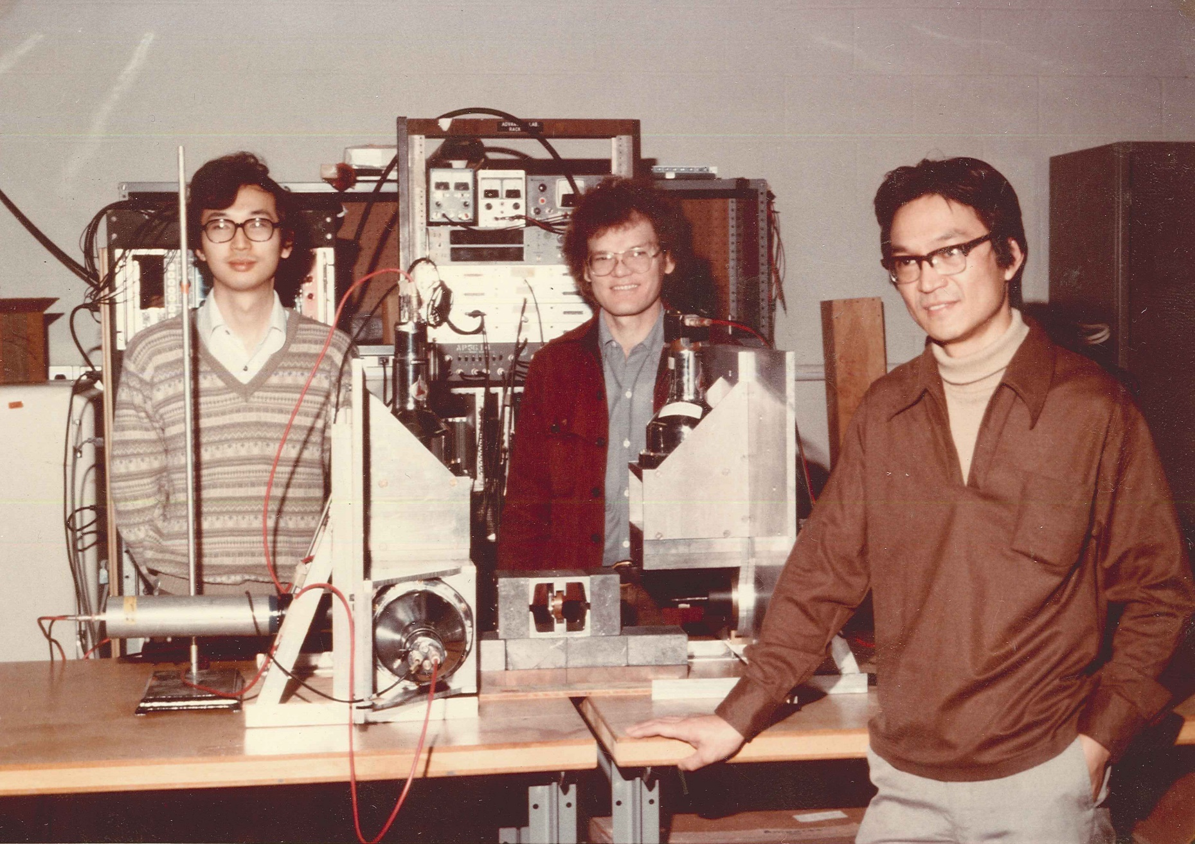
Yoshihisa Kitazawa, KTM, Changguo Lu, 1981 (Test of Bell’s Inequality in e⁺e⁻ → γγ)

Slide 12
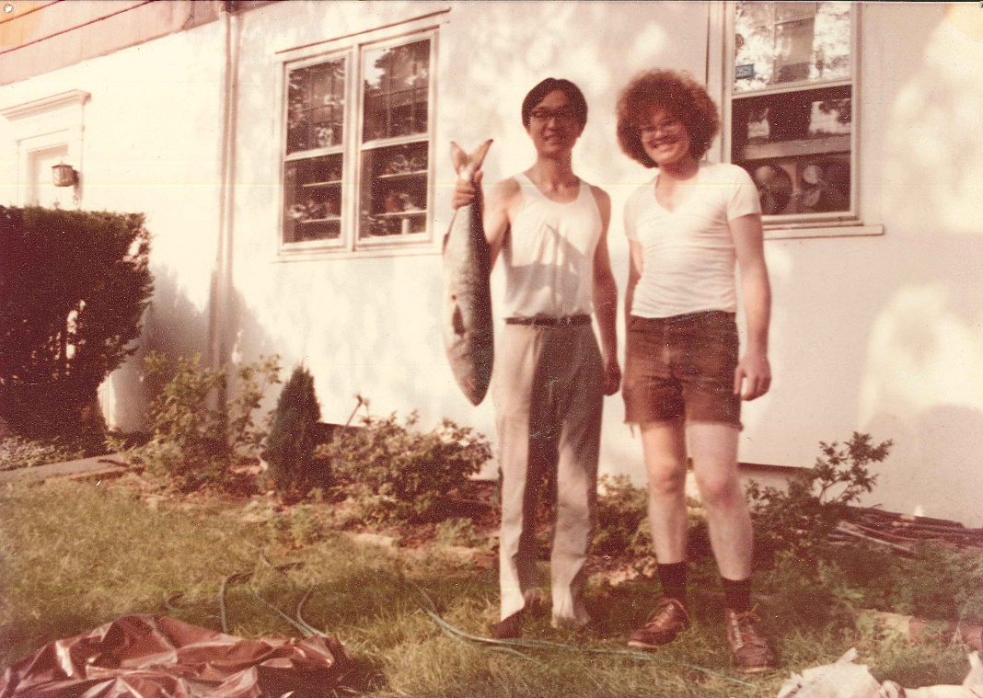
Changguo Lu, KTM, Mulberry St, Princeton, 1981,
after a midnight bluefish expedition with John Gomany

Slide 13
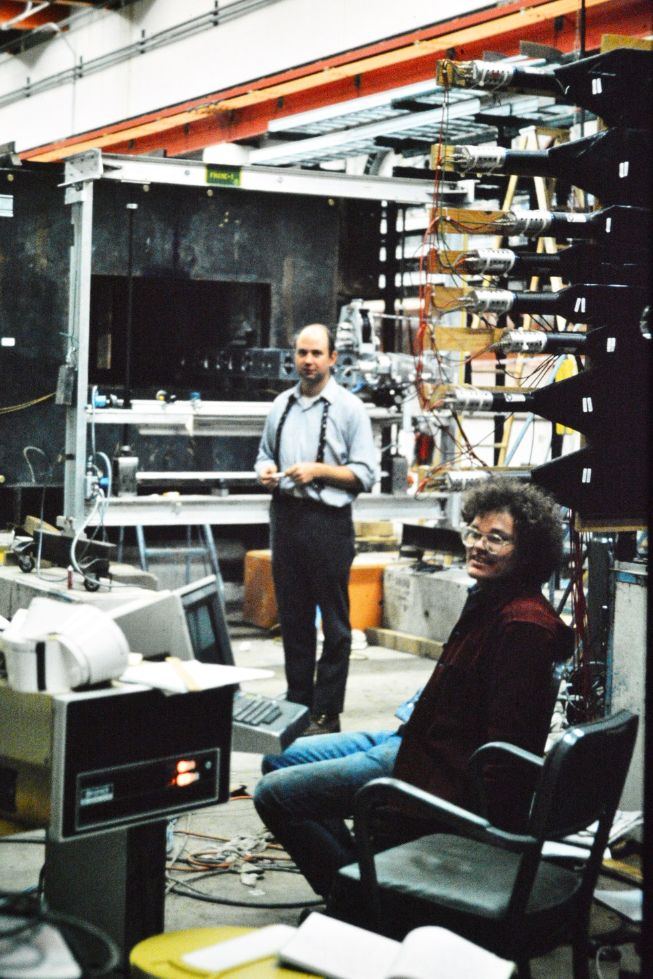
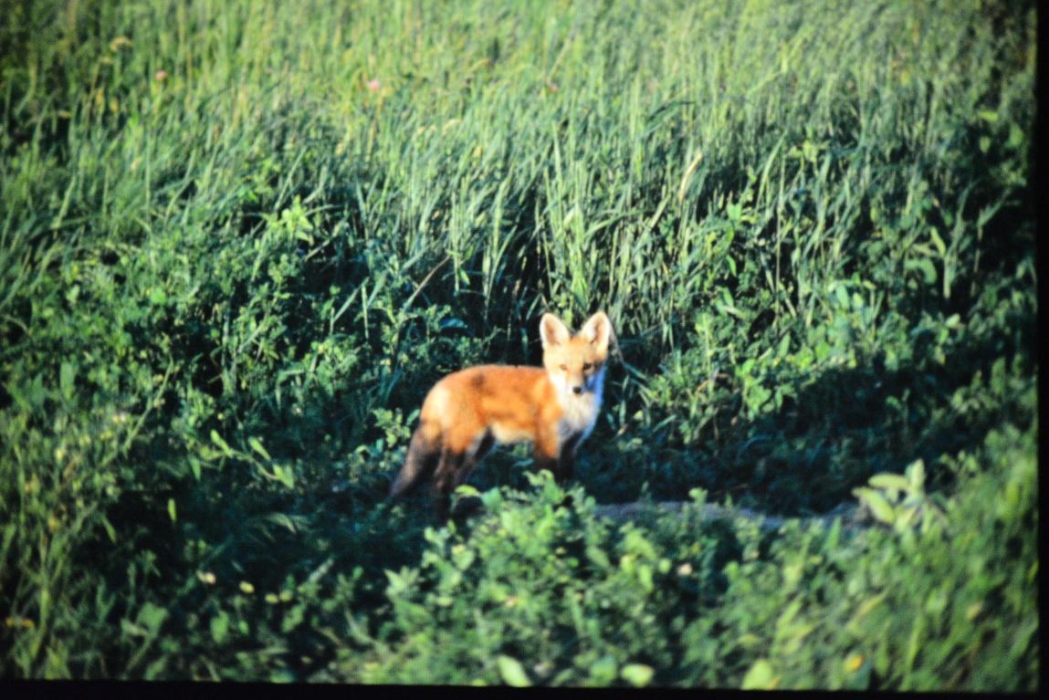
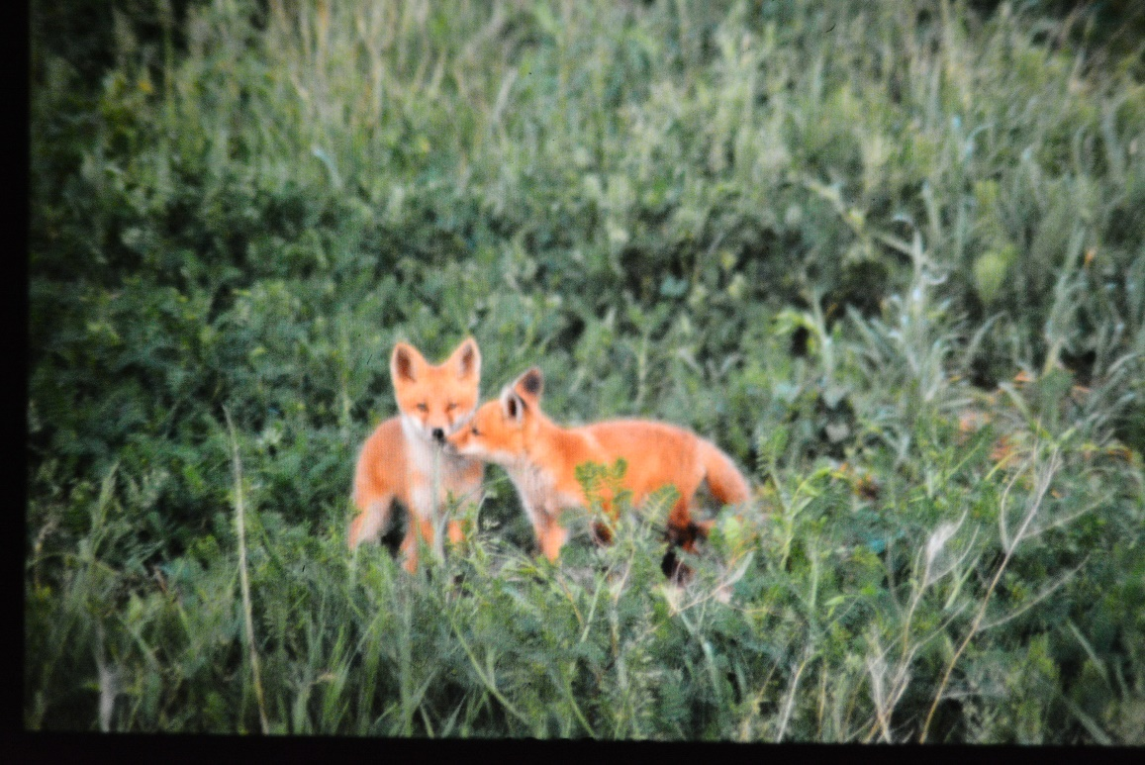
Stew Smith, KTM, Foxes, FNAL E615, 1982, Photos by Cristina Biino

Slide 14
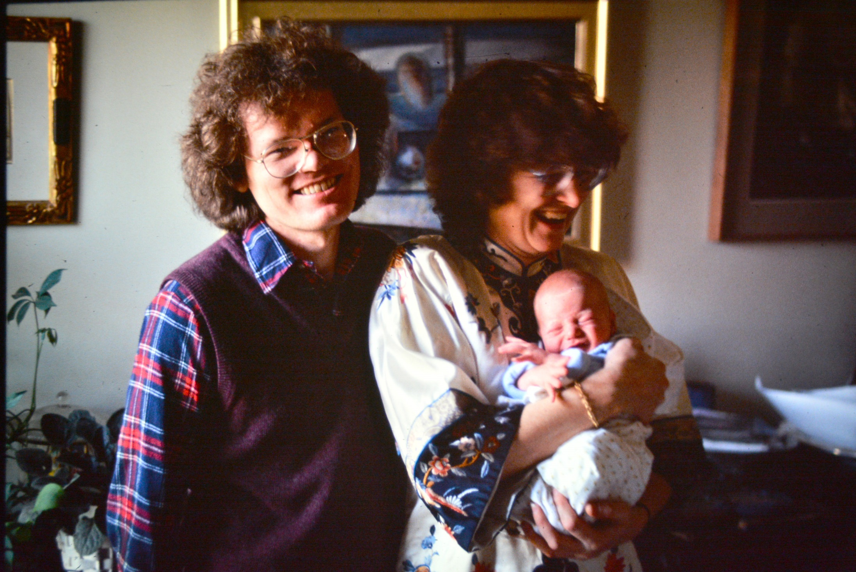
KTM, Nancy Schaefer, Alex, Winant Farm, 1983, Photo by Cristina Biino

Slide 15
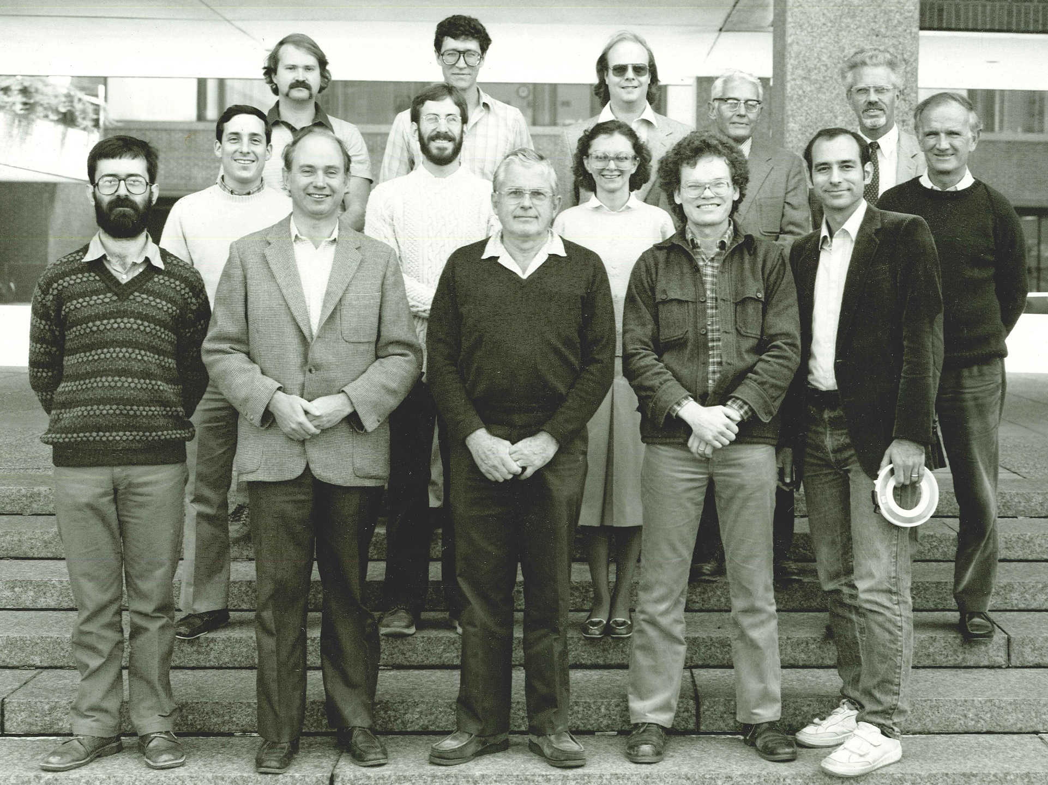
Princeton High Energy Physics, 1984
Jon Bakken, Bill Louis, Dan Marlow, George Reynolds, Pierre Piroue
John Greenhalgh, Peter Meyers, Cristina Biino, Val Fitch
David Stickland, Stew Smith, Frank Shoemaker, KTM, George Gollin

Slide 16
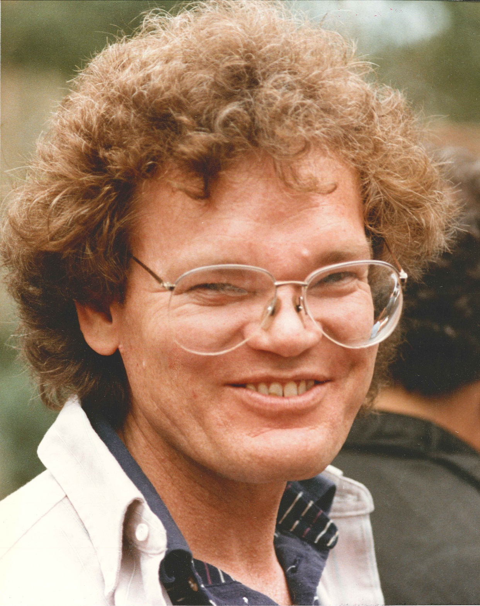
KTM, 1989, Photo by Bob Palmer

Slide 17
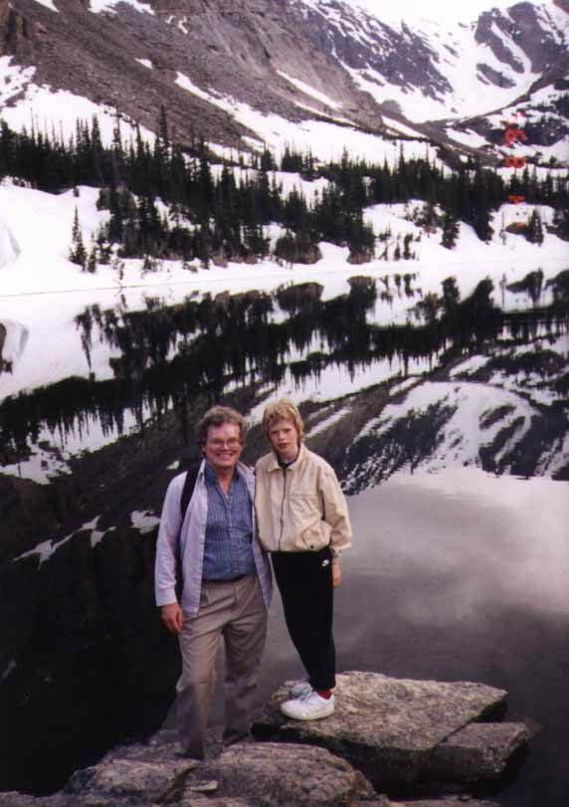
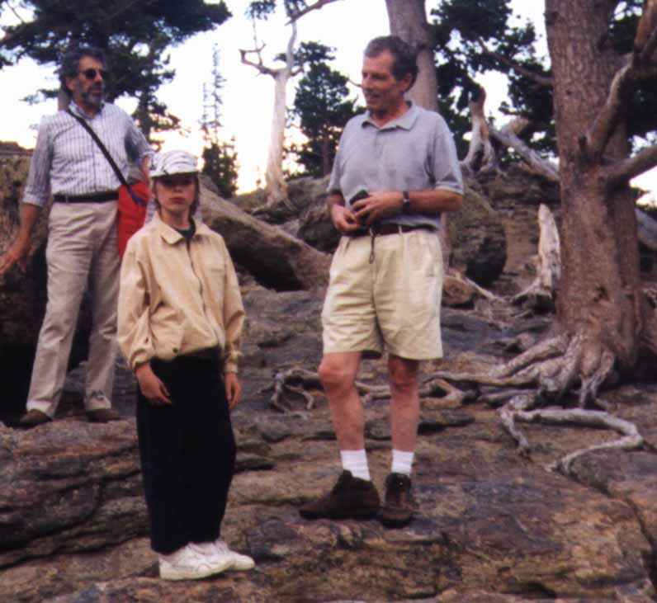
Stan Hertzbach, Alex McDonald, Clem Heusch
KTM, Alex McDonald, The Loch, Estes Park, 1995 (SSC Workshop)

Slide 18
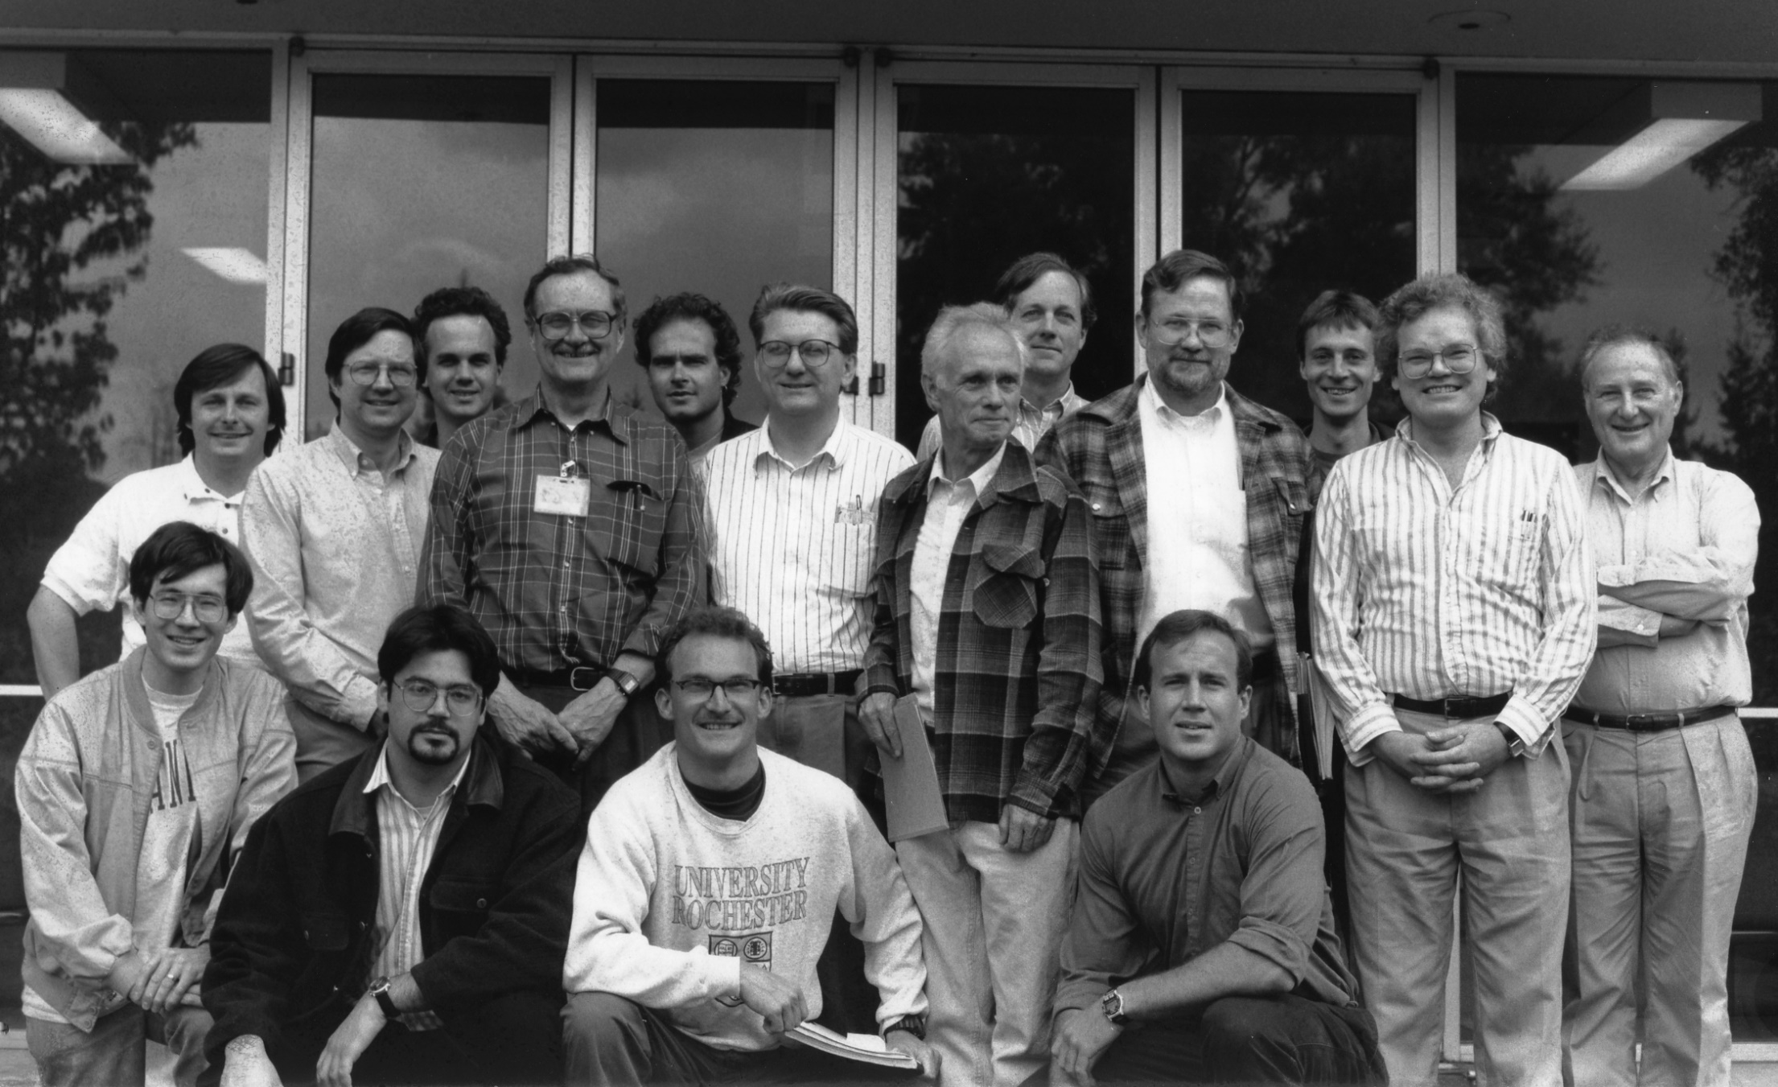
SLAC E144, 1997
Kostya Shmakov, David Meyerhofer, Charlie Bamber, Bill Bugg, Uli Haug,
Achim Weidemann, Dieter Walz, Dave Burke, Jim Spence, Christian Bula, KTM, Adrian Melissinos
Glenn Horton-Smith, Theo Kotseroglou, Wolfram Ragg, Steve Boege

Slide 19
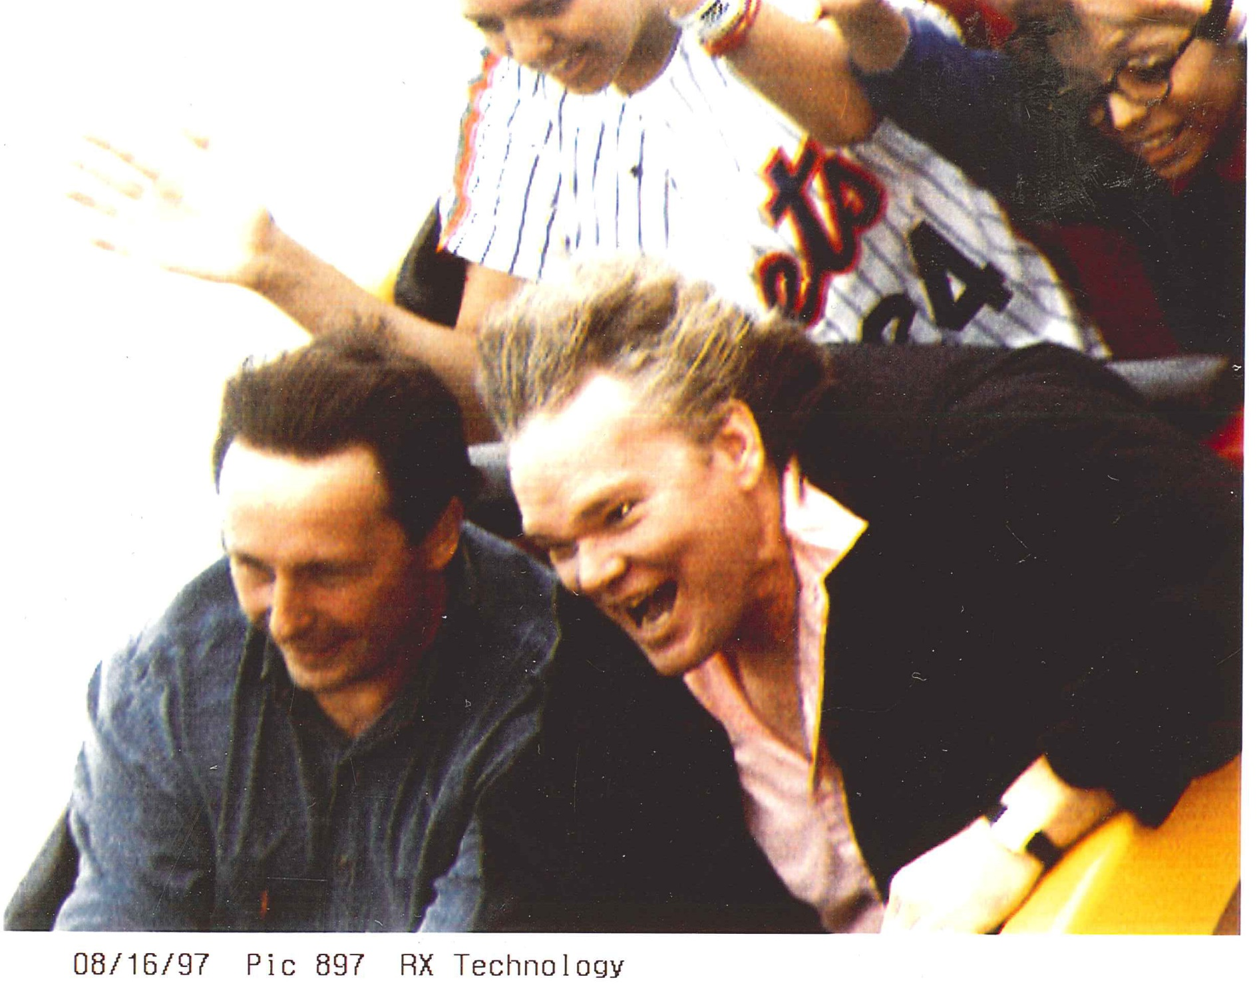
Kostya Shmakov, KTM, Santa Cruz Roller Coaster, 1997 (SLAC E144)

Slide 20
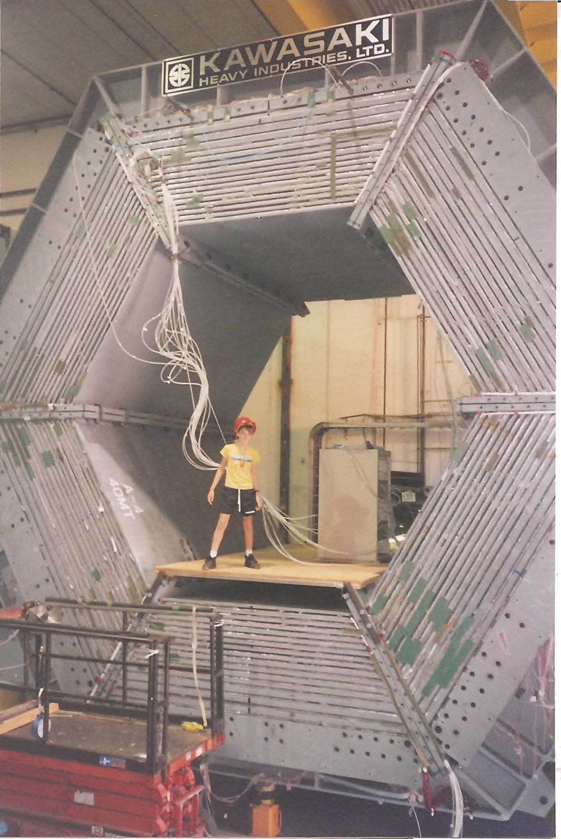
Owen Schaefer, BaBar magnet, SLAC, 1997

Slide 21
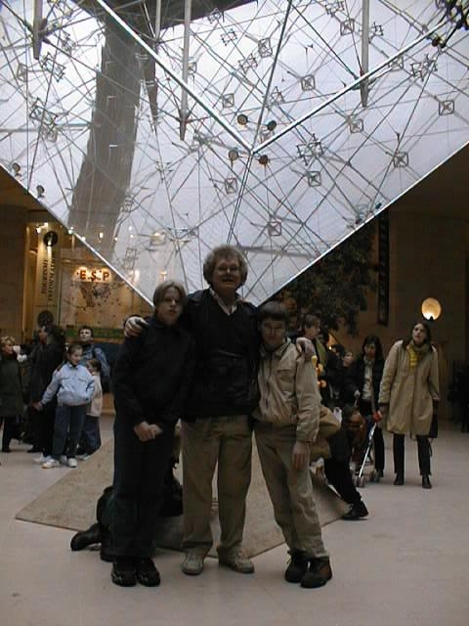
Alex McDonald, KTM, Owen Schaefer, The Louvre, 1998

Slide 22
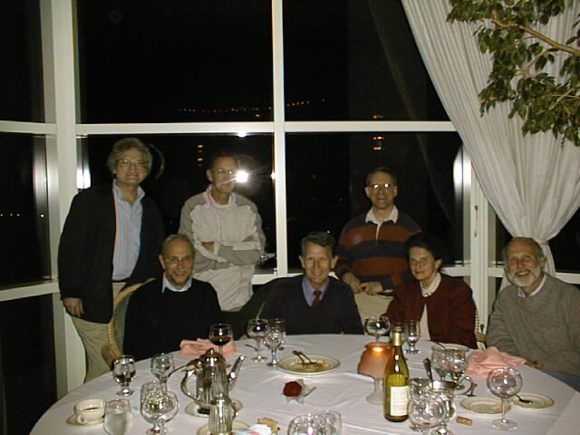
KTM, Eberhard Kiel, Bob Palmer, Colin Johnson, Bob Weggel, Audrey Johnson,
Harold Kirk (Muon Collider Meeting, Alabama, 1998)

Slide 23
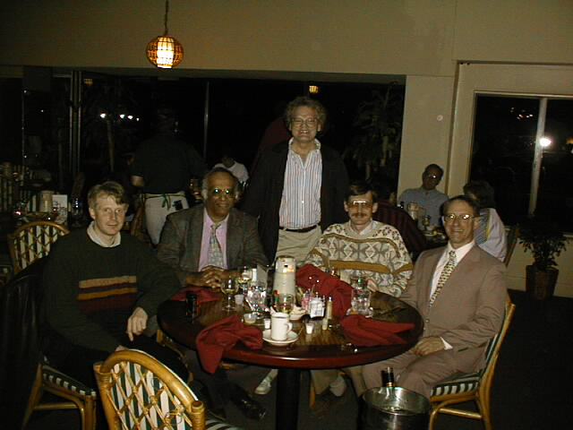
Norbert Holtkamp, Rajendran Raja, KTM, Steve Geer, Bob Weggel (Alabama, 1998)

Slide 24
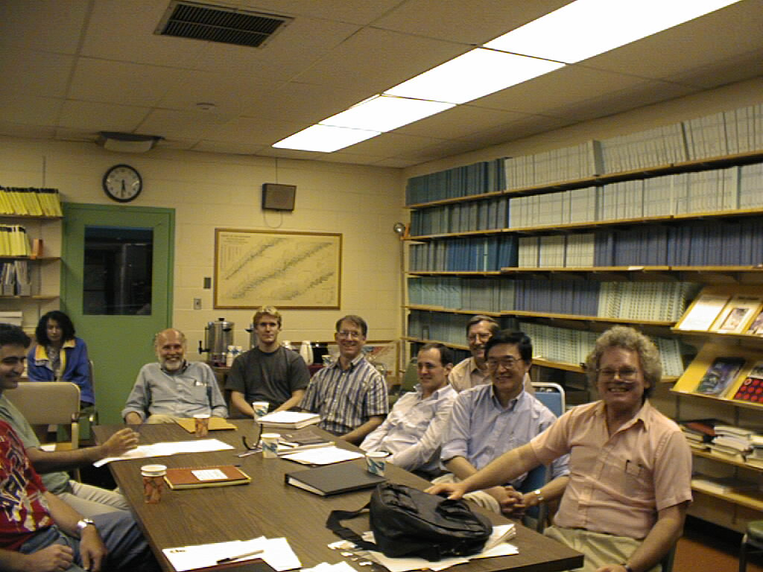
Yagmur Torun, Hulya Guler, Harold Kirk, Sven Vahsen, Bob Weggel, Bruce King,
Rick Fernow, Changguo Lu, KTM, Muon Collider Meeting, BNL, 1998

Slide 25
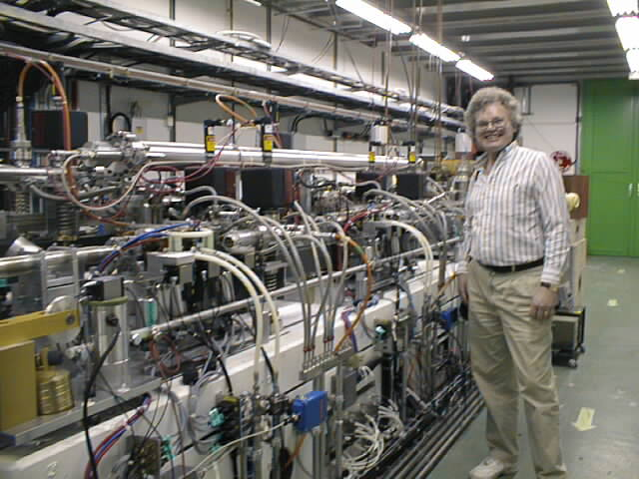
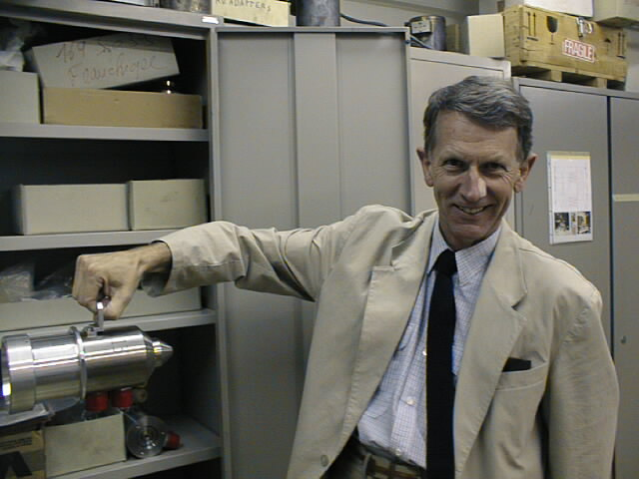
Colin Johnson
Spare ACOL target
KTM, CLIC Test Facility
CERN, 1998

Slide 26
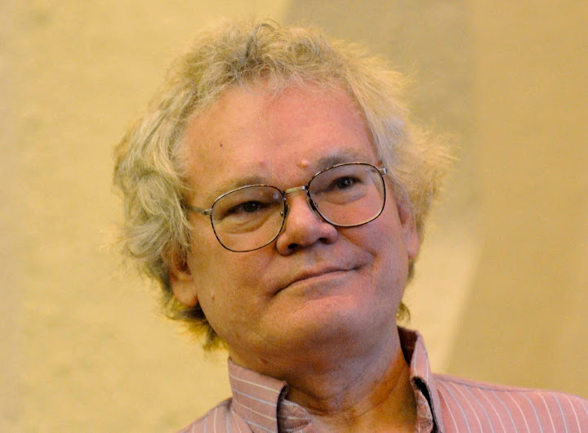
KTM, ~ 1999, Photo by Bob Palmer

Slide 27
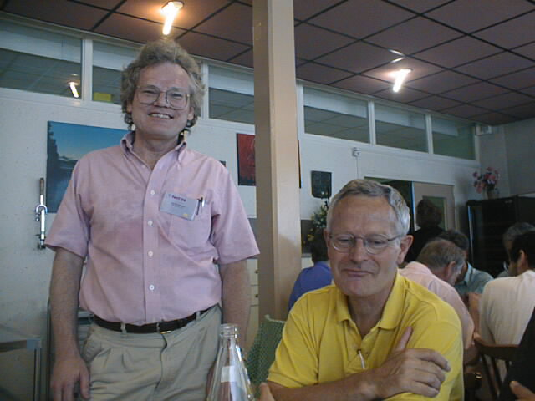
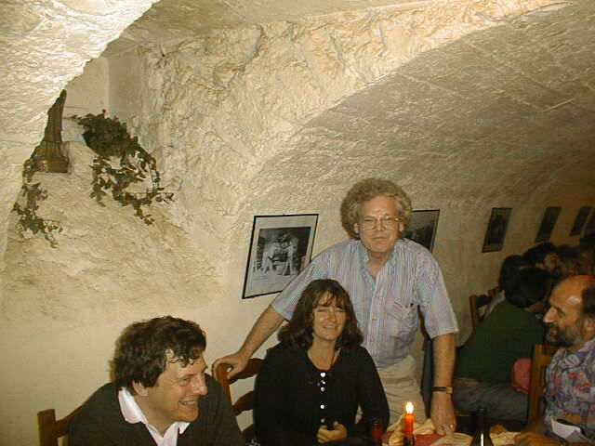
KTM, Bruno Autin
NuFact99, Lyon Jonathan Wurtele, Rita Cooper, KTM, Alain Blondel

Slide 28
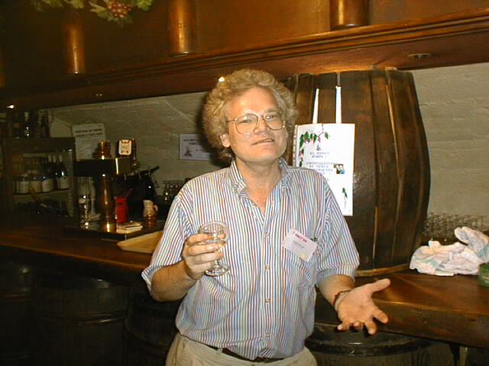
KTM, NuFact99, Lyon

Slide 29
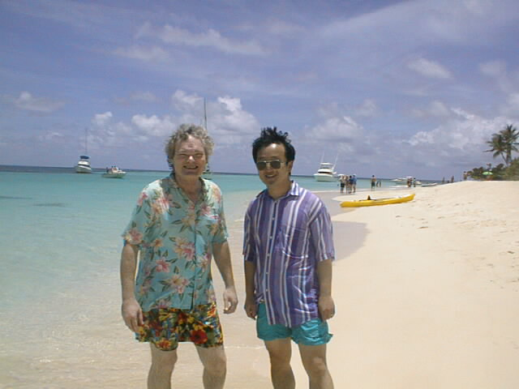
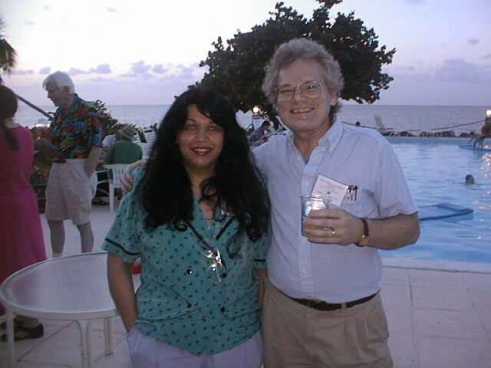
Zohreh Parsa, KTM
KTM, Derun Li
St Croix Muon Collider Workshop, 1999

Slide 30
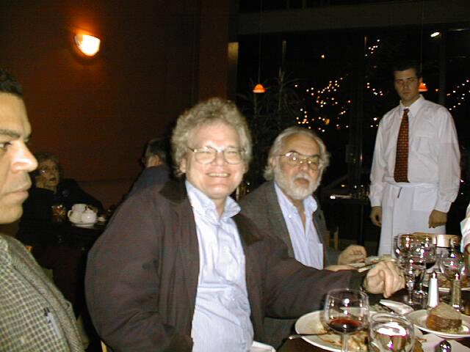
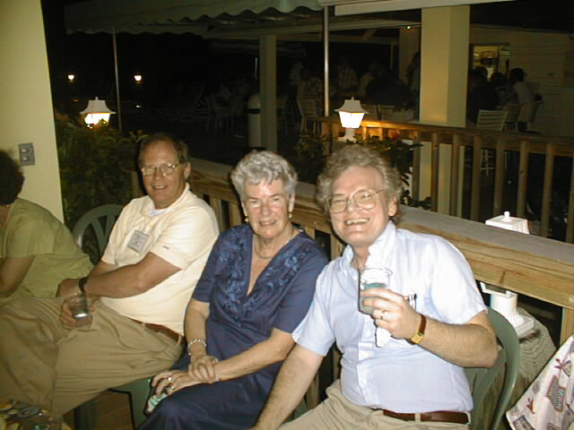
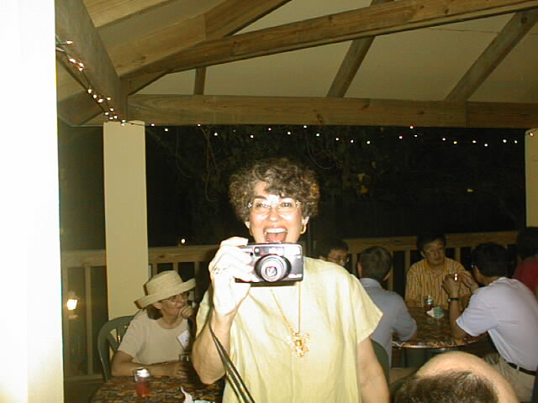
Ahmed Hassanein, KTM, Juan Gallardo
Jim Norem, Pat Tuttle, KTM
St Croix Muon Collider Workshop
1999
Sylvia Kirk

Slide 31
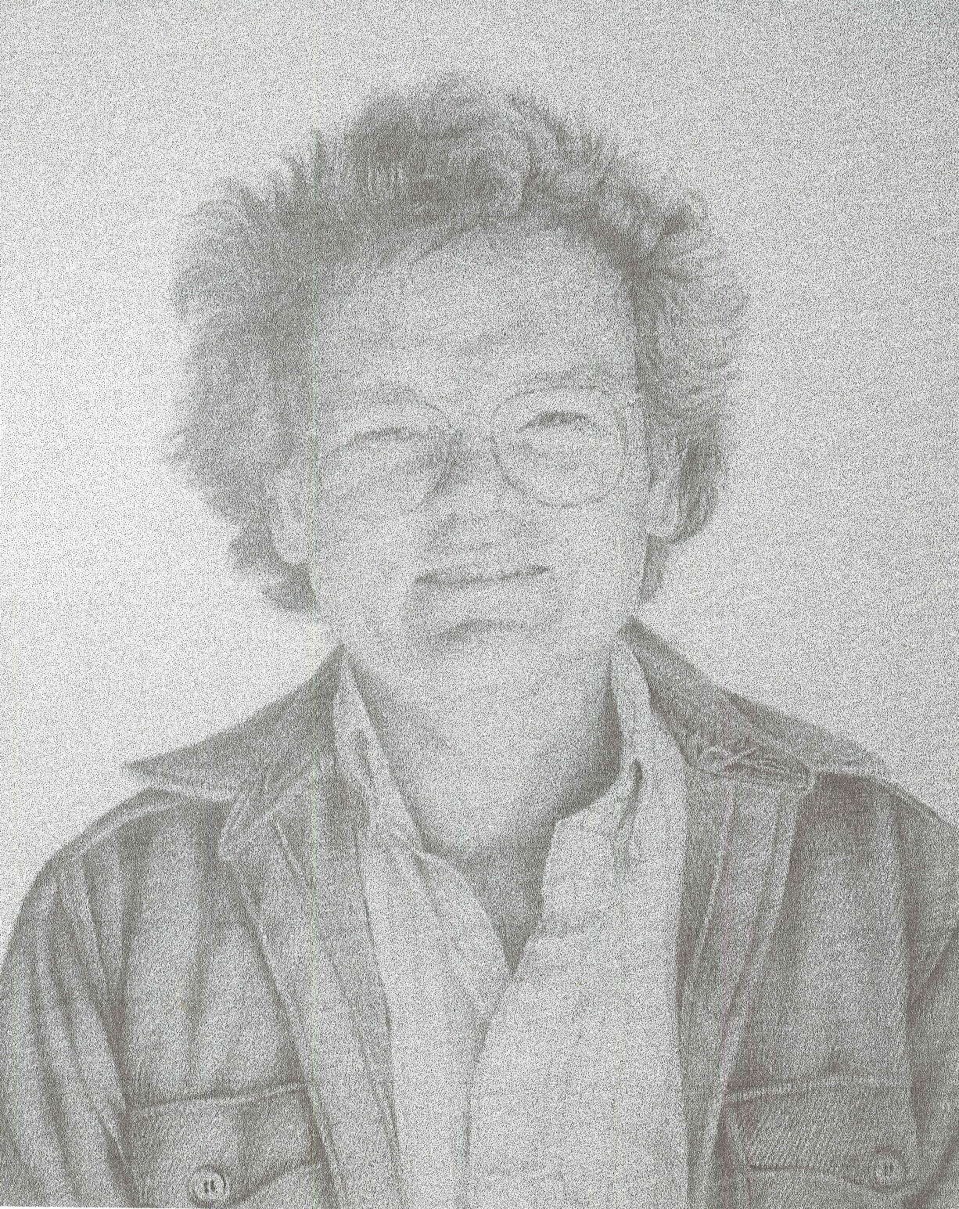
KTM, by Jan McDonald, ~ 2000

Slide 32
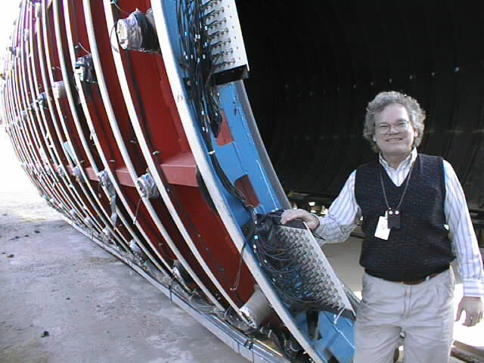
KTM, LSND Experiment, LANL, 2000

Slide 33
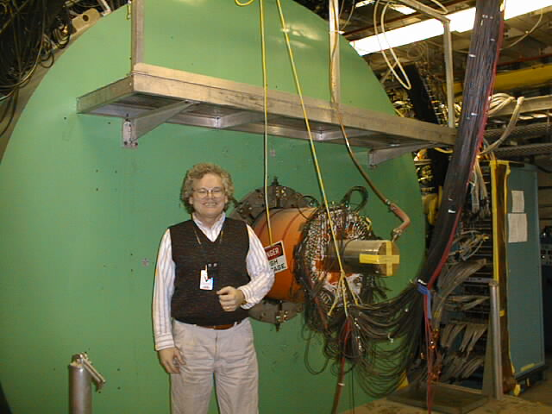
KTM, LSND Experiment, LANL, 2000

Slide 34
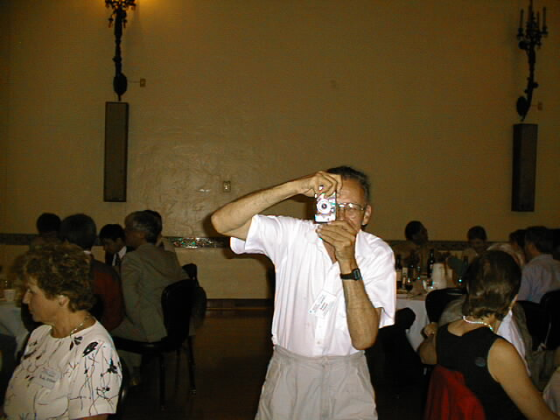
Bob Palmer photographing KTM, NuFact00, Monterey

Slide 35
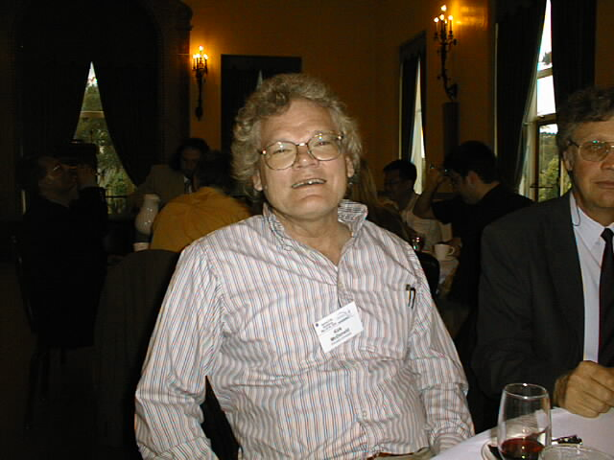
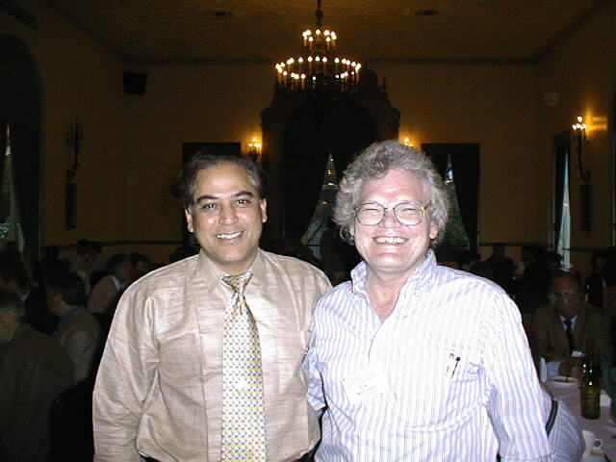
Swapan Chattopadhyay, KTM
Photo probably not by Bob Palmer
NuFact00, Monterey

Slide 36
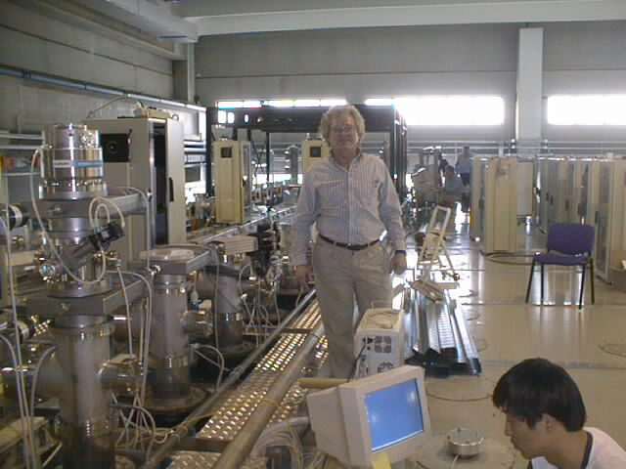
KTM, XiaoFeng Yang, ICARUS Detector, Pavia, 2001

Slide 37
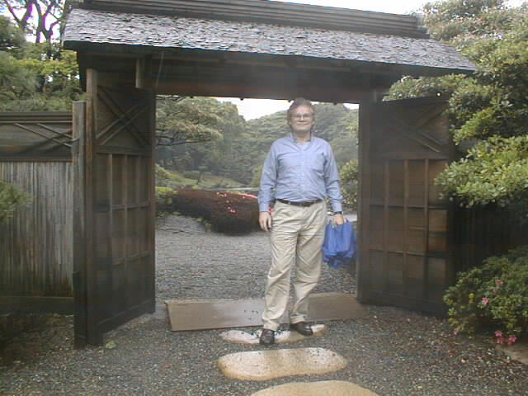
KTM, NuFact01, Tokyo/Tsukuba

Slide 38
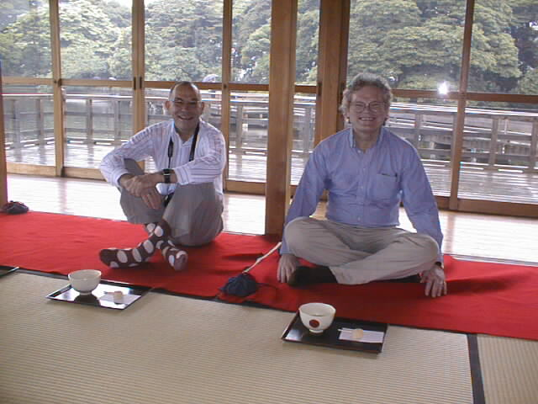
Helge Ravn, KTM, NuFact01, Tokyo/Tsukuba

Slide 39
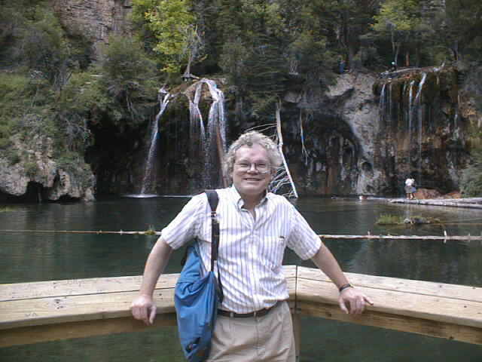
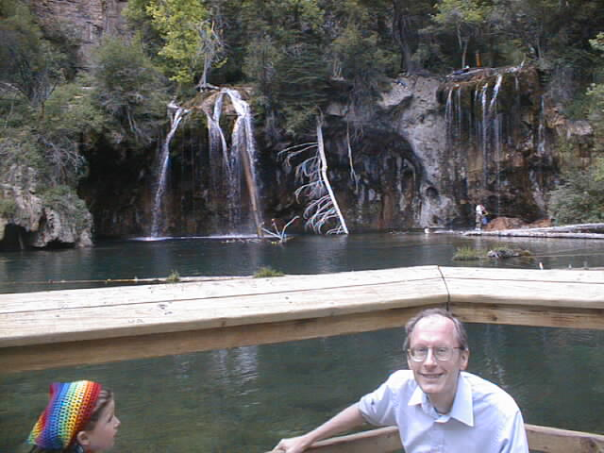
Bob Shrock
KTM, Hanging Lake, CO, 2001
(Snowmass SSC Workshop)

Slide 40
Steve Kahn, KTM
KTM. Nick Simos, Adrian Fabich
BNL E951, 2001
Roman Samulyak, Ralf Prigl,
Thomas Tsang

Slide 41
BNL E951 End of Run Party, 2001
Kathleen Tuohy, Harold Kirk, Scott Berg, Bob Weggel, Nick Simos, Bill Weng,
Juan Gallardo, Rick Fernow, Steve Kahn, KTM

Slide 42
KTM, Bob Palmer, 1st High Power Targetry Workshop, 2001 (Ronkonkoma/Fire Island)

Slide 43
Ludmilla Wightman
KTM
Norma Smith, Barbara Gilman
KTM
Curt Callan Symposium, 2002

Slide 44
Larry Sulak, KTM, SamiosFest, BNL, 2002

Slide 45
Don Summers, KTM
NuFact02, London

Slide 46
Harold Kirk, Alex McDonald, KTM, Nancy Schaefer, NuFact02, London

Slide 47
Ken Peach, Bruno Autin, KTM, Bob Palmer, Lord Sainsbury, NuFact02, London

Slide 48
David Jefferies, KTM, Alan Turing Statue, U Sheffield, 2002, Photo by Alan Boswell

Slide 49
Gail Hansen, KTM
KTM, Alex Bogacz, Al Garren
Muon-Collider Shelter-Island Workshop
2002

Slide 50
KTM, Ostriches, Picacho Peak, AZ, 2002

Slide 51
KTM, Epcot Center, Tucson, 2003

Slide 52
KTM, Eric Prebys & Mother, Phoenix, 2003

Slide 53
KTM, Ed Groth, Rubby Sherr Fest, 2003

Slide 54
KTM, Val Fitch, Frank Shoemaker, Rubby Sherr Fest, 2003

Slide 55
KTM, Princeton Physics Picnic, 2003

Slide 56
KTM, Tokyo, 2003 (J2K Meeting), Photo by Harold Kirk

Slide 57
Lee Roberts, KTM, Tokyo, 2003 (J2K Meeting), Photo by Harold Kirk

Slide 58
Lutz Bartz, Christian Bula, KTM, Aarau, Switzerland, 2003 (MERIT Experiment)

Slide 59
KTM, BNL Hot Cell, 2003, Photo by Harold Kirk

Slide 60
Stavros Melissinos (Poet/Sandalmaker), KTM, Athens, 2004

Slide 61
KTM, Volodymyr Krytskyy, Vitalii Gasanenko, Norbert Krutzik
(Ukrainian Engineers)
Nick Simos, KTM, “Greek Alps,” 2004
(Homeland Security Initiative)

Slide 62
KTM, Achim Stahl
Roman Poeschl, KTM, Achim Stahl, Peter Schüler
Statue of Marx and Engels
SLAC E166 Group Meeting, Berlin 2004

Slide 63
Vinod Bharadwaj, KTM, Statue of Helmholtz, Humboldt U, Berlin, 2004

Slide 64
KTM + Gypsies, Thirsty Bear, San Francisco, 2004 (SLAC E166)

Slide 65
KTM, NuFact04, Kyoto, 2004
(Watazen Ryoken)
Harold Kirk, KTM, Marylou Abata, Photo by Sylvia Kirk

Slide 66
Owen Schaefer, Alex McDonald, KTM, Top of Mt. Princeton, CO, 2004
(ILC Snowmass Workshop)

Slide 67
Norma & Stew Smith, KTM, Gross-Wilczek Fest, 2005

Slide 68
Jason Puchalla, Suzanne Staggs, KTM, Gross-Wilczek Fest, 2005

Slide 69
KTM, Princeton Physics Picnic, 2005

Slide 70
KTM, Commencement, Princeton, 2005, Photo by Robert Austin

Slide 71
Roger Bennett, KTM, Café du Soleil, Geneva, 2005 (MERIT Experiment)

Slide 72
KTM, London, East End, 2005, (MERIT Experiment), Photo by Nancy Schaefer

Slide 73
Sylvia Kirk, Alex McDonald, KTM, Harold Kirk, Nancy Schaefer, NuFact05, Rome

Slide 74
KTM, SLAC E166, 2005
Alexander Mikhailichenko, KTM

Slide 75
KTM, SLAC E166, 2005, Collage by Alexander Mikhailichenko

Slide 76
Suzanne Staggs, Lyman Page, Tom Shutt, KTM, 2005 (Envoi á Tom)

Slide 77
KTM, Silver Ingot Bridge, Beijing
Changguo Lu, KTM, “Hutong Hotel”
Beijing, 2006
(Daya Bay Collaboration Meeting)

Slide 78
KTM, MERIT Experiment
CERN, 2006

Slide 79
KTM, Abingdon, 2006 (Neutrino Factory International Scoping Study, RAL)

Slide 80
KTM, Nuclear Power Club, Daya Bay Nuclear Power Plant, 2007

Slide 81
KTM, MERIT Experiment, CERN, 2007
Photo by Harold Kirk
KTM, Harold Kirk, Oxford, 2007, Photo by Van Graves

Slide 82
KTM, MERIT Experiment, CERN, 2007
KTM, Lyon, Photo by Poh Lin Tan

Slide 83
Kathy Patterson, Sam Morreale, KTM, EP Lab Holiday Party, 2007

Slide 84
Cooling fans
Working on the mercury snout
KTM, MERIT Experiment, CERN, 2008

Slide 85
Harold Kirk, KTM, Van Graves, Café de Paris, Geneva, 2008 (MERIT Experiment)

Slide 86
Nancy Schaefer, KTM
Cuandixia Ming Village, 2008
KTM, “Jimmy Jing Hutong Hotel”
Beijing, 2008
(Daya Bay Collaboration Meeting)
Photo by Nancy Schaefer

Slide 87
KTM, Nancy Schaefer, Kevin Brown, PAC09, Vancouver

Slide 88
KTM, Mongkok Bird Park, Hong Kong, 2009
(Daya Bay Collaboration Meeting), Photo by Nancy Schaefer

Slide 89
On Elephant Head Peak
The Dude Abides
KTM, Tucson, 2009

Slide 90
Pies baked by KTM, Tucson, 2009, Photo by Jan McDonald

Slide 91
McDonalds: Lee, Nancy, Roni, Jan, Gail, Betsy, KTM, Tucson, 2009

Slide 92
Owen Schaefer, Alex McDonald, KTM, Princeton, 2009, Photo by Nancy Schaefer

Slide 93
KTM, IPAC10, Kyoto, Photos by Nancy Schaefer

Slide 94
Bob Bernstein, KTM, Chris Quigg, Patty McBride, Bruce Winstein Fest, Chicago, 2011

Slide 95
Harold Kirk, KTM, Niels Bohr Institute, 2011
(4th High Power Targetry Workshop), Photo by Sylvia Kirk

Slide 96
KTM, Alex McDonald, NuFact12, New Orleans

Slide 97
KTM, IPAC13, Shanghai, Photos by Nancy Schaefer

Slide 98
Control Room
KTM, Daya Bay Reactor Antineutrino Experiment, 2013

Slide 99
KTM, Amber Restaurant, Hong Kong, 2013
KTM, Alex Bogacz, Hisham Sayed
Bell Tower, Beijing (Nufact13)

Slide 100
Spinning at the east end of the Silk Road
KTM, Xian, 2015 (JUNO Workshop)
Photos by Nancy Schaefer

Slide 101
Marshall Cleland, KTM, BNL Dynamitron (invented by Cleland), 2015, Photo by Harold Kirk

Slide 102
Pablo Saldanha, KTM, Quantum Information Conference, Paraty, Brazil, 2015
Photos by Nancy Schaefer

Slide 103
KTM, Nikolaos Charitonidis, Harold Kirk, on the Isis
6th High Power Targetry Workshop, Oxford, 2016, Photo by Nancy Schaefer

Slide 104
KTM, IPAC16, Busan

Slide 105
KTM, IPAC16, Busan, Photo by Nancy Schaefer

Slide 106
Einstein2, by Leonard Breger, 2004
Donated to Princeton Physics Department
(now in KTM’s office)

Slide 107
KTM, Flavio Cavanna, Andre Rubbia
KTM, Sebastien Murphy
TPC Field Cage
Andre Rubbia, KTM
Membrane Cryostat
WA105, CERN, 2016
Franco Sergiampietri, KTM

