Slide 1
Lepton-pairs from hadrons
then and now
James E Pilcher
June 17, 2016

Slide 2
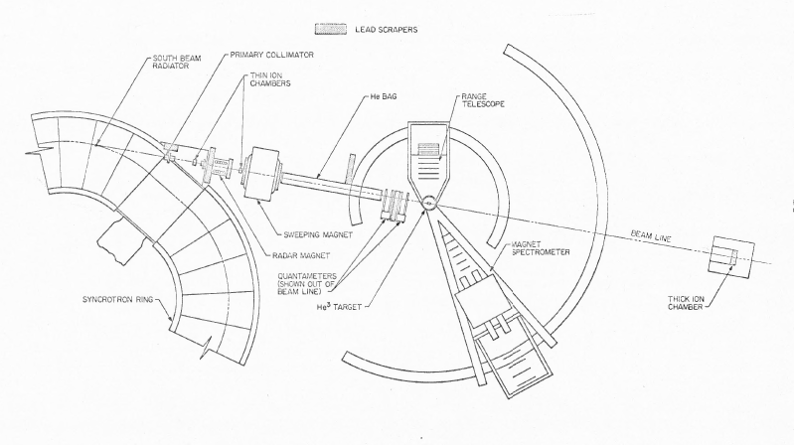
The early years
We worked together on a series of Fermilab experiments on hadronically produced mu-pairs from ~1974 to ~1990
Kirk came to Chicago as Fermi Postdoctoral Fellow in 1974
with an outstanding background
Thesis with the Heusch group at on the Caltech synchrotron, 1972
preceeded by Charlie Prescot, Elliott Bloom, Bruce Winstein
spectacular training in experimental HEP
Thesis on γ + He³ → p + d
as part of a test of T invariance.
Two arm spectrometer for p and d detection
1.5 GeV
electron
synchrotron

Slide 3
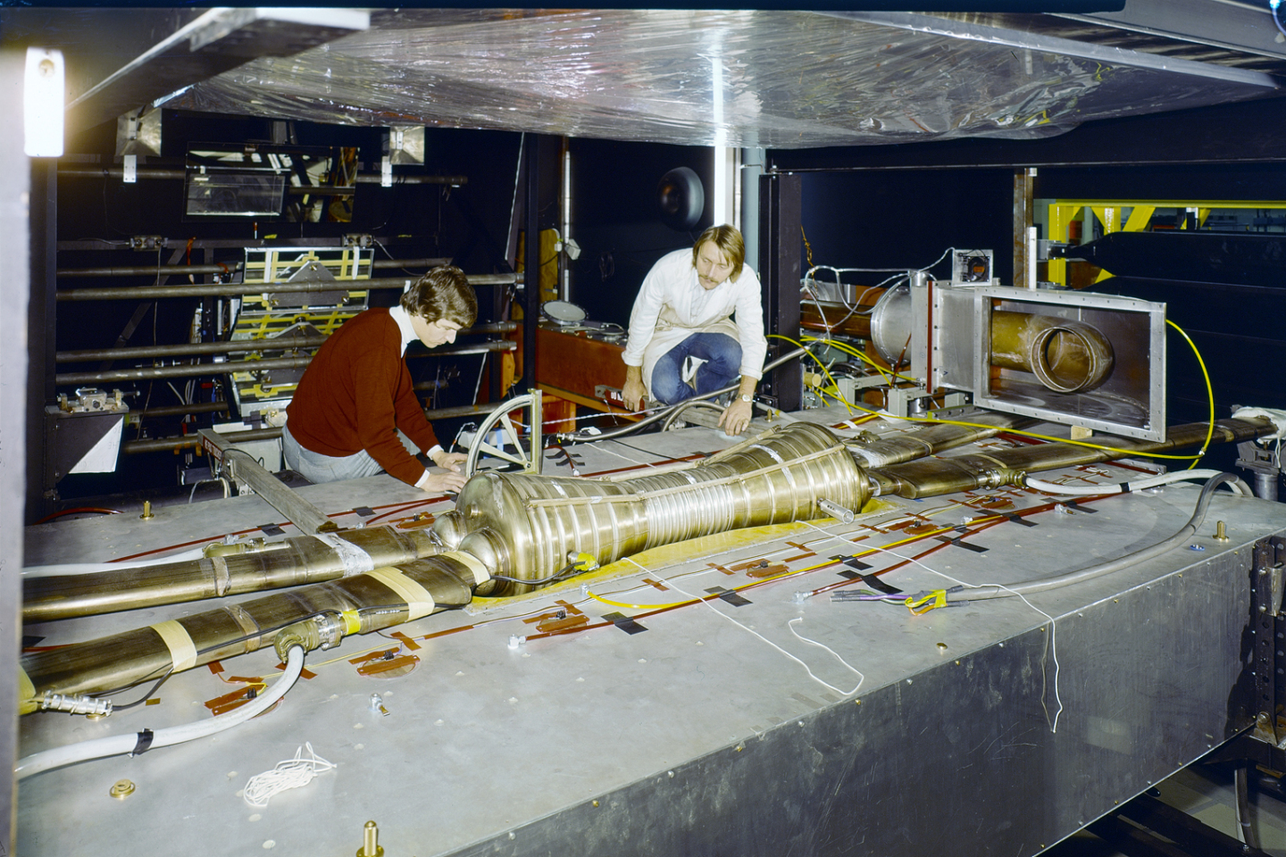
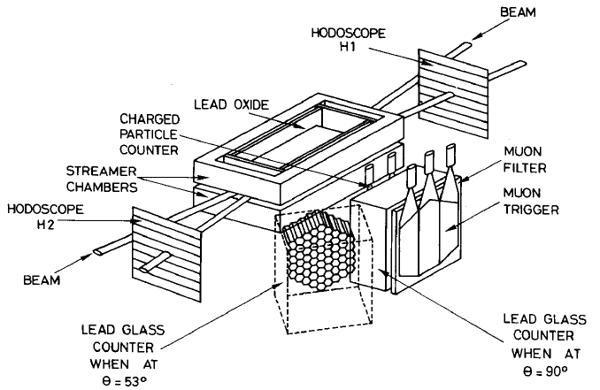
The early years
After Caltech, CERN ~1972-74
early operation of the Intersecting Storage Rings
first evidence for hard parton-parton scattering
Streamer chamber experiment triggering on high p_{T} s
with Aachen, CERN, Heidelberg, Munich group, R701
including Pierre Darriulat

Slide 4
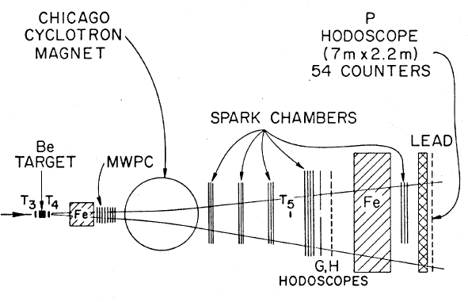
At Chicago
Kirk joined us at Chicago in 1974
Enrico Fermi Fellow
Experiment 331 proposed at Fermilab in August 1974
study lepton pair production with a large acceptance spectrometer
PAC suggested we use the Chicago Cyclotron Spectrometer assembled for deep inelastic muon scattering
with modest changes for triggering, beam definition, hadron filtering, etc.
approved Nov. 25, 1974, just after the “November revolution”
Group of 9 people made it all work
with Kirk a key player

Slide 5
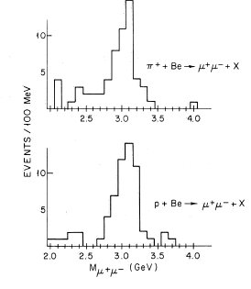
Fermilab E-331
Our first publication
Clear sighting of J/ψ production by pions
ratty early data
much more to come

Slide 6
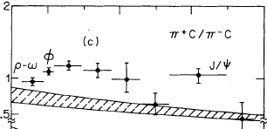
Fermilab E-331
π⁺ and π⁻ are equally effective at producing J/ψ
Continuum cross section at higher masses is larger for π⁻
Need more sensitive data ⇒ E-444
E-331 gave us 7 PRL articles appearing in 1976-7
4 with over 100 citations (“very well known papers” in SPIRES)
1 with over 250 citations (“famous papers” in SPIRES)

Slide 7
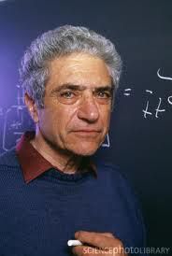
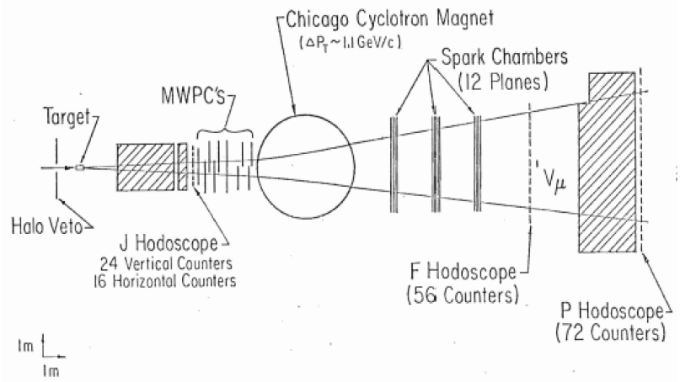
Fermilab E-444
Proposed as a higher sensitivity follow-on to E-331 in Sept. 1975
Approved Nov. 1975
First data taking June 1977
Larger MWPC array upstream of magnet to increase acceptance at low x
Kirk borrowed the Steinberger chambers from CERN
Second large triggering hodoscope downstream of magnet
F (Fermi) hodoscope
Electronic “mass-box” for triggering (note 3 hodoscopes after filter)
Improved cross section
sensitivity by over two
orders of magnitude.

Slide 8
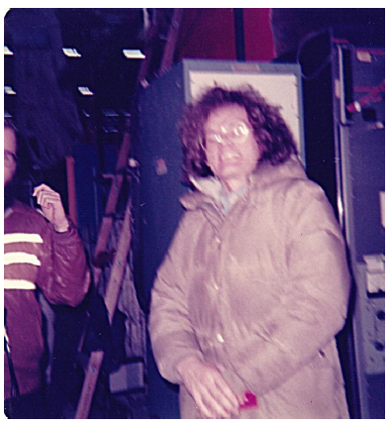
Fermilab E-444
Kirk cleaned up the neutron background in the J hodoscope

Slide 9
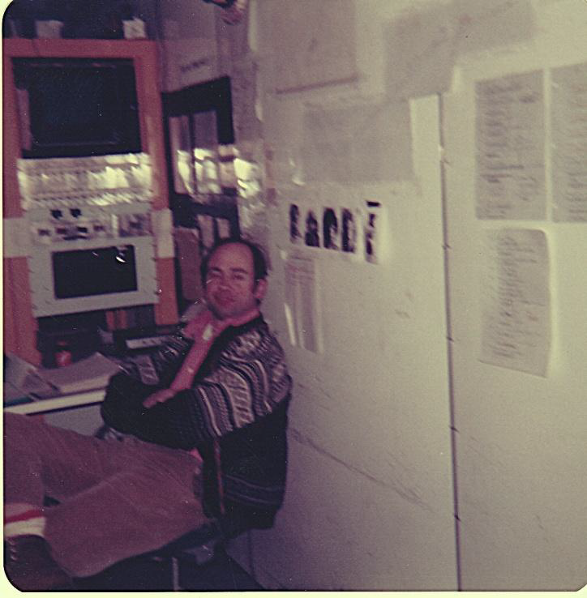
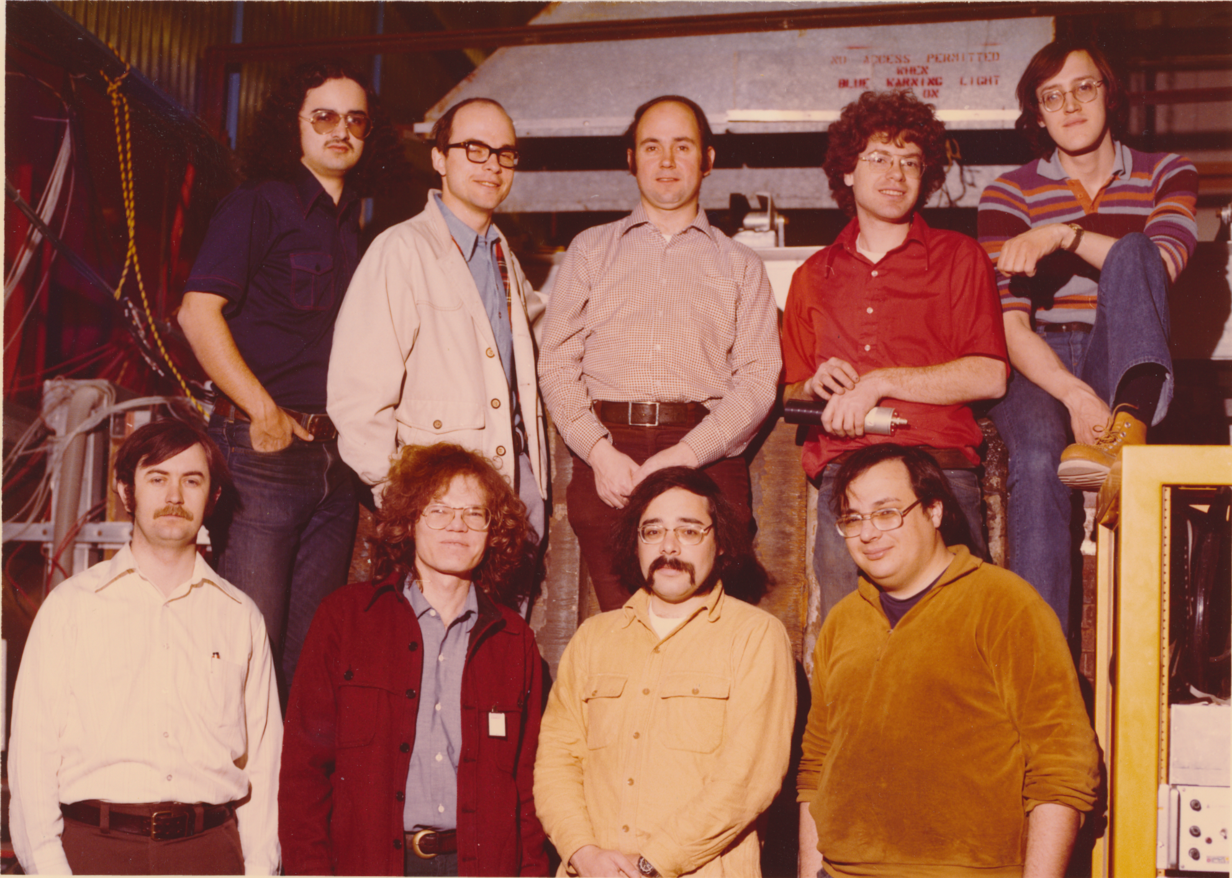
Fermilab E-444
The team
Stew at the control desk

Slide 10
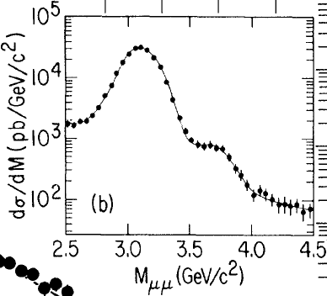
Fermilab E-444
similar cast of characters with rotation of the two students
The 300 J/ψ from E-331 ⇒ 66,000 in E-444
220 times gain in sensitivity for π⁻ beam

Slide 11
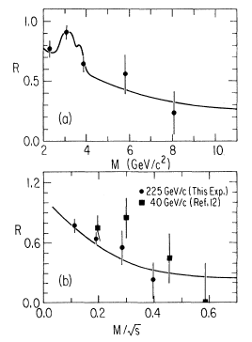
Fermilab E-444
similar gains for continuum cross sections
Ratio → 1/4 for quark-antiquark
annihilation at high x when the
contribution from sea quarks
becomes small.
nice confirmation of Drell-Yan
mechanism

Slide 12
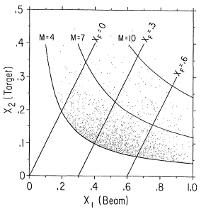
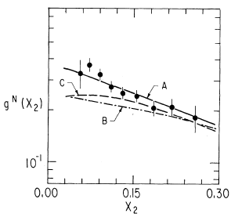
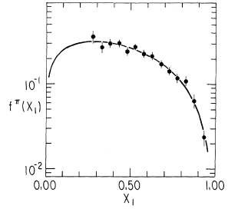
Fermilab E-444
Measure pion structure function
Nucleon
Pion
E-444 gave us 6 PRL articles appearing in 1979-80
2 with over 100 citations (“very well known papers” in SPIRES)

Slide 13
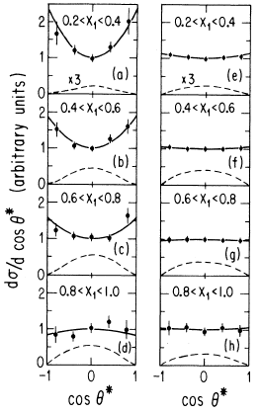
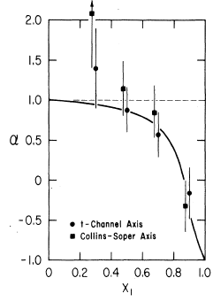
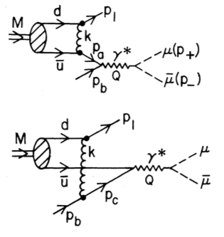
Fermilab E-444
A bonus
Unexpected effect observed in E-444 at high X₁
evidence for longitudinal photon polarization characteristic a modified production mechanism (higher twist effect?)
Annihilating quark predicted to be
off-shell (massive) in this kinematic
region.
modifies angular distribution

Slide 14
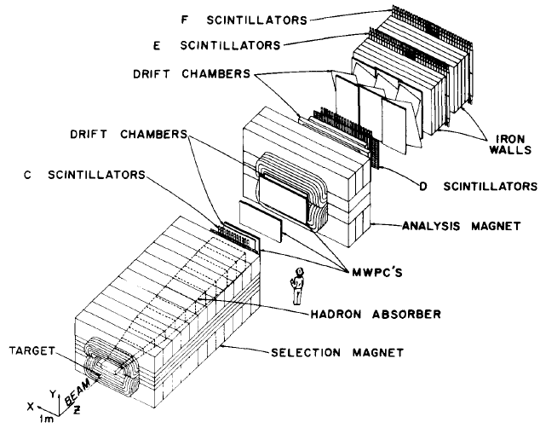
Fermilab E-615
proposed to follow up on this observation
go to the ultimate sensitivity possible at Fermilab
beam of 3 x 10⁸ pions/s in Proton West area
new dedicated detector set-up

Slide 15
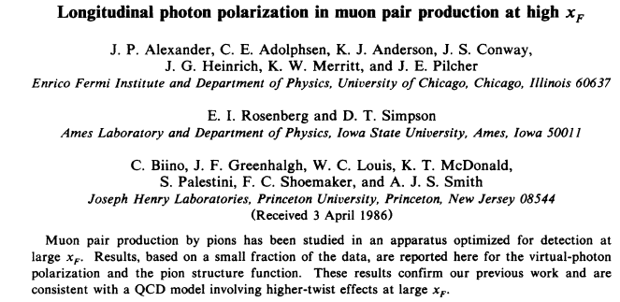
Fermilab E-615
Experiment proposed in May 1979
approved July 1979
Kirk spokesperson
First engineering run in 1983 with main operation in 1983-4
huge data sample collected
~60K events with masses above 4 GeV

Slide 16
Fermilab E-615
Able to characterize clear departures from leading order annihilation
By 1990 most of us had gone our separate ways
E-615 gave us 8 journal articles appearing between 1986 and 1991
2 with over 100 citations (“very well known papers” in SPIRES)
1 with 336 citations (where > 250 is a “famous paper”)
this was the most cited of all our mu-pair papers
John Conway’s PRD thesis paper

Slide 17
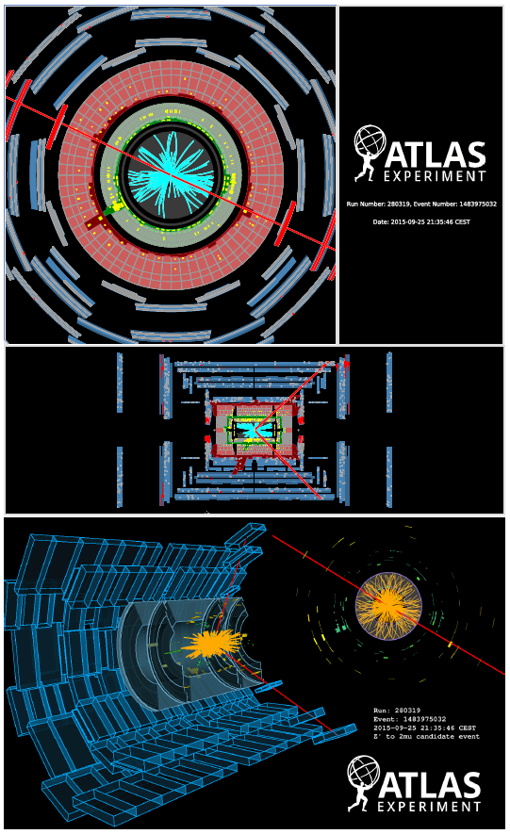
And now?
10⁹ intactions per second
~30 “simultaneously”
100 x 10⁶ tiny detection elements
Heavy material to absorb
strongly interacting particles
but segmented and instrumented
to measure energy and position
Muons bent in a magnetic field
Trajectory measured
This interaction has a pair of muons
with an effective mass of 1390 GeV

Slide 18
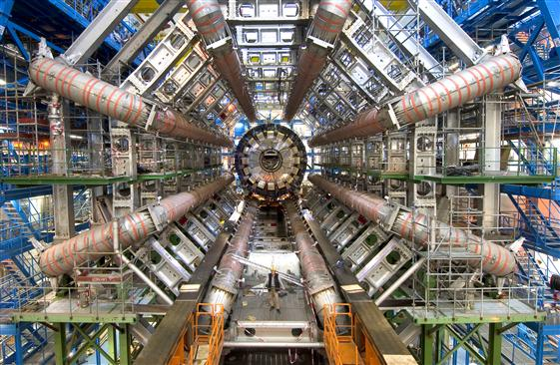
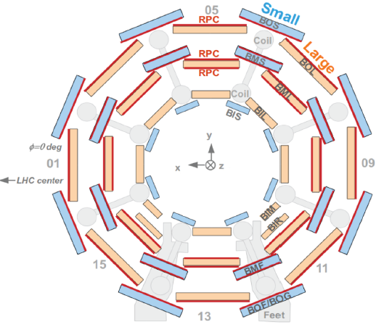
The ATLAS muon spectrometer
8 superconducting coils carrying 25,000 A
25 m long
outer diameter 20.1 m
inner diameter 9.4 m
Trajectories measured with groups of 3-cm dia.
drift tubes
resolution for each station (multi-layer) ~35 um
Momentum resolution ~10% for 1 TeV muons
Performance for lower momentum aided by inner detector

Slide 19
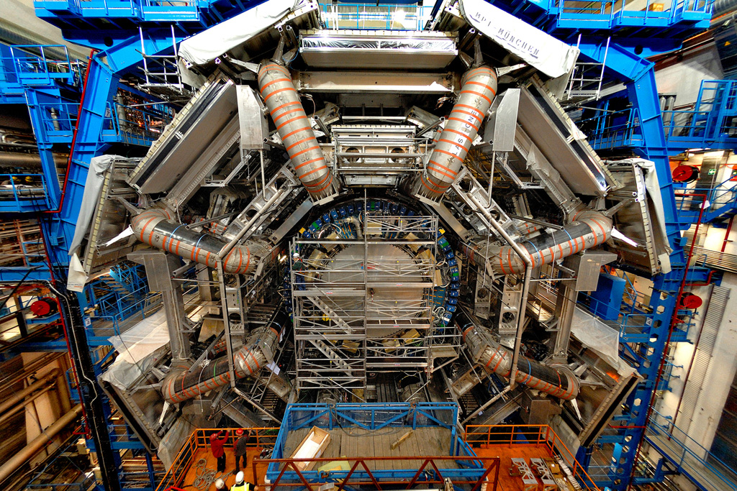
The ATLAS muon spectrometer

Slide 20
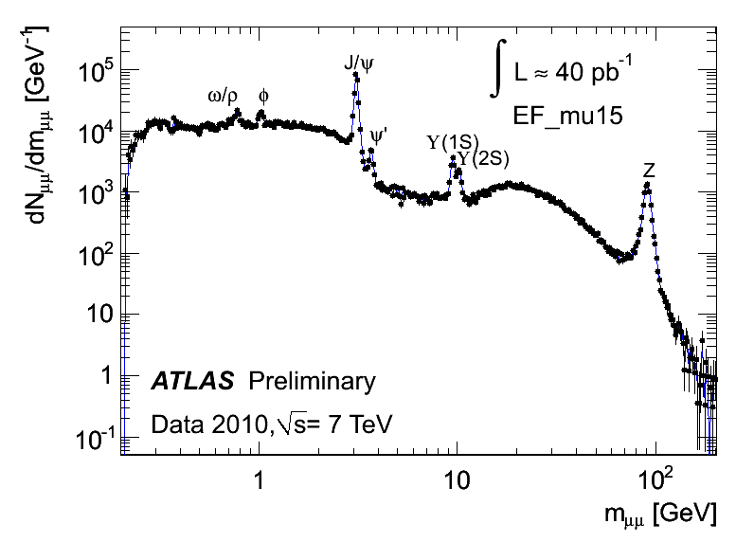
ATLAS μ-pair signal
uncorrected mass spectrum (distorted by trigger)
data from ~2 hrs of operation at current luminosities

Slide 21
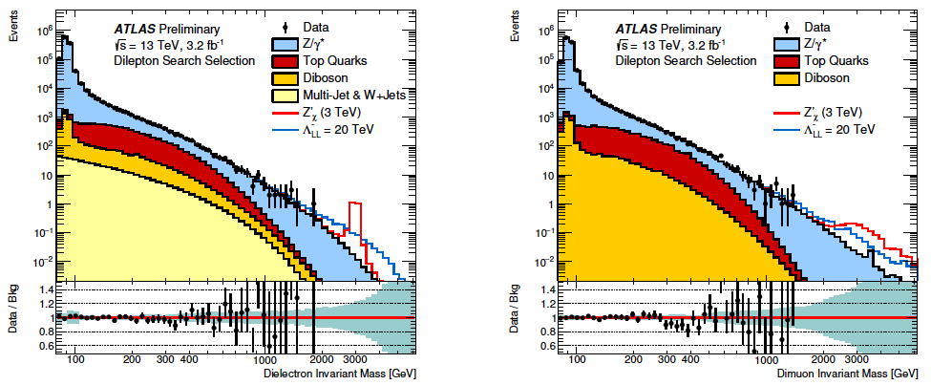
ATLAS Drell-Yan mass spectrum
Electrons
Muons
spectral shapes very well understood
no new mass enhancements seen
M_{Z’} > 3.4 TeV (with SM couplings)
mass scale of any “contact” interactions distorting the spectrum
M > 16 TeV

Slide 22
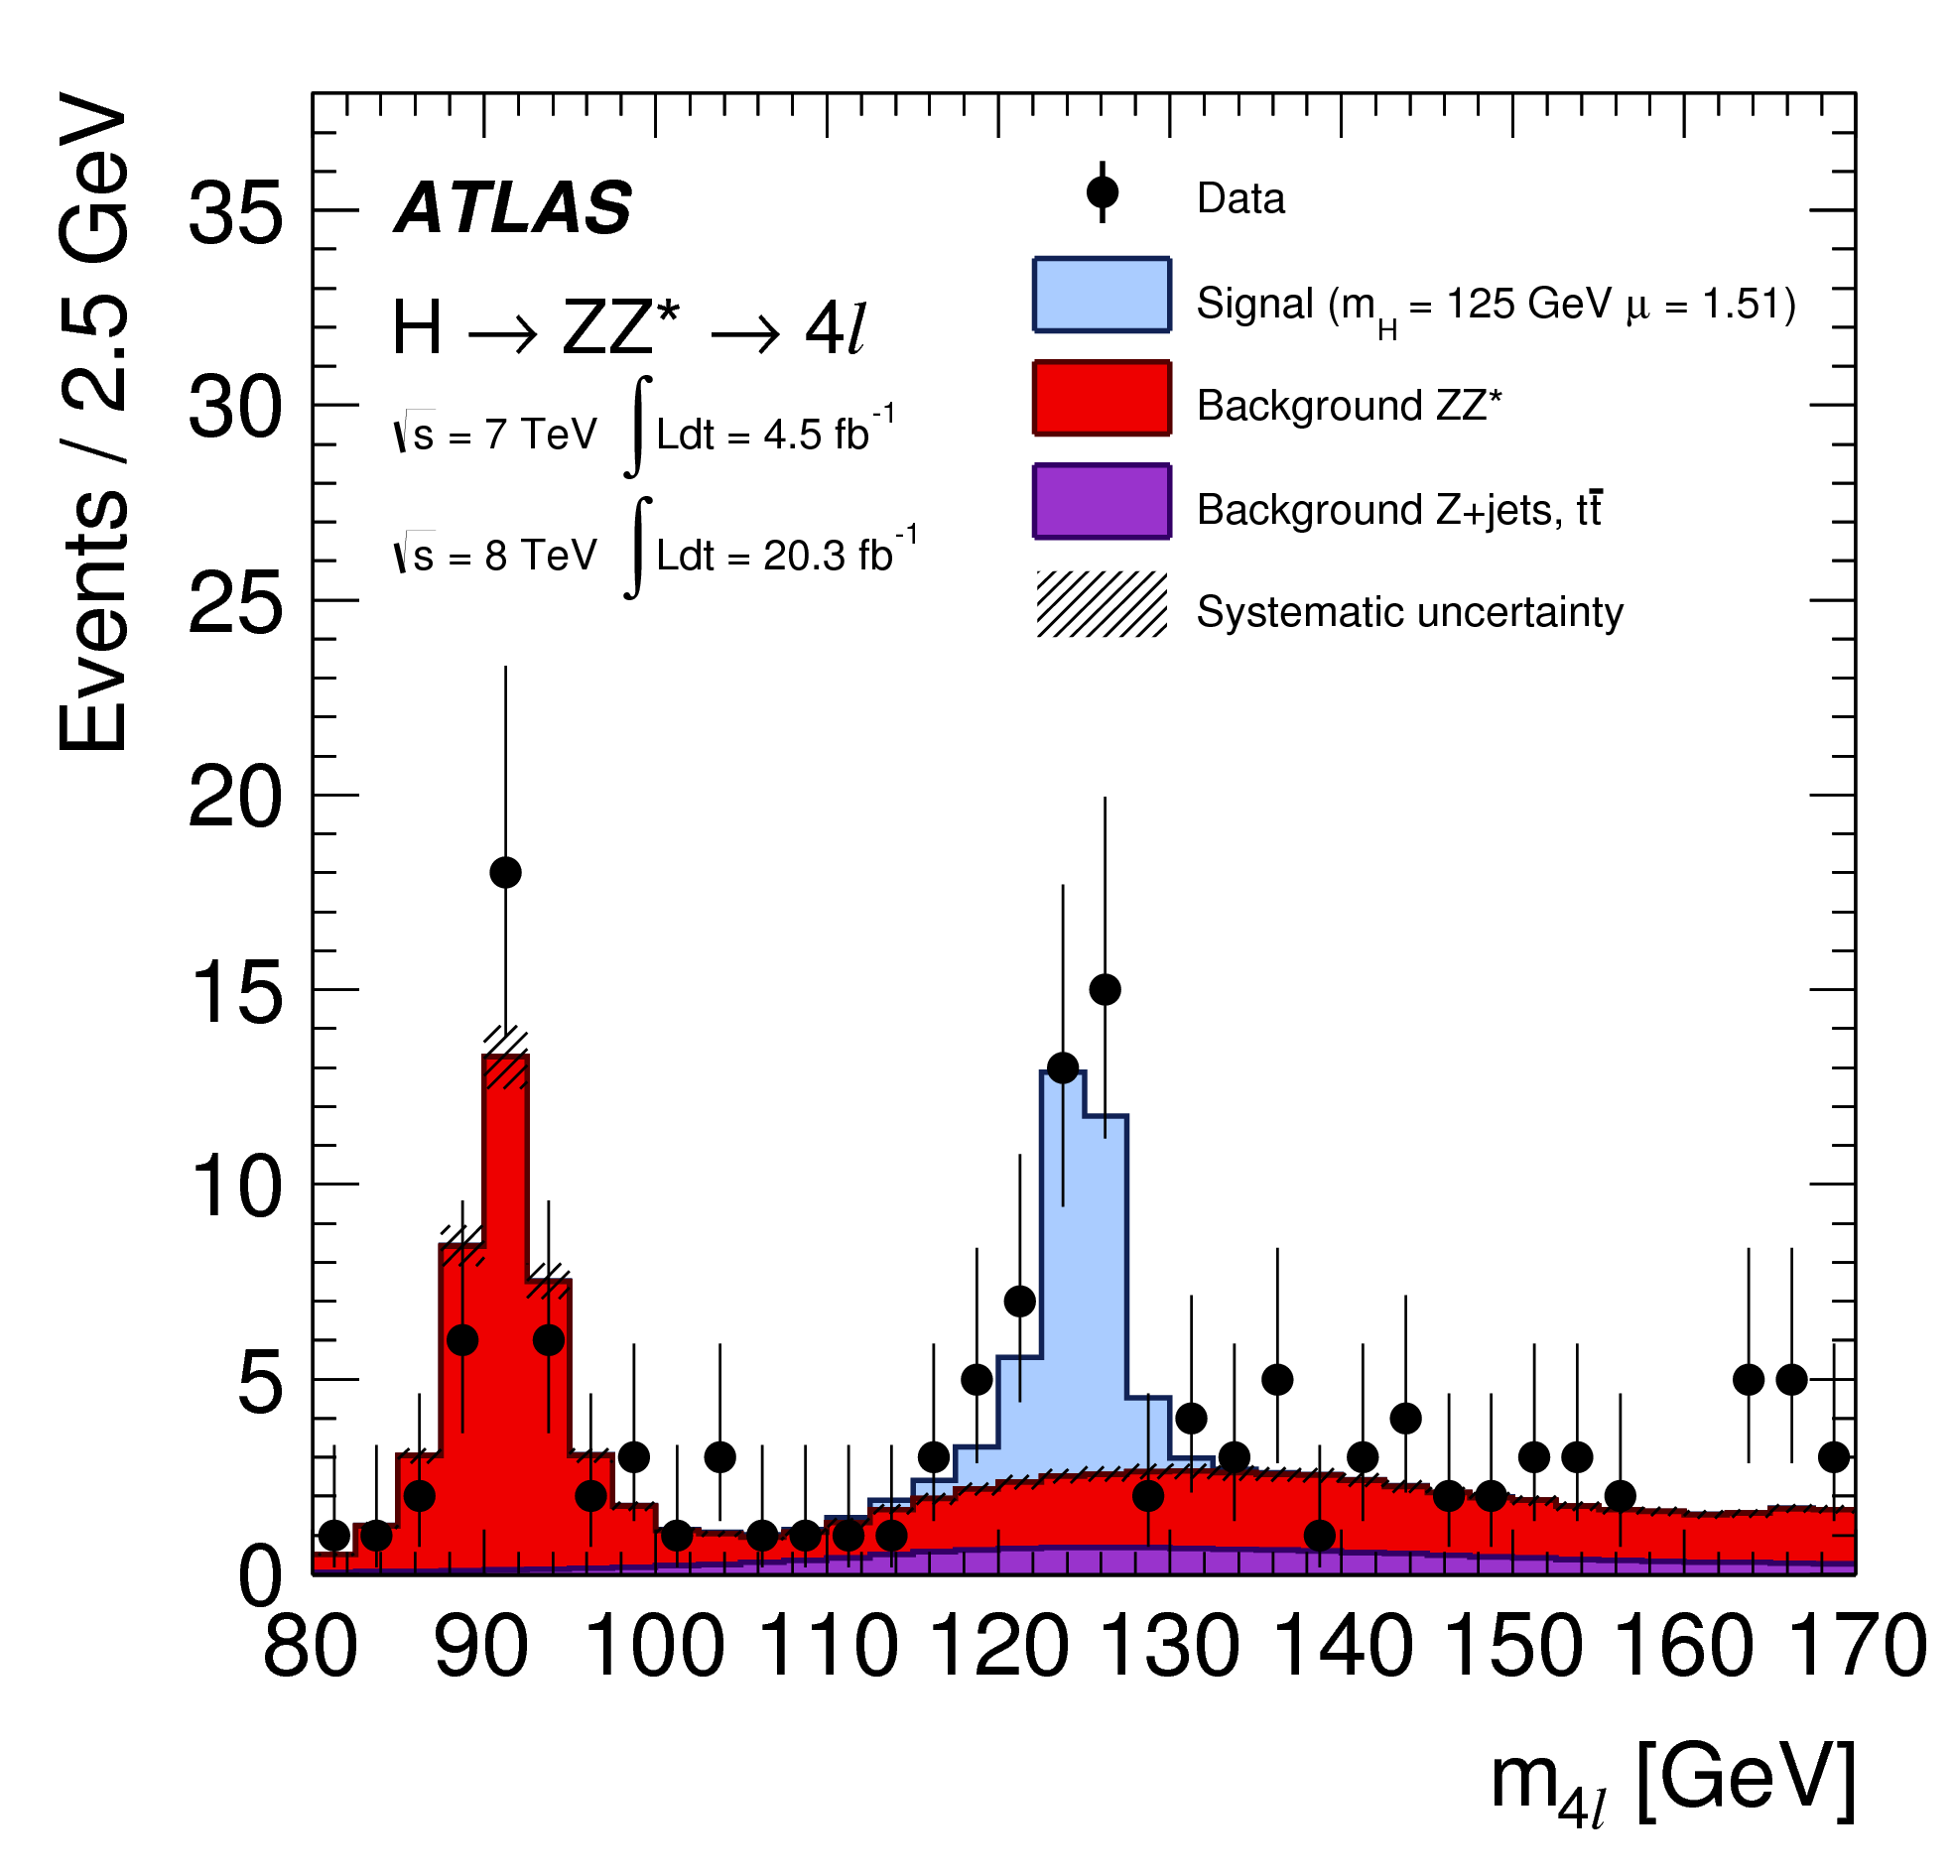
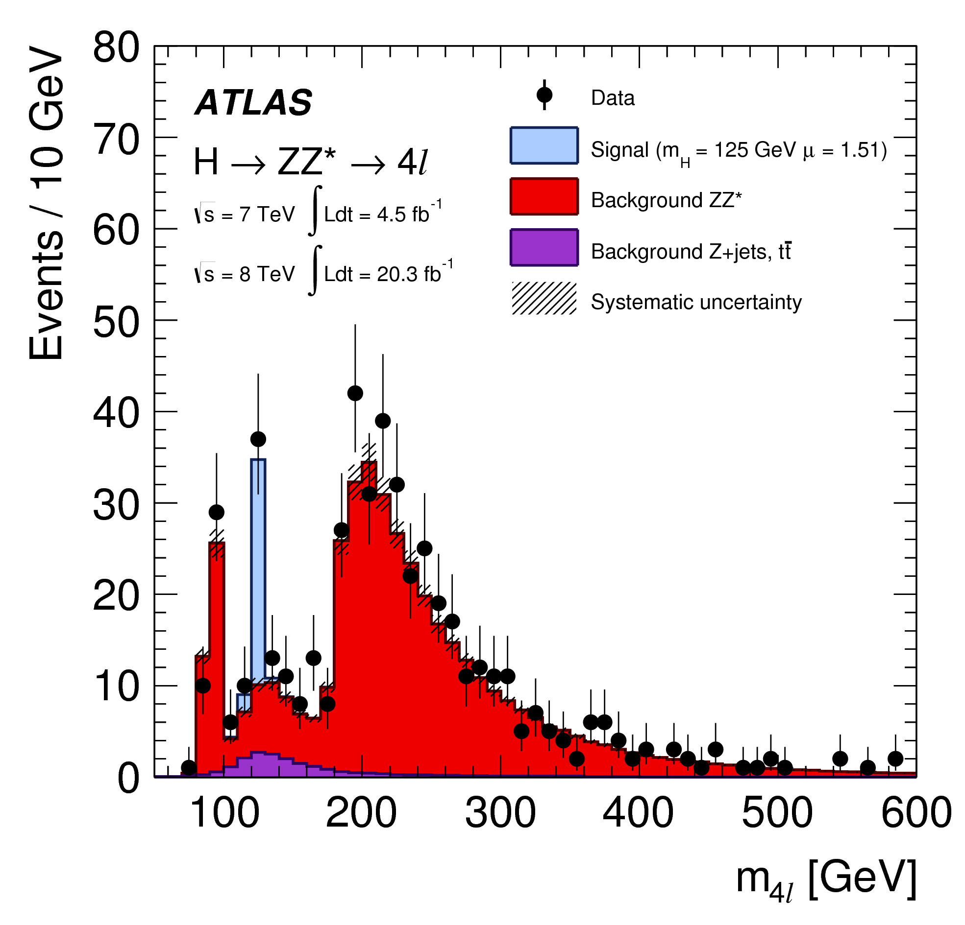
An ATLAS signal instead of a limit
the Higgs decay mode with the lowest background
signal is also small because of the Z branching ratios to leptons
~26 events on a background of 10 events from Run 1 data
excellent information on the Higgs mass
unlike H → W⁺W⁻

Slide 23
Conclusions
mu-pair physics is still alive and well
the environment has evolved
15 years to plan and build the detector
~$1B to be assembled
~3000 people involved
the style has evolved
no stone is left unturned
the performance of the detector and analysis environment is outstanding
very powerful simulation tools
accurate physics generators for most processes
full simulation of particle interactions in the detector material
massive computing environment
now embarked on Run 2 at 13 TeV
physics beyond the lightest Higgs boson?

