Slide 1
Kirk McDonald, Particle Physicist and Scholar s
Symposium to honour our great friend and colleague on his retirement from Princeton
AJS Smith
June 17, 2016

Slide 2
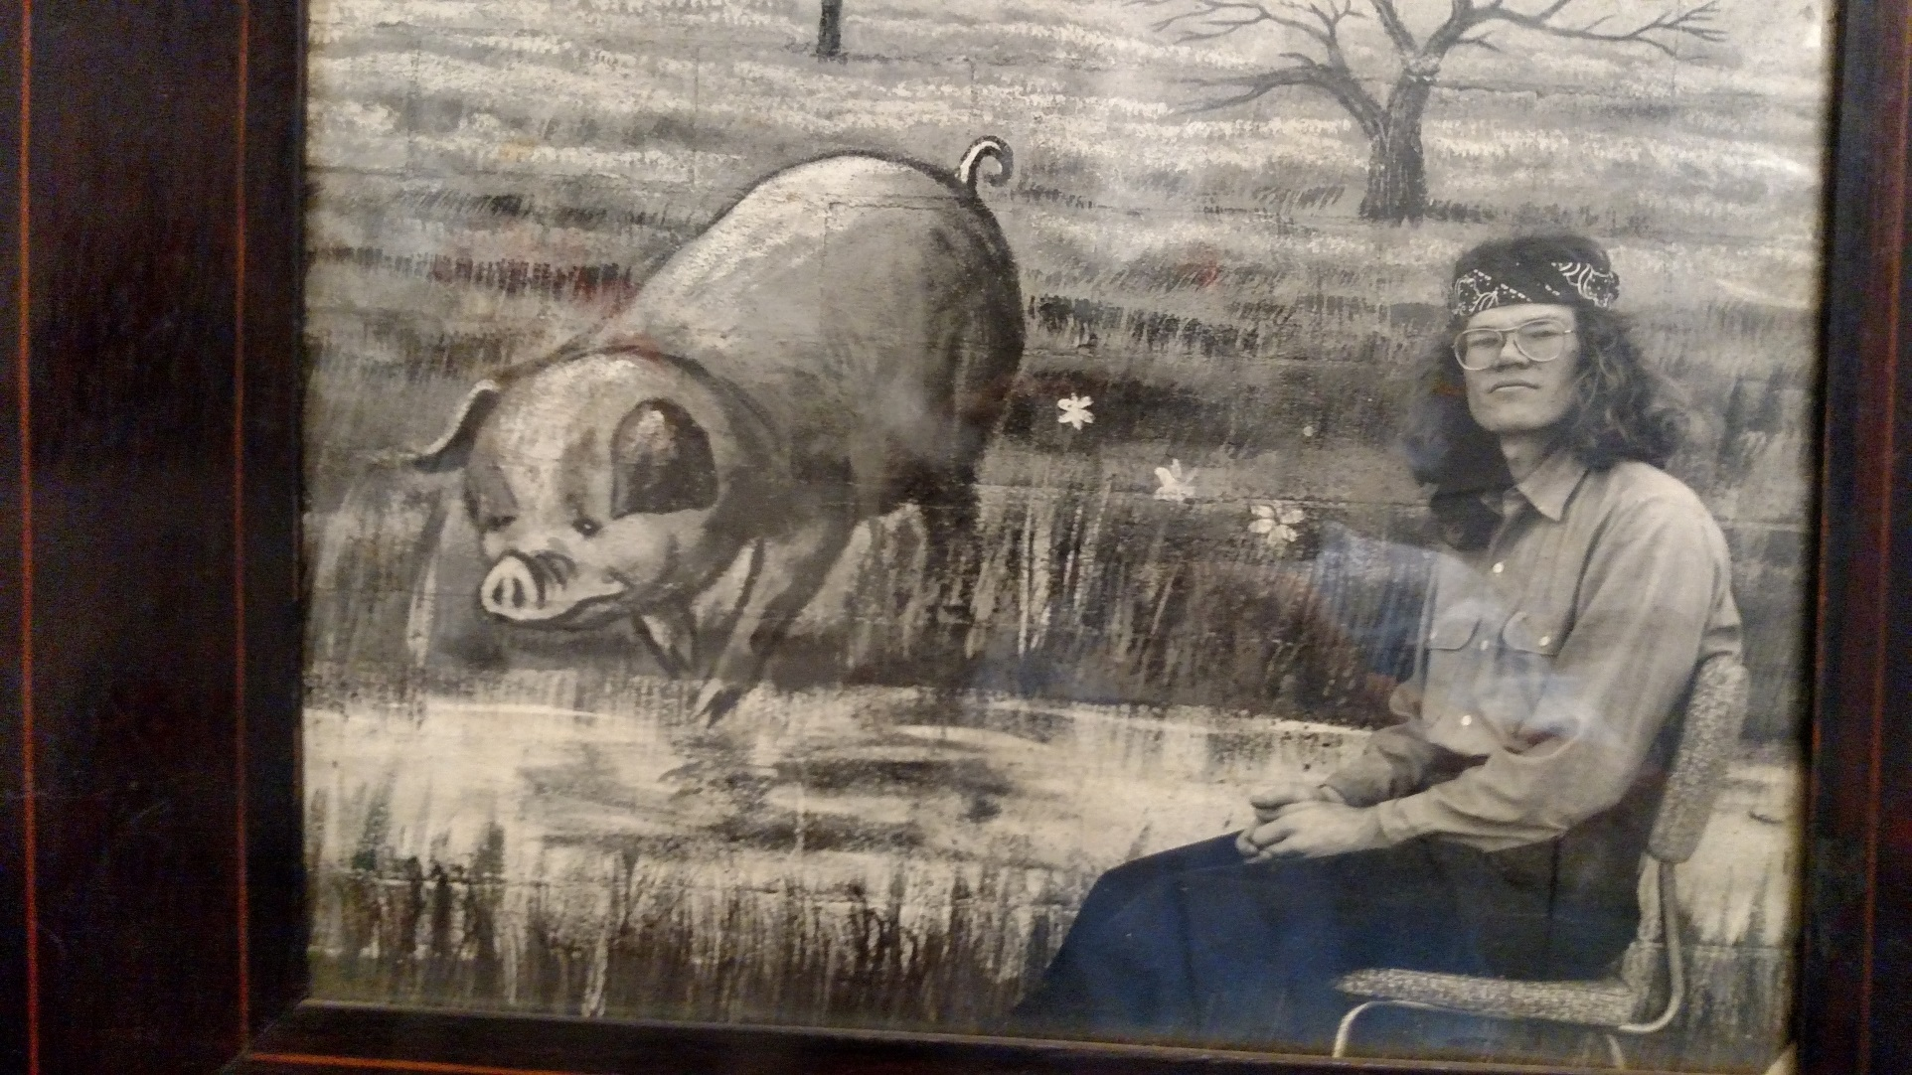
Early days: Kirk in Tucson, class of ‘66

Slide 3
Grad School at Caltech 1966-71
CP violation furor – Weak? EM? Strong?
  Apparent evidence for T violation in the EM sector, in comparing n p ↔ d γ, but neutrons were tough to work with
  Kirk’s thesis measured p d ↔ He³ γ
    No neutrons to deal with
    Photoproduction experiment the last at the Caltech synchrotron
    Inverse reaction at LBL
  He found that T invariance held.

Slide 4
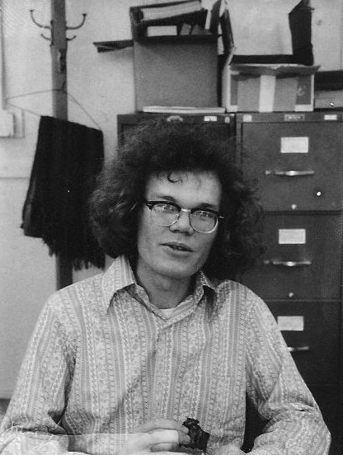
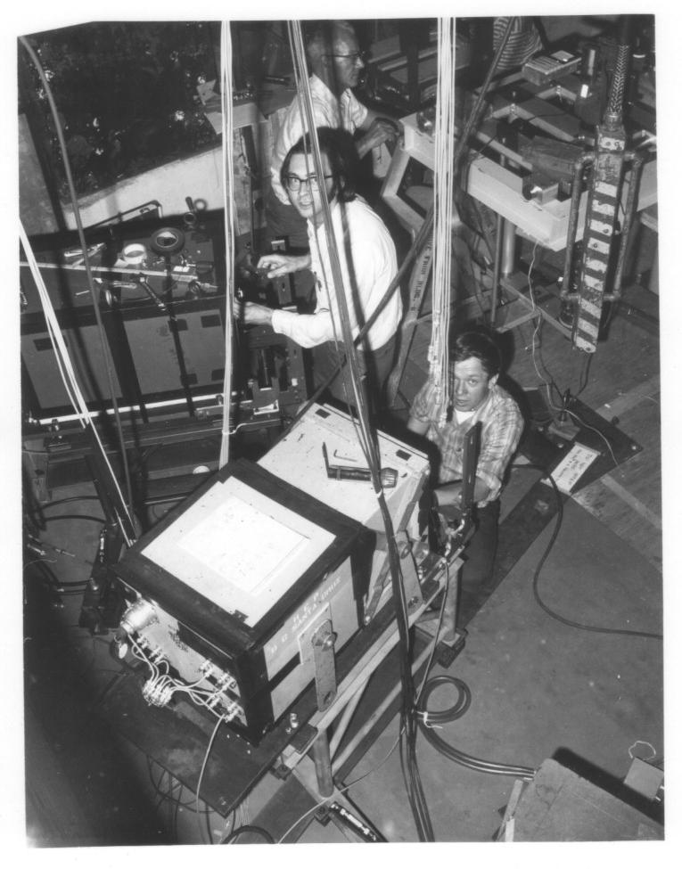
LBL 1971 p d → He³ γ

Slide 5
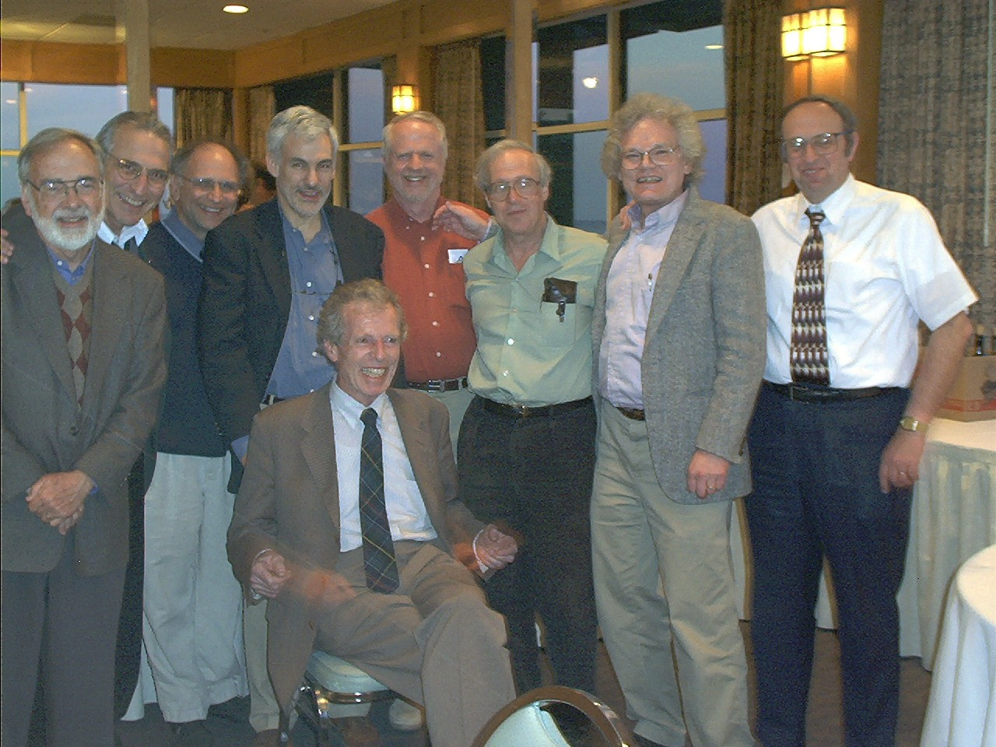
The Heusch Puppies, Caltech 2002
Charles Prescott, Elliott Bloom, Leon Rochester, Bruce Winstein,
Bill McNeely, Steve Yellin, Kirk McDonald, Abe Seiden
Clemens Heusch

Slide 6
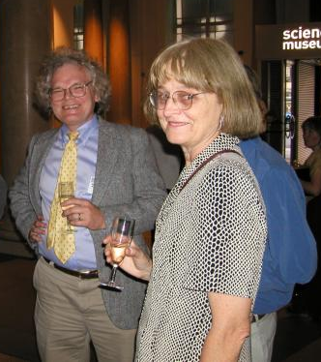
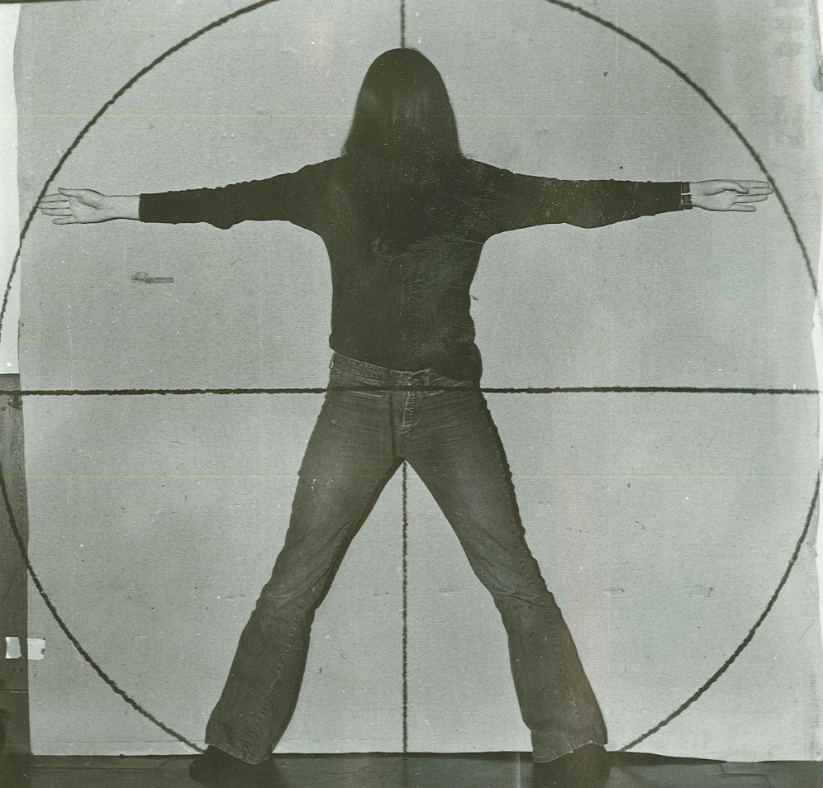
Nancy Schaefer,
Vitruvian Woman, Caltech, ~ 1971

Slide 7
At CERN 1972 -1974
Intersecting Storage Rings (ISR) provided world’s highest energy collisions, and hope to gain insight on strong interactions
Kirk won a CERN fellowship to work with Pierre Darriulat, Klaus Tittel, Martin Holder et al on experiments studying the correlations of high-transverse-momentum photons and π⁰ ‘s.
NO photos from this period at all! What does this imply?

Slide 8
Fermi Fellow, U Chicago 1974-76
Production of mu- pairs by pions and protons – E 331 at Fermilab. (Jim Pilcher’s talk.)
  J/Psi production spectrum
  Contribution of mu pairs to the single prompt muon spectrum
  Observation of the Drell-Yan process

Slide 9
To Princeton in 1976: mu-pair physics continues (JEP, CB and SP will describe)
E-444: Comprehensive study of hadronic mu-pairs
  Search for higher-mass vector mesons beyond the J/psi and Psi-prime
  Clear confirmation that mu pairs with M > 4 GeV were produced by the Drell Yan mechanism.
  Structure function measurements for pions, protons and kaons.
  Hint of higher-twist effects at high x = p║/ p_{beam}.
E-615: high-precision measurement of structure functions, emphasizing high x and higher twist.

Slide 10
BNL E 732: Search for the η_{C} at the AGS
(1979-82)
π ⁻ A →η_{C} + X
|
This experiment introduced Kirk to BNL and to the Kycia-Littenberg group.
→γγ

Slide 11
Princeton HEP Group ~1984

Slide 12
High-field QED → Matter from Light
(SLAC E 144 during the 1990’s)
Photons from high-power laser collide with high energy photons from SLAC 50-GeV electron beam to produce e⁺ e ⁻ pairs
Created a popular-science sensation – subject of Adrian’s talk.

Slide 13
Kirk and B physics
b quark discovered in 1977 at Fermilab, studied systematically at Cornell and DESY for 20 years.
  B lifetime found to be “long” (1.5 ps), and B⁰ – B⁰ mixing observed .
  Potentially large CP Asymmetries (0.5 vs 0.002).
    Alas, not measurable at available accelerators.
In the late 80’s Kirk and Changuo Lu at Princeton partnered with Nigel Lockyer and folks at Penn to spearhead an R&D effort toward a dedicated B physics experiment at the SSC, named BCD. Spawned R&D on CsI photocathodes. Alas, what might have been…..
e+e- colliders, the “B Factories,” came on line in 1999 at Stanford and in Tsukuba Japan, tuned to Ecm =10.53 GeV
  Main goal -- to discover and characterise CP violation.
  To do this, they needed ~100 times as much “luminosity” as produced by previous accelerators
  Even more challenging, the beams had to have different energies.

Slide 14
Measuring CKM angles in the B⁰_{d} system
B⁰→ππ, ρρ, ρπ, a⁰π
B.R. ~ few 10⁻ ⁶
α
V_{ud}V*_{ub}+ V_{cd} V*_{cb}+ V_{td}V*_{tb} = 0
V_{td}
~500 fb⁻¹
needed for a first pass
V_{ub}
γ
β
B⁰→J/ψK⁰_{S}
B⁰→DK
V_{cb}
Very clean,
Eff B.R. ~ 10⁻ ⁴
Useful BR ~10⁻⁷
Tough!!

Slide 15
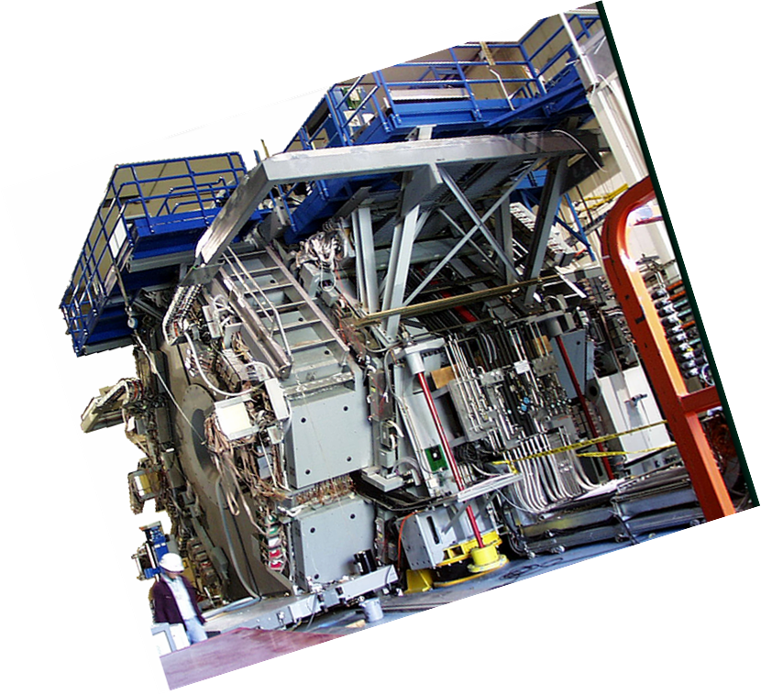
BABAR Detector 1999 — 2008

Slide 16
Kirk and BaBar
Founding member in 1993-4
Member, original executive board
Contributed in every possible way to all phases of the BaBar drift chamber project
  Cell design, response to stresses
    Destructive testing!!
  End plates and wire were two of the biggest challenges – we took them on.
  Tension measurements – Kirk figured out that Madam Wu’s solenoid coils were perfect.
Once Drift Chamber problems had been solved, Kirk’s interests changed to accelerator physics.

Slide 17
Kirk and Accelerator Physics
SLAC E-144 sparked his interest, with Dave Burke et al.
Long-term focus on muon colliders and neutrino factories
  Muon capture and transport systems
  R&D and construction of mercury-jet targets
  Subject of Bob Palmer’s talk
SLAC E-166: Linear Collider R&D – polarized positrons from an undulator-based source

Slide 19
Kirk and Changguo Lu
T D Lee called us in 1979 to propose that we host two Chinese scientists after the cultural revolution. Kirk and I excitedly accepted – Ye Ming Han and Lu Changuo arrived in December. They worked with us on E-732 at Brookhaven, and Lu soon became umbilically connected with Kirk. They have been partners ever since to the great benefit of all the experiments they have worked on.
Perhaps the most outstanding Kirk-Lu collaboration was on the Daya Bay experiment, where Lu not only contributed to the detector, especially the RPC system, but also helped enormously as a liason to IHEP scientists.

Slide 20
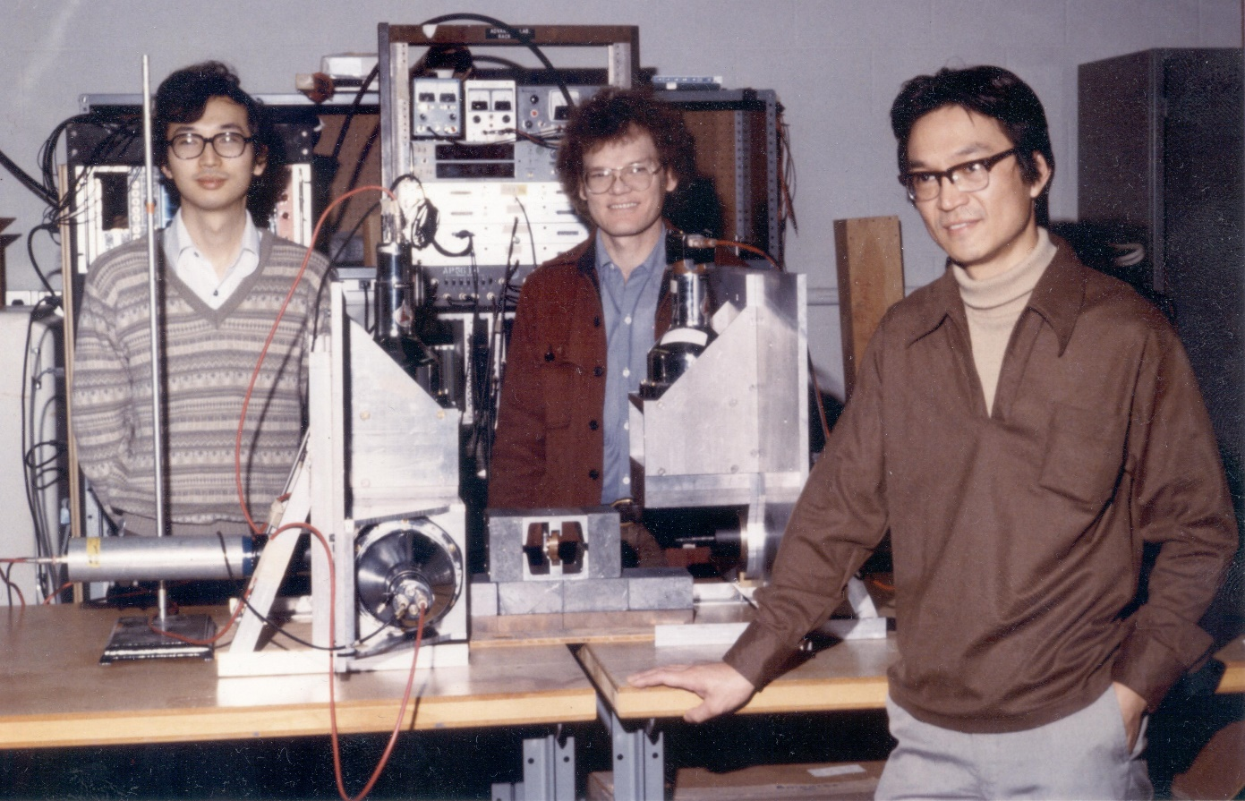
Yoshihisa Kitazawa, KTM, Changguo Lu, 1981 (Test of Bell’s Inequality in e⁺e⁻ → γγ)

Slide 21
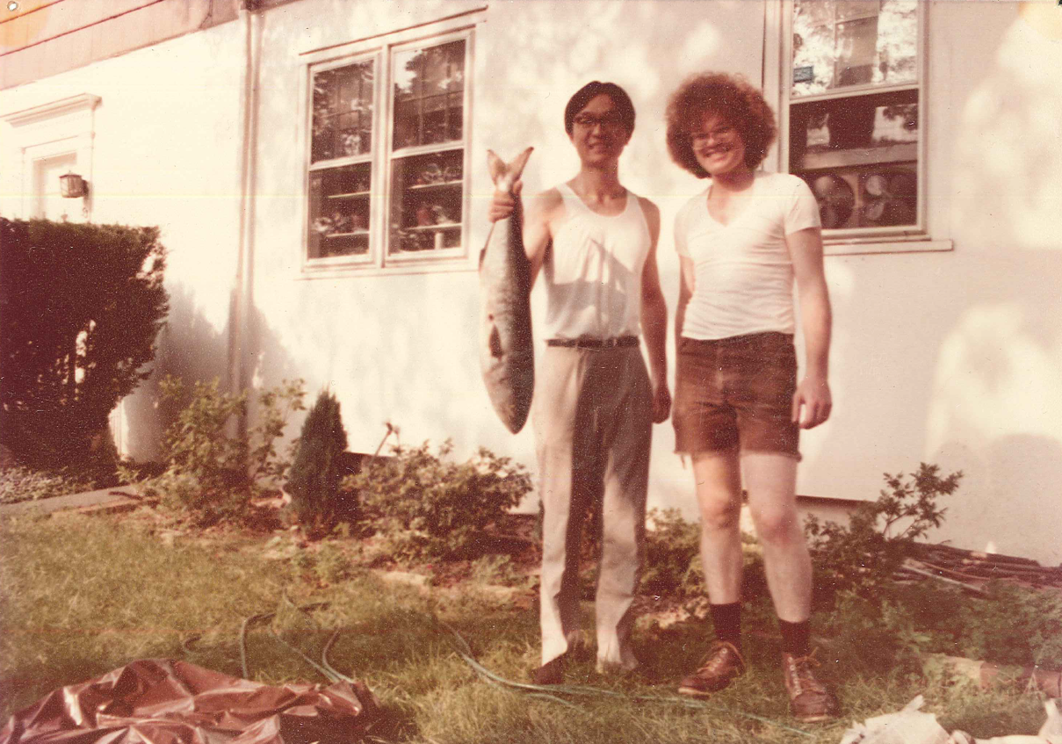
Changguo Lu, KTM, Mulberry St, Princeton, ~ 1981,
after a midnight bluefish expedition with John Gomany

Slide 22
Kirk as a Scholar and Teacher
Kirk’s publication list says it best
http://physics.princeton.edu/~mcdonald/tex/bib.pdf
Thanks so much, Kirk, for everything you’ve done for Princeton, for science, and for all of your colleagues and friends over more than 40 years.
Let me close by asking everyone to join me
in wishing Kirk and Nancy all the best.

