Slide 1
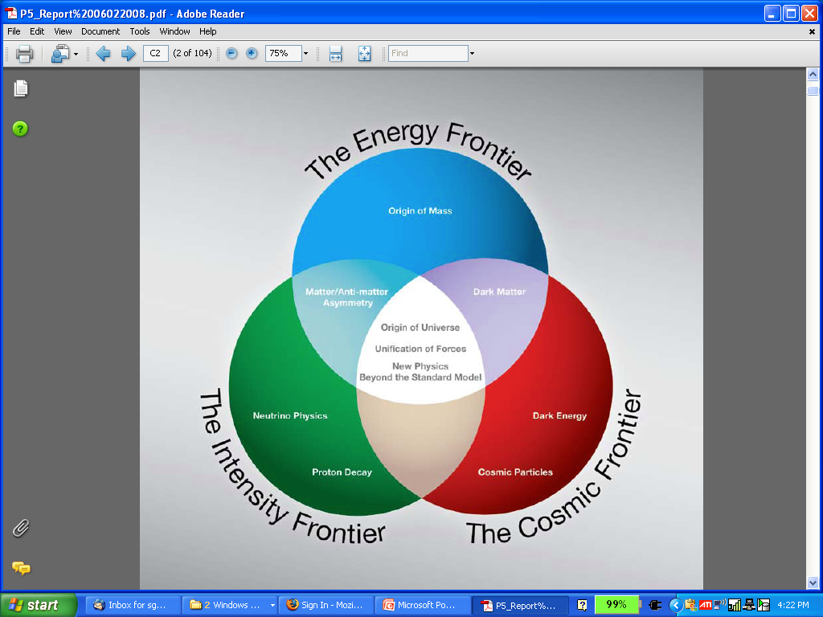
Neutrino Factories & the MC/NF Synergy
Steve Geer
Accelerator Physics Center
Fermi National Accelerator Laboratory
Muon Collider 2011
Telluride, June 27 – July 1, 2011
μ⁺
MC
μ⁻
NF
ν

Slide 2
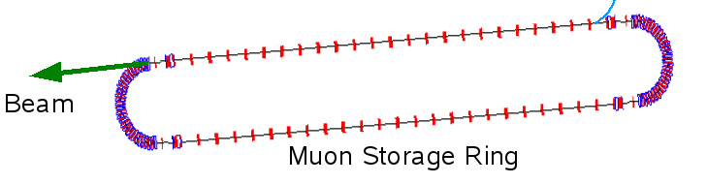
INTRODUCTION
● Over the last decade there has been significant progress in developing the concepts & technologies required to create a muon source that would provide O(10²¹) muons per year in a 6D-phase-space that fits within the acceptance of an accelerator.
● This enabling R&D opens the way for:
  MUON COLLIDERS in which μ⁺ & μ⁻
  collide in a storage ring to produce
  multi-TeV lepton-antilepton collisions.
  NEUTRINO FACTORIES in which
  muons decaying in the straight
  section of a storage ring create a
  neutrino beam with unique
  properties.
~1000 turns
before decay
μ⁻
μ⁺
Muon Decays
ν

Slide 3
MAP MISSION
The mission of the Muon Accelerator Program (MAP) is to develop and demonstrate the concepts and critical technologies required to produce, capture, condition, accelerate, and store intense beams of muons for Muon Colliders and Neutrino Factories. The goal of MAP is to deliver results that will permit the high-energy physics community to make an informed choice of the optimal path to a high-energy lepton collider and/or a next-generation neutrino beam facility. Coordination with the parallel Muon Collider Physics and Detector Study and with the International Design Study of a Neutrino Factory will ensure MAP responsiveness to physics requirements.

Slide 4
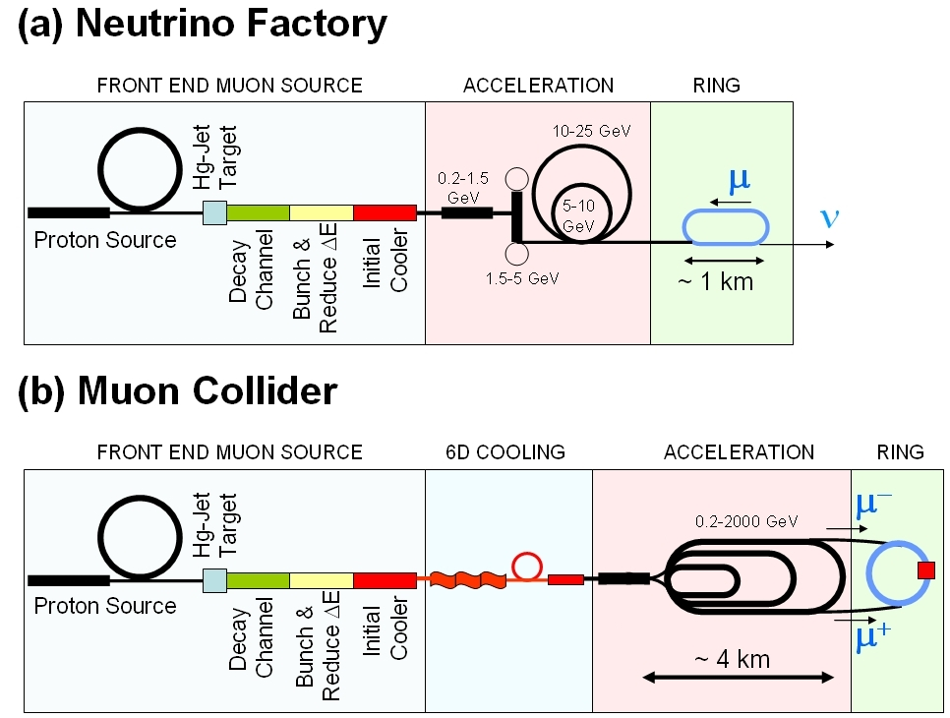
NEUTRINO FACTORY SCHEMATIC
10²¹ muons per year that fit within the acceptance of an accelerator:
ε_{⊥N}=6000 μm
ε_{//N}=25 mm
Proton source: Example: upgraded PROJECT X
(4 MW, 2±1 ns long bunches)

Slide 5
Muon Collider cf. Neutrino Factory
NEUTRINO
FACTORY
MUON
COLLIDER
In present MC baseline design, Front End is same as for NF

Slide 6
NEUTRINO FACTORY STUDIES
Over the last decade a series of design studies have developed the NF concept:
  First Generation - “Feasibility”:
    Feasibility Study 1 (FNAL 2000)
    Japanese Study 1 (2001)
    CERN Study (2004)
  Second Generation – performance & cost-reduction:
    Study 2 (BNL 2001): performance
    Studies 2a & 2b (2005): cost
  Third Generation – International:
    International Scoping Study: selected 25 GeV NF
    (RAL 2006)
    International Design Study: seeks to deliver a Reference Design report in 2 years time (ONGOING)

Slide 7
INTERNATIONAL SCOPING STUDY
published:
  Physics report : Rep. Prog. Phys
  Accelerator report: JINST 4:P07001,2009
  Detector: JINST 4:T05001,2009

Slide 8
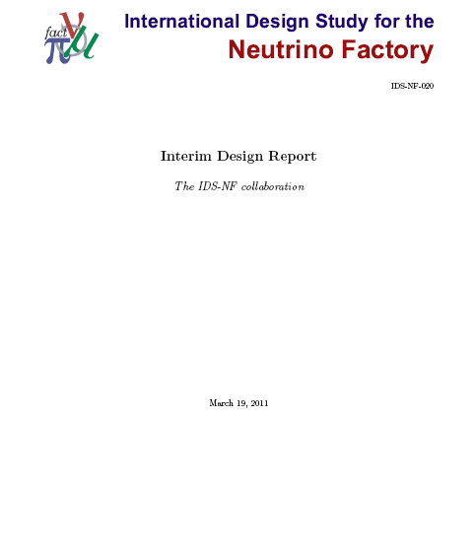
INTERNATIONAL DESIGN STUDY
Interim Design Report completed March 19, 2011.
Reviewed by ECFA sub-panel May 5-6, 2011
Next step: “Reference Design Report” in 2 years time.
130 AUTHORS
44 INSTITUTIONS
263 PAGES

Slide 9
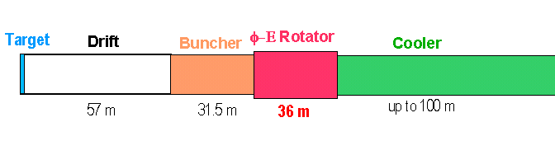
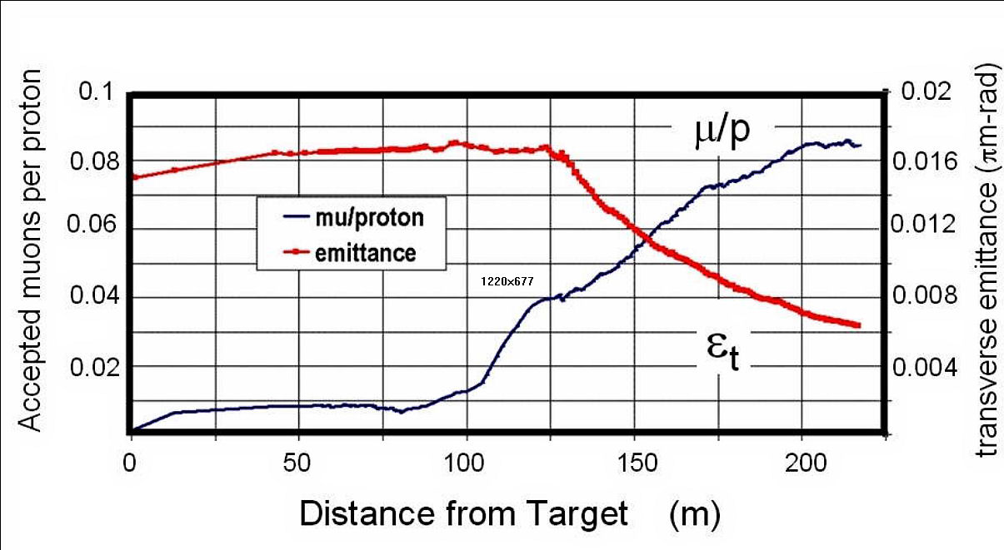
R&D SYNERGY - DESIGN
All of the front-end (target, decay channel, bunching and phase rotation, initial cooling channel) design and simulation studies are in common between Muon Collider and Neutrino Factory R&D.

Slide 10
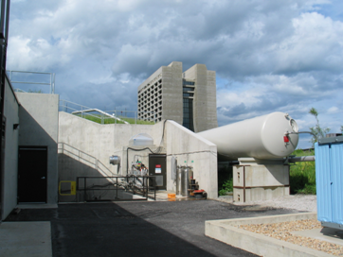
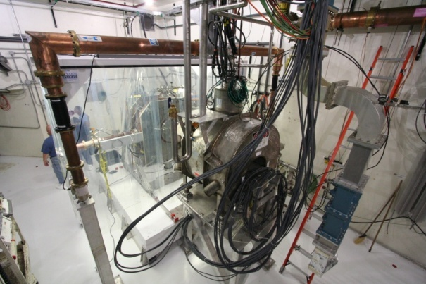
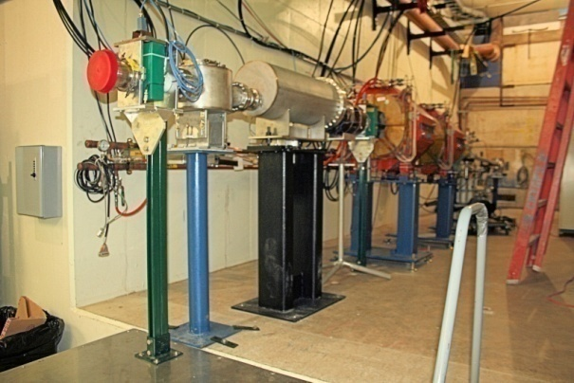
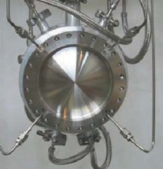
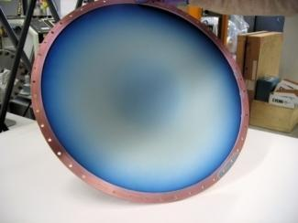
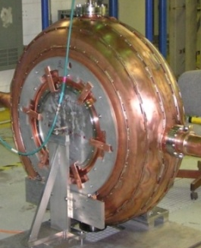
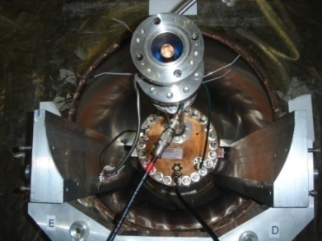
R&D SYNERGY – COMPONENT R&D
MTA built at end of FNAL Linac for ionization cooling component testing
5 T magnet, RF power at 805 MHz & 201 MHz, clean room,
LH₂ handling capability, 400 MeV beam from linac.
FIRST BEAM IN MTA BEING COMMISSIONED NOW !
42 cm ∅ Be RF
window (LBNL)
201 MHz cavities
(LBNL et al.)
High Pressure RF Cavity (FNAL & Muons Inc.)
Liq. H₂ absorber (KEK)

Slide 11
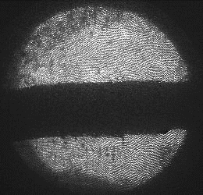
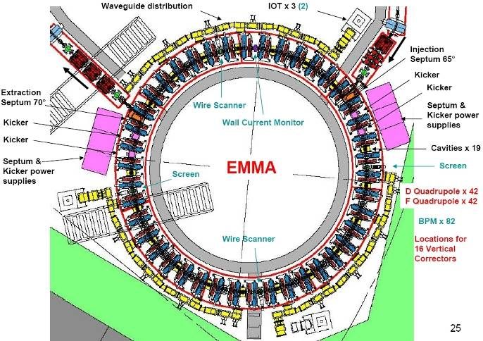
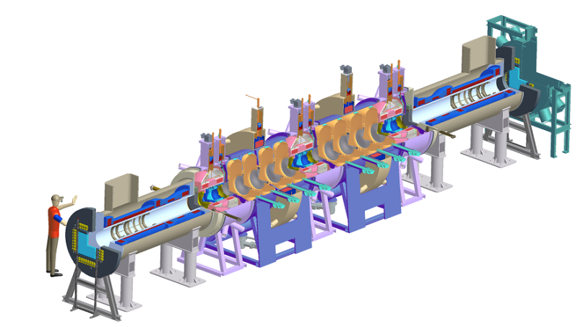
R&D SYNERGY – SYSTEM TESTS
MERIT Target proof-of-principle
experiment at CERN (completed)
EMMA Non-scaling FFAG proof-of-principle experiment at Daresbury (ongoing)
1 cm
MICE ionization cooling
Experiment at RAL
(ongoing)
Spectro-
meter
Muon Beam
Cooling section
Spectro-
meter

Slide 12
NEUTRINO OSCILLATIONS
▪ Within the framework of 3-flavor mixing, the 3 known flavor eigen-states (ν_{e},ν_{μ},ν_{τ}) are related to 3 neutrino mass eigenstates (ν₁,ν₂,ν₃) :
(
)
⁼(3×3)
(
)
ν_{e}
ν₁
ν_{μ}
ν₂
ν_{τ}
ν₃
▪ The elements of the neutrino mixing matrix can be parameterized
using 3 mixing angles (θ₁₂ , θ₂₃ , θ₁₃ ) and one complex phase (δ) :
▪ The oscillations are driven by the mass splittings: Δm²_{ij} ≡ m²_{i} - m²_{j}
▪ Neutrino oscillation measurements can check this 3-flavor mixing framework & teach us the values of θ₁₂ , θ₂₃ , θ₁₃ , δ , Δm²₁₂, Δm²₂₃ .

Slide 13
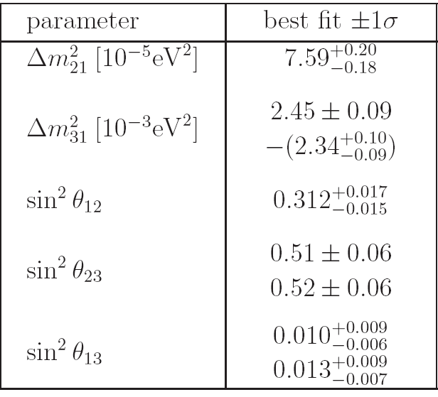
WHAT IS KNOWN
GLOBAL FIT
normal
inverted
Schwetz, Tortola, Valle;
hep-ph arXiv:1103.0734v2
normal
inverted
normal
before T2K
update
inverted

Slide 14
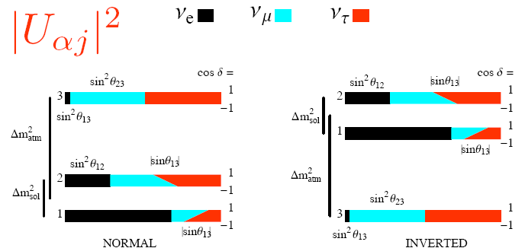
WHAT IS KNOWN
NORMAL
INVERTED

Slide 15
OPEN QUESTIONS
Is the 3-flavor mixing picture complete ?
What is the value of the mixing angle θ₁₃?
  We may be close to an answer (T2K Result) ⇒
What is the mass hierarchy (normal or inverted)?
What is δ and is there CPV in the neutrino sector ?
Requires θ₁₃ and sin δ ≠ 0
What are the precise values for all of the mixing
angles?
Discriminate between theoretical ideas about the physics responsible for neutrino masses

Slide 16
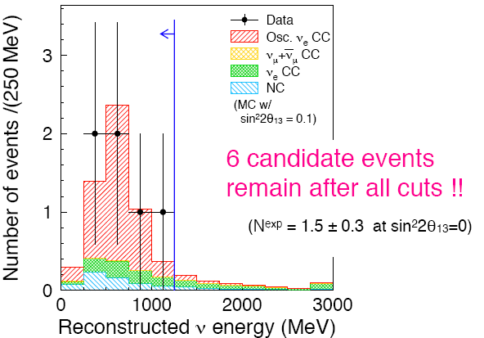
T2K and θ₁₃
Evidence for ν_{μ} → ν_{e} at atmospheric (L/E) scale & hence a finite θ₁₃
http://arxiv.org/abs/1106.1238
6 candidate events
observed
If θ₁₃ = 0, only
1.5+-0.3 expected
0.8 beam ν_{e} background
0.6 neutral current events
0.1 ν_{μ}→ν_{e} from solar term

Slide 17
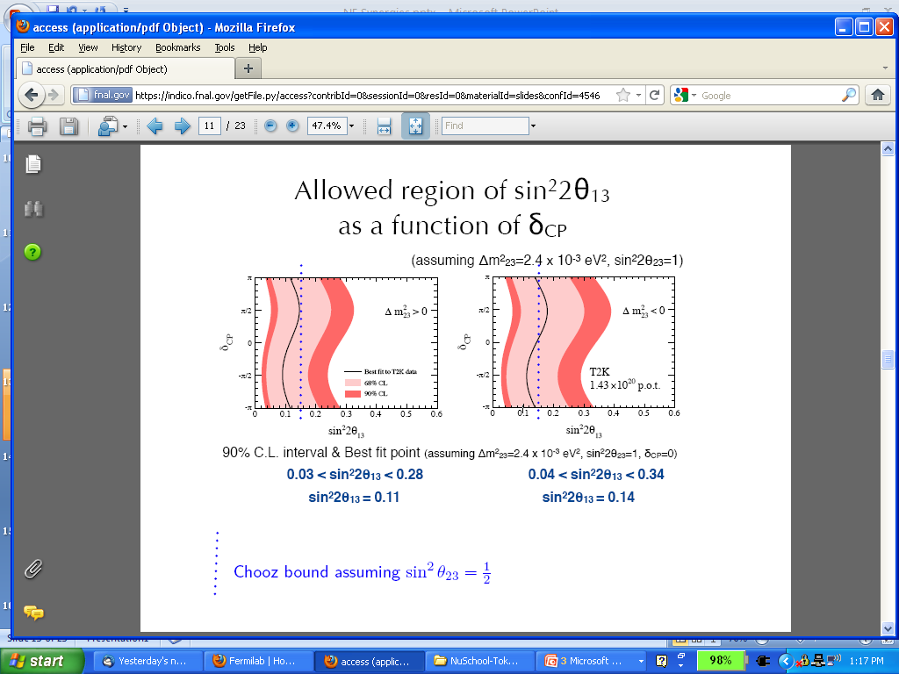
T2K: θ₁₃ RESULT
INVERTED HIERARCHY
NORMAL HIERARCHY
δ_{CP}
δ_{CP}
sin²2θ₁₃
sin²2θ₁₃
NOTE: MINOS has also presented prelim. results where θ₁₃=0 is excluded
at 89% C.L.

Slide 18
IMPORTANT LOOSE ENDS
Evidence for a finite value of θ₁₃ is not the only couple of standard deviation effect we are faced with:
  - MINOS neutrino – anti-neutrino “anomaly”
  - MiniBooNE neutrino-anti-neutrino “anomaly”
  - LSND “anomaly”
  - Reactor anti-neutrino flux uncertainty
Each of these creates
tension with the 3-flavor picture at the couple of sigma level
Note: There are also K2K/MiniBooNE/SciBooNE effects at low Q² which further enrich the picture.

Slide 19
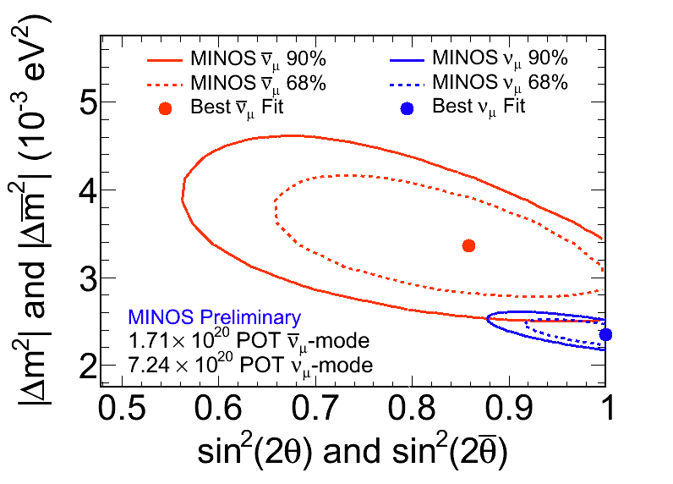
MINOS: ν_{μ} vs ν_{μ}
DISSAPEARANCE

Slide 20
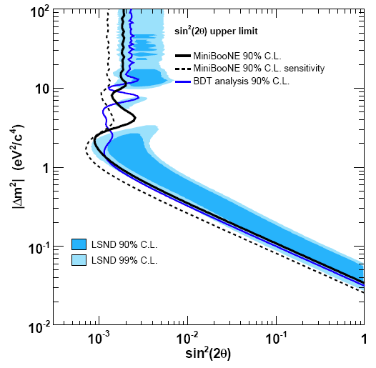
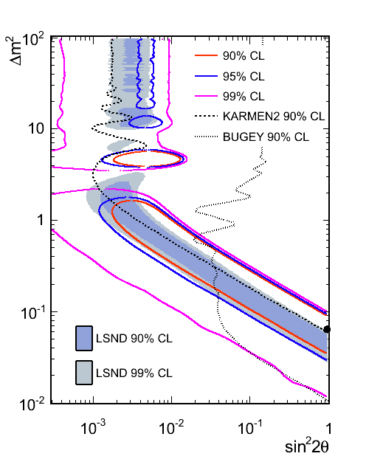
MiniBooNE: ν vs ν
ν_{μ} → ν_{e}
ν_{μ} → ν_{e}
Δm² (eV²/c⁴)
PRL 105 (arXiv:1007.1150).
sin²2θ
sin²2θ

Slide 21
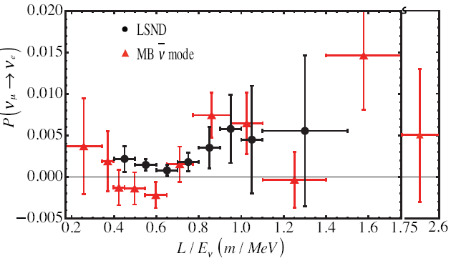
MiniBooNE vs LSND
PRL 105 (arXiv:1007.1150).
P (ν_{μ} → ν_{e})
L / E (m / MeV)

Slide 22
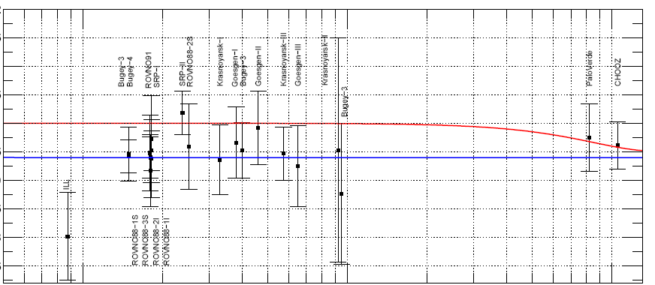
REACTOR ANTI-NEUTRINO ANOMALY
“Recently, new reactor antineutrino spectra have been provided for 235U, 239Pu, 241Pu, and 238U,increasing the mean flux by about 3 percent. To a good approximation, this reevaluation applies to all reactor neutrino experiments. The synthesis of published experiments at reactor-detector distances < 100 m leads to a ratio of observed event rate to predicted rate of 0.976±0.024. With our new flux evaluation, this ratio shifts to 0.943±0.023, leading to a deviation from unity at 98.6% C.L.”
G. Mention et al., hep-ex arXiv:1101.2755
1.1
1
0.9
N_{OBS}/N_{EXPECTED}
10 100 1000
DISTANCE TO REACTOR (m)

Slide 23
RESOLVING LOOSE ENDS
Possible explanations:
  Statistical fluctuations?
  Unidentified systematics?
  Exciting new physics beyond 3-flavor mixing?
The future neutrino oscillation program will require precise comparisons between neutrino and anti-neutrino oscillation probabilities.
If the “anomalies” are more than just statistical fluctuations then we presumably need better beams and/or better cross-section measurements and/or better neutrino detectors (lower background rates).

Slide 24
CONVENTIONAL NEUTRINO BEAMS
Focusing
Devices (Horns)
Decay Pipe
Target
μ
Proton
Beam
π,K
ν_{μ}
Properties
Beam Dump
Almost pure ν_{μ} beam (≳99%)
ν_{e} (≲1%) from π→μ → e chain and K decay (K_{e3})
ν_{μ} / ν_{μ} can be switched by flipping polarity of focusing device
Limitations
Complex parent spectrum & composition → ν flux uncertainties
High energy tails can produce background
Only one (useful) flavor (ν_{μ}) in the initial beam

Slide 25
NEUTRINO FACTORY BEAMS
Neutrino/anti-neutrino beam produced by mono-energetic well behaved parent muon beam with very well known decay kinematics
→ precise
knowledge of ν/anti-ν beam composition & spectrum
O(10²¹) Muon Decays/year
A POWERFUL PRECISION TOOL WITH LOW SYSTEMATIC UNCERTAINTIES
→ can make precise measurements based with ν_{e}, anti-ν_{e}, ν_{μ}, anti-ν_{μ}
→ can search for ν_{e} → ν_{μ} oscillations with very low backgrounds (wrong-sign muon signature)

Slide 26
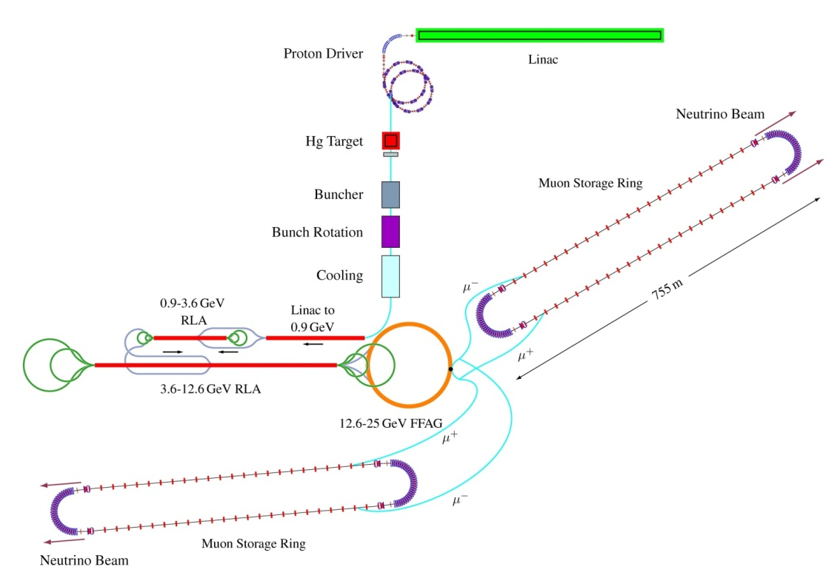
IF θ₁₃ IS SMALL ….
International Scoping Study Design
E=25 GeV Neutrino Factory
EXAMPLE:
L = 4000 km & 7500 km
M_{det} = 100kT & 50kT
10 years run
10²¹ muon decays/yr

Slide 27
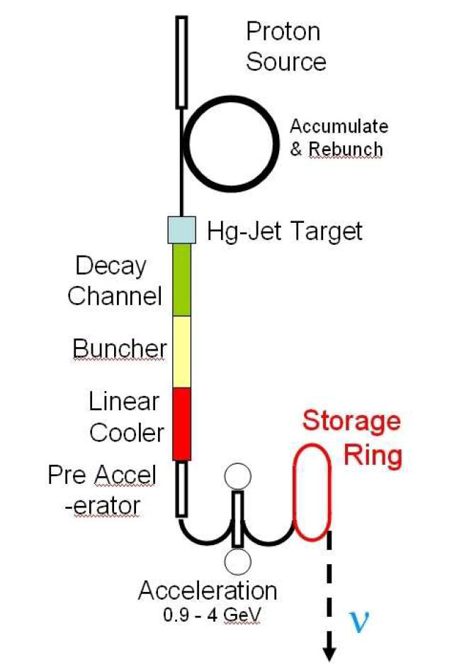
IF θ₁₃ IS LARGE ….
Low Energy Neutrino Factory
EXAMPLE:
L = 1300 km
E = 5 GeV
M_{det} = 100kT
10 years run
5 × 10²¹ muon decays/yr

Slide 28
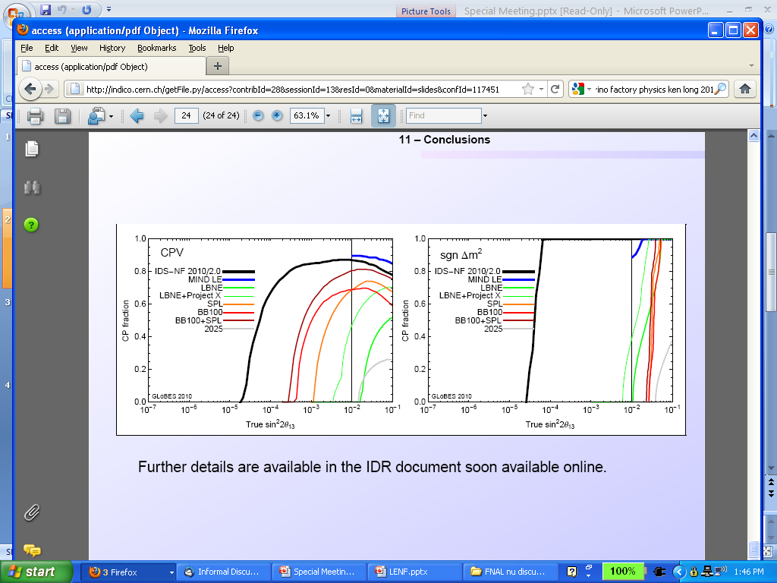
NEUTRINO FACTORY REACH
NF-IDS Status Report (May 2011): 3σ discovery reaches
Fraction of all possible δ
sin²2θ₁₃
sin²2θ₁₃
NOTE: For large θ₁₃ the LENF comfortably determines mass hierarchy for
all CP phases … so the (energy, baseline) optimization can be based just on
CPV coverage.

Slide 29
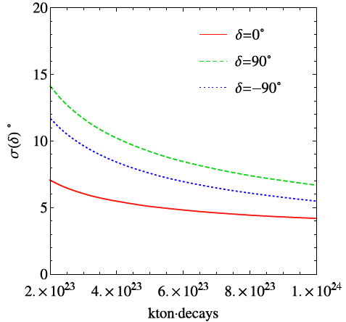
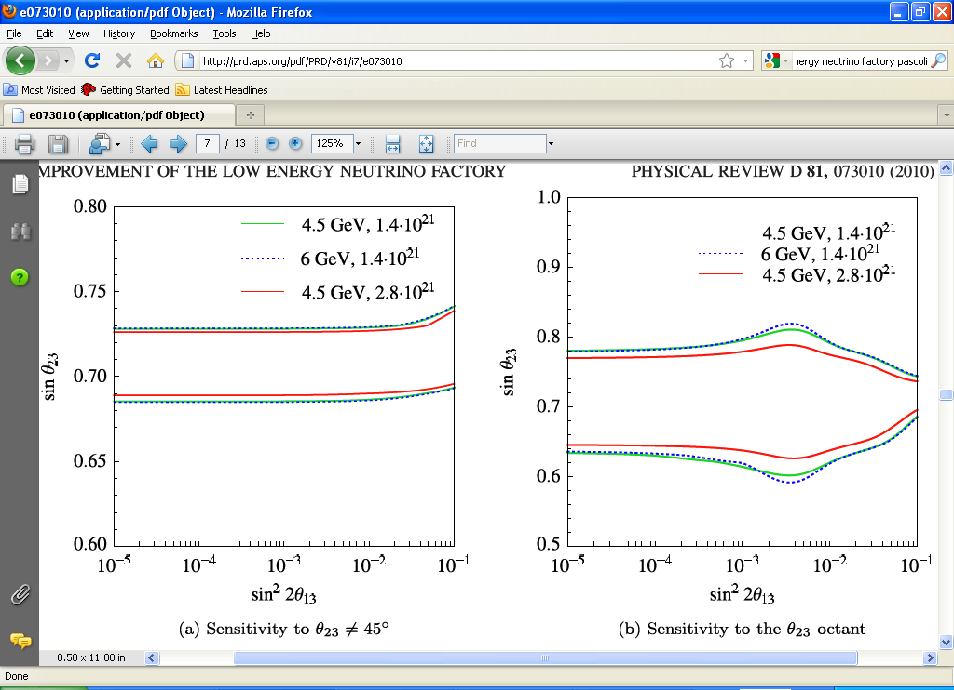
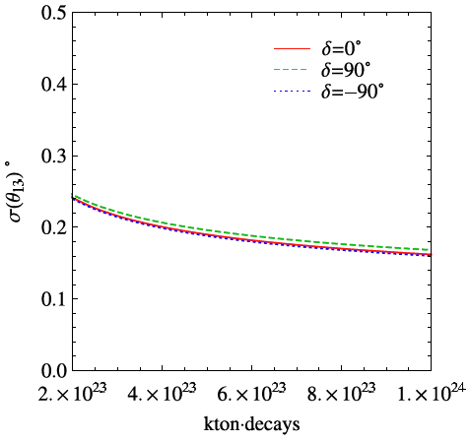
LOW ENERGY NF PRECISION
Li, Martinez, Mena, Pascoli, Phys. Rev. D81, 073010 (2010)
How well can we determine θ₂₃ octant ?
How well can we determine θ₂₃ ≠ 45º ?
How well can we measure δ ?
How well can we determine θ₁₃ ?
σ(δ) degrees
δ precision
θ₂₃ ≠ 45º
θ₂₃ octant
sin θ₂₃
sin θ₂₃
σ(θ₁₃) degrees
θ₁₃ precision
sin²2θ₁₃
sin²2θ₁₃
kton-decays

Slide 30
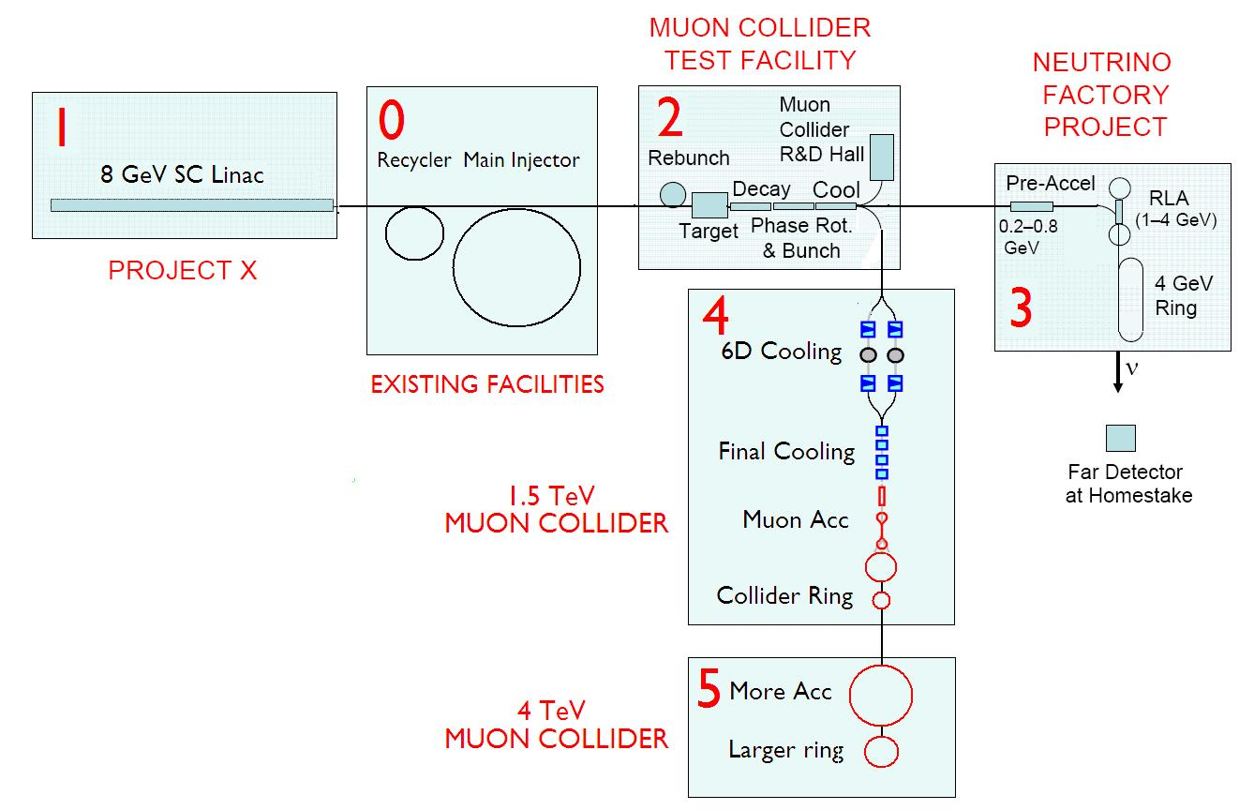

STAGING OPTIONS
4MW multi-GeV
Proton Source
α
4 GeV
NF
Accumulation &
Rebunching
3
25 GeV
NF
ALSO
Z-PRIME
FACTORY?
β
4
ALSO …

Slide 31
STRATEGY & STAGING:
AN EARLY START ?
IS A MUON STORAGE RING NEUTRINO SOURCE THE KEY TO
RESOLVING THE PRESENT CROP OF FEW SIGMA EFFECTS?
No bunching, no phase rotation, no cooling, no acceleration …. not a neutrino factory.
Create charged pions with either an internal or external target (which is best?) and allow O(1 GeV) muons to decay in a storage ring with long straight sections.
  - Precisely known neutrino and antineutrino fluxes and spectra.
  - Can measure ν_{μ}, anti-ν_{μ}, ν_{e}, and anti-ν_{e} cross sections.
  - If sufficient intensity, short baseline oscillation measurements.
NEEDS EVALUATION

Slide 32
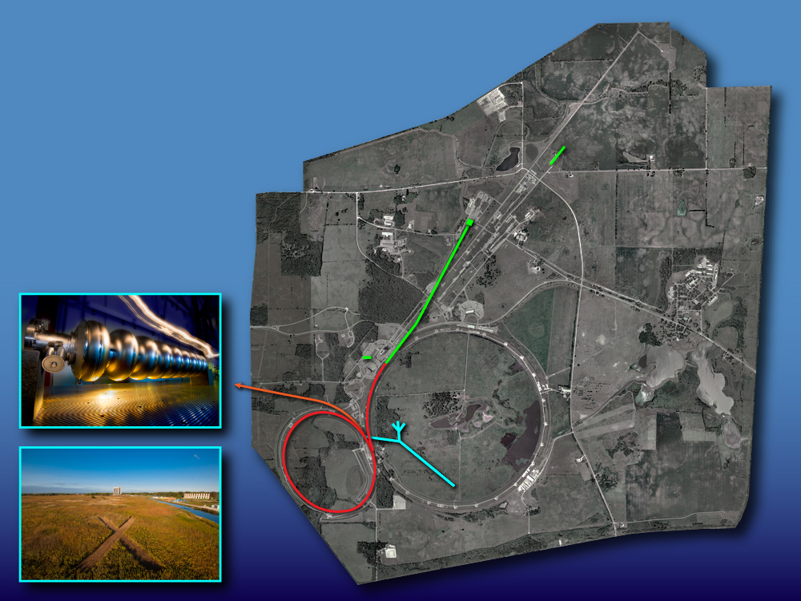
A VISION
START WITH
PROJECT X
Neutrinos
Muons
Kaons
Nuclei
“simultaneously”
2 MW (60-120 GeV)
1300 km
2 MW at ~3 GeV
flexible time structure
and pulse intensities

Slide 33
A VISION
ADD
NEUTRINO
FACTORY
Enhanced Neutrinos
Enhanced Muons
Muon Collider test bed
Kaons
Nuclei
“simultaneously”
4MW protons
5 GeV muons
1300 km

Slide 34
A VISION
ADD
MUON
COLLIDER
μ⁺
μ⁻
4 TeV Collider

Slide 35
CLOSING REMARKS
The R&D connections between Muon Colliders and Neutrino Factories are well established.
Neutrino oscillation experiments continue to provide exciting results.
  If θ₁₃ is in the range indicated by T2K, we will not have to wait
  very long for confirmation
There is a possible staging / risk-mitigation connection between Neutrino Factories and Muon Colliders.
It would be worthwhile evaluating what minimal-cost muon storage ring neutrino source could be built right now (with/without Project X), the neutrino and anti-neutrino fluxes that could be produced, and the potential impact on cross-section measurements
and the future short-baseline neutrino program.
  - The future starts now!

