Slide 1
NOνA Accelerator Upgrades: Status
Phil Adamson
Fermilab
pa@fnal.gov
“It’s all fairly straightforward”
-- Jeff Hartnell this morning

Slide 2
About this talk
This talk is not about the wonderful physics programme offered by the NOνA beamline
NOνA
MINERνA
MINOS+
See plenary talk by Jeff Hartnell this morning
Brief overview of current accelerator complex
Major upgrades required for NOνA
Status & schedule
This talk does not contain every detail of the upgrade project
Please feel free to ask about your favourite subject

Slide 3
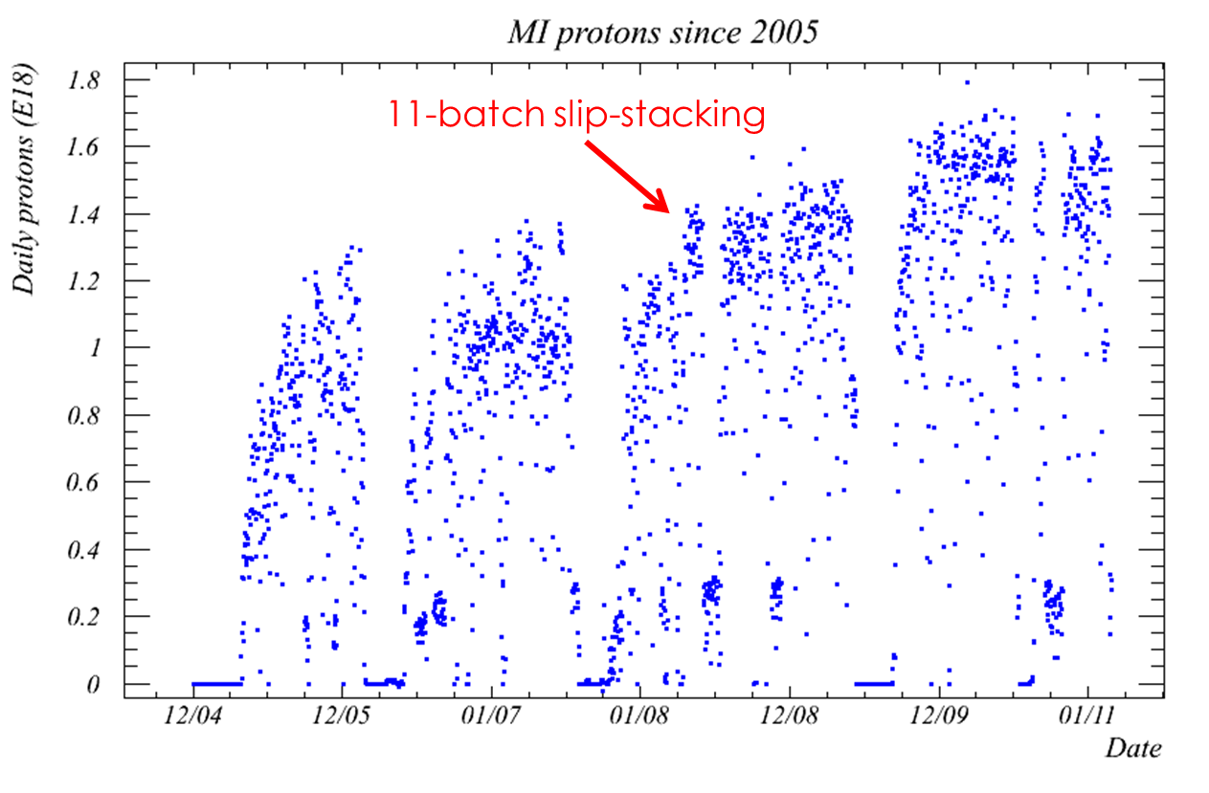
Current NuMI operation
Linac: 750 keV – 400 MeV
Cycle length is 2.2s
Typical peak NuMI beam power ~330 kW in mixed mode
Booster: 400 MeV – 8 GeV
Main Injector: 8 GeV – 120 GeV
Slip-stack 11 booster batches
2 batches to antiproton source
9 batches to NuMI
Also SY120 fixed target program
Pbar storage in recycler
Pbar and protons to Tevatron
(plus BNB, MTA, NTF, …)

Slide 4
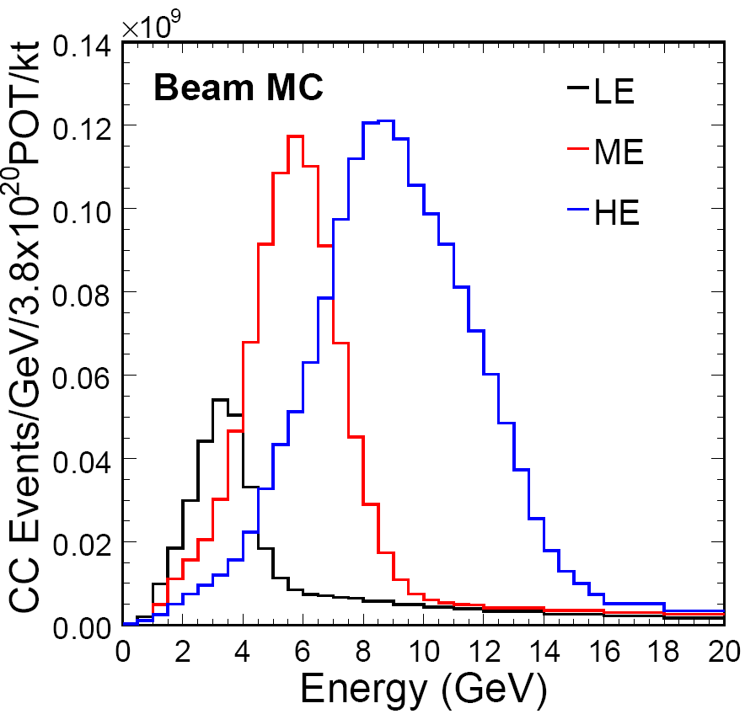
NuMI neutrino beam
Neutrino energy tuned by moving target (usually LE)
Change horn polarity to select ν_{μ} or ν_{μ}
Target
Focusing Horns
Decay Pipe
π⁻
2 m
ν_{μ}
120 GeV protons
ν_{μ}
π⁺
15 m
30 m
675 m

Slide 5
NOνA upgrades
Increase NuMI primary proton beam power
330 (380) kW -> 700 kW
Additional focus on loss control
Double the beam power
Same tunnels
Change neutrino beam energy (focussing)
Optimize flux at off-axis NOνA location

Slide 6
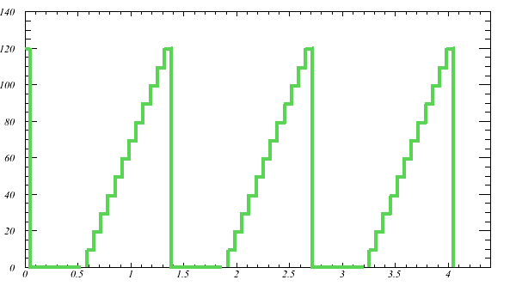
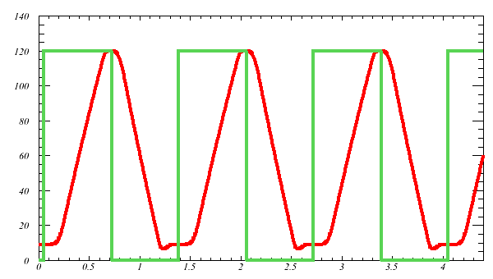
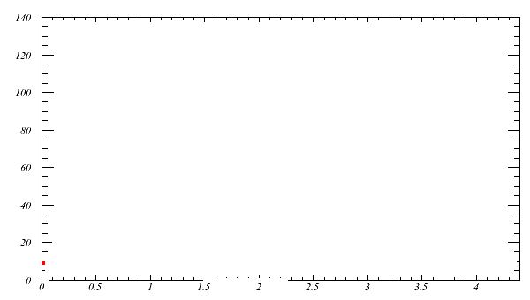
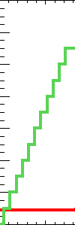
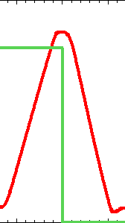
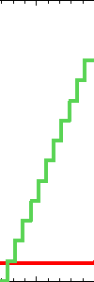
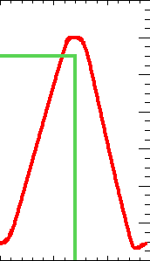
Increasing beam power
Recycler
Move slip-stacking to recycler
11 batch -> 12 batch
Increase Main Injector ramp rate (204 GeV/s -> 240 GeV/s)
330 (380) -> 700kW with only ~10% increase in per-pulse intensity
Main Injector

Slide 7
So need to rebuild recycler
Remove:
Old transfer lines
Small aperture (pbar: 6π/2π, protons: 15−20π)
Stochastic cooling
Electron cooling
Pelletron
Rebuild MI-30 with FODO lattice
Various odds and ends that might be aperture restrictions
Add:
New injection line from MI8 to recycler
New RR->MI transfer line
53 MHz RF system for slip-stacking
Instrumentation
BPMs
Low-mass Ti multiwires
IPMs
Must maintain vacuum at 10⁻¹⁰ – 10⁻¹¹ torr (TSPs)

Slide 8
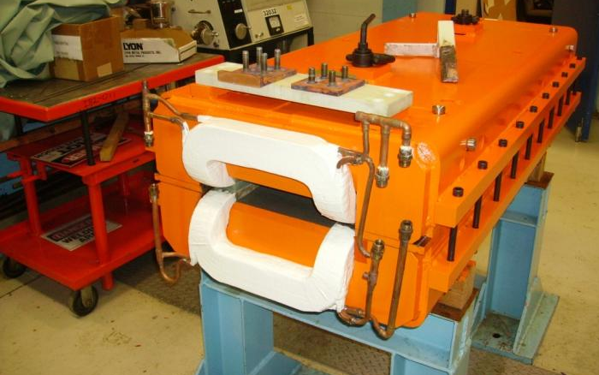
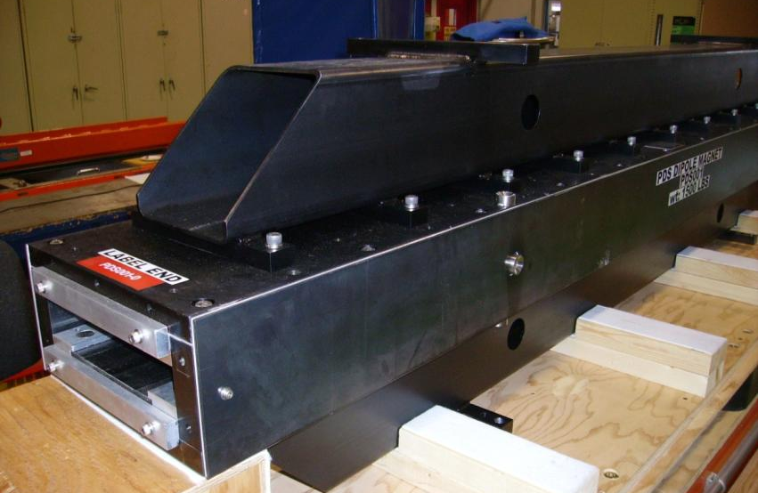
New MI-8 line
Switched dipole at 849
ADCW (wide-gap modification of old ADC magnet)
Strontium Ferrite permanent magnet dipoles like rest of MI-8
Two Samarium Cobalt dipoles (space constraints)
Strontium Ferrite recycler quads, powered quad trims for lattice matching

Slide 9
Installation in MI8
1-week shutdown in March 2011
Electric company replacing switchgear offsite
Installed first PDD magnet in new MI8

Slide 10
Rebuild 30 straight
New permanent quads for 30 straight in recycler
Total cost cheaper than re-making existing quads
ALARA

Slide 11
53 MHz RF in Recycler
Build 3 RF cavities
A, B and hot spare
150 kV per cavity
Operating range: 52.809 MHz ± 1260 Hz
10 KHz fast (~40 µs) phase shifters from Proton Driver
Recycle PAs and modulators from Tevatron
LLRF close to a copy of MI system

Slide 12
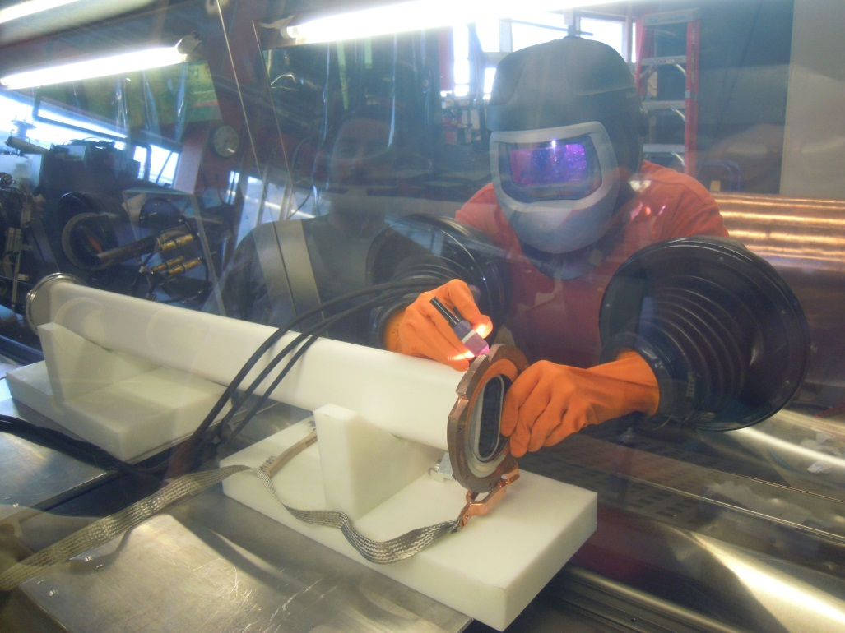
11 batches -> 12 batches
Currently place 81 bunches every 86 in MI
For NOνA, place 81 bunches every 84 in Recycler. (84 = 588/7)
Faster rising/falling edges -> many short kickers (6)
Already have 7 RKA magnets in MI: Gap Clearing Kicker system for loss control

Slide 13
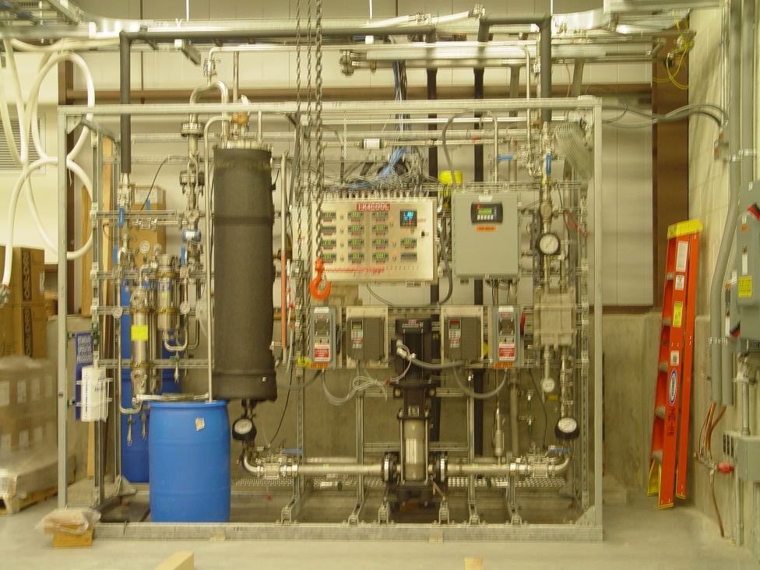
Gap Clearing Kicker System
6/7 magnets will move up to recycler for NOνA

Slide 14
GCK measurements
Edges within specification
Slower edge in damper measurement might be artifact
Damper (beam) measurement
Calculated B from measured voltages
For recycler, building “tail bumper” to cancel tail
Tail measurement similar to electrical measurements (good)

Slide 15
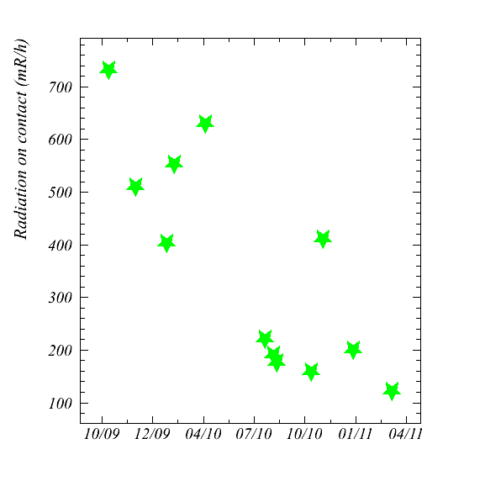
GCK reducing local losses
Green points: contact measurement at V105
GCK on for a week
Already as low as end of 2009 shutdown

Slide 16
Increase MI ramp rate
2 new MI cavities to maintain bucket area
New transformer for vertical quad bus
Increased heat load on cooling ponds
Will need more cooling for summer – study underway looking at future cooling needs (not just NOνA )
More ponds?
Run a chiller in summer?
Shade ponds?

Slide 17
Beamline upgrades
Increase rep rate
2.2s (2.0s) -> 1.33s
Replace 5 3Q120 quads with ones from A150 beamline (better cooling)
Upgrade magnet power supplies
Faster ramp
BULB
Better regulation
Current monitor -> beam permit
New kicker power supply
Beam intensity doubled, but beam loss in water-bearing rock must not double
New 1 mil Ti multiwires - lower mass in beam

Slide 18
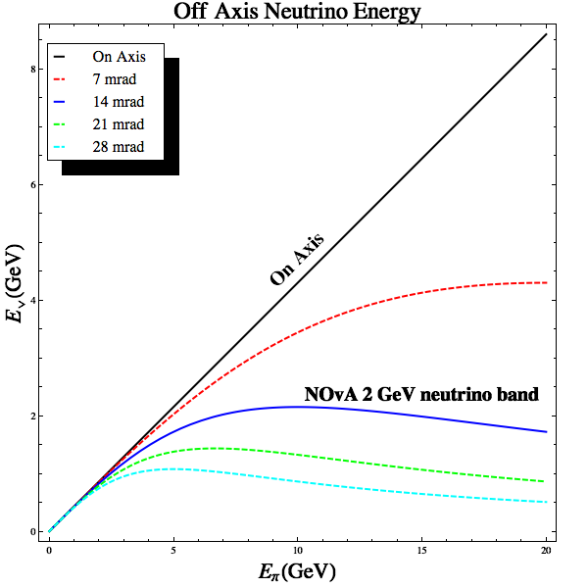
Off-axis neutrino beam
Off-axis, neutrino energy driven by angle
Adjust focusing to optimize flux
0
20

Slide 19
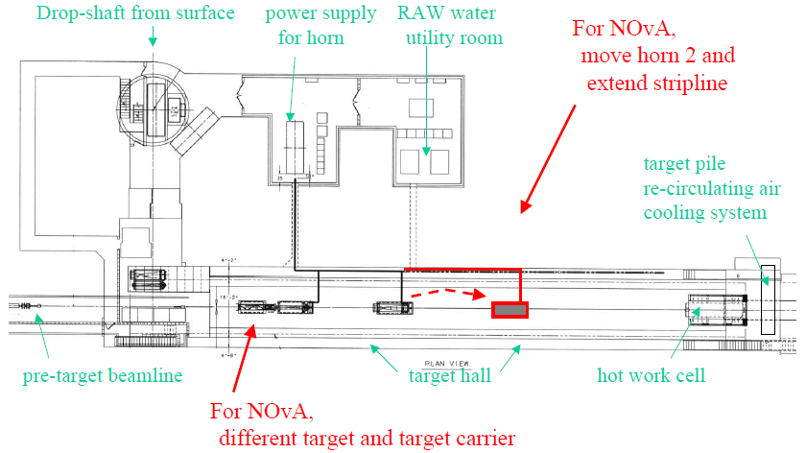
Target Hall Upgrades
NOvA: new horn 1 (thinner o.c.)

Slide 20
NOνA target
NuMI target (top) must fit inside horn 1
Small, mechanically weak. Recent problems – failure of water cooling lines
NOνA target (right) upstream of horn 1 (neutrino energy from off-axis angle)
Much more robust design. Water cooling 8 times further away from beam than NuMI
Target construction in progress – delivery this fall

Slide 21
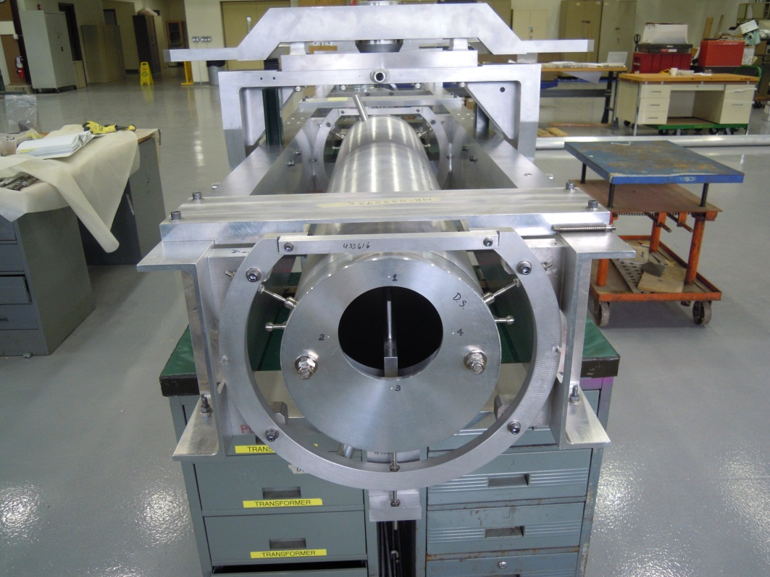
Target Carrier
“Prototype” carrier complete
Expect to use as first production carrier
Shown here with target/baffle mockup

Slide 22
Schedule & Summary
Tevatron operation completes by October 1
Begin NOνA shutdown March 5 2012
Shutdown scheduled for 11 months
Current installation schedule has work completed in 8-9 months
Then commission new accelerator complex
If accelerator work done before NuMI, can get an early start on commissioning
NOνA accelerator upgrades proceed on schedule
I look forward to commissioning the new complex and swift progress towards 700 kW

Slide 23
NOνA Accelerator Upgrades: Status
Phil Adamson
Fermilab
pa@fnal.gov

Slide 24
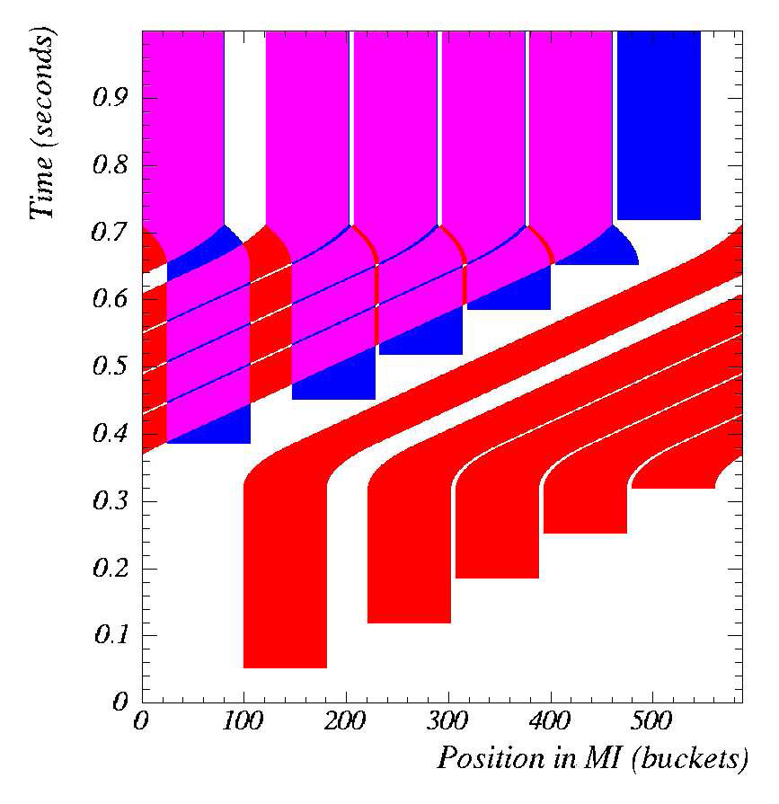
Slip-stacking
Neutrino experiments want more beam!
Inject 11 batches rather than 6
But pay for it with increased losses
(<95% efficiency)

Slide 25
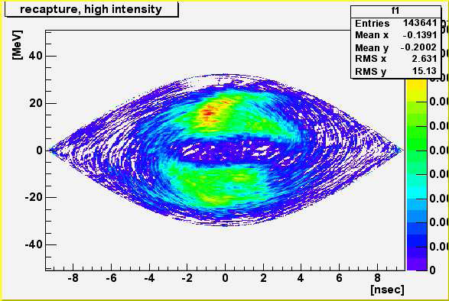
Slip-stacking recapture (real data)

Slide 26
Transfer and new MI8 lines
MLA
RR extraction Kicker
RR-30 straight section
309
308
307
306
305
304
303
302
301
K
K
Q804
Q803
GM232A,B
GM231A,B
GM230A,B
GM229B
Trim quads
Q801
Q802
Mirror magnets
VDN2
VUP1
MI-30 straight section
Q805
K
K
Q309
Q308
Q307
Q306
Q305
Q304
Q303
Q302
Q301
MI injection Kicker
MI VLAM Rolled
HKICK (1.208 mr)
5 kickers 1 bumpers
VLAM (MLAW) 13.6 mr (DC)
V2 (PDD) 19.2 mr
104
103
102
100
MQT trims
New Dipole Magnets
Recycler
K
QR852
QR853
New MQT trims
HBEND (35 mr)
848
847
846
852
851
850
849
MI8
MI
103
102
101
8 Gev line
Mini-Boone switch magnet
ADCW Switching

