Slide 1
Thermal, Mechanical and Fluid Flow Challenges of the FRIB Primary Beam Dump
Mikhail Avilov
Facility for Rare Isotope Beams
Michigan State University

Slide 2
Outline
FRIB primary Beam Dump Concept and Technical Requirements
Overview of Challenges for the Beam Dump
Mechanical Challenges
Thermal and Thermo-mechanical Challenges
Fluid Challenges
Chemical Challenges
Radiation Challenges
Summary

Slide 3
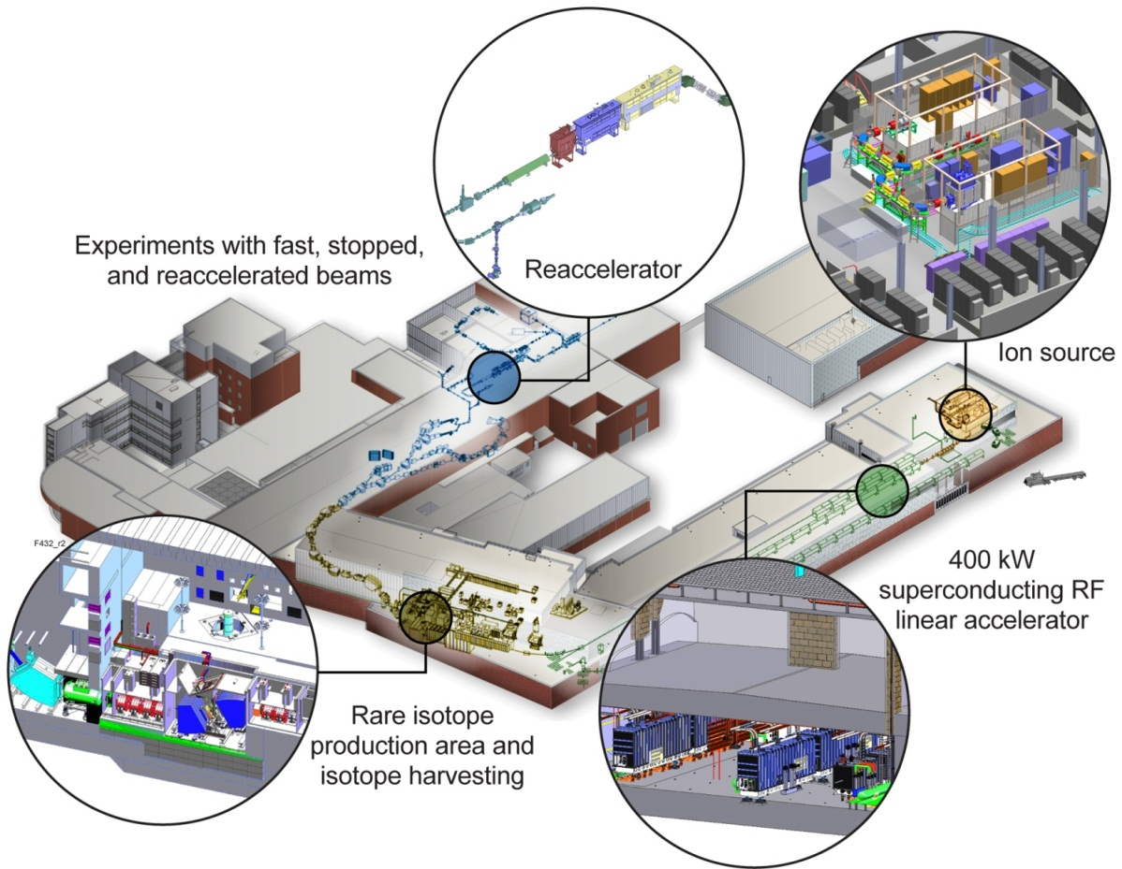
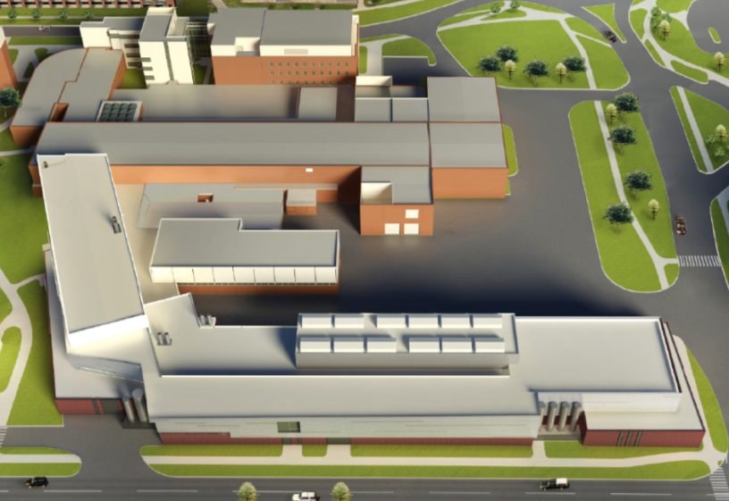
Facility for Rare Isotope Beams
World-leading heavy ion accelerator facility for rare isotope science
  Nuclear Structure
  Nuclear Astrophysics
  Fundamental Interactions
  Isotopes for Societal Needs

Slide 4
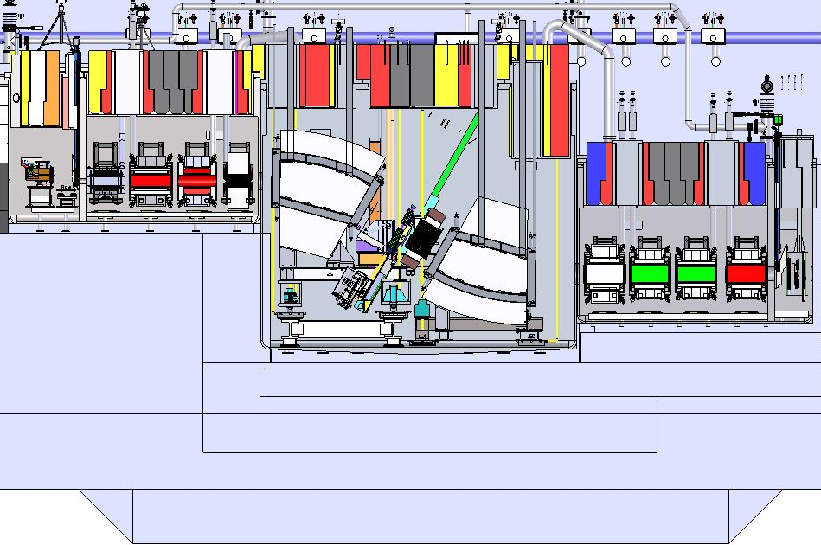
Scope and Technical Requirements
Rare isotope production targets and beam dump compatible with beam power of
400 kW at 200 MeV/u for ²³⁸U (>200 MeV/u for lighter ions)
Beamline from linac
Target
vacuum vessel
Target
Beam dump
Wedge assembly
Beam dump
vacuum vessel
Wedge
vacuum vessel

Slide 5
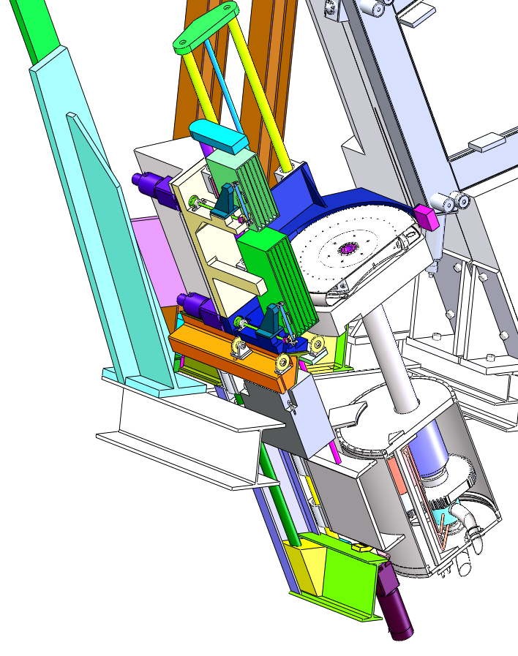
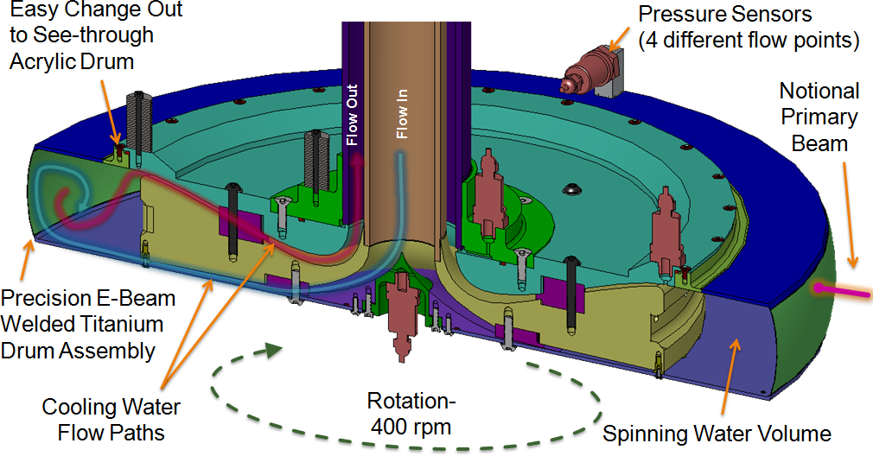
Primary Beam Dump
Water-filled Rotating Drum Concept
Beam Dump requirements
  High power capability up to 325 kW
  1 year (5500 h) lifetime desirable
  Remote replacement and maintenance
Water-filled rotating drum concept
chosen for FRIB baseline
  Using water to stop the primary beam
  and absorb beam power
Design parameters
  Ti-alloy shell thickness
  0.5 mm to minimize power
  deposition in shell
  400 rpm and 70 cm diameter
  to limit maximum temperature
  and amplitude of temperature
  changes
  60 gpm water flow to provide
  cooling and gas bubble removal
Beam Dump
schematic layout

Slide 6
Beam Dump Challenges Overview
Challenge
Mechanical
vibration
mechanical resonances
pressure-induced stress
Thermal and thermo-mechanical
thermal stress
fatigue
stress wave
thermal creep
Fluid
bubble formation: nucleate boiling
bubble formation: cavitation
wall heat transfer
Challenge
Chemical
corrosion
radiolysis
Radiation
radiation damage of materials
sputtering
radiation creep
Some effects may be enhanced by the presence of the other
Up to now no facility exists to study the combination of all these effects => perform studies that combine some challenges using existing facilities

Slide 7
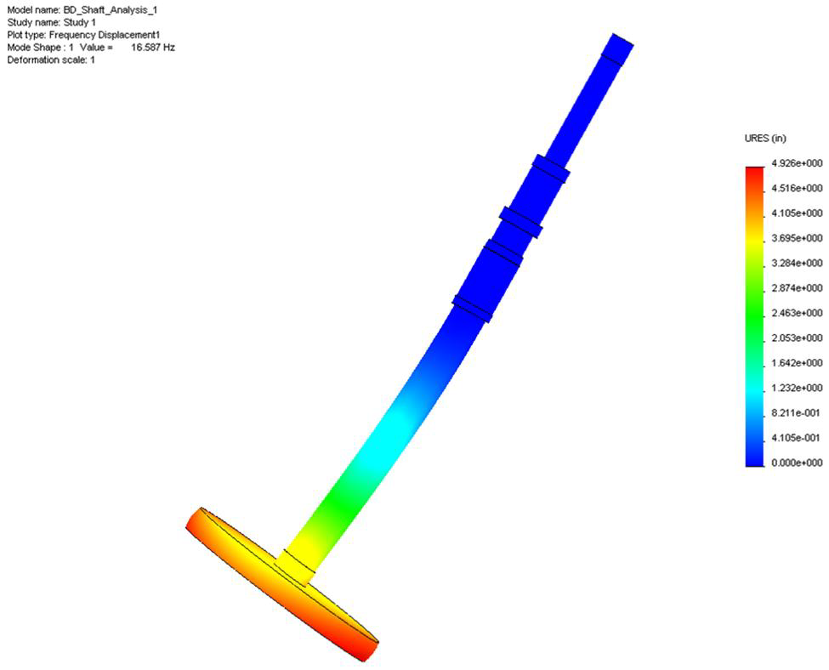
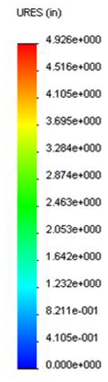
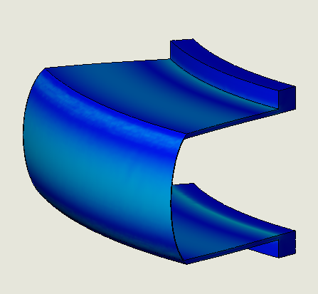

Mechanical Challenges
Vibration, Mechanical Resonances, Internal Pressure
Stress induced by internal pressure
  Studied numerically
  The optimization of the BD shell geometry performed in order to better withstand the increased pressure level due to BD rotation
  Safety factor of 5 calculated
  Verified by the mockup tests
Safety factor > 90
Mechanical resonances
  Studied numerically, the operation rotating frequency range found to be far below the first resonance peak.
  Safety factor of > 90 calculated
  Mechanical test of mockup did not
  reveal major issues
40° tangent angle
Flexible
coupler
55 psi
Safety factor ~ 5
El. motor

Slide 8
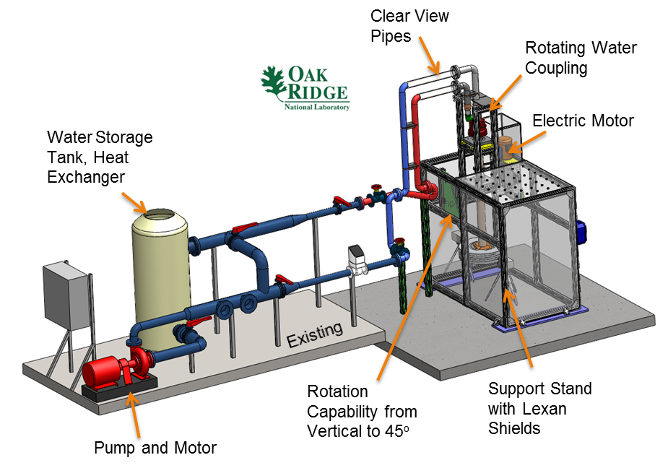
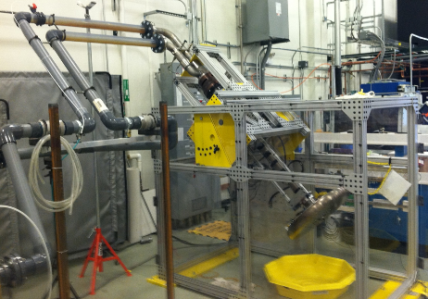
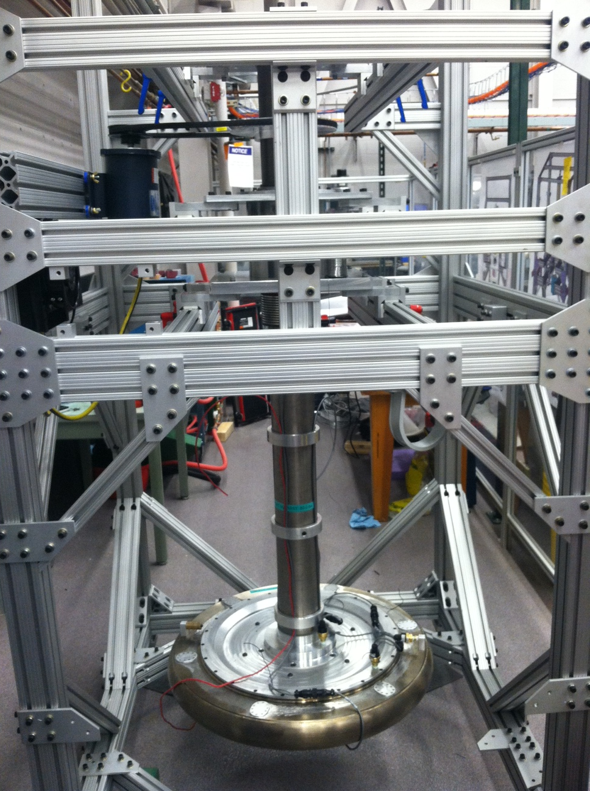
Mechanical Challenges
Mockup Tests to Confirm Mechanical Design
Beam dump mock-up tests at ORNL performed to evaluate mechanical and flow design
  Parametric study over flow parameter range
    Rotation speed, flow rates, pressures, angle
    Evaluation of pressure drops
Additional prototypic operation verified
  Mechanical balance
  Fill and drain tests
  Reliability

Slide 9
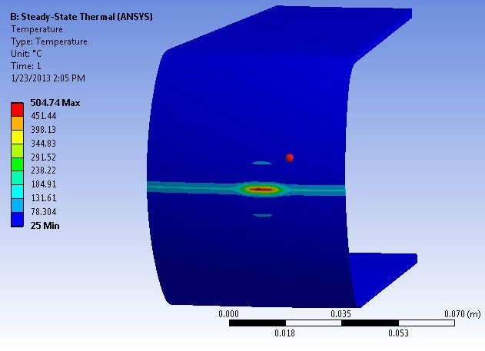
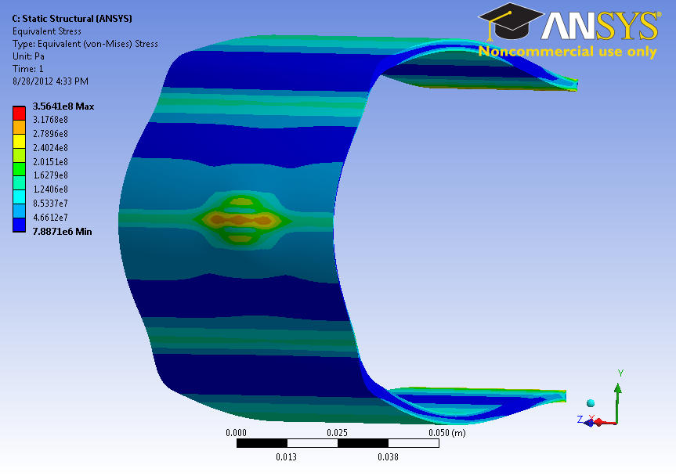
Thermal and Thermo-mechanical Challenges
Thermal Stress in the BD Shell
High power beam induces high level of thermal stress in the BD shell
  Thermal and mechanical conditions are numerically simulated for different primary beams and different rigidities
In the most severe case with U beam:
  Temperature: 350 ± 150 ºC (limited by
  500 ºC to prevent corrosion)
  Thermal stress: 250 ± 150 MPa
Far below the stress limit for Ti-6Al-4V alloy
  800 – 900 MPa
Calculated temperature profile in
the Beam Dump shell
Calculated stress profile in
the Beam Dump shell

Slide 10
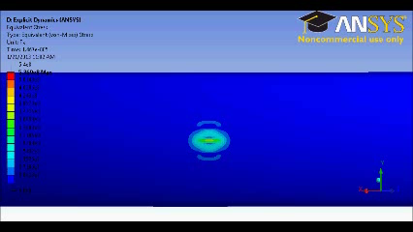
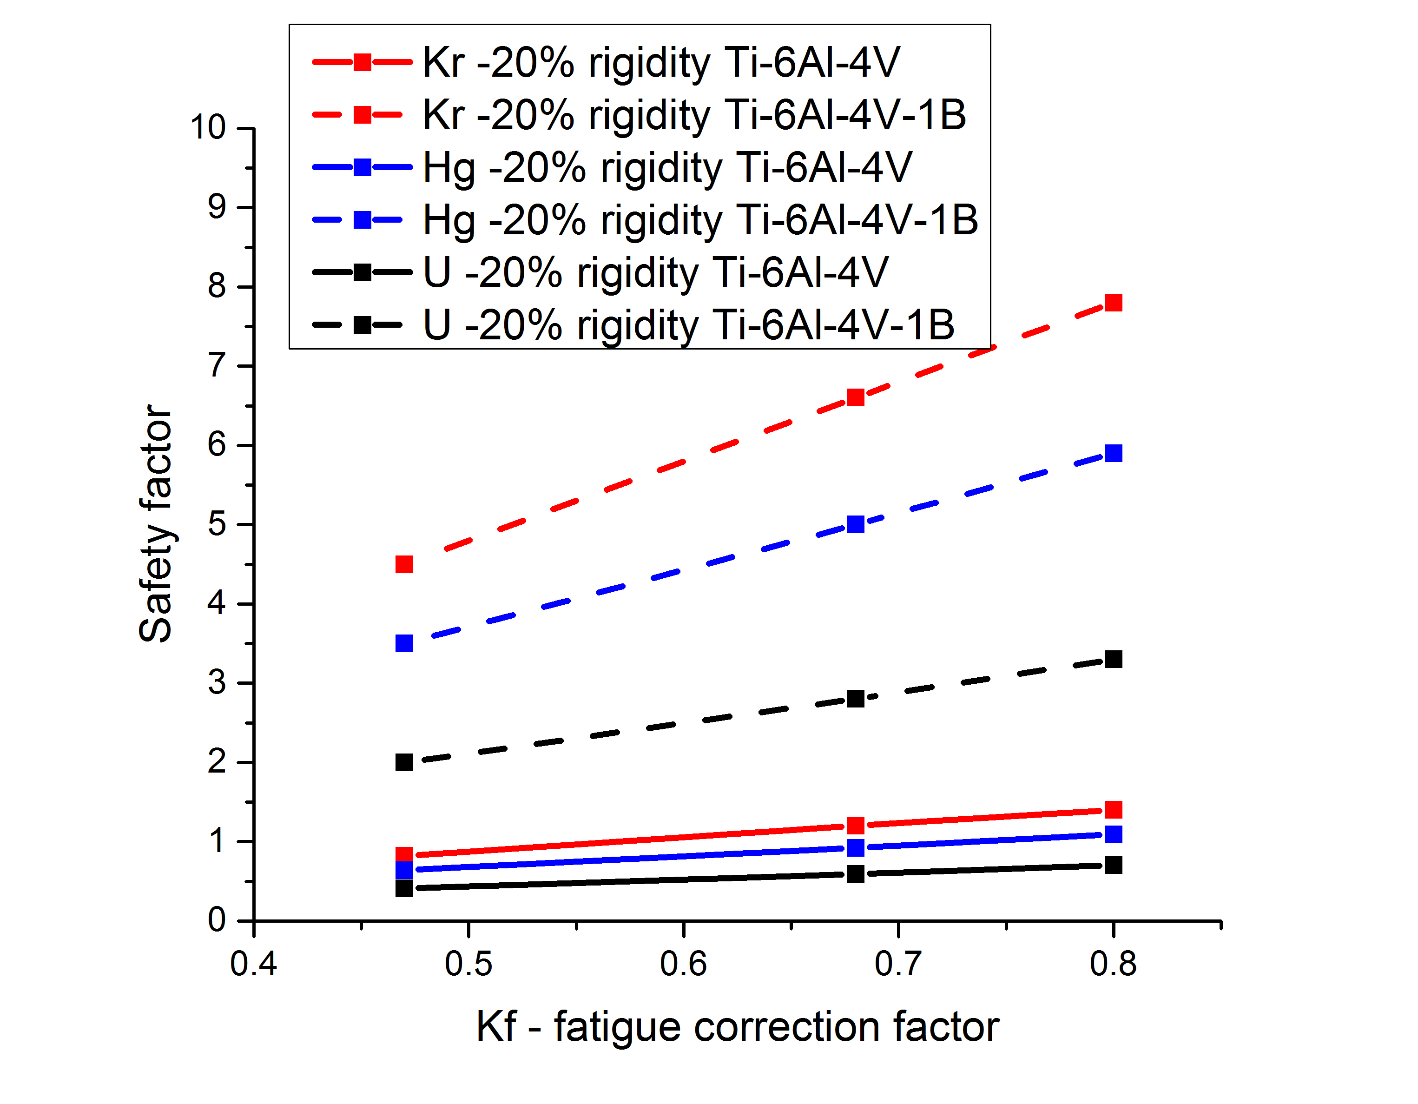
Thermal and Thermo-mechanical Challenges
Fatigue and Stress Wave
Fatigue
  BD rotation -> cyclic thermal load from the beam -> possible fatigue issues
  BD must survive 1.e8 cycles
  Adding 1% of B to Ti-6Al-4V alloy could improve significantly fatigue properties of the shell, increasing the safety factor for all primary beams and rigidities
  Validation tests required as simulation gives large dispersion in results with respect to the input parameters
  Corrosion and radiation damage may affect significantly the fatigue life
Stress wave
  Is a result of the beam impact to the rotating surface. Contributes to the total stress in the BD shell
  Simulation performed revealed stress wave contribution ~ 10% of the total stress
Fatigue safety
factor comparison
for Ti-6Al-4V and
Ti-6Al-4V-1B alloys
Stress wave propagation
in the BD shell

Slide 11

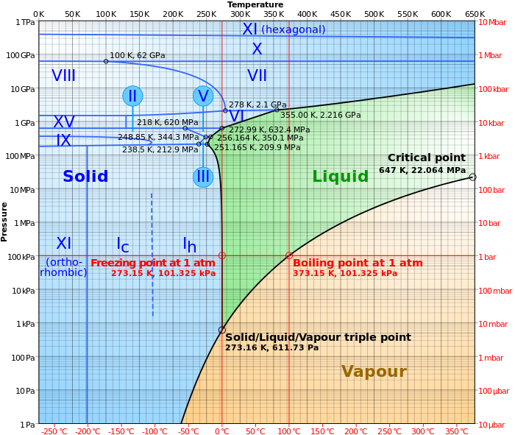
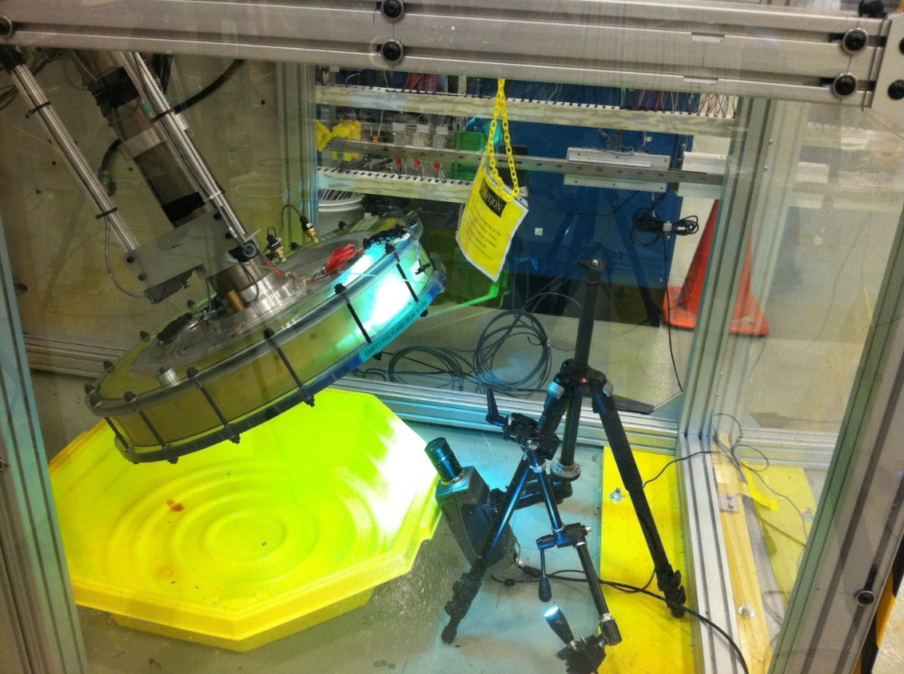
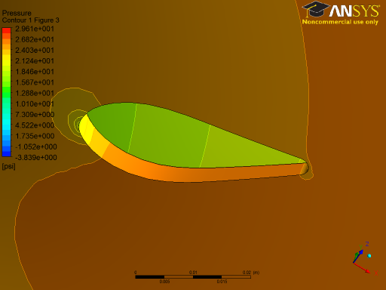
Fluid Challenges
Bubble Formation: Boiling and Cavitation
Boiling – bubble formation due to high power deposition in water and in the shell
Cavitation – bubble formation due to rapid change of pressure
Bubble formation -> bubble collapse -> shockwave -> possible BD shell damage
  Study of bubble formation on the shell is in progress
  Cavitation study – simulation and test
    Simulation showed no critical pressure changes
    BD mockup flow test did not reveal cavitation
A movie from the test
boiling
cavitation
Flow test with transparent
(acrylic) beam dump
Water phase diagram
Pressure drop simulation

Slide 12
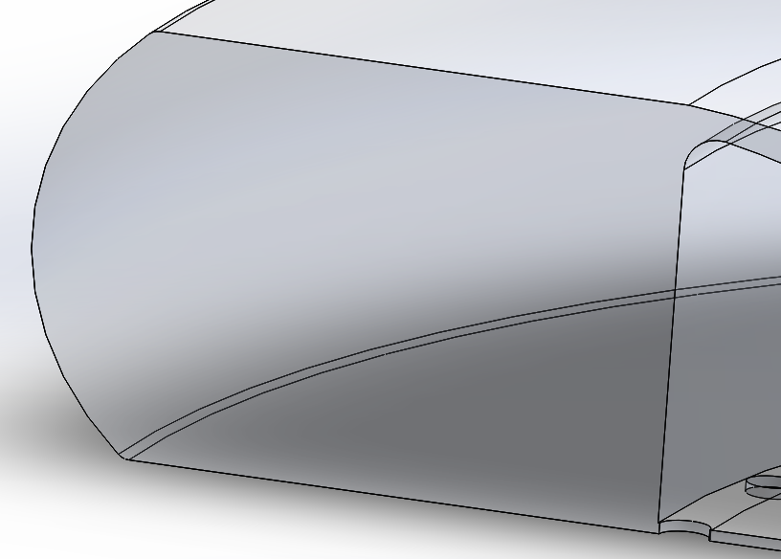
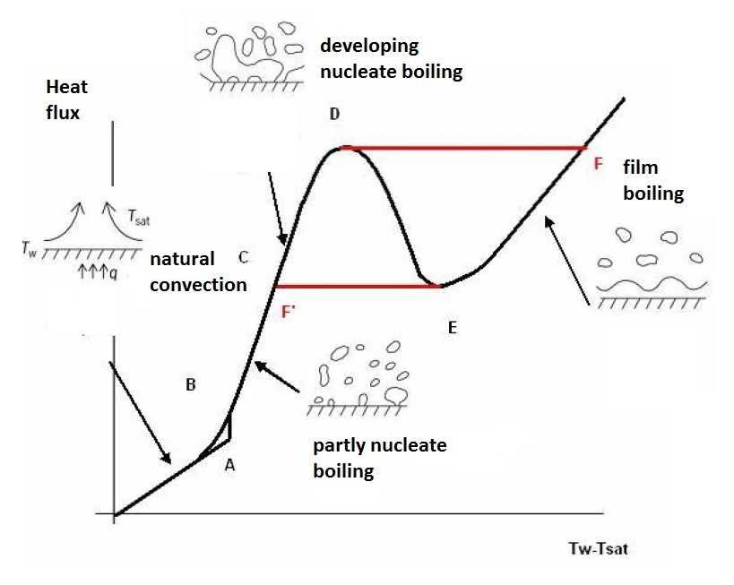
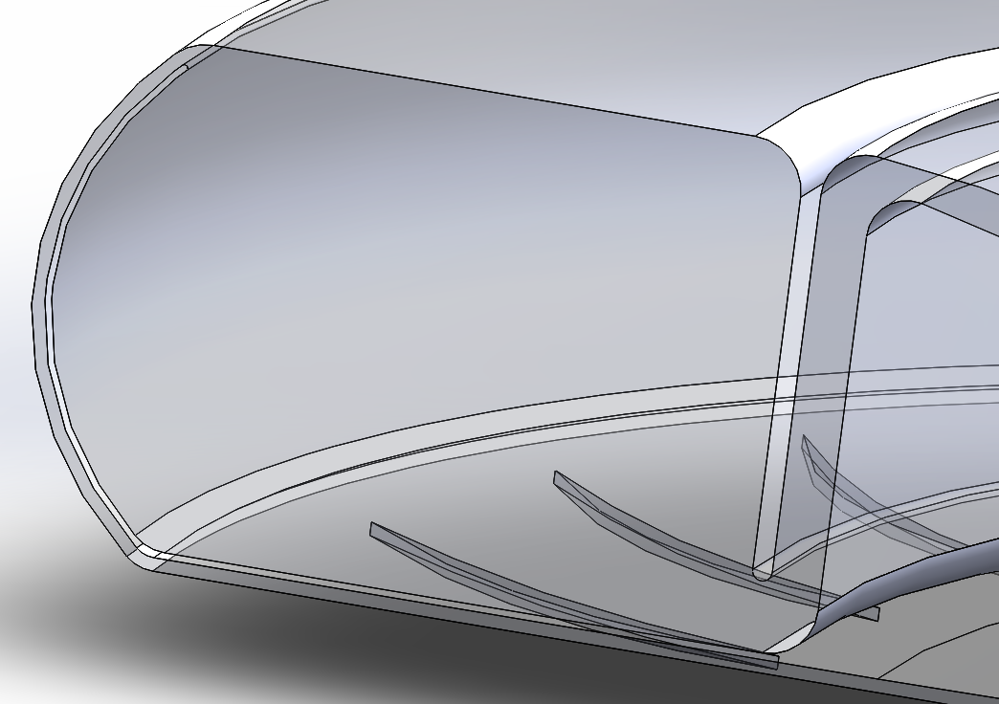
Fluid Challenges
Wall Heat Transfer [1]
Good heat transfer is essential for heat removal from the shell => highly turbulent water flow required. CFD simulation – wall heat transfer improved by introducing the turbine and insert
Different BD
flow models
Nucleate boiling allows to obtain an order of magnitude larger heat transfer
  Critical heat flux is one of the most essential parameters: exceeding it will result in transition to the film boiling -> failure
WHTC = 2500 W/m²K
CHF
WHTC = 12000 W/m²K
Boiling diagram

Slide 13
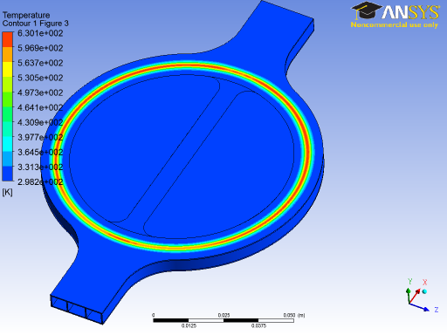
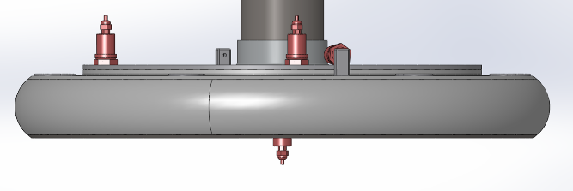


Fluid Challenges
Wall Heat Transfer [2]
Study:
  Collaboration with Fluid Mechanic Institute of Toulouse established (expertise in transitory boiling problem in nuclear power plant)
  Simulation of the BD fluid and thermal conditions with NEPTUNE code
  Q: How can fast rotation help in bubble removal from the BD shell thus improving the heat transfer?
Tests:
  Tests intended to evaluate the heat flux transfer through the shell
  Electron beam will be used to heat the mockup
  Other issues (like fatigue or bubble formation) are possible to study
Scanning e-beam
Water flow
Stationary mockup
Rotating seal
BD mockup
e-beam
VC
BINP, rotating quarter-scale mockup

Slide 14
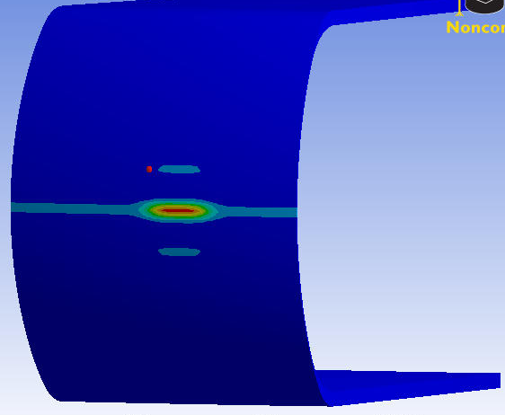
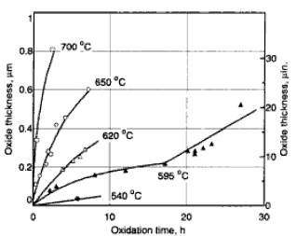
Chemical challenges
Corrosion, radiolysis
Corrosion
  Ti-6Al-4V temperature must be limited by 500 ºC to avoid strong corrosion in water
  Reduced power densities for few ion beams at few rigidities could be used
  Nanoscale corrosion studies during SHI irradiation at Sandia Lab
Radiolysis
  Liberates hydrogen and oxygen gas and produces hydrogen peroxide that may impact the BD shell
  Gas production estimates did not reveal substantial quantities of H, O and HO2
  Water circulation helps to prevent the gas accumulation
  Adding H2 (3 ppm) mitigates radiolysis
C
U beam
T_{max} = 500°C
Beam spot on the BD shell

Slide 15

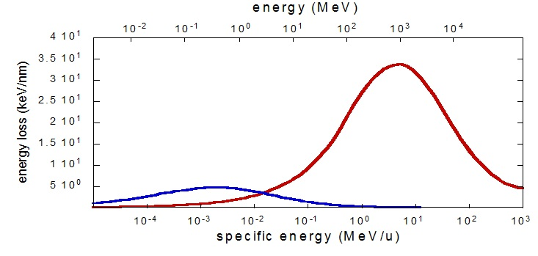
Radiation challenges
Radiation damage of Ti alloy and Sputtering
Irradiation test with Ti-6Al-4V and Ti-6Al-4V-1B alloys
  Irradiation tests were performed at IRRSUD (GANIL, Caen, France)
  No evidence of Phase transformation and ion track was shown at 3 irradiations (⁸²Kr at 25 and 45 MeV and ¹³¹Xe at 92 MeV)
  More tests ongoing at IRRSUD
  Samples of Ti-6Al-4V-1B were irradiated at NSCL with ⁴⁰Ca beam at 50 MeV/u
Sputtering
  A process of surface erosion due to bombardment by the ions
  Sputtering is stronger in insulators (TiO2)
  Sputtering evaluation for Ti and TiO2 (M. Toulemonde, GANIL): U beam at 160 MeV/u
  Thickness of sputtered layers were estimated to be 0.2 nm/year for Ti, 1 micron/year for TiO2 – should not be an issue
Talk of F. Pellemoine, this workshop
Energy loss vs. specific energy
for nuclear (blue) and electronic
(red) sputtering

Slide 16
Conclusions
Water-filled rotating drum concept of the beam dump is chosen for the FRIB baseline
No show-stoppers but challenges exists and being addressed
Some effects may be enhanced by the presence of the other (e.g. – corrosion in presence of radiation, stress limit in the presence of radiation)
  Up to now no facility exists to study an impact from all the effects combined
  All challenges were studied case-by-case experimentally and in simulation
Solutions found for most issues that could negatively impact on the BD operation
Some studies (in particular, BD fluid flow/boiling/shell heat transfer) ongoing

Slide 17
Acknowledgements
FRIB-MSU:
Frederique Pellemoine
Wolfgang Mittig
Mike Schein
Tiffany Fourmeau
Reginald Ronningen
MSU Department of Chemical
Engineering and Material Science:
Carl Boehlert
Aida Amroussia
Institute of Fluid Mechanics
(Toulouse, France):
Catherine Colin
Wladimir Bergez
ORNL:
Adam Aaron
Adam Carroll
Van Graves
Tom Burgess
GANIL:
Marcel Toulemonde

Slide 18
Thanks for your
attention!

Slide 19
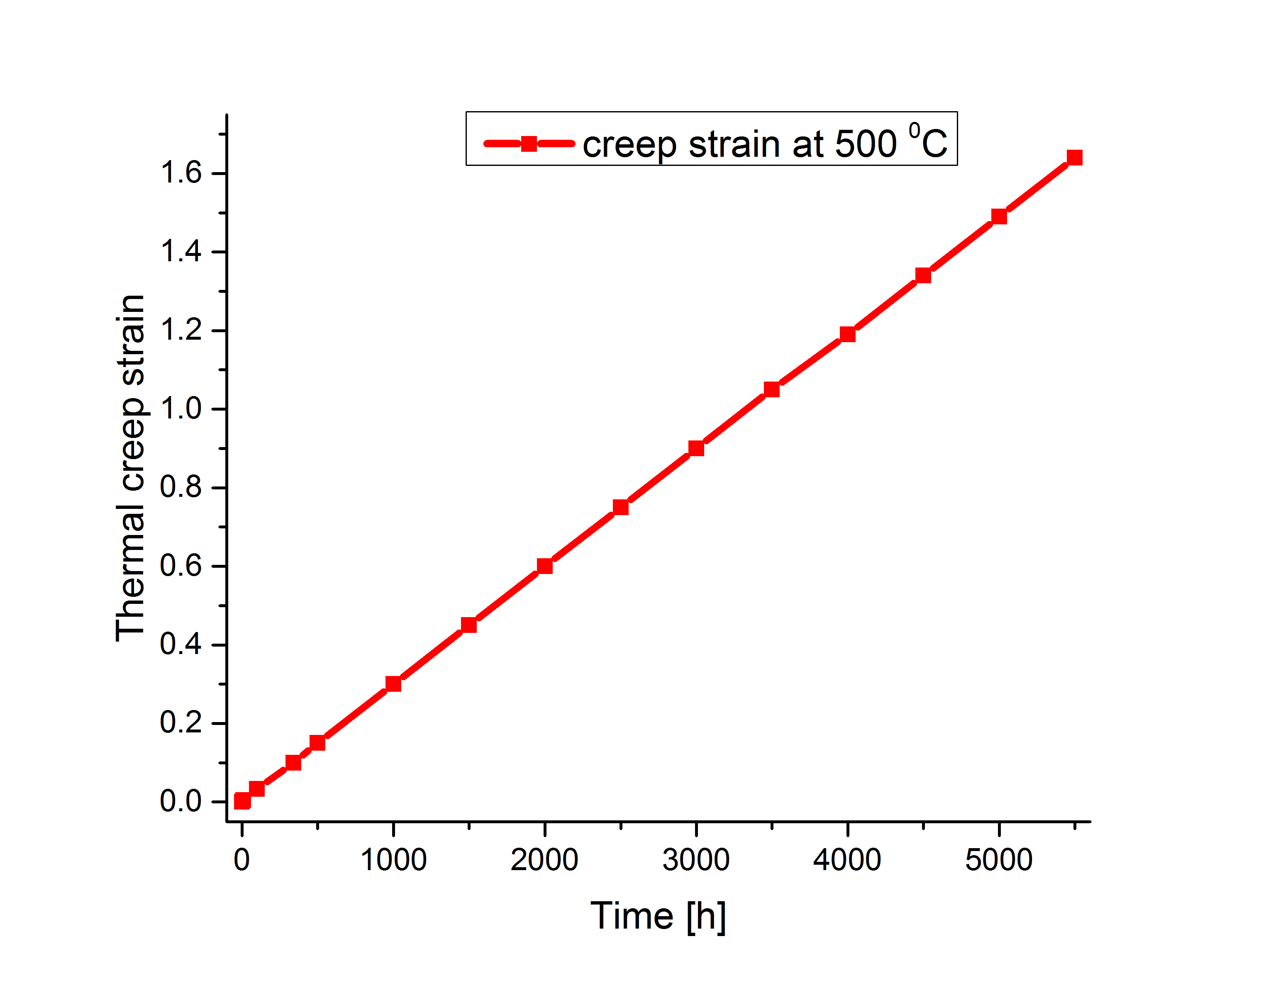
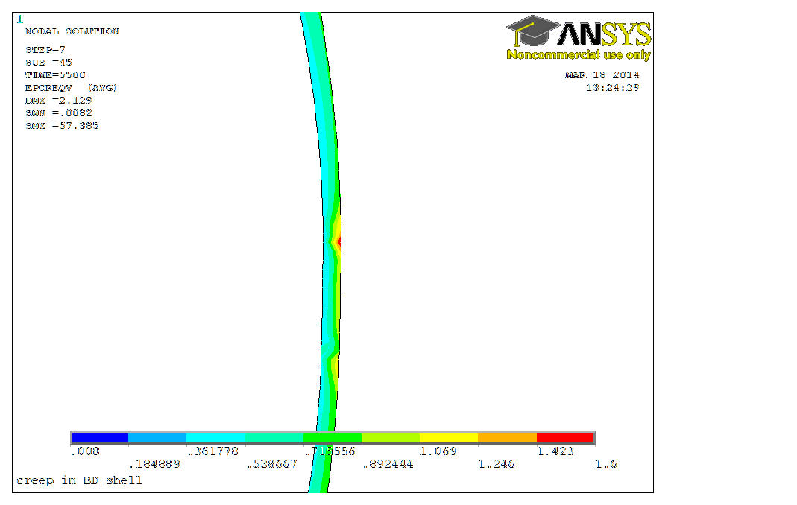
Backup slides
Thermal creep evaluation
Barboza, Neto, Silva “Creep mechanism and physical modeling for Ti-6Al-4V”
Material Science and Engineering A369 (2004) 201-209
Creep strain at failure: 0.32
Corresponds to >1000 h of
operation.
Creep strain after 2 weeks = 0.1
Creep strain after 5500 hours = 1.6
Using Ti-6Al-4V-1B alloy improves
creep properties significantly

Slide 20
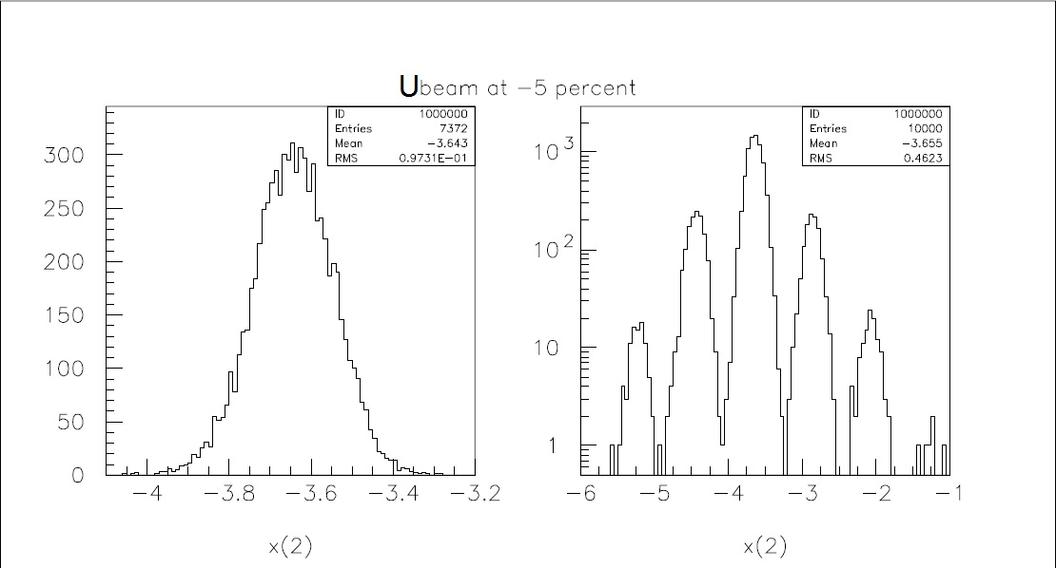
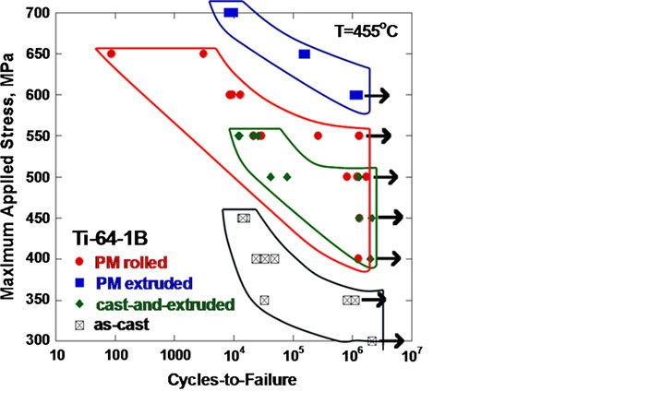
Backup slides
Beam size vs Rigidity
-5% Rigidity U beam profile on the BD shell
(worst case)
SN curves for various
Ti alloys

Slide 21
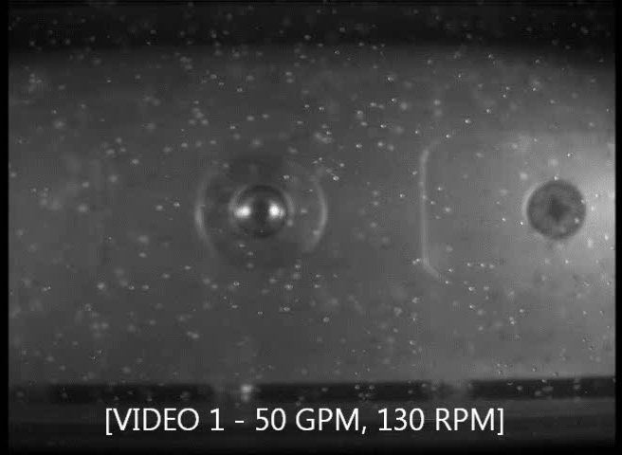
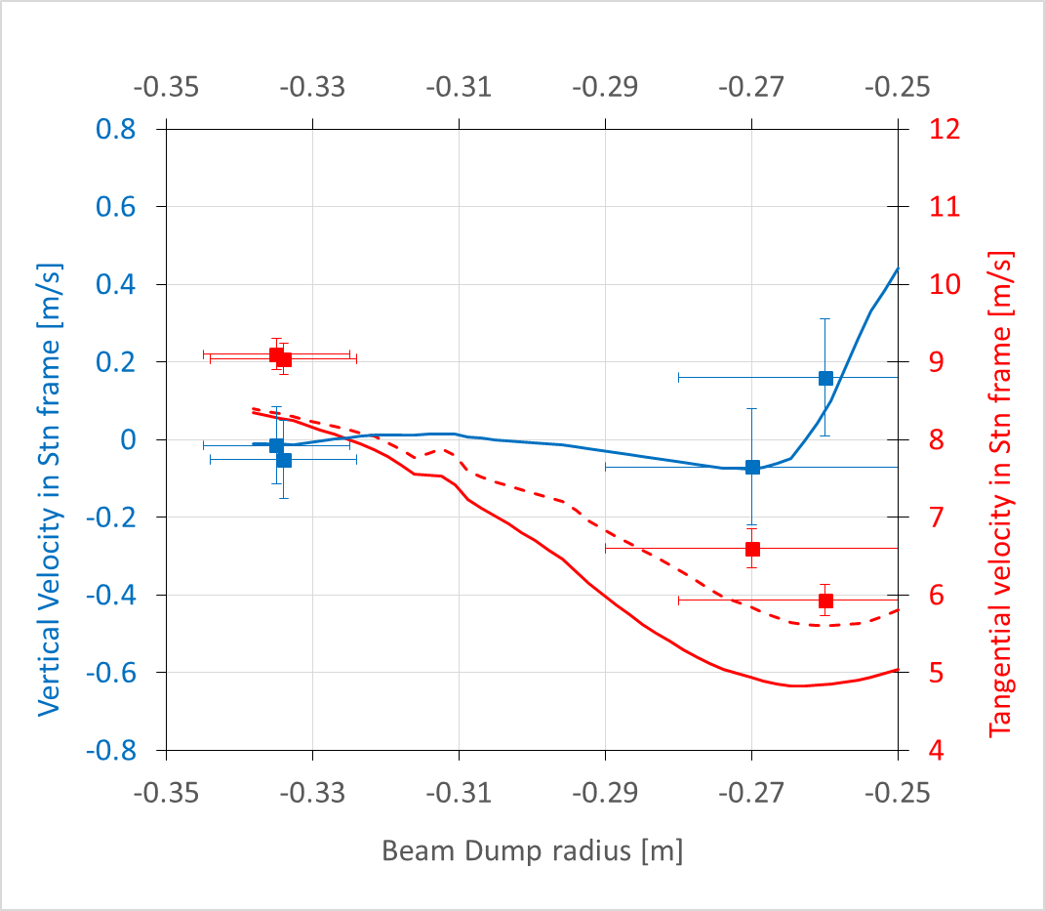
Backup slides
Flow velocity profile verified in flow test with polystyrene beads (ρ = 1.05 g/cm³)
  255 RPM and 60 GPM

Slide 22
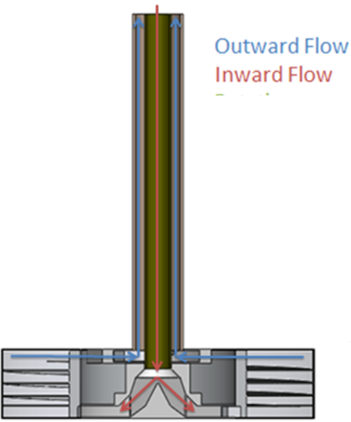
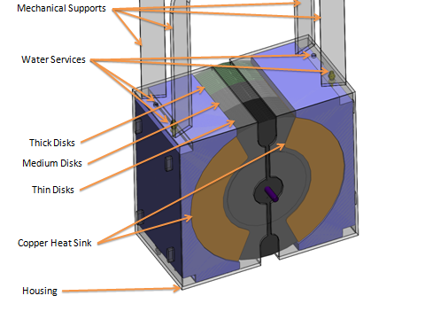
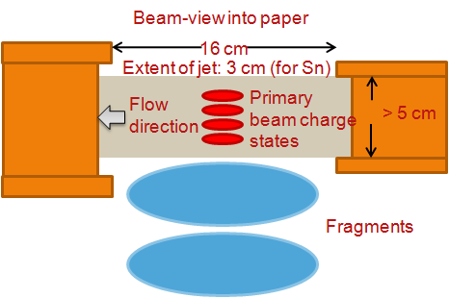
Backup slides
Chosen concept
  Water-filled rotating drum
    Most deposition occurs in water, minimize radiation damage to drum
    Adequate cooling accomplished with water through convection
    Flexibility in material selection to accommodate different requirements
Issues with other options
  Graphite disk beam dump
    excessive sublimation rates
    Insufficient cooling of disk where maximum power deposition occurs (Bragg peak)
    Buildup of inventories
    Minimal flexibility in material selection
  Liquid tin jet
    Significant instability of jet when rapidly heated
    Vaporization -> plating in beam line
    Size/complexity of molten metal loop required
    Few alternate materials for liquid metal jet
Beam

