Slide 1


Design, maintenance and operational aspects of the CNGS target
4th High Power Targetry Workshop
Malmö, Sweden, 2nd – 6th May 2, 2011
M. Calviani (CERN-EN/STI) on behalf of the CNGS Team

Slide 2
Outline
Introduction to CNGS physics case and design guidelines
CNGS target design
  FLUKA simulation optimization
  Engineering design of the target and auxiliary equipment
Operational aspects of the installation: selected topics
  Maintenance of the target system
  Investigation on target motorization failure

Slide 3
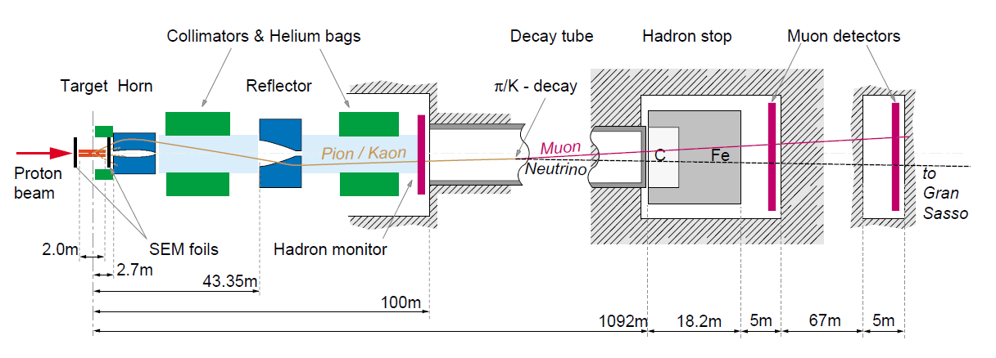
General layout of the CNGS installation
Air cooled graphite target magazine (π/K production)
2 horns (horn + reflector) → water cooled, pulsed with 10ms half-sine wave of 150/180 kA, 0.3 Hz, remote polarity change (focusing of charged mesons)
Decay pipe → 1000m 2.45 m Ø, 1 mbar vacuum (decay in flight)
Hadron absorber → C core + Fe, ~100 kW absorption proton and other hadrons
2 muon monitor stations: μ fluxes and profiles (direction of the ν beam towards LNGS)

Slide 4
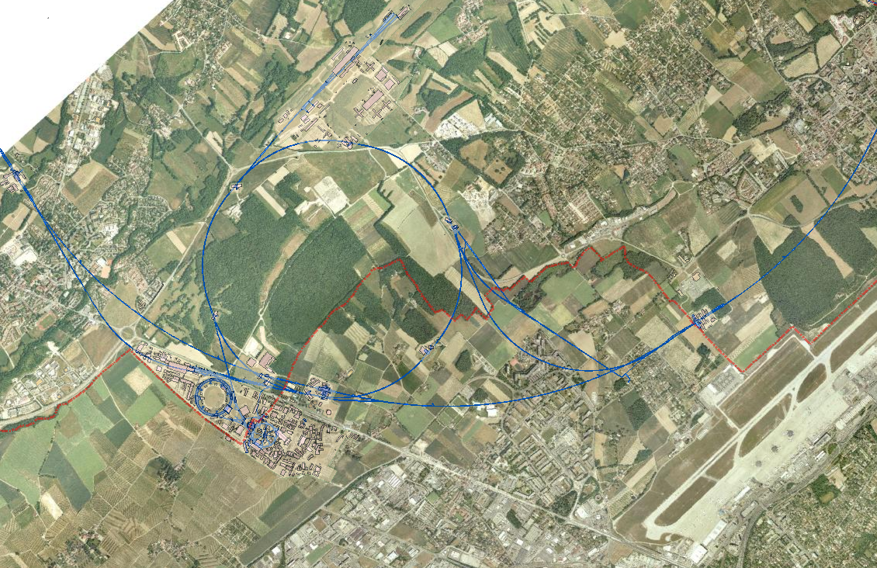
SPS: 2 fast extraction of 400 GeV/c protons every 6 seconds
Nominal 2x 2.4*10¹³ ppp in 10.5 μs interleaved by 50 ms (currently 2x 2.1*10¹³ ppp)
Beam power: ~500 kW (currently 448 kW)
Sigma = 0.53 mm
Ultimate 2x 3.5*10¹³ ppp
North Area and Prevessin site
SPS
Target area
Decay pipe
CNGS
LHC
TI8 LHC injection
TI2 LHC injection
Hadron stop + muon pits
PS and Meyrin site
ν towards LNGS

Slide 5
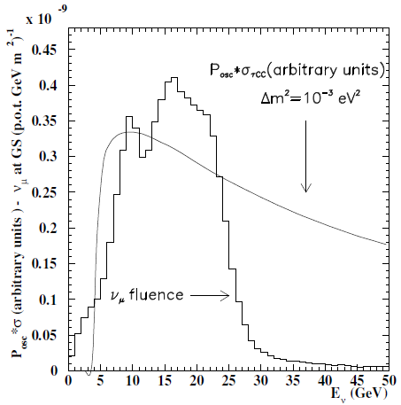
Physics requirement for the CNGS beam
3.5 GeV (threshold for τ production)
CNGS is a long base-line appearance experiment, designed for ν_{μ}→ν_{τ} oscillation search → ν_{τ} appearance in a (almost) pure ν_{μ} beam
The energy spectrum of the ν_{μ} is well matched to R~σ_{τCC}/E_{ν}² at ~17 GeV to maximize the signal rate (ν_{τ} appearance)
Low anti-ν_{μ} and ν_{e} contamination
CNGS approved for 22.5*10¹⁹ POT (5 y with 4.5*10¹⁹ POT/y)
… up to now 10.5*10¹⁹ POT
Few ν_{τ} expected in OPERA and ICARUS detectors

Slide 6
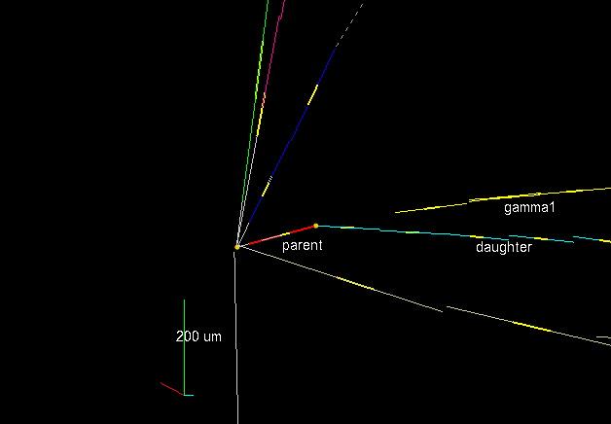
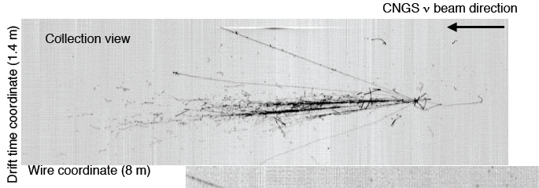
Example of neutrino events in OPERA and ICARUS
OPERA: 1.2 kton emulsion target detector
146000 lead emulsion bricks
First ν_{τ} detected
ICARUS: 600 ton Liquid Argon TPC
High sensitivity and online reconstruction of tracks
arXiv:1006.1623v1 8 June 2010

Slide 7
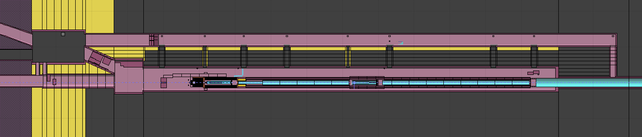
CNGS description with FLUKA
The CNGS beam-line facility is fully described within the FLUKA Monte Carlo code for various purposes:
Optimization of the target design in the initial project stages
Energy deposition in the secondary beam line → mechanical and thermal analysis
Prompt and residual dose rate → radioprotection
Monitor beam response → commissioning and diagnostics (μ distrib. at μ-pits)
Predict neutrino beam energy spectrum/composition at LNGS
TSG4
TCC4
Decay pipe
target
horn
reflector
He bags

Slide 8
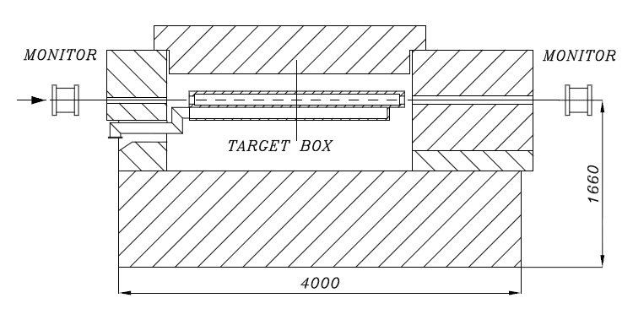
Past experience at CERN
The design of the CNGS target takes advantage of the experience with previous fixed targets at CERN
→ T9 WANF target (CHORUS and NOMAD experiments) (~180 kW beam)
→ 11 Be rods, 3 mm Ø, 10 cm long, spaced every 9 cm, He cooled (forced flow)
Operational experience with the target (e.g. corrosion in humid/radioactive environment)
FLUKA used for beam simulations and comparison with ν-induced CC events in NOMAD
WANF muon pits good agreement for the 3 detector regions
S. Peraire, 1996
Notes:
2x 1.8E13 every 14.4 seconds

Slide 9
Physics requirement of the CNGS target
Provide the highest possible proton interactions
Decrease probability of secondaries reinteraction
For HE ν beams: target needs to be segmented, in order to allow small-angle high momentum secondaries to escape the target with less path length
Target need to be robust to resist beam-induced stresses
Due to particle energy deposition the target must be cooled
With the following technological constraints:
The target should not be cooled by water (avoid mechanical shocks and activation/radioprotection issues)
Material choices should minimize the absorbed beam power and maximize radiation resistance
Target should be replaceable, with in-situ spares

Slide 10
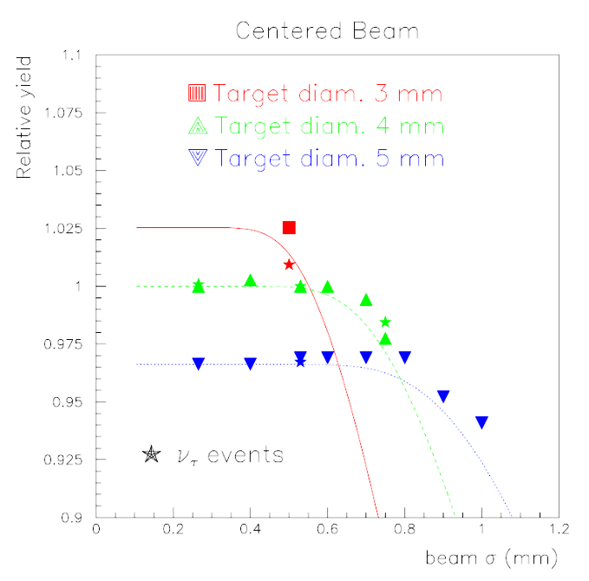
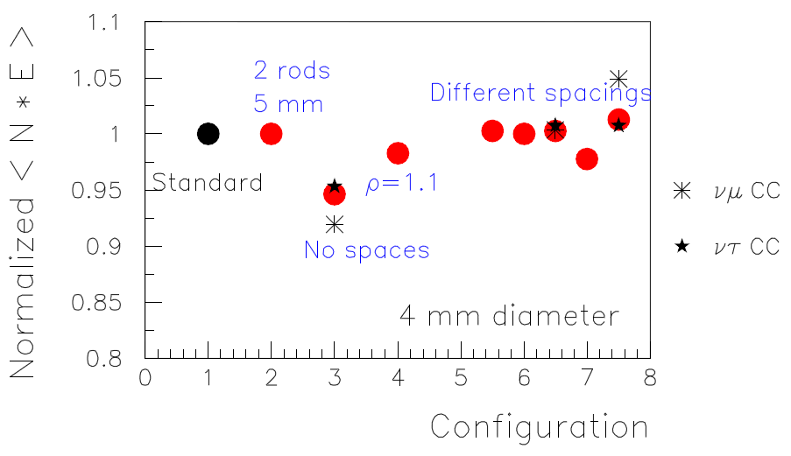
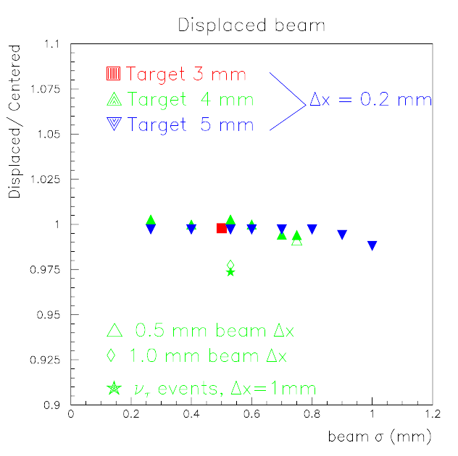
Design optimization of the CNGS target
A thorough study was performed to optimize the physics and engineering of the target unit.
Effect of beam σ and target diameter of π yield
Effect of beam displacement
Effect of target configuration on π yield
3mm comparison with WANF target
σ=0.53 mm is the reference beam
→ Due to proton beam size and target configuration, the alignment of the beam line elements is not “too much” critical for CNGS neutrino fluxes
P. Sala (2001)
Notes:
A variety of alternatives for geometry, configuration and beam size were investigated!

Slide 11
CNGS target rod configuration
100 mm
2 mm gap
Baseline configuration
Not in scale
62 mm
Proton beam
Beam focal point
Total power in rods!
Nominal (4.8*10¹³ p/6s cycle) → 886 W
Ultimate (7.0*10¹³ p/6s cycle)→ 1292 kW
5 mm Ø
508 mm
90 mm
4 mm Ø
Baseline target:
13 graphite rods, 10 cm each for a total of 3.3 λ_{I}
5 mm Ø for the first two (maintain a margin of security → containment of proton beam tails), 4 mm Ø for the others
The first 8 are separated by 9 cm each to better develop meson production, with the last 5 packed to reduce longitudinal smearing in π production (for a better focalization)

Slide 12
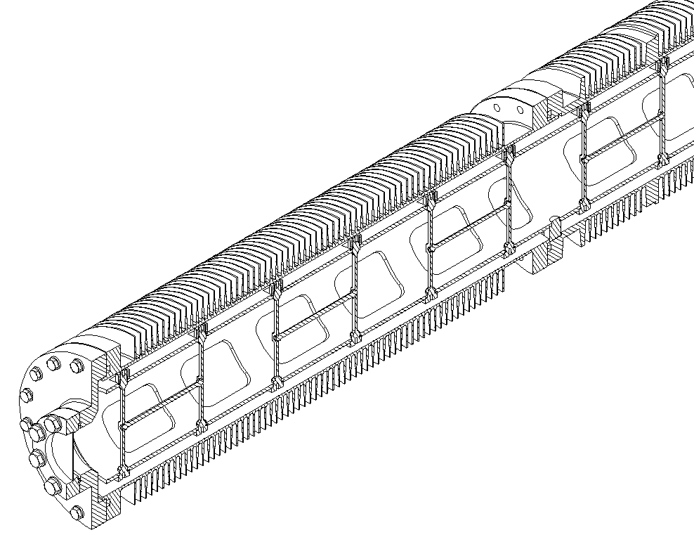
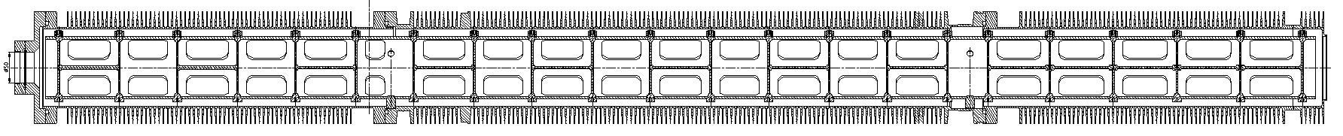
The CNGS target unit
Target unit is conceived as a static sealed system filled with 0.5 bar of He (@cold)
Cooling of the target rods is made by radiation to the Al tube and convection
The target “revolver” is flushed with air which keeps the aluminum temperature <100 ˚C
Sealed cooling finned tube (Al 5083 H111)
Material used for the target
Tube: Al-Mg alloy
Windows: Beryllium
Target support: C-C
Target rod: fine-grain graphite
Upstream window (Be Ø1.5”)
Target support tube (C-C composite)
0.5 bar at room temperature, 1.0 bar at operating conditions
Target rods and support structure
Downstream window (Be, Ø4”)
End cap
Central tube
End cap

Slide 13
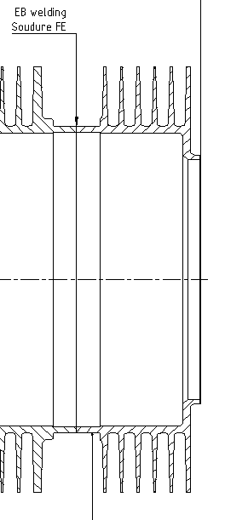
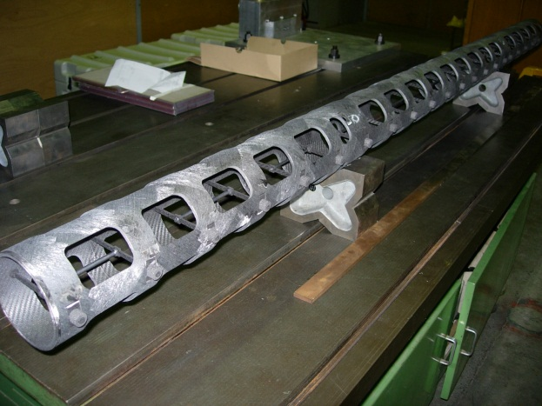
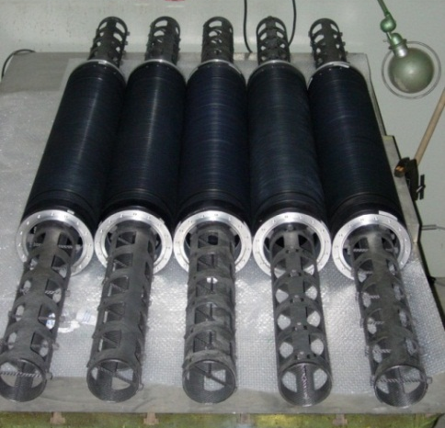
Additional details on the target
Electron beam welding!
The tube has annular fins to enhance the convective heat transfer
  He gas best to keep target wall at lower temperature BUT higher ΔT=76K
  Al anodized to increase radiative heat transport to the tube
Dedicated configuration conceived to limit the heat load on the target itself
Target rods are on a carbon support structure with holes in order to increase thermal exchange
In order to reduce the amount of material (e.g. beam heating and thus mechanical stresses) the exit Be window is e-welded directly onto the Al alloy tube
635 μm Ni-coated Be window (preserve from ambient corrosion) (381 μm upstream)

Slide 14
CNGS target rod configuration (current configuration)
5 units installed in a single target magazine
Graphite target with baseline geometry under He (Graphite 2020PT by Carbone Lorraine)
  Best understood carbon (ρ=1.76 g/cm³) → standard target!
Carbon target with baseline geometry under He (Sintered Carbon SC24 by Sintec Keramik)
C-C composite target with baseline geometry under He (Aerolor A035 by Carbone Lorraine)
  C-C suited for operation at high temperature (thermal shock resistance and low coefficient of thermal expansion) But radiation damage?
C-C composite target with baseline geometry under vacuum (Aerolor A035 by Carbone Lorraine)
  Vacuum in order to address a possible concern of stress cycling on the Be window from thermal cycling of gas
“Safe” target: graphite target with all 5 mm diameter rods under He
  Introduced as a possibility to increase the beam size from 0.53 mm to 0.75 mm
All the materials from the different producers have been tested and analyzed in lab to cross-check the technical specifications
Notes:
Stresses on Be window downstream target: keeping the unit under vacuum rather than filling with inert gas. The gas heats up during beam on periods and then cools down during beam off which lead to repeated bending of windows, hampering the lifetime of Be windows → multiple solution for target

Slide 15
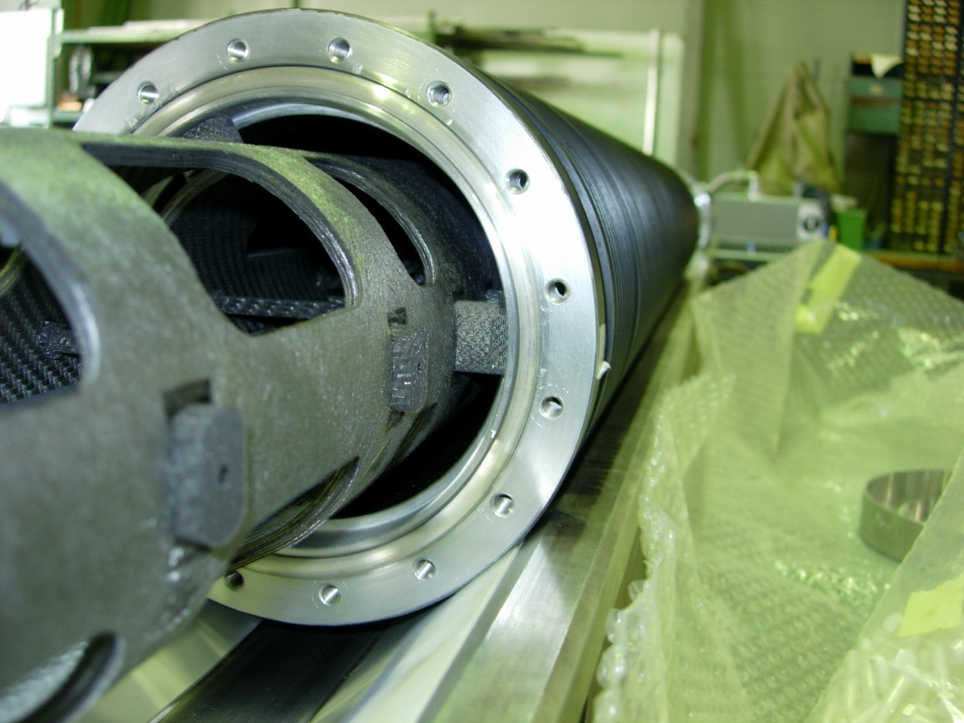
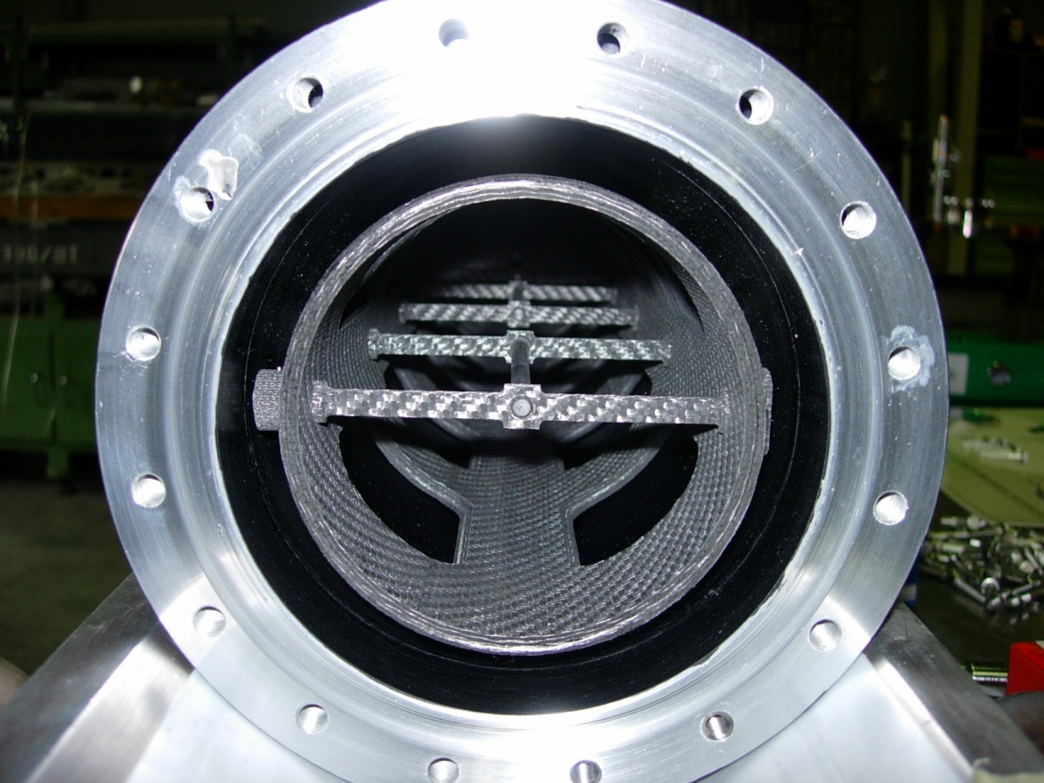
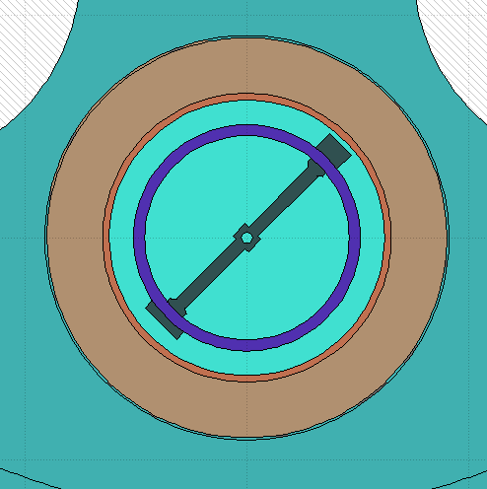
The CNGS target units as built
5 units (1 active + 4 in-situ spare) are hosted in a target magazine
An additional spare magazine is available in case of complete target failure
T_{graphite} ~ 990 ˚C
T_{C-C} ~ 375 ˚C
T_{He} ~ 365 ˚C
Graphite rods
Al external fins
Implementation in FLUKA
C-C structural tube
Al tube, anodized inside

Slide 16
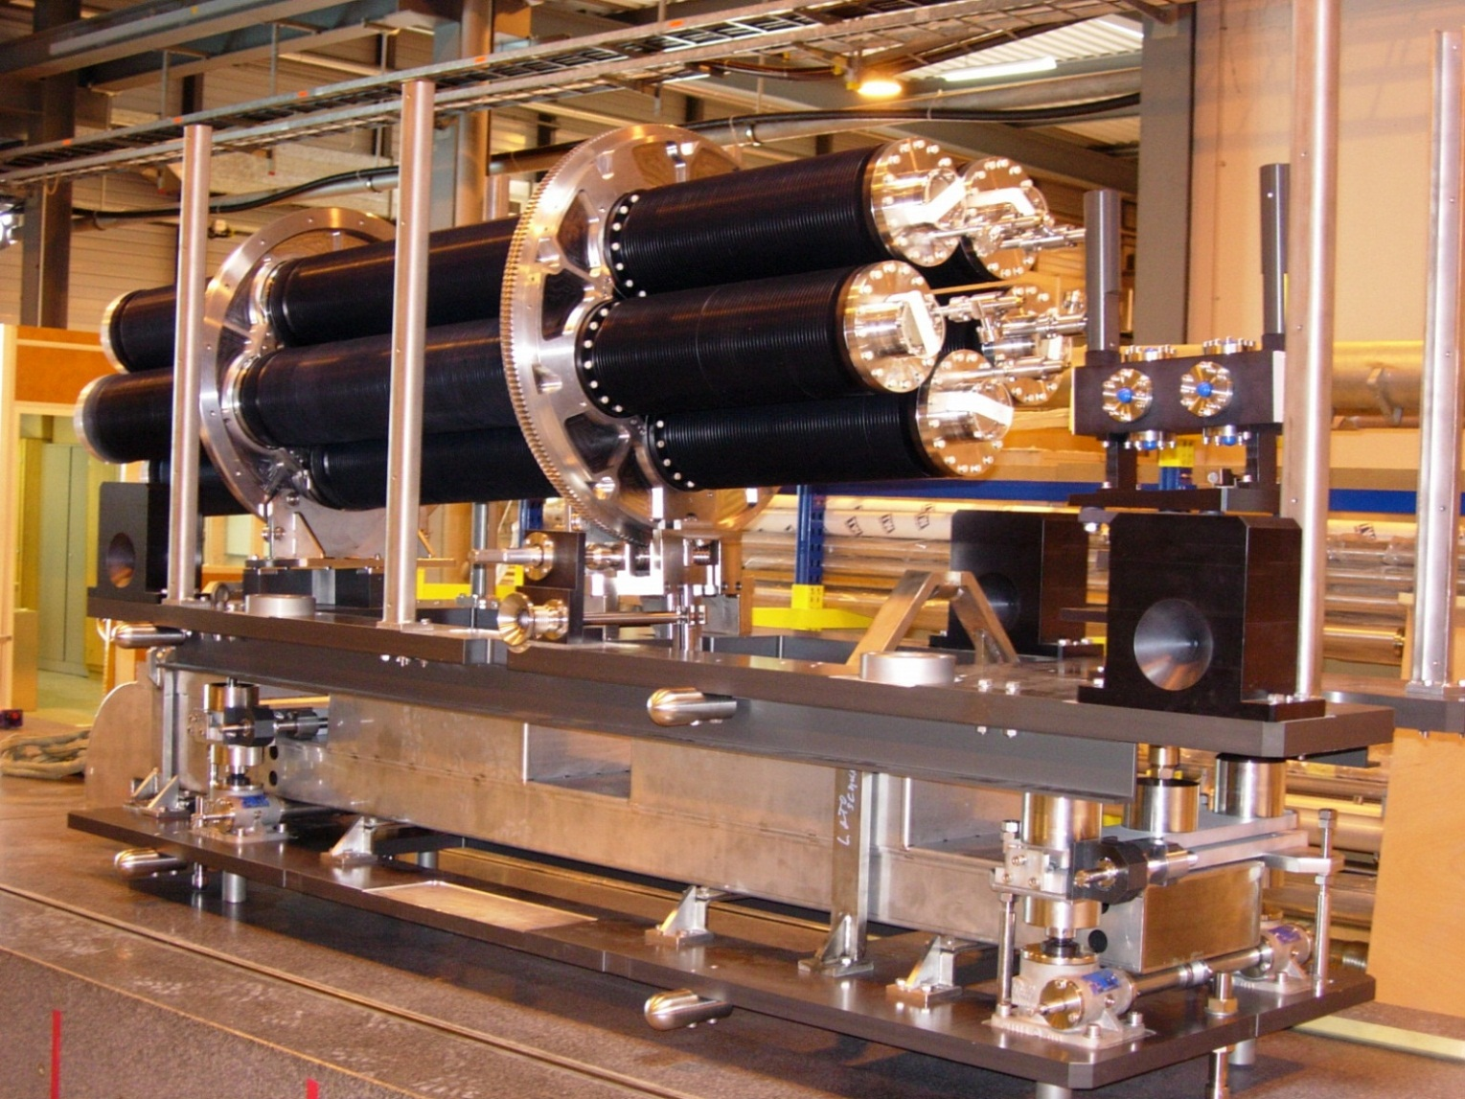
Target unit as built and installed in CNGS
Rotating disks
Target magazine
BPKG
Rotation mechanism
Alignment table (movable)
Base table (fixed)
Target displacement mechanism (lifting jacks)
Notes:
The alignment table is supported by the alignment mechanism made of two vertical lifting jacks
supporting a horizontal linear guide at each end of the table. Jacks and linear guides are driven by four
motors fixed on the outer surface of the cast-iron passage-wall and hosted in recesses inside the marble-side
shielding. A “base table” resting on the target base shielding is placed underneath the alignment mechanism,
allowing its removal by the crane.

Slide 17
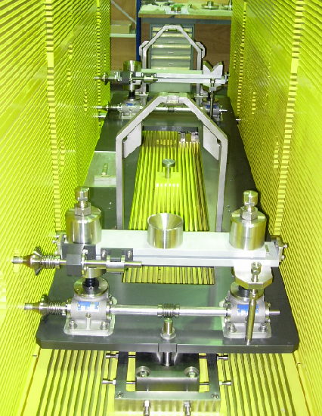
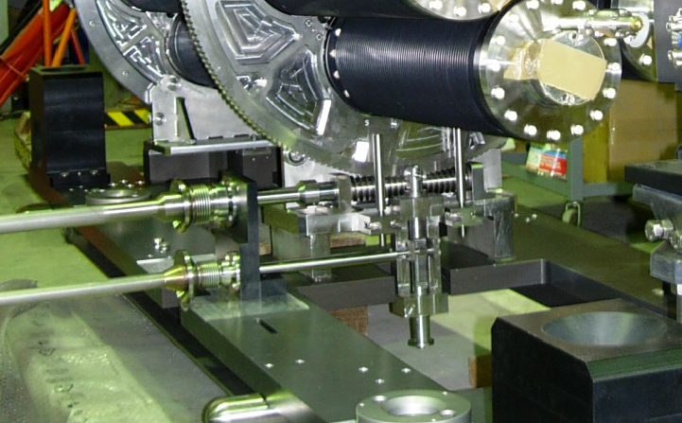
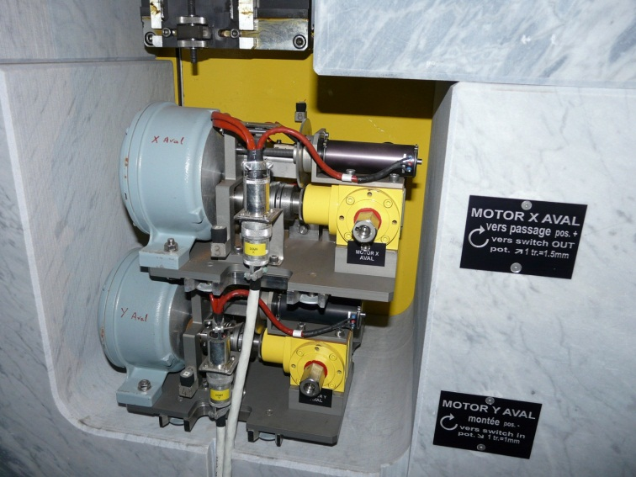
The target base/alignment table
Finned internal shielding
Fast coupling system
Indexing system
Supporting points of the alignment table
Base/alignment table is placed by guiding grooves on three adjustable points
Motorization driving the alignment table is located outside of the shielding
The connection is realized through the shielding by shafts with fast coupling systems
Horizontal movement
Vertical movement
Notes:
Each of the target, alignment and base tables are placed on 3 points (one fixed, one sliding and one free
support point) which allow pre-alignment and accurate positioning.

Slide 18
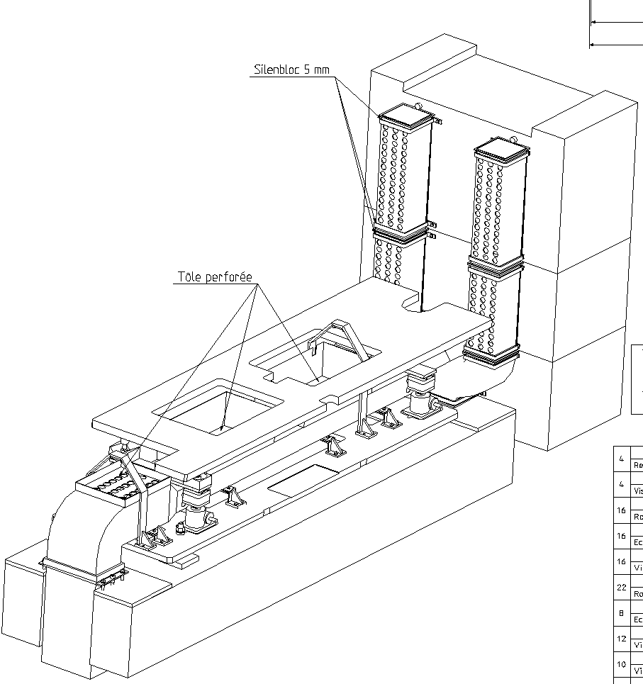
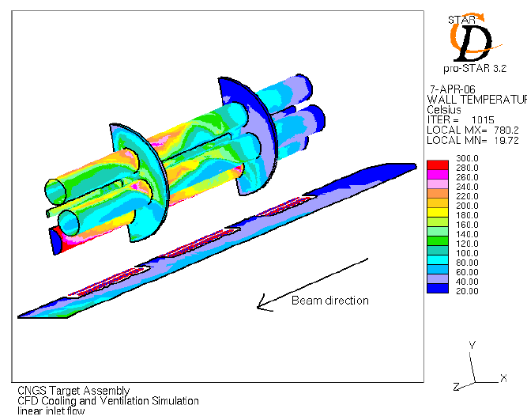
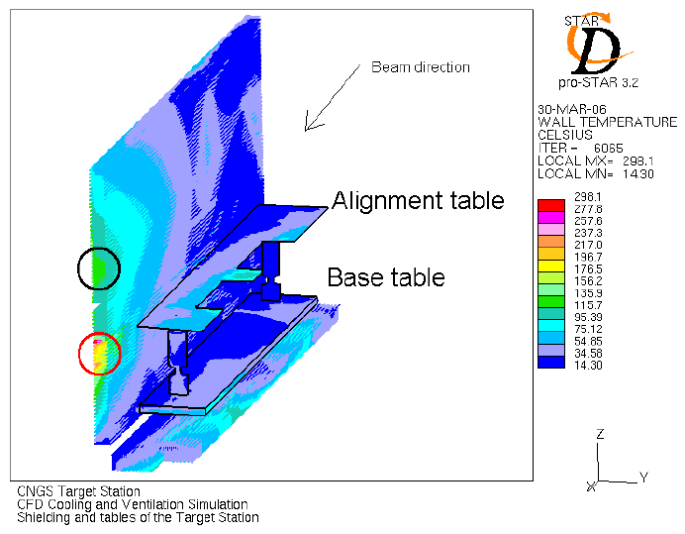
Target assembly cooling
Two main air streams in the TS, not affected by each other (3600 m³/h cooling capacity):
Vertical airflow parallel to the fins of the target assembly → TARGET
  ~6 kW to evacuate (3.4 kW active unit + 1.5 kW spare unit)
Horizontal airflow parallel to the fins of the shielding → SHIELDING
  ~15 kW (~13 kW side wall shielding)
Target station cooling
Proton beam
Target unit cooling
T_{av} = 85 ˚C, T_{max} = 93.5 ˚C (finned case!)
T_{avshield} ~40 ˚C, T_{maxshield} ~300 ˚C
M. Kuhn (2005)
Notes:
The presence of the fins increase the surface by 7x for the target and 10x for the shielding walls!

Slide 19
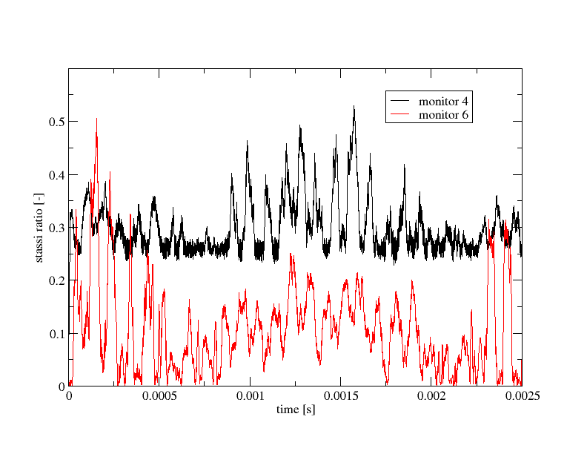
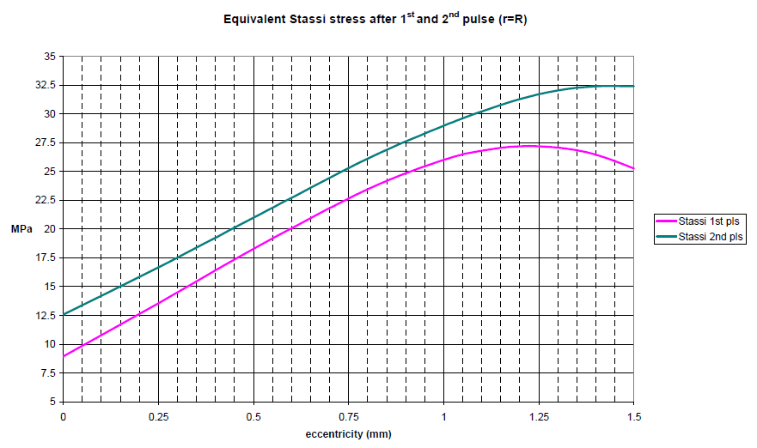
Stresses on the CNGS target rods
A critical point for CNGS is the possibility to receive off-axis beam
Worst loading conditions (1.5 mm OA, ultimate intensity, cold target, no damping)
Stassi stress ratio (Stassi equivalent stress/tensile strength) employed for design consideration
Temperature increase & boundary conditions → dynamic stresses on the rods → rapid transversal vibration
Stassi ratio always lower than 0.7 (safety factor of 1.5!) for single bunch
Beam stability on target → well within these limits…
Max. Stassi eq. stress found for 1.23 mm OA = 27.1 MPa
Time for equilibrium is > than bunch spacing → effect of the 1st bunch still present when the 2nd comes
32.4 MPa at 1.5 mm OA → Stassi ratio ~0.89
L. Massidda, CRS4, 2005, A. Bertarelli, CERN, 2003
Notes:
The Stassi stress criterion is adopted to evaluate the stress state in the structure and the Stassi ratio in particular. This design parameter is defined as the ratio betwee the Stassi equivalent stress and the tensile strength of the material

Slide 20
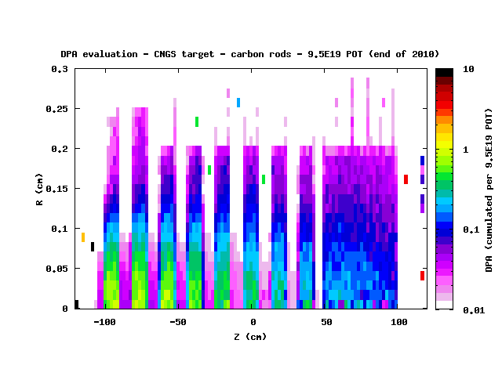
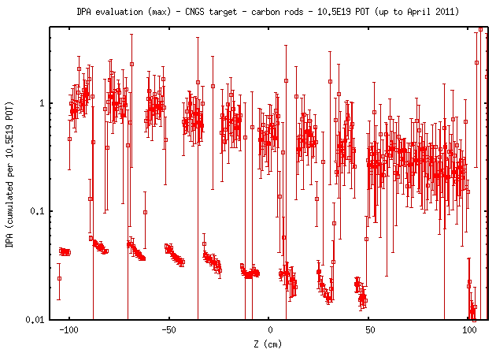
DPA evaluation by FLUKA of the CNGS target rods
FLUKA adopted to evaluate the DPA on the target graphite material
~1.5 DPA for the first 3 rods assuming 10.5*10¹⁹ POT (~0.2 mm radius)
Expected ~3 DPA at the end of expected CNGS run
Shrinkage and reduction of thermal conductivity (higher stress) → minimized by operating at high T
Operational T favors annealing and reduction of imperfection due to amorphous graphite
No apparent reduction in muon yield observed from 2008 to now (E. Gschwendtner, 2011)
Tests performed at BLIP (BNL) show no damage at 5.9*10²⁰ POT in argon atmosphere of several type of graphite (P. Hurh, HB2010)
1 DPA

Slide 21
Structural limits of the CNGS target
Mechanical limits: dynamic (beam time structure) and static stresses (beam profile)
Thermal limits: determined by cooling system
Radiation damage: might lead to defects and target failures
Dynamic stresses → spreading the beam in more batches and increasing the spacing between extractions → up to 1*10¹⁴ p/cycle
At this stage, target cooling would be the limiting factor:
  Graphite erosion by sublimation (can be an issue from ~1.5 MW)
  Degradation of helicoflex seals
Secondary beam line elements (horn, HS, DP)
RP limit
CNGS working point
Nominal CNGS
4.8*10¹³ p/6s
1.38*10²⁰ pot/y
7.6*10¹⁹ pot/y
4.56*10¹⁹ pot/y
~510 kW
200d operation
200d operation, 55% efficiency
200d operation, 55% efficiency,
60% CNGS sharing
Ultimate CNGS
7.0*10¹³ p/6s
~750 kW
Design limit for target, kicker, instrumentation
M. Meddahi et al., CERN-AB-2007-013

Slide 22
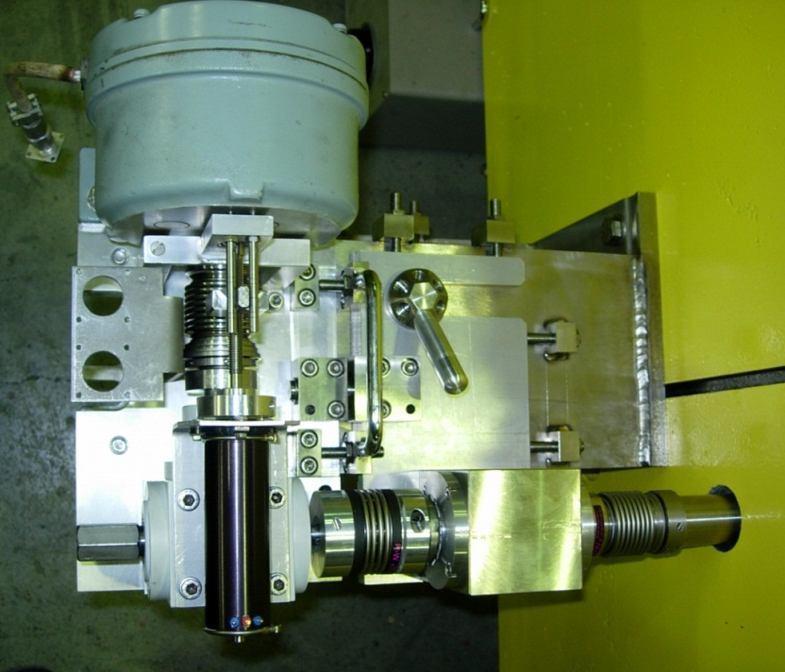
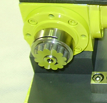
Target rotation system failure – radiation induced effects on material
Usual yearly maintenance of the target unit includes(d):
Alignment motor maintenance, DC motors with torque limiter outside the shielding block → 5 mm, precision of 100 μm
Rotation of the target magazines to 1) check the remote system movement capability and 2) to reduce formation of oxides in the bearings
During inspection/maintenance in March 2009 (@1.94*10¹⁹ POT):
Corrosion residues observed in the motorization elements (expected)
Increased torque in the magazine rotation motor (not expected!)
Motorization block
Fast coupling system
A thorough target inspection has been performed in April 2009

Slide 23
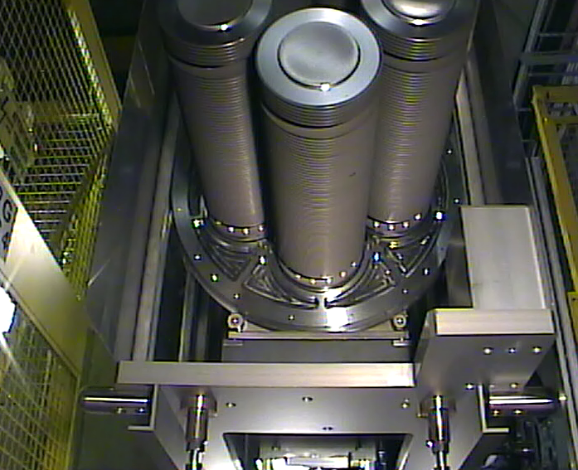
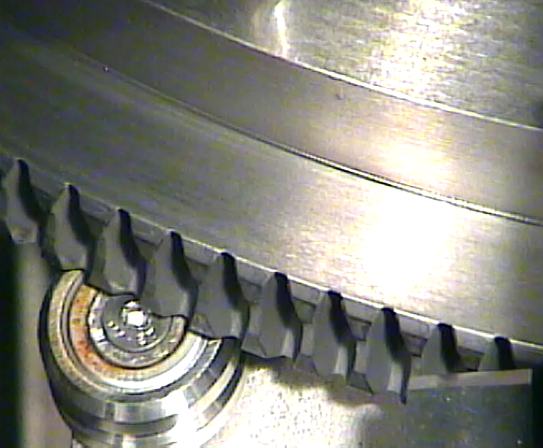
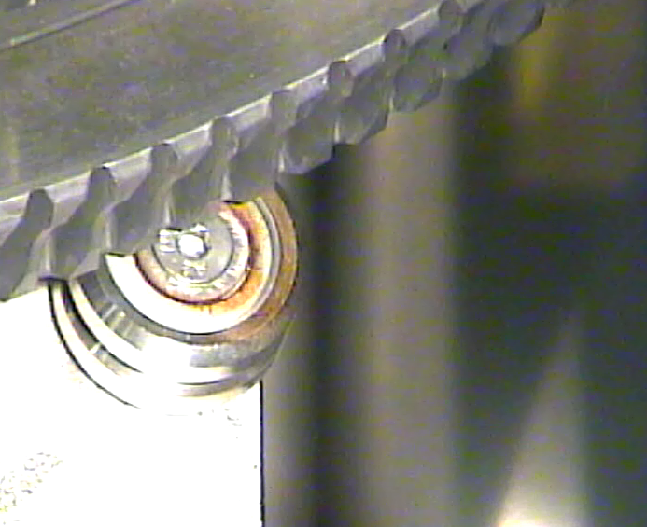
Target in-situ inspection – April 2009
Downstream T40 target looking upstream
The target has been removed from the fixed shielding
Investigation of the rotating magazine via remote-controlled webcam-endoscopy
All the ball-bearings for target rotations have sign of rust
3 moves (with difficulties) when the barrel moves
1 (downstream) does not move at all
In-situ measured torque of ~30 N*m vs. a design value of 8 N*m

Slide 24
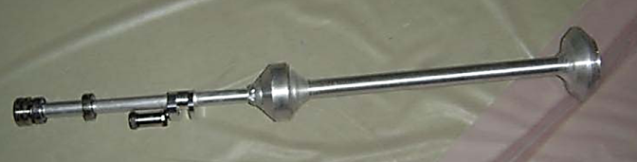
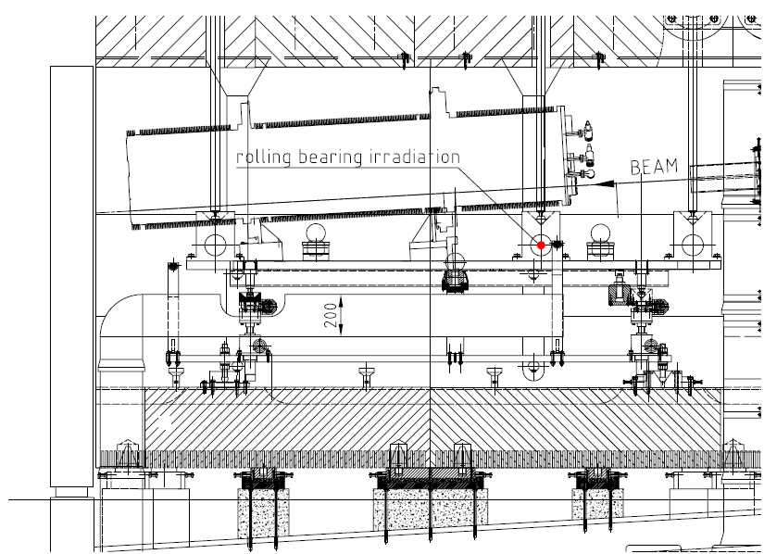
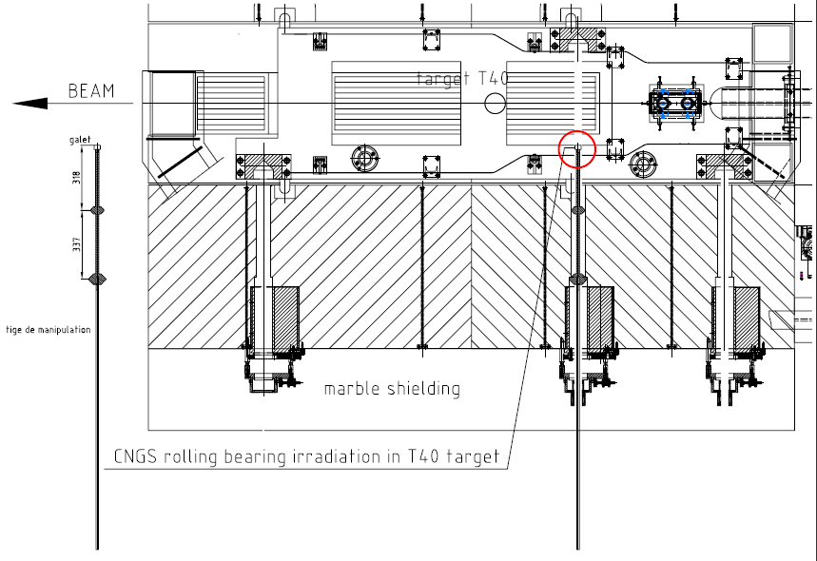
Ball bearings irradiation in the CNGS target
Material for the original bearings:
Martensitic SS 440C (inner & outer races)
Martensitic SS X46Cr13 (balls)
Lubricant (YVAC3) and anti-dust cage used
New bearings ordered in 2009 from the original manufacturer without lubricant and anti-dust cage
→ Installed in CNGS in July 2009 for irradiation on a specially designed bar
Top view
Lateral view
Notes:
… the grades containing the lowest chromium, the highest carbon and sensitized, can be more rapidly attacked if a strong HNO₃ environment develops

Slide 25
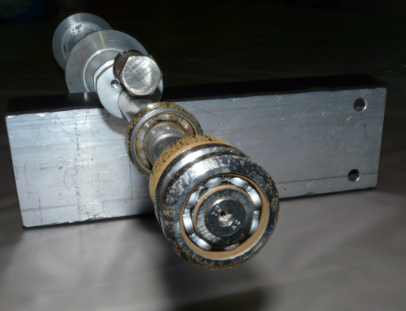
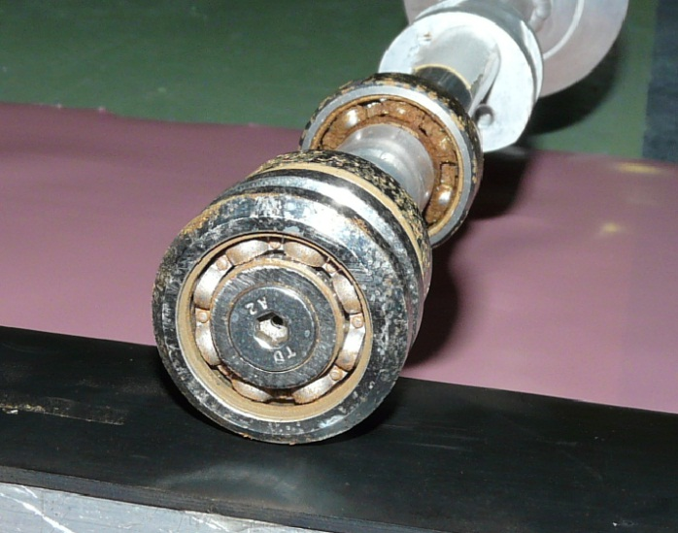
2010/2011 observations
End of 2009
2.7*10¹⁹ POT
~1.1 MGy
End of 2010
6.7*10¹⁹ POT (cum.), 2.7 MGy
Observations:
Significant rust/pitting corrosion present in both cases ???
Very difficult to turn the bearings, >>10 N*m estimated
Low grade of X46Cr13 likely the cause of the observed failure (no alloying element, low Cr/high C content)
Next steps:
Spare target with different ball bearings:
  Complete ceramic type – Si₃Ni₄ or ZrO₂
  “Hybrid”, with ring in Cronidur 30/Alacrite 554 and spheres in Si₃Ni₄.
Testing of these bearings in CNGS (>June 2011)
If a target failure occurs:
Move manually (dose …)
Move with a motor
Risk of braking the coupling element
Exchange with spare target magazine
Notes:
High carbon content in the 440C alloy might increase precipitation of carbides./
431C alloy: Cr 15-17%, C 0.20%, with Ni to improve corrosion resistance
440C alloy: Cr 16-18%, C 1.20% (high!) → possibility to precipitate carbides
Alacrite 554 (CoCr30W8)

Slide 26
Conclusions
CNGS is in operation since 2006
  It has received up to now 10.5*10¹⁹ POT, out of the approved 22.5*10¹⁹ POT, performing very well (no target exchange needed)
The target design has drawn experience form past CERN fixed targets, with increased challenges due to the high proton beam power (510 kW → 1.5 MW possible)
Operational issues encountered in operations are similar to those observed at other high power neutrino facilities
An upgrade of the spare target will be performed to prepare for a possible target failure

Slide 27
Thanks a lot for your attention!

Slide 28
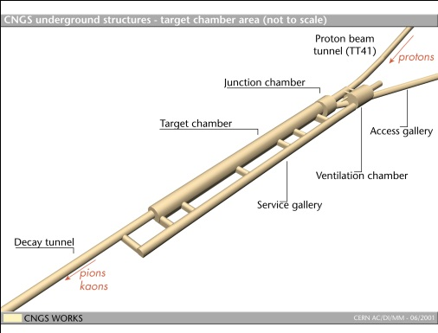
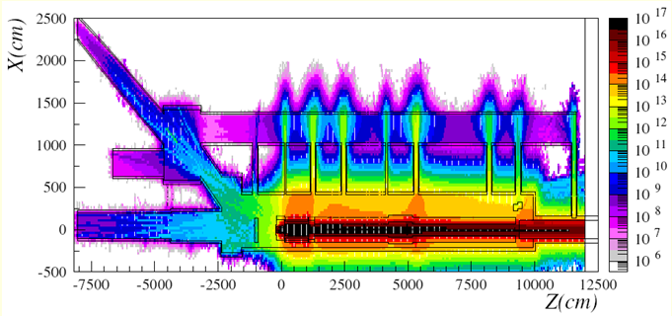
Radiation on electronics issue (1/2)
CNGS installation is deep underground (~60 m below surface level) → no surface building above CNGS target area
A large fraction of electronic is located in the tunnel area
During CNGS run in 2007 (after 7.9*10¹⁷ pot)
Failure of ventilation system installed in the CNGS tunnel area due to radiation effects in the control electronics (COTS) (SEU due to high energy hadron fluence)
Ventilation unit control electronic in the service gallery
High-E (>20 MeV) hadron fluence for a nominal year
(10⁷-10⁹ HEH/cm²/y)
Operation stopped when a fluence of only 1-5*10⁷ cm⁻² was reached
L. Sarchiapone, A. Ferrari et al., 2008

Slide 29
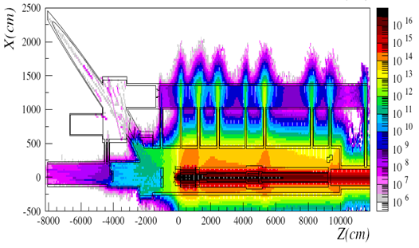
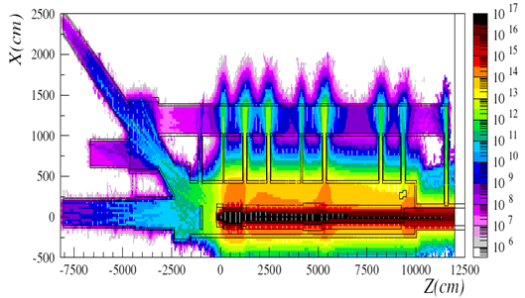
Radiation on electronics issue (2/2)
Modifications during 2007/2008 shutdown
Move as much electronics as possible out of the CNGS tunnel area
Create radiation safe area for electronics which needs to stay in the CNGS areas → massive shielding (movable plugs + chicane) added!
2006/7 10⁷-10⁹ HEH/cm²/y
From 2008: <10⁶ HEH/cm²/y
L. Sarchiapone, A. Ferrari et al., 2008
Accumulated dose not a problem for operation → HEH/n_{th} effects on COTS electronics are a problem to be addresses since the beginning in the design of high power hadron machines!

Slide 30
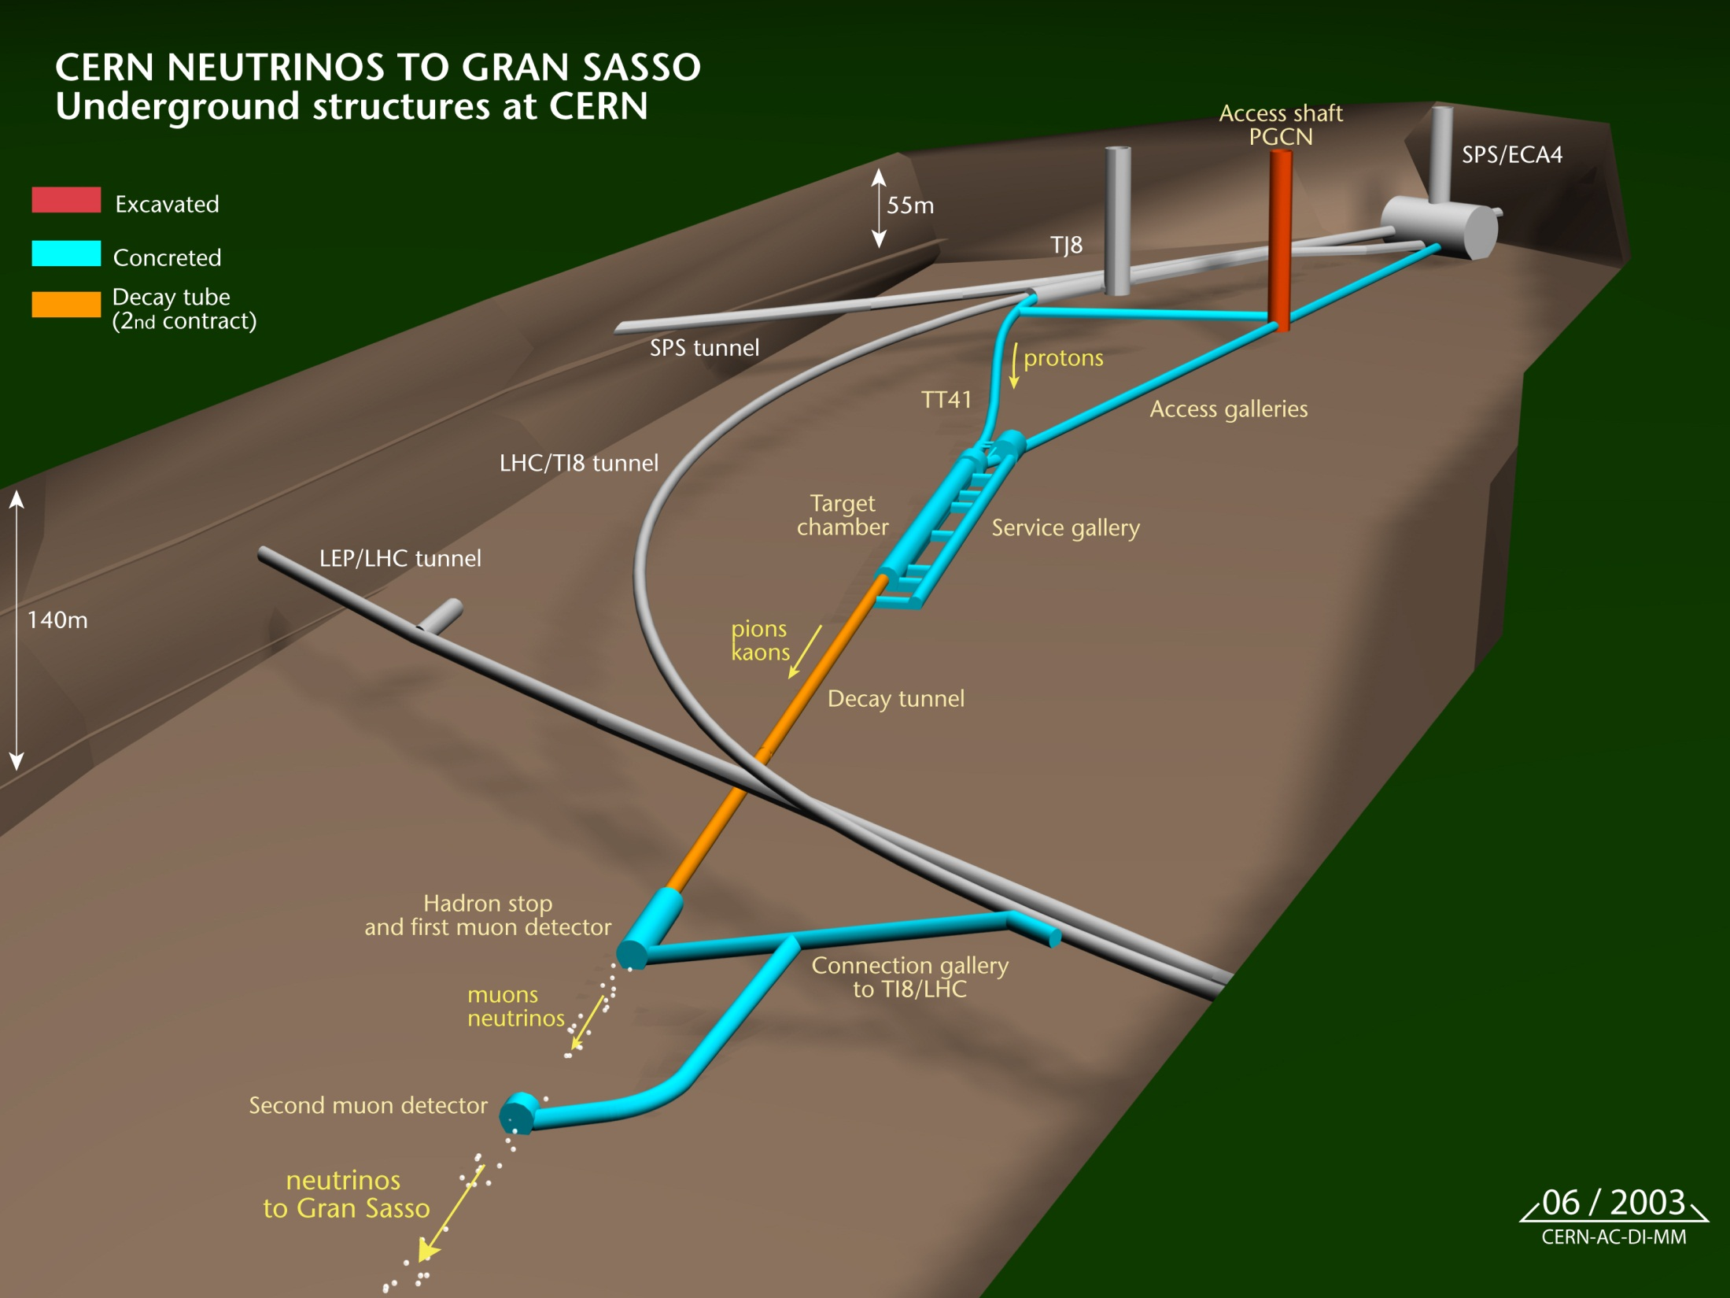
Target
Horn + Reflector
SPS: 2 fast extraction of 400 GeV/c protons every 6 seconds
Nominal 2x 2.4*10¹³ ppp in 10.5 μs interleaved by 50 ms (currently 2x 2.2*10¹³ ppp)
Beam power: ~500 kW
Sigma = 0.53 mm
Ultimate 2x 3.5*10¹³ ppp

Slide 31
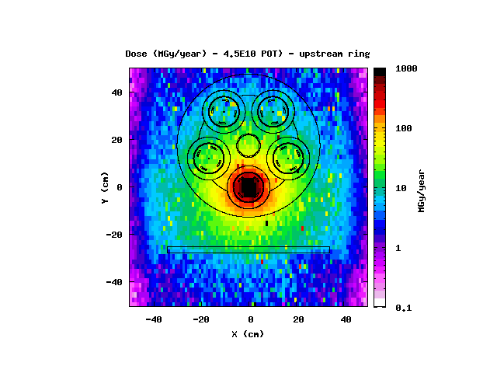
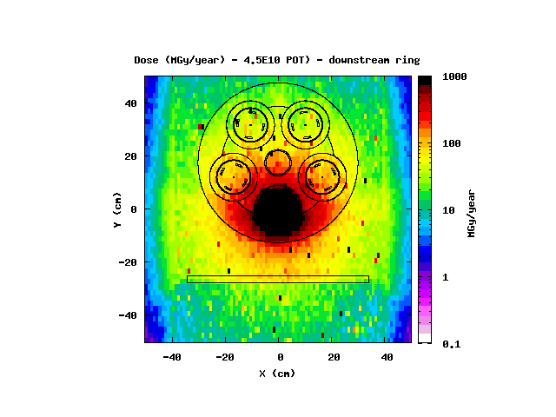
FLUKA - accumulated yearly dose at target
~20 MGy/nominal year (upstream bearing)
~150 MGy/nominal year (downstream bearing)
Failure of the bearings become evident at ~60 MGy cumulated dose (1.94*10¹⁹ pot)
Test bearings are in a zone where the radiation is ~2 MGy/nominal year

Slide 32
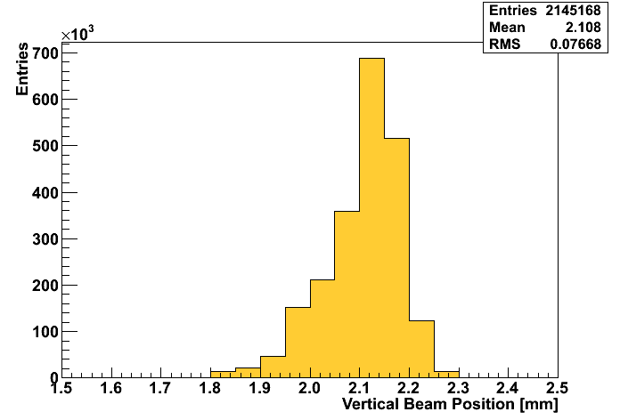
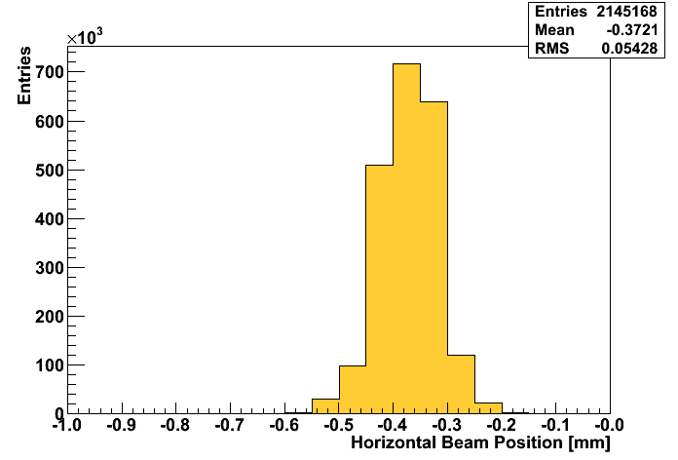
CNGS POT
Year | POT/yr
2006 | 0.08*10¹⁹
2007 | 0.08*10¹⁹
2008 | 1.78*10¹⁹
2009 | 3.52*10¹⁹
2010 | 4.04*10¹⁹
2011… | ~1*10¹⁹
Total | 10.5*10¹⁹
Nominal CNGS working point = 4.5*10¹⁹ POT/y
Received 10.5*10¹⁹ up to now
CNGS approved for 22.5*10¹⁹ POT
Before the CERN 1st LS (2013/14) CNGS would have accumulated ~18.9*10¹⁹ POT
Operation after this date will be addressed in 2012
Beam on target position stability over the entire run (H/V)
→ in agreement with the requirements of the design study (stresses on the target)
E. Gschwendtner, 2011
E. Gschwendtner, 2011
RMS=77 μm
RMS=54 μm
Vertical beam position [mm]
Horizontal beam position [mm]

Slide 33
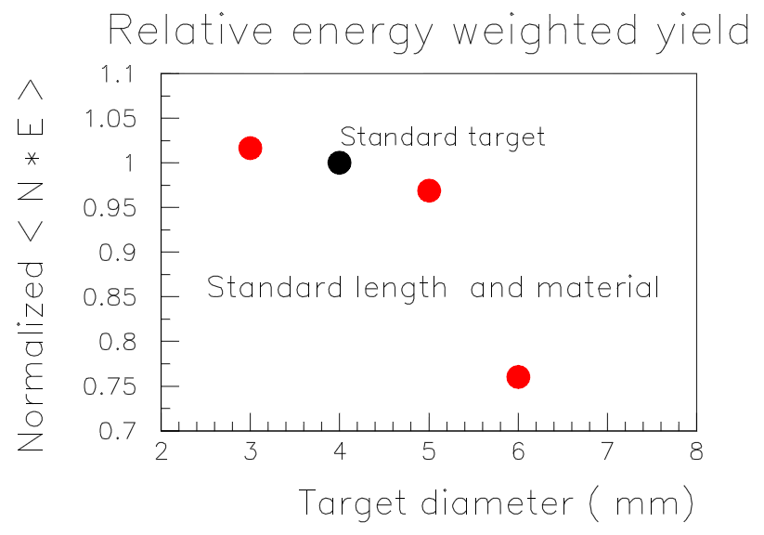
Physics requirement of the CNGS target
Physics requirement from the CNGS target:
Provide the highest possible proton interactions
Decrease at the same time probabilities of secondaries reinteraction:
→ For HE ν beams the target needs to be segmented, in order to allow small-angle high momentum secondaries to escape the target with less path length
Physics optimization of the CNGS target
Overall length 2m, C length 1.261m “standard target in these figures”
Effect of target size (on π yield)
Effect of target configuration (on π yield)
all 4 mm Ø
P. Sala (2001)
P. Sala (2001)

Slide 34
General design constrains – CNGS target
Target rods segmented and thin to maximize pion production and reduce secondaries reinteraction
Target need to be robust to resist beam-induced stresses
Due to particle energy deposition the target must be cooled
With the following technological constraints:
The target should not be cooled by water, in order to avoid mechanical shocks and increases activation/radioprotection issues
Material choices should minimize the absorbed beam power and maximize radiation resistance
Target should be replaceable, with in-situ spares
The target station should allow remote handling by a crane
The target station should allow remote calibration of the alignment table
L. Bruno

Slide 35
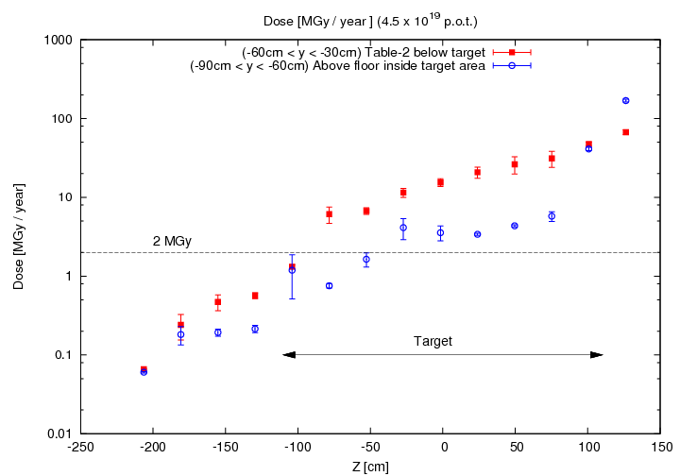


Yearly accumulated dose – CNGS target
Transversal cut, beginning of target
Transversal cut, end of target
Dose below target along the beam direction
K. Roeed, 2011

Slide 36


Slide 37

hBN collimator
Air inlet

Slide 38

Proton beam
Flow separator

Slide 39


Slide 40


