Slide 1
Design, optimization and operation of beam intercepting devices for CERN’s fixed target physics
5th High Power Target Workshop, FNAL
M. Calviani (CERN)
With contribution from: R. Losito, A. Perillo-Marcone, V. Venturi, C. Torregrosa, V. Vlachoudis, R. Catherall, A. Ferrari, R. Folch, T. Stora, R. Jacobsson and many others

Slide 2
Outline
CERN’s fixed target physics program
Review of CERN’s accelerator complex
Low-Z devices
High-Z devices
Conclusions

Slide 3
Review of CERN’s fixed target physics
CERN has a long and varied history of fixed target experiments, contributing to a diverse program of research
  Essential part of the lab’s scientific program
Hadrons physics (COMPASS, NA61...)
Nuclear physics (ISOLDE)
Neutron physics (n_TOF)
Antimatter physics (AD)
Neutrino physics (WANF, CNGS...)

Slide 4
Review of CERN’s fixed target physics
Some of the challenges:
  Cohabitation with collider physics and beam sharing
  Different facilities operating at the same time
  High intensity pulsed beams
  High reliability required

Slide 5
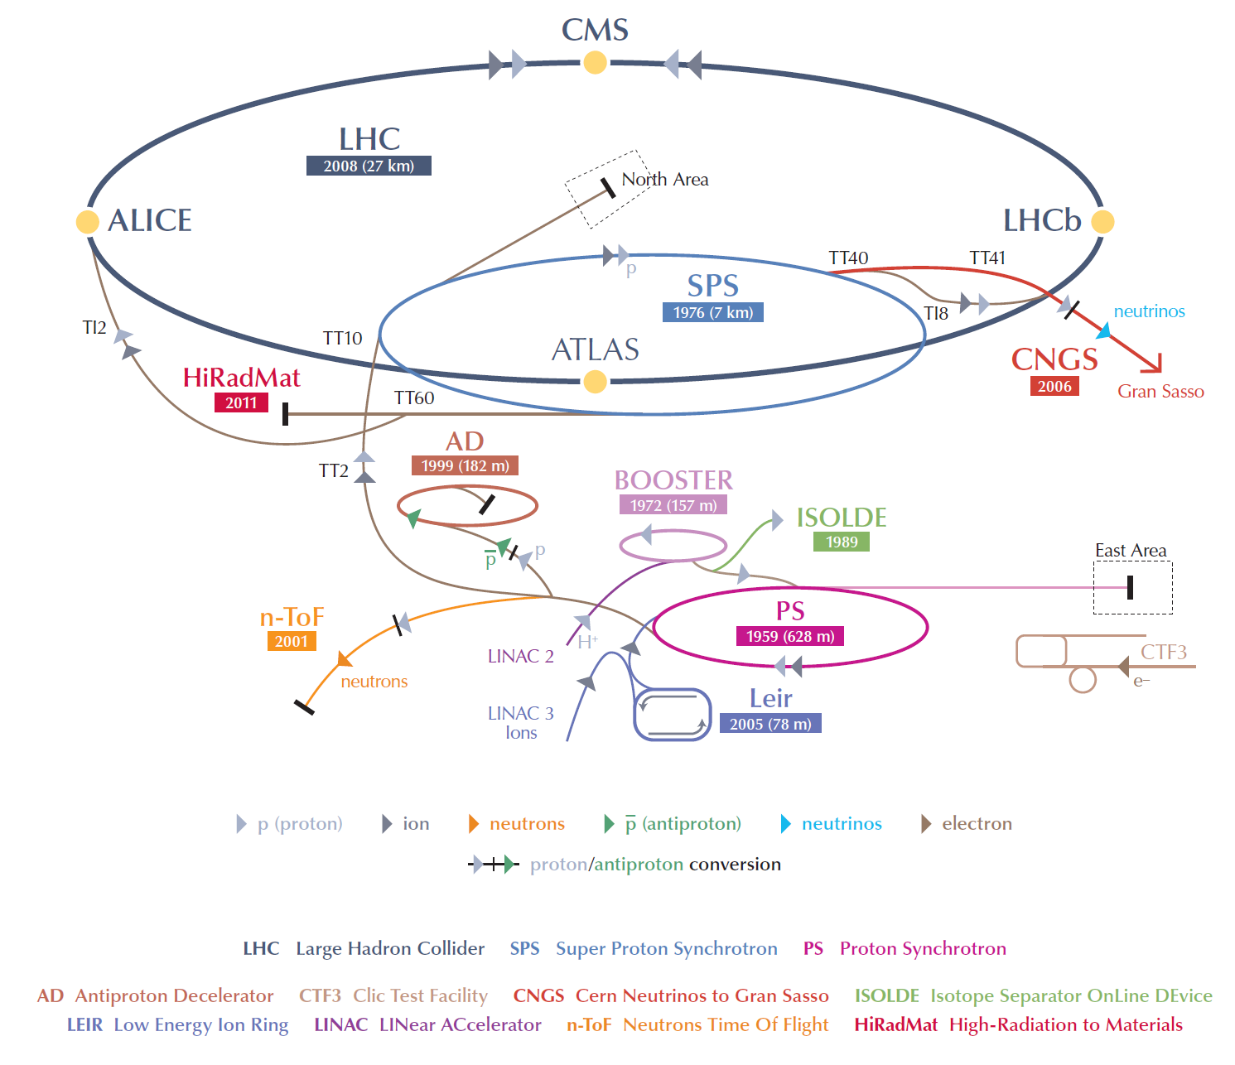
CERN’s accelerator complex
~10¹⁵ proton/year to LHC
>10²⁰ protons/year to fixed targets

Slide 6
Low-Z targets
Operational experience:
  North Area general purpose targets
  CNGS HE neutrino target
Future projects
  CENF LE neutrino target

Slide 7
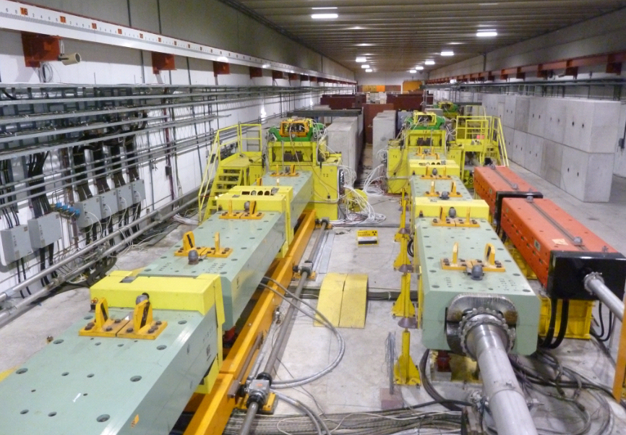
North Area targets
4 multipurpose target stations
  Beryllium S-200-F
  Slowly extracted 400 GeV/c
  2.5*10¹³ p/spill → 1.6 MJ/spill
  Beam energy ~330 kW over spill, ~100 kW over supercycle
TCC2
T4
T2
Why beryllium?
  Most of the time physics requires mixed hadron/electron beams → largest X₀/λ_{int} are preferred
  Target lengths from 5 to 50 cm

Slide 8
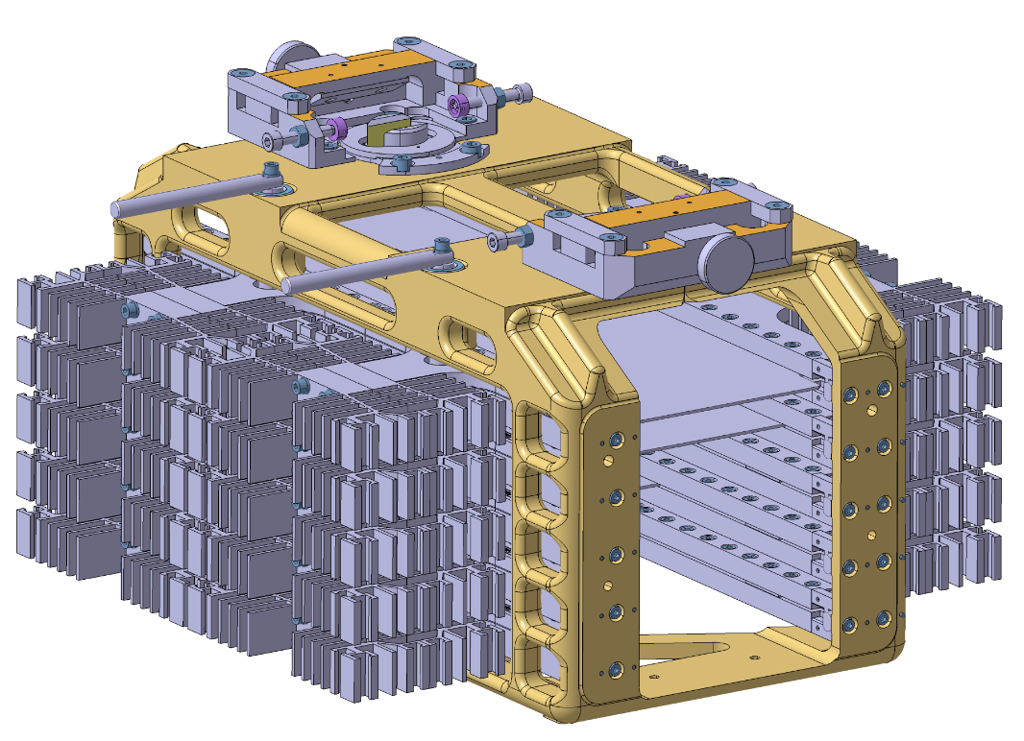
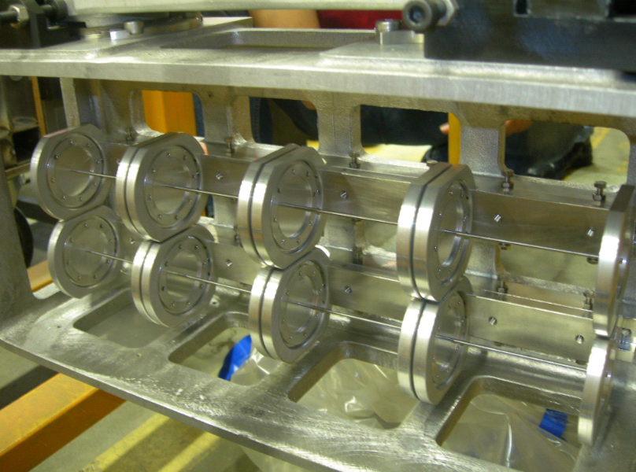
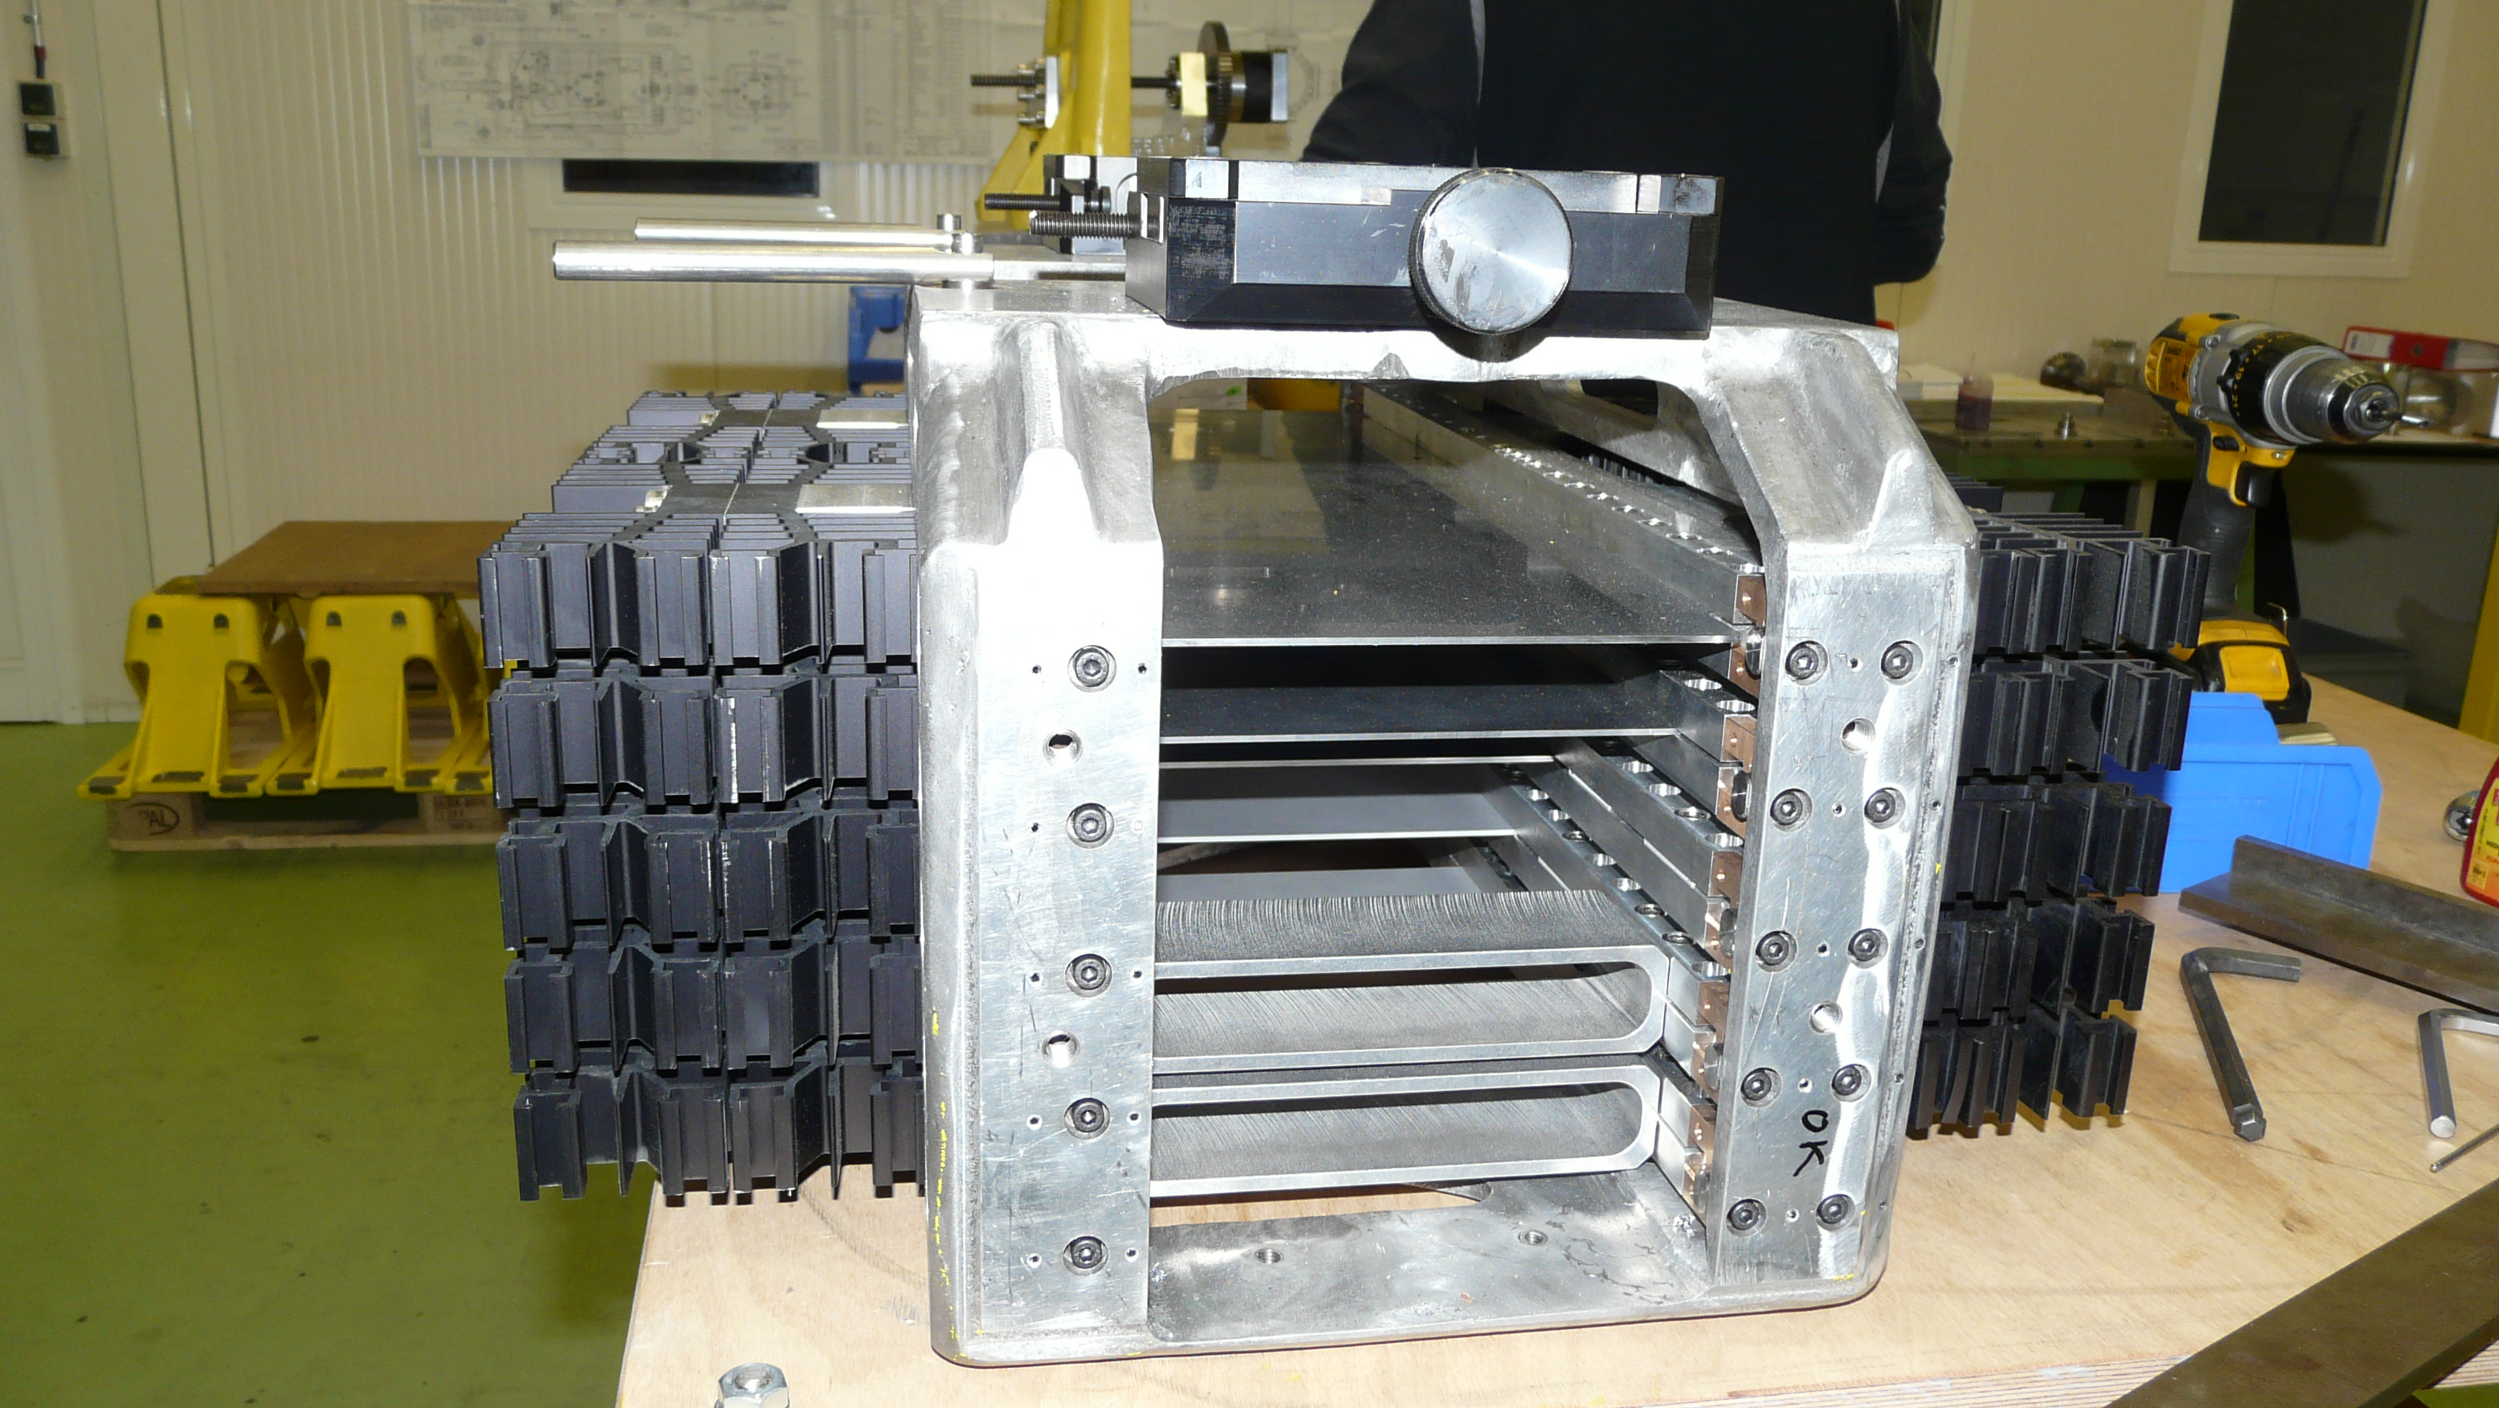
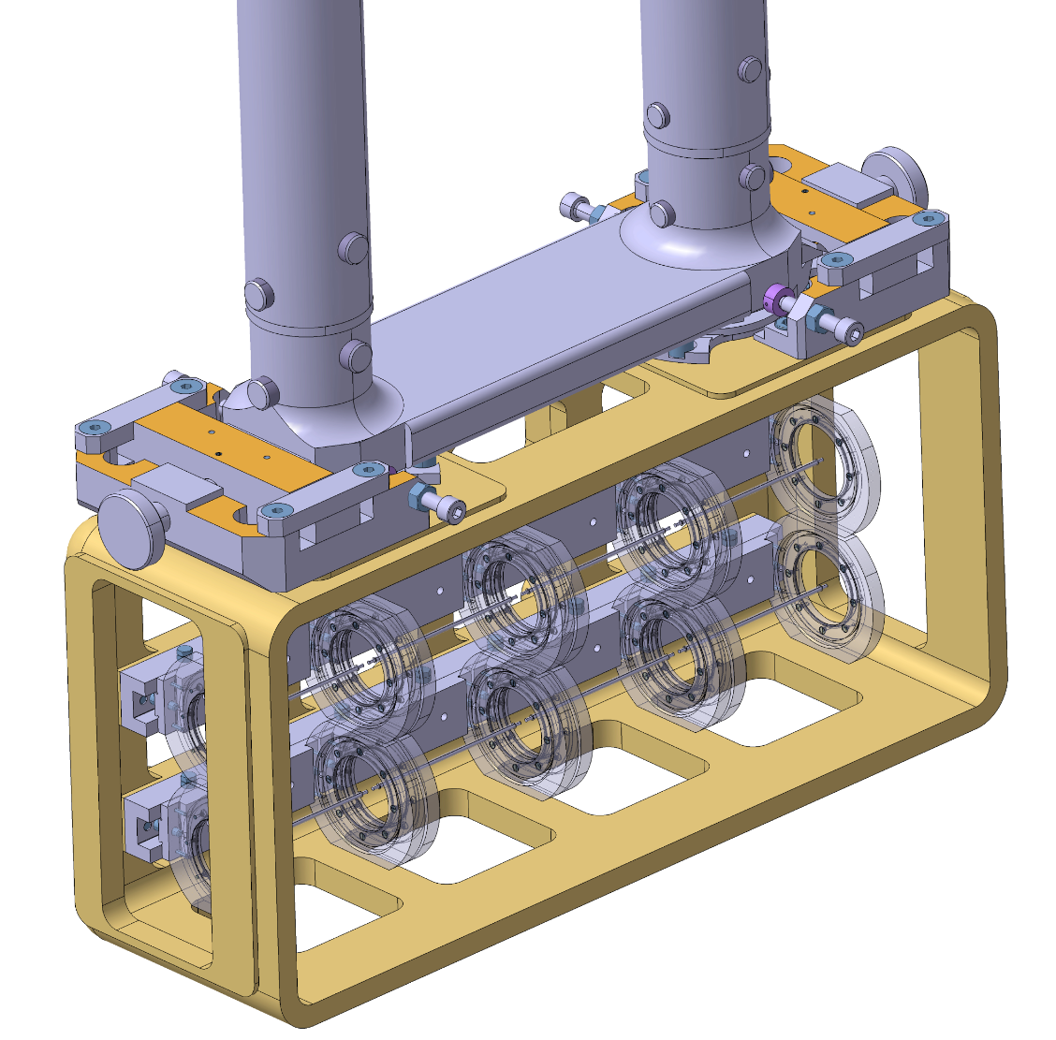
beam
Rod targets (air cooled)
Plate targets (air cooled)
beam
Operational temperature ~280 °C, ~60 MPa tensile stresses
High reliability required – no exchange expected in 20 years operation!
Global consolidation ongoing, irradiated Be plates ~O(several 10²⁰ POT)

Slide 9
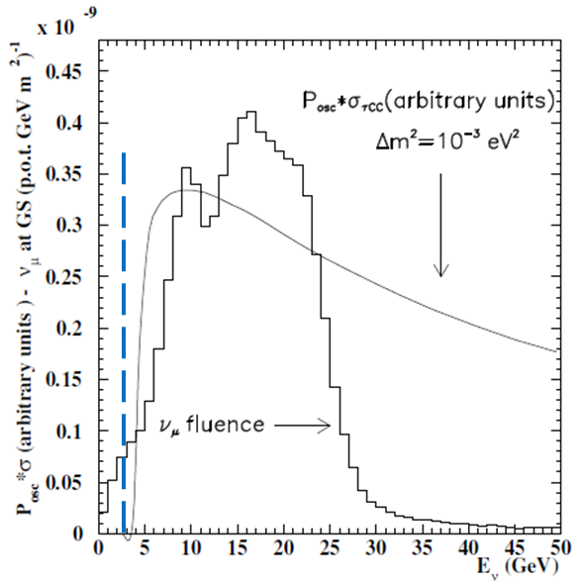
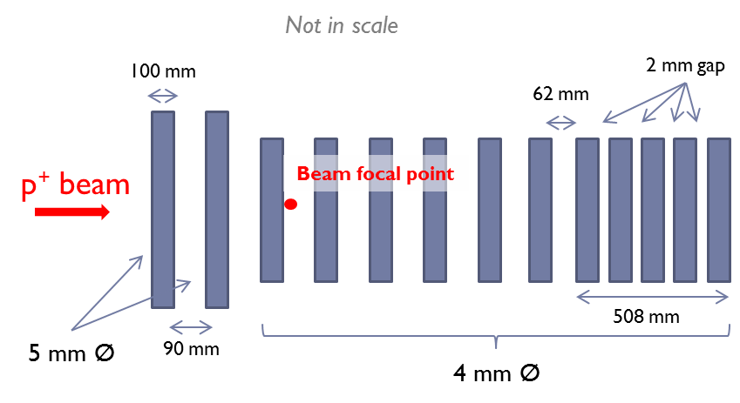
CNGS target design
Long baseline neutrino appearance experiment
Optimized for high energy (~15-20 GeV) neutrino production – segmented target, outside horn
Designed for 750 kW, operated at max ~500 kW
4 mm Ø, 0.53 mm (0.32 mm) 1σ beam

Slide 10
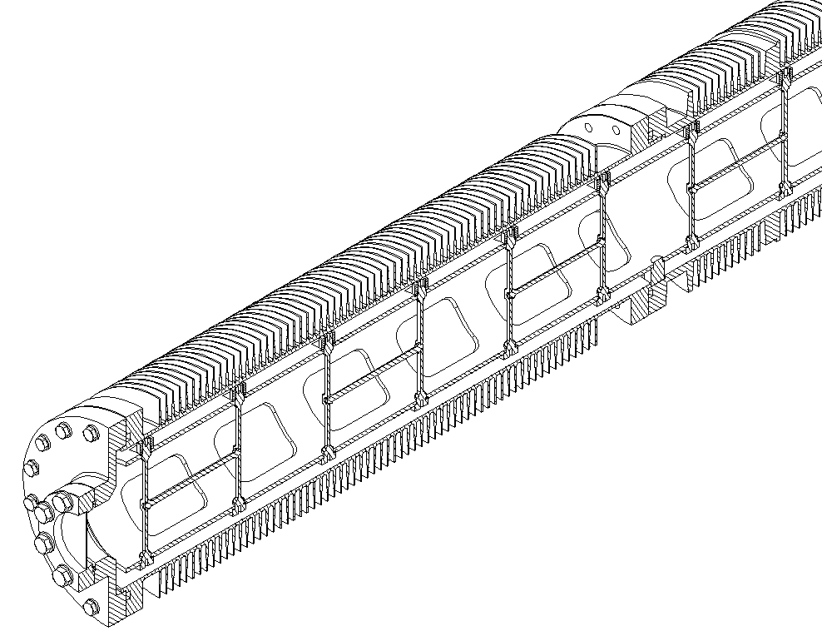
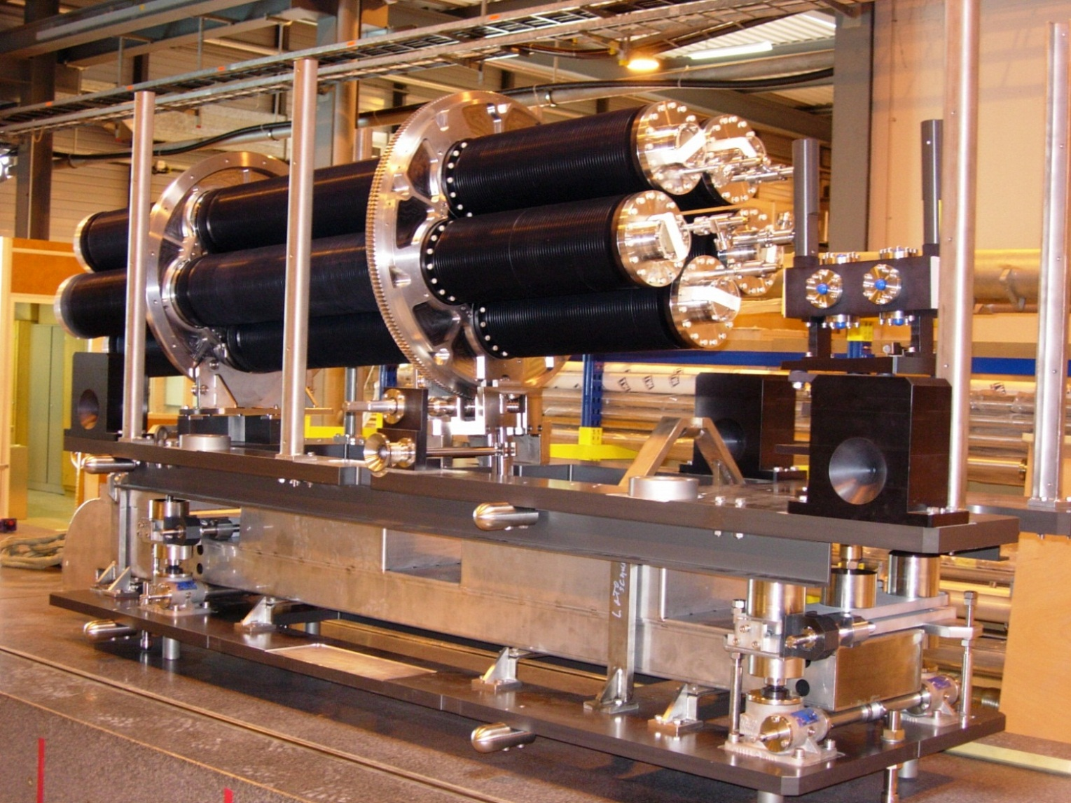
CNGS engineering challenges
CNGS target unit conceived as a static sealed system with 0.5 bar of Helium
  130 cm long graphite target (~3λ)
  Radiative-cooled target ~1200 °C
  Radiation resistance of employed graphite (2020PT, C-C composites, etc.)
Sealed cooling finned tube (Al 5083 H111)
Target rod support structure
Target support tube (C-C composite)

Slide 11
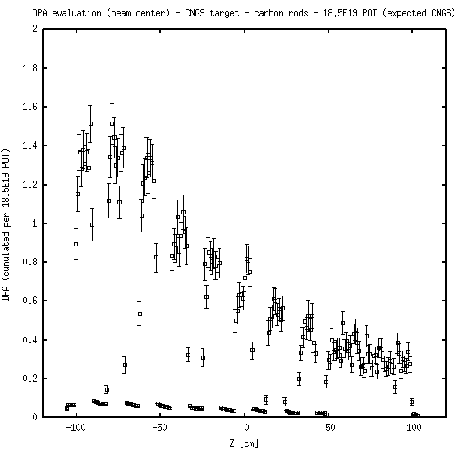
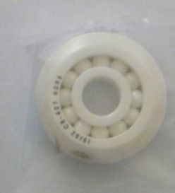
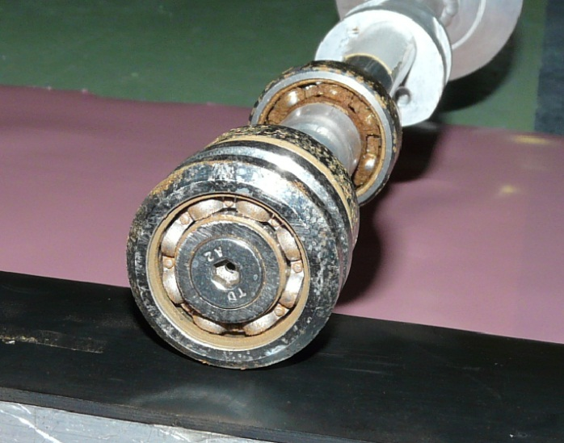
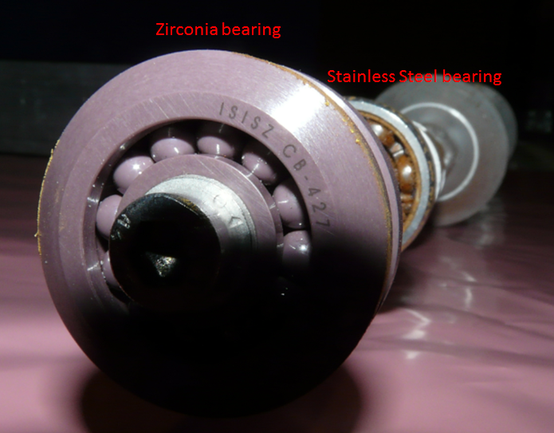
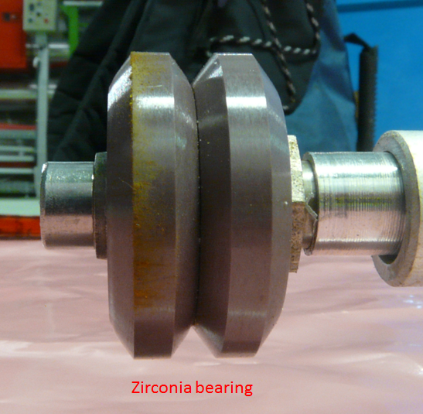
CNGS operational experience
No physical failure of the target observed at the end of operation (1.85*10²⁰ POT)
  1.5 DPA
  Advantage of operating at high temperature
FLUKA estimation for 1.85*10²⁰ POT
2010: 6.7*10¹⁹ POT 2.7 MGy
…But failure of target rotation mechanism
  Rust/pitting corrosion due to use of low grade X46Cr13 balls
  ZrO₂ bearings tested and presently under analysis
2012: 3.9*10¹⁹ POT ~2.0 MGy
Notes:
Minimization of shrinkage and reduction of thermal conductivity + favour annealing and reduction of imperfection

Slide 12
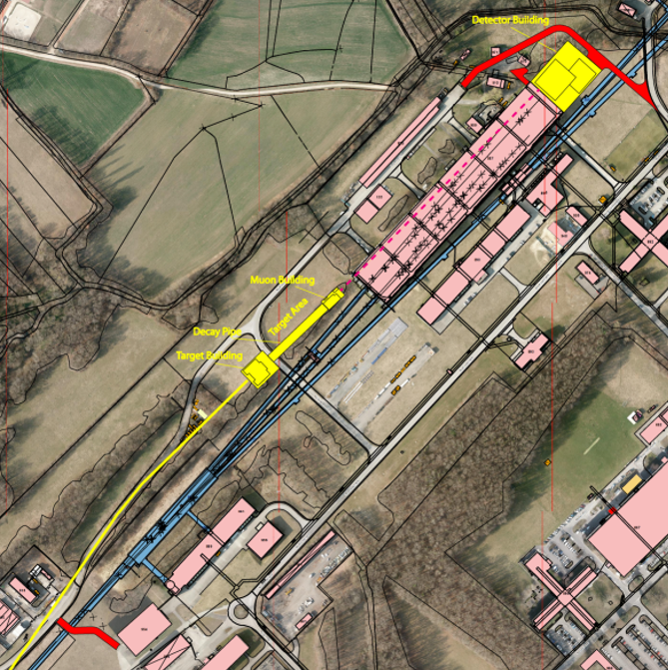
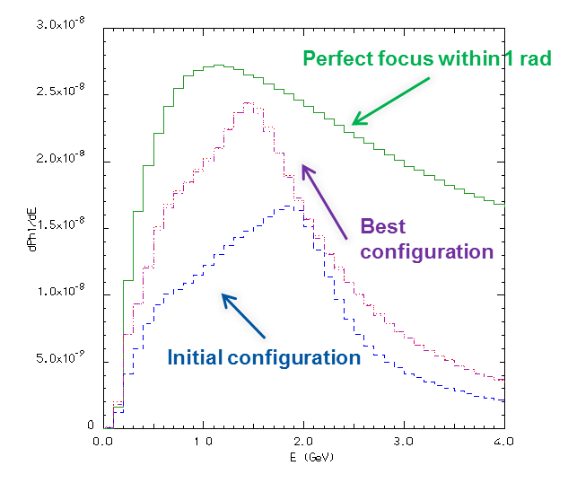
Future projects (CENF)
CERN is designing a short baseline shallow installation (link)
Design include the study for a 200 kW graphite target
See poster session C. Strabel & V. Venturi
5 GeV pion focusing – central ν_{μ} energy ~1.8 GeV
Target inside horn, followed by a reflector

Slide 13
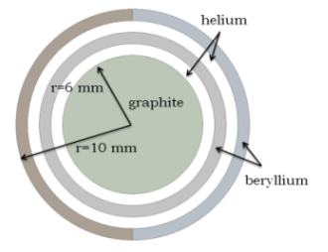
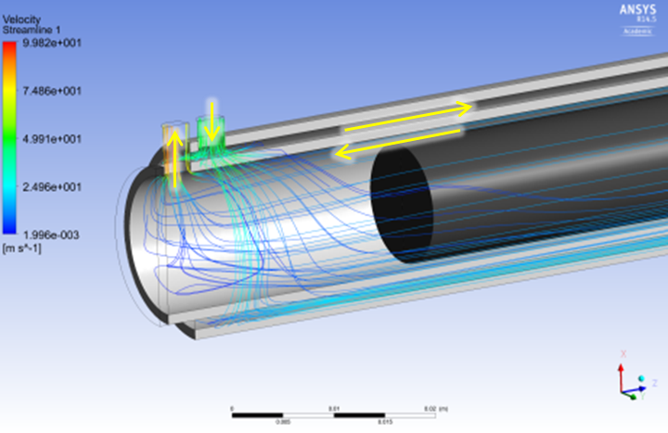
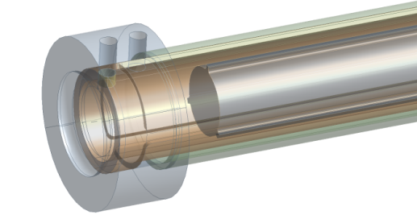
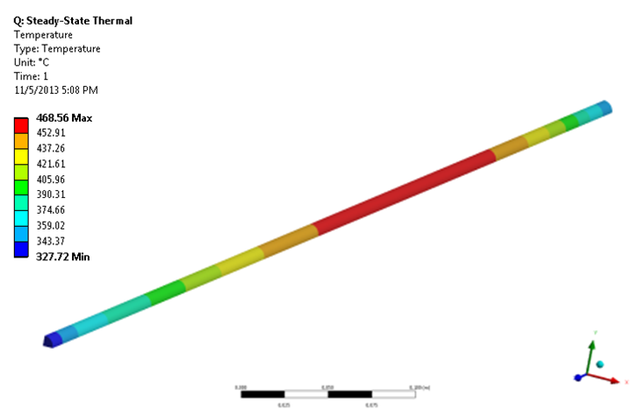
CENF target R&D
100 cm long, 12 mm Ø
  ~2 kW deposited power, He-cooled graphite 2020PT
Graphite to be maintained at 600-700K
Baseline fully cantilever inside horn
External retaining structure in beryllium
  Guarantee sufficient rigidity and low pion reabsorption
Full FEM/CFD analysis performed
See poster session V. Venturi
He gas cooling test loop will be studied in 2014/2015

Slide 14
High-Z targets
Operational experience:
  n_TOF - neutron spallation source
  Antiproton production (AD)
  ISOLDE – radioactive beam
Future projects:
  SHIP

Slide 15

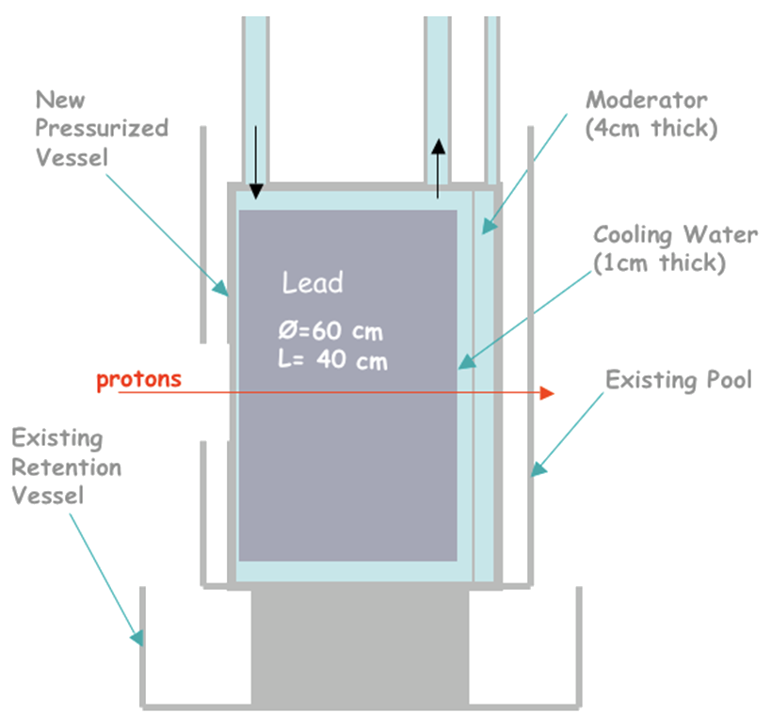
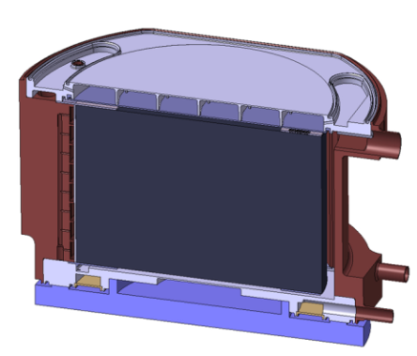
n_TOF
CERN’s 20kW neutron spallation source!
  White neutron source, ^{nat}Pb based
  TOF experiment, 3800 hours operation
  20 GeV/c proton, 8.5*10¹² p/spill, 7 ns spill
Neutron window material budget is <3 mm
  Material selection extremely important
    EN AW-5083-H111
  Water chemistry control
    O₂, ρ, pH
Pb
Neutron window

Slide 16
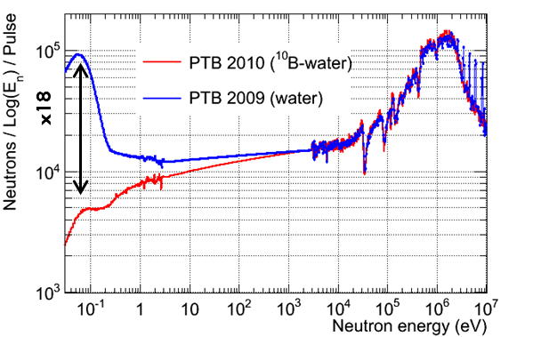
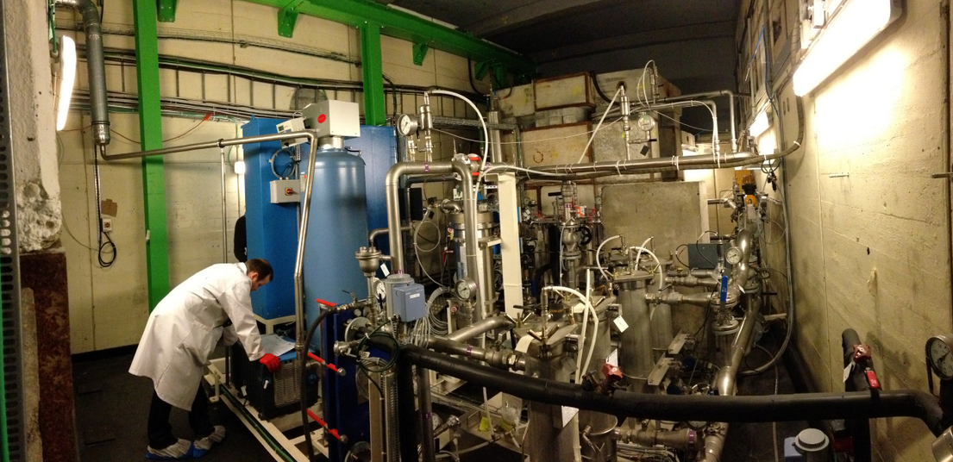
n_TOF target operation
Cooling circuit:
  H₂O flow, 6 m³/h demineralized water
Separated moderator circuit
  1.28% ¹⁰B enriched water, 0.5 m³/h
  Nuclear-grade cationic resin IRN9882

Slide 17
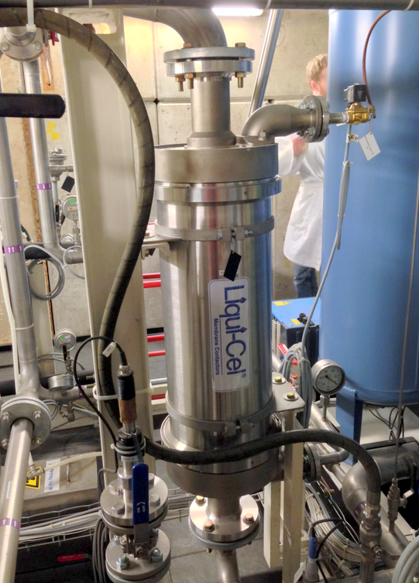
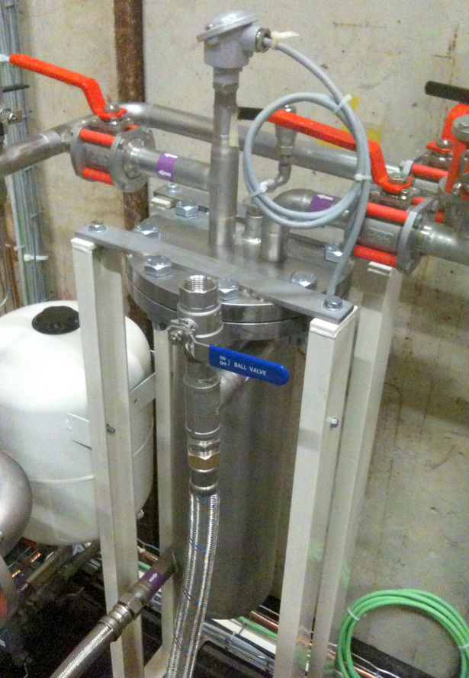
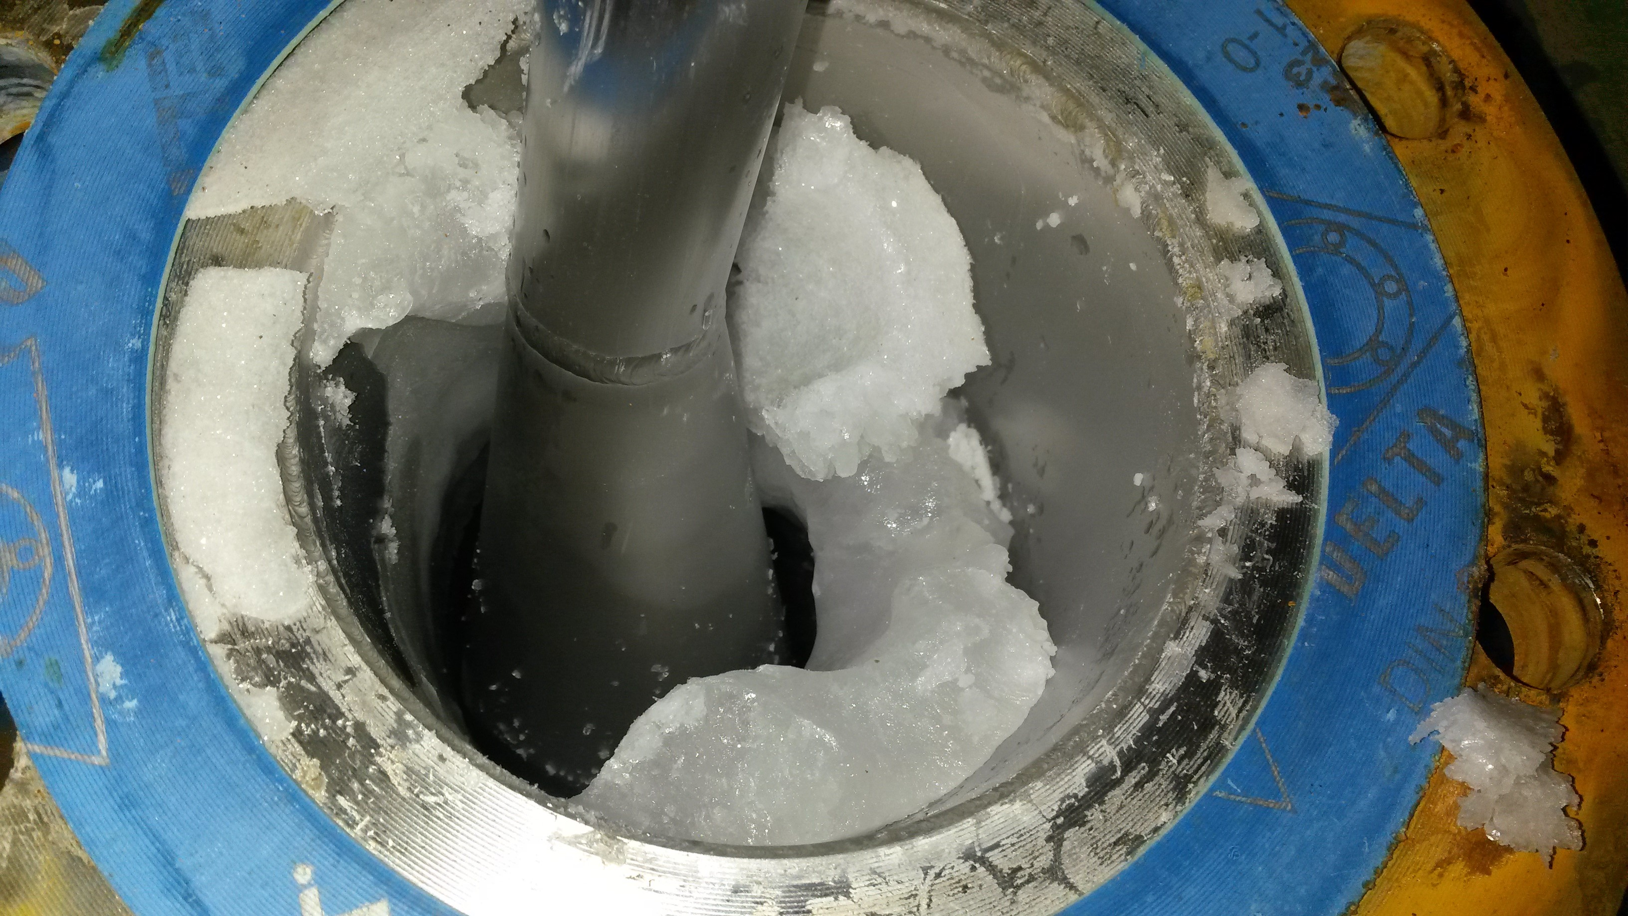
O₂ content maintained <80 ppb
Conductivity at 0.045 μS/cm (ultra-pure water!)
  Maintained by purified N₂ flush via a Liqui-Cel® membrane
Constant boron concentration maintained by a recirculating box at low temperature
  Conductivity ~60 μS/cm
  Boron crystal formation @end of run

Slide 18
n_TOF material selection
Unavoidable galvanic contact between Pb and Al alloys
Dedicated analyses allowed to quantify max. of 6 μm/y (~50 μm/y for ¹⁰B circuit) for AW5083-H111
  Thanks to water chemistry control
Erosion/corrosion of 99.99% Pb significant
  ~900 μm/y average
Material test bench
a
b
4

Slide 19
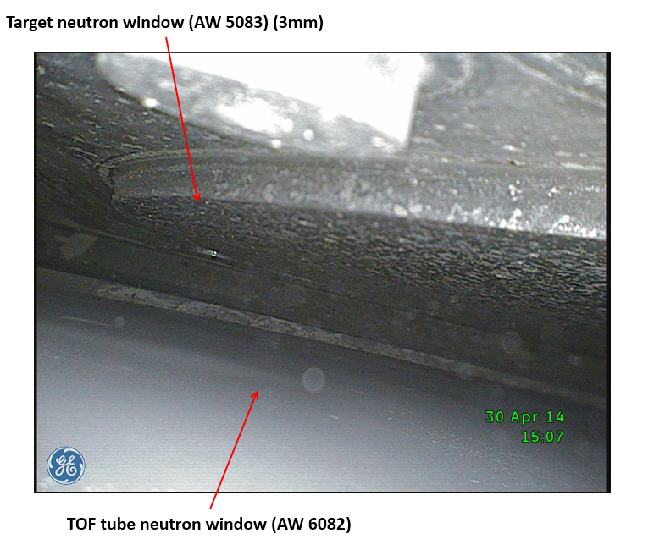
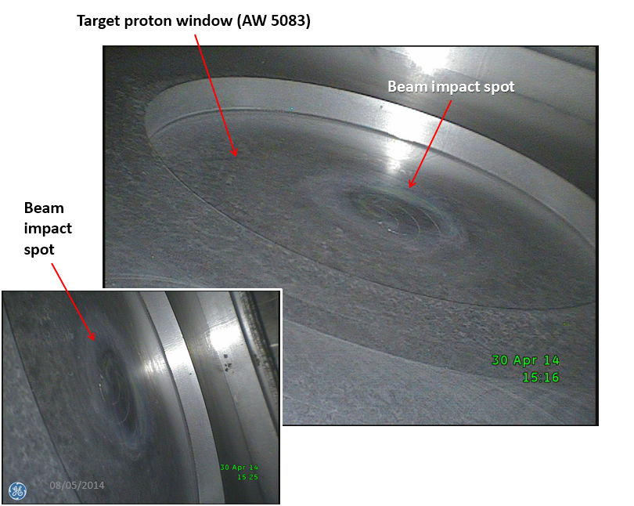
n_TOF target inspection
External inspection performed in April 2014
Only surface oxidation stains have been observed, due to humid atmosphere
COMPLETE ANALYSIS ONGOING

Slide 20
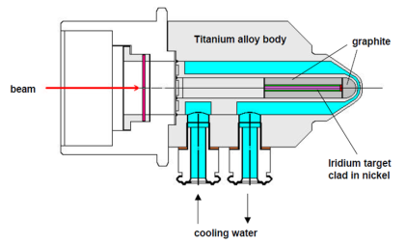
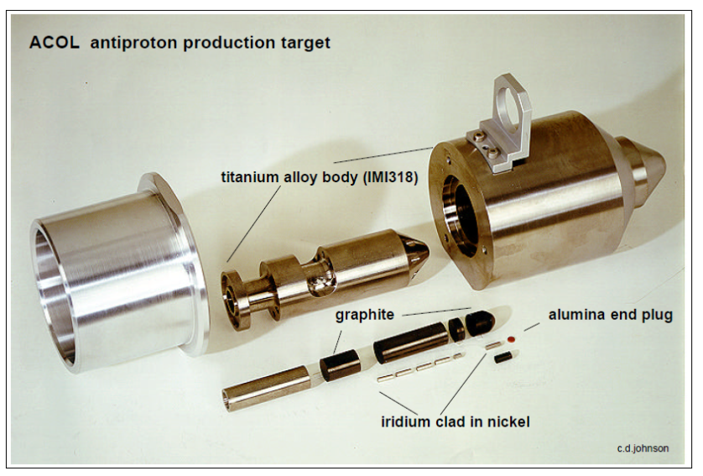
Antiproton Decelerator (AD)
Antiproton production for CERN’s antimatter physics
  ELENA ring under construction (100 keV pbars)
  Operation foreseen for the next 20 years
26 GeV/c primary beam
0.5x1mm 1σ
1.5*10¹³ p/pulse
430 ns pulse length
Rep rate ~60 s
Iridium core

Slide 21
Antiproton Decelerator (AD)
Consolidation of target area until 2018, including the construction of a new optimized production target
Requirements for physics:
  Compact target
  High-Z material
  Very focused primary beam
Challenges:
  Thermal shocks can damage target material
  Extremely high energy density coupled with short pulse
    7.5 kJ/cm³/pulse
    ~17 GJ/cm³/s
Point-like source of p-bars for the magnetic horn

Slide 22
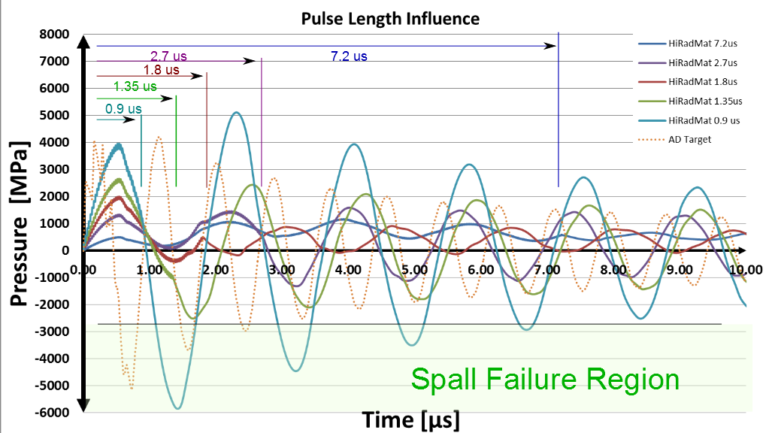
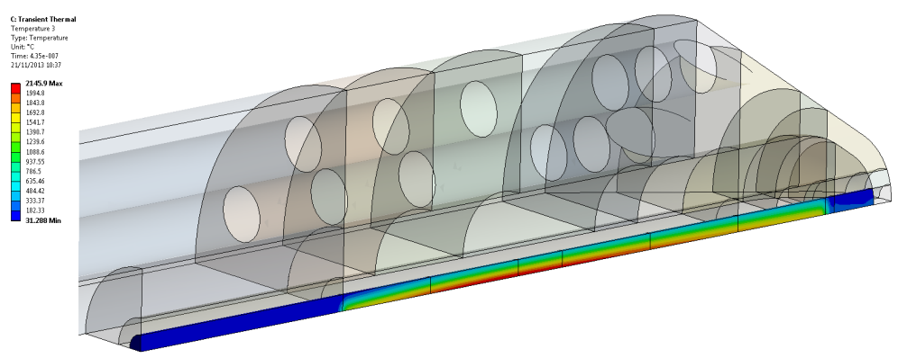
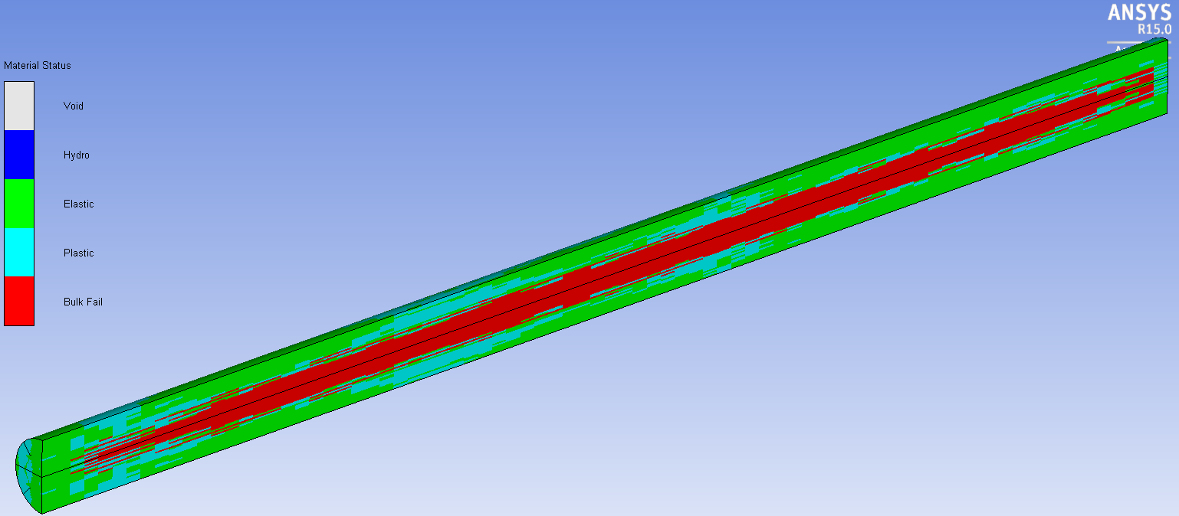
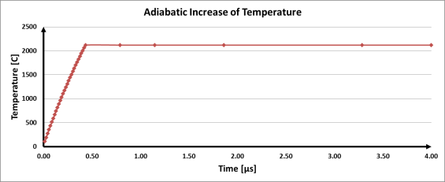
Antiproton Decelerator (AD)
2000 °C in <0.5 μs
Temperature gradient of 1500 °C in <1.5 mm
Dynamic stresses ~10 GPa
Strain rates 4*10⁴ s⁻¹
Hydro codes being used to fully simulate plastic wave propagation
  Material strength beyond plasticity
  Material damage and failure
Pulse time influences dramatically the dynamic response
Experimental tests under proton beam is necessary
  Validate numerical results & gain experimental insights on material response
HiRadMat tests foreseen in 2015

Slide 23
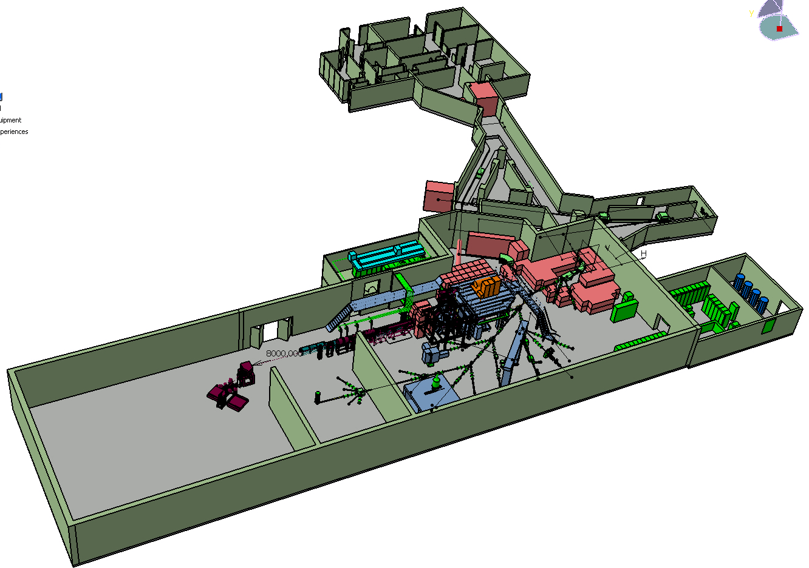
ISOLDE
On-line Isotope Mass Separator (ISOLDE)
  Facility dedicated to the production of radioactive ion beams
Class-A labs
Target area
Experimental Hall

Slide 24
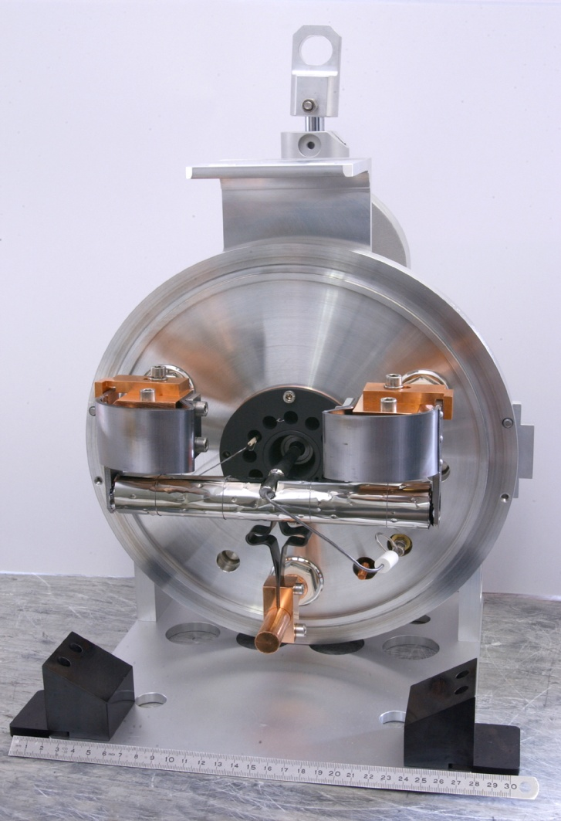
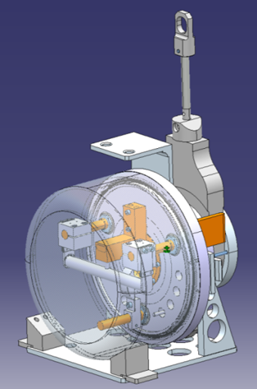
ISOLDE targets
Different target materials employed
  UC_{x}, SiC, Pb, Ta, Ti, MgO, CeO
  ~30 units produced and operated per year
  Remote handling and monitoring
Lots of development going on
See talks of M. Delonca, A.-P. Bernardes on LIEBE project
ISOLDE beam parameters:
  0.8-2.4*1013 p/pulse @1-1.4 GeV/c
  1.4-5.7 kW
  2.4-40 μs pulse, 1.2 cycle

Slide 25

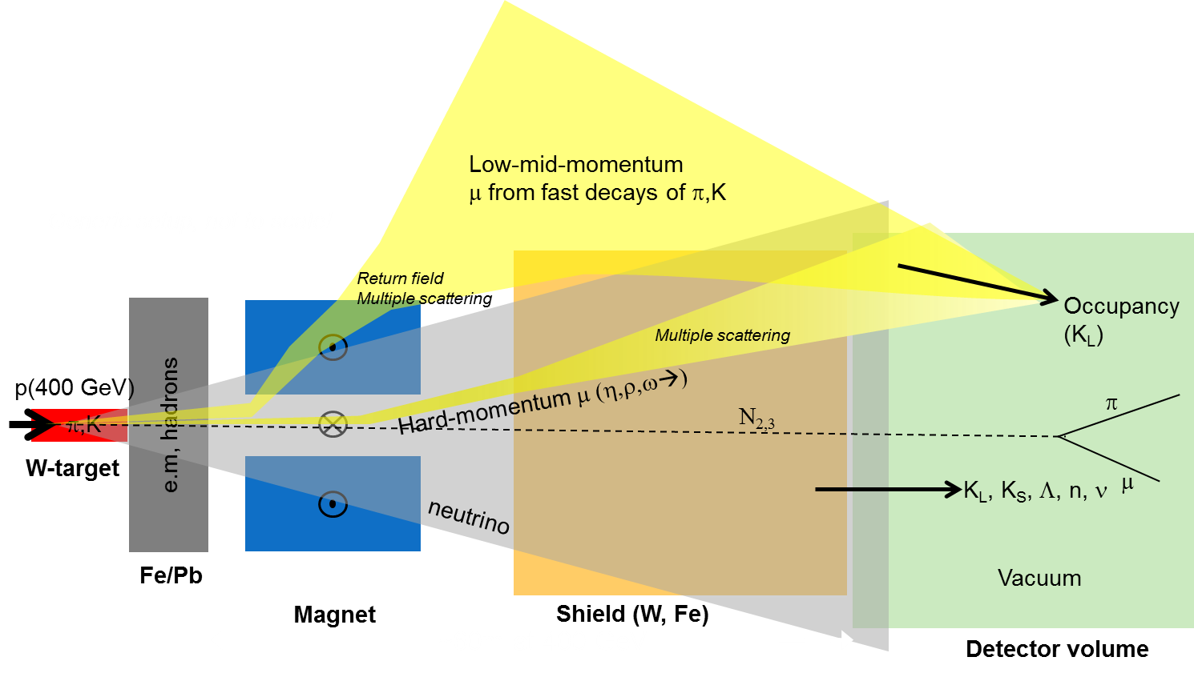
SHIP – Search for Hidden Particles
New proposal at CERN aiming for a new fixed target experiment searching for very weakly interacting and longlived particles ~O(MeV-GeV)
  http://arxiv.org/abs/1310.1762
  Production through mesons decays (π, K, D, B)
  Need a heavy target to minimize background
~530 kW @400 GeV/c
Slow extraction (~few seconds)
High intensity (4.5-7.0*10¹³ p/pulse)
R. Jacobsson (CERN)

Slide 26
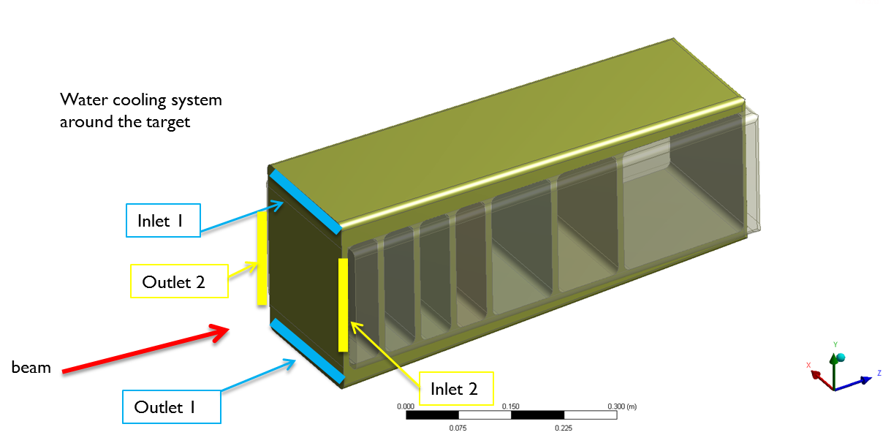
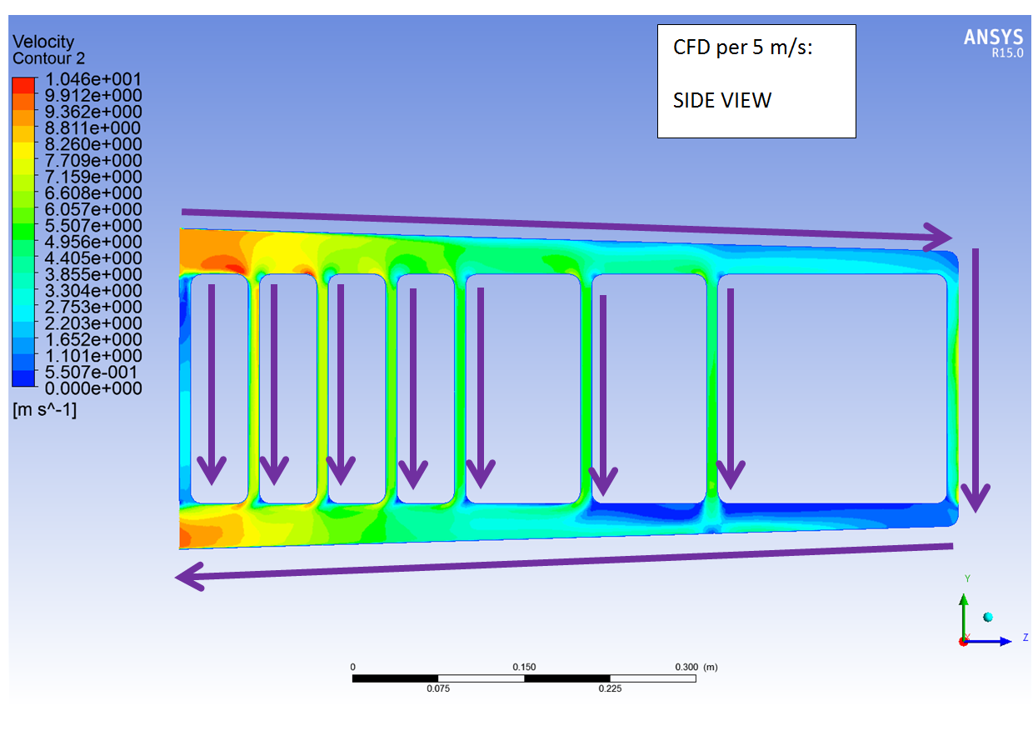
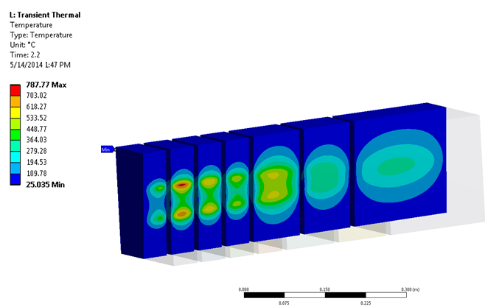
W-based target
  Inermet® and Densimet ® alloys being investigated
  Target must be segmented to withstand beam power
Preliminary
Preliminary
Challenges:
  High water flow rate (~10 m/s)
    Corrosion/erosion - Water chemistry
  High compressive stresses due to pulsed beam
  R&D on material properties, degradation of properties with radiation (RaDIATE?)
~1 GPa compressive stresses

Slide 27
Conclusions
Fixed target experiments a backbone of CERN’s programs
Several different operating target stations
Consolidation programs ongoing
New challenging projects are being proposed

Slide 29
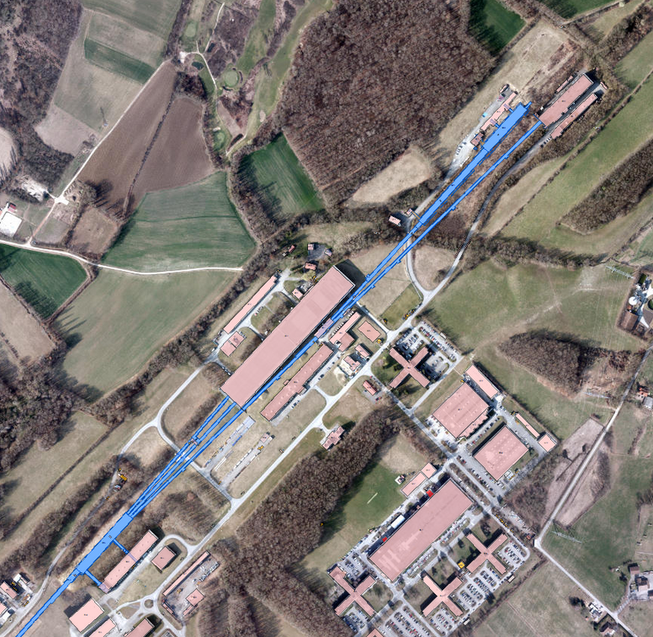
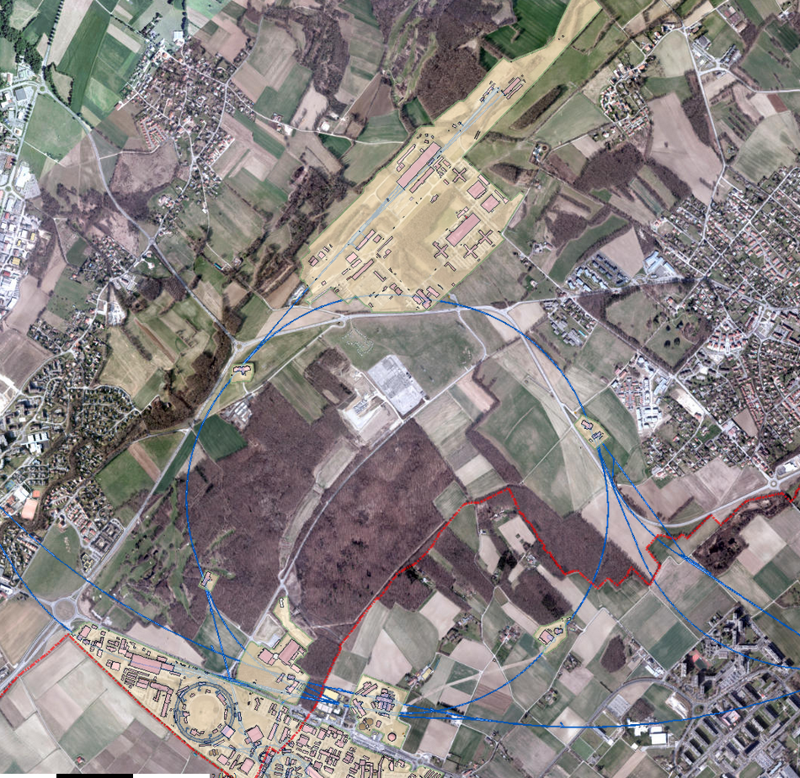
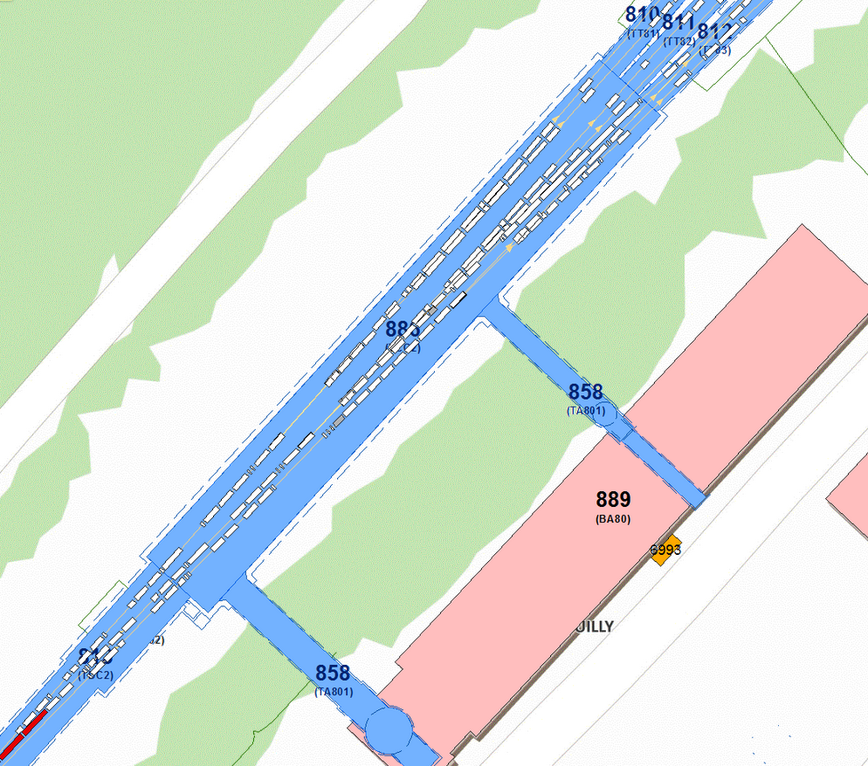
North Area targets

