Slide 1
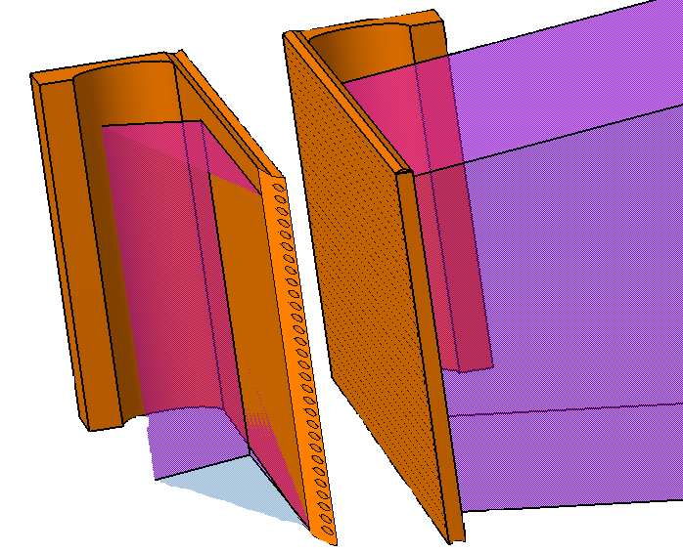
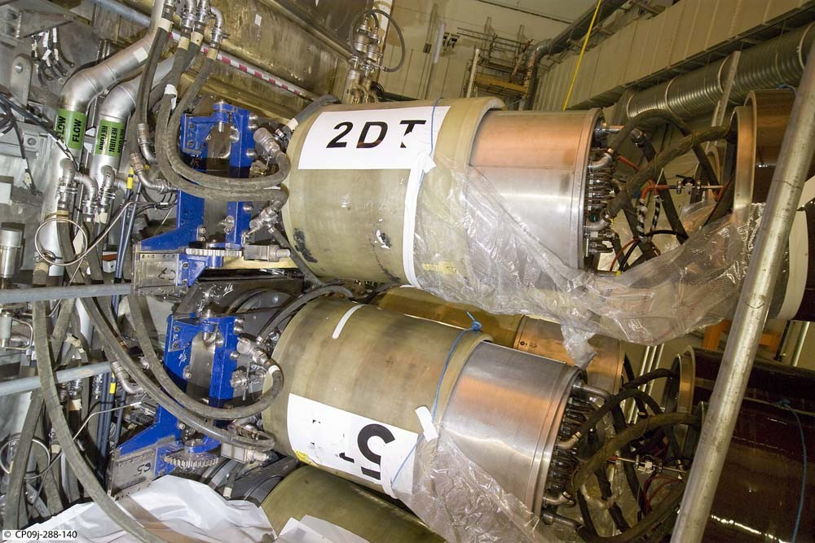
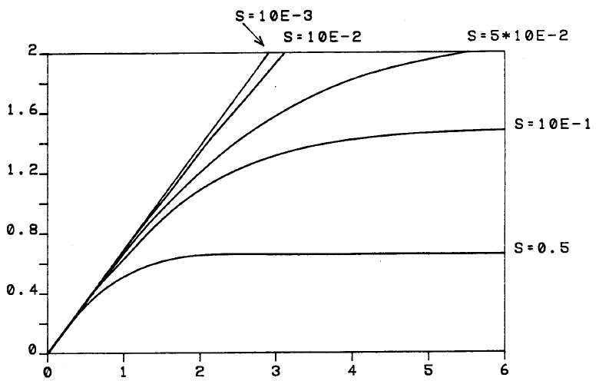
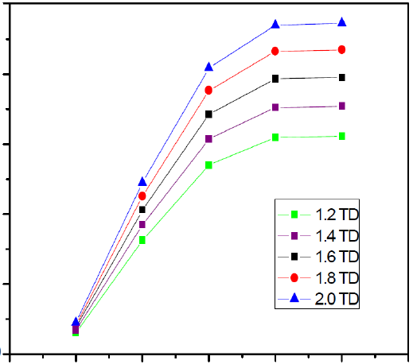
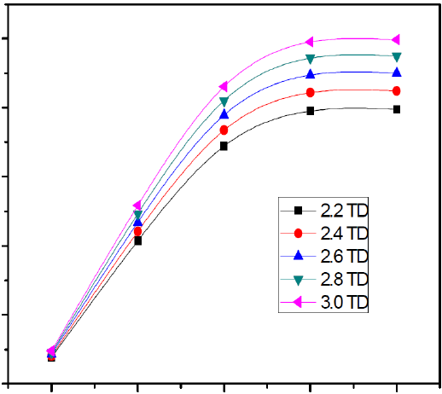
National Agency for New Technology,
Energy and Sustainable Economic Development
New Sorgentina Fusion Source (NSFS)
Experimental Facility Supporting Materials Research
P. Console Campriniª, D. Bernardiª, M. Frisoni^{b}, M. Pillon^{c}
ENEA-EURATOM Association on Fusion Research,
ENEA: ªBrasimone Research Center, Camugnano (BO) ^{b}Bologna Research Center, Bologna, ^{c}Frascati Research Center, Rome
ABSTRACT
Within the framework of fusion technology research and development, a neutron source has long been considered a key facility to perform irradiation tests aiming at populating materials engineering database – supporting DEMO reactor design and licensing. New Sorgentina Fusion Source (NSFS) has been proposed taking advantage of well-established D-T neutron generators technology, scaled in order to attain a bright source of about 10¹⁵ n/sec. Actual 14 MeV neutron spectrum is a relevant feature. Ion beams of 30 A are produced and accelerated up to some 200 keV energy. Present design considers ion generators and extraction grid technology employed in neutral injectors currently utilized at large experimental tokamaks. Then deuterium and tritium ion beams are delivered to the target - impinging on a hydride thin layer which is on-line D-T reloaded via ion implantation. Metal hydride is continuously re-deposited preventing layer from being sputtered, increasing installation load factor. Large and fast rotating target is conceived to enhance heat removal - coping with thermal transients and mechanical loads. Design is aimed at achieving challenging performances regarding elevated heat flux of 60 kW/cm² and thermal fatigue concerns. Main facility characteristics are provided, as well as target thermal and mechanical issues.
Continuous on-line layer deposition for long irradiations
D-T fusion reactions generating
14 MeV neutrons for material irradiation
D⁺ - T⁺ Ion Beams Impinging
Metal hydride layer
as D-T enriched target
Rotating wheel target
to manage high heat flux
Neutron flux enhanced up to 3 DPA/fpy in 500 cm³ irradiation test chamber
Rotating Target System
Target Neutron Yield
Ion Beam
High heat flux to target
Thermal-mechanical issues managed by rotation
4.0 ⋅ 10 ¹³ n/cm²/sec
2.5 ⋅ 10 ¹³ n/cm²/sec
1.6 ⋅ 10 ¹³ n/cm²/sec
1.1 ⋅ 10 ¹³ n/cm²/sec
6.8 ⋅ 10 ¹² n/cm²/sec
3.0 dpa/fpy
2.1 dpa/fpy
1.3 dpa/fpy
0.8 dpa/fpy
0.6 dpa/fpy
High current ion sources and accelerators
Positive Ion Neutral Injectors at tokamaks (JET)
Large wheel 4 m radius – 800 rpm rotation
0.3 msec pulse-width heating and 75 msec period
Material selection and multi-layer strategy
Double beam 30 A D+ and 30 A T+ ions is utilized
200 keV to match fusion cross-section resonances
200 cm² beam size (20cm x 10 cm)
RF source: higher monoatomic yield (fusion probability)
20 sec (up to quasi-continuous) pulse duration
q’’ = 60 kW/cm²
Calculations MCNP5-1.6 - FENDL3-rel.4
Metal hydride layer (2 micron)
20 cm
Susbtrate resistant to heat shocks
Thermal-mechanical fatigue
Highly Oriented Pyrolytic Graphite
HOPG or CFC (ongoing evaluations)
2 μm
30 A D⁺ ions 200 keV
1 mm
Structural resistant to centrifugal hydro pressure and heat removal
Copper alloy CuCrZr
1.5 mm
10 cm
12 MW each target
Cooling water
T_{bulk(inlet)} = 50°C , p_{(top)} = 660 bar
Htc = 60,000 W/m²/K
2 mm
30 A T⁺ ions 200 keV
PINI NBI at JET tokamak
0.5 mm
1.5 mm
Double rotating target
Neutron surface sources
Hydride Target Layer
Target Thermal and Mechanical Analysis
Primary: Mises Stress
Fatigue: temperature
Temperature cycle [°C]
Deuterium-tritium stocked in metal hydride form target surface
D-T ions Continuous re-load through ion beam implantation
Titanium – Erbium metal hydride: sputtering restored by on-line deposition
D-T storage in vacuum - high temperature (up to 400 °C)
2 micron layer for D⁺/T⁺ 200 keV ions
D/Ti atomic concentration
5x10¹¹
Titanium hydride
Neutron yield [n/sec/kW]
CuCrZr tubing plate
Pyro-graphite substrate
4x10¹¹
Erbium hydride
σ_{max} = 230 MPa
σ_{y} (100 °C) ≈ 380 MPa
σ_{min} = 4 MPa
σ_{max} =17 MPa
σ_{a} = Δσ/2 = 6.5 MPa
σ_{a} limit ̴ 9 MPa
Time [sec]
3x10¹¹
T_{max} _{hydride} = 370 °C
D-T re-load as function of surface sticking factor
2x10¹¹
1x10¹¹
H/metal ratio
H/metal ratio
Cycle number (10⁴)
0
0
100
200
300
0
100
200
300
Design Strategy
Early irradiation objectives matching proven technology Assets
Beam energy [keV]
Neutral beam injector systems (NBI) utilized as large area high current D⁺/T⁺ ion sources
D-T ions stored in hydride metal layer on target – D-T reload via ions implantation
High total current beam sputtering solved through on-line metal deposition
High power density delivered to target managed by rotating wheel structure
Thermal-mechanical issues approached by multi-layer design (thermal shock & substrate)
References
M. Pillon et al., Feasibility study of an intense D-T fusion source: «The New Sorgentina», Fusion Eng. and Des. (2014)
M. Martone et al., High flux high energy deuterium ions implantation in high temperature titanium, ENEA Internal Report (1992)
M. Martone, Feasibility Study of a 14 MeV Neutron Source (Sorgentina), ENEA Internal Report (1990)

