Slide 1
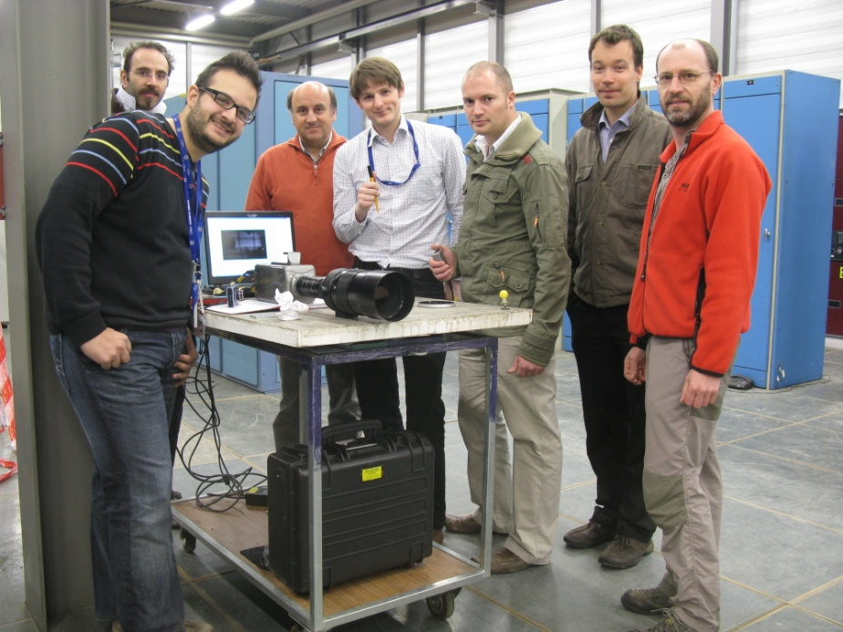
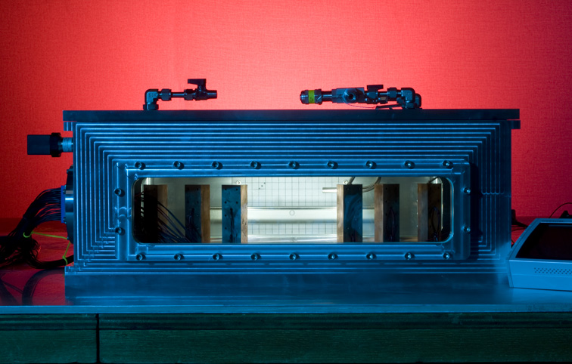
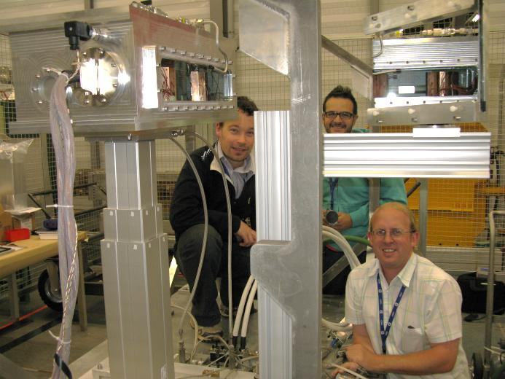
Tungsten Powder as an accelerator target
& In-Beam Testing
Ottone Caretta, Peter Loveridge, Tristan Davenne,
Mike Fitton, Joe O’Dell, Dan Wilcox and Chris Densham
(Apr. 4, 2013)
(RAL)
Ilias Efthymiopoulos, Nikolaos Charitonidis
(CERN)
Funded by ASTEC, CERN subscriptions & PASI

Slide 2
Davenne: Limitations of target technologies
Why powder?
Maintaining the target temperature and stress levels within safe limits is the main engineering design driver.
So designs become increasingly elaborate as energy and power deposited in the target are increased
Flowing or rotating targets
Segmented
Peripherally cooled monolith

Slide 3
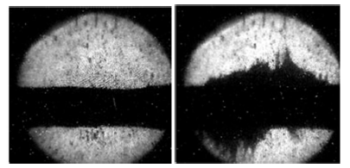
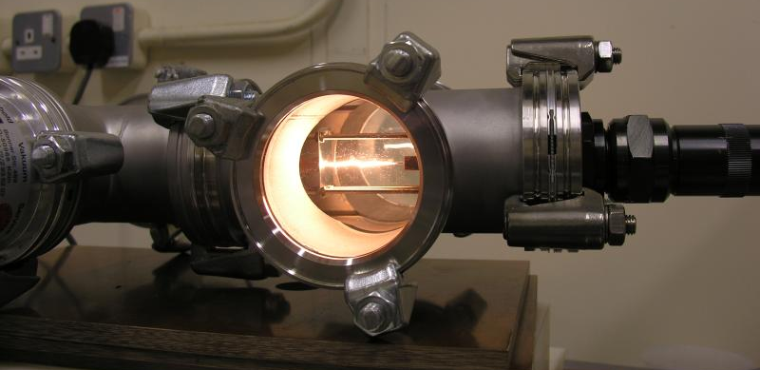
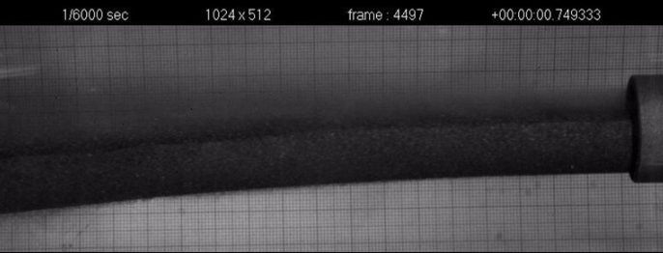
Candidate target technologies for a Neutrino Factory
1. Mercury
+ already exist, e.g. SNS
- toxic!
- reacts violently with beam
2. Moving Solid Tungsten Bars
+ studies on dynamic stress and strain-rate effects published
- Reliability in harsh environment?
- High static stress levels require much larger beam sigma
than baseline beam parameters
3. Tungsten Powder
+ Pneumatic conveyance of powder demonstrated
- wear of parts and powder
- Containment
Mercury Jet in the MERIT experiment before (left) and after (right) a proton beam interaction, Kirk et al.
lifetime testing of tungsten wires in response to dynamic thermal loading, Skoro et al.
Pneumatically conveyed dense-phase tungsten powder jet, Caretta et al.

Slide 4
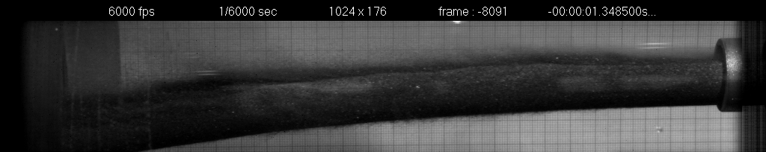
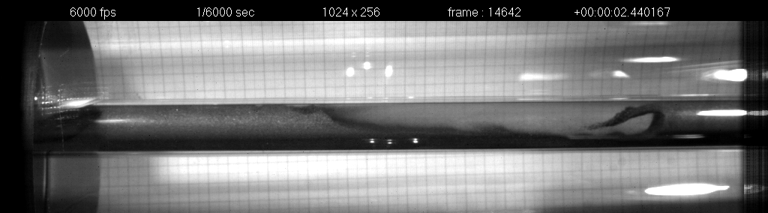
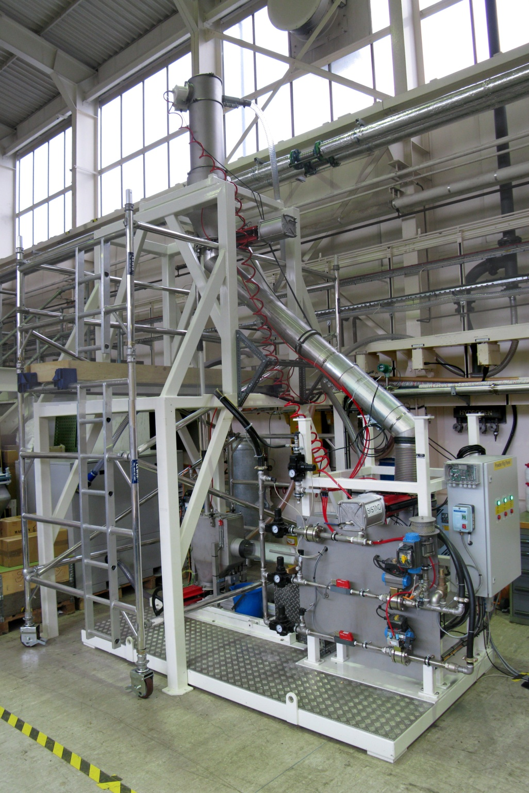
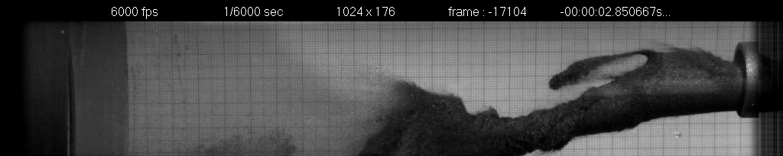
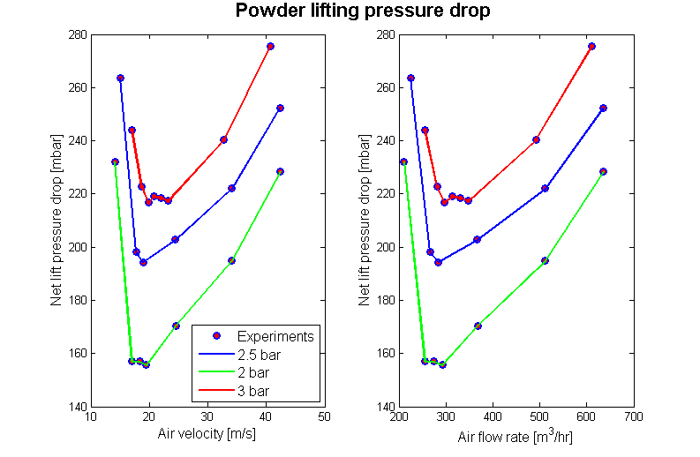
Tungsten Powder Test Programme in PASI-WP3 + ASTEC
Dense-phase delivery
Offline testing
  Pneumatic conveying
  (dense-phase and lean-phase)
  Containment / erosion
  Heat transfer and cooling of powder
High speed image: tungsten powder jet
High speed image: tungsten powder flow in a pipe
Unstable tungsten powder jet
2
Lean-phase lift
1
3
4
Drag not what expected but at least it lifts!

Slide 5
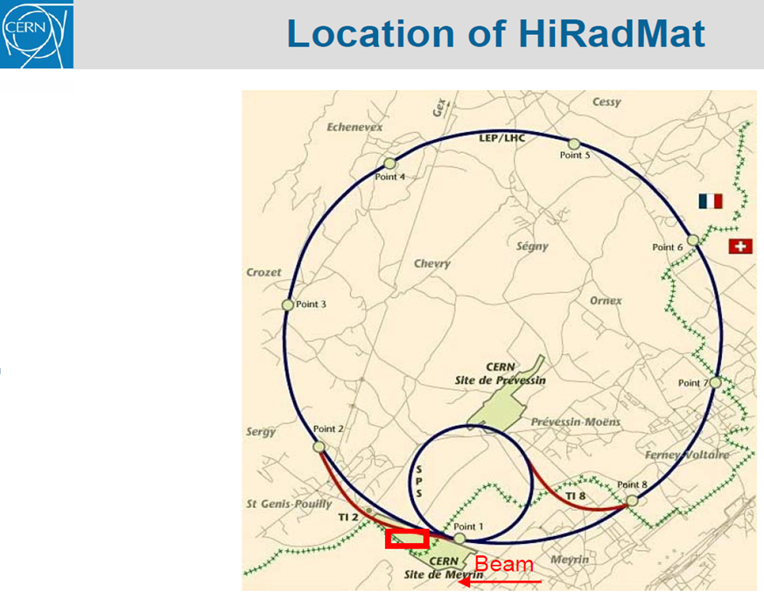
HiRadMat Beam Parameters:
A high-intensity beam pulse from SPS of proton or ion beams is directed to the HiRadMat facility in a time-sharing mode, using the existing fast extraction channel to LHC. The SPS allows accelerating beams with some 1013 protons per pulse to a momentum of 440 GeV/c.
Details of the primary beam parameters and focusing capabilities are summarised below:
Beam Energy 440 GeV
Pulse Energy up to 3.4 MJ
Bunch intensity 3.0 · 10⁹ to 1.7 · 10¹¹ protons
Number of bunches 1 to 288
Maximum pulse intensity 4.9 · 10¹³ protons
Bunch length 11.24 cm
Bunch spacing 25, 50, 75 or 150 ns
Pulse length 7.2 µs
Beam size at target variable around 1 mm²
In-beam experiment Opportunity, June 2012

Slide 6
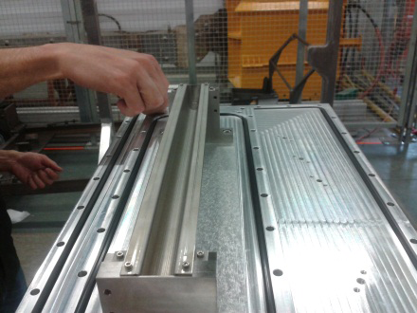
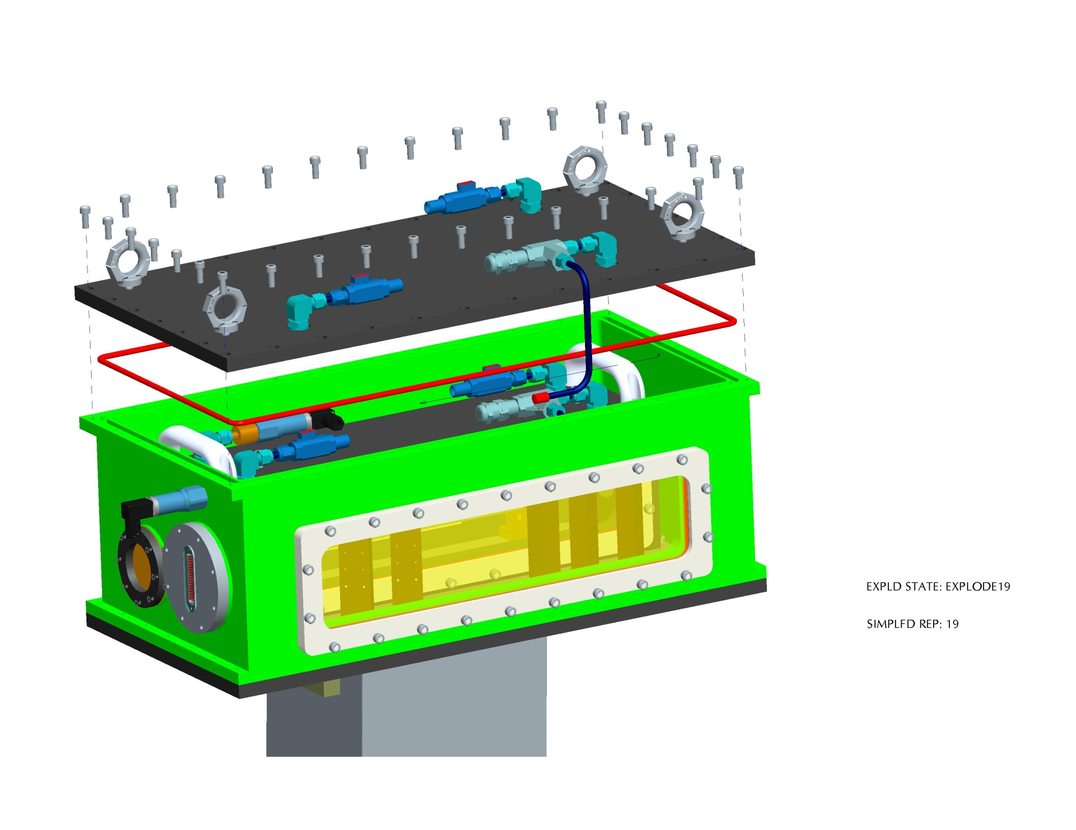
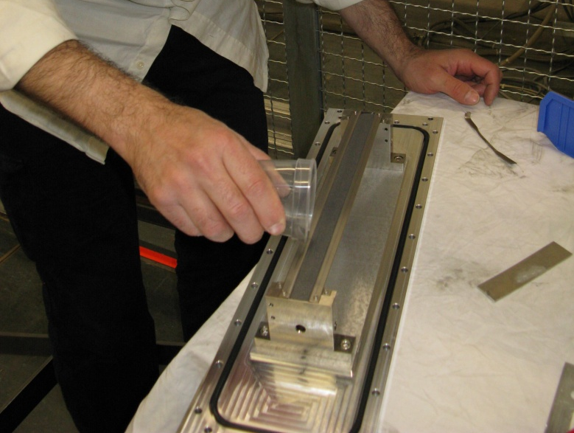
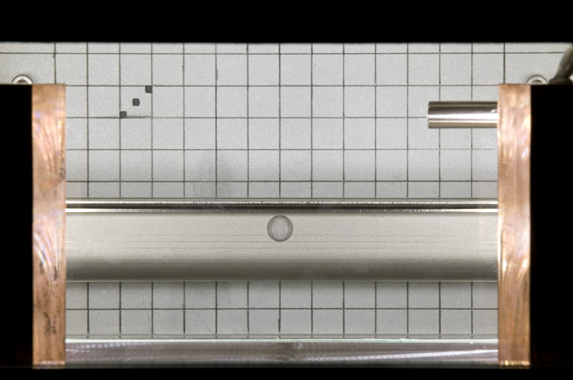
In beam test rig
Beam
LDV/camera
Open trough Assembly
Beam
LDV/camera
Filling with Tungsten Powder
Lift Table
Tungsten powder sample in an open trough configuration
Helium environment
Two layers of containment with optical windows to view the sample
Remote diagnostics via LDV and high-speed camera
View from high speed camera

Slide 7
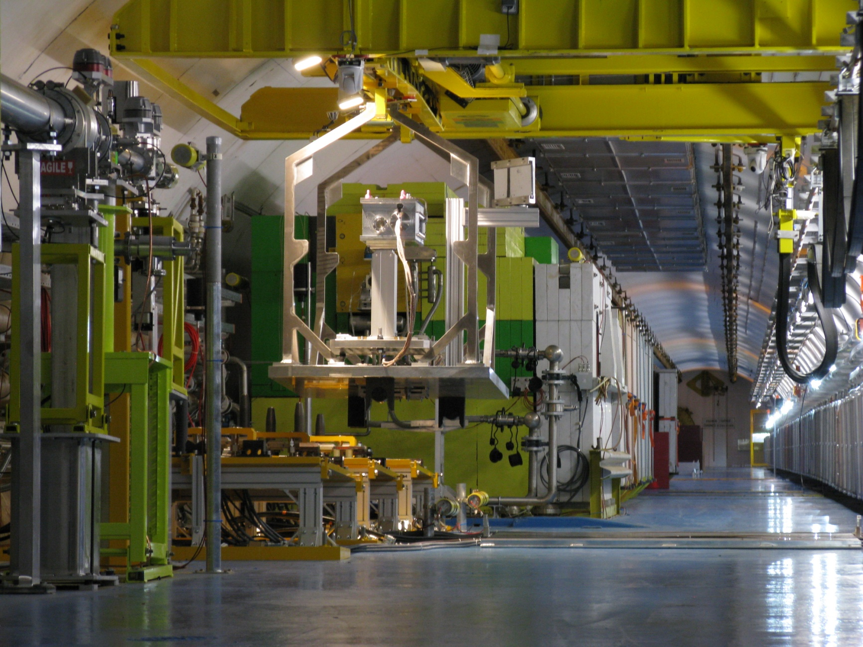
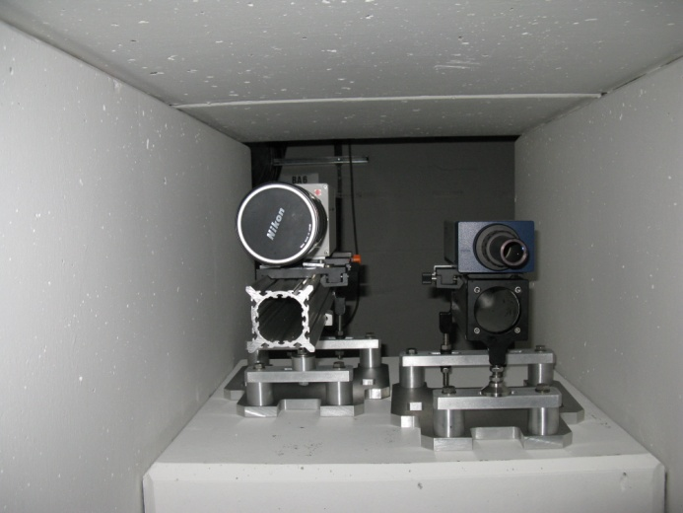
HiradMat Installation and Remote diagnostics

Slide 8
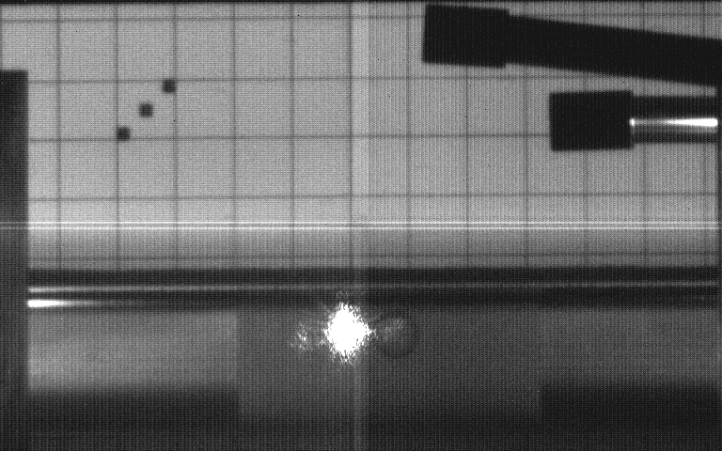
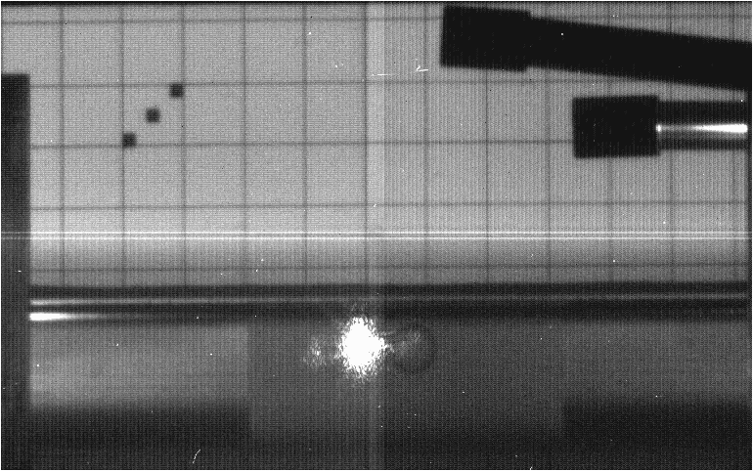
HiRadMat: Run 7
Intensity: 8.40E+10 PoT

Slide 9
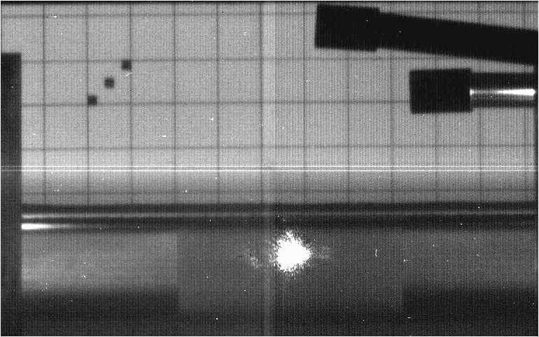
HiRadMat: Run 8
Intensity: 1.75E+11 PoT

Slide 10
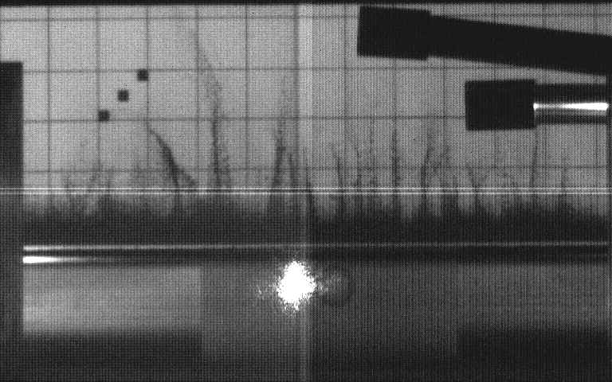
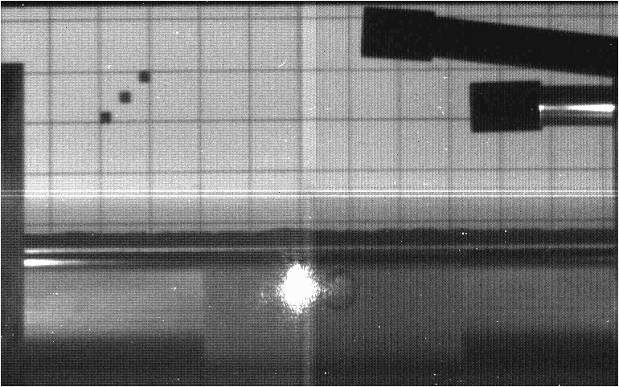
HiRadMat: Run 9
Intensity: 1.85E+11 PoT

Slide 11
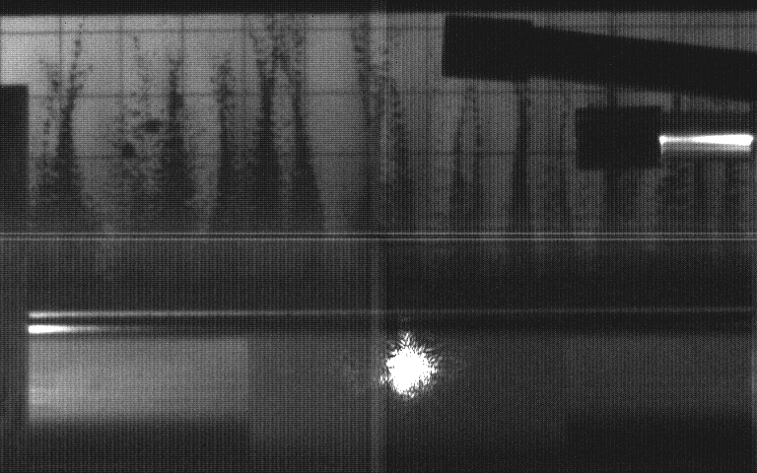
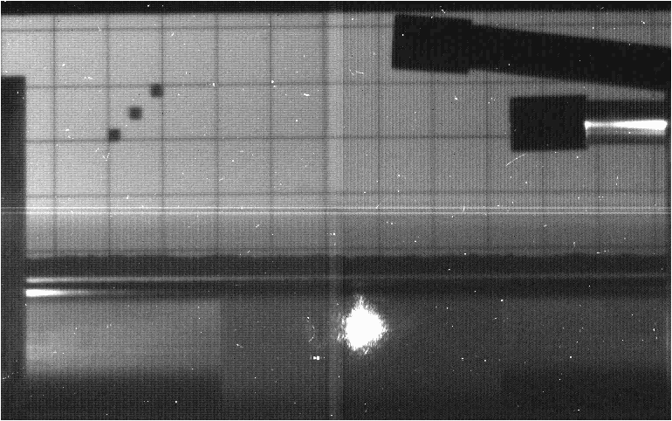
HiRadMat: Run 21
Intensity: 2.94E+11 PoT

Slide 12
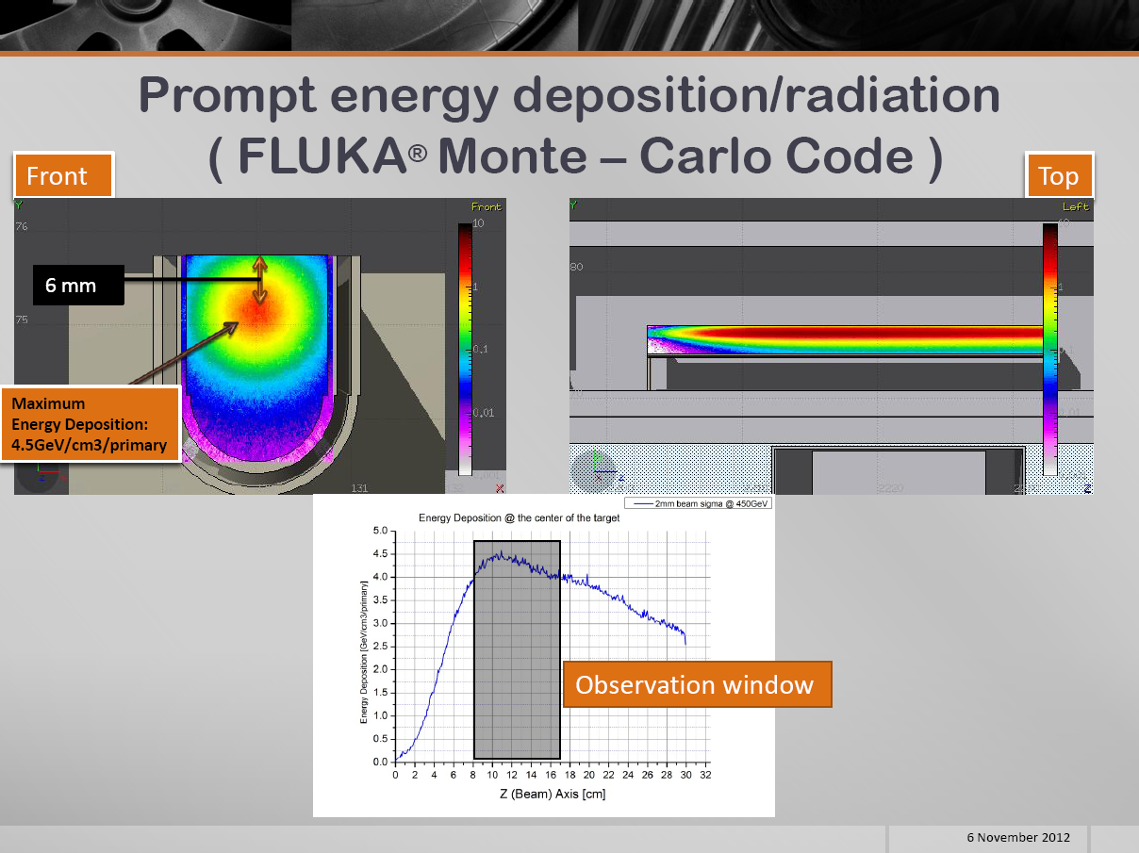

Slide 13
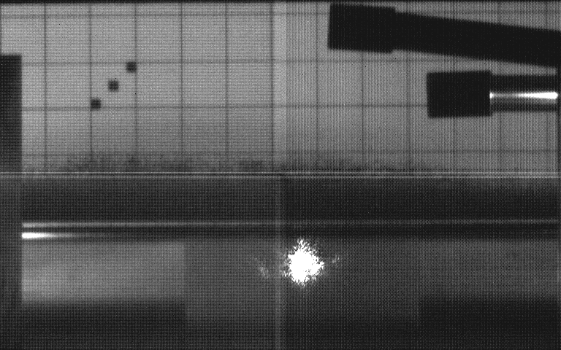
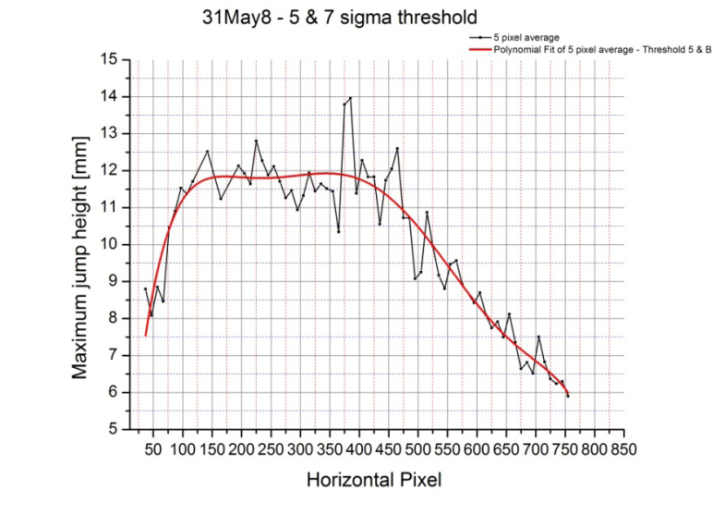
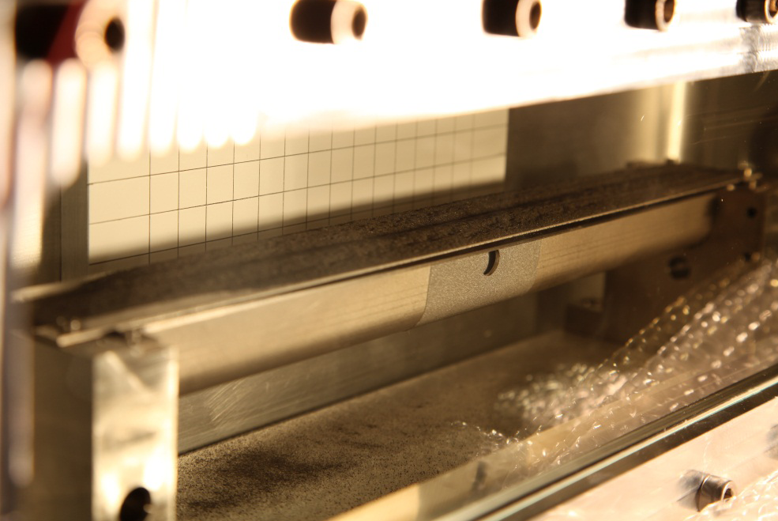

Charitonidis
Lift height correlates with deposited energy
Shot #8, 1.75e11 protons
Note: nice uniform lift
Shot #9, 1.85e11 protons
Note: filaments!
Trough photographed after the experiment.
Note: powder disruption

Slide 14
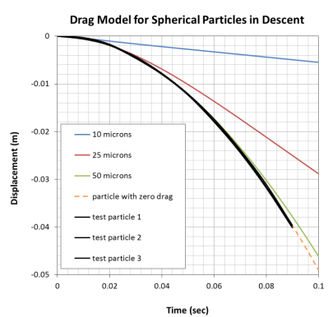
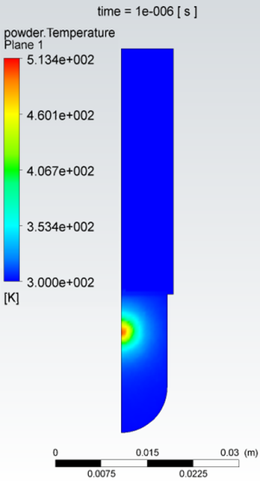
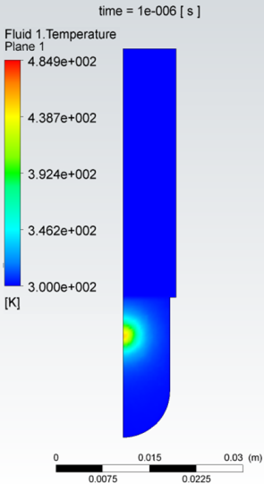
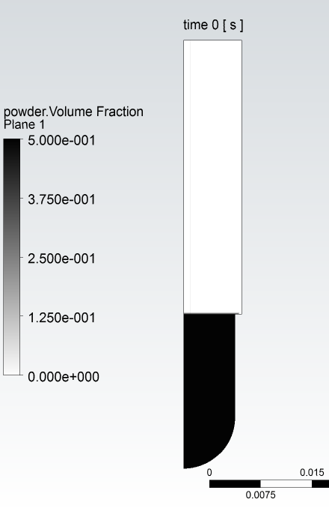
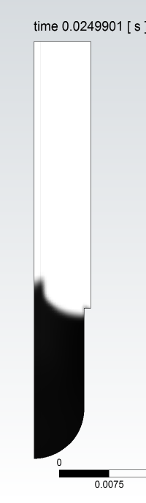
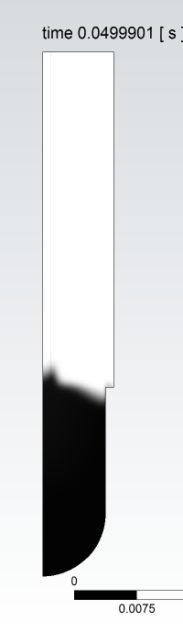
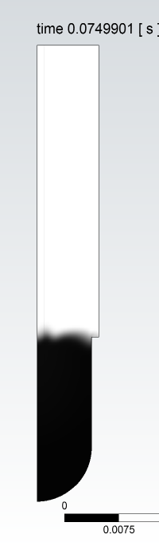

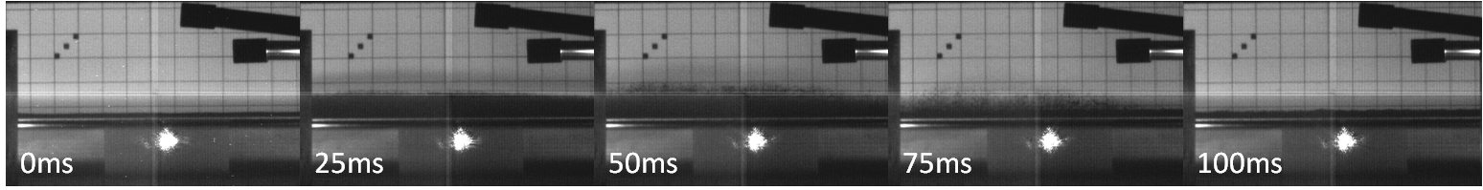
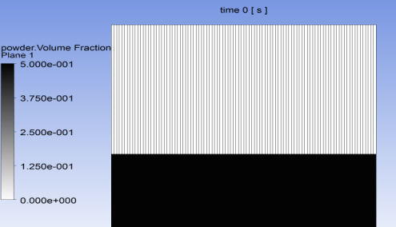
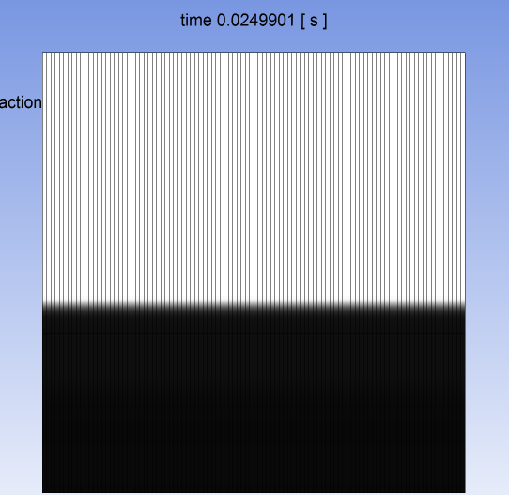
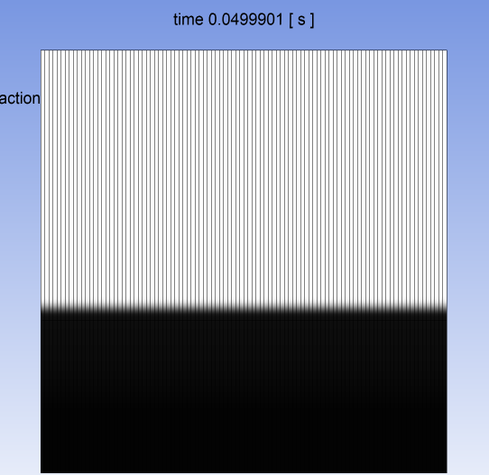
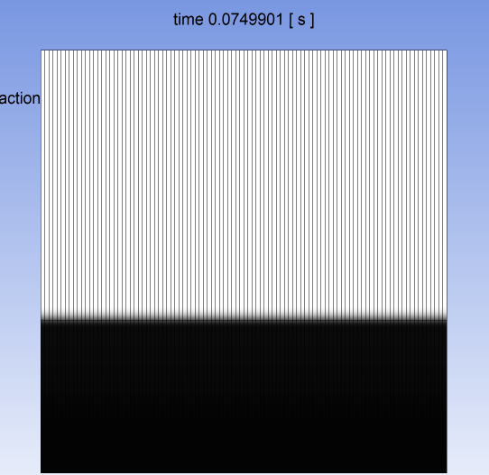
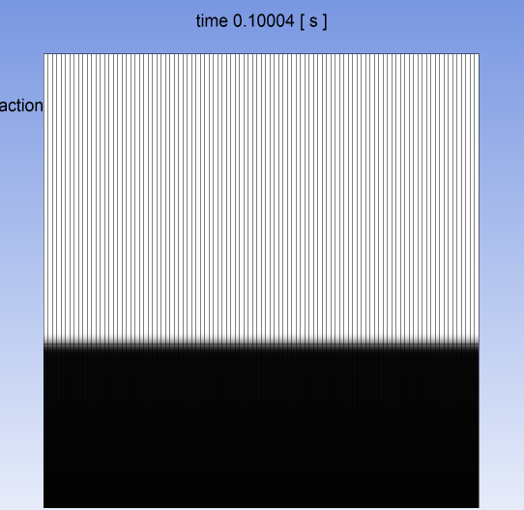
Davenne: CFD predictions/post fits
Beam heating
Average aerodynamic diameter ~30um
Test Results from Shot #8, 1.75e11 protons, beam sigma 0.75 mm x 1.1 mm
CFD simulation of Shot #8, assuming 1 micron particle size
(n.b. no lift with 25 micron particles at this intensity)

Slide 15
Speculating (stumbling in the dark!)
1. EXTERNAL STRESS
A kick from the trough?
Trough resonance perhaps too slow &
Trough does not appear moving in the HSV
2. GAS LIFT
Lift proportional to Energy deposition
CFD says yes but the energy/diameter is rather different.
Drag model is incorrect for W or
is it a different phenomenon?
3. THERMAL STRESS PROPAGATION
Lift proportional to Energy deposition
Too slow and too late compared with propagation
through a solid.
Peak ~40J/g (similar to MERIT) but
100 times lower velocities 0.5m/s.
Is this due to attenuation through the powder?

Slide 16
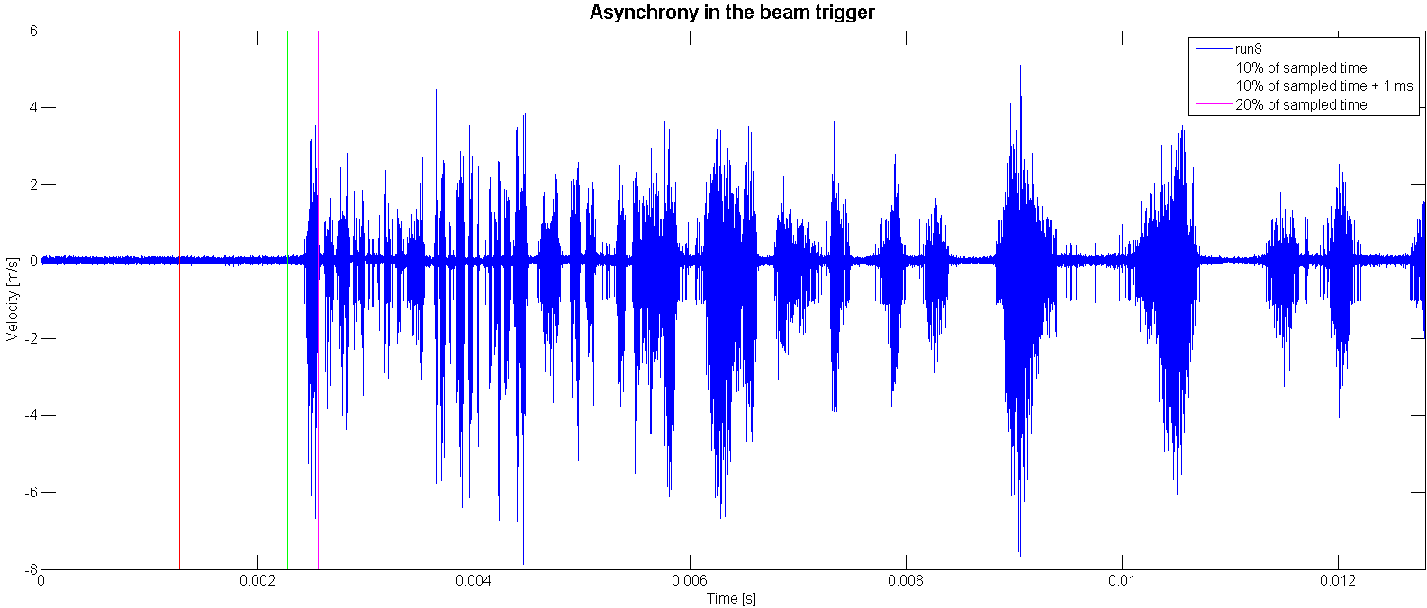
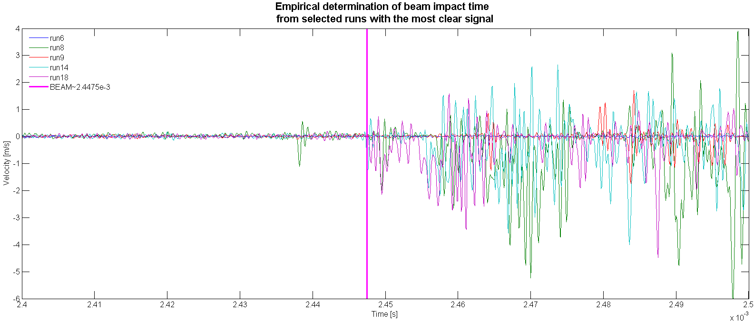
LDV: the problems Part 1
No reliable beam stamp: the gitter
i.e. no measurement of stress wave propagation time!

Slide 17
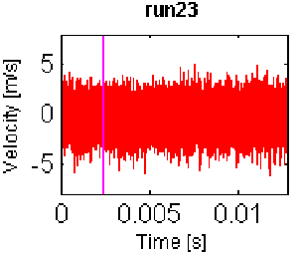
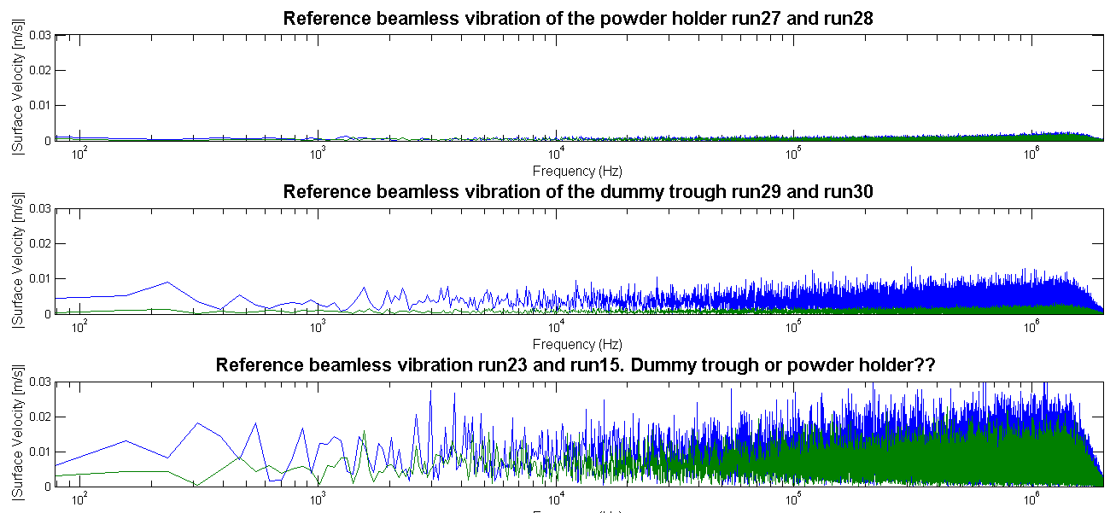
LDV: the problems Part 2
LDV vibration without beam
High frequency
high amplitude noise?!
Yet not in all the runs?!

Slide 18
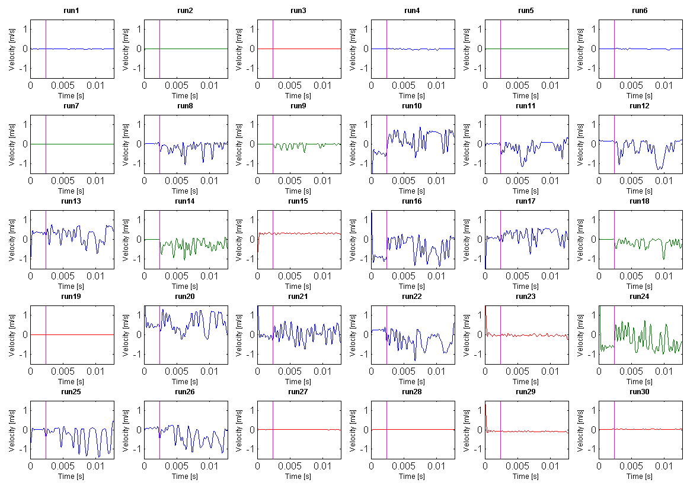
LDV: the problems Part 3
Doom: watch out for the drift!
High vibration velocities before beam impact

Slide 19
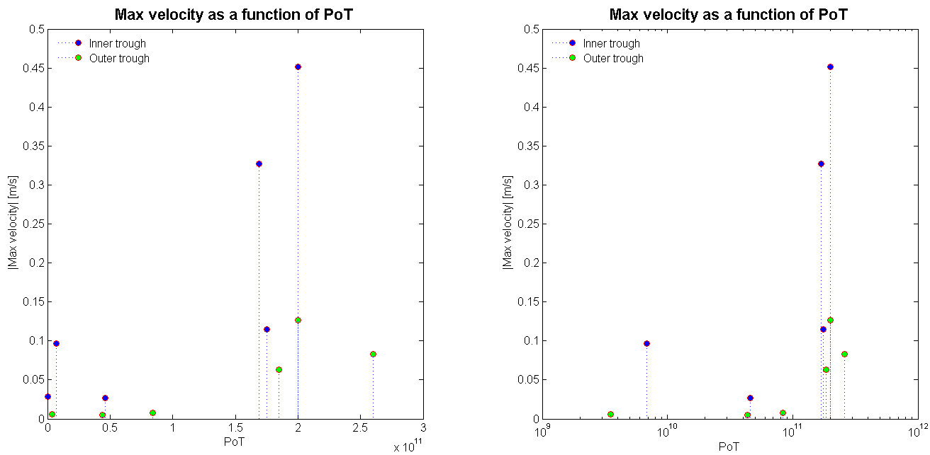
LDV: the good bits
Having taken all the bad data away (technically defined as data massaging!!)
the amplitude of vibration appears proportional to PoT
Vibration amplitude is higher in the inner trough than on the outer trough
There is a 1kHz resonant frequency peak (expected from trough resonance )

Slide 20
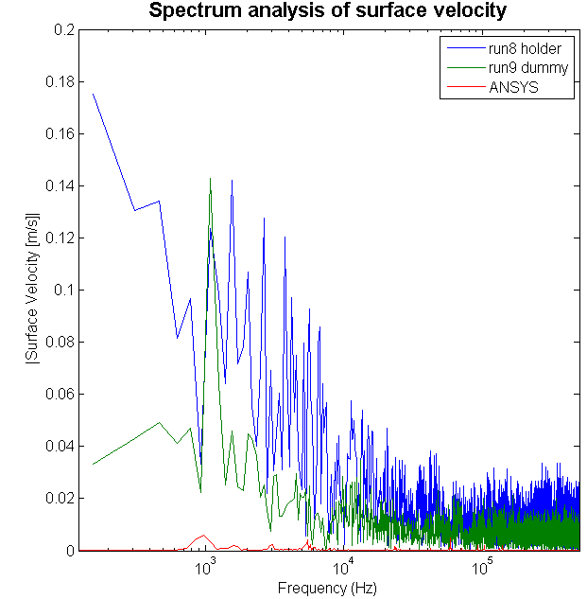
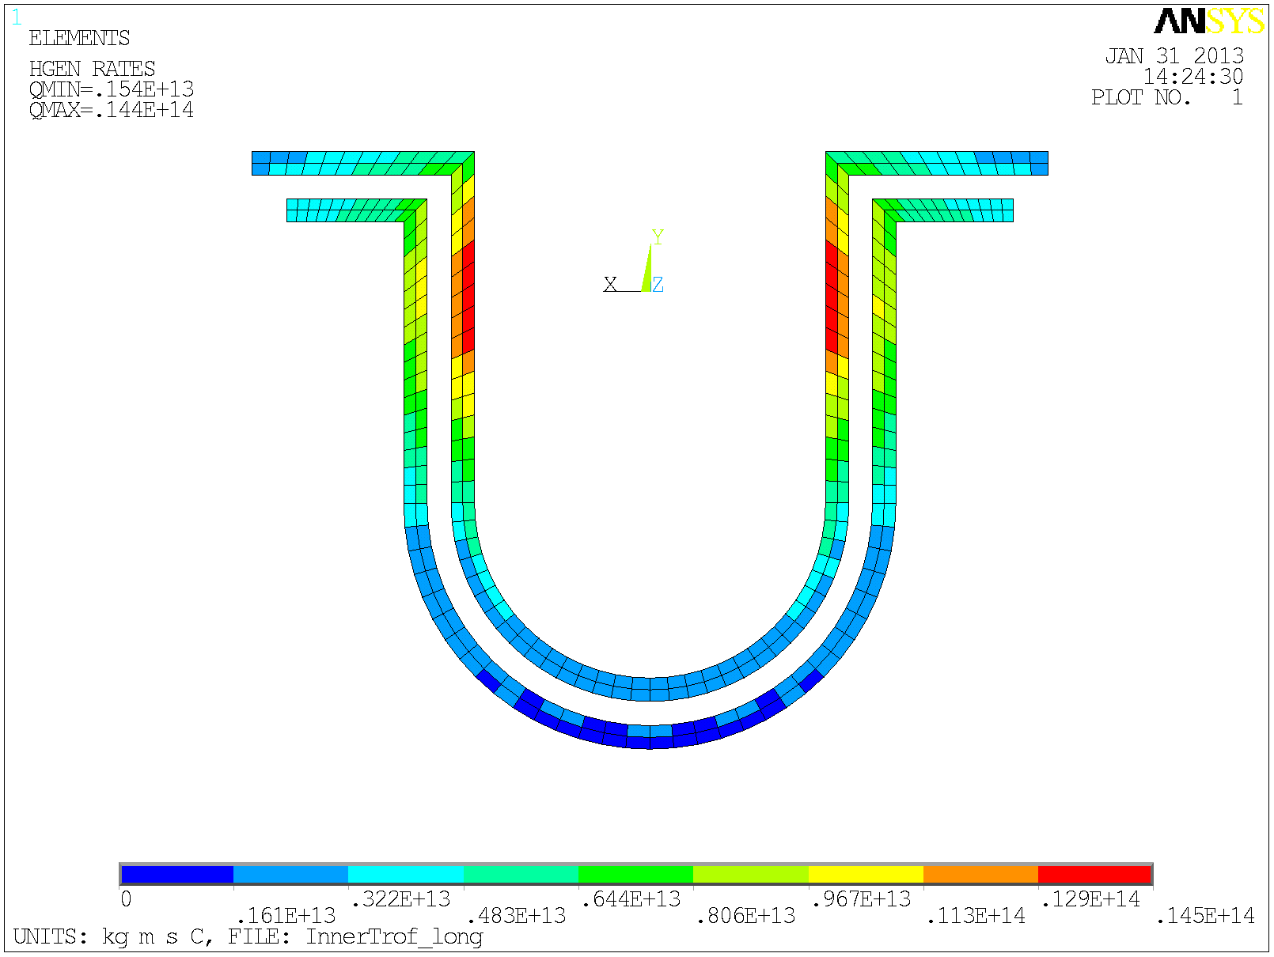


Loveridge: ANSYS predictions
ANSYS vs LDV are “apart” by one order or magnitude
0 J/cc/spill
4.4 J/cc/spill
LDV data, filtered and offset corrected
<Shot #8, 1.75e11 protons, inner trough>
<Shot #9, 1.85e11 protons, outer trough>
Velocity ≈ 1 m/s
ANSYS simulation of secondary heat induced vibrations
Velocity ≈ 0.1 m/s

Slide 21

Lessons learnt and stuff left to do
HiRadMat mark 2 (after CERN shutdown)
  Powder mono-size distribution
  More samples (prevent interference between measurements)
  Full length view of the sample
  Repeat test in He and vacuum (separate Aerodynamic Lift vs momentum transfer)
  LDV
    calibrate signal in situ
    use flat mirrors
    Establish beam gitter
    Watch out for windows interference
  Other general powder work
    Continue generic powder conveying study
    Calorimetric heat transfer
    Evaluate effect of magnetic field

