Slide 1
Advanced Numerical Methods for Simulation of Shock-waves Induced by High Energy Particle Beams
A. Dallocchio ¹, A. Bertarelli ¹, F. Carra ¹, N. Mariani ^{1, 2}
L. Peroni ³, M. Scapin ³
(1) CERN, EN-MME, Geneva, Switzerland
(2) Politecnico di Milano, Milan, Italy
(3) Politecnico di Torino, Turin, Italy
4th High Power Targetry Workshop
MALMÖ, 4 May 2011

Slide 2
Introduction
  Thermally Induced Dynamics
  Simulation Tools
  Material Modelling & Algorithms of Solution
Engineering Case Study:
  Beam Induced Damage on LHC Tungsten Collimator
Experimental Validation:
  CERN HiRadMat Facility
Conclusions
Outline

Slide 3
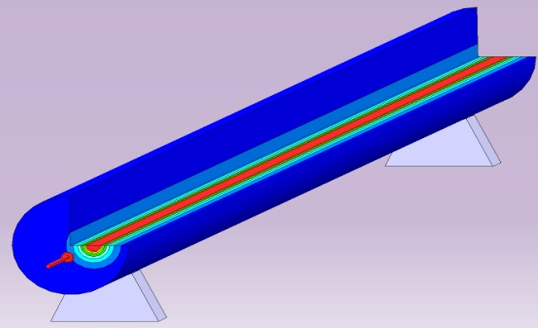
Types of Thermally Induced Dynamic Phenomena
Rapid interactions of particle beams with solids induce Dynamic Responses in matter.
Three main Dynamic Response Regimes exist, depending on several parameters:
  Deposited Energy and Energy Density
  Interaction Duration
  Material Strength ...
Regime 1: Stress waves and vibrations in the elastic domain
Low deposited energy density.
Negligible changes in density.
Wave at Elastic Speed of Sound (C₀)
Treated via analytical approach or with standard FEM codes (implicit or explicit)
Flexural displacement [m]
Experimental Data: Courtesy J. Lettry
Example: CNGS target rods
100 mm Target
Rod (Graphite)
Proton Beam
A. Bertarelli, A. Dallocchio et al.; Journal of Applied Mechanics -- May 2008 -- Volume 75, Issue 3
Thermally Induced Dynamics

Slide 4
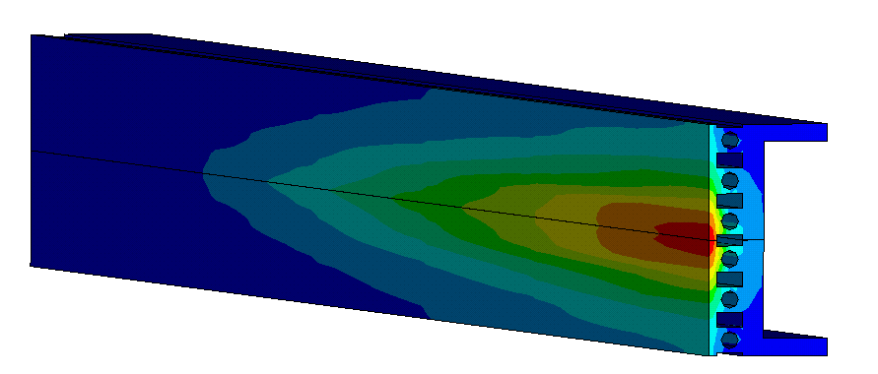
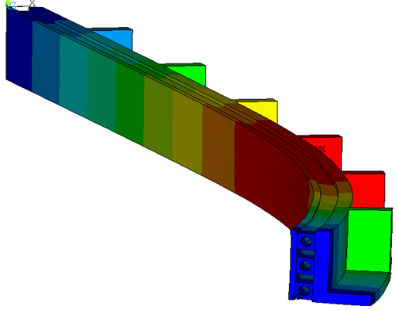
Types of Thermally Induced Dynamic Phenomena
Rapid interactions of particle beams with solids induce Dynamic Responses in matter.
Three main Dynamic Response Regimes exist, depending on several parameters:
  Deposited Energy and Energy Density
  Interaction Duration
  Material Strength ...
Regime 2: Stress waves and vibrations in the elastic/plastic domain
Medium deposited energy density.
Permanent deformations appear.
Wave slower than sound speed.
Can be treated with standard FEM codes (implicit or explicit).
Example: Collimator Metal support
After SPS - TT40 robustness test in 2004
Area of residual plastic strains
A. Dallocchio; PhD Thesis -- CERN-THESIS-2008-140
Thermally Induced Dynamics

Slide 5
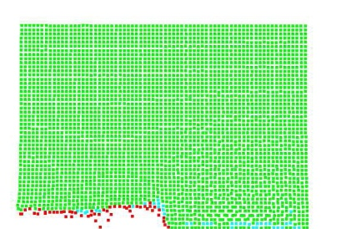



Types of Thermally Induced Dynamic Phenomena
Rapid interactions of particle beams with solids induce Dynamic Responses in matter.
Three main Dynamic Response Regimes exist, depending on several parameters:
  Deposited Energy and Energy Density
  Interaction Duration
  Material Strength ...
Uniaxial Strain Hypothesis
Regime 3: Shock Waves
Shock
Wave
Wave velocity higher than speed of sound
High deposited energy density.
Strains and pressure exceed a critical value.
Wave faster than elastic sound speed. Change of density.
Require special numerical tools.
σ_{c}
Example: Cu Target hit by ²³⁸U beam at GSI
Plastic Wave
Stress/ Pressure
Elastic
Wave
Comparison between simulated beam impact in Autodyn and Metallurgical analysis of impacted Cu target (Courtesy H. Richter / J. Lettry)
ε_{c}
Strain / Volume Change
Thermally Induced Dynamics

Slide 6
Thermally induced Shock Waves and Hydrocodes
Shock waves in beam-induced accidents ...
For W shock waves are produced at ε_{c} > 15% and for Cu at ε_{c} > 7.5% (assuming uniaxial strain)
Strains are intimately related to temperature changes, e.g. for Tungsten:
Shock waves do not appear (in metal based materials) unless changes of phase occur!!!
... and the tools to treat them
Standard structural mechanics tools (e.g. Ansys) are unable to treat problems with changes of phase and of density.
A new class of numerical simulation tools is necessary ⇨ Hydrocodes.
A Hydrocode is a non-linear numerical tool developed to study very fast, very intense loading on materials and structures.
Originally it assumed a hydrodynamic behaviour of material (no strength ⇨ fluid-like material).
Up-to-date Hydrocodes keep material strength into account.
Simulation Tools

Slide 7

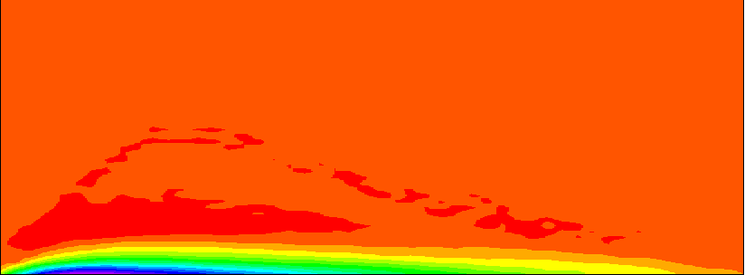

Types of Thermally Induced Dynamic Phenomena
To investigate this phenomenon, a fundamental aspect is the development of methodologies of analysis of the complete problem. To do this, it is essential to look to a multidisciplinary approach.
Physics
Solid
Thermodynamics hydrodynamics
Complex geometry, material behavior, boundaries…
Density (g/cm³)
Liquid
Structural/mechanical engineering
Shockwaves
Plasma
Particle beam
High pressure plasma/liquid
Plasticity at High Strain Rate, Pressure and Temperature
Pressure (GPa)
Thermally Induced Dynamics

Slide 8
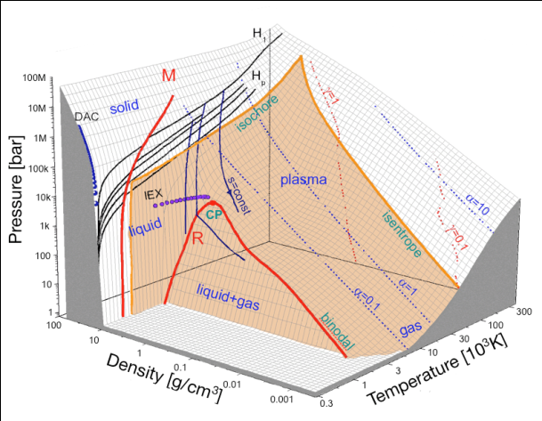
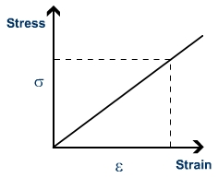
Constitutive Models: Standard Codes vs. Hydrocodes
Standard FEM Codes
Hydrocodes
Linear Elastic Behaviour
Complex Equations of State (EOS)
Mie-Gruneisen
Tabular EOS (SESAME)
Tillotson
....
Replaced by
Young’s modulus E
Static Yield Strength
Multi-parameter Strength Models
Johnson-Cook
Steinberg-Guinan
Johnson-Holmquist
....
Replaced by
Static Failure Strength
Dynamic Failure Models
Replaced by
Material Modelling

Slide 9
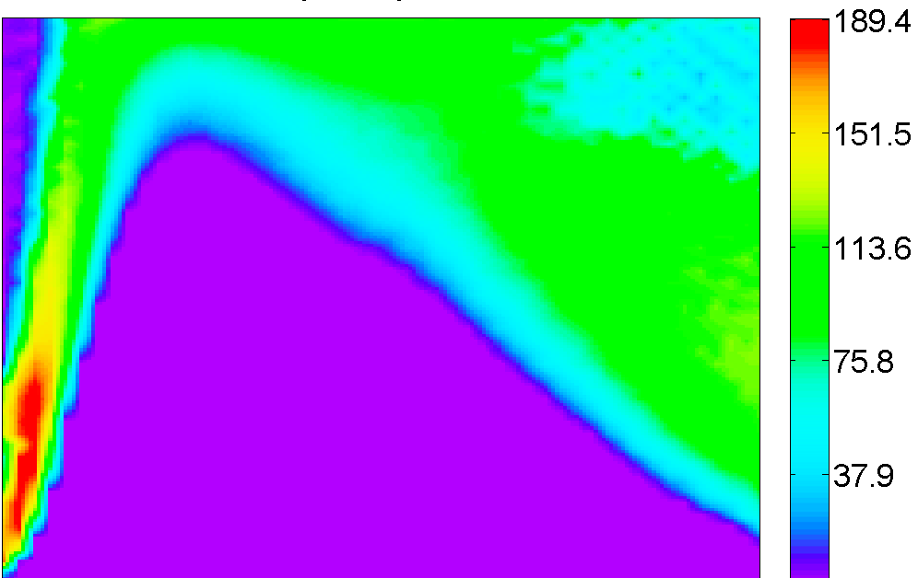
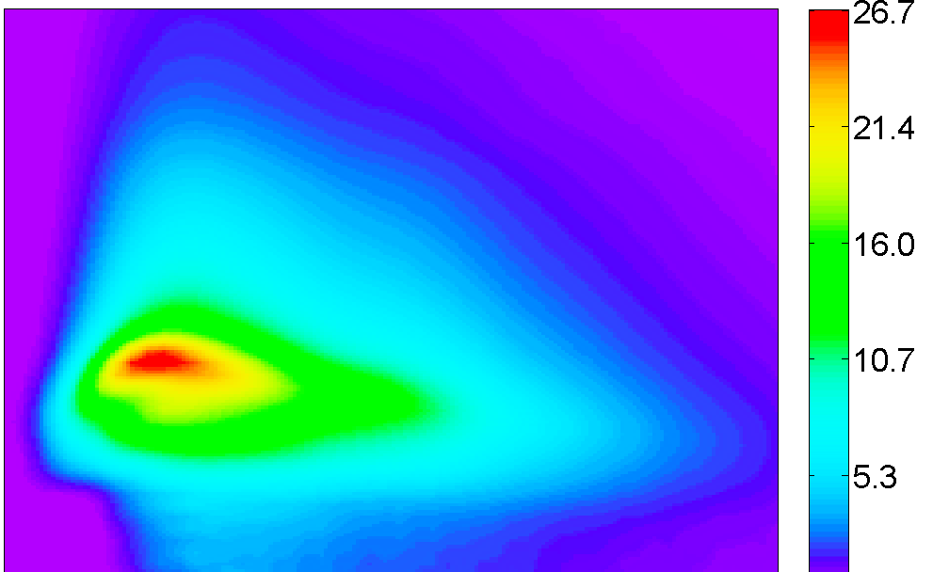
Constitutive Models: Standard Codes vs. Hydrocodes
  Stress tensor = hydrostatic tensor + deviatoric tensor
  (change in volume)
  (change in shape)
p = f (ρ,E,T…)
Grüneisen
Polynomial
Tillotson, Puff, GRAY
Tabular (SESAME, EOSPRO…)
Pressure (GPa)
Von Mises stress (MPa)
Johnson–Cook
Steinberg–Lund
Zerilli–Armstrong
Material Modelling

Slide 10
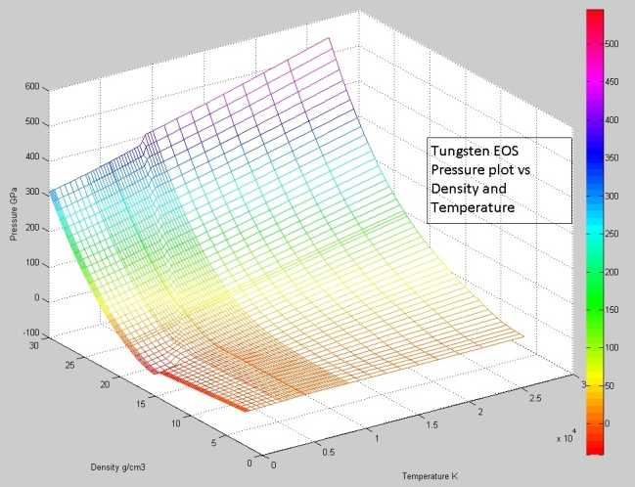
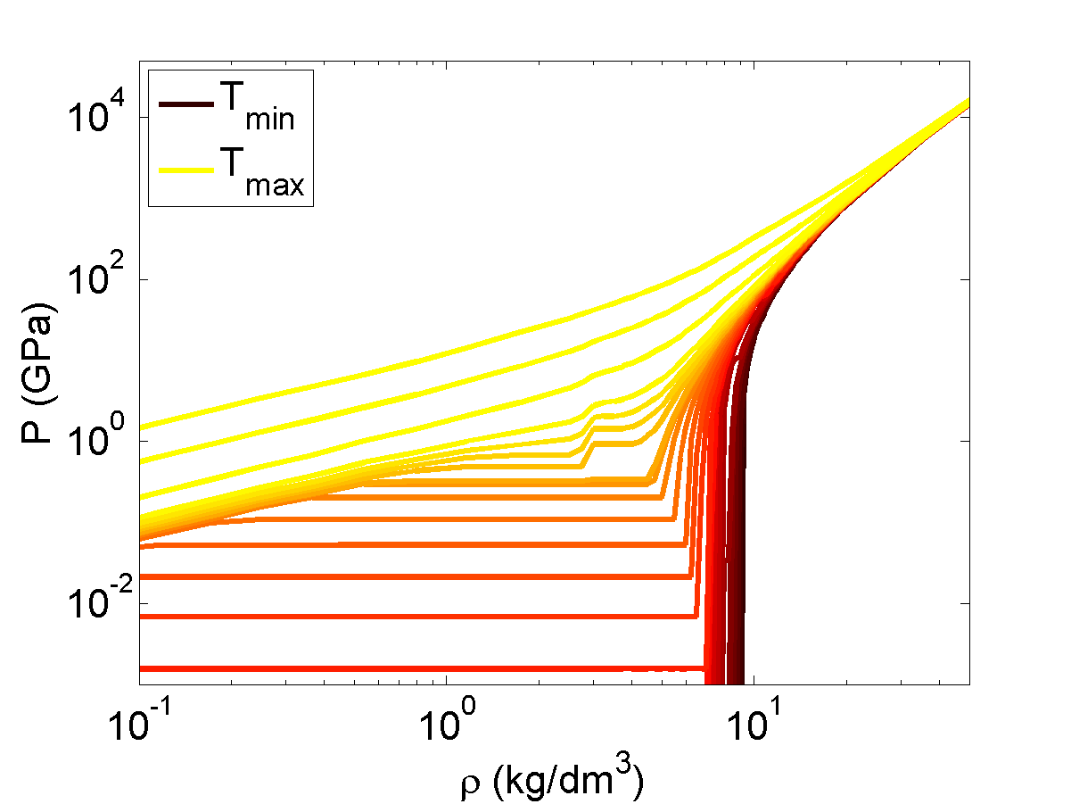
Equation of State Modelling
Tabular EOS (SESAME)
Polynomial EOS
Different analytical Models for different regions of ρ-T space for best fitting:
Tabular EOS Polynomial interpolation:
  defined over the Region of interest
  P=f(E) with f linear
  2 different polynomials for Compression (c, μ<0) and Rarefaction (T, μ>0);
W EOS (Kerley Technical Service)
Region of interest
Cu EOS (SESAME)
Material Modelling

Slide 11
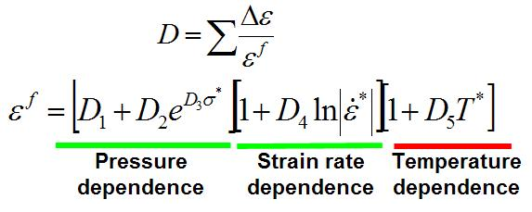
Failure Models
There is not a unique Failure Model
Different Models for Different Failure Mechanisms and Materials
Ductile Failures on high deformable materials (Cu):
Johnson-Cook Failure
Ductile Failures on low deformable materials (W Alloys):
Plastic Strain Failure
Ductile-Brittle Failures with very high strain rates
(Shock Wave propagation):
Spall Strength
(Failure due to Rarefaction Wave)
Identification of Parameters Depends on Failure Conditions
Need for Specific tests to Validate Failure Models
Material Modelling

Slide 12
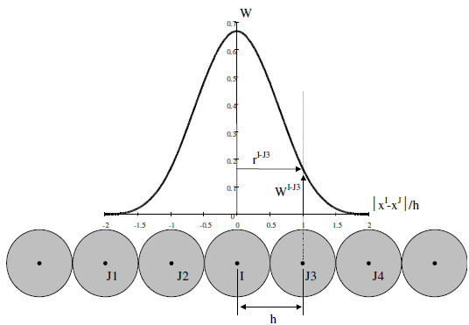

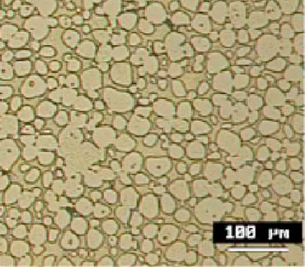
Smoothed Particle Hydrodynamics (SPH) Mesh
  Lagrangian Mesh:
  multi-node elements with shared nodes.
  SPH Mesh: single-node elements interaction modeled via Weighting Function (W) and Smoothing Length (h); Density (ρ) expressed as a function of W and h.
  SPH Tips and Tricks:
  Mesh size:
  Accurate damage assessment (splashing) vs. CPU Time
  W-Alloy: Inermet 180
  Microstructure: W grains embedded with Cu-Ni phase bonder: Typical Dimensions 50-100 μm
  Time Step
  5-10 times smaller w.r.t. Lagrangian mesh.
Possibility to study crack propagation inside the target and motion of expelled fragments/liquid droplets.
Algorithms of Solution

Slide 13
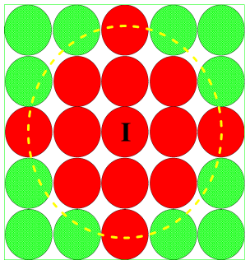
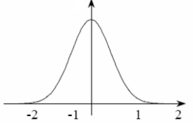
Smoothed Particle Hydrodynamics (SPH) Mesh
  Lagrangian Mesh:
  multi-node elements with shared nodes.
  SPH Mesh: single-node elements interaction modeled via Weighting Function (W) and Smoothing Length (h); Density (ρ) expressed as a function of W and h.
  SPH Tips and Tricks:
  Failure Model for Tungsten: Spall Strength
  Failure due to Rarefaction Shock-Wave
  Failure model:
  Distance between Interacting SPH Particles must be < 2h
  (to avoid energetic errors); Plastic Strain Failure Models could leads to energetic instabilities.
Possibility to study crack propagation inside the target and motion of expelled fragments/liquid droplets.
Algorithms of Solution

Slide 14
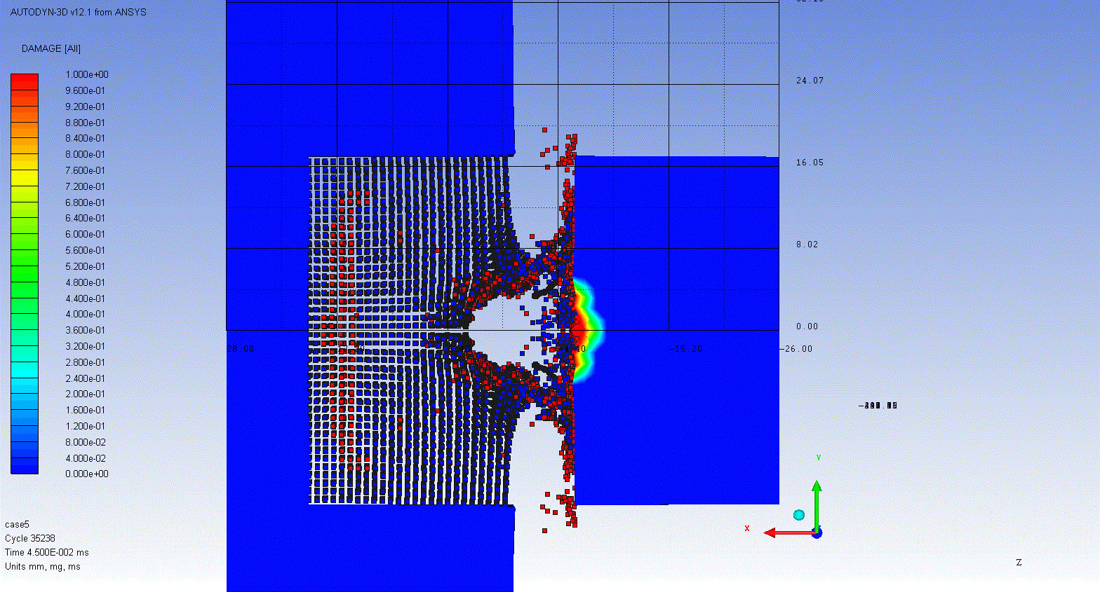
Smoothed Particle Hydrodynamics (SPH) Mesh
  Lagrangian Mesh:
  multi-node elements with shared nodes.
  SPH Mesh: single-node elements interaction modeled via Weighting Function (W) and Smoothing Length (h); Density (ρ) expressed as a function of W and h.
  SPH Tips and Tricks:
  SPH-Lagrangian Mesh Interaction:
  Effects of highly energetic droplets 10²-10³ m/s
Possibility to study crack propagation inside the target and motion of expelled fragments/liquid droplets.
Algorithms of Solution

Slide 15
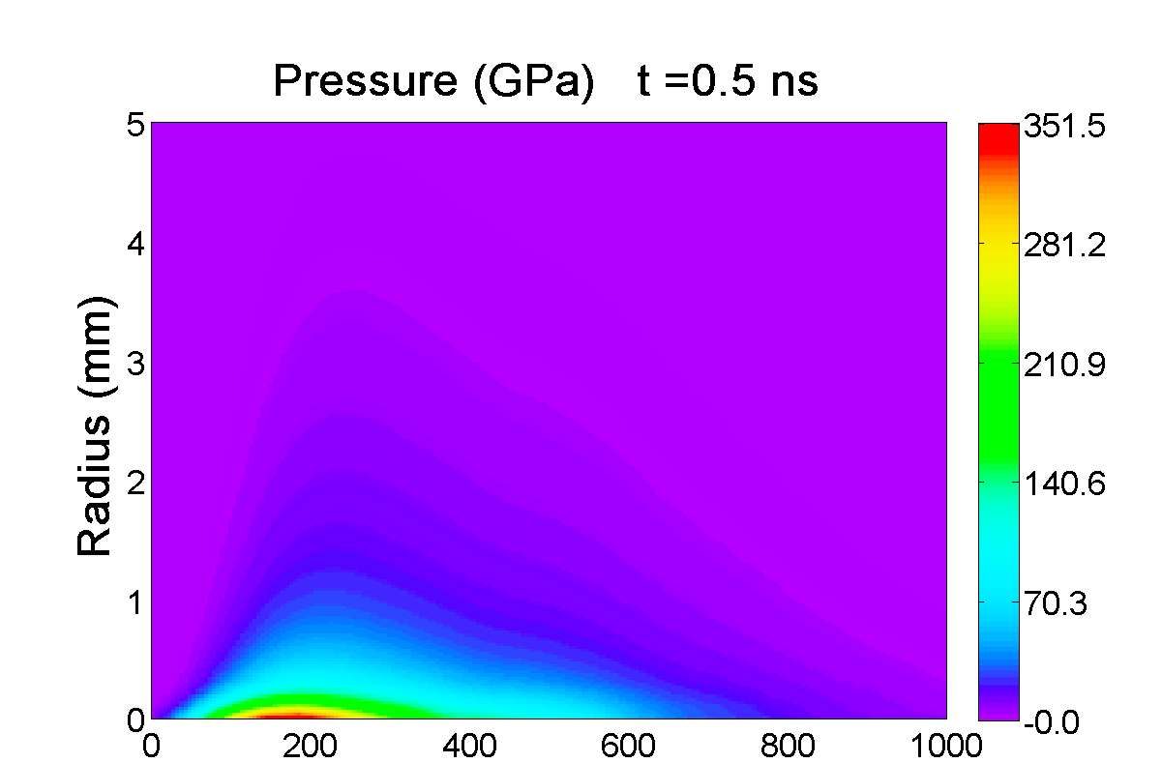
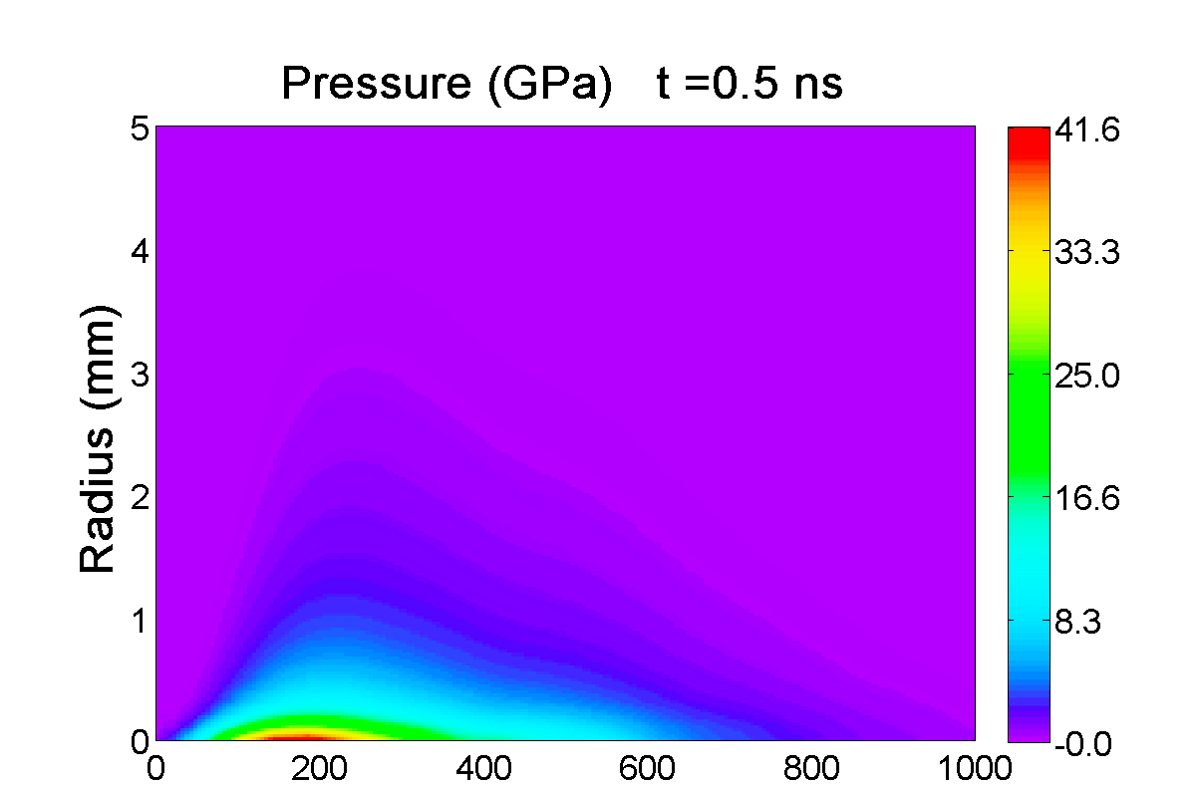
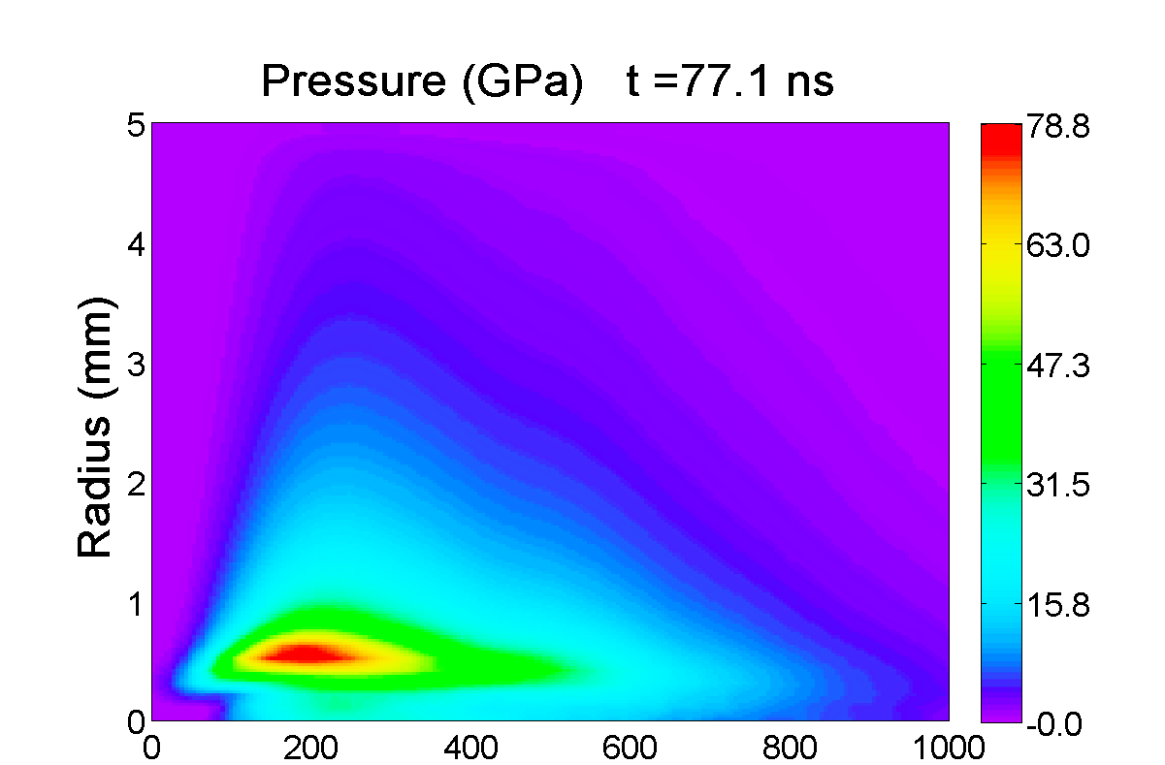
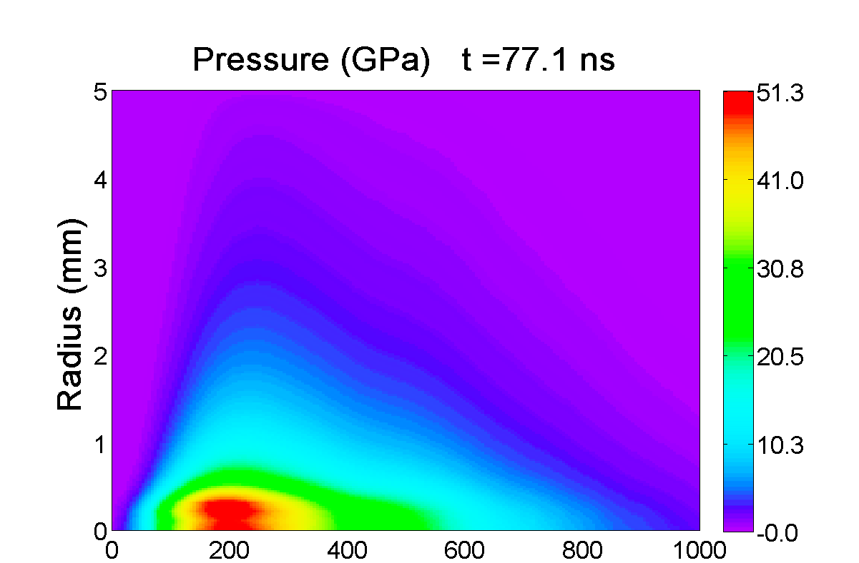
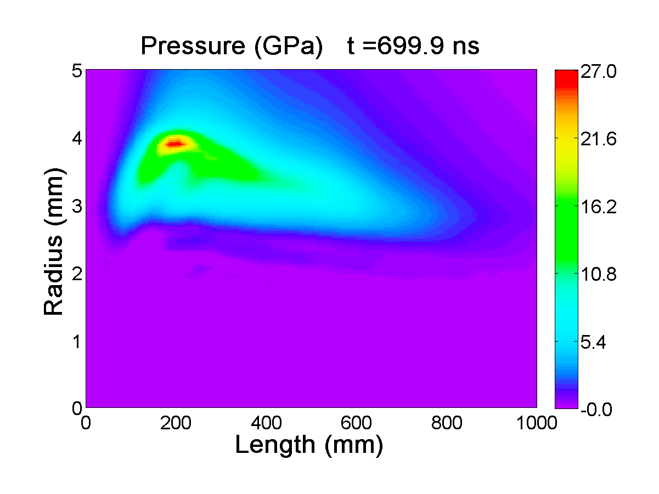
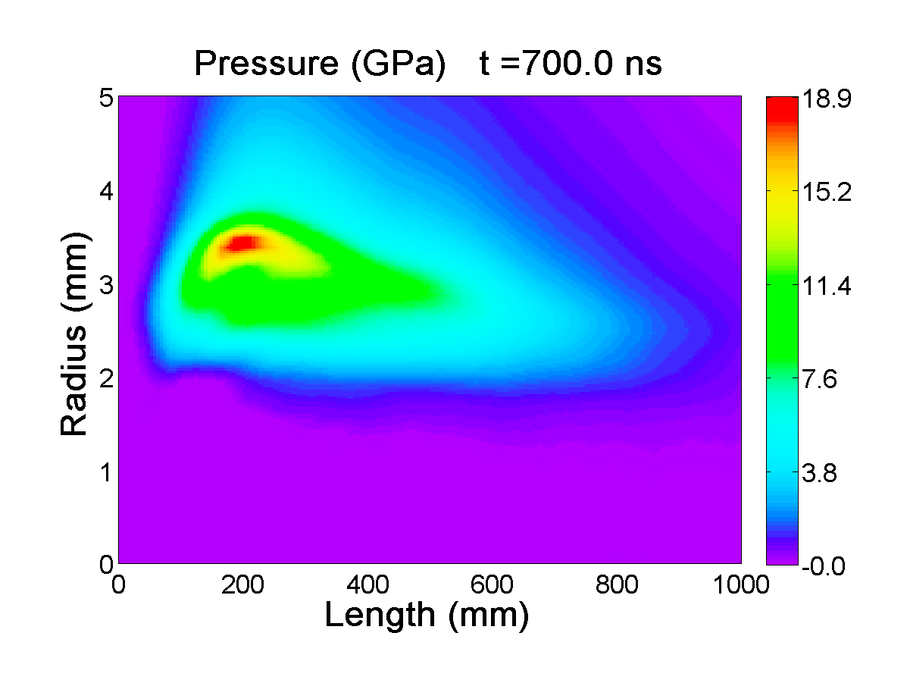
Effect of Bunch Spacing
Cu thin rod hit by 8 LHC bunches
2
□
□
2
□
1
□
1
Element 1
Deposition as 8 bunches profile
00
00
Deposition as initial condition E₀
(ns)
Element 2
00
00
00
00
(ns)
Energy Deposition

Slide 16
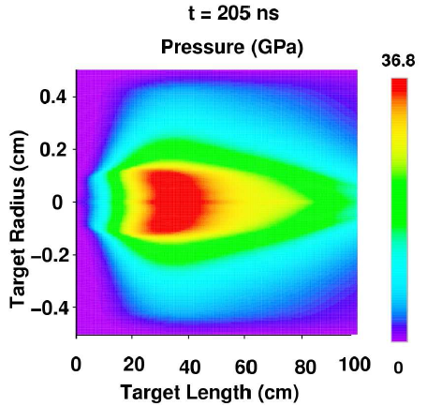
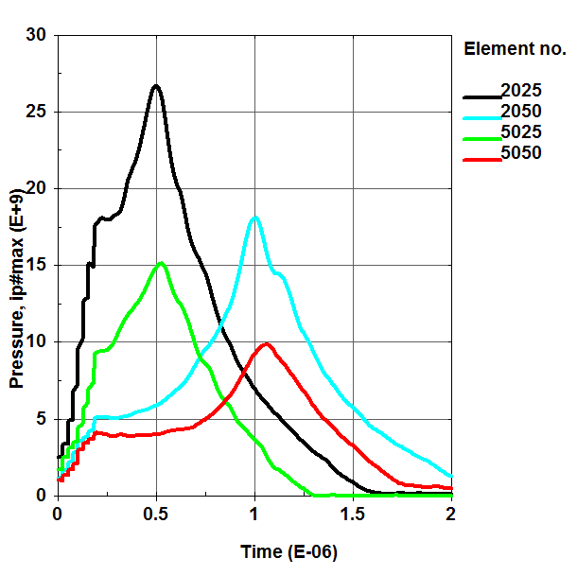
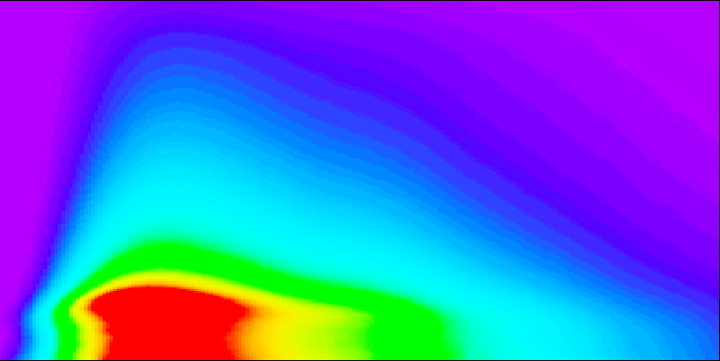
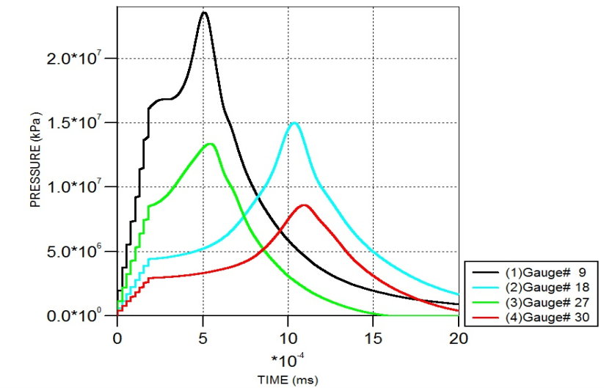
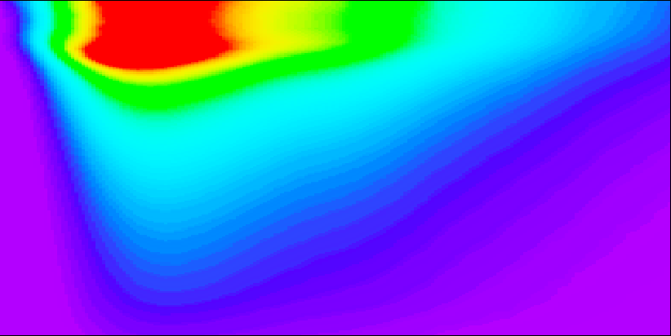
Hydrocodes: Benchmarking on Cylindrical Cu Target
CERN (Autodyn), Politecnico di Torino (LS-Dyna) and GSI (BIG-2)
Pressure (GPa)
LS-Dyna
Diameter (cm)
Diametro (cm)
BIG2 (N. Tahir)
Autodyn
Diametro (cm)
Diameter (cm)
LS-Dyna
Length (cm)
M. Scapin, A. Dallocchio, L. Peroni, “Thermo-mechanical modeling of high energy particle beam impact”. ACE-X 2010, Paris. Under review for publication on “Numerical Modeling of Materials Under Extreme Conditions”, Springer.
Benchmarking of Numerical Codes

Slide 17
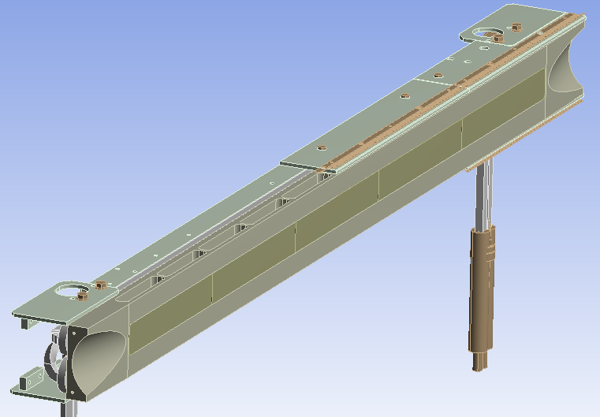
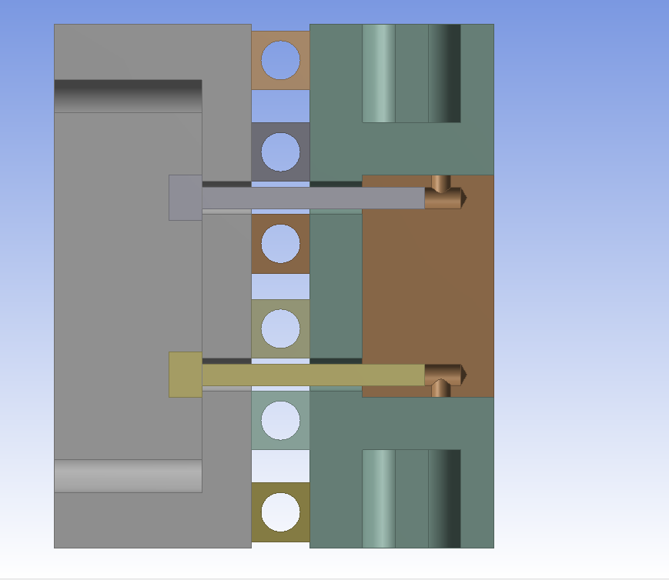
LHC Tertiary Collimator (Tungsten Jaws)
+/-10 mm through 5th axis
Stiffener
(Glidcop
modeled as OFE-Cu)
Water
Screw (x40)
(Stainless Steel)
Bloc Support
(OFE-Copper)
Cooling Pipes
(Cu(89%)-Ni(10%)-Fe(1%) modeled as OFE-Cu)
Jaw bloc (x5)
(W(95%)-Ni(3.5%)-Cu(1.5%)
partly modelled as pure W)
Material | EOS | Strength model | Failure model
Tungsten | Tabular (SESAME) | Johnson-Cook | Plastic strain/ Hydro (Pmin)
Copper OFE | Polynomial | Johnson-Cook | Johnson-Cook
Stainless steel AISI 316 | Shock | Johnson-Cook | Plastic strain
Water | Shock | - | Hydro (Pmin)
Engineering Case Study

Slide 18
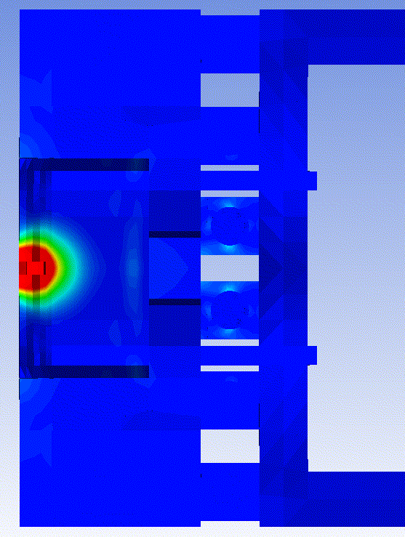
Accidental Cases and Damage Classification
Case | Beam Energy [TeV] | Norm. Emittance [μm rad] | Impacting Bunches | Particles per Bunch | Bunch spacing [ns] | Impact Depth [mm] | Deposited Energy on Jaw [kJ] | TNT Equivalent [g]
1 | 3.5 | 3.50 | 1 | 1.3x10¹¹ | - | 2 | 38.6 | 9.2
2 | 5 | 7 | 1 | 1.3x10¹¹ | - | 2 | 56.2 | 13.4
3 | 5 | 3.5 | 1 | 1.3x10¹¹ | - | 2 | 56.5 | 13.5
4 | 5 | 1.75 | 1 | 1.3x10¹¹ | - | 2 | 56.6 | 13.5
5 | 5 | 1.75 | 2 | 1.3x10¹¹ | 25 | 2 | 111.3 | 26.6
6 | 5 | 1.75 | 4 | 1.3x10¹¹ | 25 | 2 | 216.1 | 51.6
7 | 5 | 1.75 | 8 | 1.3x10¹¹ | 25 | 2 | 429.8 | 102.7
Three different damage scenarios, with increasing severity:
  Level 1 (Collimator need not be replaced). Permanent jaw deformation and damage are limited.
  Level 2 (Collimator must be replaced). Collimator and other components (e.g. Screws) are fatally compromised.
  Level 3 (Long down time of the LHC). Catastrophic damage to collimator leading to water leakage into beam vacuum (pipe crushing, tank water circuit drilling ...)
Jaw Damaged Area (red)
Level 1 : H ≤ 8 mm
Level 2: H > 8 mm
Engineering Case Study

Slide 19
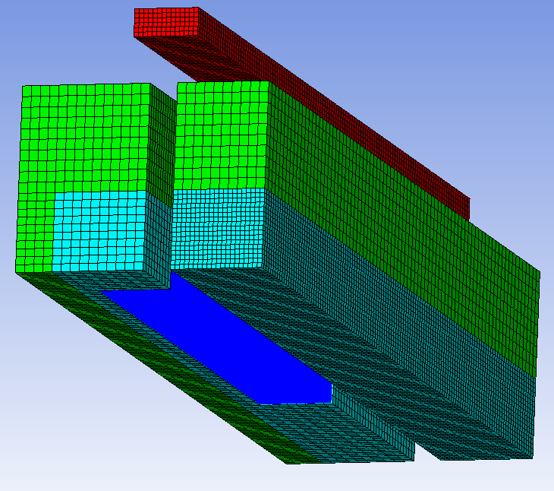
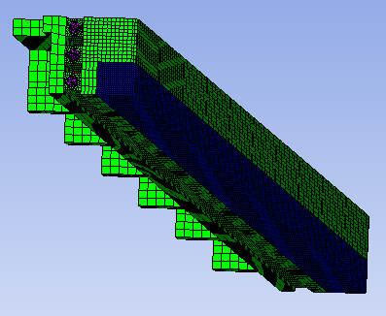
SPH vs. Lagrangian Mesh
  SPH Simulations
  Lagrangian Simulations
  First W Sector of Jaw (Length 200 mm)
  Complete Jaw (Length 500 mm)
  Lagrangian Parts
  All Lagrangian parts
  SPH Part
  Lagrangian Mesh: Shock Wave propagation along the entire structure (W inserts, Cu Jaw, Cooling Pipes, Stiffener)
  SPH Mesh: W Insert LOCAL Damage due to Beam Impact; Surrounding Lagrangian parts for Boundary Conditions
Engineering Case Study

Slide 20
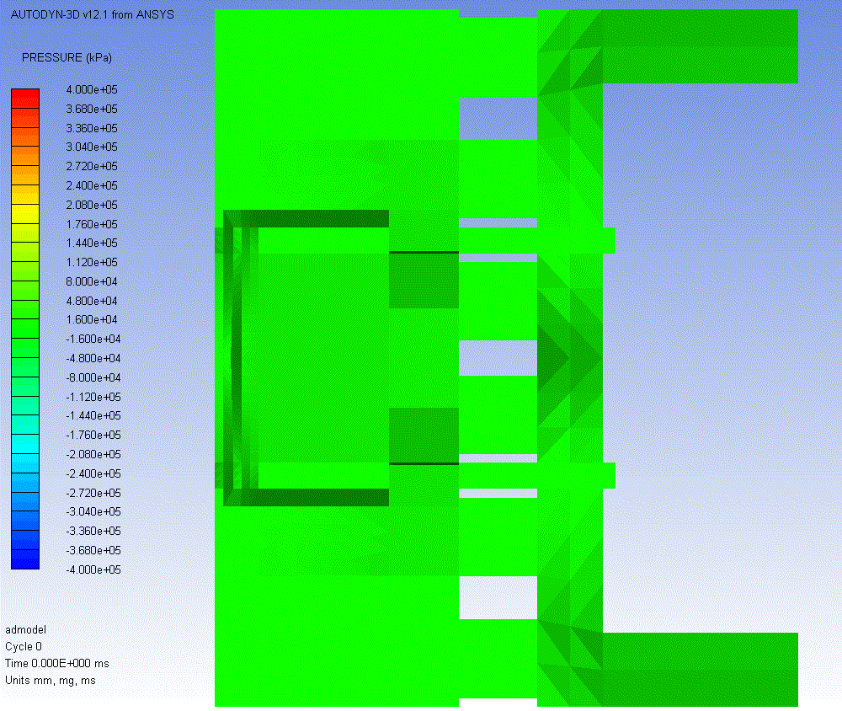
Shock-Wave Propagation (Lagrangian Mesh)
Single-bunch @ 5 TeV.
400 MPa
-400 MPa
Pressure
Accident Simulations for TCT

Slide 21
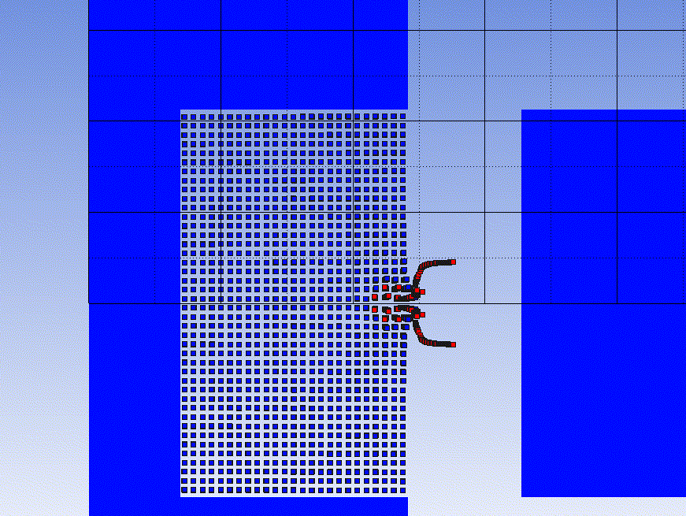
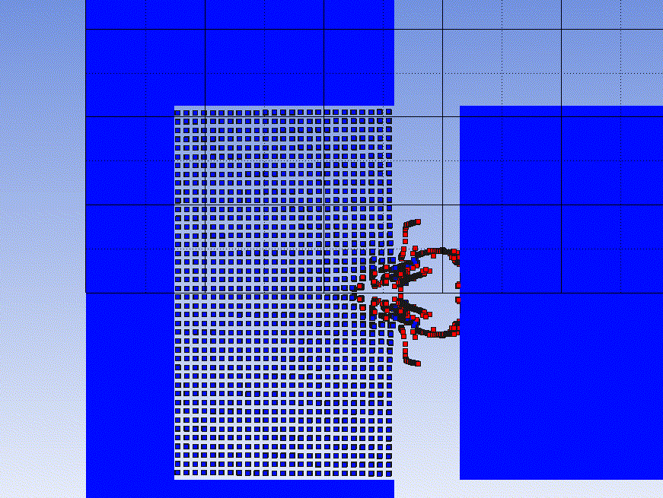
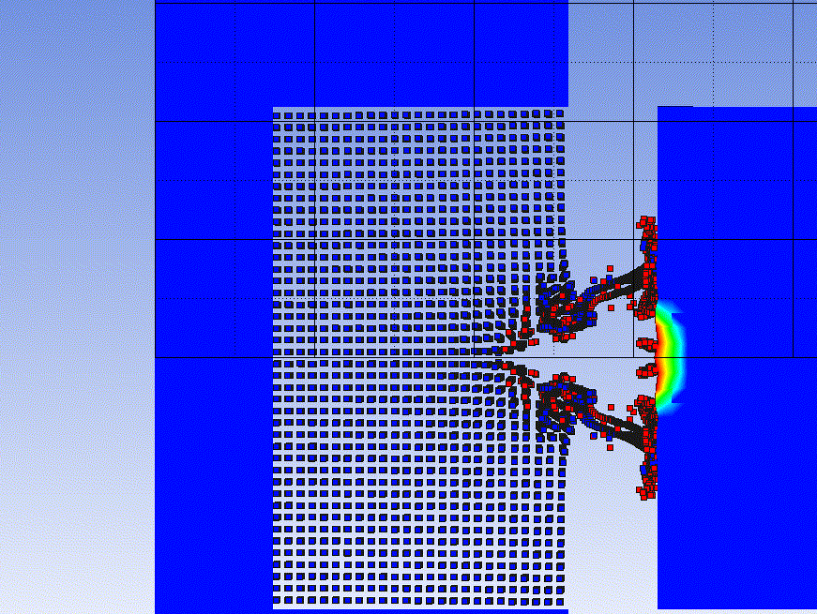
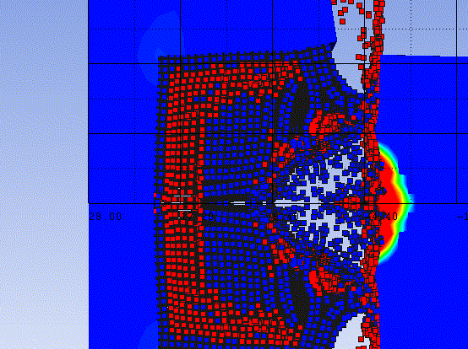
SPH simulation: W Jaw Damage Assessment
1 Bunch @ 3.5TeV
1 Bunch @ 5TeV
2 Bunches @ 5 TeV
4 Bunches @ 5 TeV
8 Bunches @ 5 TeV
Case 1
Case 2
Case 3
Case 4
Case 5
Engineering Case Study

Slide 22
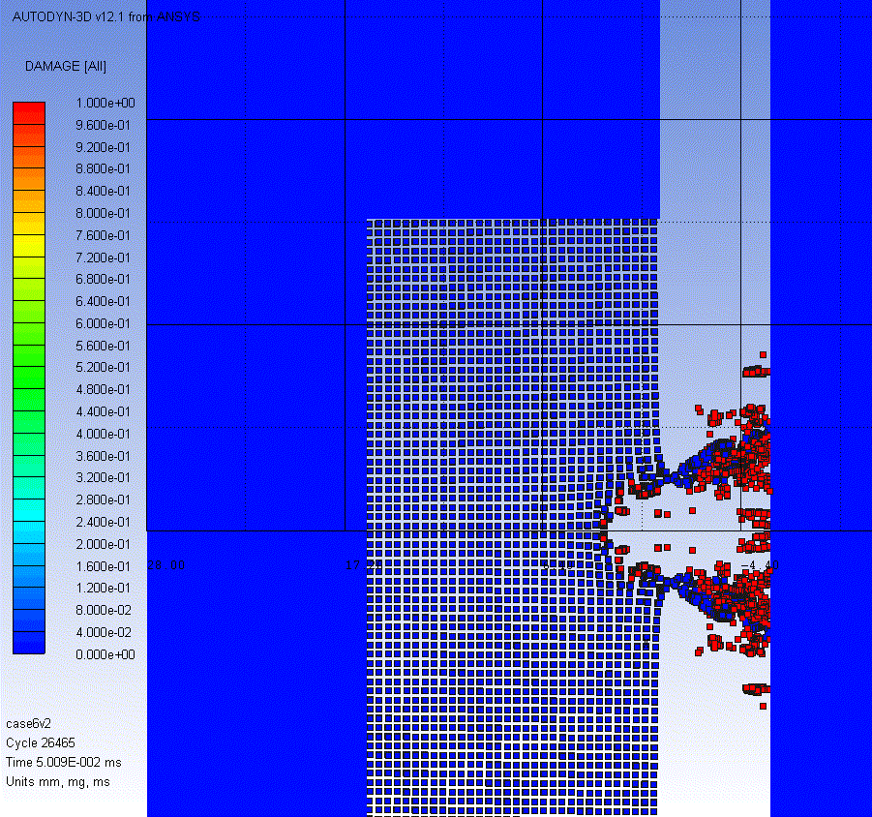
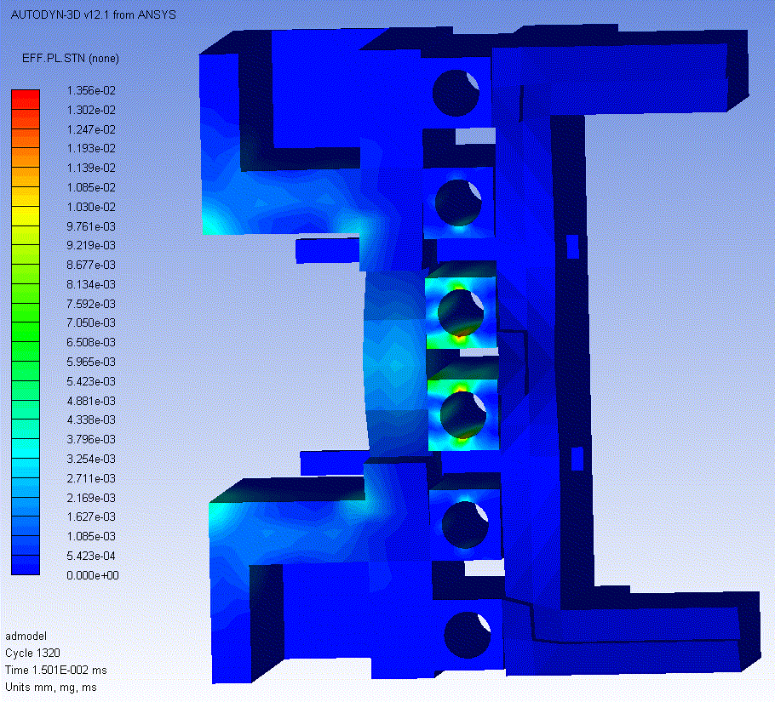
Damage Level 1 (In-situ spare surface)
1 LHC Bunch @ 5TeV.
Plastic deformations on cooling pipes and screws remain limited.
8mm damage on impacted jaw.
Particle Spray on a larger area on opposite jaw.
Max 1.4% (on Water Pipes)
~8 mm
Particle spray on opposite jaw. Sticking droplets?
Plastic Strain
Engineering Case Study

Slide 23
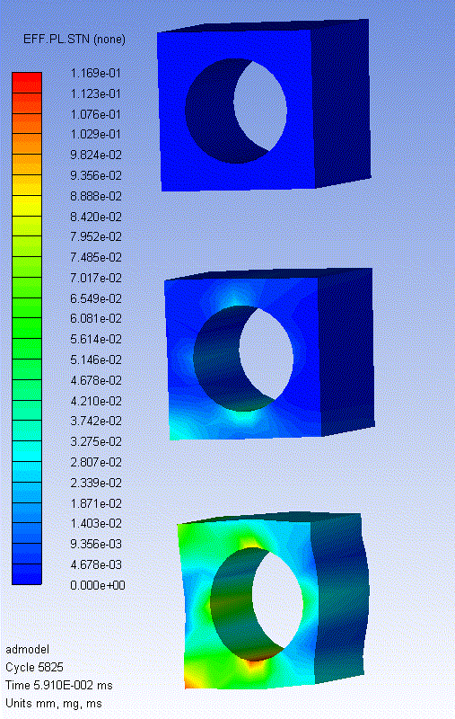
Damage Level 2 (Collimator to be replaced)
4 LHC Bunches @ 5TeV impacting at 2mm from jaw surface
Severe plastic deformations on cooling pipes and screws.
Permanent damage to opposite jaw due to particle spray.
Plastic deformation
of Pipes (max 12%)
Damaged Zone on W Jaw > 20 mm
Engineering Case Study

Slide 24
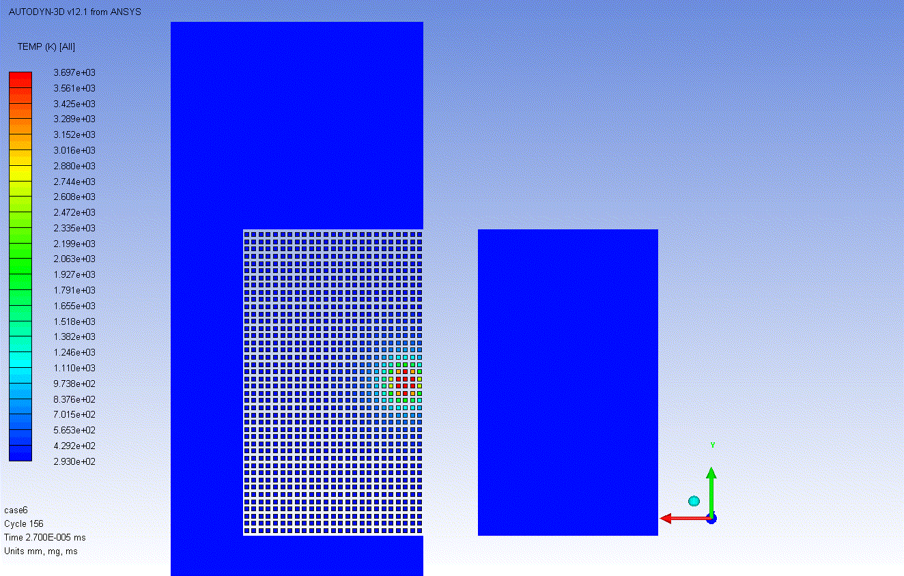
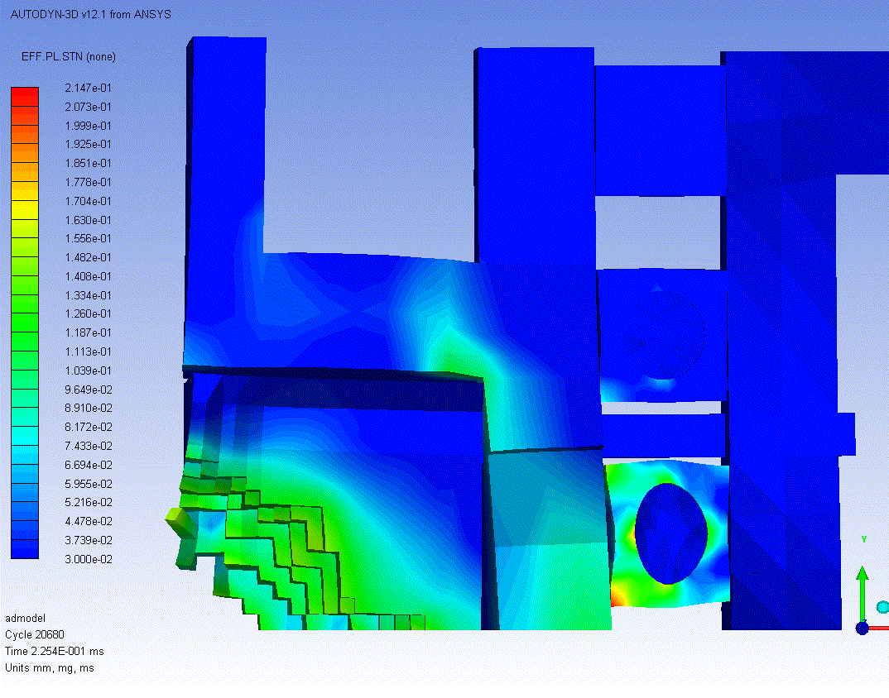
Damage Level 3 (Catastrophic Damage)
8 LHC Bunches at 5 TeV.
High probability of water leakage due to very severe plastic deformations on pipes.
Impressive jaw damage :
  Extended eroded and deformed zone.
  Projections of hot and fast solid tungsten bullets (T≈2000K, V_{max} ≈ 1 km/s) towards opposite jaw. Slower particles hit tank covers (at velocities just below ballistic limit).
  Risk of “bonding” the two jaws due to the projected resolidified material.
Engineering Case Study

Slide 25
Constitutive Models: Standard Codes vs. Hydrocodes
Flies in the ointment
Most pure material EOS are drawn from military research (mainly Los Alamos). Unfortunately these data are frequently inaccessible as they are classified.
EOS for specific mixtures and alloys are often totally unavailable.
There is no “fit-any-material” Strength or Failure Model. There is a generalized lack of experimental data for these models under extreme conditions (e.g intense beam impacts).
Approximations and extrapolations are inevitable for each of the three “ingredients” of the Hydrocode tools.
Data for pure metal (more easily available) are often used in place of alloys.
All presented results are unavoidably affected by these uncertainties.
Only dedicated experimental tests can provide the correct inputs for simulations.
  ➔ HiRadMat Facility at CERN
Experimental Validation

Slide 26
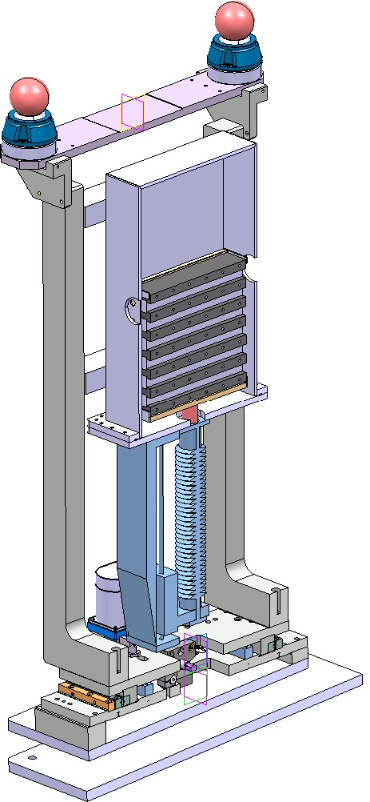
CERN HiRadMat Facility
HiRadMat:
High Radiation to Materials Project: development of a new facility at CERN.
Multi-bunch beam impact tests using SPS Beam up to 450 GeV.
Material Test Bench
Several Material candidates (“standard” + advanced).
Metals
  GlidCop, W, Mo
Ceramics
  Graphite, SiC
Metal-Diamond Composites
  CuCD, MoCD...
Material Properties
(EOS, Strength and Failure Models)
Numerical Simulation of the HiRadMat tests
(FLUKA, LSDYNA, AUTODYN)
Experimental Measurements
(LDV Laser Interferometer, PVDF, Strain Gauges, Thermal probes
+ post mortem analysis)
Validation of Material Models and of Numerical Tools.
Experimental Validation

Slide 27
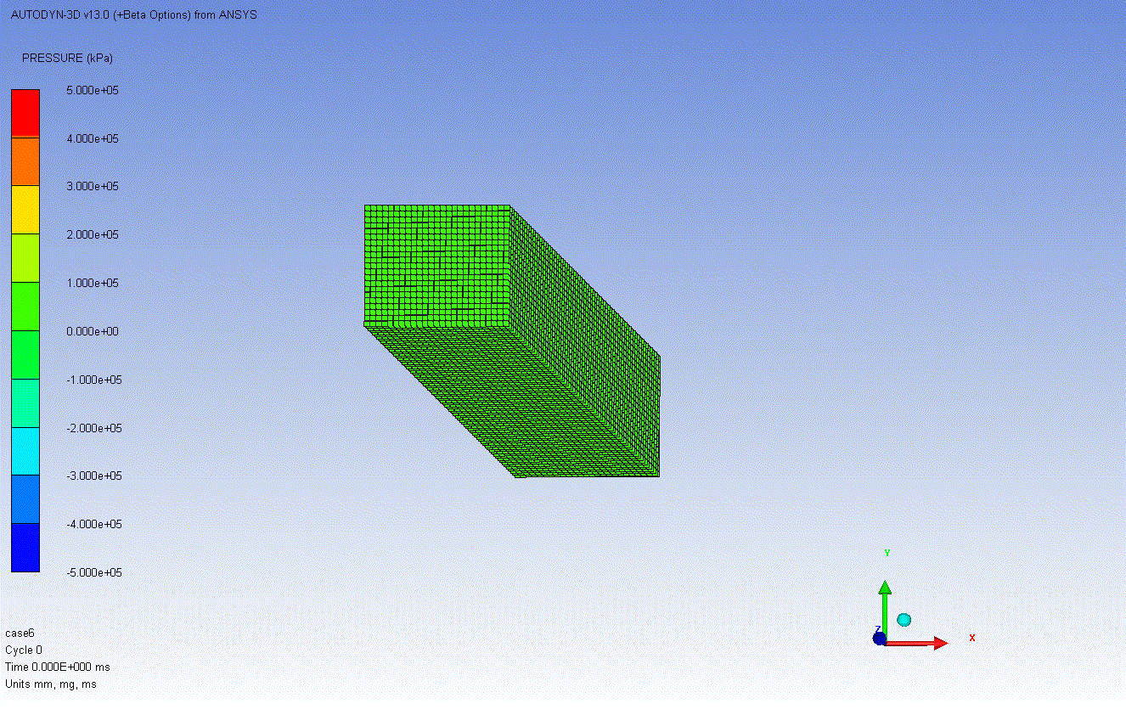
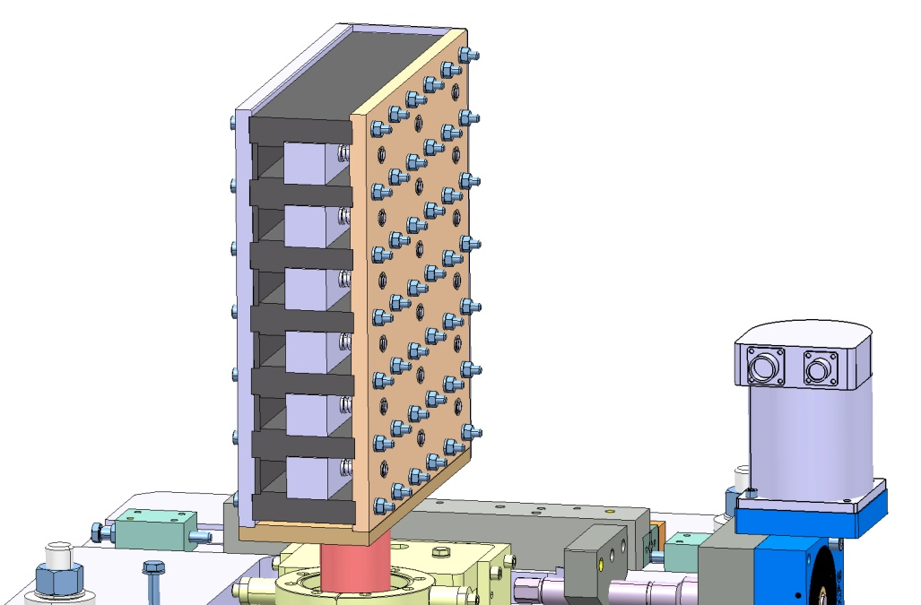
Conceptual Design of HiRadMat Sample Holder
W sample hit by one SPS bunch
Materials:
Glidcop, W, Mo, C, SiC, CuCD, MoCD
SPS Beam
PVDF and Strain Gauges
LDV measurements
Different Target materials
Horizontal Movement to change Impact location
Validation of the EOS:
  LDV, PVDF, Strain Gauges and Thermal probes
Validation of Strength and Failure models:
  Post-Mortem Analyses
  Specific Experimental tests for the characterization of the strength models.
SPS Beam
Vertical Movement to change target samples
Experimental Validation

Slide 28
Conclusions...
Beam-induced structural effects up to the melting point can be reasonably well treated with Standard FEM Codes.
When changes of phase occur and shock-wave phenomena are in place, advanced tools must be used (Hydrocodes).
Main aspects of complex numerical simulations have been discussed:
  Advanced material modelling.
  Algorithms of solution.
  Benchmarking between numerical tools.
  Energy Deposition.
State-of-the-art 3D analysis of complex Collimator model carried out including:
  Simulation of Shock-wave propagation
  Simulation of permanent damages
  Particle spray do to change of phase
Conclusions

Slide 29
...and future outlooks
W and Cu are well-known materials (Los Alamos): quite good confidence in results reliability...
...anyway Constitutive models required by Hydrocodes are well beyond commonly available material data . Most important limitation of these simulations.
Specific tests in HiRadMat are hence highly recommended as well as detailed characterization of strength models via advanced experimental mechanics.
Conceptual design of HiRadMat sample holder has been showed.
With a suitable calibration of beam parameters (number of bunches, dimension of the spot, etc.) it would be possible, thanks to HiRadMat, to investigate material behavior at high pressure and strain-rate with this new kind of “impacts”.
Coupling between FLUKA and Hydrocodes (LS-Dyna, Autodyn) is ongoing to evaluate effects of relevant variation in material density for multi-bunch impacts.
Conclusions

Slide 30
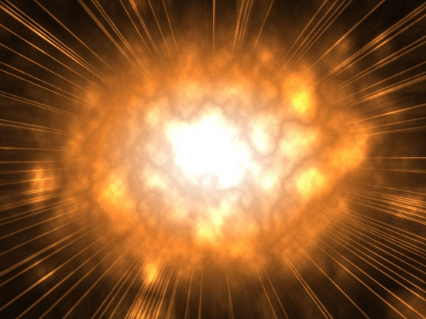
Thank you for your attention
We wish to warmly thank the FLUKA team (F. Cerutti, V. Boccone EN-STI) for the quality and quantity of their inputs.
The work of H. Richter (DGS/RP) and D. Campanini (EN-MME) in developing and making available Fluka-Autodyn interfaces is also kindly acknowledged.

Slide 31
Bonus Slides

Slide 32
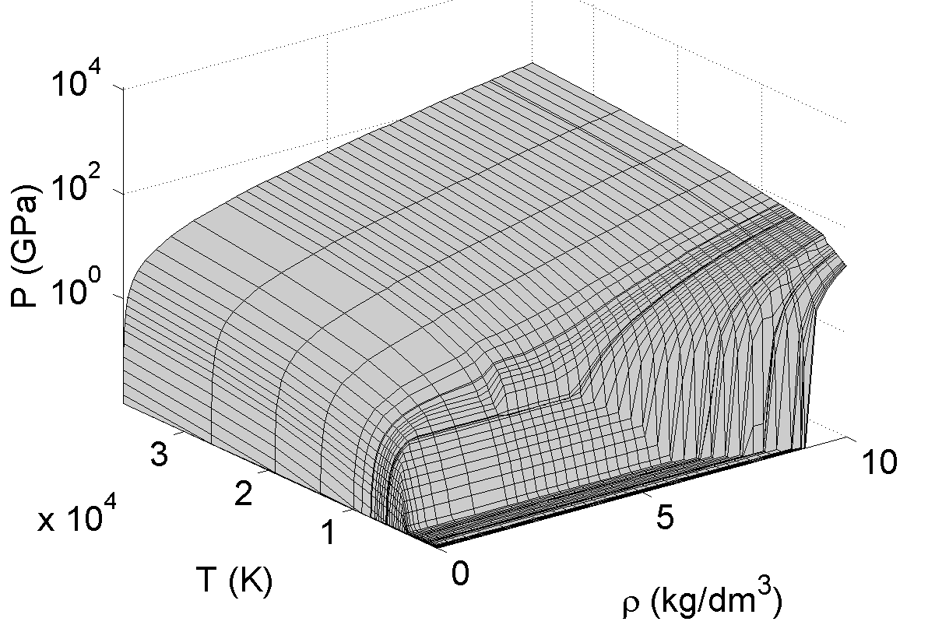
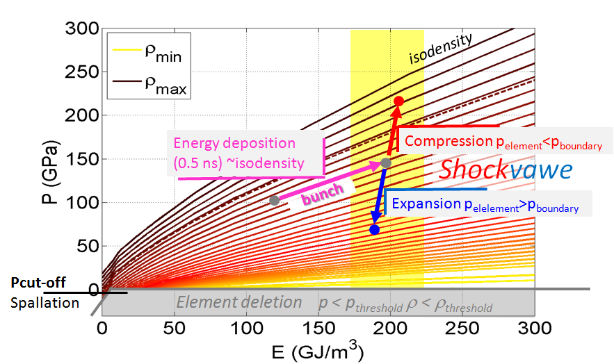
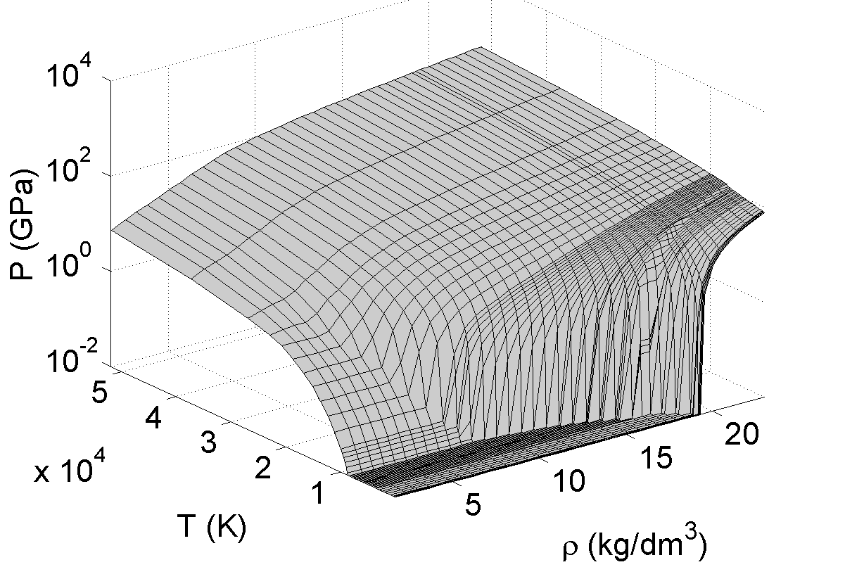
Equation of State Modelling
Copper
The EOS includes solid and fluid phases and the dependent variable (pressure) is defined as function of independent variables (internal energy and density).
Tungsten
Tabular EOS
(G. Kerley)
Material Modelling

Slide 33
Types of Thermally Induced Dynamic Phenomena
Johnson-Cook
“These models have typically been tested and calibrated with experiments on Hopkinson bars, Taylor cylinders, and with high-explosive (HE)–driven shock or compression waves at pressures up to a few tens of GPa and strain rates of 10³ to 10⁵ s⁻¹” Remington et al.
Steinberg-Guinan
For the future, improvement in the material strength model is a fundamental aspect!
When the temperature reaches the value of the melting temperature the shear strength of the material model becomes zero and starts to be considered like a fluid (pure hydrodynamic behaviour).
Copper (FCC)
Tungsten (BCC)
New materials? Cu-Diamond, Mo-Diamond
Material Modelling

Slide 34


Shock Wave Propagation
A shock Wave propagating through the interface between two solids (A and B) can be reflected and transmitted depending on the incident angle.
Impedance Z=ρ₀ U_{s} (ρ₀ - initial density, U_{s} - sound speed inside the material)
We can define 3 cases:
Z_{A} > Z_{B} ➔ Reflected and Incident Pressure Waves have opposite sign;
Z_{A} = Z_{B} ➔ The Incident Pressure Wave is totally transmitted (No reflected Pressure Wave);
Z_{A} < Z_{B} ➔ Reflected and Incident Pressure Waves have same sign.
Through the interface W-Cu (with Z_{W} > Z_{Cu}) the Pressure Wave is reflected with opposite sign.
Pressure Vs. Particle Velocity
Hugoniot Curve for different materials
Accident Simulations for TCT

Slide 35








Backup slide -- Damage Level 1 (In-situ spare surface)
Shock-wave propagation (5TeV Single-bunch impact)
Damage is confined to W as energy escaping W blocs is limited (shock impedance at W-Cu barrier).
t = 1 ns
t = 85 ns
t = 2.8 μs
t = 3.2 μs
P_{max}
2.2 GPa
P_{max}
30 GPa
Compression Wave (red)
+ Rarefaction Wave (blue)
Compression Wave
reaches W-Cu interface
t = 3.7 μs
t = 4.2 μs
t = 5.6 μs
t = 6.6 μs
P_{max}
160 MPa
Pressure
400 MPa
ΔT on Cu is less than 1.5K
293 K
P_{max}
500 MPa
Compression Wave
reaches Cu-Ni Pipes
Compression Wave bouncing back in W jaw
Case 4 (5 TeV, small beam size) shown
Accident Simulations for TCT

Slide 36






Backup Slide 3 -- Maximum Pressure
Single-bunch cases: Maximum Pressure ≤ 30 GPa
8 bunches case reaches 148 GPa
Case 1: P_{max} 19 GPa
Case 2: P_{max} 26 GPa
Case 3 and 4: P_{max} 29-30 GPa
Case 5: P_{max} 56 GPa
Case 6: P_{max} 97 GPa
Case 7: P_{max} 148 GPa
Accident Simulations for TCT

Slide 37



Particle Impact on Tank
The generated particle spray hits the Stainless Steel Tank after ~55us generating a Pressure Peak about 1.37 GPa on Tank inner surface, but without plastic deformations on Tank even after 100 us
Maximum Impacting Speed 954 m/s at 55 us, limited to few SPH particles. At 100 us the maximum speed is limited to 508 m/s.
55 us Pressure Peak on tank
100 us Maximum Speed 508 m/s
55 us Maximum Speed 954 m/s

Slide 38


Energy and pressure on water
The maximum pressure on water in the single-bunch cases is 200 bar, above the tested value of 120 bar but without provoking damages to the copper pipes
The energy deposited during the impact on the water is negligible, leading to an increase of temperature smaller than 0.1 K and to a pressure of less than 1 bar. Therefore the incoming pressure on water is only due to the wave propagation
Maximum pressure on water ~ 200 bar

