Slide 1
FETS-HIPSTER (Front End Test Stand – High Intensity Proton Source for Testing Effects of Radiation) Proposal for a new high-intensity proton irradiation source, based on an existing accelerator at the Rutherford Appleton Laboratory Proposal submitted to NNUF by: Steve Roberts (Oxford/CCFE), Chris Densham (RAL), Alan Letchford (RAL), Juergen Pozimski (Imperial College/RAL)
Presented by Tristan Davenne
Radiate Technical Meeting
September 3rd 2014

Slide 2
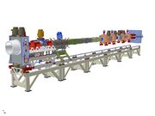
HIPSTER key points in proposal
Extension of the Front End Test Stand (FETS) research accelerator currently being commisioned at RAL could provide a unique high-intensity materials irradiation facility.
Material samples could be located within or upstream of a FETS beam dump and remote handling facilities would be constructed to enable transfer of material samples.
Activated samples would be supplied to collaborating institutes for post-irradiation examination, for example the NNUF irradiated materials test facility at CCFE (Culham Centre for Fusion Energy).

Slide 3
HIPSTER key points in proposal
HIPSTER would be capable of enabling:
- deep (~30 microns), near-uniform radiation damage to moderate levels within reasonable timescales (up to ~100 dpa per annum)
- studies of irradiation induced microstructural changes and bulk mechanical properties and behaviour including: hardening, embrittlement, creep, stress-corrosion cracking, and thermal property changes such as thermal conductivity
Protons shown to be excellent surrogates for reactor neutrons
FETS beam can generate radiation damage at end-of-life dpa levels for fission and fusion reactors
Upgrade to 15-20 MeV attractive to mimic fusion neutrons
High heat flux source (ref fusion divertor)

Slide 4
FETS beam parameters
Proton beam energy = 3MeV
Beam spot size = 100 to 1e4 cm²
Beam Pulse length = 2ms
Beam Frequency = 50Hz
Time averaged beam current = 6mA
Current during beam pulse = 60mA

Slide 5
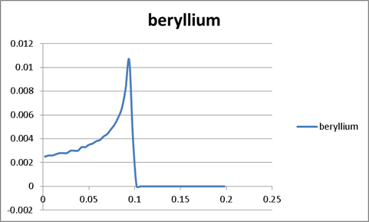
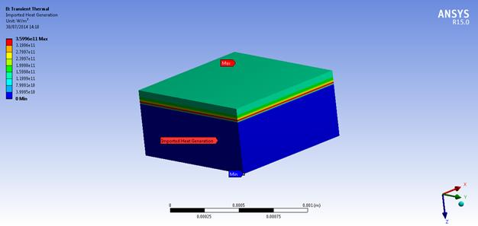
Example of energy deposition
beam stopped within 0.1mm in a beryllium sample

Slide 6
Thermal Management Challenges
Consider an irradiation sample attached to a water cooled back plate
Main Challenges –
Potentially high heat flux to cooling water
Pulsed power density results in unsteady sample temperature
Temperature difference between sample and cooling plate
Click on image to see video of simulation

Slide 7
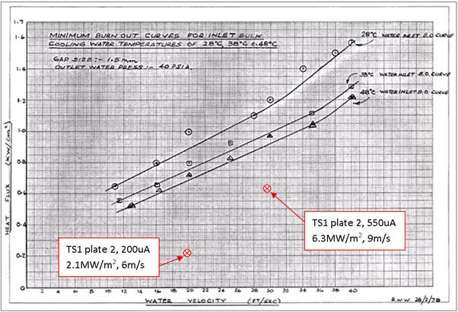
Heat Flux
For the range of beam size considered the required heat flux would be a maximum of 1.8MW/m², this is below the heat flux achieved in the ISIS Neutron target TS1 at RAL

Slide 8
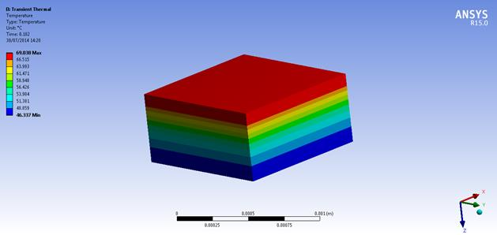
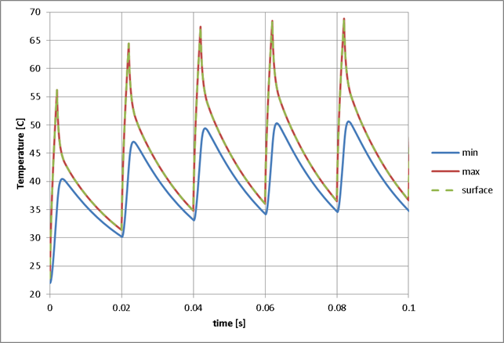
Pulsed thermal power deposition
Temperature immediately after beam pulse
Resultant temperature fluctuation depends on beam size
Conduction in the sample during the 2ms beam pulse affects peak temperature
Surface temperature similar to maximum temperature

Slide 9
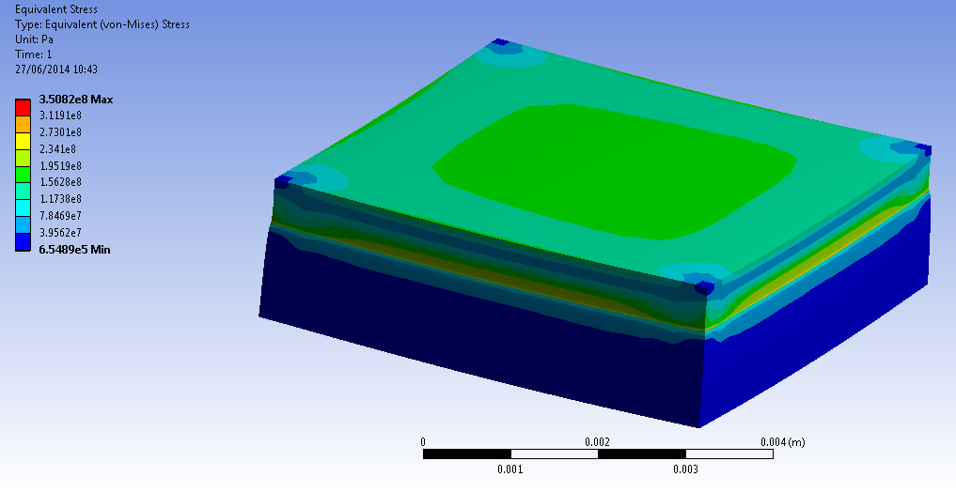
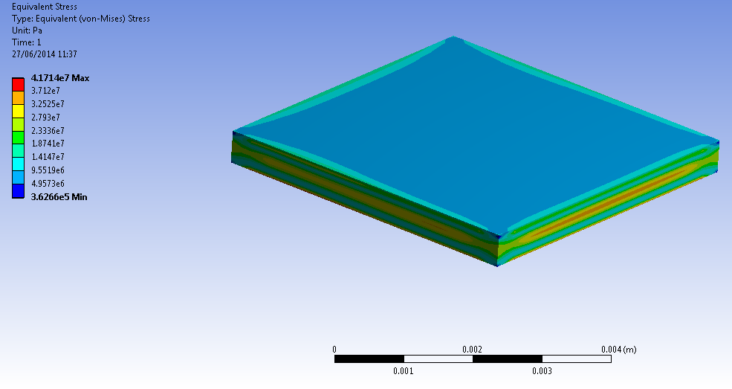
Induced Stress in Sample
High stresses arise with a focused beam on the sample especially if it is perfectly bonded to a cooled back plate
350MPa in 0.5mm thick beryllium sample bonded to aluminium cooled back plate heated by a focused FETS beam
Maximum temperature and stress in samples depends on beam size, sample shape, and attachment to cooled back plate.
42MPa in unbonded beryllium sample with focused beam

Slide 10
Summary of FETS HIPSTER Operating Parameters
A wide range of target area (beam spot size) have been considered.
SRIM calculations highlight that large dpa values are achievable even with the most blown up beam considered
The larger the beam the easier the thermal management issues are to deal with.
With a beam area of 2500 cm² the required cooling heat flux is easily manageable at 0.07MW/m², the predicted sample temperature fluctuation is less than 2K and yet 20dpa/fpy in Tungsten is still possible.

Slide 11
FETS-HIPSTER Summary
FETS can deliver beam currents far in excess of any existing proton irradiation facilities
Beam energy of 3MeV (possibly upgradeable to 15-20MeV) is of interest for fission and fusion communities
High levels of dpa achievable in short time frames
‘Deep’ irradiation (30 microns) enabling evaluation of bulk material mechanical properties
Manageable deposited thermal power density
Cheaper and shorter realisation time than proposed future irradiation facilities such as FAFNIR and IFMIF
Brought to attention of joint UK Research Council ‘fusion for energy’ strategy

