Slide 1
ISIS Target studies
Could a used ISIS target provide fusion relevant irradiated tungsten material properties?
Tristan Davenne
20th May 2015
2nd Radiate Meeting
Oxford University

Slide 2
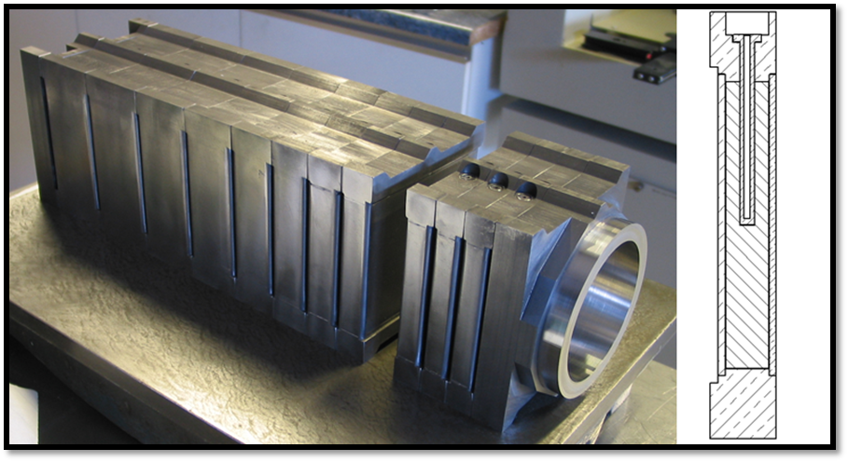
TS1 core FLUKA geometry
Geometry includes 12 tantalum clad tungsten plates and heavy water channels in between. Does not include stainless steel water manifolds on side of target.

Slide 3
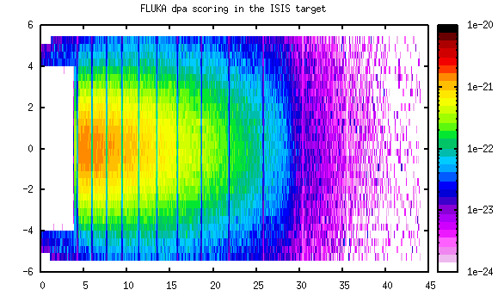
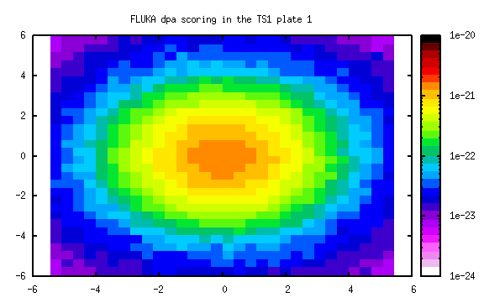
TS1 energy deposition and FLUKA dpa
Variation of dpa across a target plate
Variation of dpa through out target

Slide 4
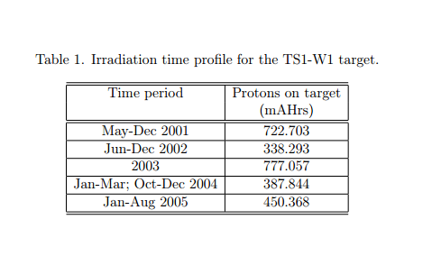
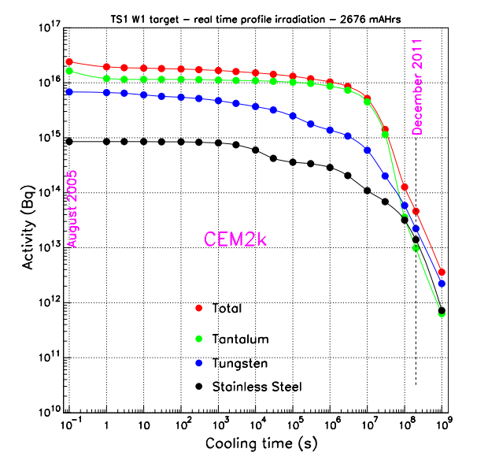
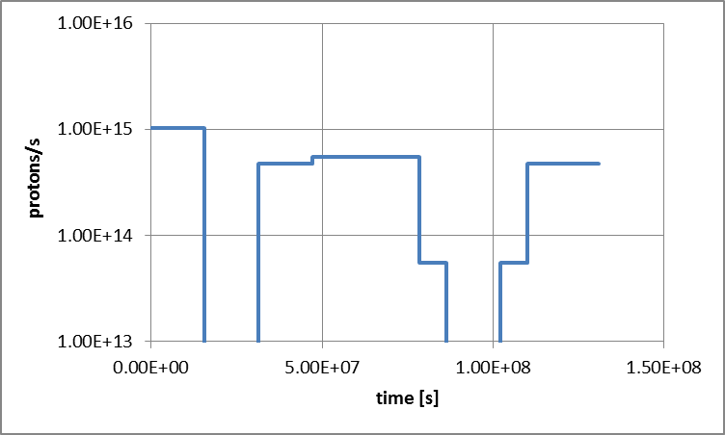
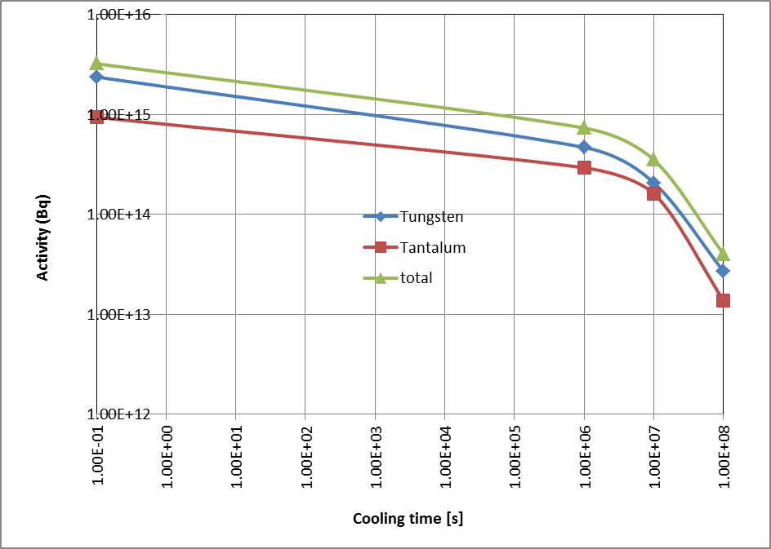
Target Activity
Total target activity from Goran Skoro’s report
Irradiation profile of TS1-W1 from Goran Skoro’s report
http://hepunx.rl.ac.uk/uknf/wp3/hidden/goran/ISIS_jobs/01_TrgtInven/ts1_w1_act.pdf
Irradiation profile interpreted for FLUKA
Total target activity calculated from simple FLUKA model

Slide 5
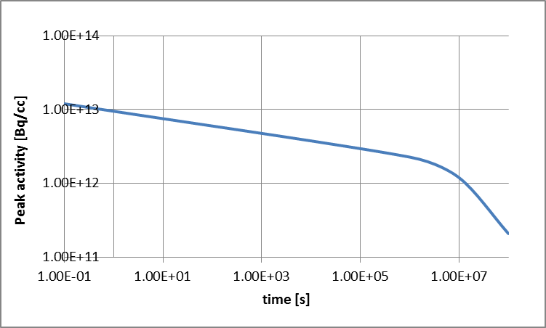
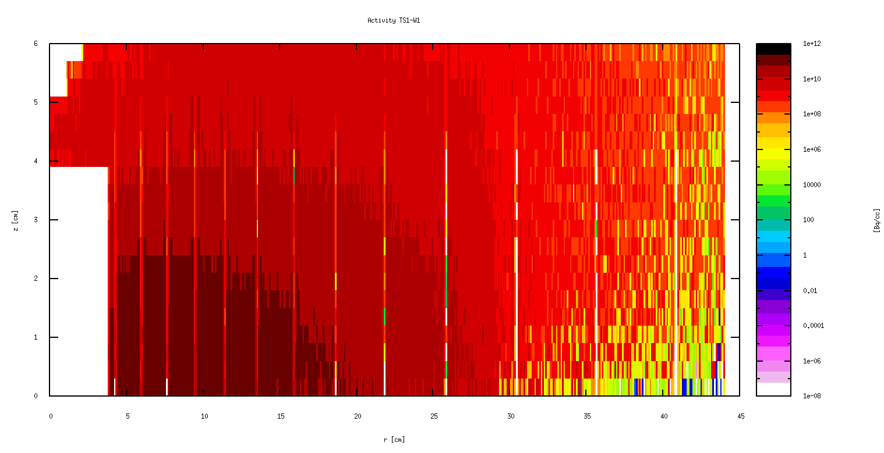
Peak Target Activity
Maximum activity in target
1.2e13 Bq/cc imeadiately after irradiation
2.1e11 Bq/cc after 1e8s
or for tungsten
1.1e10Bq/gram after 1e8s (i.e. 10GBq/gram)
Activity after 1e8s

Slide 6
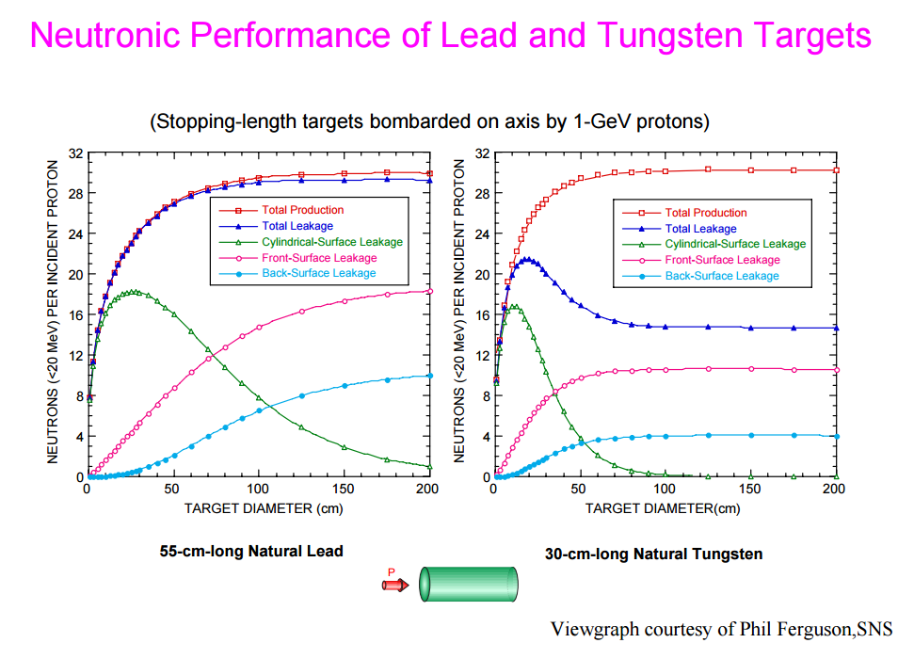
How many neutrons can you get per incident proton from a spallation target?
≈ 18 neutrons/proton for a 30cm long 10cm diameter tungsten cylinder

Slide 7
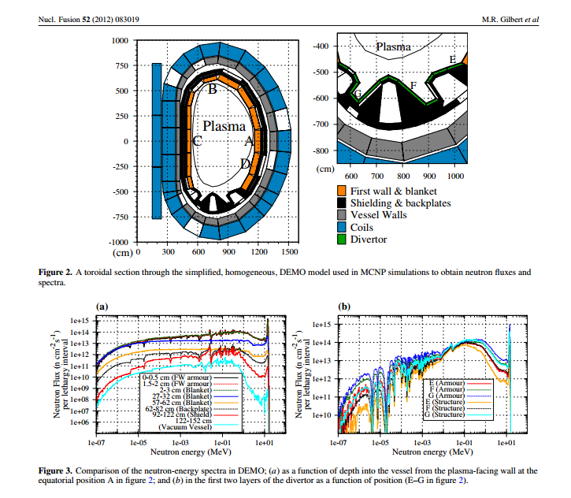
Fusion neutron spectra according to Mark Gilbert et al. J Nuc Fusion 2012
In fusion reactor DEMO expect
1e15 neutrons/cm²/s/lethargy interval in first wall tungsten armour

Slide 8
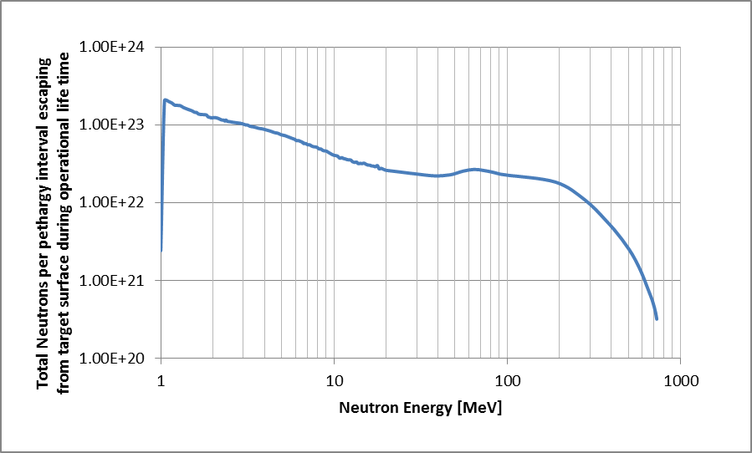
FLUKA simulation of neutron yield from ISIS target core
TS1 yields 3 neutrons per proton above 1MeV
TS1 W1 ran with 1e15 protons/s for 1e8s , i.e. 1e23protons, so about 3e23 neutrons produced
Compare with expected neutron spectrum in a fusion reactor
At 14MeV
TS1 W1 had 2e22 neutrons/lethargy interval
Assume neutrons uniformly spread over Target surface of 2000cm2
Gives 1e19 neutrons/cm2/lethargy interval
In fusion reactor DEMO expect up to
1e15 neutrons/cm2/s/lethargy interval

Slide 9
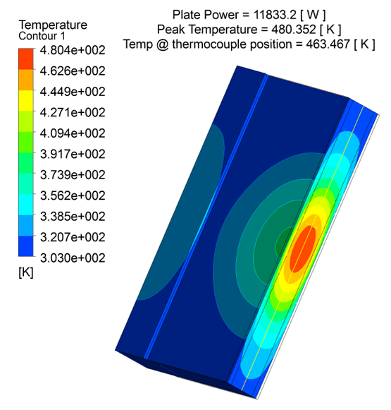
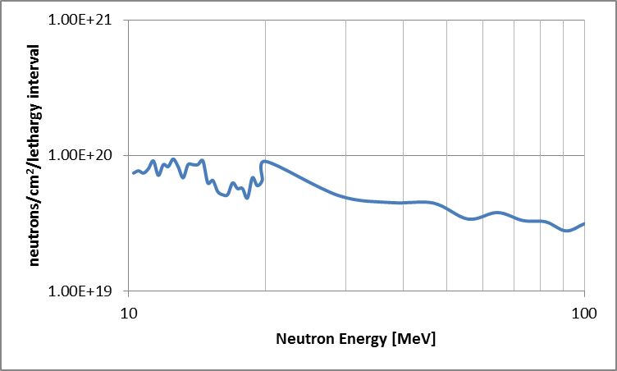
Consider neutron flux through a corner of plate 1 of TS1
At 14MeV
TS1 W1 plate 1 sample corner has seen
1e20 neutrons/cm²
(Irradiated at about 330K)
First wall armour tungsten exposed to
1e15 neutrons/cm²/s
integrated flux in sample corner equivalent
to 1e5s of operation – 28hours
Next calculation – helium and hydrogen
production through out target
2cm
Tungsten sample corner
Beam

Slide 10
PNNL have made an offer to do PIE on TS1 W1 and TS2
-Container or cask for receipt of target, size and cost depends on activity of target
-Initial size reduction requiring band saw capability in hot cell
-Visual examination with cameras (routine)
-Precision sectioning requiring installation of an EDM
-Waste disposal
PIE then to include
-Thermal conductivity
-Mechanical properties
-Microscopy

