Slide 1
SPIRAL 2 production station
Hanna Frånberg Delahaye
Radioactive beam production
GANIL-SPIRAL 2, Caen, France
May 3, 2011

Slide 2
Lay out of the presentation
SPIRAL 2 phase 2
RNB production
Front end – production module
Neutron converter
Target and ion sources
Radiation levels in the production building

Slide 3
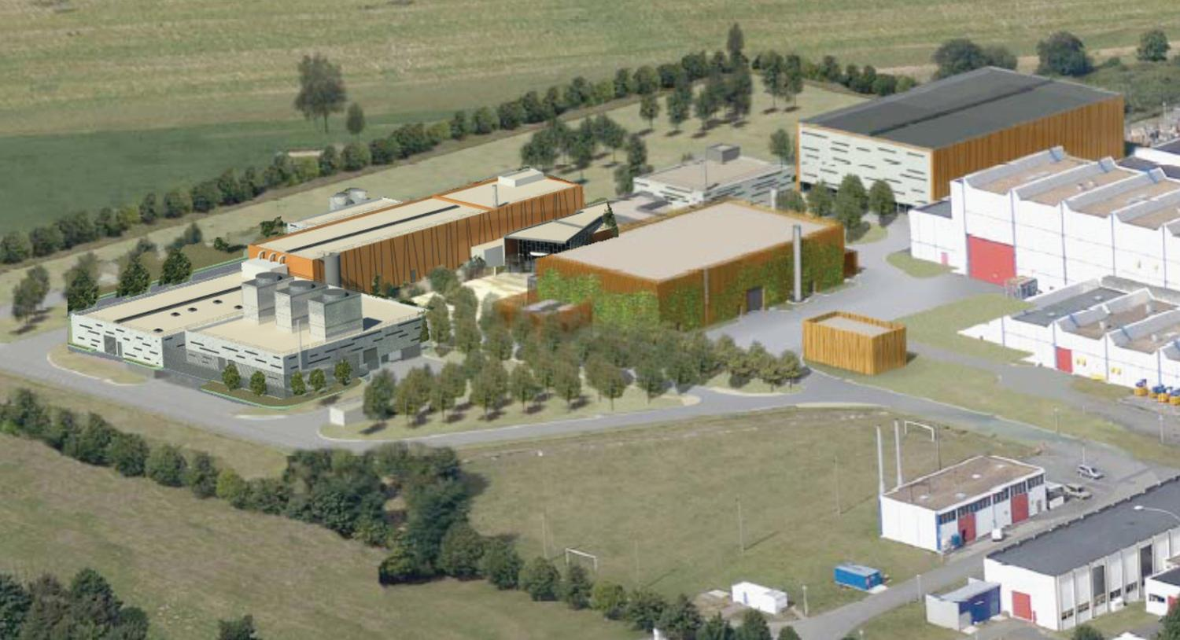
The SPIRAL 2 construction
Figures
DESIR
SPIRAL 2 phase 1
SPIRAL 2 phase 2
GANIL

Slide 4
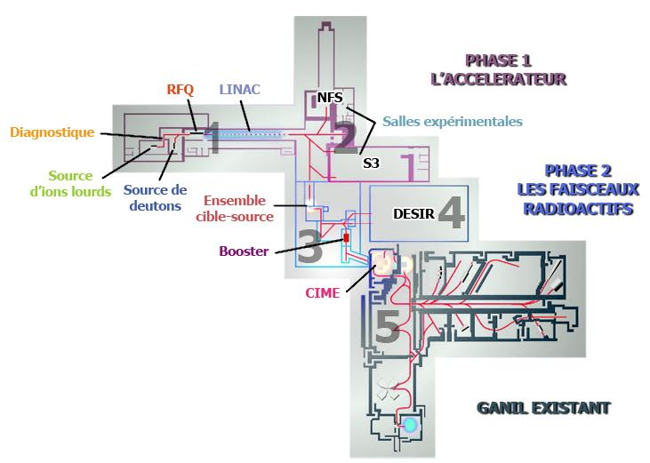
Accelerator and beam line layouts
SPIRAL 2 phase 1 the accelerator
RFQ
LINAC
Diagnostics
Experimental halls
SPIRAL 2 phase 2 radioactive ion beams
Heavy ion source
d ion source
TIS unit
SPIRAL 2 phase 2 charge breeder
CIME
GANIL today

Slide 5
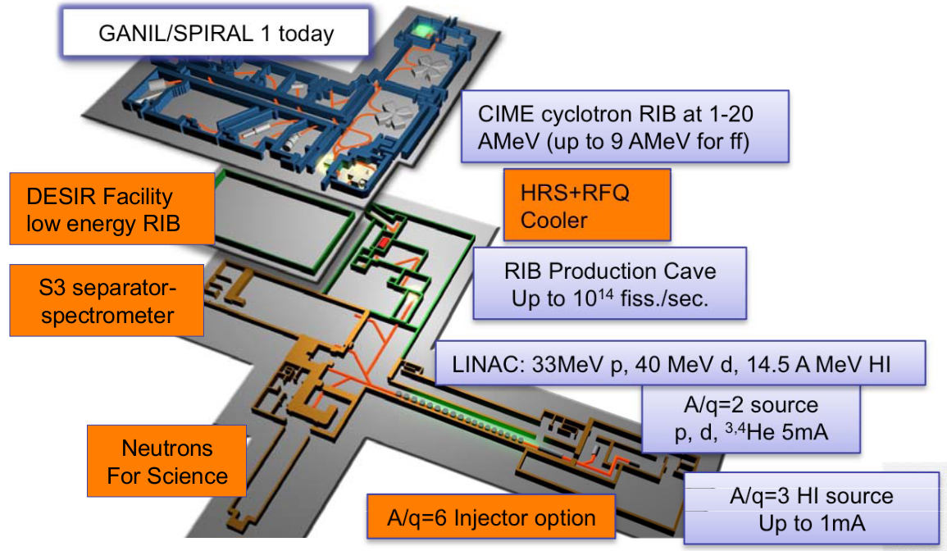

SPIRAL2 goals
RI produced by fission process, fusion evaporation residues or transfer products
High intensity stable primary beams : P, D, ^{3,4}He, heavy ions with A/Q=3 (1mA-5mA)
Energy range : from 2MeV/u up to 20MeV/u (D), 14.5MeV/u (HI), 33MeV (P)

Slide 6
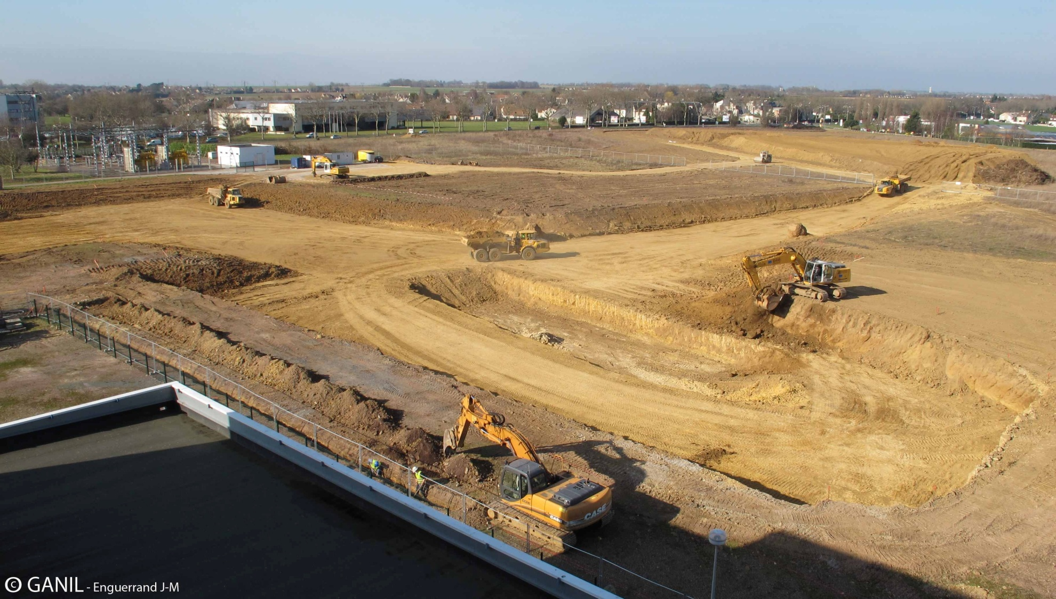
The construction has started

Slide 7
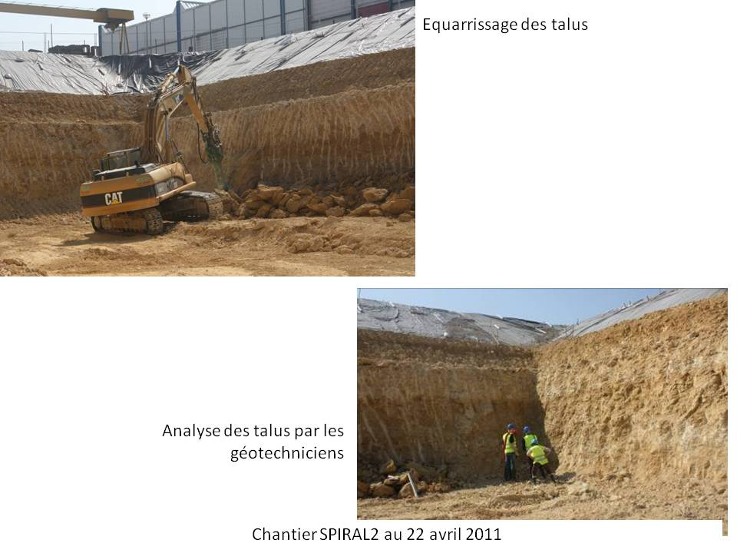
The construction has started

Slide 8
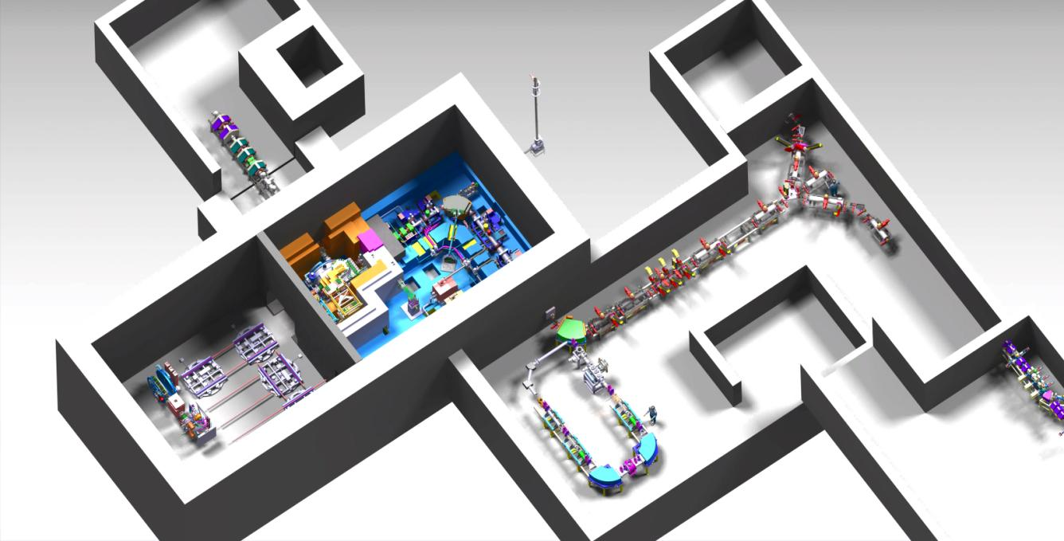
Production zones and 1+ beam lines
Hot cell
Production area
Maintenance area

Slide 9
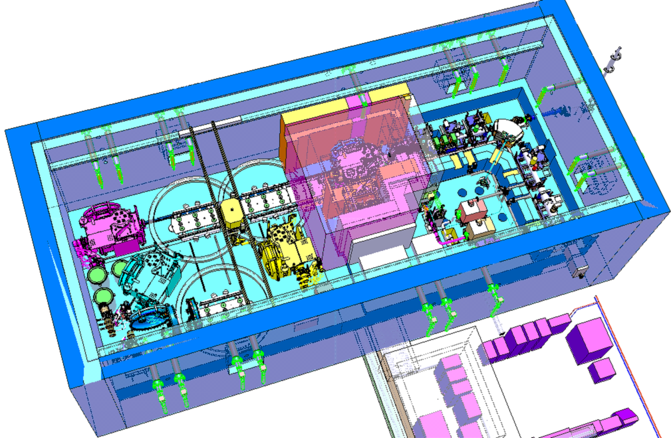
The hot cell
Translation of roof and door
Deuteron beam
Beam transport area
Robot
21 m
9,4 m
8,2 m
7 m
Maintenance area
Platform high voltage
Notes:
All mounting and demounting will be performed in the maintenance cell
Test need to be perfomed to show the feasability.
Even though there are no tele operation availible in the first tests manual demounting and mounting is important so that sequences can be defined
Optimisation of the tools to optimise the equipement needed in the maintenance cell

Slide 10
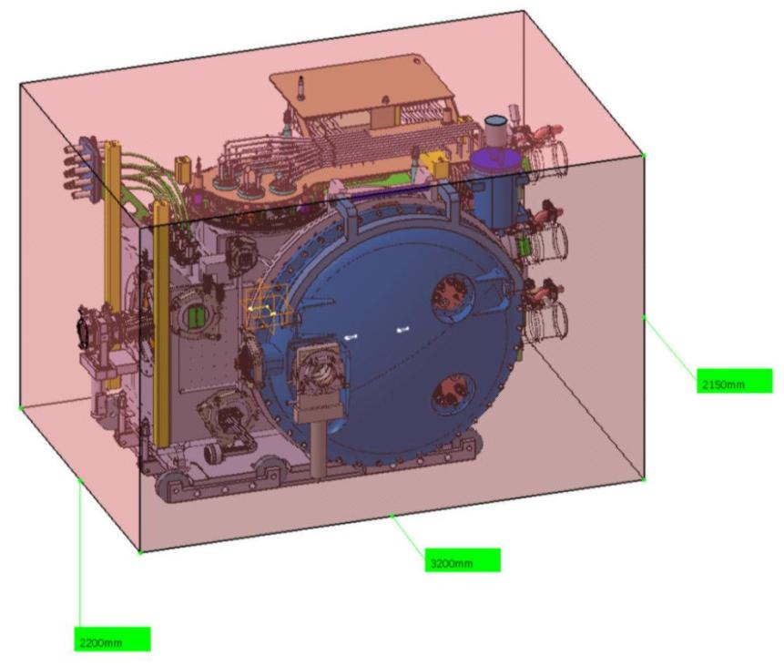
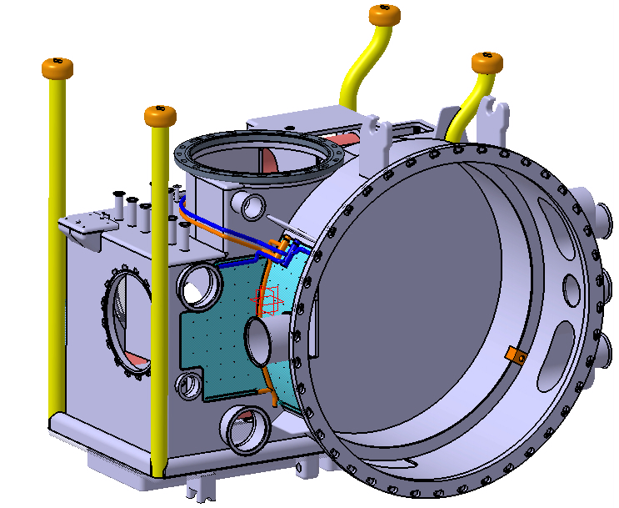
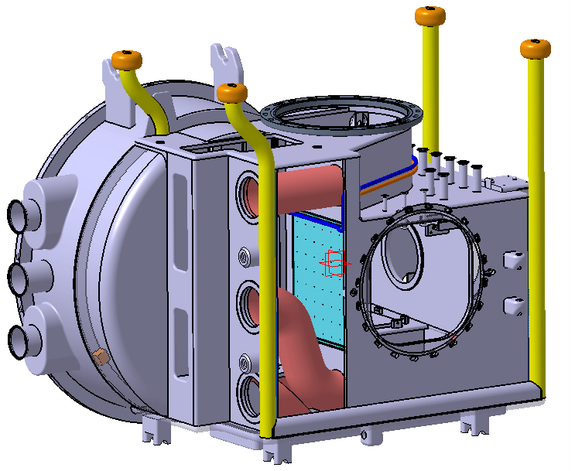
Size of the production module
Material: stainless steel 316L, Weight: 2,1t
Height: 2.15 m
Length: 3.20 m
Width: 2.20 m
Weigth: 8 t

Slide 11
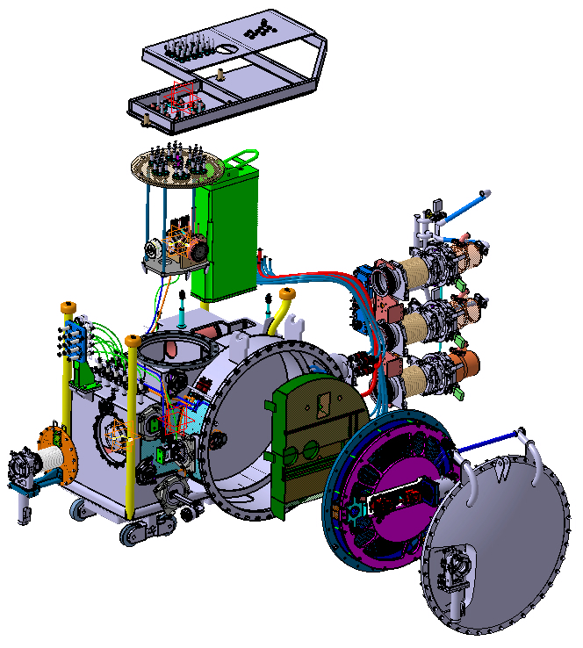
Components of the production module
Dismontable shielding
Y. Huguet
Connectors easements
Pump module
Target and ion source
High voltage connectors
Dismontable shielding
Beam optics
Neutron converter

Slide 12
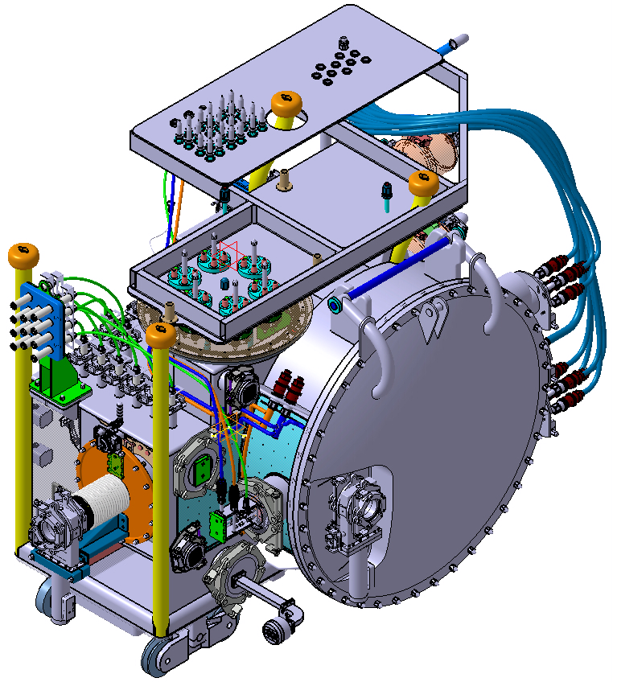
Overview of the production module
Connector plate
Y. Huguet
High voltage connectors
Beam optics
Converter connectors
Converter door
Metal valves
Radioactif beam
HF
Deuteron beam

Slide 13
The hot cell
Deuteron beam
Translation of roof and door
Beam transport area
Robot
21 m
9,4 m
8,2 m
7 m
Maintenance area
Platform high voltage
Notes:
All mounting and demounting will be performed in the maintenance cell
Test need to be perfomed to show the feasability.
Even though there are no tele operation availible in the first tests manual demounting and mounting is important so that sequences can be defined
Optimisation of the tools to optimise the equipement needed in the maintenance cell

Slide 14
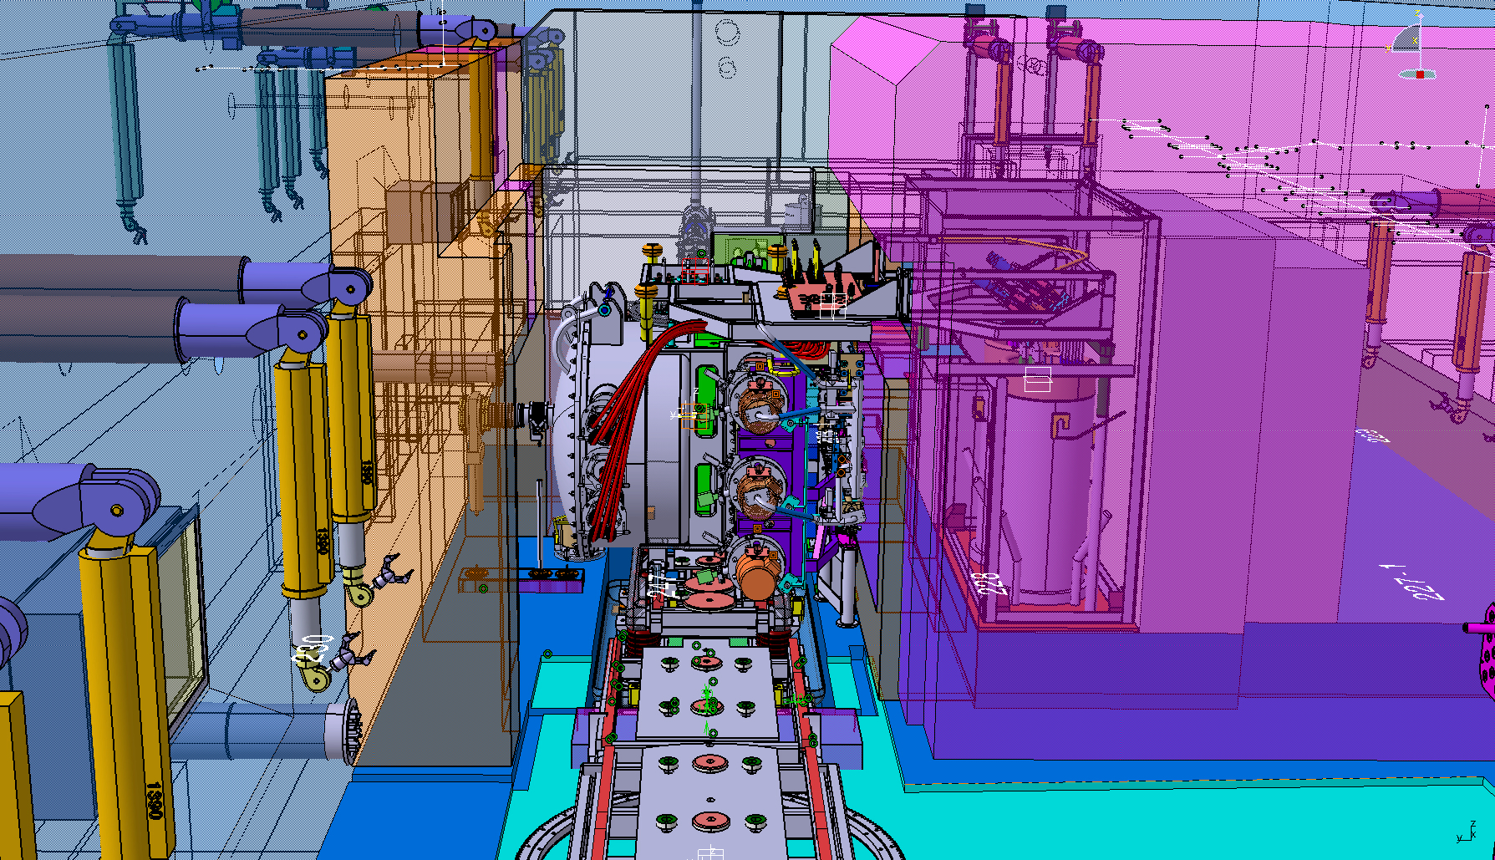
The front end

Slide 15
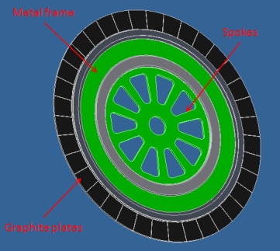
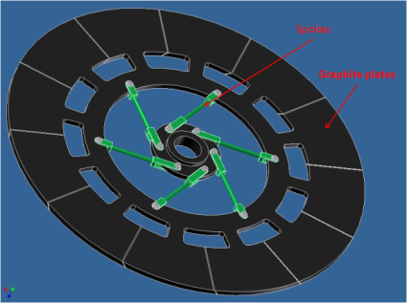
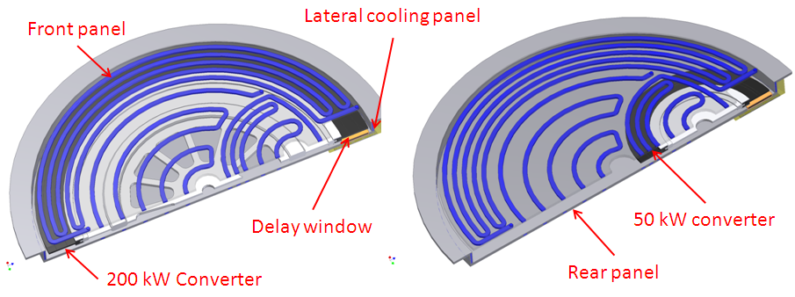
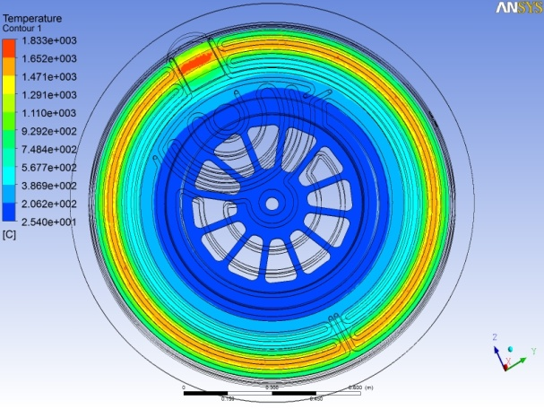
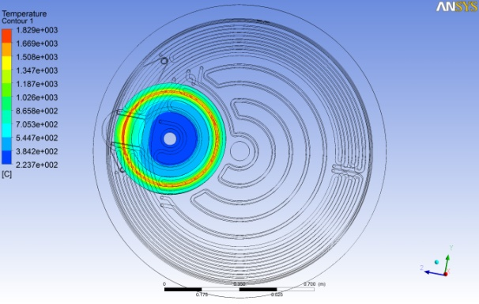
Converter design
The 200 kW and 50 kW converter design
120 and 52 cm in diameter
rotation of 6-15 Hz (temperature difference 10-20°C/turn)
AXF-5Q from POCO Graphite inc
The d beam is stopped in the 7 mm graphite disk
The working temperature of the graphite is1850°C

Slide 16
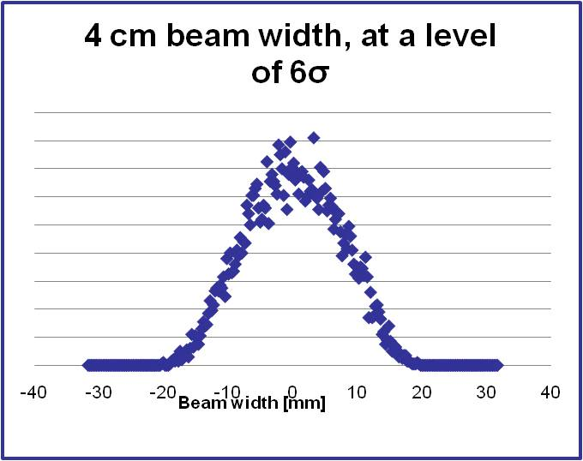
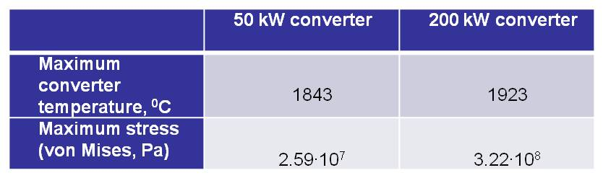
Converter design
Beam profile used for the thermo mechanical calculations
Material | Radiation damage [dpa] | Radiation source
Graphite | 50 | Deuteron beam
Wheel body (stainless steel) | 10⁻³ | Neutrons
Cooling panels (stainless steel) | 10⁻² | Neutrons
J. Bermudez, L. B. Tecchio, E. Udup

Slide 17
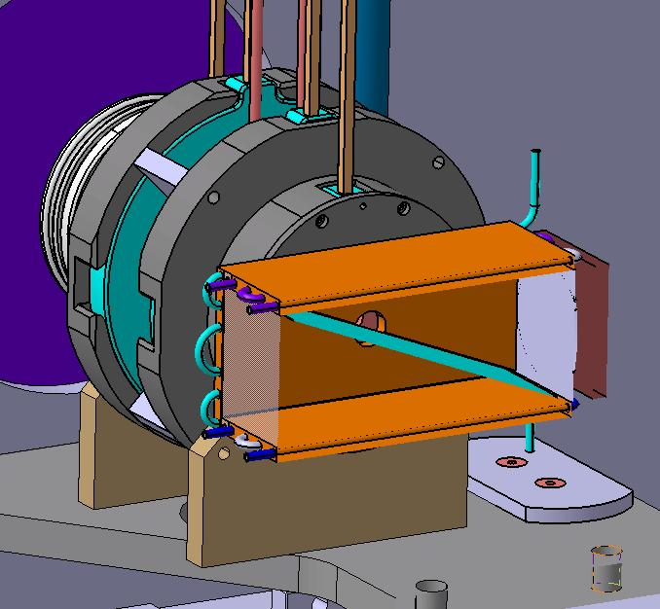
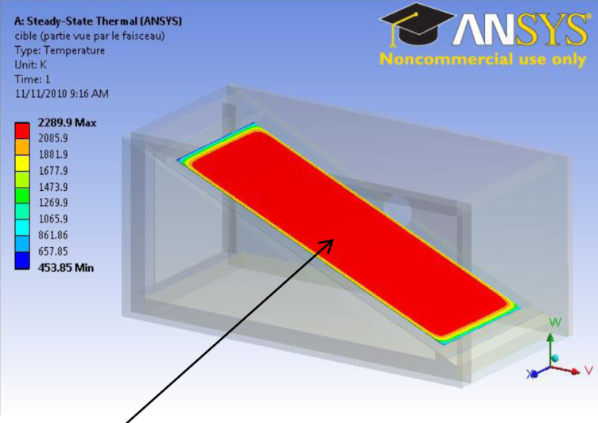
Prototype for the production of 14O at SP2
A tilted carbon target
chamber with black coating for thermal issues,
Cooling around the chamber
Beam stopper …
MONOBOB
Container
Length of the chamber (cm)
3He
Target
Emissivity of the walls
Ta window
M G Saint Laurent et A. Pichard
2300 K
P. Jardin, A. Pichard

Slide 18
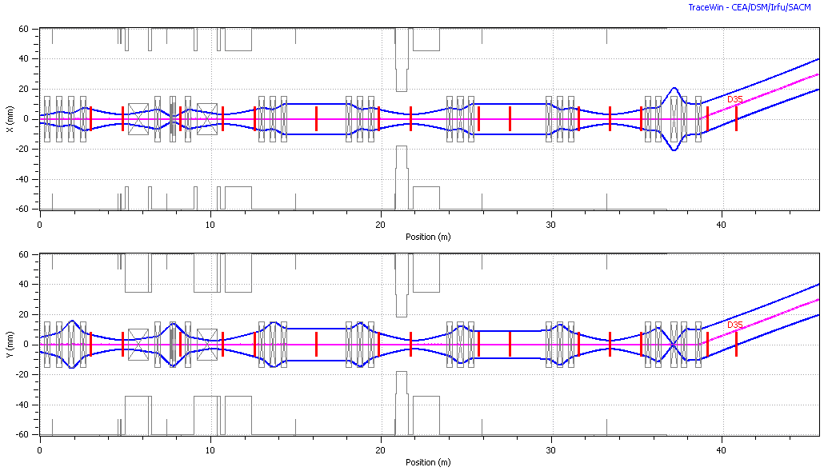
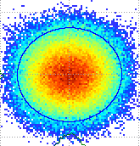
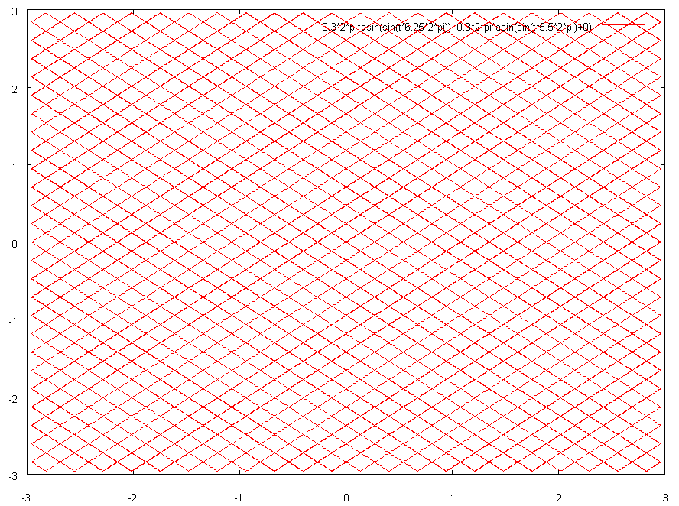
Beam scanning system
linear speed of 44 m/s is needed for a beam with a radius of 1 cm at 3 rms.
Centroïd of ± 3 cm give less than 150 W losses for a 35 kW beam
It implies a field of 350 G (due to 1/6 ions)
The preliminary frequencies are :
68.75 Hz for X and 60.5 Hz for Y.
Thermal simulations

Slide 19

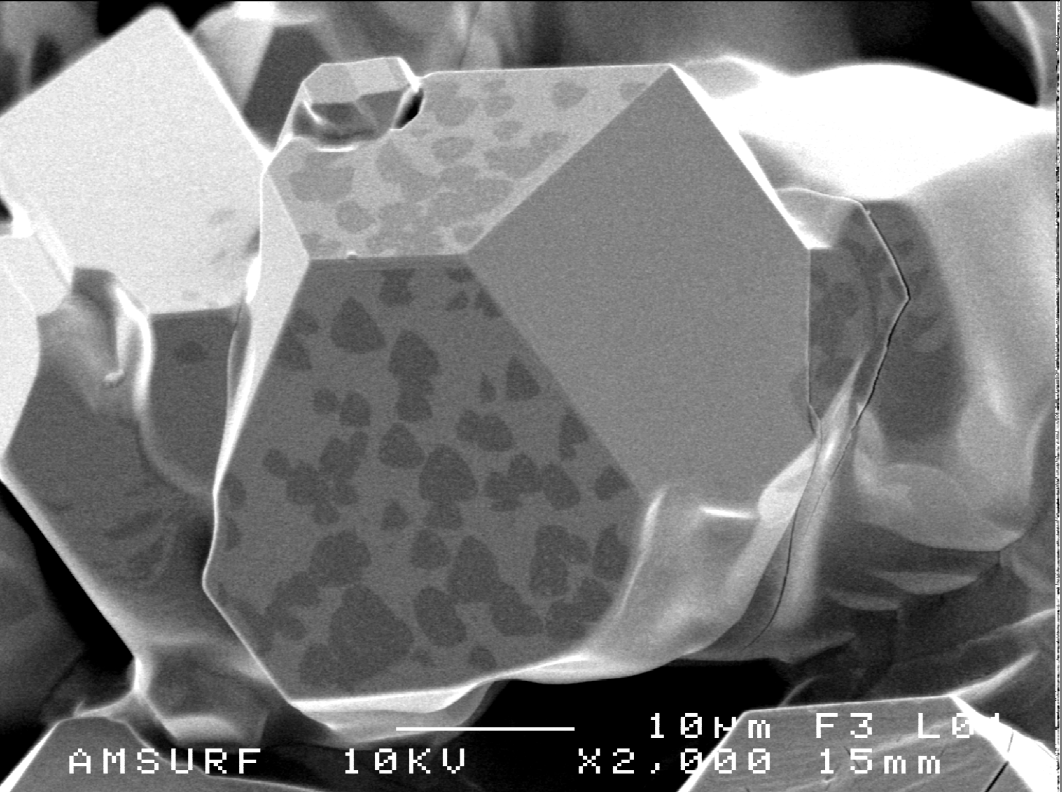
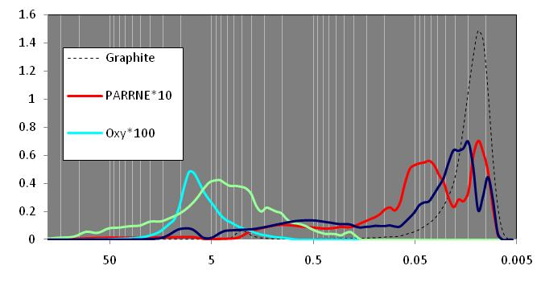


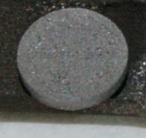
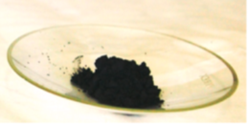
R&D on UC_{x} targets
  Synthesis of UC_{X} pellets
  Charactherisation
  Release tests
Study of physicochemical properties (by XRD, SEM, porosimeter etc.)
  Collaboration with the radiochemistry group
Study of release properties by irradiation tests
  Collaboration with the radiochemistry group and the nuclear physics group NESTER
Development of UCX targets throughout European collaborations:
  ActILab (ENSAR)
C. Lau

Slide 20
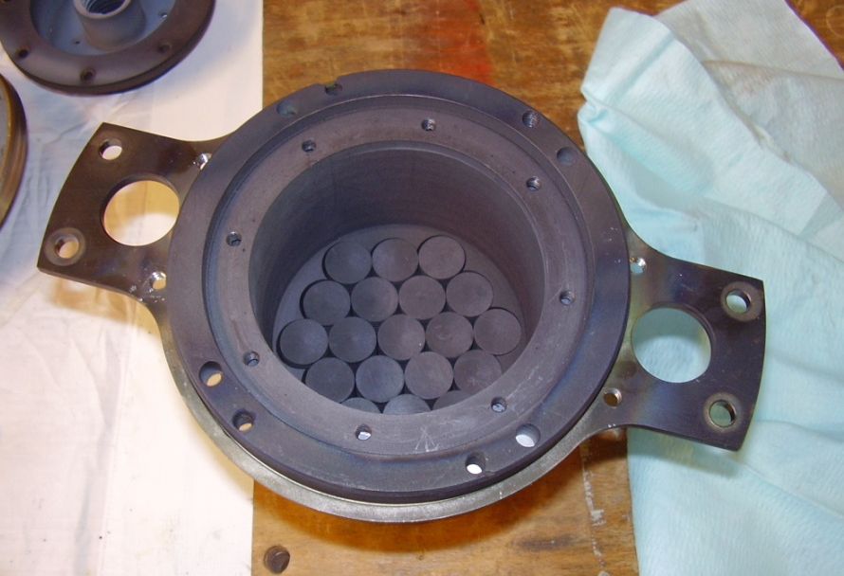
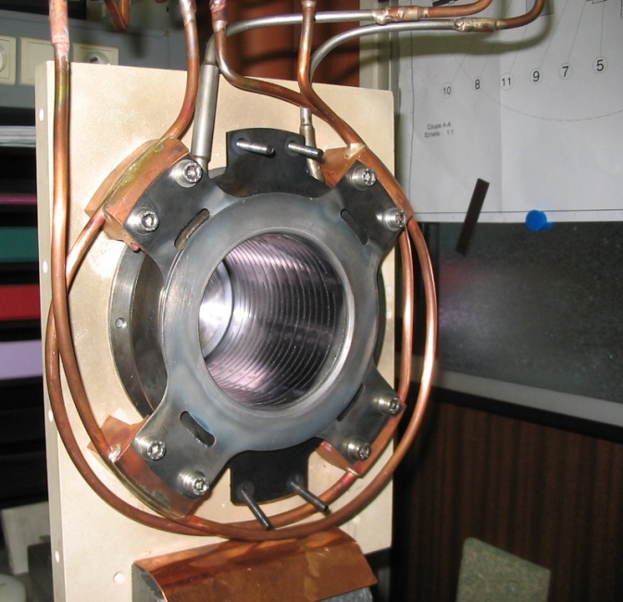
UC_{x} target
1300 UCx disks: Ø15mm/ th. 1 mm
Target : Ø=80 mm, l=80 mm
Cooled transfer tube with “zigzag”
Tantalum (Tungsten) oven

Slide 21
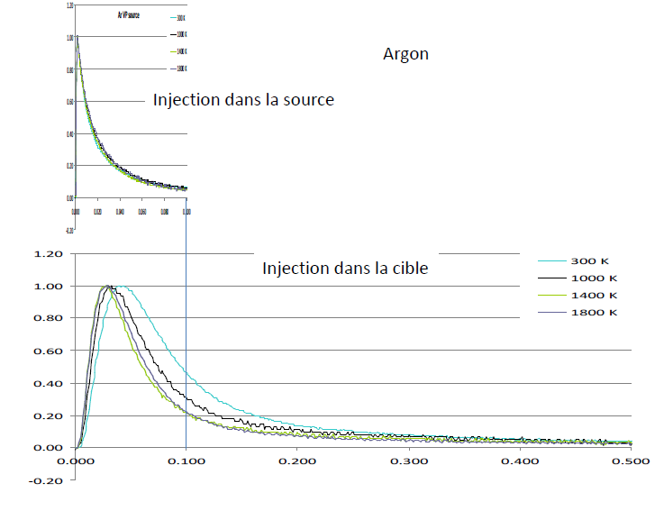
Source ECR
Studies on the waveguide for the injection of the RF
Release times measurements connected to an oven.
Adaptation tests to a long extraction.
P. Jardin, A. Pichard

Slide 22
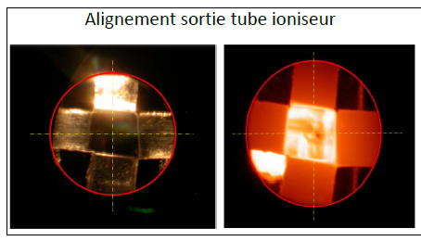
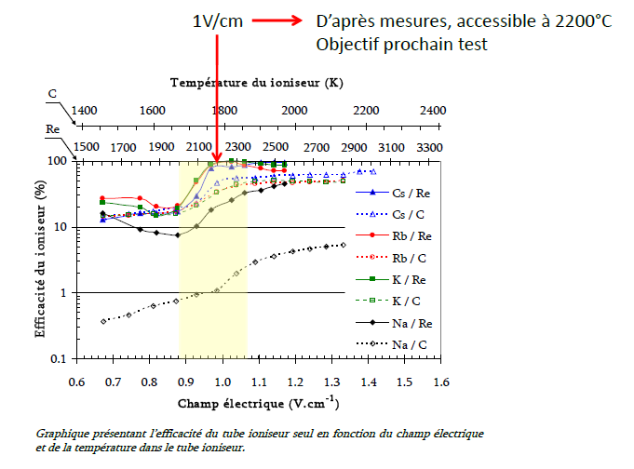
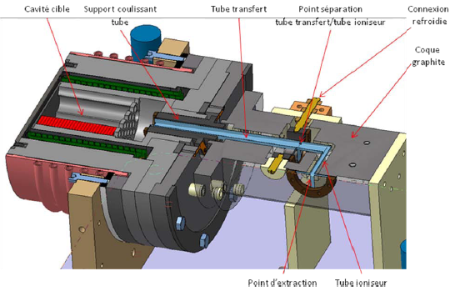
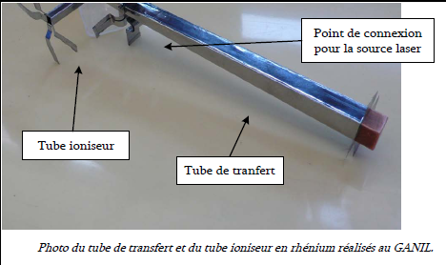
Source Ionisation surface
One source for laser and surface ionisation
No mouvement of the point of extraction
P. Jardin

Slide 23
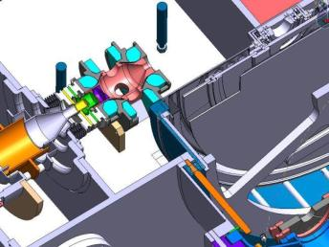
Tests for the long extraction
Optimisation of the extractions of the production module and tests bench
228 µA with 99 % transmission
Feasible
O. Bajeat

Slide 24
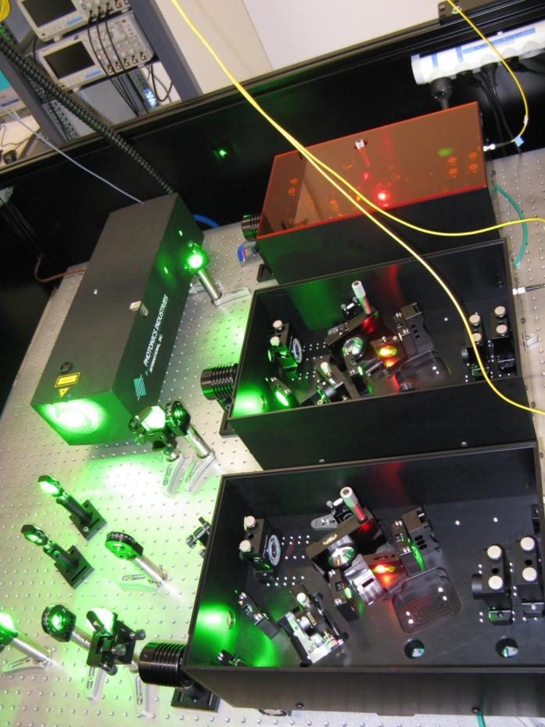
Resonant Ionization Laser Ion Source
GISELE ANR project: first prototype of the SPIRAL2 RILIS
(GANIL, IPNO)
TiSa System in collaboration with TRIUMF and the LARISSA group from Mainz University
Off line laser room fully equiped at GANIL
3 TiSa Cavities running
Up to 3.5W of InfraRed
beams produced
This work is supported by the French Research
National Agency (ANR) under contract
n° ANR-08-BLAN-0116-01
N. Lecesne GANIL

Slide 25
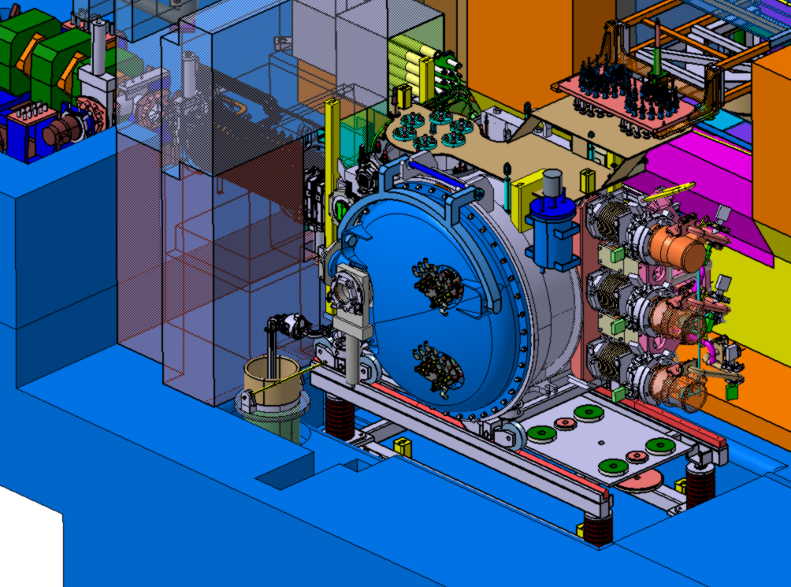
Integrated doses from the n
<10⁶ Gray / 3 months
3·10³ Gray / 3 months
10⁵ Gray / 3 months
2·10⁵ Gray / 3 months
A. Savalle
Notes:
Some words about the integrated doses. They are at the level of 10**6 gray for 3 months upper the module and 10**5 gray at the pumps, with an internal shielding inside the module. Outside the cocoon this dose is reduced with a factor of about 1 thousand

Slide 26
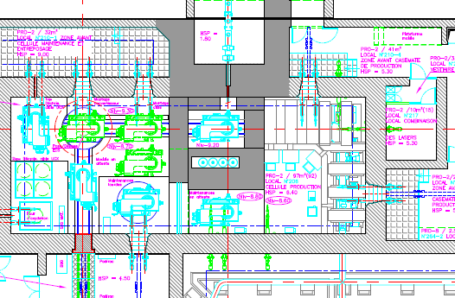
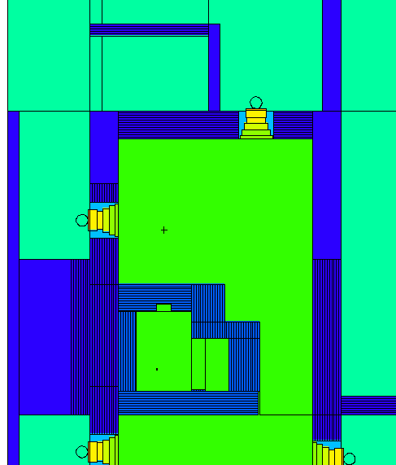
Primary calculations of the Equivalent dose rates (EDR)
1 μSv/h
4 μSv/h
7 μSv/h
P_07
P_05
<1 μSv/h
4 μSv/h
A. Savalle
P_04
P_02
Notes:
Now I present the results. In the horizontal plane the equivalent dose rates are between 1 and 7 micro-sieverts/hour, which is convenient (we have a blue zone).

Slide 27
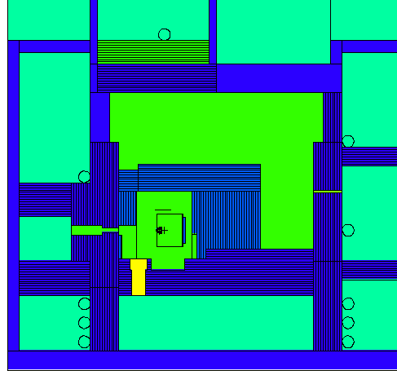
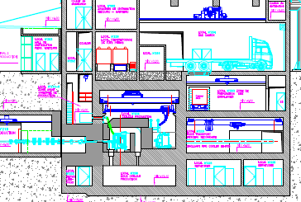
Primary calculations of the Equivalent dose rates (EDR) -2
P_09
Equivalent dose rates (EDR) -2
P_15
P_14
P_01
P_10
P_11
<7 μSv/h
50 μSv/h
22 μSv/h
4 μSv/h
0,3 μSv/h
20 μSv/h
> 10 mSv/h
A. Savalle
Notes:
We see here the equivalent dose rates in different points around the production cell, whith the actual design of the building
In some places we are above the blue zone level and about at the green zone limit. Some additional shielding may be necessary.
Above the high energy transport line the level is too high and the access will be forbidden with the beam.

Slide 28
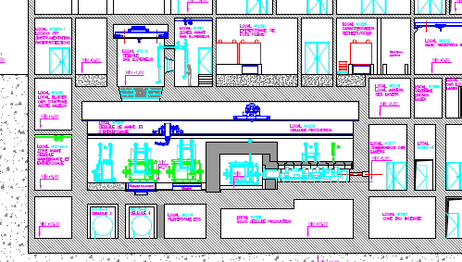
Primary calculations of the Equivalent dose rates (EDR) -3
<7 μSv/h
130 μSv/h
40 μSv/h
A. Savalle
Notes:
At the upper part of the cell, the concrete wall is not thick enough because of the crane. It has to be reinforced.

Slide 29
Acknowledgements
O. Bajeat, J. Bermudez, C. Lau, Y. Huguet, P. Jardin, N. Lecesne,G. Normand, F. de Oliviera A. Pichard, M. G. Saint Laurent, A. Savalle, L. Serani, L. Tecchio, …

Slide 30

SPIRAL 2 production module

Slide 31
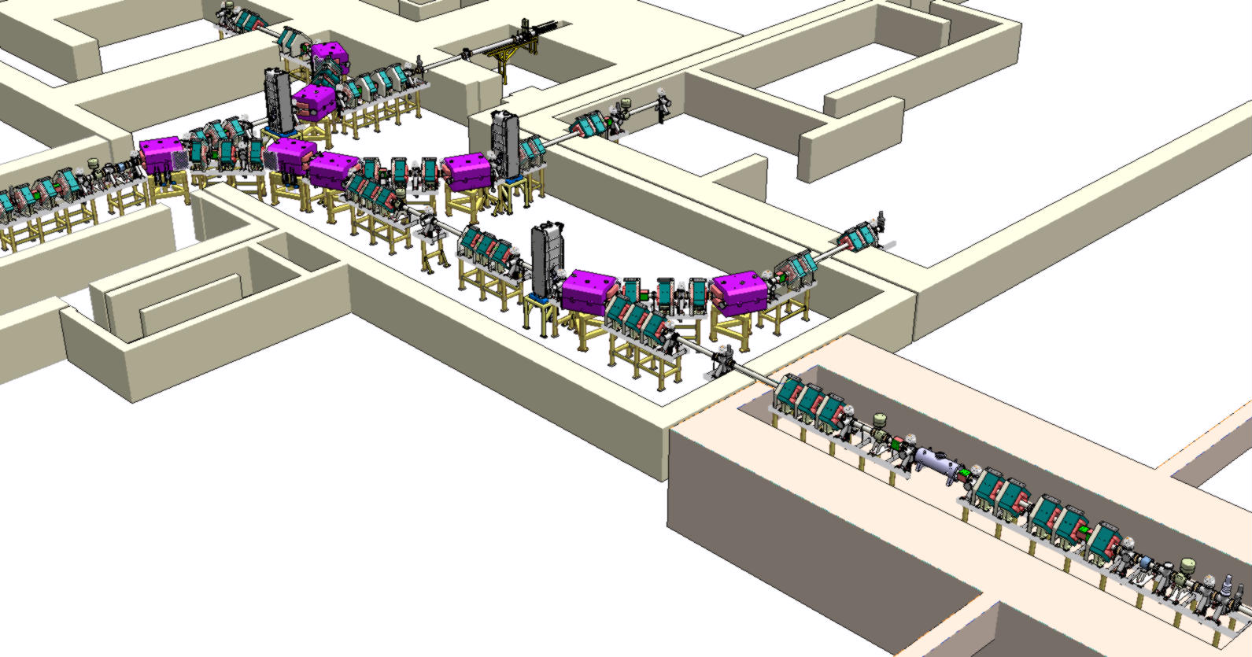
Beam parameters on target
Deutons
1/3 and 1/6 ion beams
Deutons 50 kW | R min (1rms) | Nominal radius (1rms) | R max (1rms)
x | 2.8 | 3.4 | 4
y | 3.1 | 3.4
Deutons 200 kW | R min (1rms) | Nominal radius (1rms) | R max (1rms)
x | 6 | 7.1 | 8
y | 6.5 | 7.1 | 8.5
1/3 5 MeV/A | R min (1rms) | Nominal radius (1rms) | R max (1rms)
x | 1.9 | 2.2 | 2.7
y | 1.9 | 2.2 | 2.9
1/6 5 MeV/A | R min (1rms) | Nominal radius (1rms) | R max (1rms)
x | 1.9 | 2.2 | 2.8
y | 1.7 | 2.1 | 2.7
Beam scanning
system
Achomatic deviation
2 sextuplets
Matching LINAC/LHE
Matching to the target

Slide 32
Ball bearings for the converter
Bearing Characteristic | WSP15312 RT4K4297 | W6001 RT4K4298 | W6002 RT4K4296
Material codification | W | W | W
Rings material | Stainless steel AFNOR X40CrMoVN16.2/ XD15NW
Hardness | 675 HV mini
Temperature of use | Max <500
Balls material | Ceramic AFNOR Si3N4
Hardness | 1050HV 10 mini
Cage Material | Stainless steel X105CrMo17/ AISI:440C
Lubricant | MoS2 Coating < 1 m
Holes | 40 mm | 12 mm | 15 mm
External Diameter | 68 mm | 28 mm | 32 mm
Number of balls | 20 (2x10) | 8 | 9
Nominal contact angle | 25° | 15° | 15°

