Slide 1
Comparisons of Meson Production
X. Ding
Target Studies, March 20, 2012

Slide 2
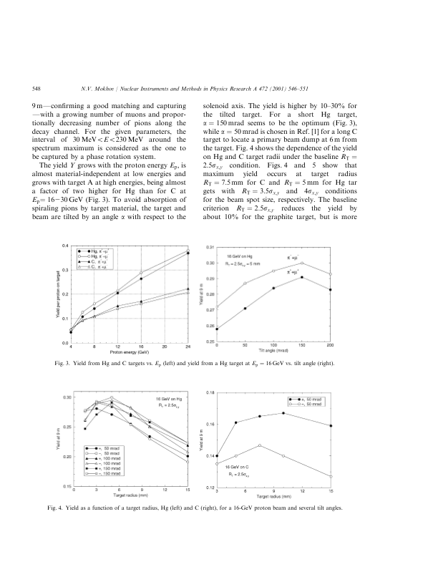
Reference
N.V.Mokhov, NIMA 472 (2001) 546-551
Target radius: 5mm, beam angle: 50 mrad (?)

Slide 3
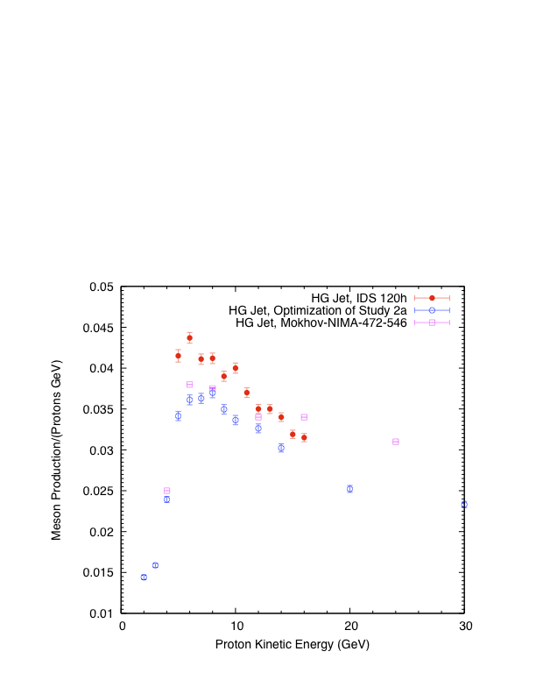
Comparison

