Slide 1
Meson Production Comparison between HG and GA at 8 GeV
(Update)
X. Ding, UCLA
Target Studies, Oct. 18, 2011

Slide 2
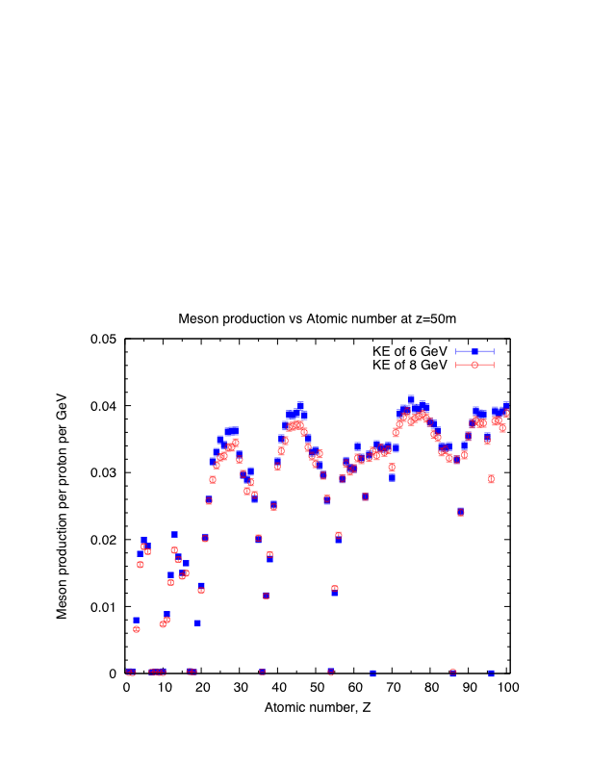
Meson Productions at 6 and 8 GeV
(All using the same geometry as Hg case)

Slide 3
Optimized Target Parameters at z=-37.5 cm
Study-2a Geometry and fieldmap, new optimization procedure (beam below the HG jet exactly at z=-37.5 cm)
The mercury jet target geometry. The proton beam and mercury jet cross at z=-37.5 cm.
Target material | HG (Mean Free Path 13.98 cm) | GA (Mean Free Path 22.12 cm) | GA (Radius scale from HG with 22.12/13.98)
Target radius (Rtg) | 0.38 cm | 0.42 cm | 0.60 cm
Proton Beam Angle (θb) | 99 mrad | 77 mrad | 87 mrad
Crossing Angle of Beam/Jet (θc) | 19.14 mrad | 9 mrad | 16.6 mrad
Path length of proton beam inside the jet [2Rtg/sin(θc)] | 39.7 cm | 93.3 cm | 72.3 cm

Slide 4
Meson Production Comparison at Z = 50 m (No. of events: 400000)
Target material | HG | GA | GA (Radius scale to be 0.6 cm)
Meson Production before optimization (0.5cm/67mrad/33mrad) | 57340 (Pos) 60791 (Neg) 118131 (Sum) | 46414 (Pos) 48830 (Neg) 95244 (Sum)
Meson Production after optimization | 61255 (Pos) 66996 (Neg) 128351 (Sum) (16.6% higher than GA case) | 54129 (Pos) 55958 (Neg) 110087 (Sum) | 53253 (Pos) 54091 (Neg) 107343 (Sum)

Slide 5
Meson Production with Varied Roll Angles
Roll Angle | 180 deg Beam below the HG Jet | 270 deg Beam on the left of HG Jet | 90 deg Beam on the right of HG Jet
Meson Production (HG Jet) (Diff) | 127477.9 (0.0%) | 130781.7 (+2.6%) | 97815.5 (-2.3%)
Meson Production (GA Jet) (Diff) | 109301 (0.0%) | 114051.6 (+4.3%) | 104005.6 (-4.8%)

Slide 6
BACKUP

Slide 7
MARS Results by J. Back

