Slide 1
Meson Production at 8 GeV for IDS120h
X. Ding, UCLA
Target Studies, Dec. 27, 2011

Slide 2
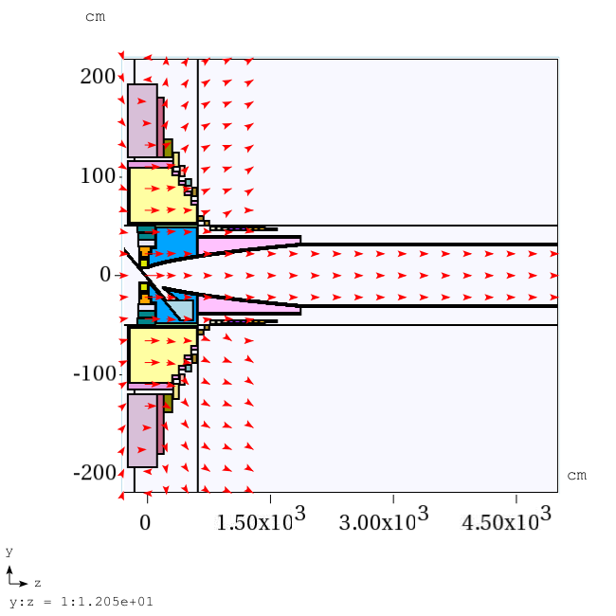
Configuration of IDS120h

Slide 3
Meson Production Study
The mercury jet target geometry. The proton beam and mercury jet cross at z=-37.5 cm.
1. IDS120h (Geometry and fieldmap)
2. Target (HG or GA)
3. Beam below the HG/GA jet exactly at z = -37.5 cm and project beam back to z = -200 cm.
4. Initial target parameters: target radius of 5 mm, beam angle of 67 mrad at z = -37.5 cm, beam/jet crossing angle of 33 mrad at z = -37.5 cm.

Slide 4
Optimized Target Parameters at z = -37.5 cm
 | HG |  |  | GA
 | Beam radius, mm | Crossing angle, mrad | Beam angle, mrad | Beam radius, mm | Crossing angle, mrad | Beam angle, mrad
Initial | 5 | 33 | 67 | 5 | 33 | 67
1st Cycle | 4.6 | 23 | 120 | 6.7 | 21 | 112
2nd Cycle | 4.15 | 23 | 117 | 5.5 | 17 | 93
3rd Cycle | 4.15 | 21.6 | 120 | 4.9 | 12.2 | 92

Slide 5
Meson Productions at 8 GeV (400,000 events)
 | HG | GA
Before optimization (Beam radius/beam angle/crossing angle | 119794 (5mm/67mrad/33mrad) | 97895 (5mm/67mrad/33mrad)
After optimization (Beam radius/beam angle/crossing angle) | 129976 (4.15mm/120mrad/21.6mrad) | 112269 (4.9mm/92mrad/12.2mrad)

