Slide 1

The European Spallation Source Neutrino Super Beam for CP Violation discovery
Marcos DRACOS
IPHC-IN2P3/CNRS Université de Strasbourg
August 14, 2015

Slide 2

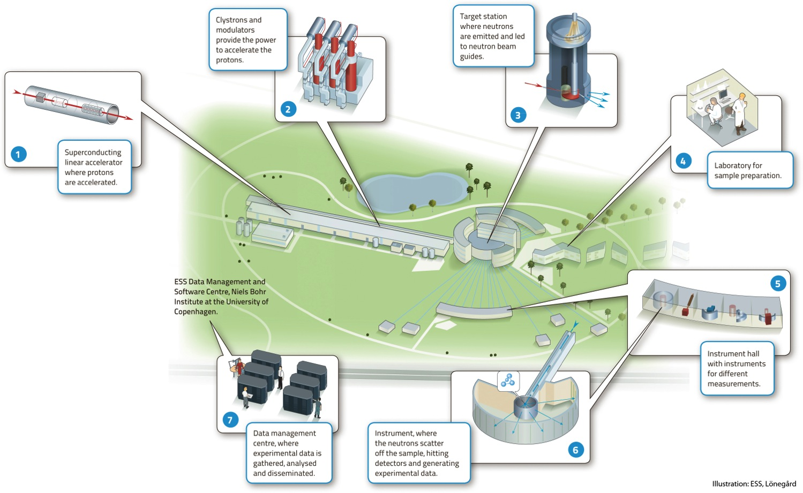



European Spallation Source
under construction phase
(~1.85 B€ facility)

Slide 3
Having access to a powerful proton beam…
What can we do with:
5 MW power
2 GeV energy
14 Hz repetition rate
10¹⁵ protons/pulse
>2.7x10²³ protons/year
proton beam
decay tunnel
p
hadrons
physics
π
ν
⨂B
target
hadronic collector
(focusing)
Detector
conventional neutrino (super) beam

Slide 4
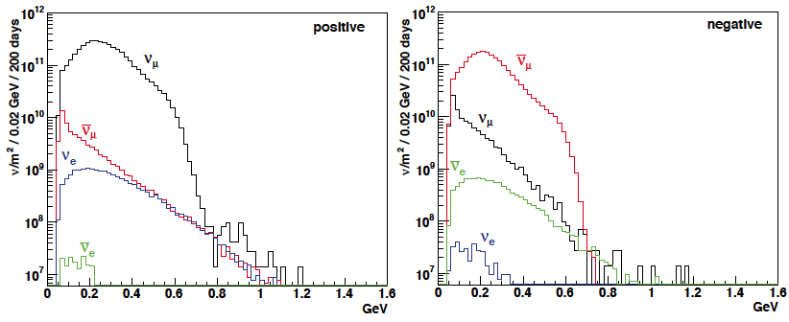
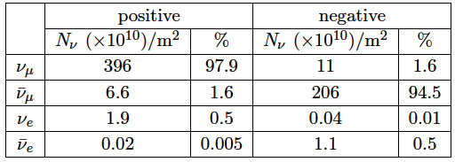
ESSνSB neutrino energy distribution
neutrinos
anti-neutrinos
at 100 km from the target and per year (in absence of oscillations)
almost pure ν_{μ} beam

Slide 5
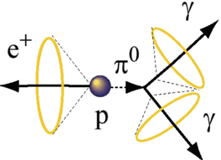
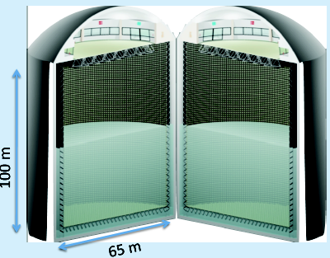
Can we go to the 2nd oscillation maximum using our proton beam?
Yes, if we place our far detector at around 500 km from the neutrino source.
MEMPHYS Cherenkov detector
(MEgaton Mass PHYSics studied by LAGUNA)
(arXiv: hep-ex/0607026)
Neutrino Oscillations (Super Beam, Beta Beam)
Proton decay
Astroparticles
Understand the gravitational collapsing: galactic SN ν
  Supernovae "relics"
Solar Neutrinos
Atmospheric Neutrinos
500 kt fiducial volume (~20xSuperK)
Readout: ~240k 8” PMTs
30% optical coverage

Slide 6
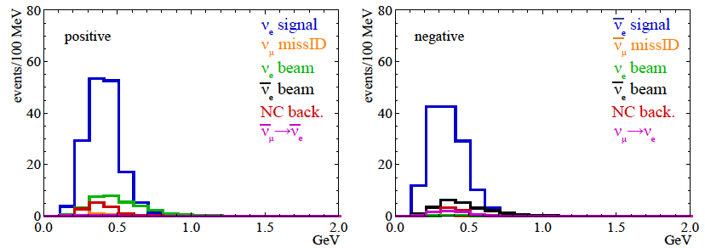
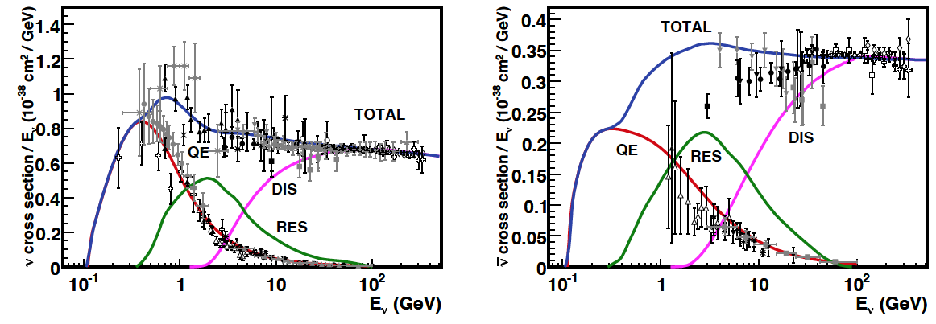
Neutrino spectra
540 km (2 GeV)
below ν_{τ} production
neutrinos
anti-neutrinos
δ_{CP}=0
2 years
8 years

Slide 7
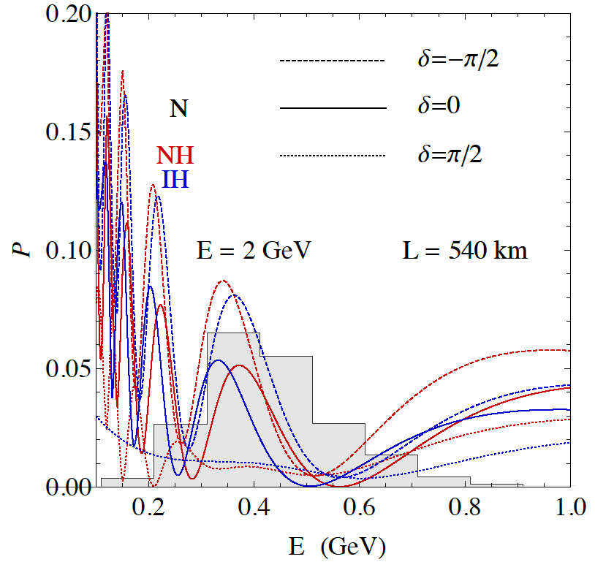
2nd Oscillation max. coverage
2nd oscillation max.
well covered by the ESS neutrino spectrum
1st oscillation max.

Slide 8
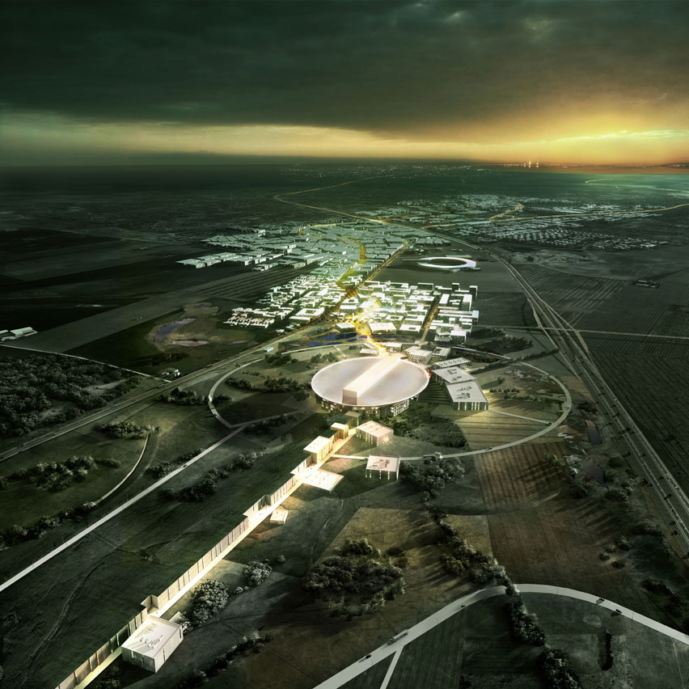
Where to find all these protons?
European Spallation Source Linac

Slide 9
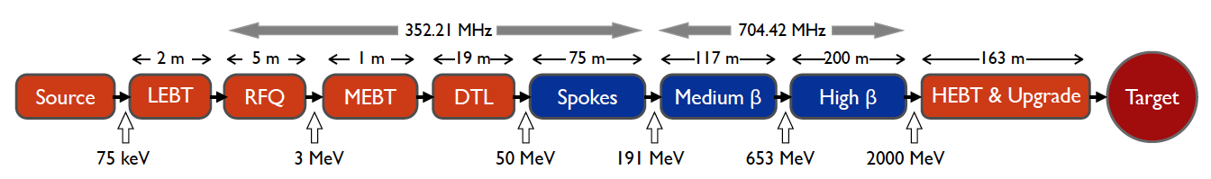
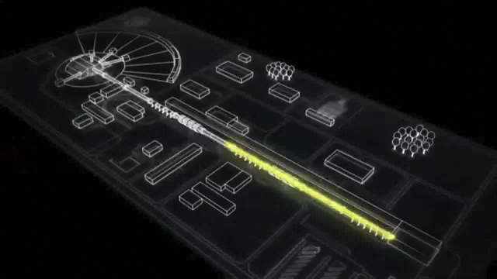
ESS proton linac
The ESS will be a copious source of spallation neutrons
5 MW average beam power
125 MW peak power
14 Hz repetition rate (2.86 ms pulse duration, 10¹⁵ protons)
2.0 GeV protons (up to 3.5 GeV with linac upgrades)
>2.7x10²³ p.o.t/year
Linac ready by 2023 (full power and energy)

Slide 10
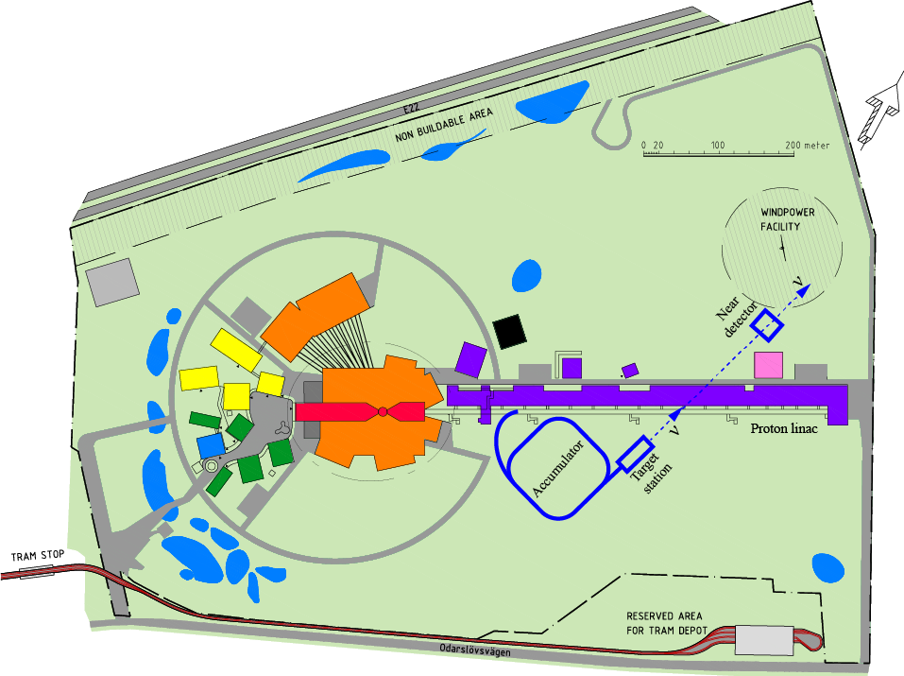
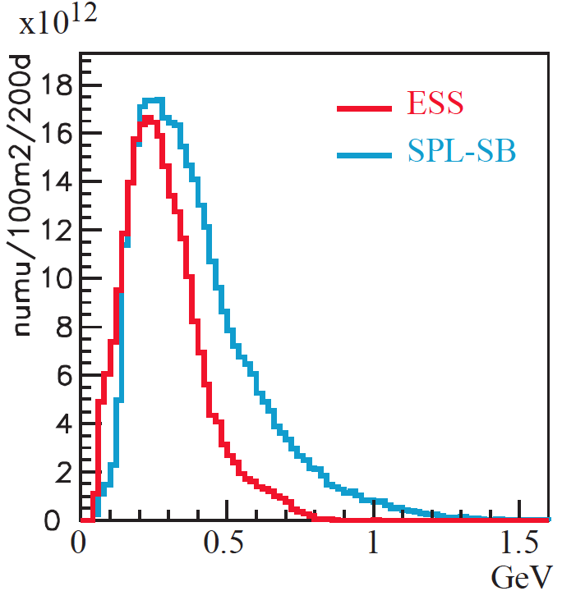
How to add a neutrino facility?
The neutron program must not be affected and if possible synergetic modifications
Linac modifications: double the rate (14 Hz → 28 Hz), from 4% duty cycle to 8%.
Accumulator (C~400 m) needed to compress to few μs the 2.86 ms proton pulses, affordable by the magnetic horn (350 kA, power consumption, Joule effect)
  H⁻ source (instead of protons)
  space charge problems to be solved
~300 MeV neutrinos
Target station (studied in EUROν)
Underground detector (studied in LAGUNA)
Short pulses (~μs) will also allow DAR experiments (as those proposed for SNS)
neutrino flux at 100 km (similar spectrum than for EU FP7 EUROν SPL SB)

Slide 11
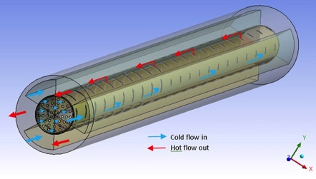
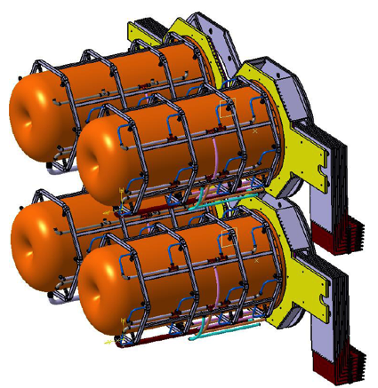
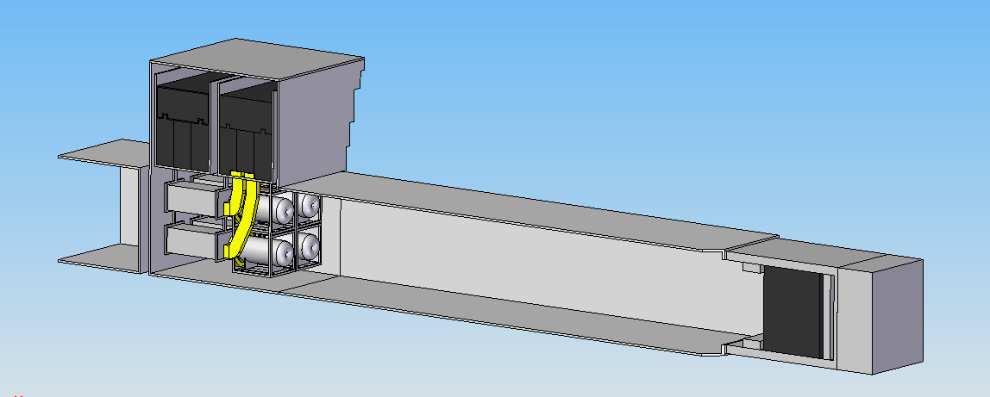
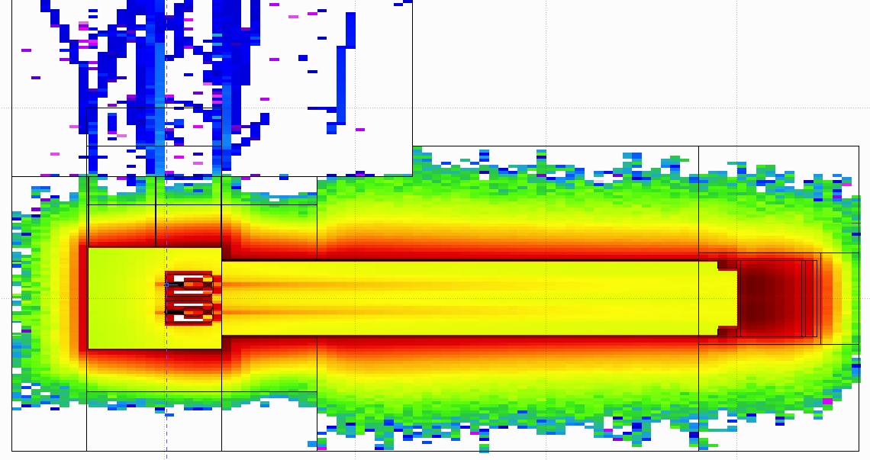
Previous Expertise
ESSνSB
BENE (2004-2008)
ISS (2005-2007)
EUROν (2008-2012)
LAGUNA (2008-2010)
LAGUNA-LBNO (2010-2014)
SNS (USA)

Slide 12
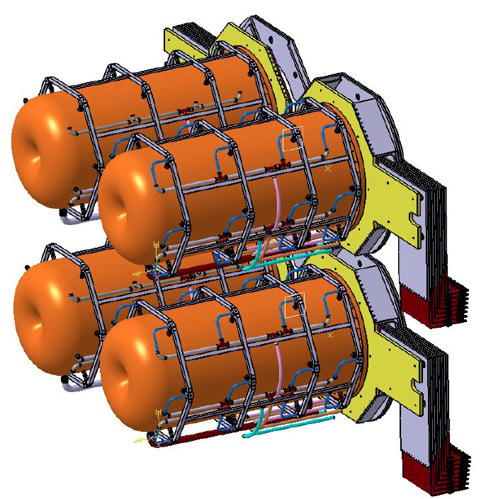
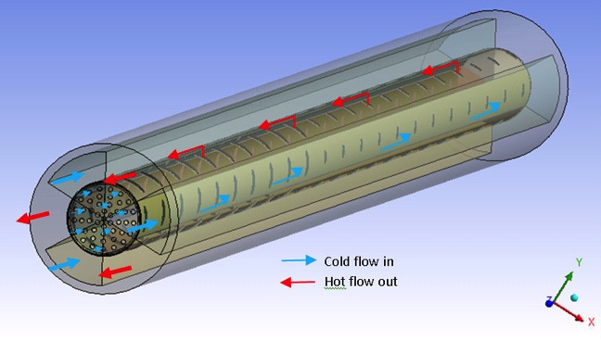
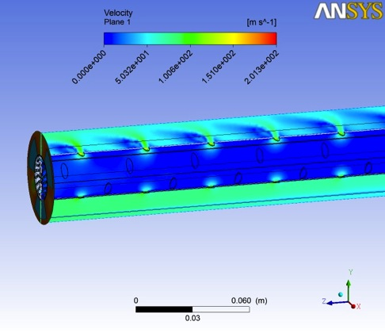
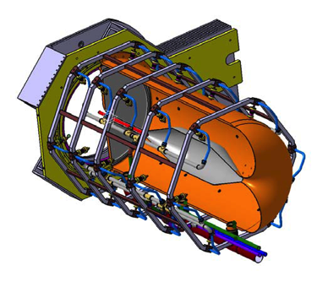
Mitigation of high power effects
(4-Target/Horn system for EUROnu Super Beam)
Packed bed canister in symmetrical transverse flow configuration (titanium alloy spheres)
4-target/horn system to mitigate the high proton beam power (4 MW) and rate (50 Hz)
Helium Flow
target inside the horn

Slide 13
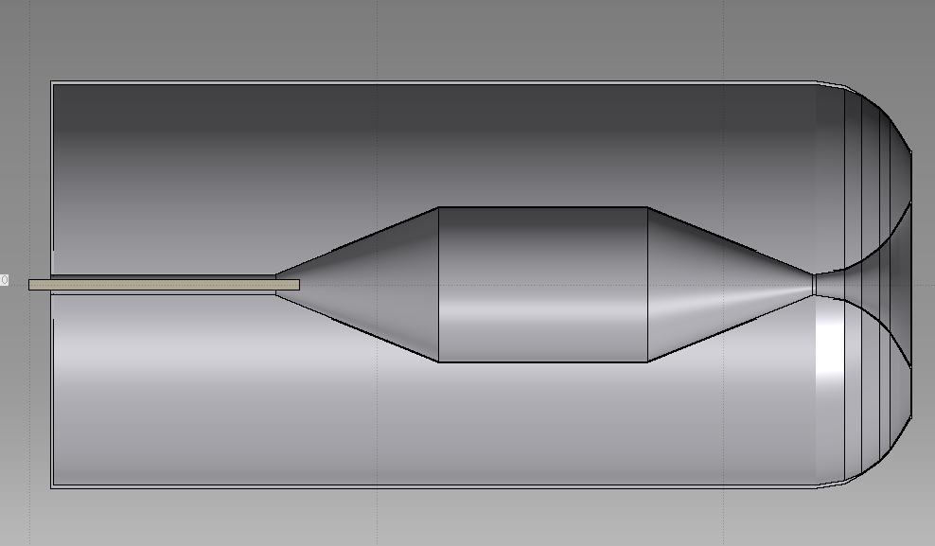
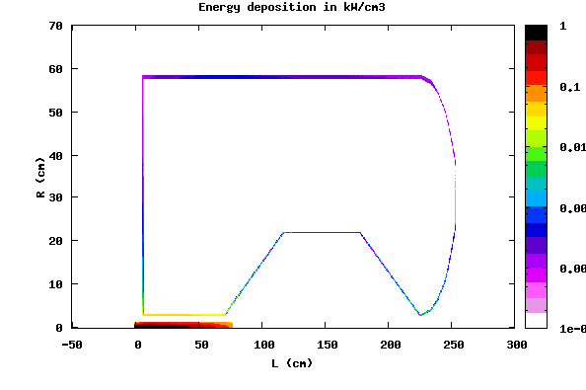
Energy Deposition from secondary particles, 3 horns,
ESSνSB -1.6 MW/EUROnu -1.3 MW
target Ti=65%d_{Ti} , R_{Ti}=1.5 cm
FLUKA 2014, flair
21/12.4 kW, t=10 mm
6.3/3.4 kW, t=10 mm
2.8/1.6 kW
2.4/1.7 kW
3.5/2.4 kW
2.1/1.2 kW
13.6/9.4 kW
P_{tg} = 212/104 kW
P_{h} = 52/32 kW
radial profile of power density kW/cm³
(N. Vassilopoulos)
Horn max
large increase of power (~x2) deposited on target @ ESS
Notes:
Large increase of power deposition on target compared to SPL

Slide 14
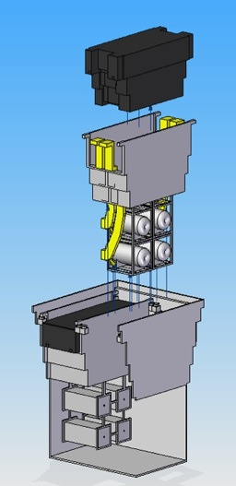
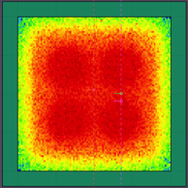
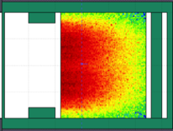
General Layout of the target station
(copied from EUROnu)
Shield Blocks
Horn Support Module
Split Proton Beam
Horns and Targets
Collimators
Decay Volume
(He, 4x4x25 m³)
Neutrino Beam Direction
Beam Dump
8 m concrete

Slide 15
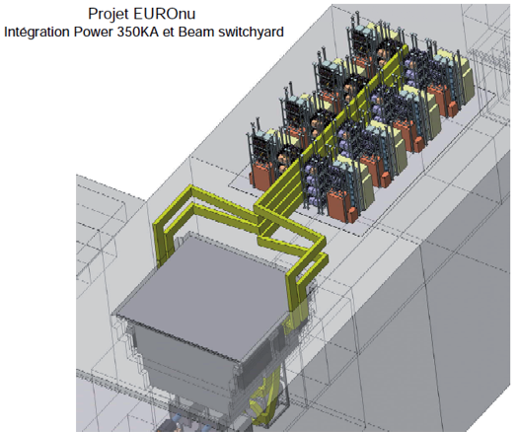
PSU
a 4x44 kA module
x 8
PSU: 8 times 4x44 kA modules
1-charger/capacitor/coil, 4-switches per 4x44 kA module
8 strip lines merged into 4 transmission lines in-out/horn
Large energy recuperation
Notes:
Discharge 8 x 4x44kA modules to each horn every 20 ms, in between energy recovered at 97 % due to no-transformer situation

Slide 16
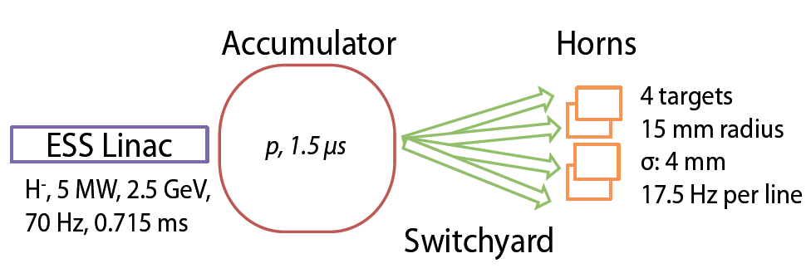
Proton Beam Switchyard
Parameter | EUROν | ESSνSB
Particle | H⁻ | H⁻
Proton kinetic energy (GeV) | 4.5 | 2.5
Pulse intensity (mA) | 40 | 62.5
Avg beam power (MW) | 4 | 5
Beam rigidity (Tm) | 17.85 | 11.02
Macro-pulse length (linac) (ms) | 2.86 | 0.715
Pulse length (accu.) (μs) | 1.5 | 1.5
Pulse repetition rate (Hz) | 50 | 70
Update of the switchyard preliminarily designed for EUROν with ESS beam parameters (config.1)
Other possible layouts currently being studied (i.e config.2)
• Selection criteria: number of magnetic elements needed + type of operation (i.e. simple or bi-polar) + prospective of beam dump requirements.
config2.
config1.
Total length: 43.4 m
Max. B-field: 0.65 T (25 kA turns / pole)
Dipole length: 2 m
Total length: 72.2 m
Max. B-field: 0.73 T (29 kA turns / pole)
Dipole length: 2 m

Slide 17
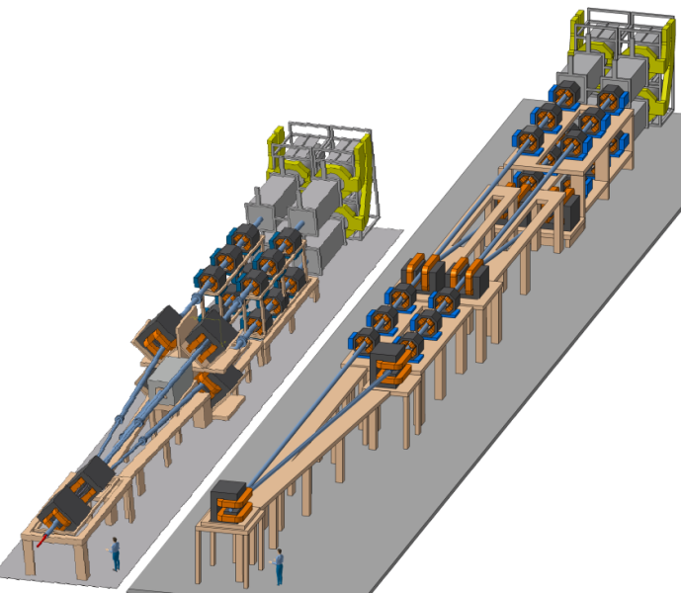
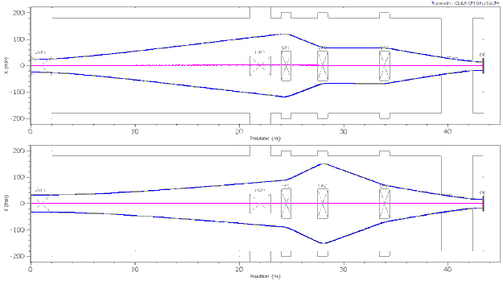
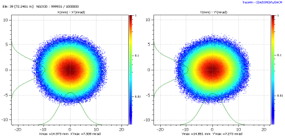
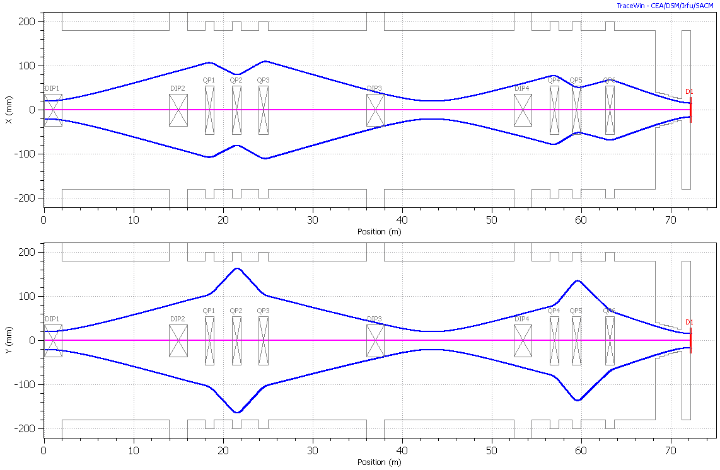
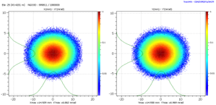
Proton Beam Switchyard
• Assumptions:
- Norm. trans. Emittances: 225 μm (99.7%)
- Momentum dispersion: 0.1% rms.
config1.
Quadrupole | Q1 | Q2 | Q3
Field gradient, T/m | 1.9 | -2.4 | 1.1
Intensity, NI per pole, kA | 30.8 | 39.0 | 17.8
config2.
Quadrupole | Q1 | Q2 | Q3 | Q4 | Q5 | Q6
Grad., T/m | 1.7 | -3.0 | 1.7 | 2.6 | -3.6 | 2.0
Intensity, NI / pole, kA | 27.2 | 48.3 | 28.5 | 41.8 | 59.9 | 33.7
> IPAC’15 Proceedings: E. Bouquerel, “Design Status of the ESSnuSB Switchyard”, MOPWA017

Slide 18
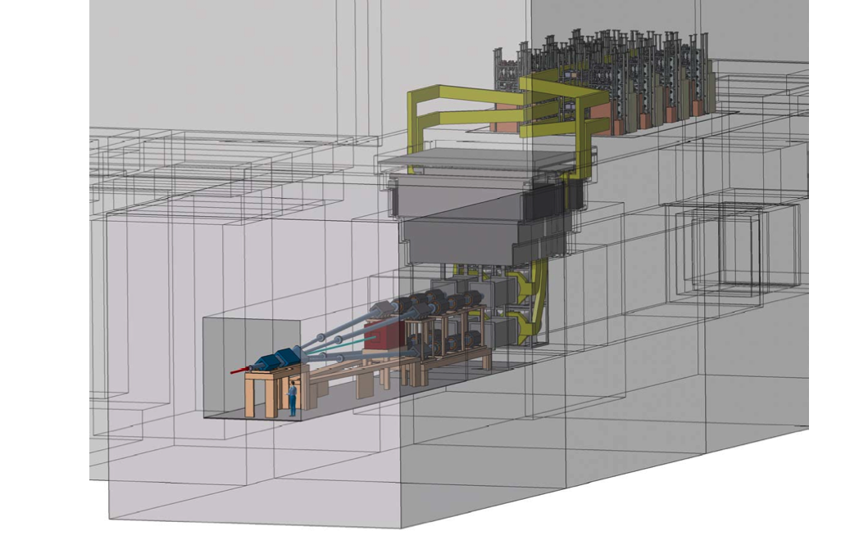
ESSνSB layout
(adopted from EUROnu Super Beam, inspired by J-PARC (T2K))
PSU
Concrete surrounding shielding (8 m)
Iron (2.2 m) and concrete (3.7 m) shielding
Beam dump
Decay tunnel
He vessel (25 m)
Concrete surrounding shielding) (8 m)
4-targets/horns
Vessel (He)
Switching yard to four proton beams or accumulator rings
EUROnu
arXiv:1212.0732
Notes:
Compact design to confine radiation

Slide 19
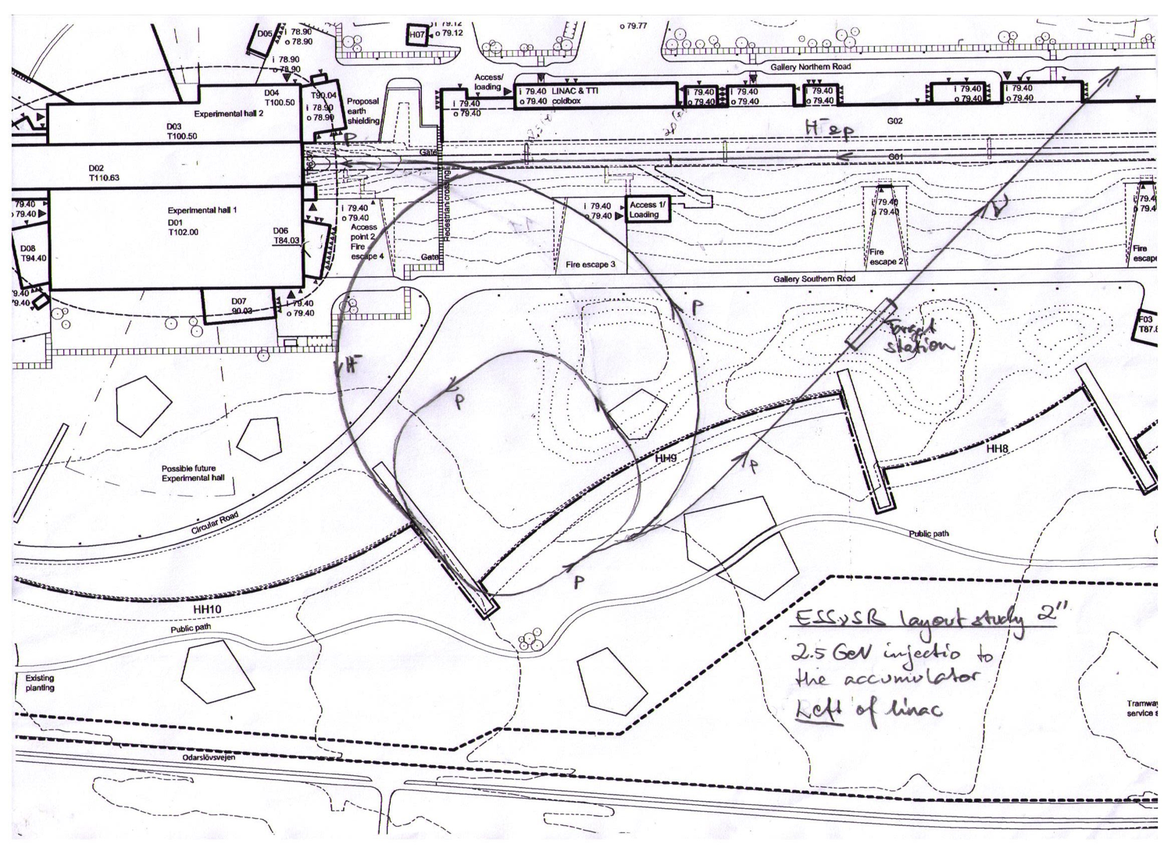
Possible Layout
Avoid sharper bends
Courtesy T. Ekelöf, F. Gerigk

Slide 20
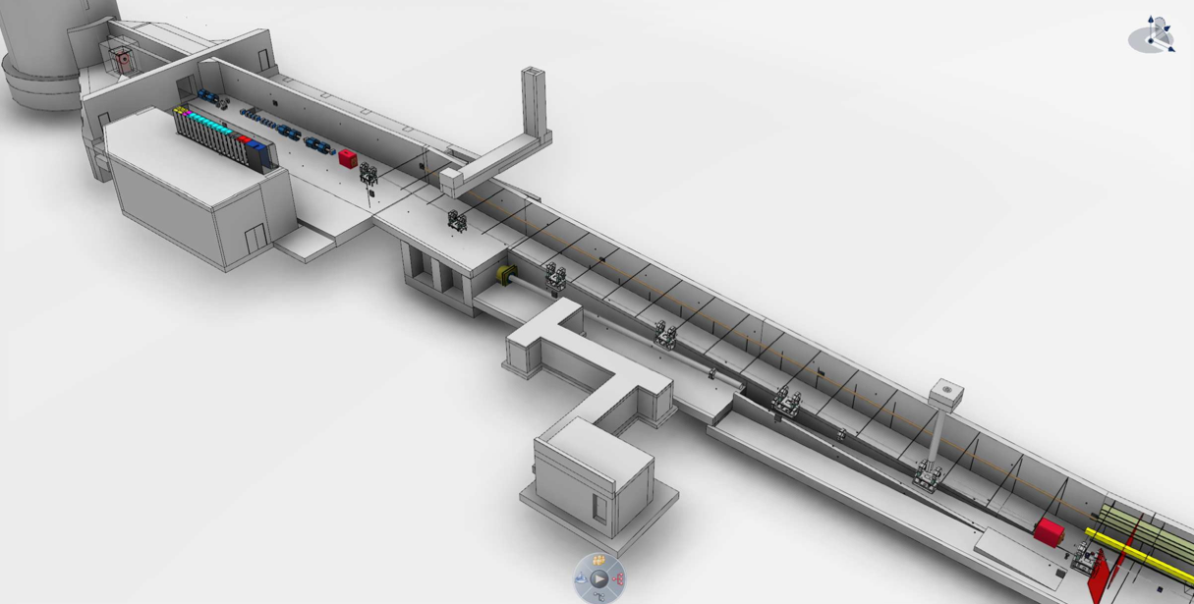
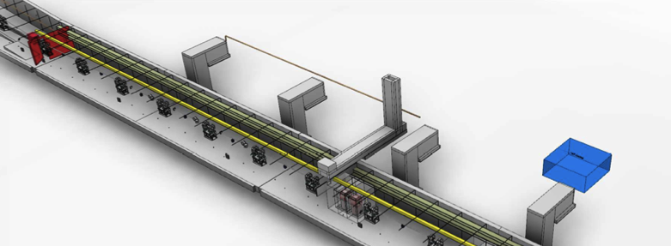
Switch from 2.5 GeV linac
(start of a quad package)
DRIFT 256.2 50 0
QUAD 410 4.61286 50 0 0 0 0 0
DRIFT 600 50 0
QUAD 410 -4.61286 50 0 0 0 0 0
DRIFT 256.2 50 0
(end of a quad package)
(start of the drift space)
DRIFT 1646.9 50 0
DRIFT 1646.9 50 0
DRIFT 1646.9 50 0
DRIFT 1646.9 50 0
(end of the drift space)
(start of a quad package)
DRIFT 256.2 50 0
QUAD 410 4.62783 50 0 0 0 0 0
DRIFT 600 50 0
QUAD 410 -4.62783 50 0 0 0 0 0
DRIFT 256.2 50 0
(end of a quad package)
(start of the drift space)
DRIFT 720.3 50 0
(end of the drift space)
(start of dipole)
BEND -4 25783.1 0 50 1
(end of dipole)
Drift-space between quads before dogleg ~ 6.6 m
Assume again 0.15 T maximum B field
Consider switching dipoles as proposed for SPL-EURISOL
Switch for H-

Slide 21
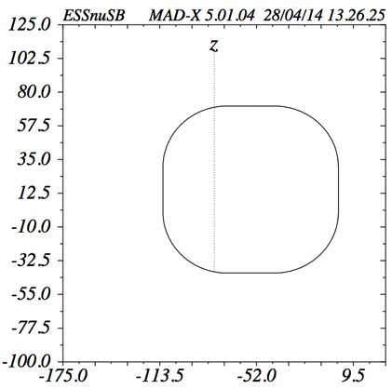
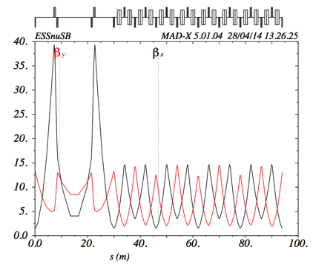
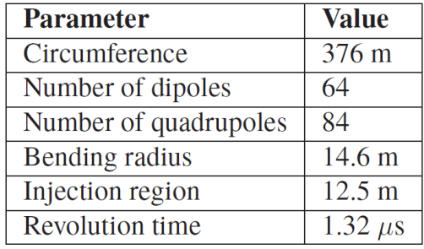
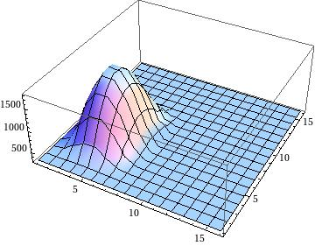
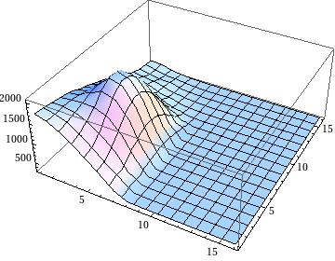
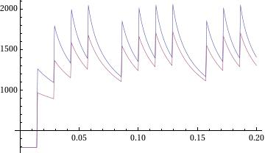
The ESSnuSB Accumulator
C=376 m
Summary of Lattice Parameters for the Accumulator
J. Jonnerby, CERN
Straight Arc
376 m long ring as one of the possible layout
Stripping foil injection: Temperature of the foils currently under studies
Maximum foil temperatures:
1797 K (H- Linac Beam)
T [˚K]
T [˚K]
T [˚K]
t [ms]
t [ms]
y [mm]
2050 K (H- + p circulating Beam)
H. Schönauer, CERN
y [mm]
t [ms]
> IPAC’15 Proceedings: E. Wildner et al., “The Accumulator of the ESSnuSB for Neutrino Production”, THPF100

Slide 22
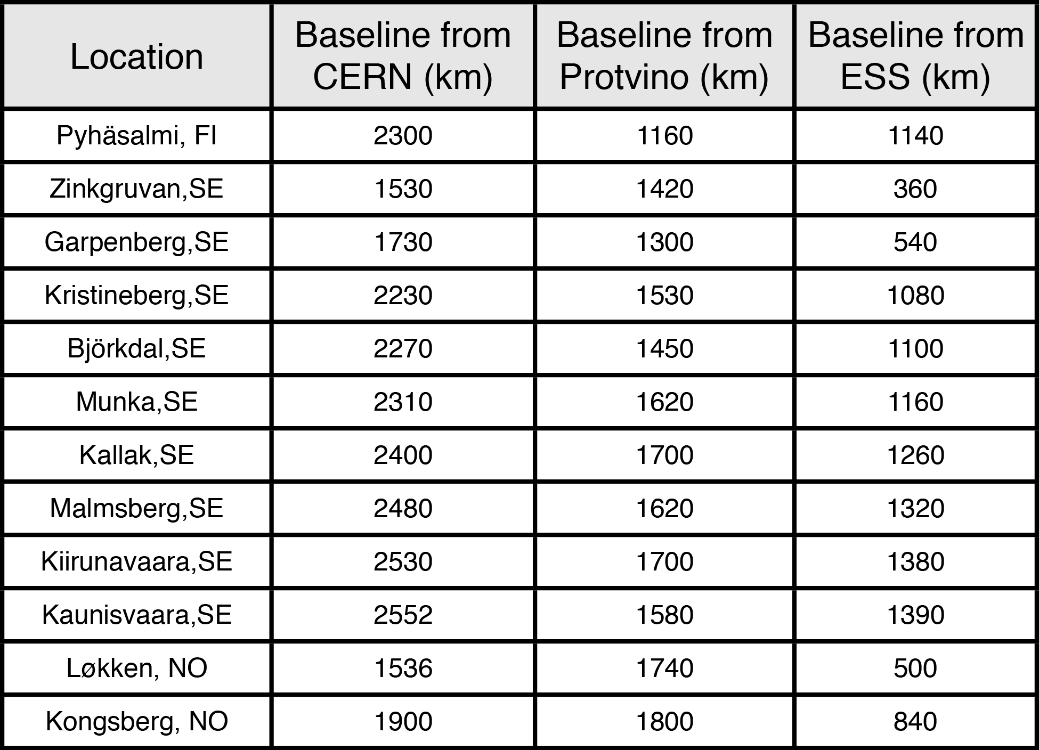
Possible locations for far detector
ESS
Kongsberg
Løkken
CERN
LAGUNA sites

Slide 23
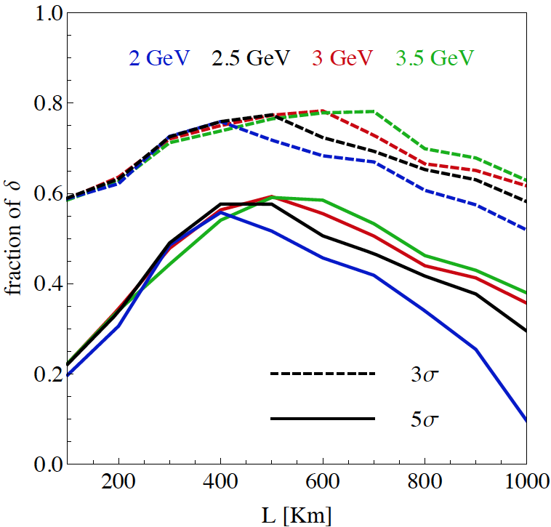
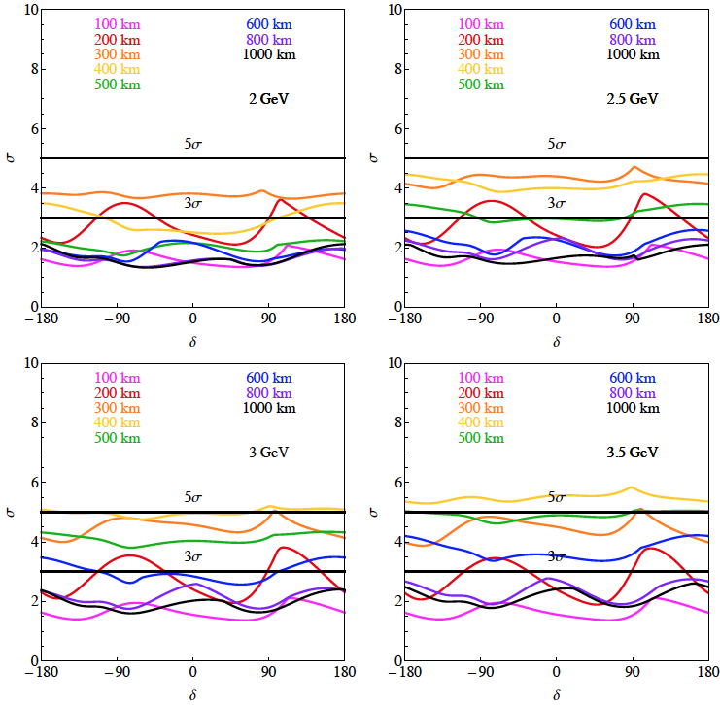
Which baseline?
CPV
MH
Garpenberg
Zinkgruvan
Zinkgruvan is better for 2 GeV
Garpenberg is better for > 2.5 GeV
systematic errors: 5%/10% (signal/backg.)
Zinkgruvan is better
atmospheric neutrinos are needed (at least at low energy)

Slide 24
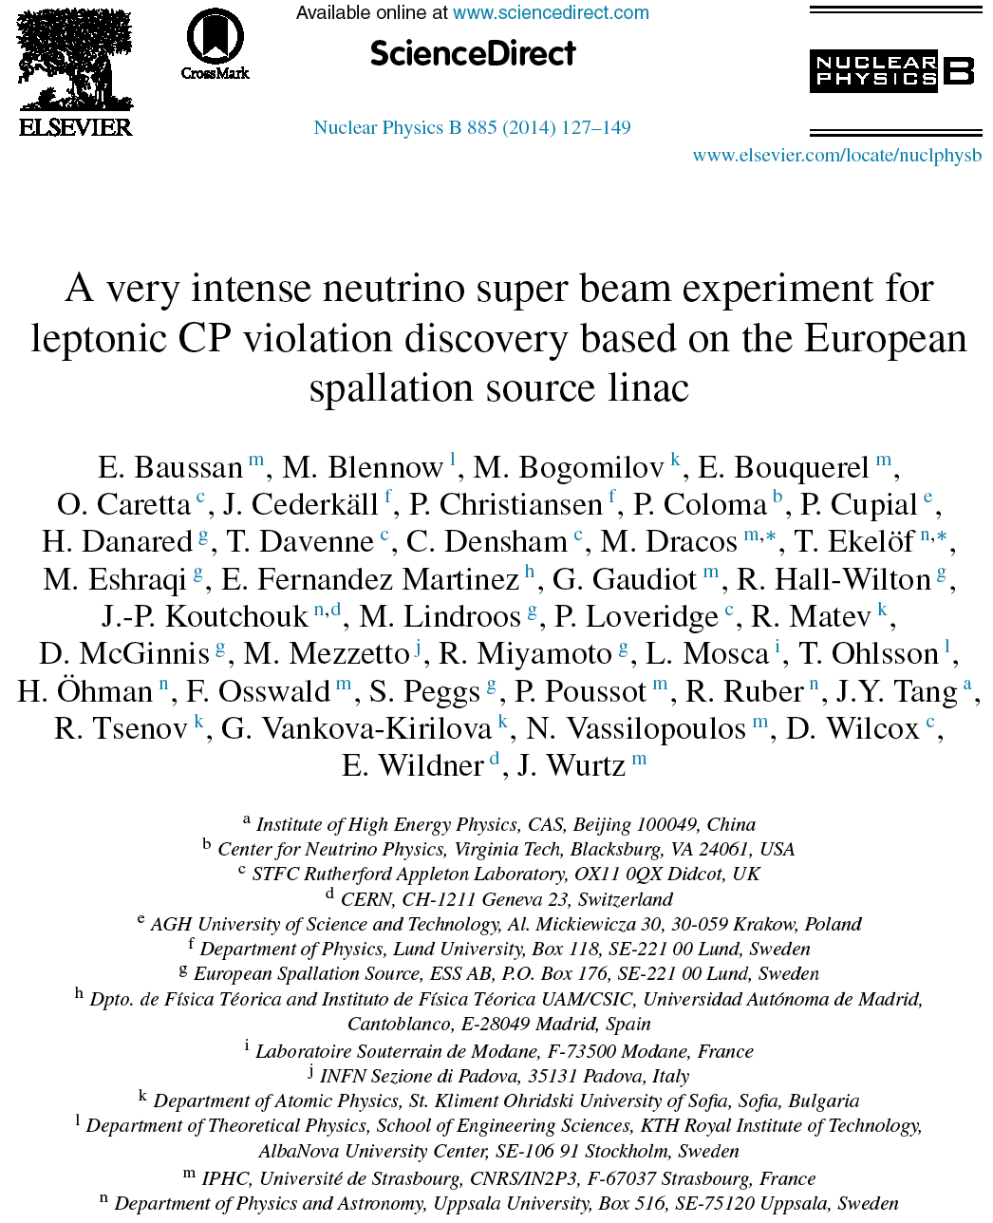
ESS Neutrino Super Beam DS
arXiv:1212.5048
arXiv:1309.7022
14 participating institutes from 10 different countries,
among them ESS and CERN

Slide 25
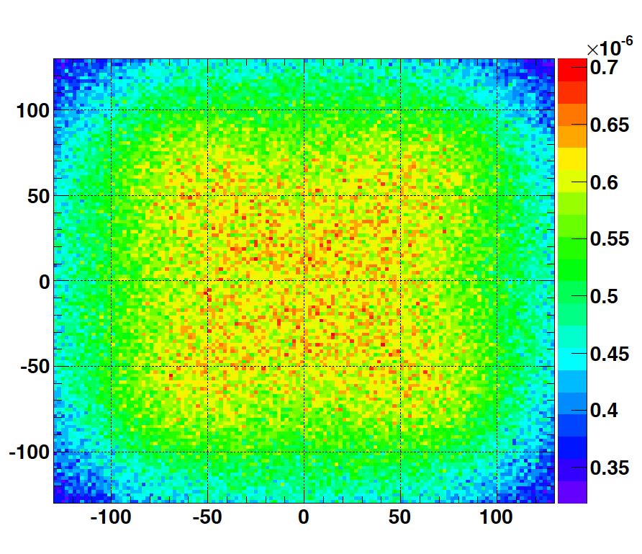
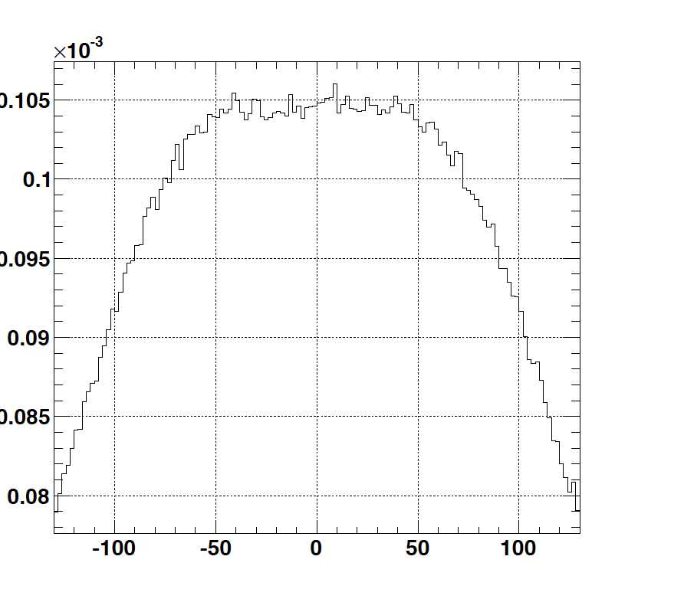
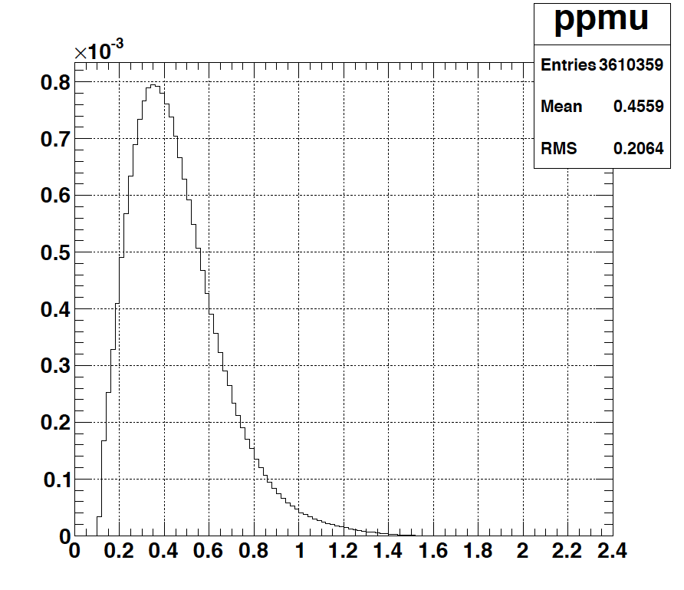
Muon at the level of the beam dump
2.7x10²³ p.o.t/year
y (cm)
muons at the level of the beam dump
(per proton)
4.2x10²⁰ μ/year
(16.3x10²⁰ for 4 m²)
x (cm)
10⁻³
4.1x10²⁰ μ/year
x (cm)
input beam for future 6D μ cooling experiments (for muon collider)
good to measure neutrino x-sections (ν_{μ}, ν_{e}) around 200-300 MeV (low energy nuSTORM)
muons/proton
<E_{μ}>~0.46 GeV
<L_{μ}>~2.9 km

Slide 26
ESS Neutrino Super Beam Design Study
A H2020 Design Study has been submitted last September
  11 institutes (including ESS and CERN) from 8 European countries
  Decision:
    Overall score 13.5/15 (5/5 for Excellence)
    not enough to be funded (only 15 MEUR for this call)
    nevertheless, the evaluators recognise that ESSνSB answers one of the priorities defined in the European Strategy for Particle Physics.
New funding sources are now investigated in order to continue this design study (probably re-apply to H2020 2016/2017 call).
Some studies for H⁻ injection and accumulation ring are included in an approved EU project concerning High Brightness neutron facility.

Slide 27




ESS under construction
October 2014

Slide 28

ESS Construction
accumulator
near detector
target station
proton linac
First proton beam by 2019
Full power/energy by 2023
February 2015

Slide 29

ESS Construction
June 2015

Slide 30



ESS Construction
June 2015

Slide 31

Conclusion
Significantly better CPV sensitivity at the 2nd oscillation maximum.
The European Spallation Source Linac will be ready in less than 10 years (5 MW, 2 GeV proton beam by 2023)
Neutrino Super Beam based on ESS linac is very promising.
ESS will have enough protons to go to the 2nd oscillation maximum and increase its CPV sensitivity.
CPV: 5 σ could be reached over 60% of δ_{CP} range (ESSνSB) with large potentiality.
Large associated detectors have a rich astroparticle physics program.
Full complementarity with a long baseline experiment on the 1st oscillation maximum using another detection technique (LAr?).
A Design Study is urgently needed.

Slide 32
Backup

Slide 33




Neutrino Oscillations with "large" θ₁₃
2nd oscillation maximum
P(ν_{μ}→ν_{e})
1st oscillation maximum
θ₁₃=1º
("small" θ₁₃)
δ_{CP}=-90
δ_{CP}=0
δ_{CP}=+90
θ₁₃=8.8º
("large" θ₁₃)
L/E
L/E
solar
atmospheric
for "large" θ₁₃ 1st oscillation maximum is dominated by atmospheric term
for small θ₁₃ 1st oscillation maximum is better
atmospheric
solar
L/E
L/E
CP interference
(arXiv:1110.4583)
θ₁₃=1º
CP interference
θ₁₃=8.8º
1st oscillation max.: A=0.3sinδ_{CP}
2nd oscillation max.: A=0.75sinδ_{CP}
more sensitivity at 2nd oscillation max.
(see arXiv:1310.5992 and arXiv:0710.0554)

Slide 34

DAR experiments
(ESS/SNS)
Typical expected supernova neutrino spectrum for different flavours (solid lines) and SNS/ESS neutrino spectrum (dashed and dotted lines)

Slide 35


Neutrino Oscillations with "large" θ₁₃
at the 1st oscillation max.: A=0.3sinδ_{CP}
at the 2nd oscillation max.: A=0.75sinδ_{CP}
2nd oscillation maximum is better
(see arXiv:1310.5992 and arXiv:0710.0554)

Slide 36

Systematic errors
Phys. Rev. D 87 (2013) 3, 033004 [arXiv:1209.5973 [hep-ph]]

Slide 37

Systematic errors and exposure
for ESSnuSB systematic errors see 1209.5973 [hep-ph] (lower limit "default" case, upper limit "optimistic" case)
P5 requirement: 75% at 3 σ
High potentiality
Neutrino Factory reach
10 years
20 years
(courtesy P. Coloma)

Slide 38


Effect of the unknown MH on CPV performance
"default" case for systematics
(P. Coloma)
small effect
practically no need to re-optimize when MH will be known

Slide 39

δ_{CP} accuracy performance
(USA snowmass process, P. Coloma)
"default" column
for systematic errors see (7.5%/15% for ESSnuSB):
Phys. Rev. D 87 (2013) 3, 033004 [arXiv:1209.5973 [hep-ph]]
arXiv:1310.4340 [hep-ex] Neutrino "snowmass" group conclusions

Slide 40


δ_{CP} coverage
CPV (2 GeV protons)
"nominal"
x2
after 10 years
with 2 times more statistics
systematic errors (nominal values): 5%/10% for signal/background
more than 50% δ_{CP} coverage using reasonable assumptions on systematic errors

Slide 41


The MEMPHYS Detector
(Proton decay)
(arXiv: hep-ex/0607026)

Slide 42


The MEMPHYS Detector
(Supernova explosion)
MEMPHYS
SUPERK
Diffuse Supernova Neutrinos
(10 years, 440 kt)
For 10 kpc: ~10⁵ events

