Slide 1
Irradiation study of Ti-6Al-4V and Ti-6Al-4V-1B for FRIB beam dump:
Experimental plan
Aida Amroussia, PhD Student
Chemical Engineering and Materials Science
Michigan State University
Nov. 26, 2013

Slide 2
Motivation
Study of irradiation damage in Ti-6Al-4V and Ti-6Al-4V-1B
Irradiation with different particles and energy levels:
    Neutron
    Heavy ions with low, intermediate and high energy
Compare the results:
Does boron addition improves mechanical properties of Ti-6Al-4V after irradiation?
Are the changes in mechanical properties of the Ti-alloys “similar” after neutron and heavy ions irradiation? At what neutron flux ? What energy/ intensity/ dpa rate?

Slide 3
Ti-6Al-4V vs Ti-6Al-4V-1B
Boron addition improves different characteristics of Ti-6Al-4V:
The stability of the microstructure is increased.
The specific stiffness and strengths increases to 50%.
Improvement of the machinability and thermo-mechanical processing is obtained.
Alloy |  | Ti-6Al-4V | Ti-6Al-4V-1B
E [GPa] | At RT | 110 | 127
 | At 500 °C | 90 | 113
Yield Stress [MPa] | At RT | 1000 | 1190
 | At 500 °C | 450 | 663
Ultimate Tensile Strength [MPa] | At RT | 827 | 1300
 | At 500 °C | 430 | 785
Minimum creep rate [s⁻¹] | T=500, 400 MPa | 1.24.10⁻⁶ | 5.89.10⁻⁸
HCF strength [MPa] | At 500 °C | 172-258 | 314-471
Chen, W., C.J. Boehlert, E.A. Payzant, and J.Y. Howe. “The Effect of Processing on the 455°C Tensile and Fatigue Behavior of Boron-modified Ti–6Al–4V.” International Journal of Fatigue 32, no. 3 (March 2010): 627–638.
Wei Chen and Carl J. Boehlert, ‘Characterization of the Microstructure, Tensile and Creep Behavior of Powder Metallurgy Processed and Rolled Ti-6Al-4V-1B Alloy’, Key Engineering Materials, 436 (2010), 195–203

Slide 4
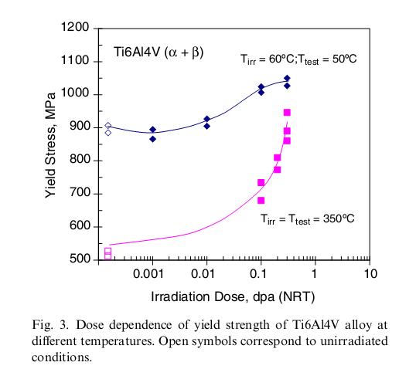
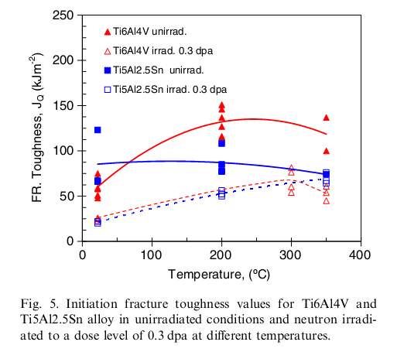
Literature review of neutron irradiation damage in Ti-6Al-4V:
Tensile and fracture toughness
Yield strength saturates at irradiation doses higher than 0.3 dpa at 60ºC.
No saturation at 350ºC
Different hardening mechanisms operate at 50ºC than at 350ºC.
S. Tähtinen, P. Moilanen and B.N. Singh, ‘Effect of Displacement Dose and Irradiation Temperature on Tensile and Fracture Toughness Properties of Titanium Alloys’, Journal of Nuclear Materials, 367-370 (2007), 627–632

Slide 5
Microstructure
Literature review of neutron irradiation damage in Ti-6Al-4V:
Temperature and dose level | Microstructure change observations
50ºC , 0.3 dpa | A high density of uniformly distributed defect clusters in the α-phase No changes in the overall dislocation or phase structures
350ºC, 0.3 dpa | Dislocation loops Vanadium precipitates
450ºC Dose 2.1 and 32 dpa | Dislocation loops β-phase precipitates in α phase
550ºC 32 dpa | Extensive void formation Coarse β-precipitates
S. Tähtinen, P. Moilanen and B.N. Singh, ‘Effect of Displacement Dose and Irradiation Temperature on Tensile and Fracture Toughness Properties of Titanium Alloys’, Journal of Nuclear Materials, 367-370 (2007), 627–632

Slide 6
Irradiation and post-irradiation characterization plan:
Neutron irradiation
Heavy ion irradiation

Slide 7
Neutron irradiation
Abundance of data on neutron irradiation of Ti-6Al-4V (low doses)
Comparison between Ti-6Al-4V and Ti-6Al-4V-1B
Reference | Irradiation Facility | Reactor | Atmosphere | Temperature | Neutron fluence | Dose
[1] | Institute of Reactor Materials, Russia | IVV-2M reactor | inert gas | 250 C | unkown | 0.2 and 0.3 dpa
[2] | Risø National Laboratory, Denmark | DR-3 reactor | atmosphere of helium | 50 C and 350 C | 1.5 10^24 n/m2 (E > 1 MeV) | 0.3 dpa
[3] | Atomic Energy Research Institute in Budapest | VVRSZM Russian Research Reactor | Cooling through He/N2 gas | 150 C | 1.08E20 n/cm2 (E > 1 MeV) | 0.15 dpa

Slide 8
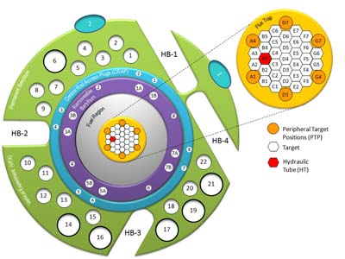
Neutron irradiation at HFIR-ORNL
Irradiation experiment:
Neutron flux =1E+14n/cm²/sec, for E>0.183 MeV.
Irradiation time: 1 cycle (23 days)
Sample: 0.76 x 1.52 x 7.6 mm
Temperature : 350 C
Post irradiation characterization :
The Materials Science and Technology Division of ORNL is equipped with remote hot cells with servo-hydraulic test systems that can perform mechanical testing:
    Scanning Electron Microscopy (SEM), Transmission Electron Microscopy (TEM) and Atom Probe Tomography (APT) to perform microstructural characterization.
    In-situ tensile testing and fracture toughness testing machines to study the mechanical properties of the neutron irradiated Ti-6Al-4V-1B.

Slide 9
Heavy ion irradiation:
Low energy irradiation at CIMAP-GANIL France
ion | energy MeV/nucleon | minimum current (µAe) | flux min (ions/(cm².s)) | required time (1UT=8 hours) | Range in the material (µm)
Ar | 1 | 15 µAe | 10¹² | 12 | 8
 | IRRSUD – Ar 36 | FRIB – O 18 | FRIB – Ca 48 | FRIB – U 238
Energy (MeV/A) | 1 | 230 | 194 | 156
Estimated dpa/h | 0.3 | 2.5.10⁻⁵ | 2.5.10⁻⁴ | 1.5.10⁻³
Total dose | - | 0.13 | 1.35 | 8.5
Se (keV/nm) | 7.24 | 0.08 | 0.6 | 12.6
Table 1 – Comparison between IRRSUD and FRIB beams

Slide 10
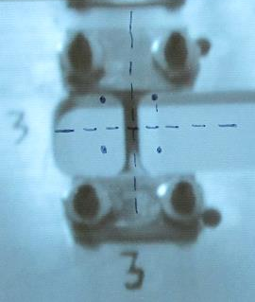
Heavy ion irradiation:
Low energy irradiation at CIMAP-GANIL France
Irradiation experiment:
Samples : Dogbone samples (550-800µm)and TEM samples
Temperature : 350 C and RT
Material: Ti-6Al-4V and Ti-6Al-4V -1B
Post-irradiation characterization at MSU:
    In-situ tensile tests
    Nano-indentation
    TEM and SEM characterization
    X-Ray diffraction ( small angle diffraction)
Beam area
Dogbone samples

Slide 11
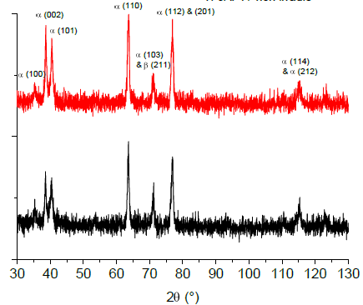
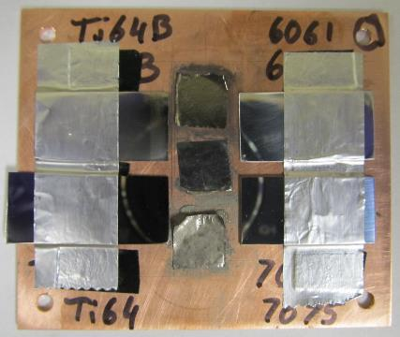
Preliminary results with Ti-6Al-4V
Two tests were performed at IRRSUD - CIMAP in July and October 2013 with both Ti-alloys (Ti-6Al-4V and Ti-6Al-4V-1B)
  4 irradiations (⁸²Kr at 25 and 45 MeV and ¹³¹Xe at 92 MeV, up to 2.5 10¹⁵ ions/cm²)
No evidence of phase transformation and ion track in Ti-6Al-4V promises good radiation resistance of this alloy
3 “glue” specimen
Ti-6Al-4V
Al-6061
Intensity (u.a.)
Xe 92 MeV – 2 10¹¹ ions/cm²
pristine
Kr 45 MeV – 5 10¹³ ions/cm²
2 θ (º)
Ti-6Al-4V-1B
Al-7075

Slide 12
Heavy ion irradiation:
Intermediate energy irradiation at ATLAS- Argonne
 | A | E total (MeV) | E (MeV/u) | Range (µm) | Se (keV/nm) | I (pnA) | P (W) | Dose rate Dpa/day
Ar | 40 | 660 | 16.50 | 150 | 2.75 | 1000 |  | 2
Kr | 84 | 1201 | 14.30 | 96 | 10.18 | 500 | 416 | 4
Post-irradiation characterization: Hot cells at Irradiated material Lab
  Tensile testing - Fracture toughness - Fatigue
  TEM / TEM
  The LECO machines for measuring oxygen, nitrogen and hydrogen contents of the irradiated samples.

Slide 13
References
[1]Rodchenkov, B.S., M.V. Evseev, Yu.S. Strebkov, L.P. Sinelnikov, and V.V. Shushlebin. “Properties of Unirradiated and Irradiated Ti–6Al–4V Alloy for ITER Flexible Connectors.” Journal of Nuclear Materials 417, no. 1–3 (October 2011)
[2]Tähtinen, S., P. Moilanen, B. N. Singh, and D. J. Edwards. “Tensile and Fracture Toughness Properties of Unirradiated and Neutron Irradiated Titanium Alloys.” Journal of Nuclear Materials 307 (2002): 416–420.
[3]Hegedüs, Ferenc, Roland Brütsch, Brian Oliver, and Pierre Marmy. Fracture Toughness and Tensile Properties of the Titanium Alloys Ti6A14V and Ti5A12. 5Sn Before and After Proton and Neutron Irradiations at 150° C. Centre de recherches en physique des plasmas (CRPP), Ecole polytechnique fédérale, 2004.

