Slide 1
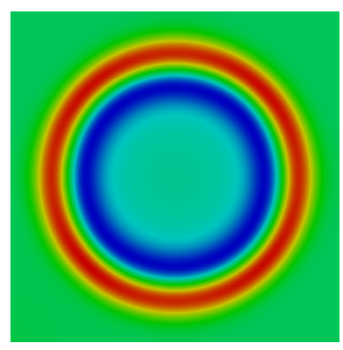
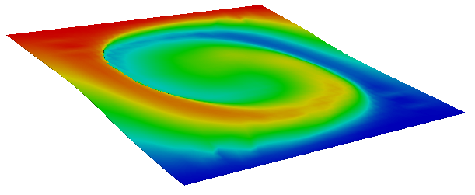
Towards the simulation of proton beam induced pressure waves in liquid metal using the Multiple Pressure Variables (MPV) approach
Jana R. Fetzer, A. Class (May 21, 2014)

Slide 2
Outline
Motivation
Multiple Pressure Variables Approach
Implementation in OpenFOAM
Validation
  Aero acoustic
  Liquid metal
Conclusion

Slide 3
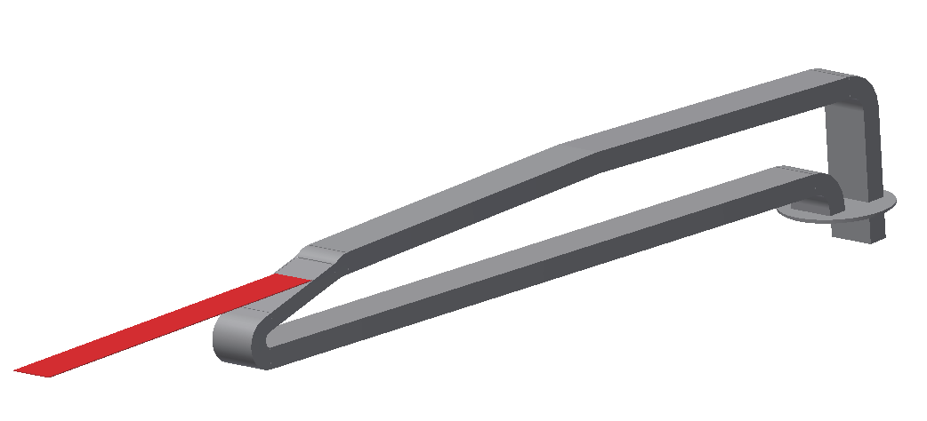
Motivation
European Spallation Source (ESS) proton beam key figures
  Proton beam power 5 MW
  Proton beam mean current 2 mA
  Long-pulse 2.86 ms
  Repetition rate 14 Hz
MEgawatt TArget: Lead bIsmuth Cooled
  Nozzle for flow conditioning and elimination of cavitation
  Successive beam pulses interact with fluid not subjected to the beam previously
  Pressure ~ 1bar
  Flow velocity 1.5-2 m/s
  LBE
nozzle
outflow
proton beam
inflow

Slide 4
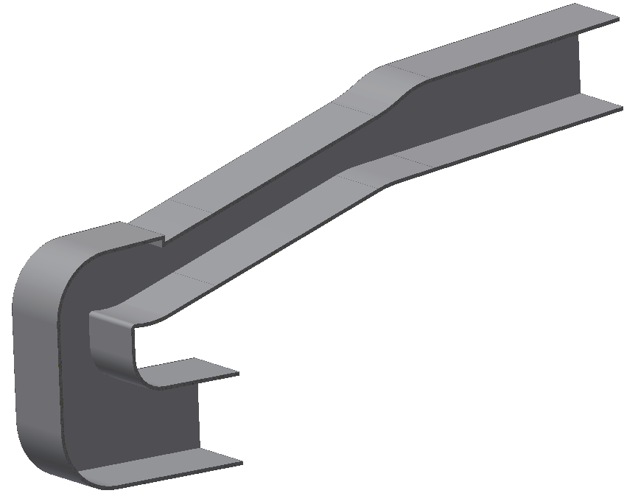
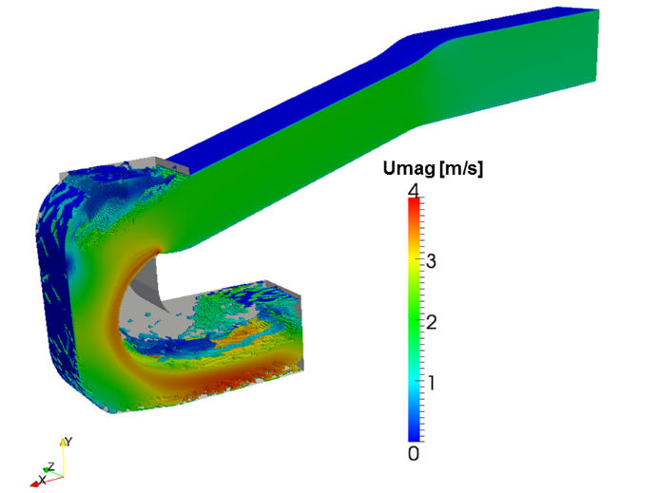
Motivation
Dedicated design measures to counteract the effects of pressure waves
  Expansion chamber in Ubend
  Spoiler enforcing flow detacement
  Two internal free surfaces
spoiler for
forced detachment
expansion
volume

Slide 5
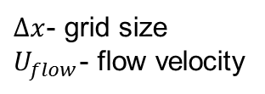
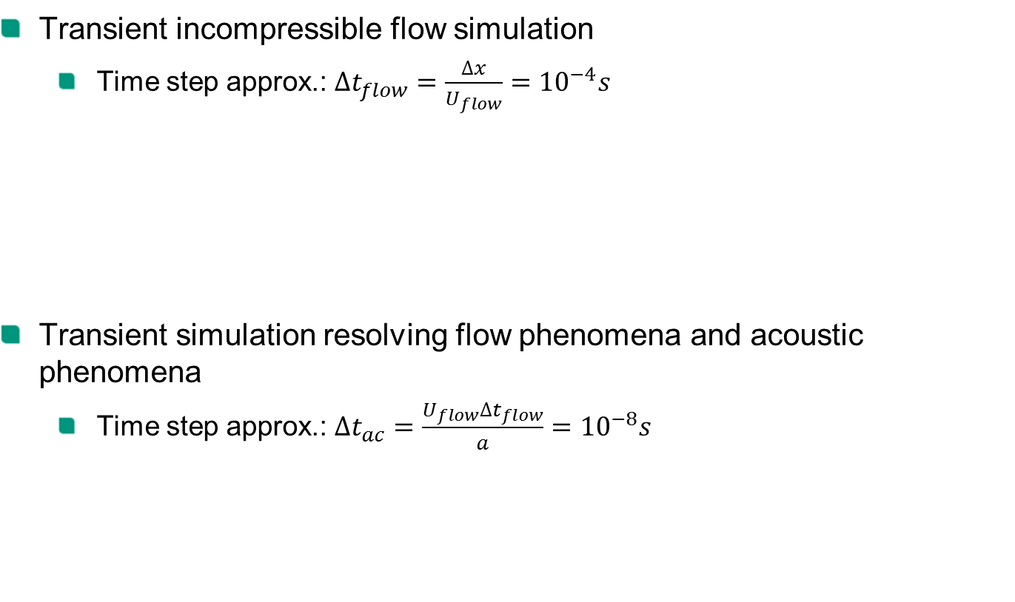
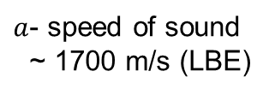
Motivation
Transient incompressible flow simulation
  Time step approx.: ${∆t_{flow}=\frac{∆x}{U_{flow}}=10}^{−4}s$
Transient simulation resolving flow phenomena and acoustic phenomena
  Time step approx.: $∆t_{ac}=\frac{U_{flow}{∆t}_{flow}}{a}={10}^{−8}s$
$∆x$- grid size
$U_{flow}$- flow velocity
$a$- speed of sound
~ 1700 m/s (LBE)

Slide 6
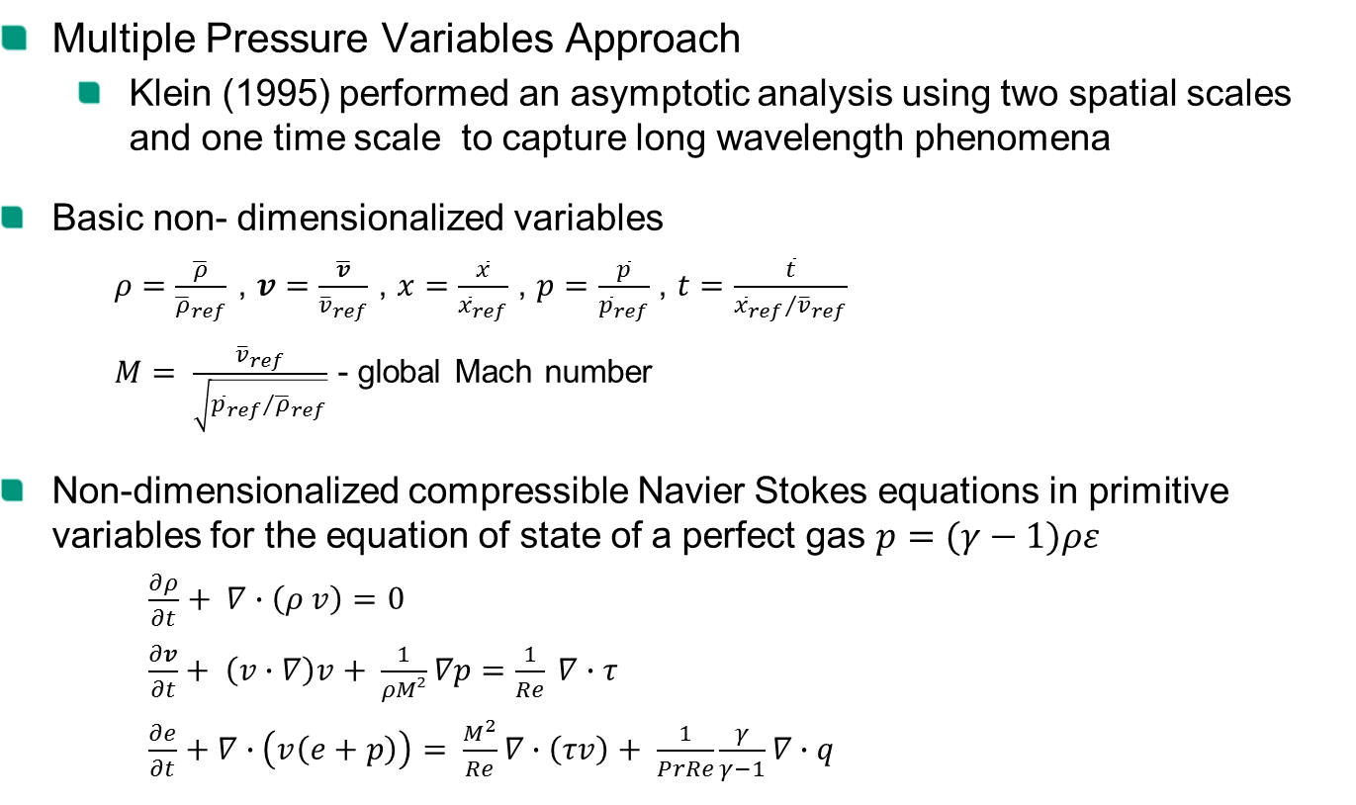
Multiple Pressure Variables Approach
Multiple Pressure Variables Approach
  Klein (1995) performed an asymptotic analysis using two spatial scales and one time scale to capture long wavelength phenomena
Basic non- dimensionalized variables
  $ρ=\frac{\overline{ρ}}{{\overline{ρ}}_{ref}}$ , $v=\frac{\overline{v}}{{\overline{v}}_{ref}}$ , $x=\frac{\overline{x}}{{\overline{x}}_{ref}}$ , $p=\frac{\overline{p}}{{\overline{p}}_{ref}}$ , $t=\frac{\overline{t}}{{{\overline{x}}_{ref}}/{{\overline{v}}_{ref}}}$
  $M= \frac{{\overline{v}}_{ref}}{\sqrt{{{\overline{p}}_{ref}}/{{\overline{ρ}}_{ref}}}}$ - global Mach number
Non-dimensionalized compressible Navier Stokes equations in primitive variables for the equation of state of a perfect gas $p=(γ−1)ρε$
$\frac{∂ρ}{∂t}+ ∇∙\left(ρ v\right)=0$
  $\frac{∂v}{∂t}+ \left(v∙∇\right)v+ \frac{1}{ρM²}∇p=\frac{1}{Re} ∇∙τ$
  $\frac{∂e}{∂t}+∇∙\left(v\left(e+p\right)\right)= \frac{M^{2}}{Re}∇∙\left(τv\right)+ \frac{1}{PrRe}\frac{γ}{γ−1}∇∙q$

Slide 7

Multiple Pressure Variables Approach
Asymptotic Considerations
  Vector of the primitive variables $u^{i}=u^{i}\left(x,ξ,t\right)$
    $x$ – local variable associated with convective phenomena
    $ξ=Mx$ – large scale coordinate associated with acoustic wave propagation
  Asymptotic expansion $u= u^{(0)}+Mu^{(1)}+M^{2}u^{(2)}+ …$
Notes:
Asymptotic expansion is inserted into the compressible Navier-Stokes Equations, terms multiplied by the same powers of the Mach number are collected to obtain a hierarchy of asymptotic limit equations.

Slide 8
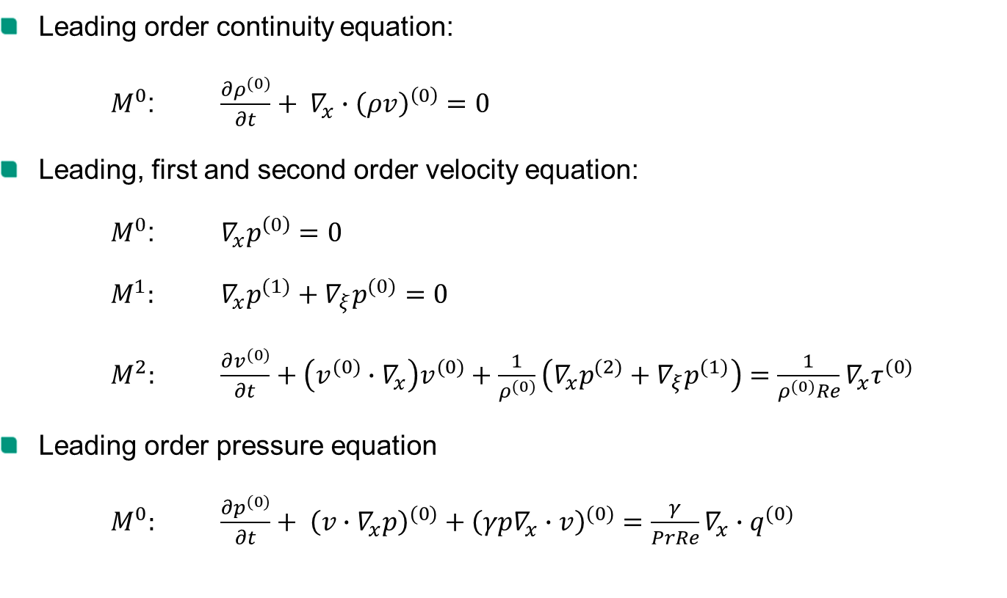
Asymptotic Limit Equations
Leading order continuity equation:
$M^{0}$: $\frac{{∂ρ}^{(0)}}{∂t}+ ∇_{x}∙{\left(ρv\right)}^{\left(0\right)}=0$
Leading, first and second order velocity equation:
$M^{0}$: $∇_{x}p^{\left(0\right)}=0$
$M^{1}:$ $∇_{x}p^{(1)}+∇_{ξ}p^{(0)}=0$
$M^{2}:$ $\frac{∂v^{(0)}}{∂t}+\left(v^{(0)}∙∇_{x}\right)v^{(0)}+\frac{1}{ρ^{(0)}}\left(∇_{x}p^{(2)}+∇_{ξ}p^{(1)}\right)=\frac{1}{ρ^{(0)}Re}∇_{x}τ^{(0)}$
Leading order pressure equation
$M^{0}:$ $\frac{{∂p}^{(0)}}{∂t}+ {\left(v∙∇_{x}p\right)}^{(0)}+{\left(γp∇_{x}∙v\right)}^{(0)}=\frac{γ}{PrRe}∇_{x}∙q^{(0)}$

Slide 9
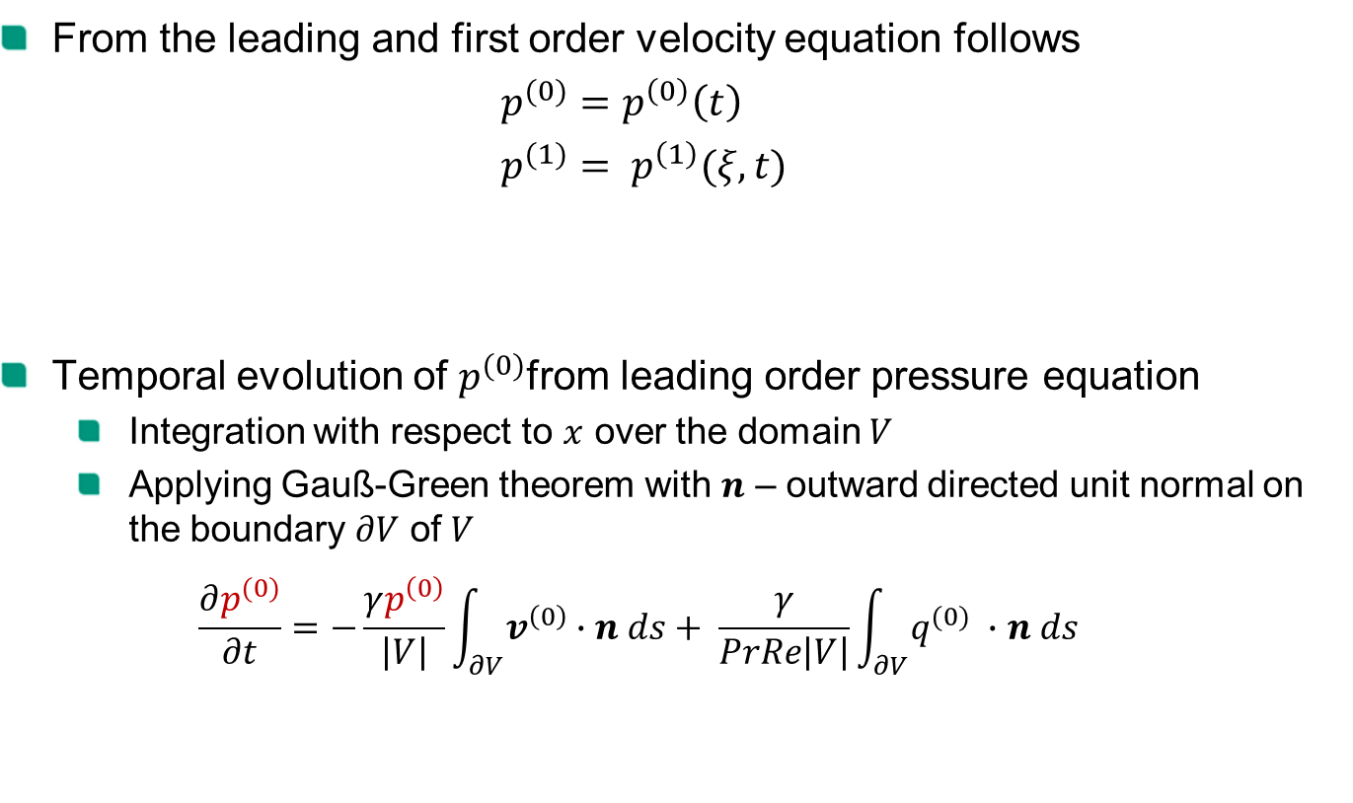
Interpretation of asymptotic equations
From the leading and first order velocity equation follows
$p^{(0)}=p^{\left(0\right)}\left(t\right)$
$p^{(1)}= p^{\left(1\right)}(ξ,t)$
Temporal evolution of $p^{(0)}$from leading order pressure equation
  Integration with respect to $x$ over the domain $V$
  Applying Gauß-Green theorem with $n$ – outward directed unit normal on the boundary $∂V$ of $V$
  $$\frac{∂p^{(0)}}{∂t}=−\frac{γp^{\left(0\right)}}{\left|V\right|}\int_{∂V}{v^{\left(0\right)}∙n ds}+ \frac{γ}{PrRe\left|V\right|}\int_{∂V}{q^{(0)} ∙n ds}$$
$p\left(x,t;M\right)=$ $p^{\left(0\right)}\left(t\right)+{Mp}^{\left(1\right)}\left(ξ,t\right)+ M^{2}p^{\left(2\right)}\left(x,ξ,t\right)+O(M³)$
compression
heat transfer

Slide 10

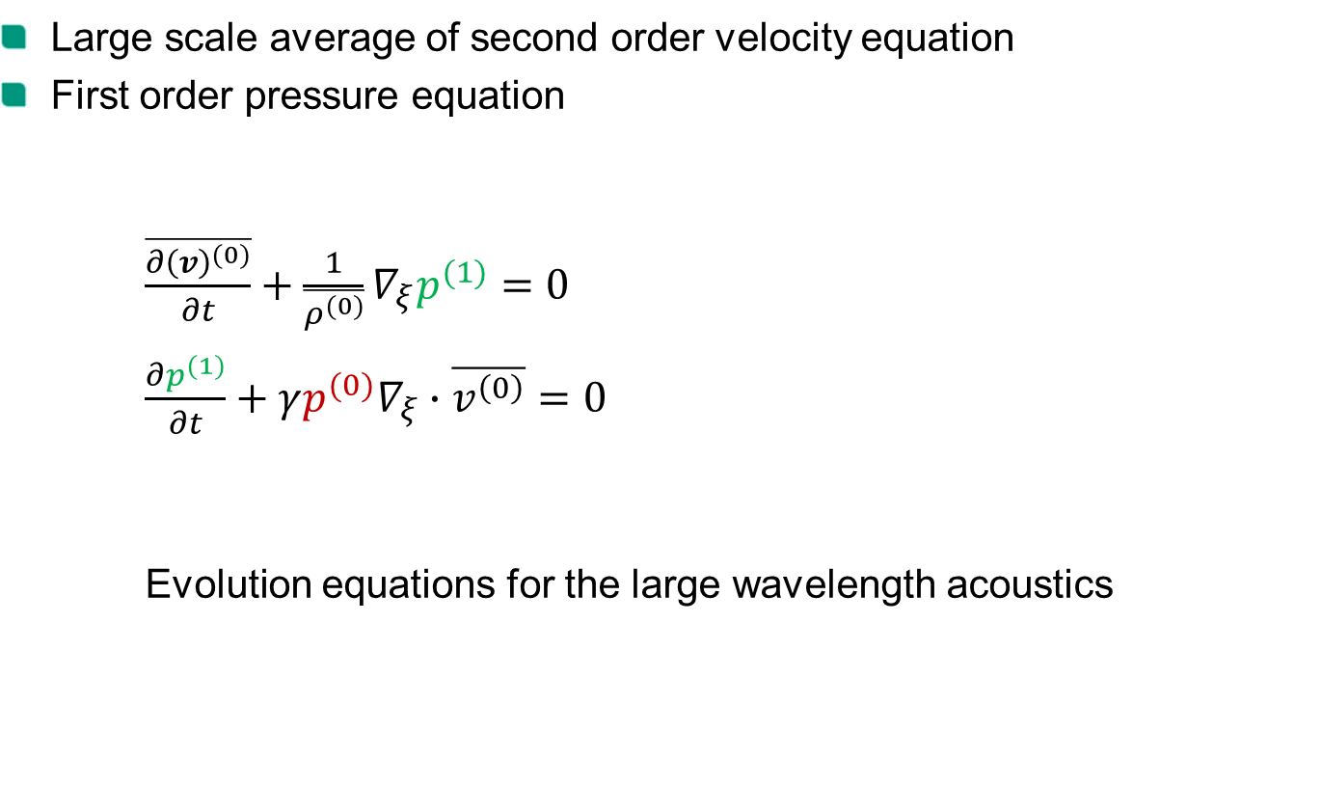
Interpretation of asymptotic equations
Large scale average of second order velocity equation
First order pressure equation
$\frac{\overline{{∂\left(v\right)}^{(0)}}}{∂t}+\frac{1}{\overline{ρ^{(0)}}}∇_{ξ}p^{(1)}=0$
$\frac{∂p^{(1)}}{∂t}+γp^{(0)}∇_{ξ}∙\overline{v^{\left(0\right)}}=0$
Evolution equations for the large wavelength acoustics
“ - “ average over local structures
$$\overline{v^{(0)}}= \frac{1}{\left|V_{ac}\right|}\int_{V_{ac}}{v^{(0)}}dx$$

Slide 11

Interpretation of asymptotic equations
Formal limit of asymptotic equations for $M=0$ in a bounded domain without heat conduction and global compression from the boundary
$$\frac{∂ρ^{(0)}}{∂t}+∇∙{\left(ρv\right)}^{\left(0\right)}=0$$
$$\frac{∂v^{(0)}}{∂t}+\left(v^{(0)}∙∇\right)v^{(0)}+\frac{1}{ρ^{(0)}}∇p^{(2)}=\frac{1}{ρ^{(0)}Re}∇∙τ$$
$$∇∙v^{\left(0\right)}=0$$
mathematical model of an incompressible flow with variable density

Slide 12

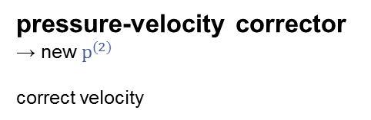
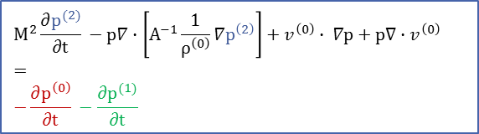


Implementation in OpenFOAM
multi region solver
pisoMPVFoam
map variables
acoustic solver
decompose pressure
thermodynamic pressure evolution
caclulate new pressure estimate p
Interpolate $p^{\left(1\right)}$ & mom
solve acoustic system
velocity predictor
→ intermediate velocity field
solve
$$Av^{(0)}+\frac{1}{ρ^{(0)}}∇_{x}p^{(2)}=f^{n}+ \frac{1}{ρ^{(0)}∆t} (mom)$$
solve energy equation
calculate material properties f(T)
pressure-velocity corrector
→ new $p^{(2)}$
correct velocity
solve
outer Iteration
$$M^{2}\frac{∂p^{(2)}}{∂t} −p∇∙\left[A^{−1}\frac{1}{ρ^{\left(0\right)}}∇p^{\left(2\right)}\right]+v^{\left(0\right)}∙ ∇p+p∇∙v^{\left(0\right)}$$
$$=$$
$$−\frac{∂p^{\left(0\right)}}{∂t} −\frac{∂p^{(1)}}{∂t}$$
inner Iteration
$p=$ $p^{\left(0\right)}+{Mp}^{\left(1\right)}+ M^{2}p^{\left(2\right)}$

Slide 13
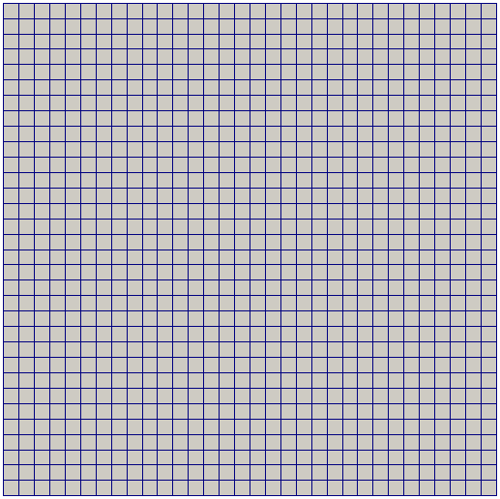
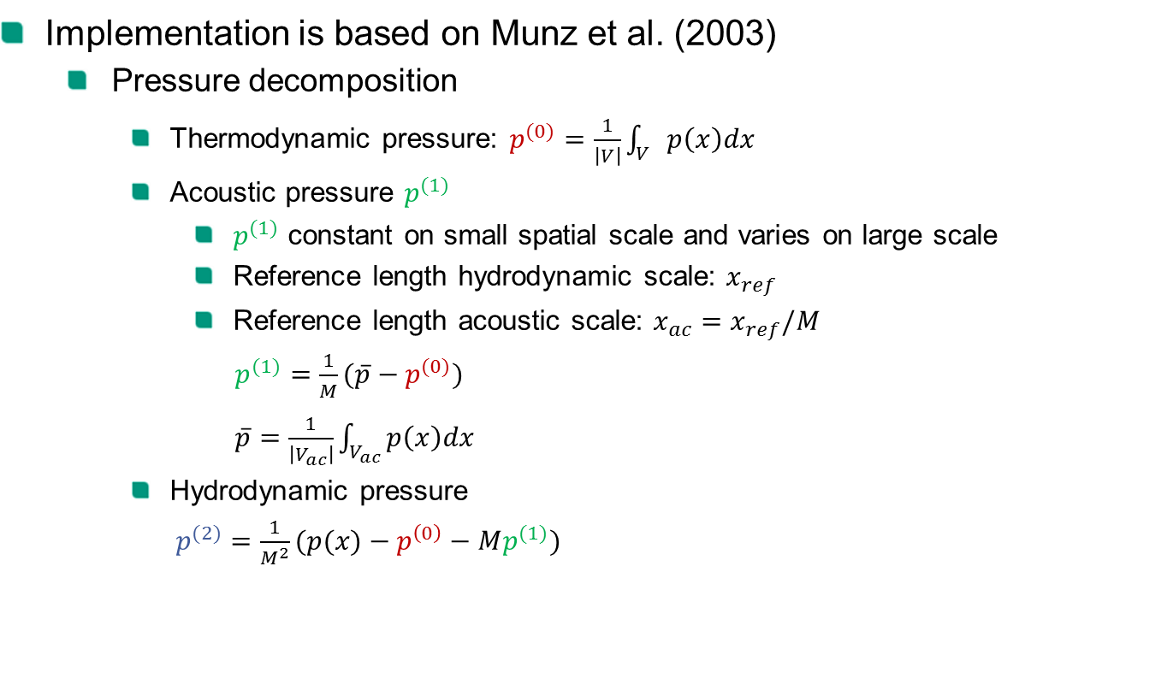

Implementation of the MPV Method in OpenFOAM
Implementation is based on Munz et al. (2003)
  Pressure decomposition
    Thermodynamic pressure: $p^{(0)}=\frac{1}{\left|V\right|}\int_{V}{p\left(x\right)dx}$
    Acoustic pressure $p^{(1)}$
      $p^{(1)}$ constant on small spatial scale and varies on large scale
      Reference length hydrodynamic scale: $x_{ref}$
      Reference length acoustic scale: $x_{ac}=x_{ref}/M$
      $p^{(1)}=\frac{1}{M}(\overline{p}−p^{(0)})$
      $\overline{p}=\frac{1}{\left|V_{ac}\right|}\int_{V_{ac}}{p\left(x\right)dx}$
    Hydrodynamic pressure
    $p^{(2)}=\frac{1}{M^{2}}(p(x)−p^{\left(0\right)}−Mp^{(1)})$
$$x_{ac}$$
M=0.125

Slide 14
Validation
Validation Matrix
 | M→0 Limit | Heat Transfer & material properties | Mach number independent behavior | Interaction flow - acoustic | turbulence
cavity | x
cavity heated | x | x
pressure pulse propagation |  |  | x
vortex box |  |  | x | x
co-rotating vortex pair |  |  | x | x
backwards facing step | x |  |  |  | x
heated rod | x | x |  |  | x
…
target | x | x |  | x | x
aero acoustic
liquid metal

Slide 15
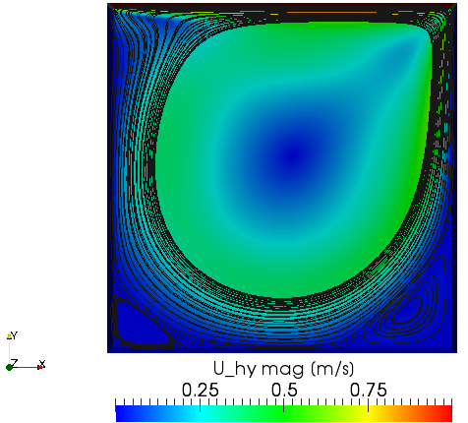





Test Cases – Aero acoustic
Lid Driven Cavity
  Laminar, Re=1000
  M = 0
  Mesh: 129 x 129 nodes
Stream tracer visualization
$$u=1.0 m/s$$
$$y=0.5m$$
$$1 m$$
$$x=0.5m$$
$$1 m$$

Slide 16
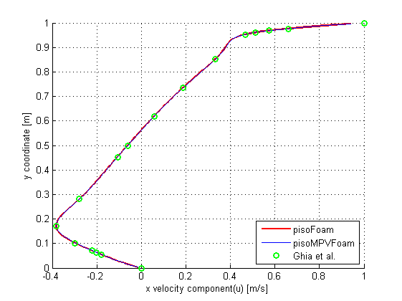
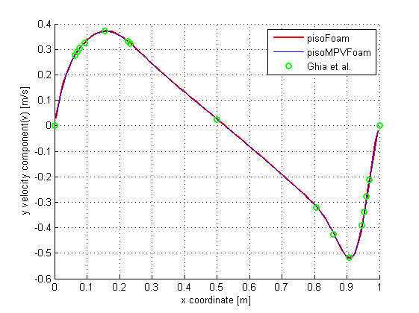


Test Cases – Aero acoustic
Horizontal and vertical velocity along vertical/horizontal cross-section
  pisoFoam and benchmark (Ghia et al.) comparison
Horizontal velocity at vertical cross-section
$$x=0.5m$$
Vertical velocity at horizontal cross-section
$$y=0.5m$$

Slide 17
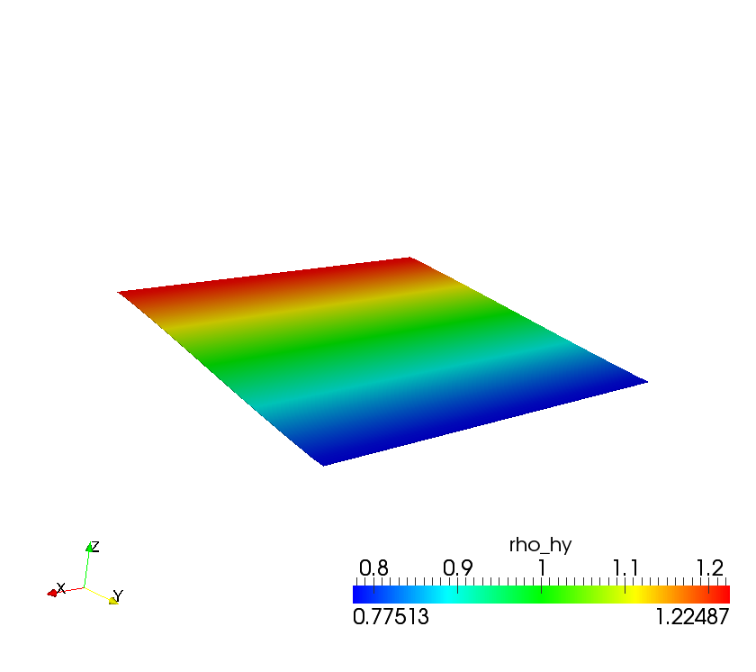



Test Cases – Aero acoustic
„Vortex in a box“ – generation of acoustic waves due to a rotating vortex
  Initial Conditions
  Mesh:
    Hydrodynamic 32x32 cells
    Acoustic 4x4 cells
$$u\left(x,y,0\right)=2sin^{2}\left(πx\right)sin\left(πy\right) cos\left(πy\right)$$
$$v\left(x,y,0\right)=−2sin\left(πx\right)\cos\left(πx\right)sin^{2}\left(πy\right)$$
$$ρ\left(x,y,0\right)=1−\frac{1}{2}\tanh\left(y−\frac{1}{2}\right)$$
$$p\left(x,y,0\right)=1.0$$
$$M=0.125$$
slip
$$1 m$$
$$1 m$$
Initial density distribution

Slide 18
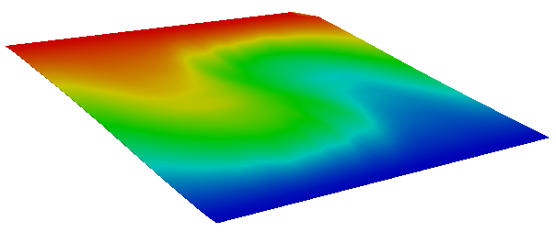
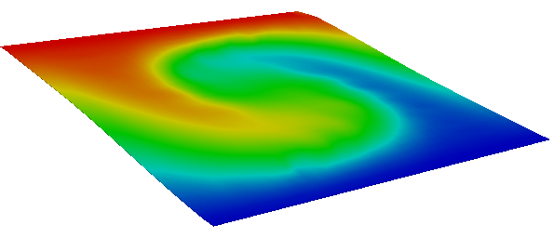
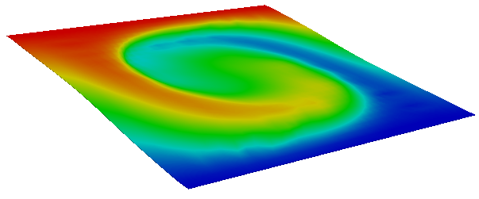




Test Cases – Aero acoustic
$$t=0.5s$$
$$t=1.0s$$
$$t=1.5s$$
$$t=2.0s$$

Slide 19

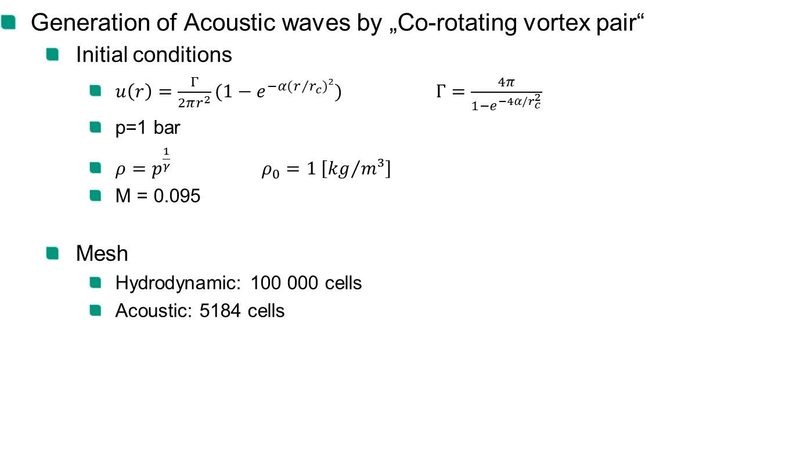


Test Cases – Aero acoustic
Generation of Acoustic waves by „Co-rotating vortex pair“
  Initial conditions
    $u\left(r\right)=\frac{Γ}{2πr^{2}}(1−e^{−α(r/{r_{c}})²})$ $Γ=\frac{4π}{1−e^{−4α/r_{c}^{2}}}$
    p=1 bar
    $ρ=p^{\frac{1}{γ}}$ $ρ_{0}=1 \left[{kg}/{m³}\right]$
    M = 0.095
  Mesh
    Hydrodynamic: 100 000 cells
    Acoustic: 5184 cells
$$80$$
$$1$$
$$80$$

Slide 20
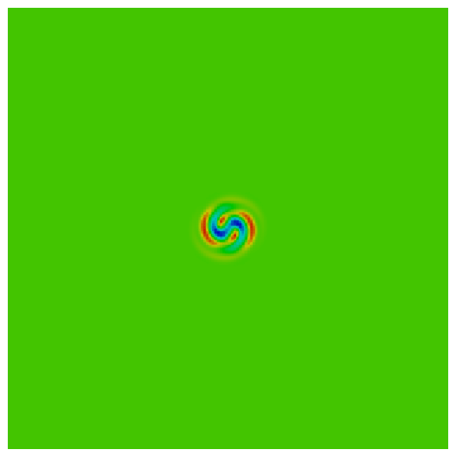
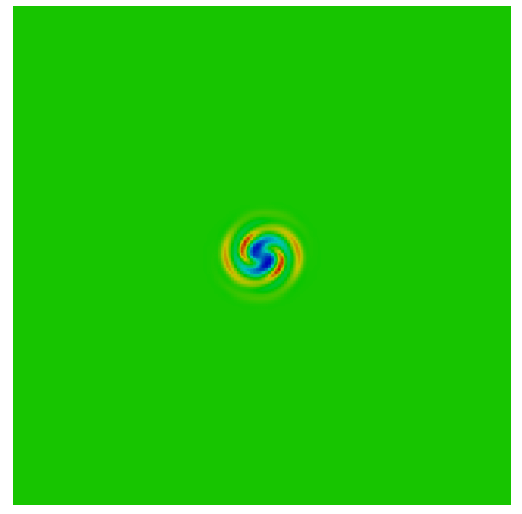
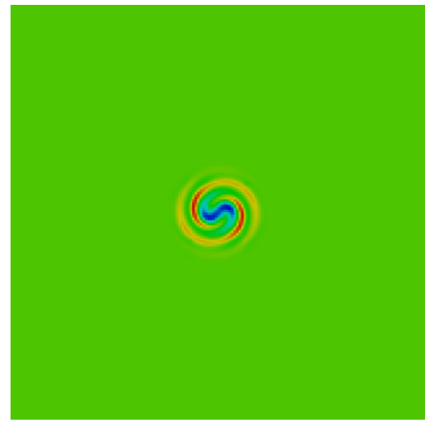
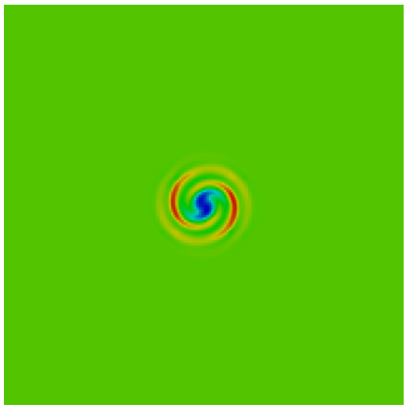
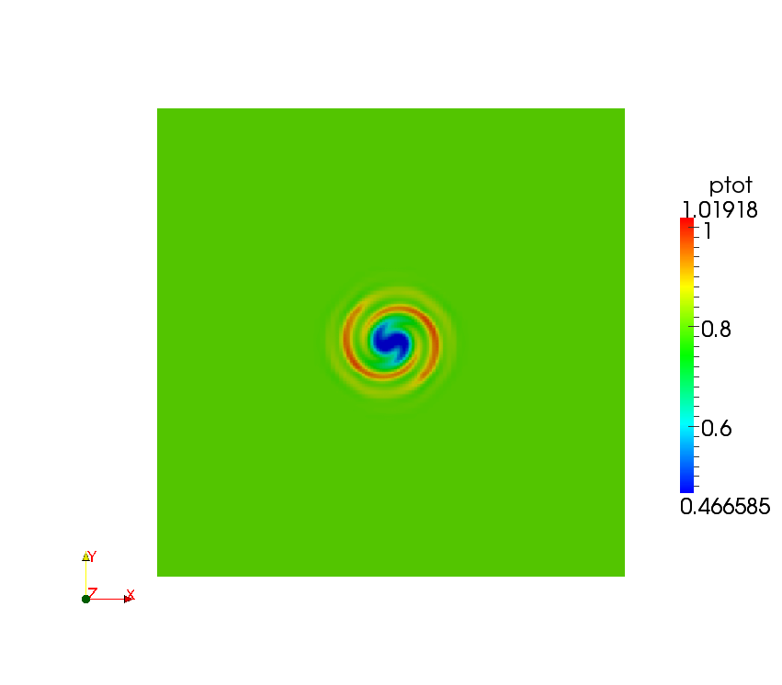
Test Cases – Aero acoustic
t =0.9 s
t = 1.2 s
t = 1.5 s
Vortex merging
t = 1.8 s
t = 2.1 s

Slide 21
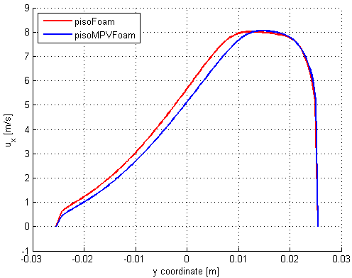
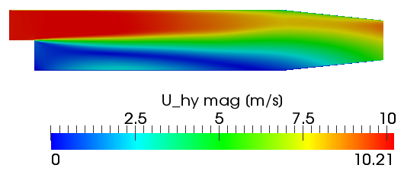
Test cases liquid metal
Backwards facing step
  Inlet velocity 10 m/s
  k-ε turbulence model
  LBE @ T=450K
Inlet ux =10 m/s
x = 0.2m
no slip
x-velocity component at x = 0.2m vertical cut

Slide 22
Conclusion & Outlook
MPV approach proposed for simulation of pulse-induced pressure wave/ hydrodynamics interaction
Low extra numerical effort for solving acoustics
Suitable for design optimization
Implementation based on OpenFOAM architecture (pisoFoam)
Extensive ongoing validation
Design measures to limit effects of pressure waves in META:LIC target will be analyzed
Input on experimental data on pressure waves is appreciated for validation

Slide 23
References
R. Klein, „Semi-implicit extension of a Godunov-type scheme based on low Mach number asymptotics I: One dimensional flow“ Journal of Computational Physics, 121, p 213-237, 1995
C.-D. Munz, S. Roller, R. Klein, K.J. Geratz, „The extension of incompressible flow solvers to the weakly compressible regime“ Journal of Computers and Fluids, 32 (2003) 173-196

