Slide 1
Buncher Schematics & CAD Model based on MICE Cavities Alan Grant Daresbury (May 8, 2012)

Slide 2
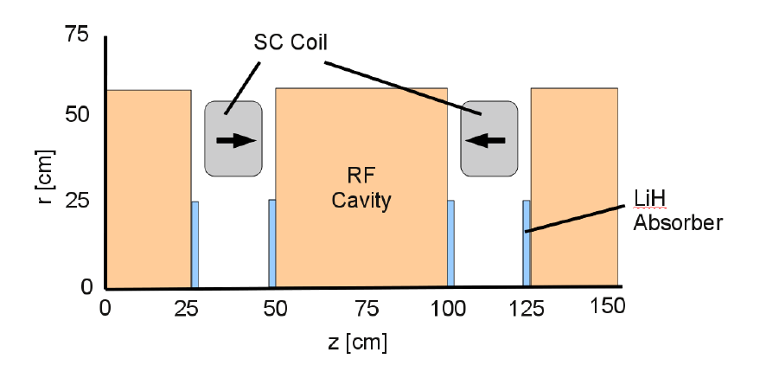
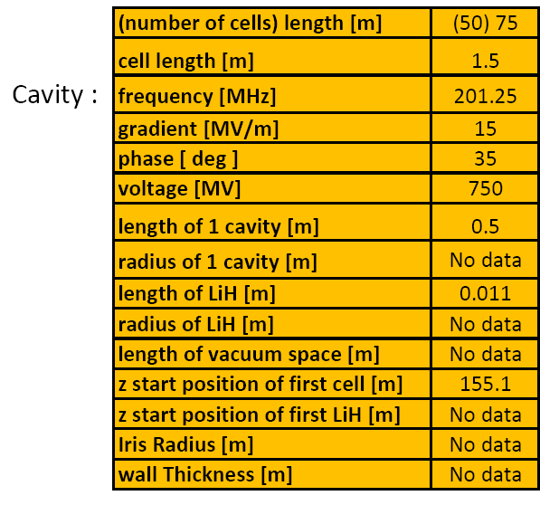
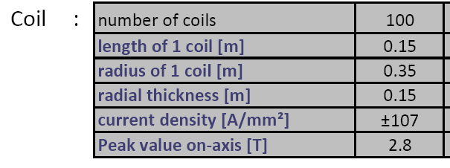
Muon Front End Cooling
Cooling section consists of 100 cells 0.75m in length
Total section length 75m
100 normal conducting RF cavities and 100 superconducting coils
Cavities RF frequency 201.25 MHz, gradient 15 MV/m.
Cavity length 0.5m, Coil length 0.15m
Be coated
Two Cells

Slide 3
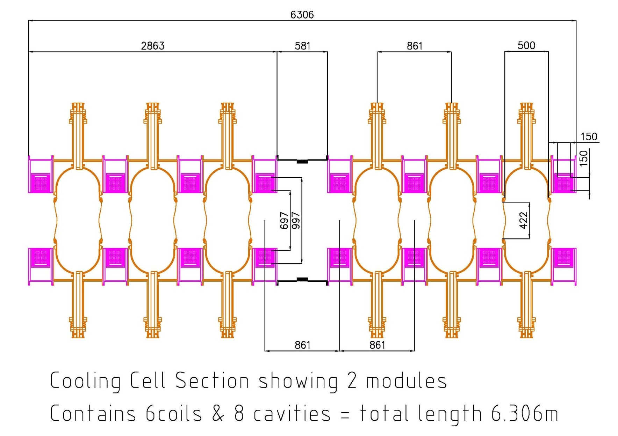
Cooling Section CAD Model
Cavity module maintained at 0.5m as schematic.
Coupling coil cross section as schematic .15m x .15m
Bellows required between each cavity / coil module.
Cell length 0.86m NOT 0.75m. This is for vacuum vessels.

Slide 4
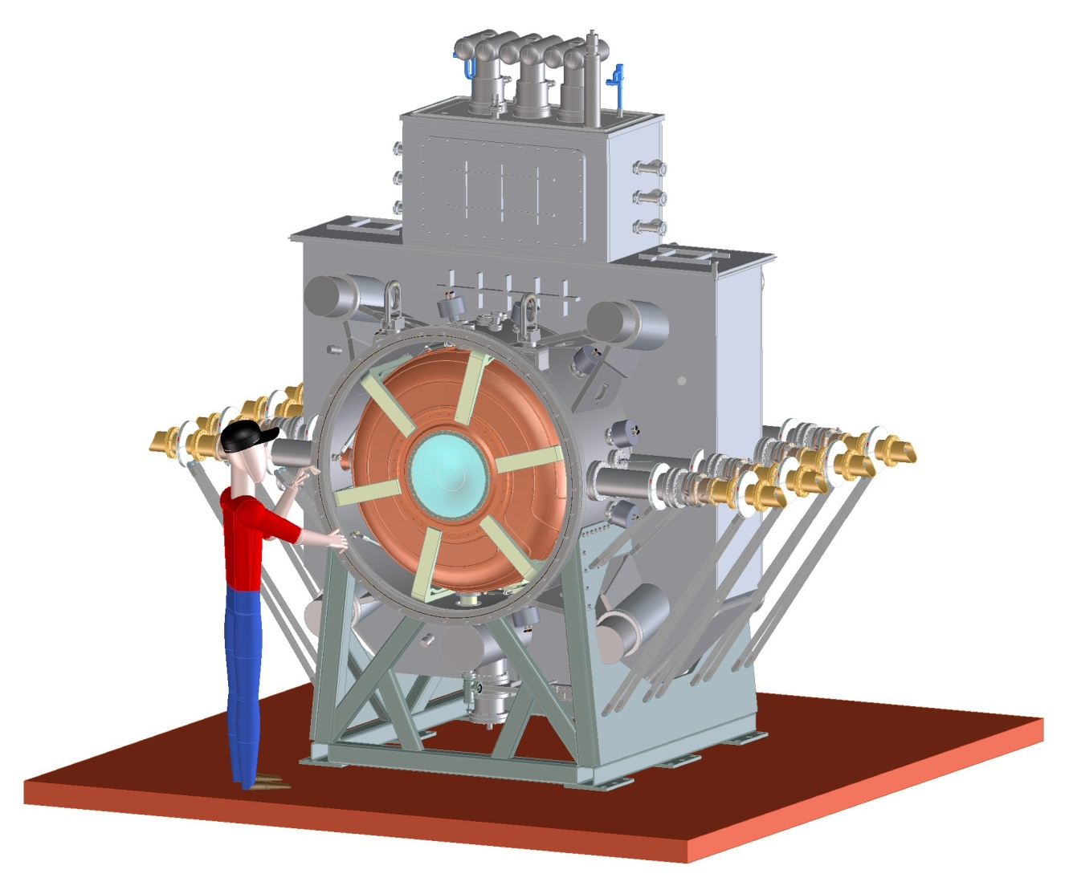
MICE RFCC Module Overview
Coupling Coil
RF Cavities
Tuner arms
Couplers

