Slide 1
Project X Experimental Facilities Target Facilities
PASI 2013 WG1
P. Hurh (FNAL)/D. Asner (PNNL)
w/ several slides stolen from R. Tschirhart (FNAL)
(Apr. 4, 2013)

Slide 2
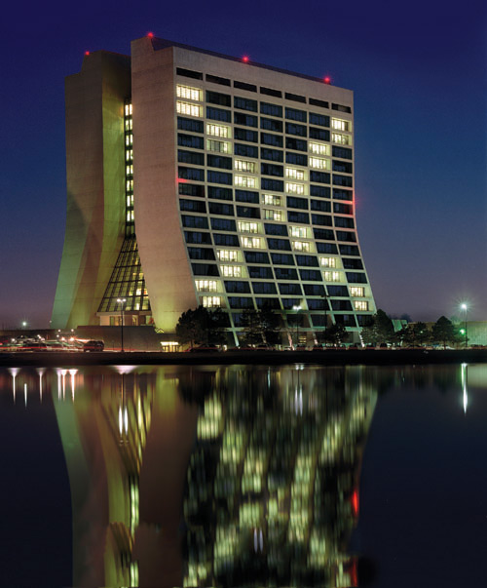
What is Project X?
Project X is a proposed proton accelerator complex at Fermilab that would provide the particle physics world with powerful and sensitive tools to explore a new scientific frontier. This facility would provide particle beams to multiple experiments searching for rare and hard-to-detect phenomena that will further our understanding of fundamental physics.
“Project X” was a temporary title used at a 2007 planning meeting where the first version was introduced. The name, for better or worse, has stuck.

Slide 4
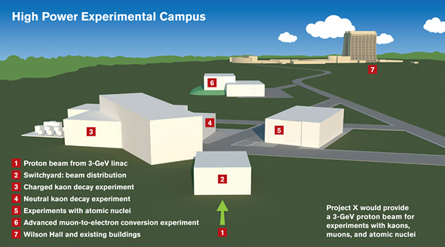

Slide 5
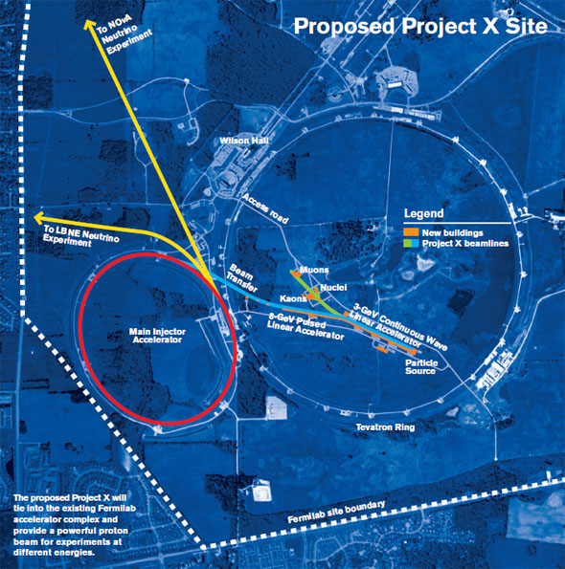

Slide 6
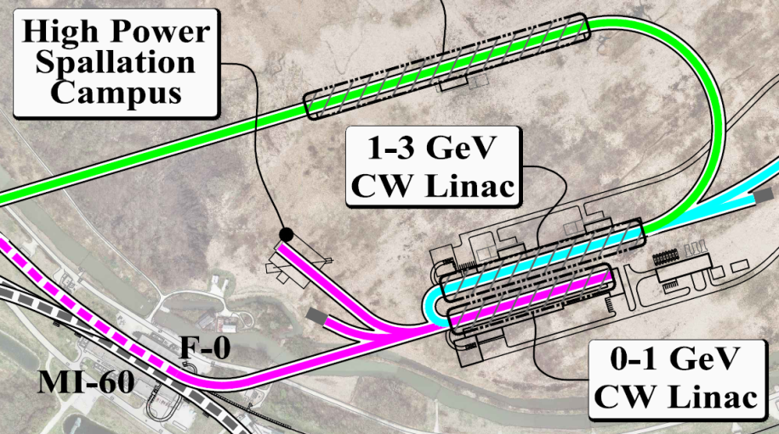
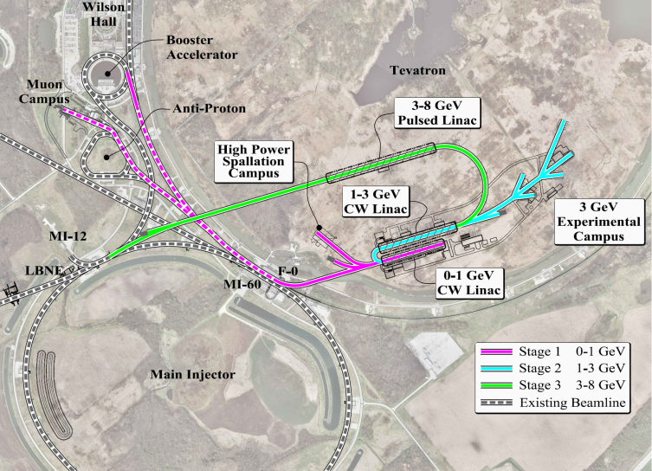
Now a staged approach

Slide 7
Stage-1 Beam timing
Campus Super-Cycle:
Every 1200 msec the linac drives the Booster exclusively for 60 msec corresponding to a 5% dedicated duty factor for the Booster. The 95% balance of the timeline is CW operations.
CW Operations
Spallation Campus
Muon Campus

Slide 8
Example Power Staging Plan for the Research Program
Program: | Onset of NOvA operations in 2013 | Stage-1: 1 GeV CW Linac driving Booster & Muon, n/edm programs | Stage-2: Upgrade to 3 GeV CW Linac | Stage-3: Project X RDR | Stage-4: Beyond RDR: 8 GeV power upgrade to 4MW
MI neutrinos | 470-700 kW** | 515-1200 kW** | 1200 kW | 2450 kW | 2450-4000 kW
8 GeV Neutrinos | 15 kW + 0-50 kW** | 0-42 kW* + 0-90 kW** | 0-84 kW* | 0-172 kW* | 3000 kW
8 GeV Muon program e.g, (g-2), Mu2e-1 | 20 kW | 0-20 kW* | 0-20 kW* | 0-172 kW* | 1000 kW
1-3 GeV Muon program, e.g. Mu2e-2 | ----- | 80 kW | 1000 kW | 1000 kW | 1000 kW
Kaon Program | 0-30 kW** (<30% df from MI) | 0-75 kW** (<45% df from MI) | 1100 kW | 1870 kW | 1870 kW
Nuclear edm ISOL program | none | 0-900 kW | 0-900 kW | 0-1000 kW | 0-1000 kW
Ultra-cold neutron program | none | 0-900 kW | 0-900 kW | 0-1000 kW | 0-1000 kW
Nuclear technology applications | none | 0-900 kW | 0-900 kW | 0-1000 kW | 0-1000 kW
# Programs: | 4 | 8 | 8 | 8 | 8
Total max power: | 735 kW | 2222 kW | 4284 kW | 6492 kW | 11870kW
LBNE
Muon
Kaon
Neutron
Neutron
Neutron
* Operating point in range depends on MI energy for neutrinos.
** Operating point in range is depends on MI injector slow-spill duty factor (df) for kaon program.

Slide 9
Project X Powered Target Facilities
LBNE
BooNE
Muon Facility
Kaon Facility
Spallation Neutron Facility (AKA Energy Station)

Slide 10
Muon Facility pre-notional concept

Slide 11
Muon Facility: pre-notional concept
V. Lebedev, Fermilab AAC 2011

Slide 12
Muon Facility: pre-notional concept
V. Lebedev, Fermilab AAC 2011

Slide 13
Kaon Facility: pre-notional concept
Neutral Kaon Experiment
Beam Absorber
Charged Kaon Experiment

Slide 14
Kaon Facility: pre-notional concept
Target options
Lower power experiments have used solid platinum
At 1+ MW carbon (graphite or composite) materials are being considered
Liquid gallium “waterfall” has also been proposed
BNL enlisted to develop concepts
Kaon, Muon, and Neutron facilities will share beam through a switchyard (when a facility is down, others can receive more beam)
Must design to take advantage of beam greater than 1 MW! (or design for upgrade later)

Slide 15
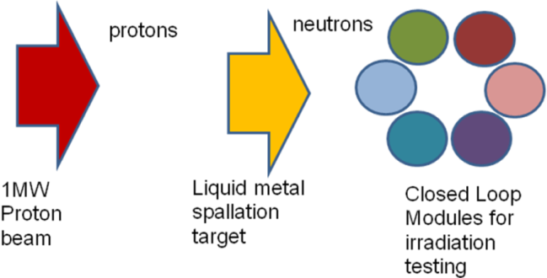
PNNL Energy Station Concept
A new approach utilizing the flexibility of an accelerator neutron source with spectral tailoring coupled with a careful design of a set of independent test loops can provide a flexible neutron test station for DOE NE applications

Slide 16
Energy Station ➔ Integrated Target Station
1 GeV
protons
Cold Neutrons
Physics Isotopes
Fusion Materials
Spallation
Target
Fission Materials

Slide 17
Project X Energy Station Workshop January 29-30, 2013
Workshop objectives
Identify & explore the nuclear and fusion energy relevant R&D that would be possible in an Energy Station associated with the Project X Linac
Discuss the hypothesis that an Energy Station associated with Project X could accelerate and enhance the ability to test and evaluate early research concepts.
Identify the synergy and benefit that the Project X Linac could bring to the nuclear & fusion energy communities.

Slide 18
Energy Station ➔ Integrated Target Station
Goal
Develop integrated spallation target station concept to serve DOE-NE, DOE-SC-FES/HEP/NP experimental needs
Rational
CW spallation neutron source could augment limited US irradiation testing capability
Synergy between Physics experimental needs and materials testing for fusion, fission communities
Project X – Stage 1
Could provide ~1 MW of beam dedicated to a spallation neutron source for nuclear materials and fuels research (Energy Station) or shared with a physics mission facility with similar neutron source requirements (Integrated Target Station)

Slide 19
Project X Integrated Target Station has the potential to benefit several areas (beyond HEP)
Highest priority opportunities within the US Nuclear and Fusion energy programs are irradiation of fusion and fast reactor structural materials.
Must provide a fusion and fast reactor relevant neutron flux at a minimum of 20 dpa per calendar year in a reasonable irradiation volume.
Enable the in-situ real-time measurements of various separate-effects phenomena in fuels or materials, which would be very valuable to the modeling and simulation technical community. Such capabilities are more feasible in an accelerator-based system than a reactor
integral effects testing of fast reactor fuels, including driver fuel, minor actinide burning fuel, and transmutation of spent fuel.
support DOE Office of Nuclear Energy plus Office of Science programs
Materials Program - Fusion Energy Sciences (FES)
Isotope Production Program – Nuclear Physics (NP)
ultra cold neutrons – Nuclear Physics (NP)

Slide 20
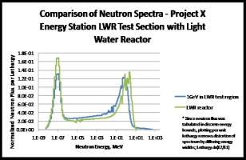
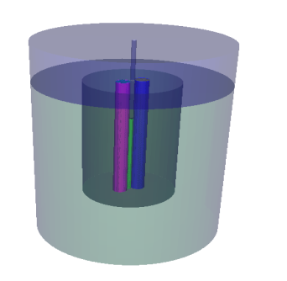
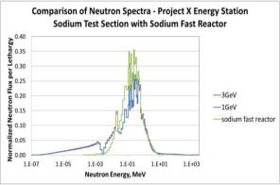
Project X Energy Station Concept
Closed Loop Test Modules
Removable/replaceable/customizable
Independent cooling system
n spectrum/material/temp/pressure to match reactor conditions
~30 cm dia
Lead Matrix Test Region
Solid lead with gas or water cooling
~ 2 m diameter, 3 m length
Low n absorb/ High n scatter
High n flux/ Fast n spectrum
Acts as gamma shield
Thermal Spectrum Test Module: LWR, HTGR, MSR
Spallation Target
Liquid Pb-Bi
>30 neutrons/proton
1 GeV protons penetrate ~50 cm in lead
Neutrons Similar to fission spectrum
Samples can be irradiated in proton beam
Adding W or U can increase n flux density
Small volume ~ 10 cm dia, 60 cm length
Cleanup system for spallation products
Project X Proton Beam
1mA @ 1 GeV (1 MW)
Reflector
Steel/iron/nickel
High n scatter
Flattens n flux distribution
Fast Spectrum Test Module: SFR, LFR, GFR

Slide 21
Energy Station is Unique Combination of Existing Technologies
Proton beam CW - 1 GeV - 1 mA - 1 MW
Spallation Target:
Liquid lead or lead-bismuth release ~30 neutrons/proton
Neutron spectrum similar to fission spectrum but with high energy tail
Technology has been demonstrate at MEGAPIE
Test Matrix
Solid lead or other (zircalloy) – high scatter, low absorption
Maximizes neutron flux, provides space for array of test modules
Simple solid block with cooling, holes for test modules
Closed Loop Test Modules
Independently tailored irradiation environments (LWR, HTGR,SFR,LFR)
Independent heating/cooling system for each to control temperatures
Concept utilized in FFTF (sodium), BOR-60 (sodium, lead), ATR (press. Water)
Reflector to minimize leakage neutrons

Slide 22
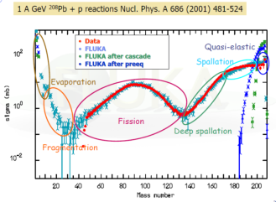
Energy Station Components – Spallation Target
Spallation Target:
6.24e15 p/s proton beam
Nominal 10 cm diameter
High neutron yield Pb or LBE ~30 neutrons/proton
1 GeV protons penetrate ~50 cm in lead
Neutron spectrum similar to fission but with high energy tail
Coolant is target material, no stress issues in target
Beam window may be life limiting
Experience base from ISIS, SINQ, MEGAPIE, SNS, is ~7-22 dpa/yr on front window for SS316, T91, Inconel
For our 10 cm diameter ES window, ~8 dpa/yr
Need careful oxidation control, on-line cleanup
Spallation products like fission products
>400 KW energy deposited
Potential for in-beam materials testing
MEGAPIE
(0.8 MW) LBE target has been demonstrated

Slide 23
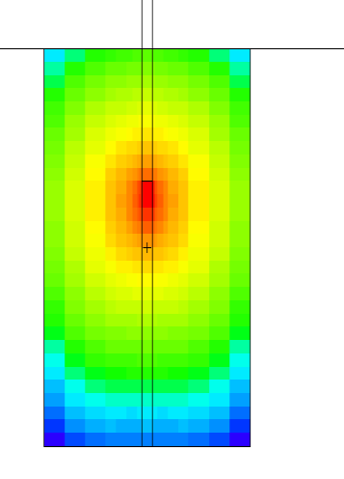
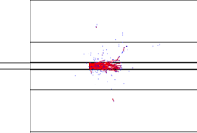
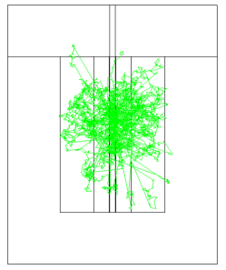
Energy Station Components – Test Matrix
Test Matrix
Solid lead or other (zircalloy) – high scatter, low absorption
Maximizes neutron flux, provides space for array of test modules
Simple thermal analysis indicates heating may allow solid lead matrix
Beam tubes could provide additional testing flexibility
Protons
200 cm
Proton beam
Lead Matrix Test Region
Neutrons
Neutron flux Distribution in Lead Matrix Test Region
300 cm

Slide 24
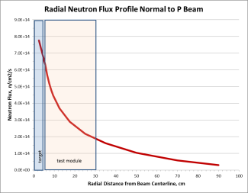
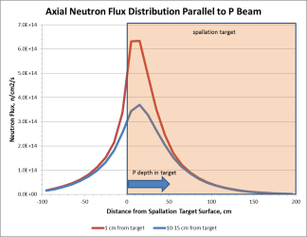
High Flux Volumes Available in Test Matrix Region
Neutron Flux Range (n/cm2/s) | Axial Extent (cm) | Outer Extent (cm) | Volume (liters)
>5e14 | 30 | 8 | ~2.8
>3e14 | 50 | 15 | ~23
>1e14 | 110 | 60 | ~600
>5e13 | 160 | 80 | ~2000
>1e13 | 250 | 100 | ~9000
1 GeV protons penetrate ~ 50 cm in lead or LBE target, generate ~30 neutrons/proton
Neutron flux falls off radially but lead matrix helps
Axial profile peaks ~20 cm below target surface, provides ~100 cm >1e14 n/cm2/s

Slide 25
Energy Station Components – Closed Loop Test Modules
Number of modules can be varied
Each module can have unique independent coolant and materials and operate at independent temperatures (sodium, lead, molten salt, water, helium)
Neutron spectrum can be tailored from fast to thermal to match reactor conditions (the gamma to neutron ratio can also be tailored)
Miniaturized test specimens can maximize testing in high flux region
Modules are Removable, Replaceable, shipped offsite for post irradiation examination (PIE)
Test materials
Coolant/structure
~100 cm
Spectral Tailoring materials

Slide 26
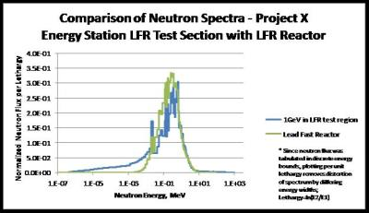
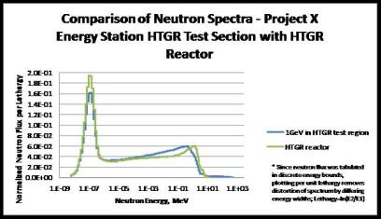
Spectrum Tailoring Can Simulate A Different Reactor in Each Module
Sodium/steel Module
Lead/steel Module
Water/Zr Light Water Module
Graphite/He Module

Slide 27
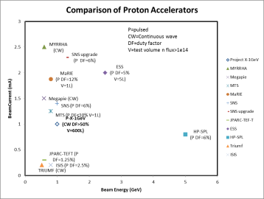
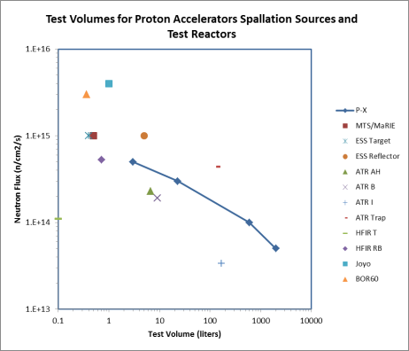
How Does Energy Station Compare?
Irradiation volumes at high flux comparable to reactors
Accelerator parameters are in range of other proposed systems

Slide 28
Energy Station Capabilities
Flexible design allows support to multiple missions for DOE-NE, SC-FES, SC-NP
Benefits of test reactor volumes and neutron fluxes without reactor issues – licensing, fuel supply, safety, waste
Robust technology allows it to be designed and constructed with today’s technology in order to fill gaps in tomorrow’s technology
Continuous wave, high availability, high beam current provides potential for irradiation tests to high fluence
Energy distribution of spallation neutrons similar to fast reactor fission spectrum but with high energy tail up to proton energy
Ability to tailor neutron spectrum from fast to thermal as well as the gamma to neutron flux ratio
H and He generation in materials higher than in reactor allowing accelerated aging testing
Potential for beneficial isotope production and/or neutron beams simultaneous with irradiation testing

Slide 29
Actions identified to evolve concept
Develop conceptual target designs that serve both particle physics and nuclear energy missions – Integrated Target Station (ITS)
Develop an ITS testing program plan that capitalizes on the unique characteristics of a high-intensity accelerator and spallation source
Define/refine the technical requirements to support the proposed testing program plan
Compile relevant design parameters to support the high-priority mission needs and provide them to the beam and target designers
Investigate the beam on/off issues for both short and long time scales. to determine which transients have the potential to be problematic due to thermal and radiation damage effects
Further consideration must be given to desired damage rate/sample volume specifications to provide a meaningful irradiation capability
Neutronics modeling of the notional Project X ITS concept needs to be refined to evaluate beam options (e.g., dual or rastered beam) to optimize flux and flux gradients in maximum usable test volumes.

Slide 30
Opportunities for Collaboration
Radiation Damage (RaDIATE)
Target Facility Conceptual Design
Energy Station (PNNL involvement)
Kaon Facility (BNL involvement)
Muon Facility
Target Technologies
High heat flux cooling
Liquid metal target technology (kaon, muon, neutron)
Beam windows
Remote handling

