Slide 1
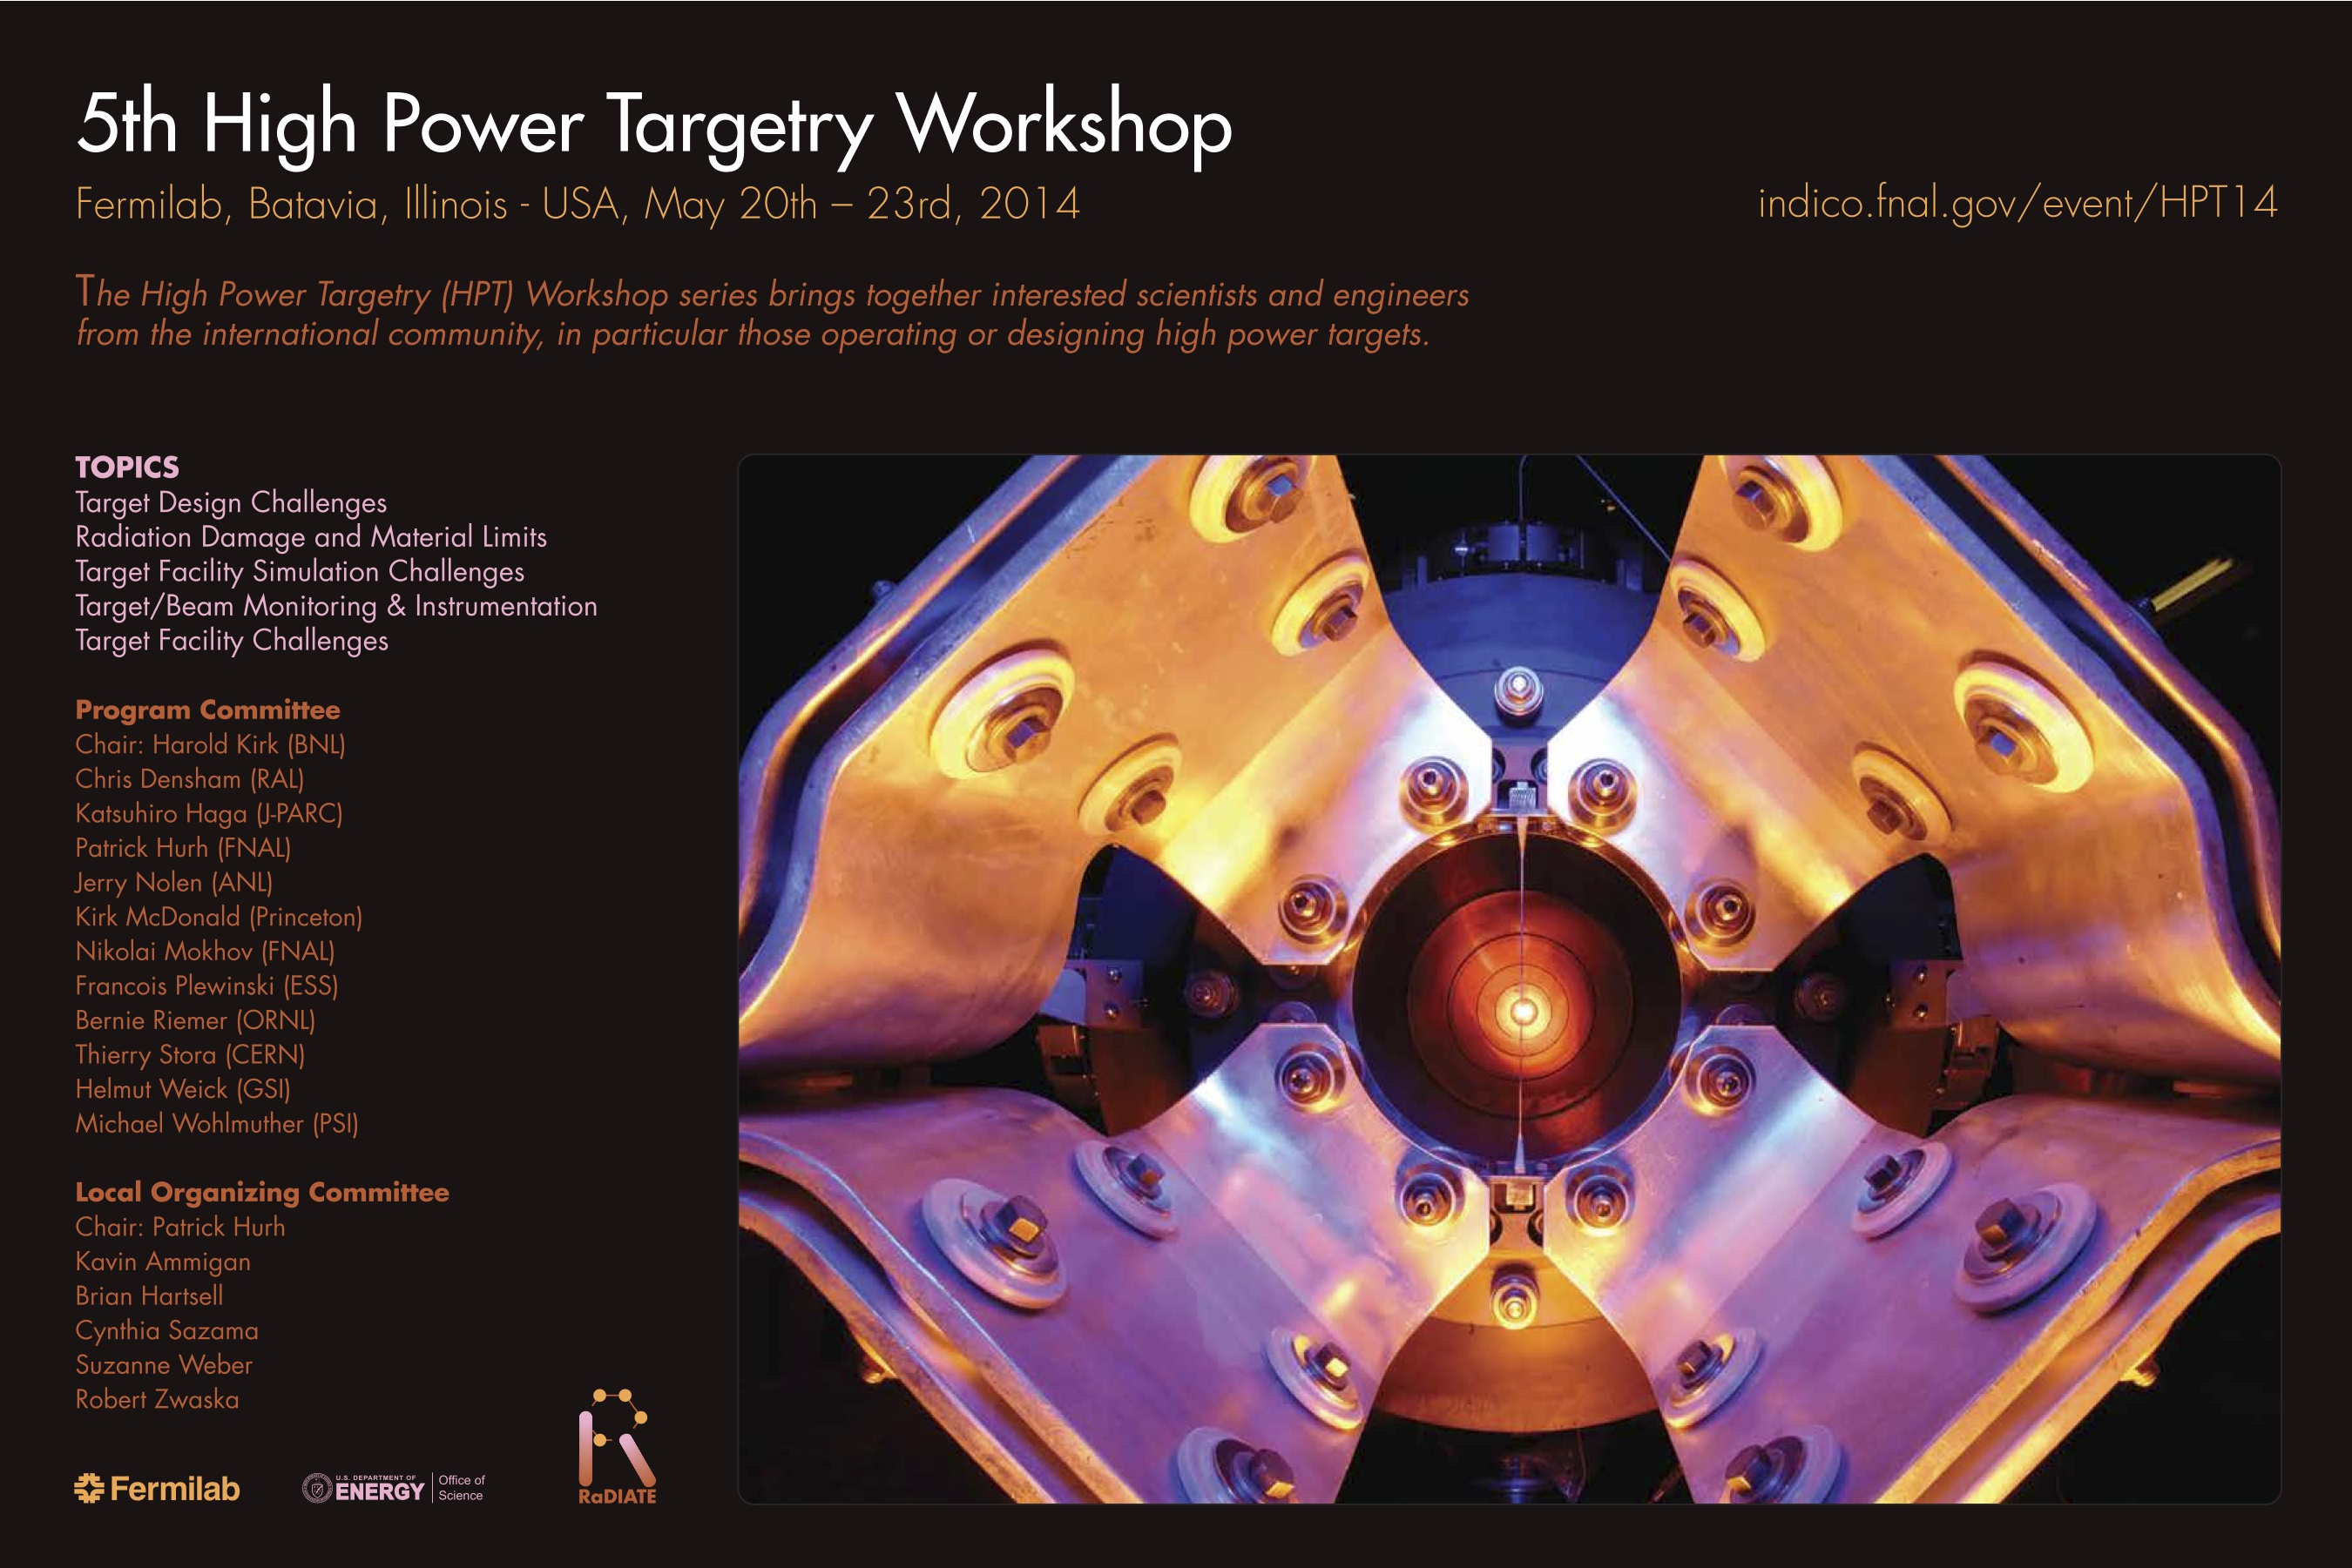
HPT Workshop Summary for MAP 2014 Spring Workshop
Patrick Hurh, Fermilab, May 29, 2014

Slide 2
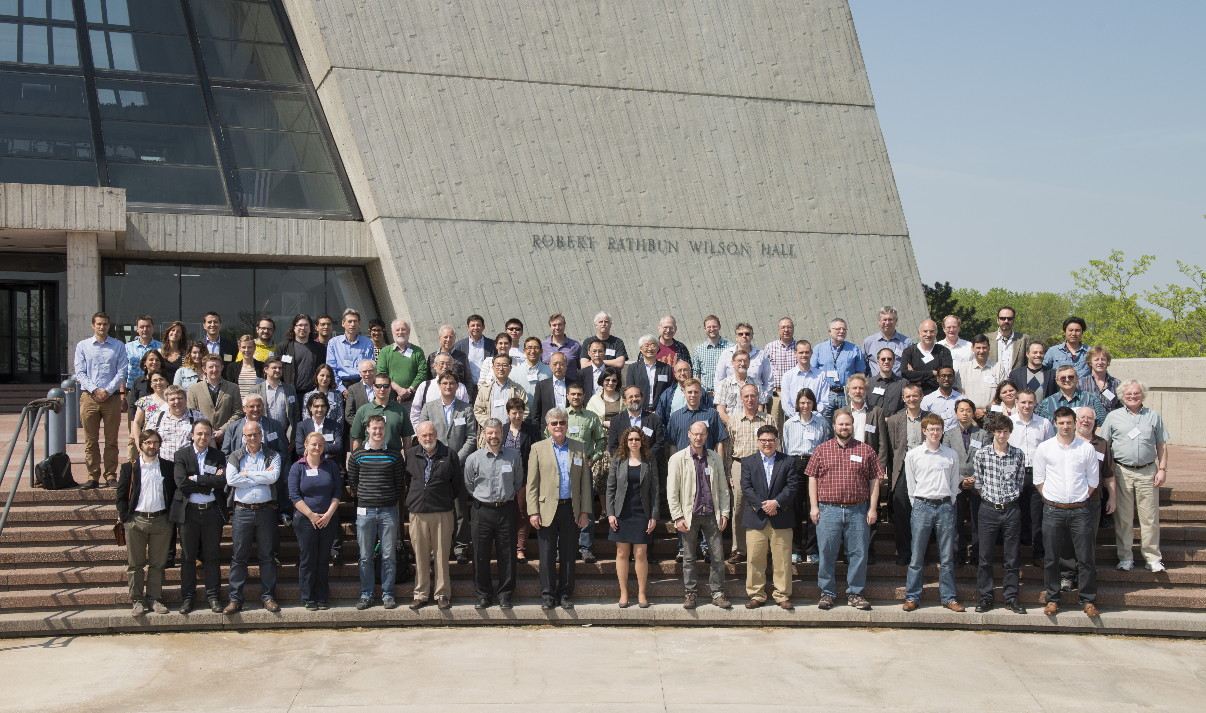
Successful Workshop!
Some numbers:
98 Registrants!
37 Posters!
40 Talks!
Many interesting discussions
34 Institutions represented from 12 countires!

Slide 3
Thanks to:
The Program Committee
The Local Organizing Committee
  Brian Hartsell
  Kavin Ammigan
  Bob Zwaska
Fermilab
  Conference Office
    Cynthia Sazama
    Suzanne Weber
    Melody Saperston

Slide 4
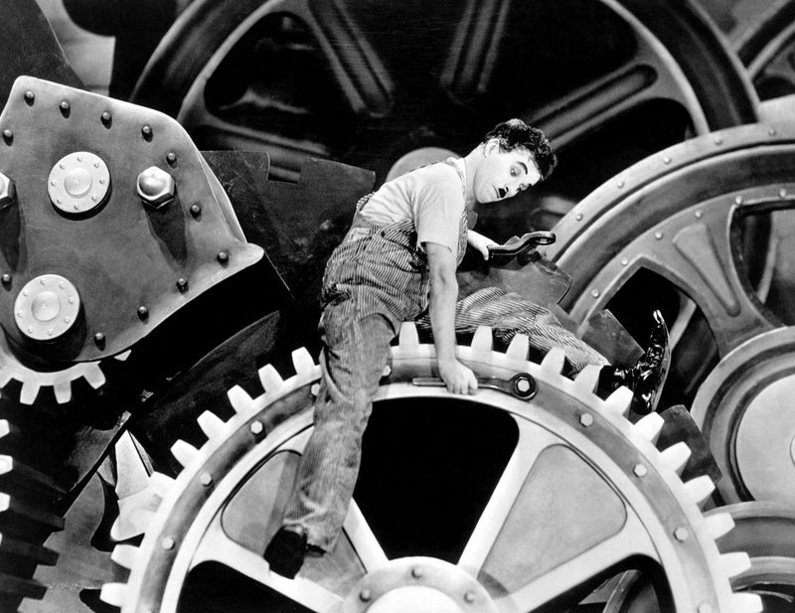
Targetry: A Vital Cog of the Accelerator Machine
Recently major accelerator facilities have been limited in beam power not by their accelerators, but by their target facilities
  “When things go wrong, they can really go wrong” - Me
  “The SNS accelerator power is restricted today by the targets” – M. A. Plum, IPAC’13
  “When you have no spare, you must repair” – J. Hylen, NuMI-MINOS, 2009

Slide 5
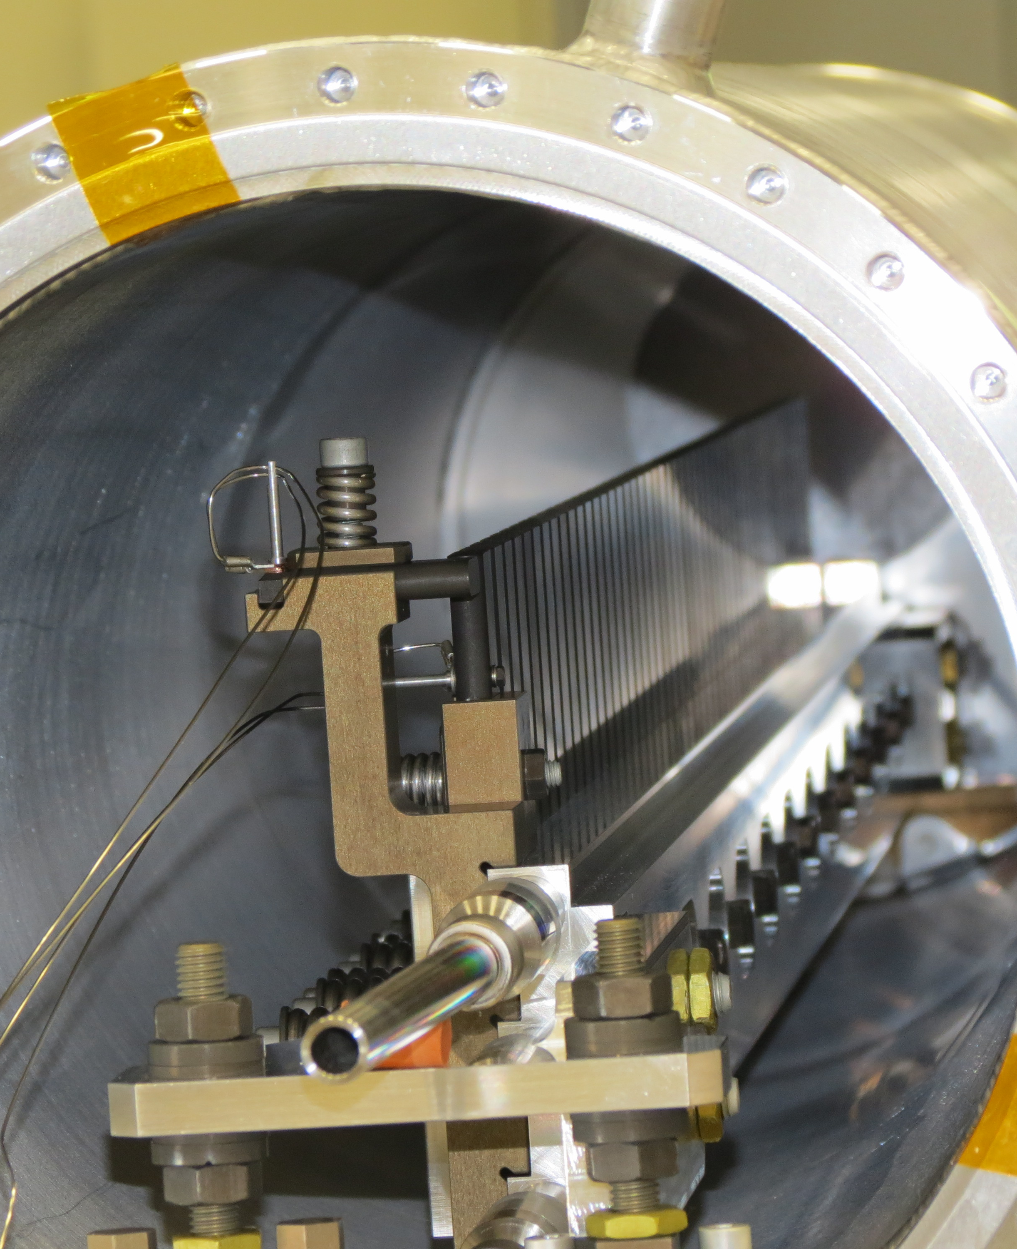
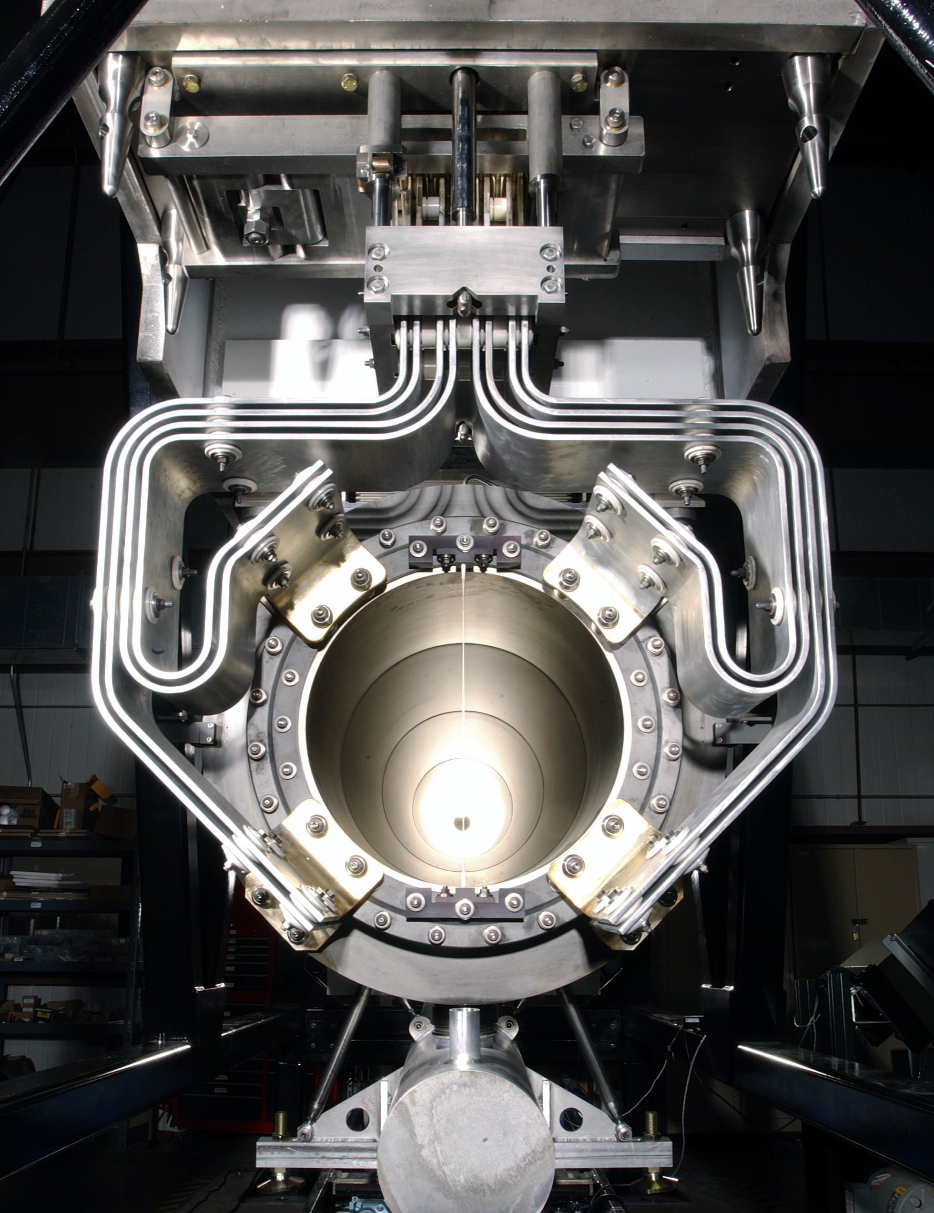
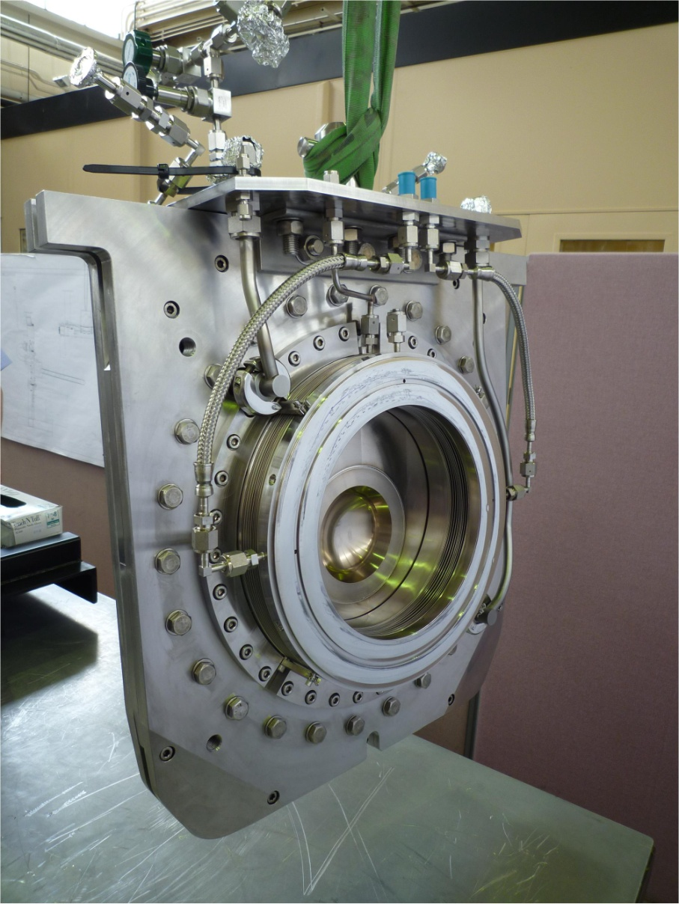
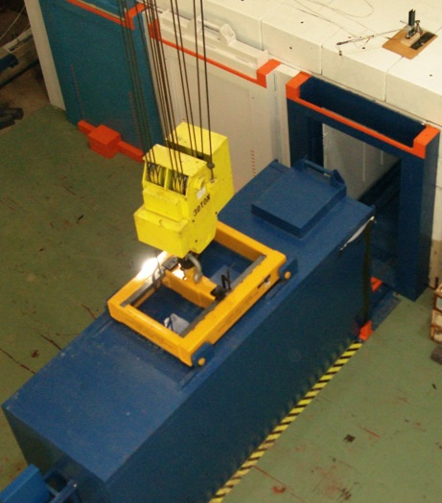
High Power Targetry Scope
Photo courtesy of CJ Densham (RAL-STFC)
Target
  Solid, Liquid, Rotating, Rastered
Other production devices:
  Collection optics (horns, solenoids)
  Monitors & Instrumentation (high radiation/temperature)
  Primary Beam window
  Absorbers/Collimators
Facility Operations:
  Remote Handling
  Shielding & Radiation Transport
  Air Handling
  Cooling Systems
  Waste stream

Slide 6
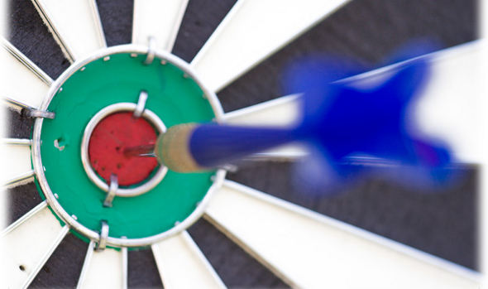
Focus Sessions
Target Design Challenges
  C. Densham, B. Riemer
Radiation Damage and Material Limits
  Y. J. Lee, S. Maloy
Target Facility Simulation Challenges
  O. Caretta, N. Mokhov
Target/Beam Monitoring & Instrumentation
  T. Shea, K. Thomsen
Target Facility Challenges
  K. Haga, R. Losito
Some talks and posters interesting to MAP
Summary of Conclusions and Future Directions

Slide 7
http://indico.fnal.gov/event/HPT14
Hylen Plenary Talk (Tues 09:30)

Slide 8
Target Design Challenges
http://indico.fnal.gov/event/HPT14

Slide 9
Heat Removal and Thermal Stress Summary
Heat Removal and Thermal Stress Summary
Flowing or rotating targets
Segmented
Peripherally cooled monolith
T.Davenne
Caretta Talk (Tues 13:20)

Slide 10
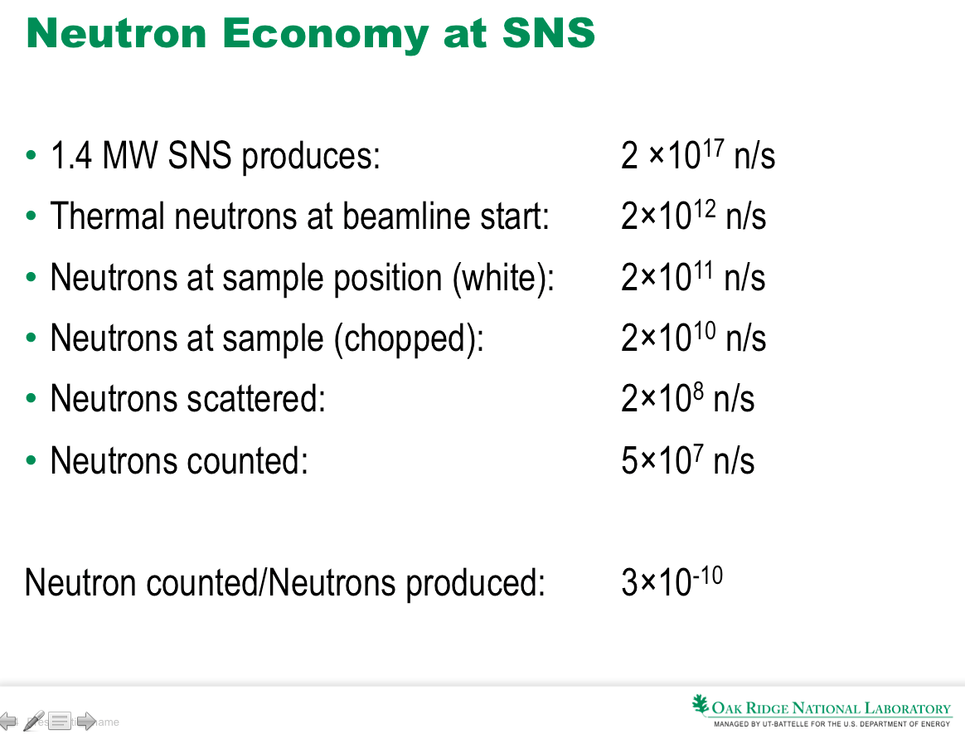
Is higher power best path to higher physics output?
Gallmeier Talk (Tues 16:20)

Slide 11
Radiation Damage & Material Limits
http://indico.fnal.gov/event/HPT14

Slide 12
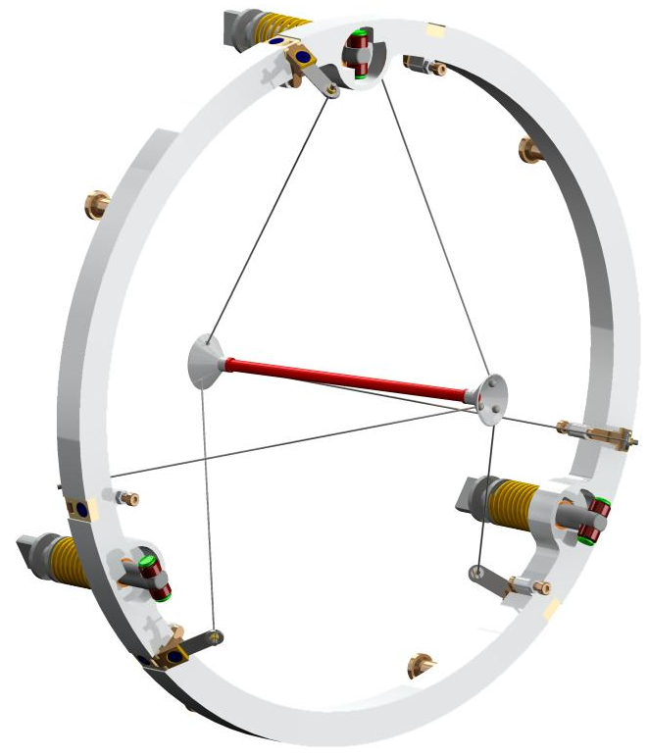
Target conceptual design
Titanium mounting ring
Refractory metal spokes
Radiatively cooled Tungsten target
Refractory metal hubs
Mounting wheel to HRS remotely operable locking mechanism (Fermilab concept)
Spoke tensioners
Densham Talk (Weds 09:05)

Slide 13
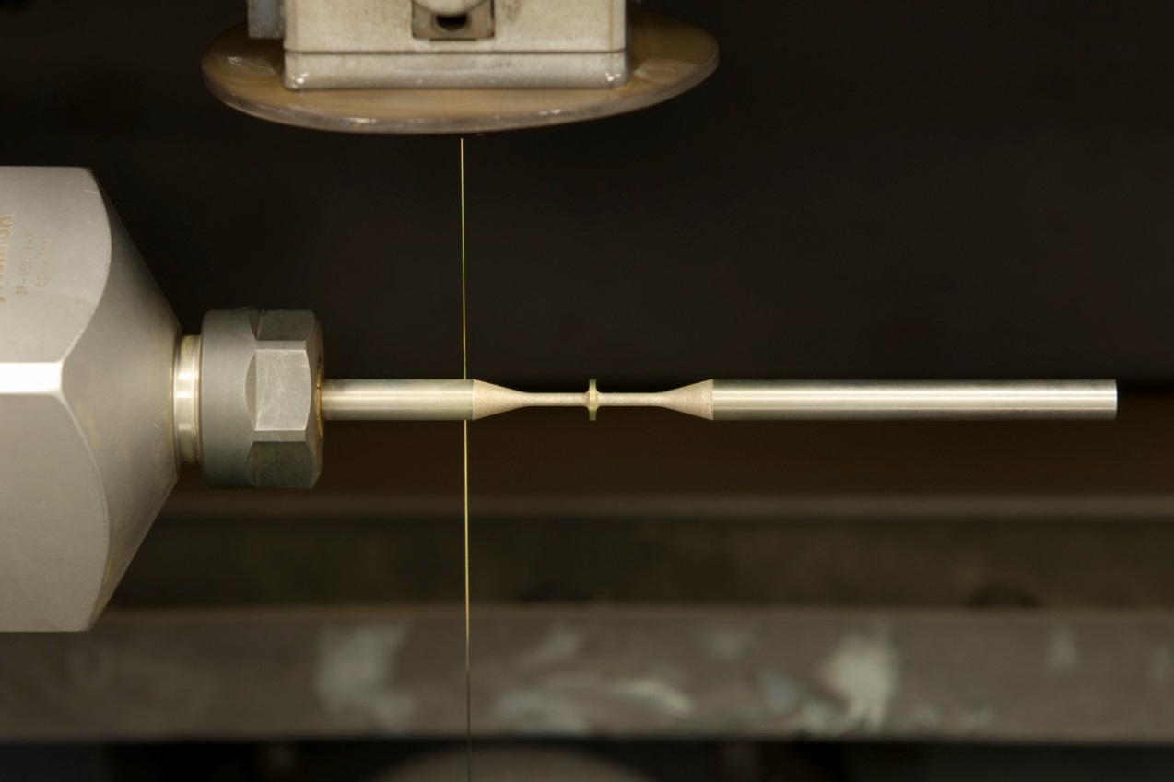
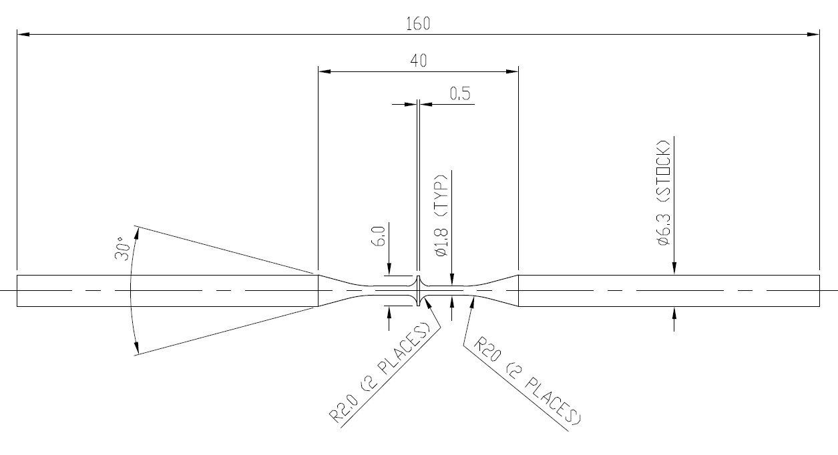
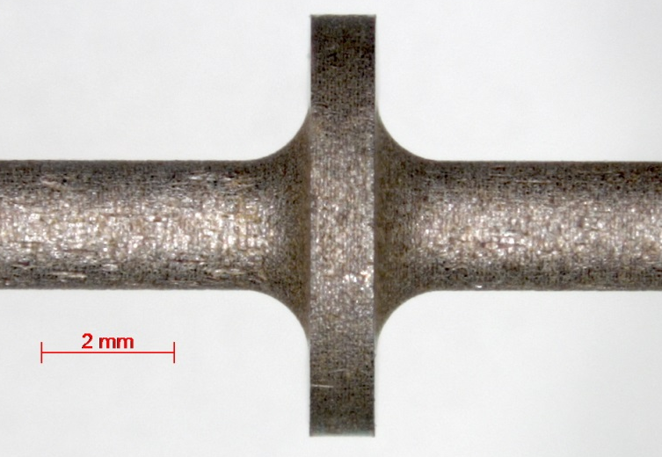
Tungsten Lifetime Test Samples
Stress-free ‘Turn and Burn’ wire EDM machining at RAL precision development facility
Densham Talk (Weds 09:05)

Slide 14



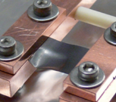
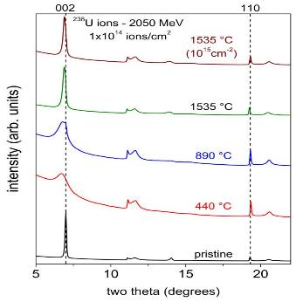
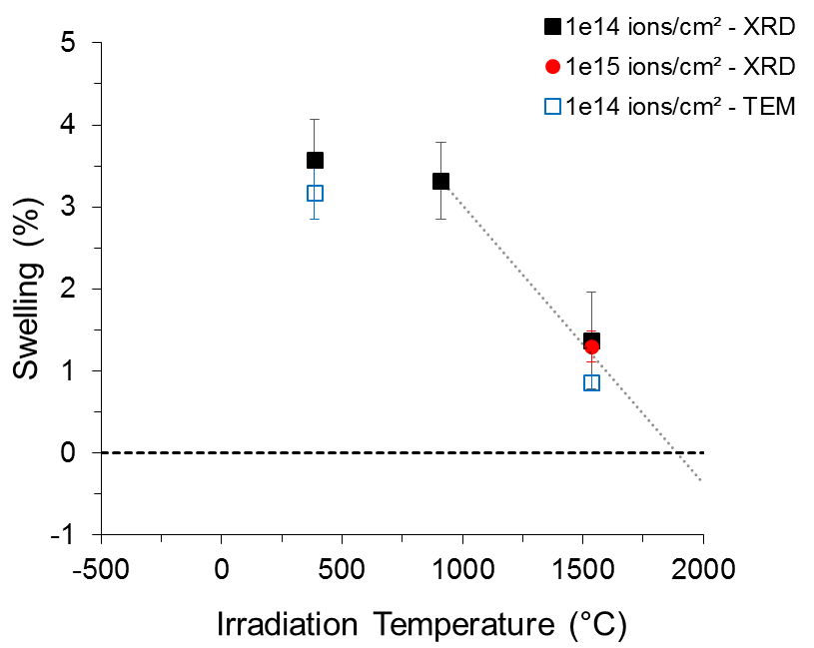
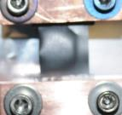
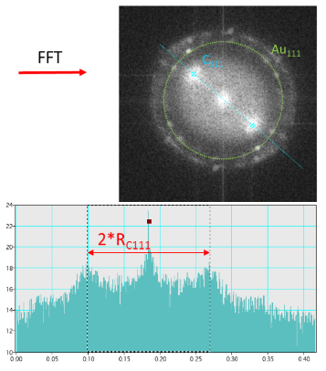
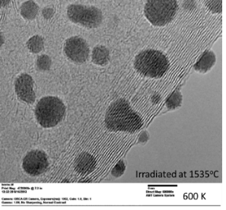
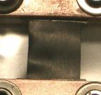
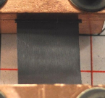
Radiation Damage Studies in Graphite
Annealing of Damage at High Temperature (> 1300ºC)
1 A - 350°C 10¹⁴ cm⁻²
11 A - 750°C 10¹⁴ cm⁻²
25 A - 1205°C 10¹⁴ cm⁻²
35 A - 1635°C 10¹⁵ cm⁻²
X-Ray Diffraction analyses
TEM analyses
Swelling is completely recovered at 1900ºC
Pellemoine Talk (Weds 10:10)

Slide 15
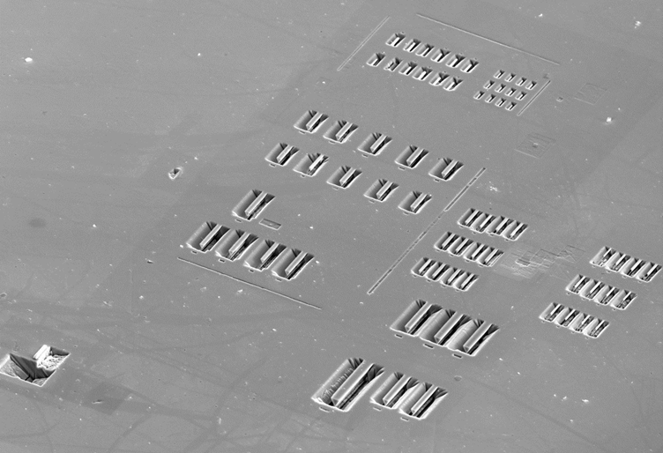
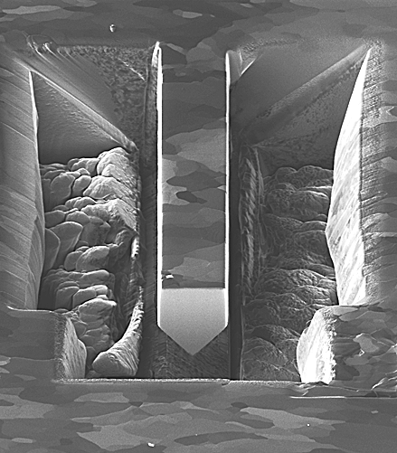
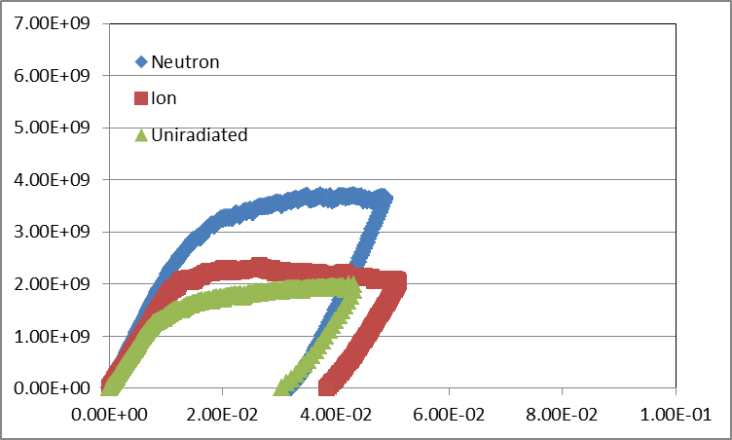
Why use micro-cantilever testing?
Chris Hardie
University of Oxford
Useful where only small samples are available (implanted layer)
Need for a sample design that can be machined in surface of bulk samples
Geometry that can be manufactured quickly and reproducibly
Fe 6%Cr
0.3mm
Stress (Pa)
Beam Thickness 2um
, D.Armstrong. University of Oxford
Strain
Kuksenko Talk (Weds 10:30)

Slide 16
Tomut Talk (Weds 10:50)

Slide 17
Target Facility Simulation
http://indico.fnal.gov/event/HPT14

Slide 18
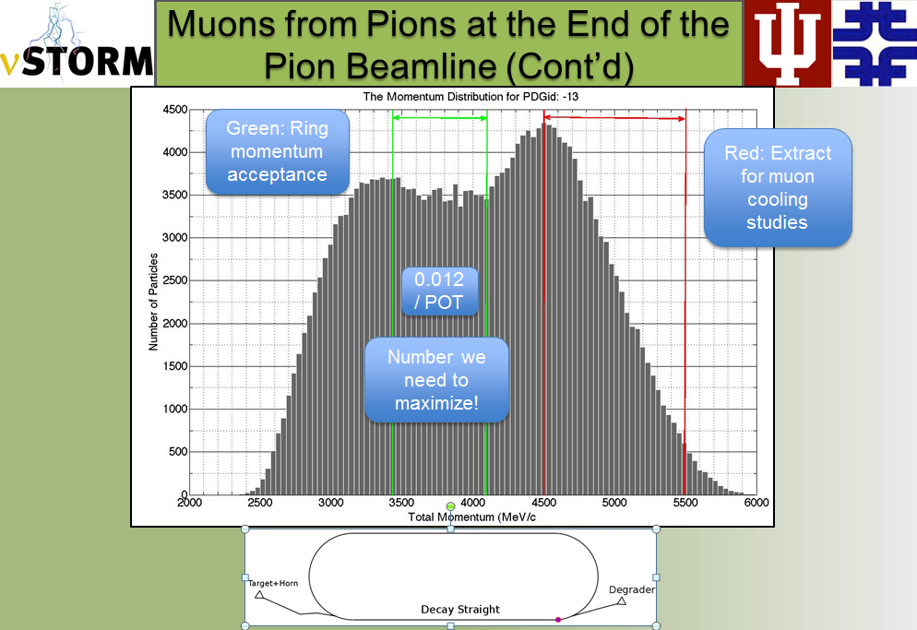
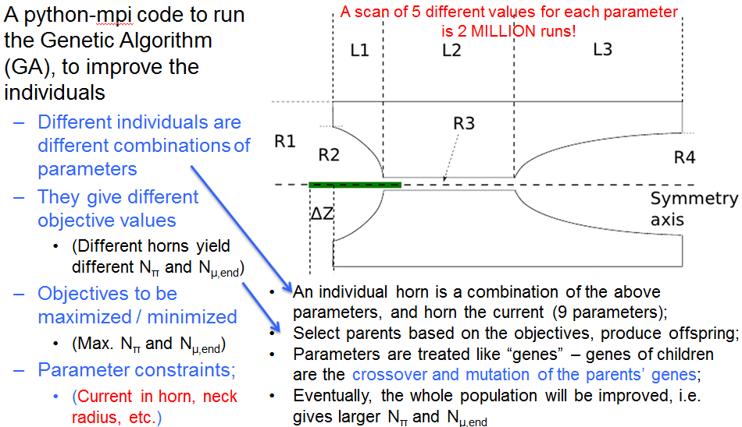
Ao Liu (Fermilab, Indiana University):
Horn Optimization for nuSTORM
1. nuSTORM benefits from the optimization:
  Expect 8.3% more neutrino flux, with a 38 cm Inconel target;
  Expect 16% more flux, with a 46 cm Inconel target.
2. Other horn-based projects – e.g. LBNE:
  Algorithm is expected to work if the objectives are known;
  Algorithm may be less complicated and faster, if no beamline tracking is needed;
  MOGA allows adding other constraints to obtain a more realistic design + optimization
Liu Talk (Weds 13:20)

Slide 19
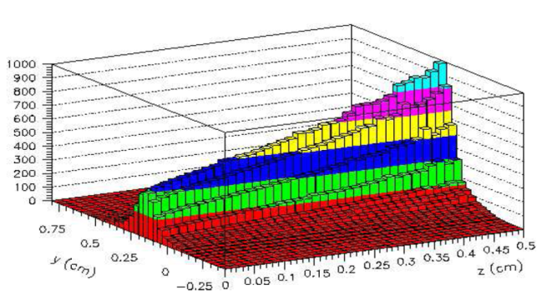
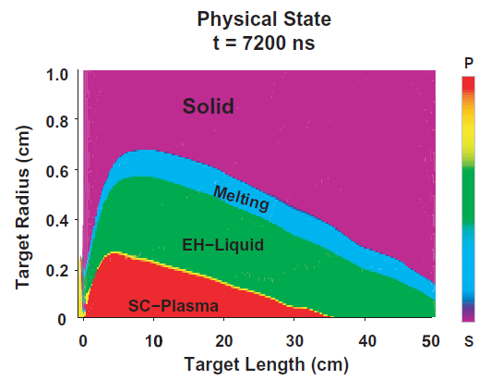
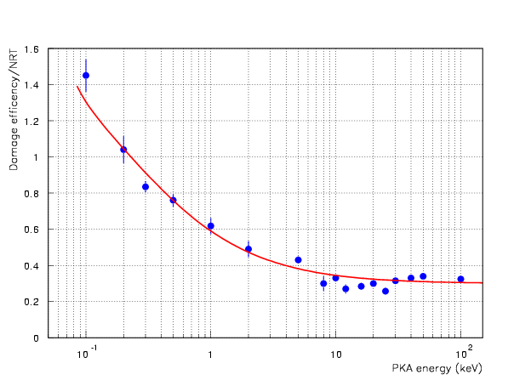
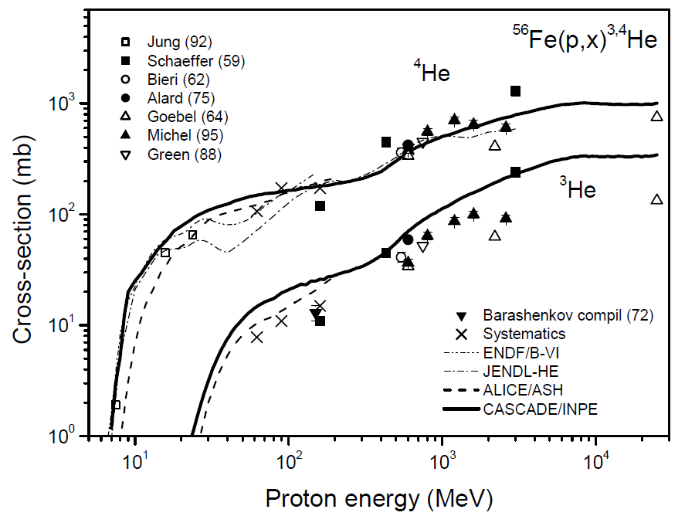
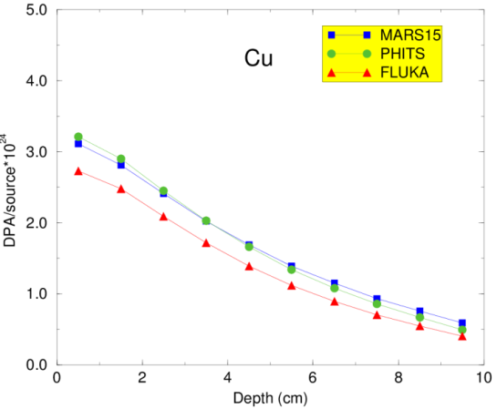
Nikolai Mokhov (Fermilab):
Beam-Induced Effects in Targets and Uncertainties in Modeling
Thermal shocks and quasi-instantaneous damage
Insulation property deterioration due to dose buildup
Radiation damage to inorganic materials due to atomic displacements (DPA) and helium production
Capabilities (impressive) and uncertainties (steadily decreasing) of modern simulation codes used to study these effects
Link of calculated quantities (DPA, dose, fluence etc.) to observable changes in critical properties of materials remains on the top of the wish-list. Mission impossible?
Discussion
Displacement efficiency k(T)
K(T)=0.8
Mokhov Talk (Weds 13:45)

Slide 20
Target & Beam Instrumentation
http://indico.fnal.gov/event/HPT14

Slide 21
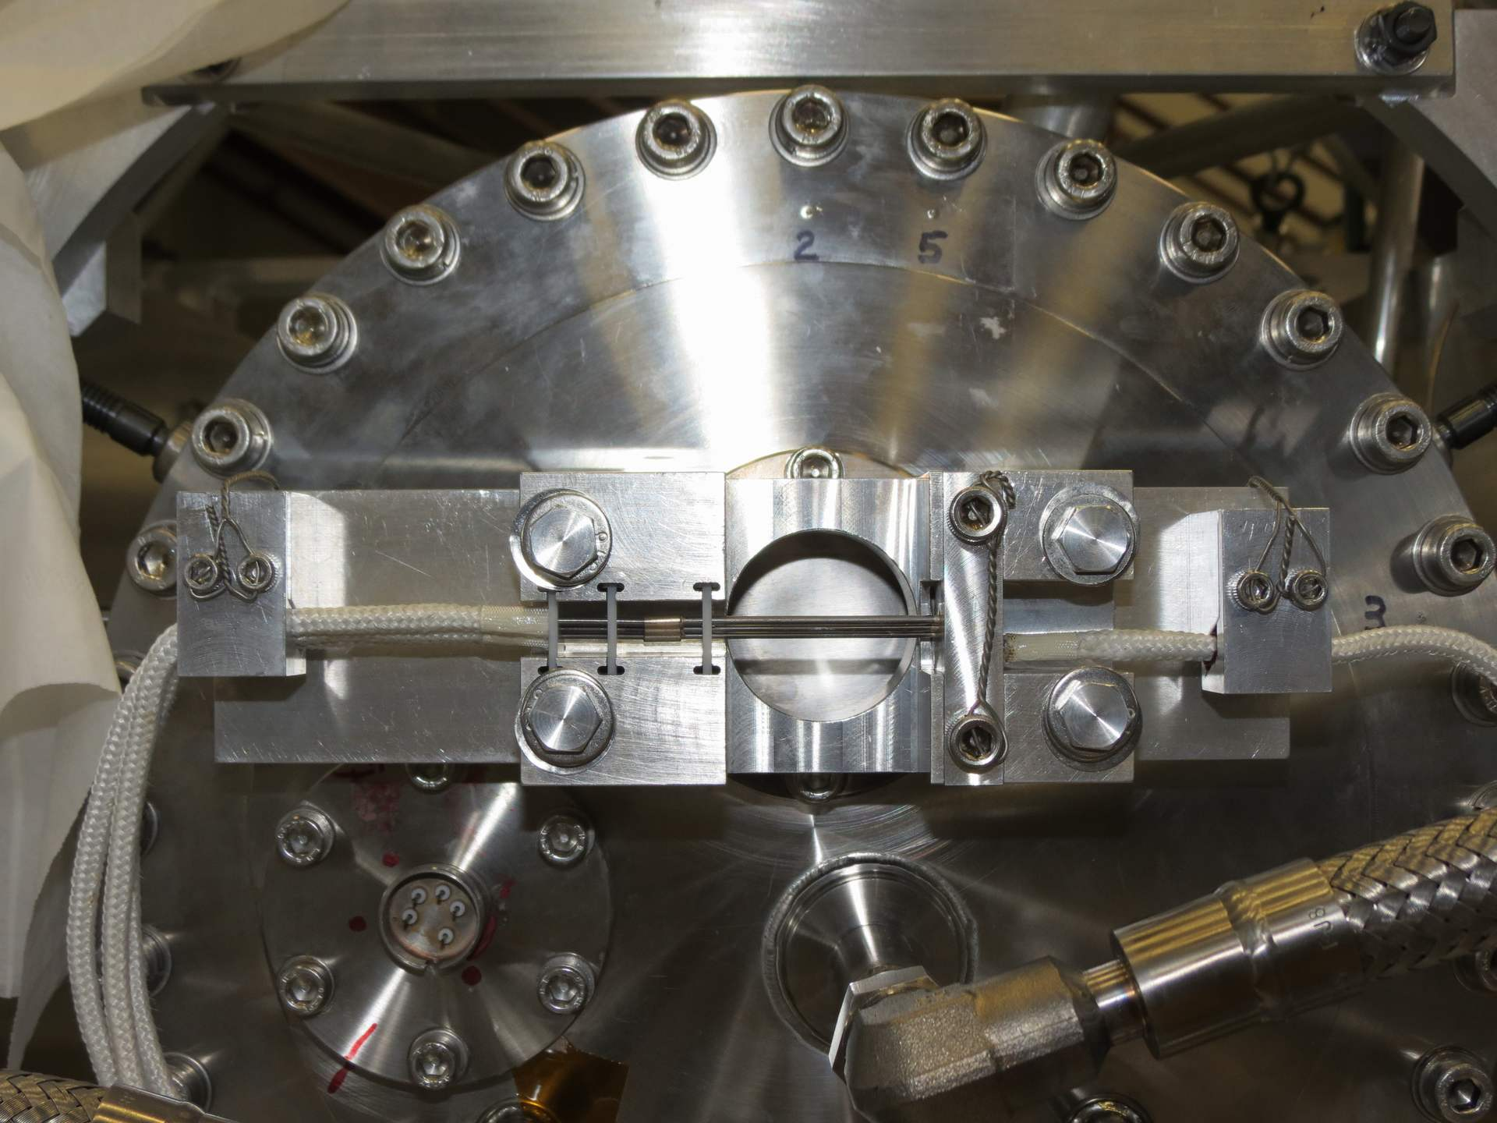
Thermocouple Device at NuMI
New device to monitor proton beam position on NuMI target
Beryllium rods and thermocouples demonstrated ability to monitor beam position to better than 0.1 mm accuracy
Simple, robust device that many attendees could see during the tour.
Hylen Talk (Thurs 08:40)

Slide 22
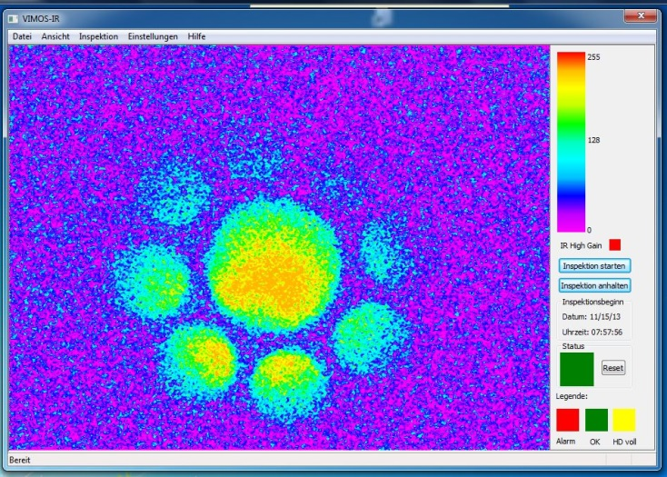
Imaging Solution at PSI
Issue transporting short wavelengths in fiber bundle
Fiber
Beam splitters
Camera 3 (IR)
80%
Long wavelengths
20%
Short wavelengths
Safety channel unchanged
Camera 1 (safety)
Camera 2 (visual)
Diagnostics’ short-wavelength camera removed, but Filter left in place.
IR - Signal with reduced short-wavelength contamination alone serves as basis for diagnostics
Increased sensitivity for lower temperatures / currents
More linear response could still be reached
Try to do all optics with mirrors only
Thomsen Talk (Thurs 10:40)

Slide 23
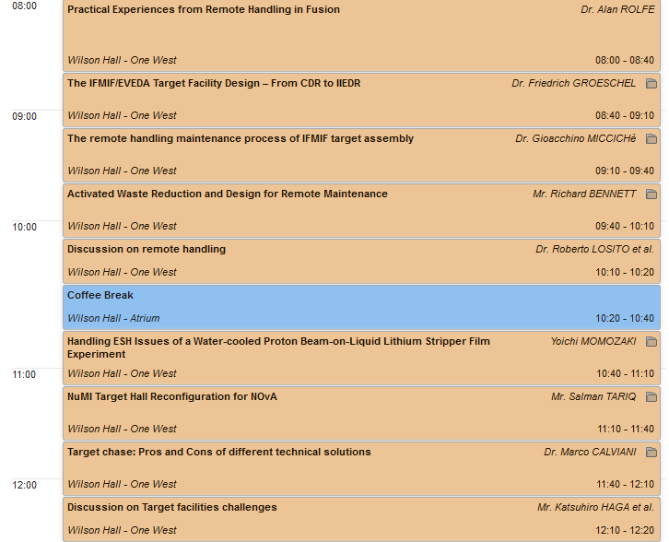
Target Facility Challenges
http://indico.fnal.gov/event/HPT14

Slide 24
Target enclosures: pro & cons of various solution
5th High Power Target Workshop
https://indico.fnal.gov/conferenceDisplay.py?confId=7870
Brainstorming session
M. Calviani (CERN)
With major contributions from: J. Hylen (FNAL), T. Ishida & T2K team (KEK/J-PARC), H. Vincke, C. Strabel, P. Vojtyla (CERN)
Calviani Talk (Fri 11:40)

Slide 25
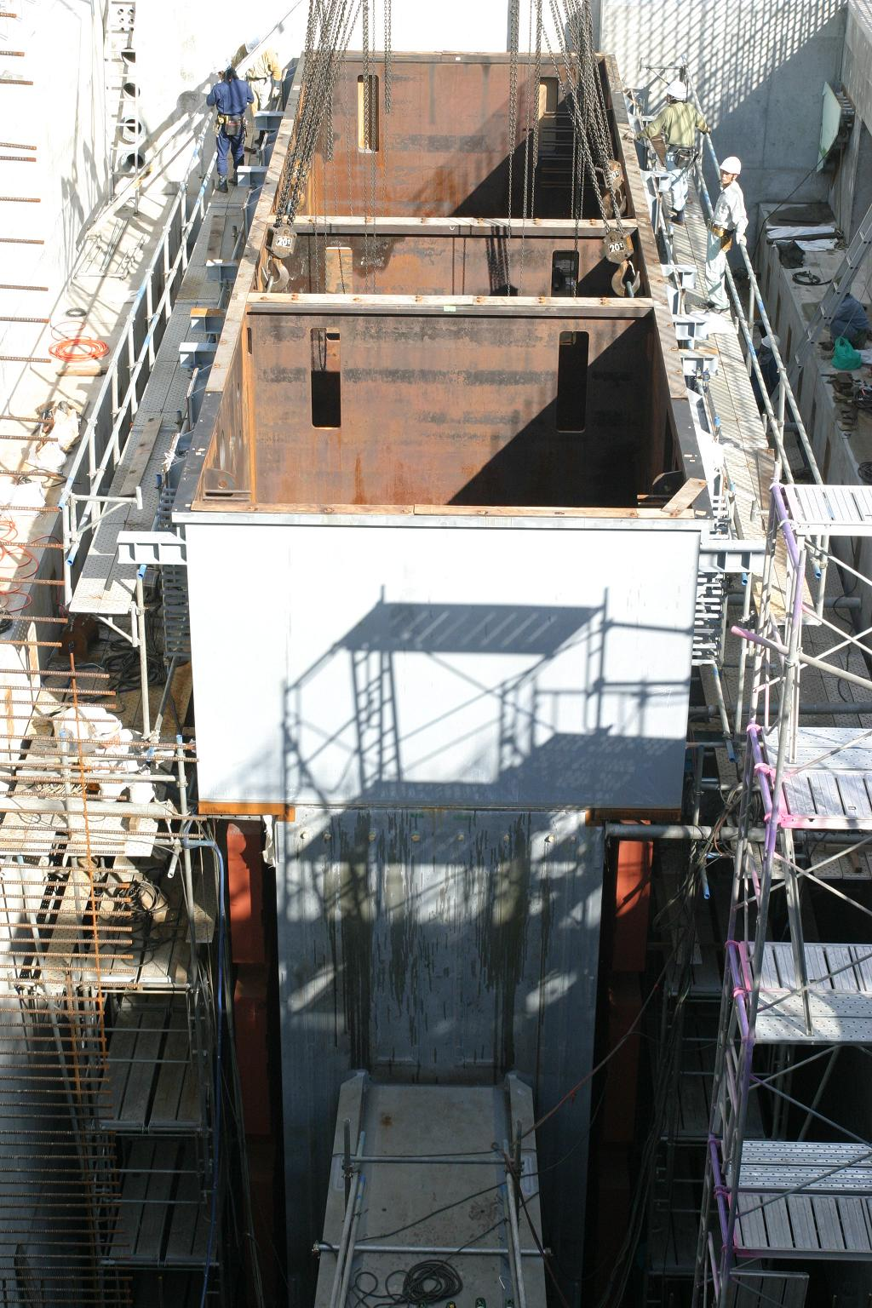
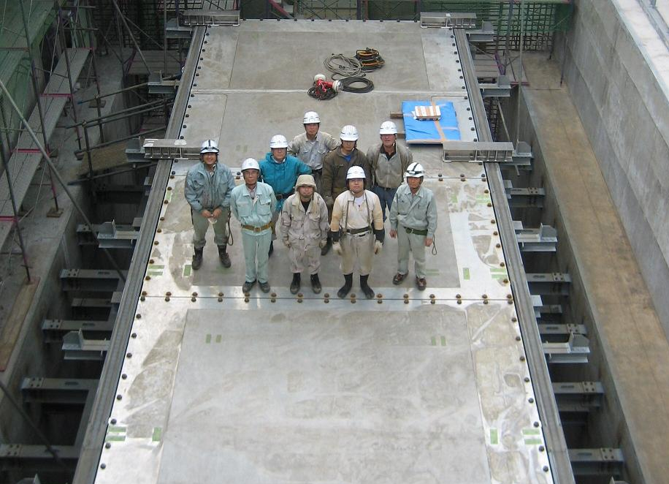
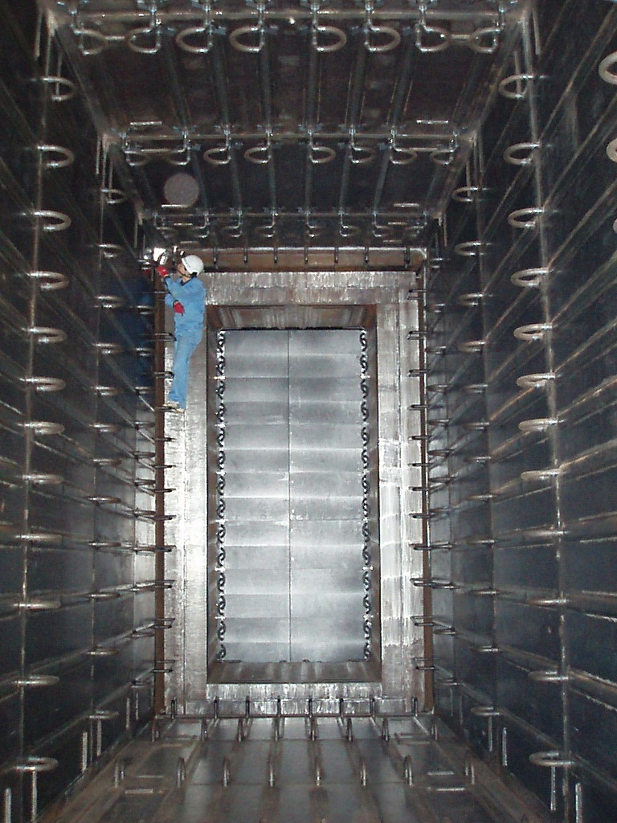
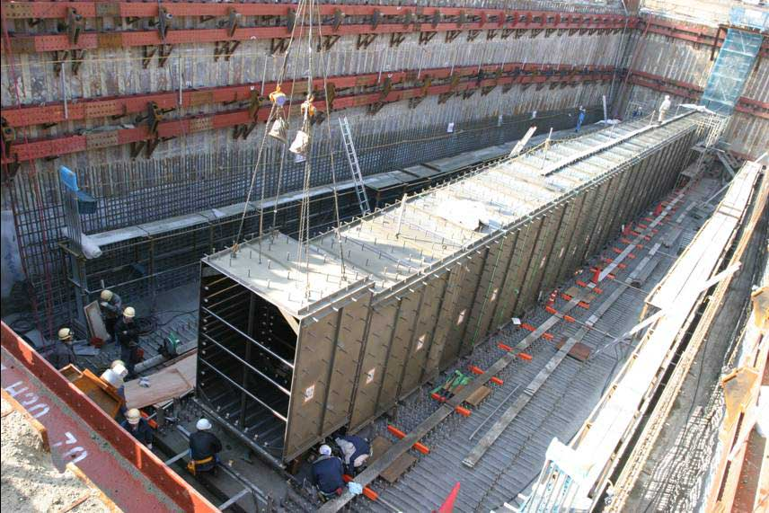
Helium Vessel Construction
TS
BD
Graphite
blocks
Top lids
(3 pieces of 120mm-thick Aluminum )
DV
Upstream DV
Support anchors
Embedded in concrete wall
Oct.05’07
Calviani Talk (Fri 11:40)

Slide 26
Posters interesting to MAP?
http://indico.fnal.gov/event/HPT14
Uniform irradiation of an extended target by high power beam.
  Dr. TSOUPAS, Nicholaos
CENF target thermo-mechanical study
  Ms. VENTURI, Valentina
Beryllium material tests: HiRadMat windows and NOvA fins
  ATHERTON, Andrew
  Dr. AMMIGAN, Kavin
  HARTSELL, Brian
LBNE 1.2MW Target Conceptual Design
  HARTSELL, Brian
A High-Power Target system for the Production of Intense Muon Beams
  Prof. MCDONALD, Kirk
PNNL Beam Window and Target Analyses
  Mr. GATES, Robert
Radiological Calculations on the LBNE Neutrino Beamline
  Dr. REITZNER, Diane
Tritium Mitigation for the LBNE Beamline
  Dr. REITZNER, Diane
Design and test of a graphite target system for in-flight fragment separator
  Dr. KIM, Jong-Won

Slide 27
HPTW Conclusions and Future Directions (in no particular order)
More radiation damage data is needed
  Need to coordinate testing activities
  Generate common database
  “Standardize” techniques and parameters to validate comparisons
    across irradiation types (energy, dose rate, temperature)
    across testing techniques (micro-, mini-, macro-mechanics)
  RaDIATE Collaboration may fill this need
Need to move toward unified design standard for target component and system design incorporating radiation damage effects
  Similar to RCC-MRx code (French nuclear power code)

Slide 28
HPTW Conclusions and Future Directions (in no particular order) ₍₂₎
Facilities need to include flexibility to perform PIE (Post-Irradiation Examination) on components in order to gain the most benefit for targetry component lifetimes
MC codes that calculate DPA should be more explicit:
  Recoil atom energies
  DPA (standard) – ASTM NRT calculation with fixed displacement efficiency (0.8)
  DPA (physical) – NRT calculation with energy dependent displacement efficiency
  Complete descriptions of origins of key parameters, such as displacement threshold energy (measurement, estimate, calculation)
Computational capabilities are now at the point that MC simulation codes can start to work with Molecular Dynamics codes to predict radiation damage effects

Slide 29
HPTW Conclusions and Future Directions (in no particular order) ₍₃₎
Compared to the accelerator upstream, no target station appears to have a comprehensive instrumentation suite
  More extensive thermal instrumentation
  Improved beam profile and position monitoring
  More robust inputs to target protection system (rastering example)
  More…
Limited collaboration between target facilities on instrumentation and across broader community
  Significant opportunity here

Slide 30
HPTW Conclusions and Future Directions (in no particular order) ₍₄₎
Remote Handling:
  Embed into design to save money/time
  Recovery from accidental situation is about 80% of design time
  If components designed completely for RH, then operations take the same time or less then with human
    If not, 5 to 10 times more!
  Simplify design
  Code of practice?
Environmental issues
  Reduce waste
    Try to declassify waste as much as you can (volume reduce, store to decay)
  Tritium confinement
    Creation and migration needs simulations and benchmarking
  Handle short lived isotopes
    Air handling needs to provide for decay time
  Flexibility necessary to solve early problems (but costly)
  He, air or vacuum?
    Depends on specific layout of facilities and local legislation

Slide 31
My general observations
Trend toward optimizing solid targets before making the leap to liquid metal targets (lithium being the exception)
Trend to staging beam power upgrades
Recognition of experts globally that successful construction and operation of HPT facilities demands development of HPT as a core institutional competency (infrastructure, experience, development)
  Need to instill that viewpoint in management (Laboratory Directorates) and funding agencies (DOE)
The HPT community is strong, vibrant and growing!

Slide 32
RaDIATE
1st Annual Collaboration Meeting May 19 2014
Welcome and News & Notes
http://www-radiate.fnal.gov/
Radiation Damage In Accelerator Target Environments

Slide 33

Next Stop: Oxford!
(HPTW 2016 at RAL)

