Slide 1




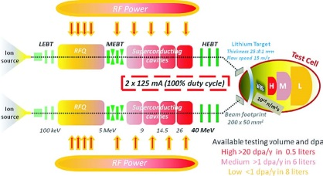
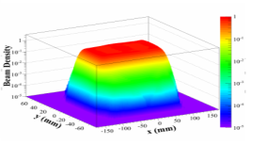
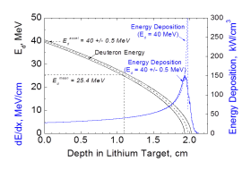
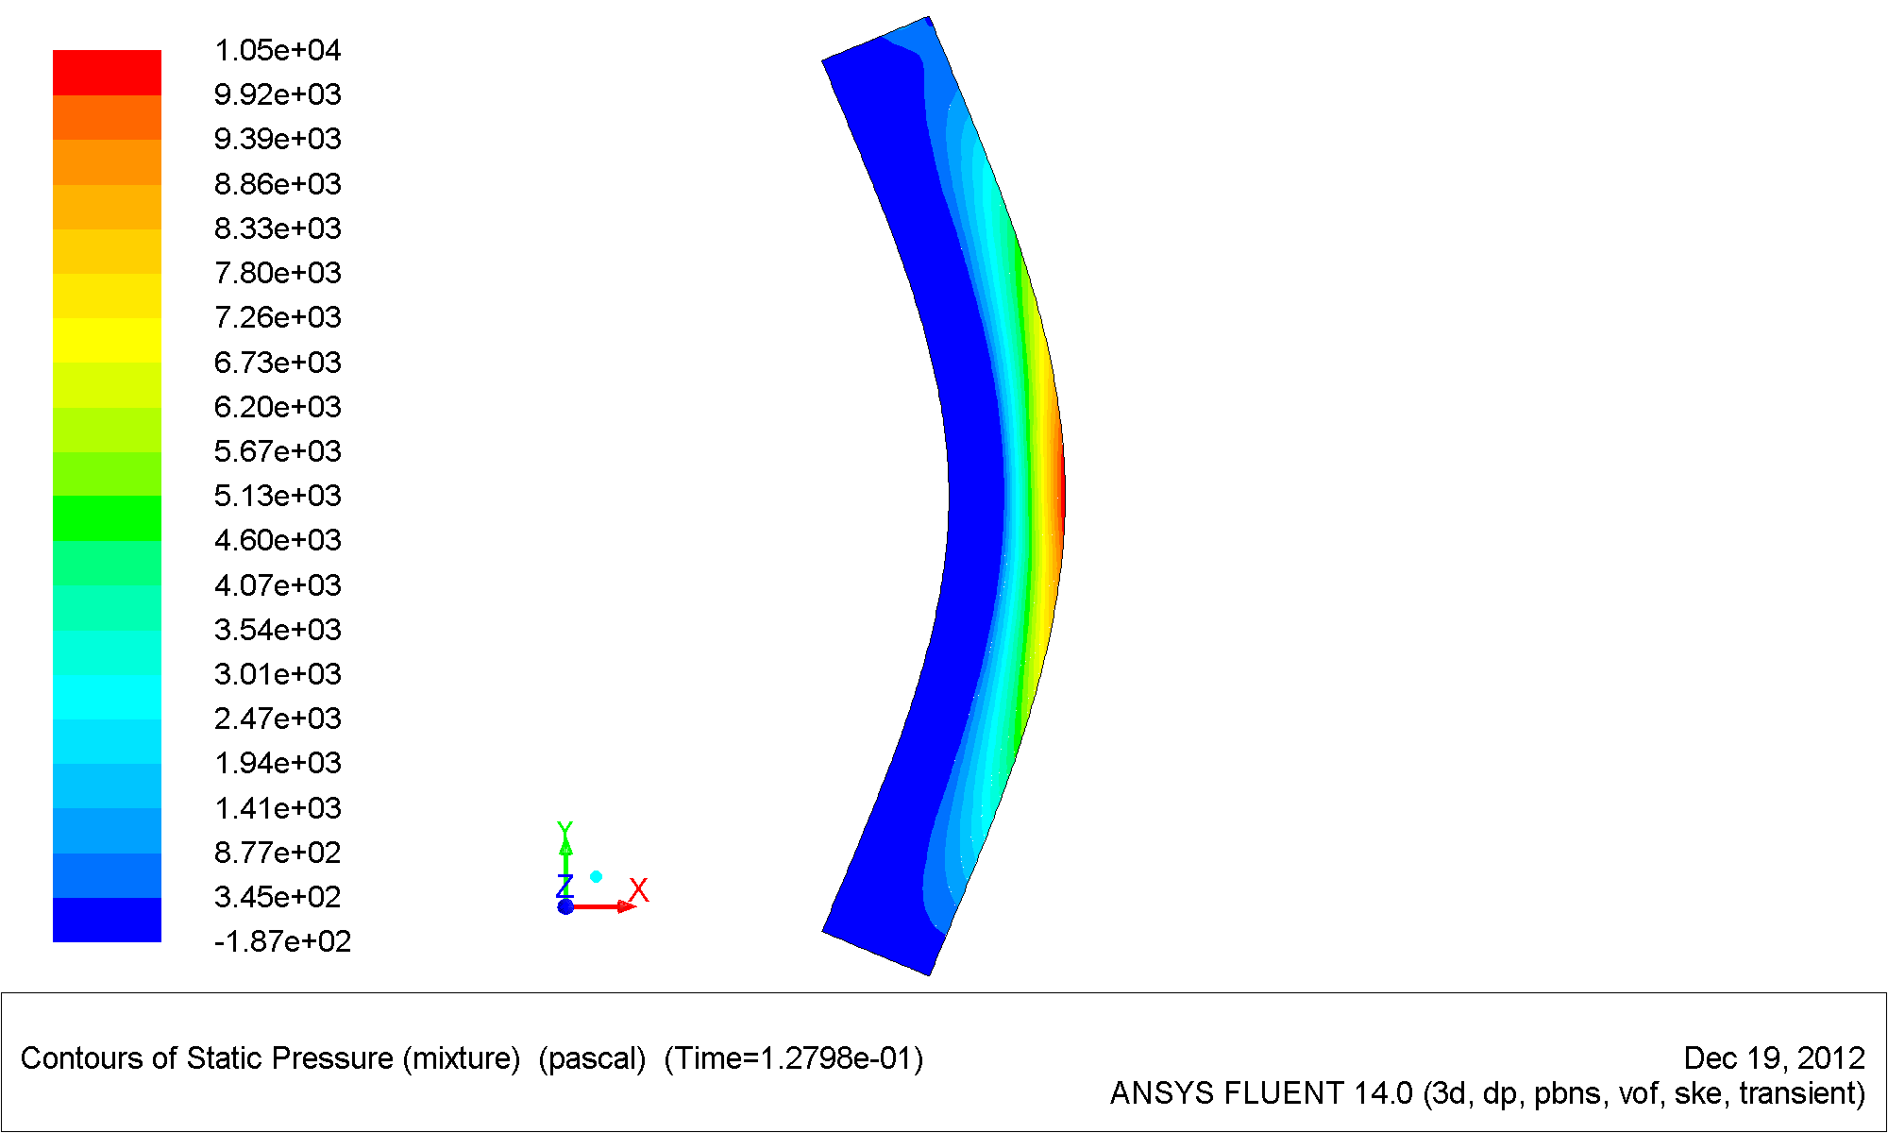
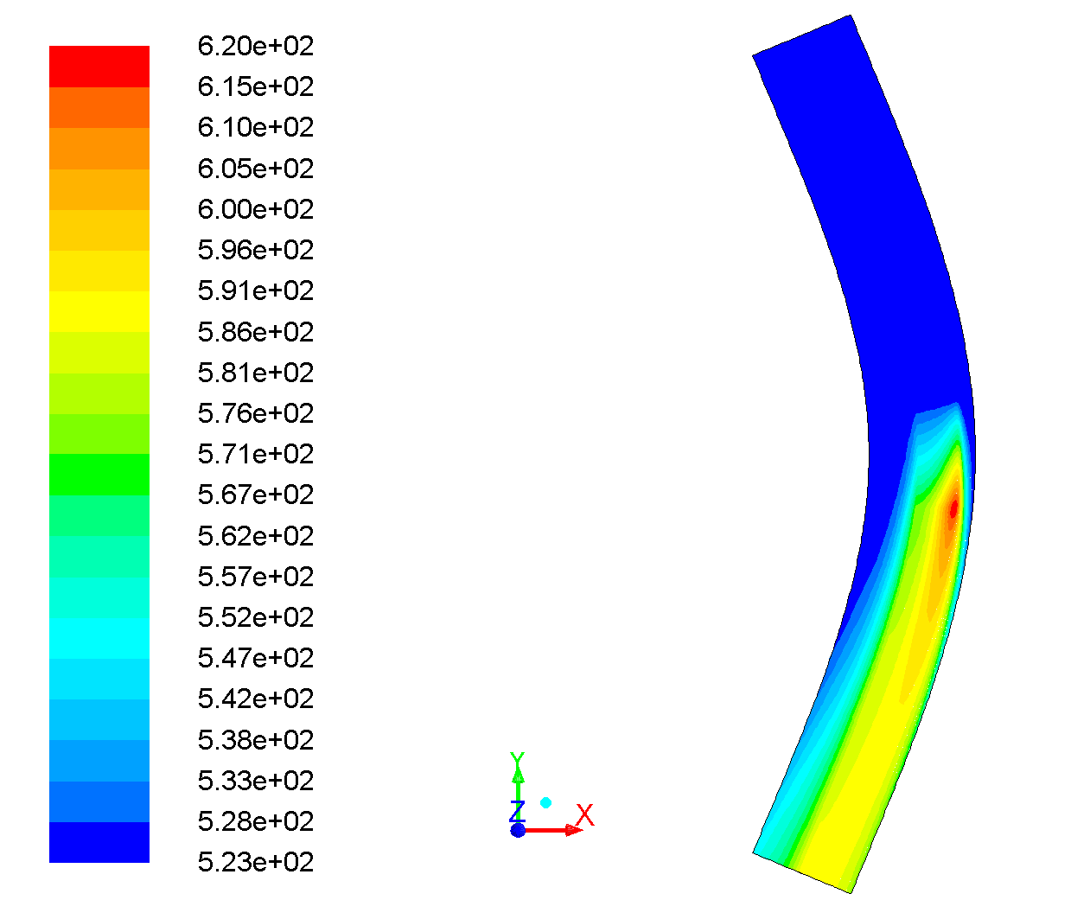
Assessment of beam-target interaction of IFMIF
A state of the art
J. Knasterª, D. Bernardi^{b}, A. García^{c}, F. Groeschel^{h}, R. Heidinger^{d}, M. Ida^{e}, A. Ibarra^{c}, G. Micchiche^{b}, F.S. Nittiª, M. Sugimoto^{f}, E. Wakai^{g}
ªIFMIF/EVEDA Project Team, Rokkasho, Japan / ^{b}ENEA, Brasimone, Italy / ^{c}CIEMAT, Madrid, Spain / ^{d}F4E, Garching, Germany
^{e}IHI, Yokohama, Japan / ^{f}JAEA, Rokkasho, Japan / ^{g}JAEA, Oarai, Japan / ^{h}KIT, Karlsruhe, Germany
In the International Fusion Materials Irradiation Facility (IFMIF) two 40 MeV at 125 mA current deuteron beams will impinge on a liquid Li target, to generate a high energy neutron flux for the Test Cell.
The main requirement for an efficient and safe operation of the plant is the stability of the Li jet.
The stability is related to the thermo-hydraulic behaviour and can be affected by the beam–target interaction.
The thermo-hydraulic behaviour of the jet has been continuously studied in the last 30 years,
theoretically and experimentally in consecutive different programs: FMIT, ESNIT, ISTC and IFMIF/EVEDA.
Concerns on the impact of the 10 MW beam power (1 GW/m² power density) and beam momentum transfer on the stability of the lithium screen are presented.
IFMIF scheme of main facilities: Linear Accelerator; Lithium Target; Test Cell
IFMIF beam characteristics
IFMIF target characteristics
2 x 5 MW D⁺ beams in CW
(100% duty cycle) impinge the
flowing Li screen with a beam
footprint of 200 mm x 50 mm
at an angle of ± 9⁰ with a flat-top profile.
Two step nozzle with a reduction rate
10:2.5:1 to obtain a stable Li flow with a
velocity of 15 m/s in a concave channel
open to the beam vacuum chamber.
Beam density
Bragg’s peak of D⁺ at 40 MeV in Li is
around 19 mm. All beam energy is
absorbed at 21 mm.
Lithium Target section
Beam energy deposition
Channel curvature radius gradually decreasing
from nozzle exit ( 6 m ) to beam center (0.25 m)
Li jet width 260 mm and thickness 25 mm
Jet thickness variation accepted +/- 1 mm
Pressure effects
Pressure profile along the channel [Pa]
Wave pressures can appear in the flowing Li by:
Thermal gradients
Maximum expansion velocity due to thermal effects occurs on the free
surface at the center of the beams footprint and results of about
0.05 m/s, with 40 MeV of energy and 25 A/m² of current density.
Thermal effects
Flowing Li is exposed to beam during 3.3 ms . The temperature rises
in downstream direction reaching maximum at lower edge of the beam
footprint.
Beam momentum transfer
The forces induced on the Li by the beam momentum transfer
generate a pressure gradient and a velocity field:
Centrifugal pressure (~kPa) raises
saturation temperature in the bulk
of the liquid preventing nucleation.
The pressure field induced in beam direction, maximized
cancelling the velocities, results
Temperature [K]
Distance from backplate wall [mm]
where E is the deuteron energy, I(x,y) the current density, e the unit
of charge and m the deuteron mass; and give a maximum value
of 32 Pa, which would be damped by the about 9 kPa of centrifugal
pressure at 19 mm depth.
T_{max} and T_{sat} at beam footprint lower edge
The 15 m/s speed evacuates the heat
preventing heating of the backwall and
guarantee a margin bigger of 41 K at
operational target pressure of 10⁻³ Pa.
The maximum velocity in beam direction, neglecting transversal
components and cancelling the pressure, results
Temperature profile along the channel [K]
and yield a value of 0.5 m/s.
Experimental validation
RIA project (Argonne Lab.) carried out experimental validation of 1 MeV
e-beam interacting with cross-flowing Li. Power densities were modulated
up to 25.4 GW/m² and flowing speeds up to 6 m/s with no instabilities.
Positive ΔP were observed in Li free surface during beam operation due
to ion induced gas desorption.
Conclusions
Analysis performed and experiments available show that the 1GW/m² beam power density will not induce instabilities in the flowing Li screen of IFMIF.
The maximum theoretical transversal velocities due to thermal expansion of the jet ( 0,05 m/s) and to momentum beam transfer (0,5 m/s) are of
some order of magnitude lower than the average jet velocity (15 m/s), the jet thickness variation induced in the foot print area will be lower of the
tolerance accepted (+/- 1 mm).
The maximum theoretical pressure gradients due to momentum beam transfer (32 Pa) are of some order of magnitude lower than centrifugal
pressures of ~kPa, constructive interferences are not expected.

