Slide 1
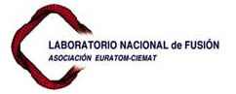

Fusion Technology at CIEMAT
Overview of Material Irradiation Activities
A. Ibarra
RaDIATE Collaboration Meeting . May 19, 2014

Slide 2
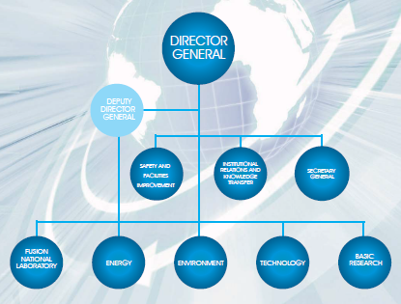
CIEMAT
CIEMAT is a public research entity focused on energy and environmental problems, founded more than 50 years ago (initially focused on nuclear research).
Several centres around Spain (main one in Madrid). Staff of around 1500 people and yearly budget around 100 M€.
CIEMAT activities are organized in 5 technical departments (ENERGY, FUSION, ENVIRONMENT, TECHNOLOGY, and BASIC RESEARCH) and 3 transversal departments.

Slide 3
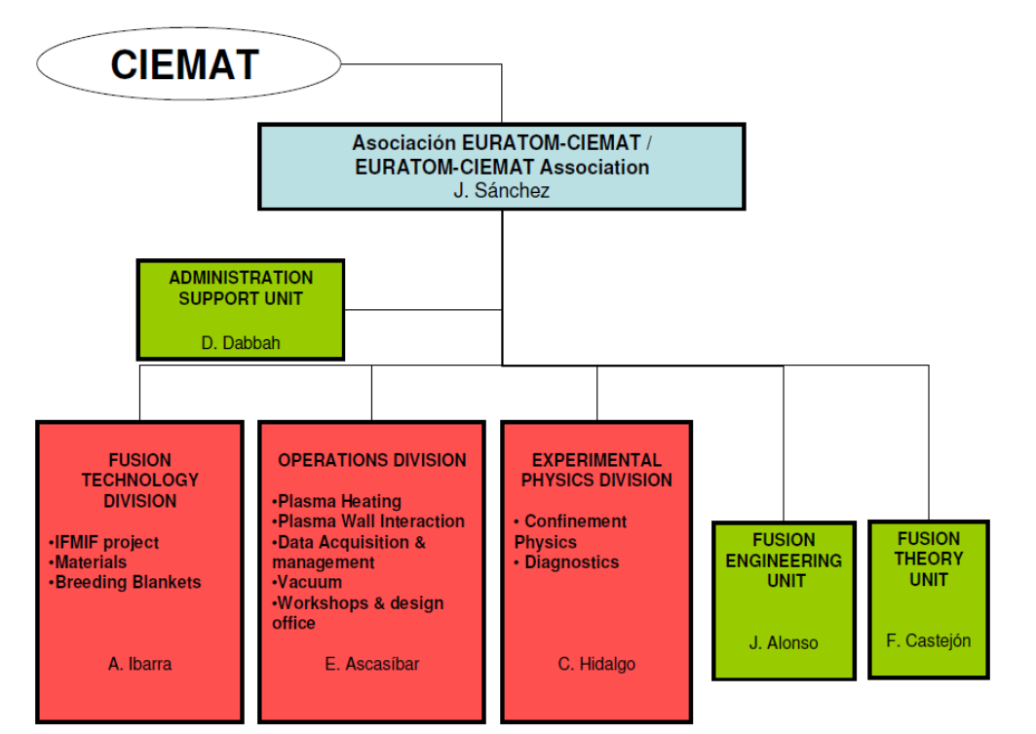
Fusion National Laboratory (FNL)
The FNL of CIEMAT carries out R&D for the development of magnetic confinement fusion as a future energy resource and coordinates the Spanish fusion research carried out as part of the EU Fusion Programme.
The main goals of the Spanish fusion programme are:
The development of the “stellarator” concept, through the exploitation of the TJ-II device
The participation in the large world fusion experiments (JET, LHD, W7X, ITER, JT60 and IFMIF)
The development of knowledge and technologies needed for DEMO and the Power Plant.

Slide 4
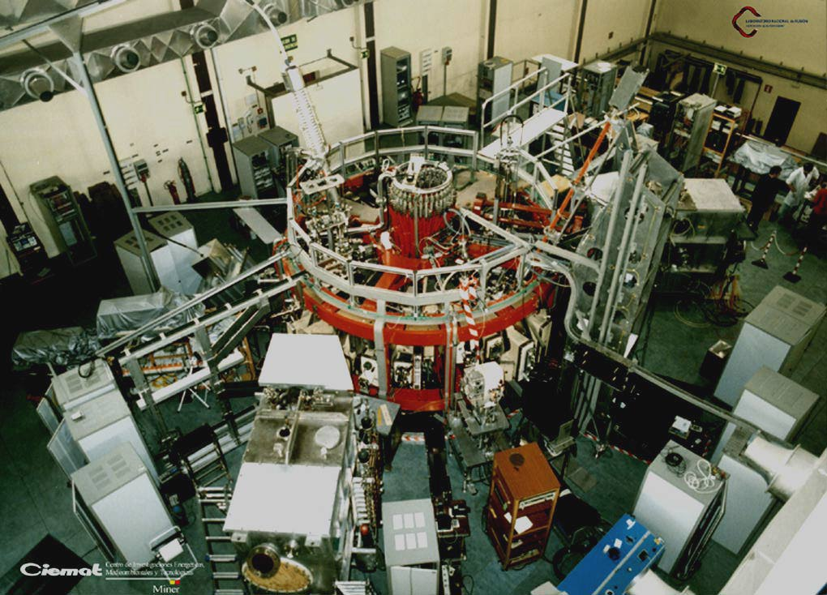
Fusion activities started at CIEMAT as early as 1975
Around 150 people is working presently in fusion-related activities at CIEMAT (plus 150 more distributed in other research centers)
The TJ-II sterellator started operation in 1997
Presently is the only one in EU and the 2nd biggest in the world

Slide 5
Fusion Technology activities
Activities on Fusion Technology started many years ago (early 80´s) around the study of radiation effects on insulator materials. Only recently a significant expansion take place.
Presently, around 50 people at CIEMAT and 70-80 distributed in other research centers.
The different research activities are focused along the following lines:
DEMO Design (mainly breeding blankets)
Development of breeding blankets technologies (mainly those related to liquid metals)
Fusion Materials Fusion Development (Functional and Structural materials, including production and characterization including irradiation effects)
Modelling, mainly of radiation damage effects
New facilities
  Participation in the IFMIF/EVEDA project
  Development of new Spanish Facilities for fusion

Slide 6
Fusion Technology activities
Most of the activities carried out at the CIEMAT group have a common background: the study of the radiation effects
Modelling and validation experiments
  Evaluation of damage, MD, Montecarlo methods, rate theory methods
  Benchmarking experiments (resistivity recovery, desorption, …)
Physical phenomena during irradiation (RIC, RIED, FL, OA, RL, RID, …)
Radiation effects on structural materials
Development of new irradiation facilities
  IFMIF
  Ion irradiation

Slide 7
New irradiation facilities

Slide 8
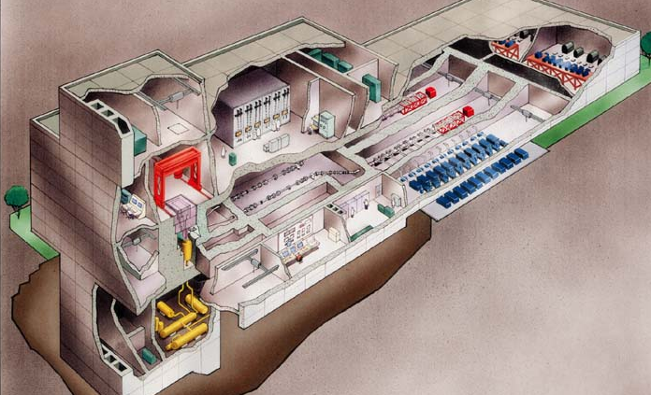
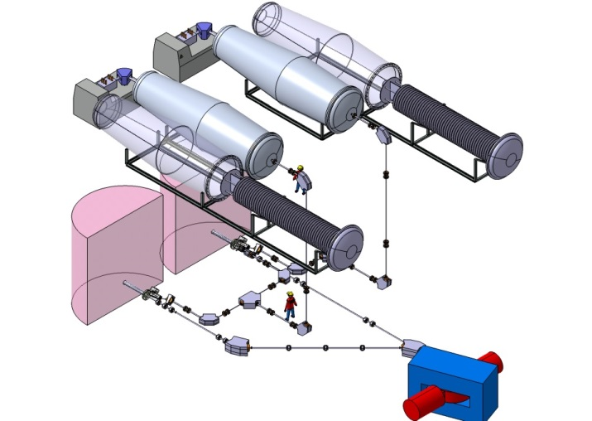
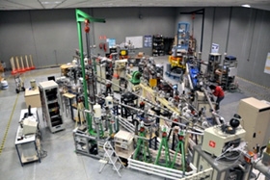
Presently there are no irradiation sources similar equivalent to DEMO
To better understand radiation effects in materials, to be able to make predictions
IFMIF Project
Spain heavily involved through the IFMIF-EVEDA Project included in the BA Agreement

Slide 9
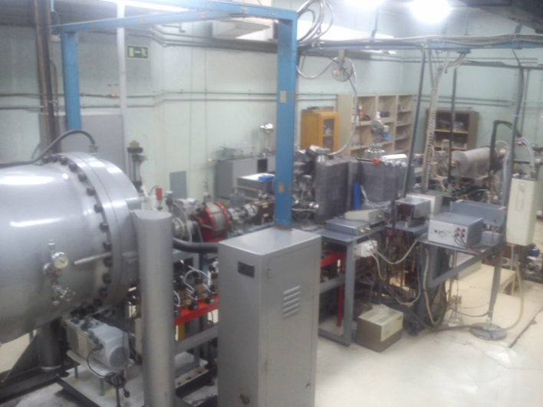
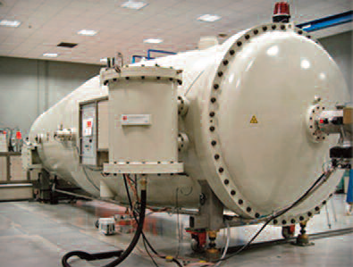
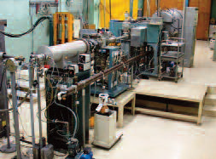
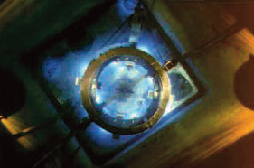
Electron, Gamma and Ion Irradiation Facilities
Collaboration with CMAM (UAM)
5 MeV Tandem Accelerator
2 MeV Van de Graaf electron Accelerator
60 keV Ion Implantator
NAYADE: Co60 γ-source

Slide 10
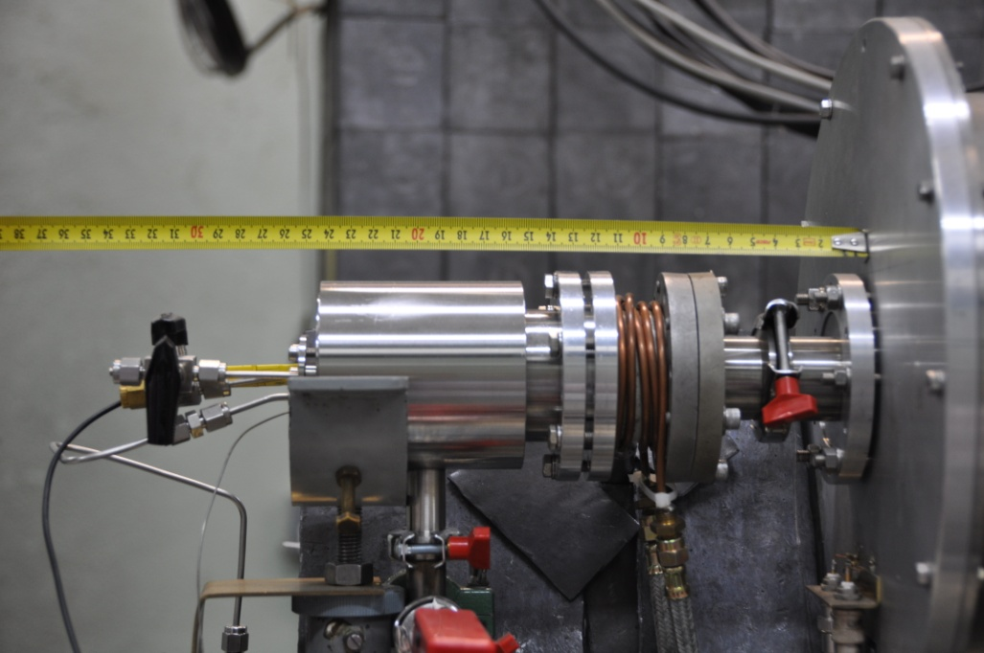
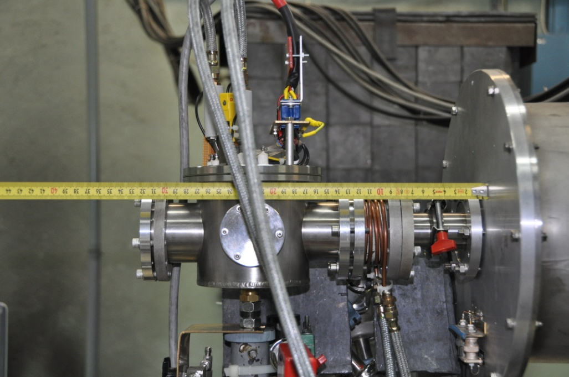
Radiation Enhanced Permeation Chamber.
Radiation Enhanced Desorption Chamber.
Very significant capabilities for in-beam measurements (later)

Slide 11
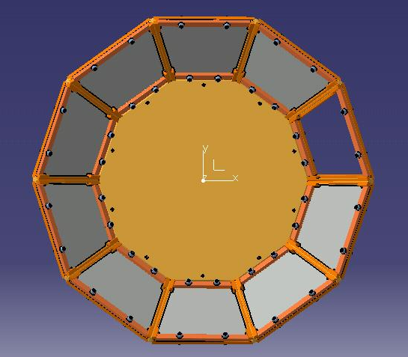
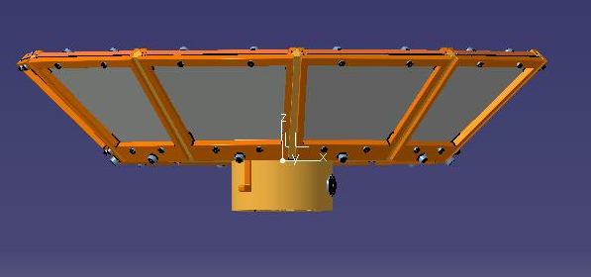
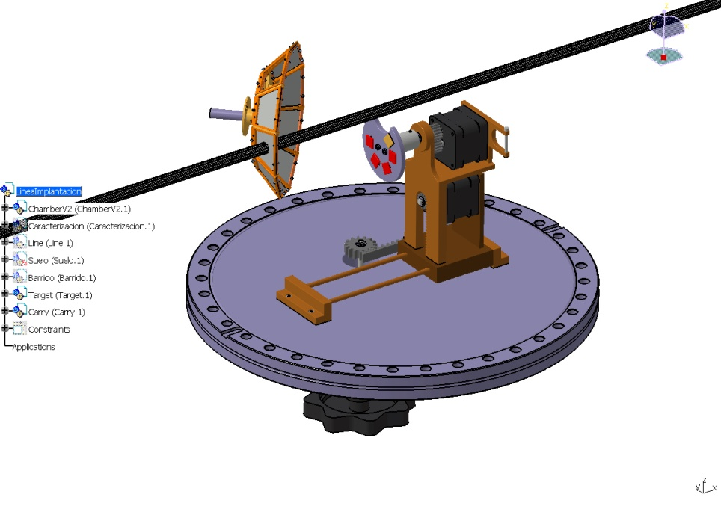
implantation beam line of CMAM
(I) Design and prototyping of an energy degrader for triple beam irradiations.
Design and manufacture of a ion beam energy degrader (H: 3.8 MeV; He: 15 MeV).
Rotating wheel with 10 Al sheets of different thicknesses (0 - 50 µm).
(II) Development of the implantation beam line and a sample holder at CMAM
Completed and tested a sample holder (useful area of 10 x 10 cm2).
Wide range of temperature (LN2 to 500 C)
4 Faraday Cups to control the beam current during the scanning. Irradiation test performed on steels, studying the beam scanning with Luminescent Silica, with very satisfactory results.

Slide 12

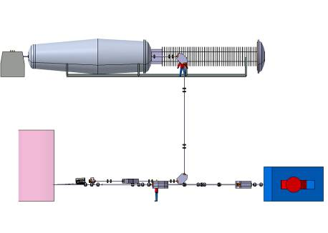
TF-triple beam facility
Techno
Fusión
Presently in standby, but conceptual design is finished and available
A Facility to contribute to the evaluation of radiation effects on fusion materials
Three simultaneous ion accelerators will emulate the neutron irradiation effects
Includes:
Two light ions tandem-type, electrostatic accelerators (mainly for He and H irradiation)
One heavy ion cyclotron (isochronous type) accelerator (Fe -400 MeV-, W -400 MeV-, Si -300 MeV-, C -100 MeV-, … and k = 110)
Also experiments under high-field magnet
Irradiation volume up to tens of microns –relevant for volume effects-

Slide 13
Physical phenomena during irradiation
Generally speaking, physical properties of materials (specially non-metallic materials) are different during irradiation
For example: electrical conductivity (RIC), optical absortion (RIA), dielectric properties,…
And a lot of new phenomena can appear: radiation induced diffusion, radiation induced electrical degradation (RIED), radioluminescence, radiation induced corrosion,…

Slide 14
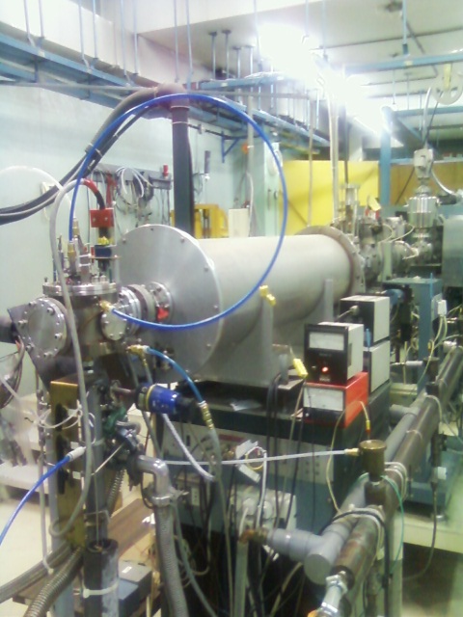
Irradiation chamber
and accelerator.
Radiation enhanced deuterium
absorption for KS-4V.

Slide 15
Ionoluminescence Si⁺⁴ implanted silica
KU1 Si⁺⁴ 24,3 MeV
KS-4V Si⁺⁴ 24,3 MeV
I301 Si⁺⁴ 24,3 MeV
IL measured during ion irradiation to study the evolution of different defects

Slide 16
Fused silica: Optical Absorption comparison
Thermal stability of gamma irradiation induced E´ defect (5.8eV) for different fused silicas

Slide 17
Radiation effects on structural materials

Slide 18
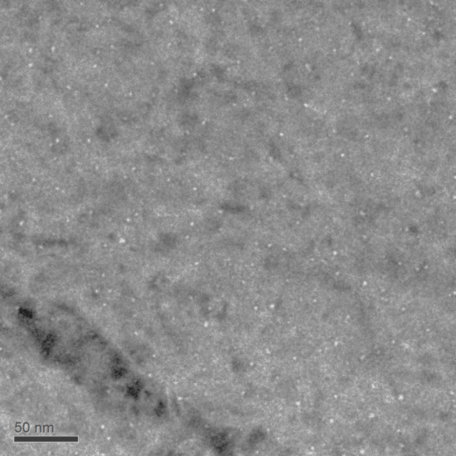
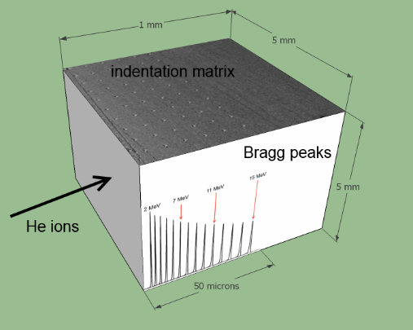
Evaluation of He and self-ion implantation
on EUROFER97 and EU-ODS EUROFER by nanoindentation and TEM
  - He
  - EUROFER & EU-ODS - 3-15 MeV at RT, 1,67e15 ions/cm², 0.625 appm He/s
Nanoindentation on transversal surface. Measuring increase in hardness due to increment in He.
Nanobubbles observed in both steels with a size around 2 nm.
750 appm He
Hardness increase observed in both steels, being more pronounce on EUROFER97.

Slide 19
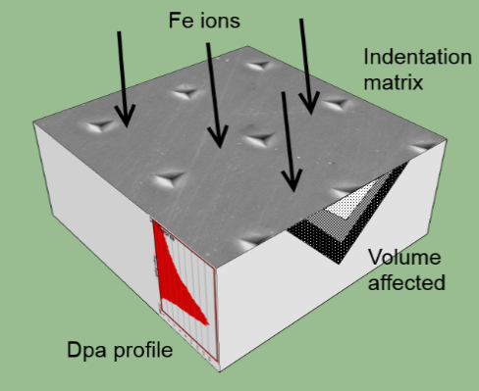
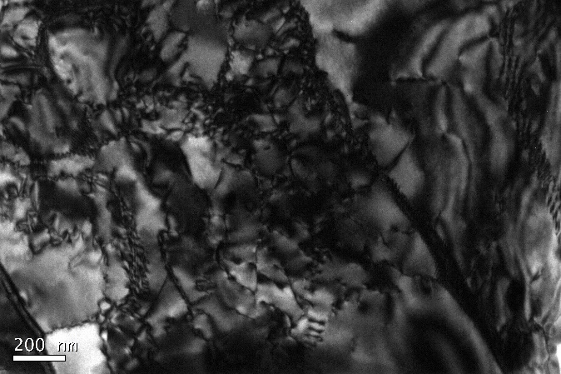
Evaluation of He and self-ion implantation
on EUROFER97 and EU-ODS EUROFER by nanoindentation and TEM
  Fe implantation:
  EUROFER & EU-ODS -
  0.05 to 30 dpa at RT.
Comparative study on mechanical properties between EUROFER97 and EU-ODS EUROFER in as received, 0.2 and 6.5 dpa status.
From 10 to 30 dpa: in progress.
Nanoindentation on normal surface to ions
Dislocation network due to self ion irradiation
Increase in hardness observed in EUROFER97. EU-ODS EUROFER shows more resistance to the same damage.

Slide 20
Modelling

Slide 21
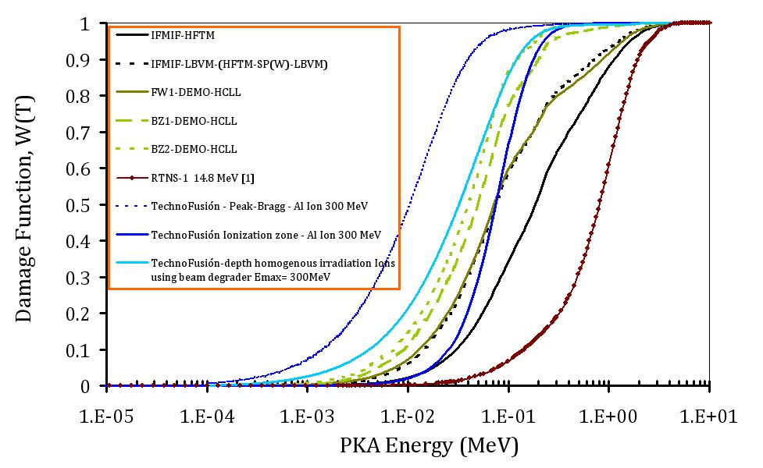
Radiation damage evaluation and its comparison
with the expected damaged by neutrons in a fusion reactor
A methodology to calculate damage (PKA spectra and, consequently, dpa and He, H generation) for different radiation sources (neutrons, ions,…electrons?) has been developed
A combination of neutron transport codes (MCNP5/MCNPX), processing of nuclear libraries (NJOY) and approximation of binary collisions (MARLOWE) is used.
MARLOWE code has been modified to estimate the stopping of ions in materials with energies of MeV (or even GeV).
This methodology is also able to take into account recombination of defects by means of an effective capture radius I-V (based on MD calculations).
Al₂O₃

Slide 22
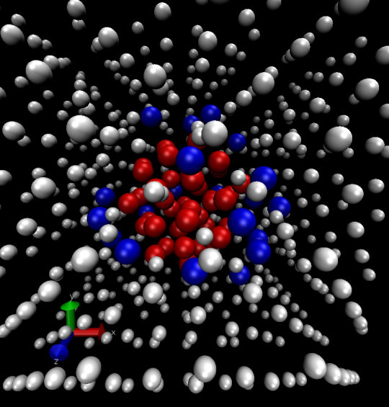
Molecular Dynamics:
The case of H-He-V in Fe
Large amounts of H and He form in steels under neutron irradiation and agglomerate with vacancies into bubbles.
Binding to HeV₅H_{m}
Cluster H₂HeV in Fe
Bubble of H-He in Fe
• With MD it is calculated the binding energy of H, He and V. This allows to calculate the frequency at which they dissociate, which is used in kinetic models (OkMC or Rate Theory).
• MD calculations reveal the structure of H-He bubbles. He is contained in a core (red spheres), surrounded by a shell of H atoms (blue spheres).

Slide 23
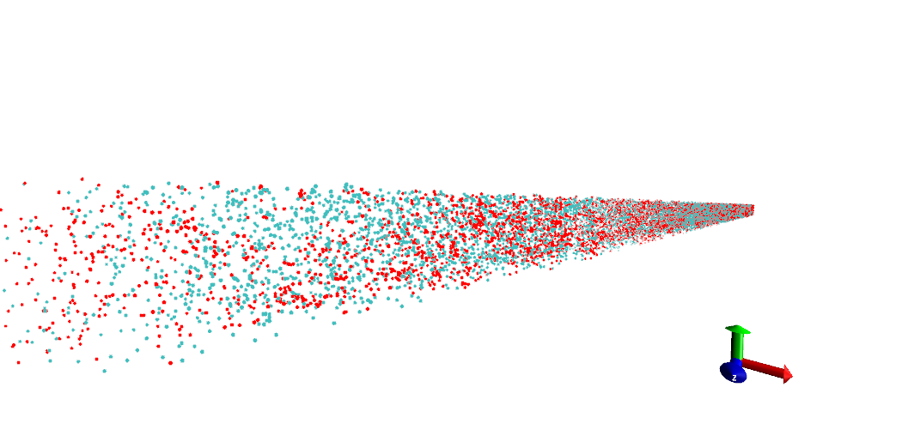
A GPU-Object kMC for the evolution of defects
• The kinetic Monte Carlo is a computer simulation method intended to simulate the evolution of a set of objects, knowing the type of event those objects can perform and the probability for each event to occur.
•Can treat difficult issues such as correlation between defects and inhomogeneities.
• CPU time of classical OkMC simulations too slow (days – weeks). Limited to 100000-200000 defects. Only allows to explore small piece of material.
• We explore the possibility to use GPU (graphics card) programming. Thousands of cores !
_{Our GPU kMC: 20 µm}
_{Typical OkMC box}
_{~60 nm}
Our GPU-OkMC is able to simulate evolution of millions of particles in only few hours.
Allows to simulate evolution of defects in a realistic piece of materials.

Slide 24
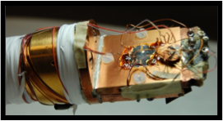
Resistivity Recovery Experiments
on Fe-Cr
(III) H⁺ Irradiation of Fe-Cr samples and its diagnosis by resistivity recovery.
A “Resistivity Recovery (RR)" system has been developed by Ciemat, reaching a new method of irradiation and measure that provides cleaner results than the classical method. RR spectra have been obtained in samples Fe_{100-x} Cr_{x} (x = 5, 10, 14) irradiated with H⁺ of to 5 MeV.
Very important for the experimental validation of the computational simulations of damage by radiation in steels.

Slide 25
Conclusions
FT group at CIEMAT has a long tradition on the study of radiation effects from the point of view of fusion materials needs
Our work is organized along the following main lines: development of new facilities, radiation effects on functional and strucutural materials, modelling and validation experiments
We are open to collaborations if something of common interest can be identified

Slide 26
Thanks for your kind attention!

