Slide 1
Present and Future test facilities for High-intensity Targetry Experiments @ CERN
Outline
Present possibilities
Test facilities in the near future
Far future possibilities
I.Efthymiopoulos, CERN
with input from Jacques Lettry & Rende Steerenberg
Targetry Workshop
Princeton, November 6, 2008

Slide 2
Present possibilities
ISOLDE target area
Beam momentum: 1 ÷ 1.4GeV/c ; from PSB
Maximum intensity : 30×10¹² protons, 230ns pulse length
Experiments:
  targetry experiments: THROUGH - THIMBLE, also using Hg
  significant target development program each year for the ISOLDE users for RIB beams
Future:
  The facility is operational and always available
  Tests should be coordinated with the ISOLDE physics program and must get the proper approval (committees, safety, etc.)
  They should also respect the constraints of the existing system
    weight, size, radioactive environment, etc.
  HIE-ISOLDE is under design, with the development of several kW targets coupled to LINAC-4 and upgraded PSB operation
    Could a test target station be envisaged somewhere in the new design for tests?
      Y. Kadi (CERN/ATB) is the right person to contact…

Slide 3
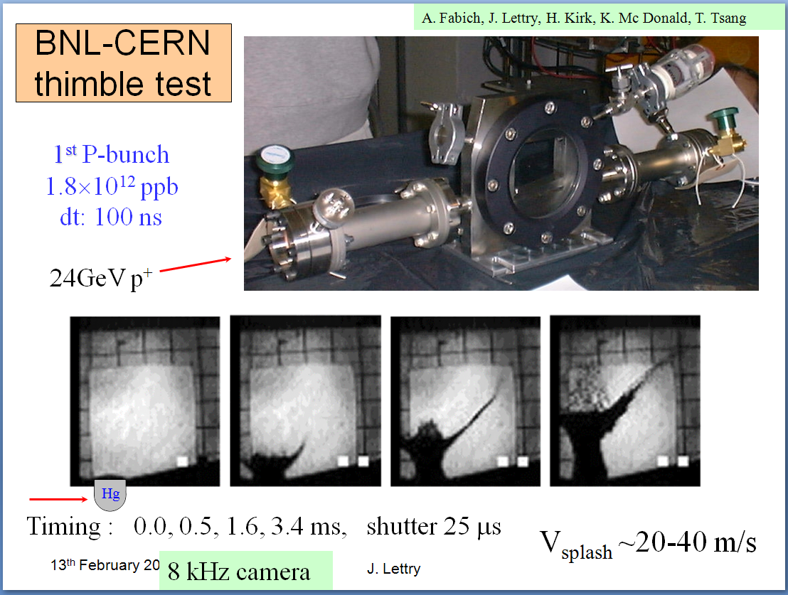
Present possibilities
ISOLDE target area
Courtesy : J. Lettry, CERN

Slide 4
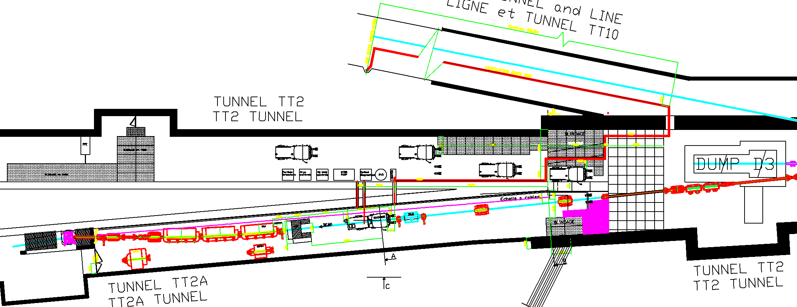
Present possibilities
FTN/n-TOF line
Beam momentum: 14÷ 24 GeV/c, from PS
Maximum Intensity : 30×10¹² protons, variable pulse length and bunch spacing
Experiments :
  MERIT; installed and completed in 2007
Future :
  Unavailable due to nTOF operation

Slide 5
Present possibilities
Other?
PS – East Area
  There is a semi-fast extraction to an IRRADIATION facility
    1-4-8 bunches @ 14 GeV/c for a total intensity <5×10¹¹ p
Re-use some of the old tunnels attached to PS
  TT7 tunnel: old neutrino target area
  AD-loop : anti-proton ring
  In both cases a complete rebuilt of the line is required
    Magnets (available?), power supplies, instrumentation
  Needs detailed evaluation study (I.E + R. Steerenberg)
  Would also need some “political” support from the management

Slide 6
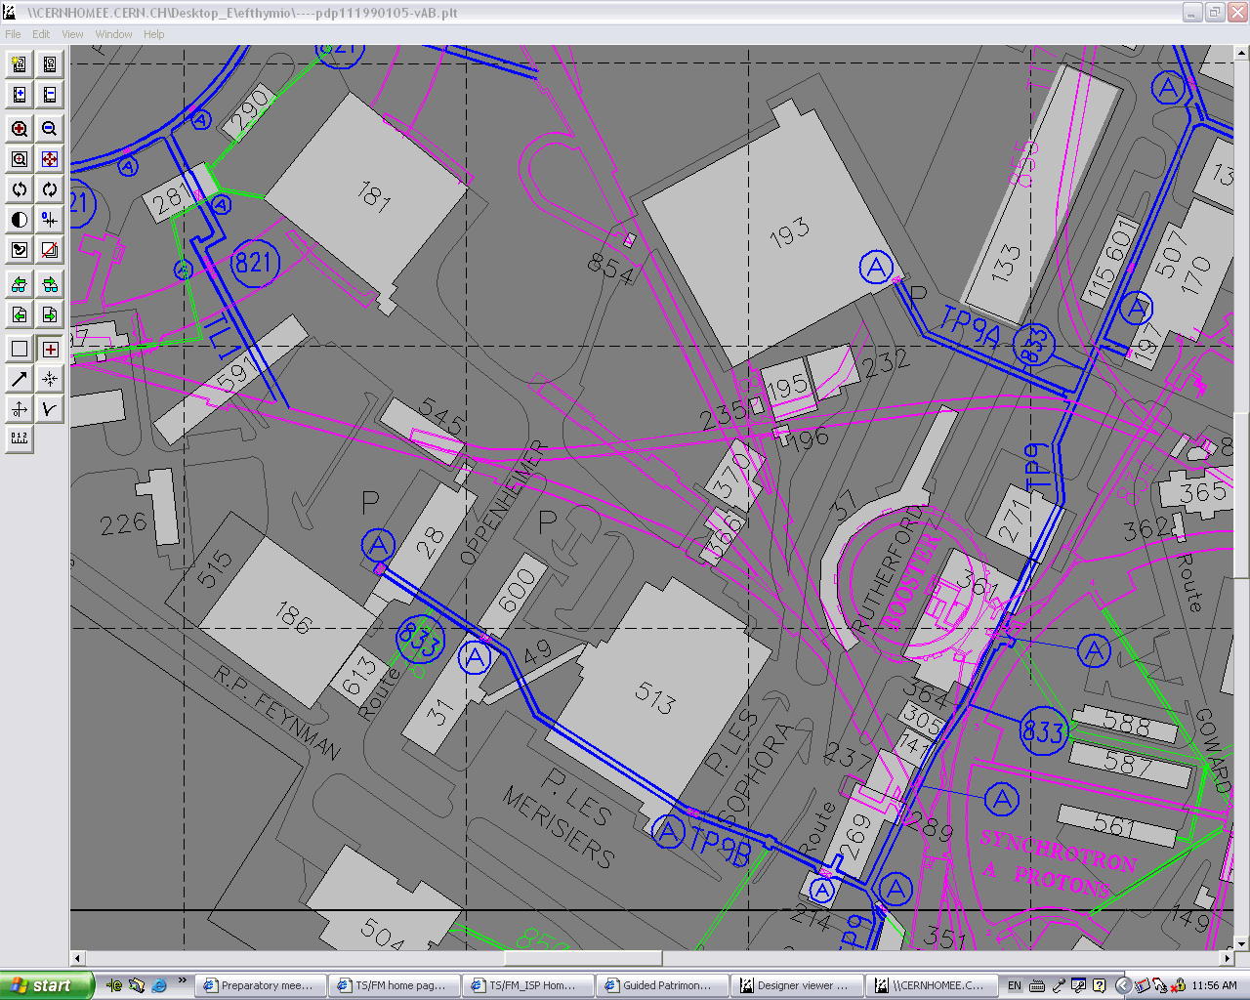
Present possibilities
TT7 & Anti-Proton Loop tunnels
Anti-proton loop
TT7 tunnel
may not be fully compatible with LINAC4/SPL layout
PS Booster
PS

Slide 7
Future test facilities for High-intensity Targetry Experiments @ CERN
Outline
Present possibilities
Test facilities in the near future
Far future possibilities

Slide 8
Test facilities in the near future
HIRADMAT
A test facility under study for material irradiation (collimators) under LHC beam conditions
Attached to SPS
  TI2 extraction line ; old WANF target area
Beam parameters:
  Beam momentum: 450 GeV/c
    could it go down to SPS injection energy (~30 GeV/c???)
  Bunch intensity: 5.0×10⁹ ÷ 1.15×10¹¹ ; 1 ÷ 288 bunches, 25ns apart
  Pulse energy 2.4MJ; length ~7us;
  1mm² beam size at the target
Design ongoing; expected to be available for “external” users by November 2010
  Part of EU funded program for “open access”

Slide 9
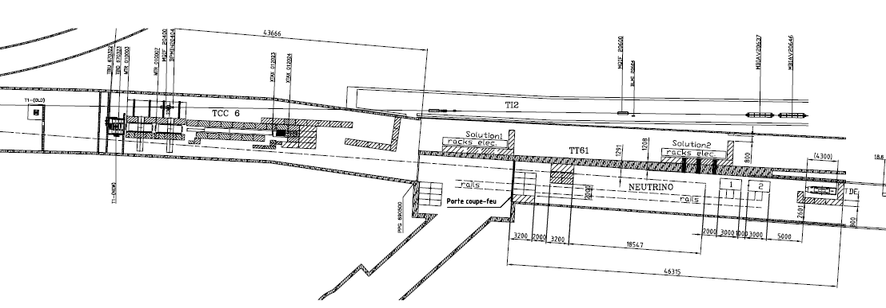
Test facilities in the near future
HIRADMAT
Test facility (under study) in old WANF tunnel
TI2 tunnel to LHC
TT61 tunnel to West Area (empty now)
Beam from SPS
Test area
~10m long
Nearby tunnel for proximity equipment

Slide 10
Future test facilities for High-intensity Targetry Experiments @ CERN
Outline
Present possibilities
Test facilities in the near future
Far future possibilities

Slide 11
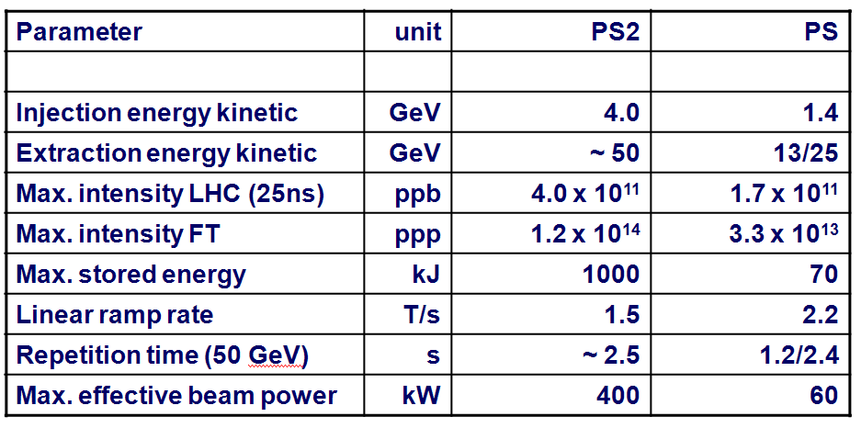
Far future possibilities
PS2 experimental areas
Experimental areas for the new PS2 machine (> 2016?)
  Underground caverns:
    high-intensity fixed target or rare decay experiment
    High-intensity irradiation + {targetry + ν-front-end} facility
Beam parameters:
Preliminary

Slide 12
Far future possibilities
PS2 machine layout
PS2 machine
~surface exp. areas
SPS ring
PS2 machine
Underground exp. areas
PS2 machine
LHC ring

