Slide 1
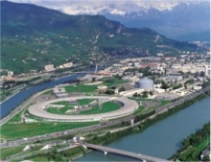














60 GHz
ECR source status
* Sixty GHz ECR Ion Source using Megawatt Magnets
T. Lamy
M. Marie-Jeanne, P. Sortais, T. Thuillier
Laboratoire de Physique Subatomique et de Cosmologie, Grenoble – France
I.V. Izotov, A. V. Sidorov, V. A. Skalyga, V. G. Zorin
Институт Прикладной Физики - RAS, Nizhny Novgorod – Russia
F. Debray, C. Trophime, N. Vidal
Laboratoire National des Champs Magnétiques Intenses, Grenoble – France

Slide 2
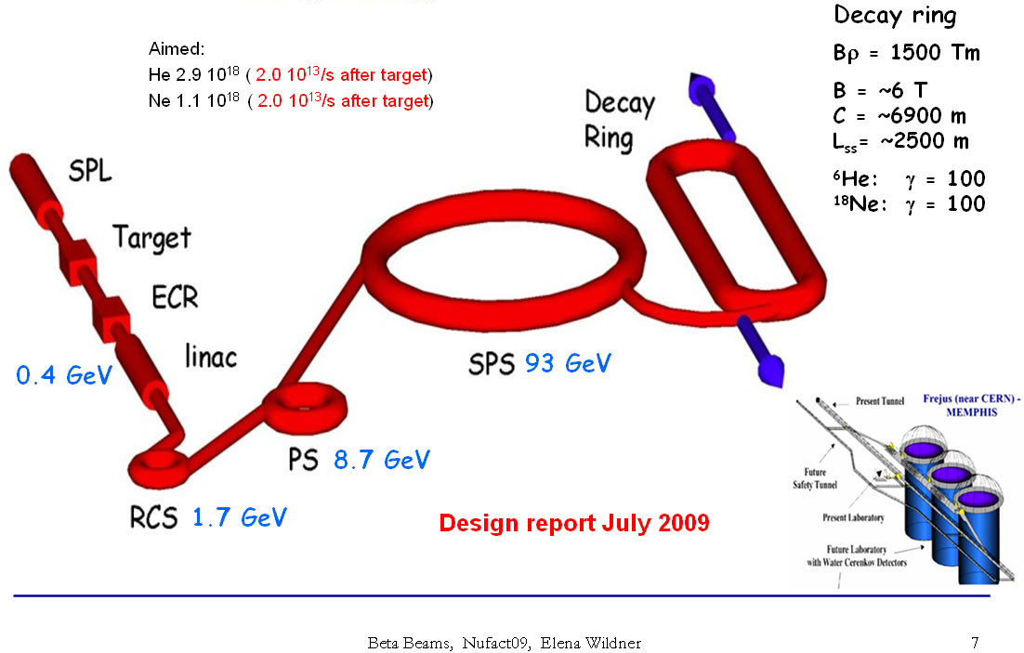
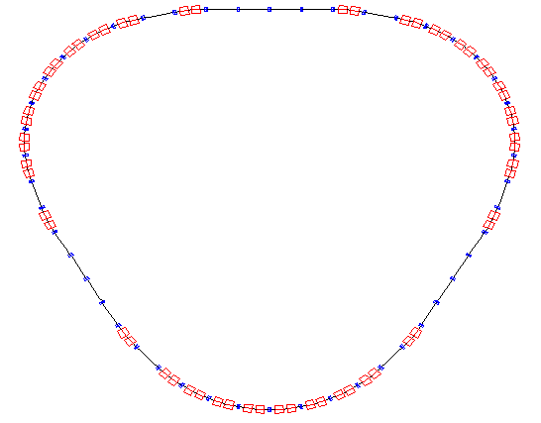
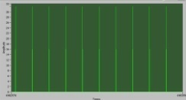
60 GHz ECR ion source for the Beta Beams
Euro-nu Beta Beams
High ionization efficiency ion source required, delivering high intensity
  Radiation hard ECR ion source
  low volume, high plasma density (high ECR frequency)
  10 Hz operation
LPSC long term strategy in ECR ion sources development
  To take advantage of this project to develop the ECR ion source operating
    At the highest present ECR frequency
    For a reasonable cost (warm technology for the magnet)
  ⁶He (t_{1/2} = 807 ms), ¹⁸Ne, ⁸B , ⁸Li
  Continuous production
  5 . 10¹³ pps
ν_{e-}
Decay ring
Superconducting
Proton LINAC
For a 100 % ionization efficiency
I(He²⁺) = 32 mA + all other species
I extracted ∼ several 100 mA
⁶He → ⁶Li + e⁻ + ν_{e-}
251.33 m
10 Hz
50 µs
Based on CERN accelerators

Slide 3
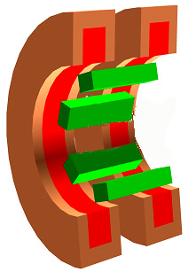
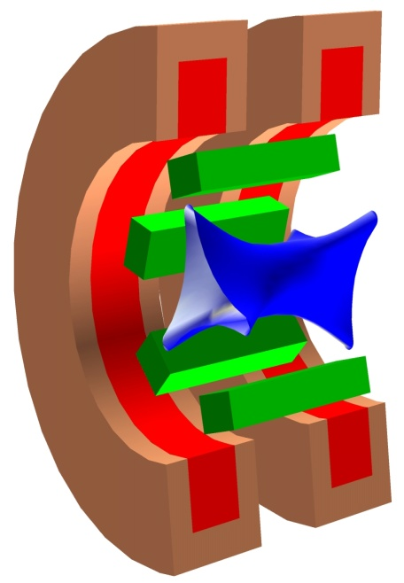
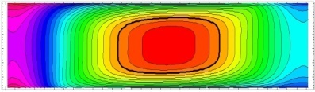
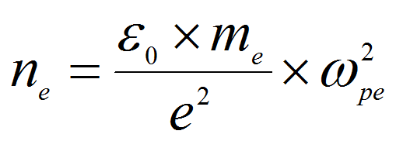
Electron Cyclotron Resonance Ion Sources (Basics)
Classical ‘Minimum B’ ECRIS
B_{rad} ≈ 2*B_{ECR}
Microwaves
Gas
Injection
Vacuum chamber
Magnetic field
(axial + radial)
Gas injection (typically 2) or vapor + gas
Microwaves (ECR)
Electron heating
Confinement of the plasma (hot e⁻, cold ions)
Step by step ionization
Extraction (High Voltage)
ECR
Ion
Extraction
B_{inj} ≈ 4 * B_{ECR}
Gas
or
vapor
B_{ext} ≈ 0.9 B_{rad}
B_{inj} = 4 T
@ ECR 28 GHz
B_{med} ≈ 0.6 B_{ECR}
Electronic cyclotronic Resonance
Cutoff density ω_{pe} = ω_{ce}
I_{extracted} ∝ n_{i} =
I ∝ ω_{ce}²
To increase I, increase n_{e} so ω_{ce} and consequently B

Slide 4
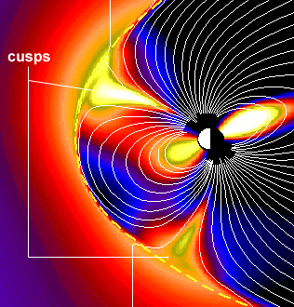
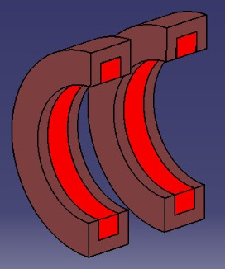
First 60 GHz ECRIS ‘SEISM’ prototype specifications
‘simple’ magnetic structure, pulsed Microwave
CUSP magnetic structure
  Compact source (l = 100 mm)
  Spherical ECR zone at center
ECR
4 T
Specifications
  60 GHz ECR, 10 Hz duty factor
  Cw magnetic field (future cw source)
    Injection 6 T
    Extraction 3 T
    Radial 4T
    2.14 T Spherical ECR zone
Injection
ECR
zone 2.14 T
Extraction
60 mm
6 T
3 T
Magnetic field lines crossing the ECR zone don’t touch the walls
4 T
100 mm between the B_{max}
Presently no ECRIS with such a (high) magnetic field (and high gradient)
Conceptual design undergoing for superconducting 56 GHz minimum B ECRIS in US and China

Slide 5

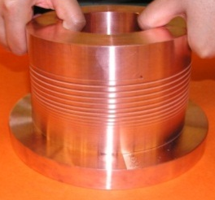
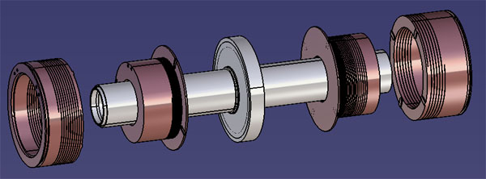
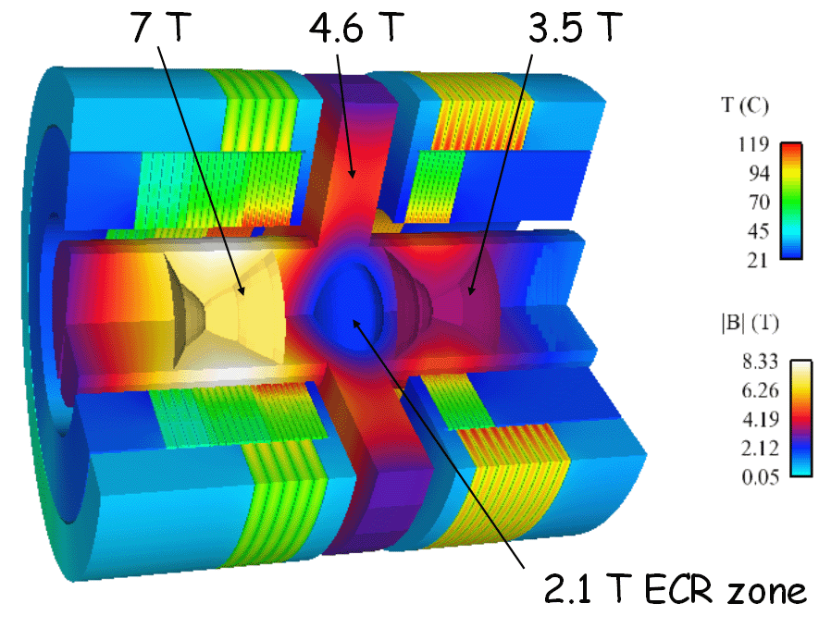
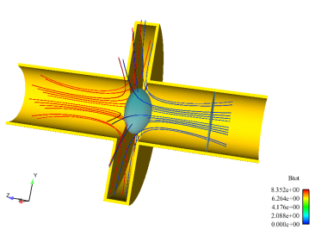
60 GHz ECRIS prototype simulation
R&D towards high ECR frequency for future ECRIS
  Low cost and fast development
  No superconductors, high field techniques (copper and water)
  Collaboration with CNRS intense magnetic fields laboratory (LNCMI)
    Choice : Polyhelix technique (high currents in copper helices)
Extraction helices
Getdp
H3
H1
H3
H4
H2
H1
H2
H4
Plasma
Chamber
injection
helices
Magnetic field lines
Extraction
2.14 T
Injection
  30000A, J~650 A/mm2
  P ~ 6 MW
  T_{Max} loc. ~ 330 °C (H1)
  T_{Mean} ~ 80°C to 180°C (H1)
> 7 T injection (spec. 6T)
> 3.5 T ion extraction (spec. 3T)
> 4.6 T radial mirror (spec. 4T)

Slide 6
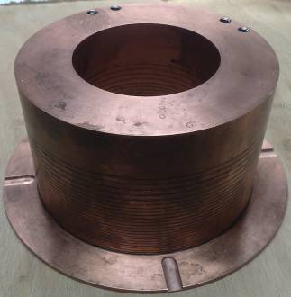
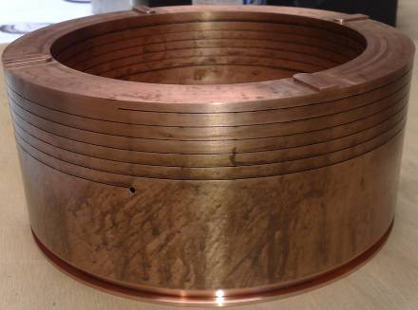
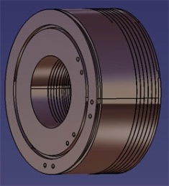
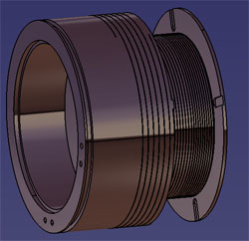
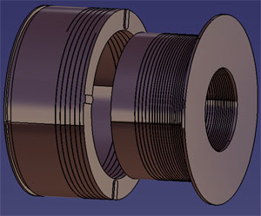

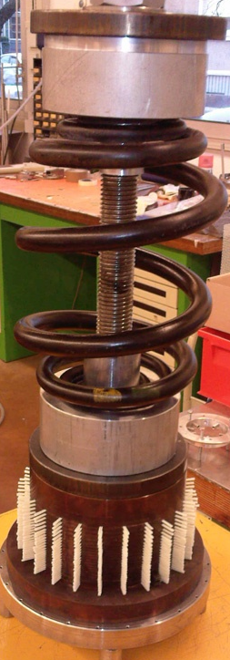
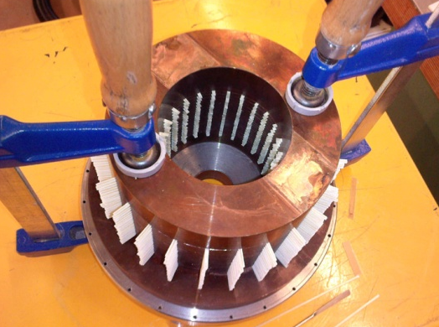
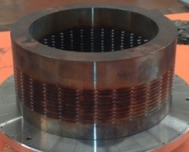
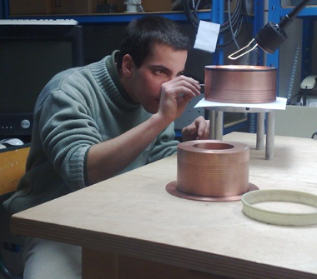
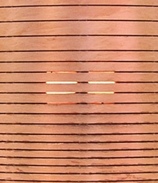
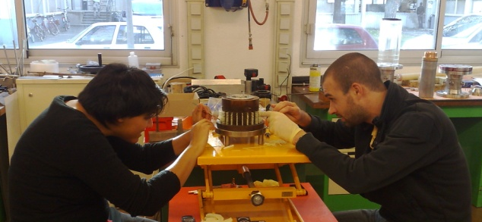
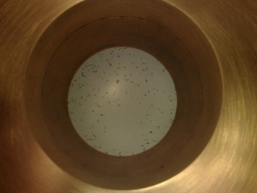

Helices construction
Helical slit cut by spark erosion
2 current leads per helix
H1
H3
Ring with recess
on the internal coils
Keys on the external coils
Chemical treatment
Positioning the prepreg insulators
Oven
Final machining
Cleaning
to prevent shortcuts
pitches from 2 to 5 mm

Slide 7
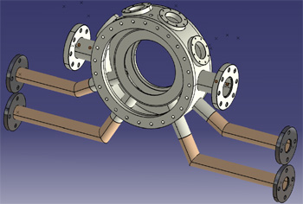
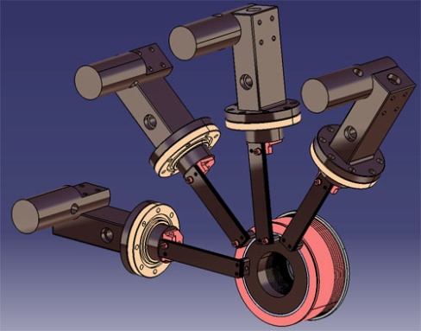
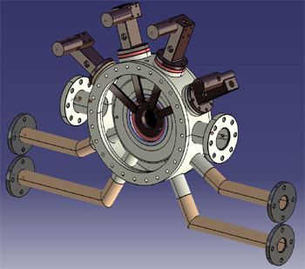
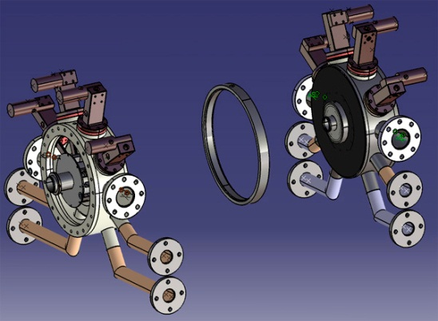
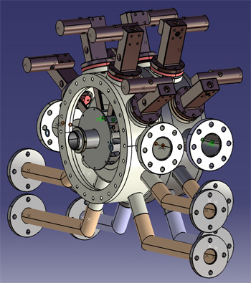
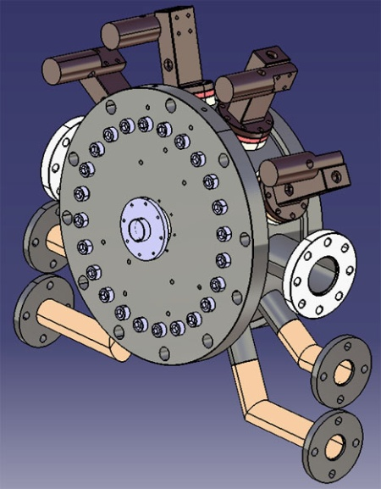
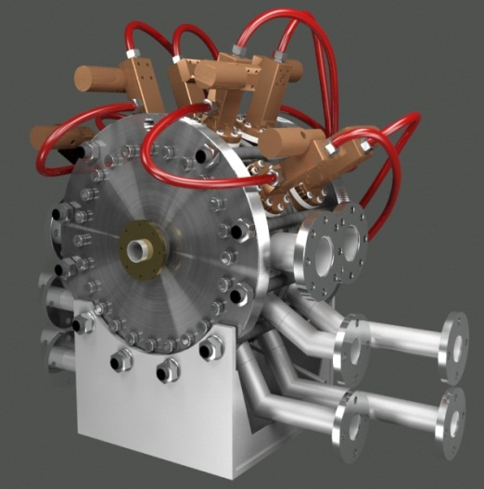
Prototype mechanical design
The basic part: ‘exchanger’
helices and current leads
2 sub-assemblies
CAD
Characteristics
  Diameter 620 mm
  Length 480 mm
  600 kg
  30 tons Repel force
Extraction Flange

Slide 8
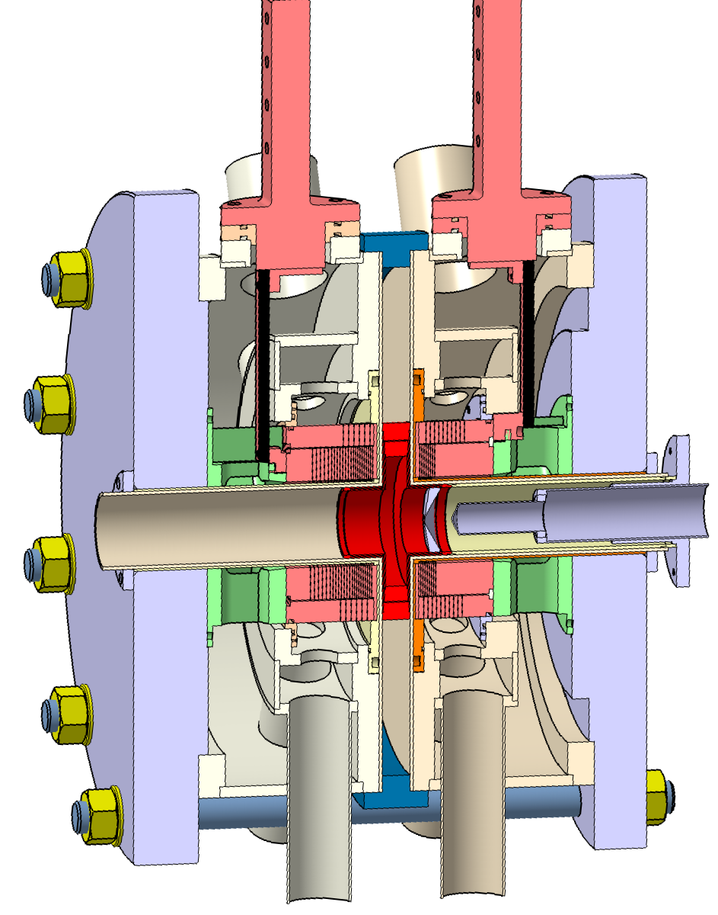
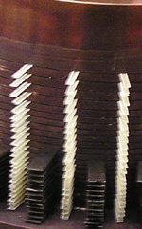
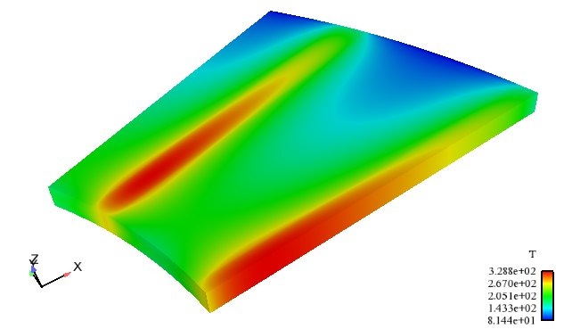

Radial cooling of the helices
Water cooling
(deionized water )
  Water cooling flow ~ 30 l/s
  Pin = 27 bars ; Pout = 4 bars
  Tinlet = 20 °C, Toutlet = 40 °C
Water
Inlet
About 700
insulators
Water
distribution
part
Insulators
10 % of the total surface
Worth case (thinner pitch of H1)
  I = 30000 A
  Empty space : 1.7 mm
  Copper thickness : 2 mm
  Tmean = 180 °C, Tmax = 330 °C
Outlet

Slide 9
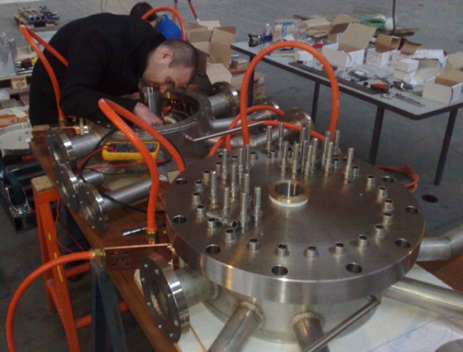
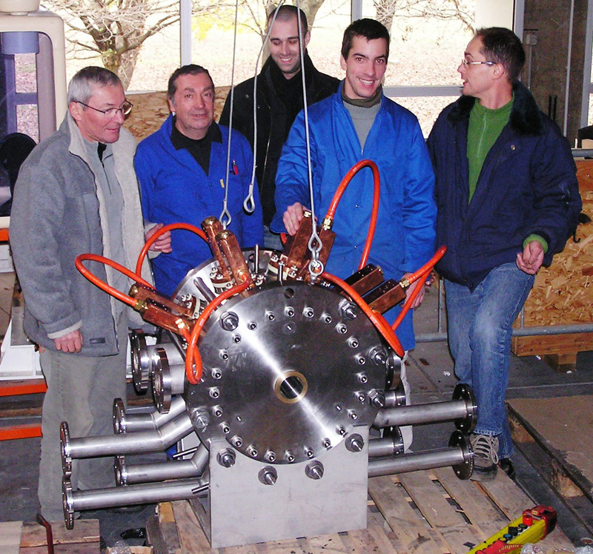
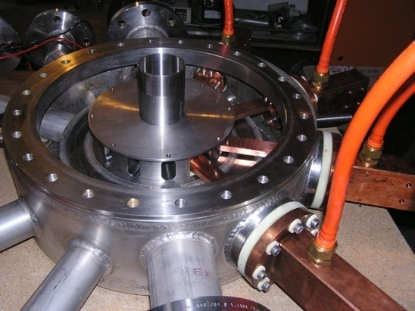
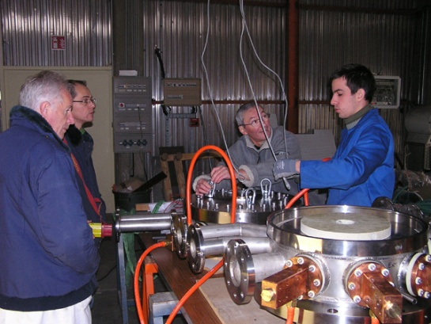
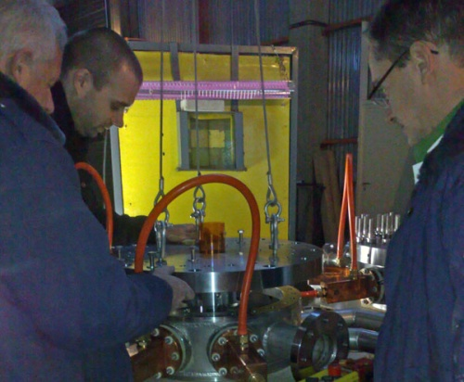
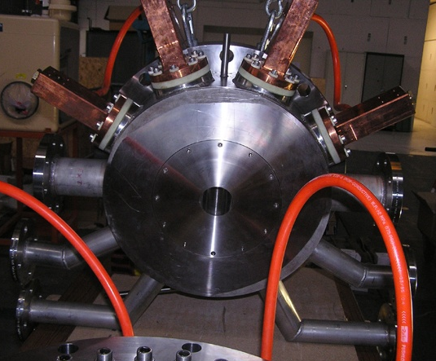
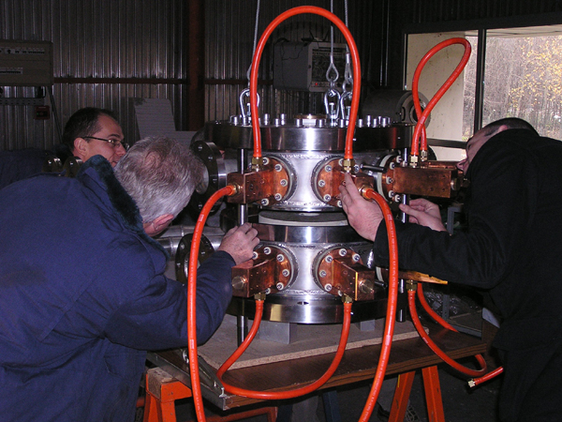
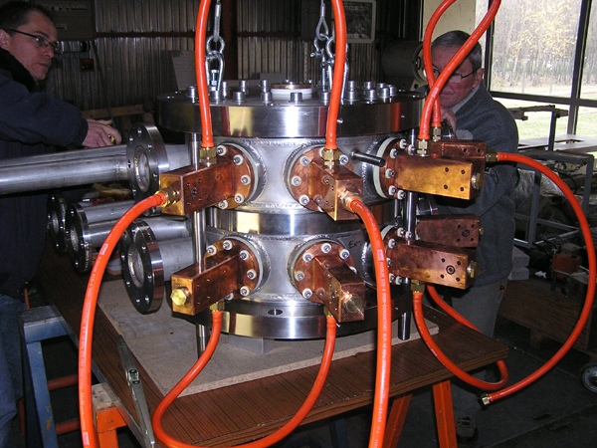
SEISM prototype assembly

Slide 10
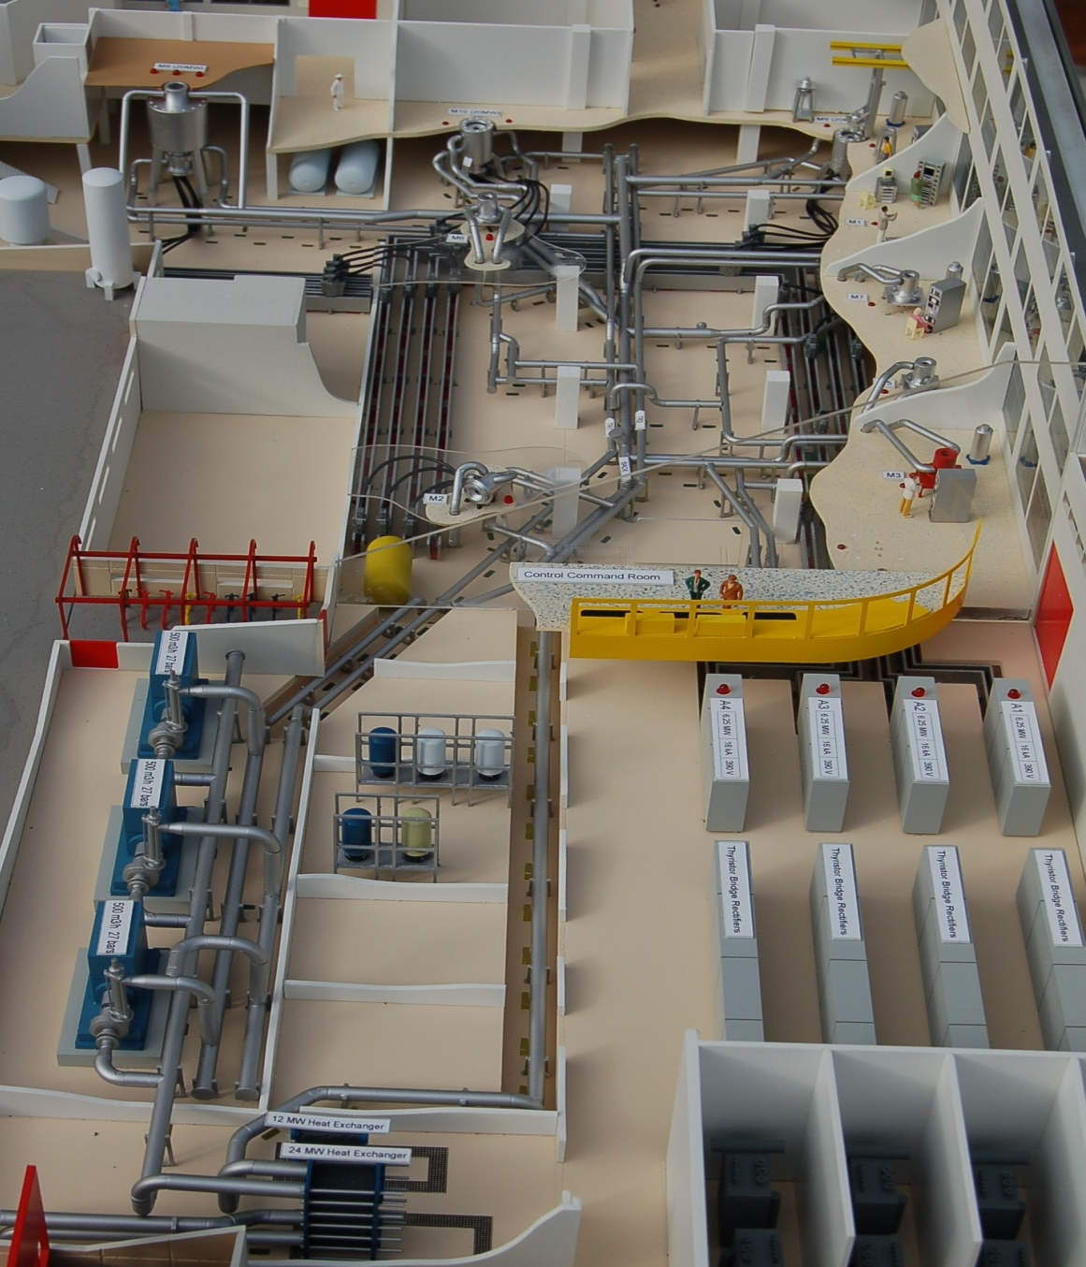
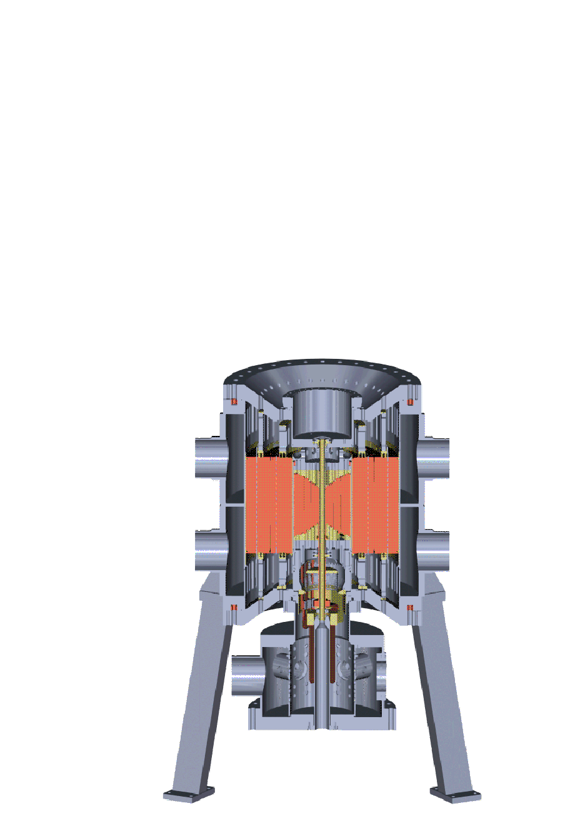
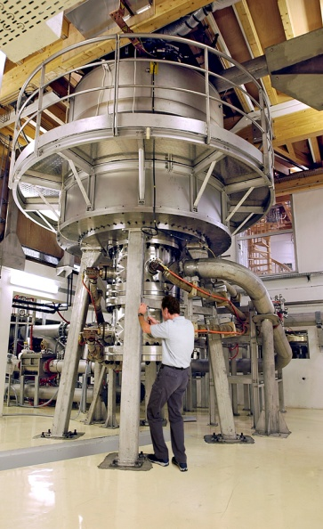
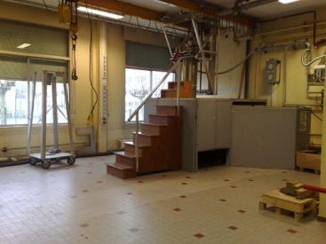
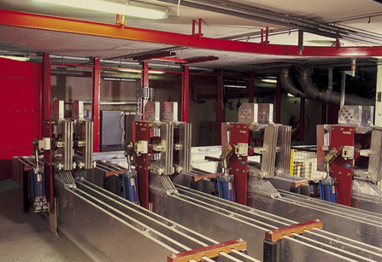
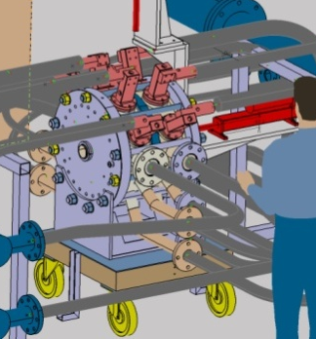

LNCMI : a place to perform experiments
19 T /160 mm
34 T /34 mm
M7
M5
4 Power supplies
15 000 A, 400 V
(24 mW)
Cooling
1000 m3/h
deionized water
28 GHz 15000 A
2.5 MW
60 GHz 30000 A
6 MW

Slide 11




SEISM prototype setup on the M5 site
M5 site adaptation for SEISM
  Parallel hydraulic circuit (∼ 50 l/s from 150 l/s)
  Serial electrical connexion with M5 (impedance matching)
M5 site

Slide 12







SEISM magnetic field measurements principles
Helices temperature monitoring
  Resistance variation with T, R=R0(1+α*ΔT), Copper (α= 0.0036)
    R0 = 3 mΩ at 10 °C (SSI Hall temperature in winter...)
  R=U/I = R0(1+α*ΔT) → ΔT
    Voltage measured during operation
    Intensity given by LNCMI supplies
Automated magnetic induction measurements
  Tesla meters, axial and radial Hall probes on specific stands (calibrated on M5)
  probes movements with jacks – steppers 1 mm / 300 mm
  Labview control
Voltage
measurement
Hall probe
Hall probes
Jack

Slide 13



Magnetic field measurements results
Axial magnetic field induction from 1500 up to 15000 A
  Axial and radial measurements three axis of the prototype (0, 15 and 30 mm)
15000 A measurements
Magnetic field induction norm
Expected results (and obtained)
  Axial symetry of the magnetic field
  Linear increase of B with intensity
Unexpected results
  10 mm shift of the maxima
  Lower amplitude on the extraction side
  No impact on the plasma characteristics

Slide 14
Iso-B for resonance zones
14 GHz
28 GHz
28 GHz (1T) ECR zone closed at about 12000 A
The 60 GHz closed ECR zone should be obtained at 26000 A
Plasma experiments are already ‘magnetically’ possible at 28 GHz
using two LNCMI current supplies
Phase 1 of this project is a success

Slide 15

Application for magnet time
  Accepted for 20 days
Characterization of ion beams extracted from a 28 GHz ECR plasma in a split magnet
To progress towards 60 GHz ECR operation of the ECRIS
  Simple beam line : magnetic spectrometer and beam characterization devices
  10 kW 28 GHz gyrotron available from LPSC
  A lot of safety issues (Microwaves, X rays, High voltage...)
After beam measurements (a few weeks)
  Terminate magnetic field measurements from 15000 up to 30000 A
  If gyrotron available : 60 GHz experiments
Puller
electrode
High voltage
ring
Plasma
electrode
28 GHz
waveguide
Inside ECRIS 28 GHz prototype design
Extraction
insulator
Plasma
chamber

Slide 16
Efficiencies and currents expected ...?
Fast ionization, efficient ionization
  High density necessary
  High ECR frequency (60 GHz) and high power density
  60 GHz : cut-off density 4.46x10¹³ ions/cm³ to be compared with
  2x10¹⁰ ions/cm³ He ...(5 x 10¹² in a 0.25 l (plasma): 2x10¹⁰ ions/cm³
  (ratio ∼ 4.5 10⁻⁴)
  Multi-Ampères source !!!! Certainly avoid multi charged ions...
    High intensity beam line will be required (mandatory...)
    But good news from Russia
8th International Workshop ‘Strong Microwaves and Terahertz Waves Sources and Applications’
July 9 - 16, 2011 Nizhny Novgorod, Russia
    1.6 mm extraction hole leads to 80% efficiency for He⁺ and only 300 mA total current
    “Gas utilization efficiency optimization for short-pulsed ECR ion source”
    I. V. Izotov, V. A. Skalyga, V. G. Zorin (IAP Nizhny Novgorod)

Slide 17




LNCMI site preparation for future experiments
Design of the High intensity beam line
  Vacuum components (turbo pumps, chambers, tubes...) ordered
  Stands ordered
  Magnetic spectrometer current supply operational
  LNCMI installation in M3 rather problematic...
      Concrete foundation slab resistance ... (Magnet > 2 tons)...
      Layout
      Magnetic fringing fields from other magnets and prototype (for gyrotron)
      A lot of safety issues (HV, MW, X rays...)

Slide 18




60 GHz gyrotron
Pulsed 60 GHz 300 kW gyrotron manufactured by GYCOM
Supplies Institute of Applied Physics - RAS (Nizhny Novgorod – Russia)
  Frequency 60 GHz, MW power 10 - 300 kW
  Pulse duration from 50 ms to 1 ms, pulse repetition rate up to 5 Hz
Gyrotron in the
cryomagnet
Tube
Matching Optics Unit
Delivery at Grenoble spring 2012
Project #3965
Design, Manufacturing and Tests of Short Pulse ECR Multi-Charged Ion Source Prototype with High Ionization Efficiency

Slide 19







Eqipex 2011 under preparation
Superconducting bus from LNCMI to LPSC (4*15000 A) allowing future ECRIS R&D
28 and 60 GHz ion sources for SPIRAL2
ION SOURCES
PLASMAS
HIGH FIELDS MAGNETS
25 MW POWER SUPPLIES
40 T HIGH FIELD
MAGNETS

Slide 20









Thank you !
We acknowledge the financial support of the European Community under the European Commission Framework Programme 7 Design Study: EUROnu, Project Number 212372. The EC is not liable for any use that may be made of the information contained herein.

