Slide 1
Study of a new high power spallation target concept
Yongjoong Lee
ESS, Materials, Target Division
5th High Power Targetry Workshop
May 20, 2014

Slide 2
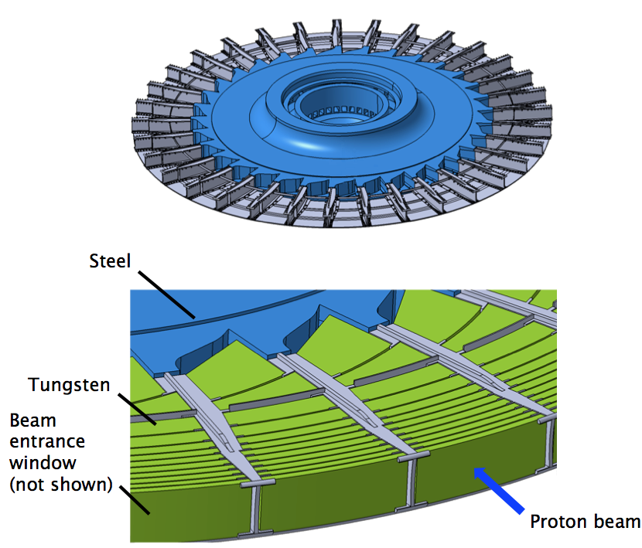
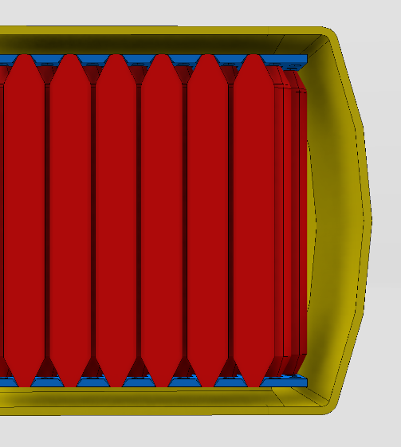
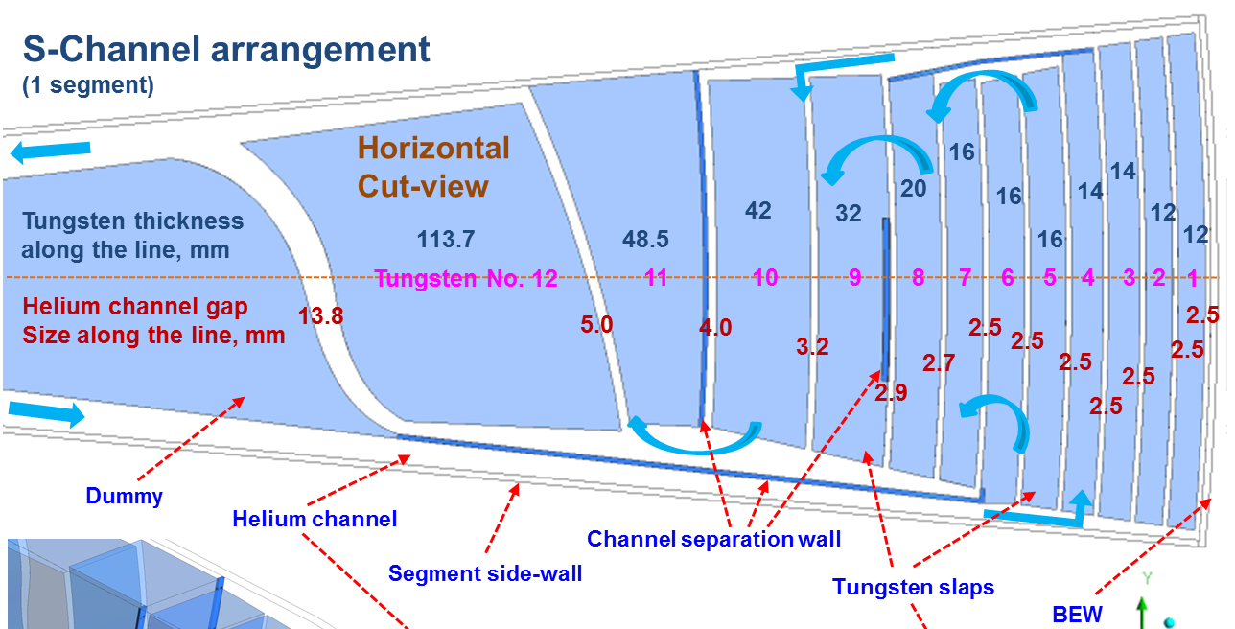
Spallation Target at ESS
5 MW spallation source
5 MW (2.0 GeV/2.5 mA) proton beam
2.86 ms long beam pulse with 14 Hz repetition rate
Rotating tungsten target:
Helium cooled target with water cooled backup

Slide 3
Motivation
Looking for a target concept that is based on simple design, with small number of standard type tungsten blocks in large dimensions.
Looking for a target concept that is based on simple cooling flow patterns such that CFD simulations have better predictability.
Demonstration of technical feasibility of a new target concept that is readily adaptable both for helium cooled and water cooled options.

Slide 4
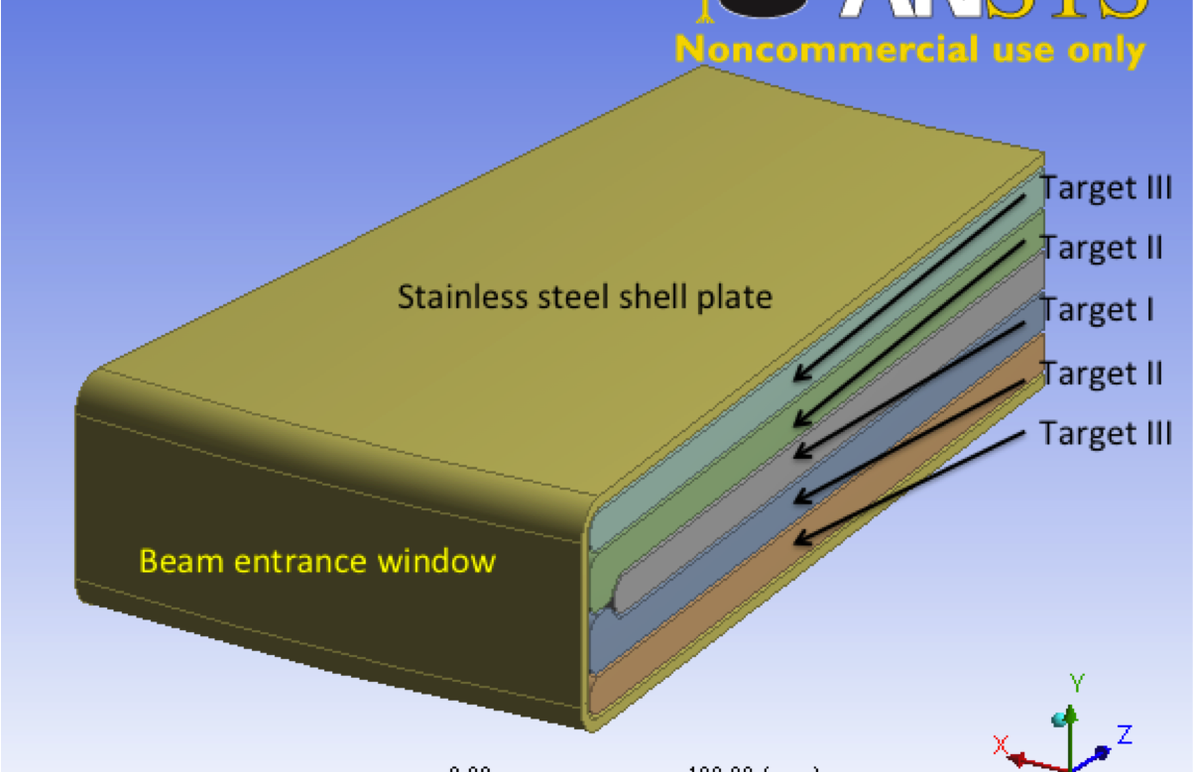
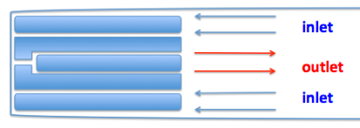
Target configuration used for this study
Five 40 cm long horizontal tungsten slabs with equal thickness 16 mm.

Slide 5
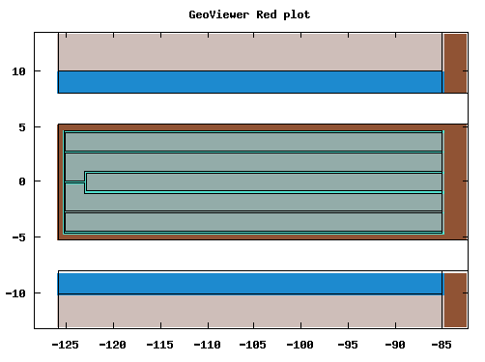
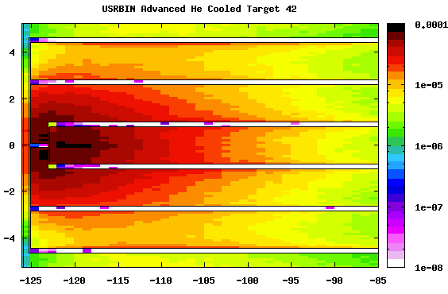
Beam power deposition
TDR Baseline (2013):
5 MW (2.5 GeV/2.0 mA) double Gaussian beam with peak current density 53 uA/cm2
Target volume | Deposited power [kW]
Target I | 820
Target II | 1374
Target III | 594
Total | 2788

Slide 6
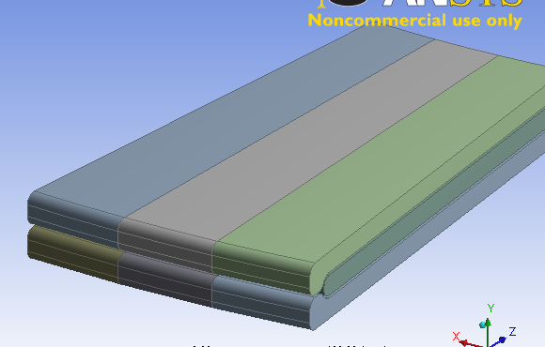
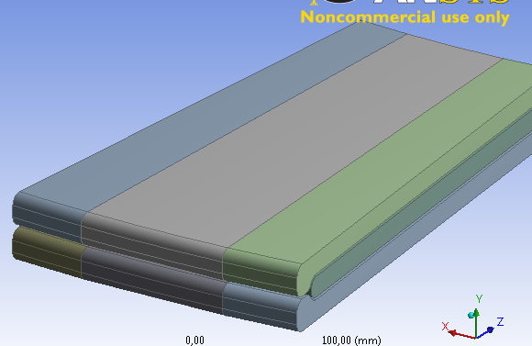
Flow analysis
Helium cooled option
3 kg/s mass flow rate
3 bar operation pressure
Total 363 tungsten slabs
Water cooled option
99 kg/s mass flow rate
6 bar operation pressure
Total 264 tungsten slabs

Slide 7
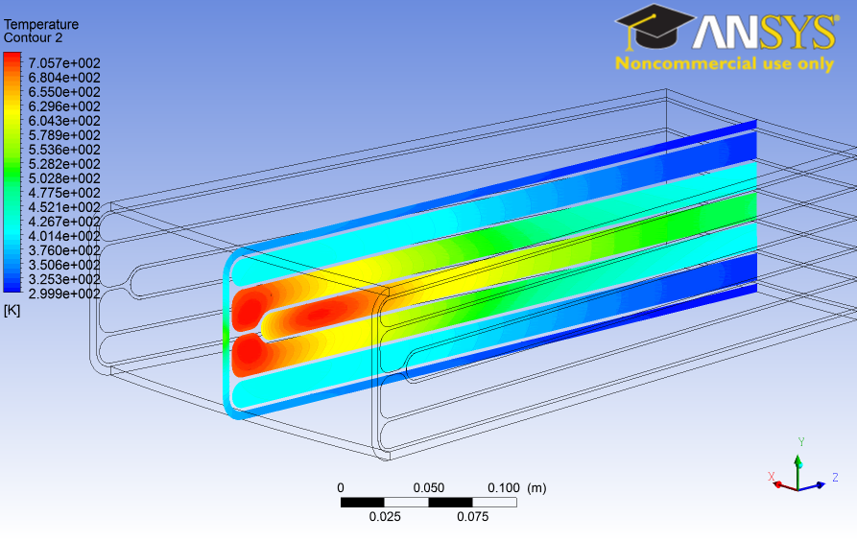
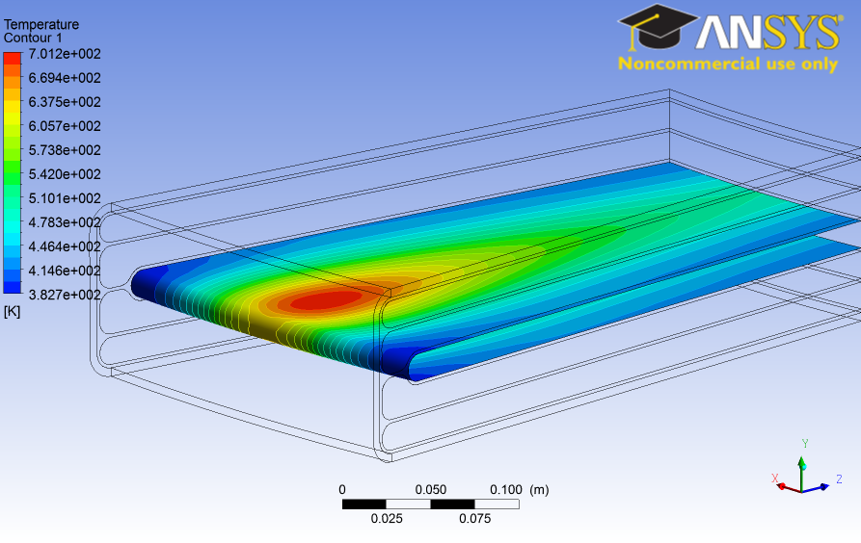
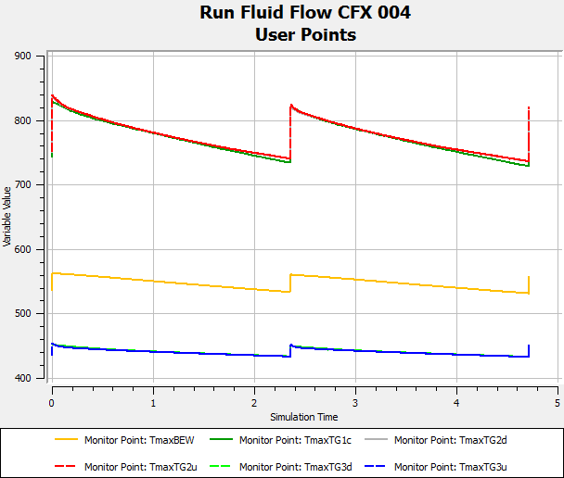
CFD: Transient helium flow analysis
Helium Cooled Target
Target Volume | Max Temperature Pre-pulse | Max Temperature Post-pulse | Temperature Amplitude
Target I | 728.5 K | 813.9 K | 85.4 K
Target II | 736.0 K | 818.8 K | 82.8 K
Target III | 432.8 K | 450.9 K | 18.1 K
Pressure Drop | 97.0 kPa: Surface and time averaged

Slide 8
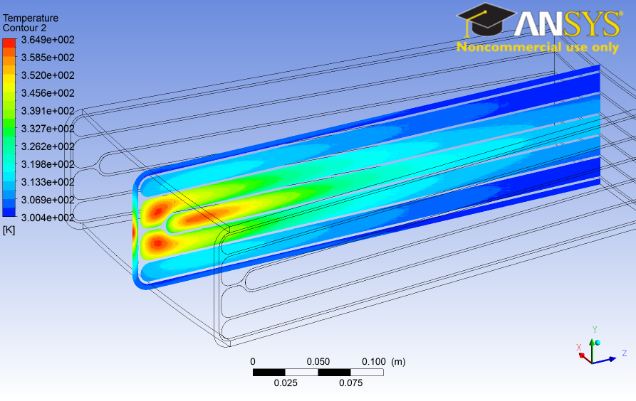
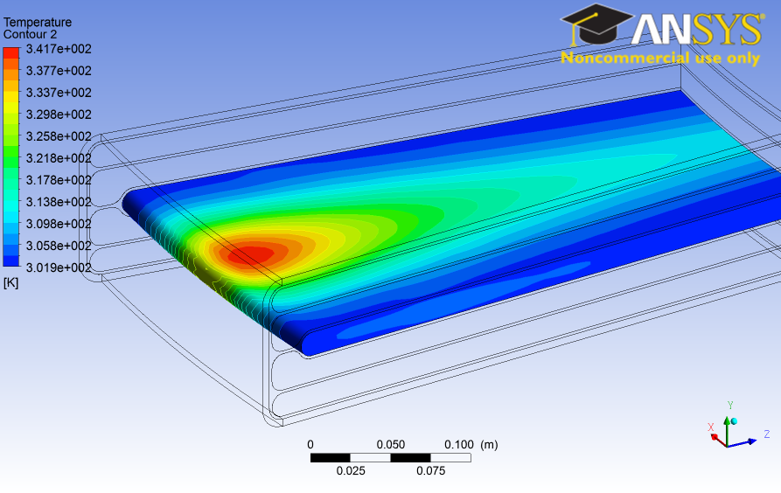
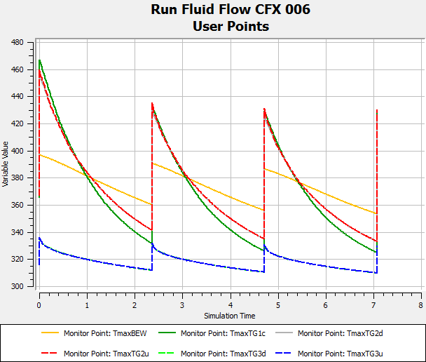
CFD: Transient water flow analysis
Water Cooled Target
Target Volume | Max Temperature Pre-pulse | Max Temp: Post-pulse (Bulk/Surface) | Temperature Amplitude
Target I | 326.1 K | 429.7 K/393.6 K | 103.6 K
Target II | 334.3 K | 428.9 K/402.3 K | 94.6 K
Target III | 310.0 K | 329.4 K/324.8 K | 19.4K
Pressure Drop | 35.3 kPa: Surface and time averaged

Slide 9
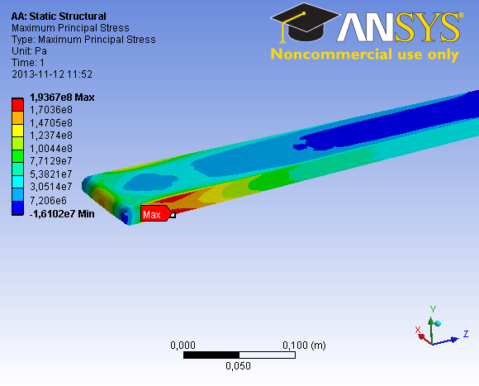
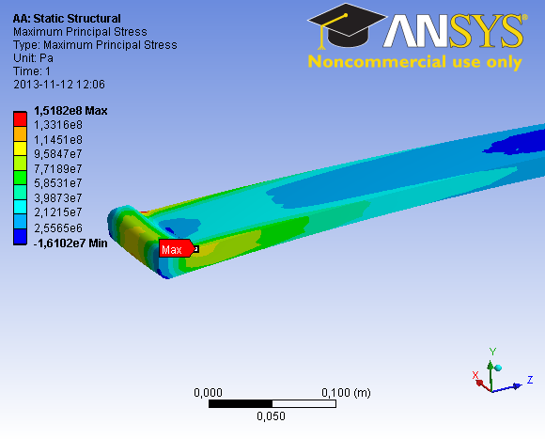
Stress analysis: Helium cooled target
Helium Cooled Target
Target Volume | Max Principal Stress Pre-pulse | Max Principal Stress Post-pulse | Stress Amplitude
Target I | 168 MPa | 194 MPa | 26 MPa
Target II | 116 MPa | 152 MPa | 36 MPa

Slide 10
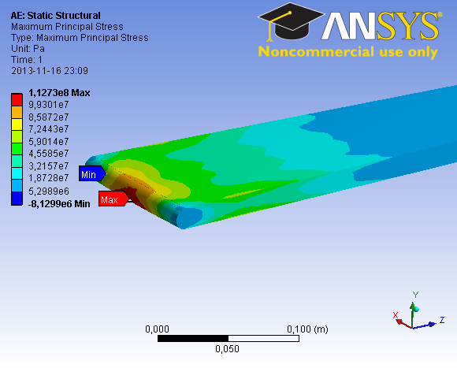
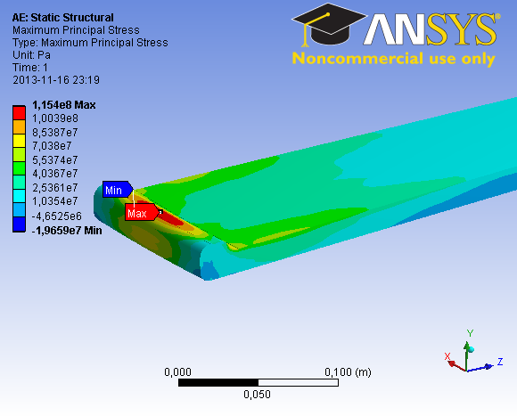
Stress analysis: Water cooled target
Water Cooled Target
Target Volume | Max Principal Stress Pre-pulse | Max Principal Stress Post-pulse | Stress Amplitude
Target I | 23 MPa | 113 MPa | 90 MPa
Target II | 26 MPa | 115 MPa | 89 MPa

Slide 11
Decay heat analysis
Irradiation history: 5 years operation with 5000 hours per year beam on target at 5 MW
Benchmark (MCNPX): 41.5 kW in bare W at time zero
 | Dose rate calculated by FLUKA in kW
Cooling time [s] | 0 | 3600 | 7200 | 14400 | 28800 | 86400
He-cooled Naked W | 32.7 | 20.0 | 18.6 | 16.9 | 14.7 | 9.9
He-cooled 0.5 mm Ta-clad W | 39.3 | 25.9 | 24.3 | 22.7 | 20.7 | 16.1
H2O-cooled 0.5 mm Ta-clad W | 42.9 | 29.4 | 27.9 | 26.2 | 24.2 | 19.6
D2O-cooled 0.5 mm Ta-clad W | 39.9 | 26.6 | 25.0 | 23.4 | 21.4 | 16.8

Slide 12
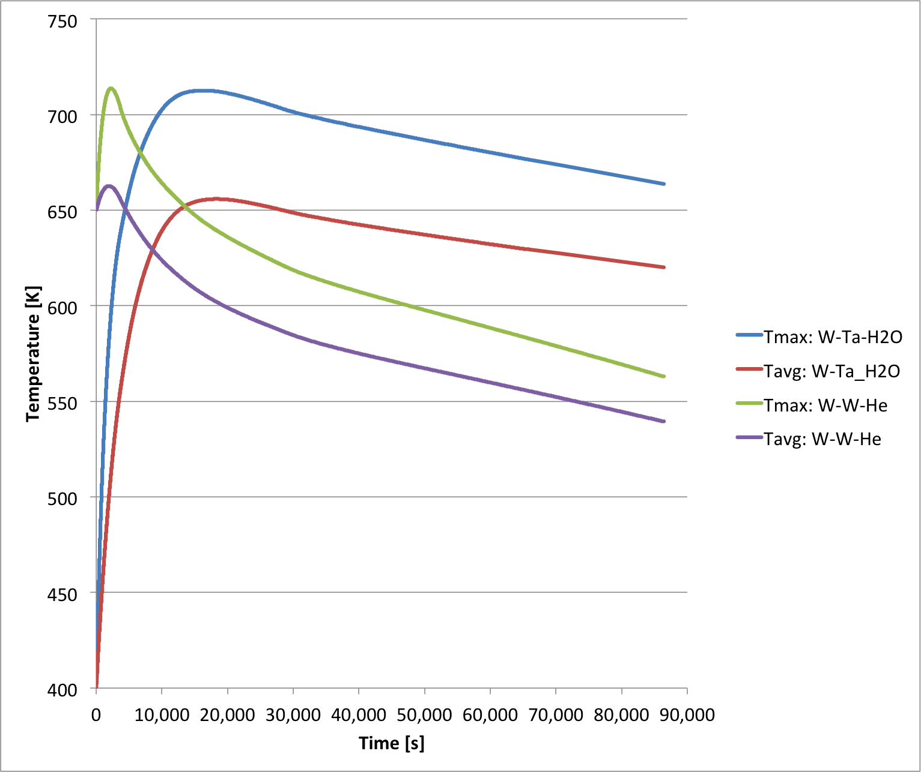
Decay heat analysis: Thermal equilibrium
Assumptions:
Normalization factor in decay heat to make it total 47 kW
Loss of coolant in the target and the monolith, with air ingression
Simple tungsten disc surrounded by monolith shielding blocks with 2 cm air gap between them.

Slide 13
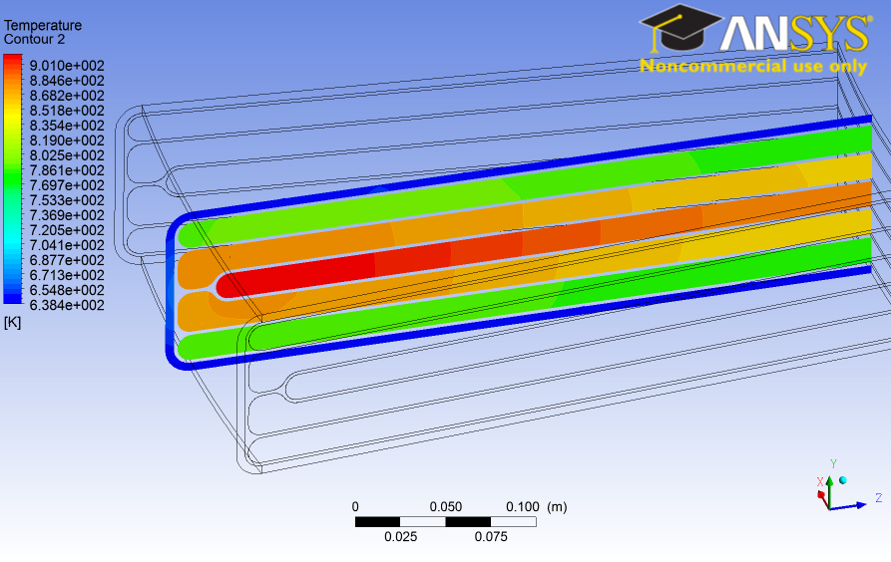
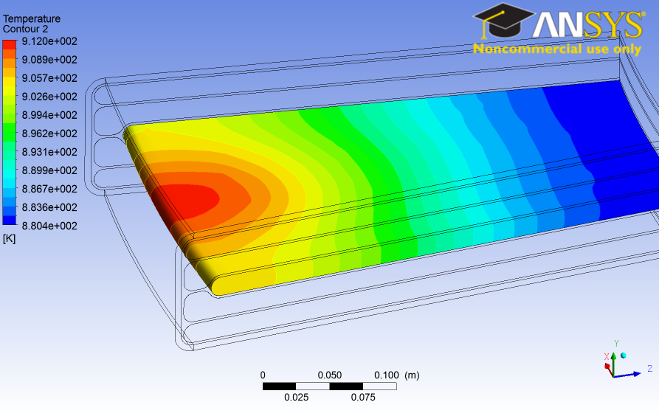
Decay heat analysis: Temperatures at thermal equilibrium
Coolant | Decay Heat at time zero | Decay heat at thermal equilibrium | Time to reach thermal equilibrium | Max. temperature at thermal equilibrium
Helium | 47 kW | 37 kW | 40 min | 912 K
Water | 62 kW | 38 kW | 270 min | 928 K

Slide 14
Exothermic heat analysis
Tungsten and tantalum oxidation: exothermic process
W + O2 -> WO2, dH = -589.7 kJ/W-mol
W + 1.5*O2 -> WO3, dH = -842.9 kJ/W-mol
Ta + 1.25*O2 -> 0.5*Ta2O5, dH = -1023.0 kJ/W-mol
Literature survey on tungsten and tantalum oxidation in air led to the estimation that the exothermic heat generated on the target surface will reach 10 kW at 800 C.

Slide 15
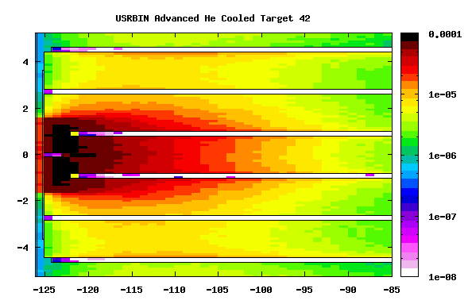
Thermomechanical properties under flat proton beam profile
New accelerator baseline at ESS:
Rastered beam scanning a rectangular surface on beam window: dx = 140 mm, dy = 32 mm
Beam parameters changed from 2.5 GeV/2.0 mA to 2.0 GeV/2.5 mA, giving the peak current density on target 55.8 uA/cm2

Slide 16
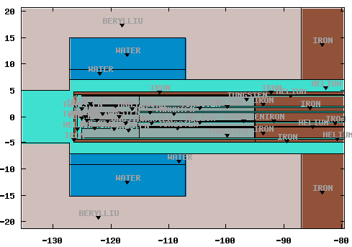
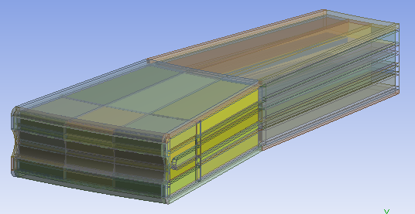
Evolution of target configuration – V2
Minimizing tungsten volume:
No visible neutronic penalty by reducing the W slab length from 40 cm to 30 cm and the W slab total thickness from 80 mm to 70 mm
Reduced W slab size reduces decay heat in W by more than 10 %.
Optimizing temperature and stress configurations in W volume.
No through going proton beam shall be allowed!

Slide 17
CFD: Transient flow analysis – V2
Helium Cooled Target: 3 kg/s @ 6 bar
Target Volume | Max Temperature Pre-pulse | Max Temperature Post-pulse | Temperature Amplitude
Target I | 697.30 | 753.47 | 56.17
Target II | 714.59 | 800.82 | 86.23
Pressure Drop | 49 kPa: Surface and time averaged
Water Cooled Target: 99 kg/s @ 6 bar
Target Volume | Max Temperature Pre-pulse | Max Temp: Post-pulse | Temperature Amplitude
Target I | 320.11 K | 411.76 K | 91.65 K
Target II | 320.31 K | 417.21 K | 96.90 K
Pressure Drop | 34 kPa: Surface and time averaged

Slide 18
Stress analysis: Helium and water cooled targets –V2
Helium Cooled Target
Target Volume | Max von-Mises Stress Pre-pulse | Max von-Mises Stress Post-pulse | Stress Amplitude
Target I | 99 MPa | 93 MPa | -6 Mpa (30 Mpa)
Target II | 68 MPa | 125 MPa | 57 Mpa (60 Mpa)
Water Cooled Target
Target Volume | Max von-Mises Stress Pre-pulse | Max von-Mises Stress Post-pulse | Stress Amplitude
Target I | 10 MPa | 70 MPa | 60 MPa
Target II | 12 MPa | 104 MPa | 92 MPa

Slide 19
Thermal and mechanical analysis: Beam entrance window
Each of the 33 sectors could be considered as an 150 kW spallation target.
Maximum Temperatures in Beam Window
 | Pre-pulse | Post-pulse | Temp. Amplitude
Helium Cooled Target | 457.87 K | 485.71 K | 27.84 K
Water Cooled Target | 321.63 K | 351.49 K | 29.86 K
Maximum Stresses in Beam Window
 | Pre-pulse | Post-pulse | Stress Amplitude
Helium Cooled Target | 210 MPa | 280 MPa | 70 MPa
Water Cooled Target | 123 MPa | 153 MPa | 30 MPa

Slide 20
Conclusions
The feasibility of the target concept based on sectorized horizontal slabs is demonstrated, both for helium cooled and water cooled options at 5 MW proton beam power.
Coolant | Number of W slabs | Max. Post-pulse temp. | Max. Post-pulse tensile stress | Max. temp. at LOCA
Helium 3 kg/s @ 6 bar | 495 bare W blocks | 801 K (528 C) | 125 MPa | < 639 C
Water 99 kg/s @ 6 bar | 495 Ta clad W blocks | 417 K (144 C) | 104 MPa | < 655 C
The exothermic heat generated from the oxidation of tungsten and tantalum could reach 10 kW at high temperatures above 700 C.
There are relatively small number of tungsten blocks in three standardized shapes.
The post pulse peak equivalent stress in the beam window is below 300 MPa both for helium cooled and water cooled options.

Slide 21
Outlook
Next steps:
Thermal and mechanical optimization
Target vessel optimization
Analysis of non-axisymmetric flux distribution
Analysis of dynamic effects of the beam rastering
Down to earth engineering and prototyping
Special thanks to Eric Pitcher, Per Nilsson and Thomas McManamy

Slide 22
Open discussions
Thank you for your comments and feedback!

