Slide 1
Horn Optimization for nuSTORM
HPTW 05/21/2014
Ao Liu*
^{A. Bross, D. Neuffer}
Fermilab, Indiana University

Slide 2
who we are, what we do
nuSTORM Overview

Slide 3
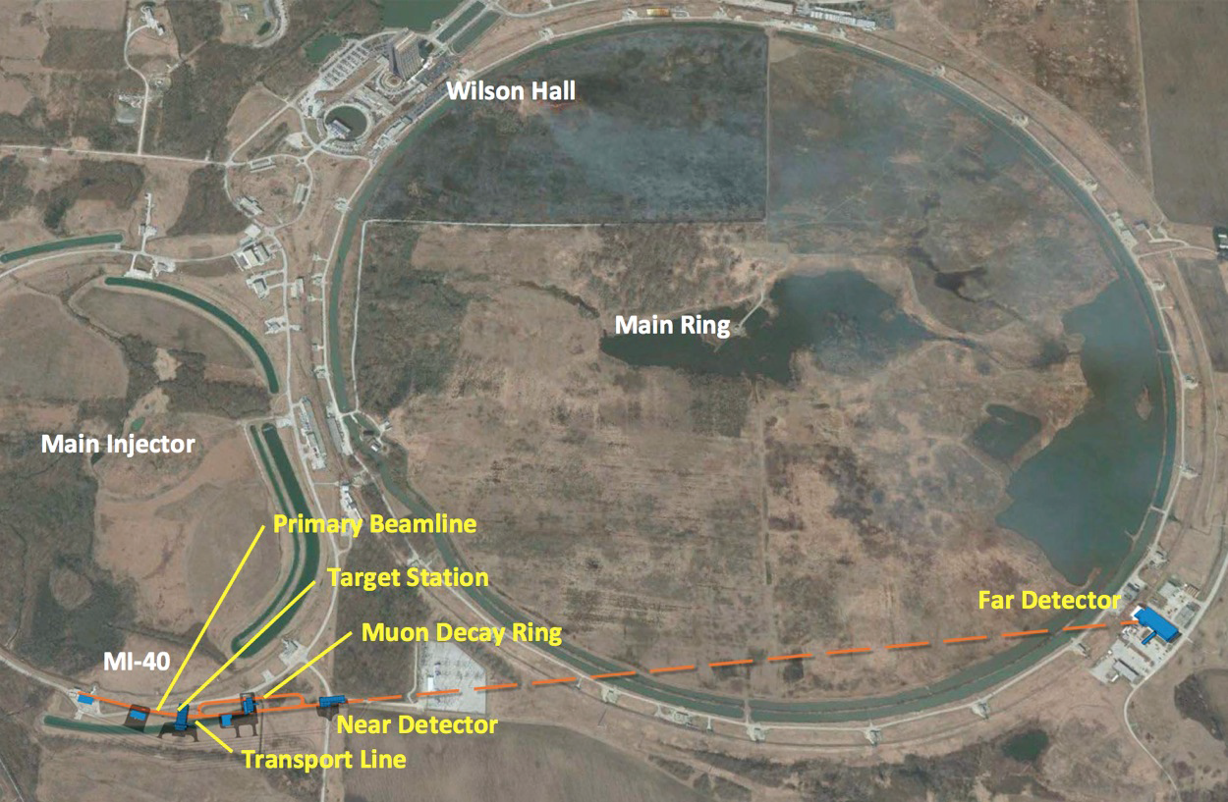
Overview – Site Plan
Photo courtesy of nuSTORM collaboration
Main Ring

Slide 4
Overview - Motivation
3.8 GeV/c muon decay ring (±10%) + near detector + far detector to study eV-scale neutrino oscillations and neutrino cross sections.
  ,
    Well understood neutrino flux + flavor
  , clean neutrino flux also utilizable
  Provides a technology test bed for muon facilities;
  Affordable
    Old technology; Simple implementation
  Now has FNAL Stage 1 approval.
Notes:
Far Detector Diameter: 5 meters; Near: 2.5 meters. Far detector length: 12-16 meters. Near detector roughly a quarter of the far one long.

Slide 5
Overview - Facility
100 KW target station
  120 GeV protons from MI;
  Magnetic horn to collect π+ or π-;
  Target material: graphite or Inconel;
A total run exposure of 10²¹ protons over 4-5 years
  2.6 x 10¹⁸ useful muon decays
Pion beamline to transport and inject the pions, and to accept the muons from pion decay
  No full-aperture fast kicker or separate pion decay channel needed. “Stochastic injection” used.

Slide 6
Overview - Target
Gold target produces the most pions– but not recommended (energy deposition in the horn)
  Graphite is the baseline target material;
  Inconel yields more pions, and energy deposition problem is more tolerable;
  Simulation tool: MARS15
Inconel used in our optimization study
Courtesy of Sergei Striganov, APC, FNAL

Slide 7
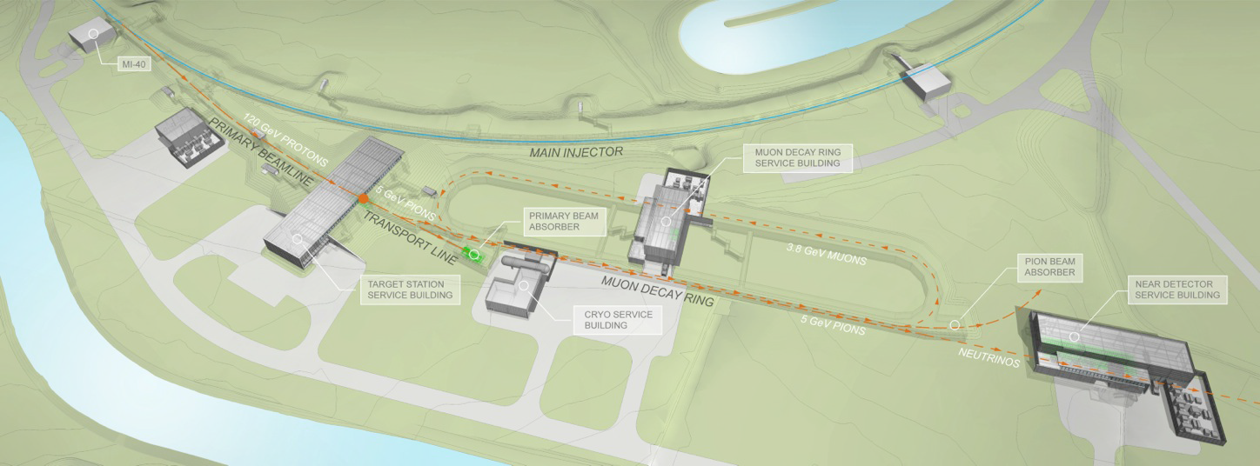
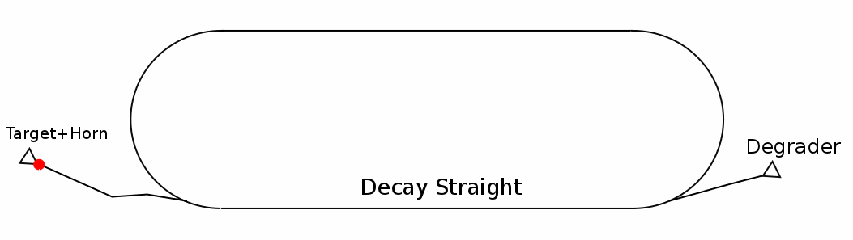

Overview – Facility near site
Photo courtesy of nuSTORM collaboration
← Animation of
the pions and muons
in the facility

Slide 8
What to optimize
Pion Beamline D&S

Slide 9
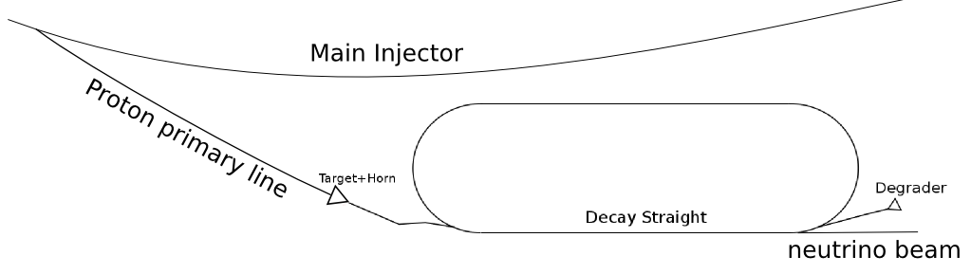
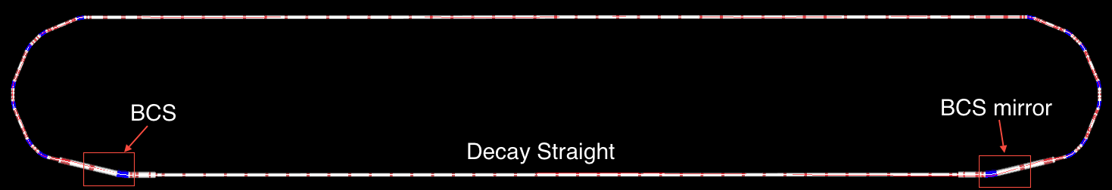
Pion Beamline Definition
The pion beamline consists of the transport beamline, the beam combination section (BCS), and the storage ring production straight shared by π and μ.
The pion beamline is designed with reference momentum P₀=5 GeV/c, the simulation was initially done using π+ collected by a NuMI-like horn with slightly different lengths and target position, no full optimization.
Pion Beamline
BCS

Slide 10
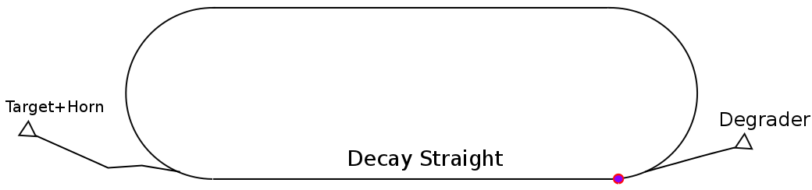
Muons from Pions at the End of the Pion Beamline
Number of μ+ in 2000 μm needs to be maximized!
G4Beamline used as the tracking tool; Geant4 implemented
Notes:
Total # of muons at the end of decay straight: 29520;

Slide 11
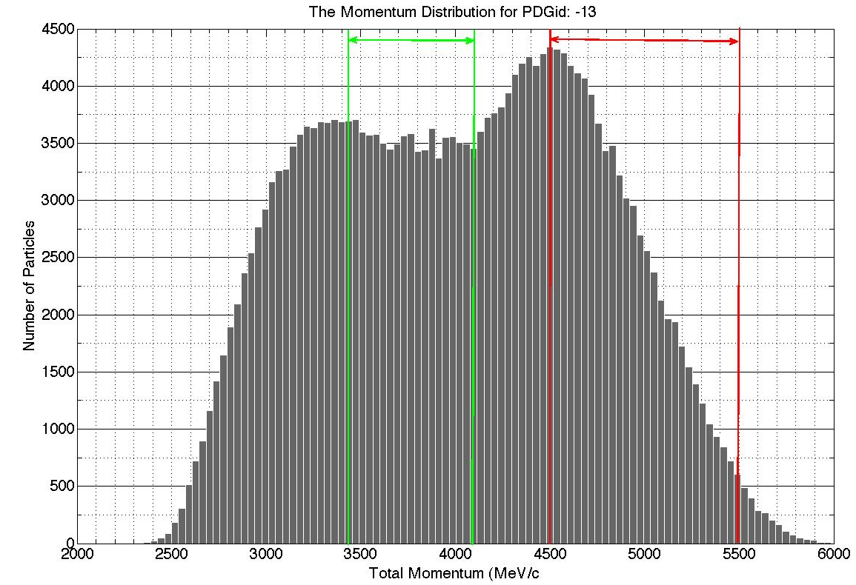
Muons from Pions at the End of the Pion Beamline (Cont’d)
Green: Ring momentum acceptance
Red: Extract
for muon cooling studies
0.012 / POT
Number we need to maximize!

Slide 12
Optimization Goal(s)
Single Goal: Maximize muons in the transverse and momentum acceptance of the ring --
  Why not directly use this criterion:
    Phase space of pions from each horn design is different, need to re-match the optics;
    Need full Monte Carlo simulation for each design;
    Too much computing power and time
Alternative Goals:
For horns collecting pions, for which the optics can be matched,
  Maximize muons within 3.8+-10% GeV/c, at the end of the production straight (N_{μ,end})
  Maximize pions within 2000 μm at the end of the horn (N_{π})
They must be optimized simultaneously – No formula for the
analytical correlation of the two.

Slide 13
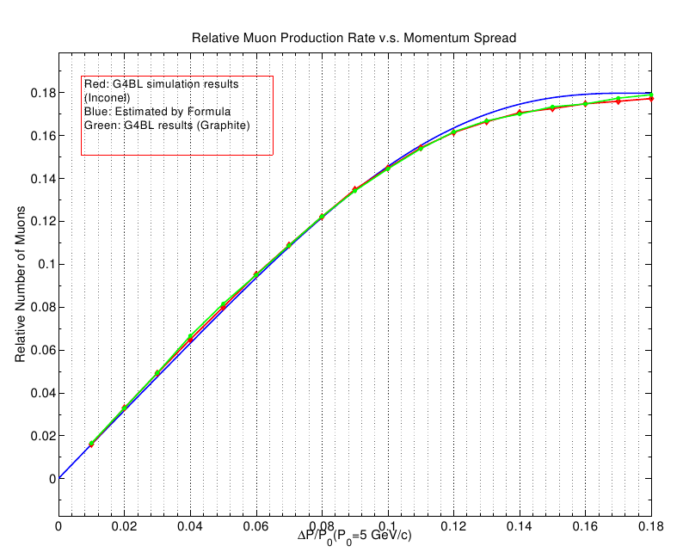

Maximizing N_{μ,end}
π+ after the horn are linearly distributed in 4-6 GeV/c ( ), the μ+ within 3.8±10% GeV/c from the N₀ π+ within P₀x(1±m) GeV/c can be estimated. (m=ΔP/P₀ and P₀=5 GeV/c)
MC tracking in G4BL well matches the estimation. (Both for Inconel and Graphite)
Maximum value found at m=0.18.
m=

Slide 14
Maximizing N_{π}
Different π+ beams from different horn collections have very different phase space distributions
  Distorted bivariate Gaussian in the phase space – must be fitted in order to obtain Twiss (Optics) parameters for matching;
  N_{π} obtained from counting π+ in the fitted 2000 μm acceptance ellipse
Large phase space area (more than 2000 μm) causes fitting bias

Slide 15
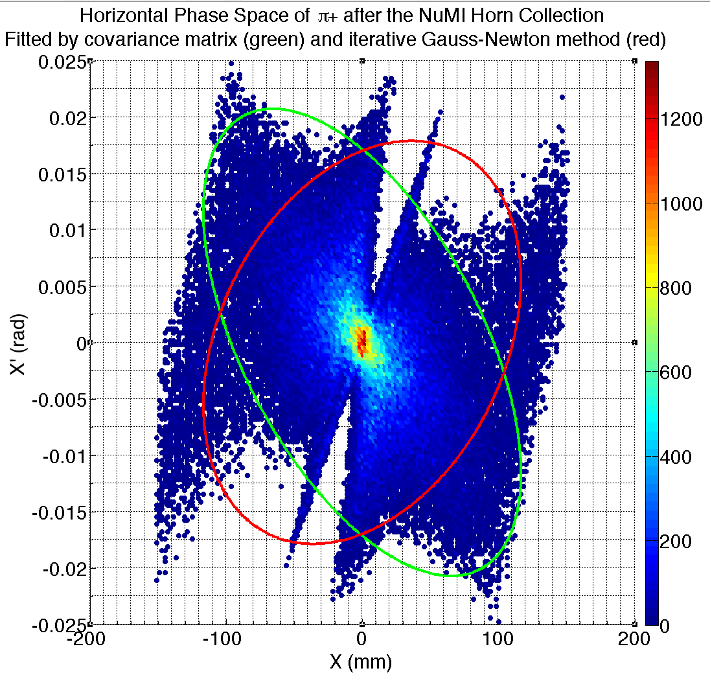
Maximizing N_{π} (Cont’d)
Direct statistics gives biased fit – red
Iterative Gauss-Newton method – green
  Iteratively discards particles with largest emittance until rms emittance reaches a specific value
Better match to the core of the beam

Slide 16
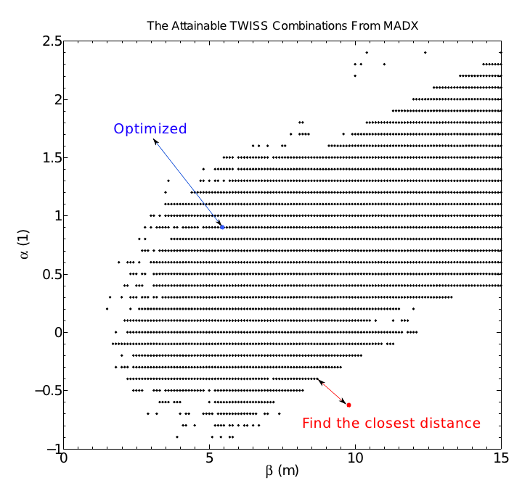
Maximizing N_{π} (Cont’d)
Is a set of Twiss parameters (α and β) useable?
A range of feasible Twiss from MADX;
  Quad. gradient limit
  Beam size limit in the beamline
  Able to find a match?
  Next set of parameters
Example:
In the range
Directly use N_{π}
Example:
Out of the range
Scale N_{π}

Slide 17
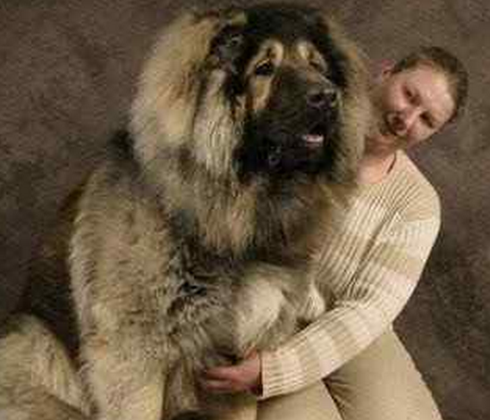
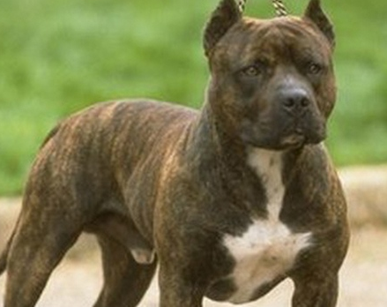
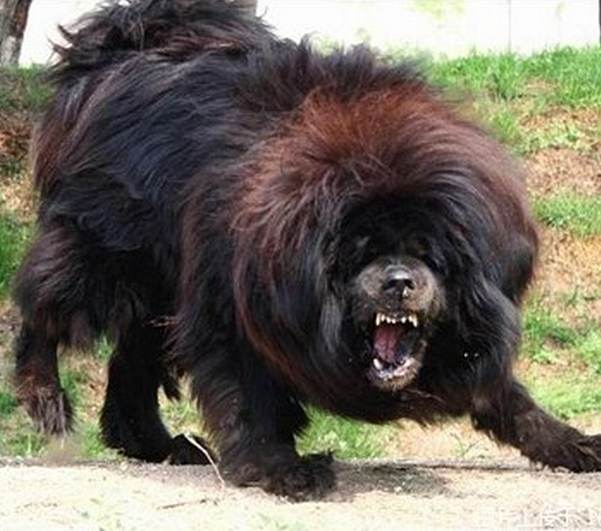
How to optimize
Many
generations
Big but calm
Aggressive but small
Big Aggressive
+
=
Nature
chooses
better
survives
Multiple Objective Genetic Algorithm (MOGA)

Slide 18
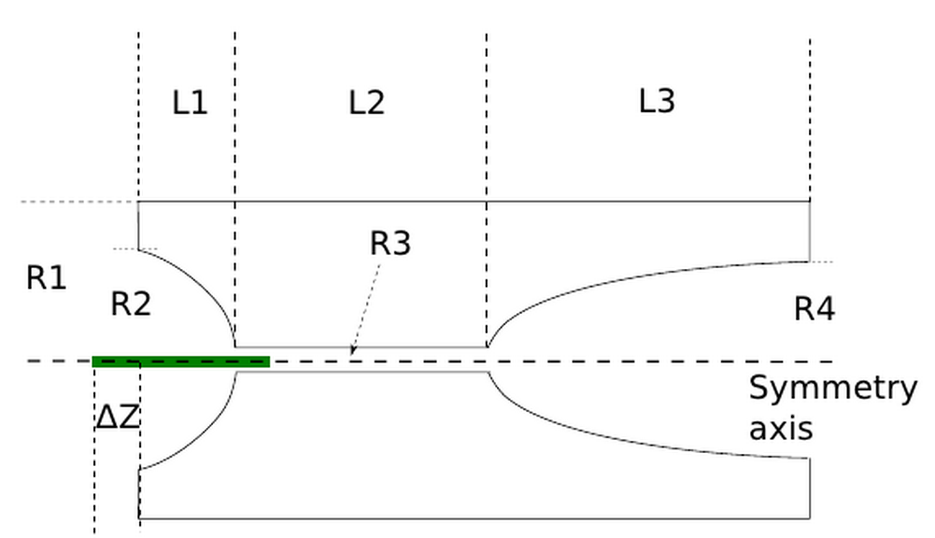
pyGAmpi
A python-mpi code to run the Genetic Algorithm (GA), to improve the individuals
  Different individuals are different combinations of parameters
  They give different objective values
    (Different horns yield different N_{π} and N_{μ,end})
  Objectives to be maximized / minimized
    (Max. N_{π} and N_{μ,end})
  Parameter constraints;
    (Current in horn, neck radius, etc.)
A scan of 5 different values for each parameter
is 2 MILLION runs!
An individual horn is a combination of the above parameters, and horn the current (9 parameters);
Select parents based on the objectives, produce offspring;
Parameters are treated like “genes” – genes of children are the crossover and mutation of the parents’ genes;
Eventually, the whole population will be improved, i.e. gives larger N_{π} and N_{μ,end}

Slide 19
MOGA process
Track π+ in the individuals, calculate N_{π} and N_{μ,end} for each case
Select the best individuals, make the offspring. A child generation is generated
Model the B-field in the horns, based on the parameters of each horn
GA starts, a number of random individual horns produced as the first generation
When the maximum generation number is reached, or the population stops improving,stop the algorithm
Population size: 200;
Generation limit: 100;
CPUs used in each generation: ~1200

Slide 20
It works
Optimization Results

Slide 21
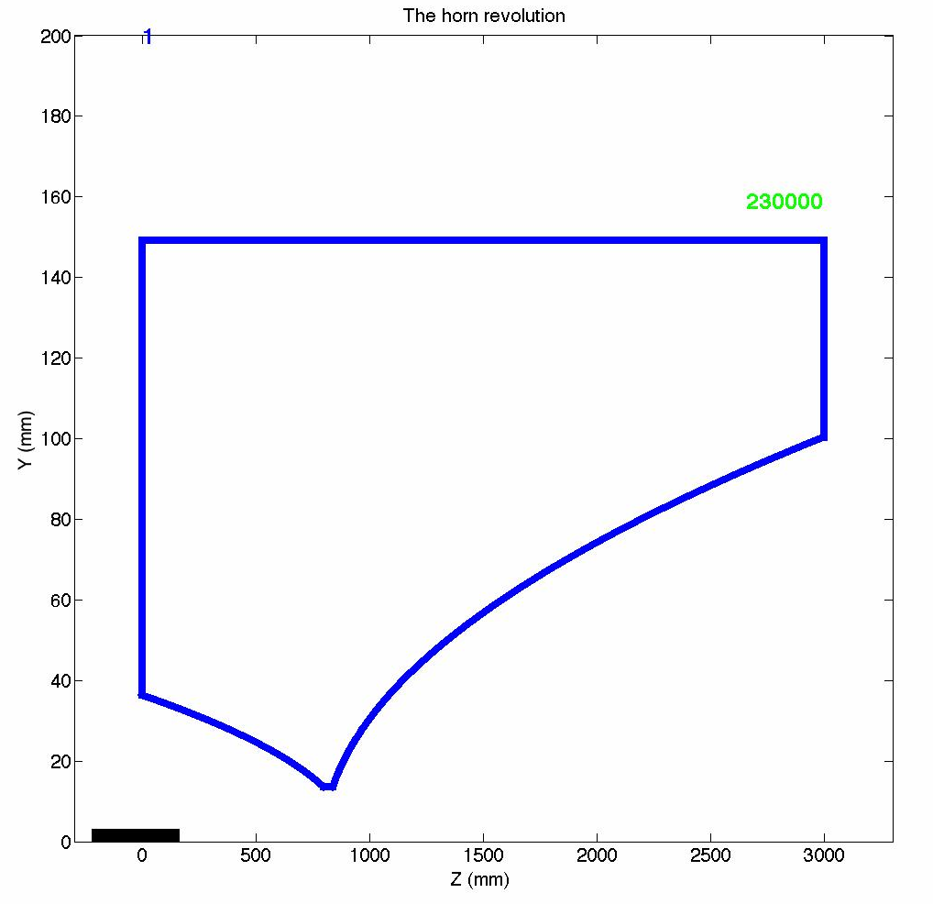
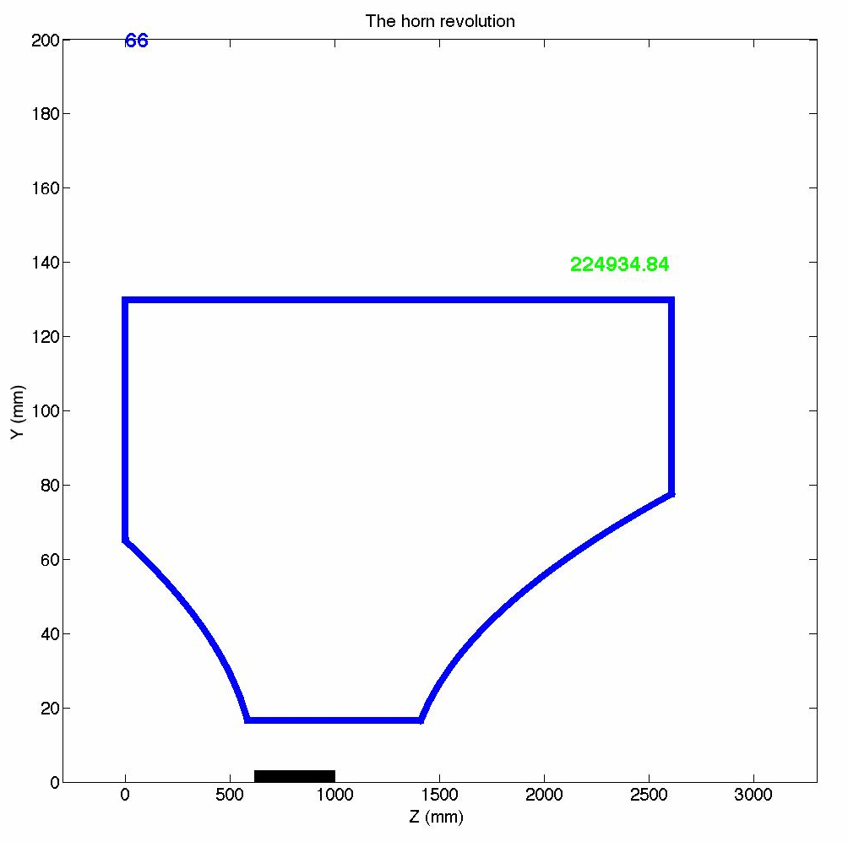
Collection of π+ from a 38 cm Inconel (2.5 interaction lengths)
Shorter (2 m) + lower current (225 kA)
+ narrower outer conductor !
N_{μ,end} increased by 14%; N_{π} increased by 18%;
Then, Pion beamline re-matched; π+ re-tracked;
μ+ in both 2000 μm and 3.8±10% GeV/c increased by 8.3%
Why not as high?
Higher-order effects not considered:
Beta-beat, phase space difference
for off-momentum particles, etc.

Slide 22

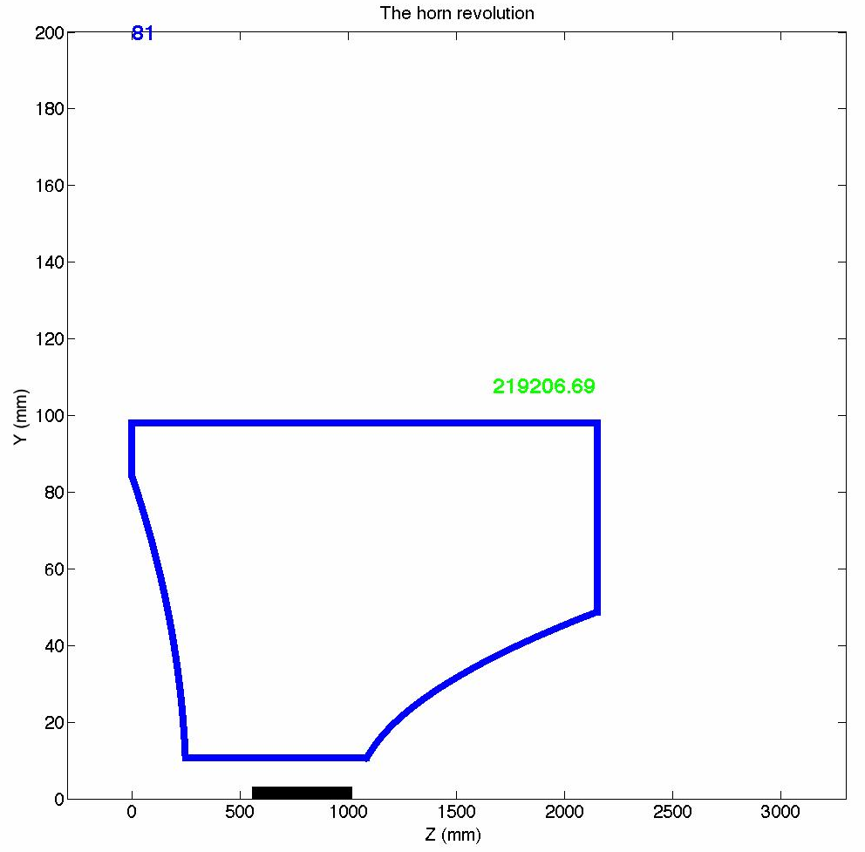
Collection of π+ from a 46 cm Inconel (3 interaction lengths)
Even shorter (1.6 m) +
Even lower current (219 kA) +
Even narrower outer conductor !
N_{μ,end} and N_{π} increased by ~20%; (If just changing the target length: ~5%)
Then, Pion beamline re-matched; π+ re-tracked;
μ+ in both 2000 μm and 3.8±10% GeV/c increased by ~16%

Slide 23
importance of the optimization
Conclusions

Slide 24
Conclusions and Future
nuSTORM benefits from the optimization:
  Expect 8.3% more neutrino flux, with a 38 cm Inconel target;
  Expect 16% more flux, with a 46 cm Inconel target.
Other horn-based projects – e.g. LBNE:
  Algorithm is expected to work if the objectives are known;
  Algorithm may be less complicated and faster, if no beamline tracking is needed;
  MOGA allows adding other constraints to obtain a more realistic design + optimization
Future:
  Modify the objectives based on further ring design studies;
  Collaboration work with other projects if needed and interested.

Slide 25
your comments are welcome
Thanks

Slide 26
in case I forgot
Back Ups

Slide 27
Overview – Site Plan
Photo courtesy of nuSTORM collaboration
Main Ring

Slide 28
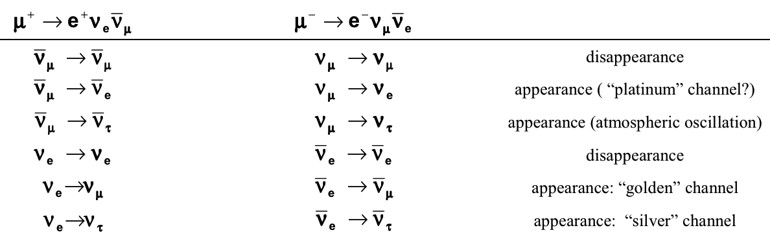
Introduction-Motivation
For the past decade, a lot of effort has been spent on neutrino oscillation physics
8 channels accessible by νSTORM
Notes:
Electron mass: 0.51 MeV; Muon mass: 105.66 MeV; Tauon mass: 1.78 GeV;

Slide 29
Introduction-Facility
100 KW target station
  120 GeV protons from MI;
  Magnetic horn to collect π+ or π-;
  Target material: graphite or Inconel;
A total run exposure of 10²¹ protons over a period of 4-5 years
  8 x 10¹² protons per pulse; cycle time 1.33 sec.
  A total of 2.6 x 10¹⁸ useful muon decays, updated from 1.9 x 10¹⁸ useful muon decays in the proposal
Pion beamline to transport and inject the pions, and to accept the muons from pion decay
  No full-aperture fast kicker or separate pion decay channel needed
Gold target gives the most pion productivity but is not recommended (intensive energy deposition in a horn)
  Graphite is the baseline target material in the proposal;
  Inconel yields more pions, but engineering challenges may rise, though better than gold;
Inconel used in the optimization study

Slide 30
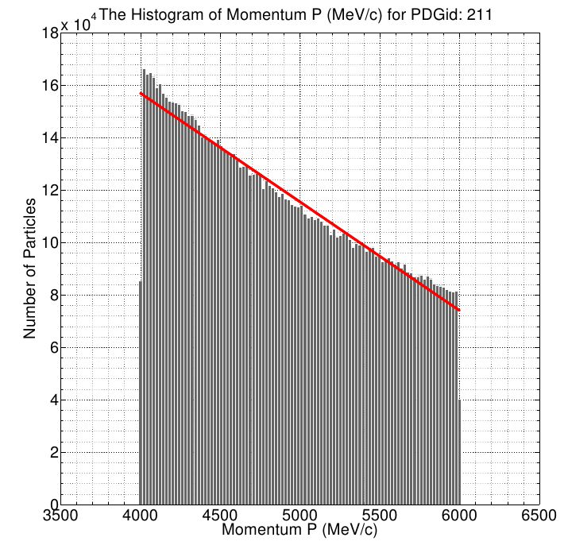
Maximizing N_{μ,end}
e.g. a= -1.46935529e-07,
b=1.23467765e-03
a and b changes only slightly w.r.t different horns (Usually a few percent)
Notes:
e.g. NuMI horn used on 46 cm Inconel yields
array([ -1.43137807e-07, 1.21568903e-03])
The optimized horn for 46 cm Inc. target yields
array([ -1.46935529e-07, 1.23467765e-03])

Slide 31
Maximizing N_{μ,end}
The above implies that the maximum number of μ+ within 3.8±10% GeV/c generated is
  Assuming the phase space acceptance of the pion beamline P_{Φ} for different initial conditions is the same;
  Τhis has taken the momentum acceptance and decay kinematics into account.
Horn variation gives slightly different coefficients a, b, and very different N₀

Slide 32
MOGA process
Track π+ in the individuals, calculate N_{π} and N_{μ,end} for each case
Select the best individuals, make the offspring. A child generation is generated
Model the B-field in the horns, based on the parameters of each horn
GA starts, a number of random individual horns produced as the first generation
When the maximum generation number is reached, or the population stops improving,stop the algorithm
~40,000 core-hours used in each search

