Slide 1
Post Irradiation Examination of an Alloy 718 Beam Window
Stuart A. Maloy¹,
Hong Bach², Tarik A. Saleh¹, Tobias J. Romero²,
Osman Anderoglu¹, Bulent H. Sencer³
1. Materials Science and Technology Division -Los Alamos National Laboratory
2. Chemistry Division -Los Alamos National Laboratory
3. Idaho National Laboratory
(May 21, 2014)

Slide 2
Outline
Isotope Production Facility
Cutting of Window and Dimensional Measurements
Calculation of Dose and Irradiation Temperature
Shear Punch Testing
  Trepanning of Specimens
  Dose/Irradiation Temperature vs. Location
  Shear Punch Testing and Data
TEM Analysis
Comparison to previous test results
Summary

Slide 3
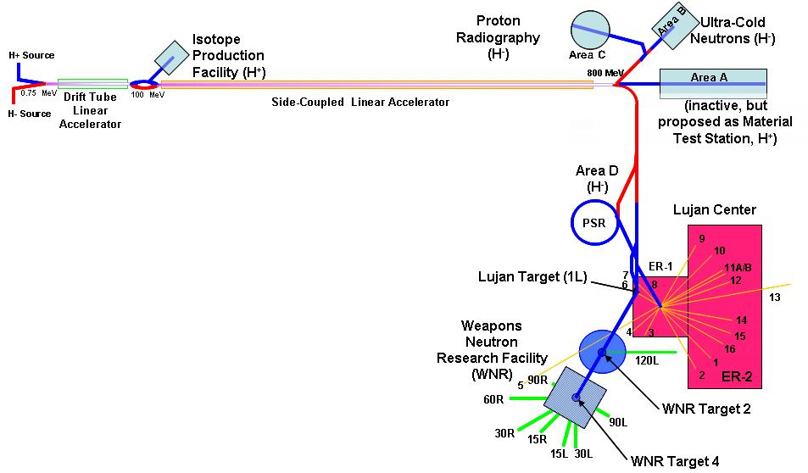
Isotope Production Facility - LANSCE
H+ is produced at the source injector, accelerated through DTL, diverted to IPF at the TR region through magnets, and ended on targets inside a heavily shielded target irradiation chamber .

Slide 4
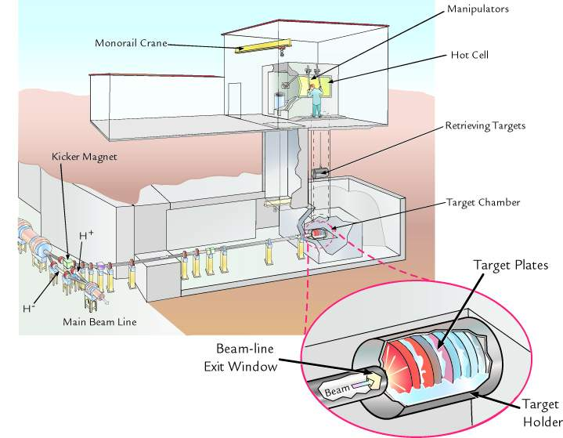
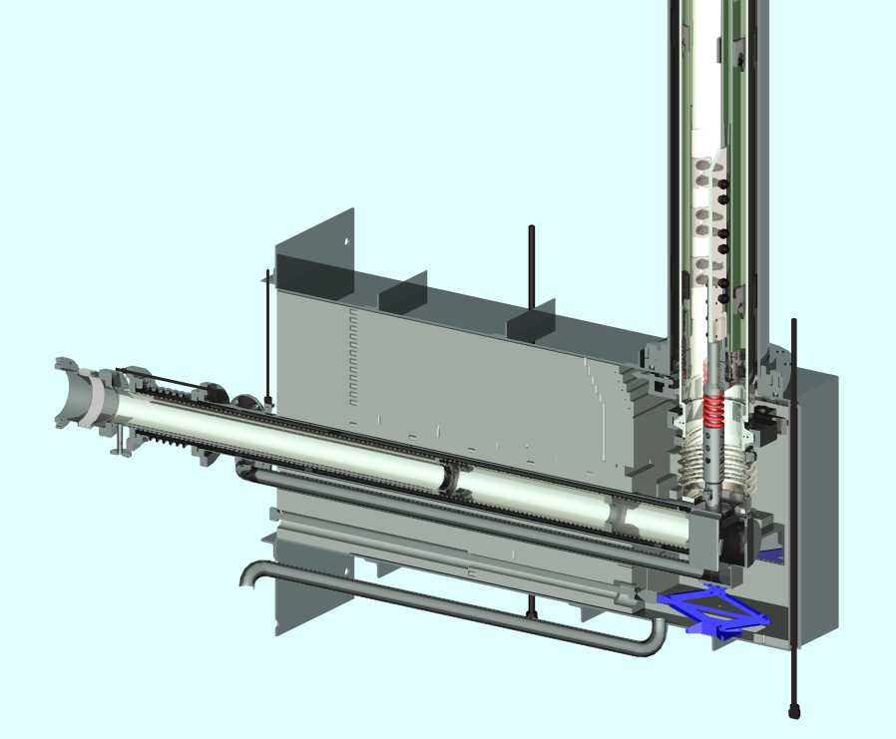
Isotope Production Facility and Beam Window
Steel
Proton Beam
Beam window
Target carrier
The proton beam is delivered via a vacuum beam pipe. Inconel 718 beam window isolates the beam pipe (under vacuum) and the target irradiation chamber (15 psig of cooling water).
Present design limit for window is 5 years and would like to increase that limit through analyzing properties after 5 years of operation.

Slide 5
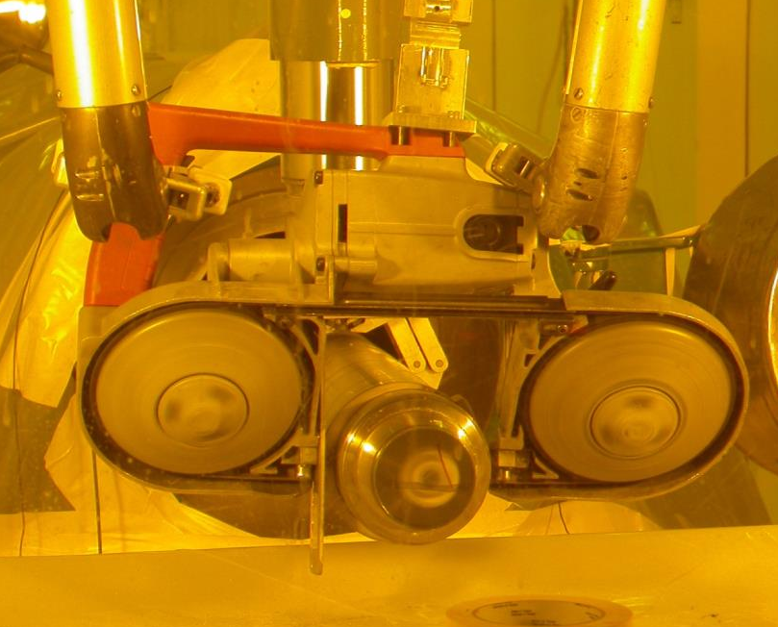
Cutting off the Window
Window was cut from beam tube remotely in the corridor of the CMR Wing 9 hot cells
Then, the window was placed into an individual hot cell for analysis and sample preparation.

Slide 6
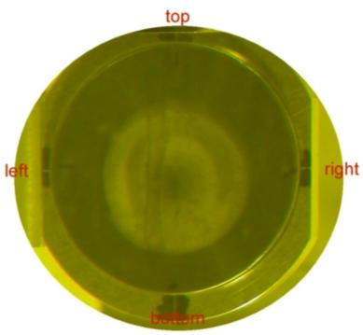
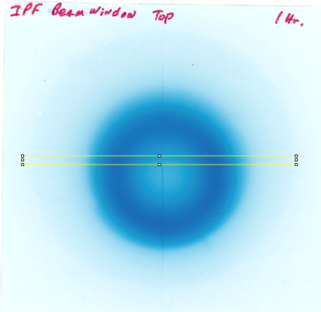
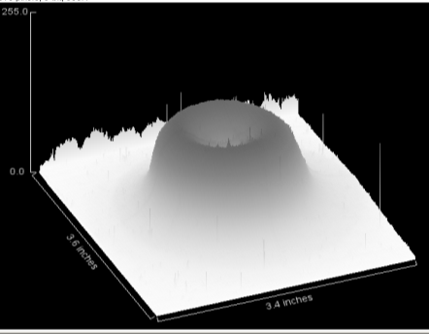
Dimensional and Dose Measurements on Window
GAFCHROMIC HD-810 dosimetry film was used to measure the absorbed dose of high energy photons from the activated beam window.
↓vaccum side ↓
Beam window deformed 1.5mm into the vacuum side.
Rastered beam profile shows a Gaussian distribution and the highest dose region corresponds to the darkest blue region on the Gafchromic film.

Slide 7
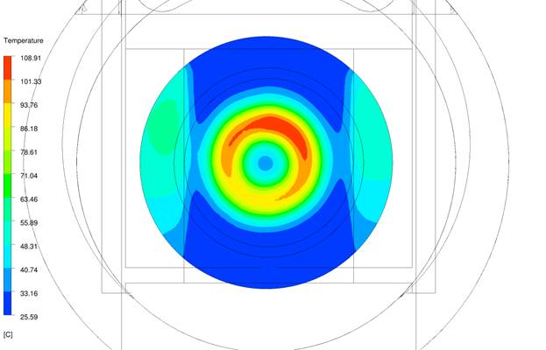
Temperature and Dose Map
0.25-1.5 dpa
109C
2-5 dpa
12.5 dpa
9.5 dpa
25C

Slide 8
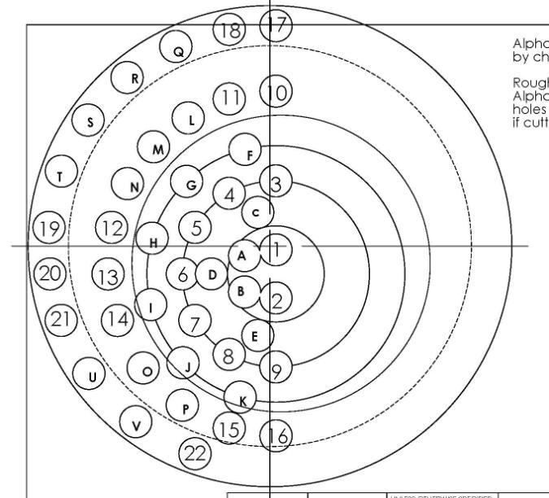
Cutting and Shear Punch Testing Plan
Beam profile was superimposed on the window to determine the cutting plan as a function of radiation dose (dpa).
3-mm OD samples were cut with a Mill machine. A total of 3 cutting bits were spent to cut out 20 numerical samples (1-20) and 5 alphabetical samples (A, B, C, E, and F).
Cut-out samples were polished and thinned from on both sides to 0.254 mm thickness.
The shear punch testing for the following samples were completed as a function of radiation dose (dpa):
  2 controls samples of unirradiated Inconel 718
  1-6, 8, 9, 10-13, 15-16, 17-18, 19-20, A-C, and E
Samples Tested
Samples Cut but Untested
Black Circles were not cut

Slide 9
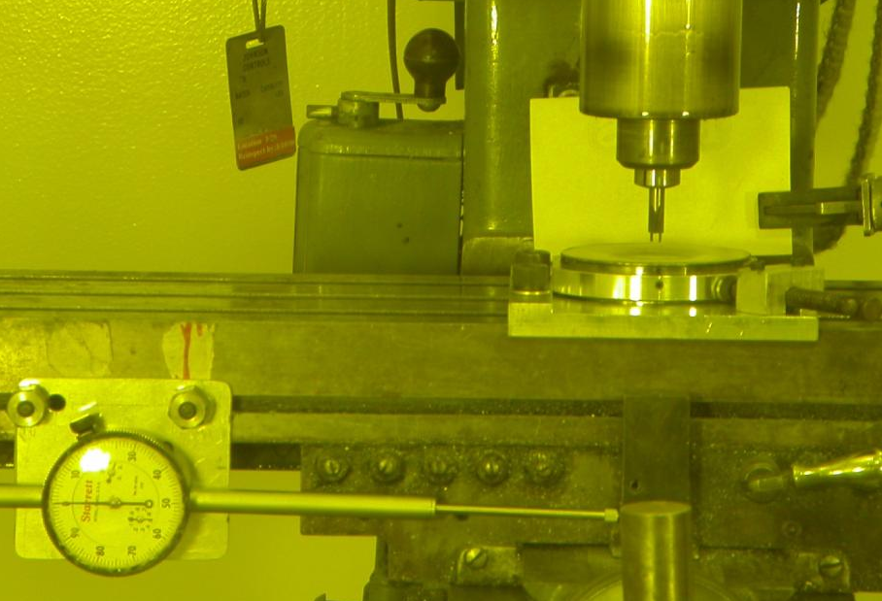
Trepanning 3 mm Diameter Samples from Window

Slide 10
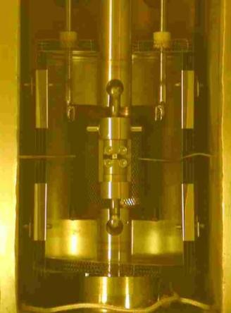
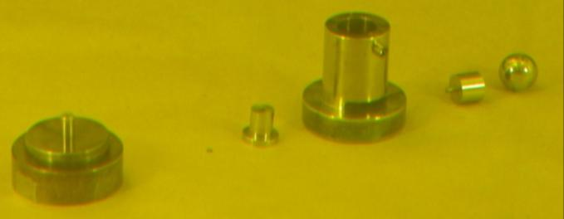
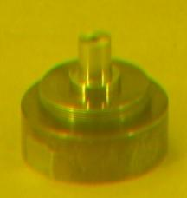
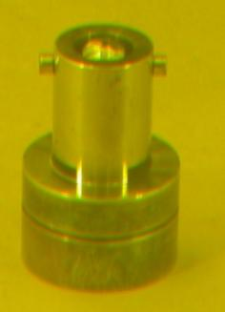
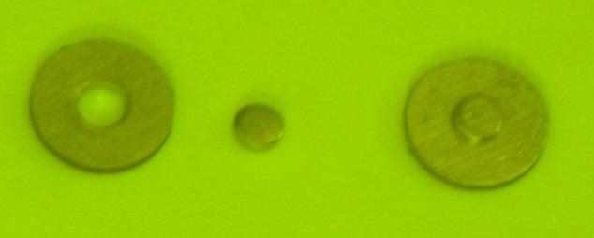
Shear Punch Testing Equipment at CMR Hot Cell
3mm diameter disk
0.25mm thick
1mm diameter punch
Disk Sits Here
Loading Direction
1 mm Punch
Sample Disk
Performed 25 shear punch tests on 3 mm diameter specimens.
Tested at initial strain rate of 5 x 10-4/s.
Tested at in ultra high purity argon.
Shear Punch Set-up
Loading sequence
Typical shear punch specimen

Slide 11
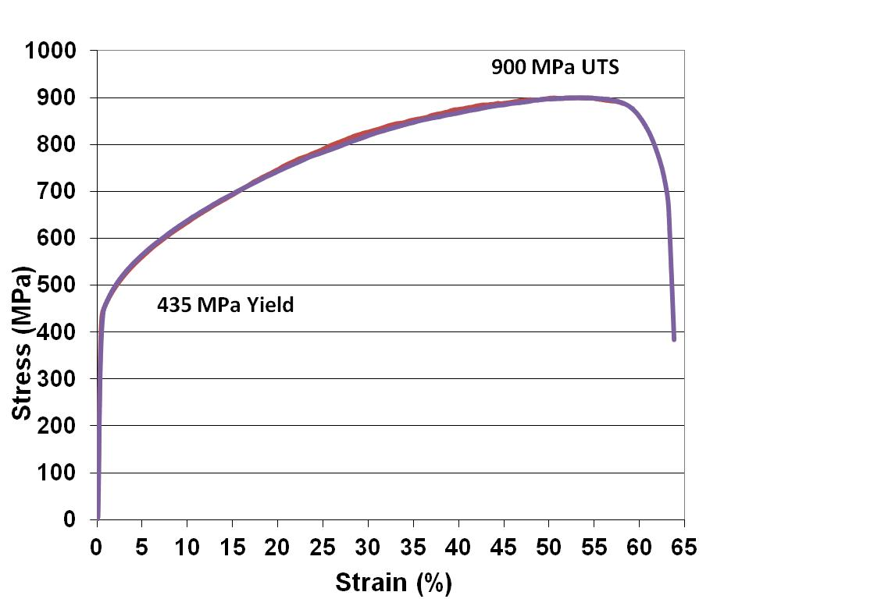
Control Material Tensile Tests vs Shear Punch
UTS correlation -1.28
Yield Correlation-1.77
Lit values 1.4, 1.73
Toloczko&Kurtz
700 MPa UTS
230-250 MPa 1%shear yield

Slide 12
Shear Punch, Outer to Inner
0.5dpa
2.55dpa
11 dpa
12.5 dpa
Control

Slide 13
Comparison of Shear Stress/displacement Curves
Dose = 12.5 dpa
Tirr= 109C
Dose = 0.5 dpa
Tirr=50C

Slide 14
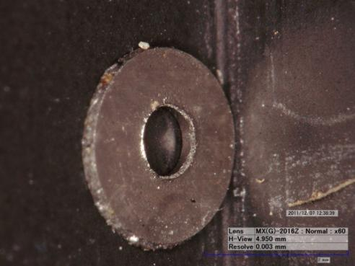
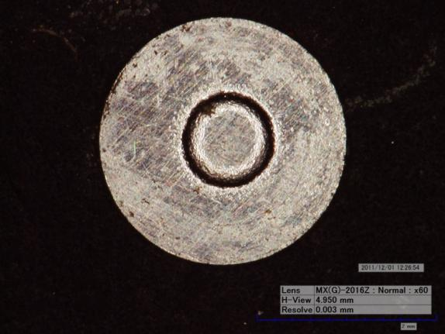
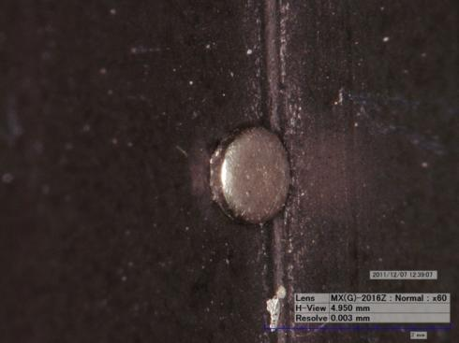
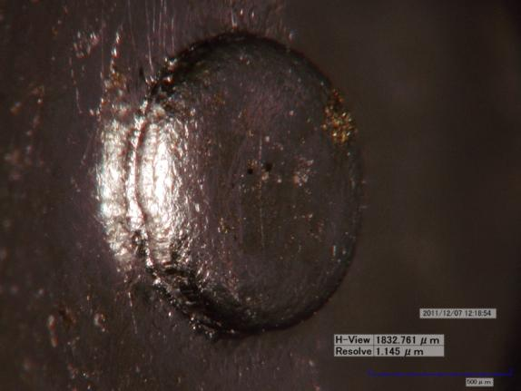
Optical Images of Exit side of Shear Punch Specimens
Control Material
Dose = 12.5 dpa

Slide 15
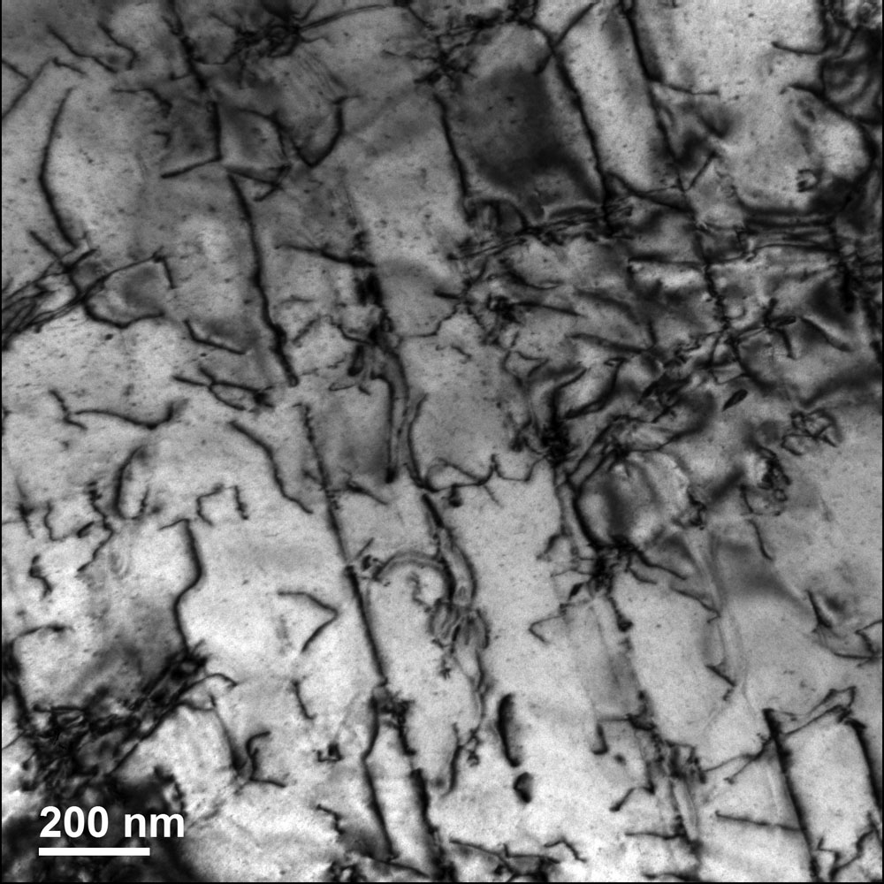
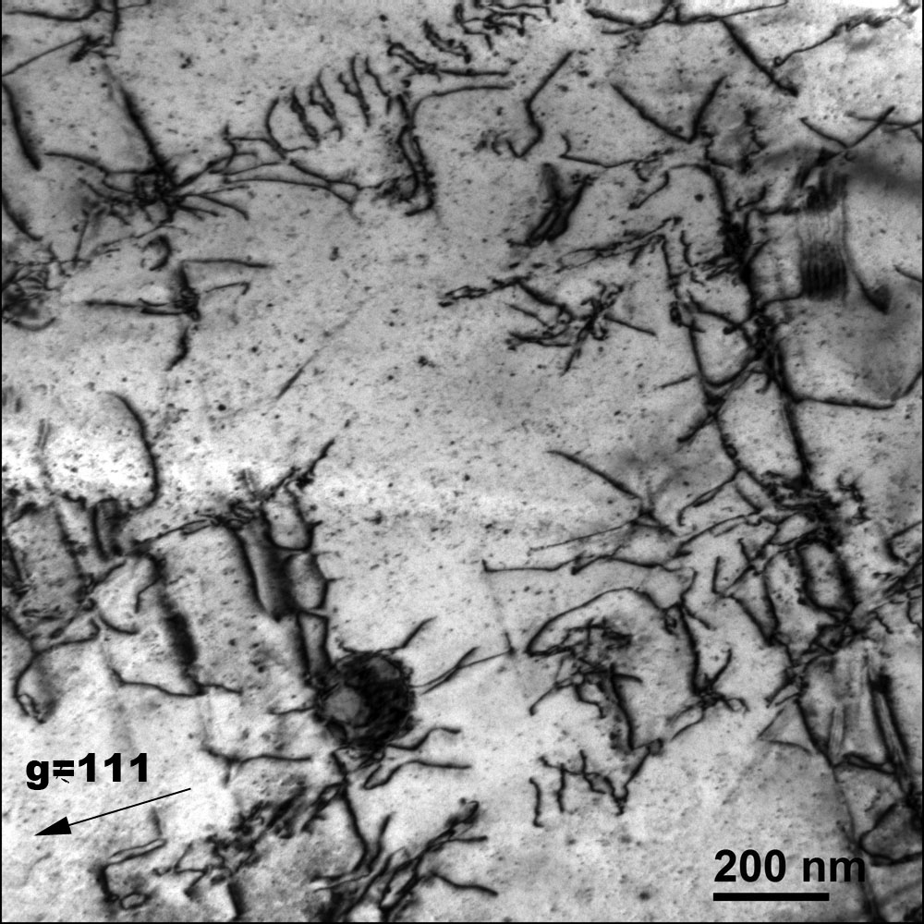
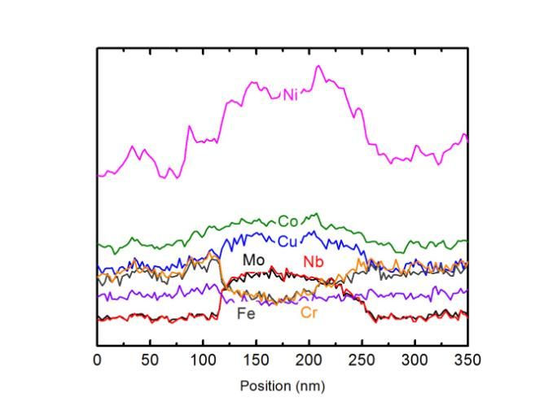
Inconel 718 Solution Annealed-unirradiated
Bright field TEM images showing dislocations and some precipitates

Slide 16
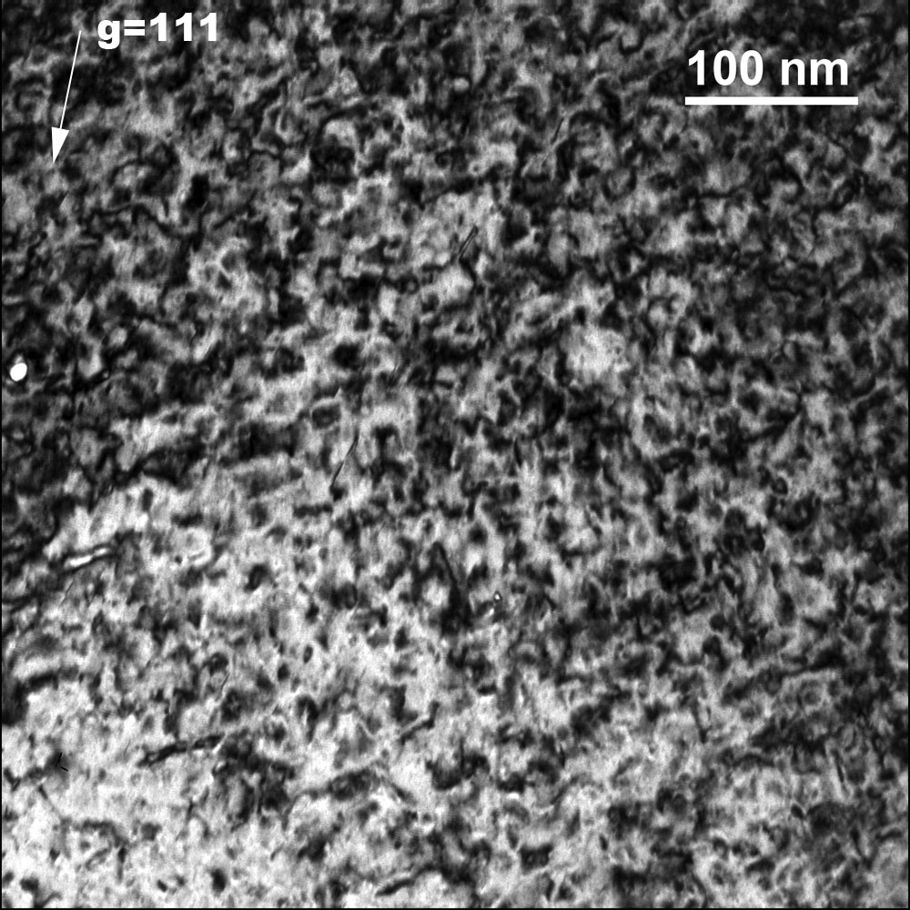
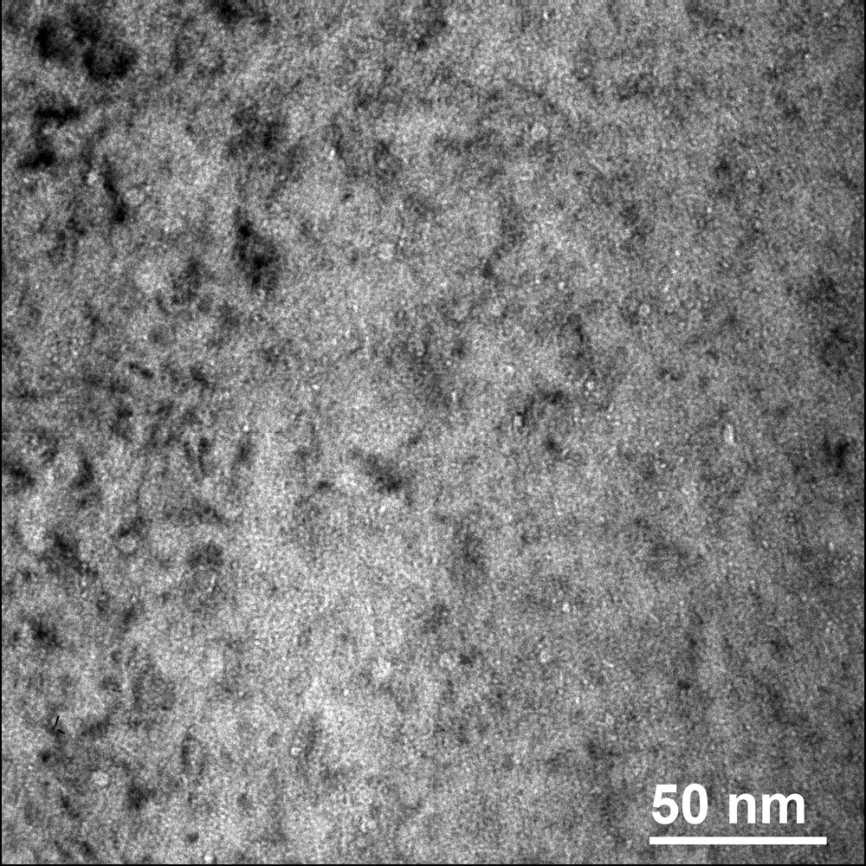
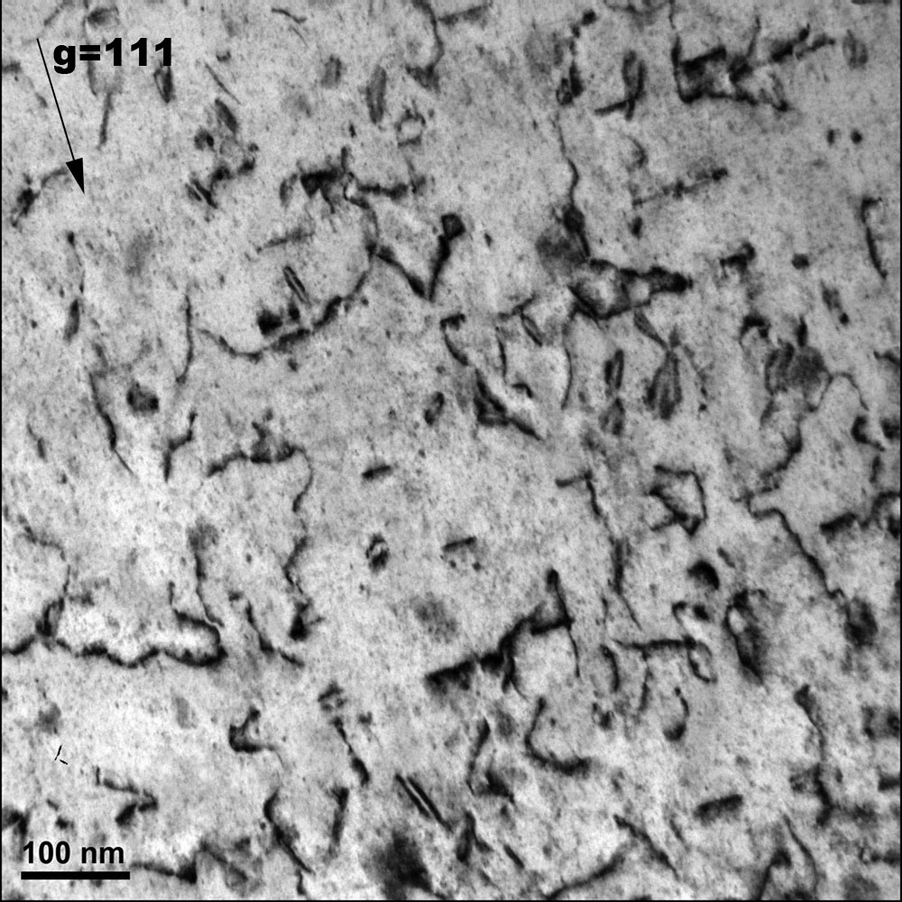
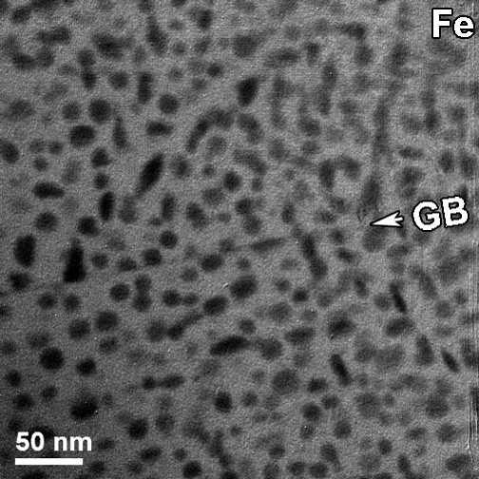
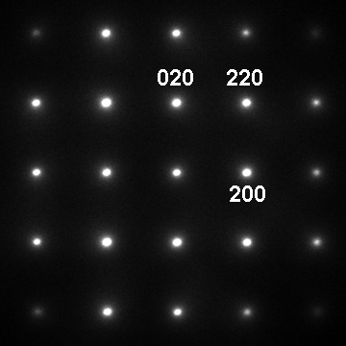
TEM Analysis of Irradiated Alloy 718 Samples
z=[111]
z=[001]
z=[001]
0.5 dpa at 50°C
12.5 dpa at 109°C

Slide 17
Previous Results on Proton Irradiated Annealed 718 SPF
Inconel 718 SPF samples irradiated in STIP-II
Samples show good retention of ductility even with much higher helium levels

Slide 18
Summary of Tensile Results
109C
0.25-1.5 dpa
2-5 dpa
12 dpa
9.5 dpa
25C
All samples display ductility in both yield vs UTS and optically.
Samples taken in outer ring and outside collimator have a higher yield and UTS than control or high radiation dose samples.
Increased hardening appears to be a combination of increased defect density, bubble density and second phase precipitation
From these results we are confident to push lifetime out to ~17 dpa
Further analysis required to understand bubble formation in low dose samples.

Slide 19
Comparison to previous tensile results
Farrell et al. (03) shows increase from 350 MPa to 900 MPa for irradiation at 50-100C for a dose of 1.2 dpa
STIP-II shows increase from 600 to 1200 MPa at 183C and 600 to 1100 MPa at 382C to doses of 7.8 and 18 dpa respectively
IPF data shows increase from 450 to 1100 MPa at 9 dpa and 850 MPa at 11-12 dpa. Also an increase to 1100 MPa is observed at 2-4 dpa.

Slide 20
Shear Punch Results

Slide 21
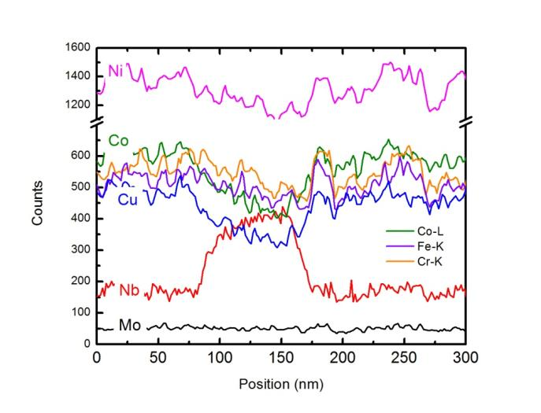
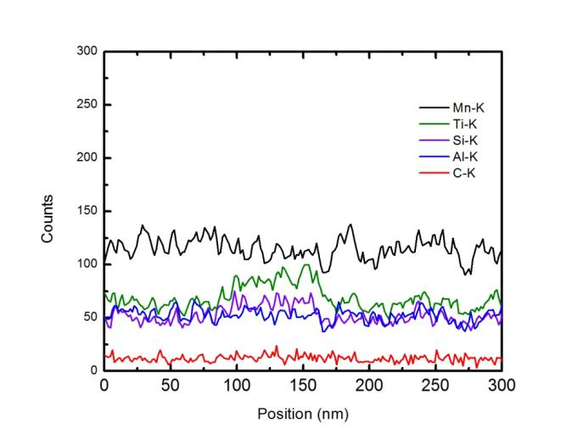
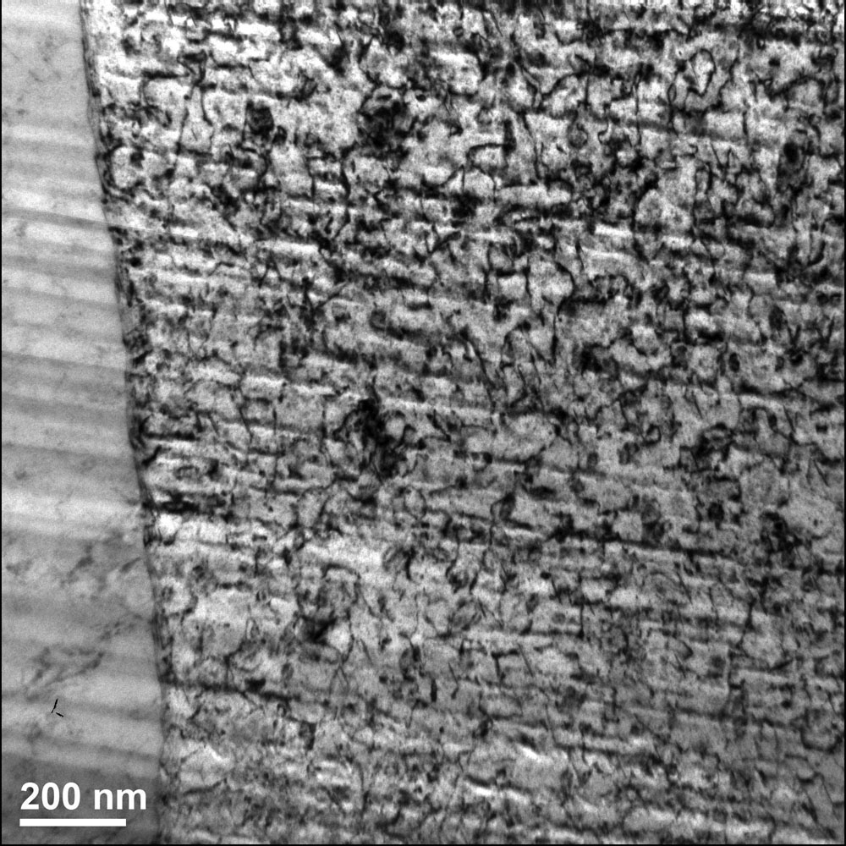
Dark and bright field TEM images showing smaller precipitates and dislocations.

Slide 22
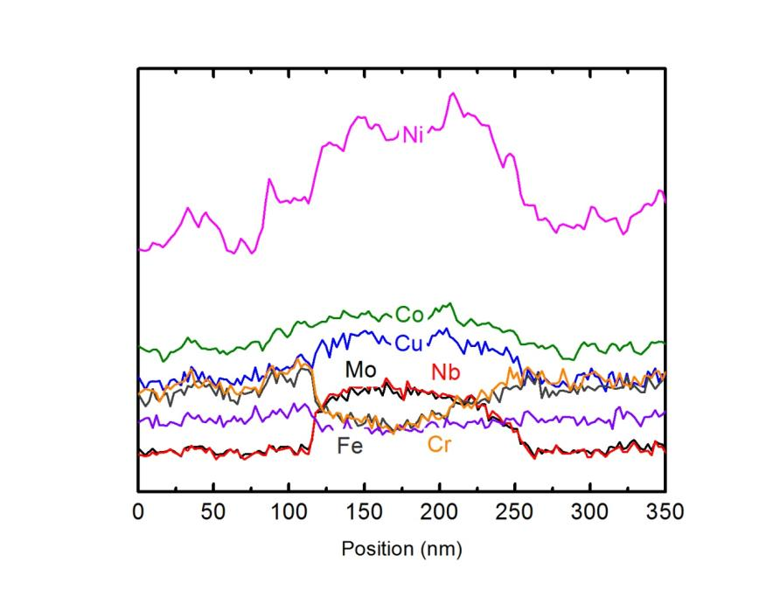
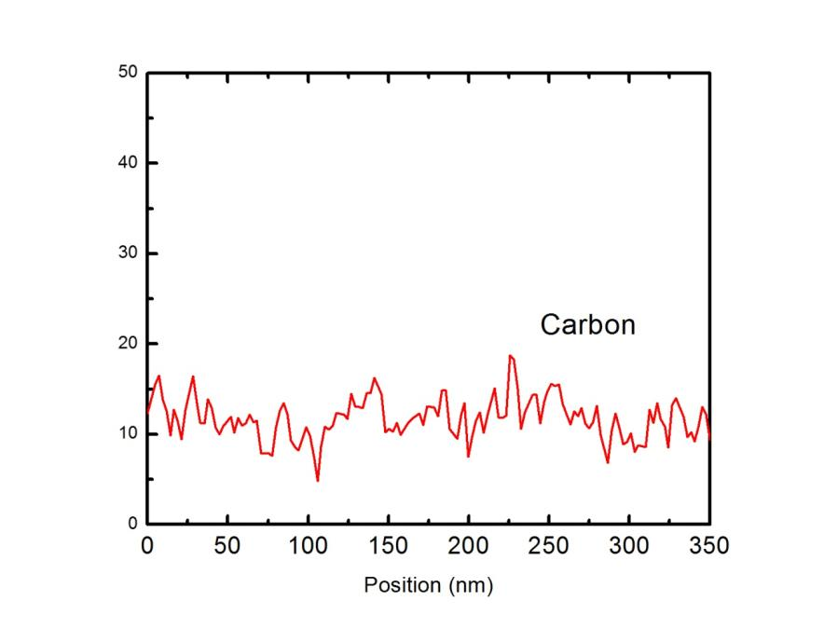
Unirradiated Inconel 718 Ni, Mo, Nb (some Co, Cu) rich precipitate

Slide 23
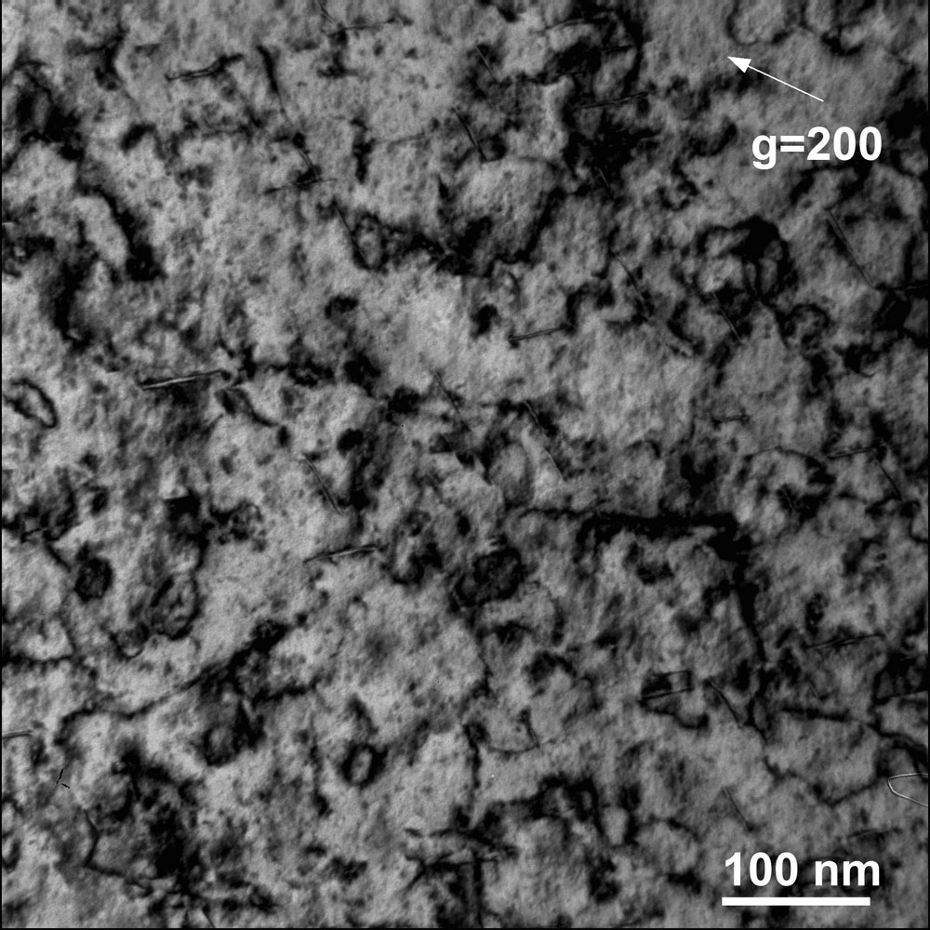
Inconel 718 #5 ~14 dpa @109°C

Slide 24
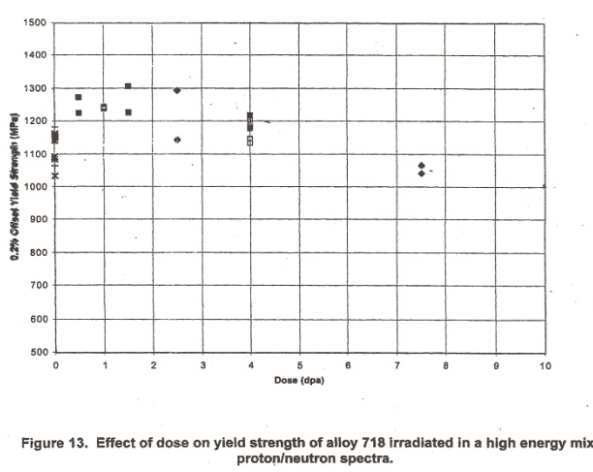
Irradiation Damage and Replacement
Beam transmission through the window incurs heating causing thermal stress.
Beam irradiates the window causing mechanical properties to change.
Beam window design criteria is 20 dpa (displacement per atom). Beam window reached the end of its life.
Estimate dose rate is 100 R/hr at contact without shielding and highly contaminated.
We replaced window in March 2010, stored at Area A and shipped to CMR in November 2010.
Calculated Von Mises stress under pressure and thermal load at the center of the target is ~ 510 MPa.
Window will fail when Von Mises stress > the yield strength
718 Yield
Dose, dpa
15
18
20
End of run cycle 2009

Slide 25
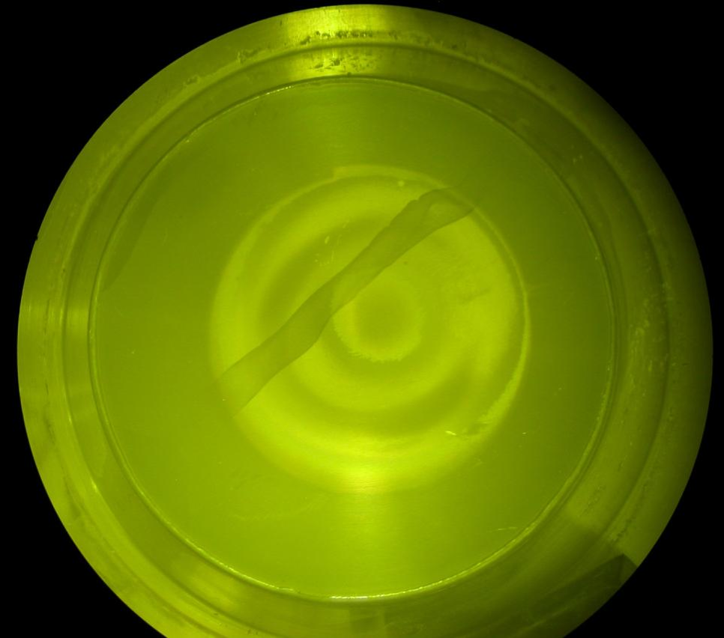
Image of Beam Window Surface
Outline of beam collimator is evident on beam window
Approximate dimensions are 10 cm diameter x 0.5 mm thick.

Slide 26
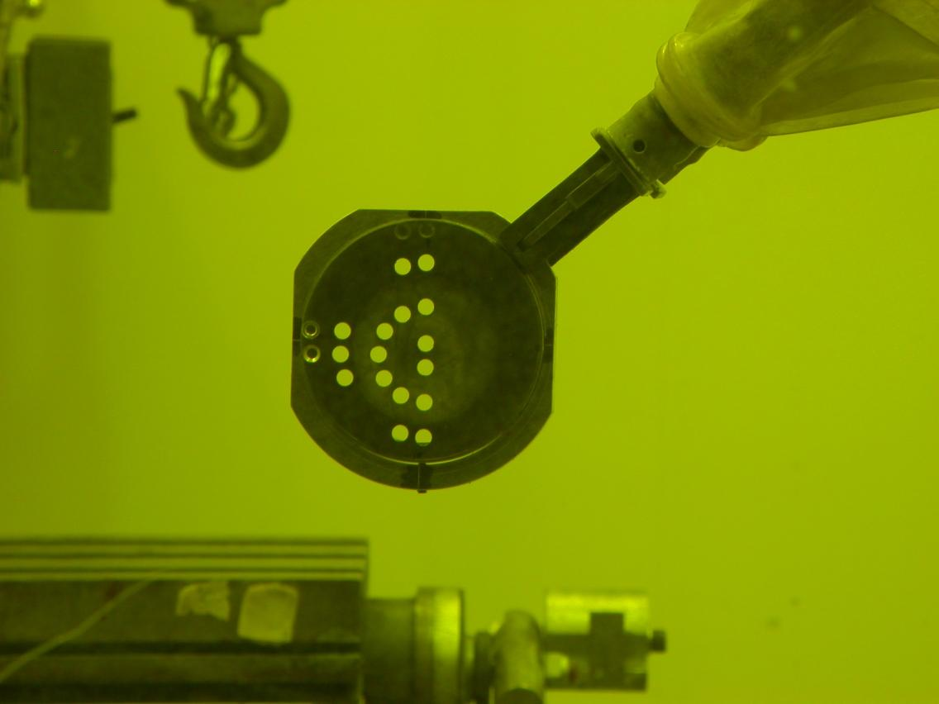
Machined Window

Slide 27
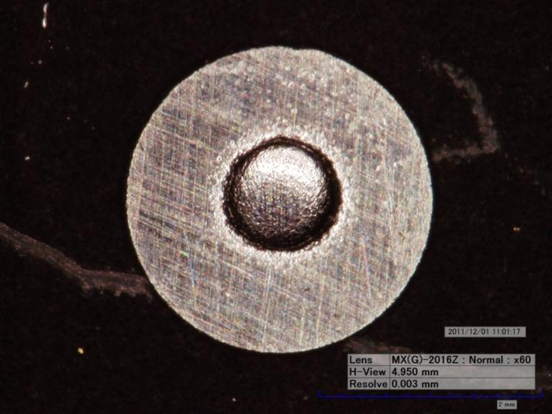
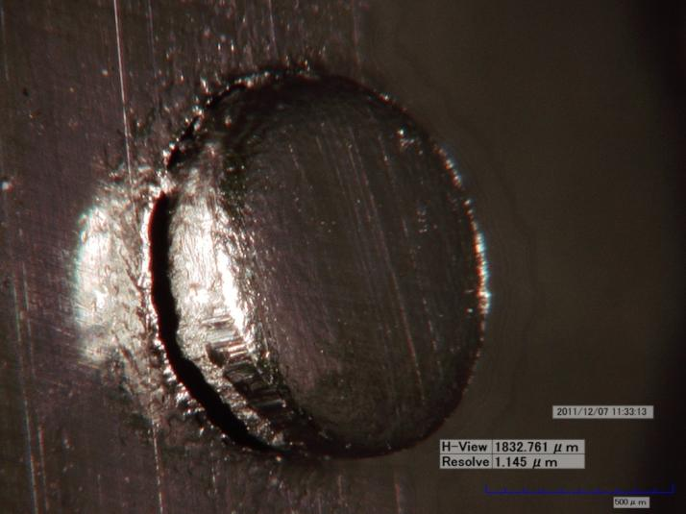
Optical Images of Control Sample #6 (Unirradiated)

Slide 28
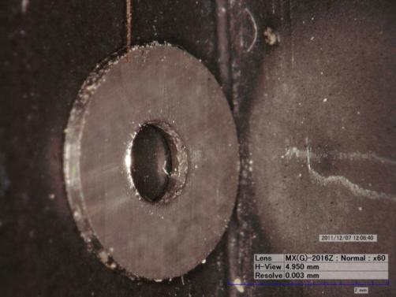
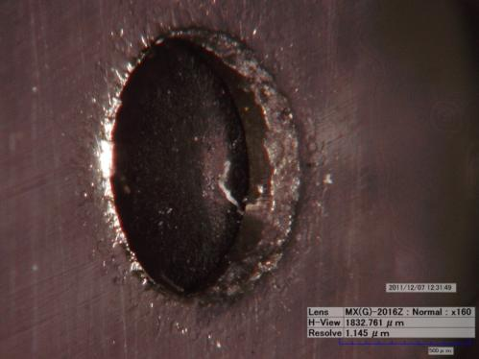
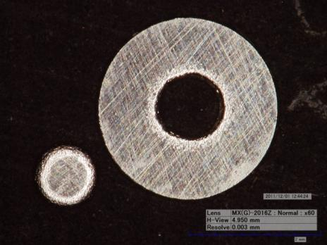
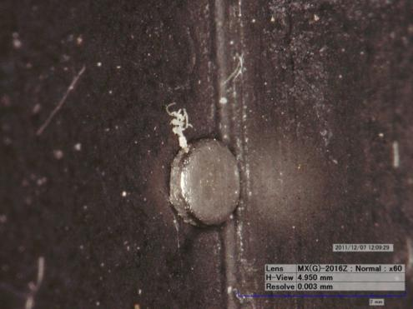
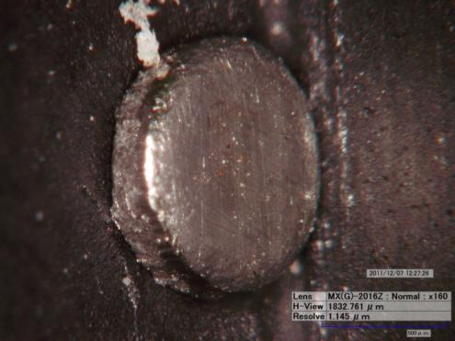
Optical Images of Sample # 8 (High Radiation Ring)

Slide 29
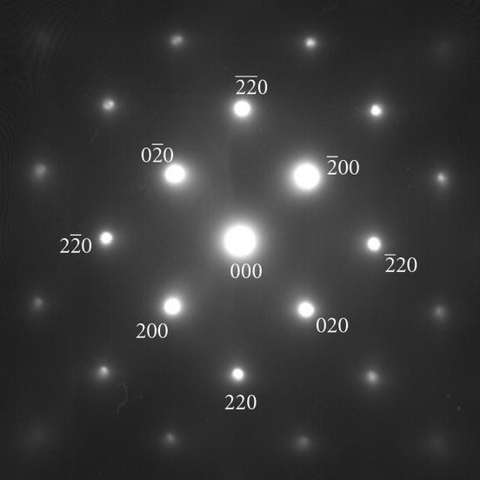
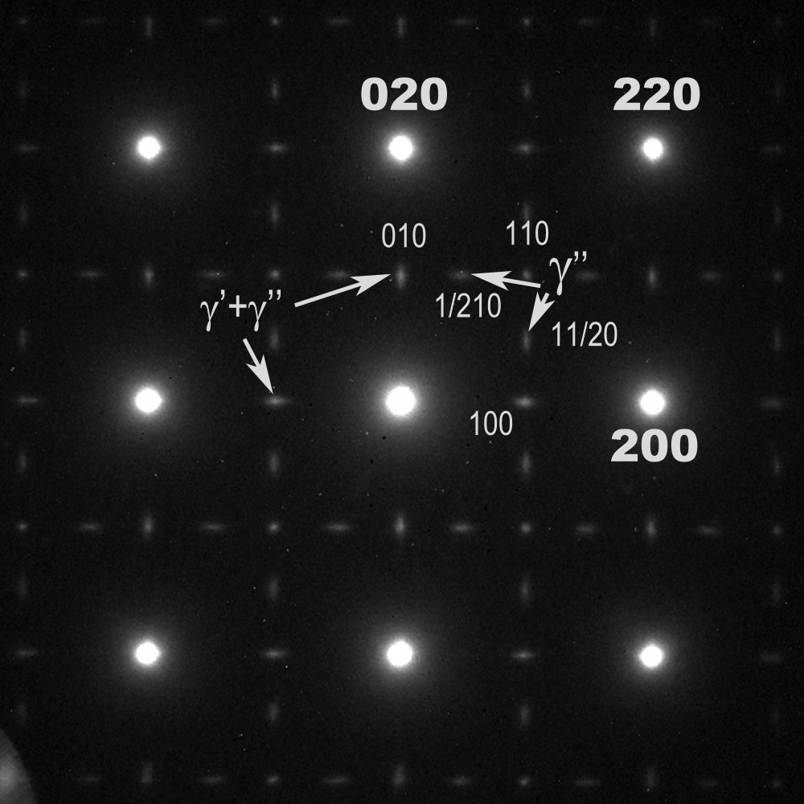
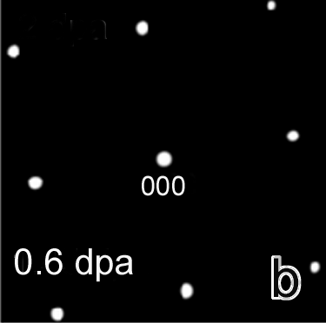
z=[111]
z=[001]
z=[001]
Unirradiated (SA)
0.5 dpa at 50°C
12.5 dpa at 109°C
Reference: M. Dehmas et al. Advances in Mat. Sci. and Eng (2011)
z=[001]
z=[001]
Unirradiated-PH
0.5 dpa at 30-60°C

Slide 30
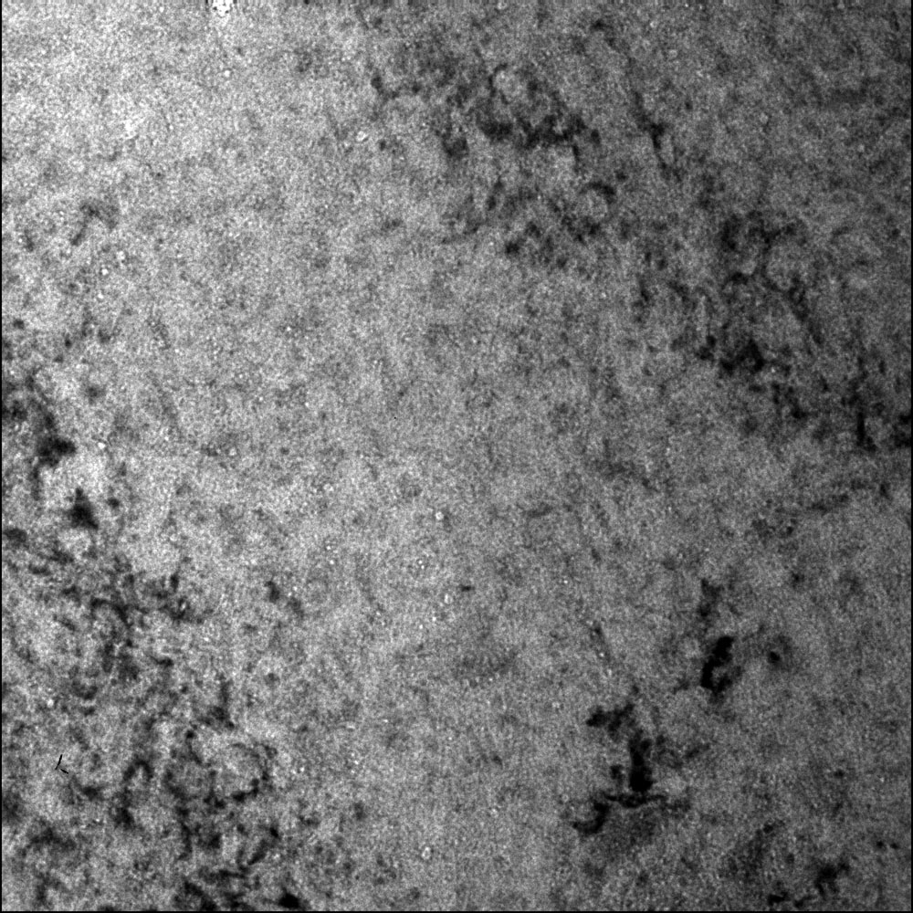
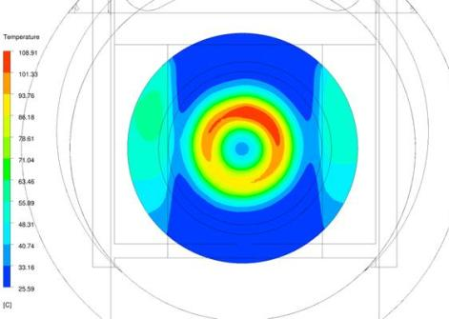
Inconel 718 #19 ~ 0.5 dpa @50°C
under focus
under focus
109C
0.25-1.5 dpa
Bright field TEM images showing dislocation loops.
Under-focus TEM images on the right are showing a high
Density of bubbles/voids that are on the order of 5-10nm.
25C

Slide 31
Inconel 718 #19 ~ 0.5 dpa @50°C γ“ precipitates

Slide 32
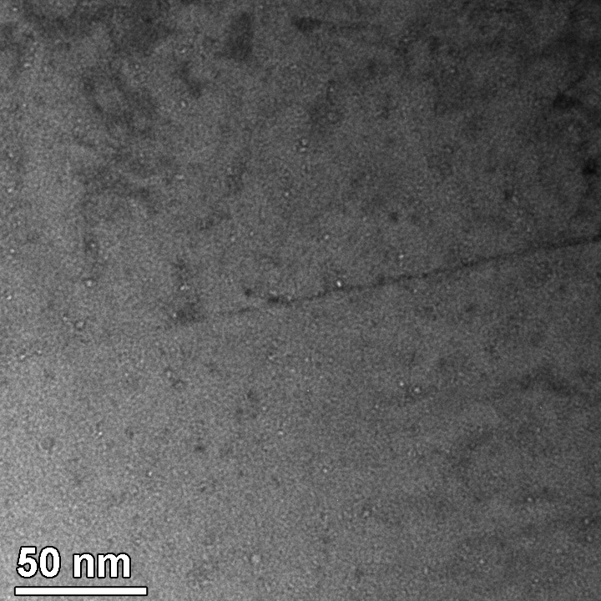



0.5 dpa 50°C

Slide 33





Inconel 718 #16~ 2.5 dpa @ ~40°C
109C
2-5 dpa
25C

Slide 34


Inconel 718 #5 ~12 dpa @109°C
109C
12dpa
Bright field TEM images showing dislocations, precipitates are not detected?
25C

Slide 35




Inconel 718 #E ~11 dpa @~75°C
109C
11 dpa
25C

Slide 36



Loop size and density
Reference: M. Dehmas et al. Advances in Mat. Sci. and Eng (2011)
Loop density
Loop size

