Slide 1
First SNS Target Replacement Experience
M. Dayton, M. Rennich, Van Graves, J. DeVore
Presented by T. McManamy
October 2009
Workshop on Applications of High Intensity Proton Accelerators
October 19-21, 2009
Fermi National Accelerator Laboratory, Batavia, IL, USA

Slide 2
Overview
Initial Target Replacement
Target Maintenance Environment
  Target Service Bay
  Maintenance Equipment
  Target Process Configuration
  Radiation and Contamination
Target Change-out Operations
First Change-out Experience

Slide 3
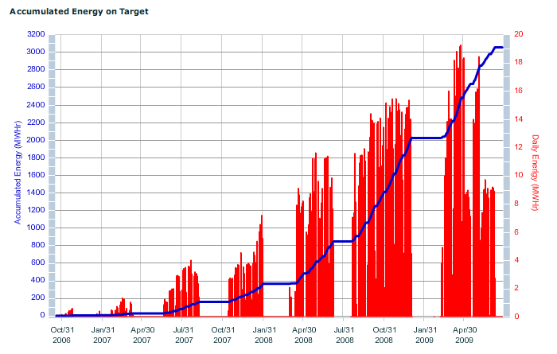
First SNS Target Replacement
Replacement of the first SNS target was successfully completed during a planned outage in August 2009
  Over 3000 Megawatt-hours of accumulated energy had resulted in dpa damage levels which necessitated replacement of the first Target Module
  As beam power levels increase, Target Module replacements could occur ~ 4 times per year

Slide 4
First SNS Target Replacement
Replacement of the target module was accomplished using only remote handling tooling and procedures (hands-on operations are not possible)
While the tooling and procedures utilized enabled successful replacement of the target, several design and operational concerns were highlighted during the process
The following charts give an overview of the target replacement process along with the insights gained

Slide 5
Target Change-out Environment
A shielded “Target Service Bay” located downstream of the target-proton beam interaction monolith serves several key functions:
  Enclosure of the mercury process
  Maintenance of the mercury process equipment, including the target
  Processing and disposing of spent mercury processing equipment
  Constructed using 1 meter of high density concrete
The Target Service Bay is designed for full remote operation. An array of sophisticated remotely operable tooling is deployed inside the cell with a bridge mounted servo-manipulator as the key element.

Slide 6
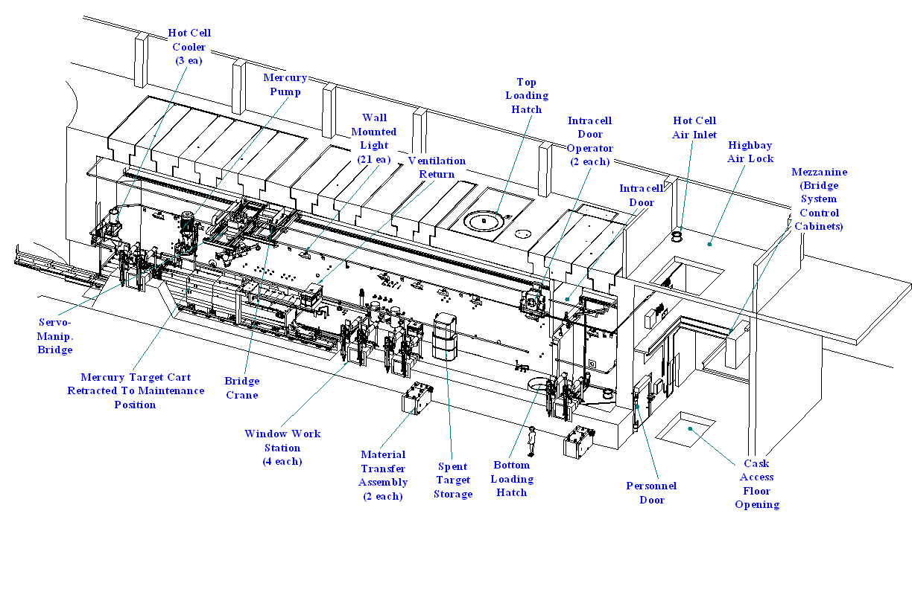
Target Service Bay

Slide 7
Target Service Bay
Mercury Pump
Servo-Manipulator
Target
Cart
Service Bay Size: 31.4 meters x 4.3 meters

Slide 8
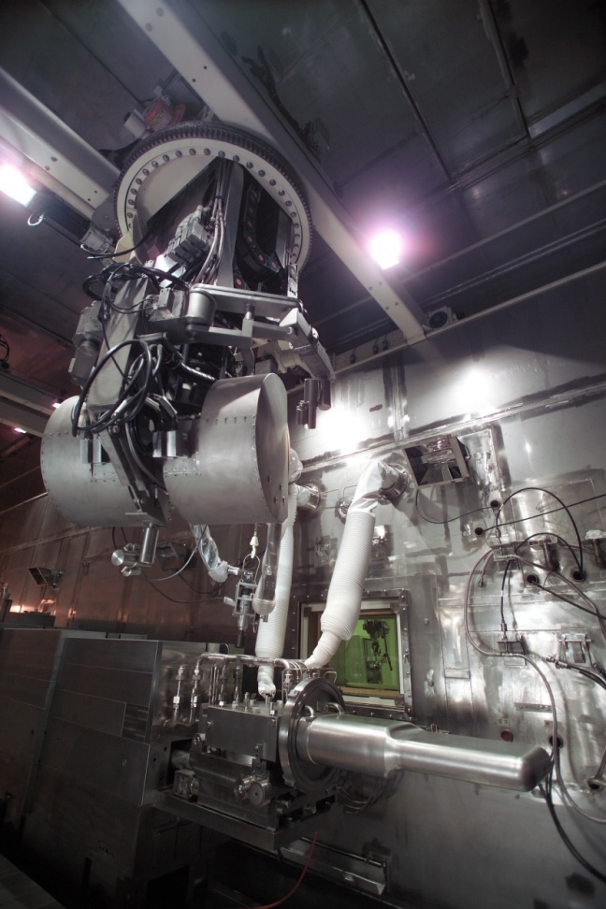
Telerob EMSM 2B Servo-Manipulator
Master-Slave Manipulator
The servo-manipulator is the defining feature of the SNS hot cell:
  Dual-arm, high performance servo-manipulator provides full cell coverage.
  Mounted on a 4-degress of freedom bridge and boom system.
  Master arm position control with Force Feedback
  Digital Control
  50 lb Continuous Capacity/100 lb peak.
  Three On-Board CCTV Cameras
  500 lb capacity Aux Hoist
Servo-Manipulator

Slide 9
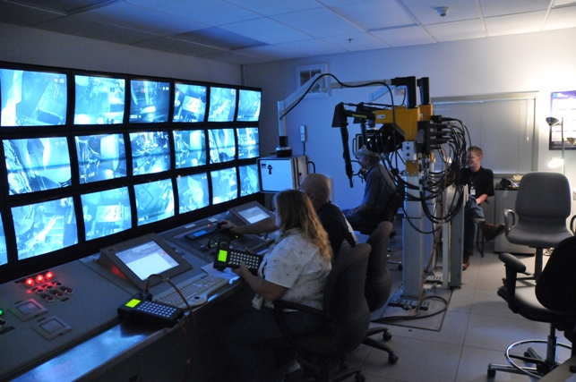
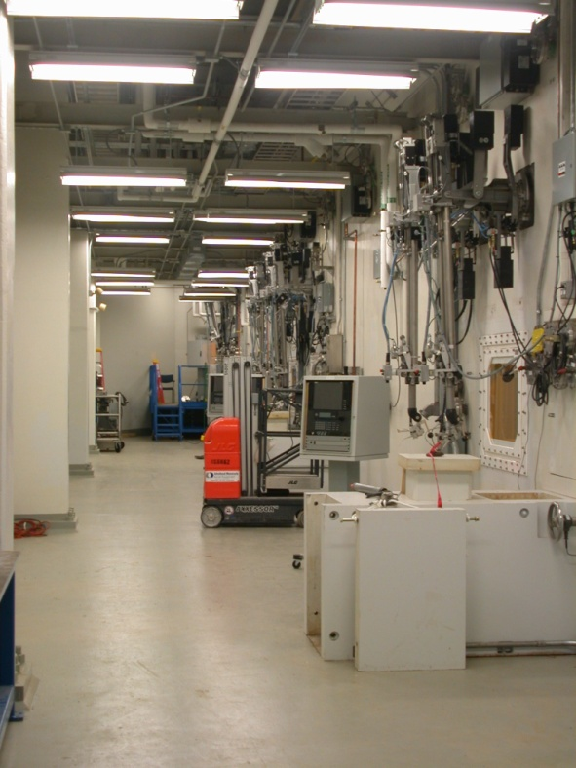
Maintenance Equipment
Four window workstations each containing a pair of master-slave manipulators are built-into the target service bay. Only one is workstation is dedicated to target change-out.
The servo-manipulator is required to perform most operations including bolt torquing, tool transport, inspections and precision operations.
Remote Handling Control Room
Manipulator Gallery

Slide 10
Mercury Process Configuration
The mercury process is simple and highly reliable. It circulates ~1.4 cubic meters (20 tons) of mercury with a centrifugal sump pump through the target and tube-in-shell heat exchanger at the rate of 16 l/s.
A 2” dump valve (all metal) used to drain the mercury to a shielded storage tank is the only active element.
However, the process loop requires numerous complicating elements such as; monitoring sensors, off-gas control vents, spill recovery lines, and power, vacuum and compressed air services.

Slide 11
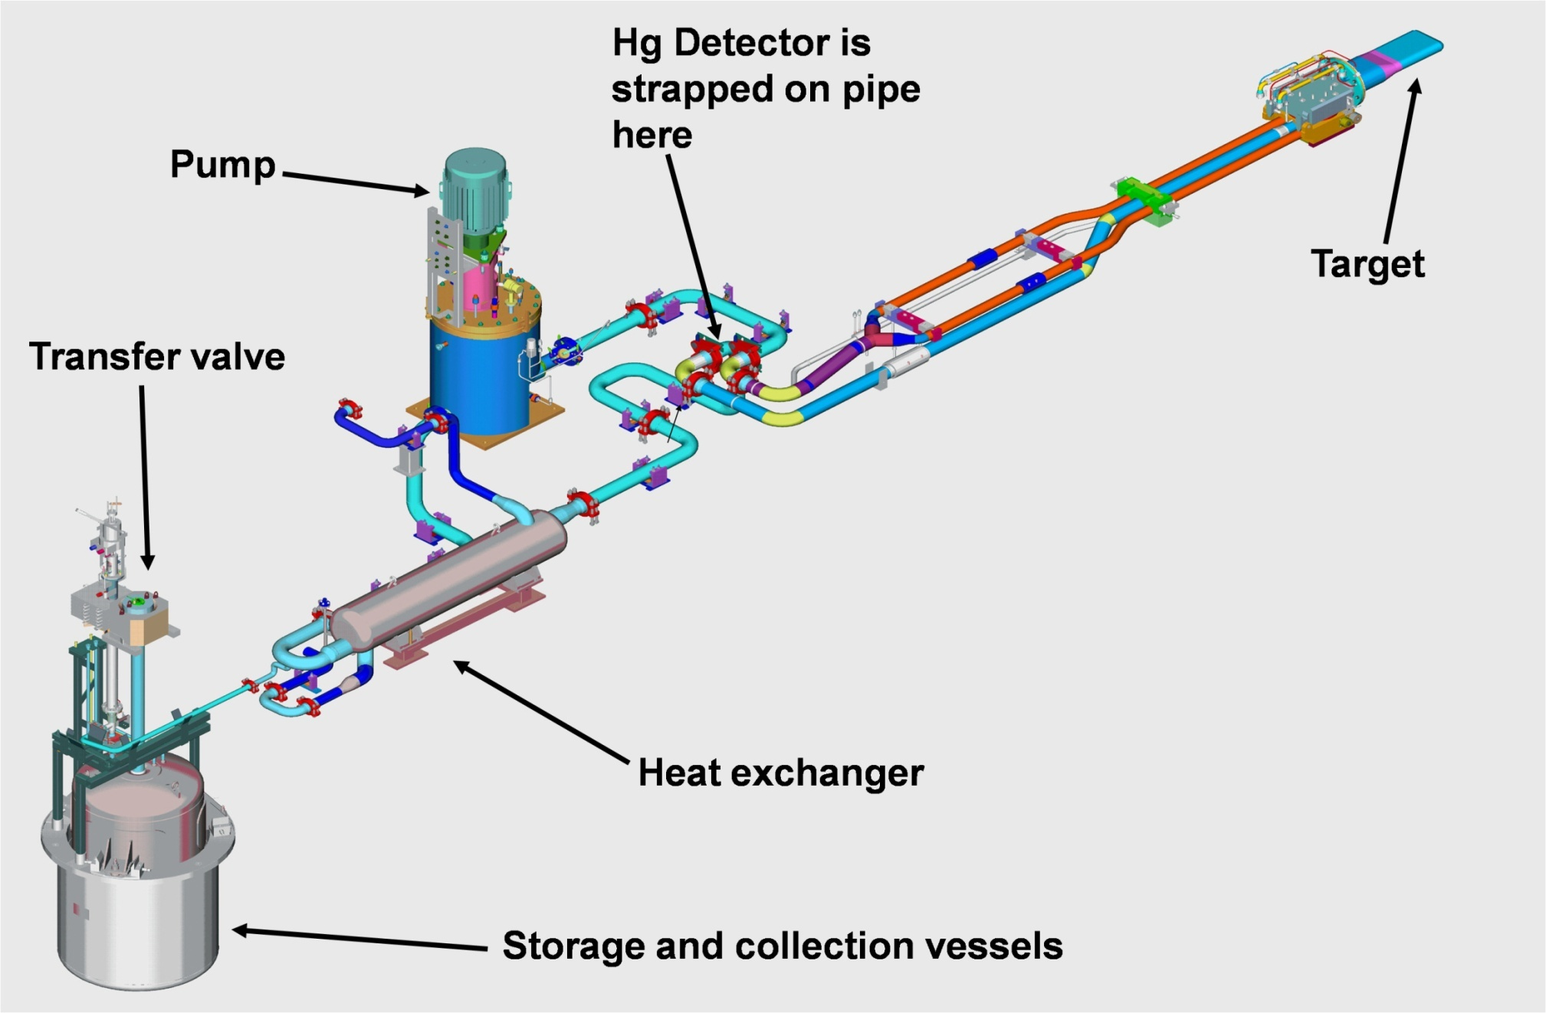
Mercury Process Configuration
Radiation Detector located on return line

Slide 12
Radiation Environment
During Beam-On Operations
  Mercury process equipment contact radiation level is ~400 gray/hr
  Steel shielding (.2 - .3 m) inside cell reduces area background to ~ 2 gray/hr
During Maintenance Operations
  With mercury drained from process lines, residual contamination results in contact radiation levels of 3-5 gray/hr
Target Radiation Levels (following 400 kW operation)
  ~14 gray/hr at 1.1 m six days after shutdown
  Full power targets (2 MW operation) are expected to be ~ 70 gray/hr at 1.1 m

Slide 13
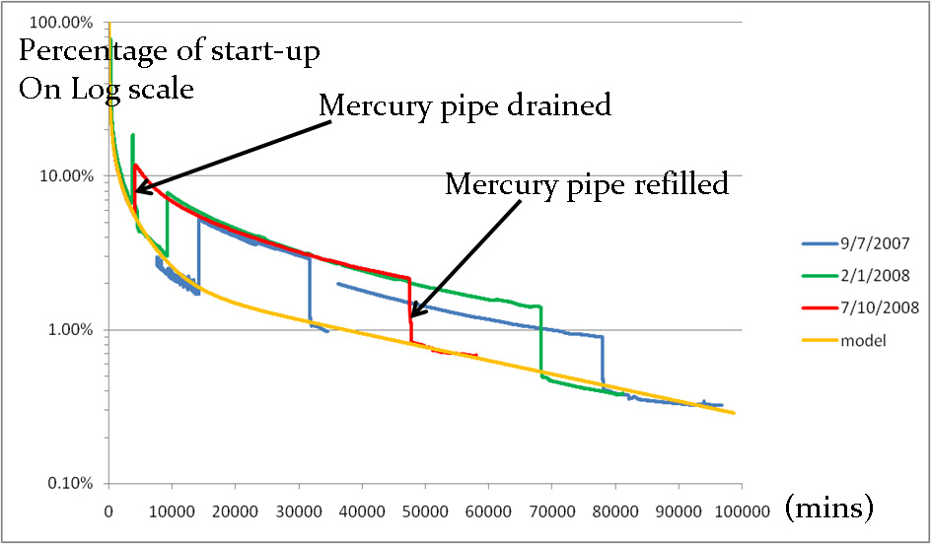
Radiation Environment
Dose rates measured on Mercury Process Piping
SNS Radiation Measurements After Shutdown
~ 5 Gray
1 Week (Target Cart Retraction)
Chengeng Zeng/David Freeman, ORNL

Slide 14
Contamination Environment
Experience has shown that the isotopic particulate contamination is long-lived and wide-spread inside the Service Bay. At the end of the first target change-out the cell background away from the process area had risen from essentially clean (10,000 disintegrations/min smears) to 400 mrad/h smears.
  Service Bay contamination has also migrated to the Transfer Bay due to in-cell ventilation systems and movement of the in-cell crane and servo-manipulator into the Transfer Bay as a part of normal operations
    A recent localized survey yielded 3,000,000 disintegrations/min smears in the Transfer Bay

Slide 15
Mercury Vapor Environment
Opening the mercury process lines results in an expected increase in mercury vapor in the Service Bay during replacement operations
Once exposed to atmosphere, the mercury forms an oxide layer that mitigates vaporization until disturbed by vibration or movement
The following charts depict the spikes seen in mercury vapor levels in the Service Bay (in micro-g/m³) during operations involving the mercury process system

Slide 16
Mercury Vapor Environment
September, 2006 Outage Hg Concentration
Initial Shield Block Removal
Initial Hg Cart Pushback
Empty Hg catch pots, reinsert cart to monolith
Loop Evacuation and Filling
Service Bay Entry
Loop Drainage to storage tank
Hg sample initial system breach
Transfer Hg sample, cell cleanup
Install gaskets
Taking Hg Sample
Analyzer Calibration
Analyzer Calibration

Slide 17
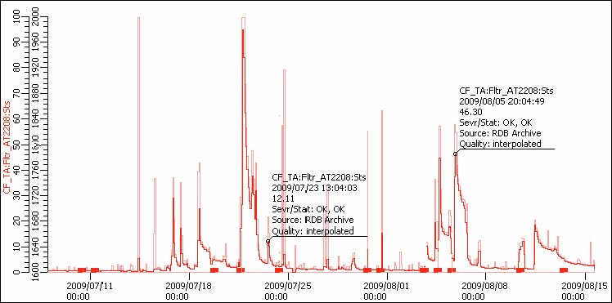
Mercury Vapor Environment
First Target Replacement Hg Concentrations
Hg Vapor (micro-g/m³)

Slide 18
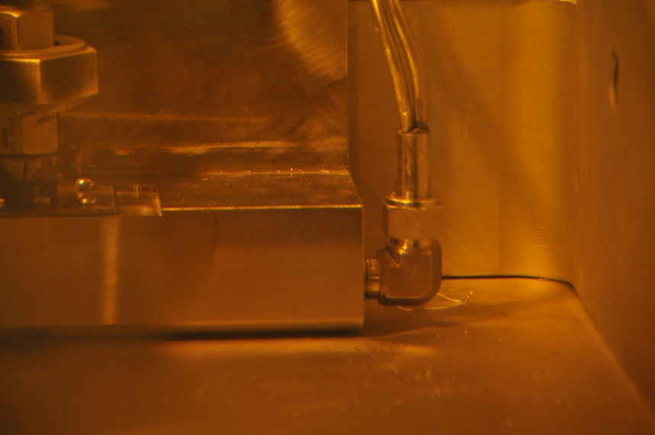
Mercury Vapor Environment
The mercury vapor environment also leads to widespread condensation of mercury on surfaces within the Service Bay unrelated to the Target replacement operations
Mercury condensate on Target Cart surfaces

Slide 19
General Reliability Considerations
The target and target process are single-point failure elements for the SNS facility.
With an expected life of a few months the target change-out operation was the focus of the cell design. The mission goal was a target exchange in five days with an expected target change-out rate of four per year.
Change-out (repair is not feasible) of the larger process equipment will be difficult and time consuming. Lifetimes for the heat exchanger, pump and dump valve is expected to be greater than 7 years. With preventative maintenance monitoring change-out of this equipment can be performed during planned facility shut-downs.
Redundancy was evaluated and found to reduce reliability by introducing more components and complexity to the process.
The servo-manipulator is required to perform virtually all process equipment operations. It has redundant bridge drives to move the system to the transfer bay for hands-on maintenance.

Slide 20
Major Target Replacement Operations
Removal and Reinstallation of the following components take place during each target replacement:
    Four pieces of in-cell shielding (14 tons of steel)
    Nine process and utility jumpers at the back of the target cart (1/2 inch fittings in addition to instrumentation connectors)
    Two 2” and two 6” water coolant and mercury process lines
    Seven process and utility jumpers at the target (1/2” to 2”)
    One spent and one new target module (8 ea. 1” tie-down bolts and 4 ea. jack screws)
Other operations include:
    Movement of the 100 ton target cart over 9 meters
    Handling of over 50 pieces of tooling
    Capture and return of released liquid mercury from open pipes
Requires four person crew/one shift operation

Slide 21
Planning versus Experience
Extensive procedural development and cold mock up testing efforts resulted in a successful target module replacement process
Initial reluctance to introduce complexity (and the associated risk) to the process drove early decisions to forego complex redundancy and interim testing measures to the design and replacement process
The recent fully-remote replacement operation focused attention on several areas of risk with this approach
  Interim process fitting leak testing
  Limitations on remote handling equipment reliability
  Limitations on remote handling equipment capability

Slide 22
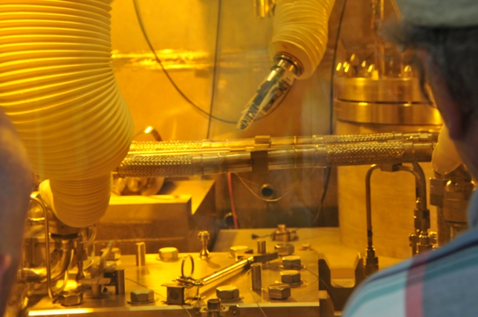
Issue 1: System Connection Test Difficulties
Due to the lack of valving in the target process loop, change-out connections cannot be tested until the Target Cart is fully inserted. Additionally, access to many of the system connections are precluded due to full insertion of the Cart.
Four target systems are potentially impacted:
    Mercury loop
    Coolant water loop
    Target Seal Helium pressure
    Target Seal Vacuum
Coolant Loop Jumper Removal
using the servo-manipulator and
master-slave manipulators
simultaneously

Slide 23
Issue 1: System Connection Test Difficulties
Mercury loop integrity testing is accomplished using a vacuum leak test when the system is fully assembled (target cart fully inserted)
  Initial vacuum testing indicated a substantial leak
Leak detection activities were impacted as only three of the five mercury process loop connections are accessible with the Target inserted. Retraction of the Target to access the remaining two connections precluded testing due to the open process loop.
Test fixtures and procedures were developed real-time to enable the leak to be identified. It was ultimately fixed by simply tightening a loose fitting.

Slide 24
Issue 1: System Connection Test Difficulties
It took approximately 3 weeks to work though this problem. Many of the tools and procedures developed during that period will be used regularly in future replacements to avoid a repeat.
Additional procedures will be developed to enable interim testing of the remaining three systems (water, helium and vacuum) to identify potential problems prior to insertion of the Target Cart.
  These procedures add complexity, time and risk to the replacement process

Slide 25
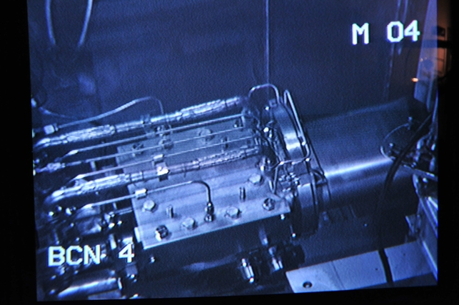
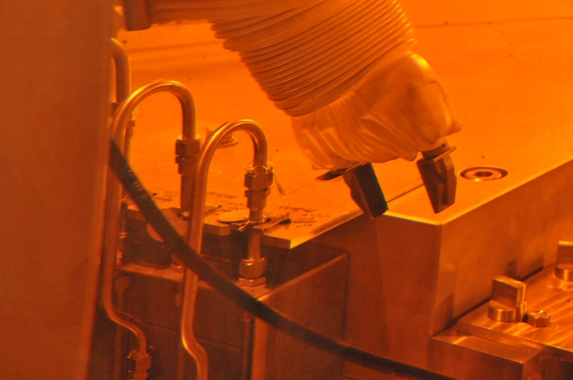
Issue 1: System Connections
Target utility jumpers are tightly packed. This makes remote access to the fittings difficult.
Jumpers between Target and Target Cart
Re-connection of utilities between
Target Cart and Facility

Slide 26
Issue 2: Counter-intuitive Target Cart Locking Mechanism
The target cart is spring-loaded in the operating position to accommodate thermal expansion with an unnecessarily complex locking mechanism.
  During Target Cart insertion, brake pins are inserted at the aft portion of the Cart and then heavily-preloaded springs act against the pins to maintain a preload on the Cart
    Subsequent retraction of the pins requires removal of this preload
  During remote operations it was very difficult for the operators to assess the point at which the preload had been removed prior to retracting the brake pins
    The initial pin retraction attempt resulted in deformation of the portion of the structure that applies force to retract the brake pins

Slide 27
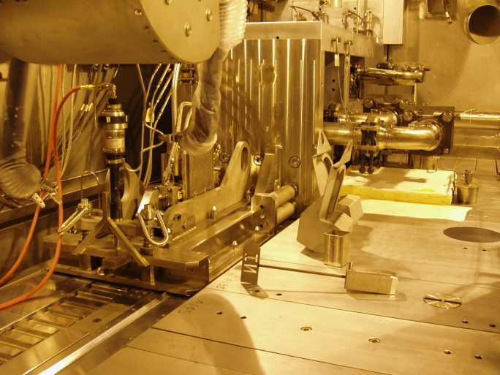
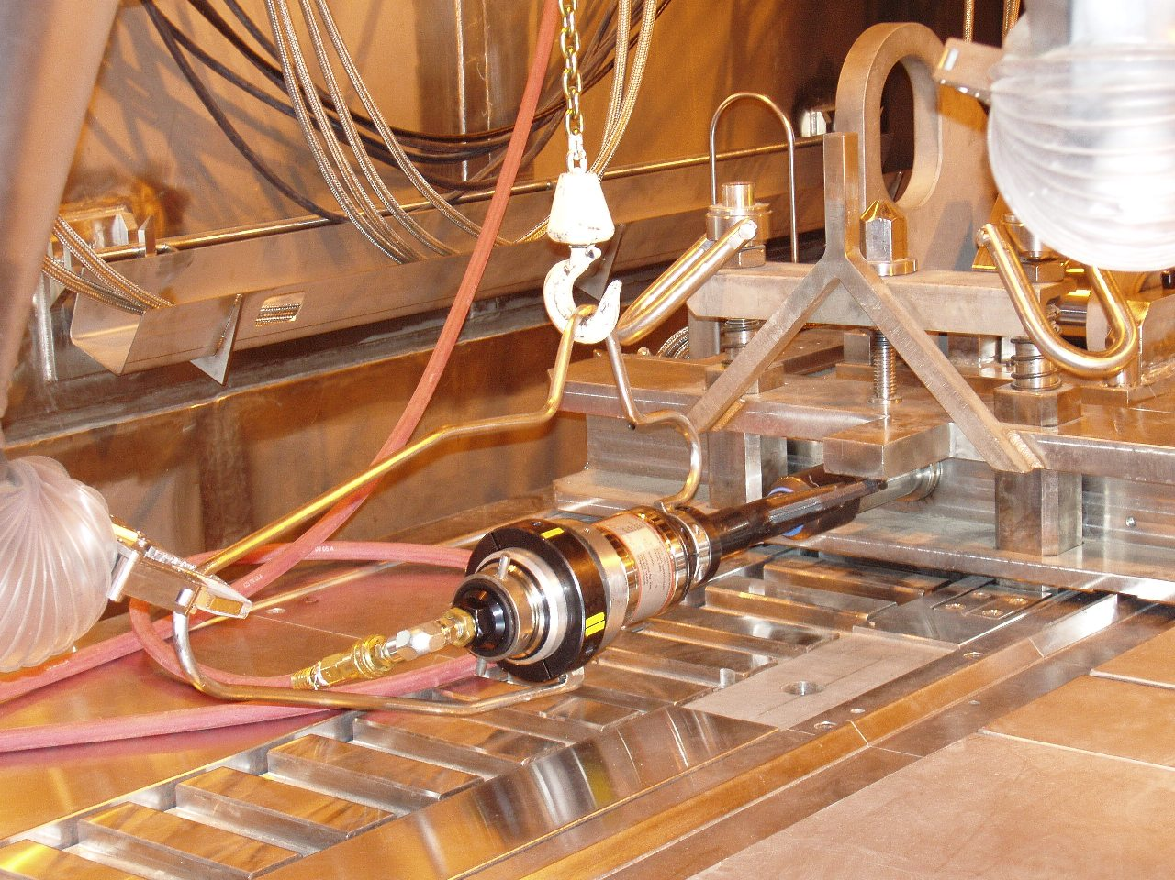
Issue 2: Counter-intuitive Target Cart Locking Mechanism
Brake pin preload/insertion mechanism
Brake pins
Locking Mechanism at Aft End
Of Target Cart
Using pneumatic wrench to preload springs

Slide 28
Issue 2: Counter-intuitive Target Cart Locking Mechanism
The mechanism remains functional but the damage has resulted in further difficulties in ensuring proper pin engagement
This issue highlights the need to design remotely-operated hardware in such a way to ensure robustness and mitigate technician judgment

Slide 29
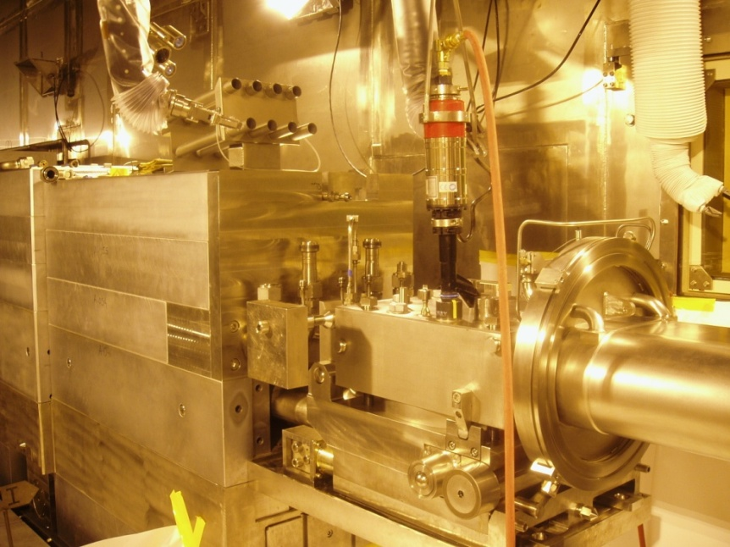
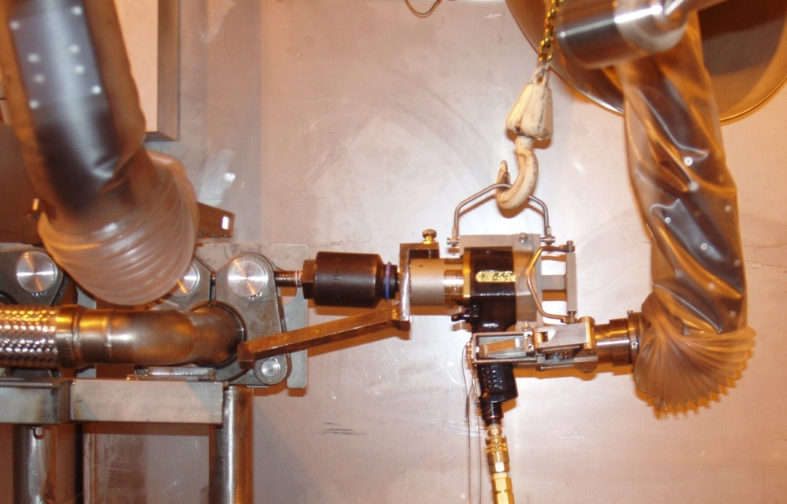
Issue 3: Torque Tools
Proper torquing is important for many target related connections; this proved to be more difficult than the cold mockup tests indicated.
Pipe and tubing jumpers are generally tightened with manual wrenches. It was found that ensuring the correct torque application for threaded connections was difficult due to the design of the manual torque wrenches.
The target tie-down bolts were torqued with sophisticated pneumatic motor driven tools with the capability of remote torque and speed adjustment. While functionally these have operated very well lubrication has proven to be more difficult than planned…
Torquing of Target Bolts
Torquing of Coolant Line Flange

Slide 30
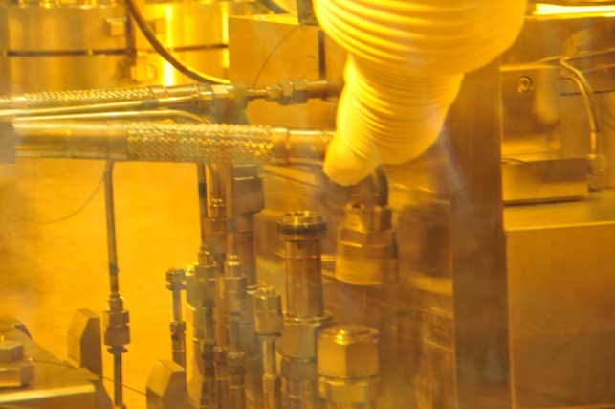
Issue 4: Thread galling
Stainless steel fittings and fasteners are used extensively through out the process. While galling has not been a problem to date the extreme consequences make it an ever present threat during remote operations.
One of the single-bolt Grayloc connectors galled during pre-ops testing. This lead to a policy of regularly using anti-seize on threads considered to be vulnerable.
A means of remotely applying anti-seize on threads is currently being developed.
Anti-seize visible
on threads
Removal of Coolant Line Jumper

Slide 31
Issue 5: Maintenance Tool Reliability
The remote handling equipment is the most complex and delicate equipment in the Service Bay
  Common issue in cells where light weight and dexterous tools are inherently less rugged than process equipment
The SNS remote handling tooling performed well, however several delays were experienced
  Several servo-manipulator grip (finger) repairs
  Master-slave manipulator removal for hand repair
  Failure of a pneumatically-operated wrench
Failures resulted in approximately 14 hours of lost time
Tool failures compound operational difficulties by extending time and usage of the remote handling equipment leading to increased tool failures

Slide 32
Conclusion
The first SNS Target Module was successfully replaced during a planned 45-day facility maintenance shut-down.
Planned target change-out operations fit within the design goal period of five days.
Un-planned events caused significant delays and highlighted areas in which the tooling, process components and operations can be improved.
The un-planned events experienced are relevant to many mercury process system elements and therefore are of broad concern.

