Slide 1
Studies on charge selection at MOMENT
Yingpeng Song
Jingyu Tang, Hantao Jing, Zhihui Li
August 11, 2015

Slide 2
Outline
Necessity for charge selection at MOMENT
Charge selection by dipole chicane
Comparison between dipoles scheme and curved solenoids scheme
Summary

Slide 3
Requirement for charge selection
At target, both π+/π- are produced, but one specie muon is used for experiment at a time [very low background of the other].
In conventional neutrino beam lines, magnetic horns focus only one charge; in solenoids-based capture system (such as MOMENT), both charges are focused equally.
Designing a charge selection scheme:
  High effectiveness of selection (purity)
  High transmission efficiency (and low emittance growth)
Discarded pions or muons may be used for other purposes

Slide 4
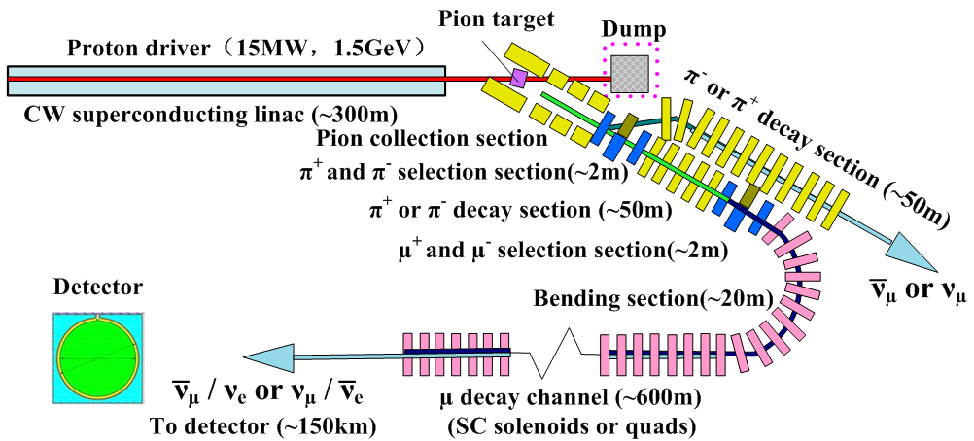
Layout of MOMENT
A
B
Two alternative charge separation locations A and B, separating either pions or muons of different charges.

Slide 5
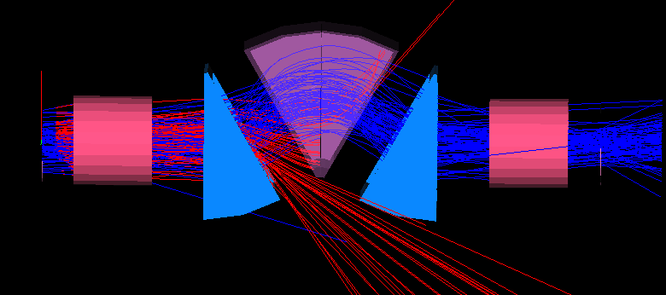
Charge selection by dipoles
The chicane is composed of three combined function dipoles (superconducting, reference particle: -20°/40°/-20°). By adjusting the edge angles and gradients to make the required focusing in both horizontal and vertical planes.
Wrong charged particles can be stopped or separated from the selected one.
Blue: pi+ red: pi-

Slide 6
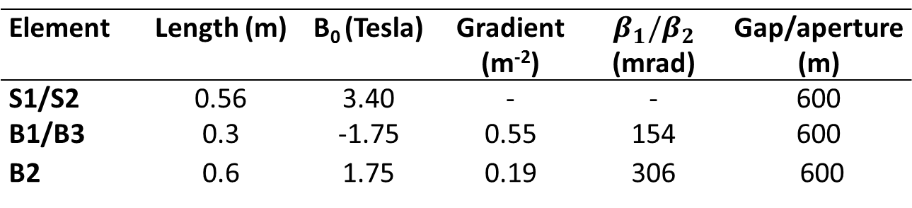
Challenges:
  Very large apertures due to extremely large emittance (field overlapping)
  Very large momentum range
Beamline and parameters
B2
S1
B1
B3
S2
Reference momentum for mu+: 300MeV/c
Element | Length (m) | B₀ (Tesla) | Gradient (m⁻²) | $$β_{1}/β_{2}$$ (mrad) | Gap/aperture (m)
S1/S2 | 0.56 | 3.40 | - | - | 600
B1/B3 | 0.3 | -1.75 | 0.55 | 154 | 600
B2 | 0.6 | 1.75 | 0.19 | 306 | 600

Slide 7
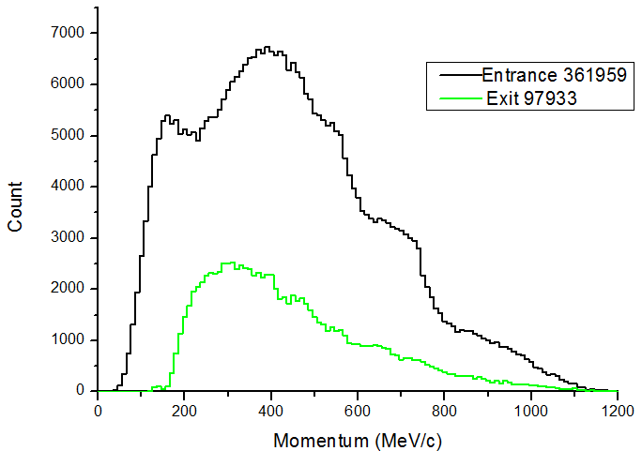
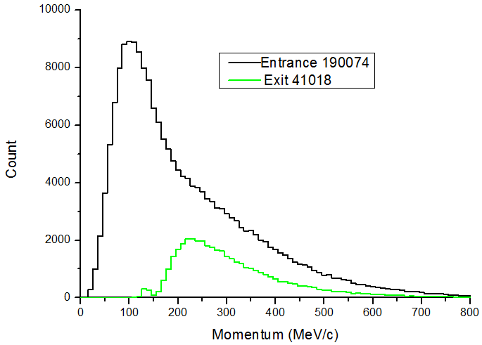
Simulation results
By using G4Beamline
 | Entrance | Exit | Transport efficiency
π+ | 361962 | 98043 | 27.1%
π- | 146706 | 21
μ+ | 190077 | 61828 | 32.5%
μ- | 98892 | 1
pi+
mu+

Slide 8
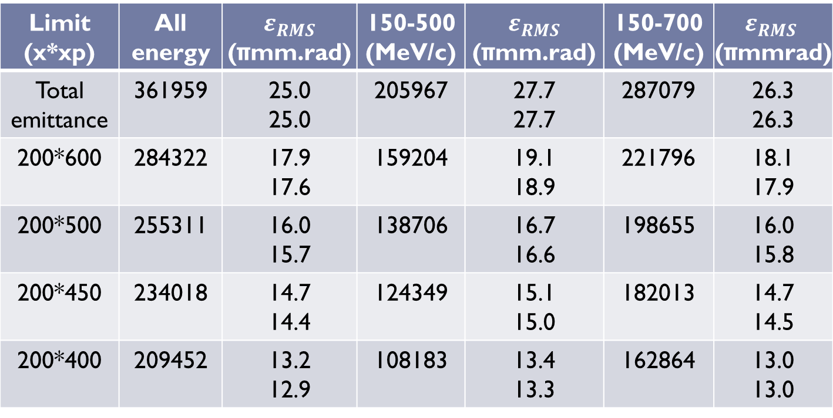
Analysis of the distribution of pi+ at the end of capture
From the target simulations
Limit (x*xp) | All energy | $ε_{RMS}$ (πmm.rad) | 150-500 (MeV/c) | $ε_{RMS}$ (πmm.rad) | 150-700 (MeV/c) | $ε_{RMS}$ (πmmrad)
Total emittance | 361959 | 25.0 25.0 | 205967 | 27.7 27.7 | 287079 | 26.3 26.3
200*600 | 284322 | 17.9 17.6 | 159204 | 19.1 18.9 | 221796 | 18.1 17.9
200*500 | 255311 | 16.0 15.7 | 138706 | 16.7 16.6 | 198655 | 16.0 15.8
200*450 | 234018 | 14.7 14.4 | 124349 | 15.1 15.0 | 182013 | 14.7 14.5
200*400 | 209452 | 13.2 12.9 | 108183 | 13.4 13.3 | 162864 | 13.0 13.0

Slide 9
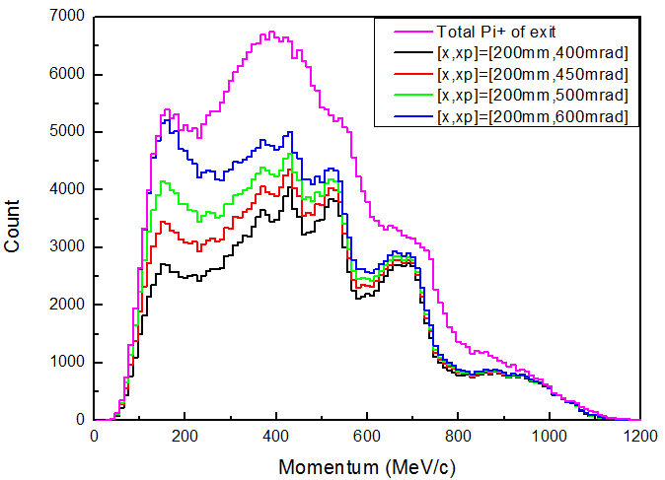
Distribution of pi+ at entrance of selection section
Momentum spectrum of different transverse emittance

Slide 10
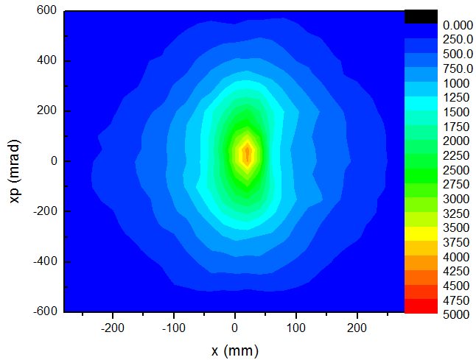
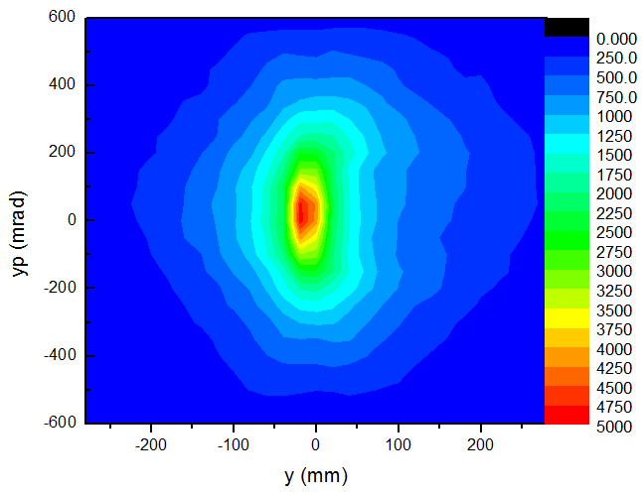
The distribution of pi+ at entrance of selection section
The density of x and y phase plane
Considering the acceptance of the downstream beamline, we choose an emittance of 200mm*450 mrad to transport, it will not cut the core of the beam

Slide 11
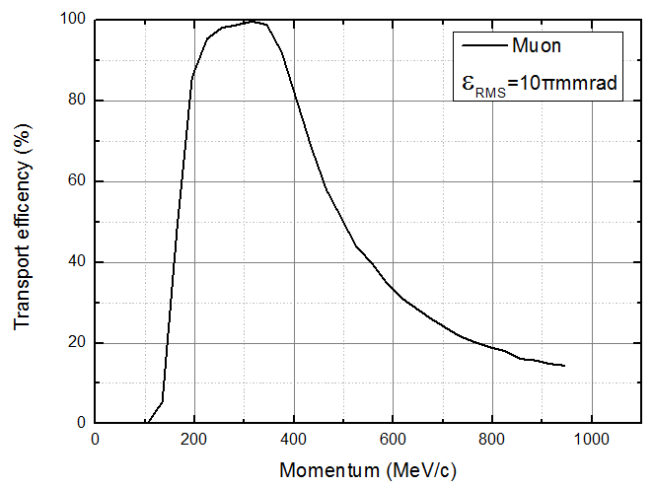
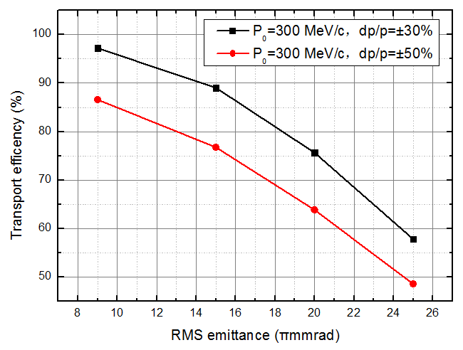
Analysis of particle loss
Mu+ transport efficiency VS momentum and emittance
The curve is obtained from linear lattice, the efficiency is ideal at momentum spread 200-400 MeV/c, but we need to accept wider momentum, nonlinear lattice will be a good choice.

Slide 12
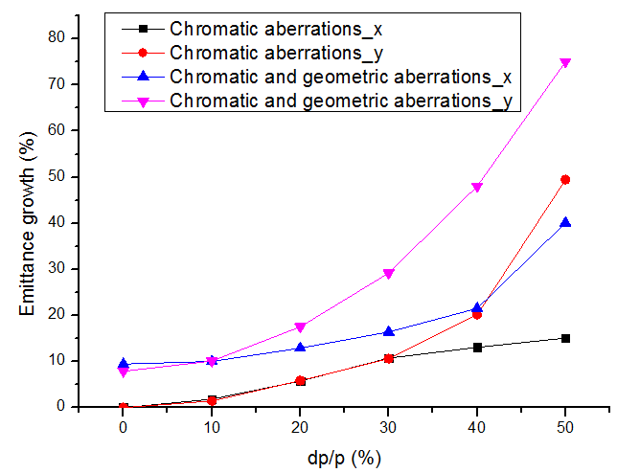

Analysis of particle loss
Emittance growth due to higher order effects
The curve is produced with $ε_{RMS}$=10 πmm-rad,

Slide 13
Charge separation at different locations
A
B

Slide 14
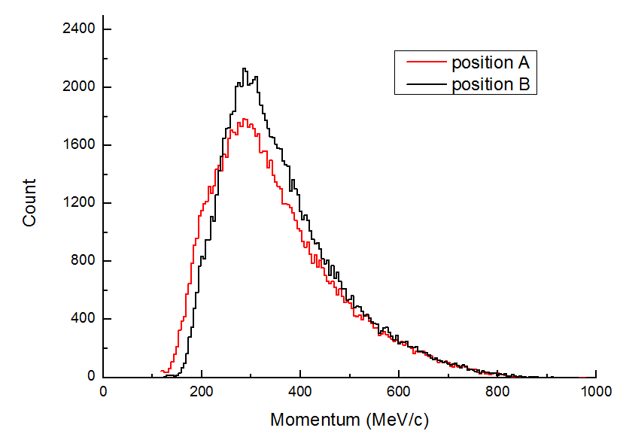
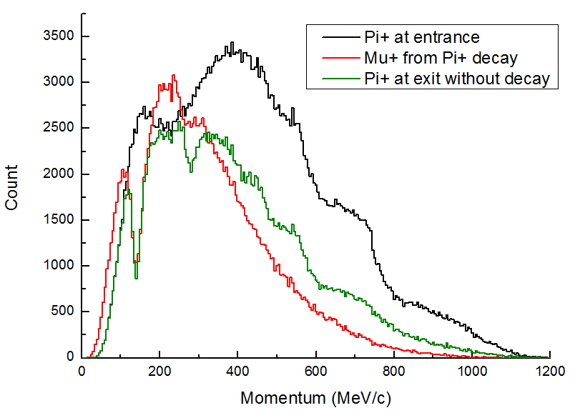
Charge selection at different locations
There is no large difference between two locations, because many high energy pions are lost in the pion decay section.
Muon spectrum at the entrance of muon decay section
The red line is from the decay of green line

Slide 15
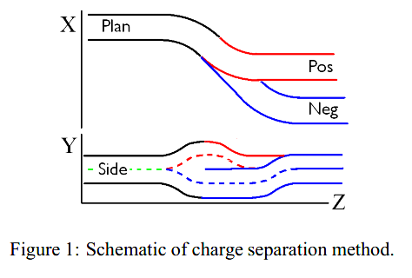
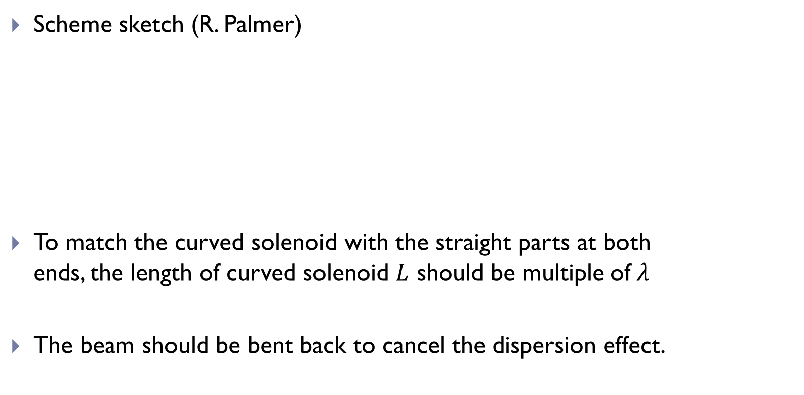
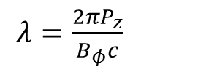

Separation by curved solenoids
Scheme sketch (R. Palmer)
To match the curved solenoid with the straight parts at both ends, the length of curved solenoid $L$ should be multiple of$λ$
The beam should be bent back to cancel the dispersion effect.
$L=n∗λ$
$λ=\frac{2πP_{z}}{B_{φ}c}$

Slide 16
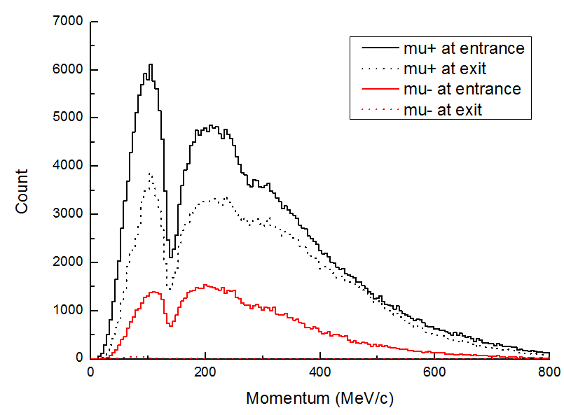

Simulation result by G4Beamline
Parameters and result
Charge selection comprised by 16 unit elements
Unit element：100mm Drift + 500mm Solenoid (Φ=700, $Bz$=3.7T, By=0.25T)
 | Muon+ | Muon-
Entrance | 348821 | 91399
Exit | 251018 | 630
Transport efficiency | 72% | 0.69%

Slide 17
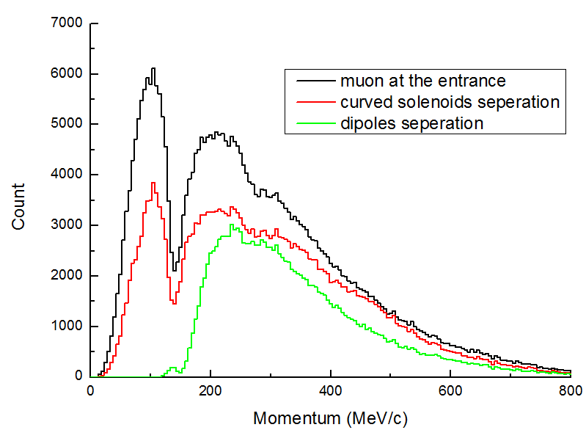
Comparison between curved solenoids and dipoles
 | Curved solenoids | Dipoles
Transport efficiency | 72.0% | 42%
Emittance growth in x plane | 60.0% | 47.1%
Emittance growth in y plane | 60.0% | 24.8%

Slide 18
Decay within the selection section
The decay curves of pion and muon
The reference momenta of muon and pion used in the curve are 291MeV/c and 285MeV/c respectively, corresponding to 300 MeV neutrino.
(Lifetimes of rest pion and muon: 26 ns and 22 μs)
It looks acceptable to have in-course decays.

Slide 19
Problems/limitation
How to reduce the effects by Second-Order Chromatic Aberrations and Second-Order Geometric Aberrations? Then we can reduce the emittance growth.
The realistic transport situation is even worse than the present study, due to the overlapping of the fringe field between adjoining dipoles (very large aperture).
To enhance the acceptance on momentum range, nonlinear field should be introduced, which is still under study.

Slide 20
Summary
Charge separation methods based on both dipole chicane and curved solenoids have been studied, with more details on the former.
Selection for both pions and muons are possible.
For relatively narrow momentum range (300±30%) MeV/c，the results are not so bad, but we hope to increase it to about ±50% by introducing nonlinear fields (more complicated, study just started).
Very large transverse emittance has important impact to the selection, some pre-collimation or low transmission efficiency has to be accepted.

Slide 21
Thank you for attention!

