Slide 1
MOMENT Synergies with Other Projects
Jingyu Tang
Institute of High Energy Physics, CAS
NuFact2015, Rio de Janeiro, Brazil, Aug. 10-15, 2015

Slide 2
Main Topics
MOMENT concept
Proton driver technology synergy with other projects
Target technology synergy with other projects
Neutrino beamline technology synergy with other projects
Detector technology synergy with other projects
Summary

Slide 3
MOMENT Concept

Slide 4
MOMENT Concept
MOMENT: A muon-decay medium baseline neutrino beam facility
MOMENT was launched in 2013 as the third phase of neutrino experiments in China
  Neutrino experiments at Daya Bay continues data-taking
  Jiangmen (JUNO, or DYB-II) has started civil construction
A dedicated machine to measure CP phase, if other experiments (such as LBNF/DUNE, HyperK) will have not completed the task
As a driving force to attract researchers from China as well international collaborators to work on neutrino experiments based on accelerators

Slide 5
A concept to exploit high-flux medium-energy muon-decay neutrinos
Using a CW proton linac as the proton driver
  Based on the China-ADS linac
  15 MW in beam power
  Fluidized target in high-field SC solenoid
  Granular tungsten or mercury jet
  Collection of pions and muons of both charges
  Neutrino beam from pure μ+ or μ- decays
  Medium energy (250 MeV) for medium-baseline experiment
  From long decay channel instead of decay rings for NF and nuSTORM

Slide 6
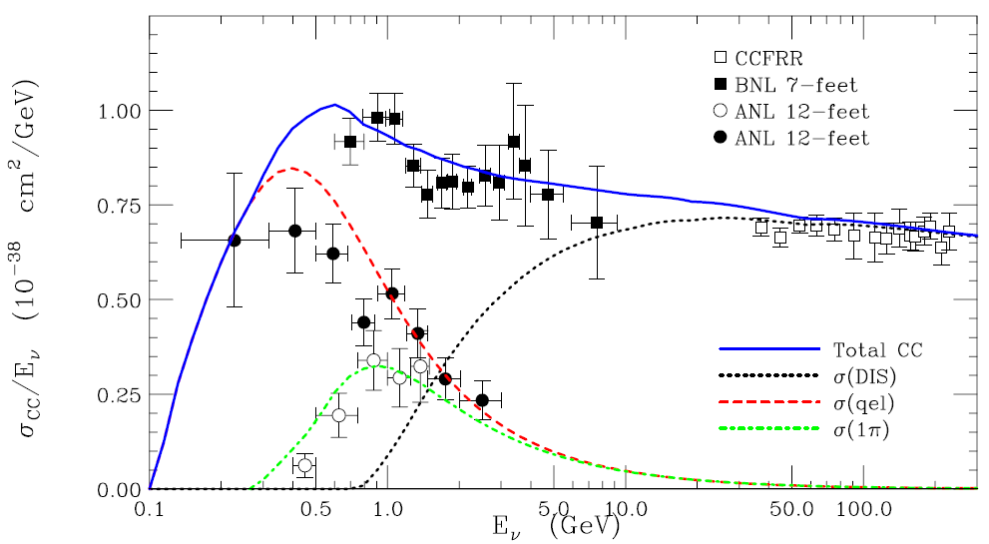
μ Decay channel - a π⁰-free neutrino beam line
Neutrino energy: ~ 300 MeV ➔ baseline = 150 km
Although we loose some statistics due to lower cross section, but we gain by being background free from π⁰

Slide 7
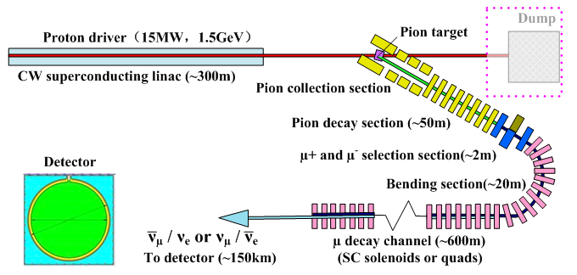
Schematic for MOMENT
Detector
Type to be defined

Slide 8
Proton driver technology synergy with other projects

Slide 9
MOMENT proton driver: a CW superconducting linac
A CW proton SC linac can provide the highest beam power, and selected as the proton driver for MOMENT
China-ADS project and MYRRHA are developing such a CW proton linac. PIP-II (PIXE) is developing CW RF linac but with lower beam duty.
If China-ADS program goes well, the linac could be also used as the proton driver for MOMENT in 2030’s.
  Proton beam: 1.5 GeV, 10 mA (15 MW)
  Alternate: extending energy to 2.0 GeV

Slide 10
Design scheme for the C-ADS linac

Slide 11
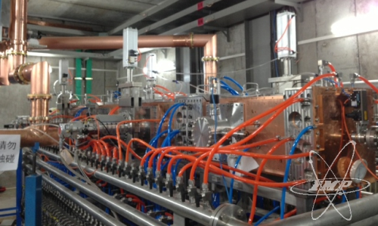
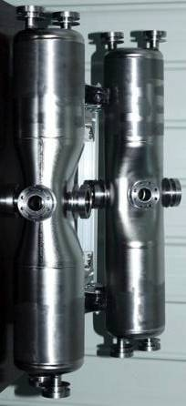
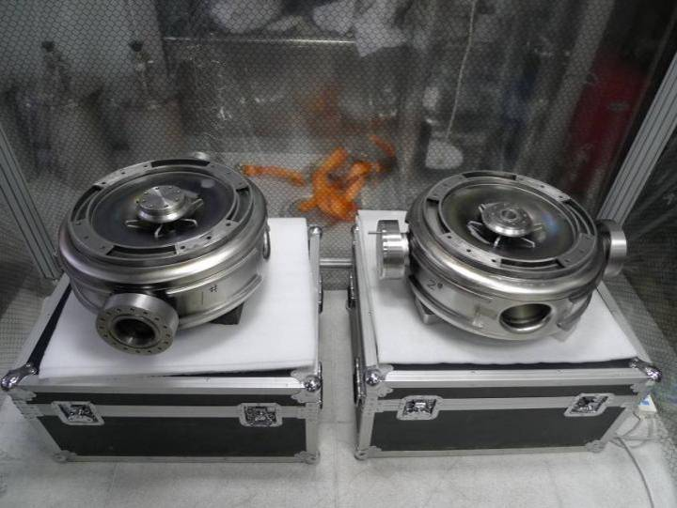
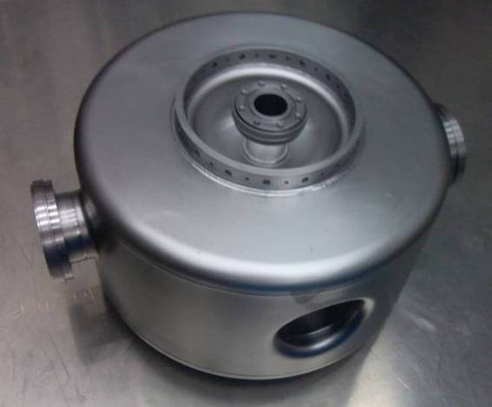
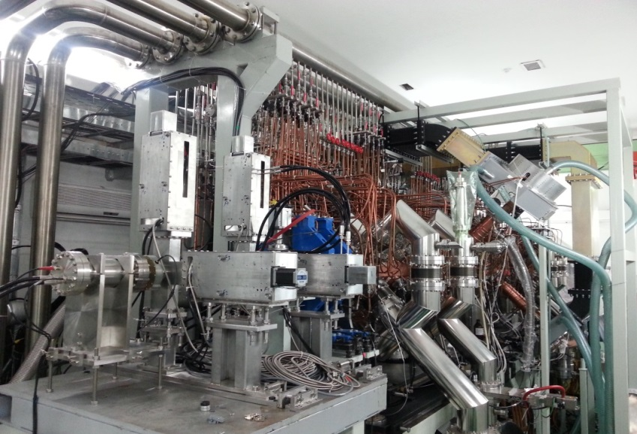
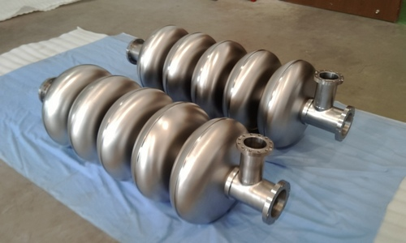
R&D efforts on ADS linac at IHEP and IMP
  IMP completed the commissioning test of a 5 MeV front-end (10 mA, 162.5 MHz, 2.1 MeV RFQ in CW mode, a cryomodule HWR in pulsed mode)
  IHEP is testing another scheme (3.2 MeV RFQ, a cryomodule Spoke, 10 mA, 325 MHz)
  Prototyping on both low-β and medium-β cavities

Slide 12
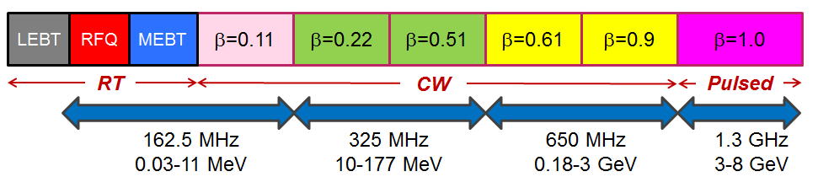
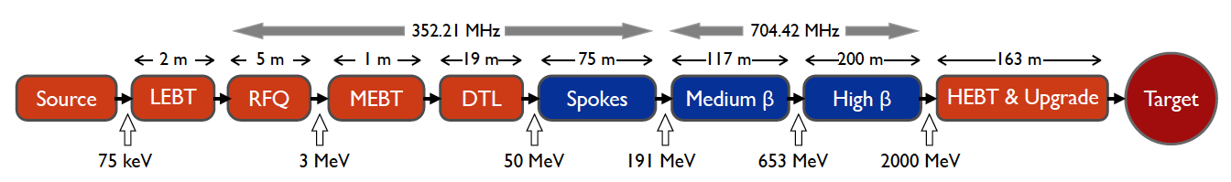
High power proton accelerators are mandatory to neutrino beam facilities
MOMENT proton driver shares technologies with the other proposed neutrino beams, such as Neutrino Factory, Project-X (now PIP-II) and ESSnuSB
  Development of superconducting cavities (low-β, medium-β, high-β) and the high duty factor RF equipment
  Beam loss control in high power proton linacs
  Interface with target station
Project-X (Upper)
ESSnuSB (Lower)

Slide 13
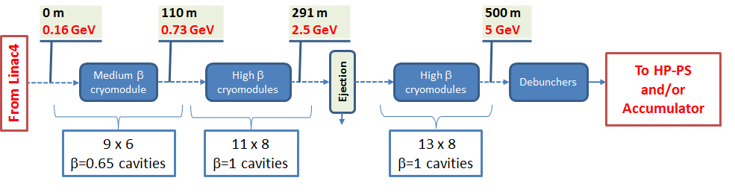
Comparison of proton drivers
Neutrino Factory (SPL)
 | Beam power (MW) | Linac Energy (GeV) | RF duty factor (%) | Peak current (mA) | SC cavity types
MOMENT | 15 | 1.5 (~2.5) | 100 | 10 | 5
Neutrino Factory | 4 | 5 (SPL) | 4 | 20 | 2
Project-X (PIP-II) | 3 (0.2) | 3 (0.8) | 100 (10) | 5 (2) | 6(5)
ESSnuSB | 5 | 2 | 4 | 62.5 | 3
(Project-X has also a pulsed linac section of 3-8 GeV)

Slide 14
Target technology synergy with other projects

Slide 15
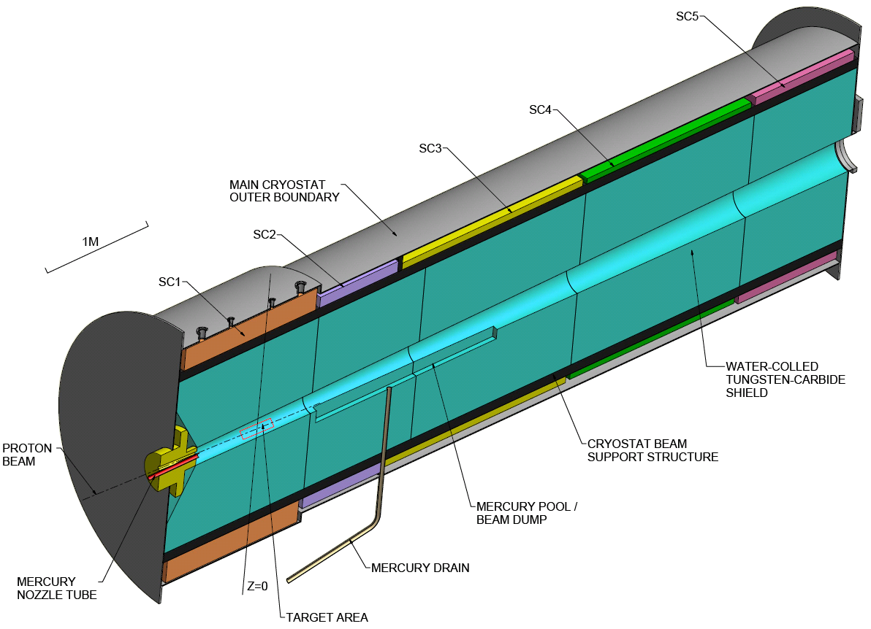
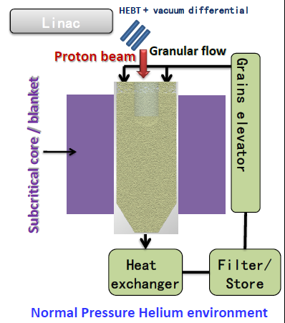
MOMENT Target Station
Baseline design: Mercury jet target (similar to NF design, MERIT) and high-field superconducting solenoids
  Higher beam power: heat load, radioactivity
  On the other hand, easier to some extent due to CW proton beam (no shock-wave problem)
More interests in developing fluidized granular target in collaborating with C-ADS target team, and also waiting for study result with fluidized tungsten-powder target by NF collaboration
Trying to work out a feasible concept based on granular target

Slide 16
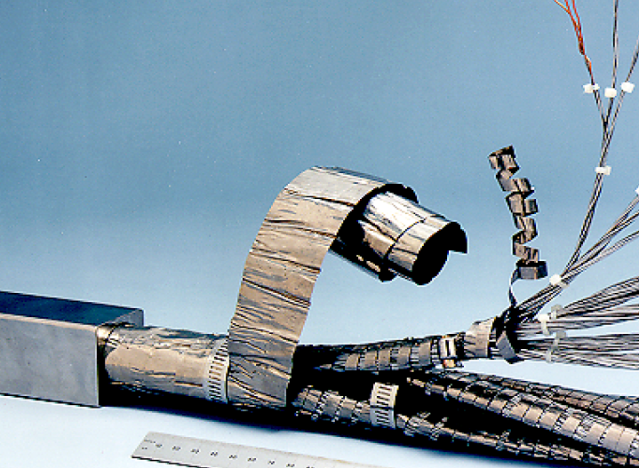
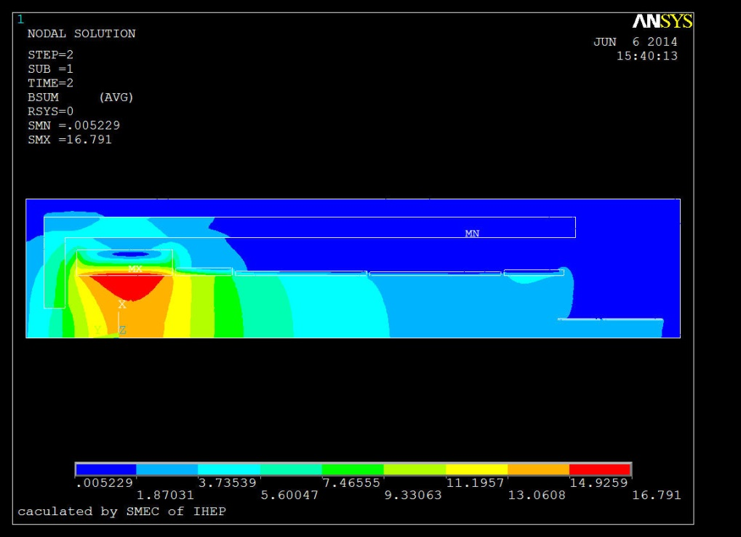
High-field superconducting solenoids
Very large apertures due to collection of secondary /tertiary beams and space for inner shielding
  Based on Nb₃Sn superconducting conductors, CICC (Cable-in-Conduit Conductor) coil (ITER)
  HTS coils are also under consideration
  High-field magnet R&D efforts at IHEP (incorporated with SPPC)

Slide 17
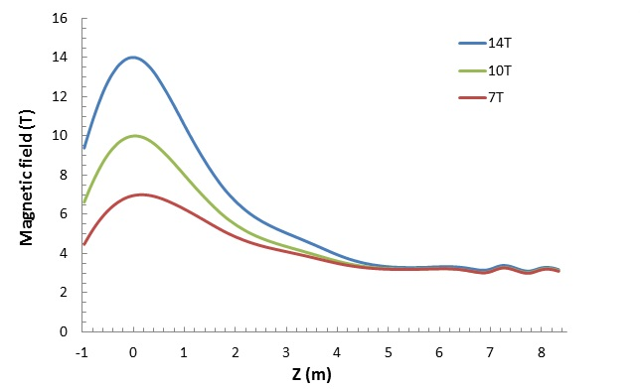
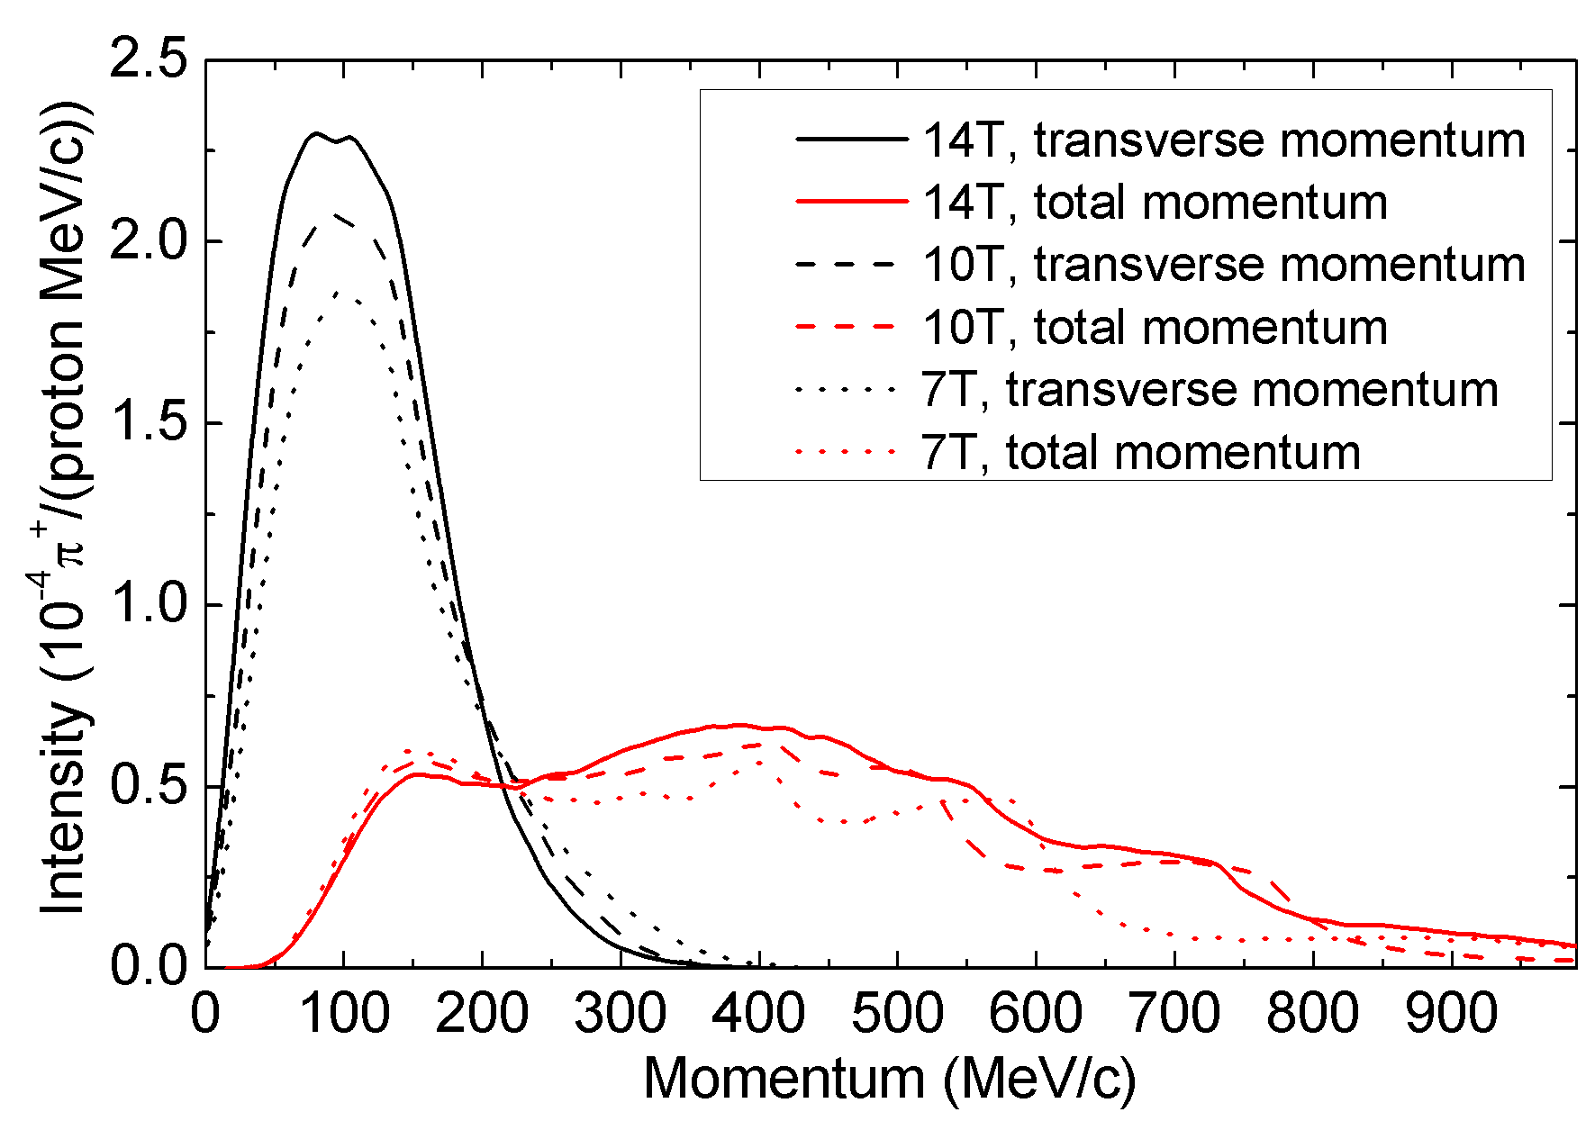
Different field levels have been studied: 7/10/14 T
  Evident advantage on pion collection with higher field
Relatively short tapering section: <5 m
High radiation dose level is considered not a big issue here (compared with ITER case)(both Nb₃Sn and HTS conductors are radiation resistant, problems are with electrical insulation)
(Vassilopoulos’ talk)

Slide 18
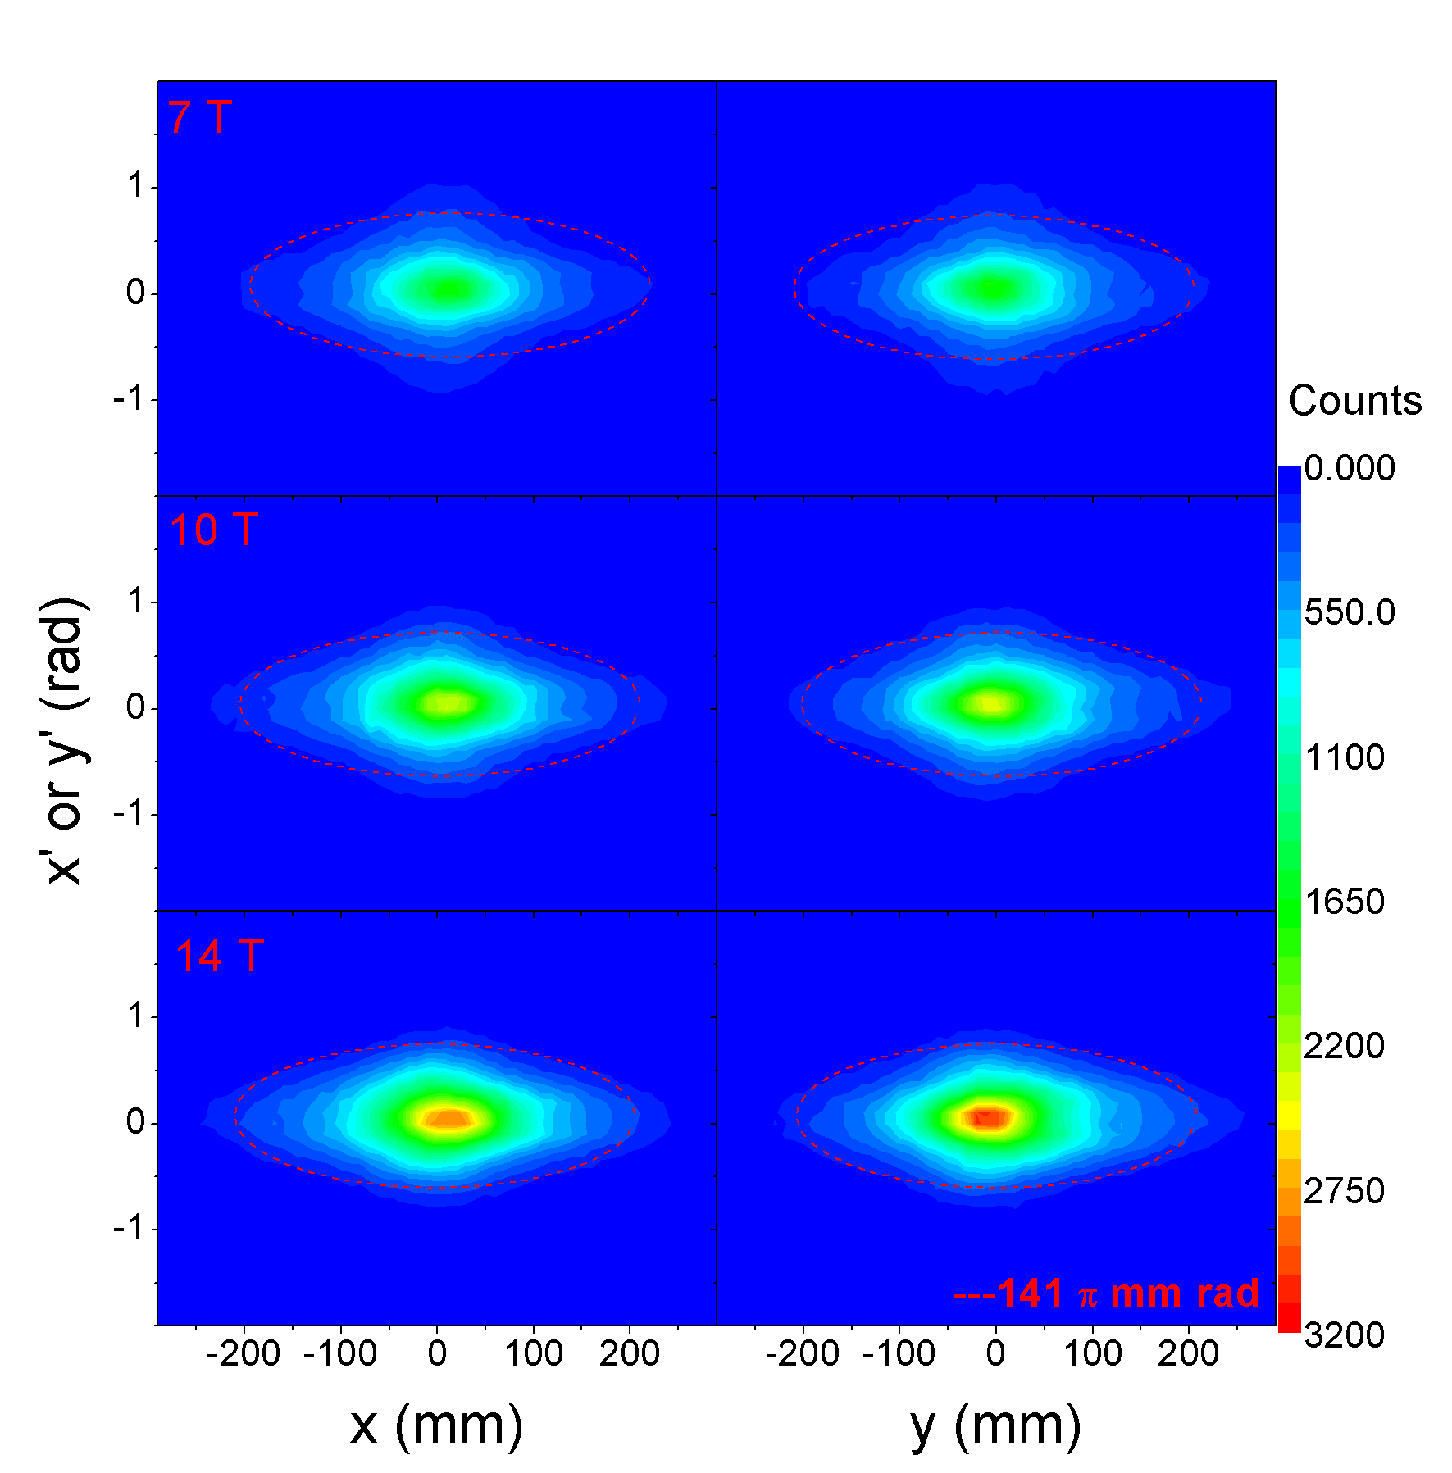
Pion production and collection
Pion production rate: 0.10 pion/proton (1.5 GeV, 300 mm Hg)
Collection efficiencies of forward/total pions: 82% / 58% (@14 T)
Distributions in (X-X’)/(Y-Y’) at end of pion decay channel (from upper down: 7/10/14T)
Higher field increases the core density significantly (favorable)

Slide 19
Spent protons
See Cai’s talk
There are two parts in the spent protons:
  Scattered protons from the side of the thin mercury jet and the pass-thru protons from the jet which have higher energy (4.7 MW with 30 cm target)
  From nuclear reactions, lower energy (1.8 MW with 30 cm target)
We must find ways to deal with the spent protons, either collimated or separating from the π/μ beam or transporting to the final dump.
  Very difficult due to high beam power and large moment range and emittance

Slide 20
High power target station is a technically challenging issue, and even more challenging when high magnetic-field is required.
  Huge heat deposit in target (cooling, shocking wave)
  Very high irradiation level (protection, material lifetime, electrical insulation)
  Very high electromagnetic force, space limitation
  Interface with primary and secondary beamlines
Conventionally, carbon target inside a magnetic horn is used (very short pulse, up to 2 MW, low repetition rate)
New type of neutrino beams (NF and MOMENT) uses high-repetition or CW proton beams, and higher power
  Mercury jet target (now preferable fluidized tungsten target)
  Superconducting solenoids for π capture and focusing
  Extremely challenging

Slide 21
Synergy efforts
Precise simulations on π production yield, material and proton energy
  MARS, GEANT4, MCNP, FLUKA: not consistent
Study on magnetic field taper
Design and R&D on fluidized tungsten target (NF and MOMENT)
Design and R&D on high-field superconducting solenoids (NF and MOMENT)
Study on cooling and shielding methods in MW targets
Interface issues with primary and secondary beamlines (windows, shielding, dump)
Spent protons

Slide 22
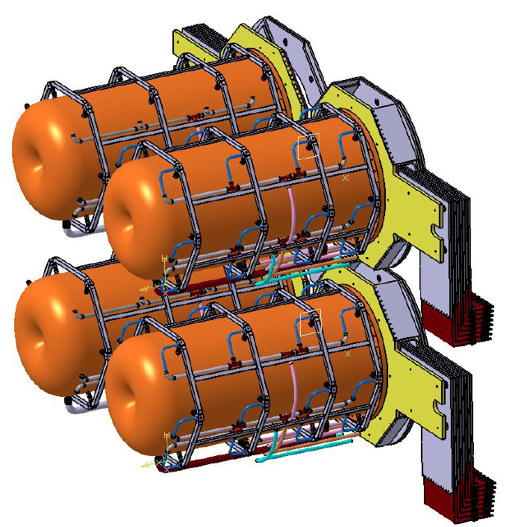
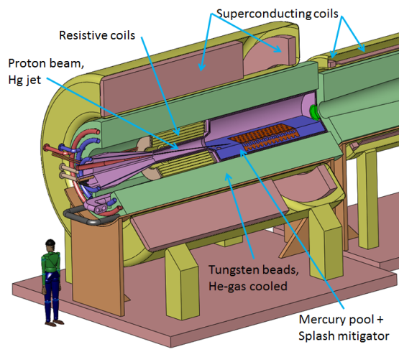
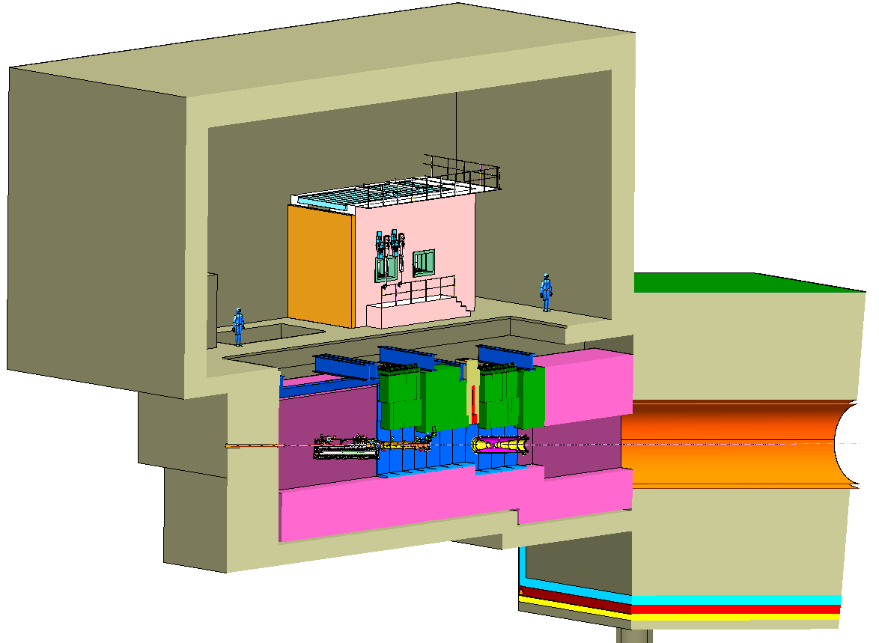
Comparison of target stations
 | Beam power (MW) | Proton energy (GeV) | Target | Magnetic field
MOMENT | 15 | 1.5 (~2.5) | Granular W or Hg jet | SC solenoids
Neutrino Factory | 4 | 5 (SPL) | Fluidized W or Hg jet | SC solenoids + RT insert
LBNF | 2 | 120 | Carbon | Horns
ESSnuSB | 5 | 2 | 4 * Carbon | Horns
NF Target Station
LBNF Target Station
ESSnuSB Target Station

Slide 23
Neutrino beamline technology synergy with other projects

Slide 24
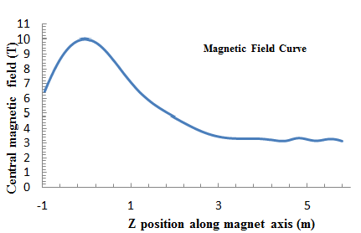
MOMENT Secondary beamline
Transporting both pions and muons
A straight section in SC solenoids of about 100 m to match the SC solenoids at the target, and for the pions to decay into muons
  Adiabatic field transition (tapering section )
  Extraction of scattered protons
  Very large emittance and momentum spread
  Longer section for energetic pions to decay
Similar beam rigidity assures that pions and muons can be transported in the same focusing channel
  Momentum and emittance of pions most preserved in muons

Slide 25
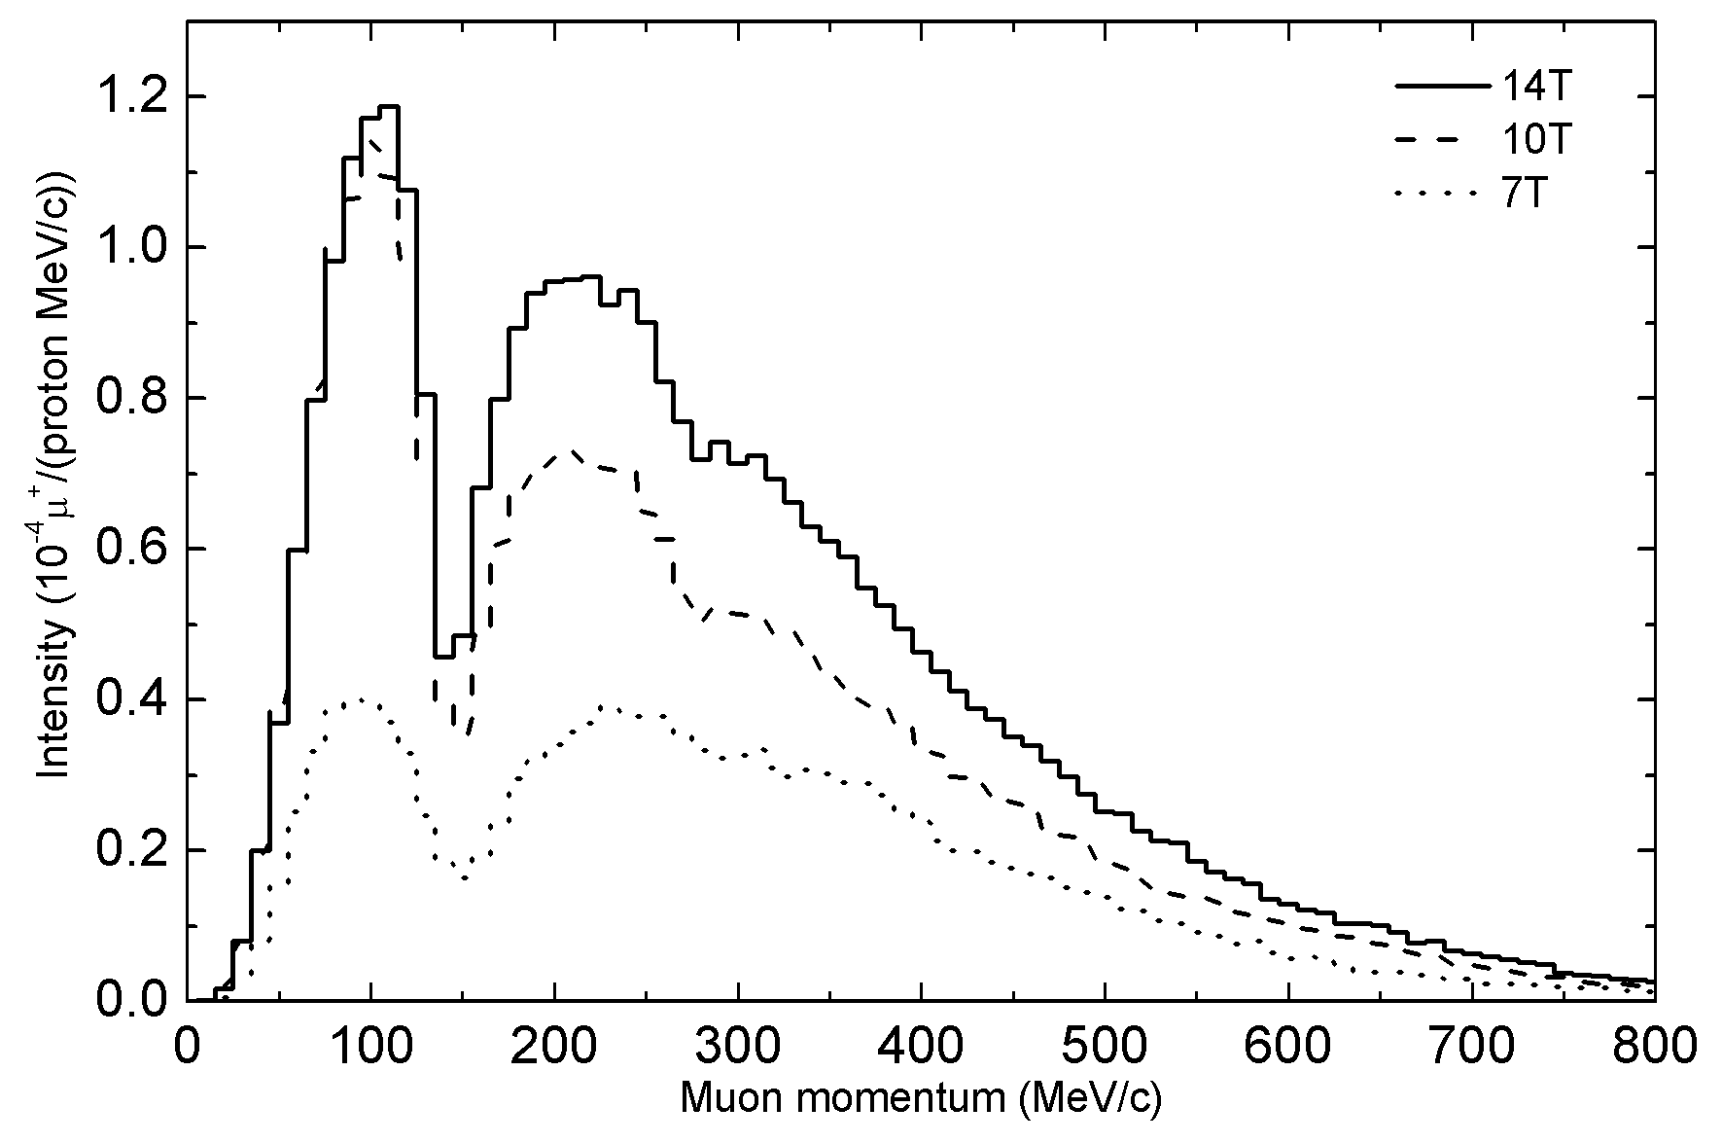
More about the pion decay channel
  SC solenoids form FOFO lattice (stop-band at certain energy)
  Very large acceptance for channels
  About 0.0052 μ+/proton for about 50 πmm-rad at entrance of muon decay channel
7 T
 | muon/proton | Portion（%）
No limit on emittance | 9.48E-03 | 100
Emittance: 100 πmm-rad | 8.04E-03 | 85
Emittance: 80 πmm-rad | 7.31E-03 | 77
Emittance: 50 πmm-rad | 5.22E-03 | 55
Emittance limit in both (X-X’) and (Y-Y’)

Slide 26
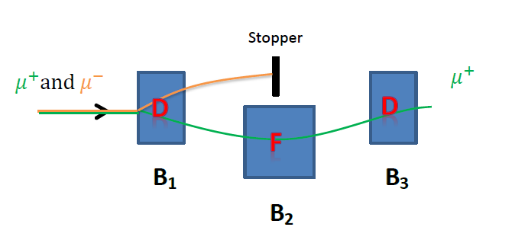
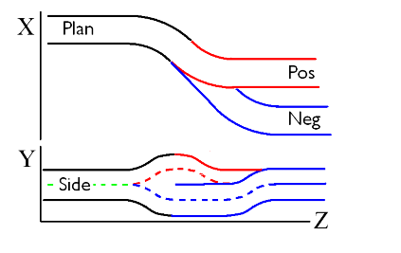
Charge selection
A selection section to select π+/μ+ from π-/μ-, as either μ+ beam or μ- beam is used for producing the required neutrinos
  Reverse the fields when changing from μ+ to μ-
  Also for removing very energetic pions who still survive
  Very difficult due to extremely large beam emittance (T/L)
  Two schemes: based on 3 SC dipoles with strong gradient (or FFAG), and bent SC solenoids

Slide 27
Muon transport and decay
- Muon decay channel
A long decay channel of about 600 m is designed for production of neutrinos
  About 35% (centered momentum: ~300 MeV/c)
Important to have smaller divergent angle
  Neutrino energy spectrum at detector related to the angle
  Modest beam emittance and large aperture
  Adiabatic matching from 3.7 T in the bending section to 1.0 T in the decay section
Aperture/Field | Acceptance (πmm-rad) X: in mm; X’: in mrad
φ600, 3.7 T | 100 (x: 280, x’: 357)
φ800, 1.0 T | 65 (x: 380, x’: 171)

Slide 28
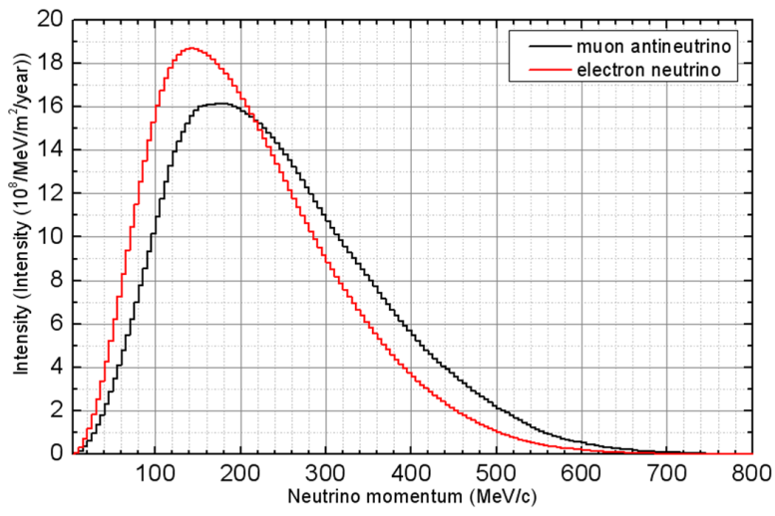
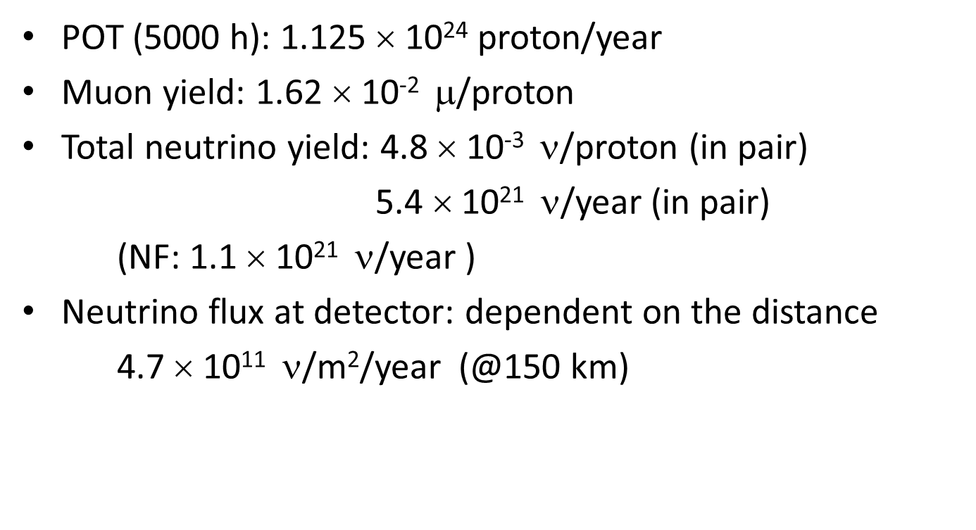
Estimate of neutrino flux
POT (5000 h): 1.125 × 10²⁴ proton/year
Muon yield: 1.62 × 10⁻² $$/proton
Total neutrino yield: 4.8 × 10⁻³ ν/proton (in pair)
5.4 × 10²¹ ν/year (in pair)
(NF: 1.1 × 10²¹ ν/year )
Neutrino flux at detector: dependent on the distance
4.7 × 10¹¹ ν/m²/year (@150 km)

Slide 29
Challenges and synergy efforts in neutrino beamlines
Charge selection of π+/π- and μ+/μ- [NF]
  Very large emittance/momentum range
Dumping both protons and secondary particles [All]
  Mixed beam, high power
Manipulation in phase space [NF, nuSTORM]
  Adiabatic conversion of transverse momentum into longitudinal
  Bunching rotation
  Emittance cooling

Slide 30
Detector technology synergy with other projects

Slide 31
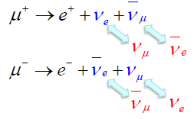
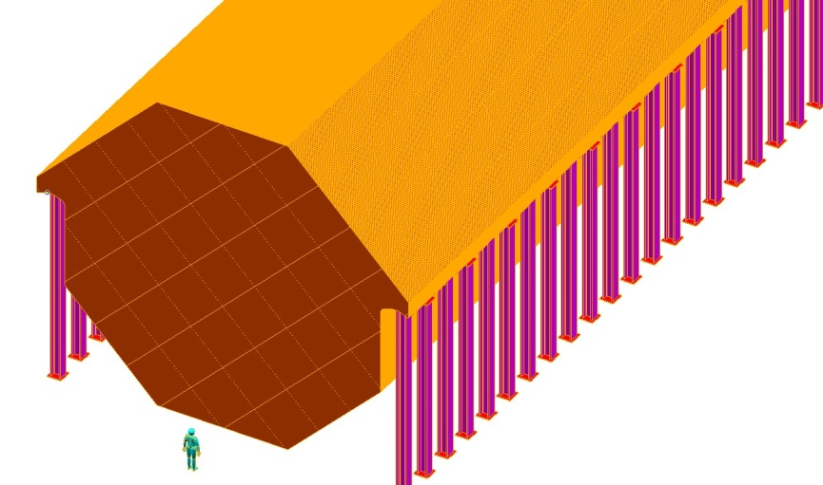
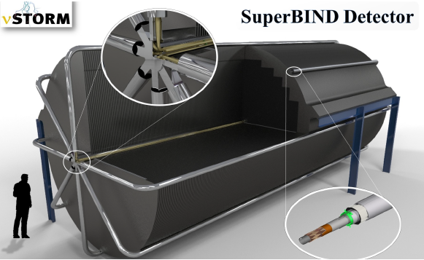
Suitable detectors for MOMENT are still under study
  Flavor sensitive: e/μ identification
Water Cherenkov, liquid Ar, liquid scin.
  Charge sensitive: ν and anti-ν
  Magnetized, liquid scin., Gd-doped water (IBD)
  NC/CC sensitive: NC background rejection
  Very large target mass required
Detector synergy
  Magnetized detector, e.g. MIND by NF and SuperBIND by nuSTORM
  Water Cherenkov detector (or doped), MEMPHIS by ESSnuSB/LBNO and HyperK detector
  Liquid scintillator detector such as JUNO

Slide 32
Summary
As an interesting study, MOMENT attracts Chinese researchers to collaborate on neutrino beams
  on MOMENT itself
  on other international projects
MOMENT shares many physical and technical aspects with other neutrino beams
  Proton driver, target, secondary beam line, detector etc.
  International collaborations will benefit the community: with the ongoing projects LBNF and Hyper-K, and with the studies Neutrino Factory, ESSnuSB and nuSTORM

Slide 33
Thank you for attention!

