Slide 1
Review of WAMSDO 2011workshop: Superconductors in LHC Upgrade
(HiLumi LHC)
René Flükiger, Gijs DeRijk
CERN
TE- SC-SCD

Slide 2
Scope of the meeting
Attempts to characterize the HL-LHC radiation environment
for the cables (superconductor and insulator) of the most
exposed magnets: the quadrupoles of the final focus triplet
These quadrupoles are most exposed to the collision
debris, for a target integrated luminosity of
3’000 fb⁻¹ at 14 TeV center-of-mass energy

Slide 3
WAMSDO Workshop Program
Irradiation of superconductors
* Nb₃Sn, Coated Conductors (magnets)
* MgB₂ (LINK current leads)
* Superconducting and mechanical properties
II. Calculations
* Modern models/codes including Coulomb elastic scattering,
nuclear interactions and DPA model parameters
* FLUKA an MARS results on energy deposition and DPA values
Irradiation of Insulators
* Radiation effects on fusion magnet components
* Mechanical properties of insulators (including EuCard data)
will be discussed by M. Eisterer

Slide 4
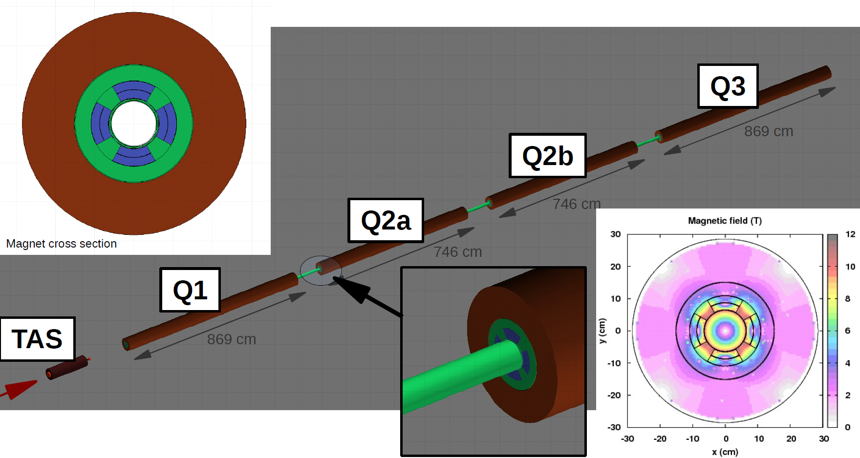
HL-LHC: The basis for model calculations
Francesco Cerutti, CERN
130 mm aperture Nb₃Sn cables (implemented an average coil material including copper and insulator)
lengths and gradient by E. Todesco
3.4 mm thick cold bore
2 mm thick beam screen
156 T/m gradient
55 mm aperture

Slide 5
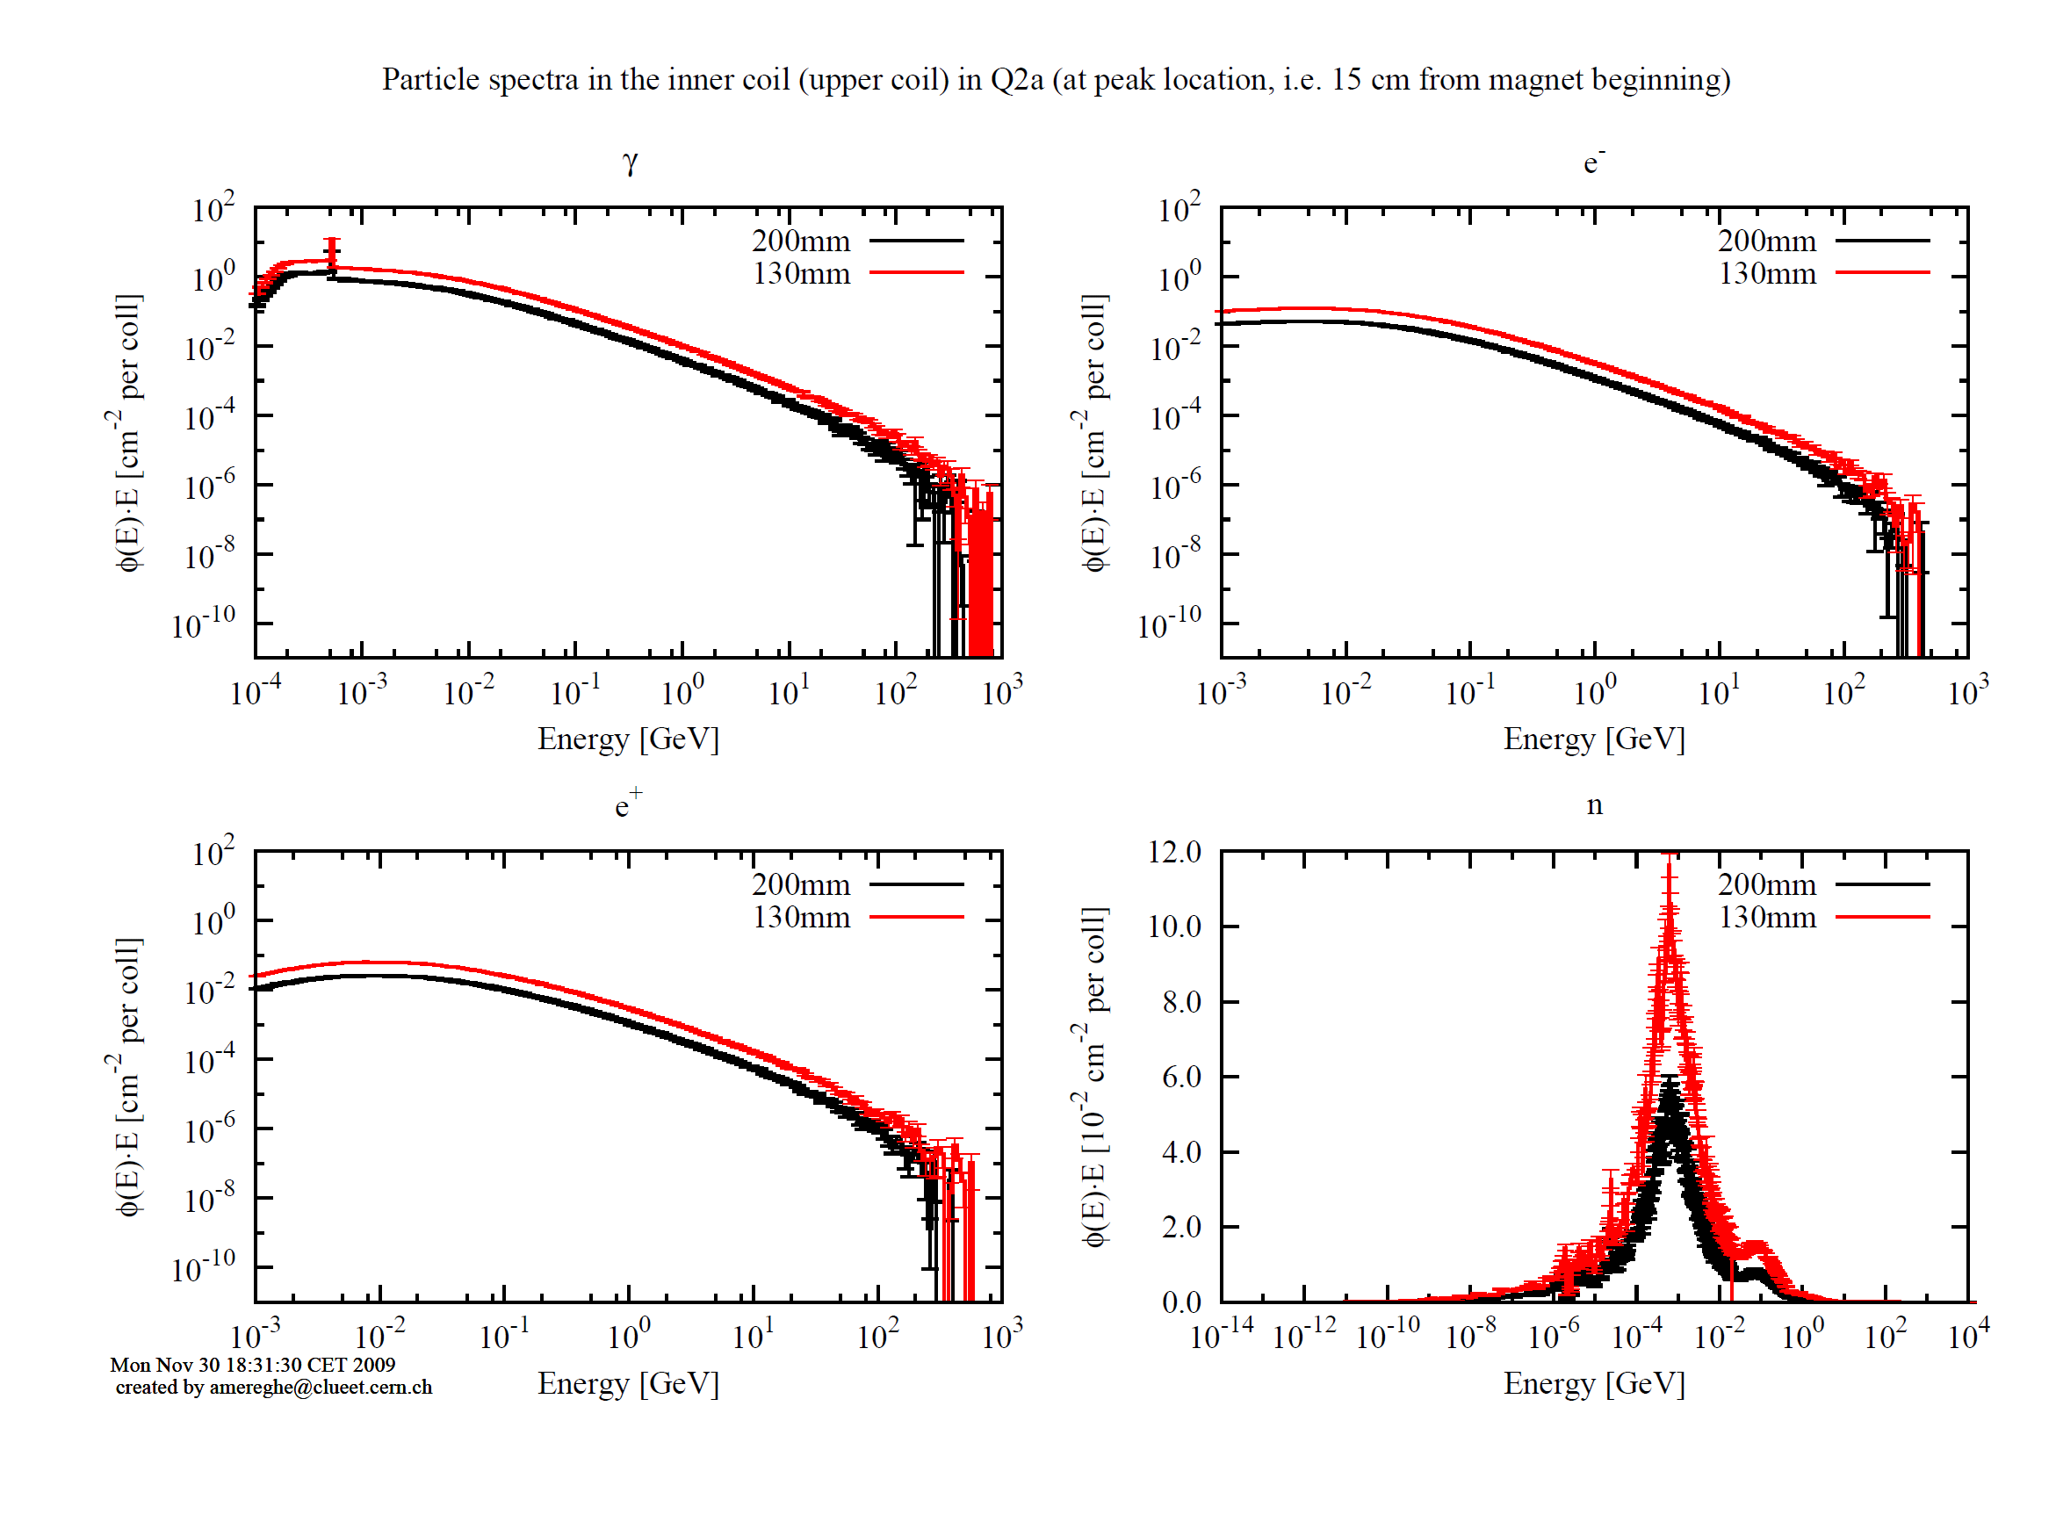
Particle spectra in the coils
photons
electrons
1 MeV
neutrons
[linear scale]
positrons
~100 MeV
F. Cerutti

Slide 6
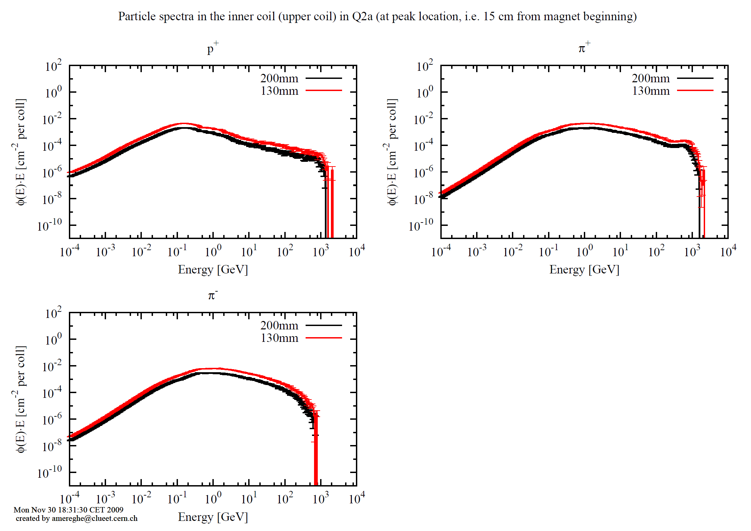
Particle spectra in the coils
protons
positive pions
negative pions
F. Cerutti

Slide 7
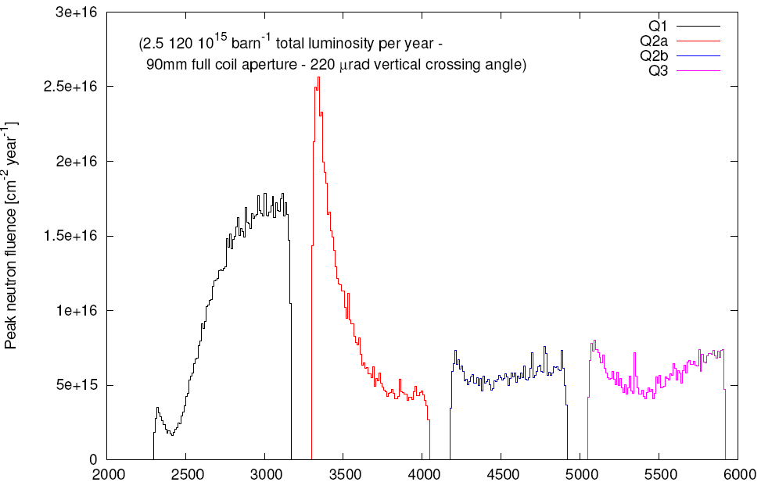
Neutron fluence in the inner winding of Quadrupoles (LHC Upgrade)
« TRIPLET »
Peak: > 1.5 x 10²¹ neutrons/m²
Fluence in 10 « years » (200 days)
Q1
Q2a
Q2b
Q3
F. Cerutti +
A.Mereghetti
(CERN), 2011
20 25 30 35 40 45 50 55 60
Distance from Collision Point (m)

Slide 8
Preliminary FLUKA calculations (without cold shielding)
Track length fraction [%]
photons | 88
electrons/positrons | 7
neutrons | 4
pions | 0.45
protons | 0.15
Francesco Cerutti
Over the HL-LHC target integrated luminosity (3000 fb⁻¹),
triplet quadrupole cables and insulators will undergo the following radiation peak values:
~ 100 MGy (dose)
~ 10⁻⁴ (DPA),
~ 1.5 x 10¹⁷ neutrons/cm²
~ 10¹⁶ pions/cm² F. Cerutti

Slide 9
I. Irradiation of superconductors
Radiation effects on superconductors Harald Weber
in ITER
Irradiation of MgB₂ Marina Putti
Irradiation experiments at BNL Peter Wanderer
Neutron Irradiation Measurements for Tatsuchi Nakamoto
Superconducting Magnet Materials
at Low Temperatures
What do we need? René Flükiger

Slide 10
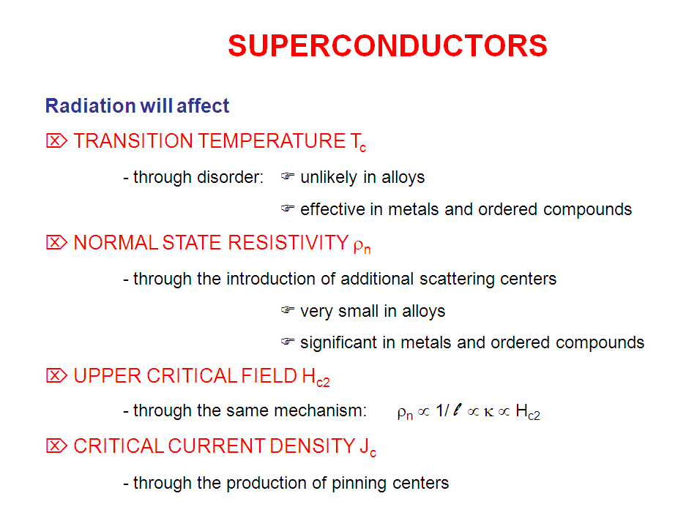
Neutron Irradiation of superconductors

Slide 11
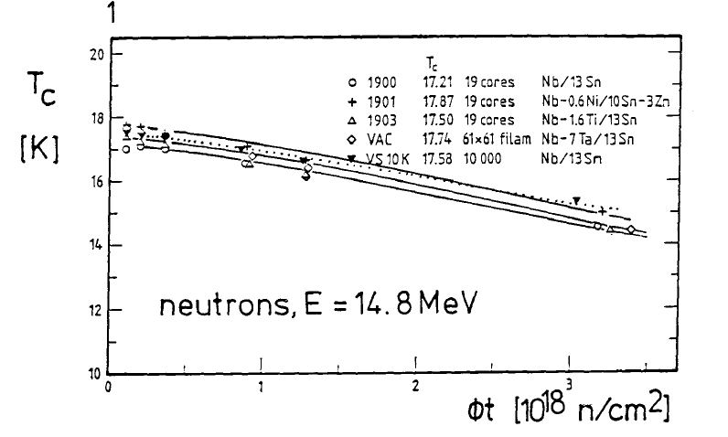
Variation of T_{c} in neutron irradiated multifilamentary Nb₃Sn wires
Neutrons, E = 14.8 MeV
[ 10²² n/m²]
F. Weiss, R. Flükiger, W. Maurer, IEEE Trans. Magn., MAG-23(1987)976

Slide 12
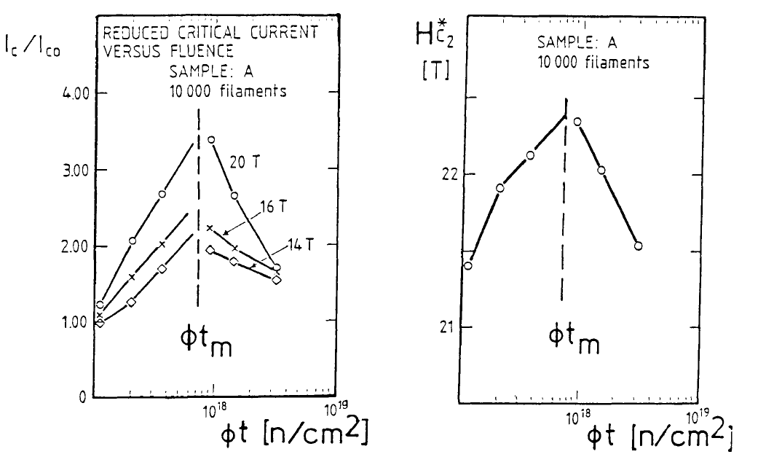
Binary Nb₃Sn wire (10’000 filaments)
B_{c2}*
[T]
Binary Nb₃Sn
10’000 filaments
I_{c}/I_{c o}
Binary Nb₃Sn
10’000 filaments
E =14 MeV
T_{irr} = 300K
10²¹ 10²² 10²³ 10²¹ 10²² 10²³
φt [n/m²] φt [n/m²]
F. Weiss et al. IEEE Trans.
Magn., MAG-23(1987)976

Slide 13
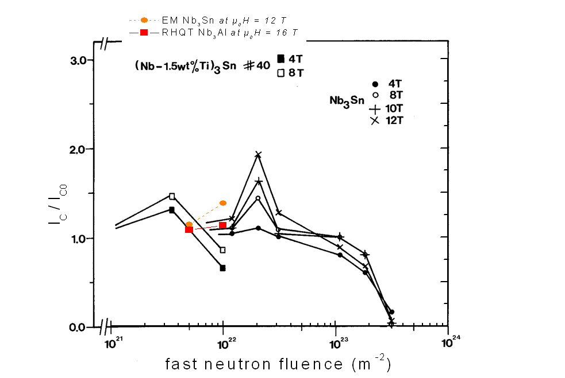
Binary and ternary alloyed Nb₃Sn wires (bronze route)
Factor 5 - 6
H. Weber at al. 1986
alloyed binary

Slide 14
Alloyed Nb₃Sn wires: J_{c} more sensitive to irradiation
Maximum I_{c}/I_{co} and B_{c2} for alloyed Nb₃Sn wires:
≈ 5 - 6 x lower fluence than for binary wires
______________________________
Wire φt_{maximum}
Binary Nb₃Sn wire 8 x 10¹⁷ n/cm²
Ti alloyed Nb₃Sn wire 1.5 x 10¹⁷ n/cm²
Ta alloyed Nb₃Sn wire 1.5 x 10¹⁷ n/cm²⁵
2) At φt_{m} the increase Δ(I_{c}/I_{co}) and Δ(B_{c2}) is lower for alloyed Nb₃Sn wires
3) At φt = 5 x 10¹⁷ n/cm²:
I_{c}/I_{co} for binary Nb₃Sn wire higher than before irradiation
but:
I_{c}/I_{co} for alloyed Nb₃Sn wires similar than before irradiation

Slide 15
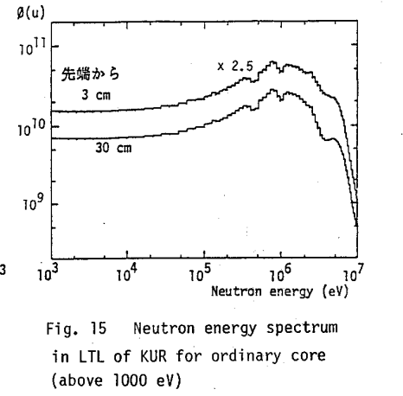
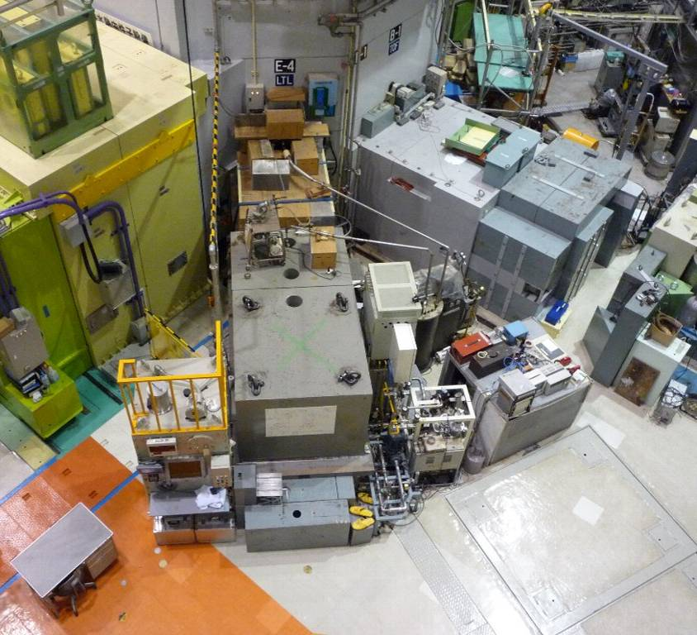
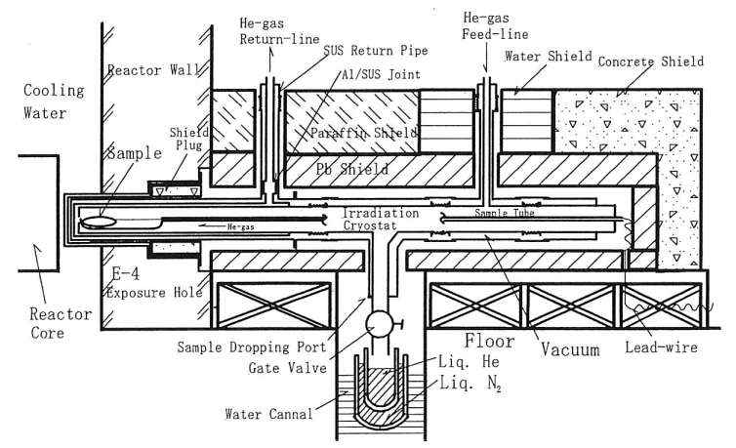
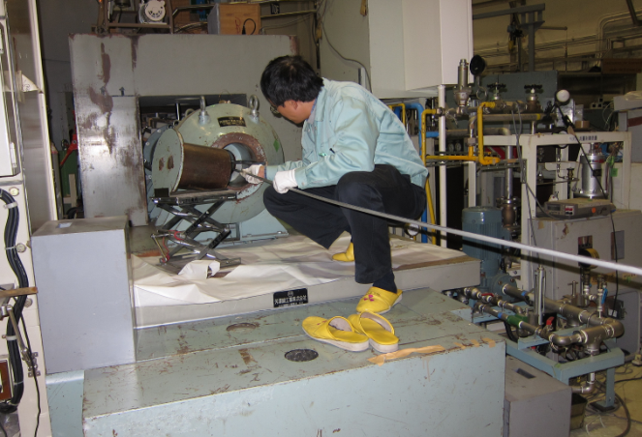
Neutron Irradiation at KUR Kyoto Univ. Reactor)
Tatsuchi Nakamoto
５MW max. thermal power
Irradiation cryostat close to reactor core
Sample cool down by He gas loop: 10K – 20K
  Fast neutron flux (En>0.1MeV): 1.4x10¹⁵ n/m²/s@1MW
0.1MeV
reactor
KUR-TR287 (1987)
M. Okada et al., NIM A463 (2001) pp213-219
Cryogenics

Slide 16
Volume expansion of irradiated Nb₃Sn

Slide 17
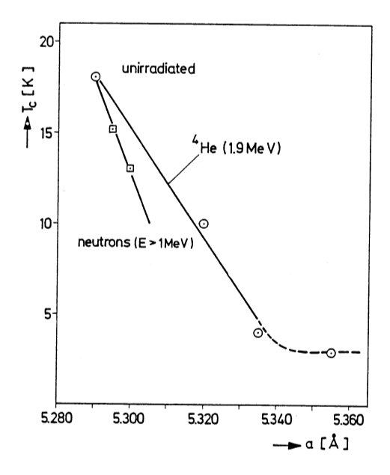
Volume expansion in irradiated Nb₃Sn
Scaling law between various sources
not yet investigated
0.5 x 10²² n/m²
Δa ≈ 0.02%
At 5 x 10²¹ n/m², close to the maximum of J_{c} vs. Φt, the volume expansion of Nb₃Sn is ≈ 0.5%. Does this have effects on the internal stresses, and thus on J_{c}, the wires being encapsulated?

Slide 18
Effect of irradiation on Cu stabilizer
Normal state resistivity essential for stabilization and quench protection
In-field resistivity experiments on copper
Irradiation must be done at low temperature (~ 5 K) due to substantial annealing
(most low temperature irradiation facilities have been shut down, only one 14 MeV source available in Japan)

Slide 19
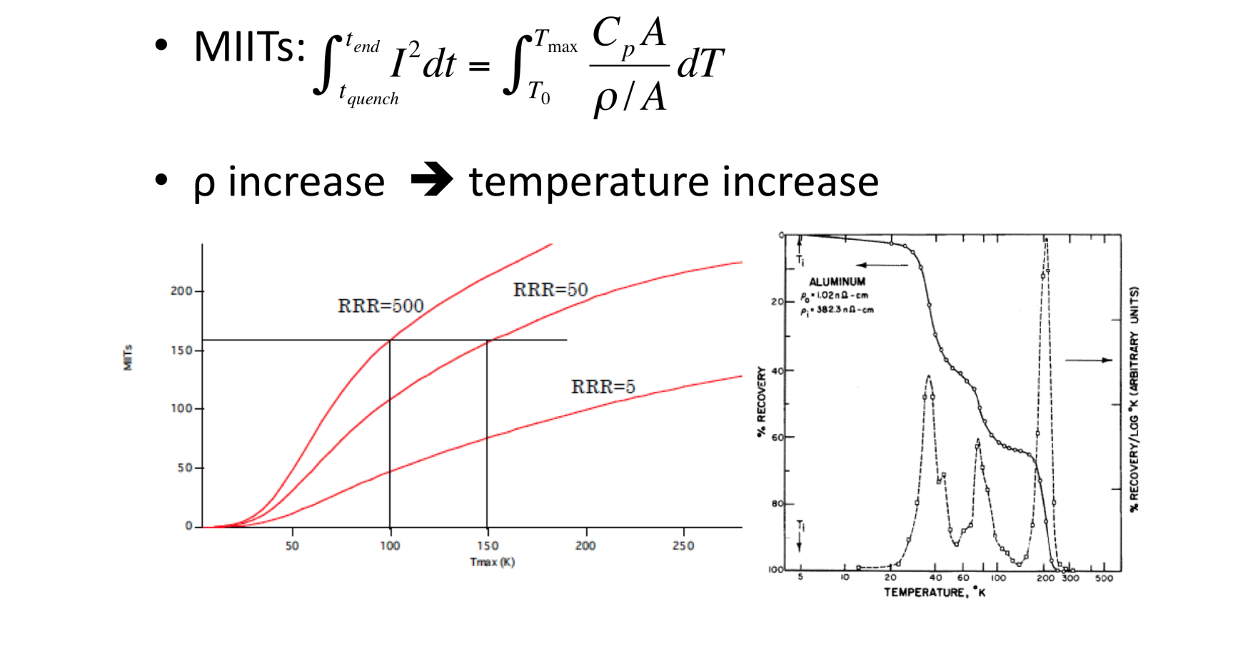
Why is ρ of Stabilizer Important?
>> very concerned with quench protection.
Neutron irradiation test for stabilizers (copper, aluminum) is undoubtedly necessary.
minimum fluence to start of degradation
anneal effect on recovery
R&D of witness sample for the operation
T. Nakamoto

Slide 20
Resistivity measurement at 10 K
Neutron irradiation at the IPNS spallation source at 5 K
Warm-up cycle to RT
Resistivity measurement at 10 K
Multifilamentary
NbTi-conductors
#34: RRR ~ 60
#35: RRR ~ 120
#36: RRR ~ 120
Resistivity increase : factor ~1.3 at 1 x 10²² n/m²

Slide 21
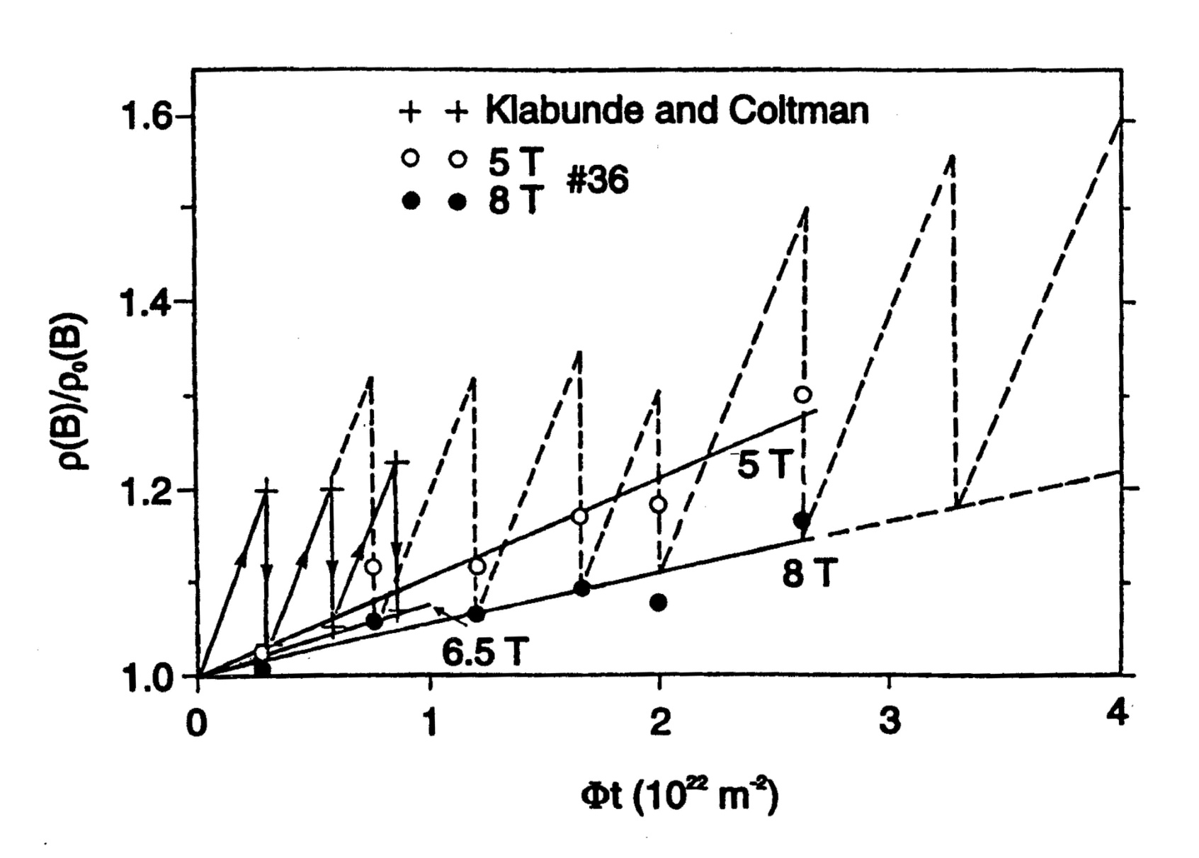
Resistivity increase : factor ~1.3 at 1 x 10²² n/m²

Slide 22
T. Nakamoto
Materials | Aluminum |  |  |  | Copper
 | Horak | Guinan | Present | Present | Horak | Guinan | Present
RRR | 2286 | 74 | 450 | 3007 | 2280 | 172 | 319
T_{irr} (K) | 4.5 | 4.2 | 12 | 14 | 4.5 | 4.2 | 14
Netutron Source | Reactor | 14 MeV | Reactor | Reactor | Reactor | 14 MeV | Reactor
Φ_{tot} (n/m²) (>0.1MeV) | 2 x 10²² | 1-2 x 10²¹ | 2.3 x 10²⁰ | 2.7 x 10²⁰ | 2 x 10²² | 1-2 x 10²¹ | 2.7 x 10²⁰
Δρ_{irr}/ Φ_{tot} x10⁻³¹(Ωm³) | 1.9 | 4.09 | 2.4 | 2.4 | 0.58 | 2.29 | 0.82
Recovery by thermal cycle | 100% | 100% | 100% | TBD | 90% | 80% | TBD
Degradation rate (Δρ_{irr}/ Φ_{tot} ) seems to be higher in 14 MeV neutron irradiation. Evaluation using a common index such as DPA would be necessary.
Present work shows that difference in RRR of Al doesn't influence the degradation rate.
For copper, degradation rates (Δρ_{irr}/ Φ_{tot} ) are ranged from 0.58 to 2.29 10⁻³¹ Ωm³. What if SC cables with the initial RRR of 200 are irradiated to 10²⁰ or 10²¹ n/m²?
  10²⁰ n/m² : RRR of 160 – 190
  10²¹ n/m² : RRR of 50 – 120
Recovery by annealing in copper sample and its multiple irradiation are planned in 2012.

Slide 23
Superconductors for operation at higher temperatures and/or higher magnetic fields
MgB₂ (T_{c} ~39 K):
Low temperature (10 – 20 K) and intermediate field (< 10 T) application
Possibly: LINK Current leads for HL-LHC
Bi-2212 (T_{c} ~87 K):
Fields up to 25 K at ≤ 4.2K
Only HTS conductor with round cross section
Difficult fabrication: needs to be improved
RE-123 (T_{c} ~92 K):
Fields > 25 T at 4.2K possible
Very high costs, cables applicable in quadrupoles?

Slide 24
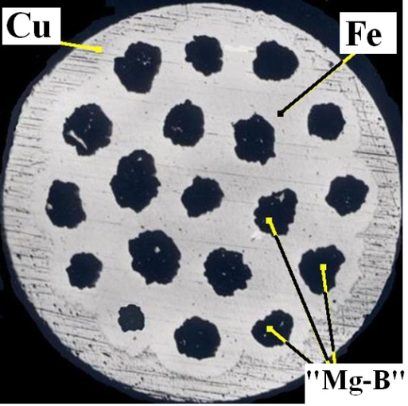
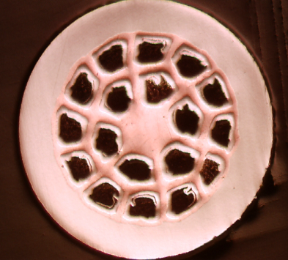
MgB₂ wires
Higher field applications only at lower T
Production of ~1 km long wires: ex-situ ok, in-situ improving, many suppliers
Dipole strand
←
ITER IT strand
←
[M. Eisterer, ATI 2006]
Columbus HyperTech

Slide 25
Critical Current Densities of MgB₂ at 4.2 K
Fluence: 10²² m⁻²
M. Eisterer, ATI 2007
Sufficient current densities only at fields below ~ 10 T
Envisaged for LINK high current leads in HL-LHC
Low cost alternative at low temperatures (< 10 K, PF coils) ?

Slide 26
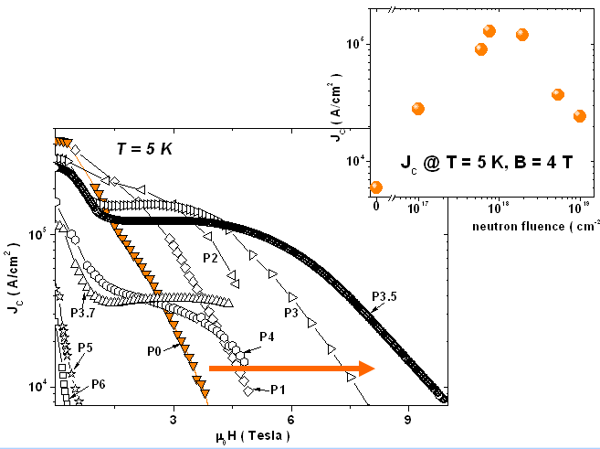
Neutron irradiated MgB₂
10²¹ 10²² 10²³
n/m²
M. Putti, 2011

Slide 27
Pinning mechanism
Pinning Force
Mg¹¹B₂
F/F_{Pmax}
Nb₃Sn wires
Nb₃Sn wires
The shift of the F_{P} peak means that a new pinning mechanisms is working
➲ Similar behaviour was observed in Nb₃Sn wires

Slide 28
H_{c2} in neutron irradiated MgB₂
irradiated

Slide 29
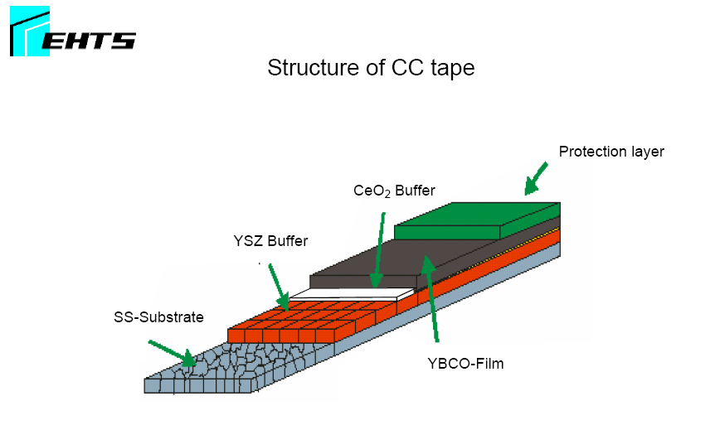
HTS Superconductors
Coated Conductors by (EHTS)
Substrate: Cr-Ni stainless steel
Buffer stack: Y₂O₃/YSZ/CeO₂
  YSZ: Ion beam assisted deposition
  (IBAD)
YBCO (2.5 µm)
  Pulsed-laser-deposition (PLD)
Silver or gold protection layer
  Vapor deposition
Stabilization: Copper ( ~ 17 µm)
  Galvanic plating process
Total thickness: 0.120 mm → J_{c}/J_{e} = 50

Slide 30
Coated Conductors: Critical Current Densities
B//ab, 50 K
B // c, 50 K
H. Weber, M. Eisterer

Slide 31
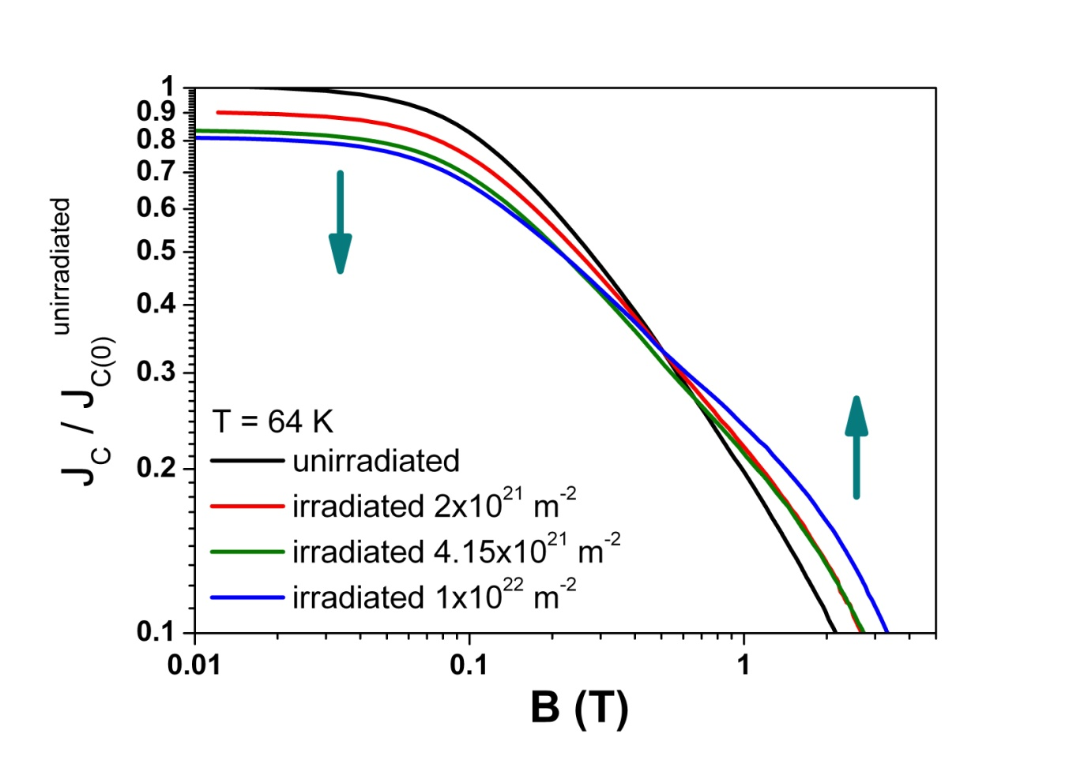
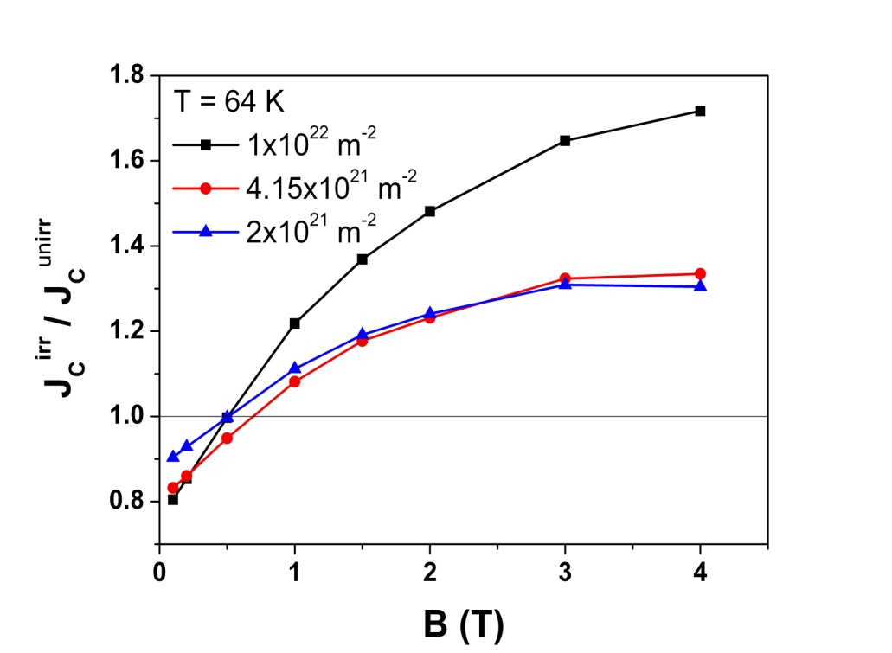
Neutron irradiation effects on J_{c} for fields // c: AMSC
Decrease of J_{C} at low fields
Increase of J_{C} at higher field
The crossover indicates a change in flux pinning
Crossover field (mT) | 2x10²¹ m⁻² | 4x10²¹ m⁻² | 1x10²² m⁻²
77 K | 244 | 382 | 630
64 K | 114 | 219 | 440
50 K | 130 | 195 | 334
H. Weber, M. Eisterer

Slide 32
Conclusions for neutron irradiated materials
LT Superconductors:
No problems regarding radiation effects expected in
HL-LHC
Stabilizer:
Degradation must be kept in mind
HTS:
Substantial R&D still required
Problems: Bending of roebled HTS cables
High costs

Slide 33
Effect of various radiation sources on superconductors
From the present knowledge:
Neutrons : Strong source of damage for superconductors
Protons: From known data, even stronger effect (charge)
Pions: Nothing is known yet. Effects expected to be
comparable to those of protons (charges +/-)
_________________________________________________
Electrons: Very little is known. Much smaller effects expected More data needed
Photons: Nothing is known. Much smaller effects expected.
(in contrast to insulators). Data needed

Slide 34
Keep in mind:
* all high energy sources act simultaneously
* there is no experience on a combined effect of several
high energy sources
* subsequent irradiations with different sources should be
carried out on selected samples
* calculations must be carried out to study combined
irradiations
(taking into account the small values of DPA (~ 10⁻⁴ ), this
may be reasonable)

Slide 35
The effect of proton irradiation on Nb₃Sn (thin films)
Pion irradiations: fluxes presently not sufficient for reaching J_{c} /J_{co}(max) In reasonable times
Calculations!

Slide 36
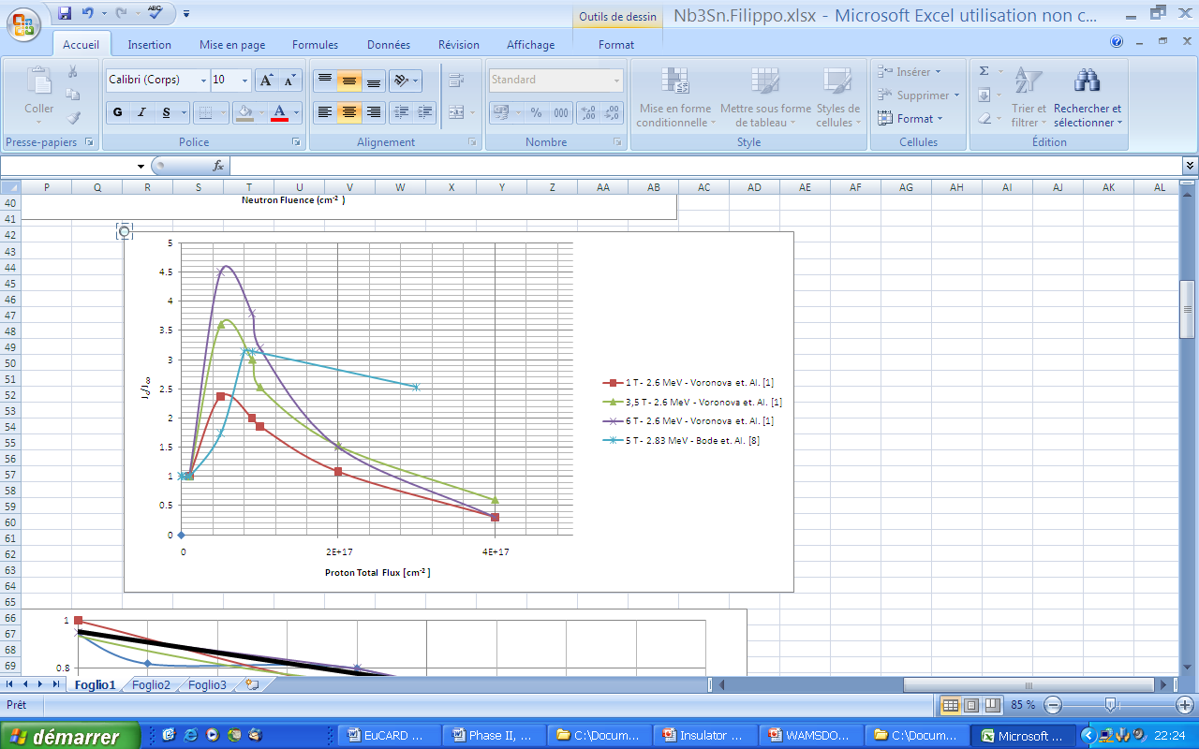
Maximum of I_{c} after proton irradiation
0.6 x 10²¹ p/m²
Factor 30 !
2 x 10²² n/m²
Binary Nb₃Sn, E = 1 MeV
J_{c}/J_{co}(max) for neutrons
I_{c}/I_{co}
After 30 GeV (Snead et al.)
No peak of J_{c}/J_{c0} !
0 1 2 3 4
Fluence (x 10²¹ p/m²)

Slide 37
Binary Nb₃Sn wires (and films):
Maximum of I_{c}: neutrons: 2 x 10²² n/m²
protons: 6 x 10²⁰ p/m ²
Ternary alloyed Nb₃Sn wires:
Maximum of I_{c}: neutrons: 3 x 10²¹ n/m²
protons: ?
Still necessary to know behavior after proton irradiation, in spite of 4% fluence with respect to neutrons !
Even more necessary: behavior under pion irradiation. Total damage of protons + pions is expected to be comparable or higher to that caused by neutrons

Slide 38
Ongoing proton irradiations at Kurchatov Institute:
Duration : 24 months
Proton energy: 35 MeV
Temperature: 300K (+ heating due to proton impact)
Maximum fluence: 1x 10²² p/m²
Tasks on irradiated wires: J_{c} by magnetization measurements*)**)
Electrical resistivity vs. T
T_{c}
TEM
Lattice parameters
Tasks on irradiated bulks: Long range atomic order parameter*)
Calculations: dpa calculations for proton irradiation
*) Measurements will be performed at CERN
**) Transport J_{c} on proton irradiated wires: will be done later

Slide 39
Also presented at WAMSDO2011:
II. Calculations
Particle Fluences on LHC magnets Francesco Cerutti
Exploring Parameter Space for Radiation Nikolai Mokhov
Effects in SC Magnets

Slide 40
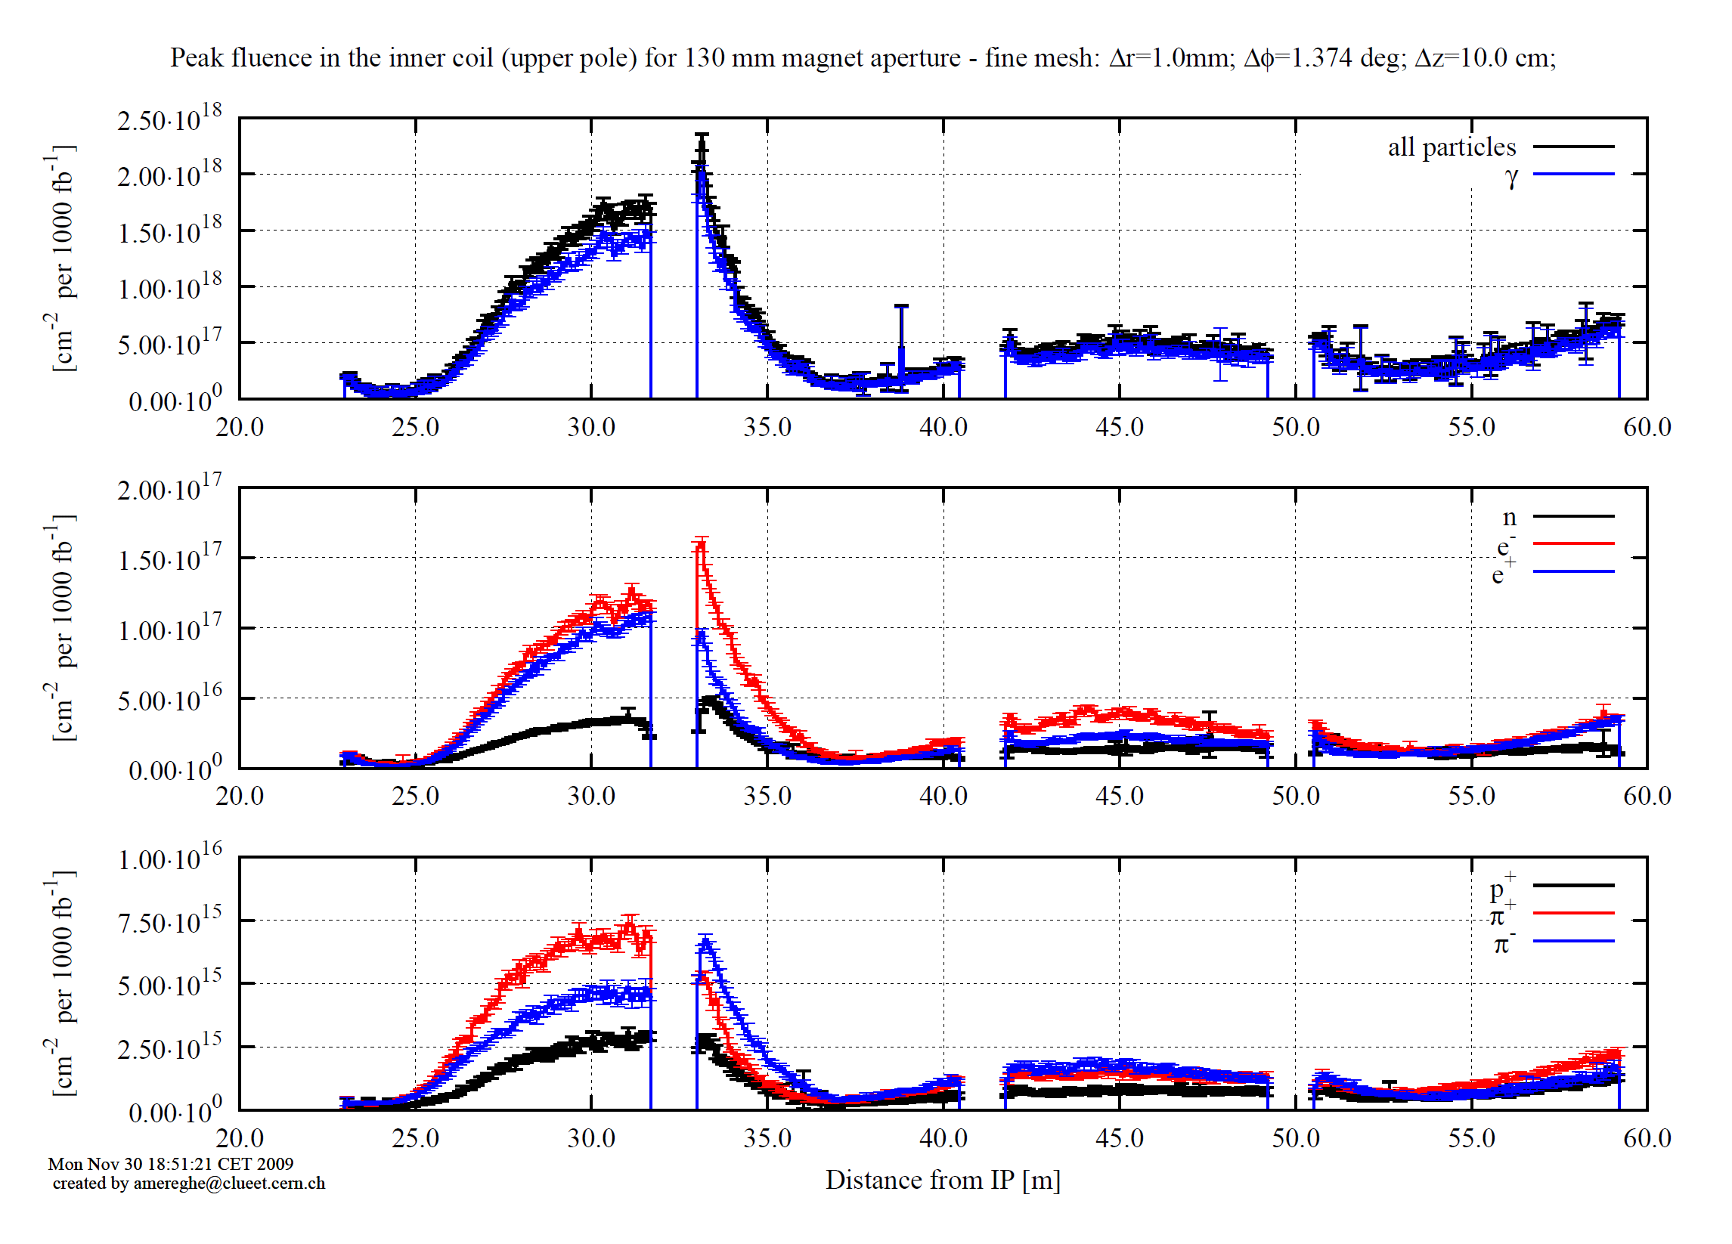
Peak fluence in the coils
in the inner cable
[cm⁻² per 1000 fb⁻¹]
x 3
At 3’000 fb⁻¹: peak of
1.5 x 10²¹ n/m² /3000 fb⁻¹
and
a few 10²⁰ pions/m²/ 3000 fb⁻¹
Track length fraction [%]
photons | 88
electrons/positrons | 7
neutrons | 4
pions | 0.45
protons | 0.15
F. Cerutti

Slide 41
Preliminary FLUKA calculations (without cold shielding)
Track length fraction [%]
photons | 88
electrons/positrons | 7
neutrons | 4
pions | 0.45
protons | 0.15
Francesco Cerutti
(at the beginning of this talk)
Over the HL-LHC target integrated luminosity (3000 fb⁻¹),
triplet quadrupole cables and insulators will undergo the following radiation peak values:
~ 100 MGy (dose)
~ 10⁻⁴ (DPA),
~ 1.5 x 10²¹ neutrons/m²
~ 10²⁰ pions/m²

Slide 42
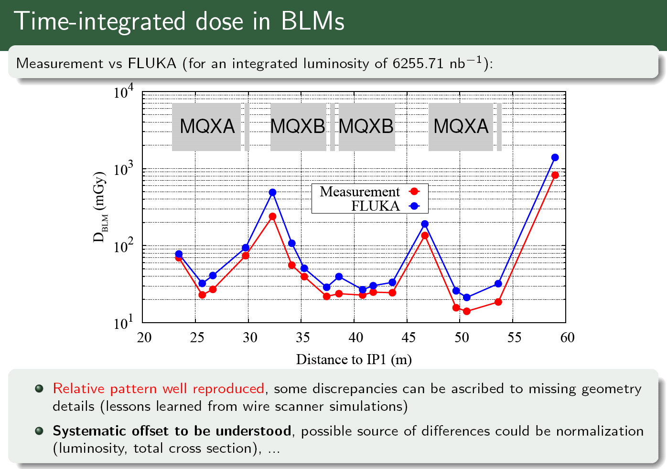
BENCHMARKING VS FIRST LHC EXPERIENCE [II]
stable collisions in P1 at 7 TeV center-of-mass on 2010 Oct 28
F. Cerutti

Slide 43
Calculation of DPA and NIEL
Displacement per atom (DTA)
Deterioration of critical properties of crystalline materials under irradiation is usually analyzed as a function of displacements per atom (DPA). The latter is a strong function of projectile type, energy and charge as well as material properties including its temperature.
Non-ionizing energy loss (NIEL)
The non-ionizing energy loss (NIEL) is a quantity that describes the rate of energy loss due to atomic displacements as a particle traverses a material.
The product of the NIEL and the particle fluence (time integrated flux) gives the displacement damage energy deposition per unit mass of material.

Slide 44
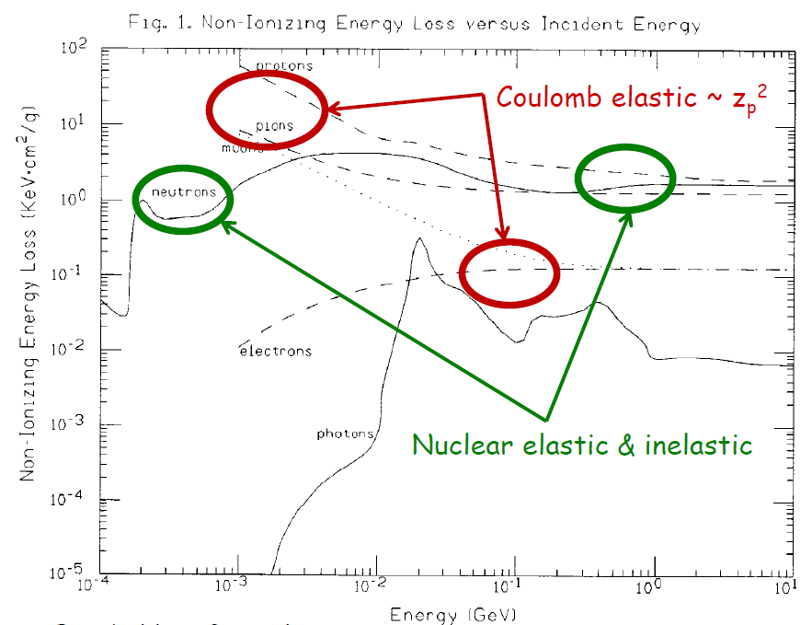
DPA/NIEL vs Particle Type & Energy in Si
A. Van Ginneken

Slide 45
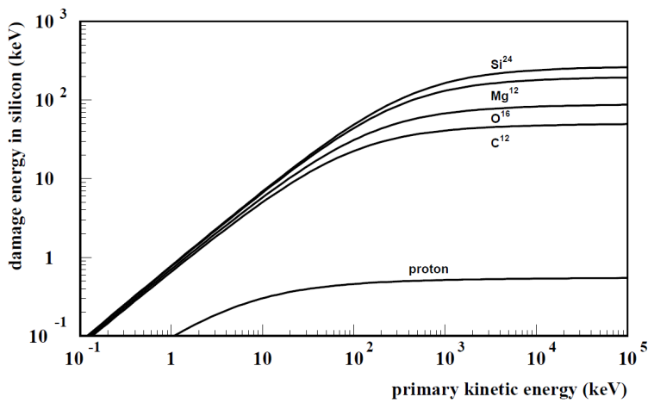
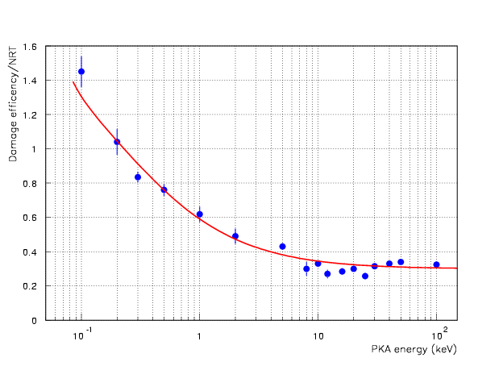
DPA Model in MARS15 (in one slide)
Norgett, Robinson, Torrens (NRT) model for atomic displacements per
target atom (DPA) caused by primary knock-on atoms (PKA), created in
elastic particle-nucleus collisions, with sequent cascades of atomic
displacements (via modified Kinchin-Pease damage function ν(T)), displace-
ment energy T_{d} (irregular function of atomic number) and displacement
efficiency K(T).
E_{d} in Si
K(T)
M. Robinson (1970)
R. Stoller (2000), G. Smirnov
All products of elastic and inelastic nuclear interactions as well as Coulomb elastic scattering of transported charged particles (hadrons, electrons, muons and heavy ions) from 1 keV to 10 TeV. Coulomb scattering: Rutherford cross-section with Mott corrections and nuclear form factors for projectile and target (important for high-Z projectiles and targets, see next two slides).

Slide 46
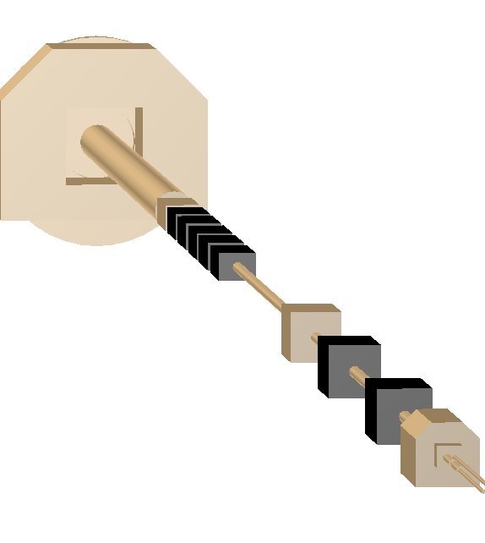
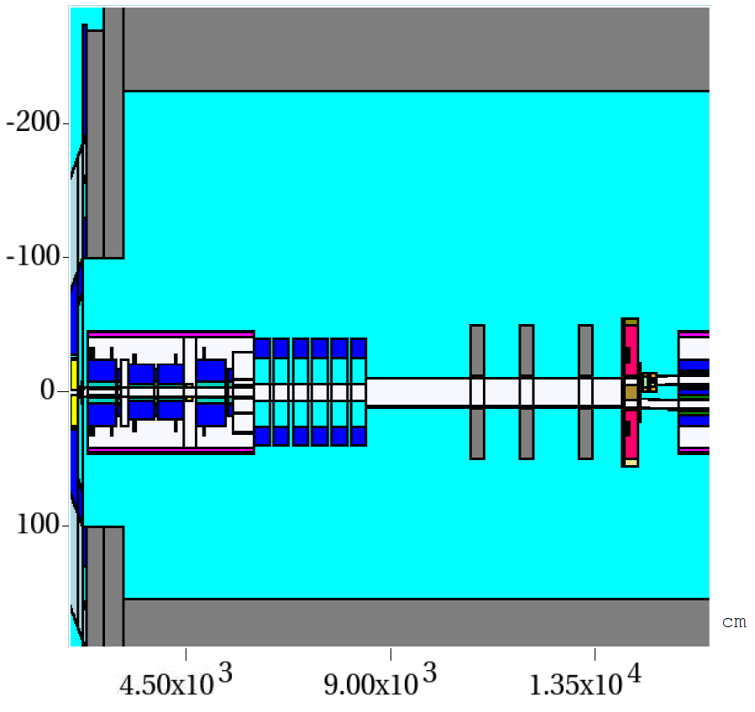
LHC IR5 MARS15 Model
N. Mokhov

Slide 47
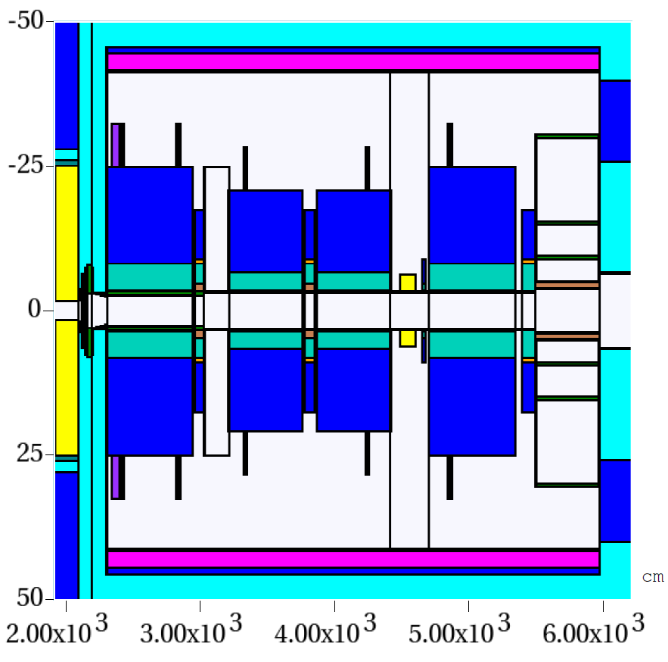
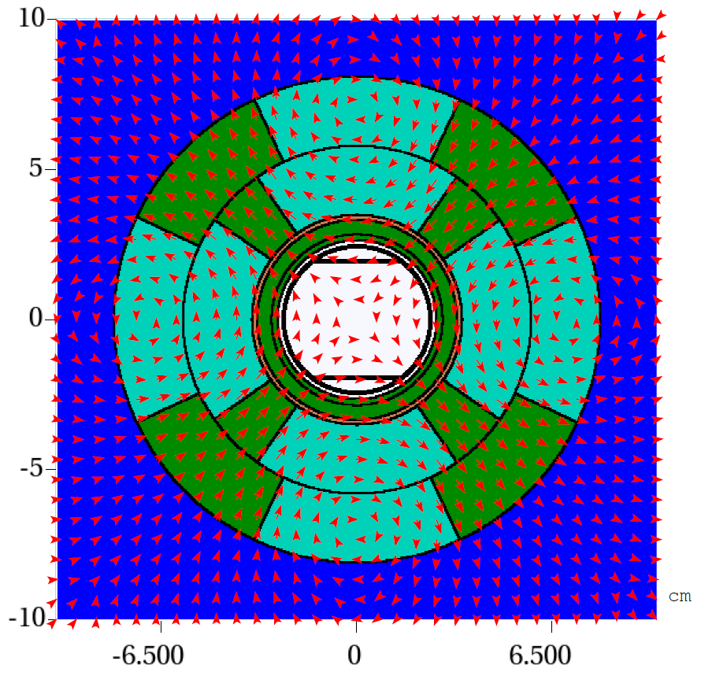
Triplet MARS15 Model
N. Mokhov

Slide 48
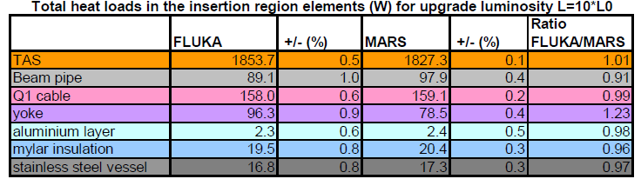
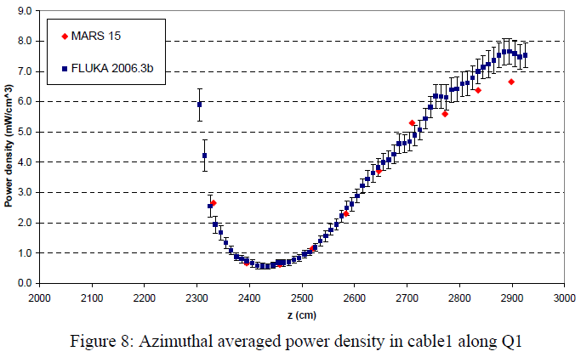
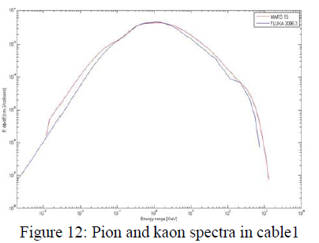
FLUKA 2006.3 and MARS15 (2007): Intercomparison
N. Mokhov

Slide 49
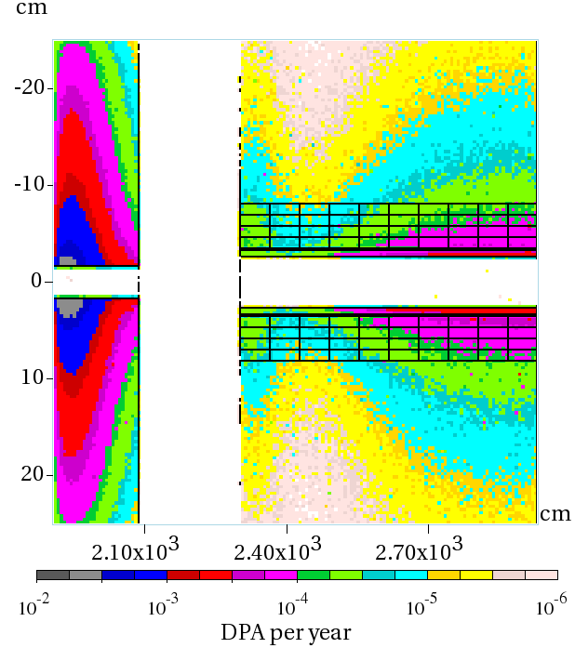
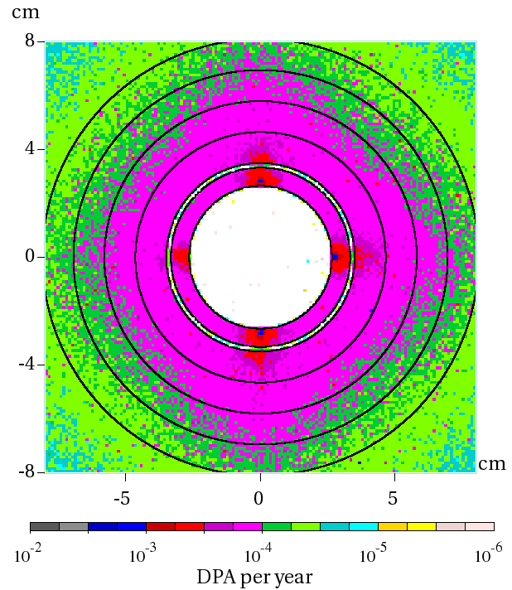
DPA
N. Mokhov

Slide 50
Mean Energy, Flux and DPA averaged over 4 Hot Spots (L, R, T, B)
Particle j | <E> (GeV) | RMS (GeV) | Flux (cm⁻²s⁻¹) | DPA/yr | DPA (%)
p | 2.93 | 10.7 | 1.3e8 | 1.75e-5 | 5
n | 0.22 | 3.7 | 2.3e9 | 8.24e-5 | 26
p, K | 13.8 | 41.6 | 5.4e8 | 4.78e-5 | 15
m | 11.3 | 19.7 | 6.3e5 | 1.70e-9 | -
g | 0.018 | 0.35 | 8.6e10 | ~2.e-5 | 6
e | 0.077 | 0.5 | 9.8e9 | 2.47e-5 | 8
Sub-thresh. |  |  |  |  | 40
Sub-thresh.: particles with E<100 keV + all fragments
N. Mokhov

Slide 51
Summary (calculations)
Independent FLUKA and MARS results on energy deposition (mostly
from EMS) for inner triplet coils are in agreement within a few %,
therefore one can predict dose in insulator with same accuracy.
Uncertainties on DPA predictions in superconductors can be as high
as a factor of 2 to 3.
MARS15 results are obtained on composition of particle flux and DPA
in the hottest spots of the final focus quadrupole superconducting
coils.
The major contributors to DPA are sub-threshold particles (40%),
neutrons > 100 keV (26%) and pions (15%).

Slide 52
Estimated total peak fluence in LHC (3’000 fb⁻¹)
Taking into account
- the calculations
- the observed difference between
neutron and proton irradiation effects
(factor ≤ 30 between fluences at J_{c}/J_{co} for 1 MeV)
- the smaller, but not negligible effect of electrons and
photons (which have considerable DPA)
Estimated total peak fluence, comprising
neutrons and charged particles (protons and pions)
is equivalent to the known effects of neutron fluence
between 3x10²¹neutrons/m² and >5x10²¹ neutrons/m²
Reduction of lifetime of quadrupoles

