Slide 1
Mu2e Production Solenoid Design
V.V. Kashikhin
February 13, 2012
Workshop on Radiation Effects in Superconducting Magnet Materials
(RESMM'12)

Slide 2
Mu2e magnet layout

Slide 3
Introduction
Production Solenoid (PS) performs the following functions in the mu2e:
Maximizes muon yield by efficiently focusing secondary pions and subsequent secondary muons towards the Transport Solenoid (TS) system, in the momentum range to be stopped in the stopping target.
  PS meets this function by supplying a prescribed magnet field profile within a prescribed aperture.
Provides a clear bore for beam line elements such as the primary production target and secondary particle radiation shield.
Allows the primary proton beam to be steered into primary target; allows outgoing proton beam to exit without striking PS magnet shield.

Slide 4
Requirements
Magnetic:
  Peak field on the axis 5 T ;
  Axial gradient -1 T/m ;
  Gradient uniformity ±5 %.
Electrical:
  Operating margins: ≥ 30 % in I_{c}, ≥ 1.5 K in T_{c} ;
  Operating current 9÷10 kA;
  Peak quench temperature ≤ 130 K;
  Voltage across terminals ≤ 600 V.
Structural:
  Withstand forces at all conditions while part of the system or stand-alone;
  Cryostated magnet weight ≤ 60 tons;
  Compliance with applicable structural codes.
Cryogenic:
  Cooling agent: LHe at 4.6 K;
  Total heat flow to LHe ≤ 100 W;
  Cryostat ID 1.5 m;
  Conduction cooling.
Radiation:
  Absorbed dose ≤ 6 MGy total;
  Minimum RRR of stabilizer in the operating cycle ≥ 100.

Slide 5
Magnetic design

Slide 6
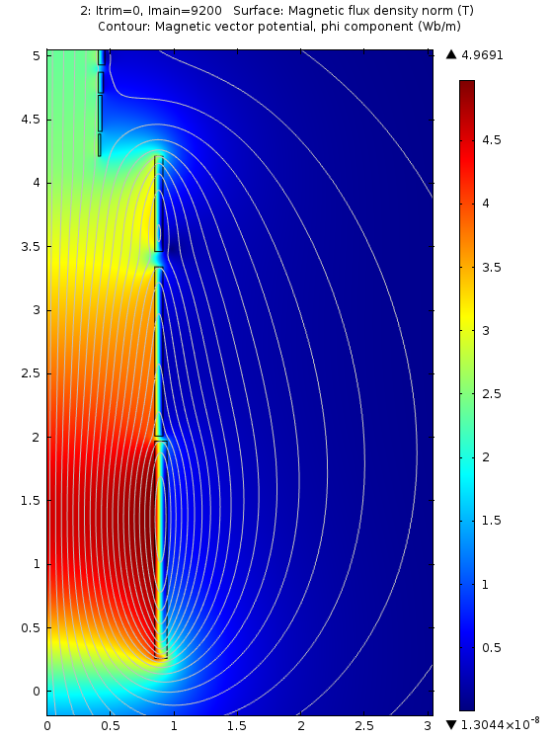
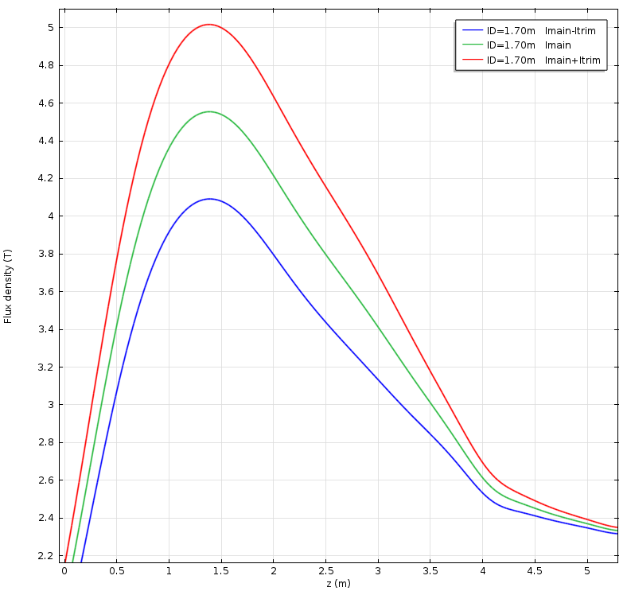
Magnetic field

Slide 7
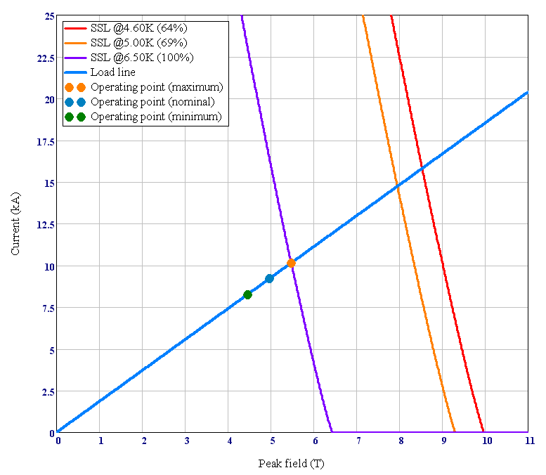
Load line

Slide 8
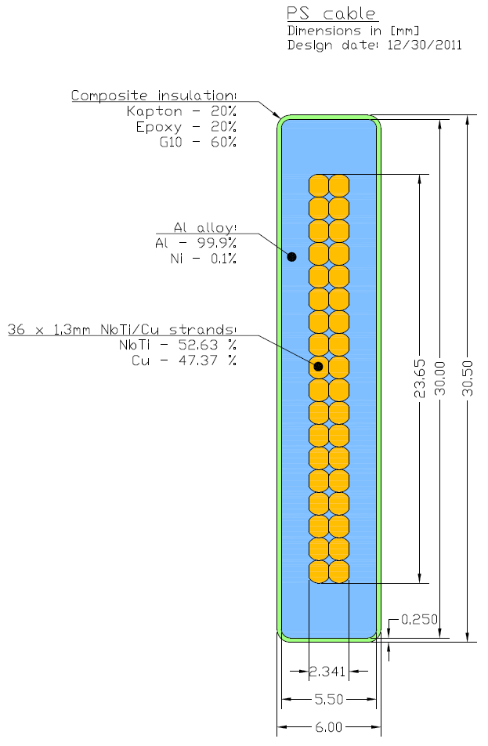
Cable parameters

Slide 9
Magnet parameters

Slide 10
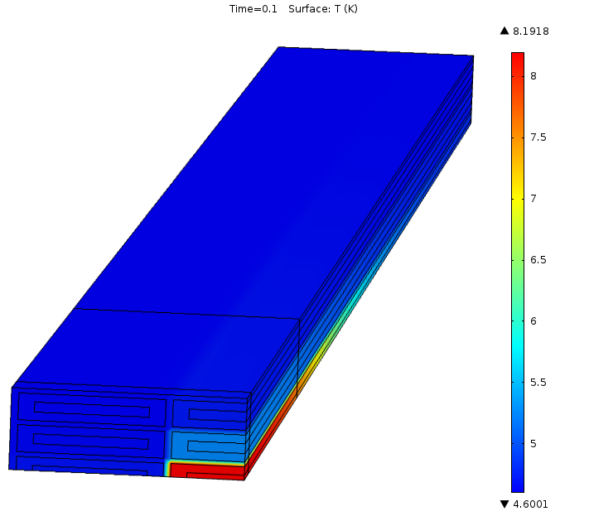
Magnet stability
Ability of the magnet to recover from a short-term transition from superconducting to normal state.
Characterized by the minimum quench energy (MQE) – the minimum energy deposited in the coil causing the irreversible transition to normal state (quench)
In the absence of a strict stability criteria, we chose the MQE to be comparable with other large solenoids that were built and tested:
  CMS MQE = 620 mJ
  ATLAS CS MQE = ~400 mJ

Slide 11
Quench protection
Adiabatic analysis by QLASA;
  No quench-back from the structure;
The peak coil temperature reaches ~45 K for non-degraded RRR;
In case of a factor of 10 RRR degradation in a short cable segment (worst case):
  RRR_{Al} = 50;
  RRR_{Cu} = 10
  Peak coil temperature < 100 K;
Meets the design requirement on the peak coil temperature.

Slide 12
Structural design

Slide 13
Stress criteria
The maximum allowable stress in the superconducting coils that are supported by the external support structures is the lesser of:
  2/3 of the minimum specified Yield Strength;
  1/2 of the minimum specified Ultimate Strength.
The measured cable strength data were taken from ATLAS CS cable.
  The actual PS cable is expected to be stronger because of the lower fraction of Al stabilizer.
The maximum allowable stress in the support shells was chosen according to 2010 ASME Boiler and Pressure Vessel Code.

Slide 14
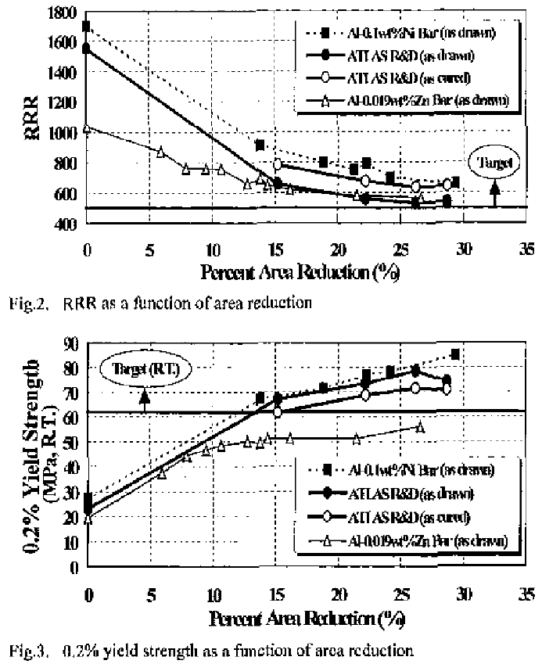
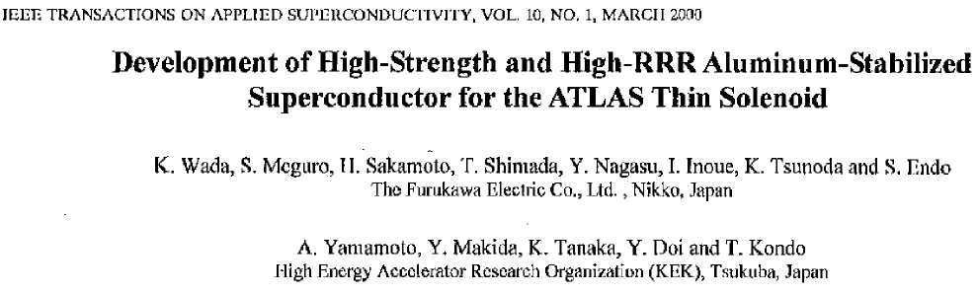
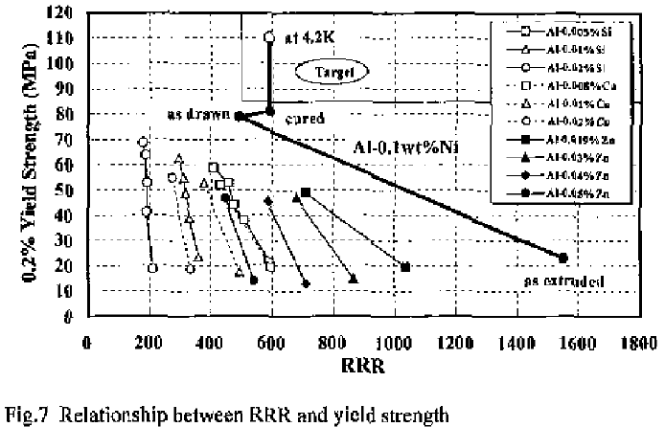
RRR vs. cable strength

Slide 15
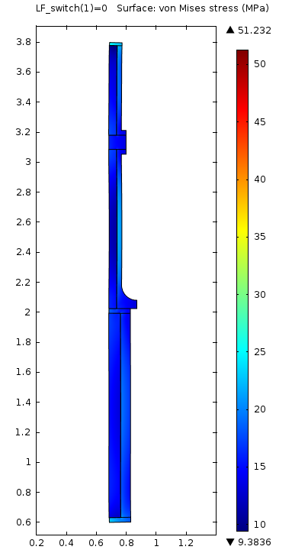
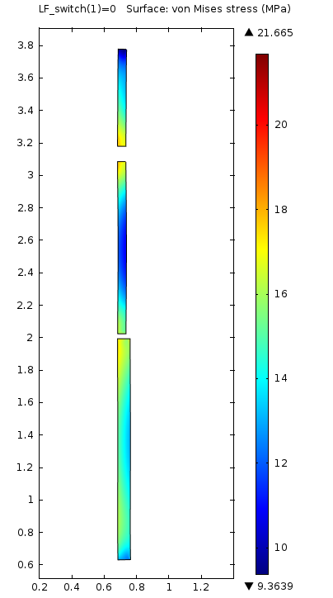
300 K -> 4 K, I = 0
Peak stress in the support structure: 51 MPa;
Peak stress in the coil: 21 MPa

Slide 16
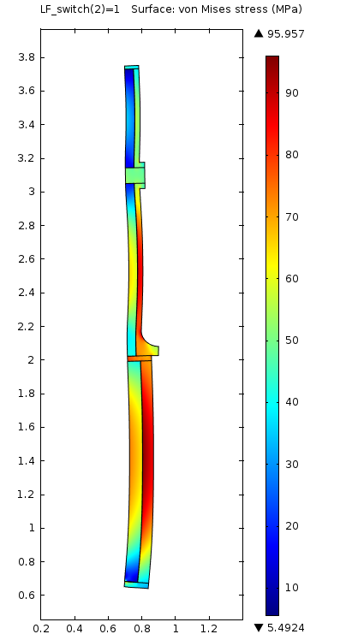
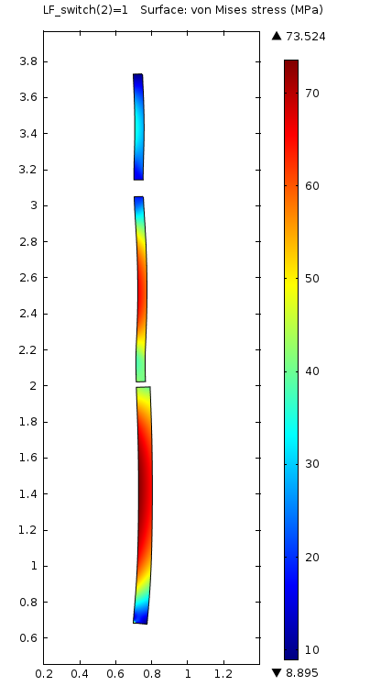
300 K -> 4 K, I -> I_{op}
Peak stress in the support structure: 96 MPa;
Peak stress in the coil: 73 MPa

Slide 17
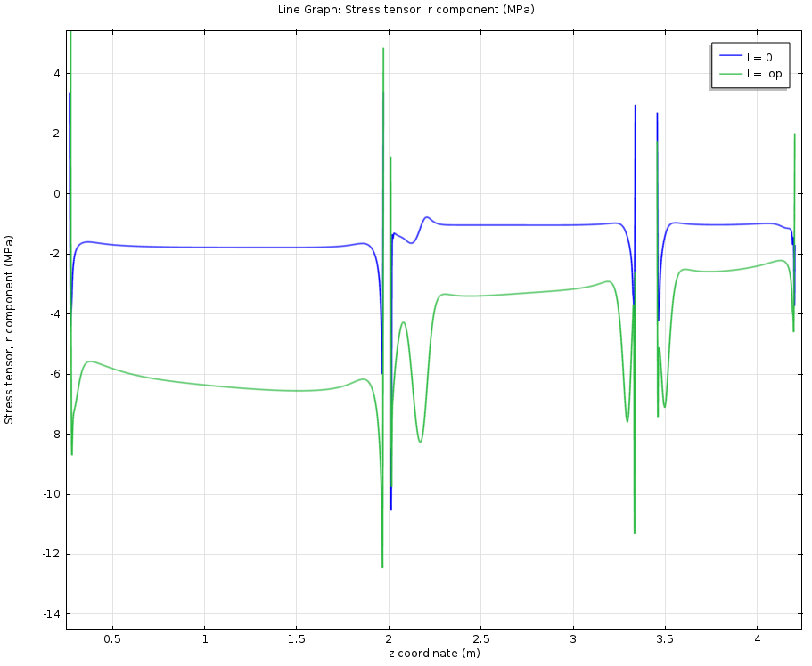
Coil-shell normal stress

Slide 18
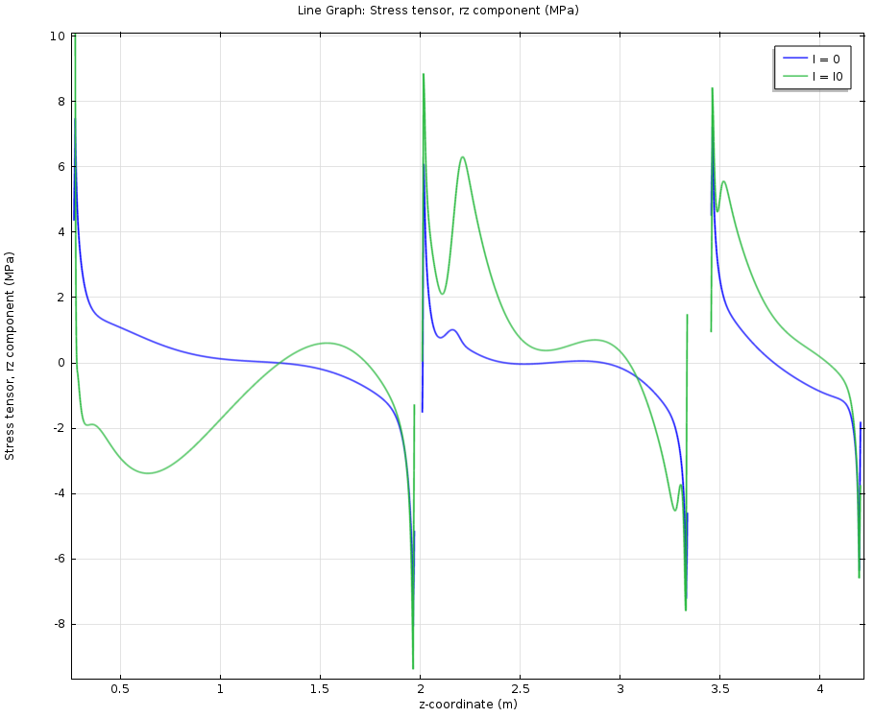
Coil-shell shear stress

Slide 19
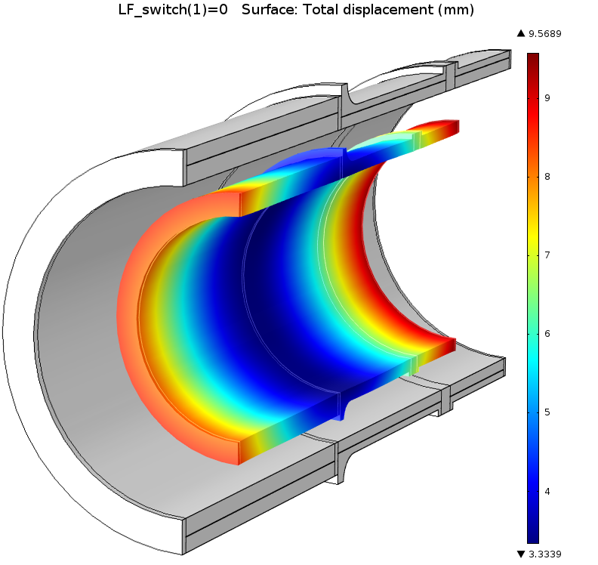
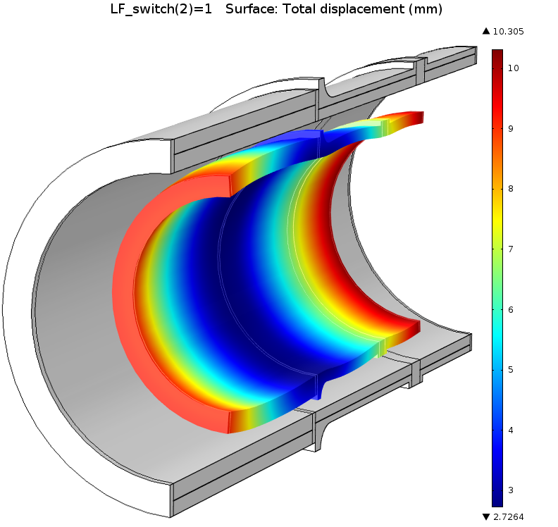
Displacements
~10 mm at the end flanges;
~3 mm at the middle support.

Slide 20
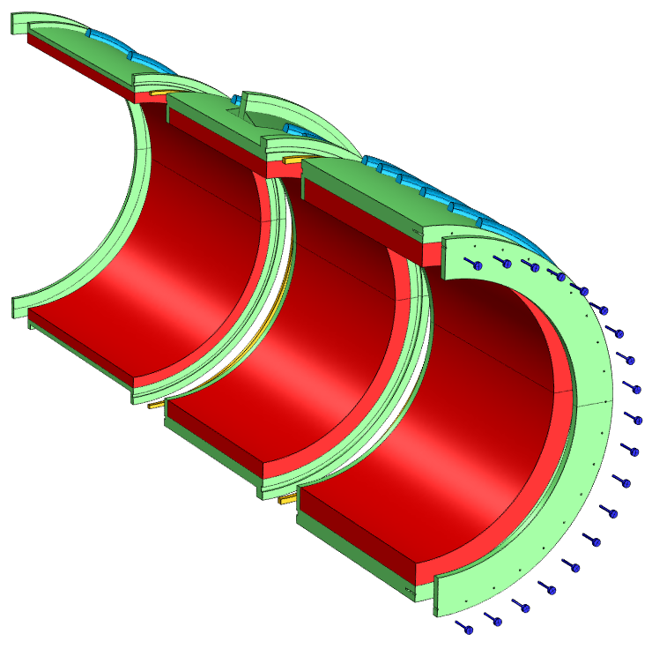
Cold mass
The coils are assembled inside the support shells made of Al 5083-O;
Each coil section is individually vacuum-impregnated with epoxy resin;
The three coil sections are bolted together during assembly to form a single cold mass;
  The azimuthal keys lock the sections together.
Cold mass dimensions:
  ID = 1.70 m;
  OD = 2.12 m (ex. cryo/supp.);
  Length = 4.0 m.

Slide 21
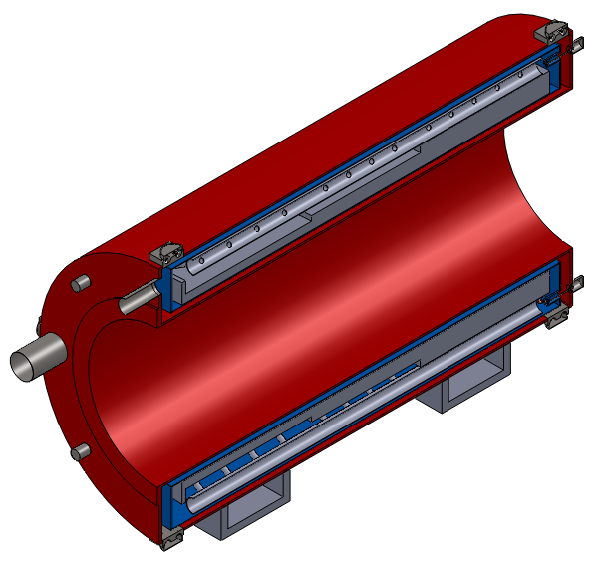
Cryostat
Vacuum vessel
Thermal shield
The cold mass is internally supported by the suspension system;
The loads are transferred to the experiment’s floor through the cryostat walls, support posts and iron yoke;
The cryostat is designed to support the additional weight of the radiation shield (~50 tons).
Cold mass assembly

Slide 22
Radiation/thermal analysis

Slide 23
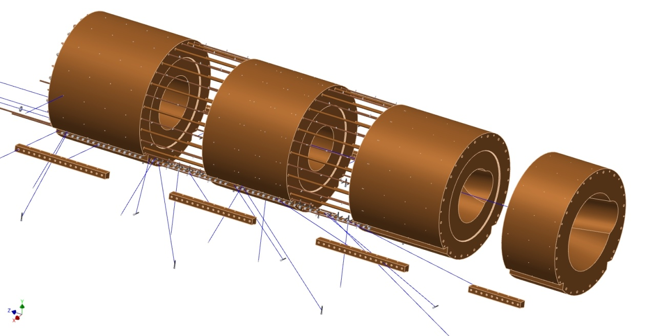
Heat and radiation shield
13.6 tons
12.4 tons
BARTOSZEK ENGINEERING
13.2 tons
6.6 tons
Bolt-on rails
Installed within the warm magnet bore;
Made from low-conductivity bronze;
Protects the superconducting coils from radiation coming from the primary proton target.

Slide 24
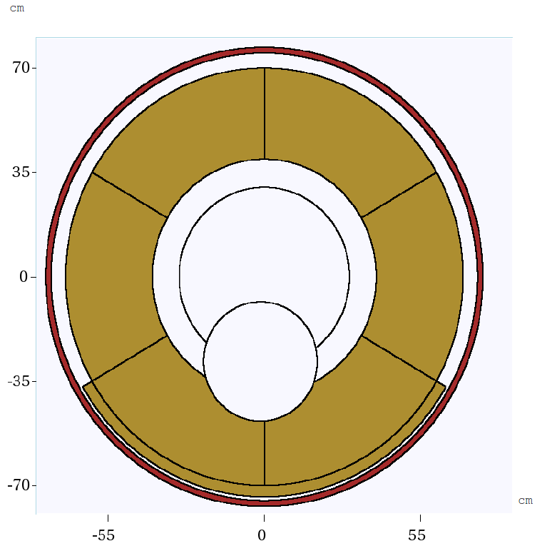
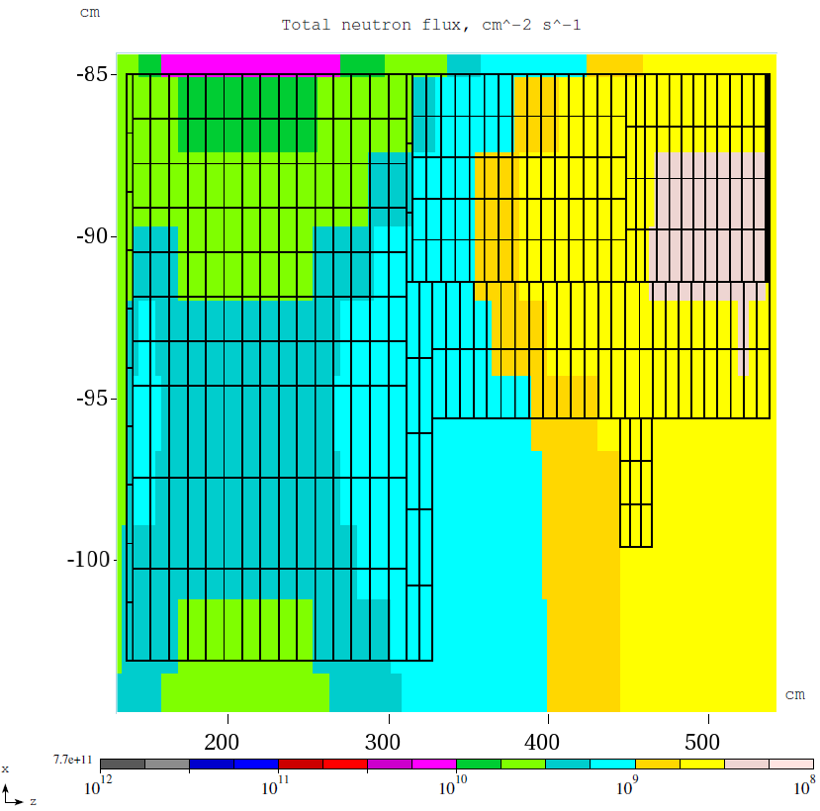
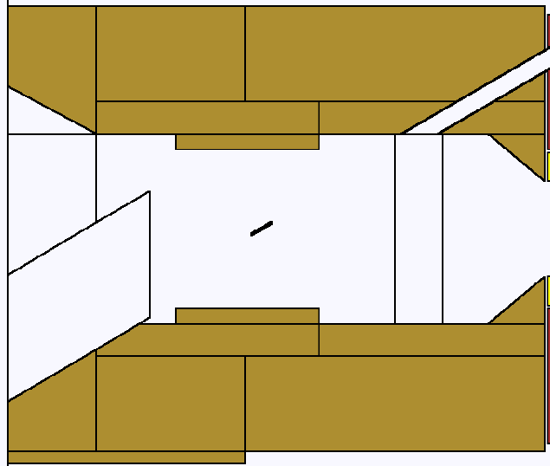
MARS radiation analysis
3D MARS model included all the details of the PS magnet and the radiation shield;
The coil properties were approximated as a mixture of the relevant materials.
See presentation of Vitaly Pronskikh

Slide 25
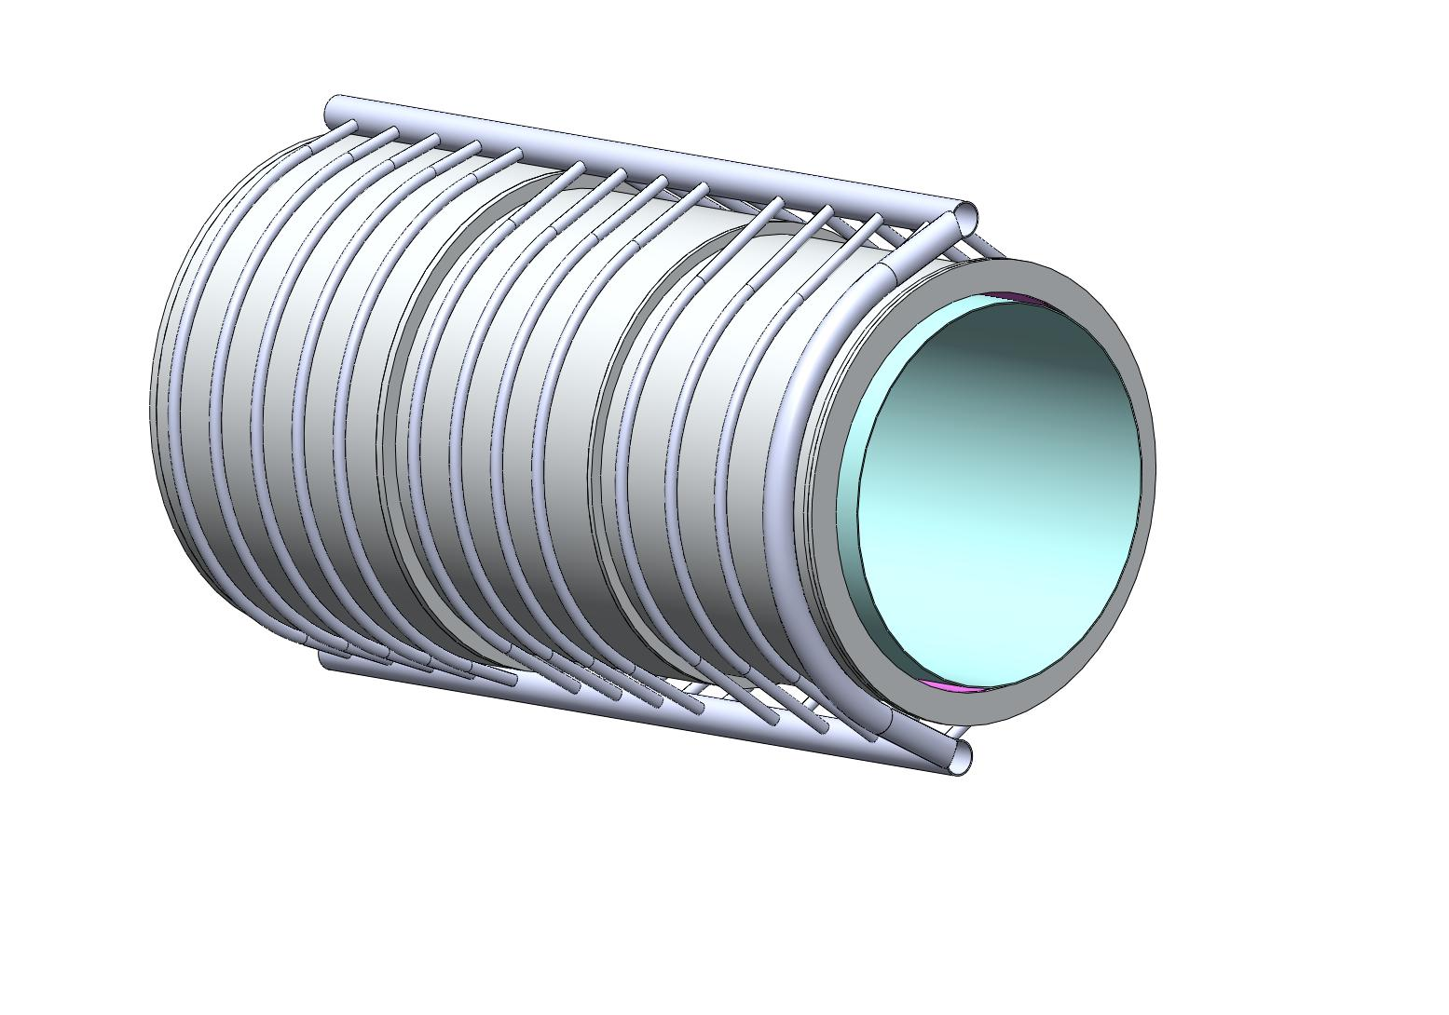
Cooling system
Cooling tubes
The cold mass is conduction cooled via thermal siphon scheme;
The support shells are equipped with azimuthal cooling tubes that create the parallel flow paths;
The tubes are connected to the upper and lower distribution lines;
A return column not thermally connected to the cold mass supplies cold liquid to the bottom.
Distribution line
Liquid return

Slide 26
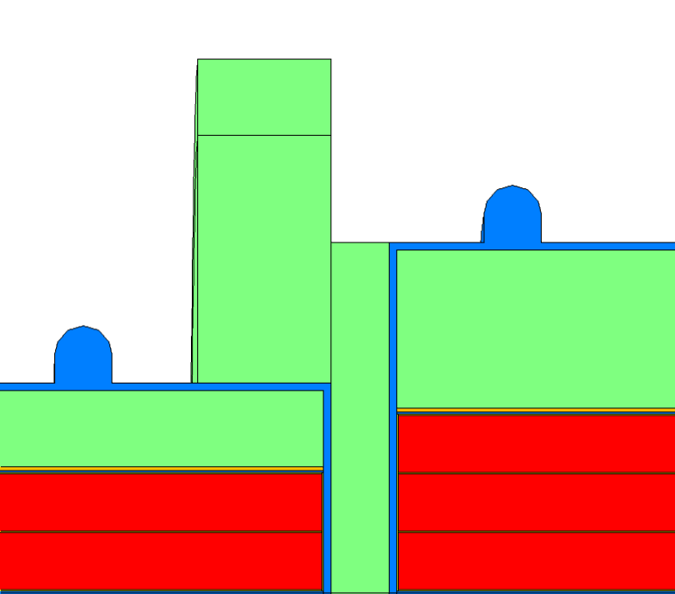
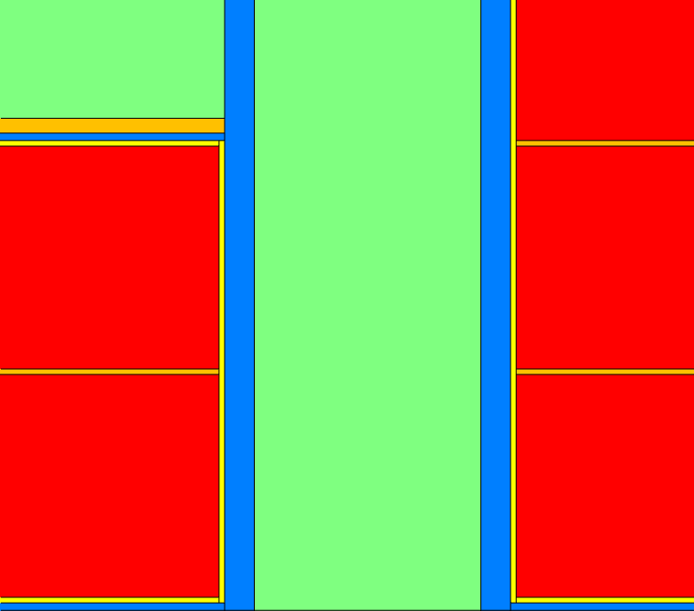
Coil-flange interface
Coil envelope is surrounded with the ground insulation:
  2x250 μm of composite insulation (2x25 μm of Kapton, fiberglass balance);
Thermal bridges at the inner and outer surfaces;
Metal to metal connection between thermal bridges and plates;
Thermal plates are stress-relieved at the corners of the support shells;
Layers of mica between the thermal plates, flanges and shells.

Slide 27
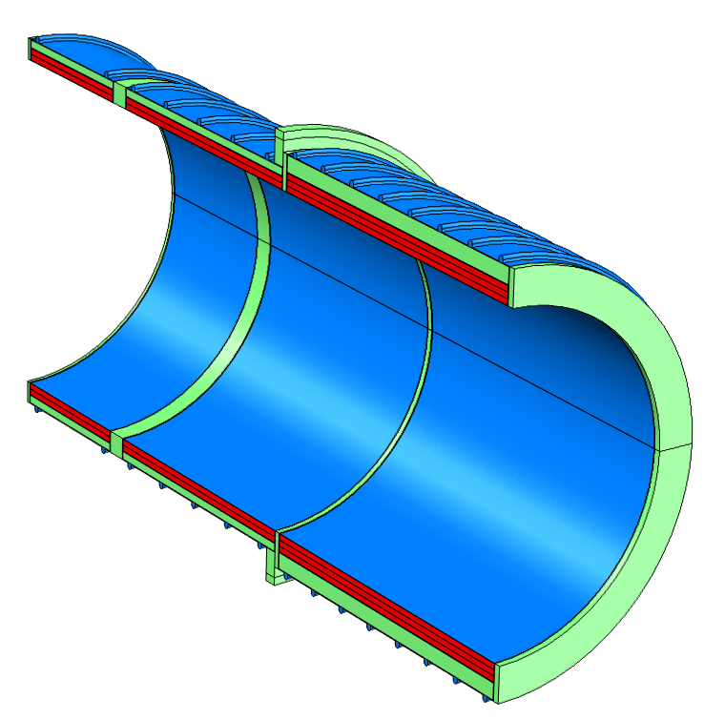
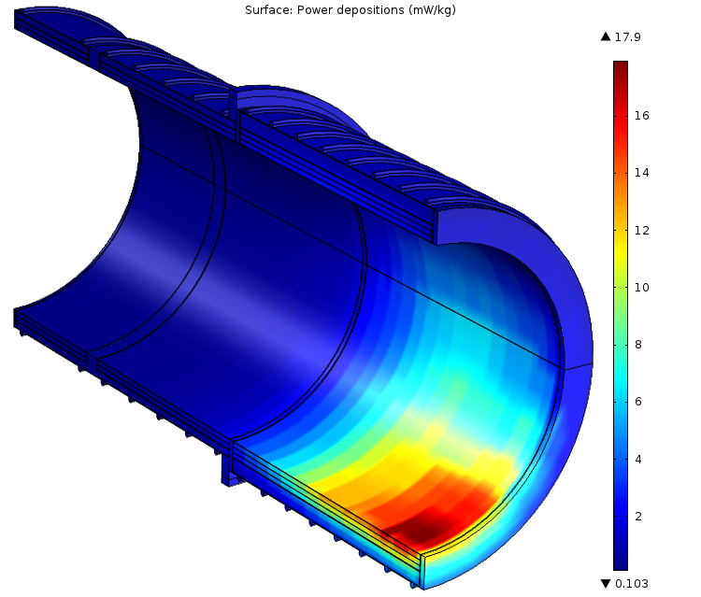
Thermal model
Peak power density is 17.9 mW/kg;
Total power deposition in the cold mass 21.0 W.

Slide 28
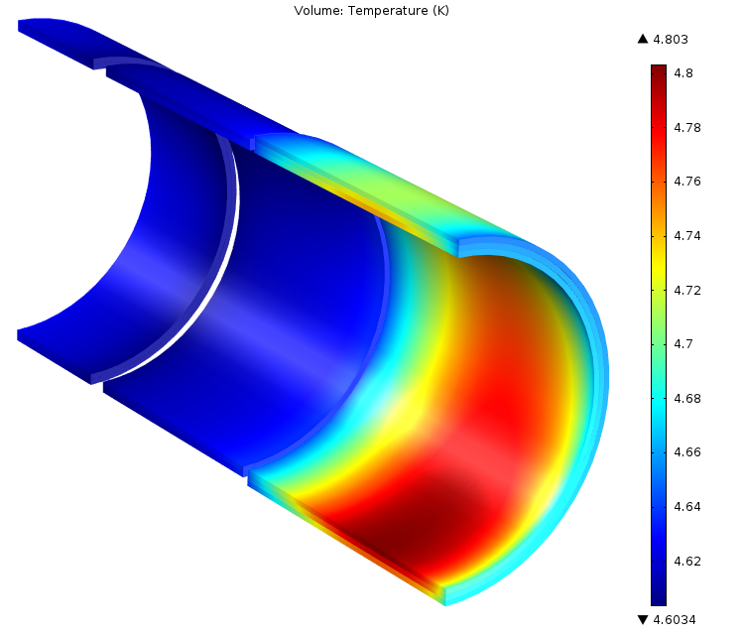

T₀=4.6 K, static+dynamic heat load
B_{max} B_{min}
Peak coil temperature at the max performance is 4.803 K;
Azimuthally non-uniform distribution.
Peak coil temperature at the min performance is 4.807 K;
Azimuthally non-uniform distribution.

Slide 29
Thermal parameter space
The thermal models are identical: same geometry, boundary conditions and heat sources;
The only difference is the material of cable stabilizer and thermal bridges/plates (Al or Cu, RRR=100);
The difference in thermal performance is due to the change of densities and thermal conductivities.

Slide 30
Summary
The PS magnet design meets the requirements;
It offers a flexibility in adjusting the peak axial field and gradient;
Conservative margins are built in;
Al stabilizer offers an advantage over Cu for the selected magnet technology and radiation environment.

