Slide 1
Solenoid Magnet System
Outline
Introduction
Scope
Key Design issues
Conclusions
RESMM’12
February 13, 2011
Michael Lamm
For the Mu2e Solenoids

Slide 2
L2 Solenoid
Production Solenoid (PS)
Transport Solenoid (TS)
Detector Solenoid (DS)
Cryogenic Distribution
Power Supply/Quench Protection
Cryoplant (actually off project)
Field Mapping
Ancillary Equipment
Insulating vacuum
Installation and commissioning

Slide 3
Design Specifications
Field quality
  Monotonic axial gradients in transport straight sections
  Field uniformity in spectrometer
Quench margin and stability
  1.5 K in temperature, 30-35% in Jc along load line, stability (TBD)
  Stabilizer resistivity, conductor heat capacity, thermal conductivity
Fits within the cryogenic budget
  1 Satellite refrigerator steady state
  1-2 Additional refrigerators for cooldown/quench recovery
Limited radiation damage
  Superconductor and insulation secondary to stabilizer degradation
  RRR reductions and annealing compatible with planned thermal cycles
  Frequency of thermal cycles (for radiation repair) coincides with expected accelerator and/or cryogenic operation cycles

Slide 4
Cost and Time Considerations
Cost is a major factor
  Raw materials for both magnet and shields
  Pool of vendors capable of building large-complex magnets
  Simplified infrastructure with commonality to rest of muon campus
Time Constraints
  Magnets are on the critical path for most of project life.
  Present Schedule
    June 2012: Prototype conductor order (1 year lead time)
    June 2013:
      Place order for conductor production run
      Place contract for magnet fabrication
Argues for using proven technologies

Slide 5
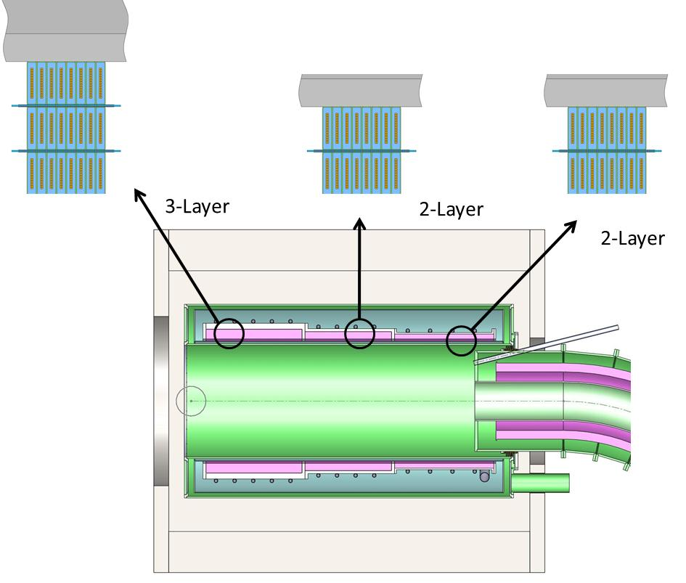
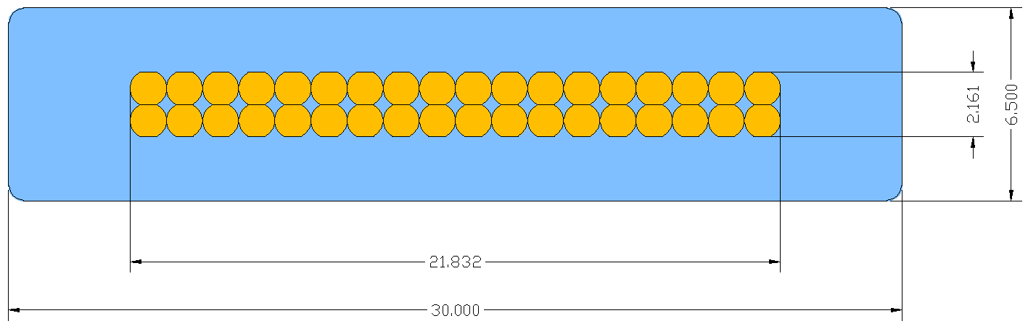
PS Baseline Design
4-5T➔ 2.5 T Axial Gradient
Gradient made by 3 axial coils same turn density but increase # of layers (3,2,2 layers)
  Wound on individual bobbins
  I operation ~9kA
  Trim power supply to adjust matching to TS
  Indirect Cooling (Thermal Siphon)
Aluminum stabilized NbTi
  reduce weight and nuclear heating
  Special high strength/high conductivity aluminum needed (like ATLAS Central Solenoid)
Vadim Kashikhin, task leader
See Next Presentation

Slide 6
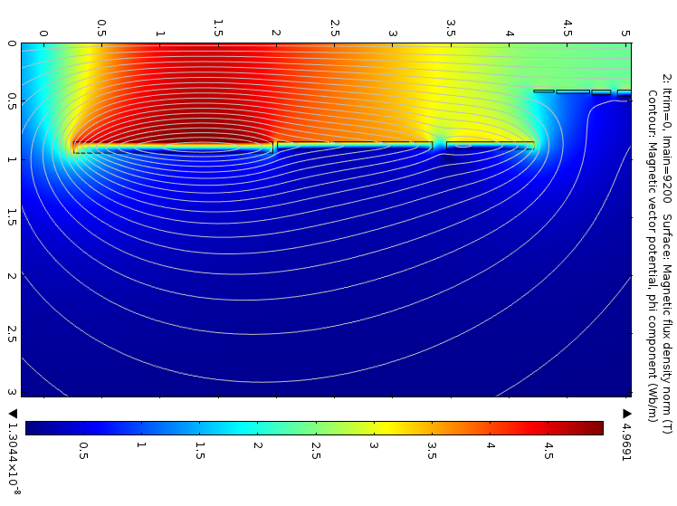
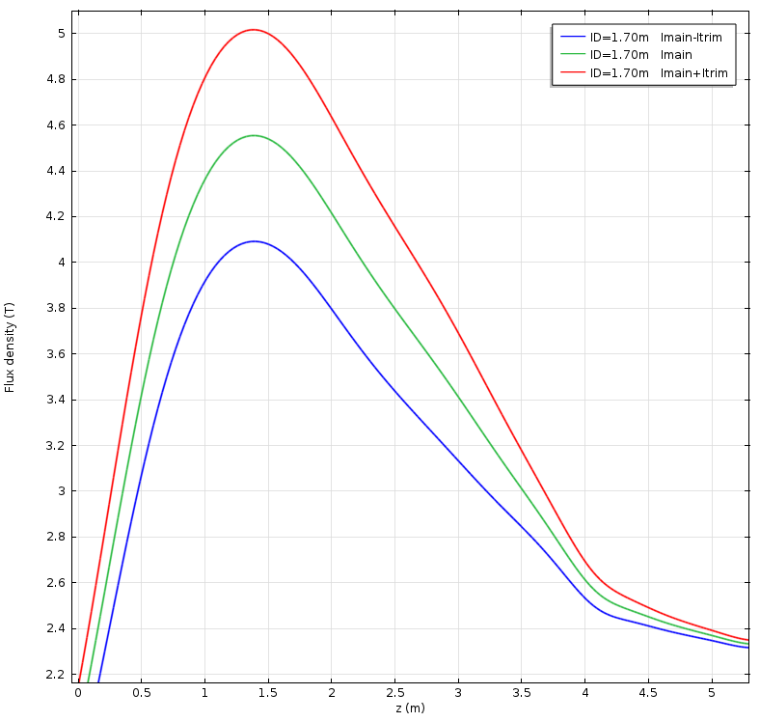
3-2-2 magnet design
Gradient Uniformity meets field spec.

Slide 7
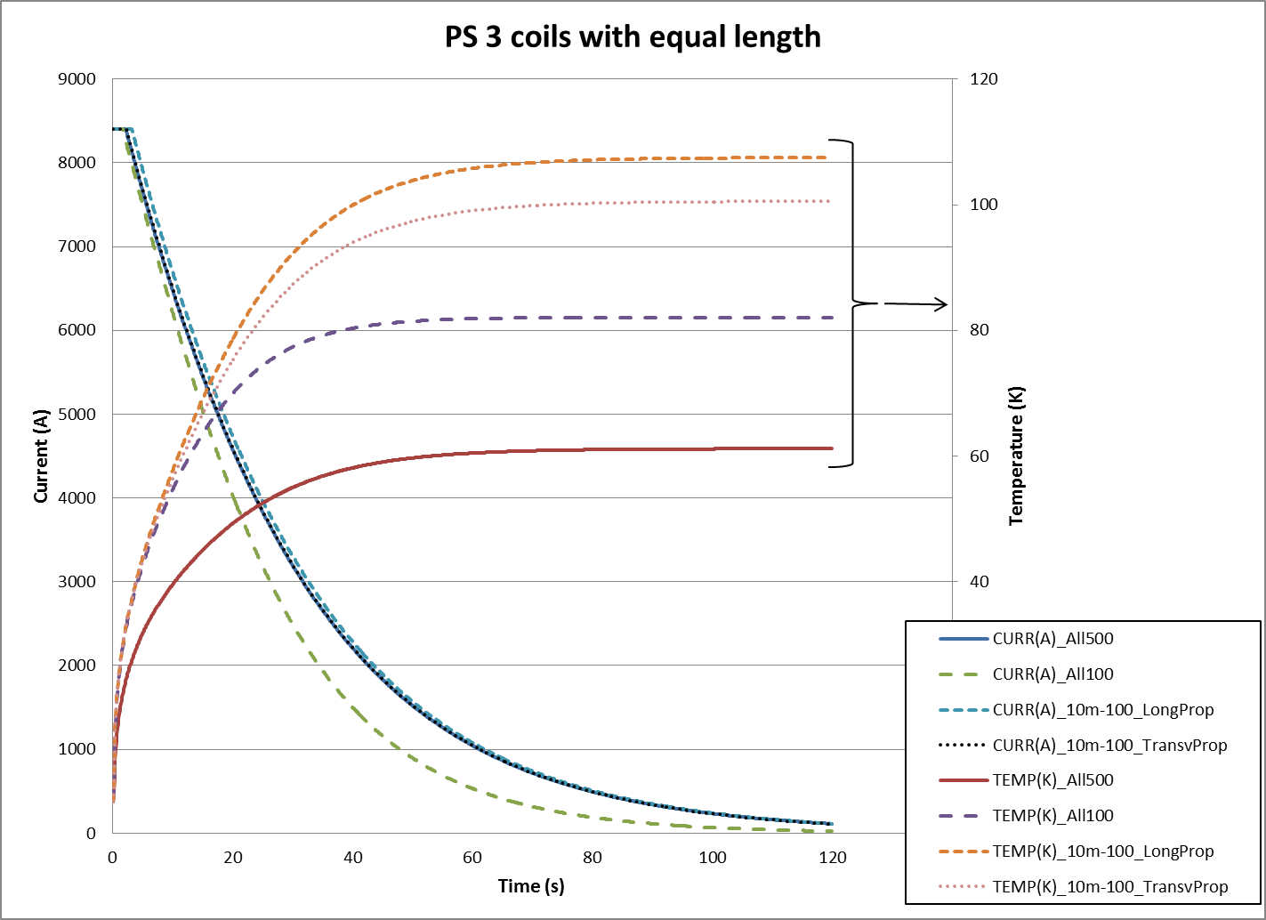
Quench protection and stabilility
PS Quench Studies
Comfortably below 130K quench limits

Slide 8
Quench Stability
Is magnet stable against quenches caused by expected mechanical motion?
  Motion of strand within cable
  Motion of cable within epoxy
  Epoxy Cracks
Difficult to predict from first principles
  Comparison to successful magnet of similar design
  Scale with properties of material elements
  Important material attributes:
    Thermal conductivity
    Resistivity at operational fields
    Heat capacity
This will be covered in the next talk….

Slide 9
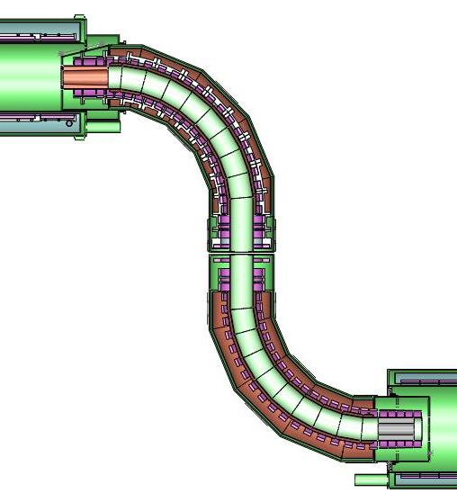
New baseline Transport Solenoid
TS1/TS5: Negative axial gradient and field Matching to PS/TS TS1 subject to primary target radiation
TS2
TS2/TS4: Horizontal tilt to compensate for horizontal drift
TS1
Rotatable Collimator, P-bar window
TS3: ➔ TS3U, TS3D. Wider coils to compensate for gap
Two cryostats: TSU, TSD
TS4
New coil fabrication proposed
G. Ambrosio
TS Leader
TS5

Slide 10
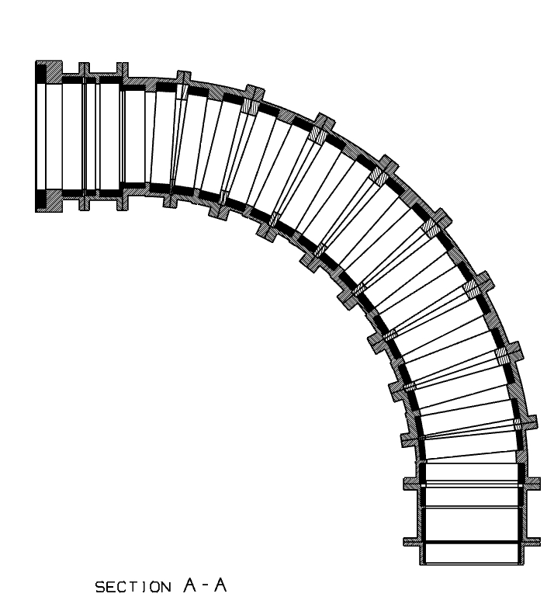
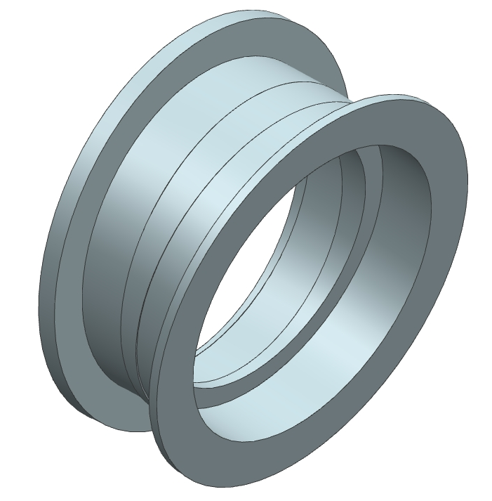
Coil Fabrication
Al Outer Supports
Conductor
Bolted connections
Fabrication unit consists of two coils with outer support aluminum structure
Forged aluminum ring, machined to final shape
Placement of coil in transport, including bends and tilts are built into outer shell assembly

Slide 11
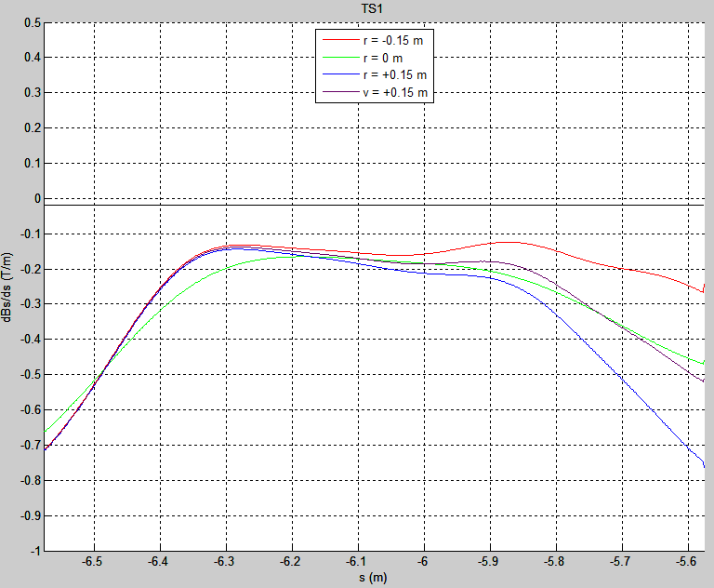
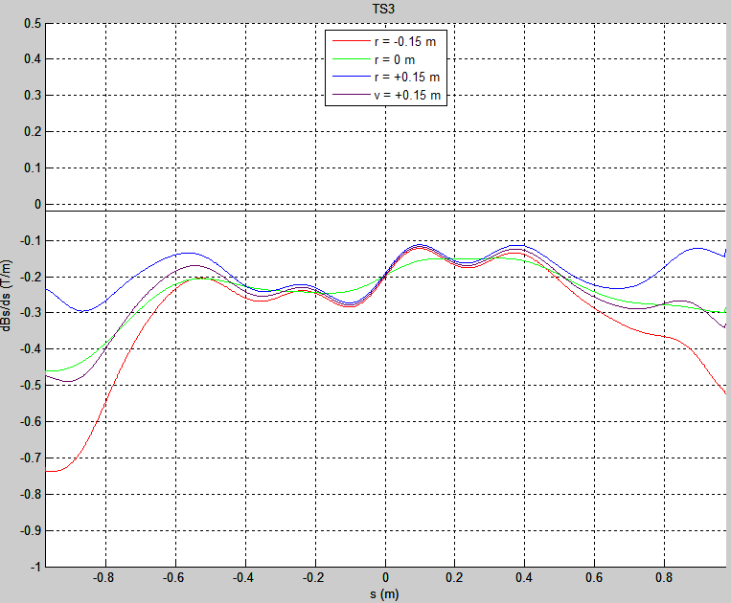
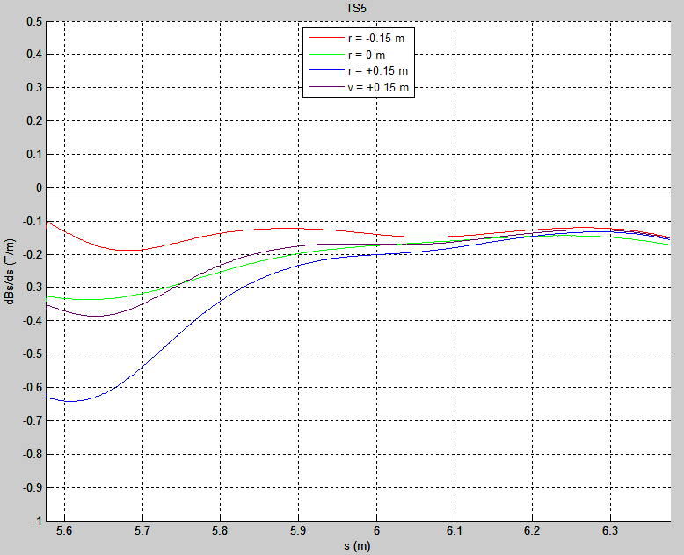
TS field quality
Negative Gradient in all straight sections
Smooth transitions between magnet elements
Design focus: sensitivity to conductor placement on meeting specs.

Slide 12
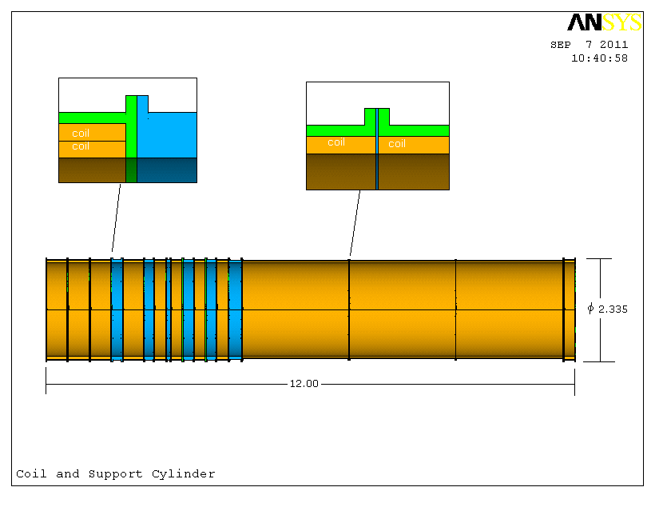
DS Baseline
Gradient Section
Spectrometer Section
Gradient section: 2 layer coils
  Gradient accomplished by use of spacers
Spectrometer: 3 Single Layer Coils ➔ shorter coils, greatly reduced conductor volume
Relaxed calorimeter field requirements➔ shorten spectrometer
No significant materials issues with respect to radiation damage
R. Ostojic
DS Leader

Slide 13
Cryogenic Distribution Scope
T. Peterson

Slide 14
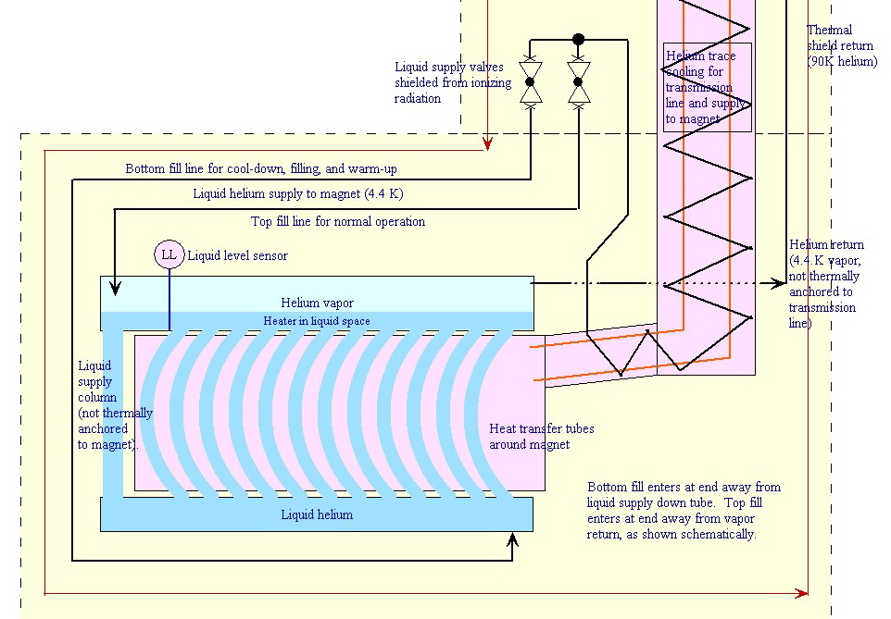
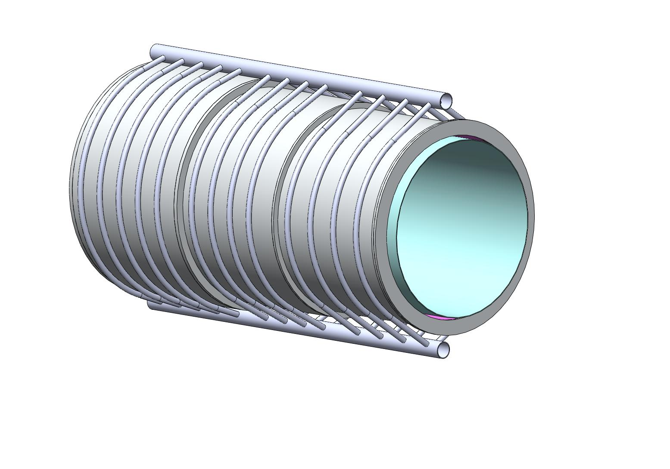
Production solenoid
thermal siphon
cooling scheme

Slide 15
Thermal Siphon vs. Forced Flow
Present baseline
  Thermal Siphon for PS
  Forced flow for TS and DS
Advantages to Thermal Siphon
  Maintain lowest temperature at magnet
  Simple, passive➔ cost effective for both design, fabrication and operation
Advantage to Forced Flow
  Can tie together circuits that are not well thermally coupled; less sensitive to geometric constraints (might be better for TS)
  Less passive ➔ more control

Slide 16
Refrigeration loads at 4.5 K
For cooling entirely with thermal siphons
  Total heat load at 4.5 K (which equals the refrigeration load) is 230 W
  Total 4.5 K helium flow rate is 12 grams/sec
For cooling PS with thermal siphon and others with forced flow
  Total refrigeration load (which is circulating pump heat plus the transfer and magnet heat loads) = 350 W
  Peak helium temperature (assuming 50 grams/sec circulating flow and a 4.50 K inlet temperature) = 4.68 K.

Slide 17
Cool-down and Warm-up
First look – Production Solenoid. Treat as simply 11.8 metric tons of aluminum for thermal energy estimate
  Start at 300 K and cool to 80 K by means of the same heat exchanger system used for thermal shield cooling
  Then cool to 5 K by means of one satellite refrigerator running in liquefier mode (getting warm gas back)
Result
  Time from 300 K to 80 K is about 18 hours
  Time from 80 K to 5 K is about 26 hours
Conclusion
  Assuming no constraints due to thermal stresses (no delta-T constraints) for the 80 K portion of the cool-down, one could cool the 11.8 ton PS solenoid in about 2 days.
  This is just a rough estimate, but it seems reasonable considering that we cooled multi-ton SSC and LHC cold iron magnets at MTF in a day.
In reality, we may have some constraints so as not to thermally stress the magnet, resulting in a time of more like 4 – 7 days.
Warm up time back to ~273K is comparable

Slide 18
Conclusion
Present design meets mu2e experiment requirements
Radiation studies (presented in related talks) show that magnet temperature will not exceed 5K.
Warm up to repair radiation damage: >1 between thermal cycles
  Time for warm up/cool down 1-2 weeks
  Consistent with reasonable expectations for accelerator operations
At 300 kGy/year,
  Damage to epoxy and superconductor ➔ > 20 year life time

Slide 19
Heat and flow estimates

Slide 20
Properties of Al and Cu
Compare Aluminum and Copper properties at 5K
Aluminum | Thermal conductivity W/(m*K) |  |  |  |  | Electrical resistivity nOhm*m
T = 5 K | B = 0 T | 1 T | 2 T | 3 T |  | B = 0 T | 1 T | 2 T | 3 T
RRR = 100 | 487 | 419 | 415 | 412
RRR = 200 | 959 | 727 | 713 | 707 |  | 0.167 | 0.208 | 0.212 | 0.215
RRR = 400 | 1907 | 1168 | 1132 | 1117 |  | 0.069 | 0.11 | 0.114 | 0.117
RRR = 600 | 2861 | 1468 | 1412 | 1387
Copper | Thermal conductivity W/(m*K) |  |  |  |  | Electrical resistivity nOhm*m
T = 5 K | B = 0 T | 1 T | 2 T | 3 T |  | B = 0 T | 1 T | 2 T | 3 T
RRR = 50 | 375 | 326 | 293 | 267
RRR = 100 | 749 | 576 | 481 | 415 |  | 0.153 | 0.193 | 0.233 | 0.273
RRR = 150 | 1122 | 775 | 611 | 509
RRR = 200 | 1494 | 936 | 707 | 574 |  | 0.077 | 0.117 | 0.157 | 0.197
Data from MATPRO:
L. Rossi, M. Sorbi, "MATPRO: a Computer Library of Material Property at Cryogenic Temperature"
INFN/TC-02/02 and CARE-Note-2005-018-HHH

