Slide 1
Beam Test Possibilities in Japan
Tatsushi NAKAMOTO
KEK

Slide 2
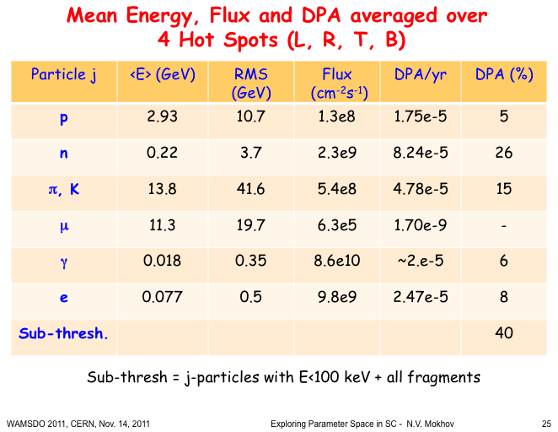
Necessary Irradiation Source
IT Quads. for HL-LHC
Mean energies of the particles are rather higher.
Effect of pions, kaons, muons. fragments?
  ➔ NO (a few?) facilities to simulate the radiation parameters perfectly.
  Evaluation using by available facilities. >> Scaling is essentially necessary.

Slide 3
Facilities for Materials Irradiation
Sources of irradiation for SC magnet materials
      Neutrons: Nuclear reactors (> 0.1 MeV), 14 MeV n by DT
      Protons: Accelerators
      Electrons: Accelerators
      Gamma rays: ⁶⁰Co , etc
      Pions: ???
      Ions (high energy): ???
Some Requirements
  Sample size (irradiation area): > 10 mm*10 mm, t > 1 mm
    ➔ Criteria(?): E_{p} > 10 MeV, E_{e} > ~MeV
  Spatial uniformity: function of scanning in accelerators.
  Fuence or absorbed dose in acceptable machine time: 10²² p/m², > 10 MGy
  Sample environment: temperature, ambient gas or vacuum
  ➔ Trade-off: irradiation temperature or fluence
  Allowable limit of radioactivity
  Evaluation apparatuses

Slide 4
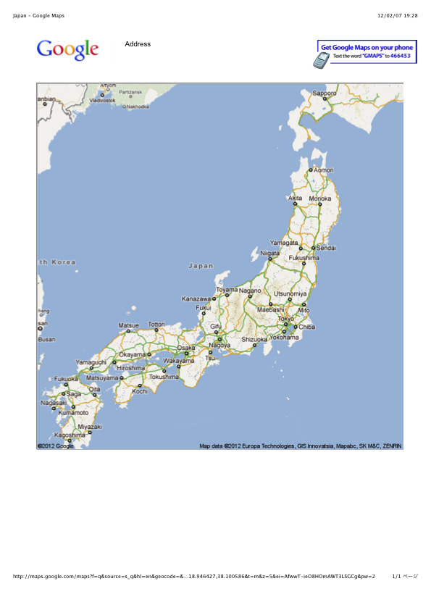
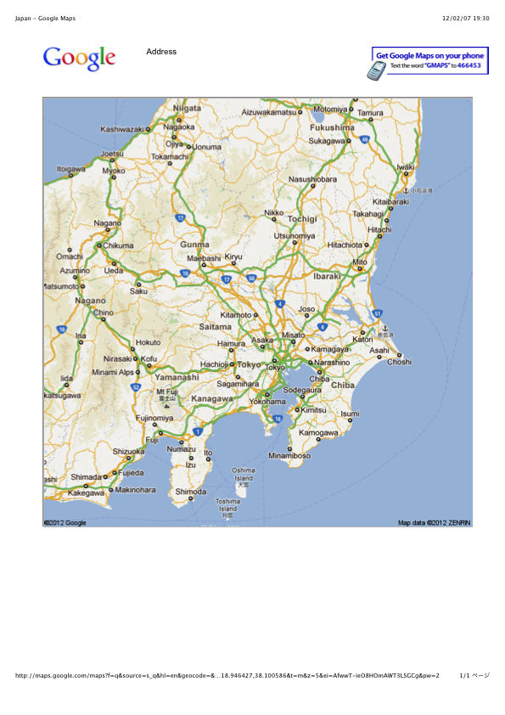
Overview of Facilities in Japan
Fukushima Daiichi Nuclear Power Plant
J-PARC & JAEA Tokai
JAEA Takasaki
KEK
IFMIF R&D ??
JAEA Oarai
(JMTR) & IMR
RIKEN
Narita
Airport
Facilities in East Japan were damaged by the earthquake at March 11, 2012.
But most of them have been recovered.
KURRI

Slide 5
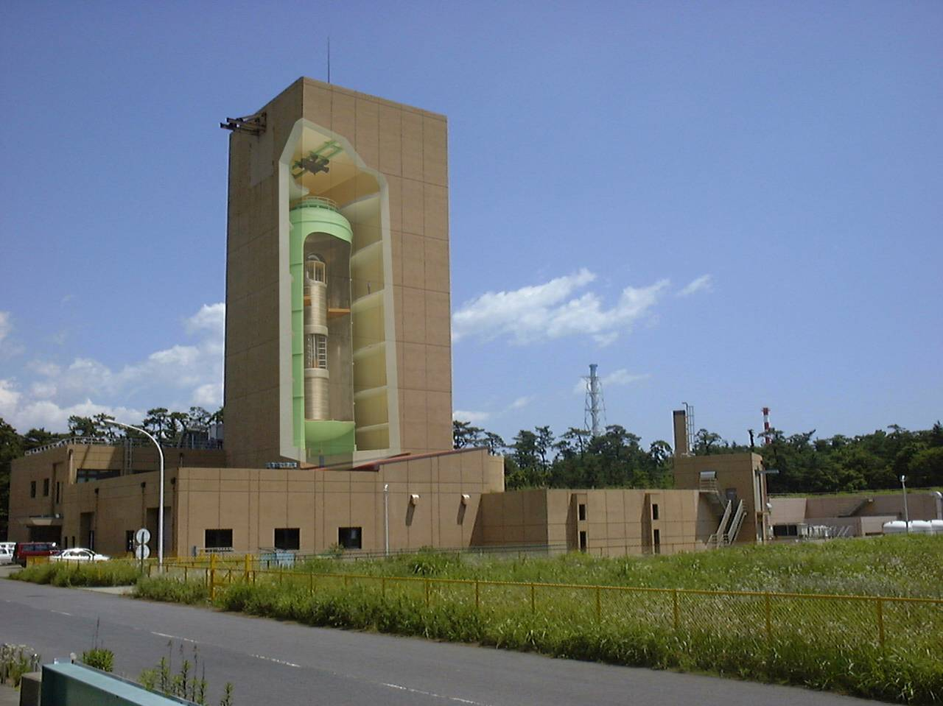
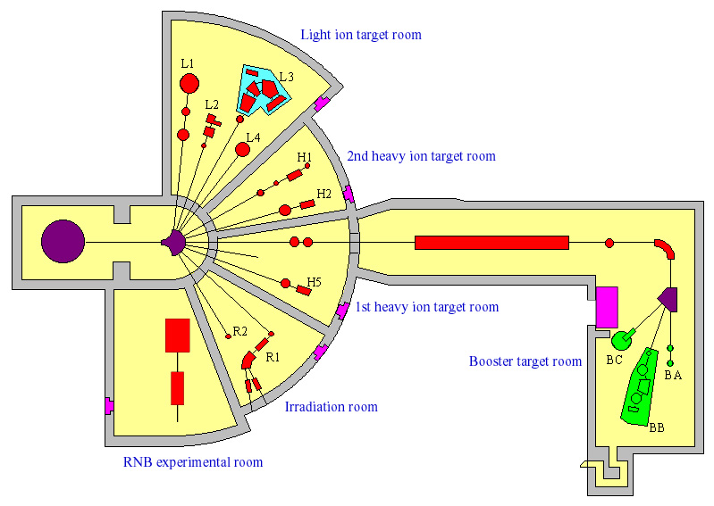
JAEA Tokai: Tandem Accelerator
Operation restarted at Sep. 2011.
Proton: 1 μA at 33 MeV, 1.5 μA at 15 MeV.
Other ions acceleration by booster is possible.
Scanning by electro static deflectors (x-y) at R2 beam line: 10 x 10 mm²
Allowable unsealed radioactivity: 1 MBq for usual nulclides.
Usage Fee: 50 kJYen/d
To be renovated.
Top view of exp. rooms

Slide 6
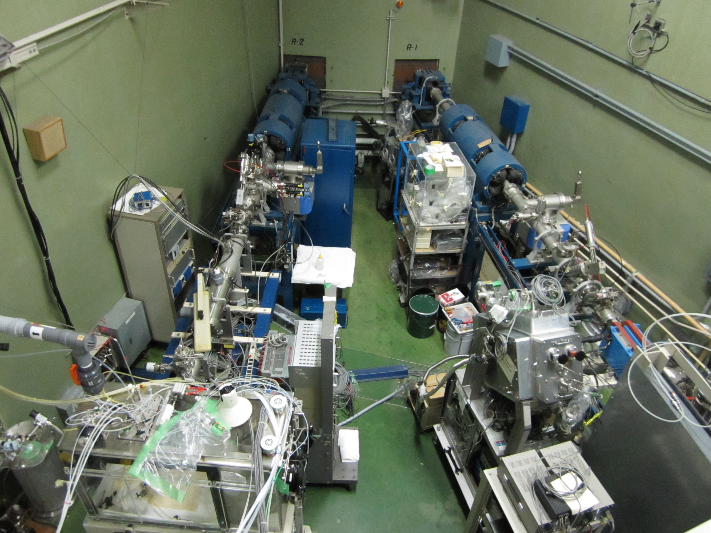
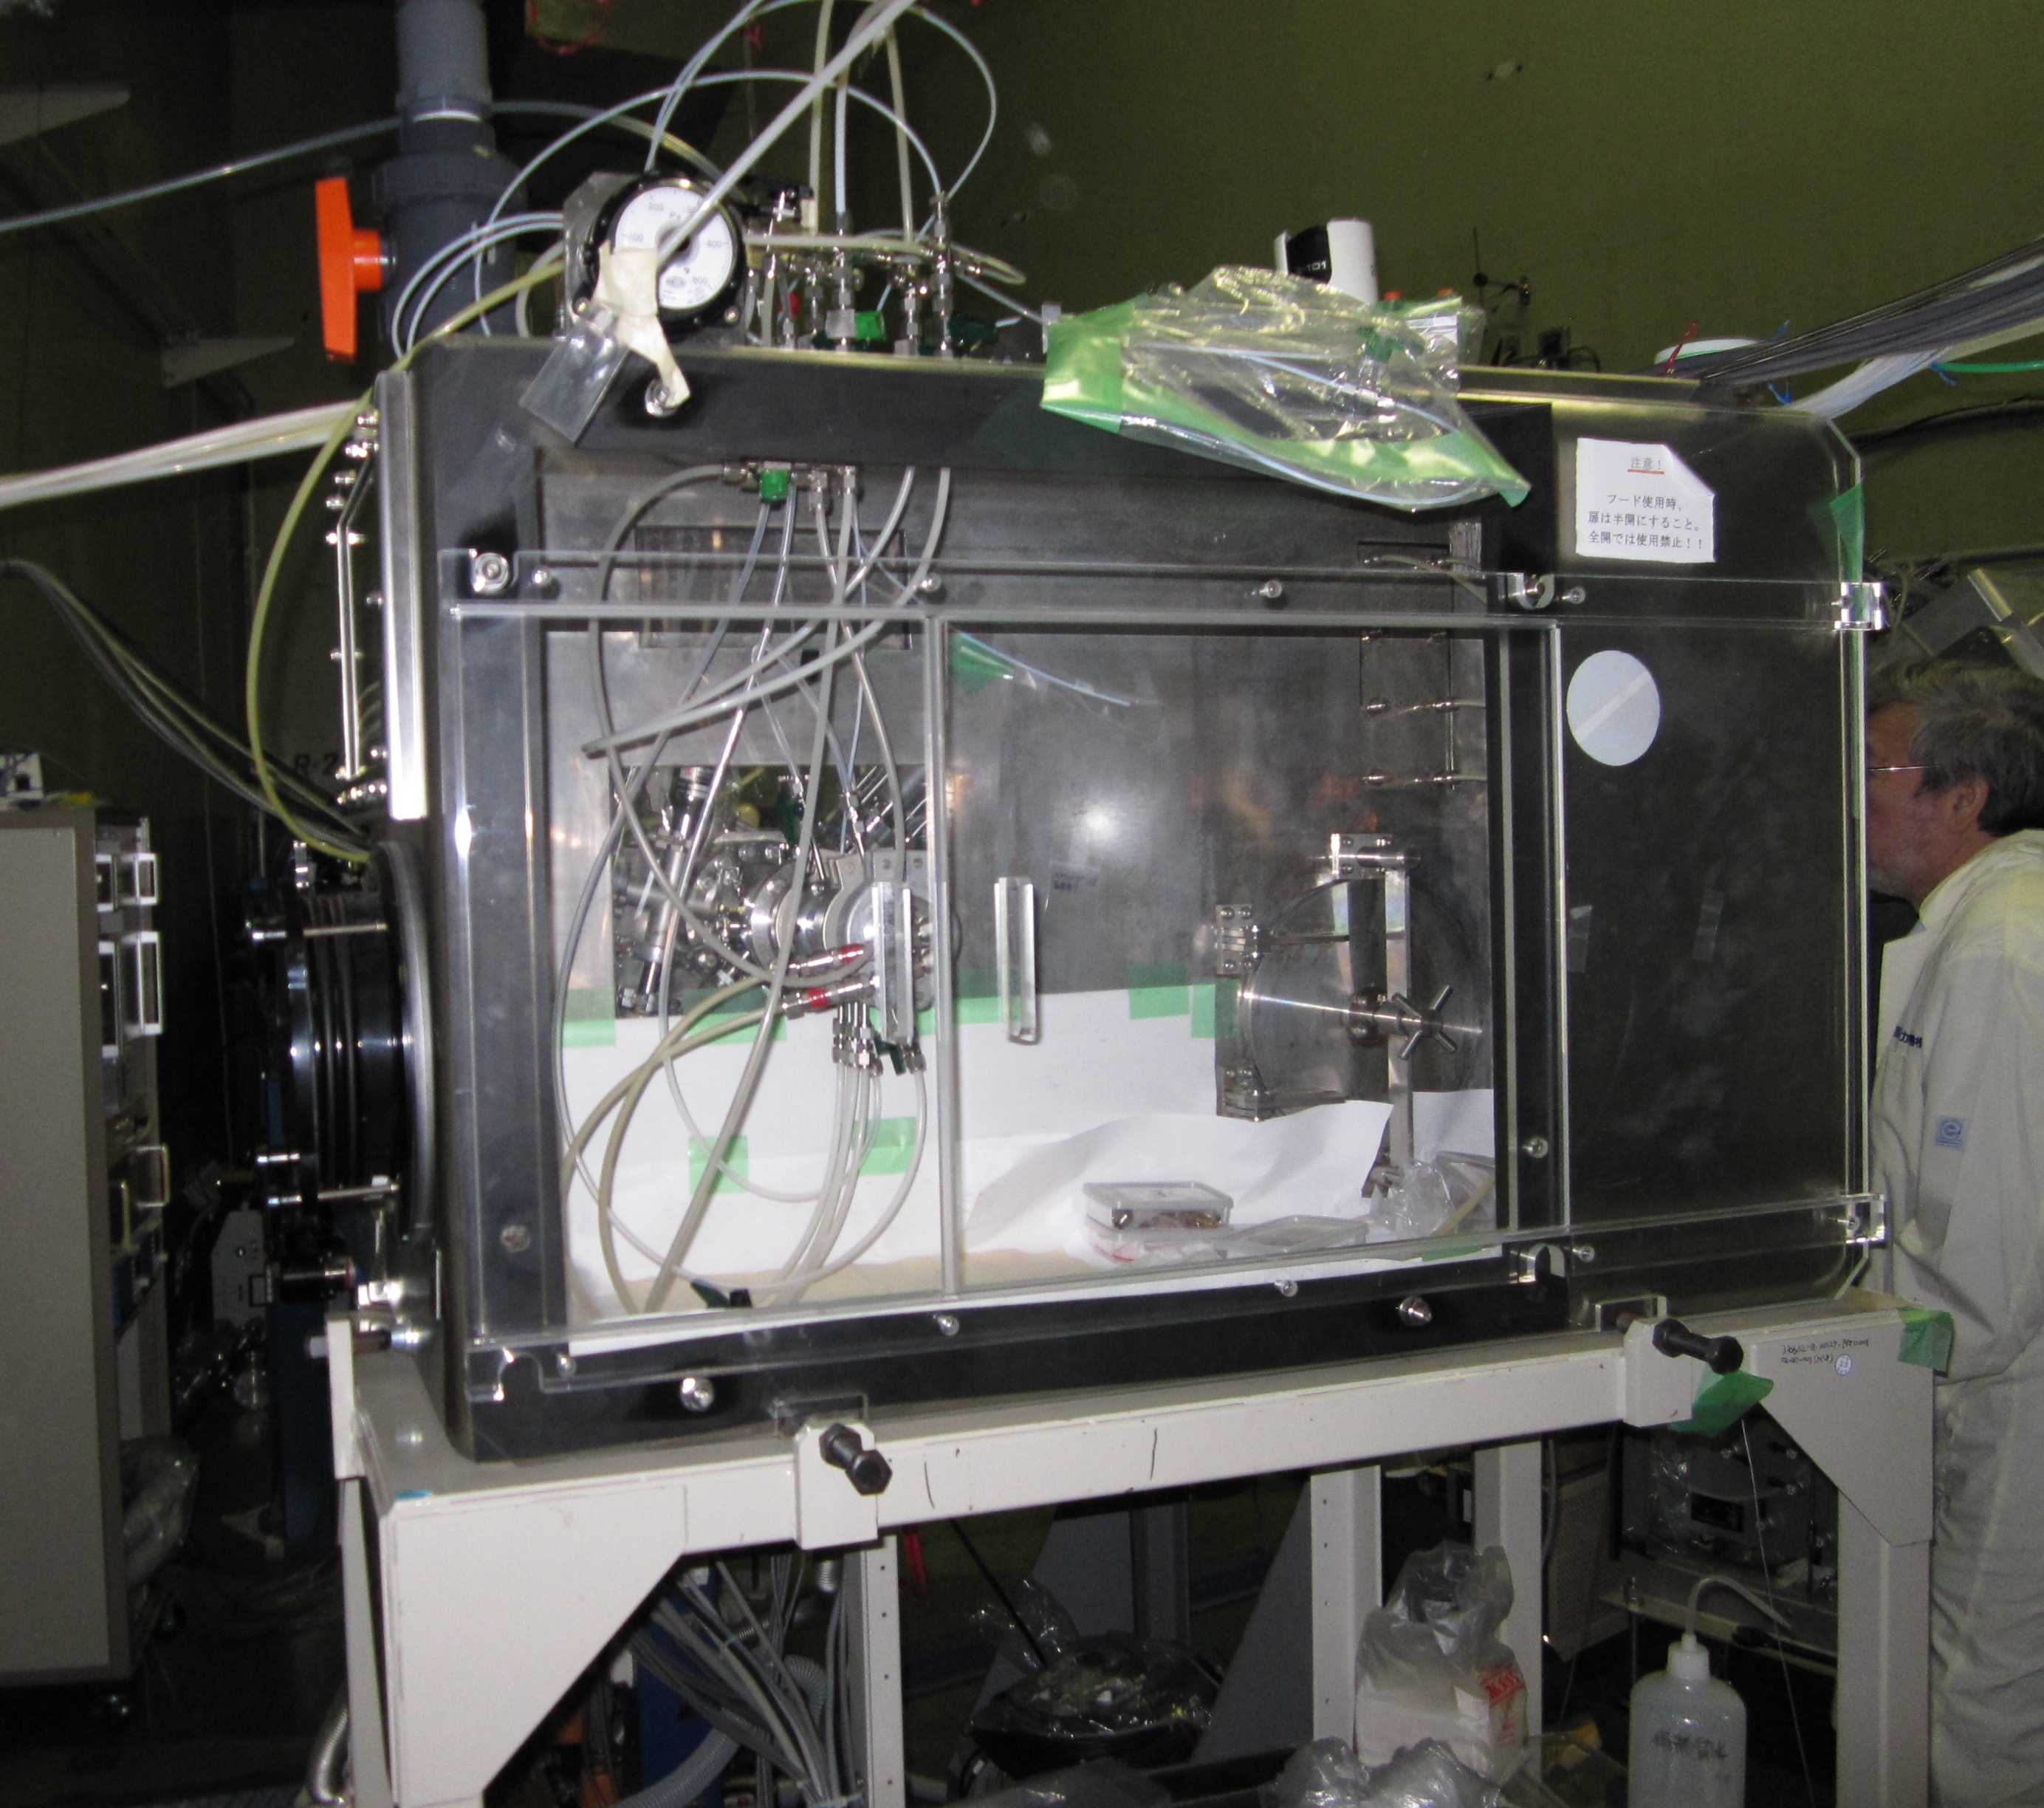
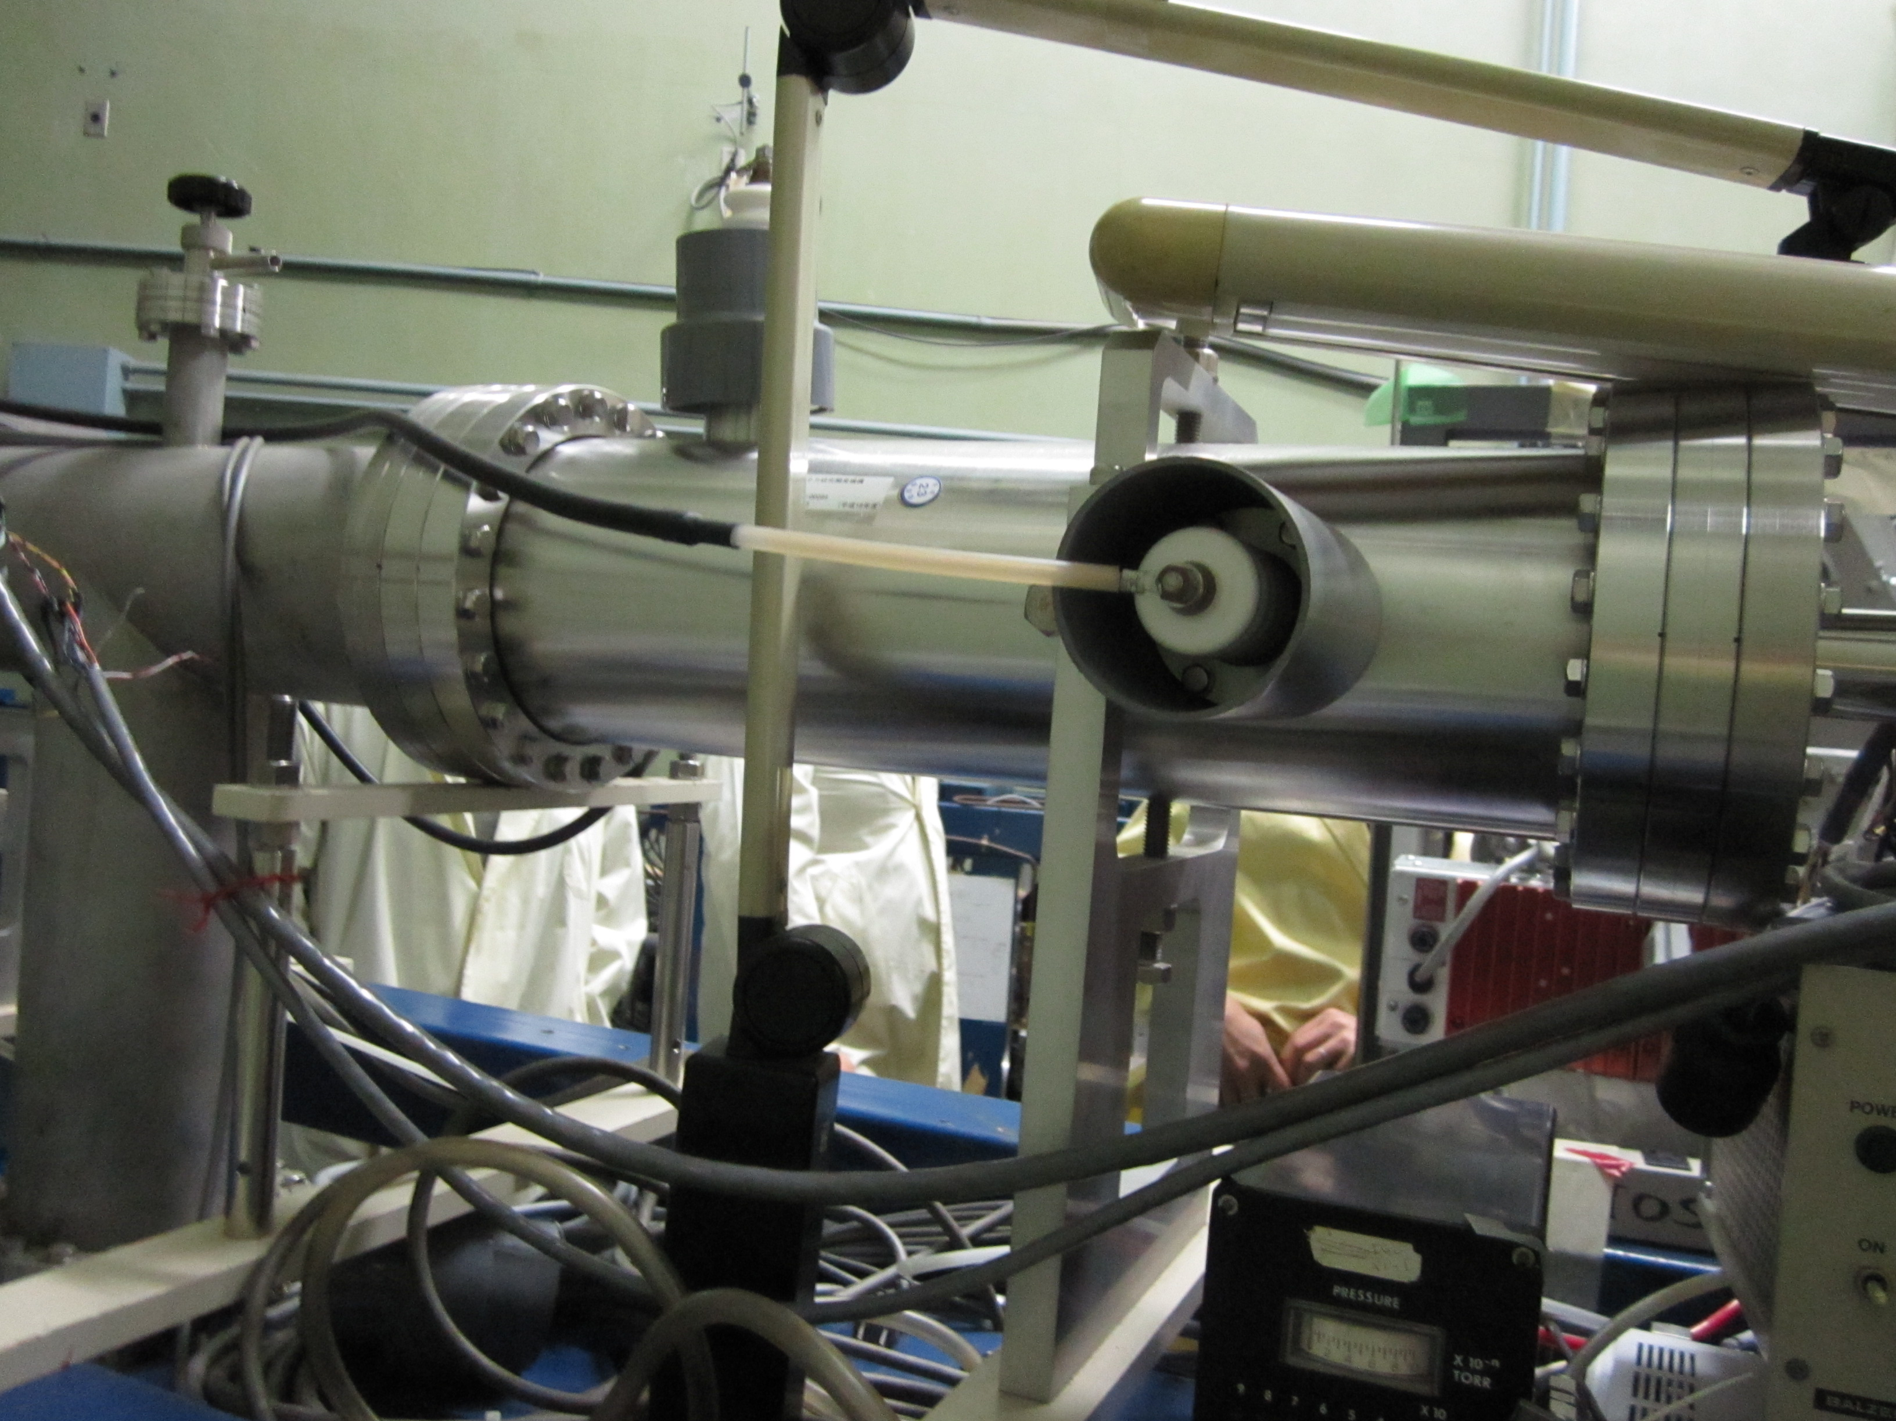
JAEA Tokai: Tandem Accelerator(2)
R2 beam line
Drafter.
Target chamber inside.
Degas must be suppressed. Pumping near samples could be needed.
Cooling of samples: water, gas flow…
Electrostatic deflectors: 10mm x 10mm

Slide 7
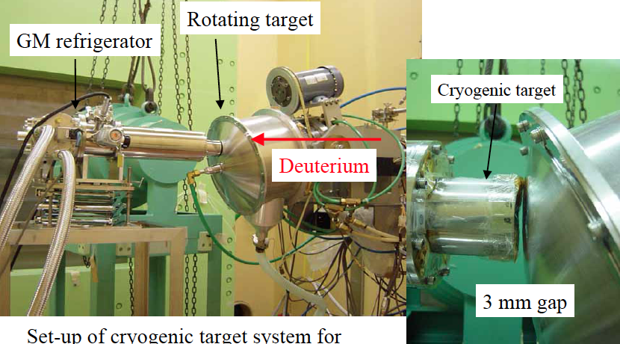
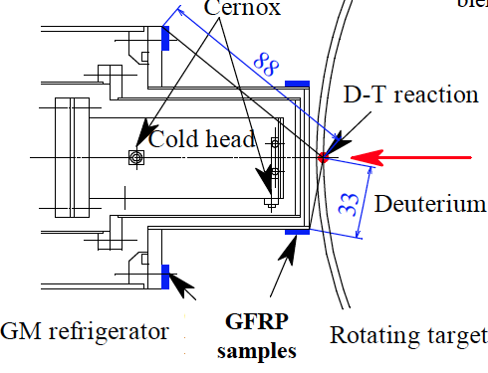
JAEA Tokai: FNS (Fusion Nutronics Source)
14 MeV neutron from DT reaction.
Production rate: 10¹² n/sec at 10 mA, 10¹⁵ n/m²s at 1 cm from target.
1 cycle: 7 hrs x 4 days. 4 cycles per year. >> 112 hrs only!!
Repair work is being carried out. Operation for users will be started in 2012.
New tritium target was successfully developed by JAEA. D beam intensities will be doubled.
Former irradiation test for SC wires at 4 K by Nishimura (NIFS): ~10²⁰ n/m²
A. Nishimura, et al., Fusion Engineering and Design 75–79 (2005) 173–177.

Slide 8
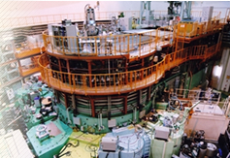
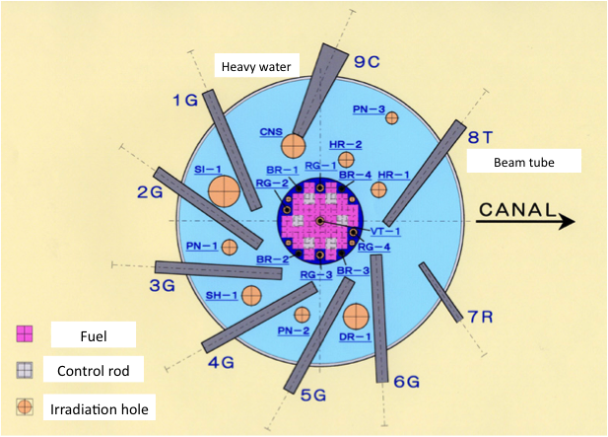
JAEA Tokai: JRR-3
Fission neutrons by research nuclear reactor.
1 cycle: 26 days. 6-7 cycles per year.
Fuel region: VT-1, RG, BR
  Capsule: φ55×L900, φ34×L150. Water cooling (30 °C). T_{sample}: ~100 °C.
  Nonstop irradiation during a whole cycle. 10¹⁸ n/m²s >> 2x10²⁴ n/m² at 1 cycle.
Heavy water reflector region: HR, PN, SI
  Capsule: typ. φ30×L150. Water cooling (30 °C). T_{sample}: ~100 °C.
  Irradiation time: 1min. – 1 cycle. 10¹⁵ – 10¹⁶ n/m²s >> 10²¹ - 10²² n/m² at 1 cycle.
Collaborative research contract with JAEA is necessary. (Or, usage fee will be charged.)
Concern: Soundness report is being checked by the government. Resume in 2012 ??

Slide 9
Overview of Facilities in Japan
Fukushima Daiichi Nuclear Power Plant
J-PARC & JAEA Tokai
JAEA Takasaki
KEK
IFMIF R&D ??
JAEA Oarai
(JMTR) & IMR
RIKEN
Narita
Airport
KURRI

Slide 10
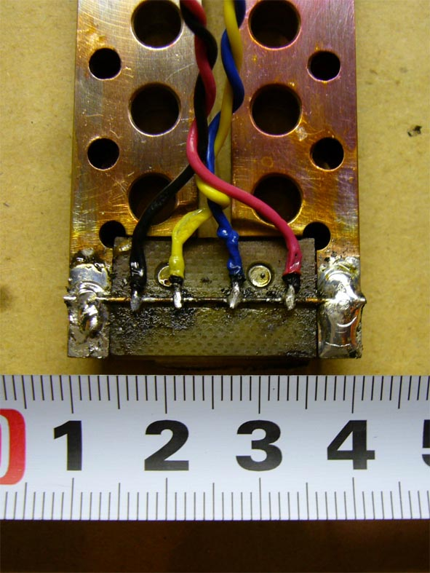
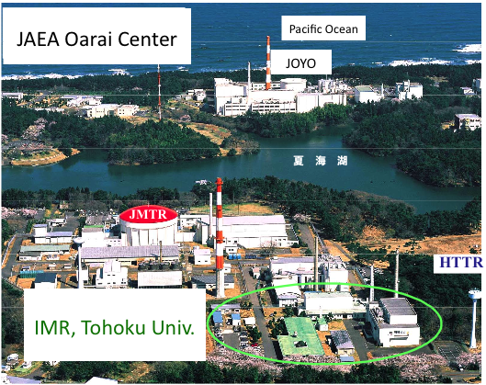
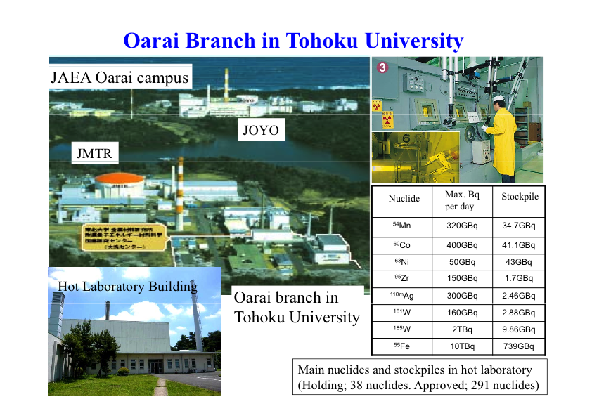
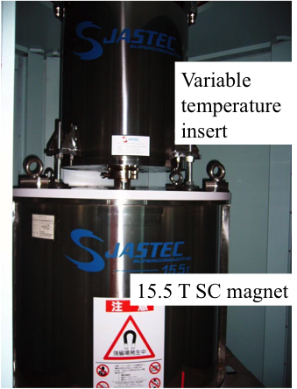
JMTR(JAEA) & IMR(Tohoku Univ.) at Oarai
Fission neutrons by Research nuclear reactor & hot laboratory for material study
JMTR
  4 cycles per year
  2012 Plan: 1 x 10¹⁷ n/m²s >> 3x10²³ n/m² at 1 cycle. T_{sample}: <100 °C.
IMR Hot Labo.
  A number of apparatuses for material study are available.
    TEM, NMR, X-ray diffractometer, mechanical testing machine, etc.
  15.5 T SC magnets w/ VTI: 4 K to RT, rating 500 A
  Allowed radioactivity: ~GBq to ~100 GBq for 291 nuclides.
Concern about JMTR: Aiming to resume at Oct. 2012. Soundness is being checked.
Courtesy of Nishimura (NIFS)

Slide 11
Overview of Facilities in Japan
Fukushima Daiichi Nuclear Power Plant
J-PARC & JAEA Tokai
JAEA Takasaki
KEK
IFMIF R&D ??
JAEA Oarai
(JMTR) & IMR
RIKEN
Narita
Airport
KURRI

Slide 12
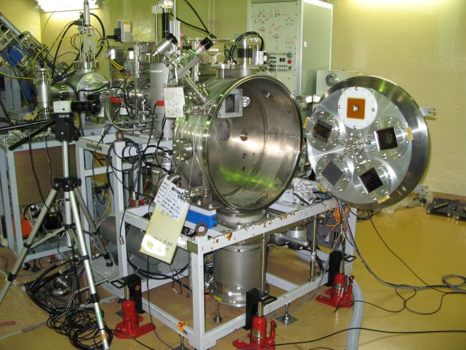
JAEA Takasaki: TIARA
AVF cyclotron + 3MV Tandem + 400 kV ion injector
Protons: 10 - 75 MeV (max. 90 MeV) , max. 2 μA
  * Replacement of beam shutter beyond E_{p} of 70 MeV.
3 operational cycles per year. Typical user time: 10 - 20 hrs in a cycle.
Rotating sample holder in LD1 beam line
Sample environment at LD1 beam line
  Vacuum chamber + multiple samples holder (up to 4)
    Degas must be suppressed.
  RT by conduction cooling w/ water.
  Sample chamber w/ LN2 conduction cooling is available. (But, not in use for > 10 years.)
Irradiation area: max. 100 mm x 100 mm (uniformity: within 10 %)
Collaborative research contract with JAEA is necessary. (Or, usage fee will be charged.)
Concern: Allowable radioactivity is rather lower. Check in advance.

Slide 13
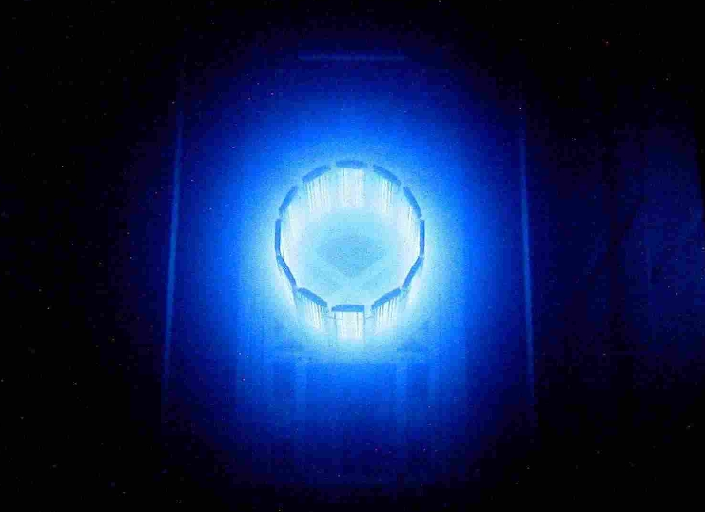
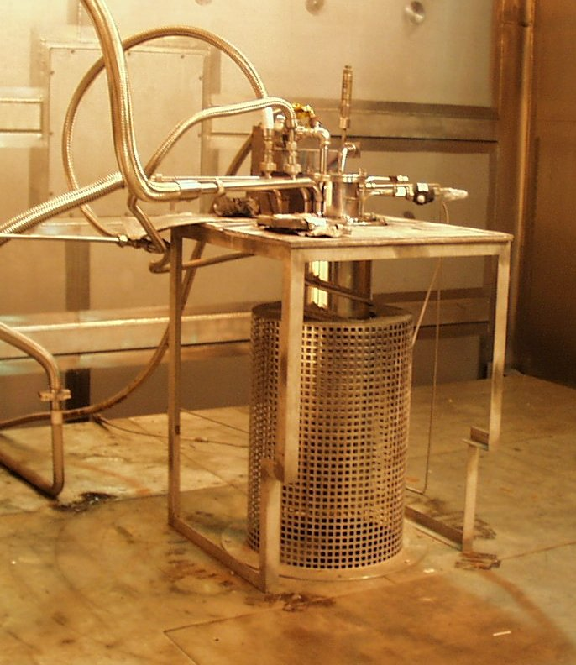
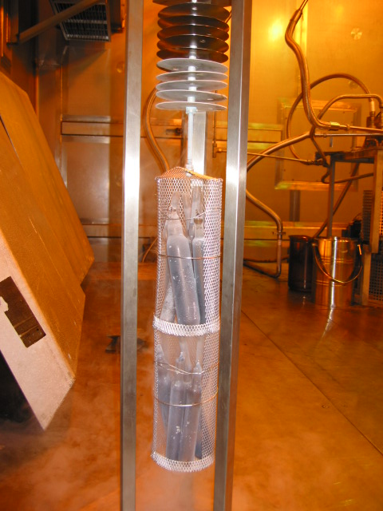
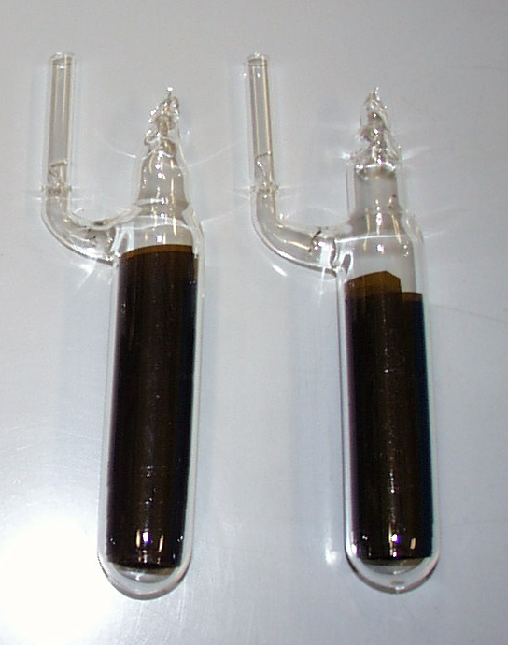
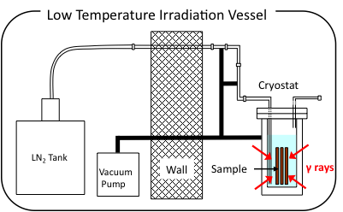
JAEA Takasaki: ⁶⁰Co gamma ray source
Gamma-rays: 6 irradiation rooms
  Idesaki's group: 1 room for RT, 1 room for LT.
Irradiation rate: 10 - 20 kGy/hr, 24 hrs.
LN2 irradiation cryostat
  Samples immersed in LN2 bath.
  dose uniformity: < 30 %
  LN2 consumption: 1300 L for 14 days (5 – 6 MGy). >> 150 kJYen
In the meantime, priority of irradiation given to the decontamination study related to the Fukushima nuclear plant accident.
See talks by Ogitsu and Idesaki.

Slide 14
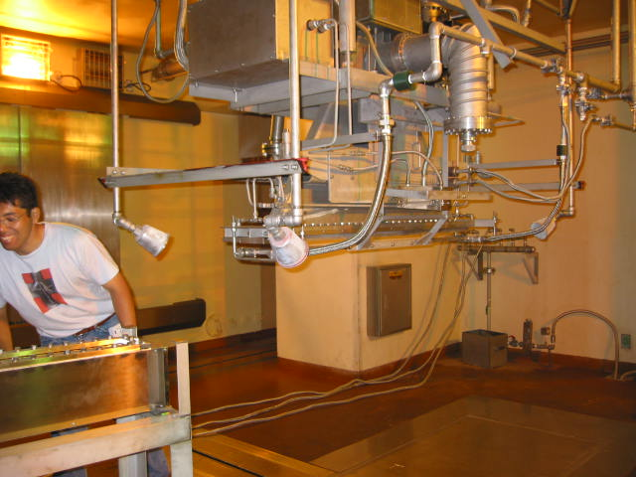
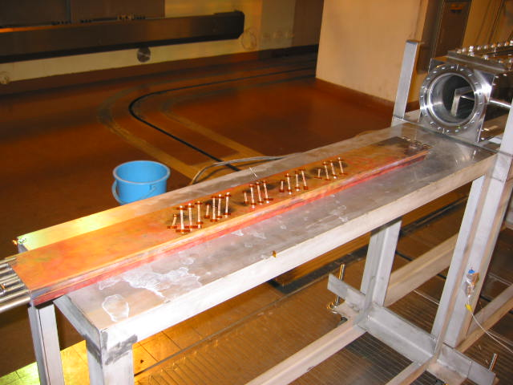
JAEA Takasaki: Electron Accelerator
Electron: E_{e} = 0.5 - 2 MeV, 0.1 - 30 mA.
  The sample should be thin enough.
8 - 13 hrs/day >> ~40 MGy for typical resins
Exposed in air or inert gas. Scanning: 50 x 1200 mm².
T_{sample}: RT
  Conduction cooling with water.
Casual use??
e beam
Sample chamber
Irradiation on HTS tape

Slide 15
Overview of Facilities in Japan
Fukushima Daiichi Nuclear Power Plant
J-PARC & JAEA Tokai
JAEA Takasaki
KEK
IFMIF R&D ??
JAEA Oarai
(JMTR) & IMR
RIKEN
Narita
Airport
KURRI

Slide 16
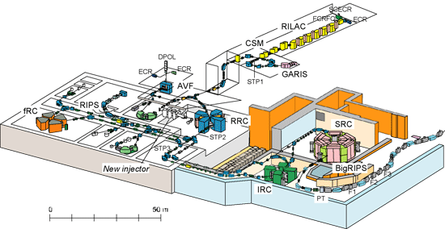
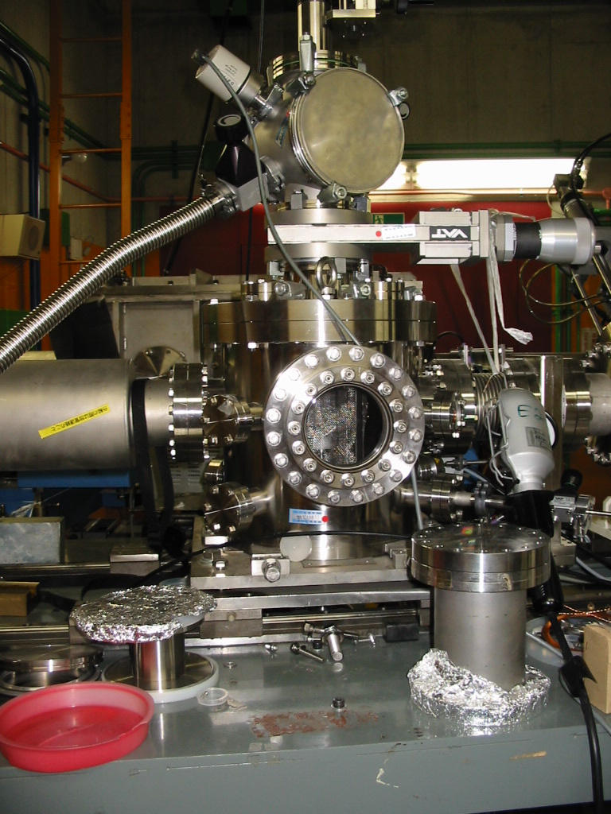
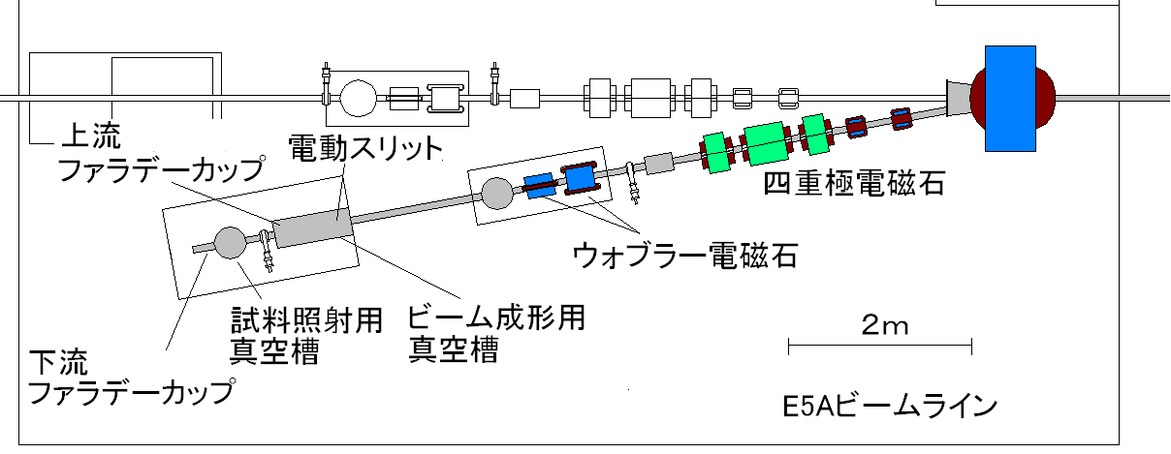
RIKEN: RIBF
RIKEN RIBF accelerators
Materials irradiation beam line: E5A
  Protons from RRC: 70, 135, 210 MeV.
  I_{p} = 10 nA
  10 x 10 mm² by Wobbler magnet
  Uniformity within 10 %
Sample Environment:
  Vacuum, 10 K* – 373 K
  * Renovation of cryogenic facility is necessary.
Machine time proposal for PAC is very competitive.
  Another beam line with 14 MeV protons (10 μA) from AVF cyclotron is available.
Faraday cup
Slit
Quad. Mag.
Wobbler Mag.
Sample
chamber
Beam shaping
chamber
Faraday
cup
E5A beam line

Slide 17
Overview of Facilities in Japan
Fukushima Daiichi Nuclear Power Plant
J-PARC & JAEA Tokai
JAEA Takasaki
KEK
IFMIF R&D ??
JAEA Oarai
(JMTR) & IMR
RIKEN
Narita
Airport
KURRI

Slide 18
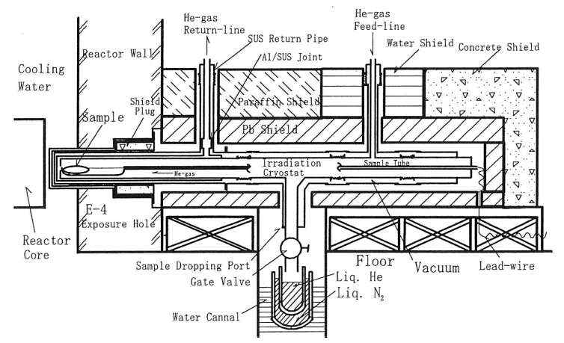
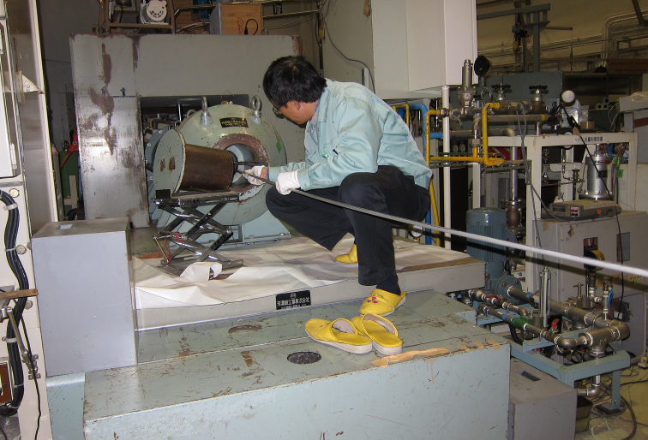
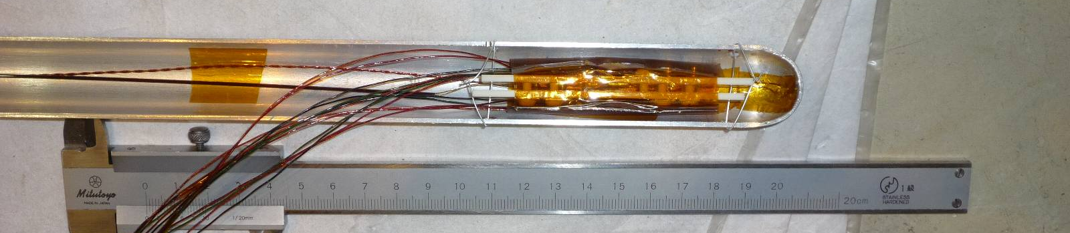
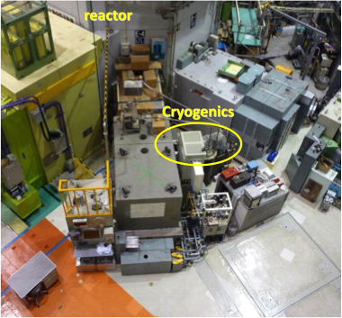
KURRI: Kyoto Univ. Research Reactor
Fission neutrons. Operated as planned in 2011.
1 cycle: 1 MW x 46 hrs + 5 MW x 6hrs. ~25 cycles per year.
Usual irradiation
  Hydraulic Conveyer at reactor core
    Aluminum capsule, ϕ_{th}: 8.2 x 10¹⁷ n/m²/s, 70 hrs at 1 MW_{eq}
  Pneumatic Tubes (Pn-1, 2, 3) at graphite reflector
    PE capsule, ϕ_{th}: 2.8 x 10¹⁷ n/m²/s, 1 hr at 1 MW_{eq}
  Slant Exposure Tube: graphite reflector
    Large-size samples, ϕ_{th}: 3.9 x 10¹⁶ n/m²/s, 70 hrs at 1 MW_{eq}.
Low Temperature Line: irradiation cryostat close to reactor core
  Cooling by He gas loop: < 20K
  ϕ_{fast} (E_{n}>0.1MeV): 1.4 x 10¹⁵ n/m²/s at 1MW
  >> 10²⁰ n/m² at 1 cycle
M. Okada et al., NIM A463 (2001) pp213-219
See Yoshida's talk.

Slide 19
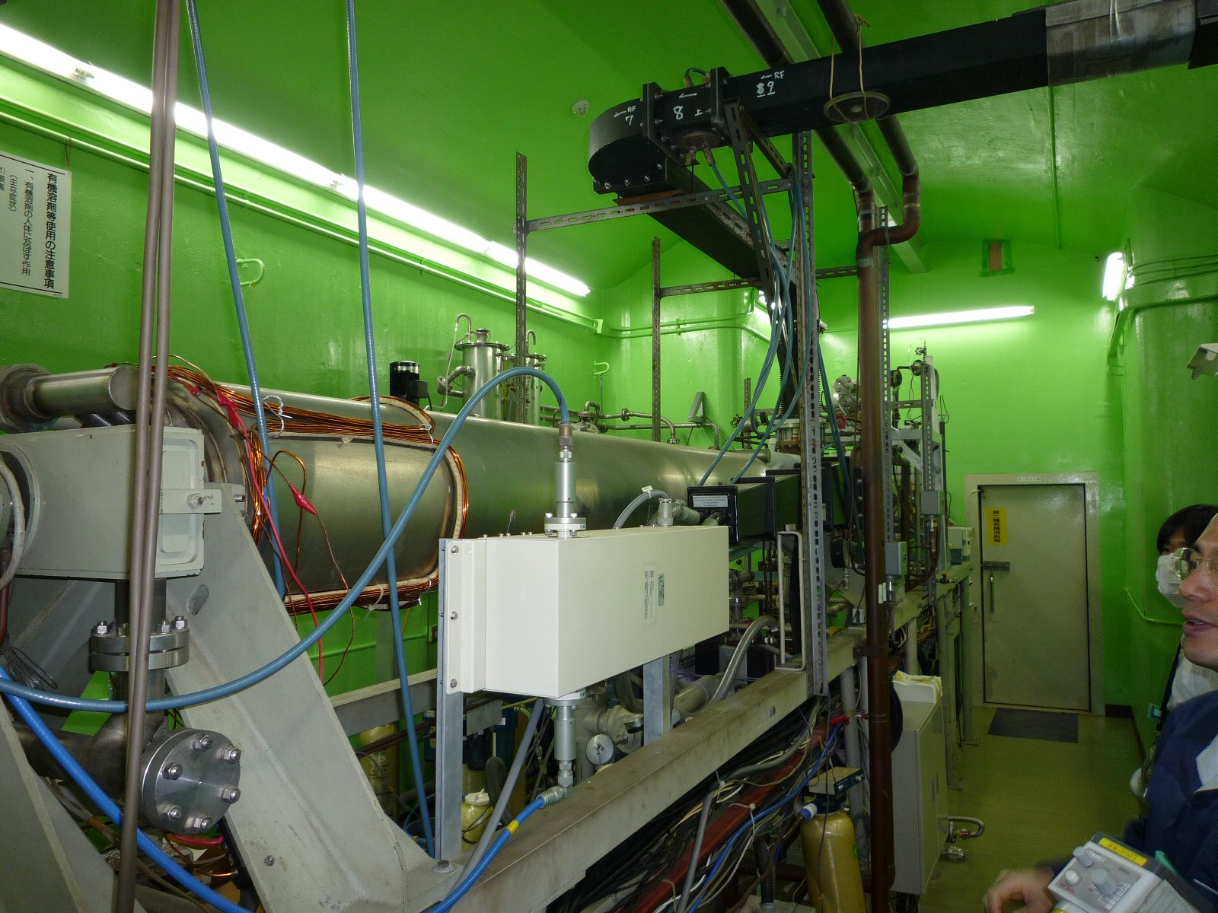
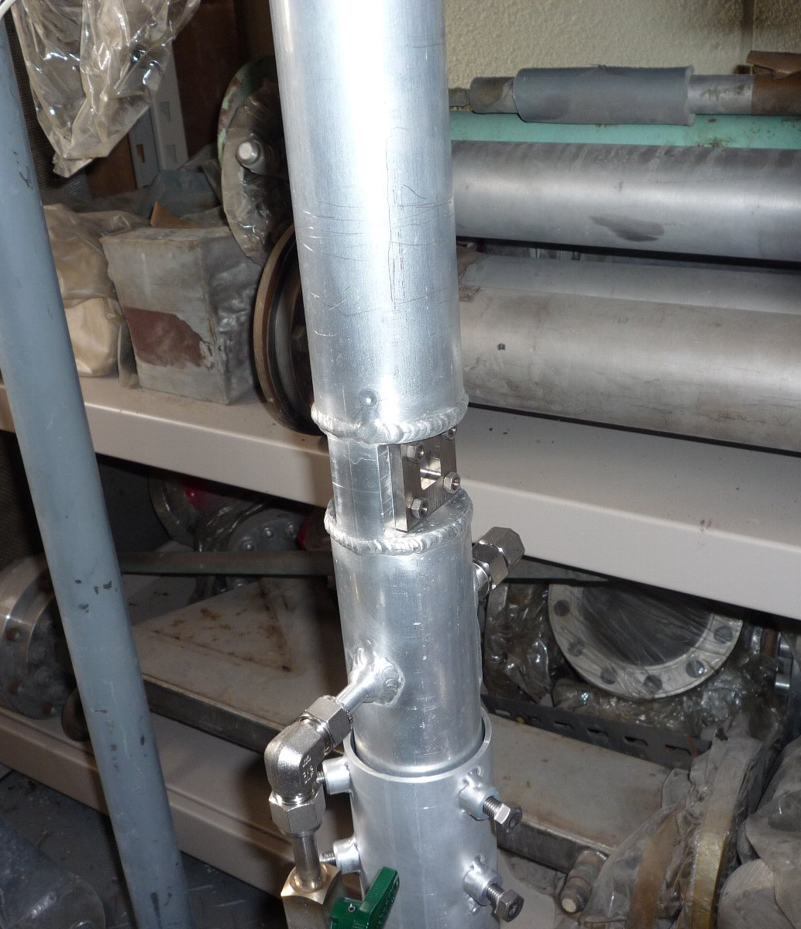
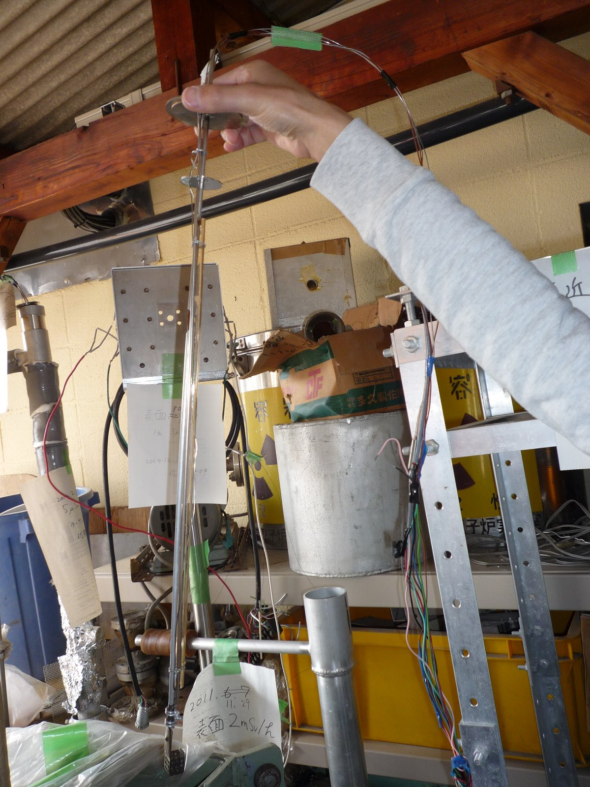
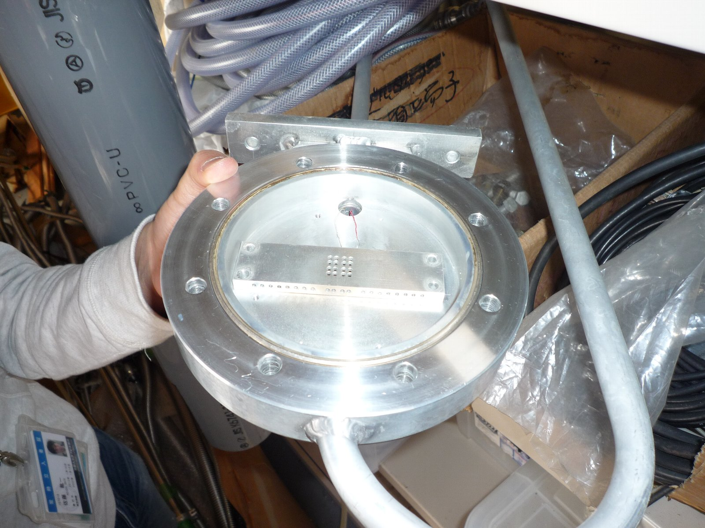
KURRI: Electron Linear Accelerator
6 MeV < E_{e} < 32 (max. 46 MeV), max. 200 μA.
  Very high absorbed dose rate: ~100 kGy/s
  sample activation beyond E_{e} of 10 MeV
  beam size: ϕ10 mm, NOT uniform.
Operation: 11 weeks per year
Sample environment
  Water cooing chamber (immersed)
  LN2 sample cryostat
sample holder 1 cm³
LN2 sample cryostat
Water cooling sample holder (inside)

Slide 20
Overview of Facilities in Japan
Fukushima Daiichi Nuclear Power Plant
J-PARC & JAEA Tokai
JAEA Takasaki
KEK
IFMIF R&D ??
JAEA Oarai
(JMTR) & IMR
RIKEN
Narita
Airport
KURRI

Slide 21
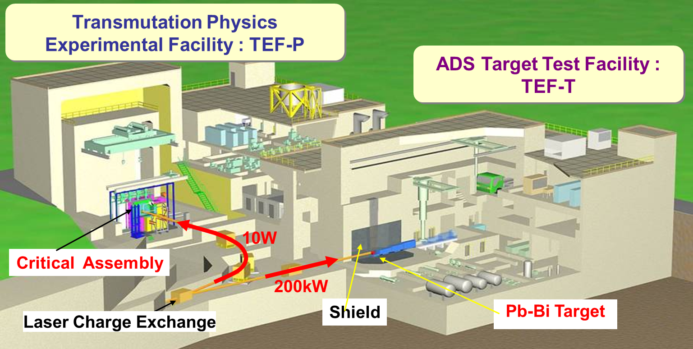
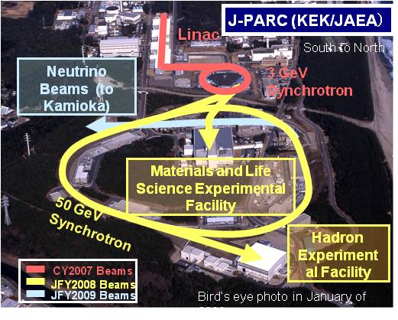
J-PARC
  Proton Linac
      Currently, providing the beam to the RCS only: 180 MeV, 30 kW.
      To be upgraded to 400 MeV soon.
      Future project: Accelerator Driven Transmutation Experimental Facility. (600 MeV, 200 kW using SC RF cavities)
        Potential Irradiation Test at primary beam line (TEF-T).
        Construction budget has not been authorized yet... When???

Slide 22
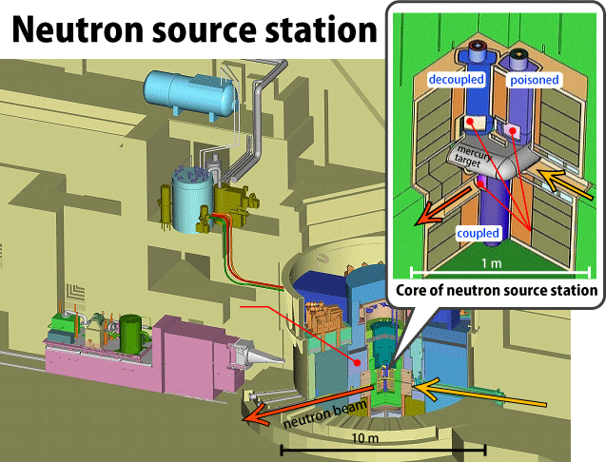
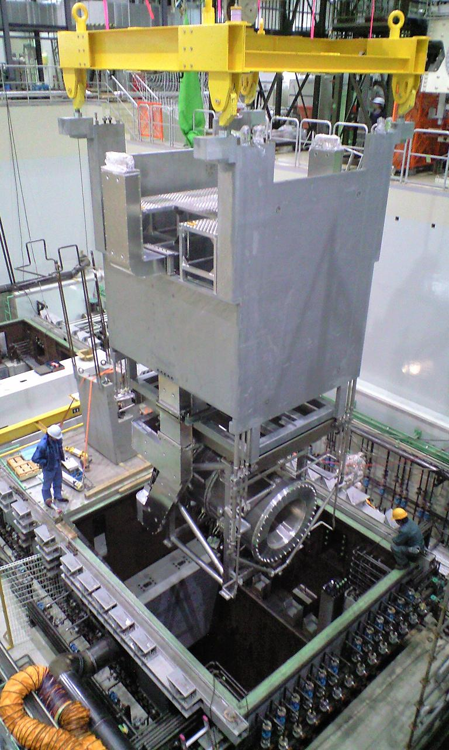
J-PARC (2)
  RCS: 3 GeV, 200 kW, 25 Hz
      Providing the beam to MLF and MR.
      To be upgraded to 1 MW.
MR: 30 GeV, 150 kW
  For T2K neutrino exp.(FX) and Hadron exp. (SX)
  To be upgraded to 750 kW.
      Sample space around target system would not be allowed…
      Access is very restricted.
      Interference for the operation and the main experiment would be concerned, even though T2K neutrino target is appropriate for pion irradiation source…
      At present, materials irradiation test at J-PARC is quite difficult.
3rd Horn Magnet Installation for T2K exp.

Slide 23
Summary
  Irradiation facilities in east Japan were damaged by the earthquake, but they were mostly recovered.
      2 research reactors are still in process of approval to resume.
Material irradiation facilities
  Protons
    3 accelerators: 10 MeV - 75 MeV (~μA), 210 MeV (10 nA)
  Electrons:
    2 accelerators: 2 - 32 MeV (> 200 μA)
  Neutrons:
    3 research reactors
    1 DT neutron sources (14 MeV)
    Cryogenic irradiation at KURR and FNS
  Gamma rays:
    2 facilities w/ ⁶⁰Co (JAEA-Takasaki, KURRI)
    Samples in LN2
Sample environment
  Difficulty of cryogenic irradiation at accelerator
  Trade-off: temperature and fluence

