Slide 1
Beam test possibilities at JINR and Fermilab
V. Pronskikh
Fermilab
02/15/2012

Slide 2
Outline
JINR: Accelerator and reactor park
  Nuclotron, Phasotron, PFR-II
Neutron production targets at JINR
  GAMMA-3, KVINTA, GENERATOR
  Beam tests on December 2011
  First observations related to Mu2e backgrounds
Irradiation facilities at Fermilab
  MTest
  Muon Test Area,
  Neutron Therapy
  ES&H Instrumentation
  MI Collimator
Conclusions

Slide 3
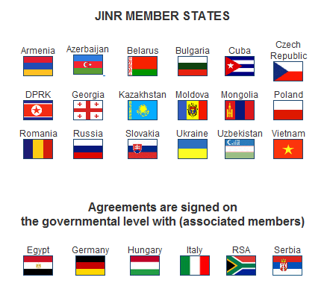
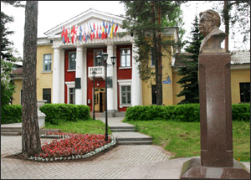


Joint Institute for Nuclear Research, Dubna
26 March 1956

Slide 4
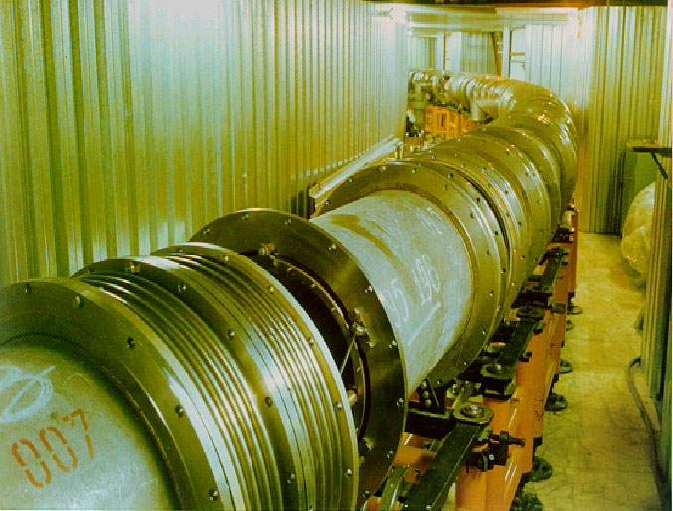
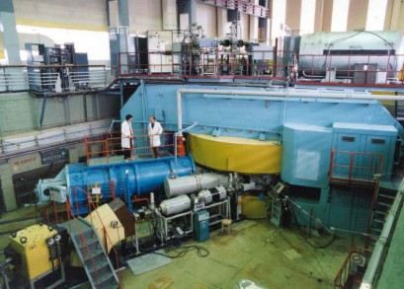
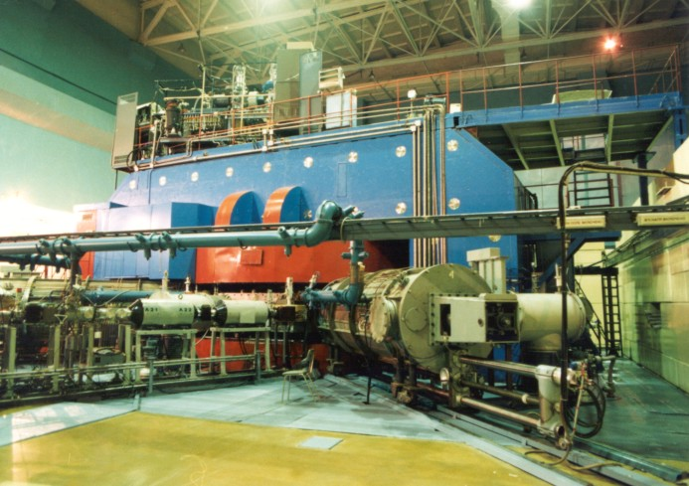
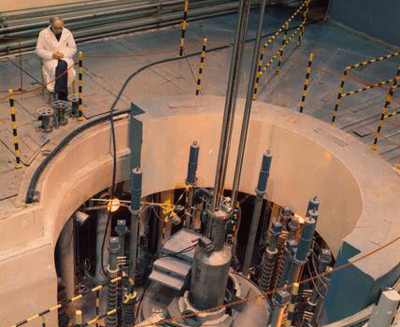
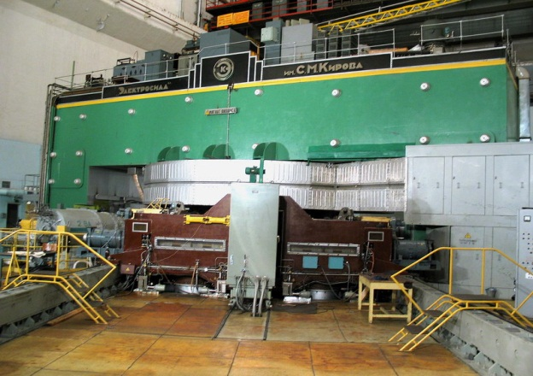
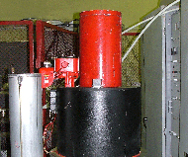
JINR basic facilities
Nuclotron
U 400
U 400 М
IBR-2
Phasotron
IREN

Slide 5
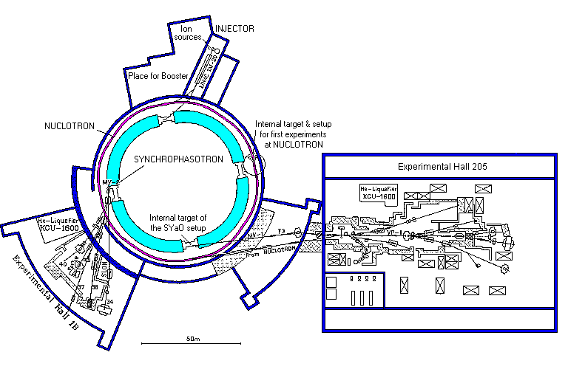
Nuclotron - superconducting synchrotron
GAMMA-3,
KVINTA
Accelerated particles | Intensity charge/pulse | Pulse duration
p | 1.5·10¹⁴ | 500µs
d | 1.0·10¹⁴ | 500
₄He² | 1.0·10¹³ | 500
₃He² | 3.5·10¹¹ | 500
₇Li³ | 5·10¹⁰ | 15
₆Li³ | 3·10⁹ | 15
₁₂C⁶ | 6.5·10¹⁰ | 25
₁₆O⁸ | 6·10⁹ | 10
₁₉F⁹ | 2.5·10⁹ | 6
₂₂Ne¹⁰ | 2·10⁷ | 40
₂₄Mg¹² | 2·10⁸ | 25
₂₈Si¹⁴ | 1·10⁸ | 25
₃₂S1⁶ | 4·10⁶ | 80
₄₀Ar²⁰ | 2.5·10⁶ | 80
₈₄Kr²⁹ | 1·10⁶ | 80
d (polarized) | 2.5·10¹⁰ | 100
Max. energy 6 (4.2) AGeV, magnetic field 2 (1.5) T
Slow extraction duration 10 s,
Actual deuteron intensity 1E10 d/spill (~1E9 d/s)
Run duration up to 30 hours

Slide 6
Why and how
“On proposal to measure irreversible DPA”, Mu2e-doc-1996-v1, October 2011
Residual nuclides produced in the course of nuclear transmutation at En > 30 MeV become irreversible DPA (cannot be annealed).
There is no such process at a reactor (En<14 MeV), cannot measure at it. Will take place at Mu2e conditions.
Need
  Accelerator of high enough energy.
  Spallation target.
Can measure
  Total DPA (need a special cryostat and dedicated experiments (special arrangements)) – future ?
  Just samples of known (measured) RRR before and after irradiation. Can be put in an existing setup not distracting other experiments. Transmutation experiments are the best fit for such synergy.

Slide 7
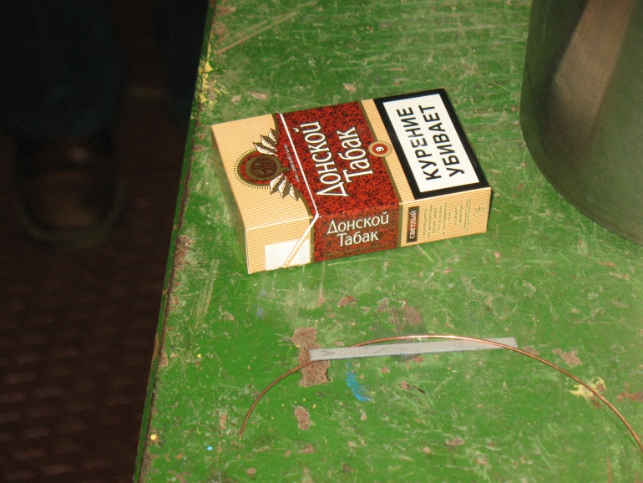
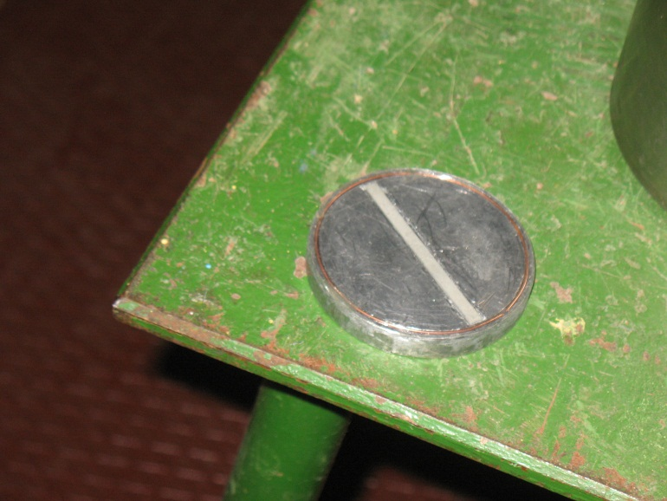
Samples irradiated at GAMMA-3 setup @ Nuclotron
d beam
The samples were placed at the depth of 10 cm inside
the target

Slide 8
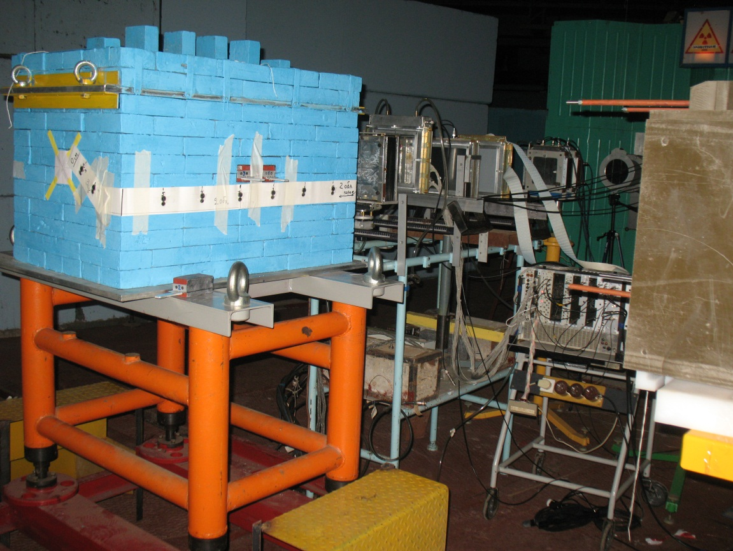
KVINTA setup at the deuteron beam
samples
“Quinta-M”
d beam
samples
m_{section} ≈ 111 kg

Slide 9
Irradiation schedule for December 2011 at Nuclotron accelerator
Setup | Deuteron kinetic energy per nucleon | Deuteron fluence
GAMMA-3 | 0.8 AGeV | ~1.7E13
KVINTA | 0.5 AGeV | ~1E13
KVINTA | 2.0 AGeV | ~1E13
1-st set of samples has been irradiated at GAMMA-3
2-nd set of samples has been irradiated at KVINTA (in both runs, spectra were measured
after each run), neutron fluence ~ 1-3E7 n/cm^2/s
3-rd set of samples will (hopefully) be irradiated on a Pb-Bi target irradiated by 660 MeV
protons at Phasotron accelerator (preliminary a month later)
4-th set of samples will (hopefully) be irradiated at a reactor (0.8 MeV) at ~E17 n/cm^2
5-th set is a control one (not to be irradiated).

Slide 10
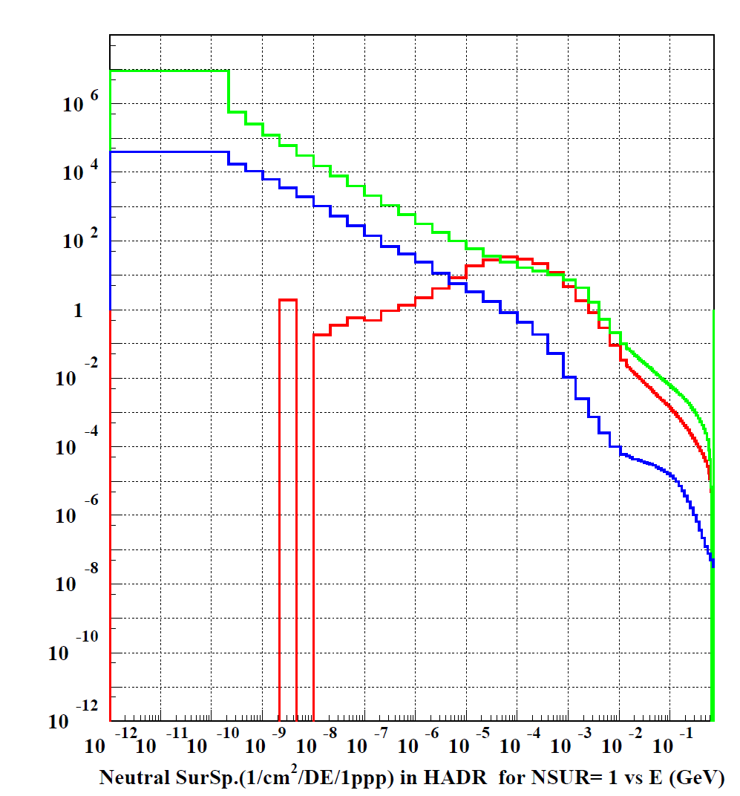
Secondary neutron spectra of Mu2e PS coils, KVINTA and GAMMA3 at 3 GeV, a Reactor
GAMMA3 d at 3 GeV
Reactor spectrum
arb. units
Mu2e coils
KVINTA d at 3 GeV
30 MeV
spallation

Slide 11
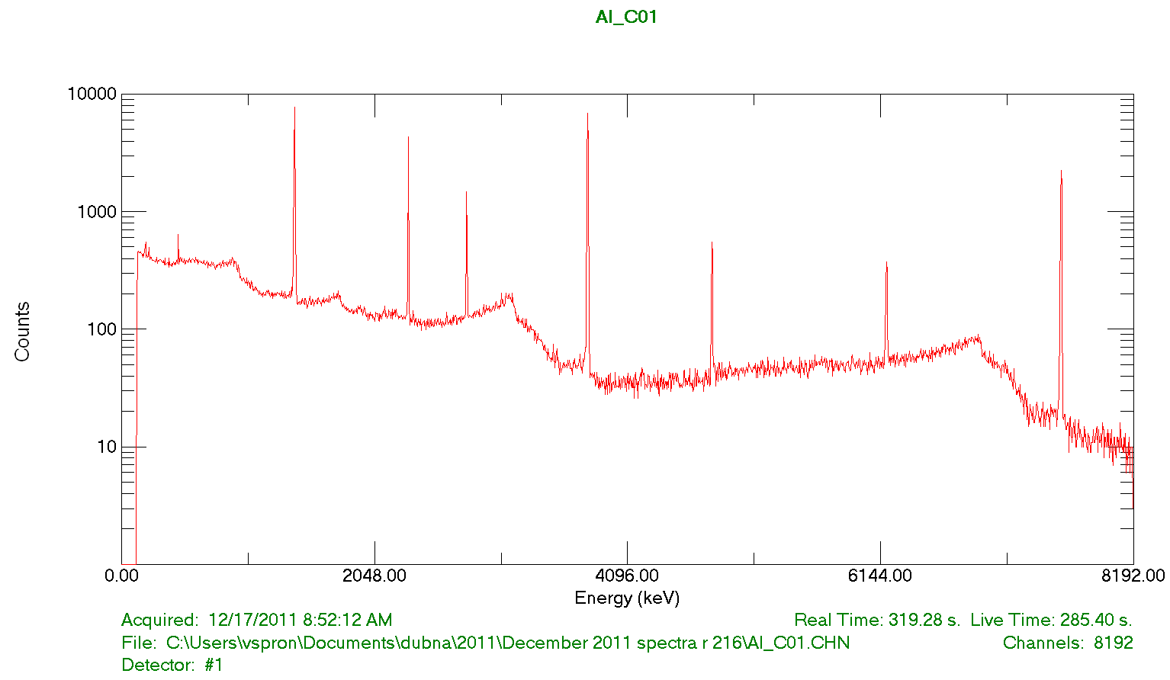
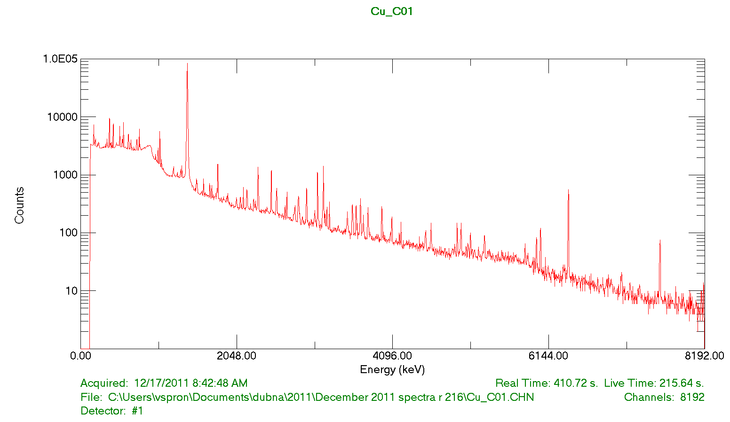
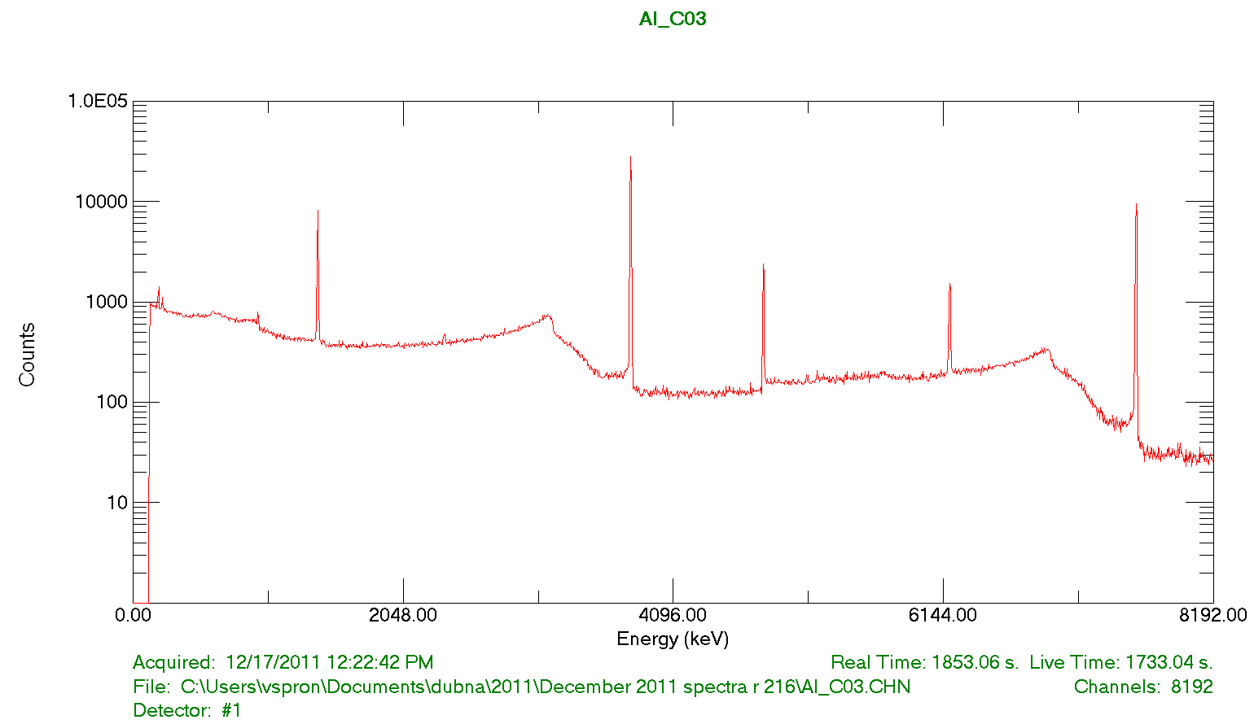
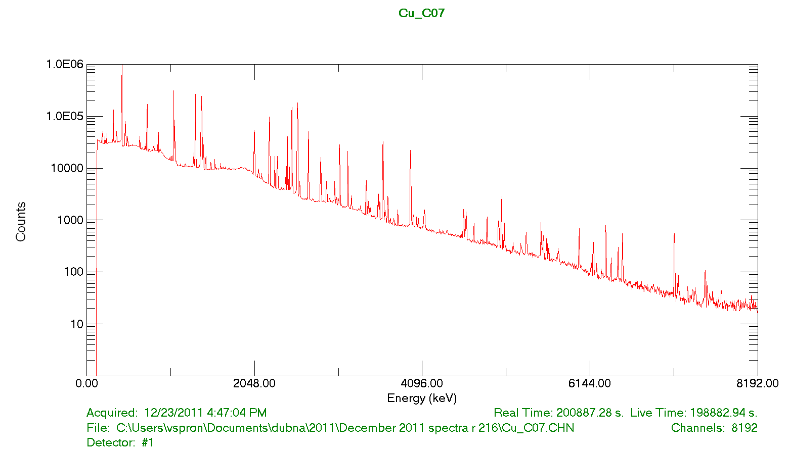
Gamma-spectra of samples after two KVINTA irradiations (0.5+2.0 AGeV)
Al-27 sample 0.5 hour after end of irradiation
Cu/NbTi sample 20 min after EOB
Al-27 sample 4 hours after end of irradiation
Cu/NbTi 8 h 25 min after EOB

Slide 12
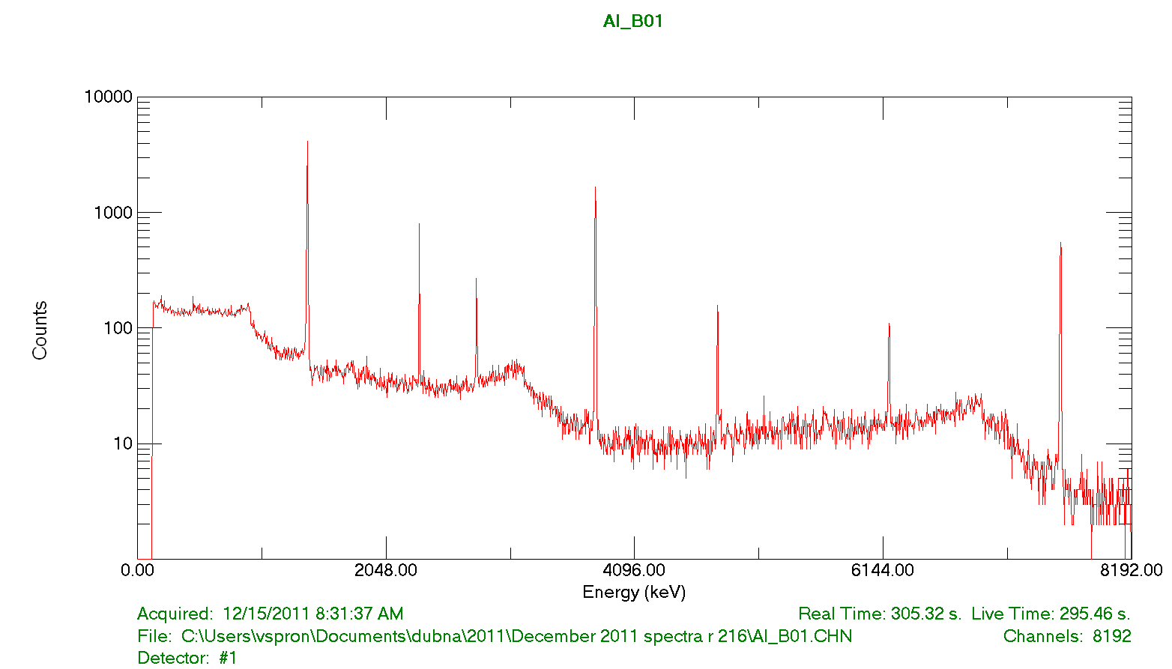
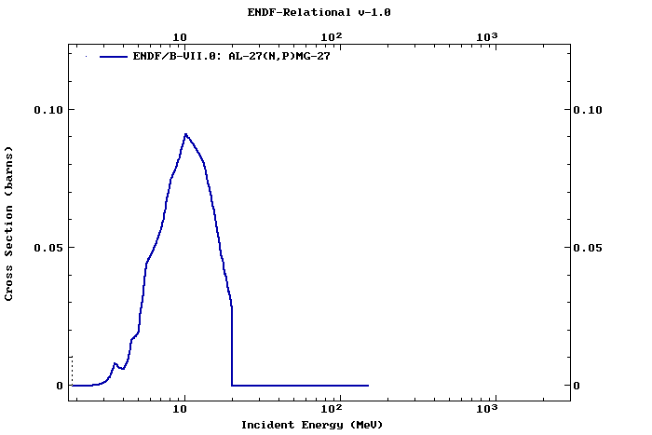
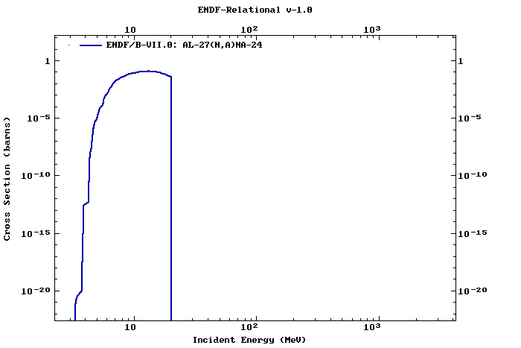
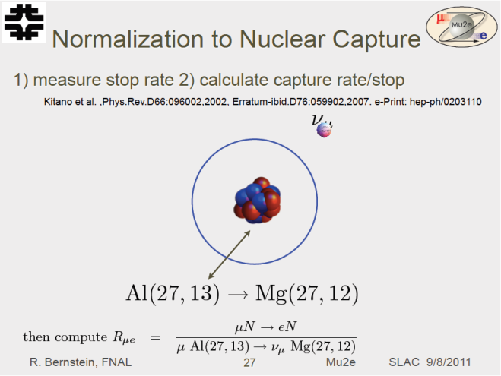
Gamma-rays from Mg-27 decay.
One more background.
Al-27 sample after first KVINTA irradiation at 0.5 AGeV
Mg-27 T1/2 = 9.5 m
Na-24
Channel

Slide 13
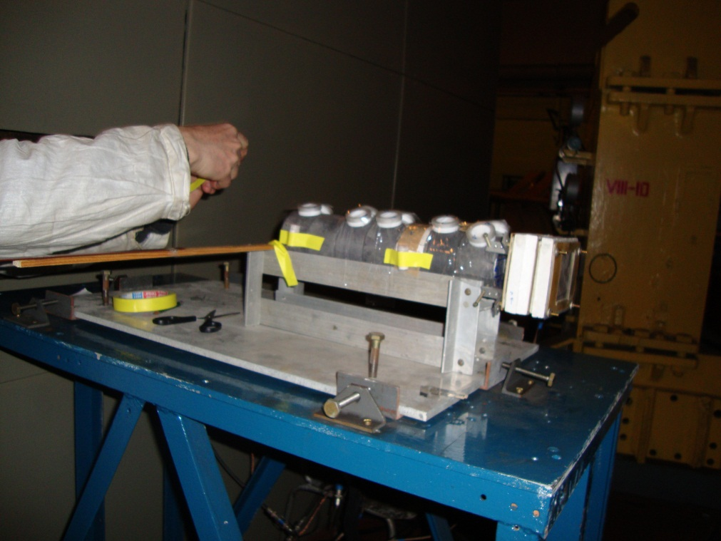
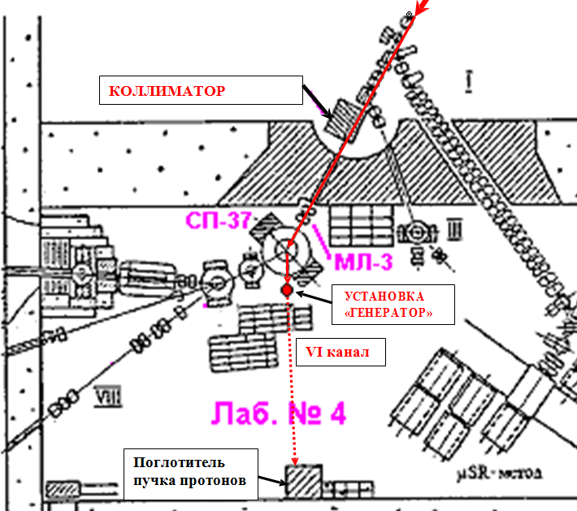
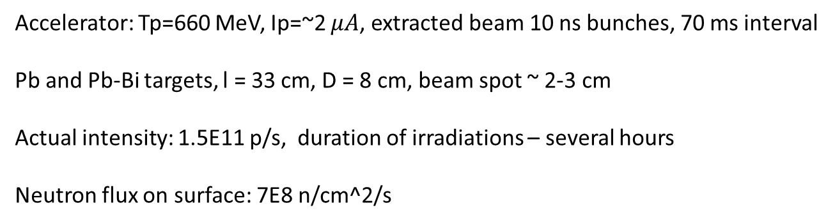
Target “GENERATOR” at Phasotron
collimator
generator
Beam
dump
Accelerator: Tp=660 MeV, Ip=~2 $μA$, extracted beam 10 ns bunches, 70 ms interval
Pb and Pb-Bi targets, l = 33 cm, D = 8 cm, beam spot ~ 2-3 cm
Actual intensity: 1.5E11 p/s, duration of irradiations – several hours
Neutron flux on surface: 7E8 n/cm^2/s

Slide 14
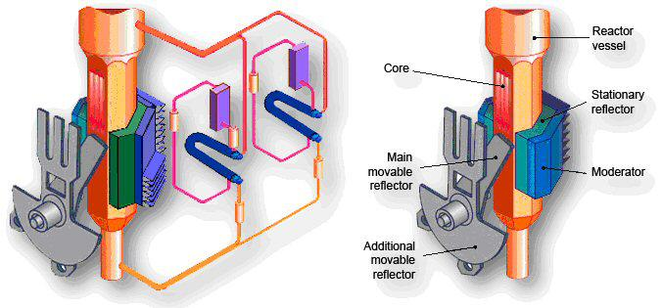
Pulsed Fast Reactor IBR-2
Pulse frequency 5 Hz, heat carrier – liquid Na, PuO2 fuel (82.5 kg)
Peak power in pulse 1500 MW, thermal power 2 MW,
Neutron flux from the moderator surface: average: 1E13 n/cm^2/s
maximum in pulse: 1E16 n/cm^2/s
En > 100 keV

Slide 15
Potential Fermilab Irradiation Facilities
Meson Test Beam Primary Line (protons)
Muon Test Area (MTA) (protons)
Neutron Therapy Facility (NTF) (neutrons)
ES&H Instrumentation Group (gamma, neutrons)
MI Collimator
See talk of Eric Ramberg

Slide 16
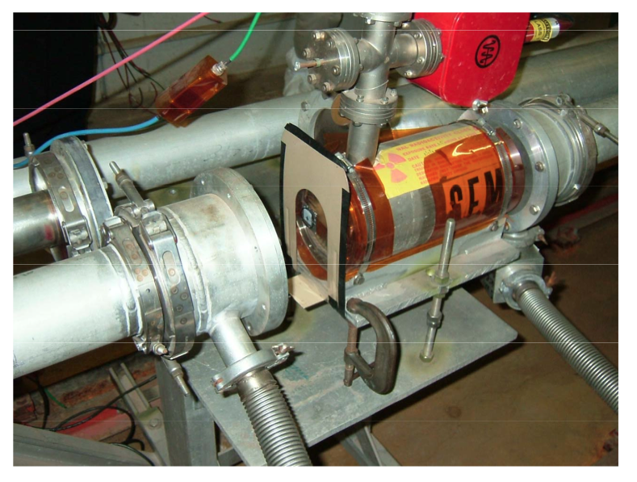
Meson Test Beam Primary Line
Fermilab Test Beam Facility is at the end of MTest beamline
120 GeV primary protons
Flux 1.5E11 protons/spill, 1 spill/minute 4 sec long,
12 hours/day
Beam spot size 1 cm^2
Gap M01 in beampipe before
it hits the first attenuator
Gap is 15 cm long
SEM flux monitor upstream
MOU submitting necessary

Slide 17
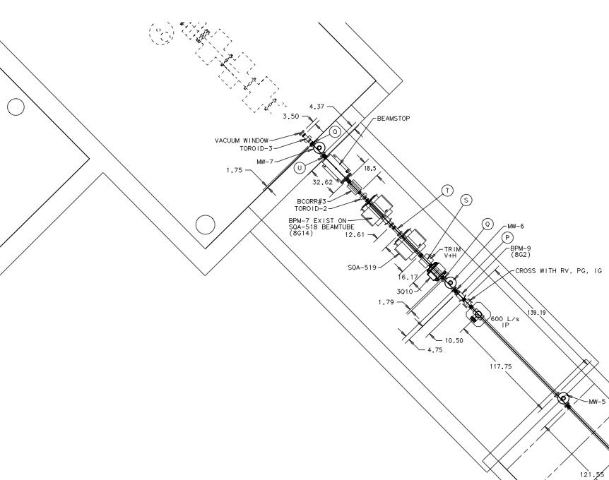
Muon Test Area (MTA)
At the end of Linac
Area not yet approved to take
primary Linac beam
Approved for 100% and 0%
transmission experiments
Up to 5E12 protons/60us bursts
One burst per minute
When the beamstop is closed
– 5E13 protons/minute
Radiation safety guidelines are not explicit about thin foils
Probably MOU is needed

Slide 18
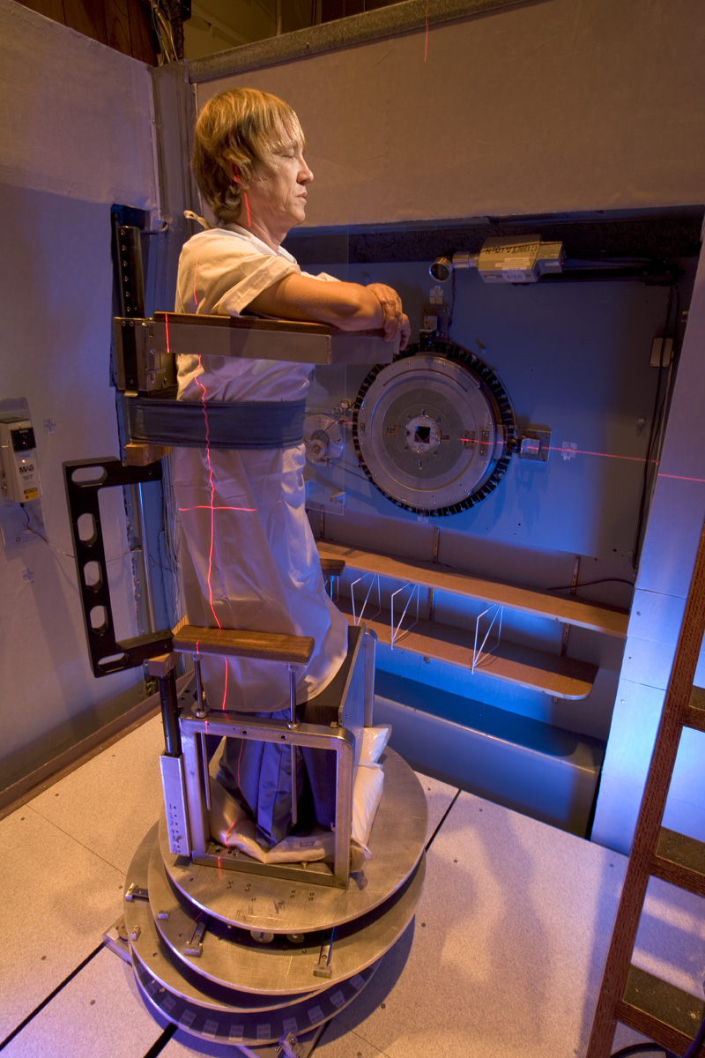
Neutron Therapy Facility (NTF)
In the middle of the Linac
Linac pulses at 66 MeV
Be or gold target
Fast neutrons (average En=10 MeV)
1E6 neutrons per pulse with 10 Hz
Irradiations last minutes
Has been used for experimental tests
Limited access points
Long term irradiations are not typically supported

Slide 19
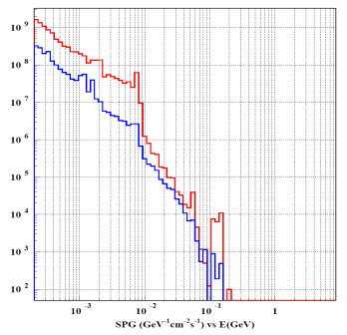
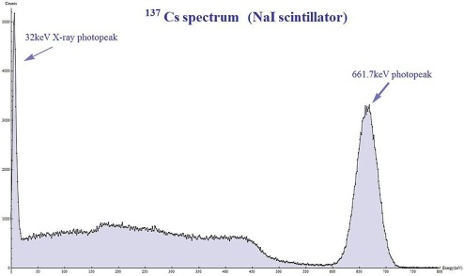
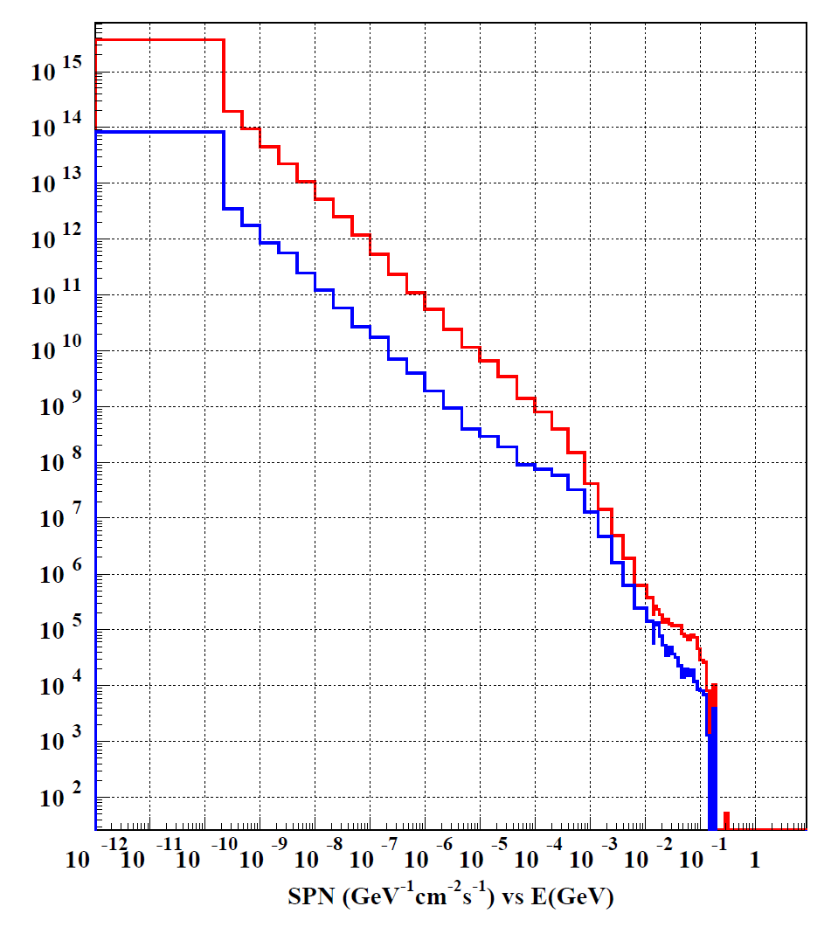
ES&H Instrumentation Group
Facility for calibration of radiation monitors
Has 3 rooms where detectors can be placed next to the source or several meters away
Cs-137 (200 Ci), 3E6 phot/cm^2/s at 30 cm (7 Gy/hr) (up to 1.4E5 /cm^2/s Mu2e @DS)
241Am+Be neutron
source (En=4.5 MeV)
6E7 n/s -> 5500 n/cm^2/s
at 30 cm from source
Mu2e@DS 105000 n/cm^2/s
Closer source-to-sample
distances are allowed
Mu2e@DS
gamma
Mu2e@DS
neutrons

Slide 20
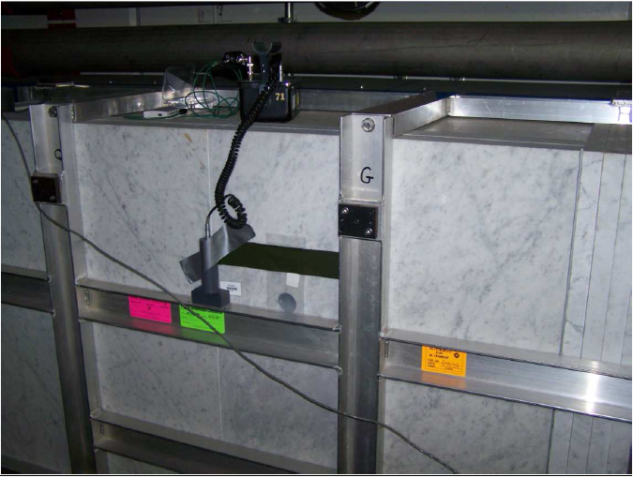
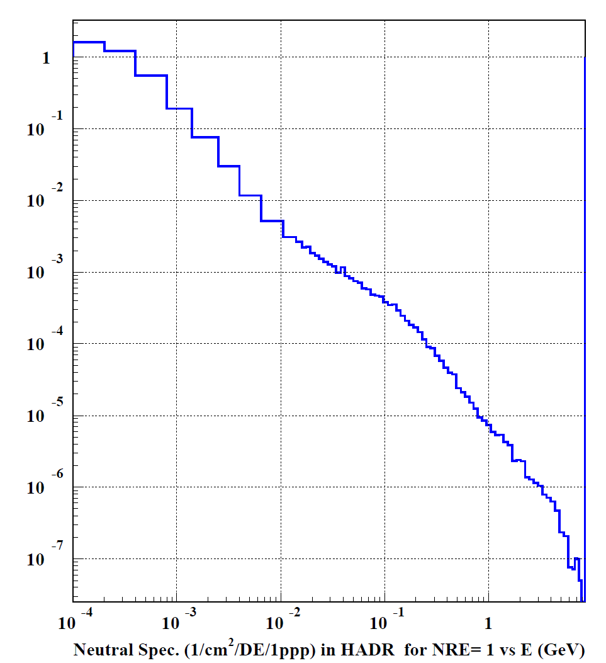
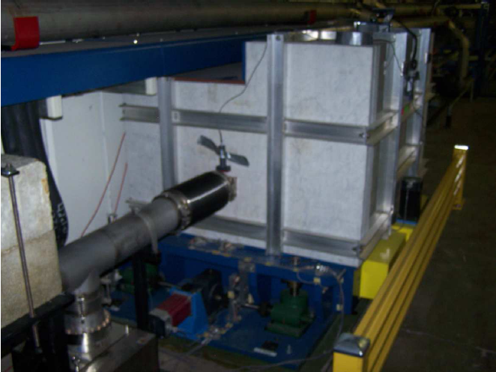
MI Collimator
shielded
~1.2E12 protons on collimator
unshielded
8.8E7-2.2E7 n/cm^2/s
B.C.Brown for details of irradiation

Slide 21
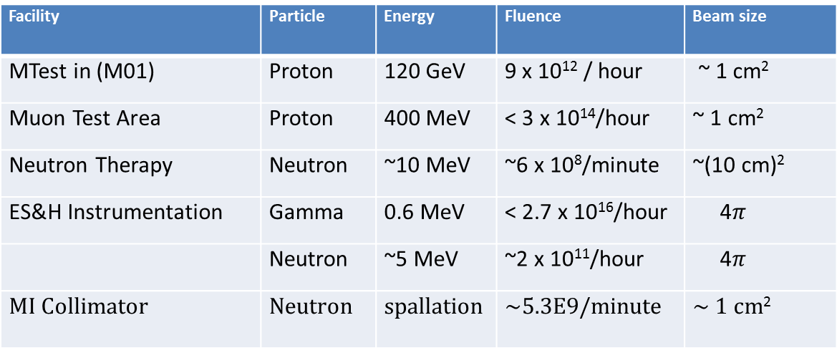
Summary
JINR
Facility | Particle | Energy | Fluence | Beam size
GAMMA-3 | Neutron | Spallation, < ~1 GeV | ~6E8/ minute | 1 cm²
KVINTA | Neutron | Spallation, < ~1 GeV | ~6E8 /minute | 1 cm²
GENERATOR | Neutron | Spallation, < 0.6 GeV | ~4E10 /minute | 1 cm²
IBR-2 | Neutron | >100 keV | ~6E14/minute | 1 cm²
Fermilab
Facility | Particle | Energy | Fluence | Beam size
MTest in (M01) | Proton | 120 GeV | 9 x 10¹² / hour | ~ 1 cm²
Muon Test Area | Proton | 400 MeV | < 3 x 10¹⁴/hour | ~ 1 cm²
Neutron Therapy | Neutron | ~10 MeV | ~6 x 10⁸/minute | ~(10 cm)²
ES&H Instrumentation | Gamma | 0.6 MeV | < 2.7 x 10¹⁶/hour | 4$π$
 | Neutron | ~5 MeV | ~2 x 10¹¹/hour | 4$π$
MI Collimator | Neutron | spallation | ~5.3E9/minute | ~ 1 cm²

