Slide 1
FRIB Preseparator Radiation Environment and Superconducting Magnet Lifetime Estimates
Roger Roberts, Dali Georgobiani, Reg Ronningen

Slide 2
Outline
FRIB, Preseparator Scope
Radiation environment
Expectations of magnet life from RIA R&D
Magnet life from present study
Target + Primary Beam Dump
Target + Possible Second Beam Dump
Summary and path forward

Slide 3
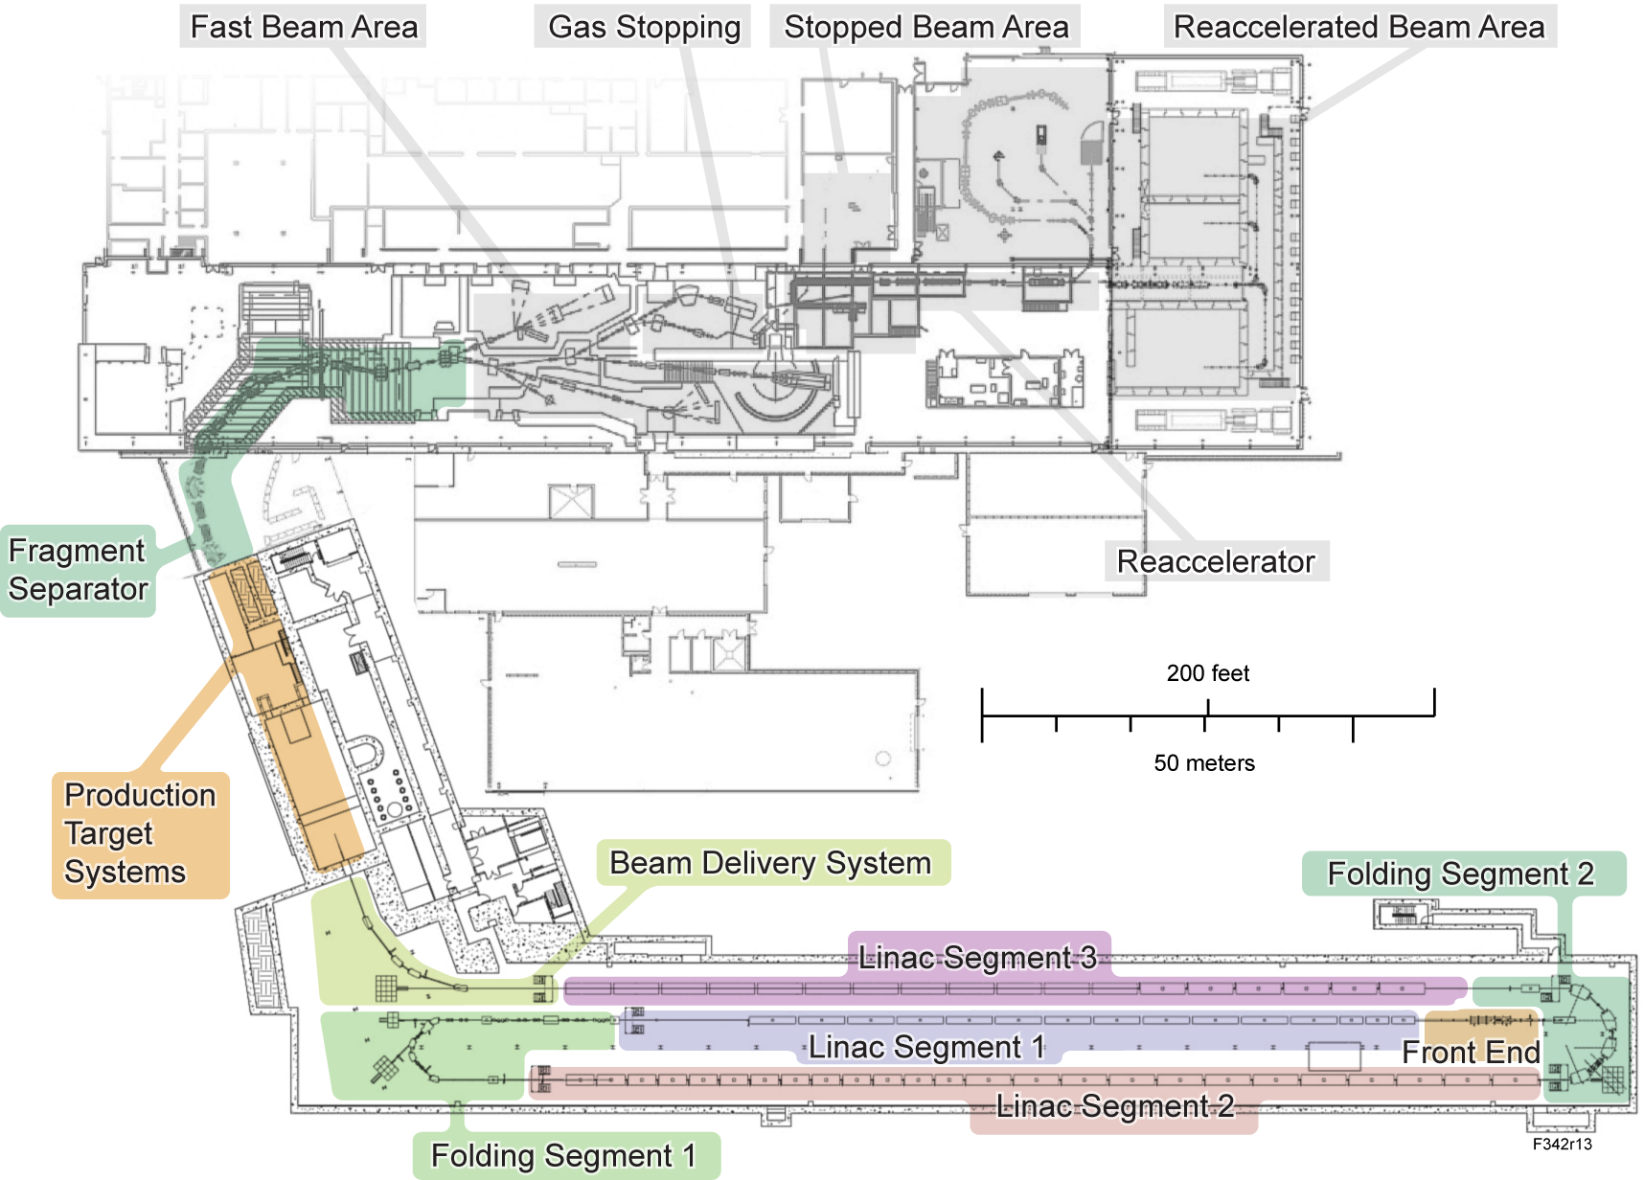
FRIB Fragment Separator is within Experimental Systems Project Scope
Facility requirements
Rare isotope production with primary beams up to 400 kW, 200 MeV/u uranium
Fast, stopped and reaccelerated beam capability
Experimental areas and scientific instrumentation for fast, stopped, and reaccelerated beams
Experimental Systems project scope
Production target facility
Fragment separator
Experimental areas for fast, stopped, and reaccelerated beams

Slide 4
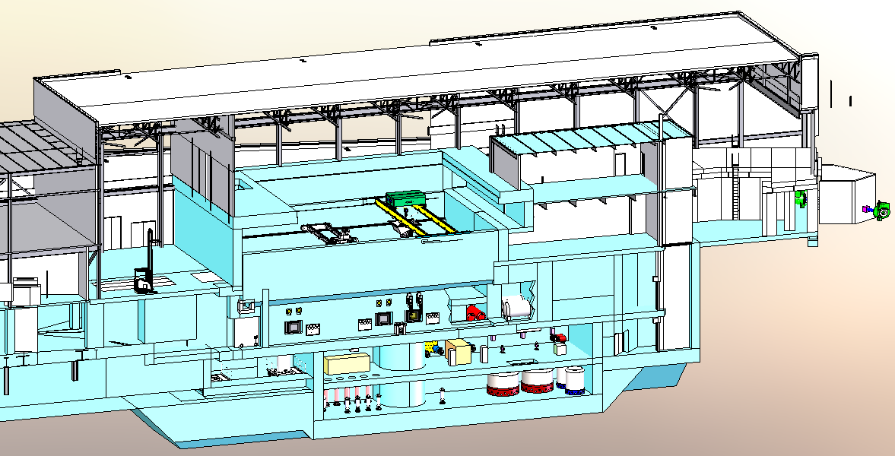
Fragment Preseparator Integrated With Target Facility
Target Facility Cutaway View
Cutaway View

Slide 5
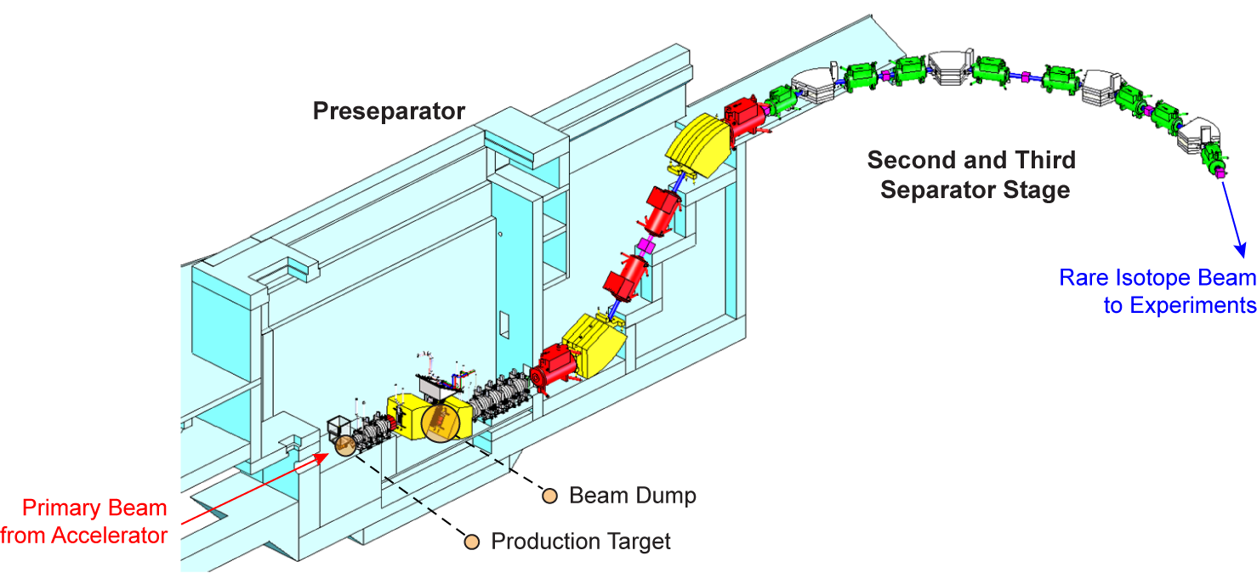
Fragment Separator Layout
Preseparator
Horizontal Stage
In “Hot Cell”
Vertical Stage
Outside “Hot Cell”
Separator
Second, Third Stages
Within Current NSCL
Hot Cell
Target Tank
Dipole/Beam Dump Tank
Wedge Tank
Hot Cell
Vertical transfer elements

Slide 6
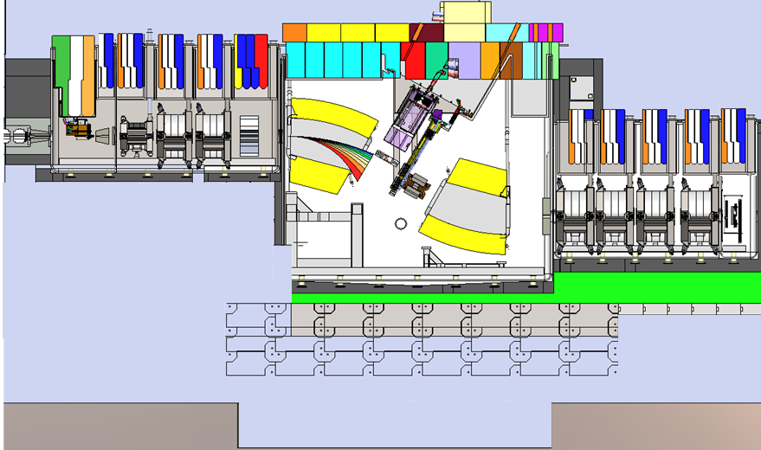
Preseparator and Vacuum Vessels in Hot Cell
Beamline from linac
HTS quadrupole
SC quadrupoles
SC dipoles
North hot cell wall
SC quadrupoles
Target
vacuum vessel
Vacuum Isolation Wall
Resistive octupole
Target
Metal shield
Beam dump
Wedge assembly
Beam dump
vacuum vessel
Room temperature Multipole
Wedge
vacuum vessel
Steel shield blocks
meters

Slide 7
Target Assembly Requirements
Rotating Air Coupling
Pneumatic Motor
(in 1 atmosphere)
Ø1” Inconel Shaft
Carbon Disk / Heat
Exchanger Assembly
400 kW, 200 MeV/u ²³⁸U beam
Up to 200 kW dissipated
1 mm diameter
Target speed requirement
5,000 rpm disk rotation – needed to prevent overheating of carbon disks
Water cooled HX, subject of ongoing design validation efforts
Allows rapid extraction of heat from beam interaction with target disks
1 mm positioning tolerance
Remotely serviceable/ replaceable from lid
Sufficient space available to accommodate future target designs (incl. liquid metal)
Integral box HX
Ferro Fluidic Bearing /Seal Assy
Shield Block
Ceramic Bearing
BEAM
50 kW prototype target to verify design

Slide 8
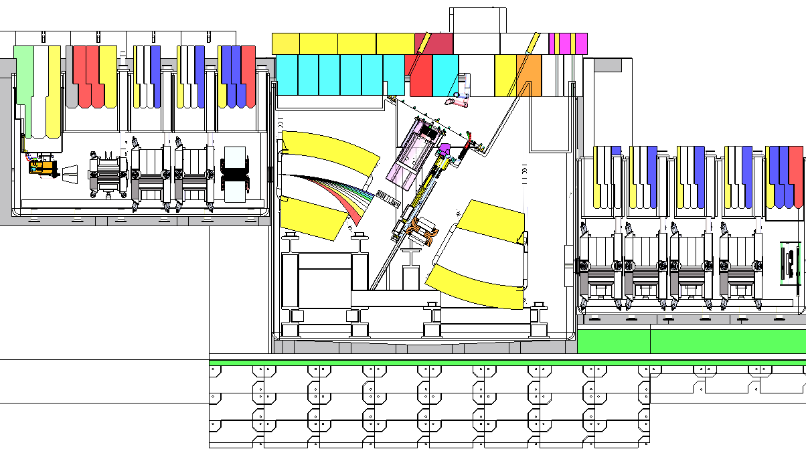
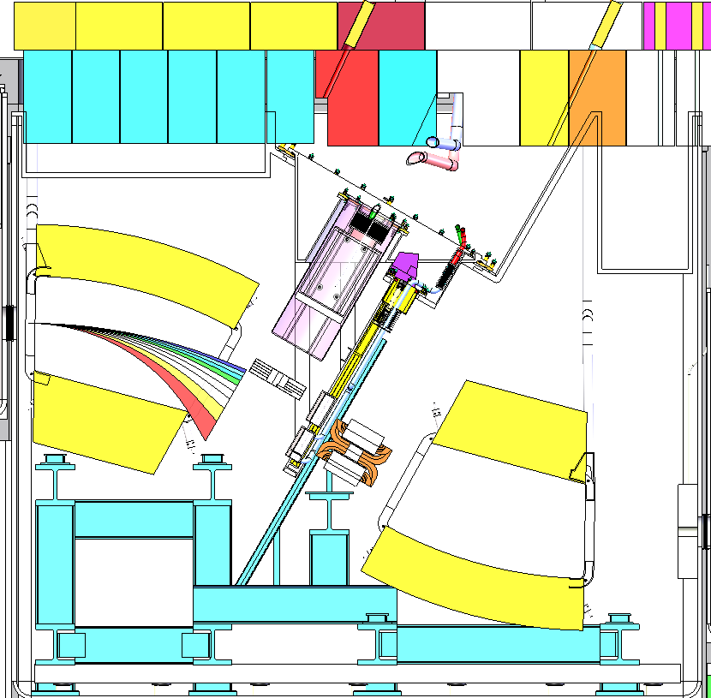
Beam Dump Scope and Technical Requirements
Intercept primary beam
Well-defined location
Needs to be adjustable
High power capability up to 325 kW
High power density: ~ 10 MW/cm³
Efficient replacement
1 year lifetime desirable
Remotely maintainable
Appropriately modular based on remote maintenance frequency
Compatible with fragment separator
Must meet fit, form, function
Compatible with operating environment
Vacuum ~10⁻⁵ Torr; magnetic field ~ 0.25 T; average radiation levels ~ 10⁴ rad/h (1 MGy/y)
Safe to operate
Quadrupole
magnets
Dipole Magnets
Target
Beam Dump Assembly
Range of beam, fragments
Desired fragment

Slide 9
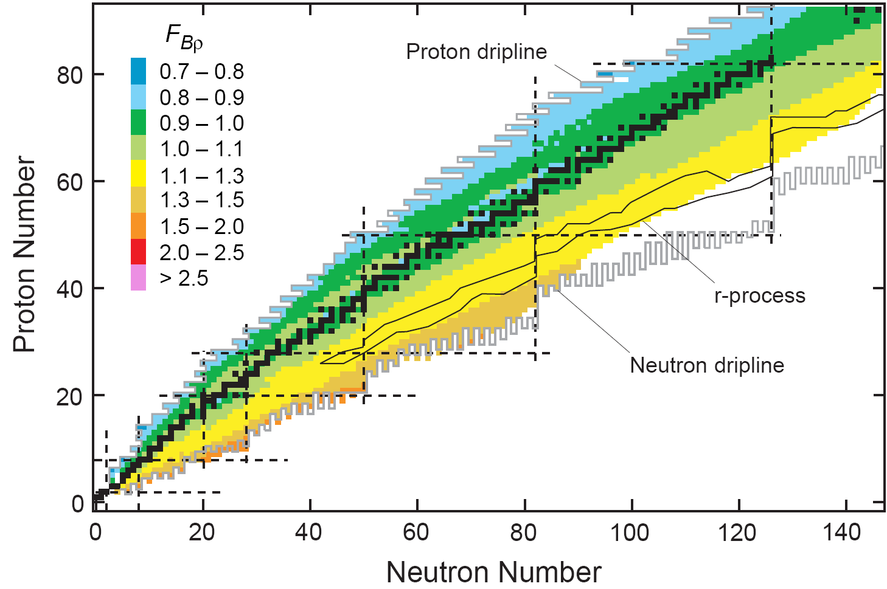
Primary Beam Position on Dump Changes with Fragment Selection
Color-code: F_{Bρ} is the ratio of the magnetic rigidity of a given fragment to that of the primary beam.
Primary beam trajectory range
Incoming beam direction
The location of the primary beam at the beam dump is shown with the same color code.
Fragment beam
Adjustable beam dump position

Slide 10
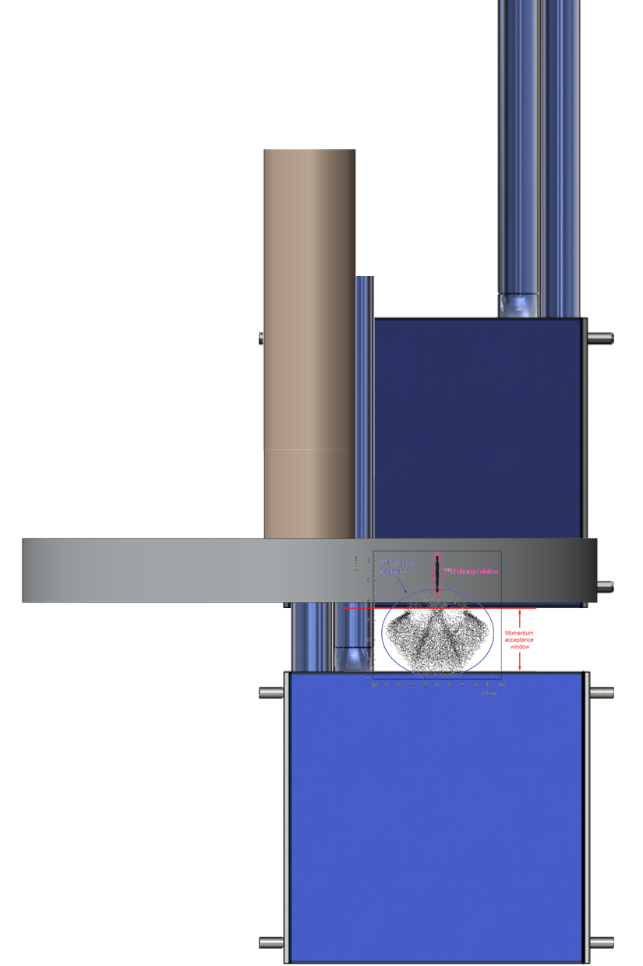
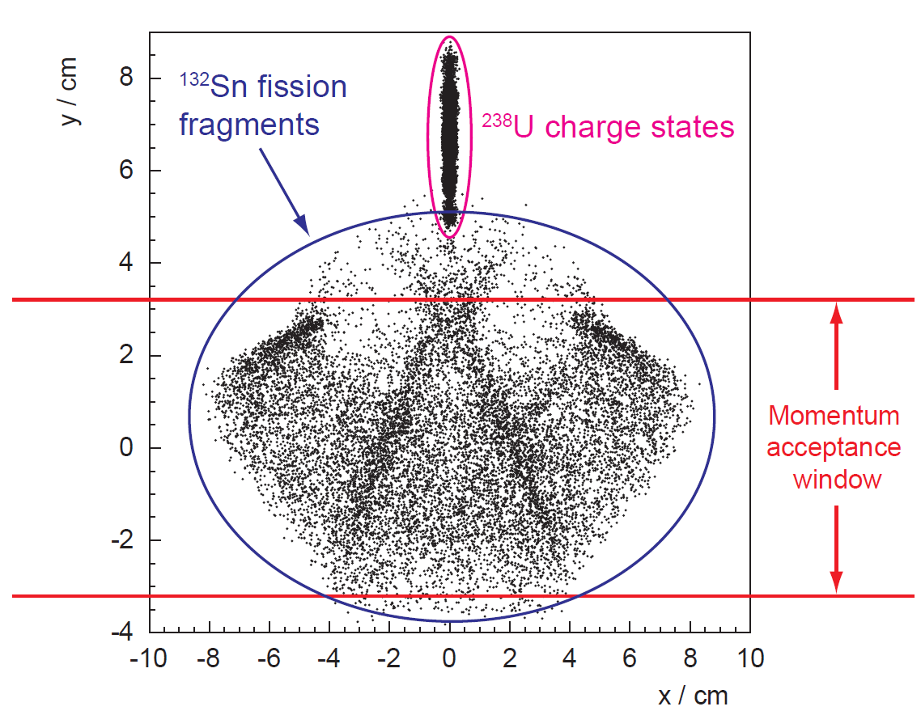
Spatial Distribution of Beam and Fragments on Dump Depends on Fragment Selection
Example: ¹³²Sn fragment distributions for ²³⁸U + C fission
Beam and fragments are in close proximity
5 charge states, most restrictive “spot” sizes σ_{x} ≈ 2.3 mm, σ_{y} ≈ 0.7 mm
Other beam/fragment combinations will be distributed differently
Fragment Catcher
Drum Dump
Fragment Catcher

Slide 11
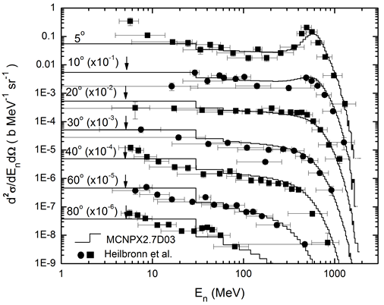
Neutron Production Cross Sections in Heavy Ion Reactions - Example
600 MeV/u Si + Cu
HIMAC (NIRS, Chiba, Japan)
L. Heilbronn, C. J. Zeitlin, Y. Iwata, T. Murakami, H. Iwase, T. Nakamura, T. Nunomiya, H. Sato, H. Yashima, R.M. Ronningen, and K. Ieki, “Secondary neutron-production cross sections from heavy-ion interactions between 230 and 600 MeV/nucleon”, Nucl. Sci. and Eng., 157, pp. 142-158(2007)
For thick-target yields, see:
T. Kurosawa et al., “Neutron yield from thick C, Al, Cu and Pb targets bombarded by 400 MeV/nucleon Ar, Fe, Xe, and 800 MeV/nucleon Si ions,” Phys. Rev. C, 62, 044615 (2000)

Slide 12
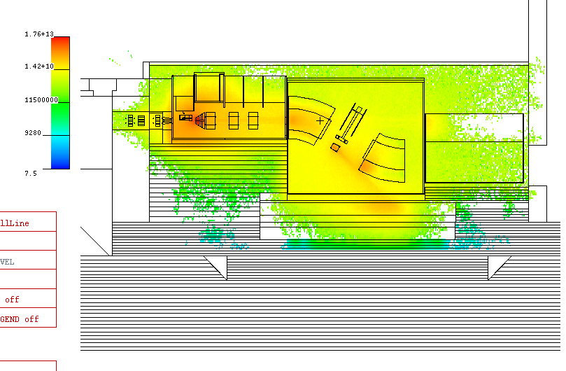
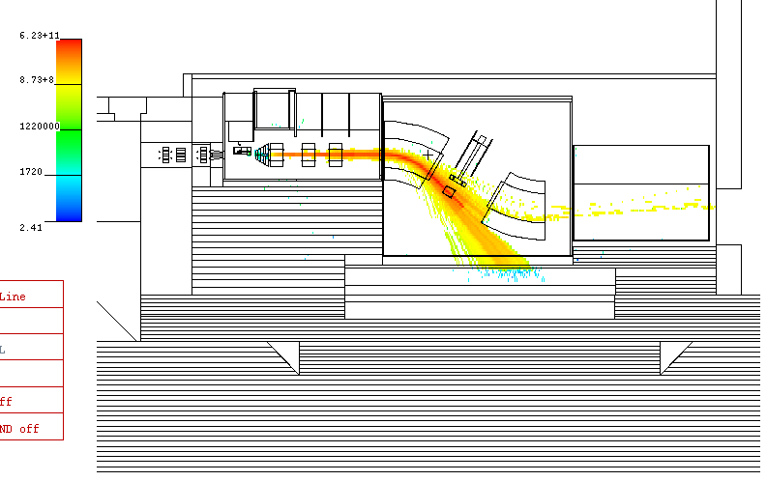
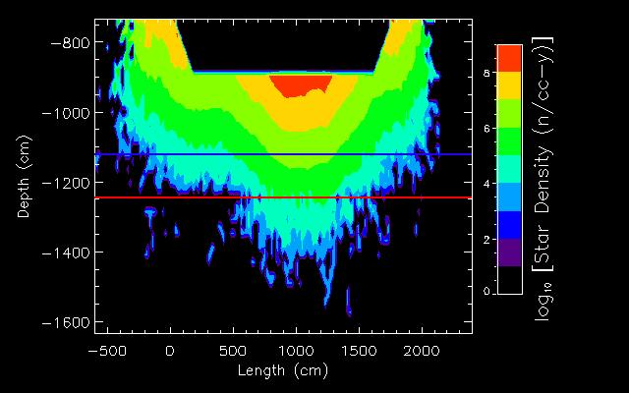
Study of Soil, Groundwater Activation
400 kW, 637 MeV/u ¹⁸O
Neutron Flux Density (to 2x10¹³ n/cm²-s)
Beam and Fragments with Z>1
Soil
Steel
Concrete
Star Density Production Rate in Soil

Slide 13
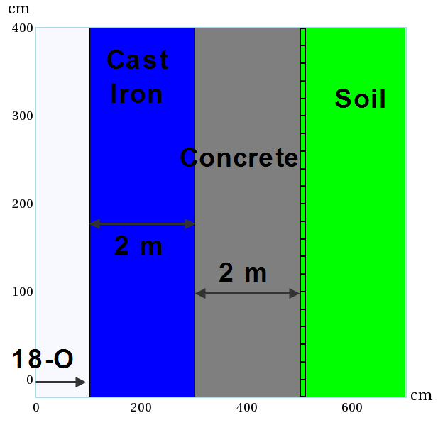
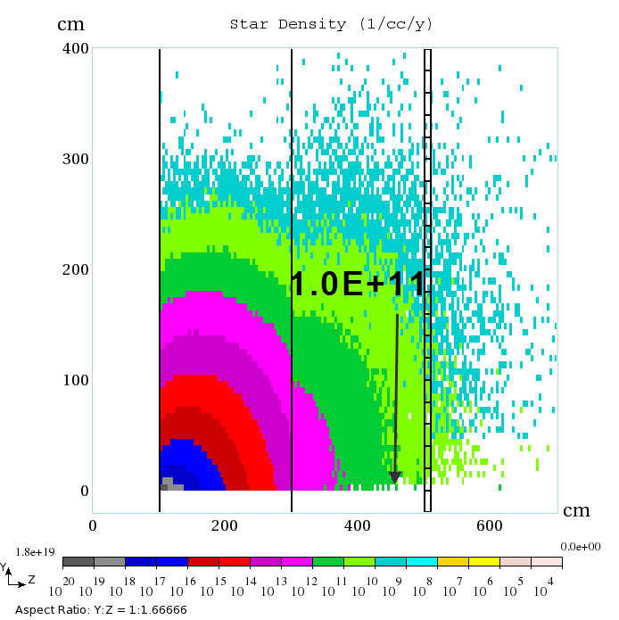
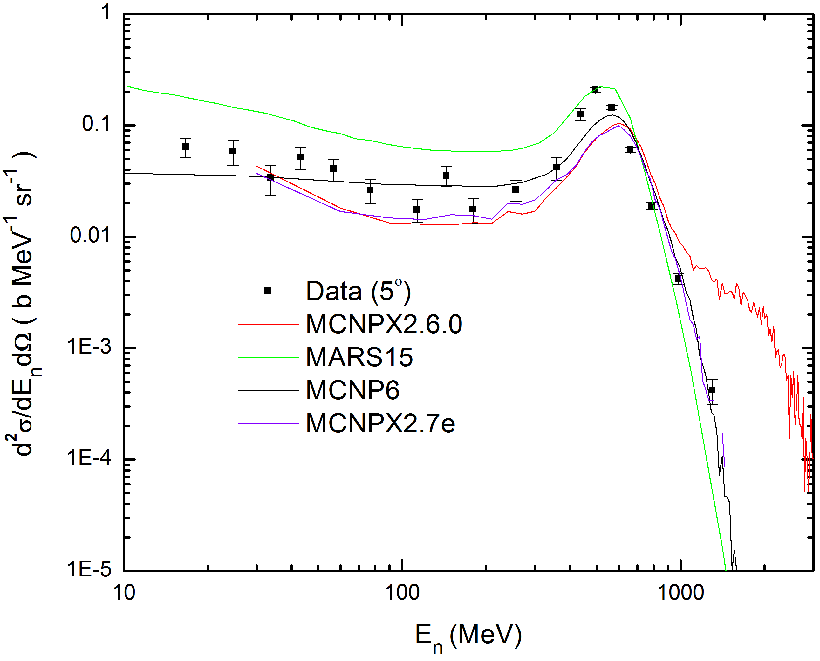
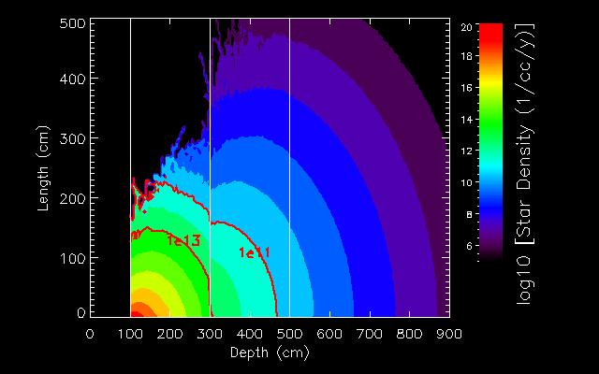
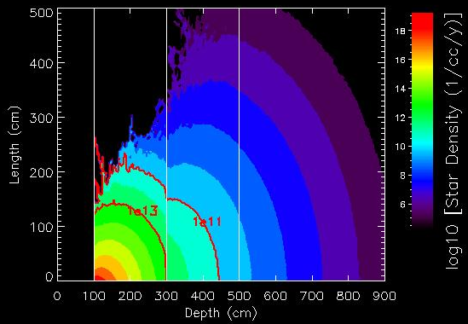
Codes are Benchmarked, Validated for Calculations Critical to Design
Model
Benchmark study performed for 400 kW 433 MeV/u ¹⁸O beam
Upgrade energy
Energy of beam is at beam dump
Purpose was to benchmark MCNPX (used for target building shield analysis) against MARS15 (used for linac shield analysis)
Problem with MCNPX 2.6.0 – has not been used in analyses when transporting heavy ions - Stepan G. Mashnik, “Validation and Verification of MCNP6 Against Intermediate and High-Energy Experimental Data and Results by Other Codes, International Conference on Mathematics and Computational Methods Applied to Nuclear Science and Engineering (M&C 2011), Rio de Janeiro, RJ, Brazil, May 8-12, 2011.
MARS15
Neutron production cross-sections
for 600 MeV/u Si on Cu
MCNPX2.6.0
MCNPX2.7e
Problem with MCNPX2.6.0

Slide 14
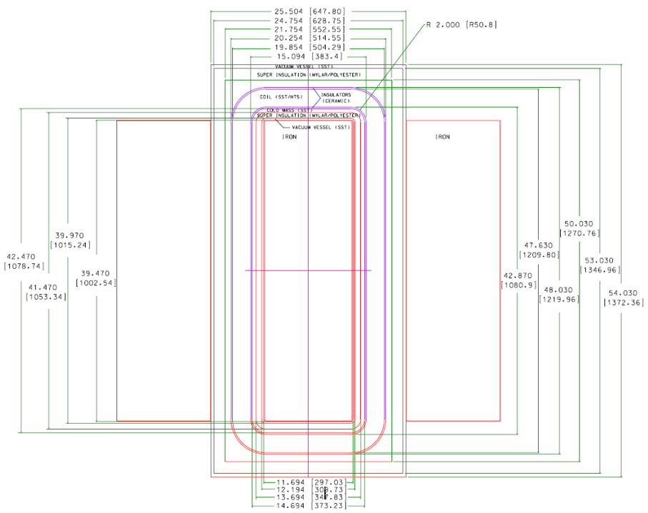
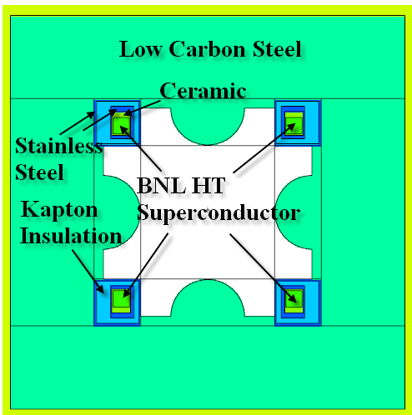
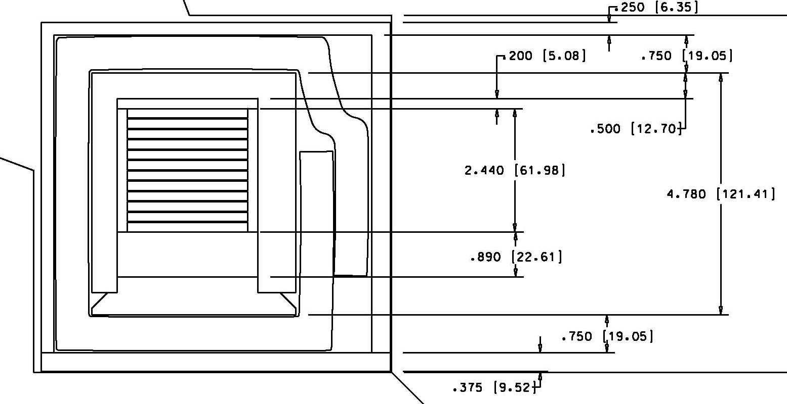
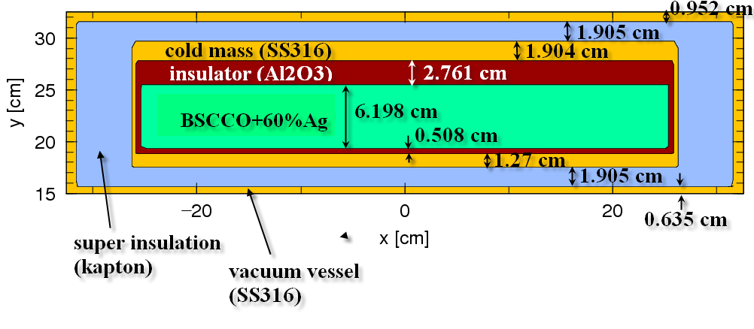
RIA R&D Work: Model of BNL Magnet Design circa 2006

Slide 15
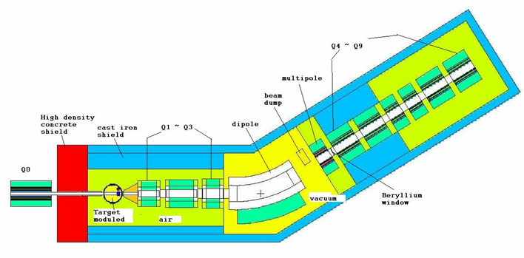
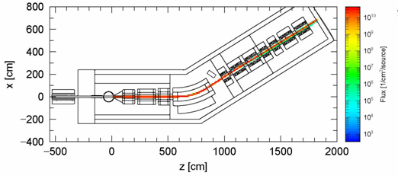
RIA R&D Expectations: Coil Life [y]
Target | Liquid lithium target |  |  |  |  | Beryllium target
Projectiles | ⁴⁸Ca | ⁴⁸Ca | ⁸⁶Kr | ¹³⁶Xe | ²³⁸U | ⁴⁸Ca | ⁸⁶Kr | ¹³⁶Xe
Energy | 350 | 500 | 520 | 500 | 400 | 500 | 520 | 500
(MeV/nucleon)
Q1 | 9 | 5 | 7 | 13 | 33 | 8 | 17 | 29
Q2 | 14 | 3 | 21 | 57 | 132 | 33 | 66 | 113
Q3 | 25 | 8 | 47 | 88 | 198 | 53 | 198 | 264
Dipole | 12 | 5 | 20 | 20 | 396 |  | 264 | 396
Sextupole | 26 | 23 | 19 | 61 | 38
Q4 | 396 | 113 | 79 | 396 | 198
Q5 | 1980 | 159 | 264 | 793 | 793
Q6 | 7930 | 793 | 396 | 3960 | 3960
Q7 | 7930 | 793 | 793 | 7930 | 7930
Q8 | 39600 | 2640 | 1980 | 7930 | 7930
Q9 | 7930 | 7930 | 396 | 2640 | 7930
²²C from 350 MeV/u ⁴⁸Ca + Li

Slide 16
FRIB Baseline Beam Parameters
Beam Parameters
400 kW on target
Target extent is 30% of ion range
Baseline Energies
Upgrade energies ~x2 larger
Secondary fluxes ~ x4 larger
Beam current (for 400 kW) ~ x0.5 – smaller
Expect doses to increase by ~x2
Angular distributions more forward peaked
Operational Year
2x10⁷s (5556 h)
Beam Ion | Specific Energy [MeV/u] | Particle Current for 400 kW [ions/s] [x10¹³] | Target Thickness for ~ 30% of Ion Range [cm]
¹⁸O | 266 | 52 | 2.22
⁴⁸Ca | 239.5 | 22 | 0.79
⁸⁶Kr | 233 | 12 | 0.43
¹³⁶Xe | 222 | 8 | 0.29
²³⁸U | 203 | 5 | 0.17

Slide 17
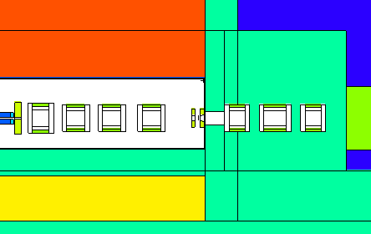
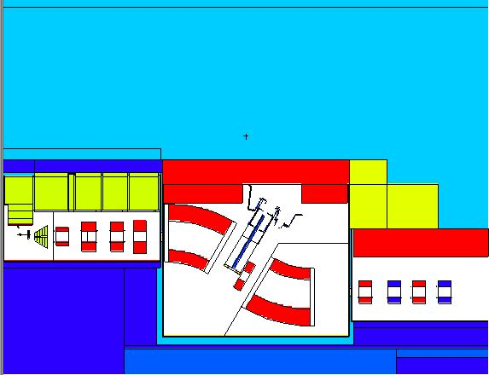
Radiation Heating in Magnets Determined Supports Magnet and Non-conventional Utility Design
Q_D1013
Q_D1024
Q_D1035
Q_D1137, Q_D1147
Q_D1218
S_D1045
DV_D1064,
DV_D1108
Q_D1158, Q_D1170
Q_D1195, Q_D1207
Two models were used for MCNP6, PHITS calculations of heating in magnets: the large-scale model (left) and a model for the possible second beam dump implementation (above)

Slide 18
Magnet Technologies Assumed
Magnet Technologies Assumed
Expected Lifetime in Units of Radiation Dose [Gy]
Order in Separator | FRIB ID | Magnet Type | Coil Technology
1 | Q1b | Quadrupole | Cu+Stycast
2 | Q2b | Quadrupole | Not yet modeled
3 | Q3b | Quadrupole | Cu+Stycast
4 | Q_D1013 | Quadrupole | HTSC (YBCO)
5 | Q_D1024 | Quadrupole | NbTi+Cu+Cyanate Ester
6 | Q_D1035 | Quadrupole | NbTi+Cu+Cyanate Ester
7 | OCT_D1045 | Octupole-Sextupole | Hollow Tube Cu+MgO
8 | DV_1064 | Dipole | NbTi+Cu+Cyanate Ester
9 | S_D1092 | Octupole-Sextupole | Hollow Tube Cu+MgO
10 | DV_D1108 | Dipole | NbTi+Cu+Cyanate Ester
11 | Q_D1137 | Quadrupole | NbTi+Cu+Cyanate Ester
12 | Q_D1147 | Quadrupole | NbTi+Cu+Cyanate Ester
13 | Q_D1158 | Quadrupole | NbTi+Cu+Cyanate Ester
14 | Q_D1170 | Quadrupole | NbTi+Cu+Cyanate Ester
Material | Expected Lifetime [Gy]
HTSC | (1 – 2)x10⁸
NbTi | ~5x10⁸
Nb₃Sn | ≥5x10⁸
Copper | > 10⁸
Ceramics(Al₂O₃, MgO, etc) | > 10⁹
Organics | > 10⁶ to 10⁸

Slide 19
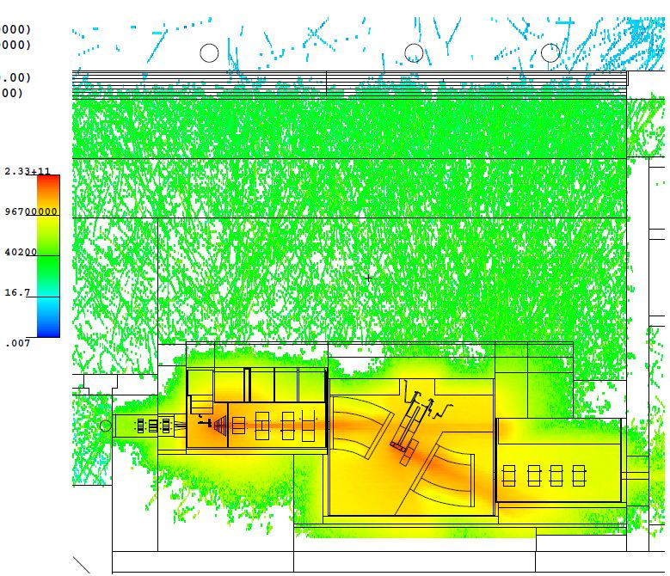
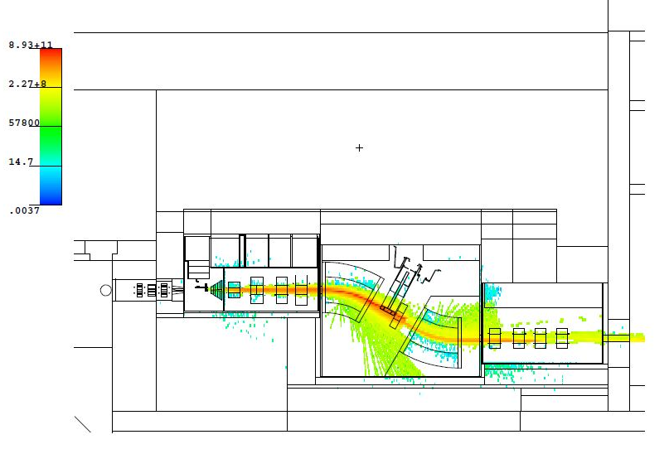
Prompt Radiation Maps
400 kW, 550 MeV/u ⁴⁸Ca
Neutron Flux Density (to 2x10¹¹ n/cm²-s)
Beam and Fragments with Z>1
Preseparator tuned for ⁴²P

Slide 20
Radiation Heating in Magnets Example: Heating, Quadrupole Cross-section
2D IDL frames of MCNP6 heating mesh tally into Windows Movie Maker
Δx = Δz = 1 cm; Δy = 0.5 cm

Slide 21
Expected Life of Preseparator Magnets
Iron, W shields studied
Need to value-engineer shield
Average heating quoted, maximum values under study and are likely factors of several larger
 | Iron Shield |  |  |  |  | W Shield
Projectiles | O18 | Ca48 | Kr86 | Xe136 | U238 | O18 | Ca48 | Kr86 | Xe136 | U238
Energy (Mev/nucleon) | 266 | 239.5 | 233 | 222 | 203 | 266 | 239.5 | 233 | 222 | 203
 | Expected Life [y] |  |  |  |  | Expected Life [y]
Q1b (BDS) | 1.7E+04 | 3.3E+04 | 6.3E+04 | 6.9E+04 | 9.0E+04 |  | 1.63E+04 | 2.72E+04 | 4.55E+04 | 4.55E+04
Q2b (BDS)
Q3b (BDS) | 3448 | 6784 | 11765 | 14493 | 19011 |  | 3401 | 5675 | 9452 | 5675
Q_D1013 | 2 | 4 | 5 | 68 | 6 |  | 9 | 15 | 32 | 6
Q_D1024 | 149 | 368 | 391 | 481 | 435 |  | 397 | 1323 | 2415 | 2778
Q_D1035 | 66 | 80 | 130 | 495 | 179 |  | 242 | 180 | 120 | 17
OCT_D1045 | 1818 | 1946 | 7364 | 495 | 4630 |  | 7003 | 11820 | 16077 | 14205
DV_1064 | 37 | 28 | 45 | 561 | 36 |  | 28 | 42 | 96 | 35
S_D1092 | 71 | 79 | 5 | 78 | 5 |  | 80 | 7 | 391 | 5
DV_D1108 | 3333 | 3731 | 706 | 867 | 2688 |  | 284 | 370 | 318 | 407
Q_D1137 | 2500 | 13228 | 994 | 2907 | 3067 |  | 2463 | 26178 | 25126 | 8532
Q_D1147 | 1333 | 2404 | 216 | 39 | 6570 |  | 16722 | 16835 | 3086 | 1381
Q_D1158 | 1333 | 7062 | 7645 | 72 | 21930 |  | 92593 | 6196 | 30 | 329
Q_D1170 | 1048 | 30303 | 862 | 110 | 21645 |  | 45045 | 5675 | 12690 | 2841

Slide 22
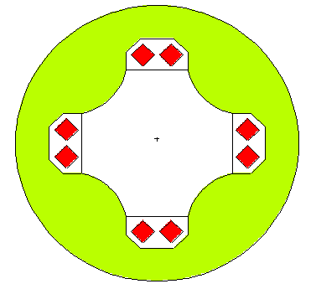
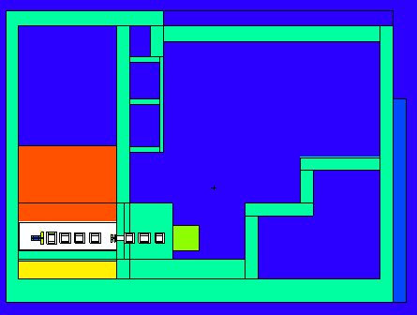
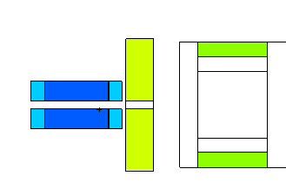
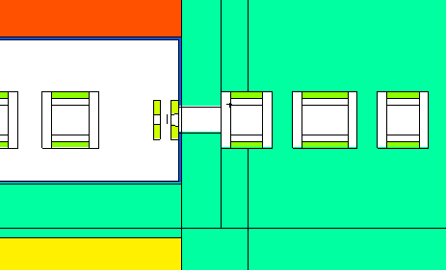
Model of Geometry for PHITS Calculation
4 quads before the wall (Q1 to Q4), in Al tank.
3 quads after the wall (Q5 to Q7), in concrete.
Bore diameters: Q1 – 44 cm, others – 40 cm.
Lengths with coils [cm]: 79,84,84,84,76,96,76
quadrupole,
transverse view
Coils (NbTi+Cu+
Stycast or Cyanate Ester)
cast iron
dipole
86Kr beams, E = 233 MeV/u
S1,S2,S3: 300,10,0.32 kW
Duratek
aperture, collimator (Hevimet)
S3
Q1
S2
S1
wedge
beam dump
(water, aluminum)
collimator (Hevimet)

Slide 23
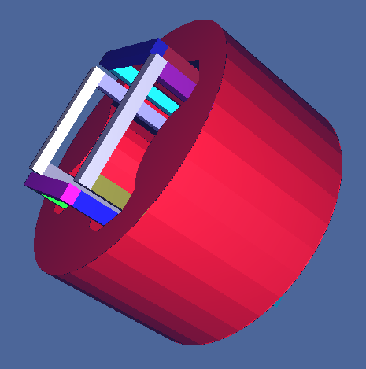
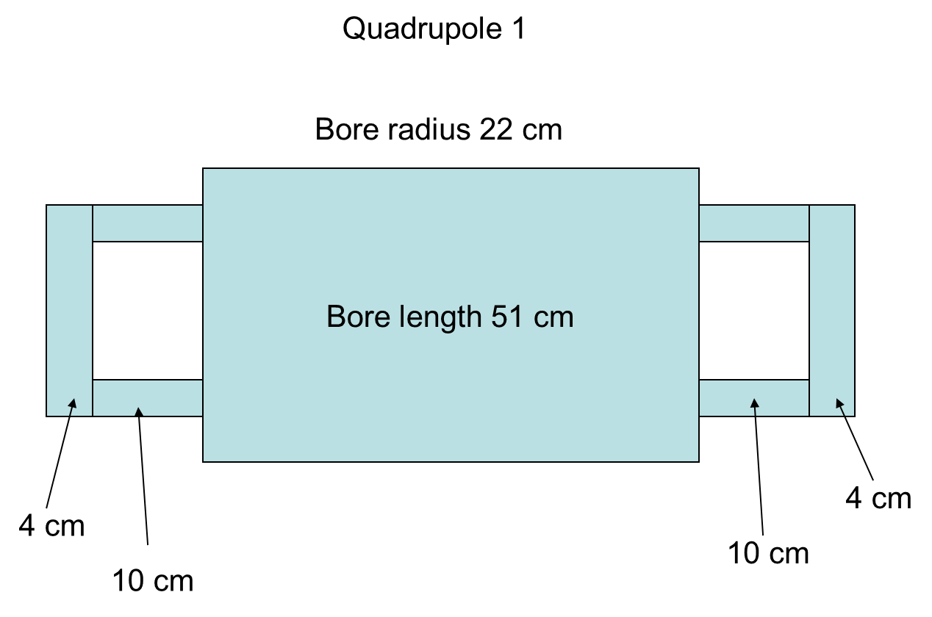
Geometry for Magnets
Models for PHITS calculations for possible 2nd beam dump operation

Slide 24
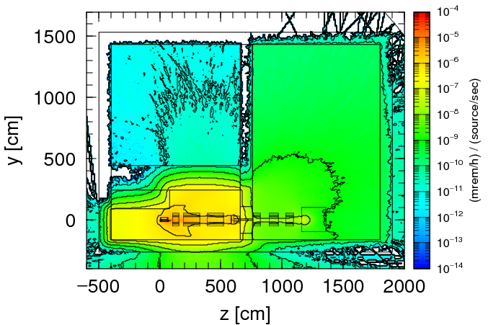
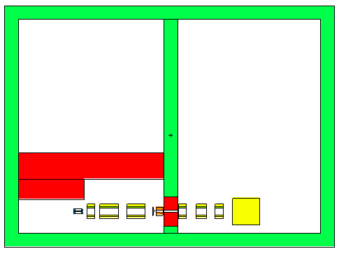
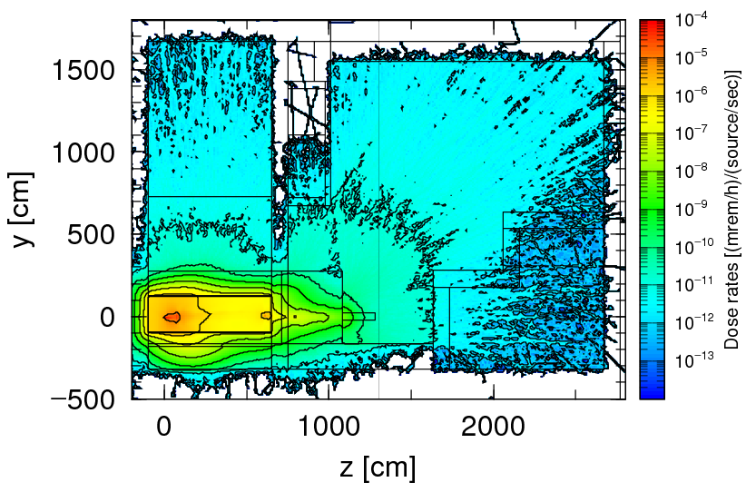
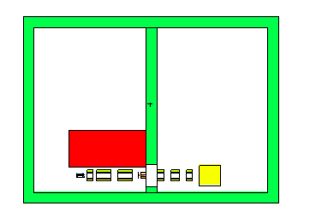
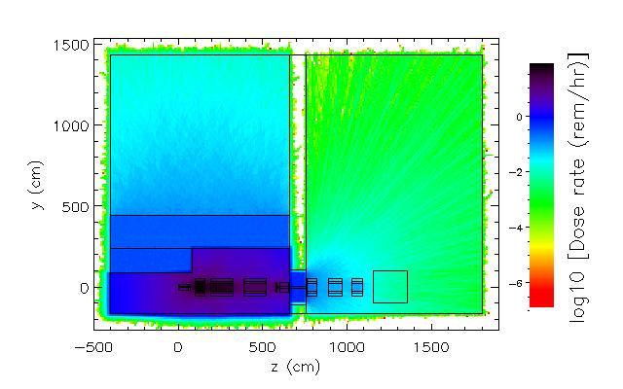
Shielding in Vertical Preseparator Region Sufficient for 2nd Beam Dump Implementation (Worst Case)
Concrete bunker around quad triplet reduces prompt dose rate to < 100 mrem/h
Concrete walls
Space behind concrete support filled with soil - within building: Activated soil is contained
Dipole steel
Sources: ⁸⁶Kr beams, 233 MeV/u located at possible second beam dump, fragment catcher, collimator, wedge system
Beam dumps
Duratek steel at minimum density spec
Aperture, Wedge, Collimator
Hands-on access possible in vertical separator region
Radiation plots – results of studies? Assume the are still planned to be included
Residual photon dose rates after 4 hr

Slide 25
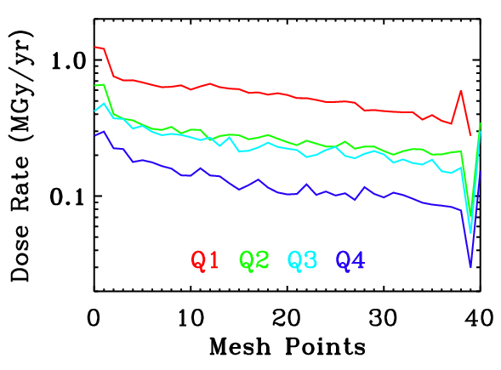
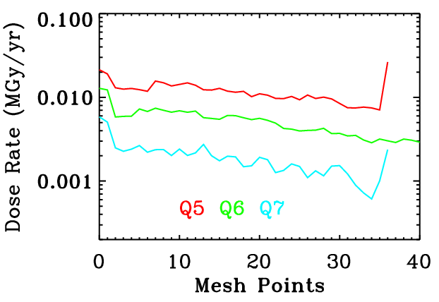
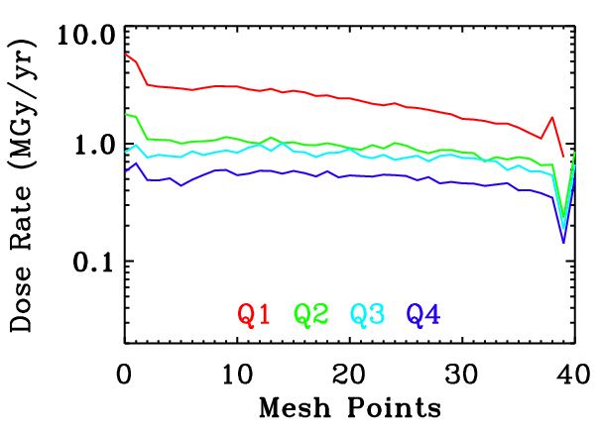
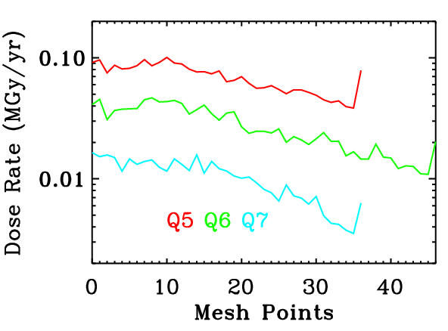
Radially Averaged Dose Rates To Quadrupoles
Model coils contain NbTi(75%)+Cu(25%)
Model coils contain Stycast

Slide 26
Radiation Heating in Magnets Example: Heating, Quadrupole Cross-section
2D IDL frames of PHITS heat mesh tally into Windows Movie Maker
Δx = Δz = 1 cm; Δy = 1 cm

Slide 27
Radiation Heating in Magnet Yokes, Coils Supports Magnet and Non-conventional Utility Design
⁸⁶Kr, 233 MeV/u, at 300 kW
Magnets | Yoke Heating [W]
Q_D1137 | 52
Q_D1147 | 22
Q_D1158 | 11
Q_D1170 | 9
Q_D1195 | 3
Q_D1207 | 4
Q_D1218 | 2
Magnets | Coil Dose Rate [MGy/y] | Lifetime [y]
Q_D1137 | 2.54 | 10
Q_D1147 | 0.87 | 29
Q_D1158 | 0.80 | 32
Q_D1170 | 0.56 | 44
Q_D1195 | 0.14 | 182
Q_D1207 | 0.05 | 497
Q_D1218 | 0.04 | 673

Slide 28
Summary
FRIB radiation environment is challenging
Power
Wide range of beams, beam trajectories
Shield studies are important
SC technology will work

