Slide 1
Superconducting Magnets for the FRIB Fragment Separator
Al Zeller, Shailendra Chouhan, Rick Swanson, Dan Cole

Slide 2
Outline
History of rare isotope science at Michigan State University leads to FRIB
Unique FRIB framework: Cooperative Agreement for financial assistance
Fragment separator
Magnets
Work supported by the U.S. Department of Energy Office of Science under Cooperate Agreement DE-SC0000661

Slide 3
Michigan State University 57,000 people; 36 sq mi; $1.8B annual revenue; 552 buildings
Notes:
5200 acres campus plus 18400 acres throughout Michigan

Slide 4
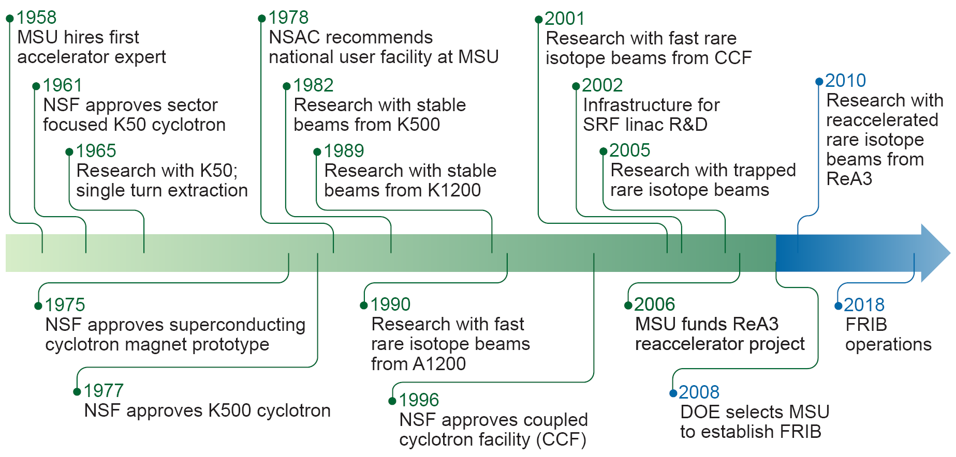
Experimental Nuclear Physics at MSU

Slide 5
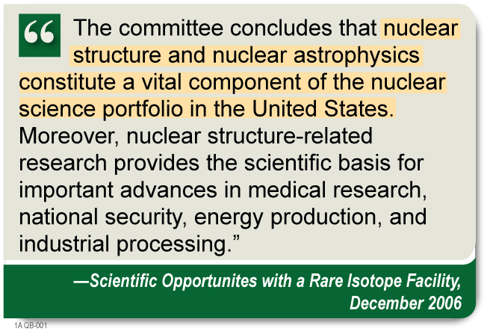
National Research Council RISAC Report
“The committee concludes that the science addressed by a rare-isotope facility, most likely based on a heavy ion linac driver, should be a high priority for the United States.” - NRC

Slide 6
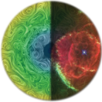
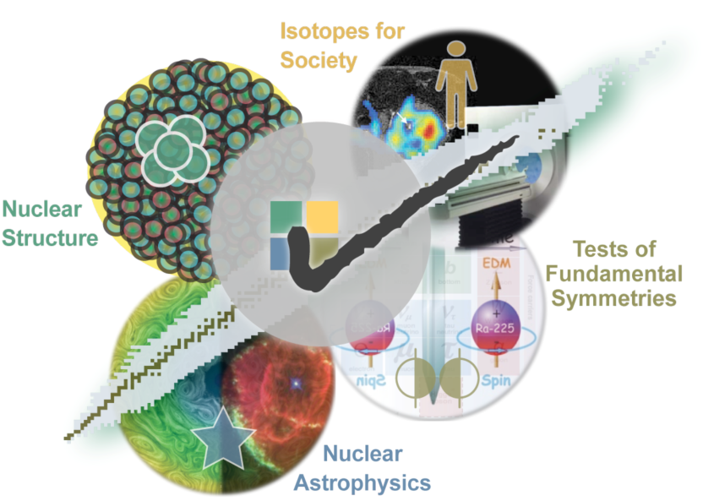
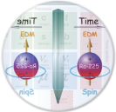
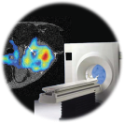
FRIB – a DOE-SC National User Facility Enabling Scientists to Make Discoveries
Properties of nucleonic matter
Classical domain of nuclear science
Many-body quantum problem: intellectual overlap to mesoscopic science – how to understand the world from simple building blocks
Nuclear processes in the universe
Energy generation in stars, (explosive) nucleo-synthesis
Properties of neutron stars, EOS of asymmetric nuclear matter
Tests of fundamental symmetries
Effects of symmetry violations are amplified in certain nuclei
Societal applications and benefits
Bio-medicine, energy, material sciences, national security

Slide 7
Major Configuration Alternatives Considered
= chosen = not chosen
Straight configuration Folded configuration Double-folded configuration
Lowest cost configuration that meets requirements. Also maintains future upgrade options.
All configurations meet requirements: ≥ 200 MeV/u, 400 kW for all ions; fast, stopped, reaccelerated beams; support infrastructure; space for 100 users at a time; world-class science program at start of operations
Future upgrade options for all configurations: Space to double experimental area; ISOL addition; Light-ion injector addition; multi-user option addition
Future energy upgrade options
≥ 400 MeV/u for all ions with ≥ 400 MeV/u for all ions with ≥ 400 MeV/u for all ions with baseline λ/2 cryomodules baseline λ/2 cryomodules high-performance cryomodules (35% gradient increase over baseline cryomodules)

Slide 8
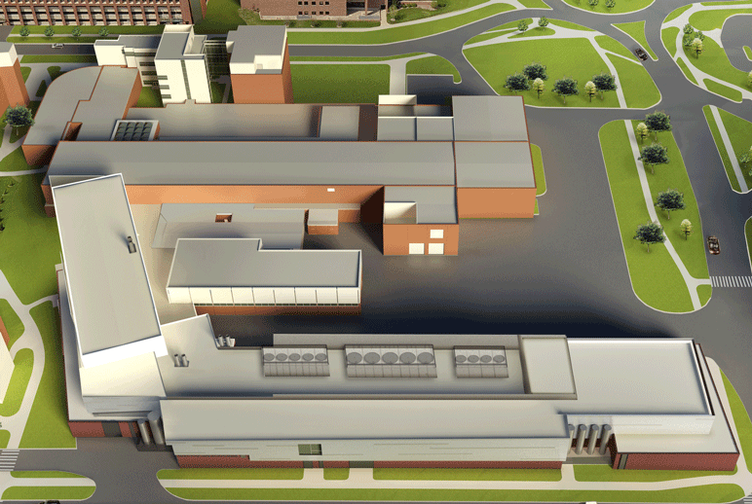
Civil Design Complete & Integrated with Technical Systems

Slide 9
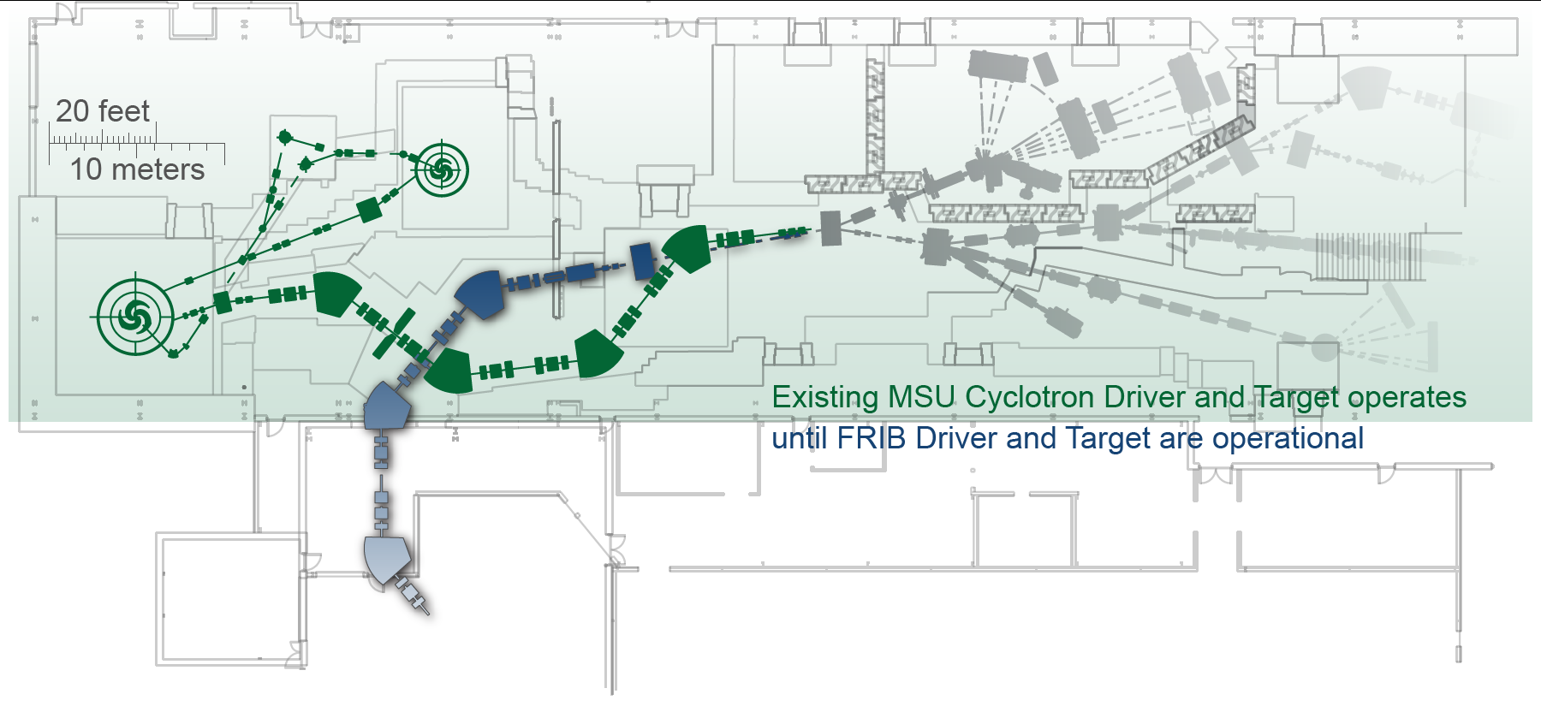
Early Science Opportunities with Fast, Stopped, and Reaccelerated Beams
Collaborations form early while FRIB is being constructed
Post-production elements commissioned before FRIB driver linac complete
Ensures world-class scientific research program at start of FRIB operation

Slide 10
CD-4 Performance Parameters
System | Parameter | Performance Criteria
Accelerator System | Accelerate multiple charge states of a heavy ion beam of ⁸⁶Kr | Measure FRIB driver linac beam w/ energy > 200 MeV/nucleon & beam current >20 pnA
Experimental System | Produce a fast rare isotope beam of ⁸⁴Se | Detect & identify ⁸⁴Se isotopes in FRIB fragment separator focal plane
 | Stop a fast rare isotope beam in gas and reaccelerate a rare isotope beam | Measure reaccelerated rare isotope beam energy > 3 MeV/nucleon
Conventional Facilities | Linac tunnel | Beneficial occupancy of subterranean tunnel of ~ 500 feet path length (minimum) to house FRIB driver linear accelerator
 | Cryogenic helium liquifier plant—bldg & eqmt | Beneficial occupancy of the CHL plant bldg and installation of CHL plant complete
 | Target area | Beneficial occupancy of target area and once beam line installed and ready for commissioning

Slide 11
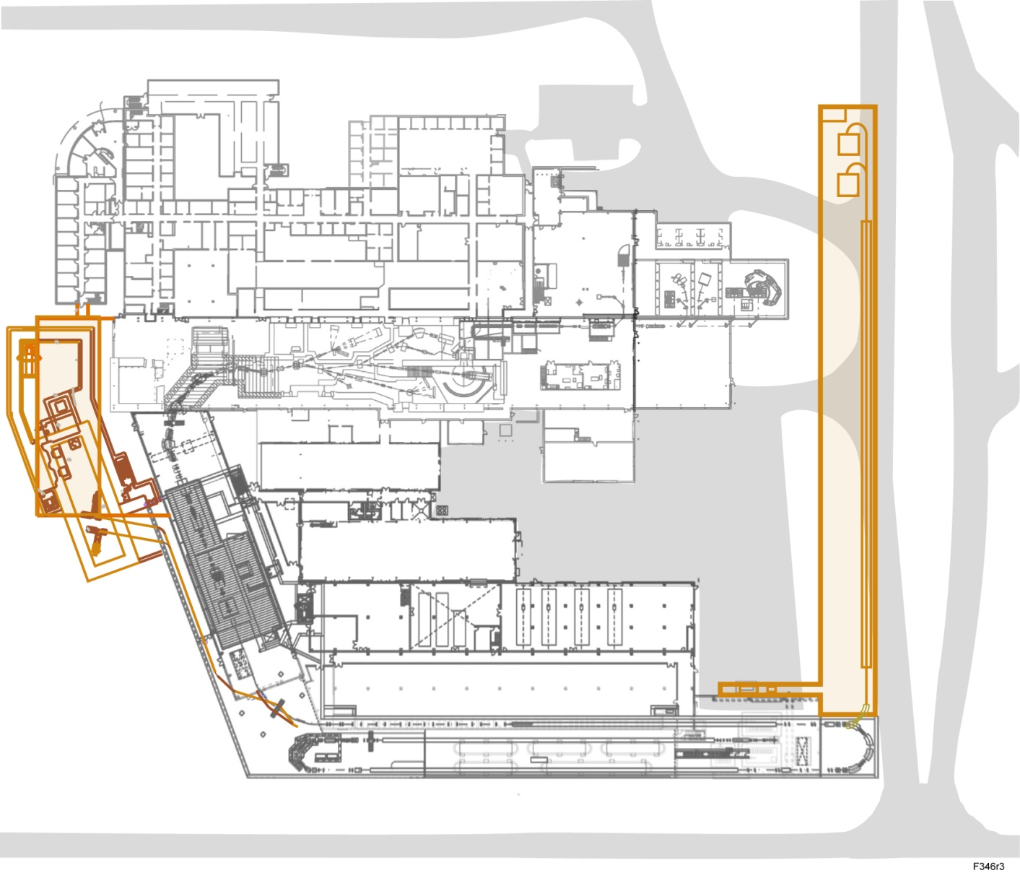
Upgrade Options for Preferred Alternative
Experimental Area double space if science needs it
Light ion injector upgrade
³He⁺, 195 MeV/u
Energy upgrade to ≥ 400 MeV/u for all ions (high performance λ/2 cryomodules)
ISOL targets
³He, 400 MeV/u
Multiuser capability
with light ion injector

Slide 12
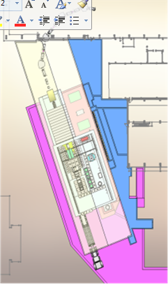
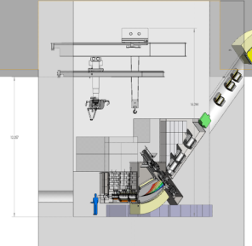
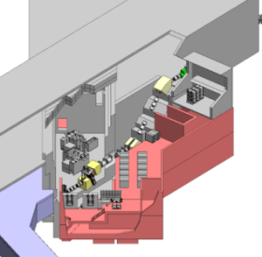
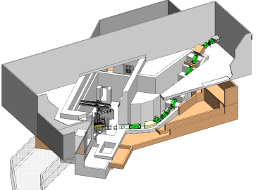
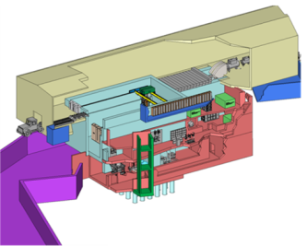
Target Facility Alternative Chosen
= chosen = not chosen
Common target building for in-flight and ISOL beam production. Compatible with V1 separator. | Common target building for in-flight and ISOL beam production. Compatible with V2 separator. | Common target building for in-flight and ISOL beam production. Compatible with H1 separator. | Single target building for in-flight production only. Compatible with V2b separator. Provides ISOL upgrade path.
A-V1
A-V2
A-H1
B-V2
B-V2 is chosen alternative: lowest-cost option with best performance for baseline requirements

Slide 13
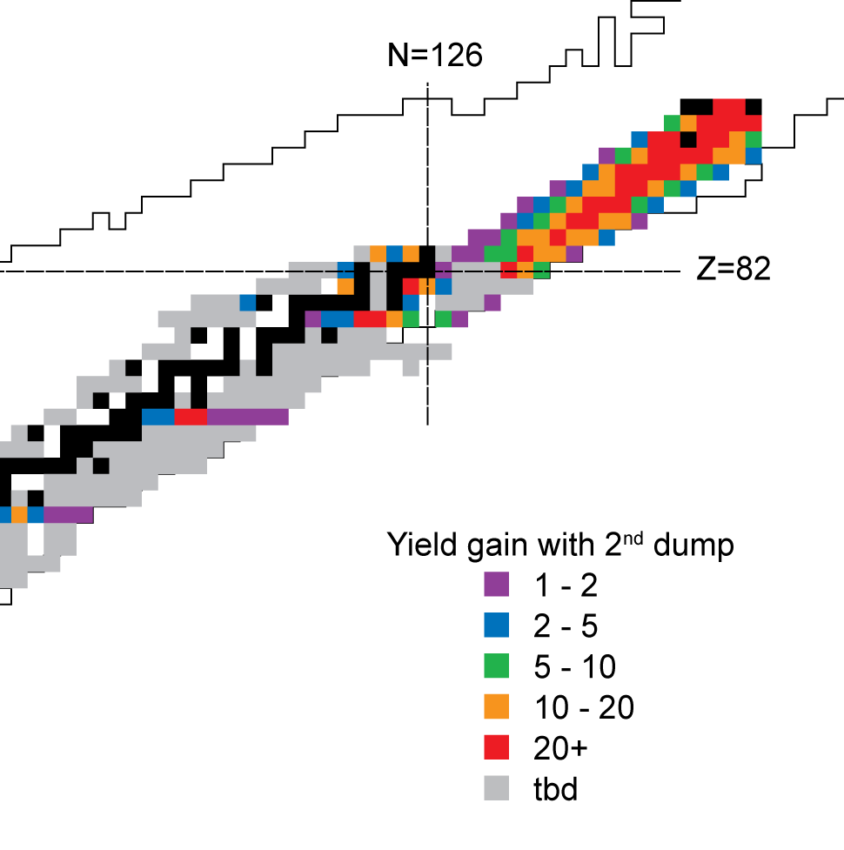
Preseparator Beam Optics Design Optimization for Maximum Science
Space for 2nd beam dump included in design
Increased dispersion and resolving power enable selection of rare isotope between charge states of primary beam
Large gain factors where alternative is to use weak rare isotope charge state
Most applicable for heavy primary beams, namely for uranium
Second beam dump option fully integrated in the ion-optical design, main driver to increase dipole bend angles to 30 degrees
Yield gain for specific isotopes with 2nd beam dump

Slide 14
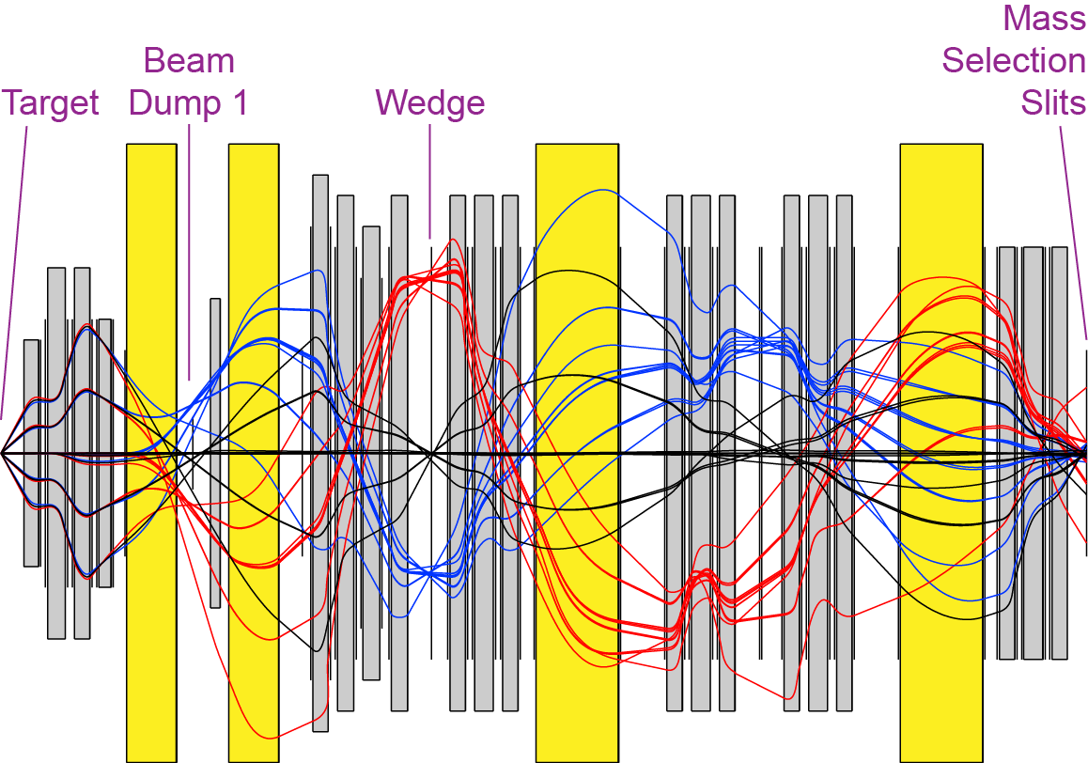
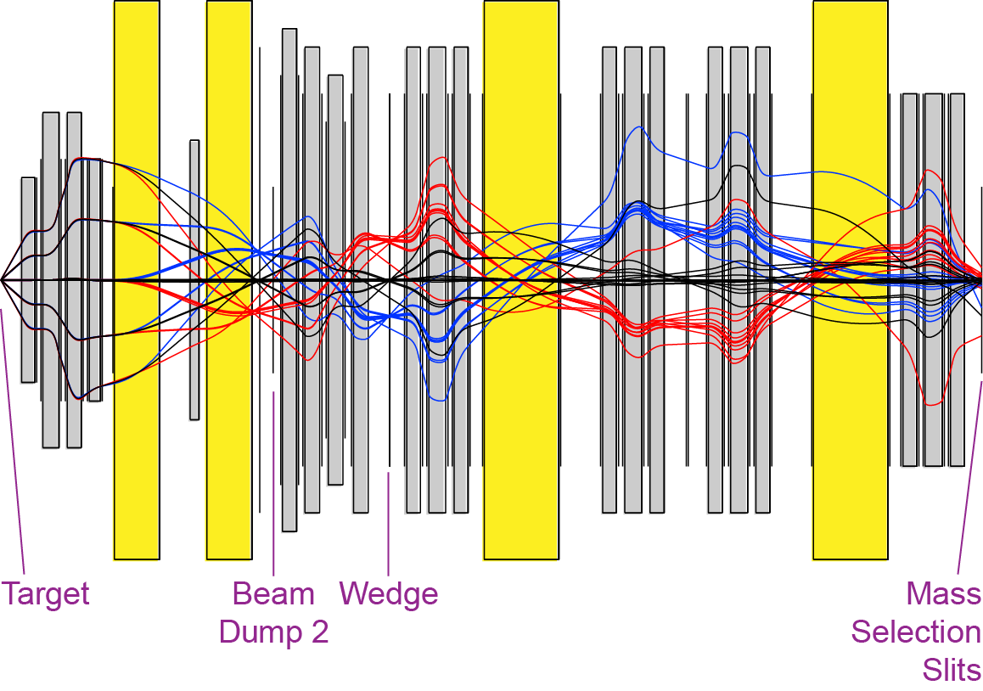
Preseparator Beam Optics Versatile Design Supports Multiple Operational Modes
Combination of multiple modes maximizes covered science range
Image at beam dump 1
Optimized for rare isotopes far from stability
Maximum momentum acceptance
Compressed by factor of 3
Maximum magnetic rigidity of 8 Tm
Trajectories shown in 5th order with aberration correction
Image at beam dump 2 (upgrade option)
Optimized for heavy rare isotopes near stability
Selection of rare isotope beam between primary beam charge states
Enhanced dispersion/resolving power at beam dump
Trajectories shown in 5th order

Slide 15
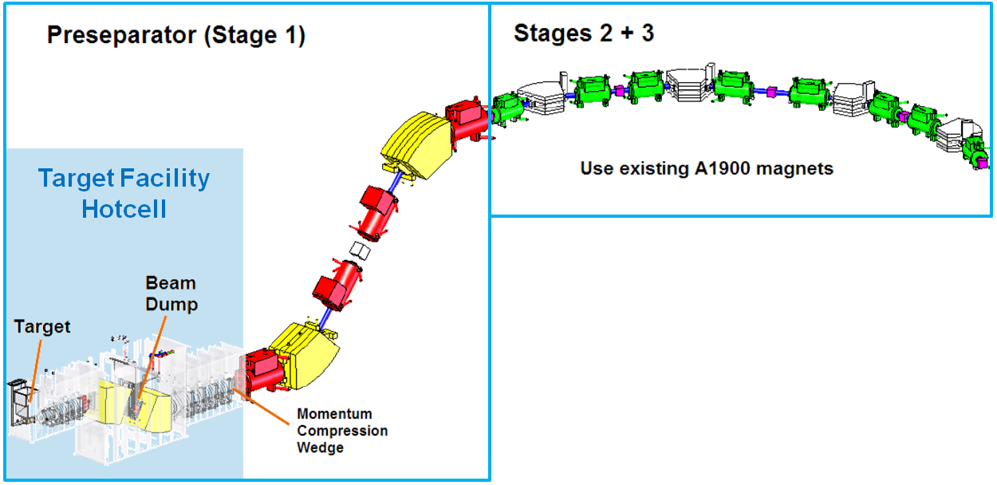
Overview Experimental Systems Fragment Separator
Scope
In-flight separation of rare isotopes with high acceptance and high resolution
Leverage rare isotope production at 400 kW beam power
Provide purest-possible rare isotopes beam to maximize science reach
Technical specifications
High-acceptance preseparator provides first beam purification step, provides defined location(s) for primary beam dump
2 additional separation stages to guarantee high beam purity
Provide future upgrade opportunities for isotope harvesting

Slide 16
Carbon Disk / Heat Exchanger Approach
Multi-slice target test assembly (5 slices shown)
Sized for 50 to 70 kW dissipated power
Dimensionally, functionally, and mechanically very similar to operational assembly
Ferrofluid Feedthru
Vacuum Shroud
Drive Shaft
Carbon Disks
Face Heat Exchangers
Rim Heat Exchanger
Beam Inlet

Slide 17
Target Assembly
Rotating Air Coupling
Pneumatic Motor
(in 1 atmosphere)
Ø1” Inconel Shaft
Carbon Disk / Heat
Exchanger Assembly
Target speed requirement
5,000 rpm disk rotation – needed to prevent overheating of carbon disks
Water cooled HX, subject of ongoing design validation efforts
Allows rapid extraction of heat from beam interaction with target disks
1 mm positioning tolerance
Remotely serviceable/ replaceable from lid
Sufficient space available to accommodate future target designs (incl. liquid metal)
1.5 m cube available
Standard types of utilities provided
(power, signal, water, air)
Integral box HX
Ferro Fluidic Bearing /Seal Assy
Shield Block
Ceramic Bearing
BEAM
50 kW

Slide 18
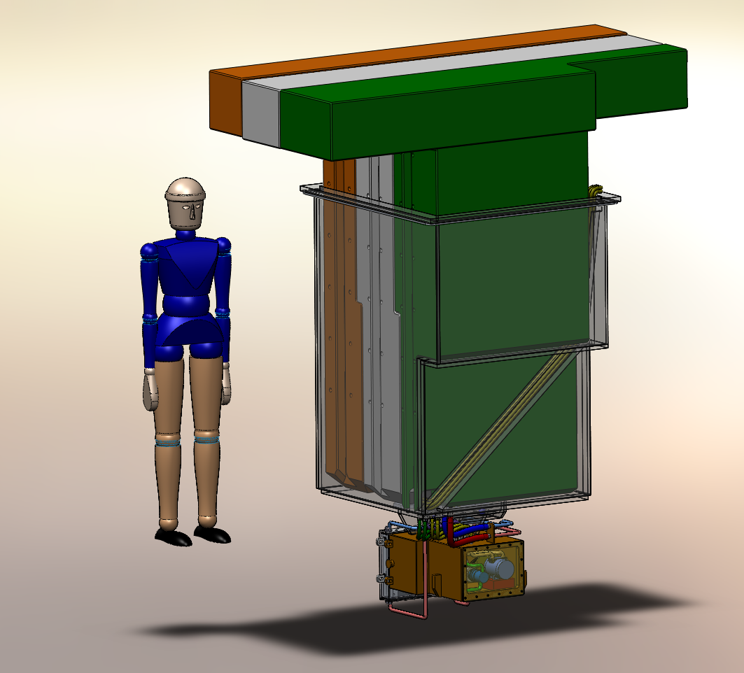
Target Assembly
Compact fully integrated target design approach adopted
Shielded motor in one atm pressurized enclosure
Shaft powers target wheel through ferrofluid vacuum feedthru
Present Configuration
Target Reentrant Shielding
Target Reentrant Lid
Replaceable Target
Module
Target rests on kinematic mounts that provide automatic positioning after target module changes

Slide 19
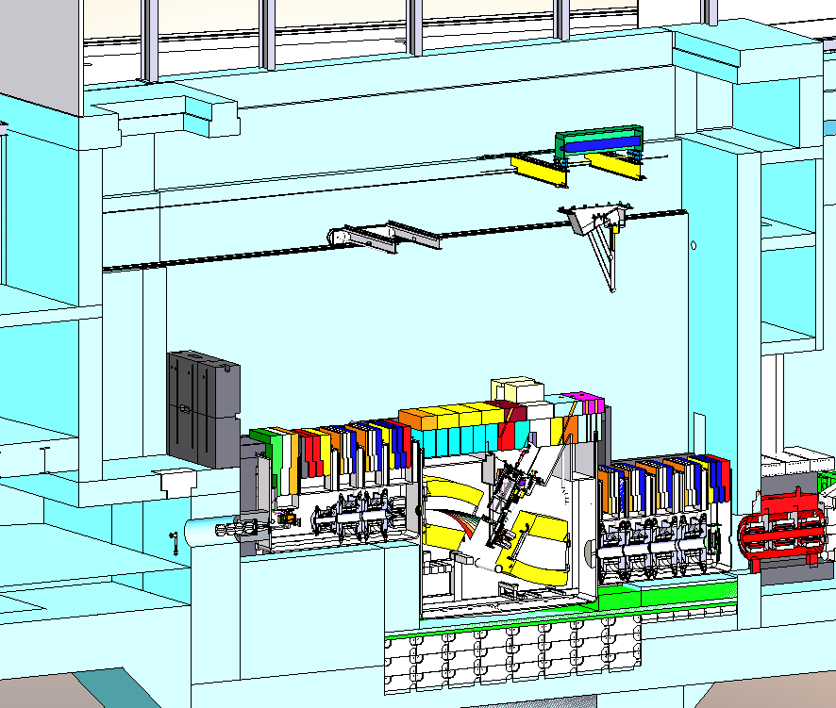
Overview Experimental Systems [1] Target Facility T.4.02/T.4.04
Scope
High-yield production of rare isotopes via in-flight production with light and heavy primary beams (400 kW, >200 MeV/u)
Technical specifications
Self-contained target building
Keep most-activated and contaminated components in one spot
State-of-the-art remote handling
Fast and safe target changes
Target applicable to light and heavy beams
Minimize number of target technologies needed
Flexible upgrades, fast implementation
Design for 400 kW 400 MeV/u uranium energy upgrade
Facility design compatible with future upgrades by implementing ISOL and multi-user capability
Target hot cell
Remote crane system
Primary beam dump
Target
Pre-separator dipoles
Floor shielding

Slide 20
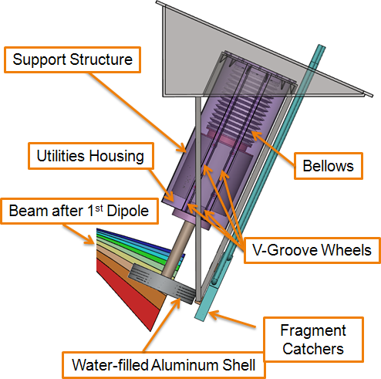
Beam dump
Water-filled rotating drum selected for FRIB baseline
Risks: high power density, radiation damage
Several alternatives studied
Rotating water-filled dump
Rotating graphite dump
Windowless liquid metal dump
Rotating water-filled dump selected for FRIB baseline
Technical risks largely retired, residual risks acceptable and mitigation in place
Thermal and hydrodynamic studies, materials evaluation, radiation damage assessment
Mechanical mockup for rotating drum for design validation designed and under construction

Slide 21
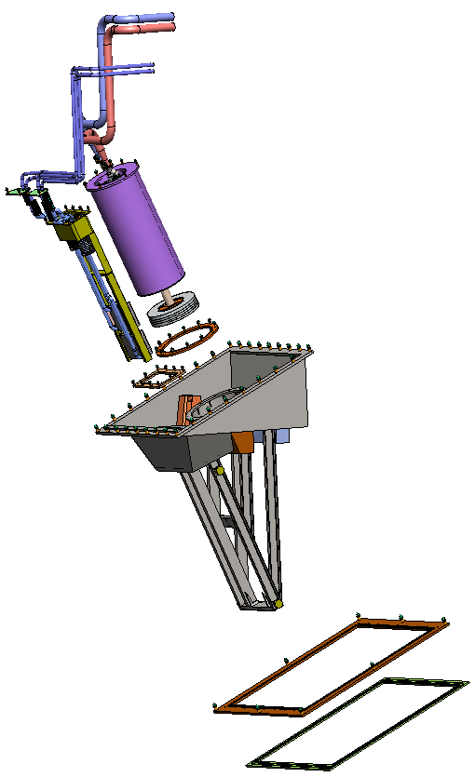
RH Considered in Component Design Example: Beam Dump
Beam dump assembly is composed of a structural frame, beam dump module with rotating water cooled drum, and fragment dump module
One of the largest and more complex components remotely handled
Modularized
Total weight: 23,000 lbs
Rotating Beam Dump Module
Fragment Dump Module
12 ft
Beam Dump Frame
Back-up Seal Flange
Primary Seal Flange
Notes:
1 AC Update with better image upon return

Slide 22
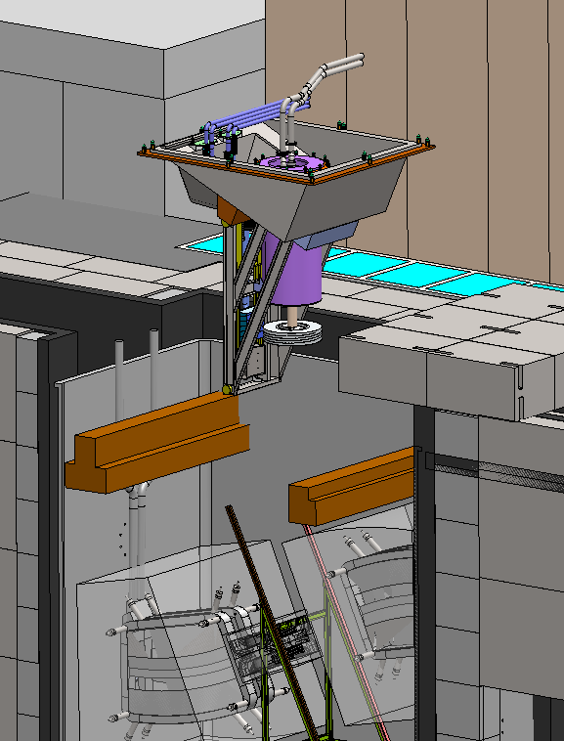
Remote Handling Concept Defined Example: Beam Dump
Remote beam dump removal
Shielding is remotely removed and stored using in-cell crane
Beam dump assembly removed using in-cell crane with multi-axis coordinated motion
Removal of beam dump with a vertical trajectory was evaluated and determined to be not feasible
Notes:
₃

Slide 23
Fragment Separator Component Overview Magnets to be Designed and Built
MSU has many years experience in designing superconducting and resistive magnets
Magnet mechanical design concepts are well established
High Temperature Superconductor Quadrupole
50 Degree SC Dipoles
Warm Iron SC Quadrupoles
RT Multipole
Hot Cell
RT Octopole
Warm Iron SC Quadrupoles
30 Degree SC Dipoles
Cold Iron SC Quad Triplets

Slide 24
Assumptions
Five year ramp to full 400 kW
Use radiation tolerant coils (cyanate ester)
Use HTS for first quad after target (BNL – see talk by Ramesh Gupta)
Use HTS for two dipoles in hot cell
All magnets have to be replaceable using remote handling

Slide 25
Fragment Separator Magnet Design Process
Beam Physics Requirements
Magnetostatic Requirements
Remote Handling
Requirements in Hot Cell
Mechanical Design

Slide 26
Warm iron quad (half)
Connection box
Link
Yoke key
Quad Coil
Support
Multipole coils

Slide 27
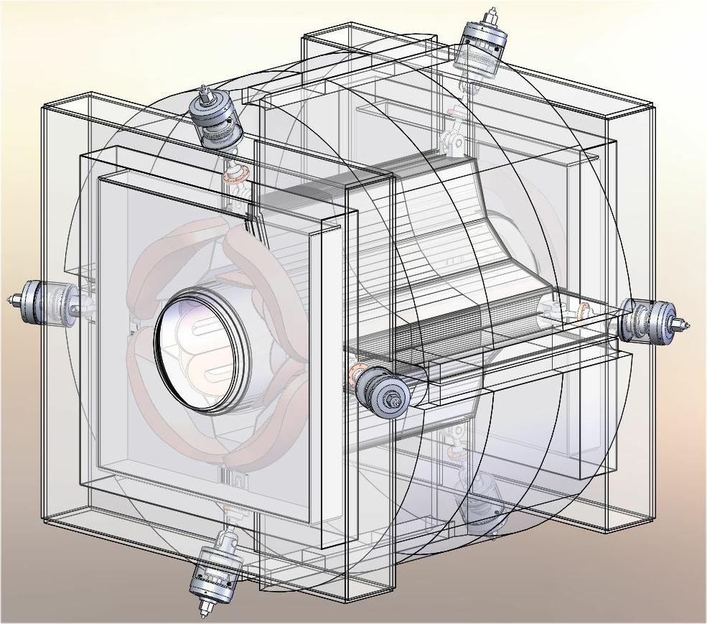
Warm iron quad(2)

Slide 28
30 degree dipole

Slide 29
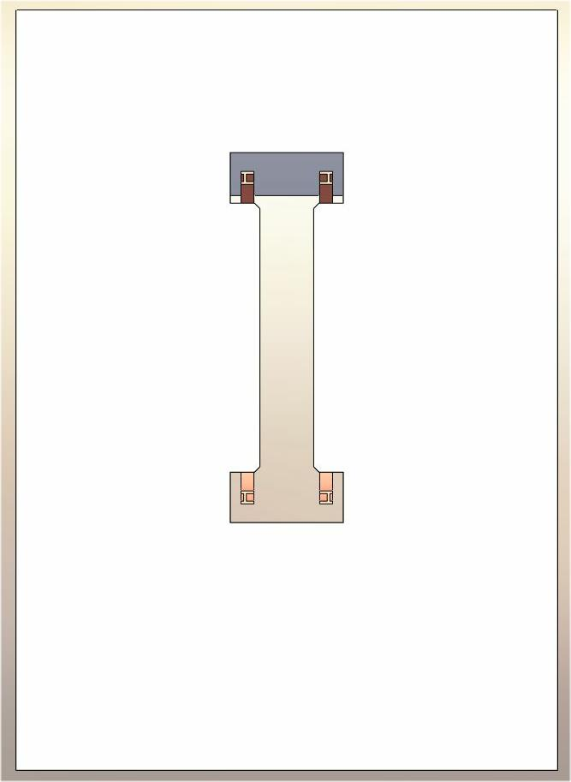
30 degree dipole(2)
HTS
Coil
(from
Ramesh
Gupta)
Conventional coil

Slide 30
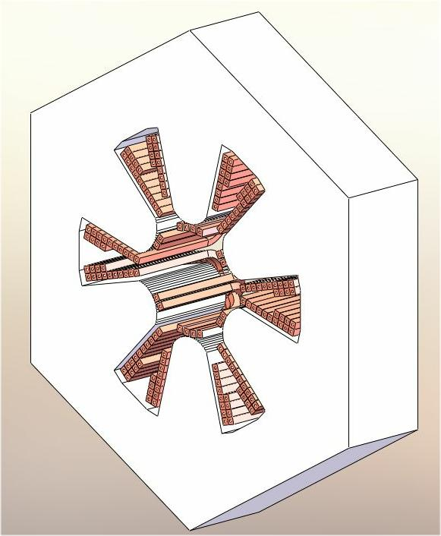
Radiation resistant hex-oct
Uses 19 mm metal-oxide insulated hollow copper

Slide 31
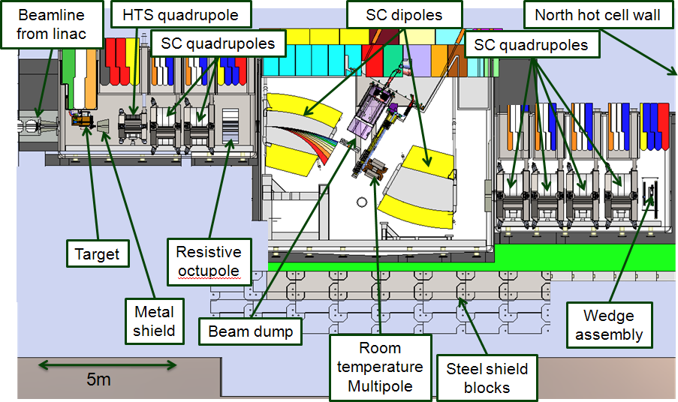
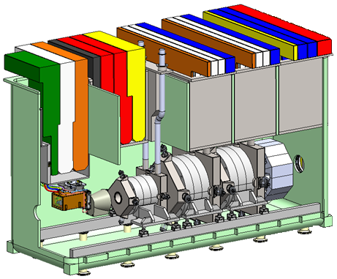
Fragment Separator Mechanical Design
Structural analysis performed
Realistic design for vacuum vessel and local shielding – basis for credible cost estimates
Vacuum vessel design optimized
Improved pumping performance supports fast target and wedge changes
Component alignment and mounting
Mount and alignment system design in hot-cell refined
Solutions for downstream fragment separator components developed
Component design progressing
Details being developed
Remote-handling included

Slide 32
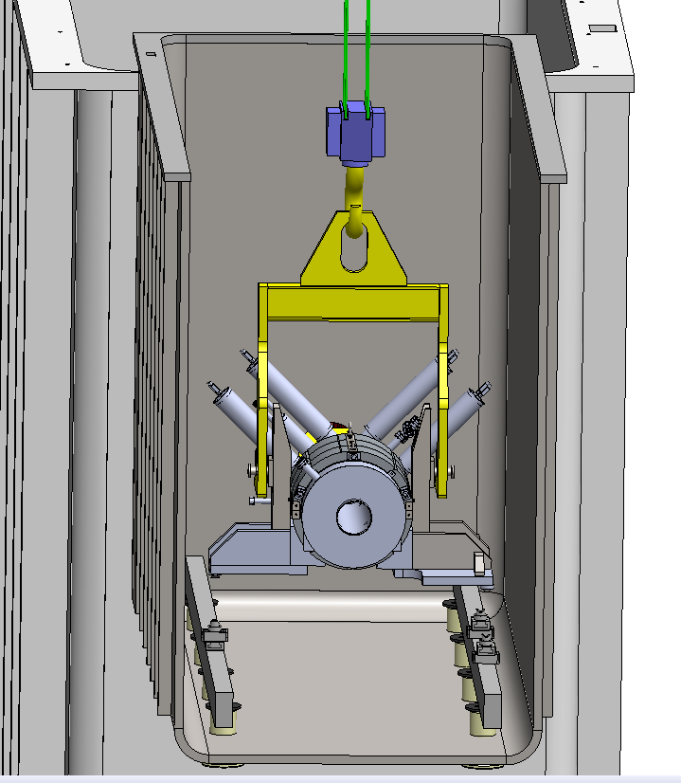
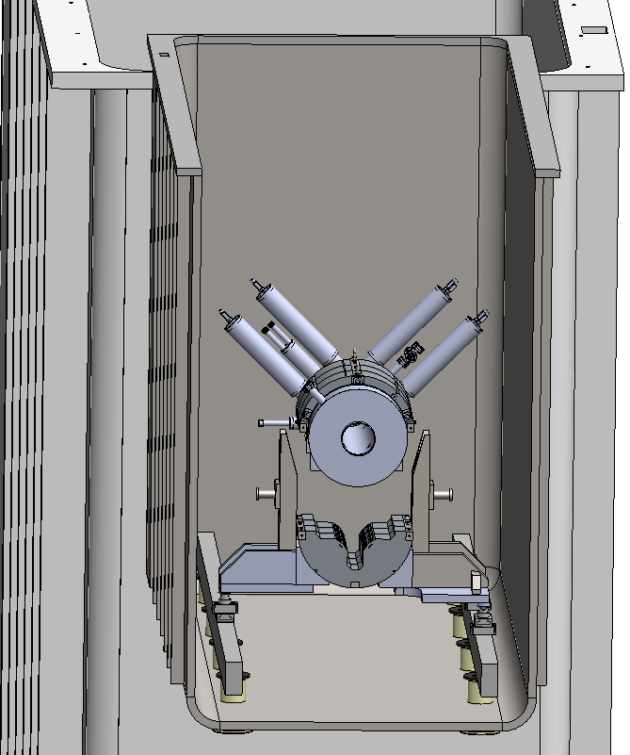
SC Magnet Remote Handling – Two Concepts Under Evaluation
Remove upper yoke and coil package as a unit, leave lower yoke in vacuum vessel, close tolerance assembly process done with limited visibility, but kinematic mount is protected from damage
Remove complete magnet as a unit, all high precision assemblies completed at the window workstation but kinematic mounts are exposed to damage

Slide 33
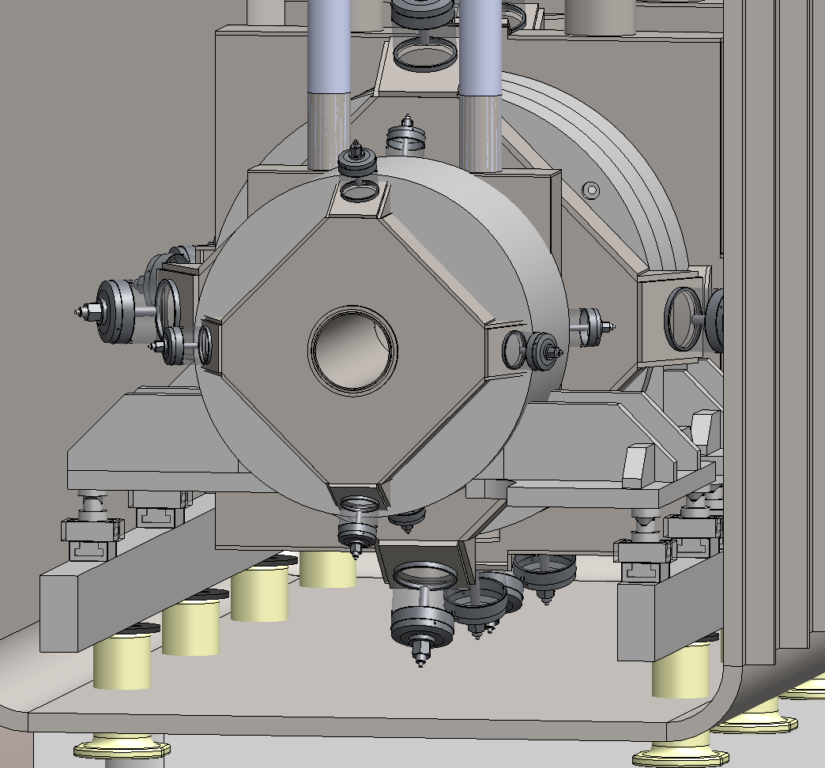
Mounts Passive Precision Kinematic Mount Approach Adopted
Magnets and beam line components require long term mount stability
High precision adjustment is provided at initial installation
Remotely serviceable shim system used to maintain magnet alignment after beam activation
Individual tri-leg kinematic mounts are used by each beam line component to provide permanent automatic alignment during reinstallation after removal
All kinematic mounts will have capability of adjustment after beam line activation through use of a reconfigured shim system
Realignment measurements are used to machine new shims with adjusted thicknesses and center positions
Magnet or other component to be realigned is removed from vacuum vessel with crane and placed at manipulator window workstation
Old shims are removed and new shims installed, then component is reinstalled onto alignment/support rails
Alignment /
Support rails
Remotely replaceable shims
Slide gibs

Slide 34
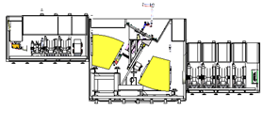
30 Degree Dipoles
Yoke design will be compatible with different coil technologies, HTS or LTS
In the process of evaluating BNL HTS coil design for baseline
Detailed coil design is pending coil type decision, with no expected impact on availability of design at CD-2
SC coil design very similar to 50 degree dipoles
HTS coil design is less complex, i.e. no helium Dewar
Yoke iron configuration provides some challenges to assembly process with the limited crane capacity and restricted access inside vacuum vessel
Mounting scheme defined; independent of magnet type decision

Slide 35
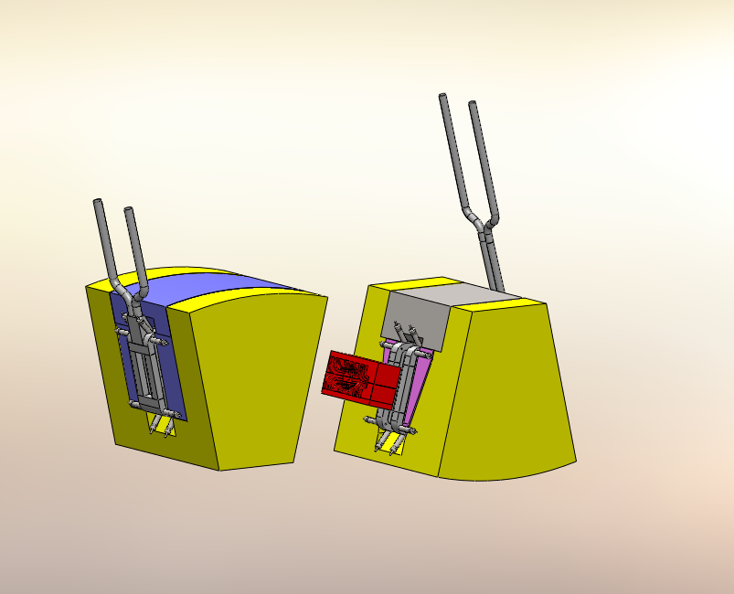
Dipole Remote Handling - Two Concepts Under Evaluation
CONCEPT 1
Consider mechanism to allow yoke halves to translate apart.
CONCEPT 2
Consider tapered yoke hardware to insure intimate contact between parts to react magnetic loads.
Estimated yoke mass about 75 tons, estimated coil package life is 3-5 years
Both yokes likely requires active cooling estimated heat load 5 kW for dipole 1, 10 kW for dipole 2
Approaches to Disassemble
Assembled

Slide 36
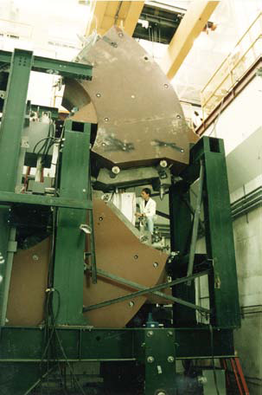
Design References for Fragment Separator Dipole Magnets
75 tons per dipole is similar in size to the FRIB 30 degree dipoles
NSCL – S800 Spectrograph

Slide 37
Overview Experimental Systems Fragment Separator
Outside of hot cell, radiation decreases, so we can use more conventional magnet construction techniques

Slide 38
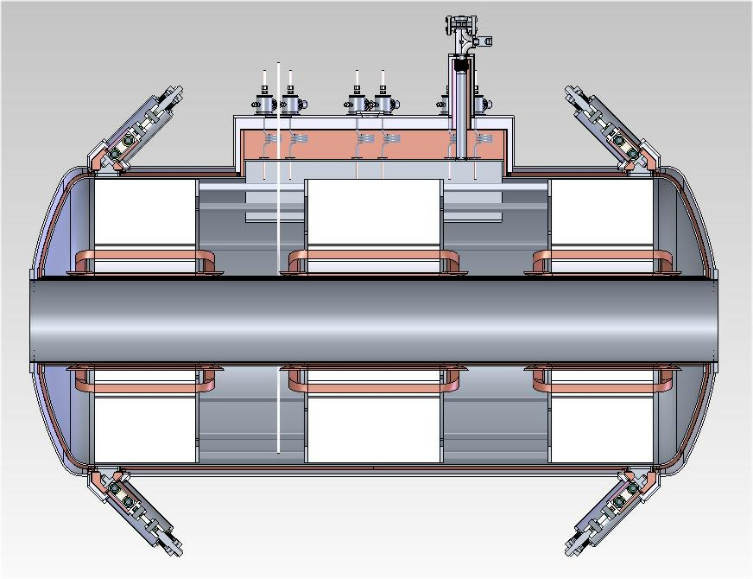
Horizontal cold iron triplet

Slide 39
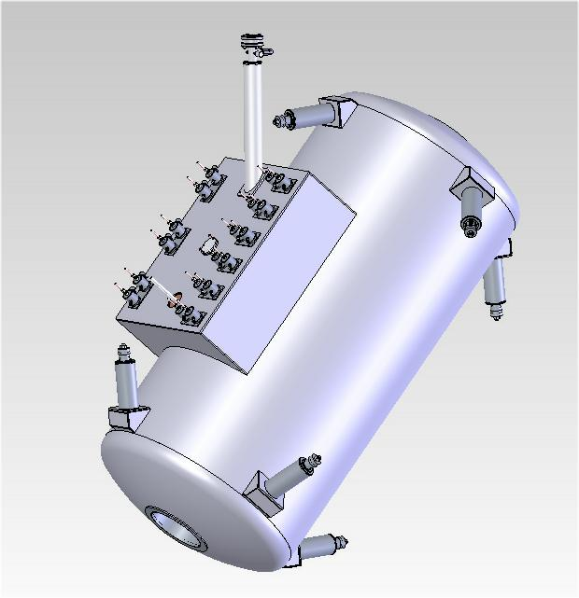
Cold iron triplet on 50⁰ line

Slide 40
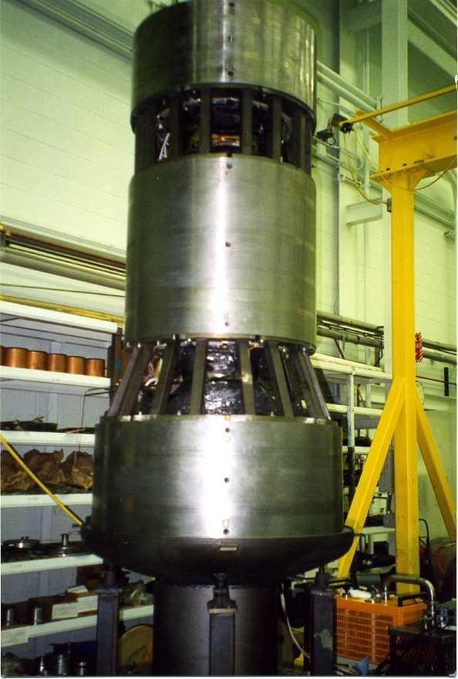
Cold-iron Quad Assembly [1] Methods are Established – A1900
A1900 triplet cold assembly
Inserting the cold assembly into
the helium vessel

Slide 41
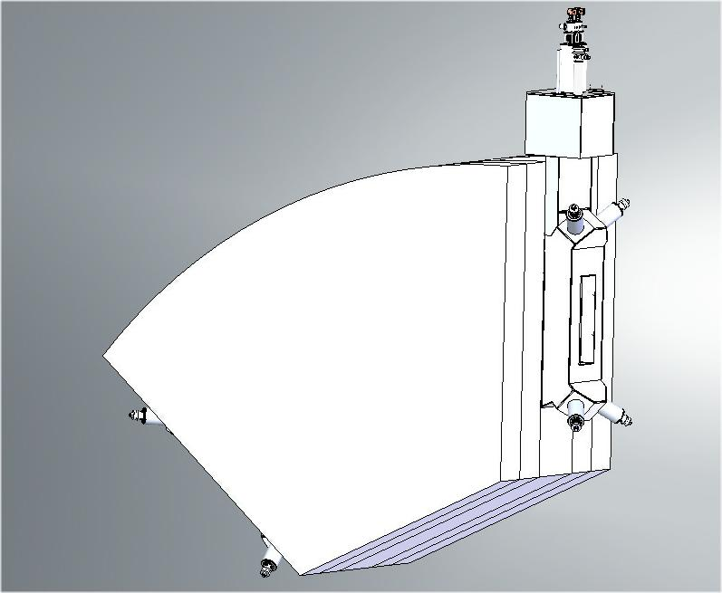
50 degree dipoles

Slide 42
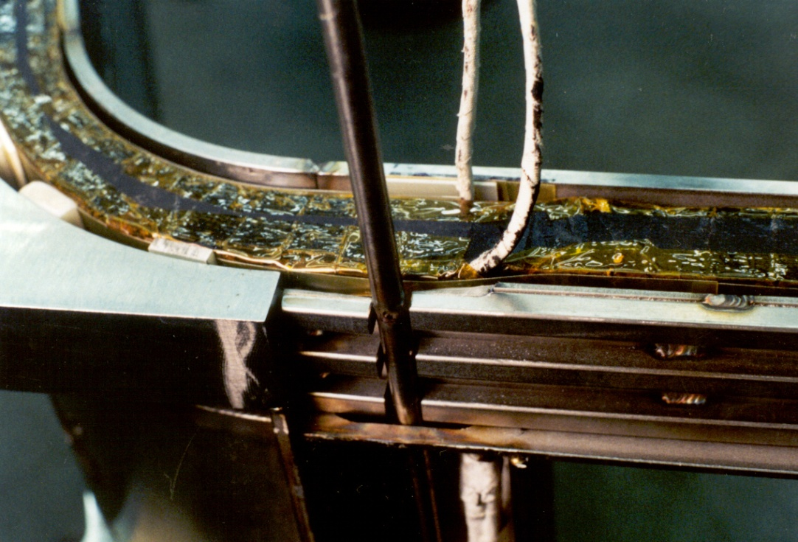
NSCL A1900 Type Magnets Fabrication Technique Established
Complete coil
Coils free standing –
not wound on bobbin
Coil in bobbin
Stainless steel tubes are
used to provide pre-load

Slide 43
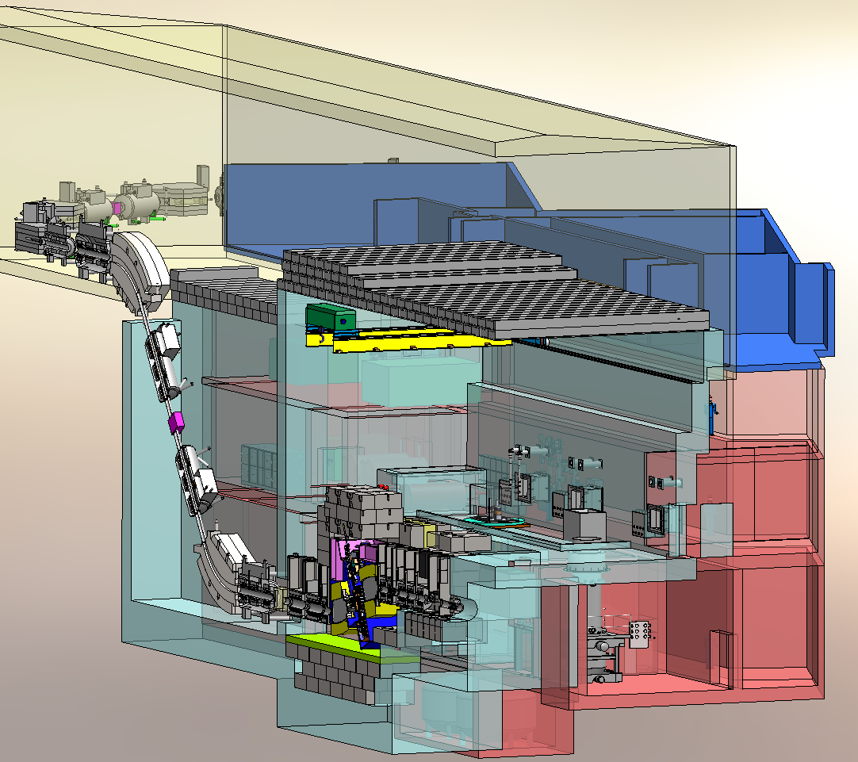
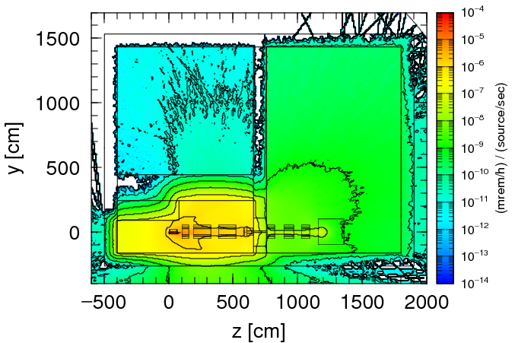
Target Facility Engineering/Design CD-2/3A Path Supported by Radiation Transport Calculations
Major radiation analyses are complete and support CD-2/3A
Radiation effects drive target facility design directly or indirectly (Ronningen)
Bulk shielding determined and sufficient
Ground water and soil activation, air activation
Prompt radiation from beam interaction and from non-conventional utilities
Inventory and activation analyses support system designs and hazards analysis
Inventory in cooling loops – potential releases
Activation of components
Radiation heating and damage analyses to support equipment and utility design
Magnet heating, lifetime of critical components
●
●
●
●
●
●
●
●
●
●
●
●
●
●
●
●
●
●
●

Slide 44
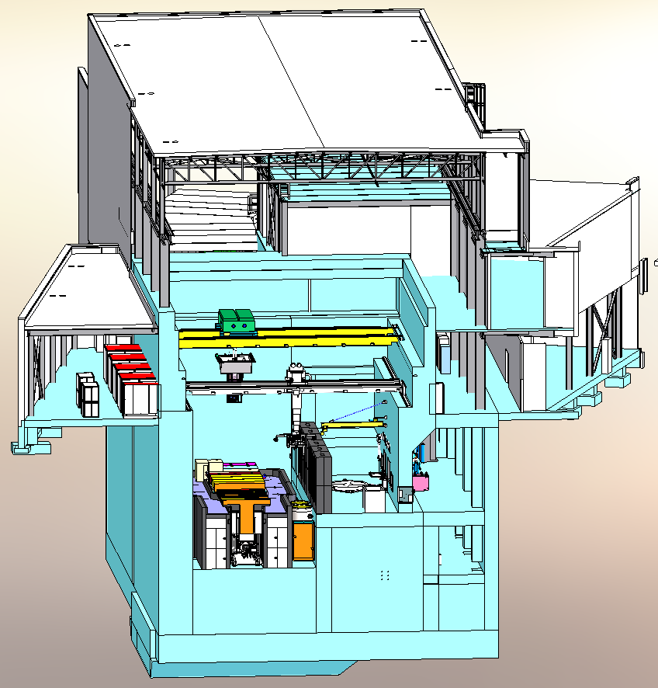
Target Facility Engineering/Design On Track for CD-2/3A in Spring 2012
Interfaces and boundaries defined
FRIB accelerator tunnel
Existing NSCL and MSU buildings and infrastructure
NSCL beam distribution system
Interruption of NSCL/CCF operation during civil construction
Engineering/Design
Incorporates target/fragment separator system
Accommodates support systems (non-conventional utilities and remote handling equipment)
Fulfills maintenance and remote-handling requirements
Provides adequate shielding
Optimized room utilization, verified installation path

Slide 45
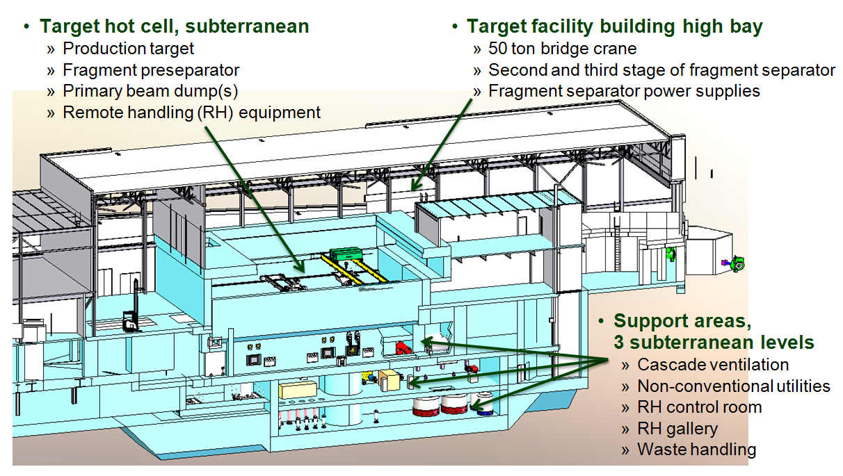
Target Facility Engineering/Design [2] Supports CD-2/3A in Spring 2012
18-Borden
Optimized and engineering advanced
Layout of subterranean support areas to provide space for supporting equipment
Equipment location and ergonomics
Path for equipment installation

Slide 46
Conclusions
Preliminary design that supports initial operations
Integrated into complete target facility
Transition to HTS coils in future upgrades

