Slide 1
T2K Beam Window Design
Matt Rooney, Chris Densham, Mike Fitton, Yoshikazu Yamada, Clive Mark, Mike Gallop.
High Power Targets Workshop
Malmö
May 2, 2011

Slide 2
Comparison of neutrino beams
 | EUROnu superbeam | LBNE (700 kW) | LBNE (2 MW) | T2K
Beam power | 1 | 0.7 | 2 | 0.75 | MW
Beam energy | 5 | 60 | 60 | 30 | GeV
Protons per pulse | 1.50e14 | 5.60e13 | 1.6e14 | 3.30e14
Beam sigma | 4 | 1.5 | 3.5 | 4.24 | mm
Peak energy dep. | ~ 80 | ~ 200 | ~ 128 | ~ 160 | J/cc/spill
Pulse length | 5 | 10 | 5 | 5 | μs
Frequency | 12 | 1.32 | 1.32 | 0.47 | Hz
NOTE: Energy deposition is normalised to beryllium.

Slide 3
Main beam window candidate materials
Others candidates: AlBeMet, GUM, INVAR…

Slide 4
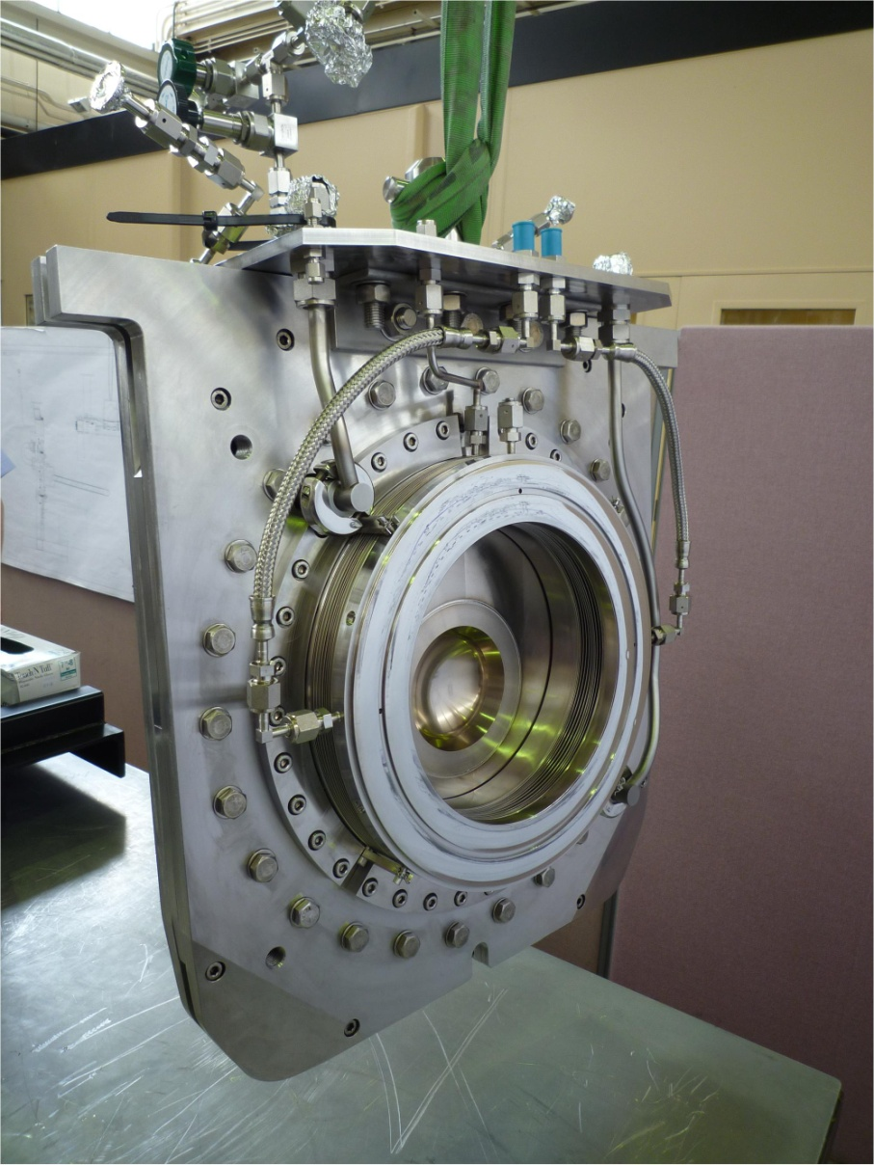
T2K beam window
Double-skinned titanium alloy window, cooled by helium gas.
Installed October 2009.
Designed for 0.75 MW beam power.

Slide 5
T2K target station
Window
Proton beam
Focusing horns
Target

Slide 6
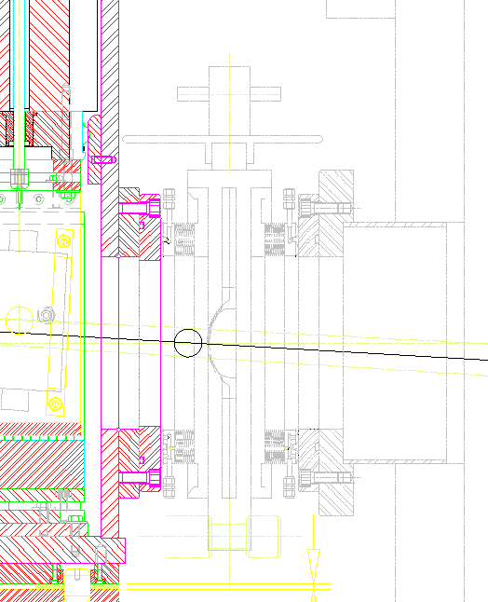
Position in beamline
Monitor
stack
To Target

Slide 7
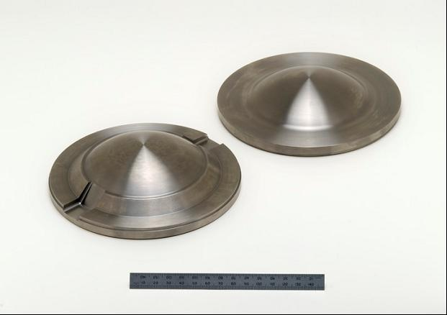
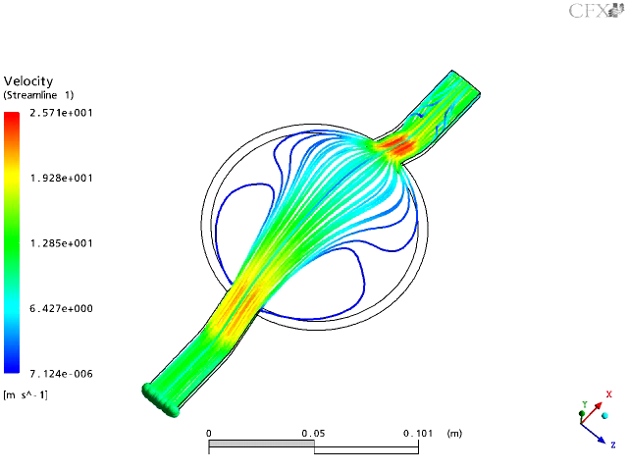
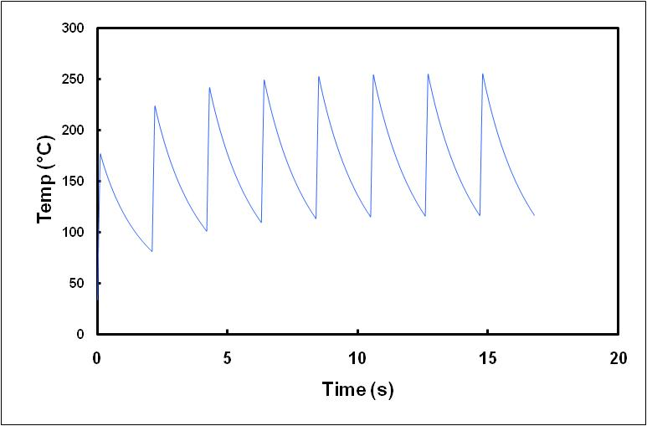
Double skinned window with helium cooling
Average He velocity ≈ 5 m/s
CFD by M. Fitton (RAL)
Transient temp over first 8 pulses (30 GeV)

Slide 8
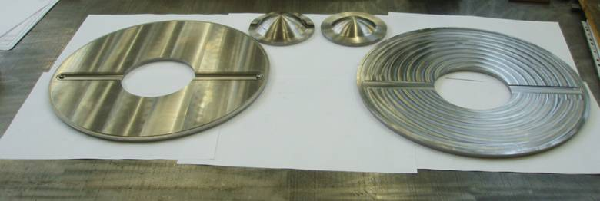
Titanium components
Downstream dome
Upstream dome
Downstream plate
Upstream plate

Slide 9
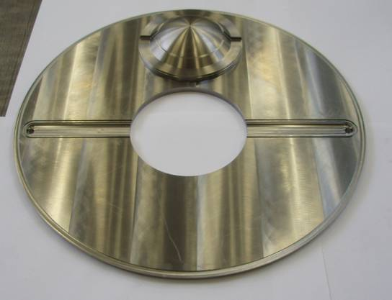
Helium flow grooves
He in
He out

Slide 10
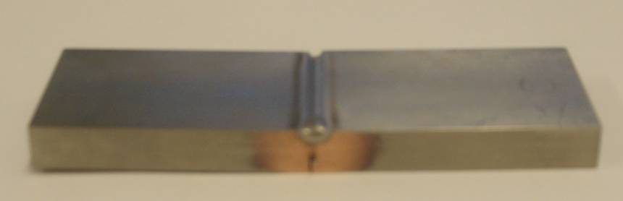
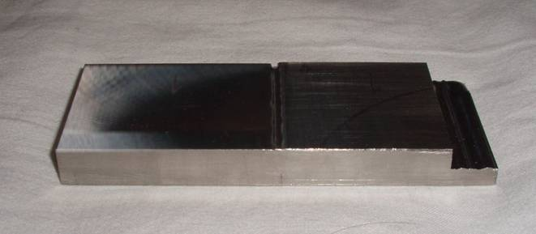
Test piece distortion
1
2
No distortion
1 mm gap
Test piece 1 distorted due to welding, no. 2 did not.
In the worst case, the test pieces distorted by up to 1 mm.
This distortion could create large stresses in the titanium domes.

Slide 11
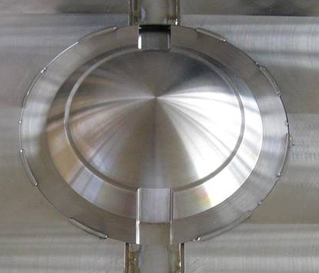
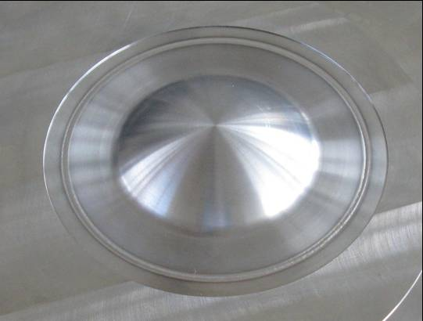
Solution
50% stitch weld
Continuous circumferential weld

Slide 12
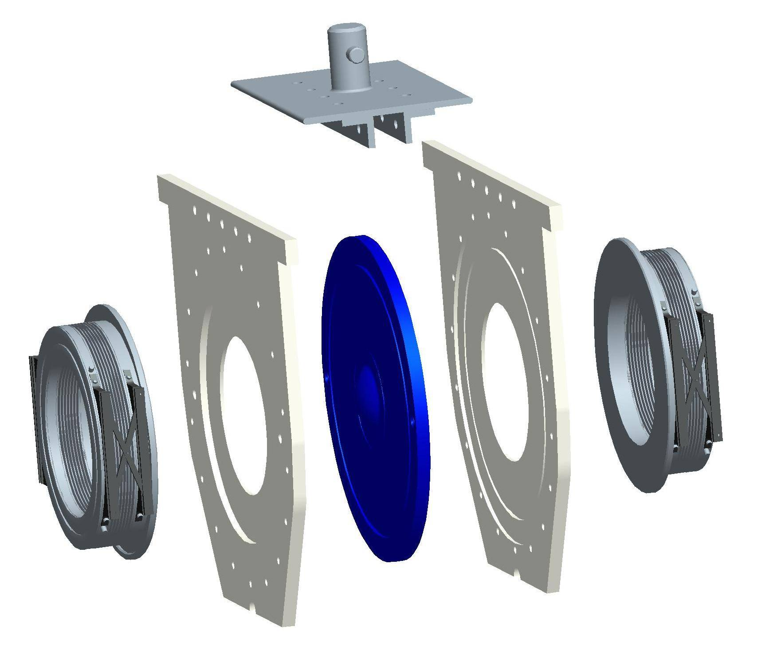
Main components
Top plate
Used for inserting and removing window
Protects pillow seals and mating flanges
Provides a connection point for services
Pillow seals
Seal helium vessel and beam line
NOTE: Model is out of date.
Pantograph was not used in final design.
Side plates
Provide a firm support for the beam window to hold it in position
Ti-6Al-4V beam window

Slide 13
Illustration of window in position
Monitor stack
(TRIUMF, Canada)
Target
station
(KEK,
Japan)
Beam window
(RAL, UK)
Window inserted and removed remotely with bayonet tool
from above. Top plate provides rough guidance until
contact with three support bars is initiated to provide
accurate final location. Bus bars must withstand ~ 1 tonne resultant pressure load.
Notes:
3 bars and monitor chamber, as well as holding the window vertically, also provide a reaction to resist the force on the window due to the pressure difference across it.

Slide 14
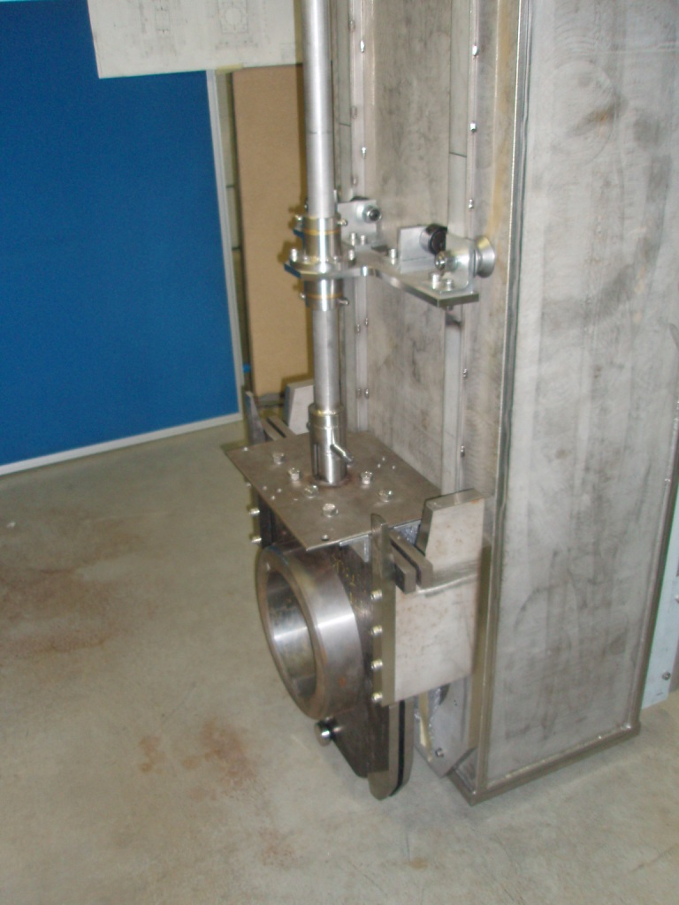
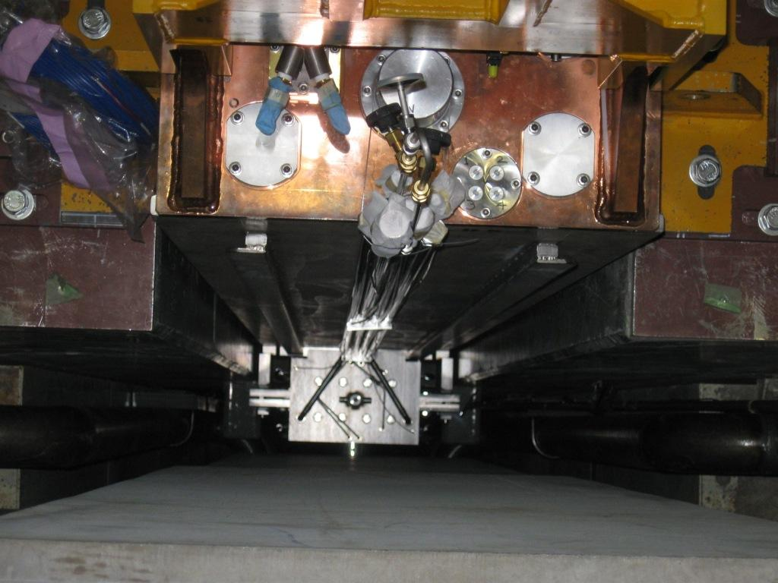
Installation and removal
Installed from above with bayonet tool.
Operator can stand on top of target station for final alignment and pipe connections once the window is in place.

Slide 15
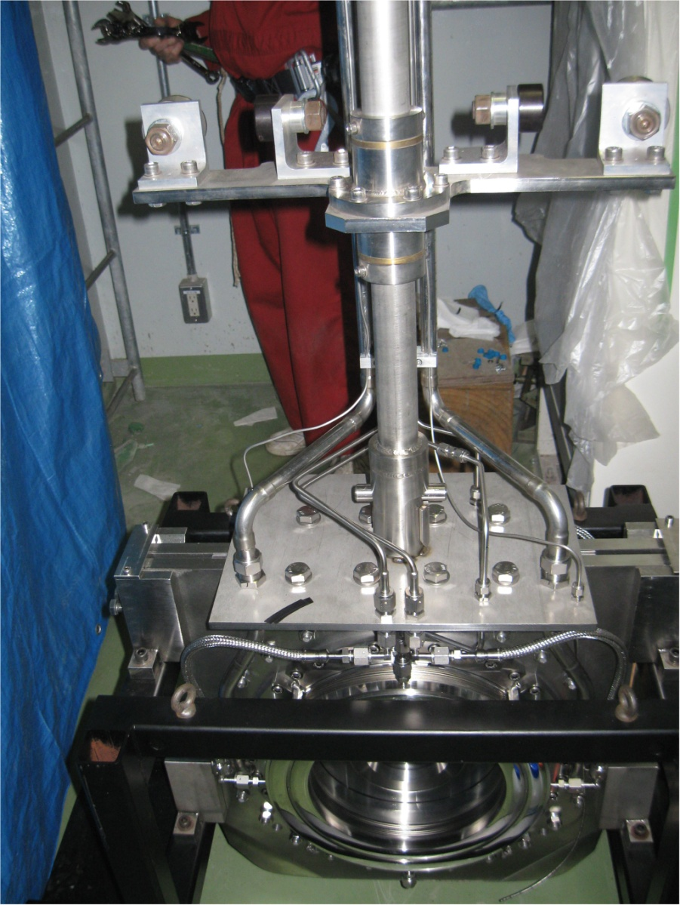
Installation and removal

Slide 16
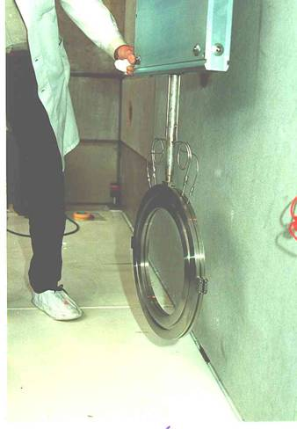
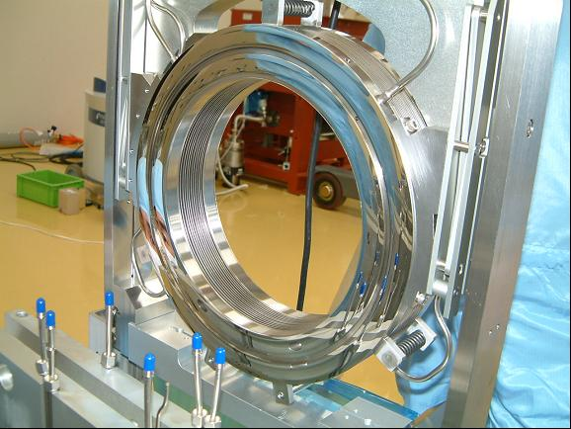
Inflatable bellows seals
PSI
KEK Muon Group
Picture courtesy of Y. Miyake and
S. Makimura (KEK)
Picture courtesy of PSI

Slide 17
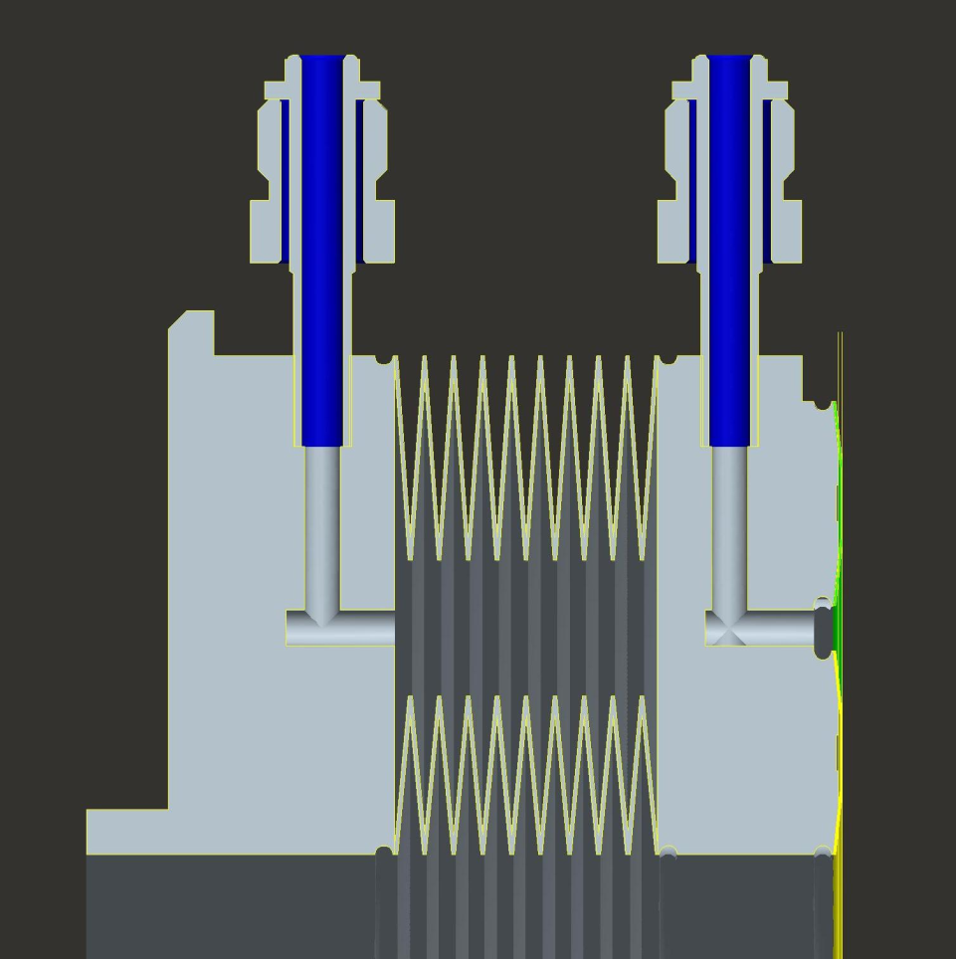
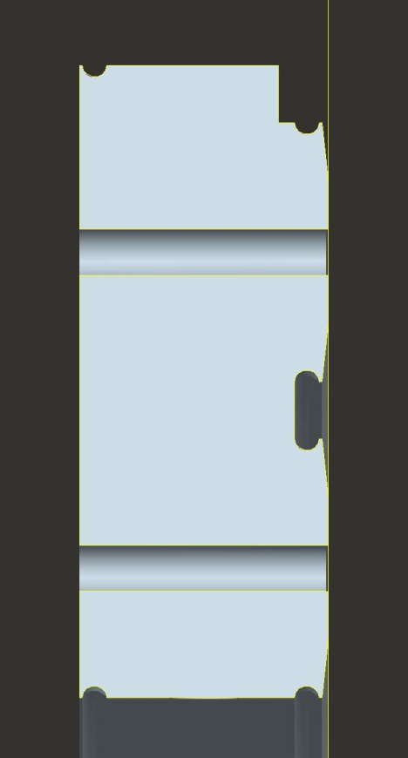
Cross section through seal
Pressure ≈ 3 bar gauge
Vacuum
Pressure
Pressurised
foil
diaphragms
Pressure

Slide 18
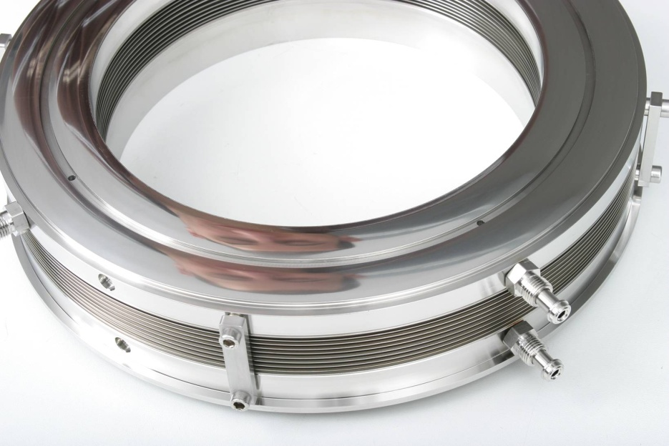
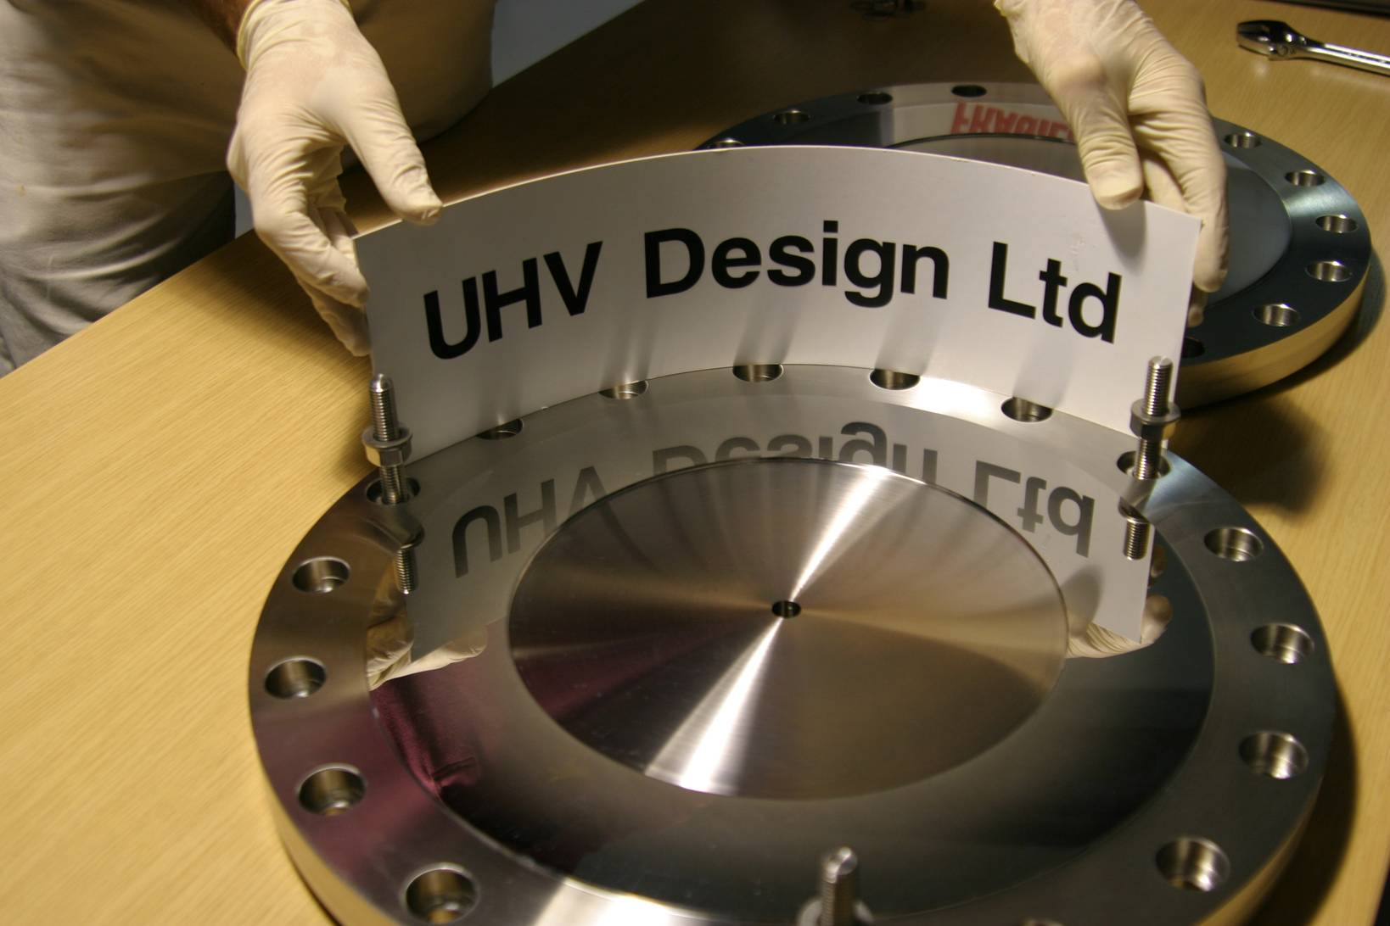
Seal and mating flange
Seal foils (surface roughness, Ra = 0.004 µm, Rt = 0.030 µm)
Polished flange (surface roughness, Ra = 0.020 µm)

Slide 19
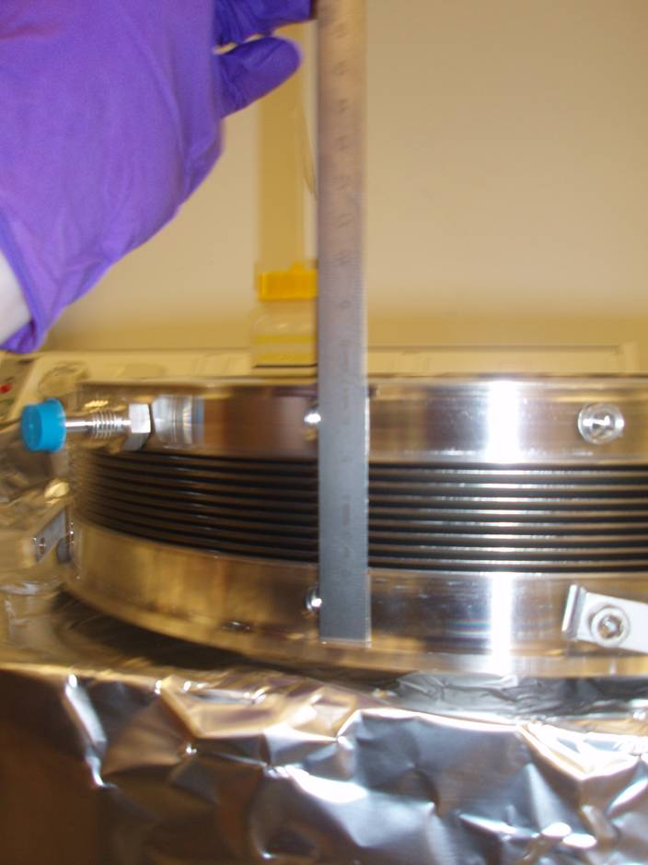
Bellows extension
Plastic deformation of bellows resulted in the natural or ‘free’ length of the seal increasing from 68 mm to 78 mm.
As a result, a vacuum will need to be applied to bellows on installation and removal to reduce the length of the seals.

Slide 20
Upgrade potential?
0.75 MW; 3.3x10¹⁴ PPP; 4.24 mm beam sigma
~150 ℃ temperature jump
Max stress waves ~ 100-150MPa
Transient thermal stress ~ 90MPa
Yield strength of titanium ~ 900 MPa

Slide 21
Summary
T2K beam window installed in October 2009
1.46 x 10²⁰ protons so far
No evidence of damage from earthquake
One spare window available in the event of failure

Slide 22
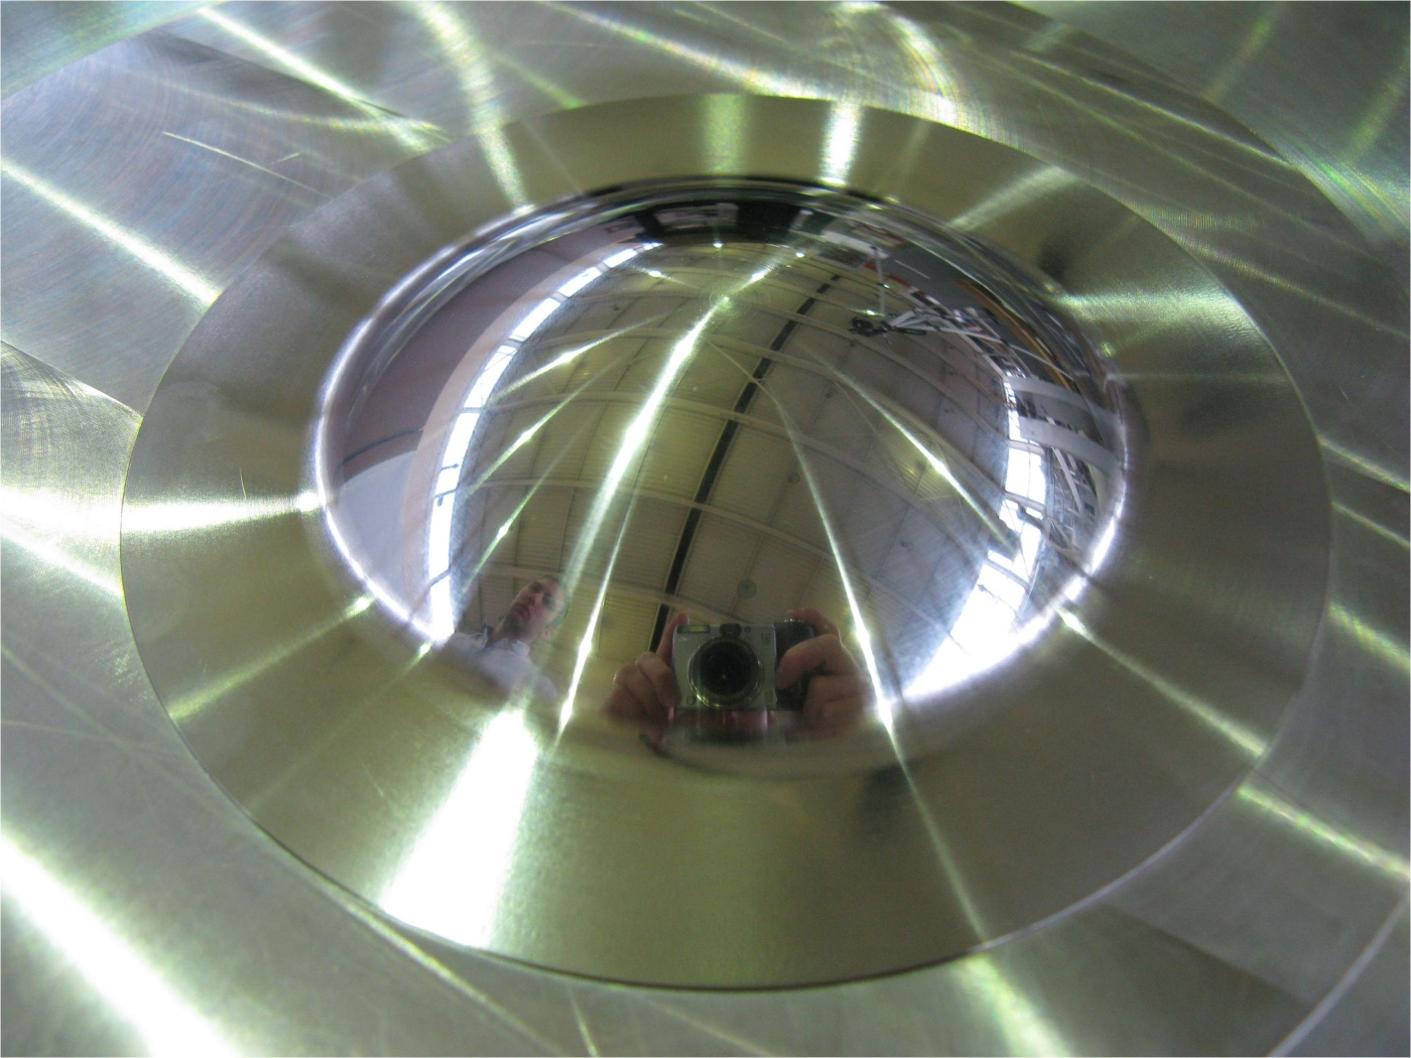
Thank you

