Slide 1
A complete demonstrator for a muon cooled collider ring
Carlo Rubbia
INFN and
Gran Sasso Science Institute, L’Aquila, Italy

Slide 2
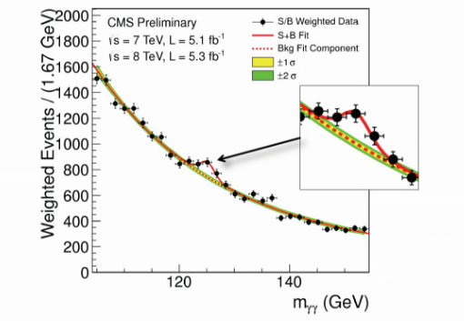
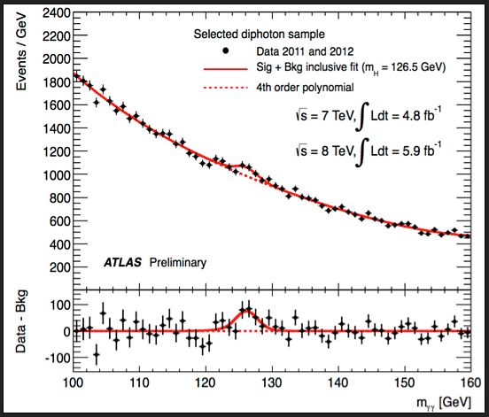
The discovery of the Higgs particle
Signal and background in the H -> 2 γ channel
CMS
ATLAS

Slide 3
The observation of the Higgs at 125 GeV
CMS and Atlas have observed a narrow line of high significance at about 125 GeV mass, compatible with the Standard Model Higgs boson.
  ATLAS: m_{H} = 125.5 ± 0.2 (stat) ± 0.6 (sys) GeV
  CMS: m_{H} = 125.8 ± 0.4 (stat) ± 0.4 (sys) GeV
Their data are consistent with fermionic and bosonic coupling expected from a SM Higgs particle.
Searches have been performed in several decay modes, however in the presence of very substantial backgrounds.
Experimental energy resolutions have been so far much wider of any conceivable intrinsic Higgs width.
Results of both experiments also exclude other SM Higgs bosons up to approximately 600 GeV.

Slide 4
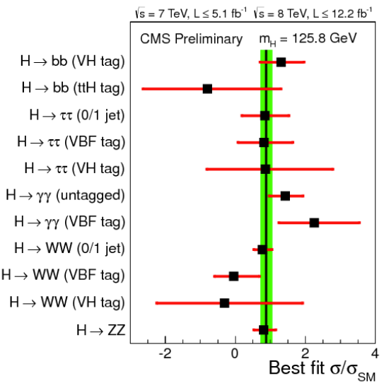
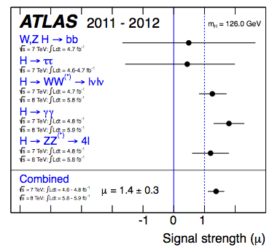
Present results
Many different channels but all with very large backgrounds

Slide 5
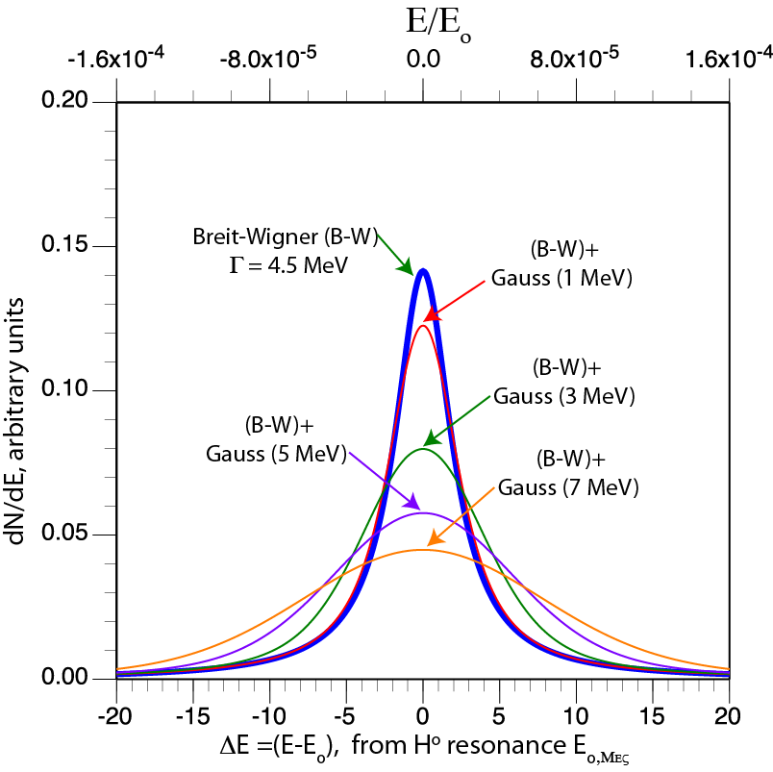
The Higgs width according to the Standard Model
Like in the case of the Z⁰, the determination of the H⁰ width will be crucial in the determination of the nature of the particle and the underlying theory
Cross section is shown here, convoluted with a Gaussian beam distribution.
Signal is not affected only if the rms beam energy width is ≤ a few MeV.
4.5 MeV wdth:A very demanding resolution R ≈ 0.003% is required

Slide 6
Stability of the Higgs sector
For these values, the electroweak vacuum is claimed metastable, but with a lifetime longer than the age of the Universe.
The Standard Model can be valid without new physics all the way up to the Planck scale.Thus, there may be only one standard model (SM) Higgs and no need for the “no fail theorem”.
arXiv:1310.0763v3 [hep-ph] 30 Dec 2013

Slide 7
Ultimate LHC uncertainties are due to systematic effects
The estimates reflect 1 LHC detector accumulating 300 fb⁻¹ of data, dominated at this level by systematic errors of the ATLAS and CMS collaborations and their best understanding.
ATLAS and CMS have estimated errors also for 3000 fb⁻¹ from the High-L LHC.
However such estimates can hardly be a straightforward extrapolation of the current performances.
arXiv:1207.2516v3 [hep-ph] 1 Apr 2013
LHC 300fb⁻¹
+5%
1 σ uncertainty
-5%
Unambiguous discoveries require 5 σ

Slide 8
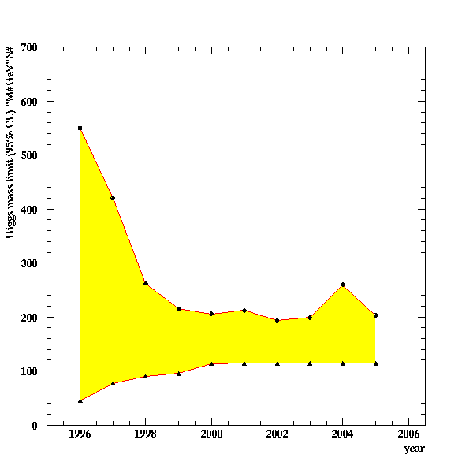
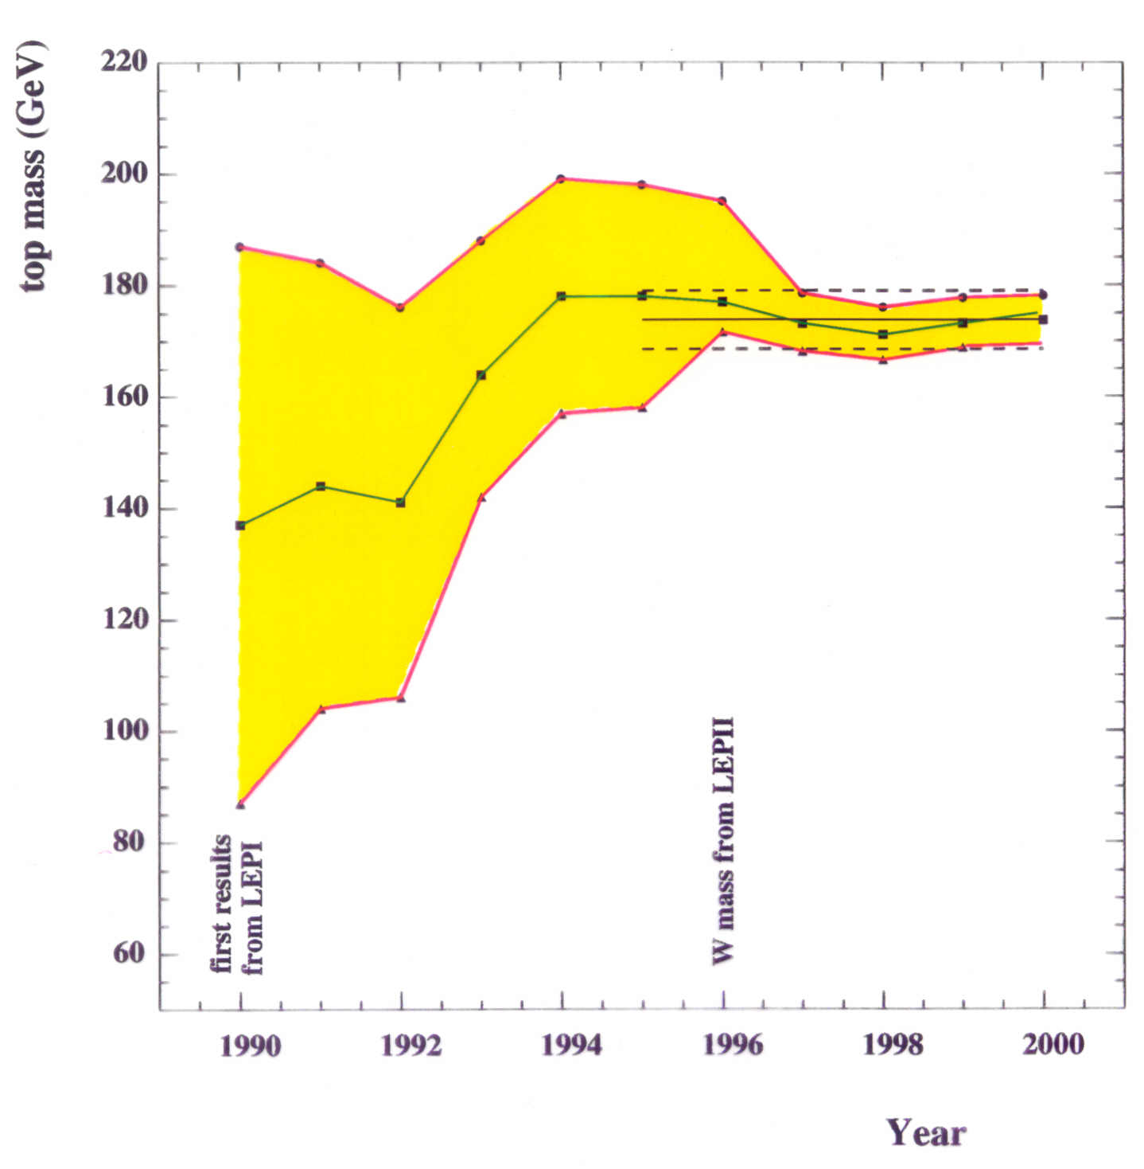
Predictive power of higher diagrams: the case of LEP
After the p-pbar discovery of the Z⁰ , its detailed studies at LEP in very clean conditions have been an essential second phase. Higher order corrections have anticipated the masses of both the top quark and of the Higgs scalar.
mtop
mHiggs
LEP1
LEP2
MH between 114 and ~200 GeV
Experimental discovery
MH = 125 - 127 GeV
LEP2
Experimental discovery
2012

Slide 9
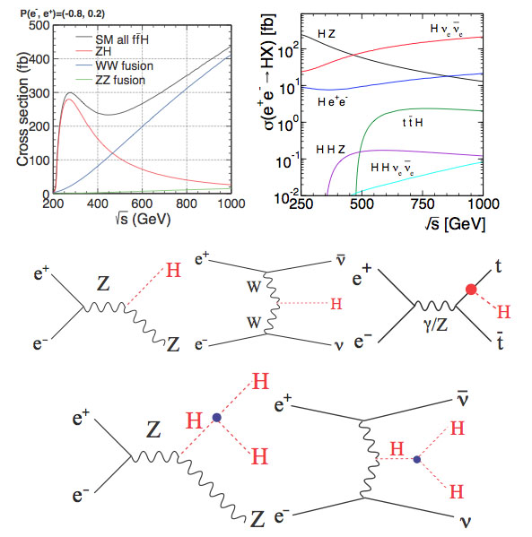
Higgs related higher order electroweak processes
Production cross sections of the Higgs boson with the mass of 125 GeV for e⁺e⁻ as a function of the energy √s (A)
The cross sections of the production e⁺e⁻ -> HX as a function of the √s energy (B)
The Higgs-strahlung diagram (Left), the W-boson fusion process (Middle) and the top-quark association (Right).
Double Higgs boson diagrams via off-shell Higgs-strahlung (Left) and W-boson fusion (Right) processes
(A)
(B)
80 km e+e- ring at CERN
In order to study comprehensively all these processes energies of 0.6-1 TeV are needed

Slide 10
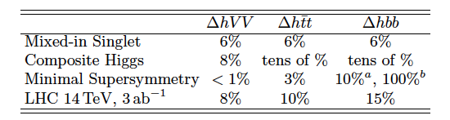
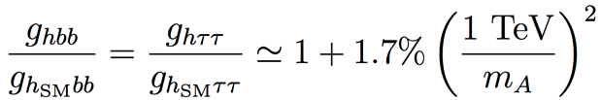
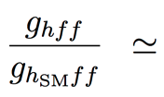
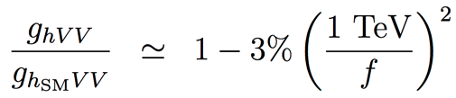
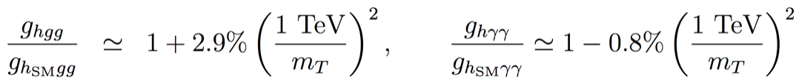
Potential deviations from Standard Model
What precision is needed in order to search for possible additional deviations from the SM, even under the assumption that there is no other additional “Higgs” state at the LHC ?
Predicted ultimate LHC accuracies for “exotic” alternatives
R.S. Gupta et al.
Ultimate at LHC
1 ab= 10⁻⁴² cm²
SUSY tan(β)>5
  Composite Higgs
  Top partners
Sensitivity to “TeV” new physics for “5 sigma” discoveries may need 1 per-cent to sub 1-per-cent σ accuracies on rates.
arXiv:1206.3560v3 [hep-ph] 27 Sep 2012

Slide 11
Studying the Higgs signal beyond LHC
The scalar sector is definitely one of the keys to the future understanding of elementary particle physics.
Like in the case of W and Z, with LEP after the pbar-p a similar second phase may be also necessary for the H⁰
The presence of structure beyond the SM may manifest itself as tiny corrections in the observation of large number of events/year in very clean experimental conditions.
Two future alternatives are hereby compared:
  A e⁺e⁻ collider at L > 10³⁴ and a Z + H⁰ signal of ≈ 200 fb. The circumference of a new, LEP-like ring is of about ≈ 80 km or the length of a Linear Collider is ≈31 km.
  A μ⁺μ⁻ collider at L > 10³² and a H⁰ signal in the s-state of ≈ 20’000 fb. The collider radius is much smaller, only ≈ 50 m, but the novel “muon cooling” facility is required.
However a comprehnsive Higgs study requires √s energies of ≈ 1 TeV, only possible with a linear e⁺e collider or a μ⁺μ⁻ ring.
1 femtobarn (fb)
=10⁻³⁹ cm²

Slide 12

The first option: a huge e⁺ e⁻ LEP like ring.
UNK Higgs
Factory, 2012
FNAL site filler, 2012
LEP3 2011
West Coast
design, 2012
LEP3 on LI, 2012
Chinese Higgs
Factory, 2012
SuperTristan 2012
LEP3 in Texas, 2012
LEP3, TLeP,
FNAL site-filler +,,,,
Options for circular e+e-
Higgs factories are becoming
popular around the world
F. Zimmerman

Slide 13

Super Tristan
80 km ring in KEK area
12.7 km
KEK

Slide 14
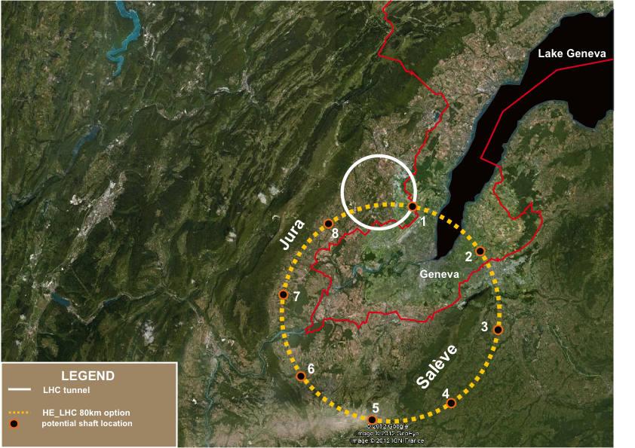
TLEP tunnel in the Geneva area
«Pre-Feasibility Study for an 80-km tunnel at CERN»
John Osborne and Caroline Waaijer,
CERN, ARUP & GADZ, submitted to ESPG

Slide 15
Requirements for the Higgs with a e⁺e⁻ ring collider
The luminosity is pushed to the beam-strahlung limit.
Collisions are at an angle, but with fewer bunches than for a B-Factory: a nano-beam scheme
σ_{x}/φ
2φ
σ_{z}
Luminosity (several x 10³⁴ cm⁻² s⁻¹), costs and power consumption (≈100 MW) are comparable to those of a linear collider ILC.
In order to reach luminosity (factor ≈ 500 x LEP2) and power consumptions ( factor 5 x LEP2) the main cures are
  Huge ring (80 km for SuperTristan or for T-LEP)
  Extremely small vertical emittance, with a beam crossing size the order of 0.01 µ (it has been 3 µ for LEP2)
The performance is at the border of feasibility (E_{cm}≈ 250 GeV).
The Higgs width, H-strahlung and double Higgs diagrams cannot be studied by any acceptable e⁺e⁻ ring collider.
15

Slide 16
The ILC option
The International Linear Collider (ILC) is a high-luminosity linear electron-positron collider based on 1.3 GHz superconducting radio-frequency (SCRF) accelerating technology.
Its energy √s is 200–500 GeV (extendable to 1 TeV).
LINAC at 25 MeV/m
LINAC at 25 MeV/m
  ILC, CLIC, NLC, JLC +…
The total footprint for 500 GeV is ∼31 km. To upgrade the machine to Ecms = 1 TeV, the linacs and the beam transport lines would be extended by another ∼ 22 km.
A comprehnsive Higgs study requires √s ≈ 1 TeV,

Slide 17
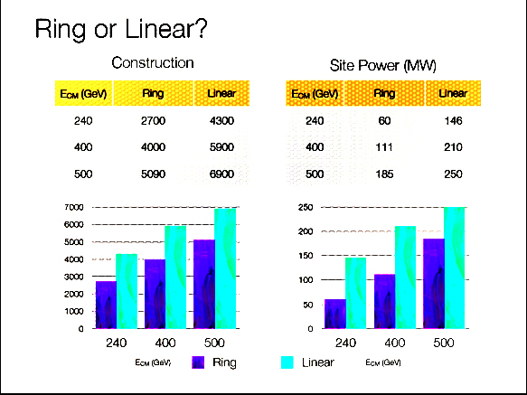
Super-Tristan vs ILC
Linear collider and circular ring have comparable costs and power consumptions
The more conservative ring alternative is preferred.

Slide 18
Predictions for the Higgs at LHC and e+-e- colliders
Compared with th LHC, in order to be fully effective, the energy of an ILC should be increased progressively from 250 GeV to ≈ 1 TeV, with correspondingly longer structures and higher powers.
LHC 300 fb⁻¹
Ring or ILC1 250 GeV 250 fb⁻¹
ILC 500 GeV 500 fb⁻¹
ILCTeV 1.0 TeV 1000 fb⁻¹
Unambiguous discovery requires 5 σ
+ 1%
1 σ uncertainty
arXiv:1207.2516v3 [hep-ph] 1 Apr 2013

Slide 19
Two Higgs related µ+µ- collider alternatives
Replacing electron with cooled muons may offer two main and independent programmes:
  A Higgs factory ring in the the s-channel resonance at √s = 126 GeV in which its very narrow width and most decay channels may be accurately measured
  A higher energy collider ring eventually up to the TeV and of luminosity comparable to one of a e⁺e⁻ linear collider
These rings can easily fit within the CERN site.
  For √s = 126 GeV the ring radius is ≈ 50 m (about 1/2 of the CERN PS or BNL AGS) and resolution ≈ 0.003%
  For √s = 1 TeV the corresponding ring radius is ≈ 400 m (less than ½ of the CERN SPS) and resolution ≈ 0.1 %
Both alternatives must cool and accelerate to the required √s about 2 x 10¹² muons with 5 MWatt, 10/50 s⁻¹ protons at ≥ 5 GeV.
But the need of a LINAC to accelerate both μ⁺ and μ⁻ up to 62.5 and 500 GeV respectively in order to fit within the CERN site needs a packed recirculating structure which must be studied.

Slide 20
1.-The direct s-channel Higgs production in a μ⁺μ⁻ collider
The direct H⁰ cross section is greatly enhanced in a μ⁺μ⁻ collider when compared to an e⁺e⁻ collider, since the s-channel coupling to a scalar is proportional to the lepton mass.
Like in the well known case of the Z⁰ production, the H⁰ scalar production in the s-state offers conditions of unique cleanliness .
A unique feature of such process — if of an appropriate luminosity — is that its actual mass, its very narrow width and most decay channels may be directly measured with accuracy.
Therefore the properties of the Higgs boson can be detailed over a larger fraction of model parameter space than at any other proposed accelerator method.
A particularly important conclusion is that it will have greater potentials for distinguishing between a standard SM and the SM-like H⁰ of SUSY or of other than any other collider.

Slide 21
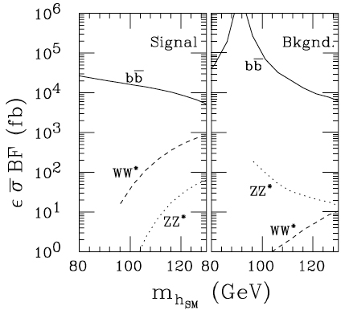
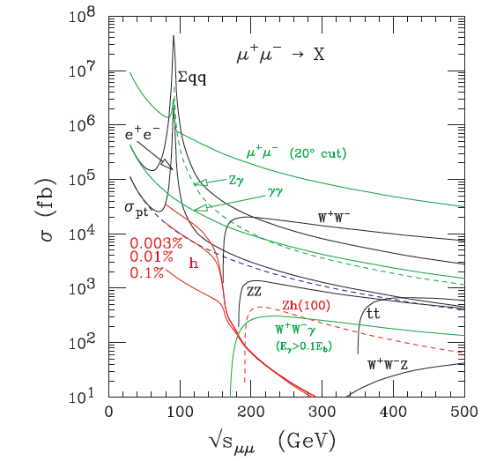
A muon collider in order to determine the Higgs channels
A μ± collider with adequate muon cooling and L > 10³² cm⁻² s⁻¹ .
Decay electron backgrounds are important: : 2 x 10¹² μ± decays produce 6.5 x 10⁶ collimated e± decays/meter with E_{ave}≈ 20 GeV.
The very narrow resonant signal (4.12 MeV ,Γ/M_{H} =3.6 x 10⁻⁵ for the SM) will dominate over most non resonant backgrounds.

Slide 22
Leading Higgs processes
Signal and background for H → bb, WW∗ at a energy resolution R = 0.003%. folded with a Gaussian energy spread ∆ = 3.75 MeV and 0.05 fb⁻¹/step and with detection efficiencies included.
Effective pb at the √s resonance for two resolutions R and with the SM branching fractions = H → bb 56% and WW∗= 23%
arXiv:1210.7803 [hep-ph].

Slide 23
2.-Muon cooling at TeV energies
Over the past decade, there has been significant progress in developing the concepts and technologies needed to produce, capture, cool and accelerate O(10²¹) muons per year.
Extensive studies have been performed during the late nineties in the US in EU and elsewhere and widely discussed inseveral international workshops and by the MICE collaboration.
Conclusions were that acceleration of cooled muon rings at TeV energies was a perfect alternative to the ILC program.
The recent discoveries of the Higgs particle at 125 GeV and the observation of the sin(θ₁₃) neutrino oscillation mechanism have strongly revived also the interest for these studies.
  In addition to the Higgs developments, a neutrino factory (NF), where high-energy muons decay to produce an intense beam of neutrinos and antineutrinos is considered as a very interesting alternative which has been widely analized and shown feasible.

Slide 24
Baseline US parameters for a high energy muon cooling
Two circular colliders with energies of 3 TeV and 400 GeV have been considered in the US. with a respective circumference of 6 km (SPS like) and 1 Km (ISR like).
Both arrangements could easily fit within the present CERN site
But a powerful LINAC is needed in order to accelerate both μ± up to 1.5 TeV.
≈ 10⁴
    C. Ankenbrandt et al., Physical Review STAB 2, 081001 (1999),
    M. Alsharo’a et al., Physical Review STAB 6, 081001 (2003).
L = 7 x 10³⁴

Slide 25
Protons for a muon based Higgs factory at CERN
Layout of superconducting SPL with intermediate extractions.
SPL design is very flexible and it can be adapted to the needs of many high-power proton beam applications.
50 Hz
4 MWatt
CERN 14-07

Slide 26
A tentative proposal for a Higgs factory at CERN
The muon cooled Higgs factory can be easily housed within CERN
The new 5 GeV Linac will provide at 50 c/s a multi MWatt H⁻ beam with enough pions/muons to supply the muon factory.
The basic additional accelerator structure will be the following:
  Two additional small storage rings with R ≈ 50 m will strip H⁻ to a tight p bunch and compress the LP-SPL beam to a few ns.
  Muons of both signs are focused in a axially symmetric B = 20 T field, reducing progressively p_{t} with a horn and B = 2 T
  A buncher and a rotator compresses muons to ≈ 250 MeV/c
  Muon Cooling in 3D compresses emittances by a factor >10⁶.
Bunches 1-2 x 10¹² μ± are accelerated to 62.5 GeV with an unconventional, bi-directional recirculating LINAC ≈200 m long.
Muons are colliding in a SC storage ring of R ≈ 60 m (about one half of the CERN-PS , 1/100 of LHC) where > 10⁴ Higgs events/y are recorded for each of the experiments.

Slide 27
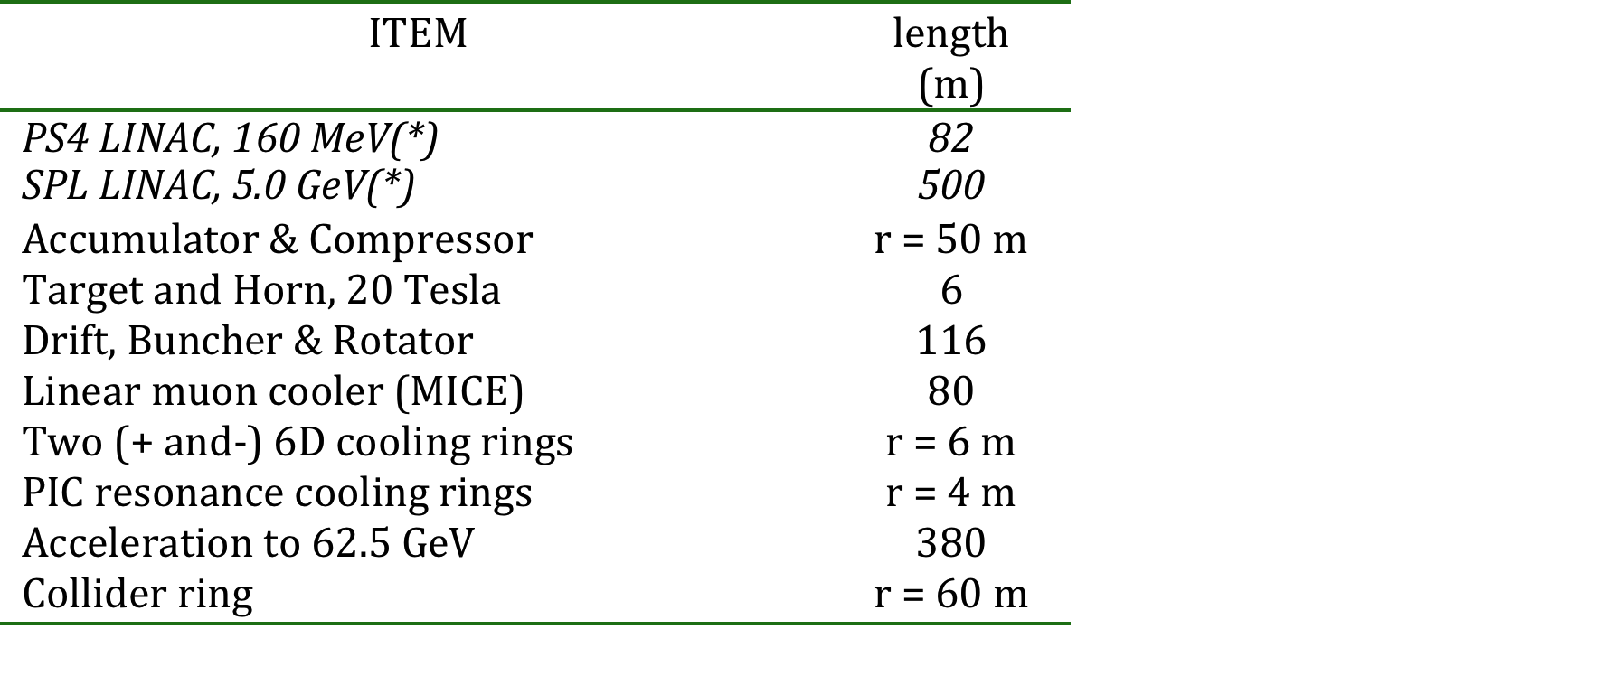
The site layout
(*) The PS4 and the SPL LINACS are part of the planned
LHC programme. (r is the radius of the circular rings)

Slide 28
Two coupled rings to build a tight proton bunch
A tight p bunch may be realized with a pair of rings with R≈50 m (Accumulator and Compressor).
The H⁻ beam produced by the SPS LINAC at 5 GeV is stripped to p produce a number of short pulses , condensed into a few, shorter (2ns) bunches
“A Feasibility study of accumulator and compressor for SPL”.
CERN-AB-2008-060 (2008)

Slide 29
Target and focussing in a axially symmetric B field
Liquid metal target is immersed in high field solenoid (20 T)
  Proton beam is oriented with about 20° with respect to axis
  Particles with p_{t} < 0.25 GeV/c are trapped (about ½ of all)
  Pions decay into muons
  Focussing both signs of particles
The MERIT/CERN experiment has successfully injected a Hg-jet into a 15-T solenoid
Pions/muons drifting as a function of c τ
Z = 1 m
GeV/c ->
c τ
Z = 58 m
GeV/c ->
.
c τ

Slide 30
Beam energy compression
Initially, there is a small spread in time, but a very large spread in energy. The target is followed by a drift space, where a strong correlation develops between time and energy.
Two different methods my be used in order to provide nearly non-distorting phase rotation;:
  260 m of Induction linacs, see FS2 design report(BNL-52623).
  Neuffer’s RF bunched beams with RF rotation (IPAC 2013).
Induction linacs reduce the r.m.s energy spread to 4.4% and after bunching to a spread to ≈ 8%. In the Neuffer’s scheme, the final rms energy spread is 10.5%.

Slide 31
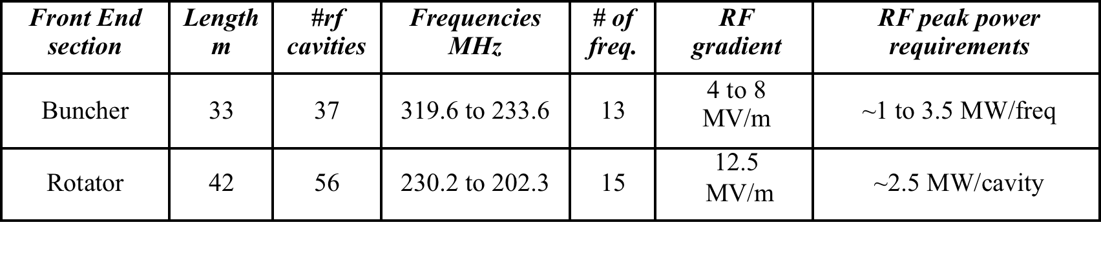
Buncher and rotator to compress muon beam spectrum
p
εT = 20 mm rad
εL = 30 mm rad
Drift
Buncher
Rotator
π→μ
FE Target
Solenoid
Drift
Buncher
Rotator
Cooler
10 m
~50 m
~30m
36m
~80 m
≈250 MeV/c
4 MW of protons at 5 GeV
50 p pulses/s with 1.0 x 10¹⁴ ppp
Muons of both signs are collected
A very efficient capture : 1.2 x 10¹³ muons/pp within the 12 best bunches.
Train of many muon bunches, requires later recombination and signs
Solenoidal coils at about 2 T

Slide 32
Ionization cooling
This method, called “dE/dx cooling" closely resembles the synchrotron compression of relativistic electrons — with the multiple energy losses in a thin, low-Z absorber substituting the synchrotron radiated light.
The main feature of this method is that it produces an extremely fast cooling, compared to other traditional methods. This is a necessity for the muon case.
Transverse betatron oscillations are “cooled” by a target “foil” typically a fraction of g/cm² thick. An accelerating cavity is continuously replacing the lost momentum.
Unfortunately for slow muons the specific dE/dx loss is increasing with decreasing momentum. In order to “cool” also longitudinally, chromaticity has to be introduced with a wedge shaped “dE/dx foil”, in order to reverse (increase) the ionisation losses for faster particles.
D. Neuffer, Particle Accelerators 1983, Vol. 14, pp. 75-90

Slide 33
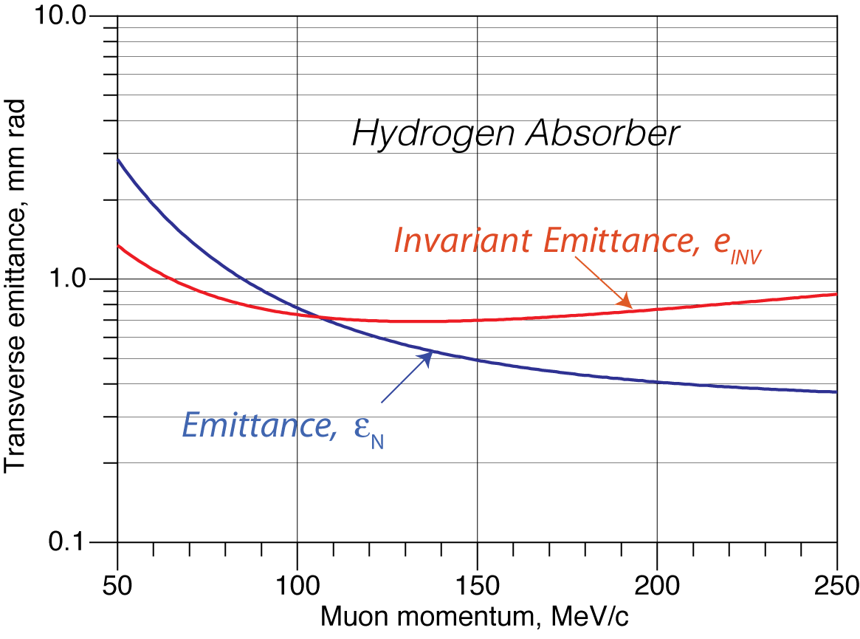
Muon cooling ring: transverse emittance
The emittance ε_{Ν} evolves whereby dE/dx losses are balanced by multiple scattering (Neuffer and McDonald):
Cooling
Scattering
β* = beta at cross
mμ,βμ = mu values
Xo = Rad. Length
dE/dz = ioniz. Loss
The cooling process will continue until an equilibrium transverse emittance has been reached:
The equilibrium emittance εΝ and its invariant εΝ/βγ are shown as a function of the muon momentum.
For H2 and β*= 10 cm, εΝ/βγ ≤ 700 mm mr from 80 to 300 MeV/c
For a 125 GeV collider and β*= 5 cm
bunch equil. transverse size is ≈ 240 µ

Slide 34
Muon cooling ring: longitudinal emittance
  Longitudinal balance is due to heat producing straggling balancing dE/dx cooling. A dE/dx radial wedge is needed in order to exchange longitudinal and transverse phase-spaces.
  Balancing heating and cooling for a Gaussian distribution limit:
Intrinsic Energy loss
Wedge shaped absorber
Straggling
, where f_{A} is the fraction of the transport length occupied by the absorber, which has an energy absorption coefficient
η is the chromatic dispersion at the absorber and δ and are the thickness and radial tilt of the absorber
the straggling (H2) is given by

Slide 35
Longitudinal balance (cont.)
The thickness of the absorber must vary with the transverse position, producing the appropriate energy dependence of energy loss, resulting in a decrease of the energy spread
Energy cooling will also reduce somewhat the transverse cooling, according to the Robinson’s law on sum of damping decrements.
From D. V. Neuffer, NIM A 350 (1994) 27-35
dE/dx loss as a function
of the muon momentum
for hydrogen (very near
to min for 250 MeV/c)

Slide 36
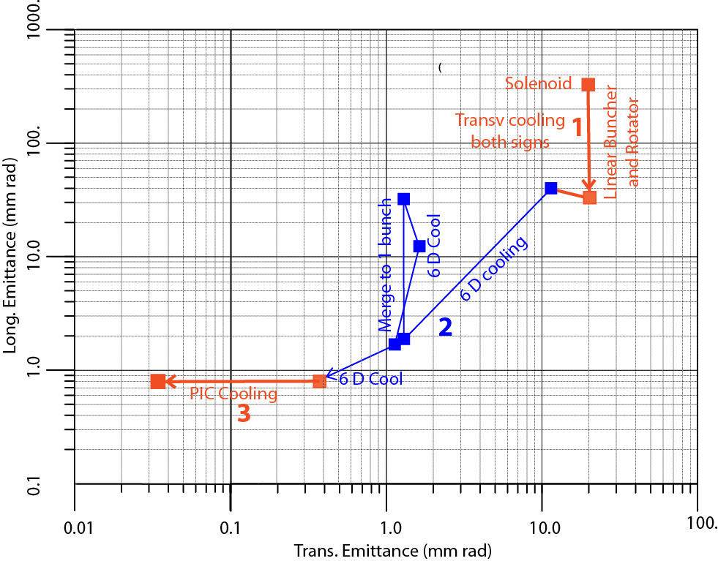
Describing the full cooling procedure
Three successive steps are required in order to bring the cooling process at very low energies, after capture and bunching + rotation.
Linear transverse cooling of both signs amd small Δp increase.
Ring cooling in 6D with B brings the μ⁺ and μ⁻ to a reasonable size Merging and cooling to single bunches
PIC resonance cooling. where the normal elliptical motion in x-x' phase space has become hyperbolic.
(

Slide 37
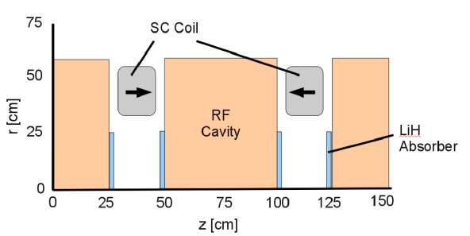
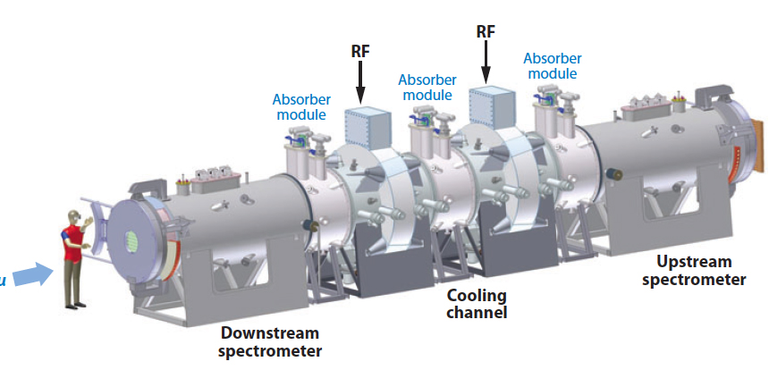
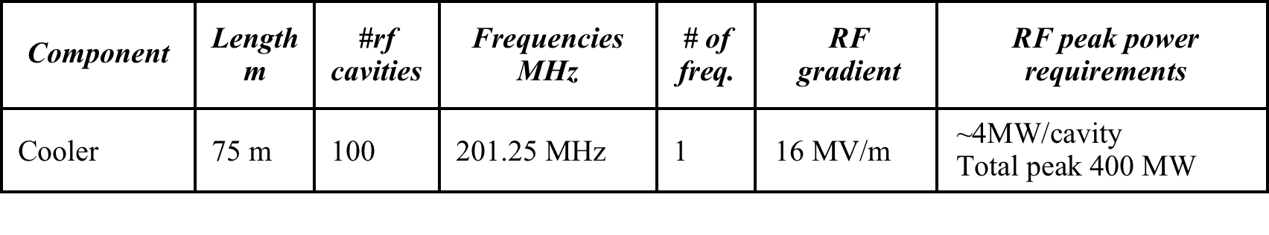
1.-Linear transverse pre-cooling
Muons of both signs are cooled transversally with LiH absorbers and simultaneously accelerated with RF cavities at 200 MHz.
2 Tesla solenoidal focussing
Slight longitudinal momentum blow-up
Method similar to the one of project MICE

Slide 38
Hardware implementations of muon cooling
A main muon cooling hardware implementation over the last decade has been the MICE experiment.
So far only Step I has been completed
Step IV was foreseen in 2016
Step VI after 2019
But in Aug 2014 the DOE T and M review board has reassessed the muon accelerator program MICE and its early closure
However a MICE like experiment is an essential part of an
initial cooling experiment and it should be continued

Slide 39
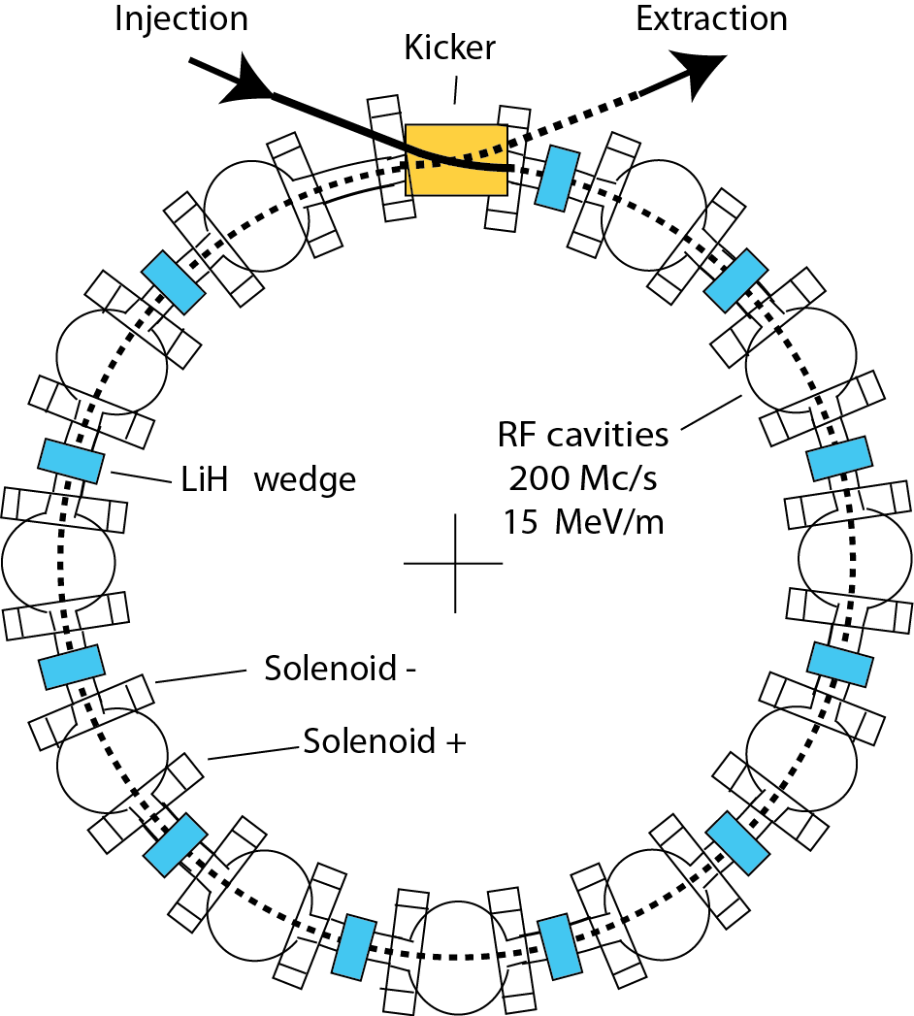
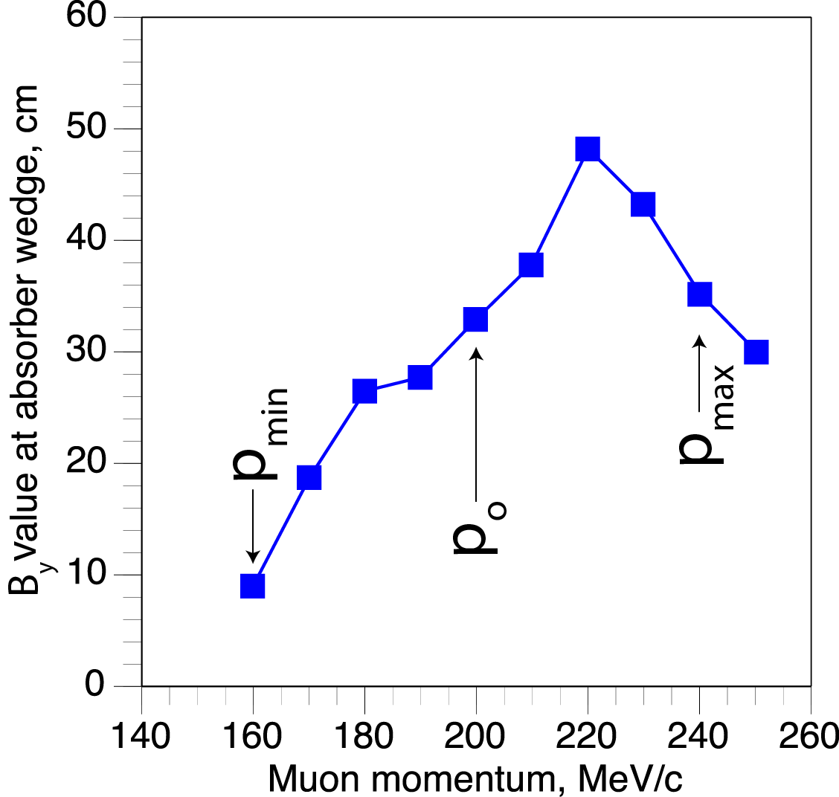
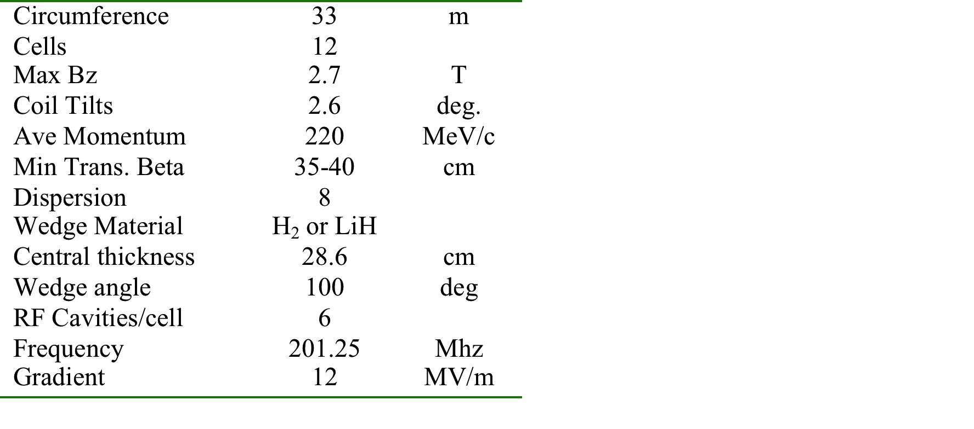
2.-The cooling ring (Balbekov, Palmer)
An idealized muon cooling process has been numerically evaluated in 6D by Balbekov and by Palmer et al. in a small ring and for p_{μ} ≈ 200 MeV.
In order to increase the incoming muon acceptance, strong focussing is performed with solenoids in alternate directions, rather than with q-poles (RFOFO).

Slide 40
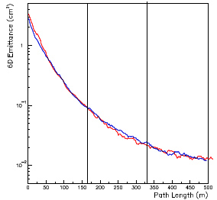
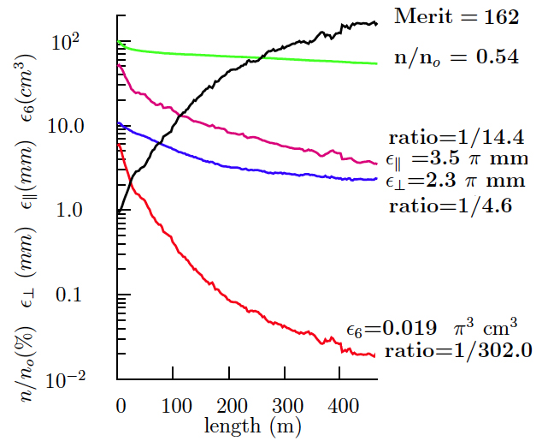
Performance of Palmer et al. design
A first estimate of the expected cooling process is given. This is not an engineering design: for instance injection, extraction, etc. have still to be evaluated.
The so called ”merit factor” in the 6D takes into account the fractional loss of muons in the process and due to decays.
GEANT (red line) and ICOOL (blue)

Slide 41
3.-PIC, the Parametric Resonance Cooling of muons
Combining ionization cooling with parametric resonances is expected to lead to muon with much smaller transv. sizes.
A linear magnetic transport channel has been designed by Ya.S. Derbenev et al, where a half integer resonance is induced such that the normal elliptical motion of particles in x-x' phase space becomes hyperbolic, with particles moving to smaller x and larger x' at the channel focal points.
Thin absorbers placed at the focal points of the channel then cool the angular divergence by the usual ionization cooling.
LEFT ordinary oscillations
RIGHT hyperbolic motion
induced by perturbations near an (one half integer) resonance of the betatron frequency.
x x’ = const
V. S. Morozov et al, AIP 1507, 843 (2012);

Slide 42
Details of PIC
Without damping, the beam dynamics is not stable because the beam envelope grows with every period. Energy absorbers at the focal points stabilize the beam through the ionization cooling.
The longitudinal emittance is maintained constant tapering the absorbers and placing them at points of appropriate dispersion, vertical β and two horizontal β.
. Comparison of cooling factors (ratio of initial to final 6D emittance) with and without the PIC condition vs number of cells: more than 10× gain

Slide 43
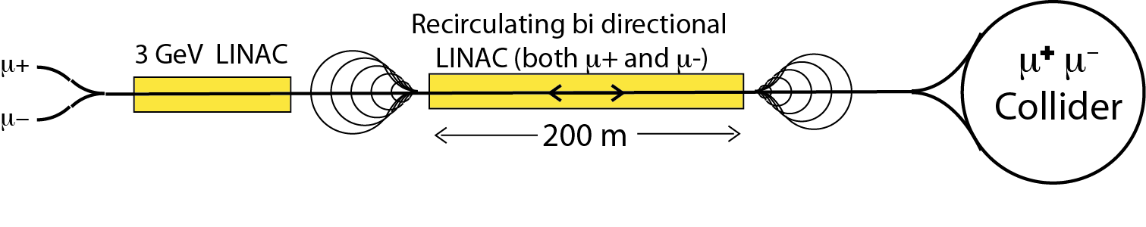
Bunch acceleration to 62.5 GeV
  In order to realize a Higgs Factory at the known energy of 126 GeV, an acceleration system is progressively rising the energy of captured muons to m_{H}o/2
  Adiabatic longitudinal Liouvillian acceleration to p_{f}= 62.5 GeV/c.
  Both µ⁺ and µ⁻ are accelerated sequentially in the same LINAC with opposite polarity RF buckets
A recirculating LINAC and 25 MeV/m with f.i. 5 GeV energy/step + multiple bi-directional passages to 63 GeV (≈ 200 m long)
A similar layout for the second phase with √s ≈ 1 TeV will require a recirculating length of 1.6 km, still well within CERN site.
D. Neuffer, 2013

Slide 44
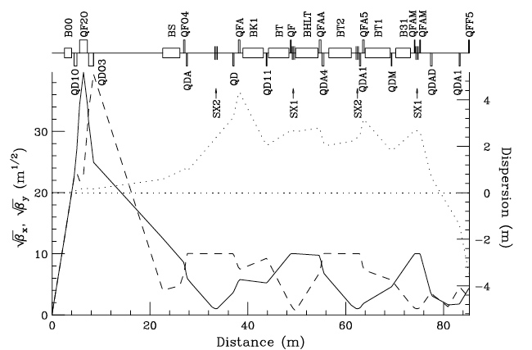
6.-Muons collide in a storage ring of R ≈ 60 m
Lattice structure at the crossing point, including local chromaticity corrections with β_{x} = β_{y} = β* = 5 cm.
Ankenbrandt et al. (1999)

Slide 45
Eatimated performance of the Hº-factory
Two asymptotically cooled μ bunches of opposite signs collide in two low-beta interaction points with β*= 5 cm and a free length of about 10 m, where the two detectors are located.
The bunch transverse rms size is 0.05 mm and the μ−μ tune shift is 0.086.
A luminosity of 5 x 10³² cm⁻² s⁻¹ is achieved with 1 x10¹² μ/bunch.
The SM Higgs rate is ≈ 44’000 ev/year in each detector.
An arrangement with at least two detector positions is reccomended

Slide 46


Determining the muon energies with extreme precision
The extremely narrow Higgs width is unprecedented
At each pulse, the energy of the muons has to be determined with an accuracy of the order of σE/E ≈ 3 x 10⁻⁵.
A method has been described by Raja and Tollestrup in 1998.
  Electron energy polarized from µ decay; Pe ≈~25% → 10%.
  Electron energy in the lab given by
  Polarization precess each turn is ω = γ(g−2)/2 x 2π
  the total energy E(t) due to the decay electrons observed during turn t in the e.m. calorimeter will have the expression
  The electron-rate is extremely high (≈ 10⁵ ev/pulse)
  Since frequencies can be measured very precisely, E(t) and δE can be measured to a few hundred keV at each pulse
Raja and Tollestrup (1998) Phys. Rev. D 58 013005

Slide 47
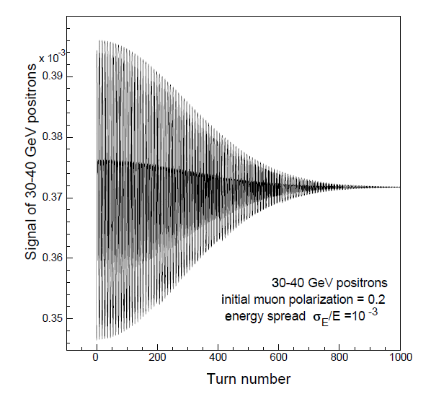
The muon decay spectrometer
    Electron rate is observed with a transverse B field of 4 T.
Simulated data and the fitted function at integer values of the turn number for 50 turns for 60 GeV/ c and 70 GeV/c µ’s.
Muon spectrometer
Full distribution of decay electrons
P = 0.26 is assumed with a fractional fluctuation of 0.5 x 10⁻² per point

Slide 48
Finding the location of the Higgs
Presently the Higgs mass is known to some 600 MeV. It will be known to ≈ 100 MeV from the LHC with 300 fb⁻¹ . But at a muon collider we need to find M_{H} to ~4 MeV and then select the resonance location.
Finding the Higgs requires a few months running at 1.7 x 10³¹ luminosity.

Slide 49
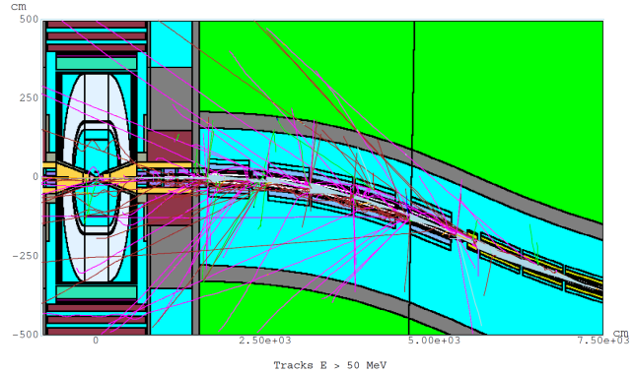
Muon related backgrounds
A major problem is caused by muon decays, namely electrons from µ decay inside the detector with ≈ 2x10³ e/meter/ns, however collimated within an average angle of 10⁻³ rad.
A superb collimation is required with the help of absorbers in front of the detector’s straight sections.
    Drozhdin, Mokhov et al.

Slide 50
The muon Higgs collider:
Advantages
  Large cross section σ (μ⁺μ⁻ → h) = 41 pb in s-channel resonance, compared to e⁺e⁻ → ZH with 0.2 pb at 250 GeV.
  Small size footprint: it may fit in the CERN site
  Cost so far unknown but far smaller than the ILC.
  No synchrotron radiation and beamstrahlung problems
  Precise measurements of line shape and total decay width Γ
  Exquisite measurements of all channels and tests of SM.
  A low cost demonstration of muon cooling can be done first.
Challanges
  Muon 2D and 3D cooling needs to be demonstrated
  Need ultimately very small c.o.m energy spread (0.003%)
  Backgrounds from constant muon decay
  Significant R&D required towards end-to-end design

Slide 51
The next step: the realization of the Initial Cooling Experiment
Physics requirements and the studies already undertaken with muon cooling suggest that a next step, prior to but adequate for a specific physics programme could be the practical realization of an appropriate cooling ring demonstrator.
Indicatively this corresponds to the realization of unconventional small ring of 20 to 40 meters circumference in order to achieve the theoretically expected longitudinal and transverse emittances of asymptotically cooled muons.
The injection of muons from pion decays could be coming from some existing accelerator at a reasonable intensity.
The goal is to proof experimentally the full 3D cooling.
The other facilities, namely (1) the pion/muon production, (2) the final, high intensity cooling system (3) the subsequent muon acceleration and (4) the accumulation in a storage ring could be constructed later and only after the success of the initial cooling experiment has been confirmed at a low cost.

Slide 52
Early description of the cooling experiment
A cooling ring is preferable to an open structure
In order to introduce a first major reduction in the transverse and longitudinal emittances:
  solenoids instead of quadrupoles have a wider acceptance
  with a few turns, only integer resonances are harmful
  As a first cooler, the ionization absorber does not have to be made with LH₂: other solid materials (LiH) may be used.
  Wedge shaped absorbers in order to ensure the Robinson’s law on sum of damping decrements.
The initial pion beam is produced by a short (≈1-2 ns) proton bunch. Pions decay into a appropriate muon beam which is injected in the ring. The beam line is used to select the muon beam with an suitable divergence and with adequate dp/p.
The present description is based on the CERN-PS although another accelerator (FNAL booster, SIN, etc.) might be used.

Slide 53
Muon beam injection
The method of muon injection closely follows the well known g-2 experiments at CERN, BNL and FNAL, although at a much lower muon momentum. An appropriate inflector has been used in order inject the muon beam into the ring.
The optimally stored momentum selected is ≈ 250 MeV/c and the injected momentum spread may be of order of few % r.m.s.
Alternatively the spontaneous π/μ backward decays of a pion beam traversing the ring straight section could be used to capture backward decaying muons without the need of a kicker.
Example of the inflector of the g - 2 experiment

Slide 54
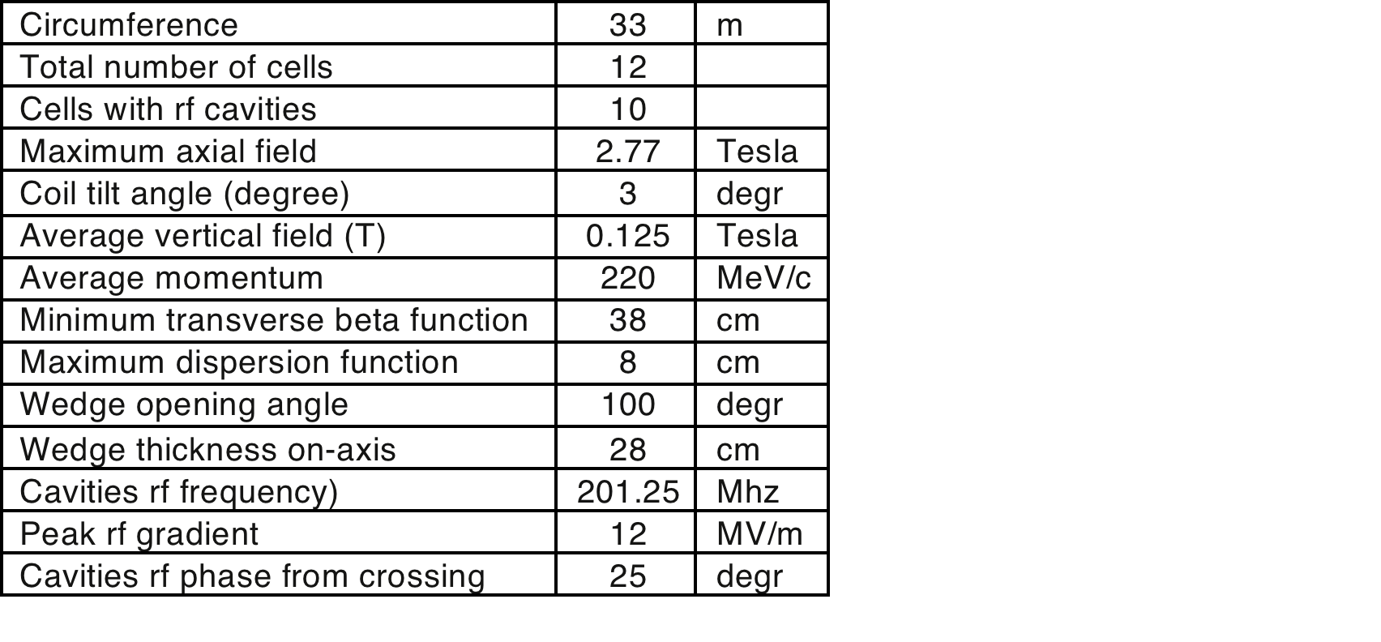
Some examples: The RFOFO Ionization Cooling
The design by Palmer et al. is based on solenoids tilted in order to ensure also bending. The H absorbers are wedge shaped to ensure longitudinal cooling.
Extraction
Injection
arXiv:physics/0504098 v1 14 Apr 2005
Two separate, 180* apart injection and extraction pulsed inflectors may be preferable
Pulsed inflector

Slide 55
A solenoid-dipole ring cooler for a muon collider
Another exemplificative cooing ring is the one of Garren et al. (NIM, A 654 (2011) 40–44).
Injection/extraction kickers are used in a straight section; a superconducting flux pipe is used for the injected beam.
Racetrack ring
Four-sided ring

Slide 56
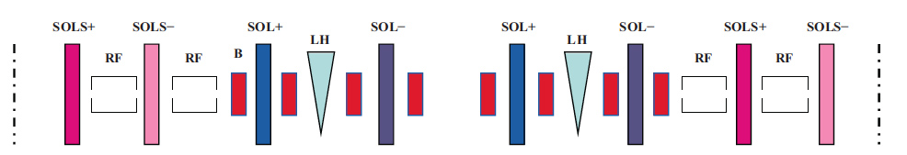
An achromatic cooling ring
Arcs are achromatic both horizontally and vertically. The dispersion is zero in the straight sections between the arcs.
The four-sided ring has four 90° arcs with 8 dipoles separated by alternately oriented solenoids (SOL+ and SOL-).

Slide 57
Expected ring performance
Starting from a typical initial emittance of about 20 (π) mm rad tranversally and longitudinally, the 3D cooled emittance should be demonstrated in agreement with calculations when reaching the equilibrium asymptotic ring situation.
During the cooling, an appropriate number of standard pickup electrodes should be used in order to observe the beam signals.
The cooled beam should then be extracted with a second kicker. The transverse emittances and/or the momentum spread are measured by an appropriate beam analysis transport.
The behavior under PIC cooling conditions may be separately tested in the same ring structure but at a very different tuning point near the semi-integer resonances.
The injected beam conditions should correspond to the requirements of the PIC conditions, namely a much narrower transverse angular spread and a small momentum spread as expected after the first cooling in the final setup.

Slide 58
The first muon cooling ring should present no unexpected behaviour and good agreement between calculations and experiment is expected both transversely and longitudinally
The novel Parametric Resonance Cooling (PIC) involves instead the balance between a strong resonance growth and ionization cooling and it may involve significant and unexpected conditions which are hard to predict.
Therefore the experimental demonstration of the cooling must be concentrated on such a resonant behaviour.
On the other hand the success of the novel Parametric Resonance Cooling is a necessary premise for a viable luminosity of the initial proton parameters of the future CERN accelerators since the expected Higgs luminosity is proportional to the inverse of the transverse emittance, hence about one order of magnitude of increment is expected from PIC.

Slide 59
Conclusions
The recent discovery of the Higgs particle of 125 GeV at CERN has highlighted the unique features of the direct production of a H⁰ scalar in the s-state, in analogy with the two steps of the Z with the pbar-p and LEP programmes and where the mass, total and partial widths of the H⁰ can be directly measured with a remarkable accuracy and a very large number of events.
A high energy μ⁺μ⁻-collider is the only possible circular high energy lepton Higgs collider that can be easily situated within the existing CERN (or FNAL) sites.
A first step could be the practical and experimental realization of a full scale cooling demonstrator, a relatively modest and low cost system but capable to conclusively demonstrate “ionization cooling” at the level required for a Higgs factory and eventually as premise for a subsequent multi-TeV collider and/or a long distance ν factory.

Slide 60
A proposal for discussion:
It is proposed to develop an international team with the aim of designing, financing and constructing the above described cooling muon ring for the Initial Cooling Experiment.
A campaign of extensive measurements, hopefully confirming the expectations of muon cooling theory could then be performed, starting for instance with a single proton bunch and the CERN-PS accelerator.
Alternatively, this experiment might be realized either at the Fermilab Booster, at the BNL-AGS or even elsewhere (UK, Switzerland).

Slide 61
Thank you !

