Slide 1


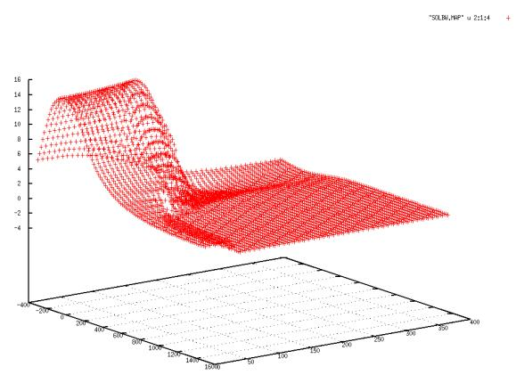
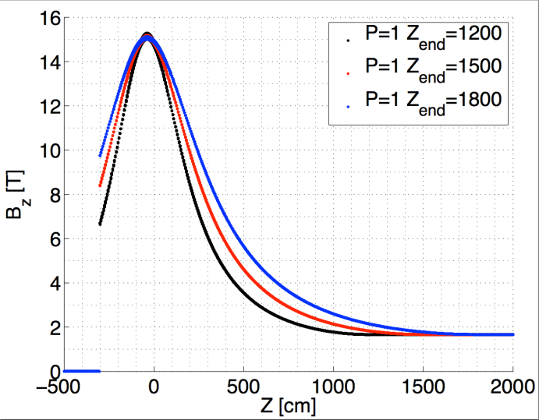
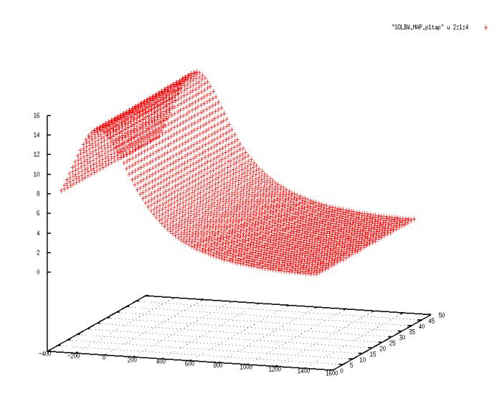
Magnetic Configuration of the Muon Collider/ Neutrino Factory Target System
Hisham Kamal Sayed,^{*1} H.G Kirk,¹ K.T. McDonald²
¹ Brookhaven National Laboratory, Upton, NY 11953
² Joseph Henry Laboratories, Princeton University, Princeton, NJ 08544
Abstract
Muon Production IDS120h 15 T
MARS 1510 Simulation Setup
An alternative capture-solenoid field is presented for the mercury jet target for a neutrino factory or muon collider. A peak solenoid field of 15 T at the mercury-target location is studied in comparison to the current baseline value of 20 T. The magnetic-field profile tapers down to 1.5 T in the Front End, nominally beginning 15 m downstream of the target. This field profile is optimized to maximize the “useful” muons 50 m downstream from the target within a kinetic-energy window of 80-140 MeV. Two parameters are considered for the optimization study: the length z_{end} of the tapered field and the field strength in the front end. The axial-magnetic-field profile is specified analytically using an inverse-cubic equation and the off-axis field is computed from a series expansion based on derivatives of the axial field. The simulation is performed using the MARS15 code.
Particle-capture requirement (P_{t} ≤ 0.225 GeV/c)
  B × r = 20 T × 7.5 cm = 150 T-cm
  B × r = 15 T × 10 cm = 150 T-cm
Fixed-flux requirement (Aperture requirement)
  B × r² = 20 × 7.5² = 1125 T-cm²
  B × r² = 15 × 10² = 1500 T-cm²
MARS simulations with 15-T peak field & new aperture settings (taper radius r = 30 cm at all z)
Beam Pipe with constant r = 30 cm.
Beam Pipe material changed to
“MARS-Blackhole” to speed calculation.
Added subroutine to m1510.f (FIELD) to calculate the field an using inverse-cubic fit.
Hg jet
B_{z}(z=0,r=0) = 15 T
IDS120h (R. Weggel)
Proton Beam
B_{z}(r=0) = 15 T
Beam Pipe
B_{z} [T]
RESULTS
Mercury Target – Proton Jet Baseline Parameters (from optimization by X. Ding using MARS15)
Muon count at 50 m for kinetic energy within 80-140 MeV:
Mercury-Target Parameters
  Angle of target to solenoid axis θ_{target}= 0.137 rad
  Target radius r_{target} = 0.404 cm
Proton Beam Parameters
  E = 8 GeV
  θ_{beam} = 0.117 rad
  σ_{x}= σ_{y}= 0.1212 cm (Gaussian distribution)
Solenoid Field
  20 T peak field at target position (z = -37.5 cm)
  Aperture at Target, r = 7.5 cm,
  Aperture at Front End, r = 30 cm
  z_{end} = 1500 cm, where B_{z} =1.5 T
Muons within kinetic-energy cut of 40-180 MeV
  N_{muons at z = 50 m} = 3.27 × 10⁴ (N_{initial protons} = 10⁵)
z [cm]
r [cm]
  Analytic Form for Tapered Solenoid
Inverse-Cubic Taper, defined by initial & final axial fields (B₁ & B₂), their derivatives, and position of end of taper (z_{end}):
Off-axis field approximation:
z_{end} [cm]
Tapered field using inverse-cubic field (P = 1)
Conclusion
Promising results for 15-T peak field at the target, particularly if increase z_{end} beyond 15 m and the Front-End magnetic field above the 1.5-T baseline.
To be done:
  Investigate transmission through the downstream phase rotator & cooling sections, using ICOOL.
Hg jet
θ_{Beam}
θ_{Target}
Solenoid axis
B_{z} [T]
Proton beam
z [cm]
r [cm]
*Email: hsayed@bnl.gov
Work supported in part by US DOE Contract No. DE-AC02-98CH10886.

