Slide 1
Solenoid Decay Channel Study
Hisham Kamal Sayed
Advanced Accelerator Group
Brookhaven National Lab
April 3, 2012

Slide 2
IDS120J Solenoid Field Map (icool boundary conditions)
Length [m] Inner R [m] Outer R Current [A/mm²]
0.05 0.5 0.868 45.815
3.483 0.5 0.523 47.67
0.05 0.5 0.868 45.815

Slide 3
Solenoid Field Map (IDS120K(J))
On Axis Field
Normalized Δ(120J,120K)
%

Slide 4
Initial Particle Distribution
PARTICLE GENERATIONS by ICOOL
R_low = 0.0 R_high = 0.1 [m] phi_low = 0 [degree] phi_high = 360 z_low =0 z_high=0
Pr_low = 0 [GeV/c] Pr_high = 0.07 Pphi_low = -0.001 Pphi_high =0.001 Pz_low=0.1 [GeV/c] Pz_high = 0.5

Slide 5
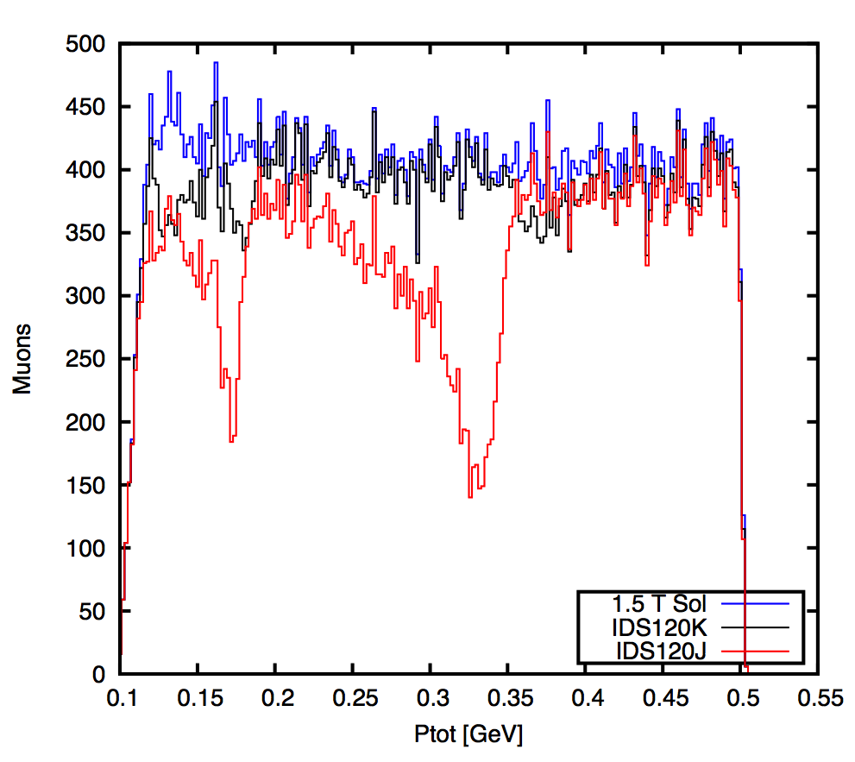
Particle Tracking
Initial Number of Particles 99000
Particles passed 1.5 T const. sol field 80528 (18%)
Particles passed IDS120J channel 66451 (17%)
Particles passed IDS120K channel 76473 (5%)

Slide 6
Dynamic Aperture
X [m]
Y [m]

Slide 7
Low Energy (IDS120K)

