Slide 1
transport Study for The Muon Collider/Neutrino Factory Frontend
HISHAM KAMAL SAYED
Physics Department
BROOKHAVEN NATIONAL LABORATORY
TGT-AAG Meeting Dec. 13th 2012

Slide 2
Baseline Optimized Parameters (X. Ding)
Hg Target
  θ_{Target}=0.137 rad
  R_{Target}=0.404 cm
Proton Beam
  E=8 GeV
  θ_{Beam}=0.117 rad
  σ_{x}=σ_{y}=0.1212 cm (Gaussian Distribution)
  σ_{t}=σ_{z}=0 (Pancake Distribution)
Solenoid Field
  IDS120h → 20 T peak field at target position (Z=-37.5)
  Aperture at Target R=7.5 cm - End aperture R = 30 cm
  Fixed Field Z = 15 m → Bz=1.5 T

Slide 3
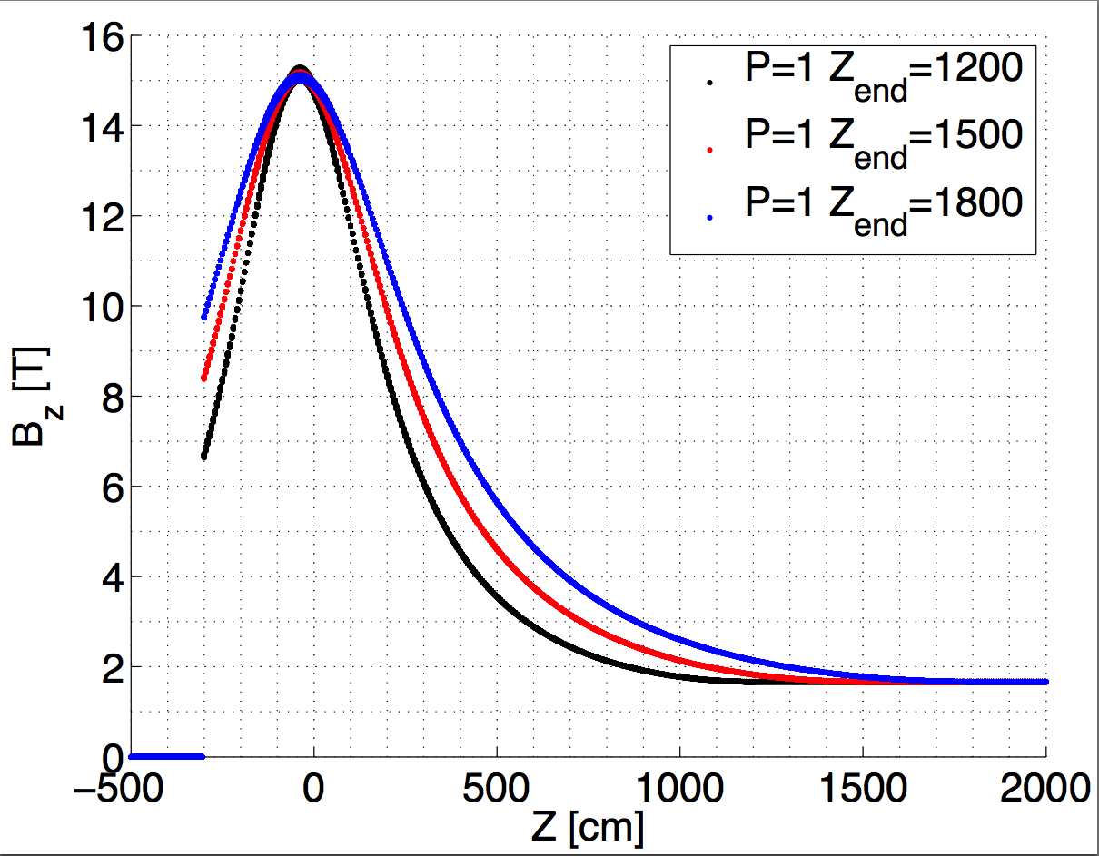
Analytic form for Tapered Solenoid
Inverse-Cubic Taper
Field at R=0
Off-axis field approximation
! First Order
BZ = B1 / CUBIC**POW
BR = -R / 2. * DBZ1
! Second Order
BZ = BZ - R**2 / 4. * DBZ2
BR = BR + R**3 / 16. * DBZ3
! Third Order
BZ = BZ + R**4 / 64.0 * DBZ4
BR = BR - R**5 / 384.0 * DBZ5
! Fourth Order
BZ = BZ - R**6 / 2304.0 * DBZ6
BR = BR + R**7 / 18432.0 * DBZ7

Slide 4
Initial Particle Distributions
Distribution of all Mesons at z=0
Distribution of Muons which made it to the end of cooling section and satisfied acceleration acceptance cuts

Slide 5
Good Muons Particle Distributions
Distribution of Muons which made it to the end of cooling section and satisfied acceleration acceptance cuts
Distribution of all Mesons at z=0

Slide 6
Mesons Initial Distribiution

Slide 7
Fixing time of arrival
TOA Protons at z=-75 cm
TOA Protons at z=-200 cm
MARS simulation was performed with a “pancake” shaped proton beam, lunched at t=0 from a specified z<0.
The Gaussian time distribution is “usually” produced by using a random Gaussian generator on the meson distribution at z=0.

Slide 8
Transmission
MARS simulation results:
Counting muons at 50 m with K.E. 80-140 MeV
Solenoid Taper Length [cm]

Slide 9
Transmission
Good particles are those who satisfy the following conditions/cuts
Survived the phase rotator and cooling sections
Acceleration acceptance cuts
  0.1 <Pz< 0.3 GeV
  Transverse cut R < 0.3 m
  Longitudinal cut < 0.15 m
Nmuons{Good}
Nmuons{Pz cut}
Nmuons{All cuts}

Slide 10
More Cooling
For every taper length optimized TOA
For 8 m taper length TOA scan
Baseline cooling end
140 cell (z=265 m)

Slide 11
Time & Taper Length scan
Using baseline cooling section
(140 cooling cell)
Using longer cooling section
(200 Cooling cell)

Slide 12
Time & Taper Length scan
TOA for optimum throughput at end of cooling for each capture solenoid case

Slide 13
Phase Space Distributions

Slide 14
Phase Space Distributions

Slide 15
Phase Space Distributions

Slide 16
Phase Space Distributions

Slide 17
Phase Space Distributions

Slide 18
Phase Space Distributions

Slide 19
Phase Space Distributions

Slide 20
Phase Space Distributions (Short versus long taper)
Pions

Slide 21
Phase Space Distributions (Short versus long taper)
Pions

Slide 22
Phase Space Distributions (Short versus long taper)

Slide 23
Phase Space Distributions (Short versus long taper)

Slide 24
Conclusion & Summary
Longer tapers have more meson yield at the decay channel (z=50).
Shorter tapers produce “more good” muons which could be bunched & cooled.
The maximum yield requires tapers with z=4-6 m.
Adding longer cooling channel is required to reach maximum cooling.

