Slide 1
Optimized Solenoid Based Capture Mechanism for a Muon Collider/Neutrino Factory Target System
HISHAM KAMAL SAYED
BROOKHAVEN NATIONAL LABORATORY
MAP COLLABORATION MEETING, FERMILAB, June 20 2013

Slide 2
INTRODUCTION & LAYOUT
Muon Capture in Target & Front END
Capture Solenoid Field Study:
  Optimizing quantity: Muon (Pions) count – transverse capture
    Target Solenoid peak field
    Final end field
  Optimizing quality: Muon (Pions) longitudinal phase space (transverse-longitudinal coupling) – transverse-longitudinal capture
    - Taper field profile
Optimizing the time of flight of incident beam (Buncher-Rotator RF phase)
Transverse focusing field in decay-channel-buncher-rotator
Match to ionization cooling channel for every end field case 1.5 T → 3.5 T
Performance of front end as a function of proton bunch length
Realistic Coil Design & performance optimization

Slide 3
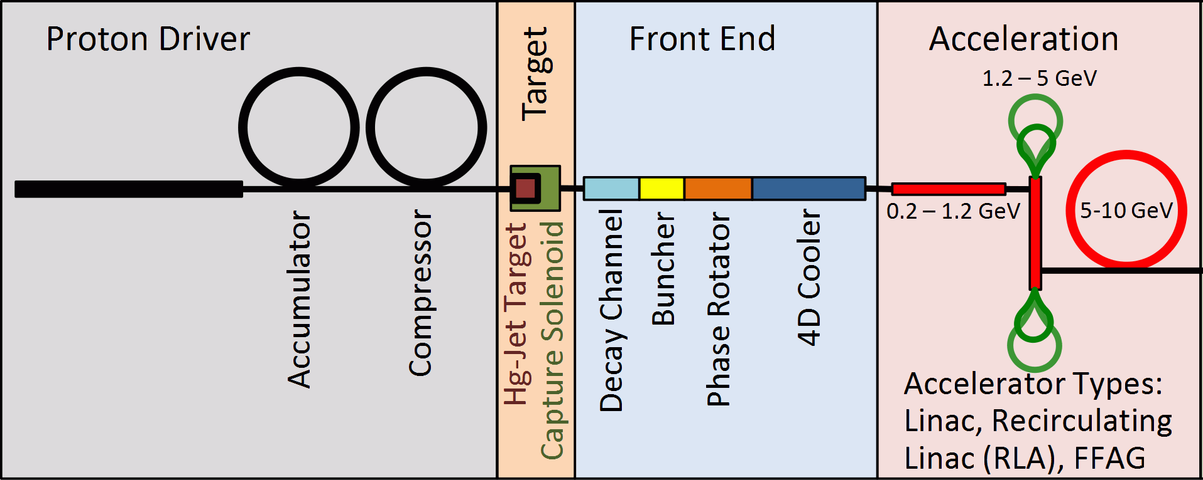
Muon Collider/Neutrino FACTORY LAYOUT
Target System Solenoid:
Capture μ± of energies ~ 100-400 MeV from a 4-MW proton beam (E ~ 8 GeV).

Slide 4
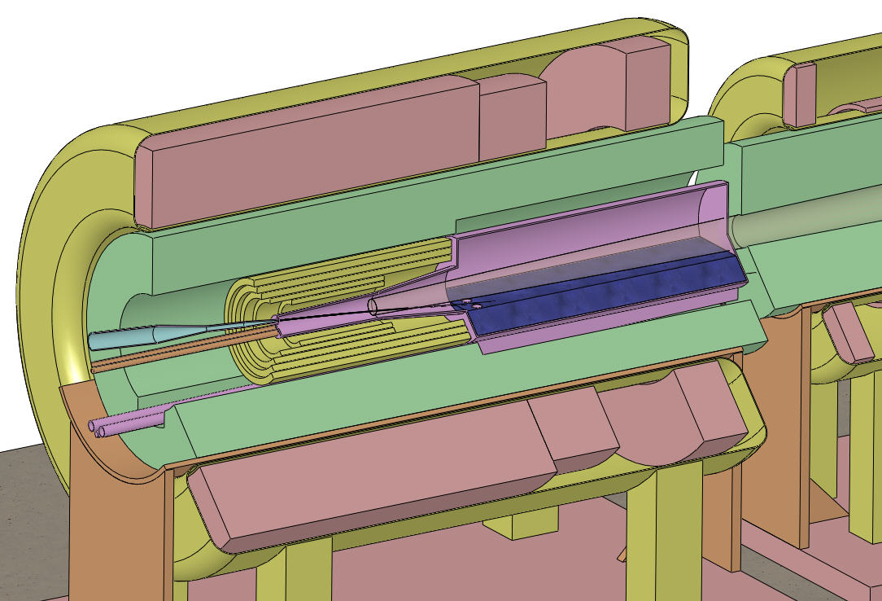
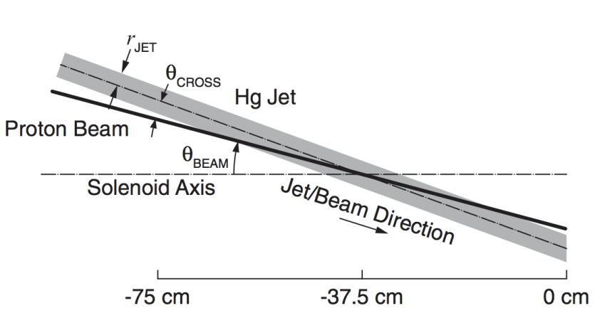
Target System Current Baseline Design
SC magnets
Production of 10¹⁴ μ/s from 10¹⁵ p/s (≈ 4 MW proton beam)
Proton beam readily tilted with respect to magnetic axis.
Shielding of the superconducting magnets from radiation is a major issue.
Tungsten beads
Proton beam and
Mercury jet
Hg Target
Proton Beam
  E=8 GeV
Solenoid Field
  IDS120h → 20 T peak field at target position (Z=-37.5)
  Aperture at Target R=7.5 cm - End aperture R = 30 cm
  Fixed Field Z = 15 m → Bz=1.5 T
Production: Muons within energy KE cut 40-180 MeV end of decay channel
  N_{μ+π+κ}/N_{P}=0.3-0.4
Resistive magnets
Mercury collection pool
With splash mitigator
5-T copper magnet insert; 10-T Nb3Sn coil + 5-T NbTi outsert.
Desirable to eliminate the copper magnet (or replace by a 20-T HTS insert).

Slide 5
Tapered Target Solenoid optimization
Inverse-Cubic Taper
Off-axis field approximation
1.5 T
2.5 T
3.5 T
1.5 T
2.5 T
3.5 T

Slide 6
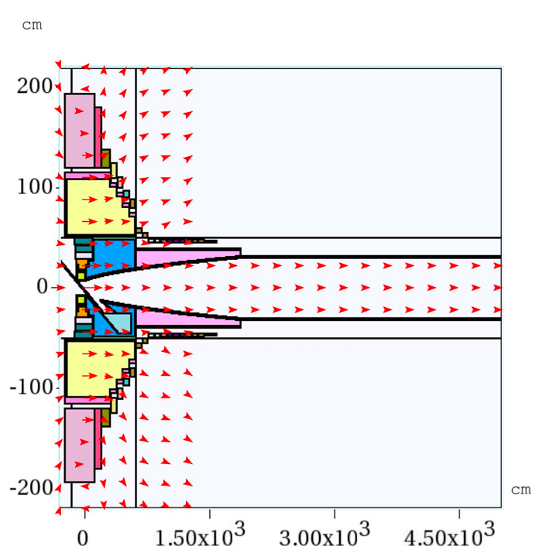
MARS Simulations & Transmission
MARS1510 Simulation:
Counting muons at 50 m with K.E. 80-140 MeV
R_{ini}=7.5-10 cm
B_{i}=20-15 T
r_{final}=30 cm
L_{taper} [cm]

Slide 7
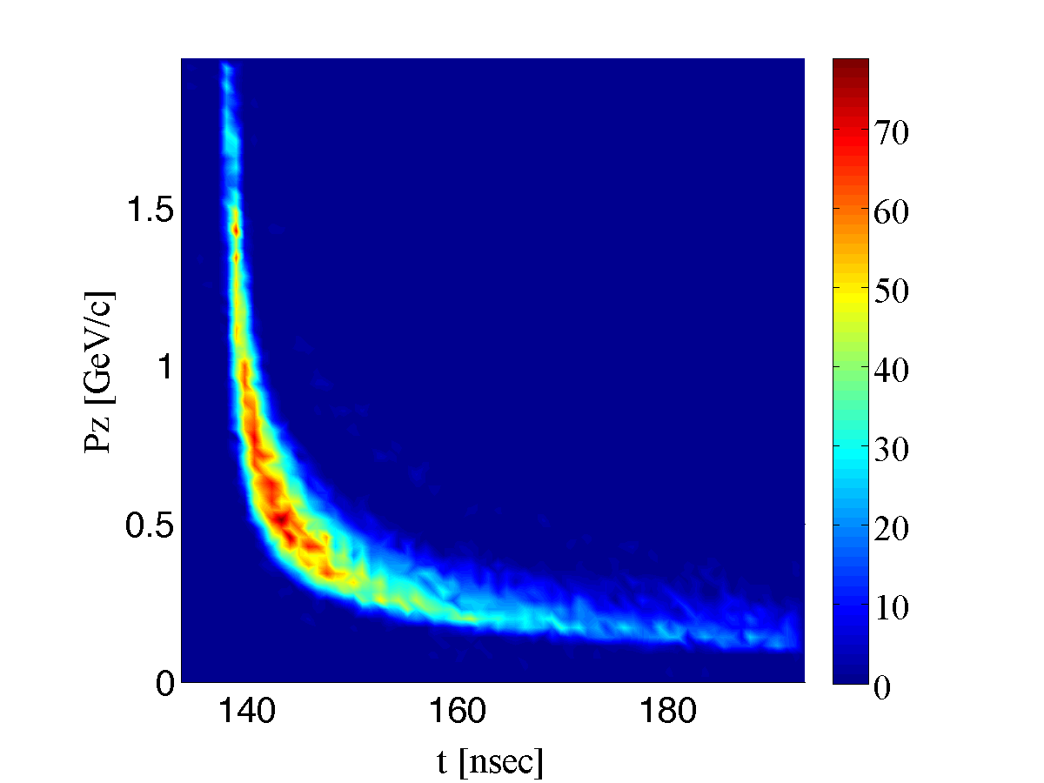
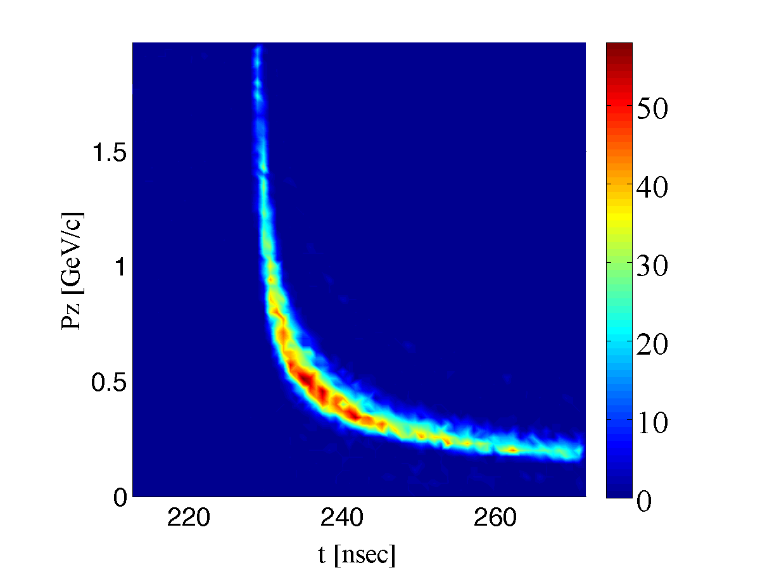
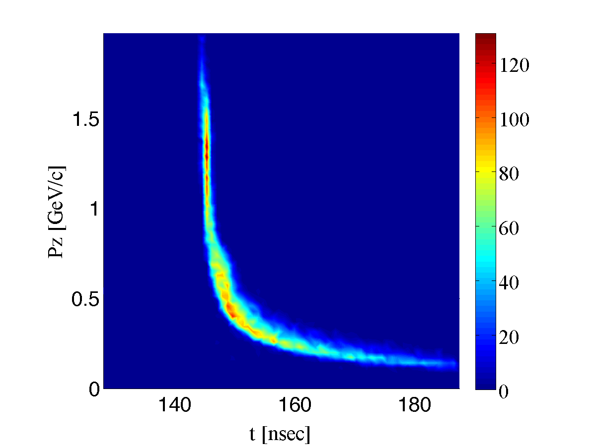
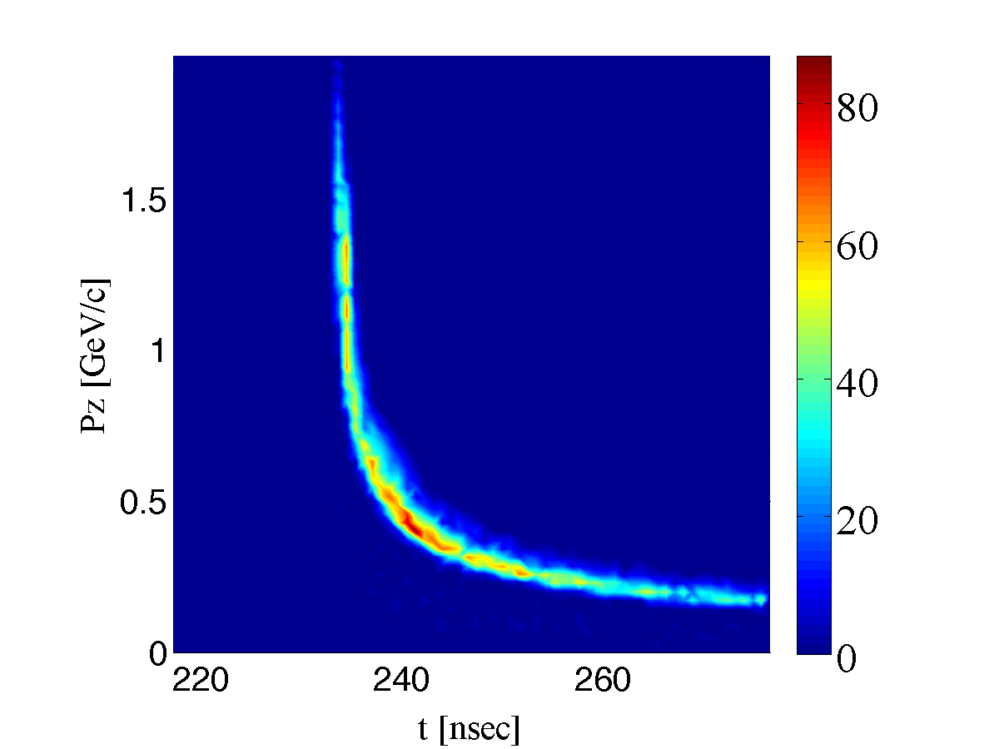
Longitudinal Phase Space Distributions (Short versus long taper)
End of taper
Long adiabatic taper 40 m
End of Decay
Short taper 4 m

Slide 8
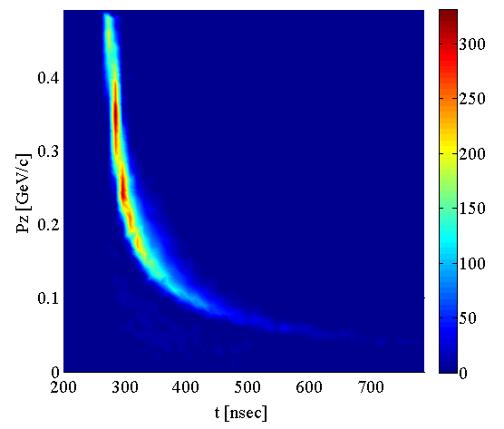
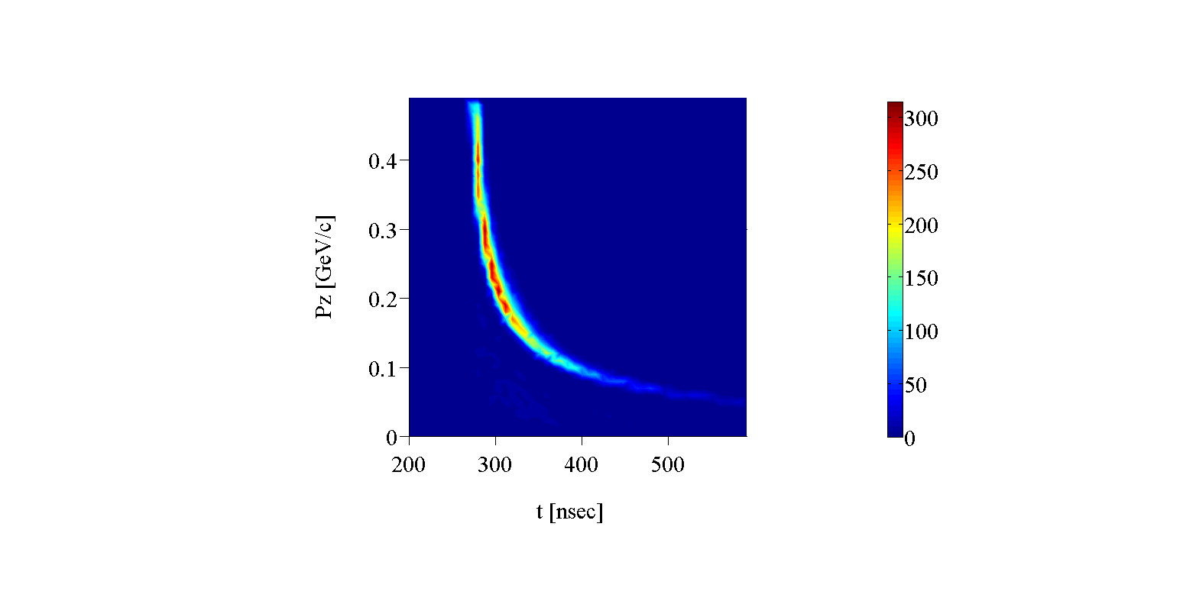
Phase Space Distributions (Short versus long taper)
T-Pz Correlations at end of decay channel
Long Solenoid taper:
More particles
More dispersed (misses the buncher acceptance windows)
Short Solenoid taper:
more condensed distributions that fits more particles within the buncher acceptance windows
Long Taper
Short Taper

Slide 9
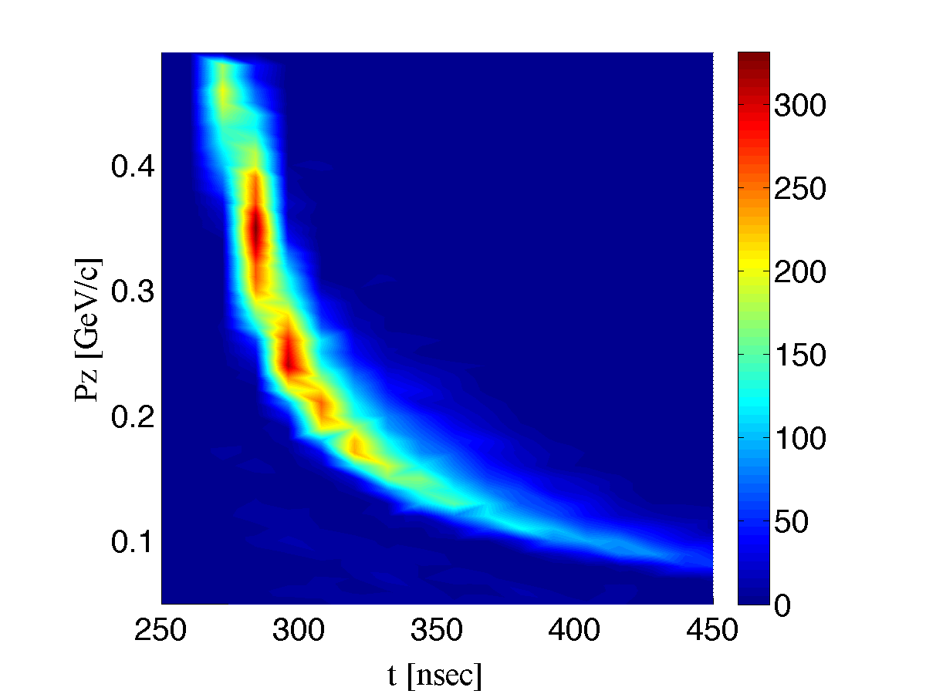
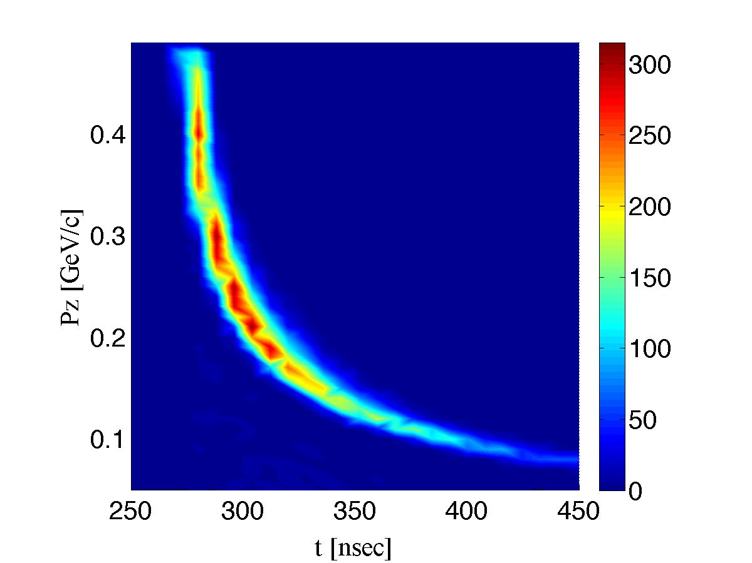
Phase Space Distributions (Short versus long taper)
T-Pz phase space at end of decay channel
Long Taper 40 m
Short Taper 4 m
Long Solenoid taper:
More particles
More dispersed (misses the buncher acceptance windows)
Short Solenoid taper:
Higher density t-pz distribution
Fits more particles within the acceptance of buncher/rotator

Slide 10
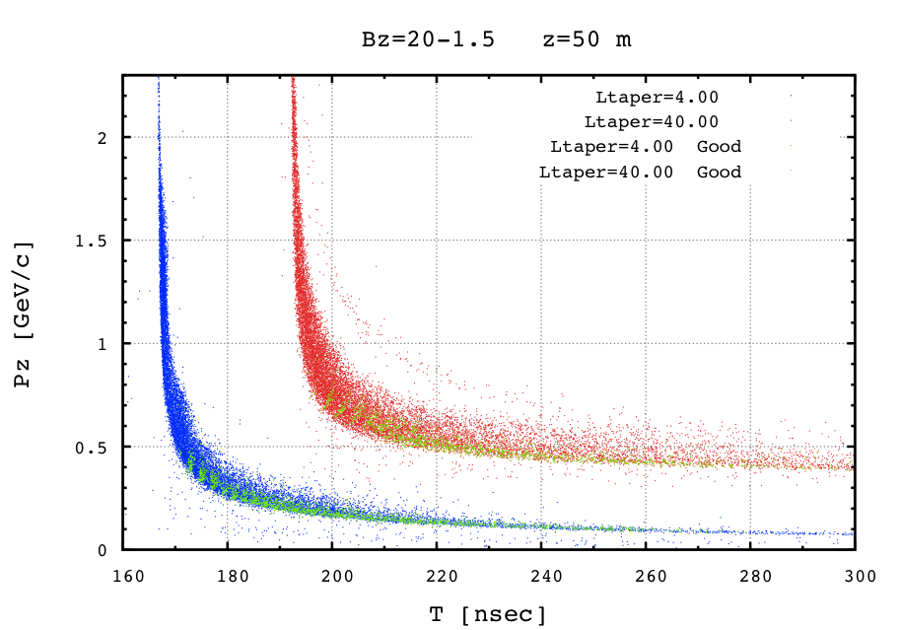
Phase Space - Short versus long taper
T-Pz Correlations at end of decay channel of good particles
Green: Initial distribution of good particles which were bunched and cooled in 4D cooling channel
Short Taper
Long Taper
Long Taper
Short Taper
Good Particles

Slide 11
Performance dependence on Time of Flight (RF Phase)
TOA Protons at z=-75 cm
TOA Protons at z=-200 cm

Slide 12
Front End Performance
Using baseline cooling section
(140 cooling cell)
Using longer cooling section
(200 Cooling cell)
~ 30%
~ 30%
High statistics tracking of Muons through the front end

Slide 13
Front End Performance
Using longer cooling section
(200 Cooling cell)
High statistics tracking of Muons through the front end

Slide 14
Muon yield versus end field & Bunch Length
Muon yield versus end field
Muon yield versus Proton Bunch Length
Bunch length=0 nsec
Bz(Target)=20 T
20% for every 1 T incerease in constant field
Baseline
Performance of FE as function of Constant solenoid filed in Decay Channel – Buncher – Rotator (matched to +/- 2.8 T ionization cooling channel)
~ 3% loss per 1 nsec increase in bunch length

Slide 15
New Short Target capture realistic magnet (Weggel)
Taper Magnets
Decay channel Triplet
Muon Target Capture Magnet
Short Taper length =7 m- B=20-1.5 T
On axis field [scale /20 T]
Target Magnets
Taper Magnets
Decay channel Triplet
Muon Target Capture Magnet
Short Taper length =5 m- B=20-2.5 T
On axis field [scale /20 T]
Target Magnets

Slide 16
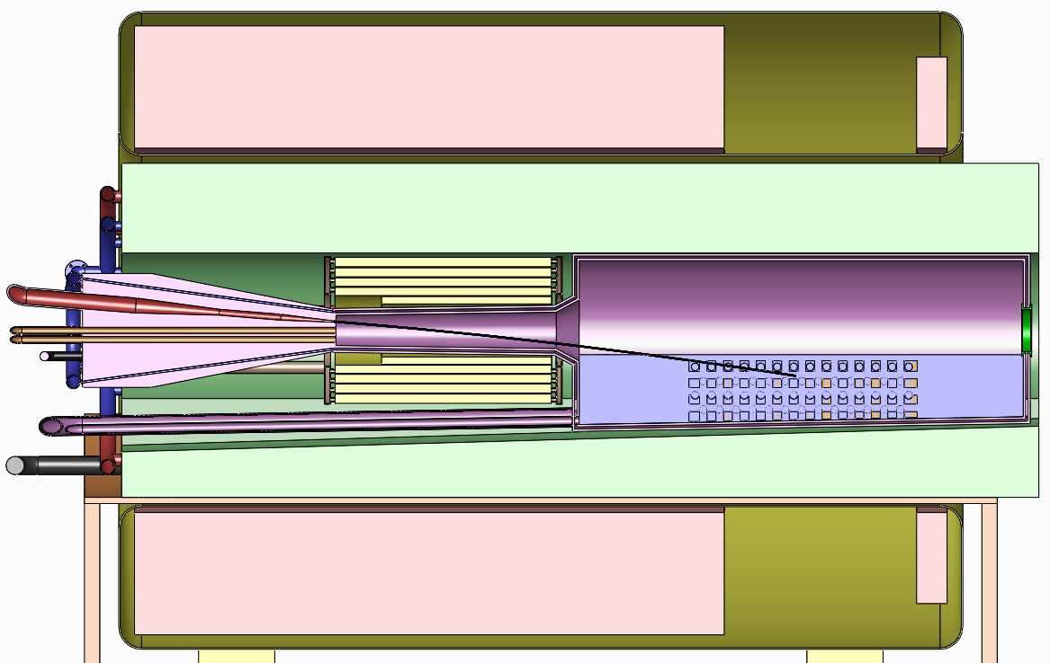
New Short Target capture magnet (Weggel)
Muon Target Short Taper Magnet taper length =7 m- B=20-1.5 & 2.5 T
Bz [T]
Target SC Magnets Field Map calculated from realistic coils
Engineering (V. Grave)
IDS120_20-1.5T7m2+5 Cryo 1

Slide 17
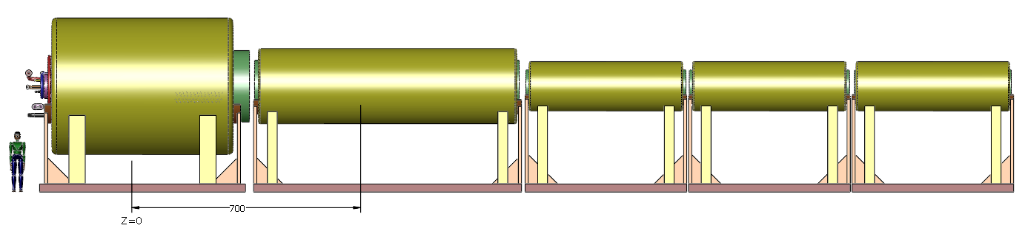
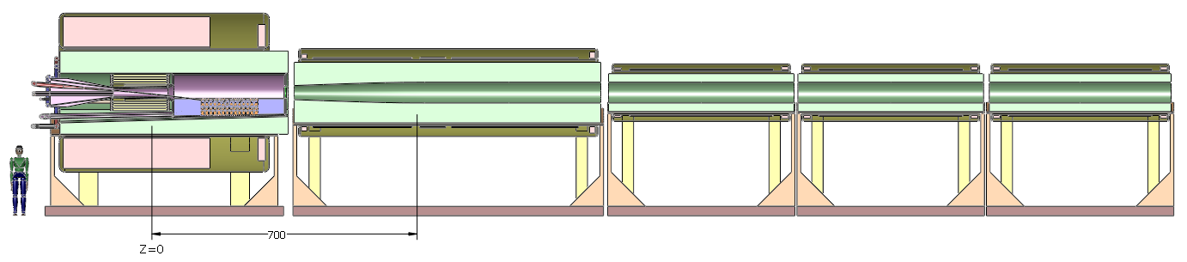
New Decay channel realistic magnet (Weggel)
The pions produced in the target decay to muons in a Decay Channel (50 m)
Three superconducting coils (5-m-long ) Bz(r=0) ~ 1.5 or 2.5 T solenoid field.
Suppress stop bands in the momentum transmission.
7 m
5 m
IDS120L20-1.5T 7m
Magnet | Length [m] | Inner R [m] | Outer R [m] | J [A/mm²]
1 | 0.19 | 0.6 | 0.68 | 47.18
2 | 3.8 | 0.6 | 0.63 | 40.00
3 | 0.19 | 0.6 | 0.68 | 47.18
Axial-field profile of two Decay-Channel modules

Slide 18
Realistic Coil based decay channel solenoid stop band study
Suppression of stop bands in the Decay Channel:
Tracking muons through decay channel 10 cells (50 m) optimize magnet design for best performance
Transmission:
Constant 1.5 Solenoid Field %67
IDS120L20to1.5T7m %62
Modified IDS120L20to1.5T7m %66
IDS120L20to1.5T7m
IDS120L20to1.5T7m
Optimization

Slide 19
Conclusion & Summary
1- Target Solenoid parameters that affect the particle Capture & Transmission at target or after cooling
Initial peak Field – Taper length – End Field
2- Impact:
Short taper preserves the longitudinal phase-space → muons can be captured efficiently in the buncher-phase rotation sections and more muons at the end of cooling.
The maximum yield requires taper length of 7-5 m for all cases (20-15T) (1.5-3.5T) for any bunch length.
3- Final constant end field increases the yield by 20% for every 1 T increase in the field beyond the 1.5 T baseline
4- Initial proton bunch length influence the muon/proton yield at the end of the cooling channel
~ 3% reduction per 1 nsec increase in bunch length.
5- Realistic Coil design.

