Slide 1
FRONTEND Design & OPTIMIZATION studies
HISHAM KAMAL SAYED
BROOKHAVEN NATIONAL LABORATORY
June 26, 2014
Collaboration:
J. S. Berg - X. Ding - V.B. Graves - H.G. Kirk - K.T. McDonald - D. Neuffer - R. B. Palmer - P. Snopok - D. Stratakis - R.J. Weggel

Slide 2
Front end desing & optimization
OUTLINE
Goal : Optmize number of useful muons and limit the proton beam power energy transmitted to the first RF cavity in the buncher
Involved systems:
Carbon target geometry
Capture field
Chicane design
Be absorber
1- Target geometry parameters:
Carbon target length, radius, and tilt angle to solenoid axis
2- Target Capture field: constant field length - taper length - end field
3- Chicane parameters: Length - curvature – focsuing field
4- Be absorber thickness and location
5- Energy deposition in the target area + Chicane will be evaluated and involved in the optimization – future work.

Slide 3
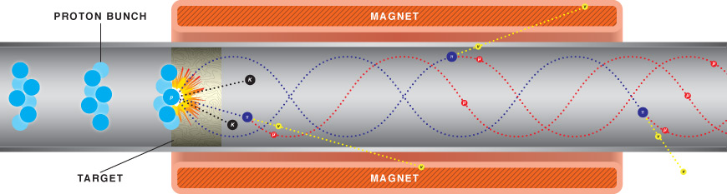
Muon Beam production
Challenges with muon beams:
- Short lifetime ~ 2 μs
- Require fast and aggressive way of reducing the muon beam transverse and longitudinal emittance to deliver the required luminosity
Production and acceleration of muon beam
High energy proton beam on Hg or graphite target
Captured pion beam has a large emittance
Pions decay into muons with even larger emittance
Transverse phase space
ε_{T(rms)} ~ 25 mm-rad
Large momentum spread
Longitudinal phase space

Slide 4
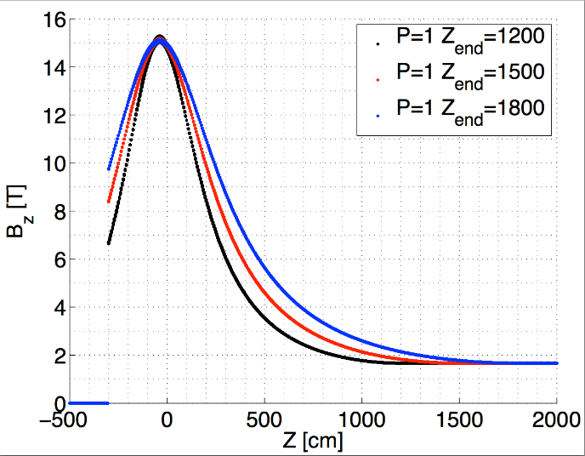
Tapered Capture Solenoid optimization
Target Solenoid on axis field
Inverse-Cubic Taper
B₁
- Initial peak Field B₁
– Taper length z
– End Field B₂
B₂
Taper Length z₁-z₂
Impact of the Peak field on the number and phase space of the captured pions
Impact of taper length on the number and phase space of the captured pions/muons
Impact of the end field on the number of captured muons

Slide 5
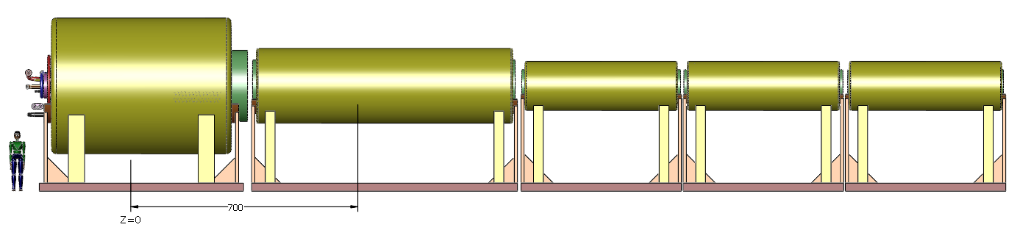
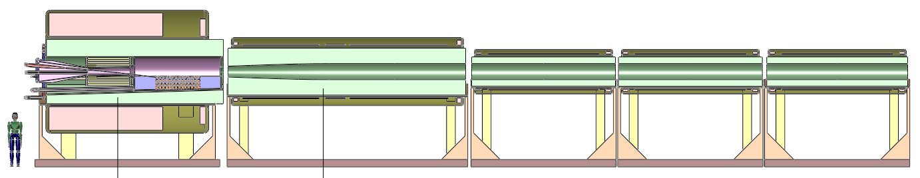
New Short Target capture with realistic superconducting magnets
New baseline Muon Target Capture Magnet :
Short Taper length = 5 m
B = 20-2.0 T, 20 – 2.5 T 20 – 3.5 T
Taper Magnets
Decay channel Triplet
On axis field [scale /20 T]
Target Magnets
(R. Weggel)
5 m
V. Graves

Slide 6
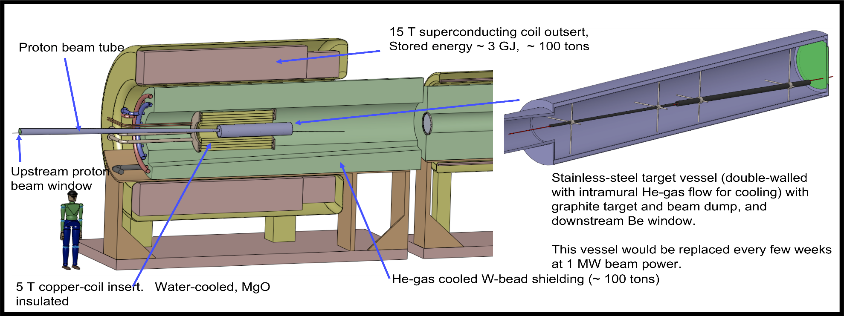
CARBON TARGET GEOMETRY OPTIMIZATION
http://physics.princeton.edu/mumu/target/hptw5_poster.pdf

Slide 7

CARBON TARGET GEOMETRY OPTIMIZATION
Target geometry parameters (channel includes target + chicane + decay channel):
    → Carbon target length -- radius -- tilt angle to solenoid axis
    → Proton beam size
    Objective: optmize at z=70 m
    Σ π+μ+κ within
    pz < 450 MeV/c (to compensate for the Be absorber effect)
    pt < 150 MeV/c
Initial lattice in G4Beamline – using GEANT4 physics list QGSP
B_{z} = 20 to 2.0-7.0 T over variable taper length
Initial protons K.E. = 6.75 GeV - σ_{t} = 2 ns
Tracking includes target + chicane + decay channel
The optmization run 6 hours on 240 cores at NERSC using Multiobjective – Multivariable parallel genetic algorithm

Slide 8
CARBON TARGET GEOMETRY OPTIMIZATION
Optimizing the target geomtery and proton beam parameters.
Objective is the muon count at end of decay channel
Optimal working point 1-2 mm
Optimal working point 1-3 degrees

Slide 9
CARBON TARGET GEOMETRY OPTIMIZATION
Optimizing the target geomtery and proton beam parameters.
Objective is the muon count at end of decay channel
Optimal working point ~ 1 cm, but r < 1 cm not studied
Optimal working point 70-90 cm

Slide 10
CARBON TARGET GEOMETRY OPTIMIZATION
Optimal working point for C-target
Proton beam size 1-2 mm
C–rod Length 80 cm
C–rod radius < 1 cm
Beam + target angle to solenoid axis 2-3 degree (50-75 mrad)

Slide 11
Dependence of transverse emittance & Capture efficiency on Peak Field
Emittance growth due to betatron oscillation decohenrce:
Pions created at the target
  Small radial extent (small transverse emittance)
  Large spread in energy and axial point of origin
Particles with different energy and different transverse amplitude rotate over the transverse phase space at different oscillation frequencies.
Strong solenoid field stabilizes the emittance growth by reduction of axial extend
The final projected transverse emittance is smaller for higher fields
Limit of operation of solenoids in high radiation area
MARS Simulation of π⁺ & μ⁺ production from 8 GeV proton beam on Hg target.
- Emittance calculation from covariance matrix
- particle count at end of the target

Slide 12
CARBON TARGET GEOMETRY OPTIMIZATION
Optmization of the target end field and decay channel – (no buncher- rotator RF)
Points with differing colors have different target geomtry parameters

Slide 13
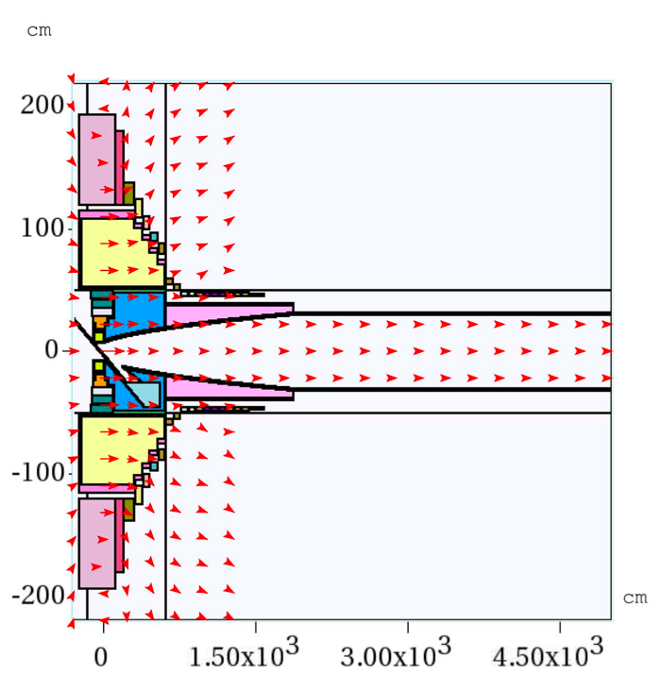
MARS Simulations & Transmission
Muon count within energy cut at end of decay channel
Adiabatic condition:
length scale over which the magnetic field changes is large compared to betatron wavelength of the helical trajectory of a particle
r_{final}=30 cm
Muon count at z=50 increases for longer solenoid taper
MARS15 Simulation:
Counting muons at 50 m with K.E. 80-140 MeV

Slide 14
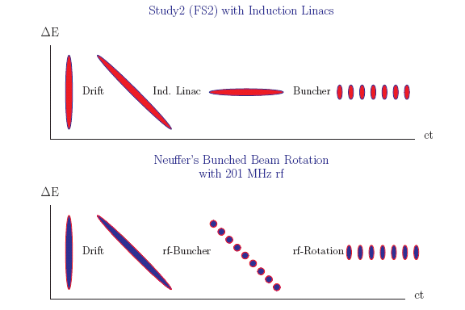
buncher and Energy phase rotator
Target: π production
Drift: π’s decay to μ’s + creation of time-energy correlations
Adiabatic bunch:
Converts the initial single short muon bunch with very large energy spread into a train of 12 microbunches with much reduced energy spread
Energy phase rotatation: Align microbunches to equal energies - RF 232 to 201 MHz - 12 MV/m
Transverse ionization cooling: RF 201.25 MHz

Slide 15
Longitudinal Phase Space Distributions (Short versus long taper)
Temporal difference between the arrival time at a position z of a particle with a nonzero transverse amplitude and that of a particle with zero transverse amplitude
Long adiabatic taper 40 m
z=20 m
End of Decay z=80 m
After buncher
Short taper 4 m
Shorter bunch length
Higher longitudinal phase space density

Slide 16
Dependence of time spread & transverse emittance on taper length
Muon beam emittance calculation was done at the end of the decay channel at z = 70 m
Initial proton bunch has pancake temporal distribution σ_{t} = 0 ns for this calculation
Time spread dependence on taper length
Implication on projected emittance
Projected transverse emittance did not change dramatically
Longitudnal emittance decreases more dramatically
Time Spread increase by 90%

Slide 17
Numerical Nonlinear Global Optimization algorithms on NERSC
Expensive objective evaluations on CRAY: (In collaboration with LBNL)
  High performance parallel environment: N cores > 1000
    Run parallel evaluations of the objective functions ( Parallel Evolutionary algorithms)
    Each evaluation of the objective run in parallel to limit the cost of every evaluation (parallel Icool – G4BL , MARS .. etc.).
Implemented algorithm:
  Parallel Differential Evolutionary Algorithms
Momentum distribution of "useful muons” at end of phase rotator
Muon Front End Global Optimization
Multivariable optimization of the Muon Accelerator Front End:
  Optimal taper length
  Optimizing the broad band match to the 4D ionization cooling channel
24% more than previuos baseline performance
End Field Limitations:
- Operation of RF cavities in magnetic fields

Slide 18
Front end performance at different end fields
Performance of the Front end without the chicane
End fields higher than 4 T do not show any improved performance

Slide 19
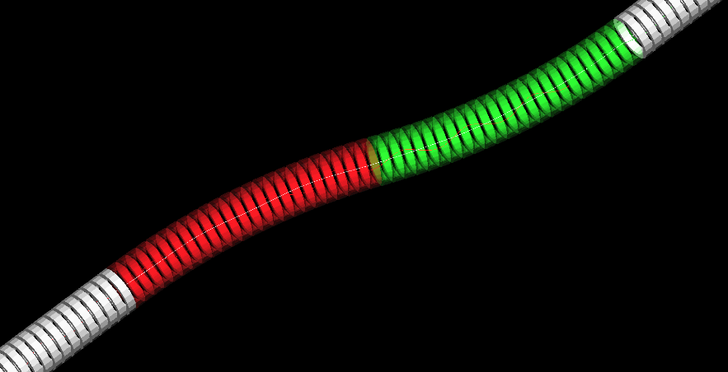
Chicane
Short taper (6 m ) integrated with the new chicane from Pavel's G4BL lattice (same parameters as in ICOOL)
Started optimizing the chicane parameters (initial values - D. Neuffer's icool lattice)
    Chicane half length L (initial value L = 6.0)
    Chicane radius of curvature h (initial value = 0.05818 1/m) ⇒ Bend angle = 351 mrad
    Be absorber length (initial value = 100.0 mm)
    On-axis field is a free parameter – optimization will be carried for B = 2.0, 2.5, 3.0 T
    Chicane aperture 40 cm (might be a free parameter as well)
Objectives → minimize total KE of transmitted protons Σ KE_{protons}
    → Maximize number of transmitted muons Σ π+μ+κ within 0 < p_{z} < 450 MeV/c (to compensate for the Be absorber effect) & 0 < p_{t} < 150 MeV/c
  Run 100 K particles through the chicane with initial parameters Σ KE_{protons} = 29 GeV & Σ N_{mu}= 4377

Slide 20
Chicane
Run 500 K particles through the chicane with automated optimization algorithm
Chicane location: z = 21 m from target
Absorber location: end of chicane
    B₀ = 2.0 T

Slide 21
Chicane
Run 500 K particles through the chicane with automated optimization algorithm
Chicane location: z = 21 m from target
Absorber location: end of chicane
    B₀ = 2.5 T

Slide 22
Chicane
Run 500 K particles through the chicane with automated optimization algorithm
Chicane location: z = 21 m from target
Absorber location: end of chicane
    B₀ = 3.0 T
Higher end fields increases muon transmission through the front end and also increase the total KE of the transmitted protons after the absorbers

Slide 23
Conclusion & Summary
New objective for front end optimization
    Handle excesseive proton beam + unwanted secondaries
    Capture as much muons
Energy deposition has to be integrated in the optimization study
  Partitioning of energy deposited in
    Chicane
    Be absorber
Optmization includes
    Target geomtery
    Chicane field + chicane geomtery
    Be absorber
    Re-tune buncher & phase roation

