Slide 1
Post-RDR-draft update on chicane shielding and energy deposition
Pavel Snopok
Front end phone meeting
August 13, 2013

Slide 2
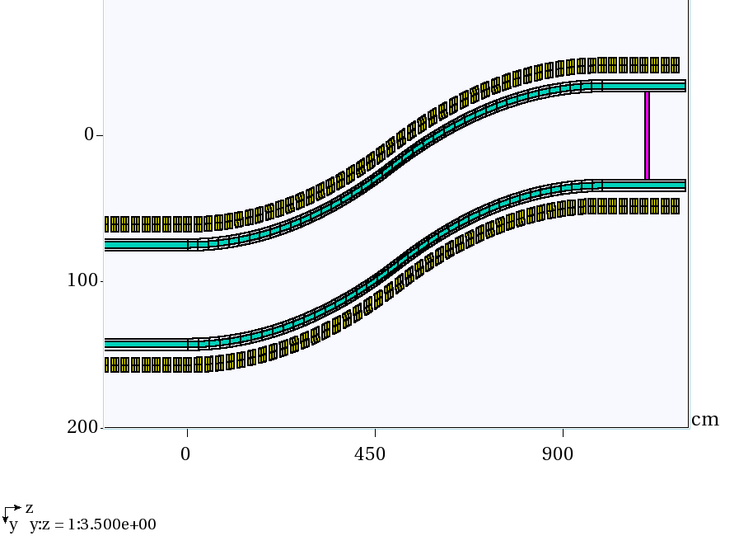
Simulation update
Z=0 now corresponds to 19 m downstream of the target to be consistent with RDR.
W density reduced to 60% to take into account packing fraction for beads.

Slide 3
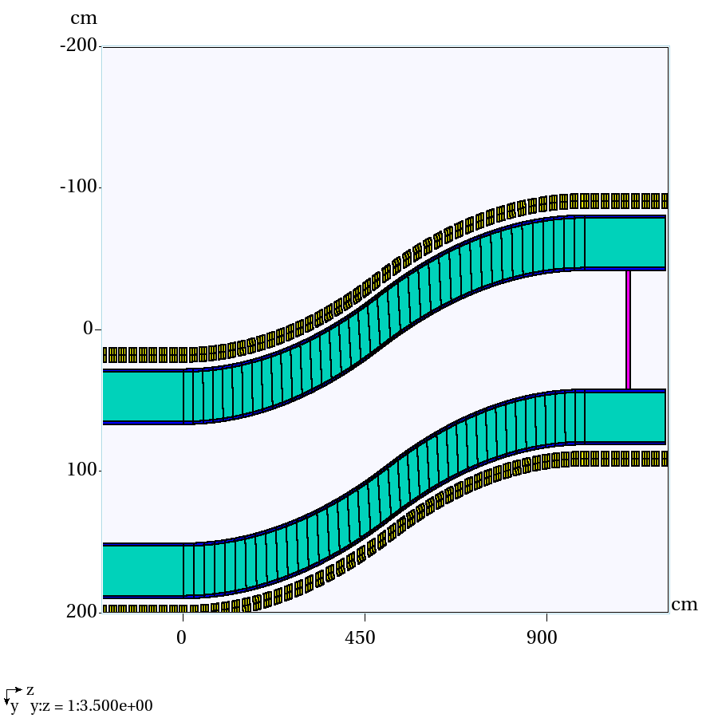
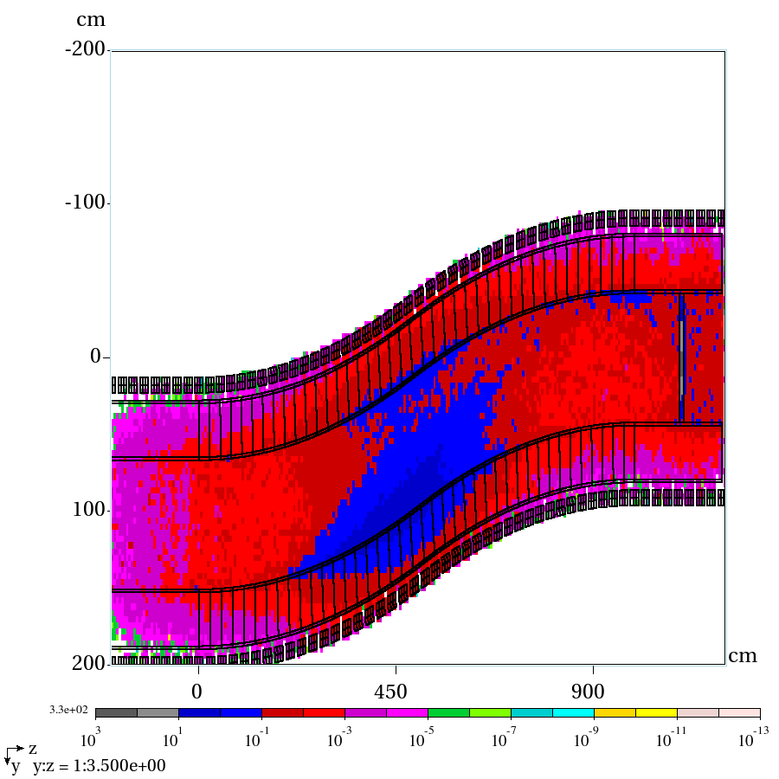
Uniform 35 cm shielding
Empty channel
PD total, mW/g

Slide 4
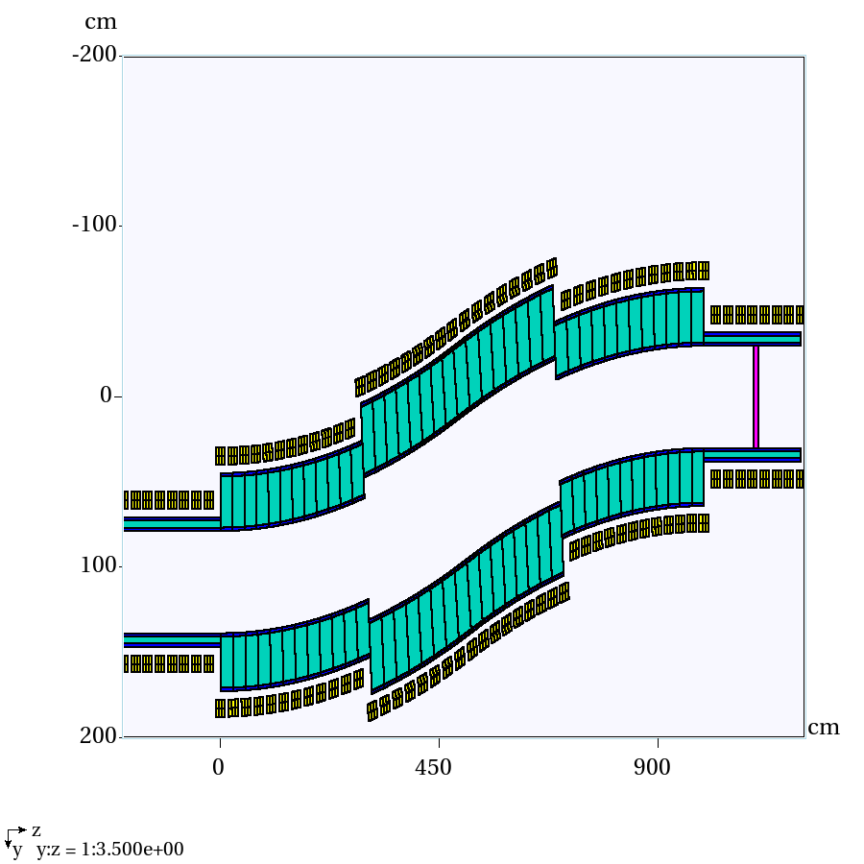
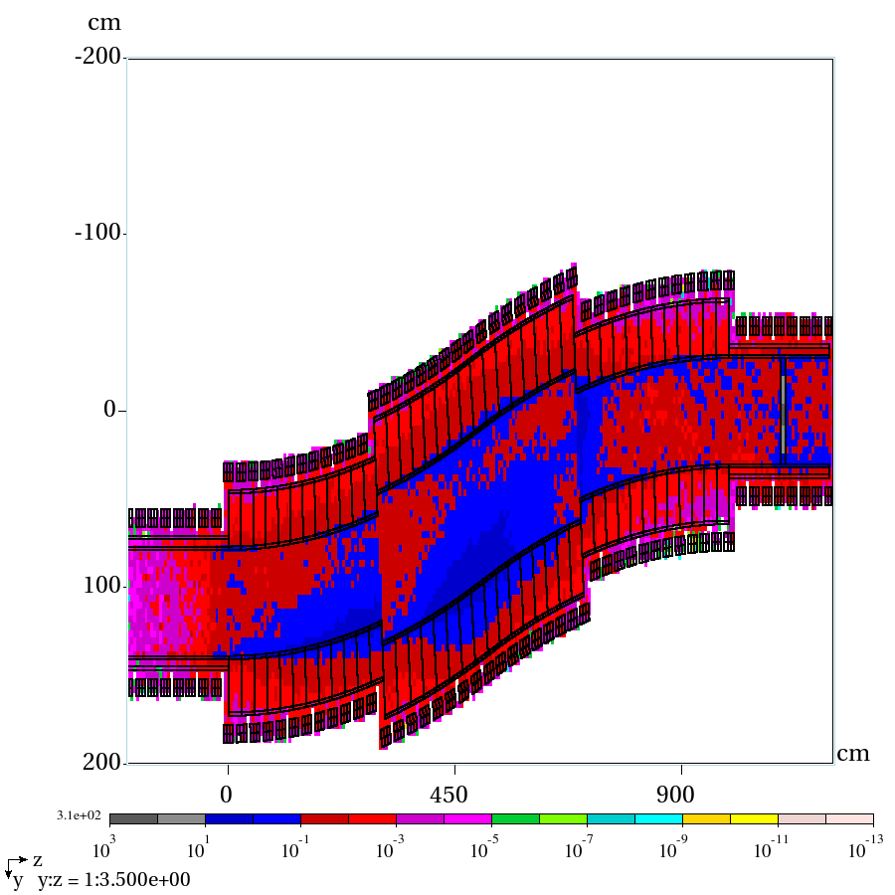
Non-uniform 30 and 40 cm shielding
Empty channel
PD total, mW/g

Slide 5
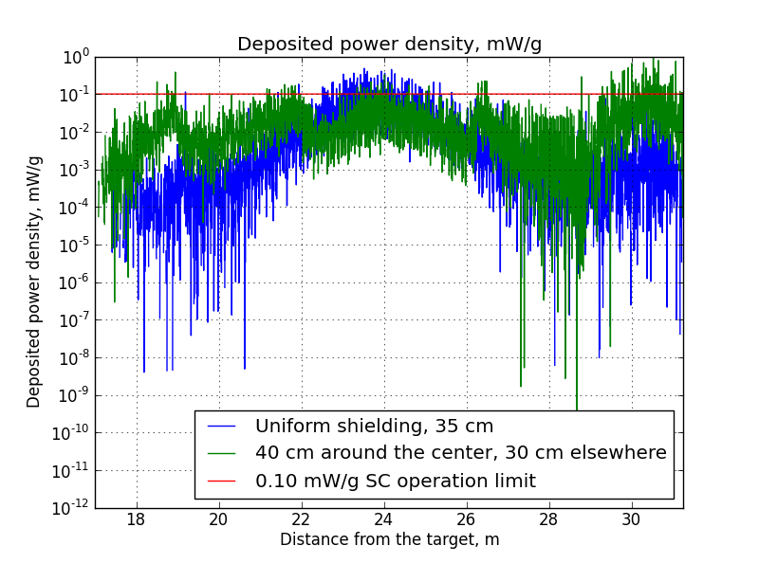
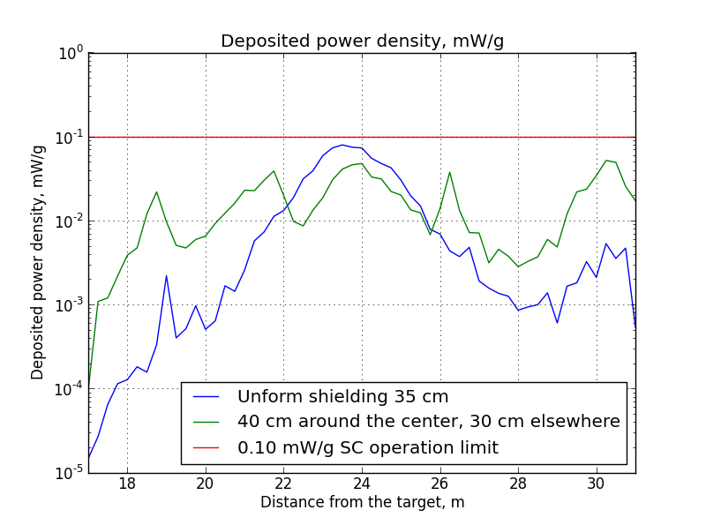
Overall DPD per coil/segment
Segmented coil analysis, total DPD, mW/g
Average DPD per coil, mW/g
In both cases red line corresponds to 0.1 mW/g SC limit

