Slide 1
Chicane simulation update
Pavel Snopok
Front end phone meeting
January 14, 2014

Slide 2
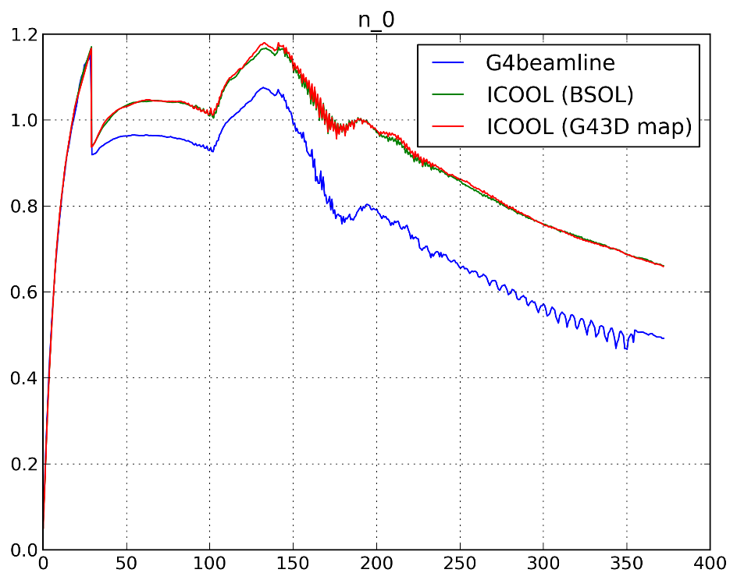
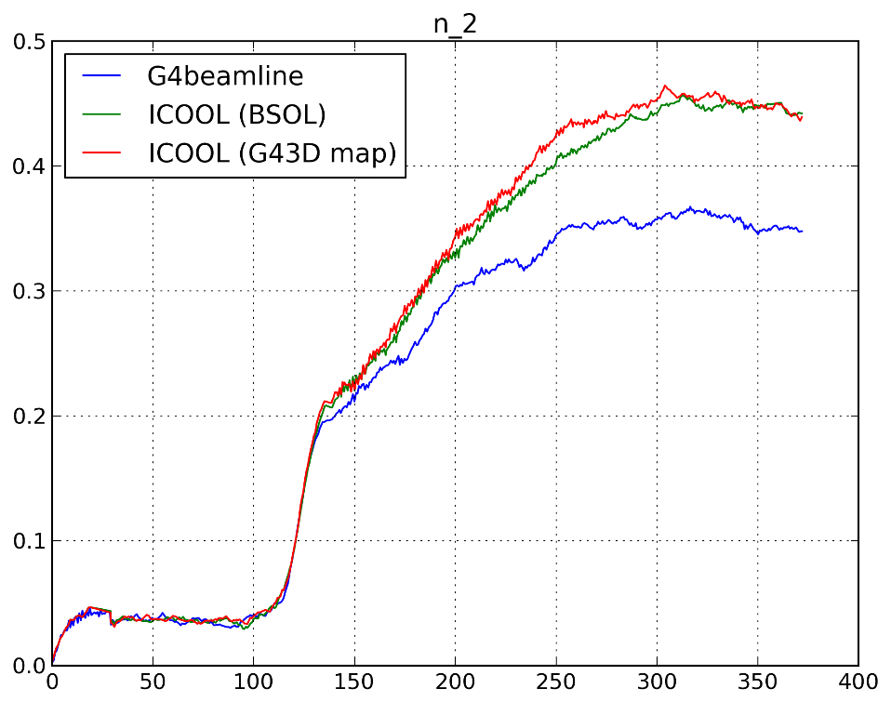
Last time: ICOOL vs G4beamline
Number of muons
Number of useful muons
within canonical cuts
Relatively large statistics: 300k incident particles, correct distribution
(wrong distribution sent earlier by email, no 2 ns correction to time)

Slide 3
Source of discrepancy, mitigation
Be proton absorber is causing a difference in transmission.
ICOOL does not simulate pion propagation through material properly.
Use G4beamline for the part of the channel where pions are of concern (capture + drift).
Move the proton absorber downstream (following Dave’s ICOOL decks).
There is no G4beamline deck for the 325 MHz, 2 T frontend => working on it right now.

Slide 4
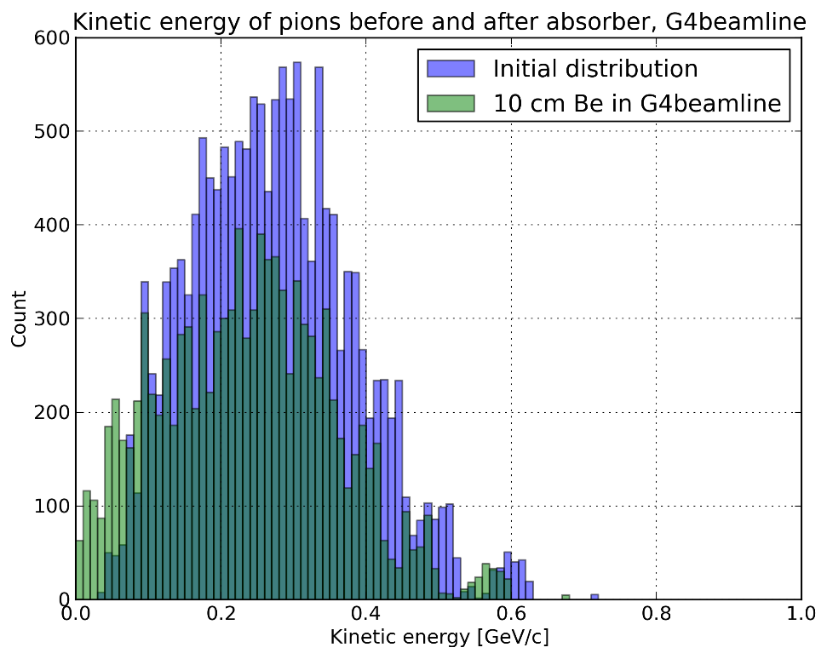
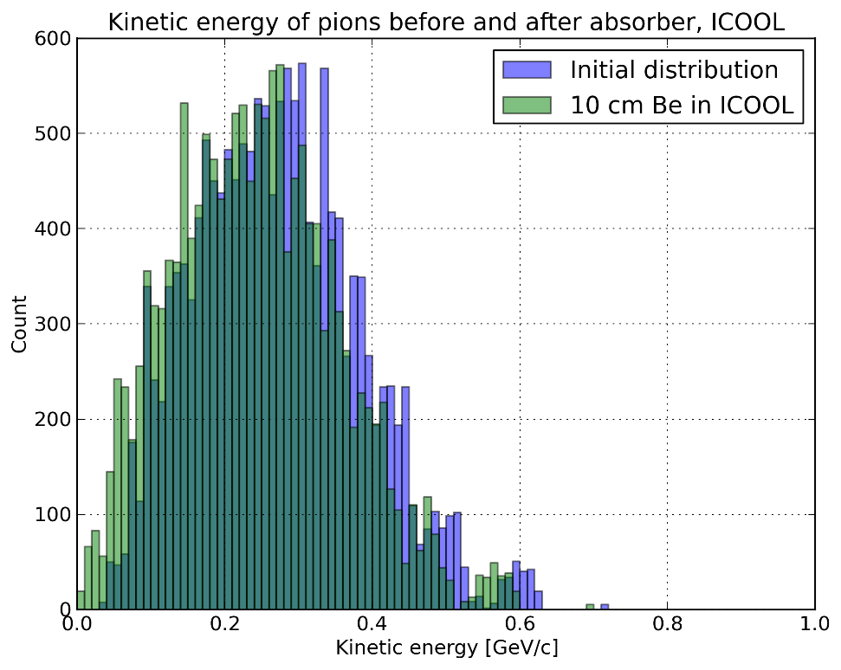
Pions through absorber:
ICOOL vs G4beamline
G4beamline
ICOOL

Slide 5
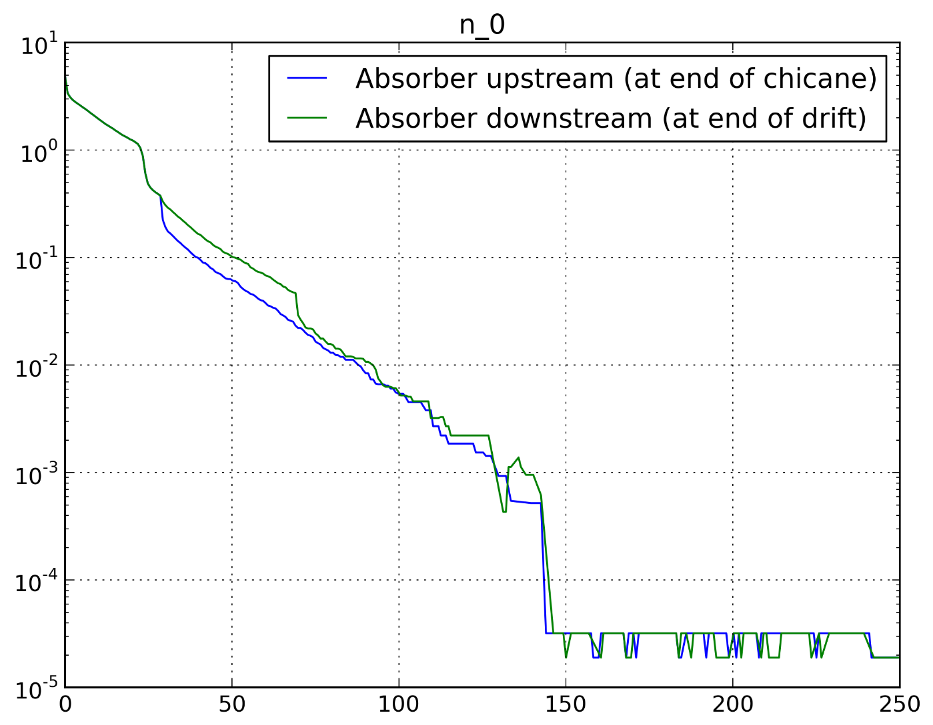
Pions: effect of moving the absorber

Slide 6
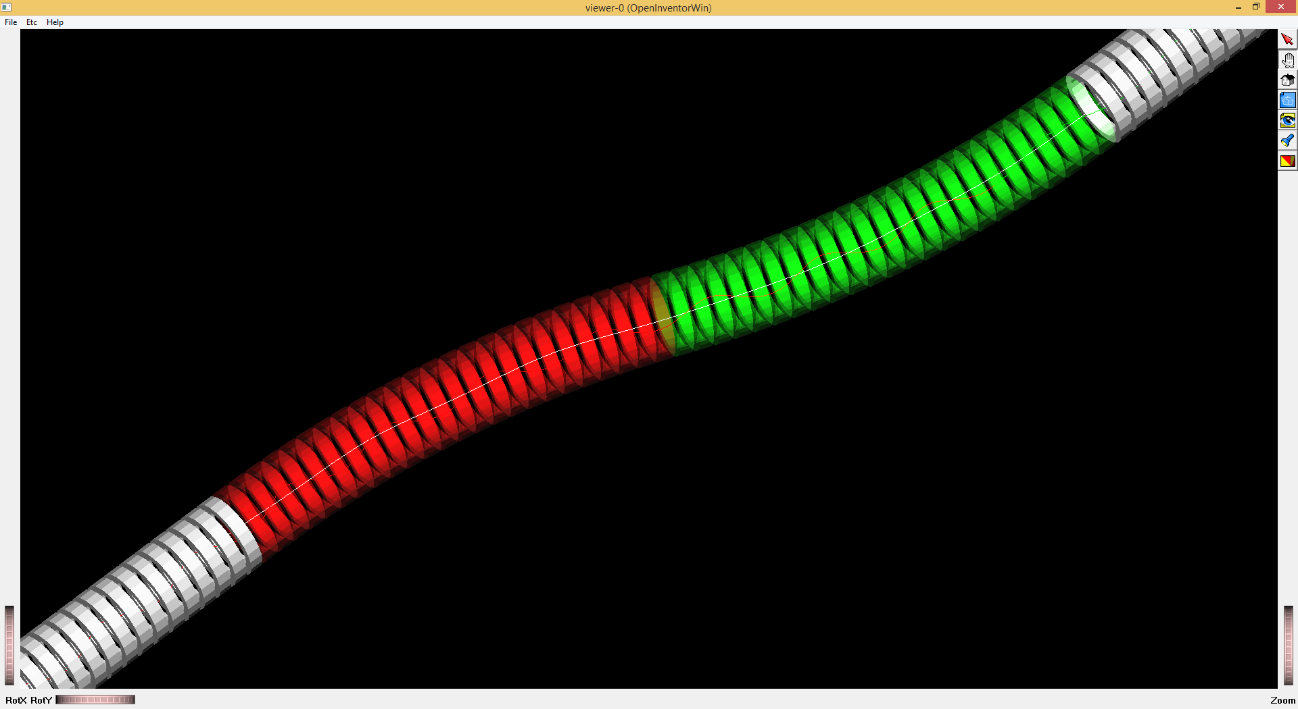
New chicane: 2 T

Slide 7
New Front End in G4beamline
You won’t see it in the picture, but the arc length of each cell in the chicane is slightly different from that in the drift part.
The reason is the BSOL approach: I take the SREGION length + curvature to define the chicane angle => chicane arc length
…while Chris was using a predefined number of cells of a certain arc length (250 mm) + angle per cell, and the Z length was derived from those.
What I do is choose the cell length as close to 250 mm as possible based on the chicane arc length derived from BSOL parameters.
This way the chicane length is the same in ICOOL and G4bl.

Slide 8
Current status
I have:
the short taper (14.75 m),
some initial drift (6 m),
chicane at 2 T (12 m),
second part of the drift (43 m).
I don’t have:
Buncher/phase rotator/matcher/cooler, but presumably those could be simulated in ICOOL, since pions are not an issue anymore.

